Slide 2
Towards HTS REBCO HFM magnets at CERN
A. Baskys, A. Ballarino, C. Barth, N. Gal, F. J. Mangiarotti, J. Mazet, D. Perini

Slide 3
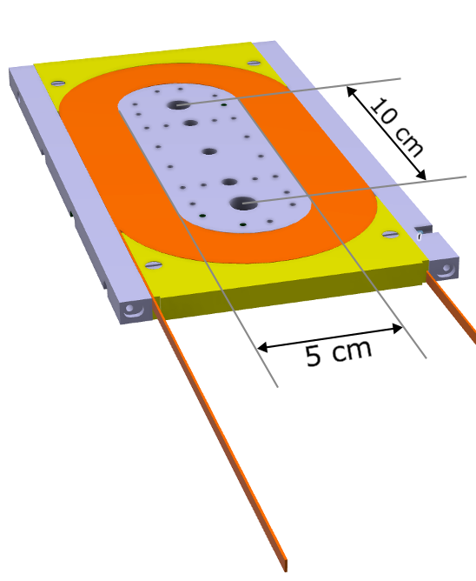
Introduction
At CERN, we explore how HTS materials can help to push the magnetic field envelope for the accelerator magnets beyond the limitations of LTS conductors.
As a stepping stone to achieving this goal, CERN has launched the development of model coils in racetrack geometry that can be scaled up for use in common coil-type magnets. The model coils were used to validate the winding tooling, newly developed cable insulation technology, instrumentation placement, conductor performance and other key design choices with a short iteration cycle that allows for rapid development.
In Phase 1 of this work, we developed single and double racetrack coil modules and tested their performance in liquid nitrogen and helium.
In Phase 2, we designed and launched the production of mechanical structures to assemble the racetrack modules into a common coil configuration.
We detail the coil design and several lessons learned during the progression from single-layer to double-layer coils with a layer jump and the initial test results.
Double layer racetrack module – the main building block of a testbed for REBCO magnet technologies

Slide 4
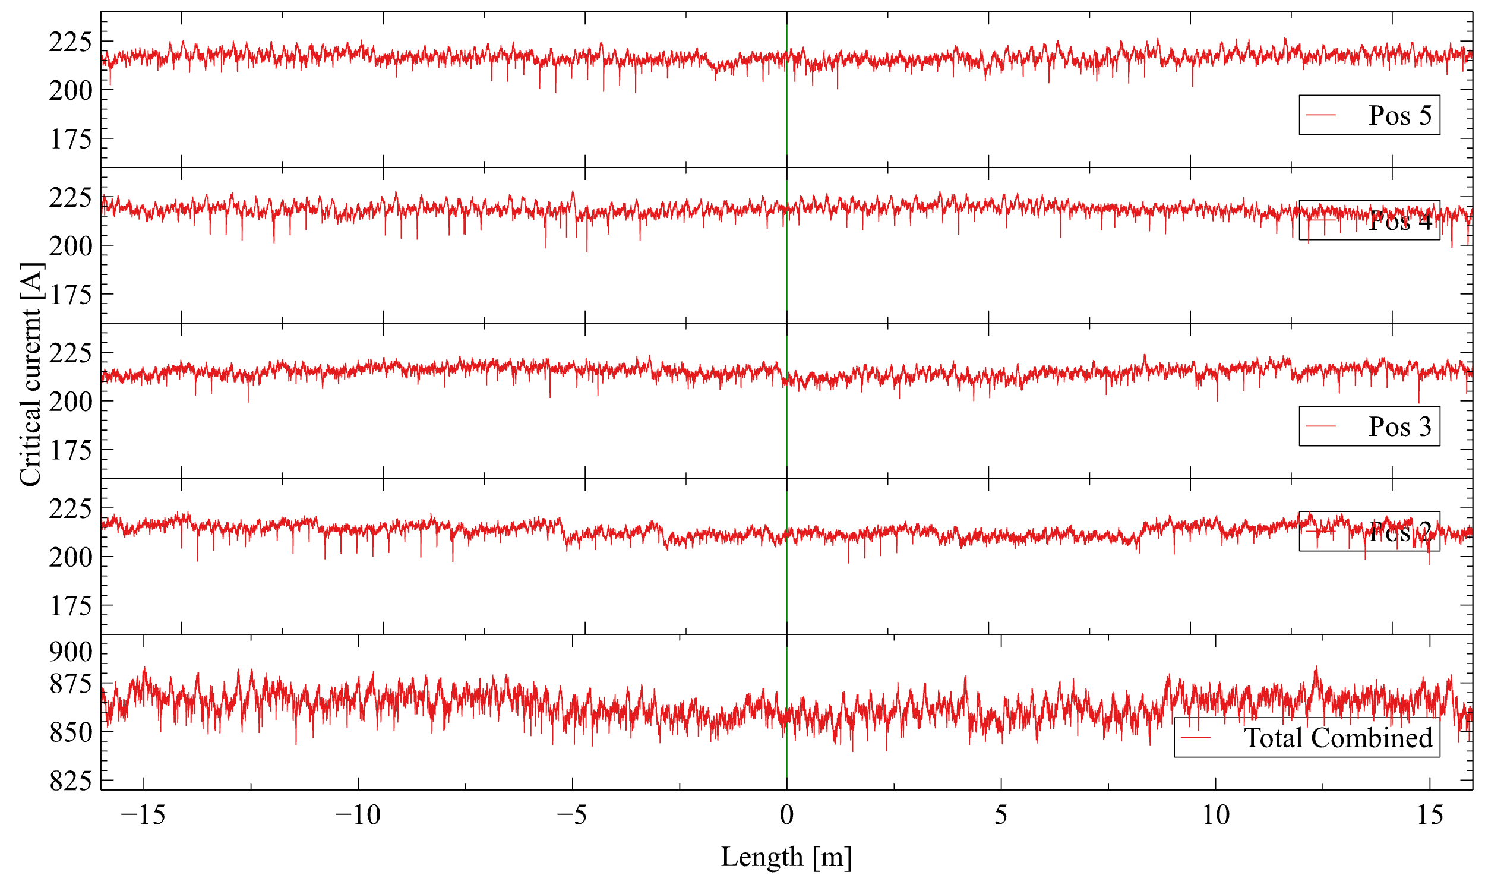
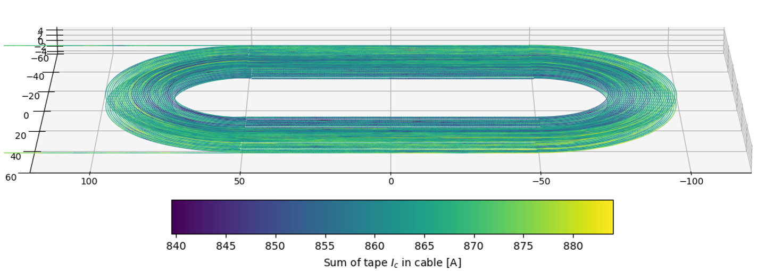
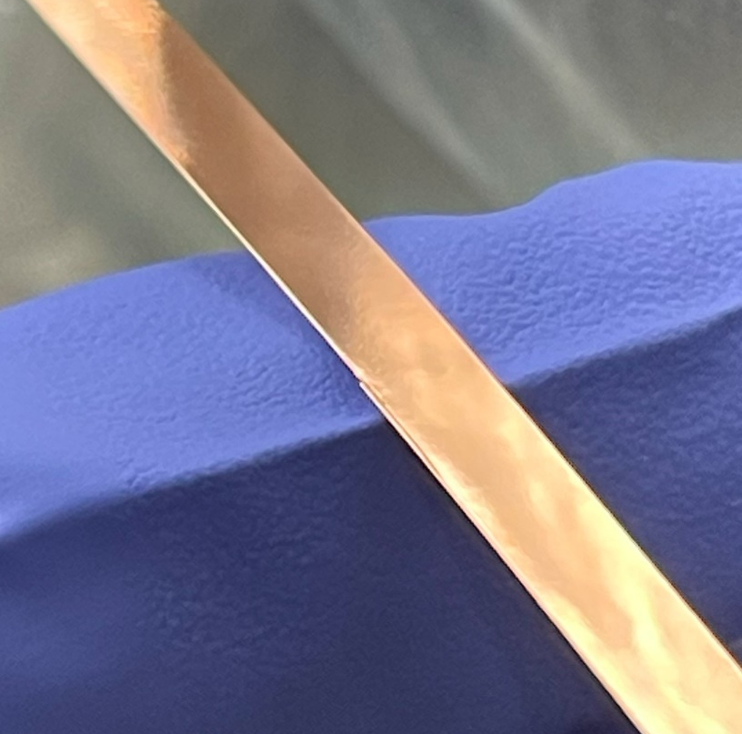
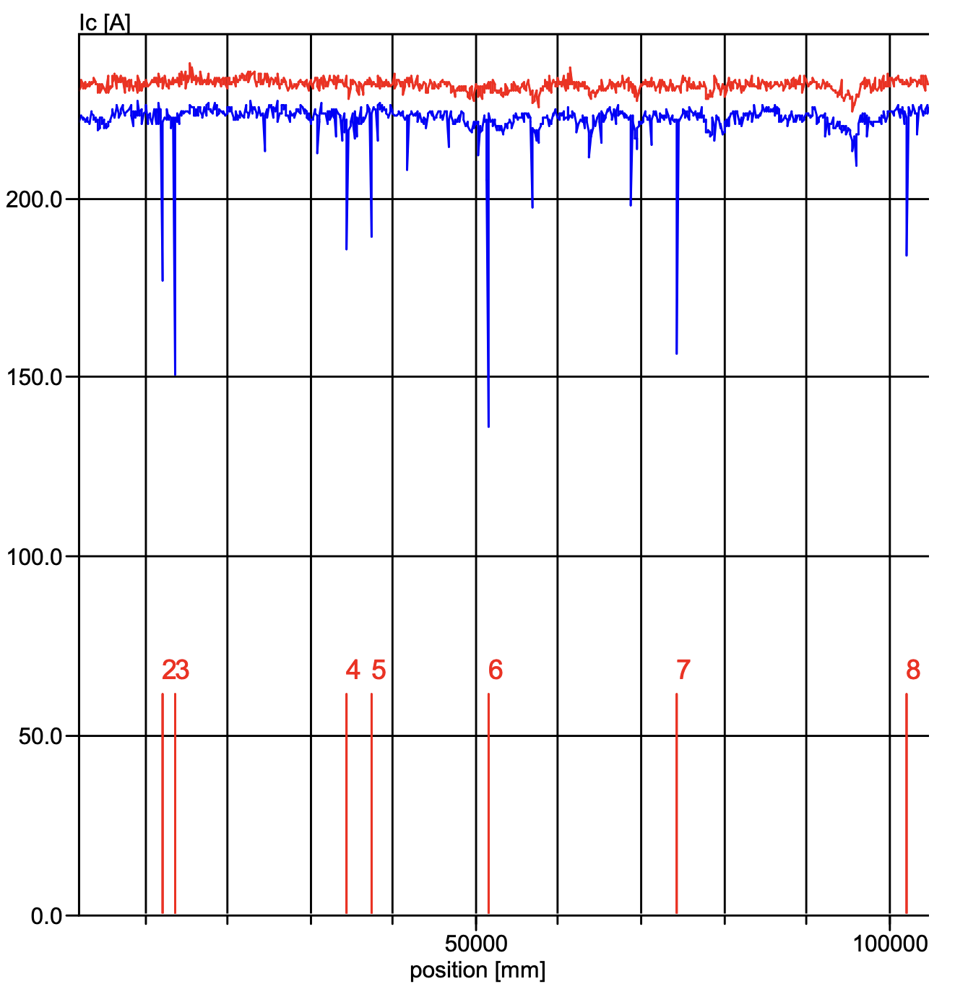
Conductor characterization
Conductor characterization is a very important part at this stage of coil development. It is a significant effort but critical to:
predict/model magnet behavior;
identify any flaws in the starting material and their nature;
presentation by A. Ballarino, Wednesday 10:00.
I_{c} variation in strands used for a coil
Acceptance measurements
Informational measurements
Transport I_{c} (77 K)
I_{c} @ 4 K, 0-15 T
Internal Resistance (lapjoint resistance)
Minimum bending radius
I_{c} along length (TapeStar)
Metallographic
cross-sections
Dimensional measurements (R2R)
Thermal degradation
Periodic defect - change in width & sharp edge
Non-conforming tape with dropouts in critical current.

Slide 5
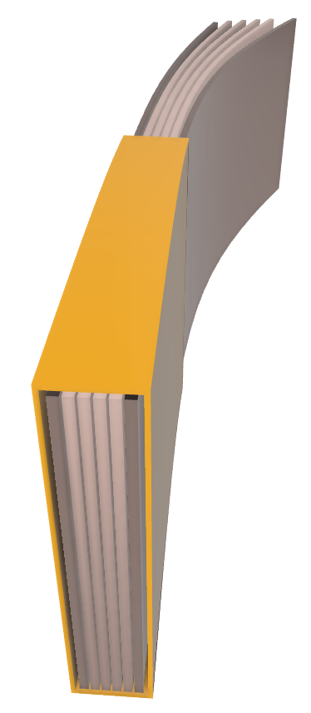
Cable design
The HTS cable used in this study so far is a dielectric insulated stack of REBCO tapes comprising of:
Four 4 mm wide REBCO tapes arranged as two pairs in face-to-face configuration;
Two copper tapes surrounding REBCO;
Kapton wrap insulation with an average thickness of 75 μm;
No resin impregnation.
Cable was designed as a starting point for small magnets:
Nominal current 2 kA;
Operating up to 10 T field;
Inductance < 30 mH;
Hotspot temperature < 150 K;
Quench detection time ~10 ms;
Extraction voltage < 1 kV;
Efforts are ongoing for developing alternative cable geometries that incorporate aspects of filamentarization and transposition.
Kapton wrap
2x Copper tape (2x100 μm)
4x REBCO tape
Schematic representation of the cable used

Slide 6
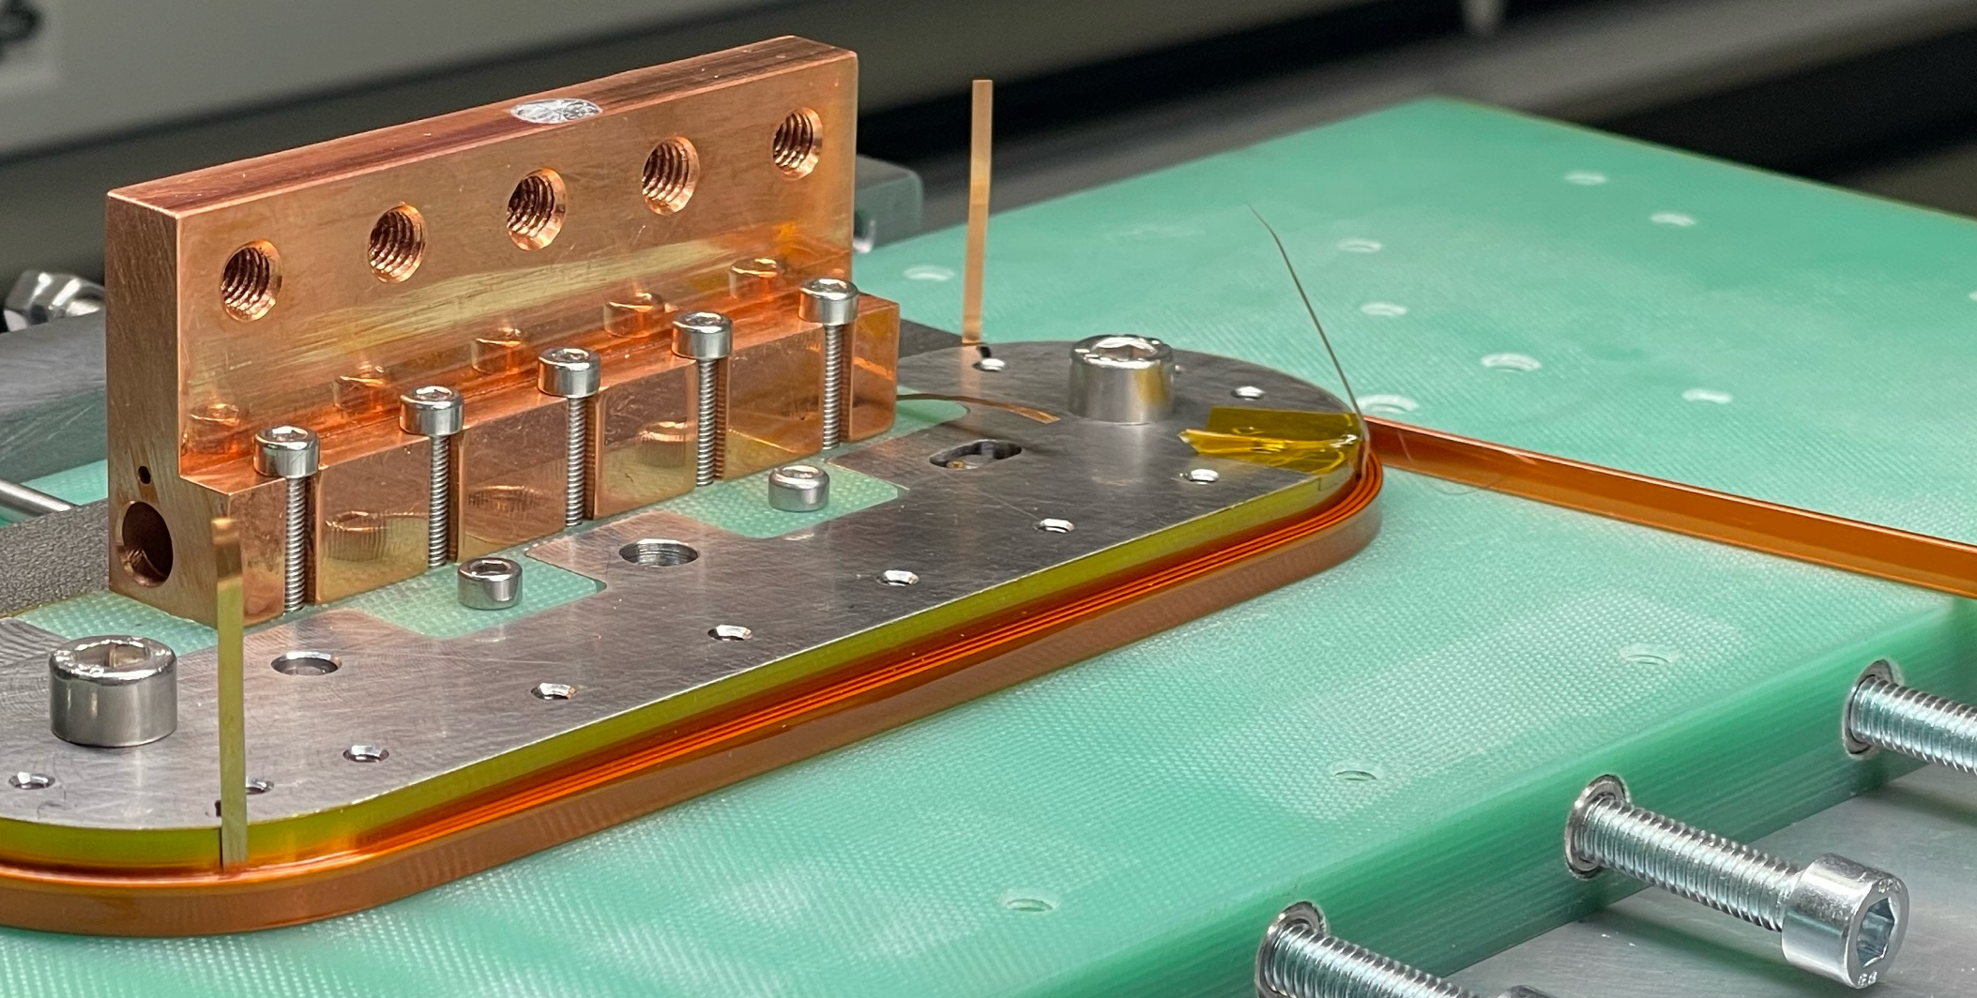
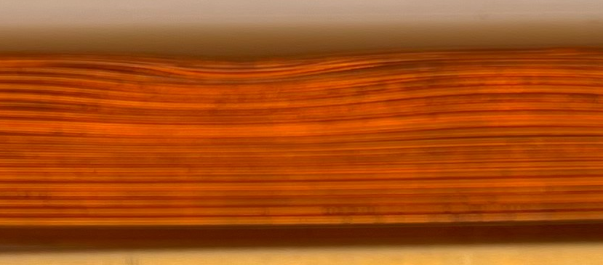
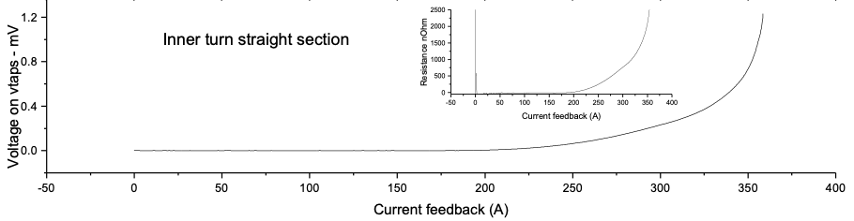
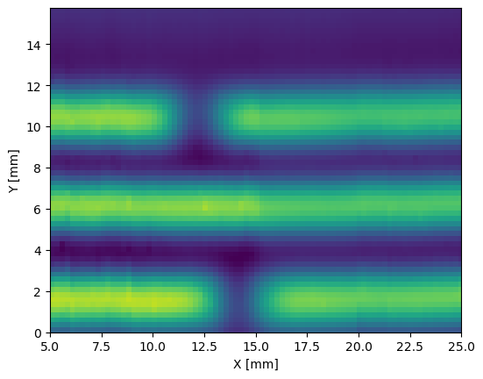
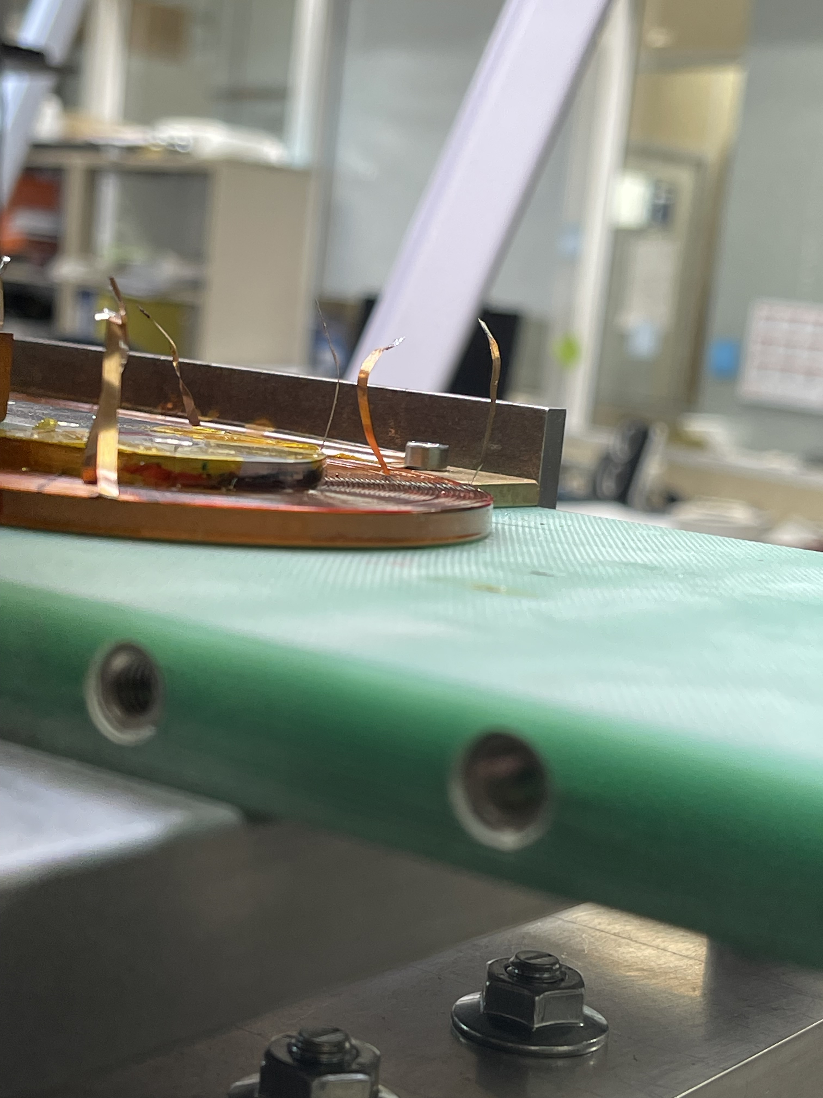
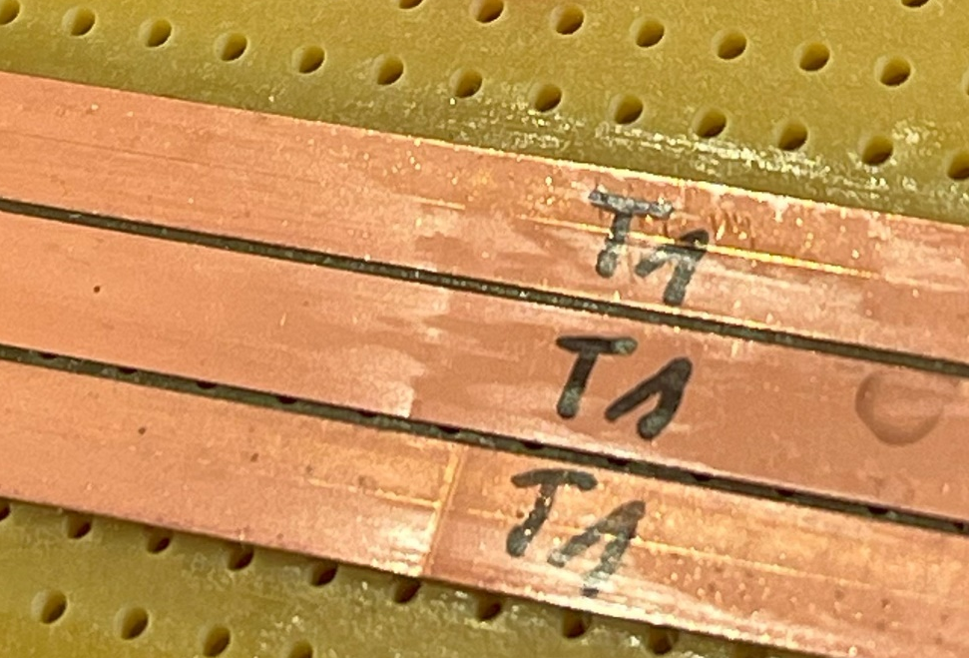
Single layer racetrack coils
Single layer coils were manufactured to:
Develop coil winding process;
Validate newly developed in-line cable insulation method with Kapton;
Address issue of cable buckling in the straight section of coil;
Validate voltage tap placement method;
Develop conductor characterization methods for defect localization.
Single layer coil design during winding (J. Mazet)
Winding issue (buckling) at the straight section of racetrack
Field map above tape samples
Hall-scan of currents induced in extracted strands
Resistive slope before transition in a section of a coil.

Slide 7
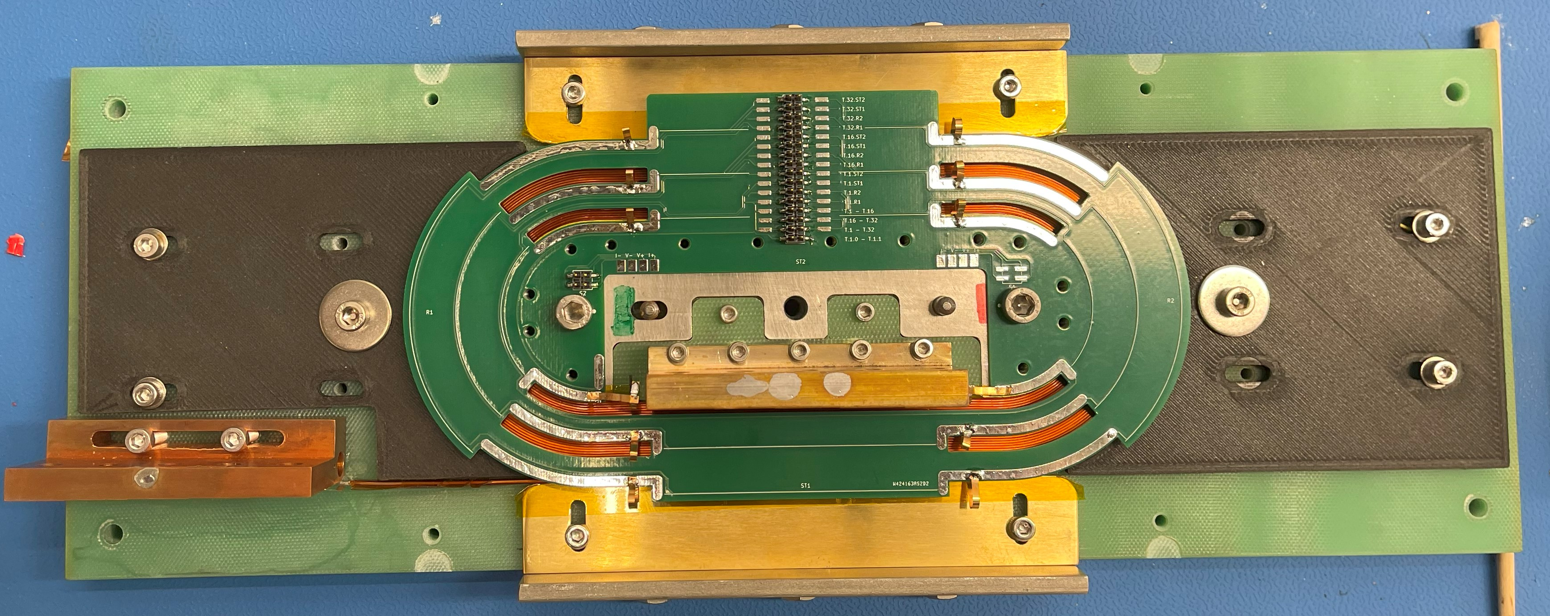
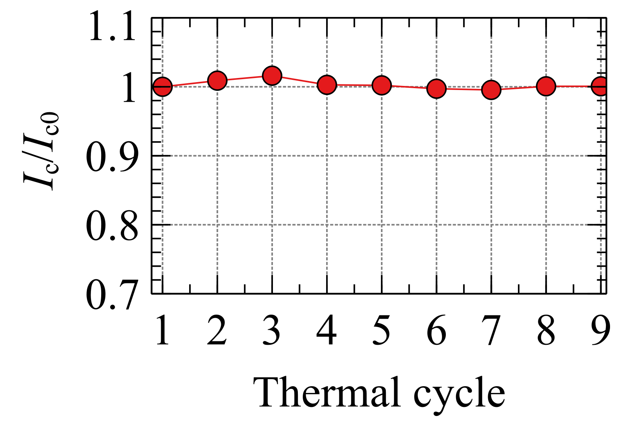
Single layer racetrack coils (2)
The coil SR_FC01_03 was successfully tested with previous issues addressed and no signs of conductor damage.
The coil was also thermally cycled 9 times with no I_{c} degradation.
Single layer racetrack coil prepared for LN2 test
Parameter | SR_FC01_03
# of turns | 32
Pole radius (mm) | 25
Straight section length (mm) | 110
Inductance (mH) | 0.206
I_{c} at 1 mV, 77 K (A) | 312
Coil constant (mT/A) | 0.393
Field at center at I_{c} and 77K (mT) | 123
A. Saba

Slide 8
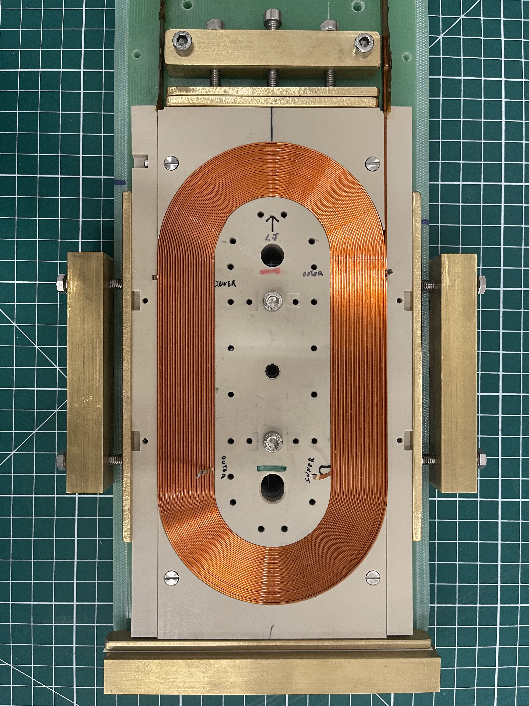
Double layer racetrack coils
The pole design was updated for double-layer racetrack with layer jump.
After winding the double racetrack coil is contained in PEEK module that will in turn be placed in a mechanical support structure.
Parameter | Value
# of turns | 35
Pole radius (mm) | 25
Tape/cable width (mm) | 4
Straight section length (mm) | 100
Inductance (mH) | 0.790
I_{c} at 1 mV, 77 K (A) | 276
Coil constant (mT/A) | 0.867
Field at center at I_{c} and 77 K (mT) | 239
After tests at LN2, the strands from the coil were extracted and scanned with TAPESTAR™, which did not reveal conductor damage.
Double layer racetrack coil after winding, contained in module made of glass loaded PEEK

Slide 9
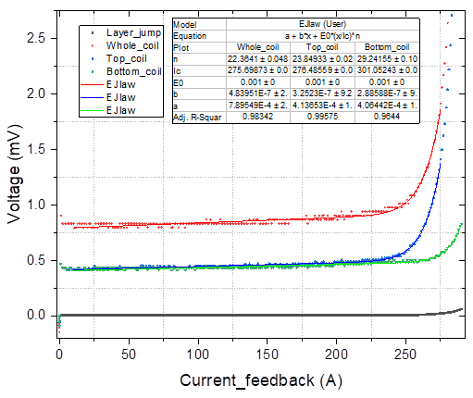
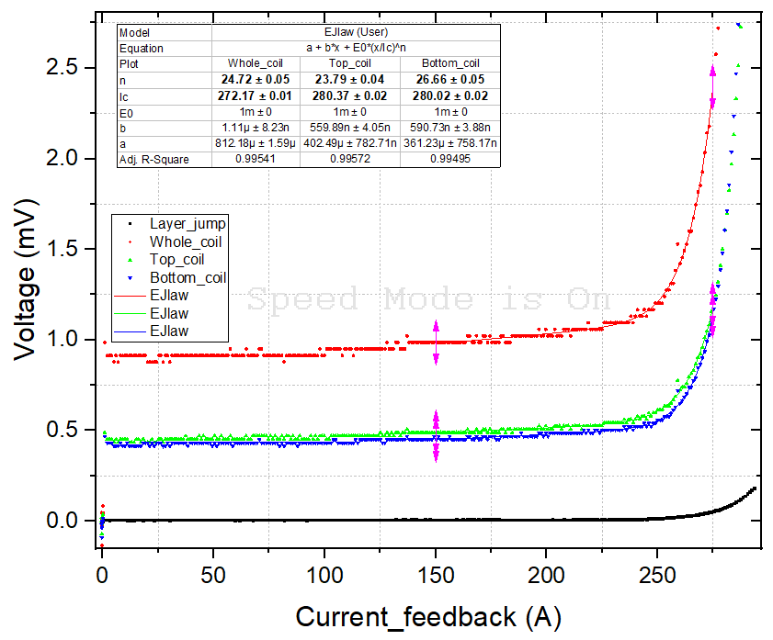
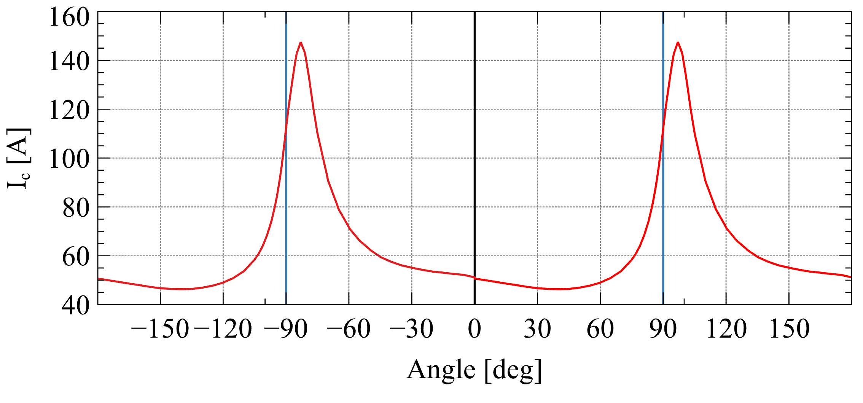
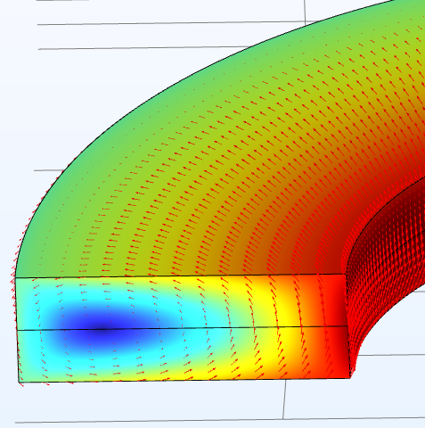
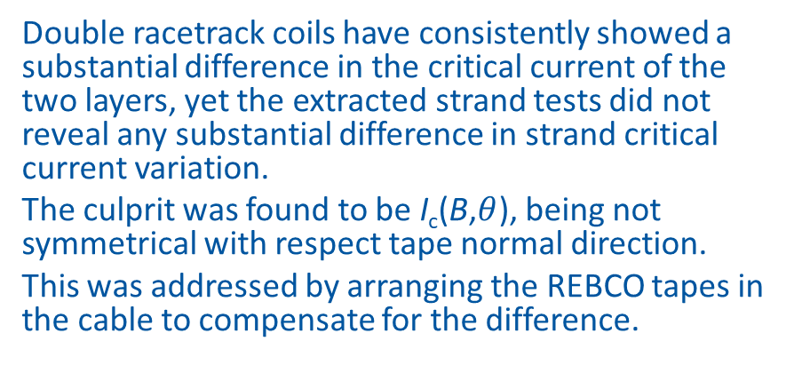
Effect of I_{c}(B,𝜃)
a)
Double racetrack coils have consistently showed a substantial difference in the critical current of the two layers, yet the extracted strand tests did not reveal any substantial difference in strand critical current variation.
The culprit was found to be I_{c}(B,$θ$), being not symmetrical with respect tape normal direction.
This was addressed by arranging the REBCO tapes in the cable to compensate for the difference.
b)
Angular I_{c} dependency at 77 K 0.5 T shows asymmetric ab-plane peaks DOI:10.6084/m9.figshare.23536374.v4
Typical difference in coil layer I_{c} before a) and after b) change of tape stacking in cable

Slide 10
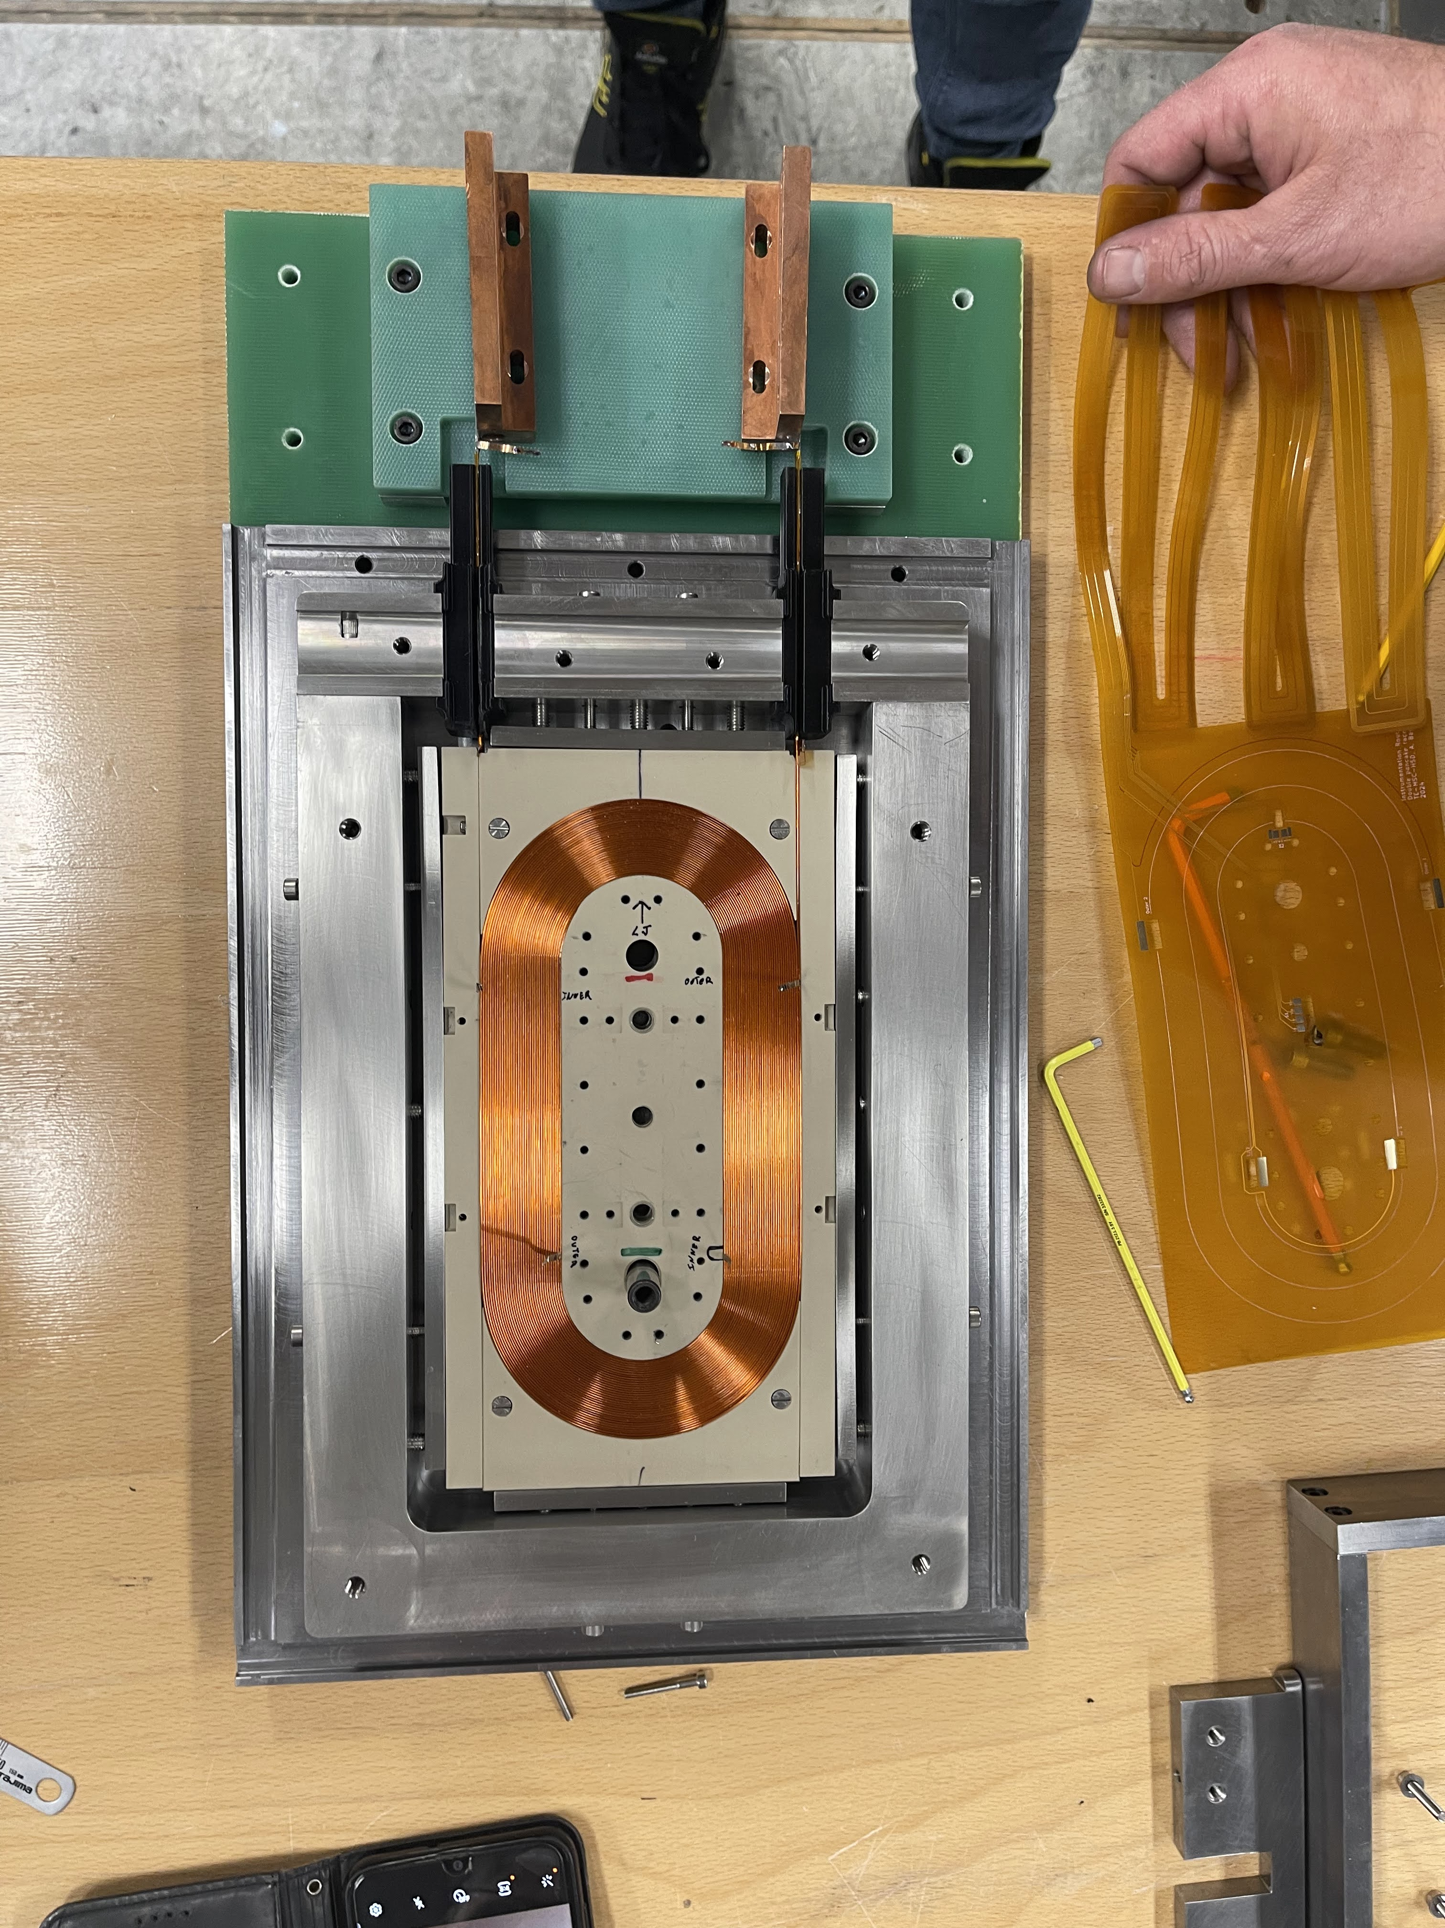
Tests in LHe
Coil assembly tested in SM18
The first tests of one double racetrack coil module were performed in December 2024 and January 2025 in the diode test station at SM18.
Unlike for tests in LN2 the coil modules require a dedicated mechanical support structure due to forces involved.
Cold powering parameters: | DR_FFC01_06
Operation temperature | 4.5 K
Nominal current @ 4.5 K | 2000 A
Field at pole center @ I_{nom} | 2.65 T
Peak field on conductor @ I_{nom} | 5.2 T
Estimated short sample limit @ 4.5 K | 2650 A
Max. allowed test current (field) @ 4.5 K | 2500 A (3.06 T central field)
Cable critical current^{[1]} @ 77 K, s.f. | I_{c}, _{min}: 839 A; I_{c}, _{avg}: 863 A
Nominal ramp rate | 5 A/s
Stored energy @ I_{nom} | 1.9 kJ
Inductance @ I_{nom} | 0.97 mH (above saturation)
Maximum allowed hotspot temperature | 100 K
MIITs @ T_{op}= 4.5 K | 0.20 (100 K), 0.35 (200 K)
REBCO conductor length used | 140 m
Coil module
SS mechanical support
Iron shell
^{[1]} Faraday Factory Japan. Sum of conductor I_{c} along cable length

Slide 11
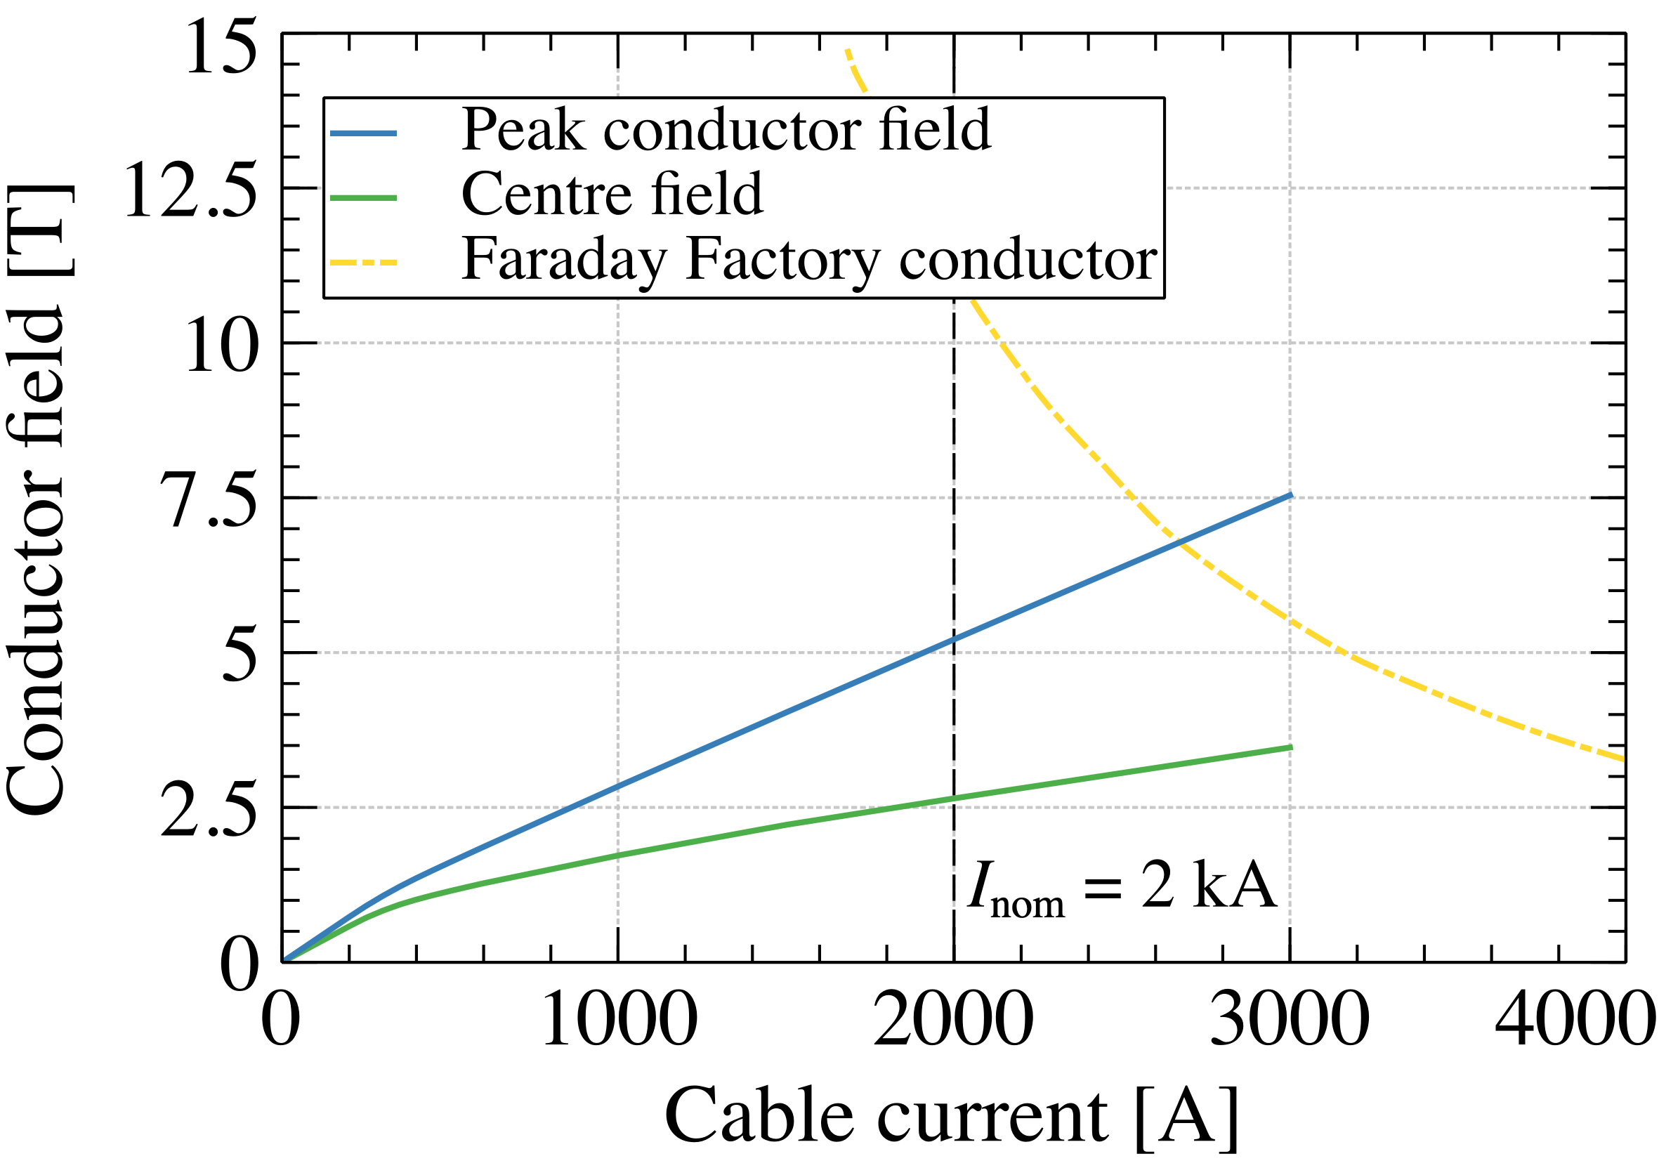
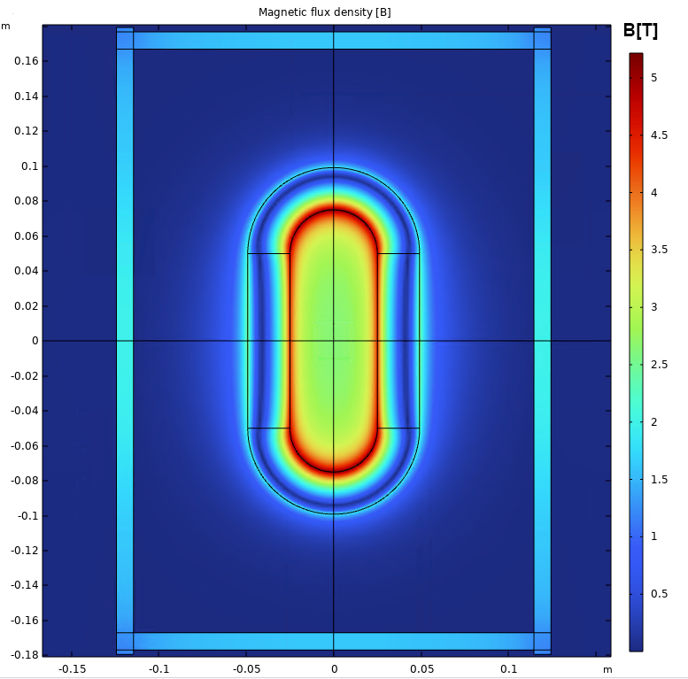
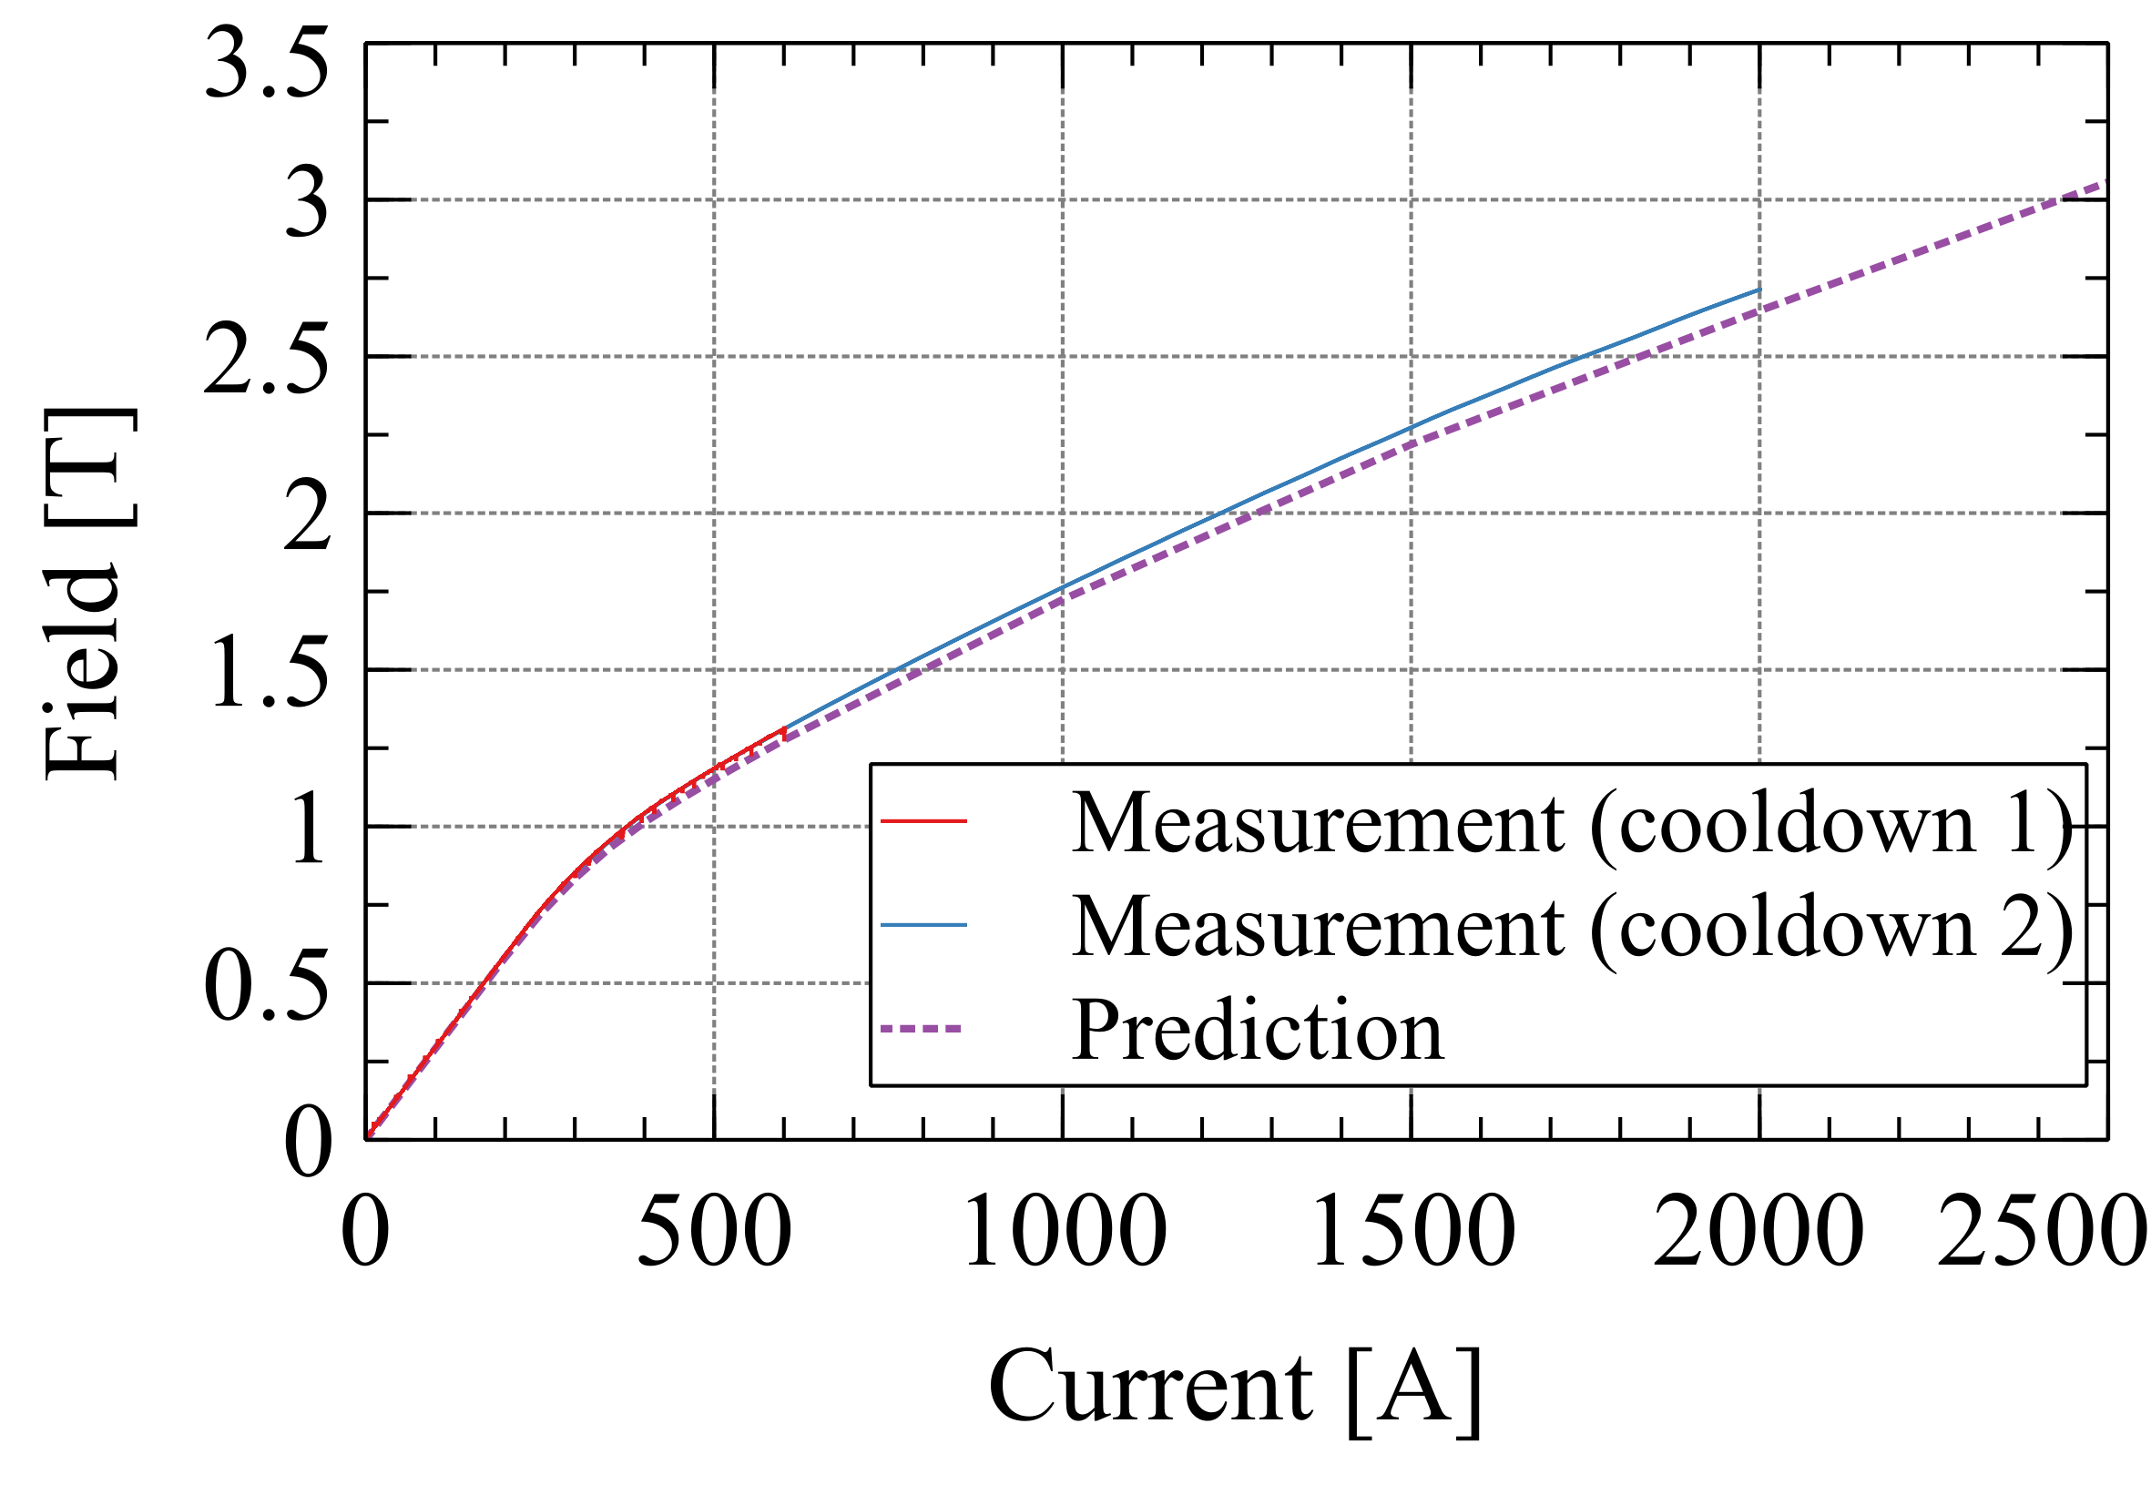
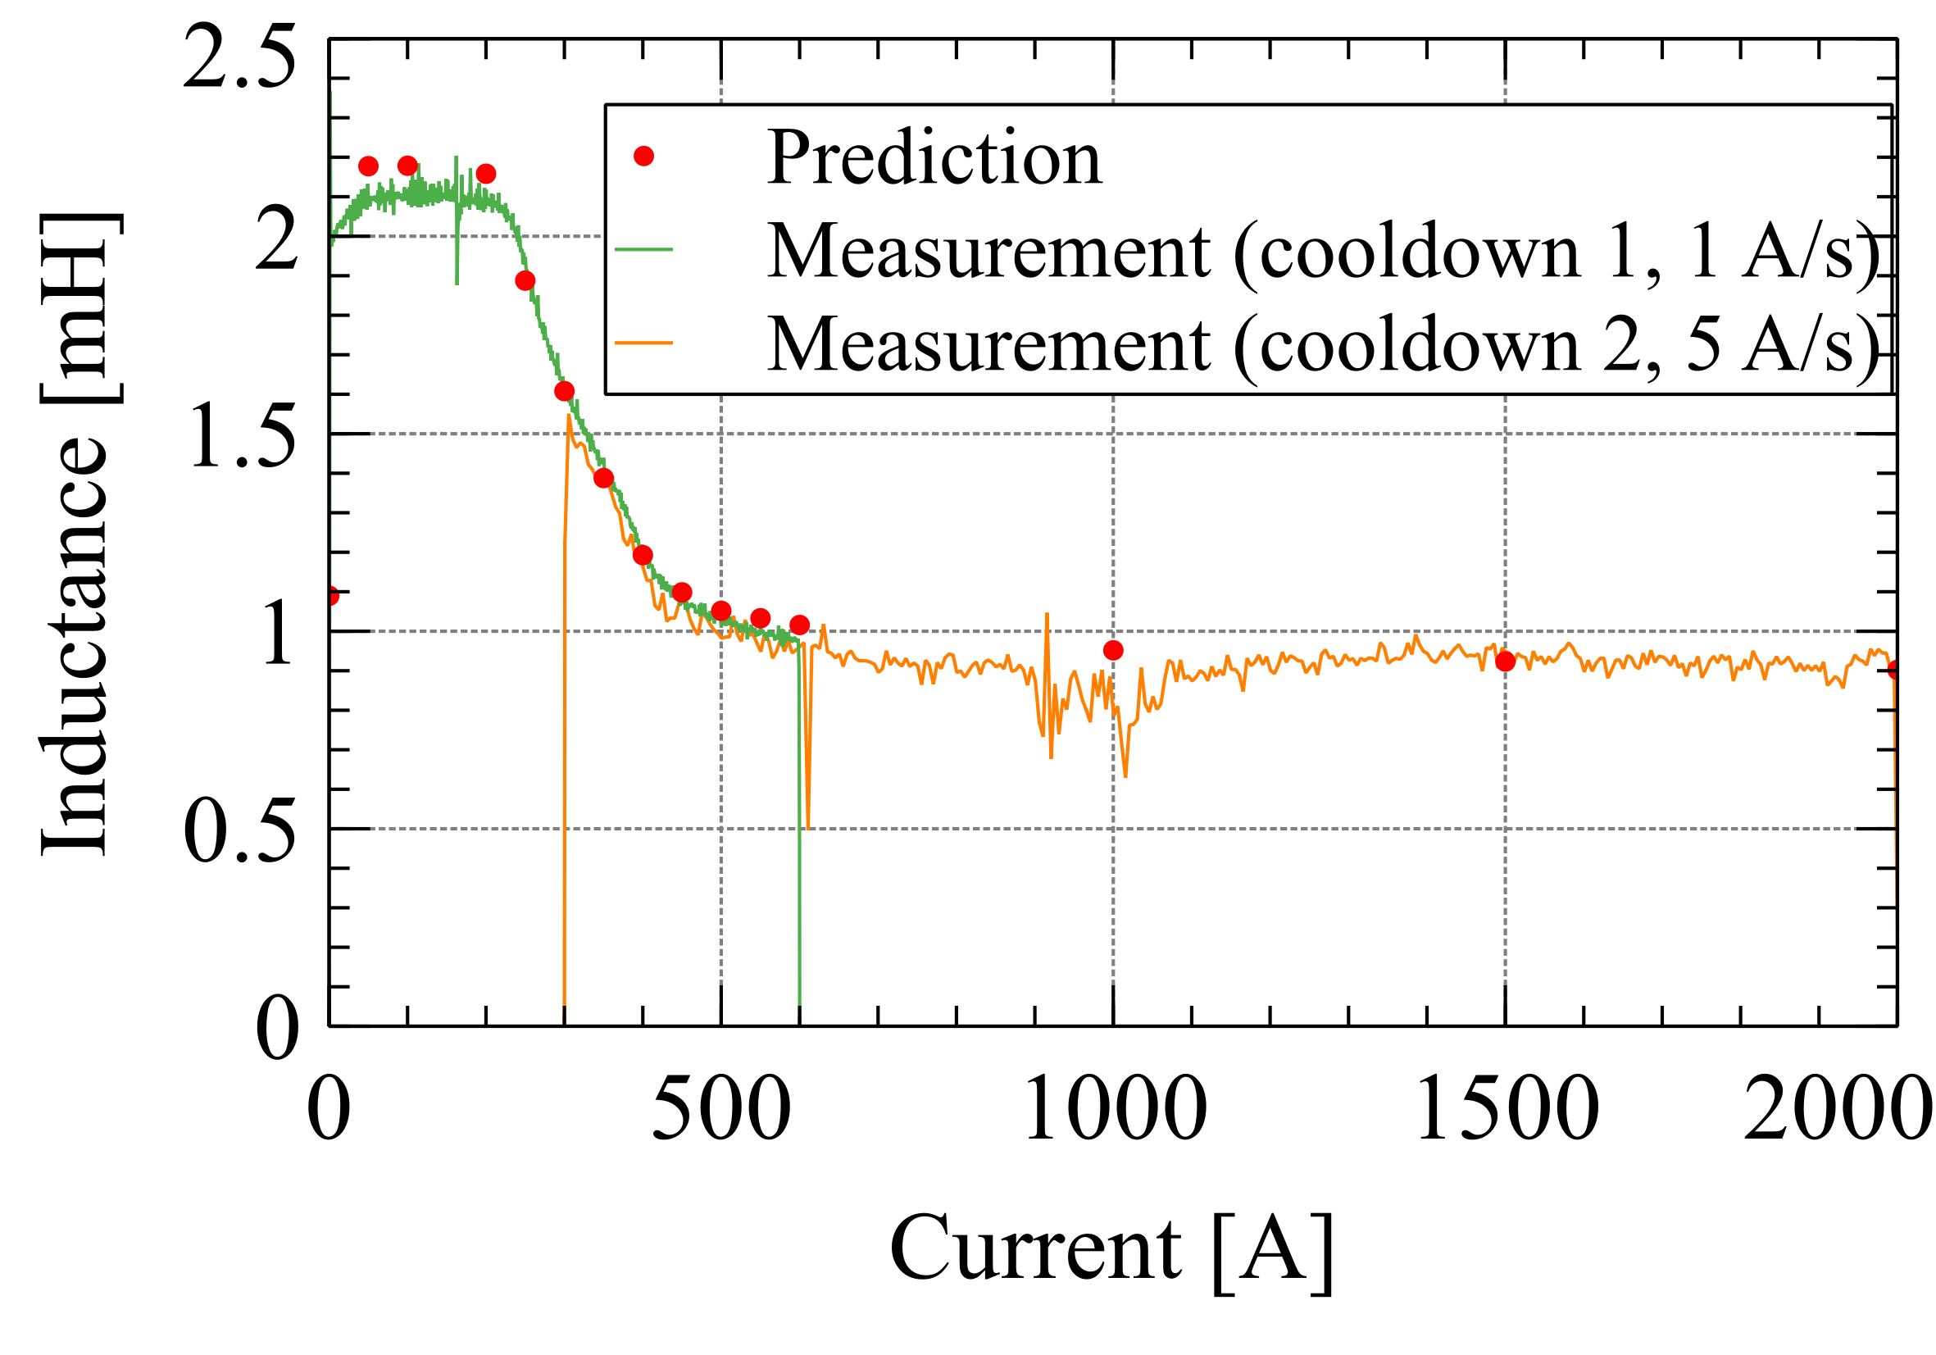
Tests in LHe (2)
At the nominal current of 2 kA , the magnet has about a 25% margin to the load line with the peak conductor field at 5.2 T.
The magnet experienced 4 thermal cycles in total (two to 77 K and a further two to 4.2 K).
During the first cooldown to 4.2 K, the current was limited to 600 A due to power supply, and during the second cooldown, a 20 kA power supply was used (standby current of 300 A).
The magnet performance was in line with the expectations. The magnet reached a nominal current and 2.72 T as measured in the coil center.
Magnet load-line and center field with respect to performance conductor in ⊥ field.
Predicted and measured magnetic field at the center of the coil.
Predicted and measured inductance of the coil.
Field map in the midplane of the double layer racetrack coil

Slide 12
Tests in LHe (3)
During the ramp to the nominal current, no onset of the superconducting-normal transition was observed;
No training quenches;
A subsequent ramp and current hold at I_{nom} for 30 min showed no voltage or temperature drift.
Difference in voltage signal between two layers of the racetrack coil during ramp to nominal current.

Slide 13
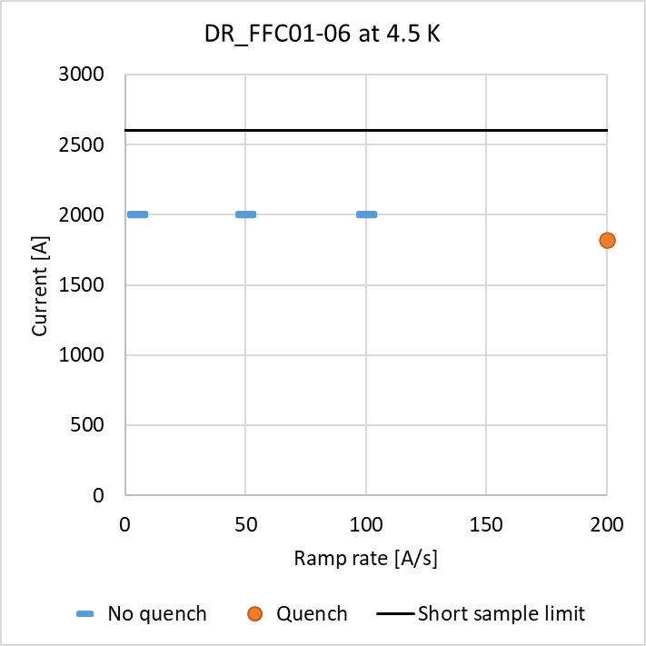
Tests in LHe (4)
For non-transposed cable we expect non-uniform current distribution among tapes during fast ramps.
Ramp rate study was performed:
Current was successfully ramped to I_{nom} at 5, 50, 100 A/s;
During a ramp at 200 A/s, a quench occurred at a current of 1820 A, and an associated temperature rise was recorded;
The quench initiated in the layer jump region at the boundary between the straight and curved sections of the coil;
During the quench, the voltage rose to 100 mV in 20 ms – easily detectable.
The coil performance was not limited by protection.

Slide 14
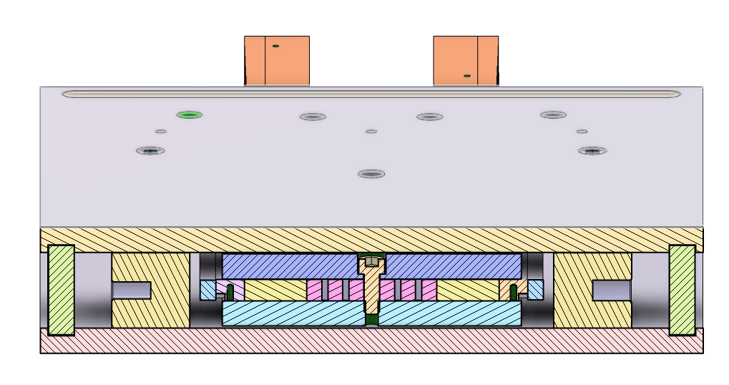
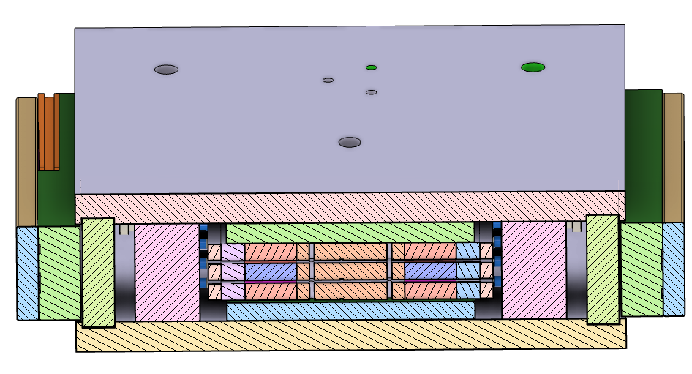
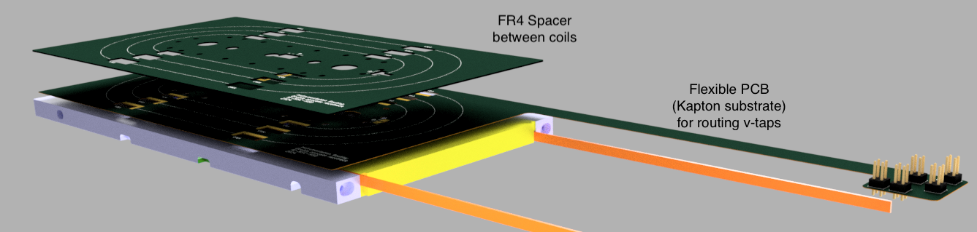
Next steps
An identical single racetrack coil will be tested in the coming weeks to repeat the test plan with the additional aim of:
Reaching short sample limit current (~2650 A);
Perform endurance test with at least 100 ramps to I_{nom};
Gain insight into coil performance variation between identically prepared coils.
Subsequently, a set of three identical coils will be measured in a similar mechanical structure, reaching higher magnetic fields and forces.
Thin 1.1 mm interlayer for instrumentation and wiring made using flexible PCBs
Three double racetrack coils
One double racetrack coil
Mechanical structure for testing of one double layer racetrack coil.
Structure for up to three double-layer racetrack coils (5.8 T in center, 9.7 T peak field).

Slide 15
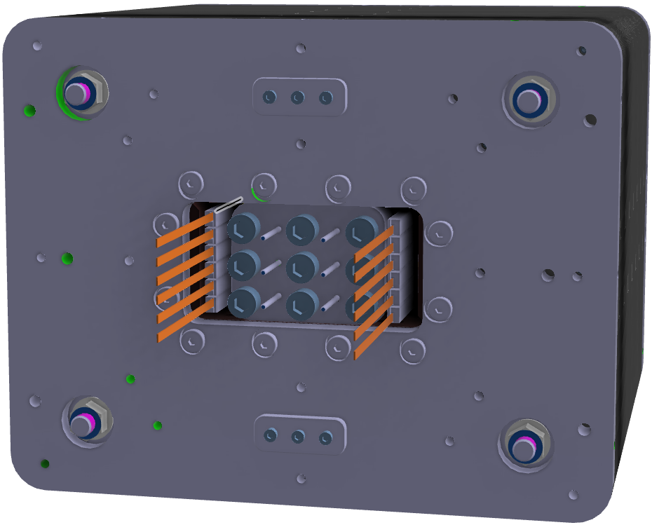
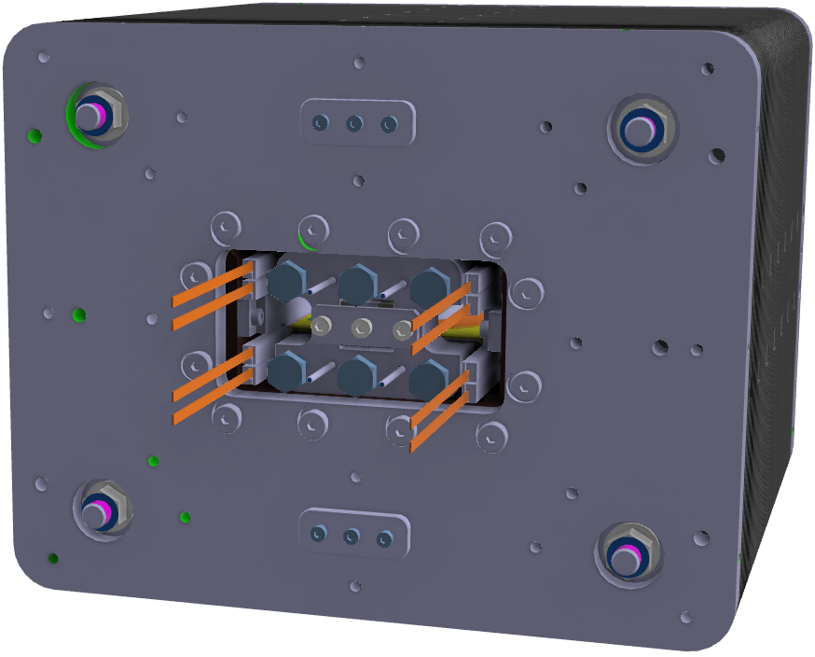
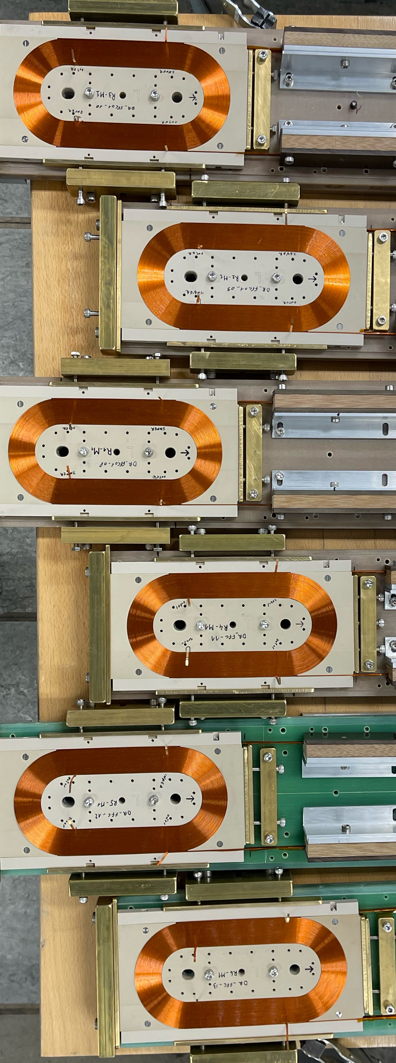
Next steps (2)
For phase two of the small model racetrack program, the production of the mechanical structure was launched, which allows the assembly of the coil modules in stacked racetrack or a common coil configuration.
Mechanical structure for Phase 2 accommodating 6 double layer racetrack coil modules. 10.6 T in the central bore, 13.7 T peak field.
Structure accommodating 4 modules in common coil configuration with small, 2 cm bore. 5.6 T in the central bore and 6.6 T peak conductor field at 4.2 K.
Double racetrack coils wound for Phase 2

Slide 16
Conclusions
Single and double layer racetrack coil modules were developed, and a number of coils were wound using electrically insulated stacked tape cable. The coils were tested in liquid nitrogen.
A double layer racetrack was tested in liquid helium and successfully reached nominal current (2 kA, 2.7 T in central bore and about 5.2 T peak field in the conductor).
An assembly of three double layer racetracks (∼ 5.8 T in central bore, 9.7 T peak field at 4.2 K) is being prepared. The test is planned for May 2025.
The small model racetrack program acts as a base reference and a research platform for testing conductor and new cable designs.
Design of 10 T common coil magnet with 50 mm wide bore is underway;
Conceptual study of 15-20 T magnet was launched;
Efforts are ongoing for developing alternative cable geometries that incorporate aspects of filamentarization and transposition.

