Slide 2
Towards HTS ReBCO HFM magnets at INFN
Author: L. Rossi, M. Statera, S. Sorti
INFN and Milano University

Slide 3
Outline
INFN present experience with HTS magnets: IRIS-ESMA
INFN HTS R&D: models, facilities and experiments
Preliminary analysis of 10 T dipole demonstrator for HFM
Outlook to 14 T dipole accelerator magnets

Slide 4




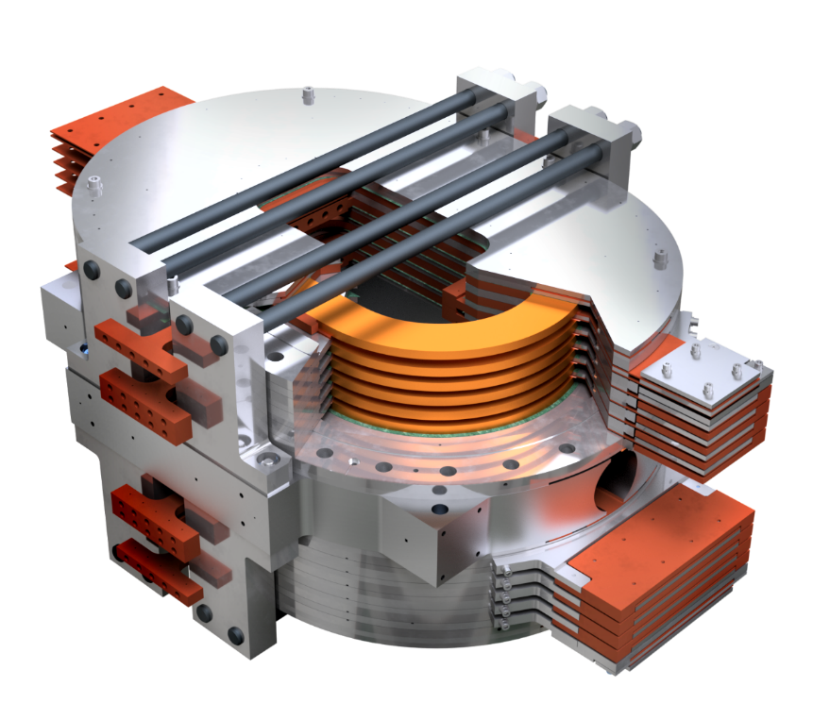
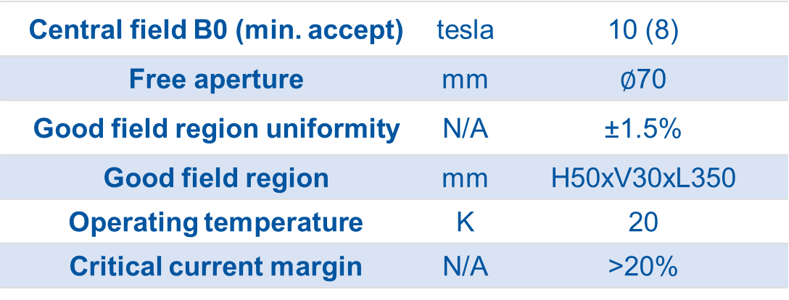
IRIS Energy Saving Magnet (ESMA)
Test operation with cryogen-free technology
Test (non)-insulation technology
Installed in INFN Genoa facility @ end 2025
IRIS WP9 institutes:
Engineering design
and construction:
Central field B0 (min. accept) | tesla | 10 (8)
Free aperture | mm | $∅$70
Good field region uniformity | N/A | ±1.5%
Good field region | mm | H50xV30xL350
Operating temperature | K | 20
Critical current margin | N/A | >20%

Slide 5

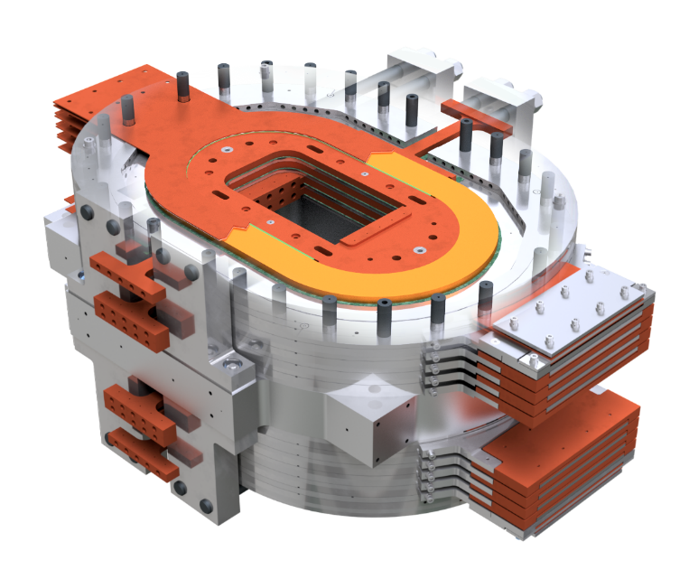
IRIS Energy Saving Magnet (ESMA)
Modular structure (12 identical, modular coils);
Cable: 2×12-mm-wide tape
+ 26 μm AISI 304 tape, 1150 A;
516 m of per pancake
(internal splicing needed);
Protection: tailored system
(sensors + algorithm) to keep
operation in safe regime.
Last resort is fast ramp-down.
48 W losses to charge in 3 h
(no need for fast cycles)
Cooling plates
Contraction-matching mandrel + inner electrode
Coil pressers system (partially omitted for clarity)
REBCO flat coil
Interfaces for bridges to cryocoolers
Outer electrode
Metal
Cryostat tie-rods anchoring
Cu stabil.
Tape
YBCO
Substrate
Notes:
Le nostre soluzioni che proveremo

Slide 6
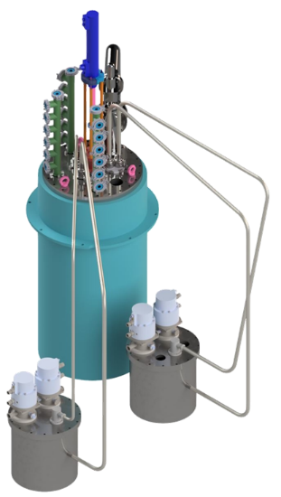
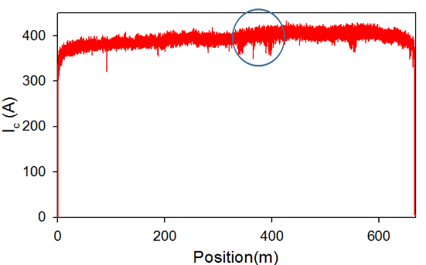

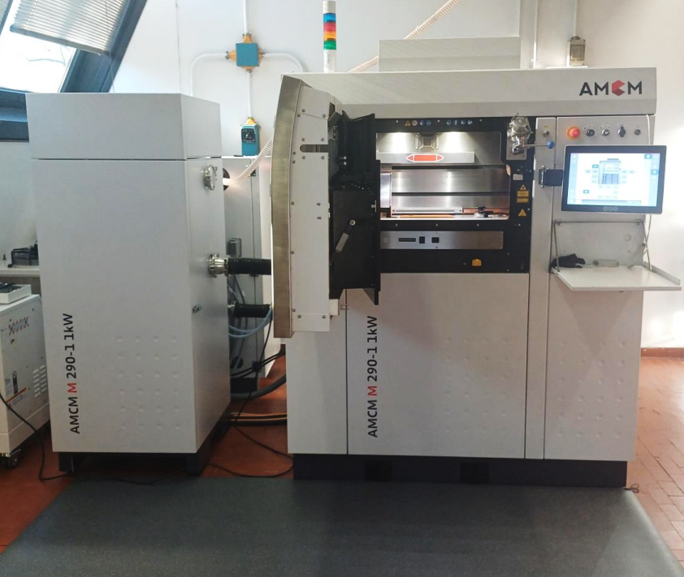
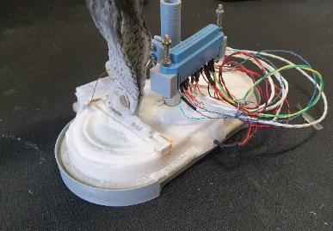
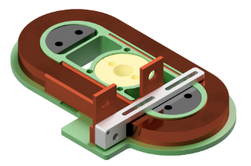
HTS R&D at INFN: experimental activities at LASA
Tape QA and characterization
→ ordered EF Mcorder (fall ’25)
(with visual inspection module)
Splicing and joints repeatable manufacturing online
(while winding)
Small coils with different insulation technologies
→ ordered multi-tape winding machine (fall ’25)
Under-development apparatus for variable-temperature tests, with optional background field
Commissioned in-house Additive Manufacturing polymeric & metallic (3D printer), starting R&D activity on mechanical structures for advanced 3D winding of tapes.
20 K
55K
Balconi, Beneduce, Cannavò, Crespi, Dotti, Pedrini, Rossi, Santini, Sorti, Statera

Slide 7
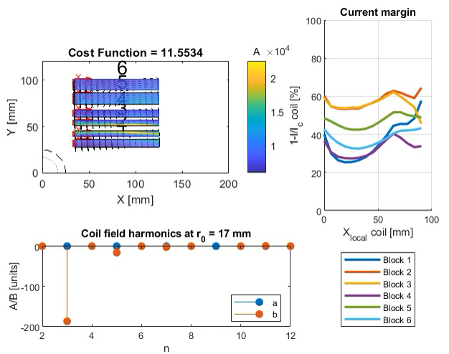
HTS R&D at INFN: numerical tools
(in addition to commercial software)
Matlab + FEMM for Magnet design, aiming at
ad-hoc routines for HTS, allowing for:
  Estimation of losses and dynamic field quality
  from the beginning (semi-analytical models)
  (Cost) optimization of magnet design accounting
  for tape features
  → also to explore non-standard geometries
In addition, ongoing upgrading of the quench
code QLASA to include HTS and their features.
Optimization
Jc×mm²
Mariani, Mariotto, Scarantino, Sorti

Slide 8
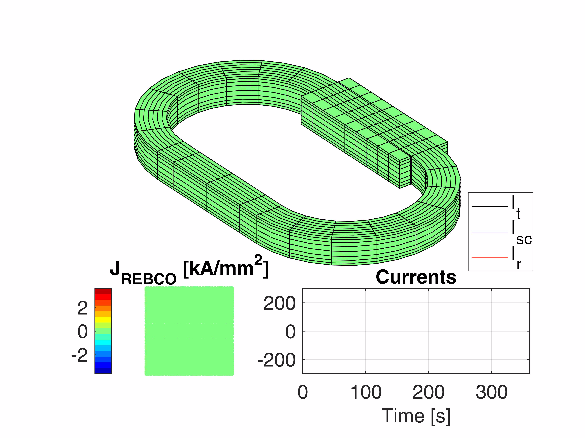
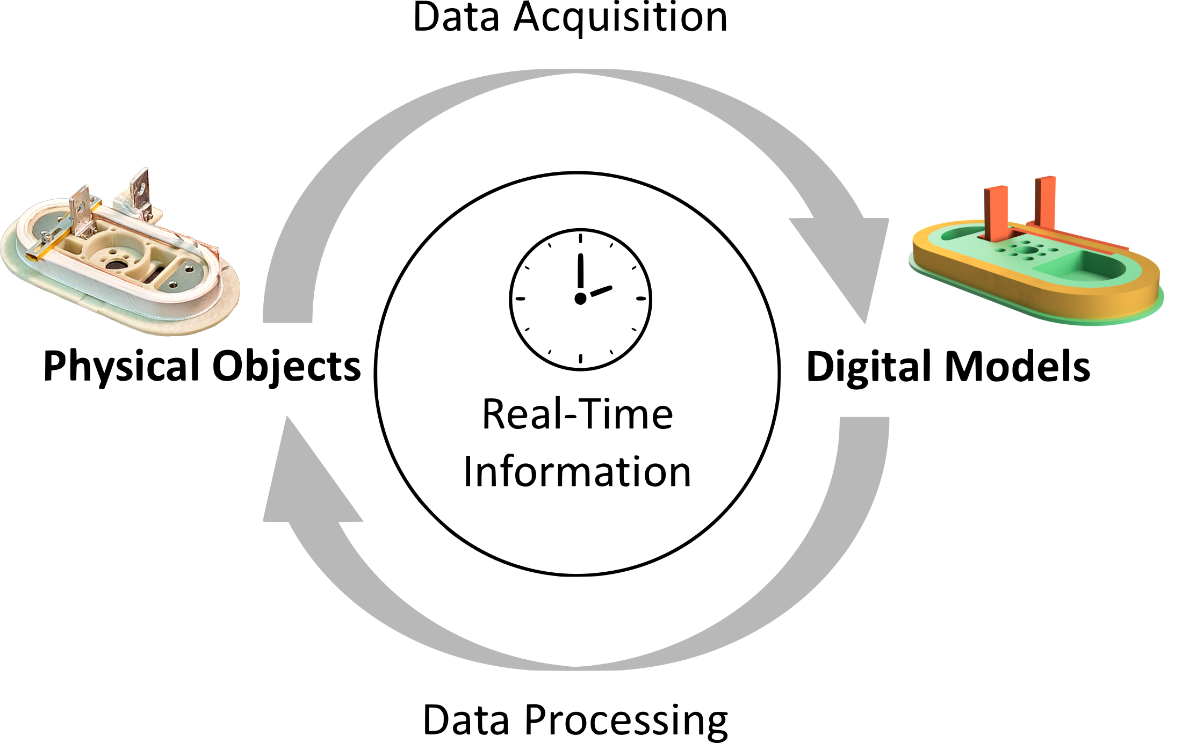
HTS R&D at INFN: numerical tools
(in addition to commercial software)
For Magnet operation: Aiming at modern automation for HTS magnets:
  Model + data online monitoring, measurements and diagnostic
  Optimal control of charge/discharge:
Strongly physics-based approach: full 3D model of magnet, E.M., thermal and possibly mechanical
+ model order-reduction and data-driven correction
The same code will serve also as complementary
to QLASA, for quench of NI magnets
Charging optimization based on Pontryagin's Min. Principle
[Balconi et al. IEEE TAS (2024)]
Model-order reduction through Proper Orthogonal Decomposition for real time applications
[Sorti et al. IEEE TAS (2025)]

Slide 9
INFN HTS R&D
IRIS
Modeling
Conductor
Design
Construction
Test
CONDUCTOR
Explore
conductor
geometry
design
protection
10 T Demonstrator
MODELING
14 T
conceptual design
DESIGN

Slide 10

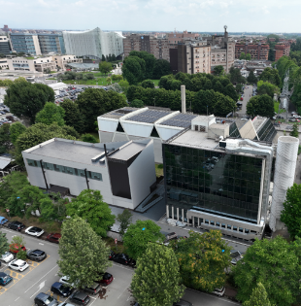
HTS at INFN: recap and timeline
 | 2025 |  |  |  | 2026 |  | 2027 | 2028
 | Q1 | Q2 | Q3 | Q4 | Q1 | Q2
Tests | Ongoing activities on tape QA, splices, small coils at LN₂ | Flat pancakes campaigns toward low T (below LN2) | ESMA preliminary tests on single coils | ESMA completed and tested | 20 K racetracks + additional ESMA tests
Facility | Upgraded LASA HTS laboratory | Preparation for LHe tests of HTS coils | New multi-tape winding machine | Mcorder and 20 K cooling | SML laboratory preparation at LASA
Models | 100% electro- magnetic | 100% thermal and mechanical | Real-Time algorithm model+sensors | Model validation with ESMA | Study on optimal sensor network for advanced automation
10 T demonstrator
14 T
conceptual design
Render of the Superconducting Magnet Laboratory under construction at LASA

Slide 11
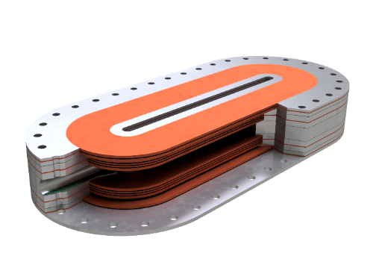
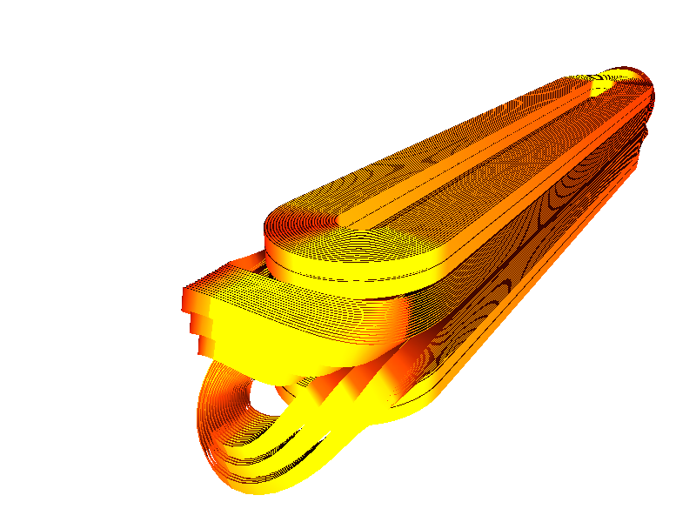
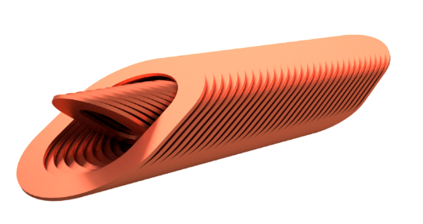
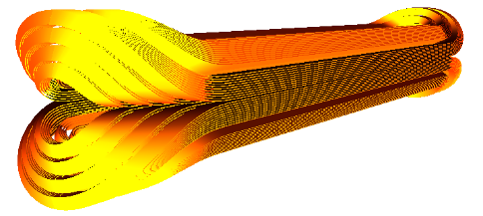
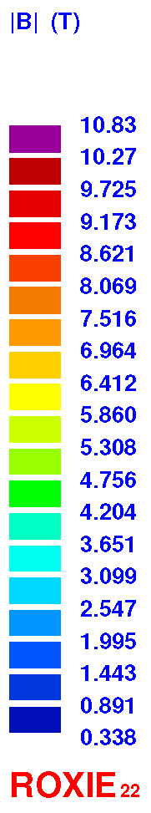

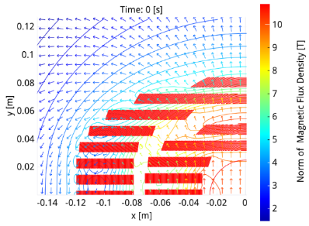
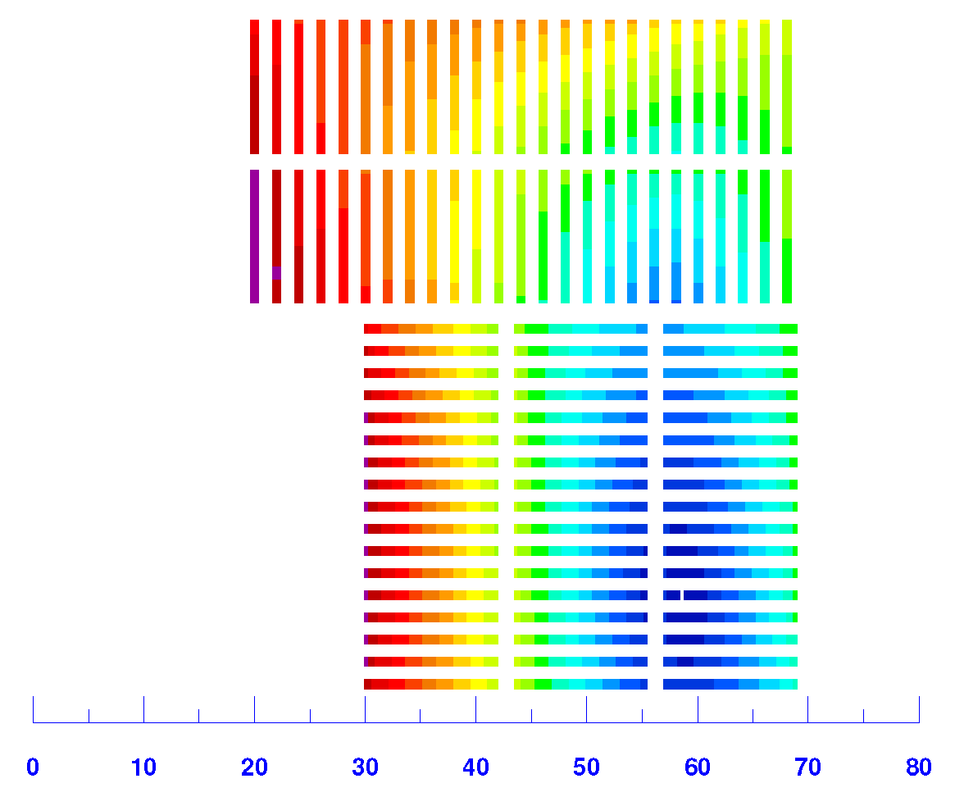
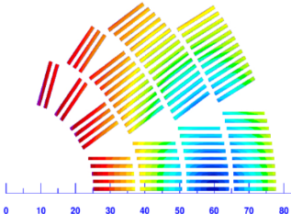
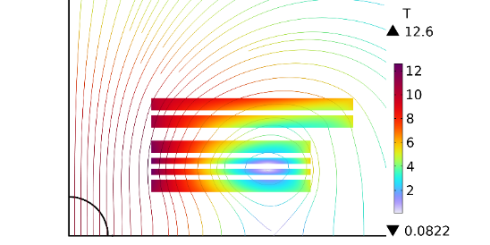
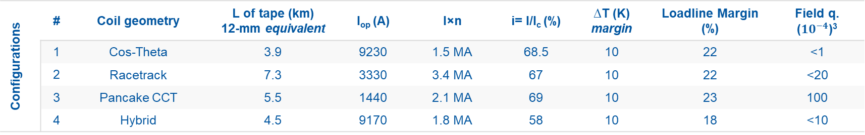
10 T dipole demonstrator
1) free aperture (i.e. up to coils), assuming beam pipe of 40 mm
2) standard FFJ, low field is https://htsdb.wimbush.eu/dataset/13708690
3) to be optimized in further studies
Common | B centre | Aperture diameter¹ | T_{op} | Straight section | Tape quality² | Max. Unit Length | Target J_{Cu}
 | 10 T | 50 mm | 20 K | 700 mm | FFJ 2021 | 200 m | 800 A/mm²
Configurations | # | Coil geometry | L of tape (km) 12-mm equivalent | I_{op} (A) | I×n | i= I/I_{c} (%) | ∆T (K) margin | Loadline Margin (%) | Field q. (${10}^{−4}$)³
 | 1 | Cos-Theta | 3.9 | 9230 | 1.5 MA | 68.5 | 10 | 22 | <1
 | 2 | Racetrack | 7.3 | 3330 | 3.4 MA | 67 | 10 | 22 | <20
 | 3 | Pancake CCT | 5.5 | 1440 | 2.1 MA | 69 | 10 | 23 | 100
 | 4 | Hybrid | 4.5 | 9170 | 1.8 MA | 58 | 10 | 18 | <10
1
2
3
4

Slide 12
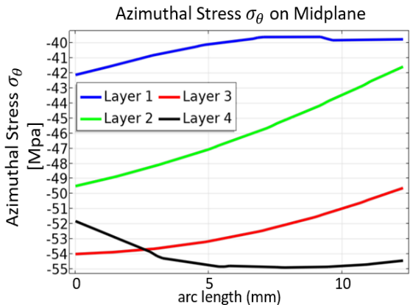
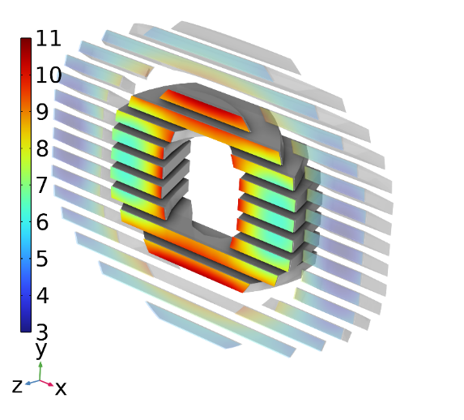
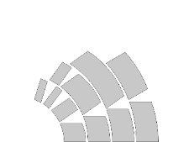
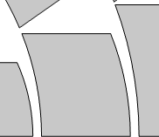
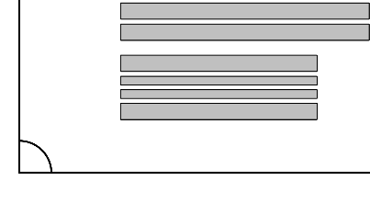




Preliminary mechanical evaluations
B(T)
Forces on inner layer
$$layers n°$$
$$arc length$$
y
6
$$1 2 3 4$$
$$0$$
$$[mm]$$
$$12.3$$
1
x
CCT has an intrinsically 3D force pattern: forces on inner layer try to rotate the pancakes → need a deep study of the mechanics
Hybrid coil is instead more similar to racetrack configuration
Bonded Layers hypothesis
→ maximum compression
in the outer layer (black line)
No positive radial and azimuthal stresses
Forces on coils near¹ than ESMA → same mechanical structure (also same concept)
Open point is cable mechanics especially regarding filler (dry, wax, epoxy?)

Slide 13
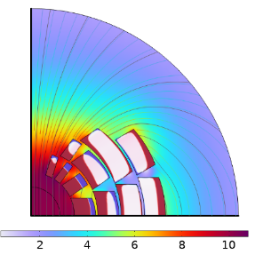
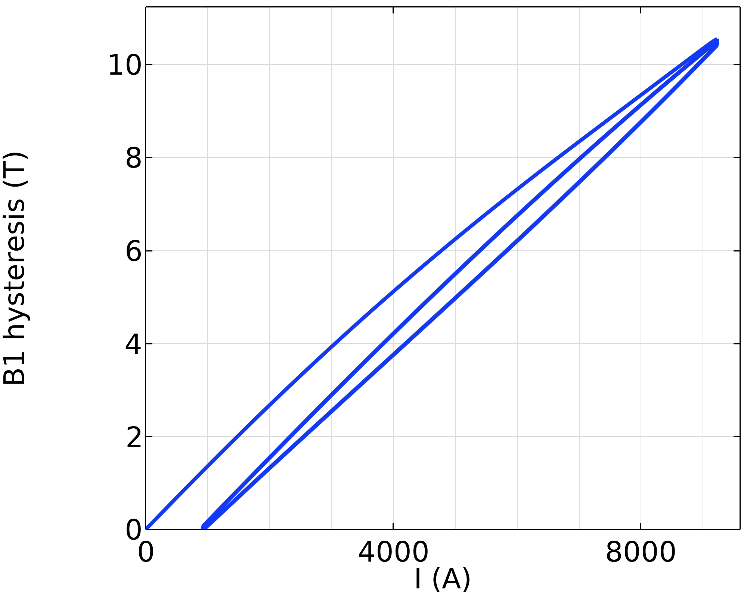
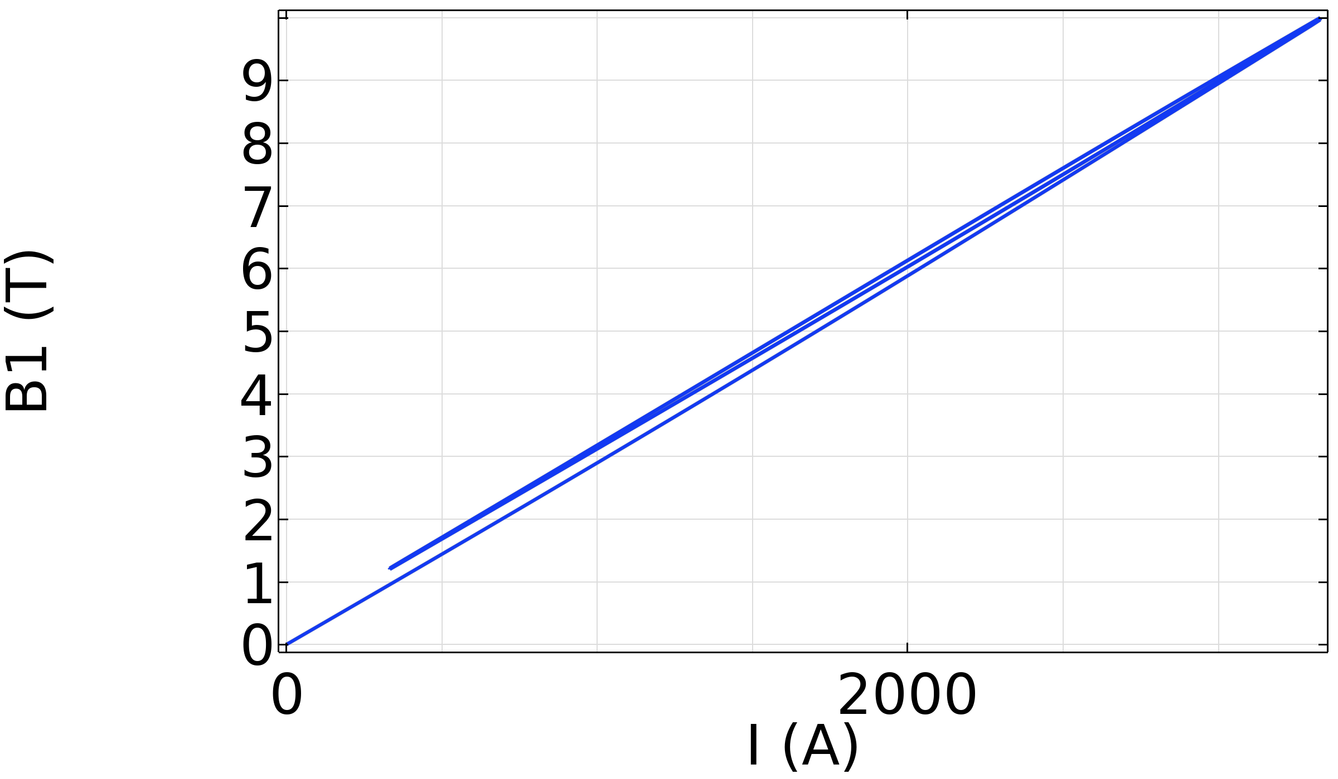
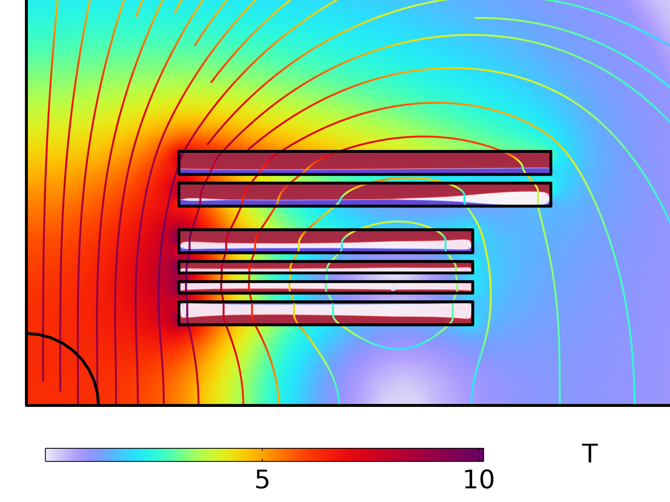
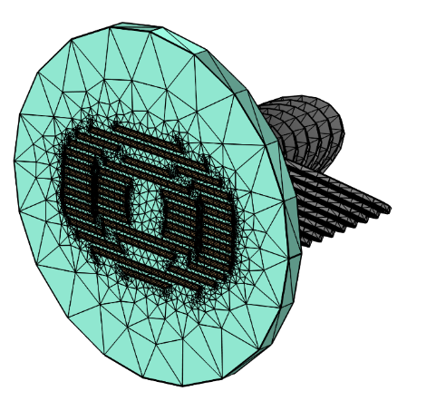
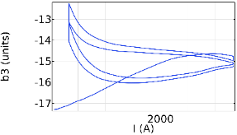
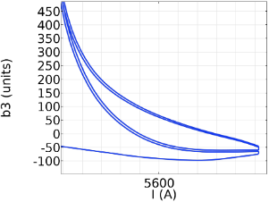
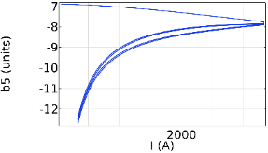
Losses and field quality
B1 hysteresis -0.6 T to 1.0 T
B1 hysteresis -0.15 T to 0.2 T
Periodicity
B1 cancels out
B(T)
B(T)
1° ramp ok
Simulating synchrotron-like cycle with COMSOL
Main issue: dipole screened at low current after 1st cycle by inner layer magnetization
Mitigations WIP (work in progress)
(change cable, degaussing, …)
Integrated losses on second cycle: 20 kJ/m (almost all in layer 1)
Same model and evaluations as cos-theta, but ×2 losses: 40 kJ/m per cycle
No critical issues on field quality.
Mitigation for losses: ESMA-like approach of Cu cooling channels/bridges
Started modelling periodic slice of CCT (COMSOL 3D), still a WIP
Hybrid also WIP, but expected as cos-theta

Slide 14
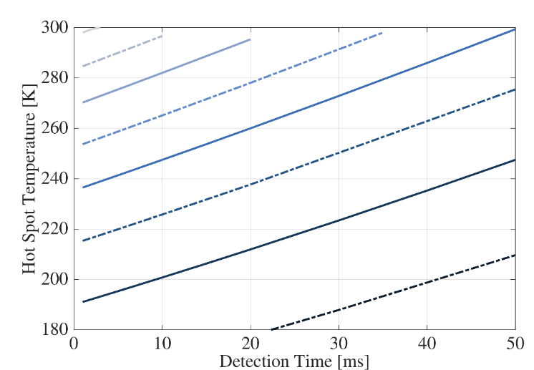
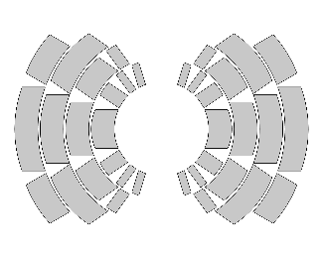
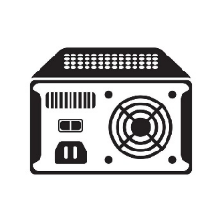


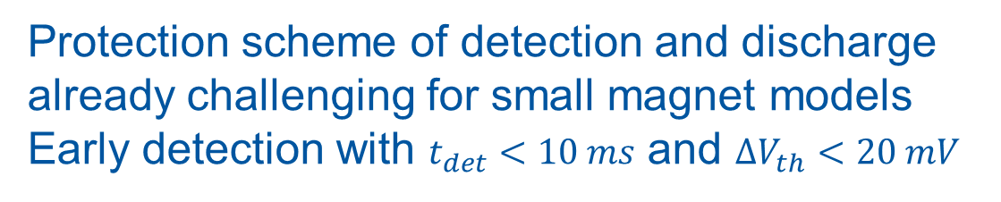
Quench Simulations
Insulated coils quench simulations: QLASA
  HTS conductors already implemented
17.5 mV
15 mV
12.5 mV
10 mV
Detection Voltage Thresholds
7.5 mV
5 mV
Protection scheme of detection and discharge already challenging for small magnet models
Early detection with $t_{det}<10 ms$ and ${ΔV}_{th}<20 mV$
1 mV
Effort to develop protection schemes
based on quench prevention.
Already under development for ESMA, we need to extend also to insulated magnets
PS current
Control
Sensors

Slide 15
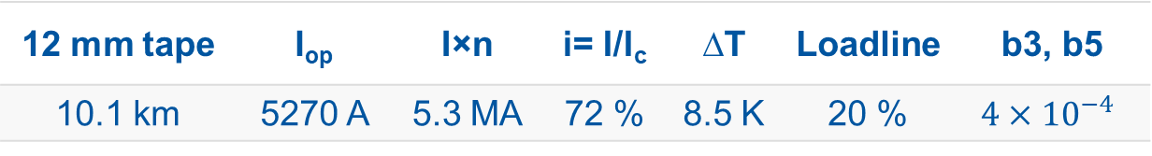
Toward 14 T dipole
Preliminary evaluation of racetrack configuration
(more experience already available).
Conservative assumption of the best-to-date production
FFJ (+20% of standard one).
Magnetic design concept:
conductor grading for
efficient tape consumption.
Example here with 3 widths.
(also stack grading is possible
if ↑ tapes in cable)
60%
30%
12 mm tape | I_{op} | I×n | i= I/I_{c} | ∆T | Loadline | b3, b5
10.1 km | 5270 A | 5.3 MA | 72 % | 8.5 K | 20 % | $$4{×10}^{−4}$$

Slide 16
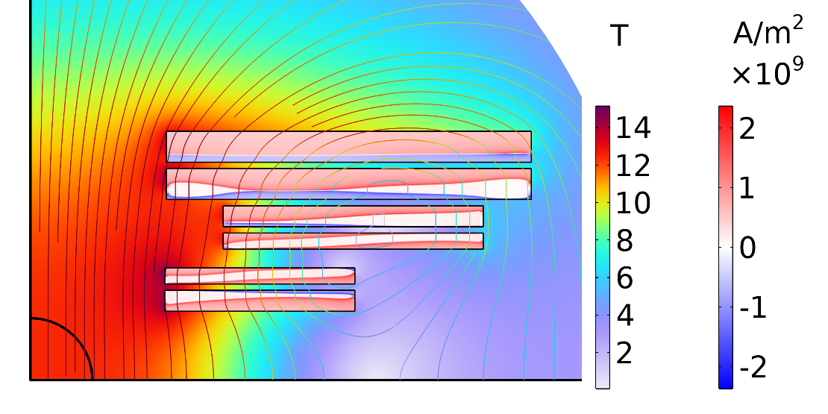
Toward 14 T dipole, vs 10 T demonstrator
+40% conductor (+20% performances) for +40% field
+100% forces (higher than ESMA) → further studies will be needed
Better field quality, < 5 U (more design freedom)
Same i=I/I_{c}, less ∆T ( - 1.2 K, higher field) and less L.L. margin ( -2.5 %)
Losses about twice more

Slide 17
Conclusion
INFN LASA (Milan) and Genoa have already started a preliminary study for candidate layouts for the 10 T HFM demonstrator
Within the NextGenerationEU project IRIS, a complete dipole magnet is being constructed, and it will be ready at the end of the year
Driven by IRIS, LASA is expanding its capabilities in accelerator magnet manufacturing and test, HTS included

Slide 18
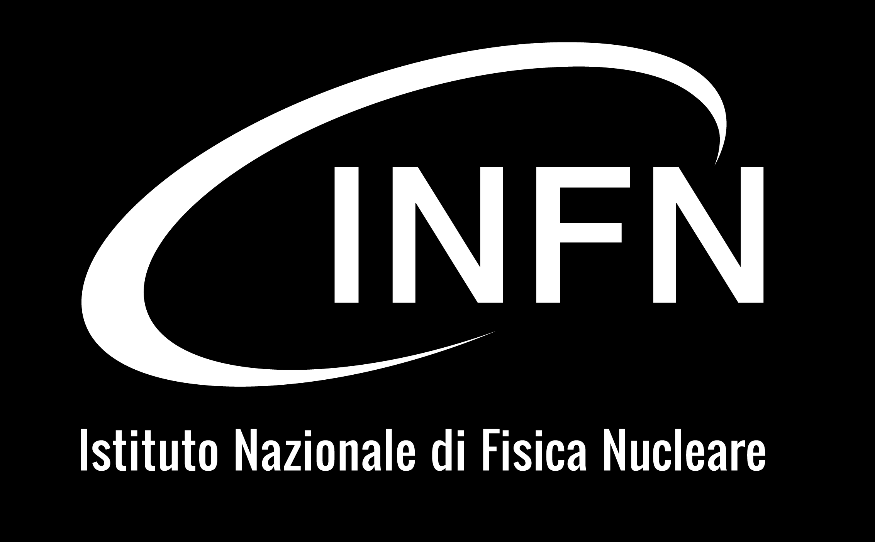
L. Alfonso, L. Balconi, E. Beneduce, A. Bersani,
B. Caiffi, M. Cannavò, G. Crespi, S. Dotti, S. Farinon, F. Mariani, S. Mariotto, D. Novelli, D. Pedrini, L. Rossi, C. Santini, G. Scarantino, S. Sorti, M. Statera
Thanks for your attention! Questions?

Slide 19
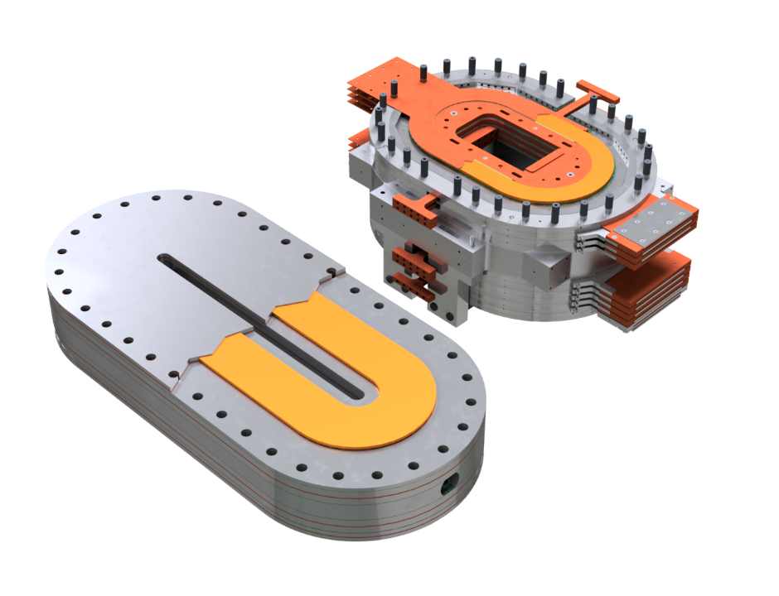
Back-up: ESMA vs 10 T racetrack demo
A racetrack demo would still pose many challenges
if compared to ESMA:
Field quality, static and dynamic
  Need for insulation and stabilizer,
  and protection without NI “safety”
  Possible issues from persistent currents
Coils of different geometries
  More complicated mechanical assembly
  Demo would be about + 50% of length
  Likely to have thicker coils

Slide 20
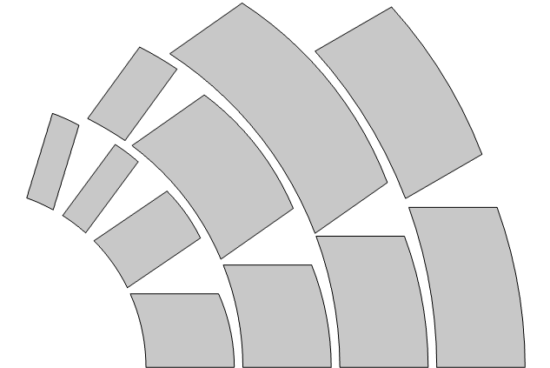
Back-up: dipole cancellation
Ramping up, the inner layer sees an almost uniform dipole field. It tries to oppose but get finally penetrated
Ramping down, it captures the dipole and oppose to its reduction, while the outer layers never get properly magnetized
At very low field, this is a strong m generating a reverse dipole even cancelling the main one
Mitigation under study: different cable, different inner-layer design, degaussing to restore virgin state, local actions on inner blocks.

