Slide 1

HFM
High Field Magnets
Towards REBCO HFMs
at PSI/CHART
Programme
D. Araujo, B. Auchmann, A. Brem, M. Duda, J. Kosse, C. Lindner, T. Michlmayr, H. Rodrigues, D. Sotnikov, A. Stampfli
HFM Annual Meeting, CERN, 10-12 February, 2025
This work was performed under the auspices of and with
support from the Swiss Accelerator Research and Technology
(CHART) program, http://chart.ch.

Slide 2

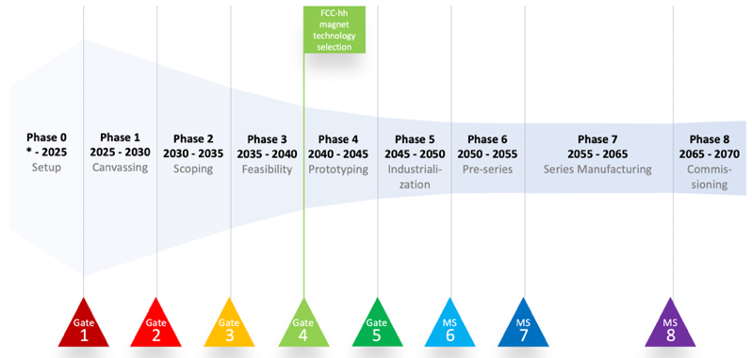
Contents: Setup and Initial Canvassing at PSI

Slide 3
Setup

Slide 4
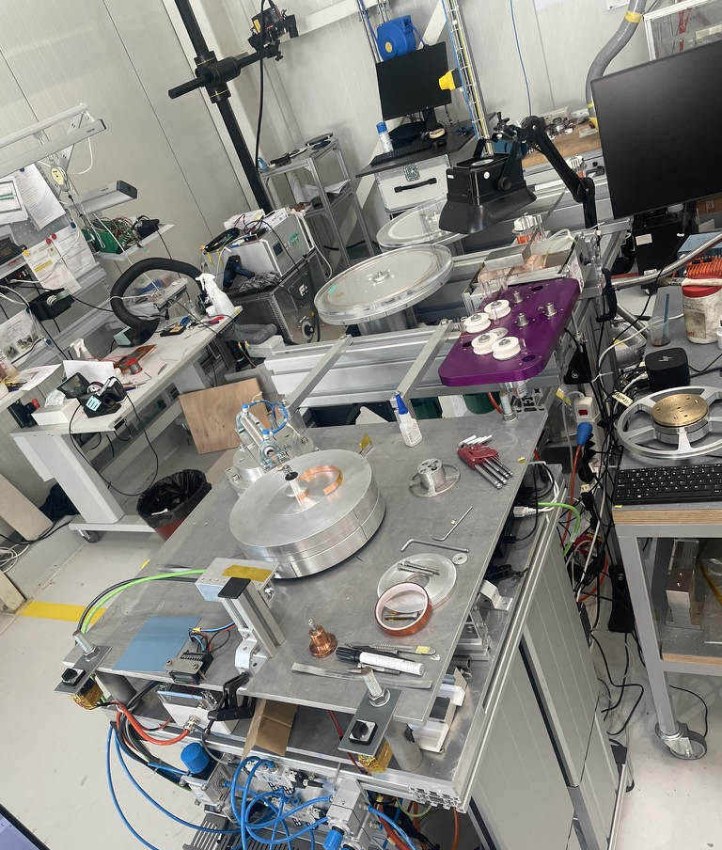
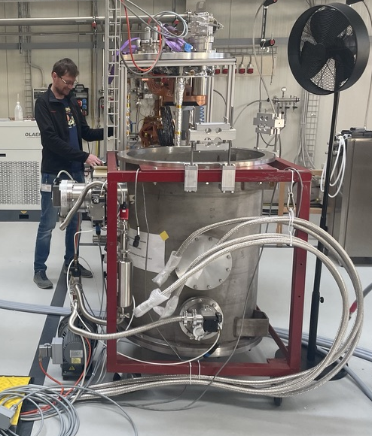
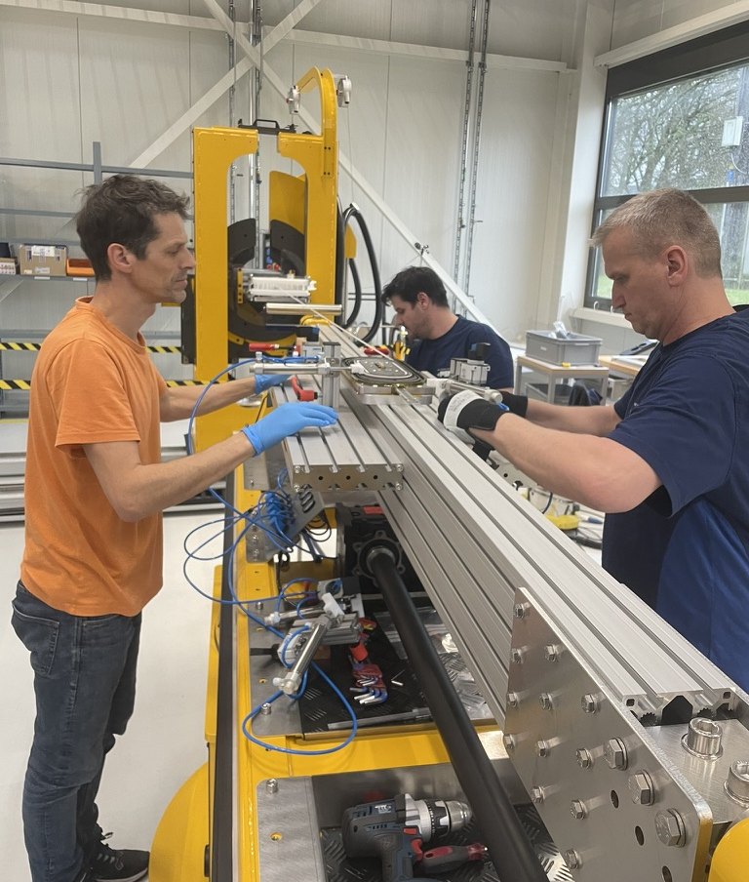
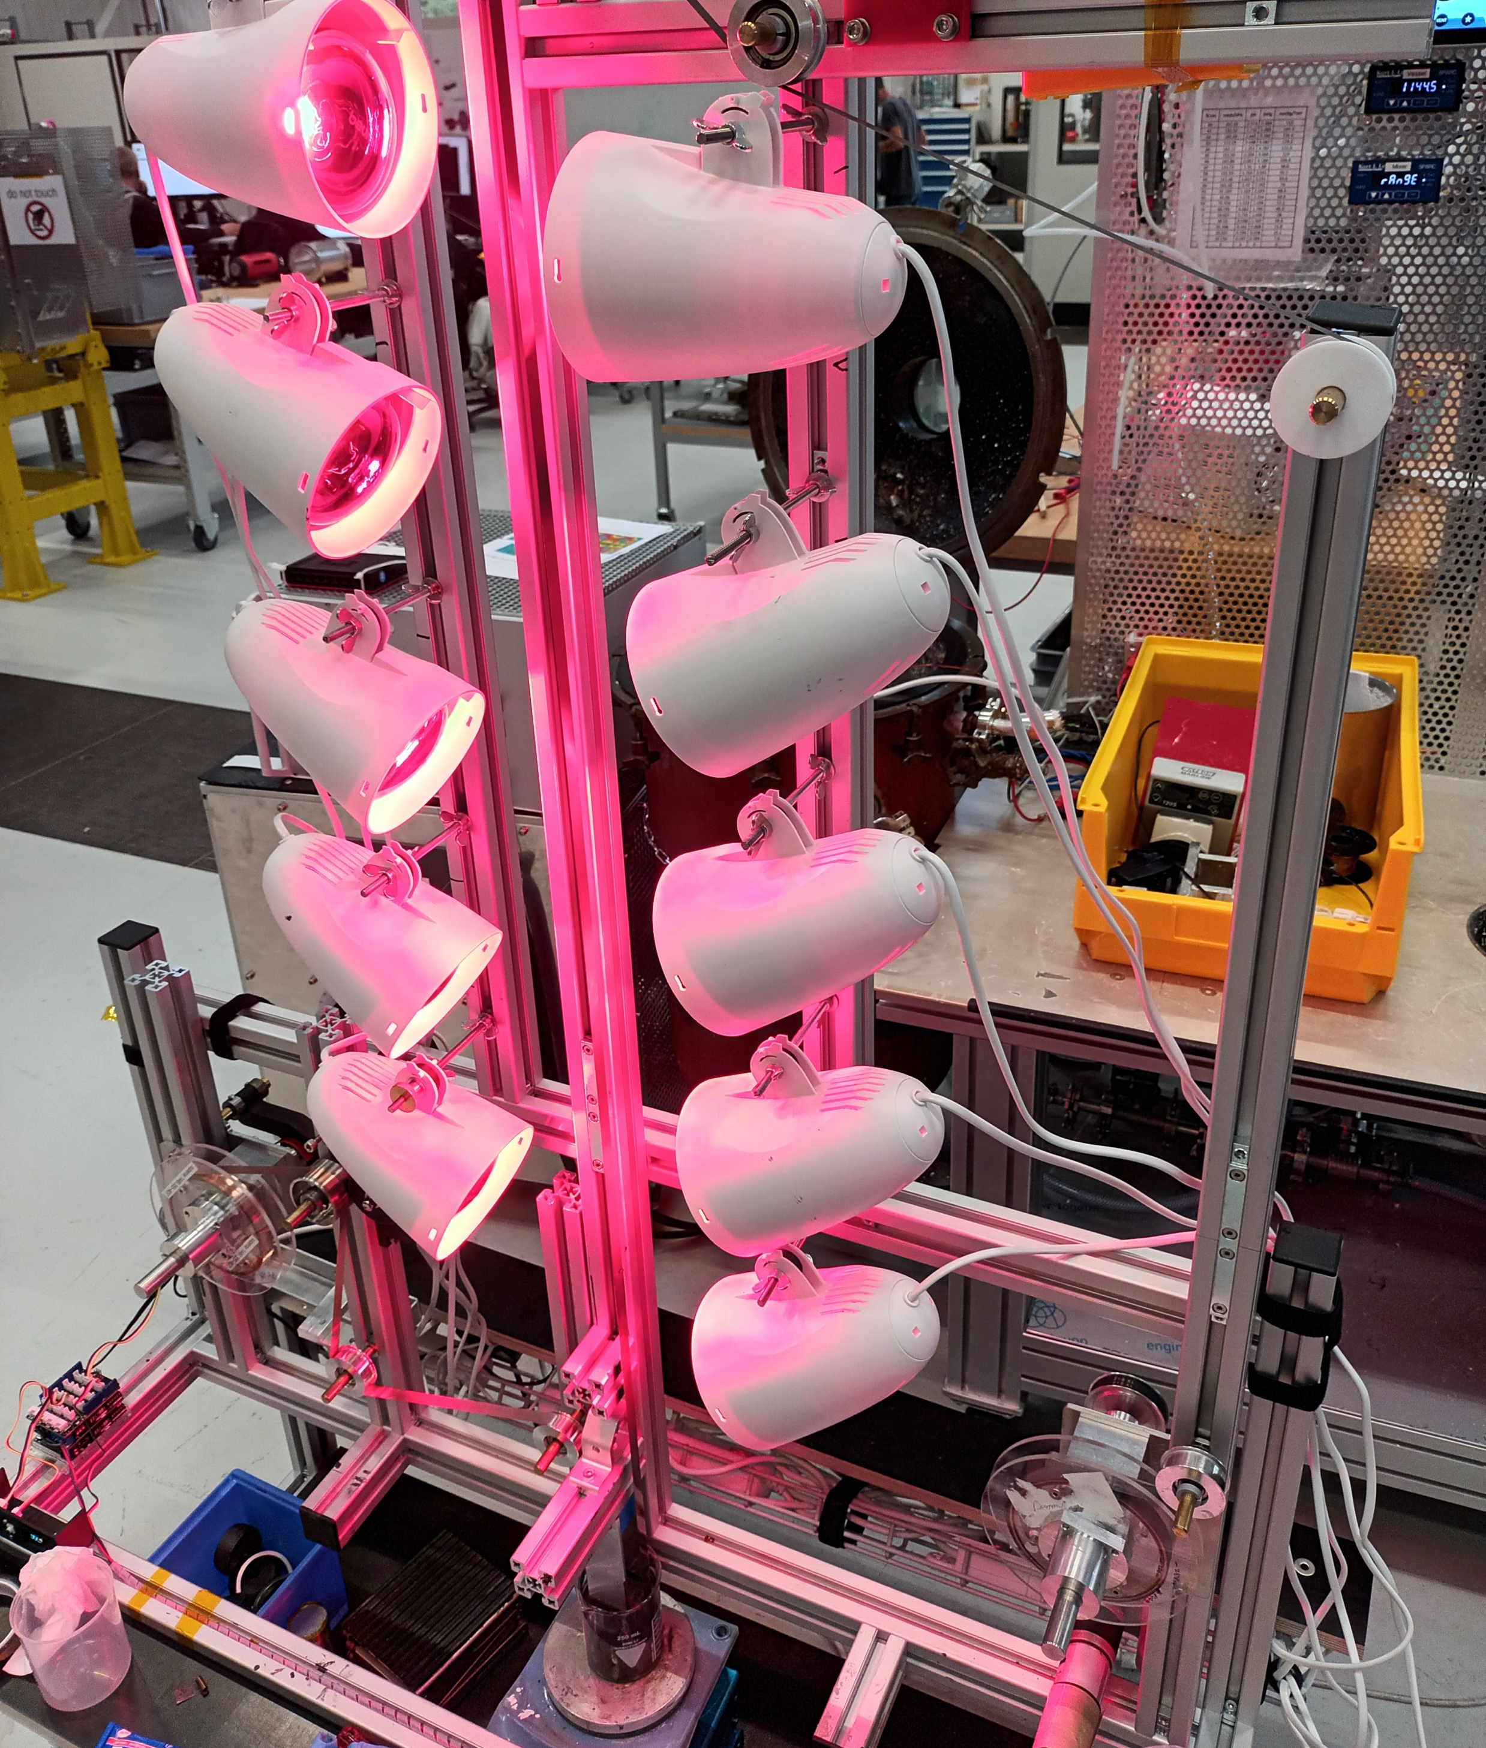
Infrastructure
Flat-coil winding table, two spools.
Cryogen-free test station up to 2 kA
Winding table for non-planar coils.
Coating line.

Slide 5
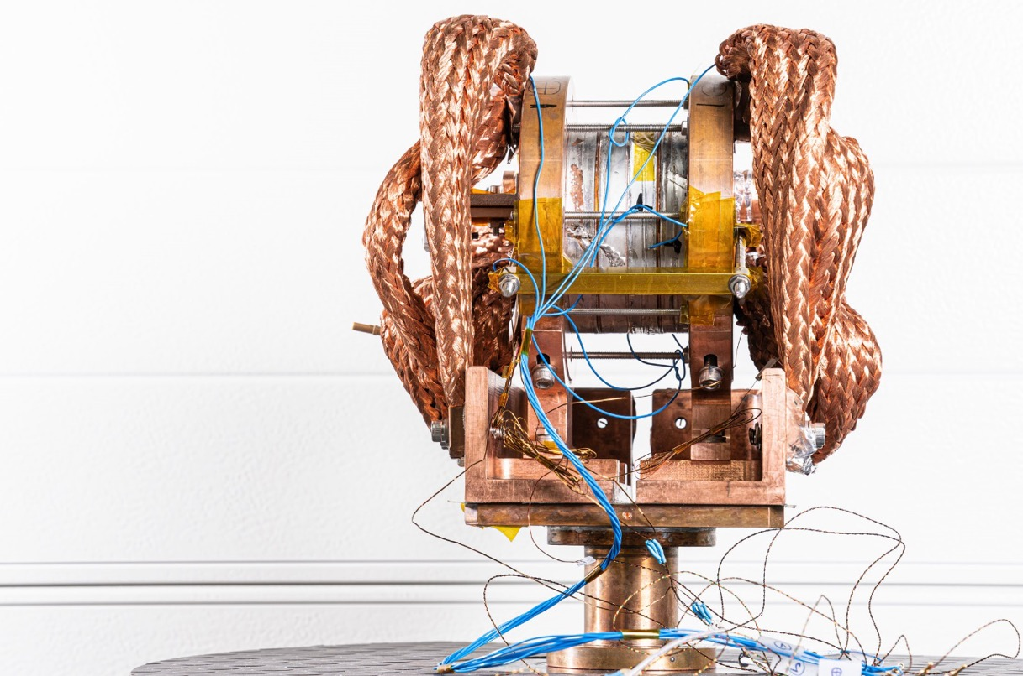
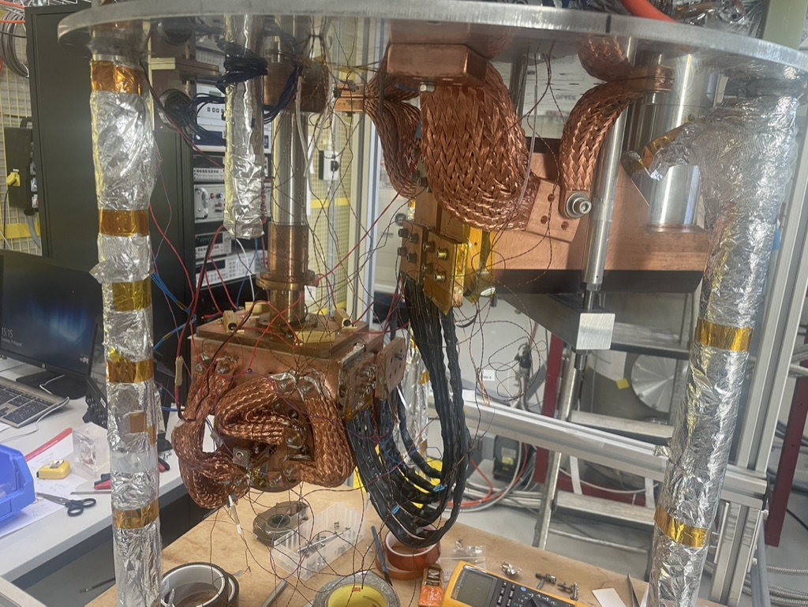
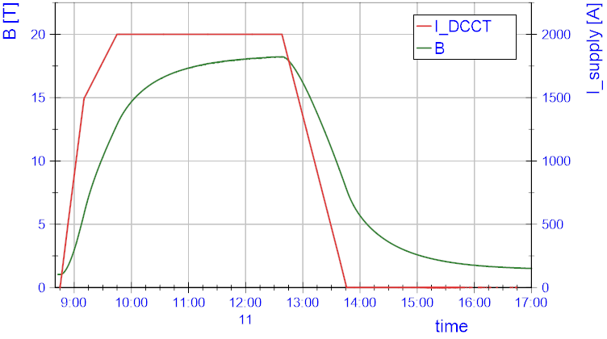

NI Coils
May 2022
inside
Courtesy: H. Garcia Rodigues, J. Kosse, M. Duda

Slide 6
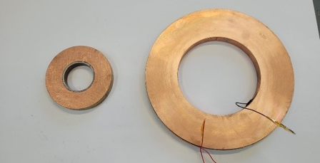
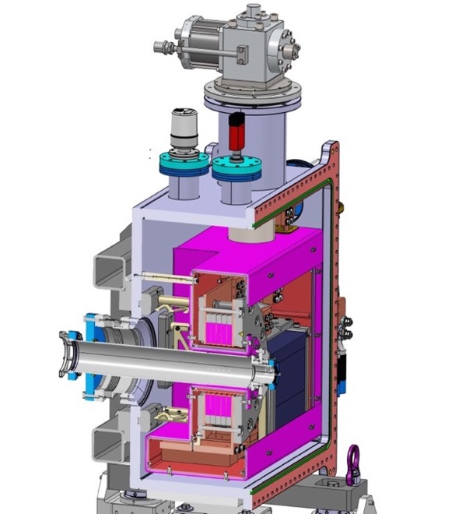
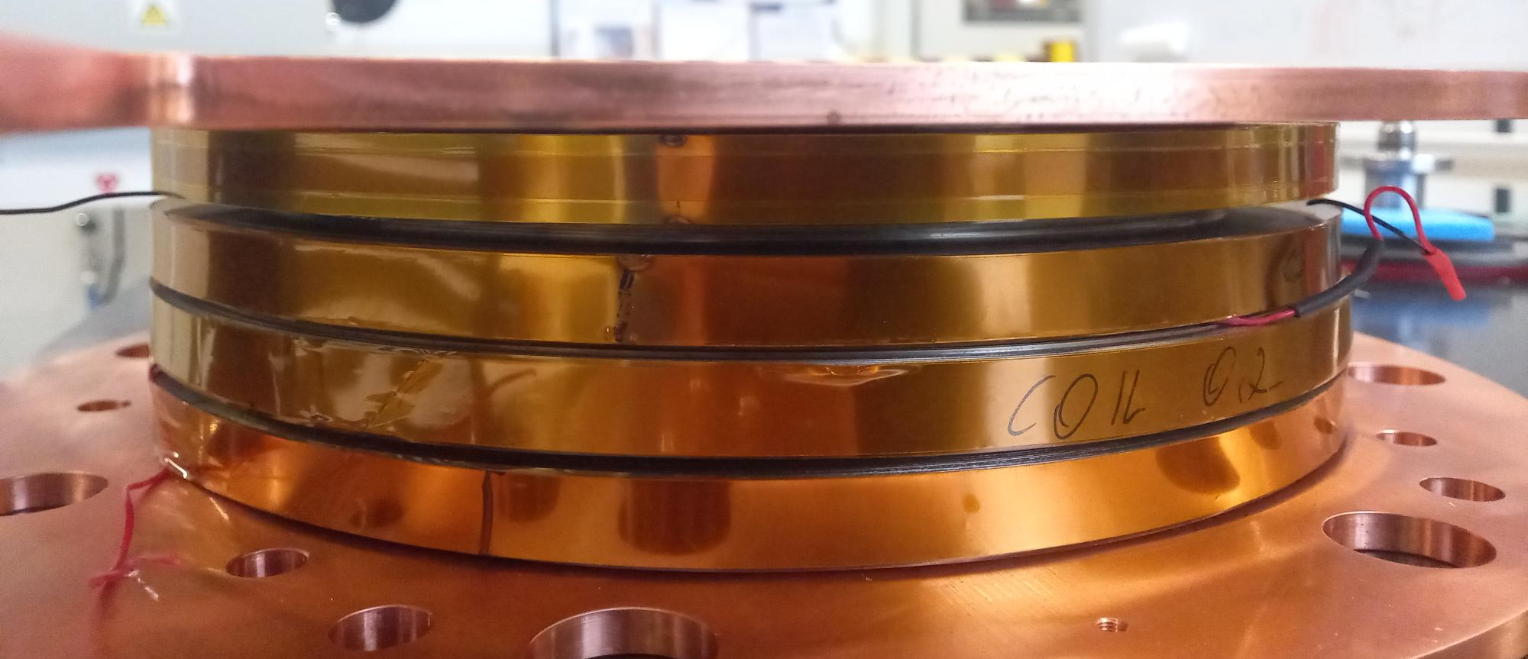
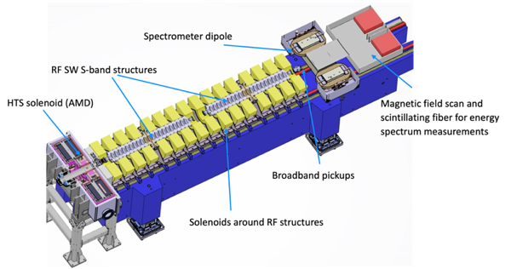
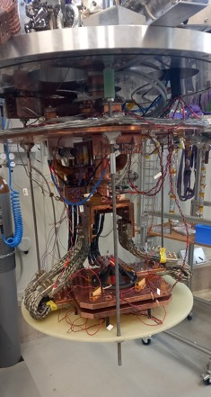
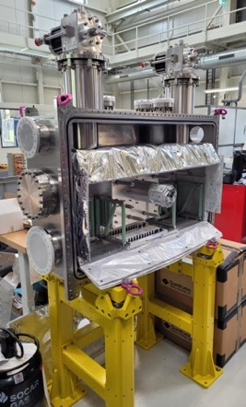

Synergies: FCCee Injector Study: P3 experiment (PSI Positron Production)
HTS no-insulation positron-capture solenoid, to demonstrate
positron source with 10x increased yield wrt. state of the art.
Manufacturing/commissioning in 2024/25.
Experiment at PSI’s SwissFEL 2025/26
15 K conduction-cooling
https://iopscience.iop.org/article/10.1088/1361-6668/ada9d3/pdf
5 coils from 12 mm ReBCO, 110 mm ID
21 T peak field
target
Solid-state (Pb)
thermal buffer
15 T in 72 mm
warm bore
Coil technology licensed from
Courtesy: M. Duda, H. Garcia Rodigues, J. Kosse, T. Michlmayr

Slide 7
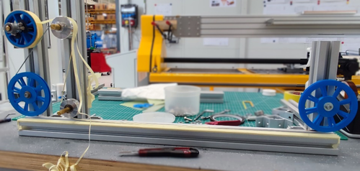
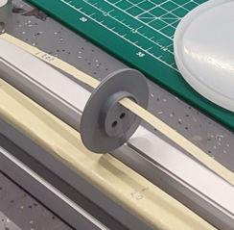
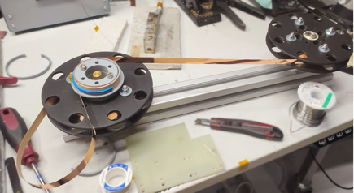
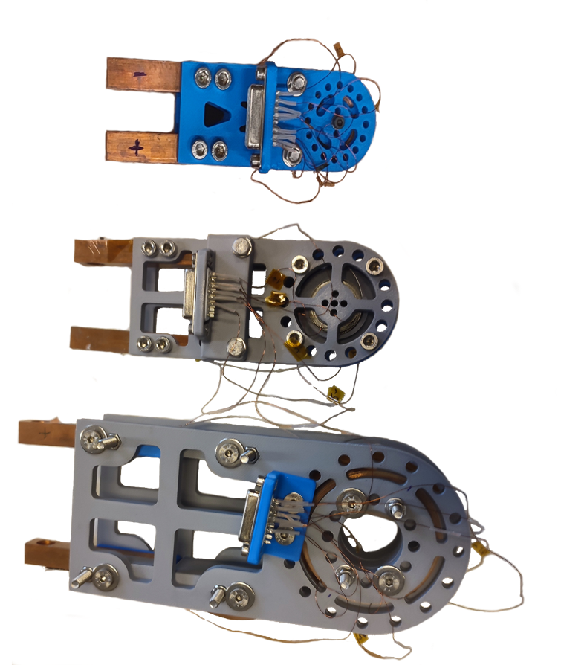
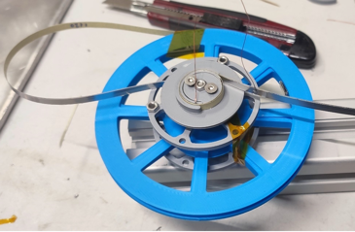
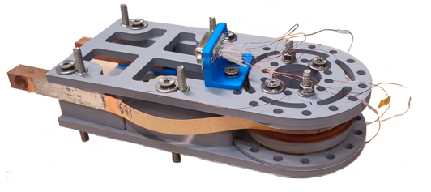
BabyHTS: AC loss model-validation coils
✘
✔︎
Paper insulation → double pancake start → winding → v-taps → leads
Coil name | Cable | Inner diameter, Twisting, mm | Inner diameter, Former, mm | Outer diameter, limit, mm | Insulation between windings, mm
blueBerry | 4 mm single tape | 17 | 20 | 30 | 0.6
greyBerry4d | 4 mm soldered 2-stack | 17 | 20 | 40 | 0.6
greyBerry12 | 12 mm single tape | 57 | 60 | 70 | 0.6
✔︎
Courtesy: Dmitry Sotnikov

Slide 8

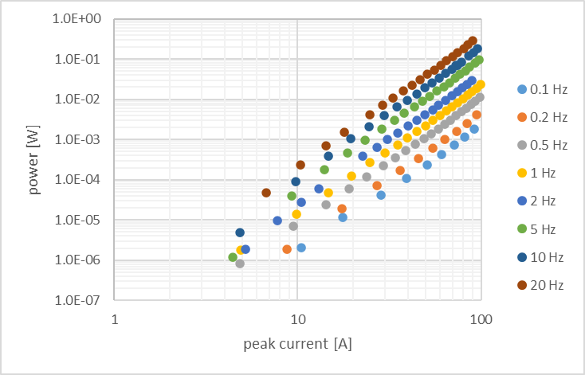
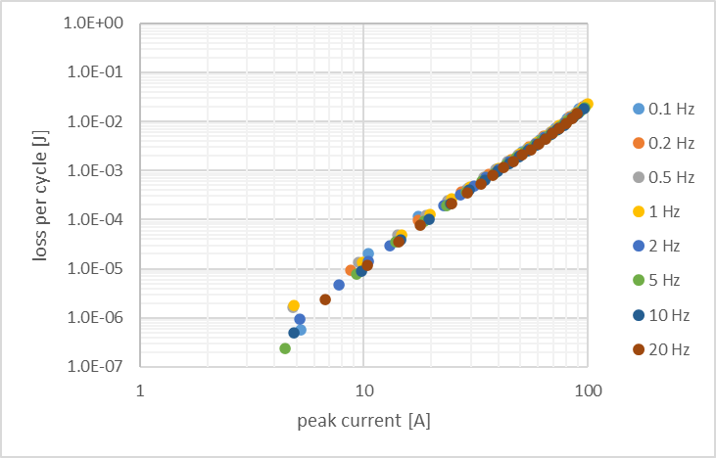
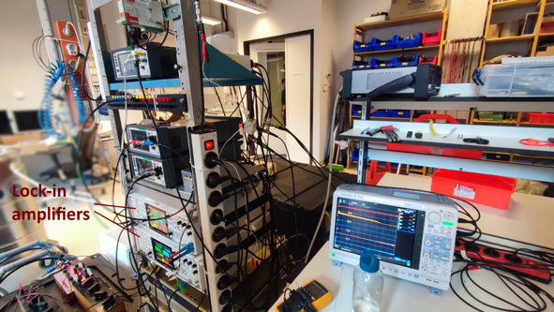
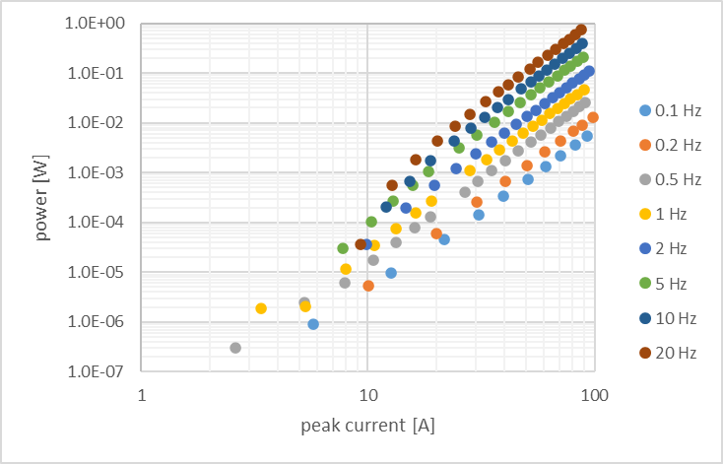
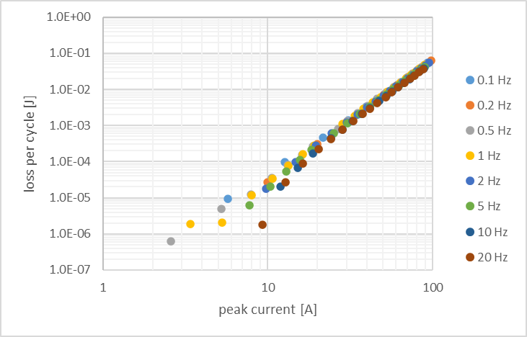

BabyHTS: AC loss model-validation coils
AC loss measurements at University of Twente via amplitude and phase shift measurement with two lock-in amplifiers.
Applied current is AC with frequency from 0.1 Hz to 20 Hz, with amplitudes up to 100 A.
$$W_{coil}=I_{rms}∙U_{rms}∙T∙cosθ$$
greyBerry4d
Tape: 4mm
Turns: 20
P_max = 0.28W
greyBerry12
Tape: 2x12mm
Turns: 14
P_max = 0.73W
Courtesy: Anna Kario, Simon Otten and Thomas Hanhart

Slide 9
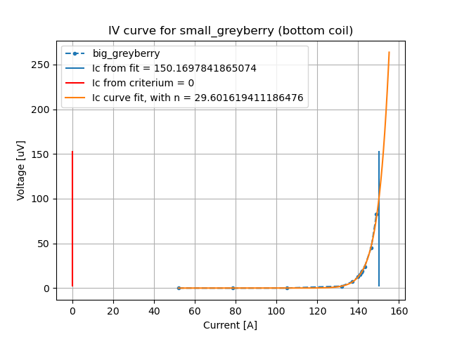
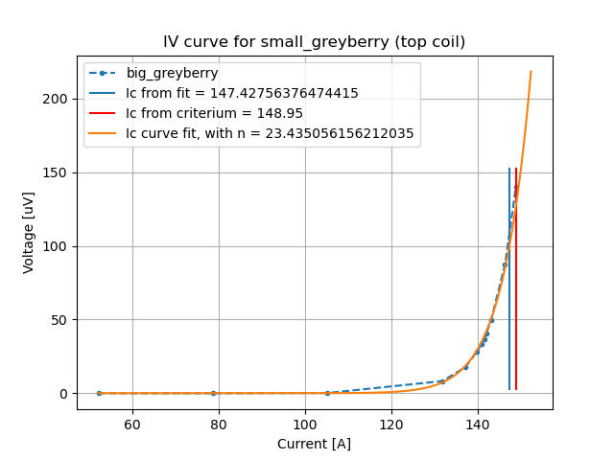
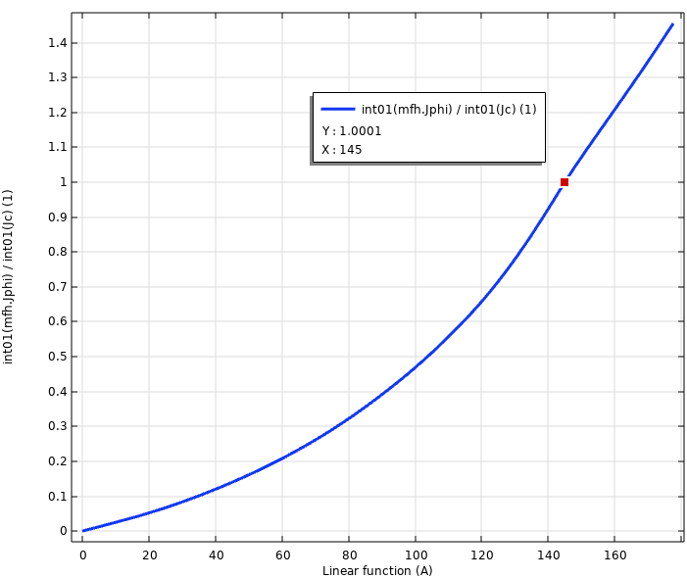
BabyHTS: AC loss model-validation coils
Critical current measurement done on both pancakes separately.
Matches Robinson database with factor 0.8: 150 A for measurement and 145 A for model.
Measured in University of Twente
Critical current validation in FEM
Courtesy: Simon Otten and Thomas Hanhart

Slide 10
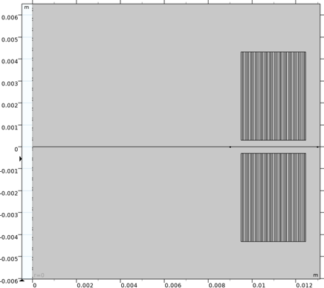
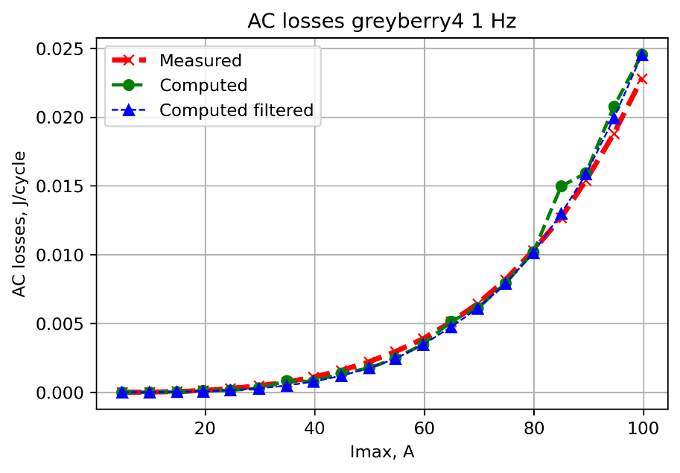
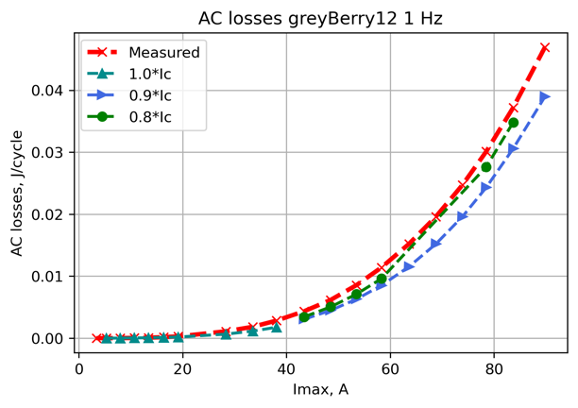
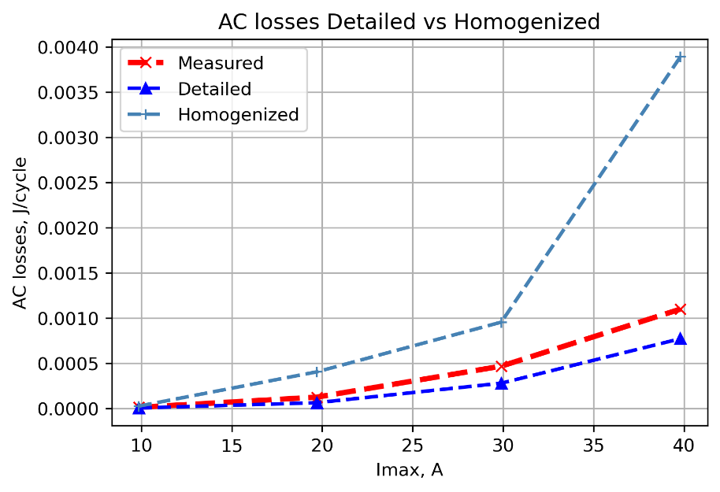
BabyHTS: AC loss model-validation coils
Numerical models resolve the REBCO layer and homogenized the
other metal layers (Hastelloy, silver, copper).
Agreement to measurements is good for 4-mm 2-stack and
12-mm 1-stackcable.
Note: fully homogenized model inaccurate and divergent.
Courtesy: Simon Otten, Thomas Hanhart and Dmitry Sotnikov

Slide 11

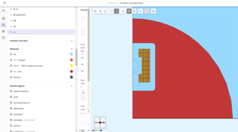
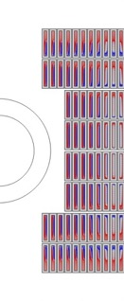
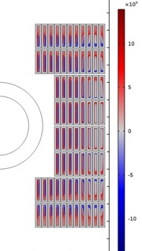
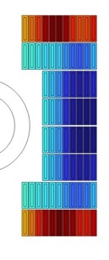
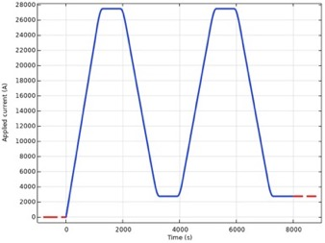
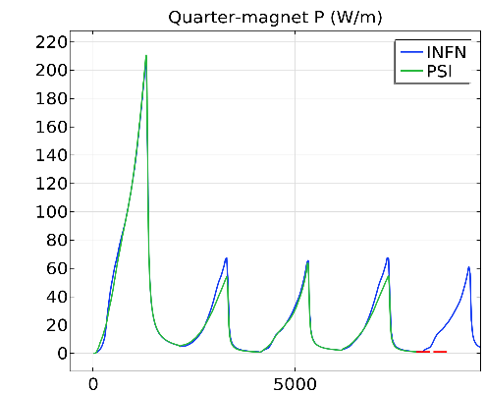
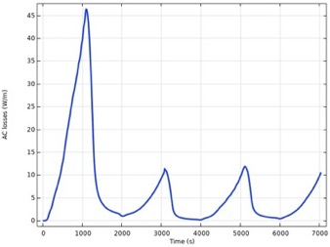
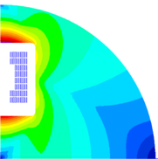
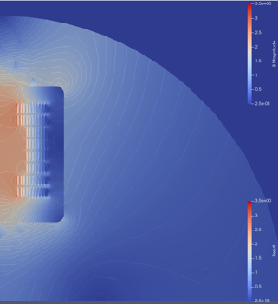
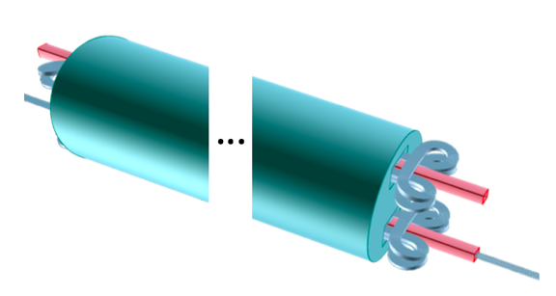


HTS Modeling WG Benchmark
ROXIE → COMSOL , Quanscient, Racoon (LBE)
Qualify models and tools with the HFM HTS Modeling WG
All based on homogenization per tape stack.
Screening-current and -loss calculation
Power density [W/m, integrated over cable x-sec]
Screening current density [A/m²]
ROXIE
11
Paul Scherrer Institute PSI
11.02.25
Results by: J. van Nugteren, S. Sorti, and D. Sotnikov

Slide 12
Initial Canvassing

Slide 13
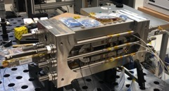
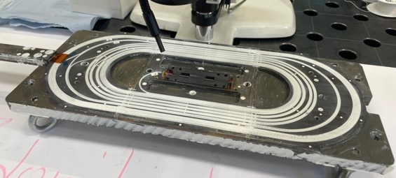
First Goal: HTS subscale
Re-use subSMCC coil design and structure for
REBCO magnet (6-8 tapes).
SMCC magnet with apertures for field quality measurements.
  Accuracy, stability, reproducibility
Experimental and numerical protection studies
  EE, CLIQ, ESC
Protection study under way to determine cable layout
Coil manufacturing in Q2’25.
Nb3Sn subSMCC

Slide 14
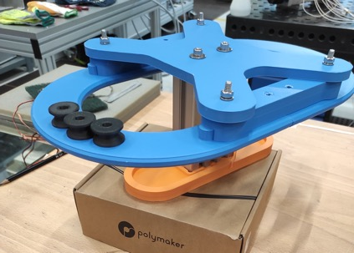
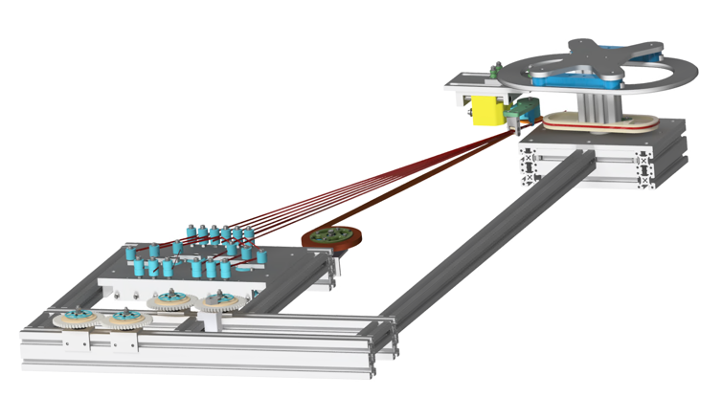
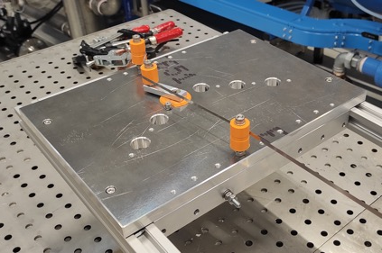
Towards winding, insulating, and soldering a tape-stack cable.
Soldered REBCO insulated tapes-stack cable.
  multiple soldered 2-stacks from FFJ,
  soldered together in-winding with pressure
  and heat source (induction, hot-air blower), tbd.
  Fall-back: dry stack of soldered 2-stacks.
Courtesy: Christian Lindner

Slide 15
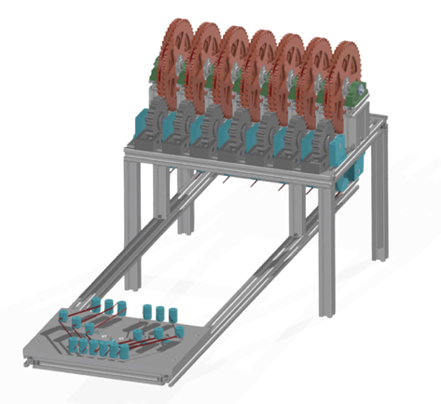
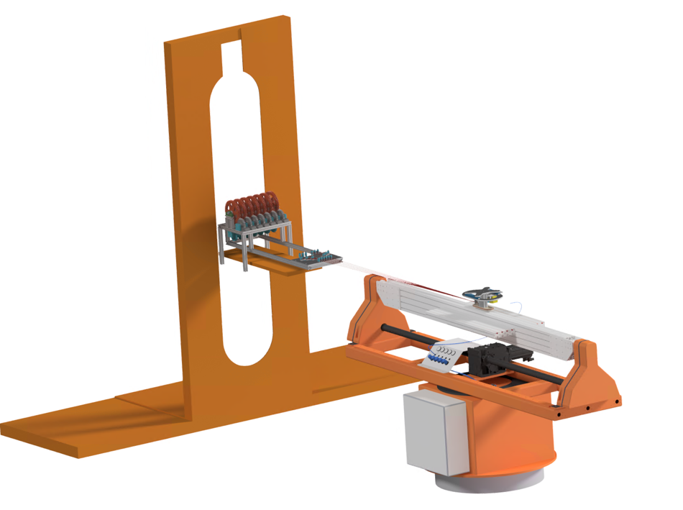

Towards winding, insulating, and soldering a tape-stack cable.
Soldered REBCO insulated tapes-stack cable.
  multiple soldered 2-stacks from FFJ,
  soldered together in-winding with pressure
  and heat source (induction, hot-air blower), tbd.
  Fall-back: dry stack of soldered 2-stacks.
Courtesy: Christian Lindner

Slide 16




REBCO Block-Coil Dipole Scaling Exercise
As expected, AC losses grow non-linearly with field due to larger field sweep and growth in coil-size.
In this study (for which all previous caveats and assumptions apply) AC losses increase 4-fold from 14 to 20 T.
Initial results indicate that losses decrease mildly towards lower temperatures.

Slide 17



ReBCO FCC-hh Dipole Scaling Exercise
Analogue study for scaling with temperature (5-30 K) for constant 14 T bore field indicates weak scaling of
AC losses, notable cost increase.

Slide 18
Conclusion
PSI has entered the canvassing phase, attempting to implement soldered tape-stack cables in a stress-managed structure to address questions of mechanics and reproducibility.
Numerical tools are being developed and need validation.
Canvassing efforts need to be accompanied by model-based extrapolations to full scope of HFM HTS goals.

