Slide 1
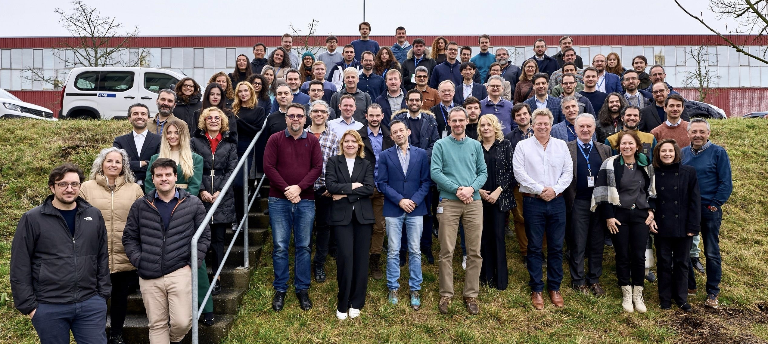
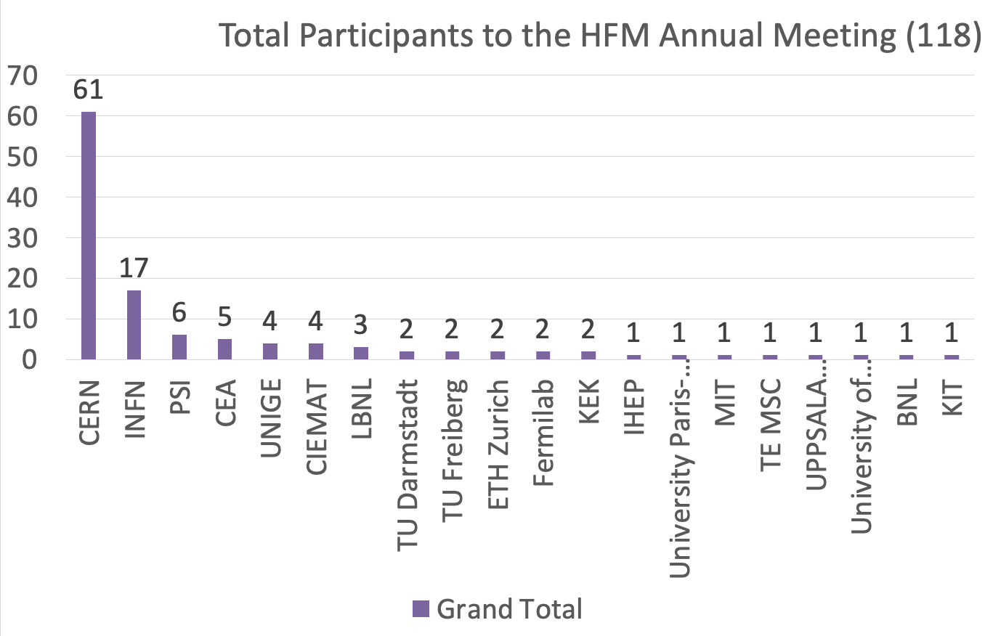
2.5 days
30 presentations
3 discussion sessions
118 participants
+ few clandestines

Slide 2
Thanks
Attendees for engagement and discussions
Speakers and session chairs
  special thanks to overseas speakers!
Program committee:
RDL coordinators + Soren Prestemon
Programme Office – made it all happen!
Have a safe travel back home!

