Slide 2
KEK Progress on
Nb₃Sn conductors
Michinaka SUGANO
KEK
On behalf of Japanese and CERN collaborators

Slide 3
Outline
Collaborative work between KEK and CERN on the development of Nb₃Sn conductor aiming for higher J_{c} (1st phase)
New collaborative work on the development of high performance Nb₃Sn conductor (2nd phase)
  Research structure
  Tasks for KEK
  Approaches to achieve the tasks
  Current status

Slide 4
Achievements in the collaborative work in the 1st phase

Slide 5
1st phase of Nb₃Sn conductor development program
KEK and CERN signed the MoU regarding the collaborative work on high performance Nb₃Sn wires for FCC in 2016.
This 1st phase of R&D program lasted until 2022.
Two Japanese wire manufacturers, JASTEC and Furukawa Electric, joined the program.
JASTEC selected Distributed-Tin (DT) process, while Furukawa Electric chose Nb-tube process.

Slide 6
Target specifications for the 1st phase
Improvement in non-Cu J_{c} towards 1500 A/mm² at 4.2 K, 16 T was prioritized.
The interim target was set to be 1000 A/mm² at 4.2 K, 16 T.
Parameter | Ultimate target | Stage 1 | Stage 2
Wire diameter (mm) | ~1 | ~1 | ~1
Cu/non-Cu ratio | ~1 | ~1 | ~1
Non-Cu J_{c} (4.2 K, 16 T) (A /mm²) | ≥ 1500 | ≥ 1000; aim 1200 | ≥ 1500
µ₀ΔM (1 T, 4.2 K) (mT) | ≤ 150
d_{eff} (µm) | ≤ 20 | ≤ 60 | ≤ 60
RRR | ≥ 150 | ≥ 150 | ≥ 150
Unit lengths / km | ≥ 5
Cost | 5 EUR / kA m

Slide 7
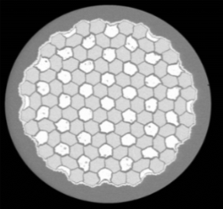
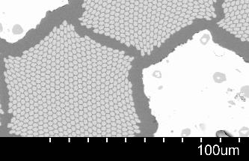
DT wires developed by JASTEC
Φ1.0 mm
Sn
Nb
Sn
Nb
Cross-section of DT wire (before Heat treatment)
Multi Nb module (pure Nb)
Mono core of Sn (Sn-Ti alloy)
Nb common barrier
Cu stabilizer outside the barrier
Strategies for higher J_{c}
Improvement in Sn diffusion
Ternary additive elements

Slide 8
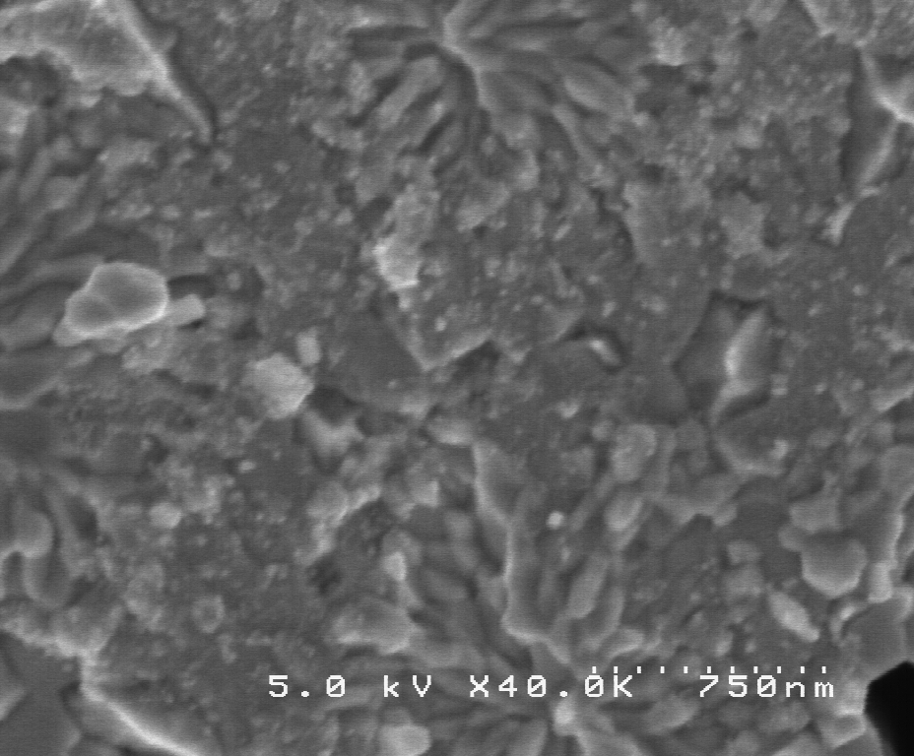
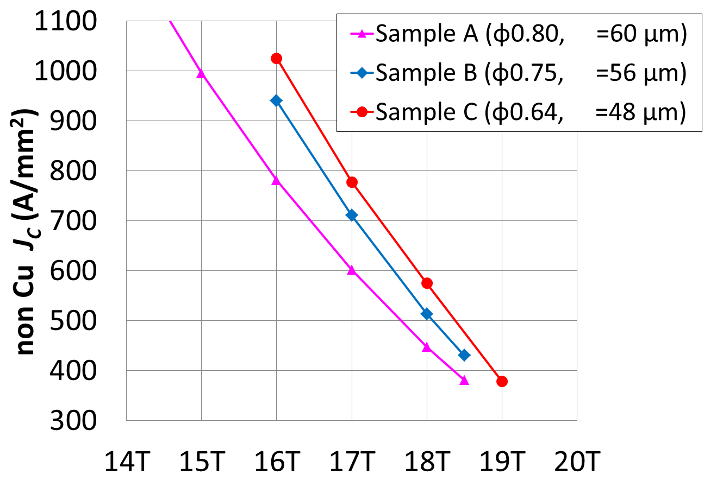
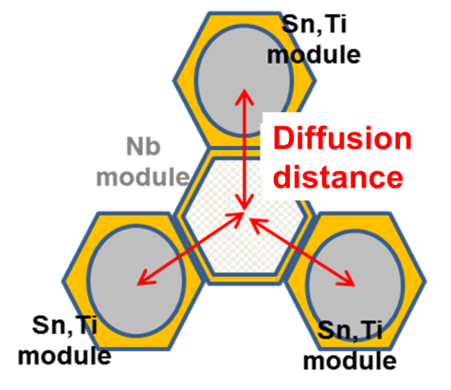
Shortening the Sn diffusion distance
Sn diffusion distance (L_{d}) was reduced by drawing down the φ0.8 wire
Longer Sn diffusion distance
Sample A
L_{d}
L_{d}
L_{d}
Shorter Sn diffusion distance
Sample C
4.2K, Ec=0.1µV/cm
14
15
16
17
18
19
20
SEM images of A15 area far from Sn core in longer and shorter Sn diffusion distances.
Magnetic field (T)
A reduction in the Sn diffusion distance improves
non-Cu J_{c} by 28% (1025 A/mm² at 4.2 K, 16 T).

Slide 9
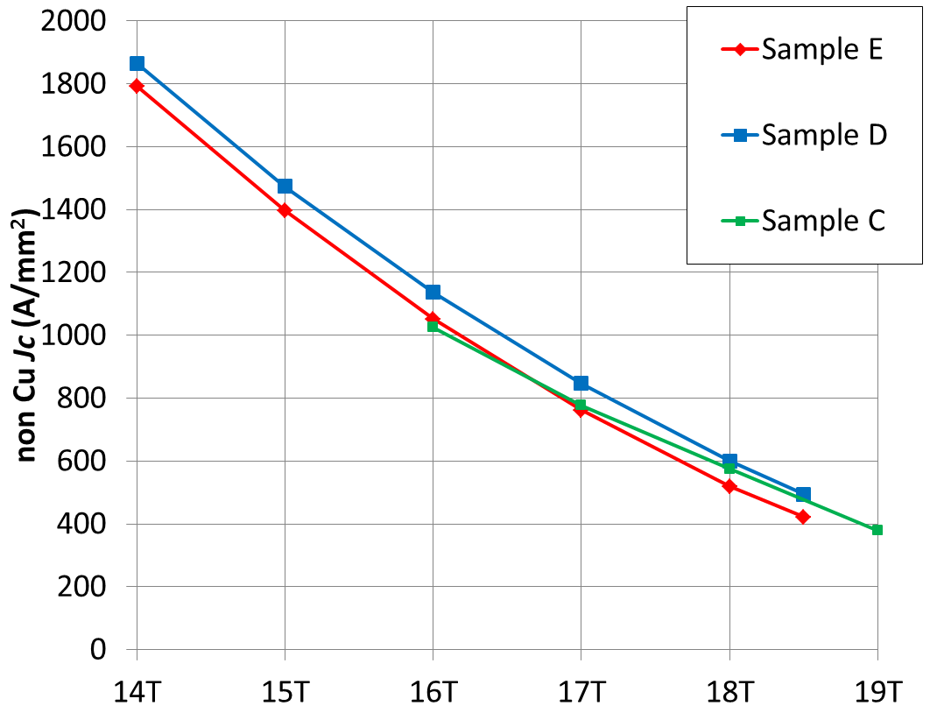
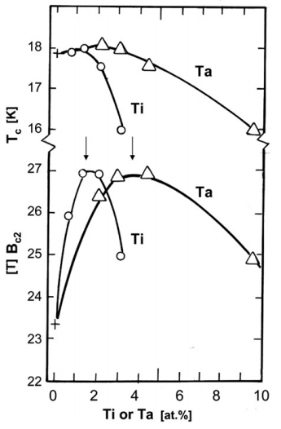
Ternary additive element
Ti content in matrix
Sn diffusion
distance
L_{d}=32 μm
0.38wt%
0.44wt%
L_{d}=48 μm
0.55wt%
non-Cu J_{c} =
1137 A/mm² at 16T
Ti content: C > D > E
R. Flükiger, Cryogenics 48 (2008) 293-307
4.2K, Ec=0.1µV/cm
14
15
16
17
18
19
Magnetic field (T)
Controlling Ti content in Sn core leads to an improvement in J_{c} at 16 T.

Slide 10
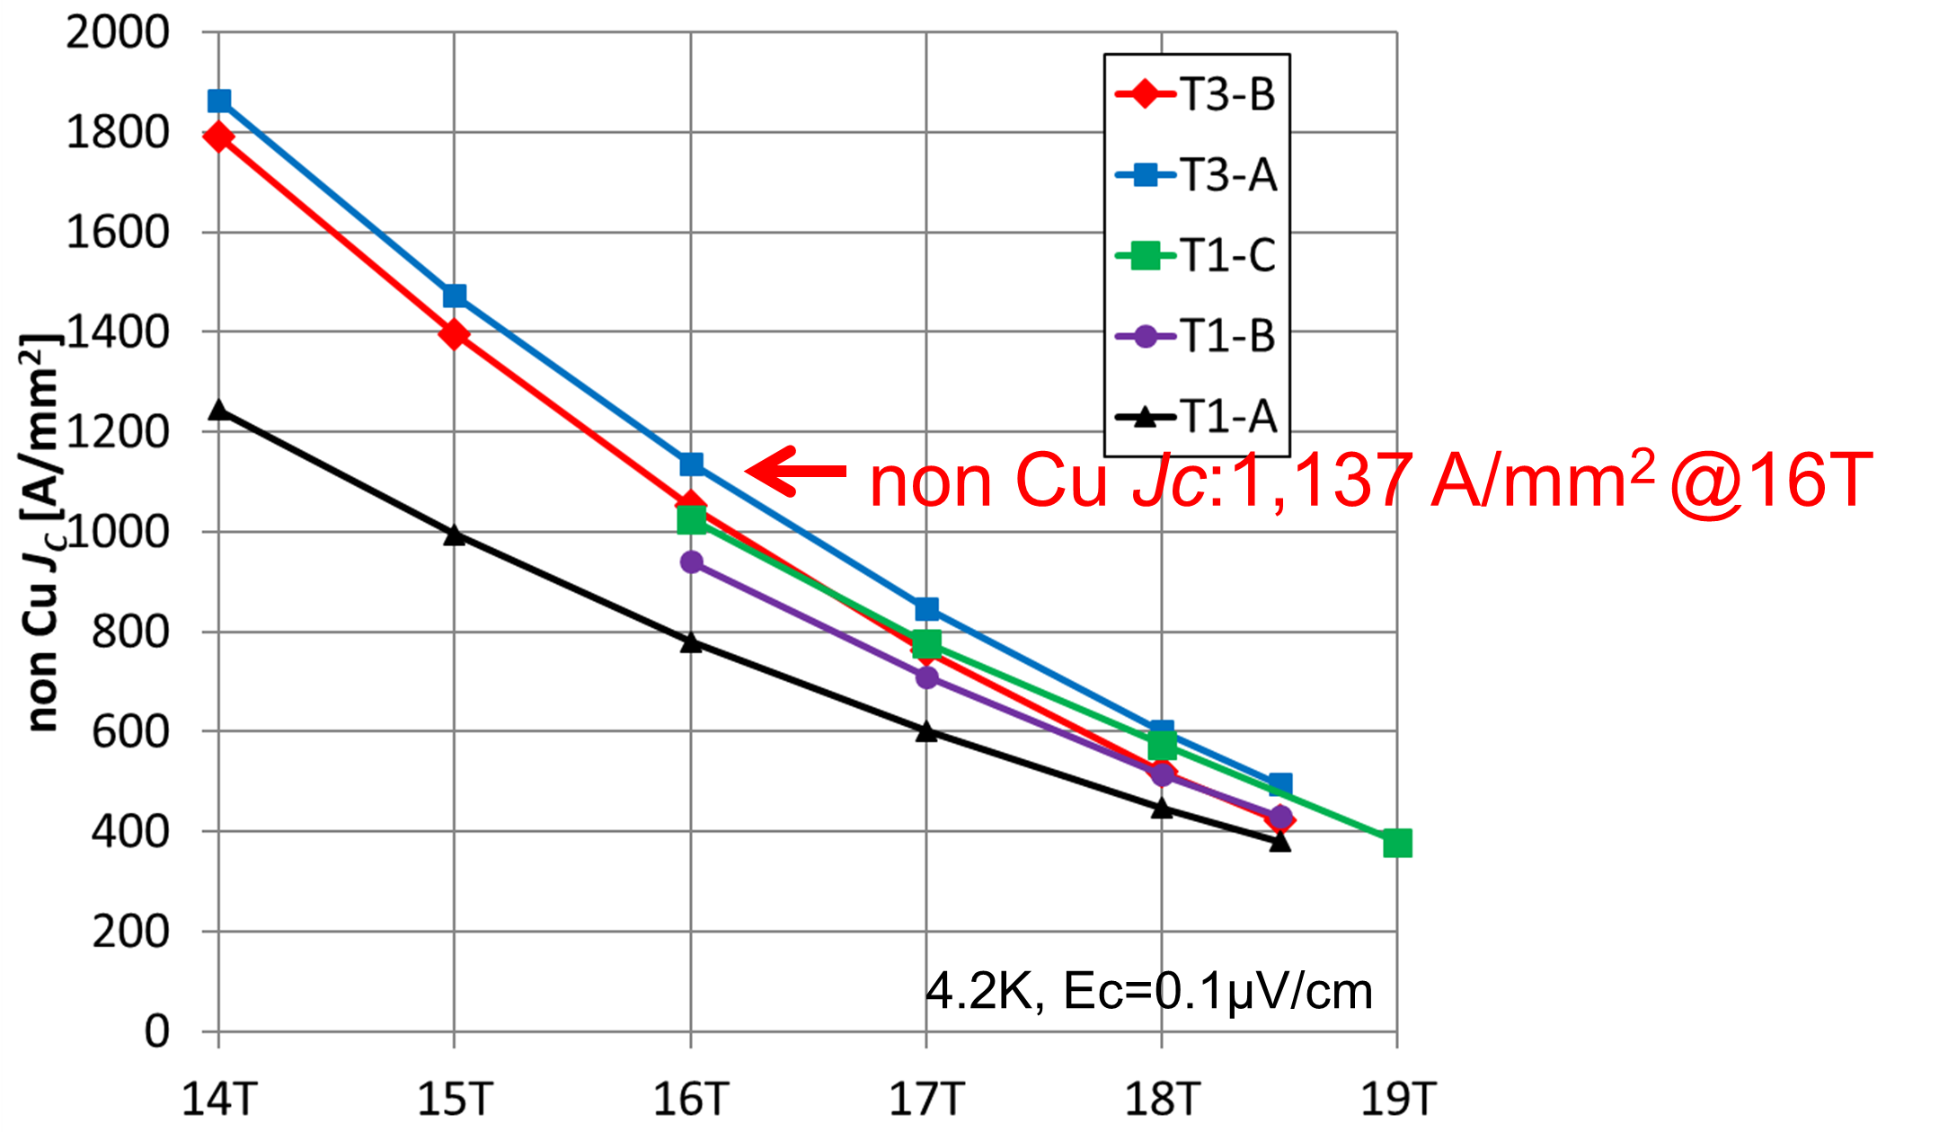
The highest non-Cu J_{c} in DT wires in the 1st phase
non-Cu Jc (A/mm²)
1.4 times higher
before this R&D
14
15
16
17
18
19
Magnetic field (T)
 | T1-A | T1-B | T1-C | T3-A | T3-B
Wire diameter (mm) | 0.80 | 0.74 | 0.64 | 0.80 | 0.80
Sn diffusion distance (µm) | 60 | 58 | 48 | 32 | 32
Ti ratio (wt%) | 0.55 | 0.55 | 0.55 | 0.48 | 0.35
Non Cu J_{C} ( A/mm² )@16T | 800 | 930 | 1025 | 1137 | 1032
Non-Cu J_{c} of 1100 A/mm² at 4.2 K, 16 T was achieved in Trial 3 wires, exceeding the interim target of 1000 A/mm².

Slide 11
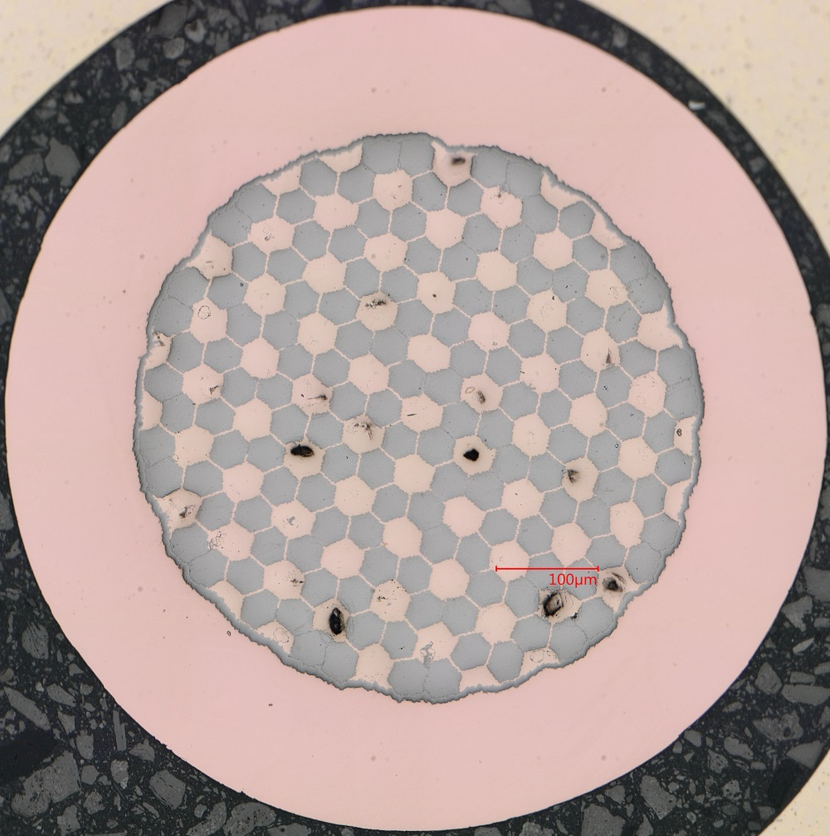
Effective filament diameter (d_{eff})
• The magnetization curves were measured at CERN to evaluate the effective
filament diameter.
 | Trial 1 | Trial 3A
Diameter (mm) | 0.7 | 0.8
d_{eff} (µm) | 267 | 54.5
non-Cu J_{c} (A/mm²) | 930 | 1137
Trial 1
Trial 3A
Single
module
0.8 mm
Magnetization curves
Significant flux jump in the initial wire (Trial 1) was strongly suppressed in Trial 3 with high non-Cu J_{c}.
The calculated d_{eff} was ~55 μm corresponding to two modules.
→ The interim target of d_{eff} ≤ 60 μm was confirmed to be satisfied.

Slide 12
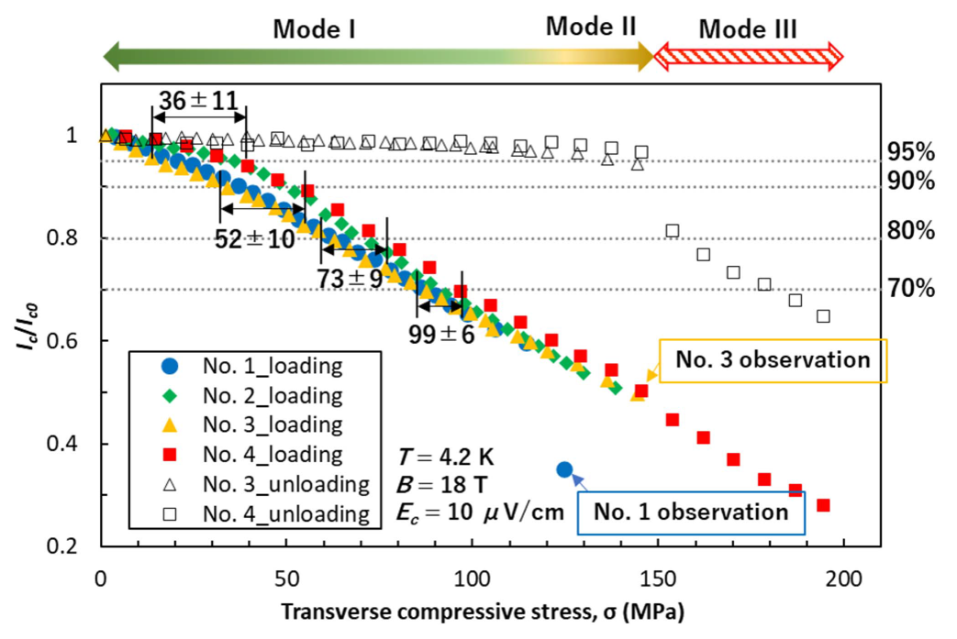
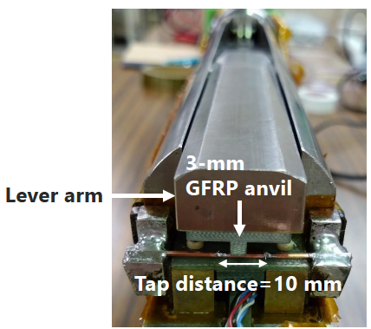
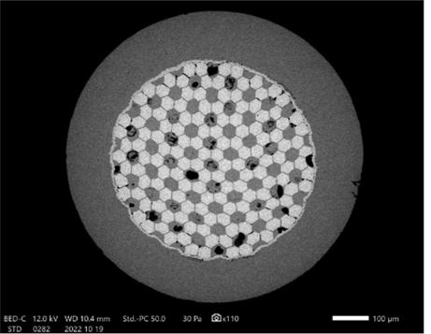
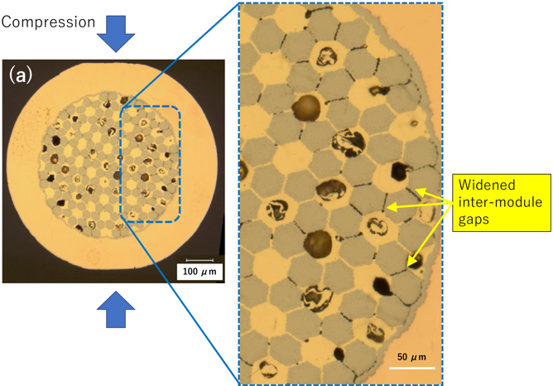
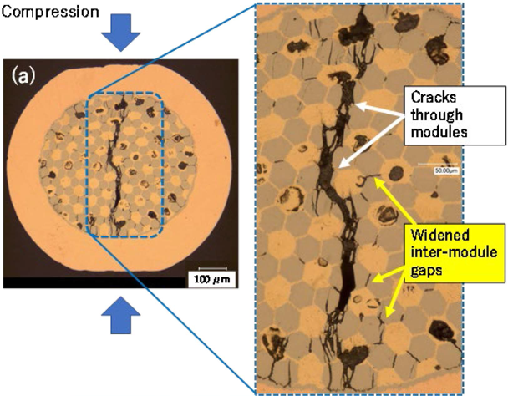
Tolerance against transverse stress of Trial 3 wires
Irreversible I_{c} degradation
Normalized critical current
Transverse
compression
Mode II
Transverse compressive stress (MPa)
Irreversible I_{c} degradation starts at around 150 MPa
→ Promising stress tolerance
Origin of I_{c} change
  Mode II: Plastic deformation of the metal matrix
  Mode III: Crack propagation across the wire
Mode III
M. Nakamoto, M. Sugano, IEEE TAS (2023).

Slide 13
New collaborative work to develop the high performance Nb₃Sn wires
(2nd phase)

Slide 14
2nd phase of Nb₃Sn conductor development program
KEK and CERN signed the MoU (KE6084) to start new collaborative work over three years since August 2024.
HFM WP1.15 – KEK collaboration for development of advanced high-field Nb₃Sn conductor
Contact person
  CERN: Thierry Boutboul
  KEK: Michinaka Sugano

Slide 15
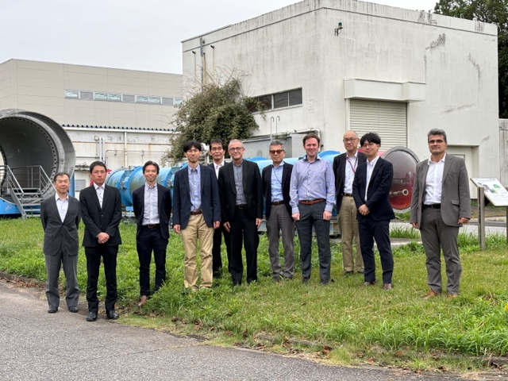
Structure
CERN
T. Boutboul
S. Hopkins
A. Devred
KEK
M. Sugano
T. Ogitsu
• Technical
suggestion
• In-depth
characterization
• Directing R&D
• Characterization
• Discussion of specs
• Order of fabrication
of trial wires
Technical
discussion
Fundamental
R&D
NIMS
N. Banno
Furukawa
Electric
Tohoku Univ.
S. Awaji
JASTEC
Consultation
Consultation
Mini-workshop
held in Oct, 2024

Slide 16
Tasks for KEK
There are three main tasks for KEK.
  Task 1: Industrialization of Distributed-Tin (DT) Nb₃Sn wires
  Task 2: Reinforcement of Nb₃Sn wire
  Task 3: Enhancement of the J_{c} of Nb₃Sn wire
Task 1 has the highest priority.

Slide 17
Task 1: Industrialization of Distributed-Tin (DT) Nb₃Sn wires
JASTEC DT wire with non-Cu J_{c} > 1100 A/mm² (4.2 K, 16 T) had a workability issue. The most important item to realize is production with a longer piece length of this wire.
Targets for Task 1 (2024 Aug – 2026 Aug)
  non-Cu J_{c}(4.2 K, 16 T) > 1100 A/mm²
  Wire diameter=0.85 mm
  Cu/non-Cu ratio > 1.1
  Effective filament diameter < 50 μm
  RRR after the wire reaction > 150
  The target piece length > 250 m

Slide 18
Approaches to Task 1
Strategies to improve in the workability of JASTEC DT wire
  Controlling the hardness of Nb modules
    Heat treatment of multifilamentary Nb wires before assembling with Sn cores
    Comparison between Nb raw materials from different suppliers
  Enhancing the hardness of Sn alloy
  DT wires with Cu-Zn matrix

Slide 19
Task 2: Reinforcement of Nb₃Sn wire
Aiming for mechanical reinforcement against transverse compressive stress
Targets for Task 2 (2024 Aug – 2027 Aug)
  Develop and validate methods to reinforce Nb₃Sn wires
  non-Cu J_{c}(4.2 K, 16 T) > 1000 A/mm²
  Wire diameter=0.85–1.1 mm
  Cu/non-Cu ratio > 1.1
  Effective filament diameter < 50 μm
  RRR after the wire reaction > 150
  The target piece length > 100 m

Slide 20
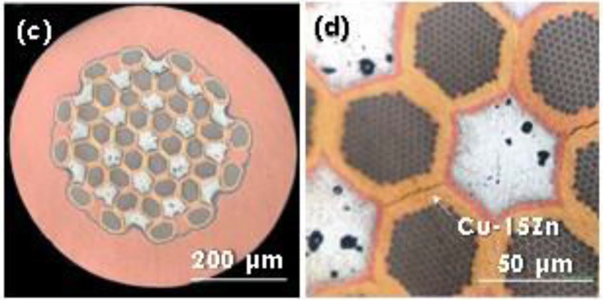
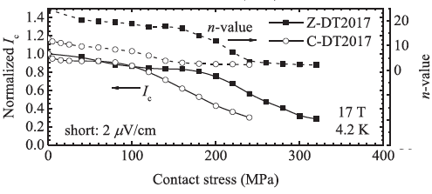
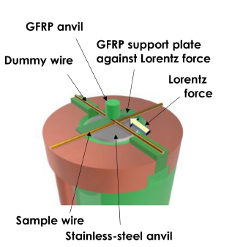
Approaches to Task 2
Proof-of-principle for mechanical reinforcement measures
  DT wires with Cu-Zn matrix (JASTEC-NIMS technology)
  Cu-Nb reinforcement (Furukawa-Tohoku Univ. technology)
Cu-Zn matrix DT wire
Cu-Nb reinforcement wire
Cu-Nb
(reinforcer)
Cu-Nb reinforce bronze-processed Nb₃Sn wire
Cu-Zn matrix
Cu-matrix
Cu-Nb reinforced DT wires
Banno et al, IEEE TAS 34 (2024) 8400505.

Slide 21
Task 3: Enhancement of the J_{c} of Nb₃Sn wire
Aiming for improvement in non-Cu J_{c} towards 1500 A/mm² at 4.2 K, 16 T
Targets for Task 3 (2024 Aug – 2027 Aug)
  Develop and validate methods to enhance non-Cu J_{c} of Nb₃Sn wires towards 1500 A/mm² (4.2 K, 16 T)
  The highest achievable J_{c}
  Wire diameter=0.85–1.1 mm
  Cu/non-Cu ratio > 1.1
  Effective filament diameter < 50 μm
  RRR after the wire reaction > 150
  The target piece length > 100 m

Slide 22
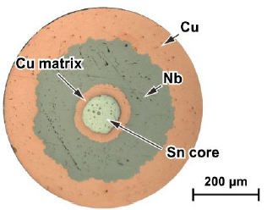
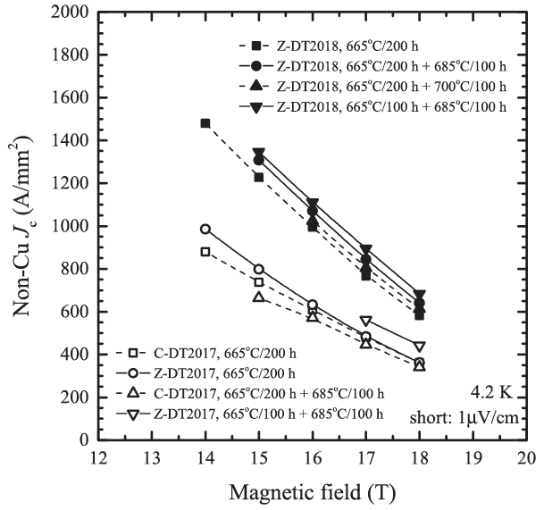
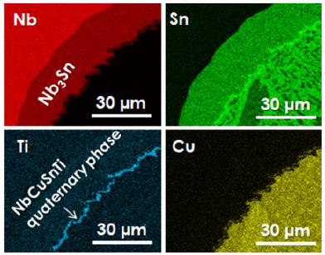
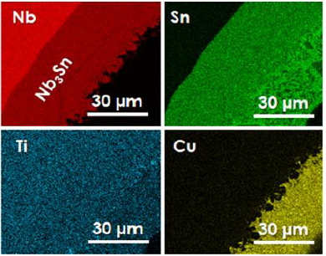
Approaches to Task 3
Pursuing the possibility of J_{c} improvement for DT wires with Cu-Zn matrix
Fundamental research to improve J_{c} in NIMS
  Influence of Ti-doping site
Cu-Zn matrix
DT wires
Ti-doping to Sn or Cu
Ti-doping to Nb
Cu-matrix
DT wires
Banno et al, IEEE TAS 30 (2020) 6000705.
Banno, Superconductivity 6 (0203) 100047.

Slide 23
Current status
KEK submitted to CERN the plan for Task 1 as Deliverable1.1 in October 2024.
JASTEC started to fabricate trial wires for Task 1. The item to check first is the effect of controlling the hardness of Nb modules for better workability.
KEK just started to discuss the development strategies for Task 2 and 3 with Furukawa Electric.
NIMS is conducting fundamental research for Task 3. The findings will be incorporated into the trial wires which JASTEC will fabricate.

Slide 24
Conclusions
New collaborative work between KEK and CERN started in August 2024 to develop the advanced high-field Nb₃Sn conductors.
Two Japanese wire manufacturers, JASTEC and Furukawa Electric, have joined this program. NIMS and Tohoku Univ. have also participated as academic partners.
The most prioritized task is the industrialization of DT wires. JASTEC has started fabrication of the first trial wires for Task 1.
Plans for the other two main tasks of mechanical reinforcement and improving J_{c} will also be defined by July 2025. Once the plan is submitted to CERN, fabrication of the trial wires for Task 2 and 3 will be started.

