Slide 2
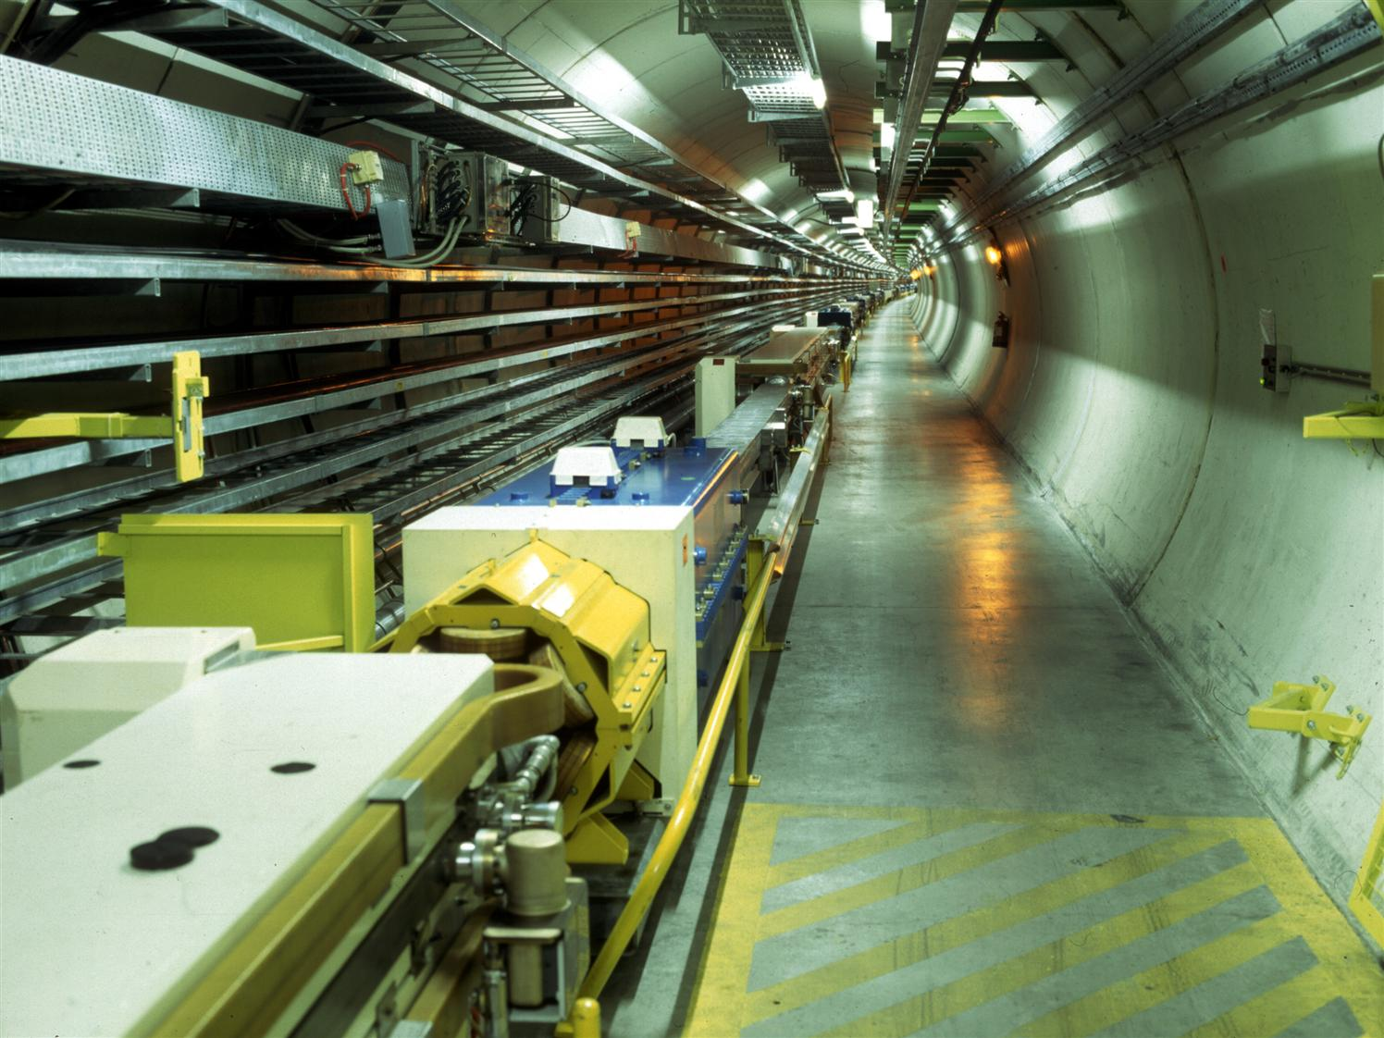
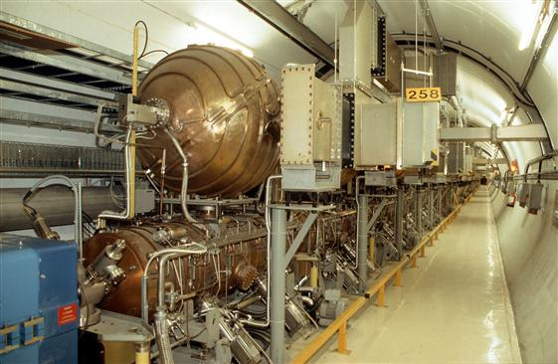
Solenoid spin compensation with bumps
Jorg Wenninger
BE-OP-LHC

Slide 3
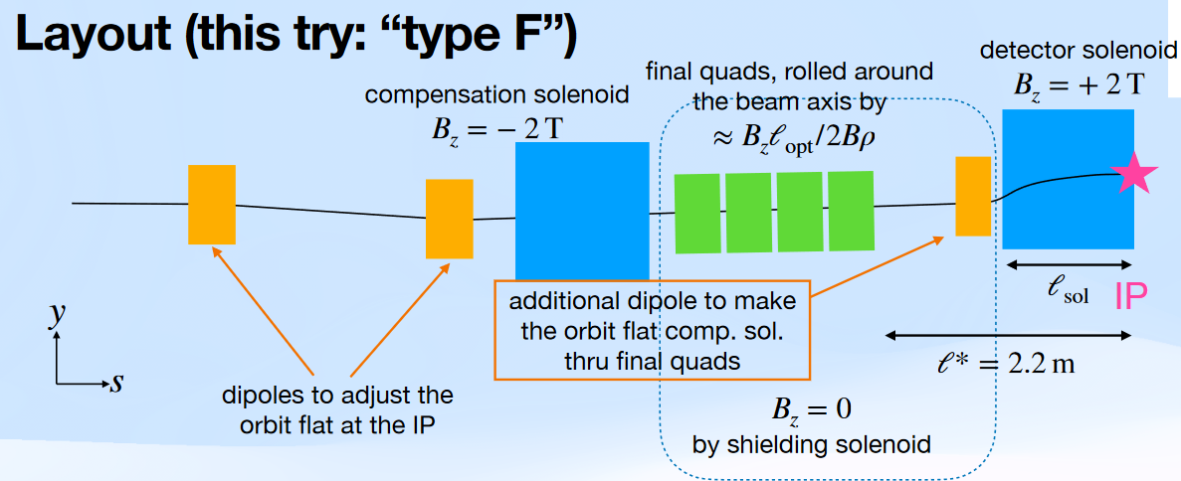
Introduction (1)
Recently new layouts of the IR with non-local solenoid compensations have been discussed at MDI meetings.
The compensation solenoid is moved out of the inner MDI region to ~±10 m from the IP. The compensation solenoid field can be lowered (from ~5T to 2T), coupling of solenoid and compensation solenoid are avoided.
K. Oide, https://indico.cern.ch/event/1476514/
As a side effect, coupling compensation is no longer local and vertical orbit shifts appears in the IR.
  The horizontal crossing angle of the beam through the solenoid generates a vertical orbit deflection that is no longer contained within the MDI region.

Slide 4
Introduction (2)
The new layout proposal for the IR has an impact on the n₀ axis due to interleaved spin deflections around the s- and x-axis:
  Reduction of the asymptotic polarization to ~1% based on K. Oide’s tracking simulations.
  Systematic spin tune shifts affecting the energy systematic error – to be evaluated.
The spin direction could be restored with vertical orbit bumps on both sides of every IR.
  The bumps will have impact on the vertical emittance – to be checked.
Such a compensation scheme was used successfully at LEP.
Since Xsuite does not include spin tracking (coming soon?): for this study a simple tracking of the spin was setup (no n₀ axis calculation!), benchmarked on LEP solenoid compensation.
  First step towards identifying compensation for FCCee.

Slide 5
Part 1: LEP

Slide 6

Solenoids at LEP
All 4 LEP experiments had solenoids of varying strength (NC and SC).
LEP had no anti-solenoids, the GLOBAL coupling was corrected using skew quadrupoles.
  There is evidently local coupling between solenoids and skews.
Experiment | BL (Tm)
L3 | 6.078
ALEPH (SC) | 10.082
OPAL | 2.613
DELPHI (SC) | 9.030
At 45.5 GeV, the spin rotation around the s-axis due to the ALEPH solenoid was 66 mrad.
Without compensation, the predicted asymptotic polarization was in the range 1-5% - in practice it was generally ~0%.
  Without compensation, the energy calibration program at the end of physics fills would have been impossible.

Slide 7
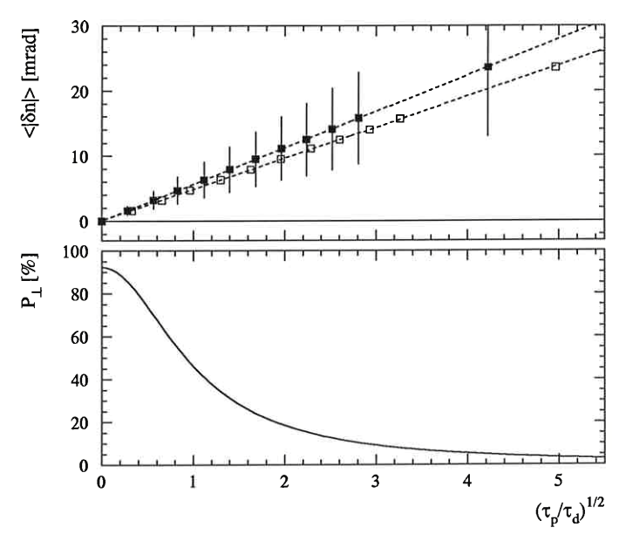
Polarization & n-axis
Average deviation of n₀ from vertical direction
Correlation between n-axis deviation from the vertical and expected polarization: for > 20 mrad the expected polarization is lowered to ~few %.
  Filled squares: linear approx. (SITF)
  Open squares : non-lin. (SODOM)

Slide 8
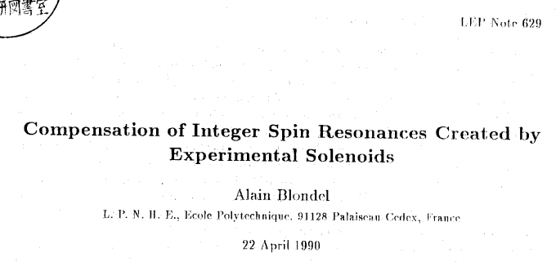
Solenoid compensation
Compensation scheme to restore the spin axis using bumps at the beginning of the arcs on both side of every IP (nickname: “SolSpin”).
Took advantage of the 60° vertical betatron arc phase advance in use around the Z → long bumps, favorable spin phase advance.
Dispersion suppressor
Dispersion suppressor
Solenoid
Double pi-bump to rotate the spin vector out of the vertical.
Precession in the dispersion suppressor by Δν_{s} ~1.1 [2π].
Rotation by the solenoid.
Precession in the dispersion suppressor by Δν_{s} ~1.1 [2π].
Double pi-bump to rotate the spin vector back to the vertical orientation.
Compensation bump
Compensation bump

Slide 9
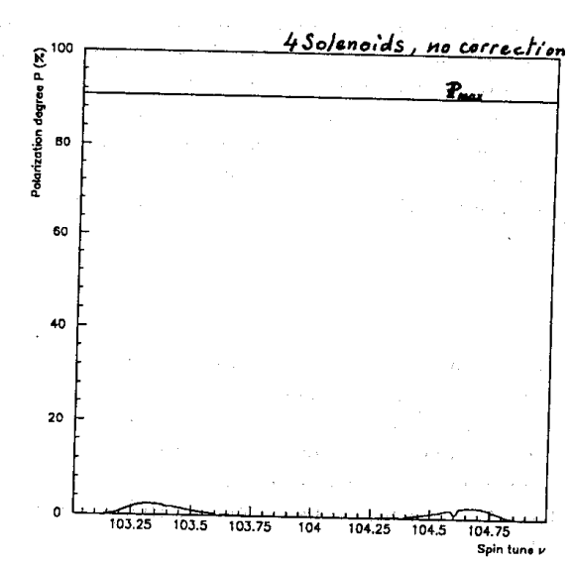
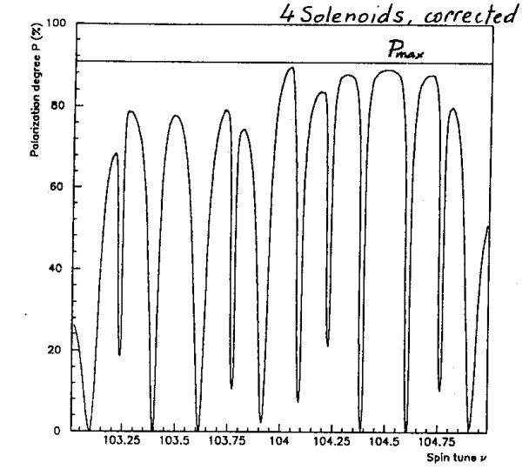
Solenoid compensation
Predictions (SLIM)
Energy (ν_{s}) range
@ Z pole (45.6…GeV)

Slide 10
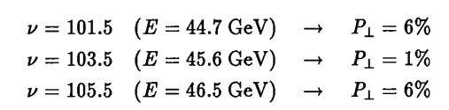
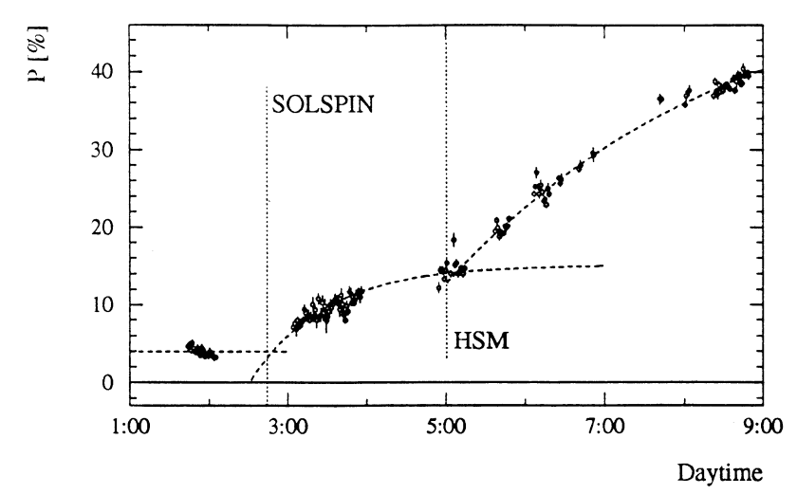
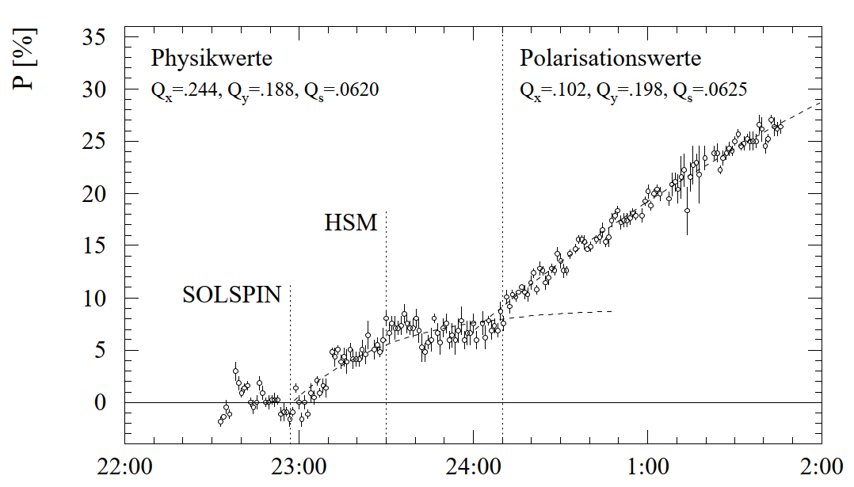
Polarization wo/with SolSpin bumps
Predicted impact of solenoids (linear):
Two examples with polarization wo/with compensation bumps.
In the experiment on the left: ~4% polarization without compensation.
CERN/SL 94-08
E = 44.7 GeV, ν_{s} ~101.5
E = 44.7 GeV, ν_{s} ~101.5
PHD R. Assmann

Slide 11
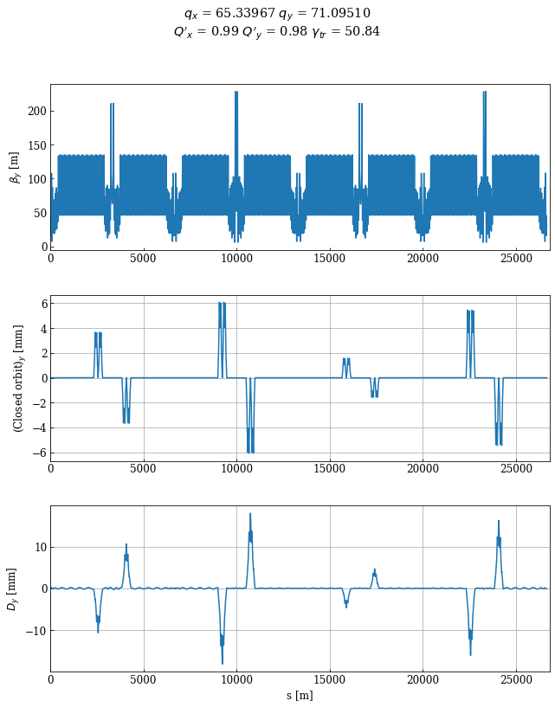
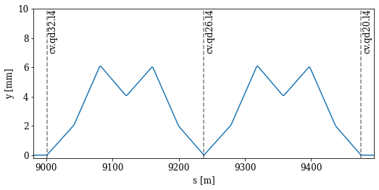
Compensation bumps
Complete bump set
Double pi-bump, ALEPH left side
L3
ALEPH
OPAL
DELPHI
Vertical orbit
Δμ_{y} = 2π
Δν_{s} = 4π + π/2
Vertical dispersion

Slide 12
Impact on emittance/performance
The double pi-bumps at π phase advance contain well the vertical dispersion within the bump region, limiting the vertical emittance growth.
At the Z, the vertical bumps generate a vertical emittance of ε_{y} ~ 150 pm.
For a natural horizontal emittance of ε_{x} = 12-30 nm (wo/with wigglers) for the LEP 90/60 optics (optics with 90° phase advance in H and 60 ° V), this corresponds to ε_{y}/ε_{x} ~0.5-1.2%.
  At 45 GeV LEP operated with ε_{y}/ε_{x} ~1% in physics production.
At LEP no polarization in physics: polarization studies & energy calibration outside physics data taking → emittance growth not critical.

Slide 13
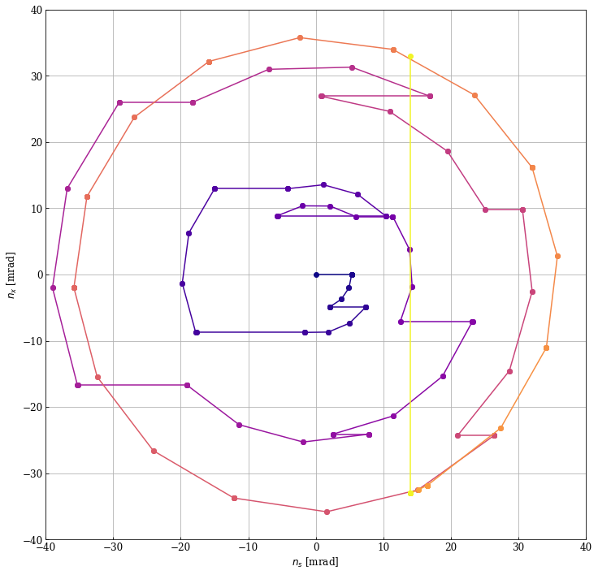
Spin path arc to IP
Exit solenoid
Spin vector orientation assuming initial vertical direction from entrance of the left side compensation bump to the exit of the solenoid.
Color coded from dark blue (start) to yellow (end).
  Each point: one machine element.
Horizontal lines: spin deflections induced by vertical orbit correctors or offsets in quadrupoles.
Curved sections: precession in dipoles.
n_{x} (mrad)
Start
End of bumps
Entrance solenoid
n_{s} (mrad)

Slide 14
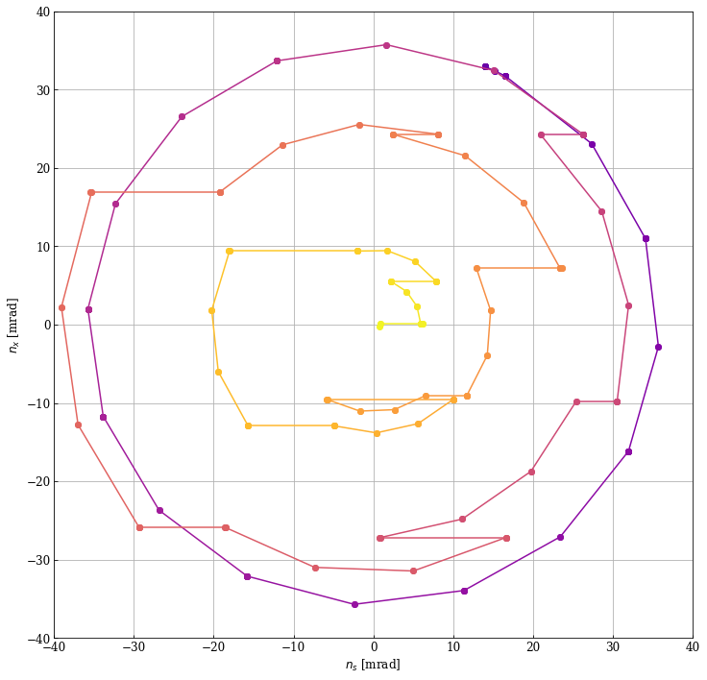
Spin path IP to arc
Exit solenoid
Start of bumps
Spin vector orientation from exit of the solenoid to the end of the right-side compensation bump.
Color coded from dark blue (start) to yellow (end).
Horizontal lines: spin deflections induced by vertical orbit correctors or offsets in quadrupoles.
Curved sections: precession in dipoles.
n_{x} (mrad)
End
n_{s} (mrad)

Slide 15
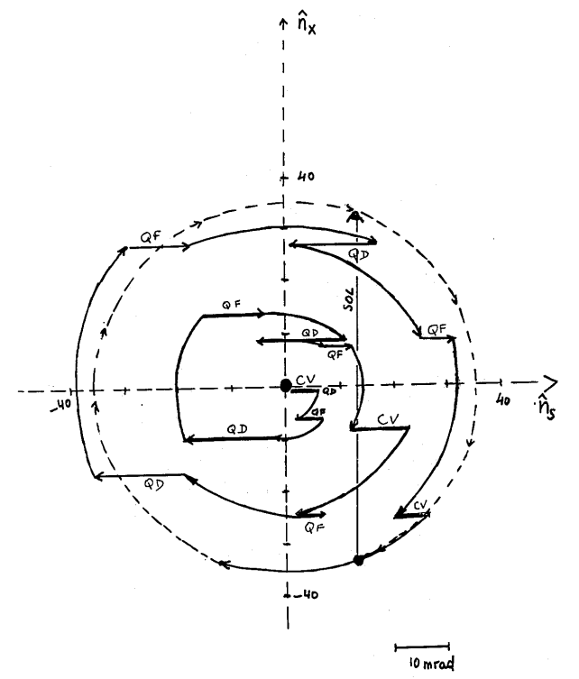
Original versus replay
2024
LEP note 629, 1990

Slide 16
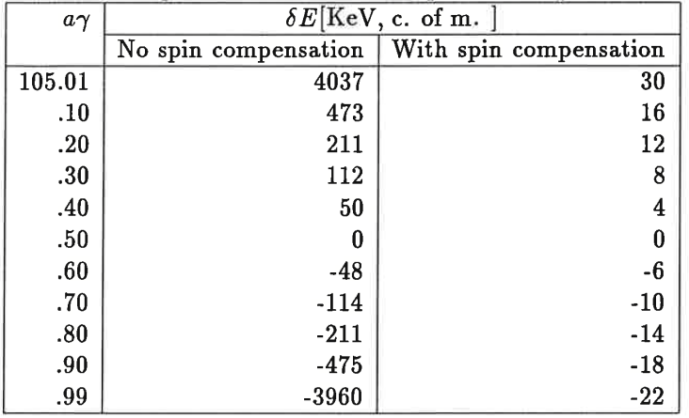


Impact of solenoids on spin tune @ LEP
CERN/SL 93-26
The systematic spin tune shift due to the solenoids (and compensation bumps) and associated systematic error on the beam (or centre-mass) energy was estimated to be negligible for LEP.
The shift is difficult to check experimentally due to the long time required to ramp and compensate the solenoid (→ energy drifts):
  One single check, no energy change within ±0.44 MeV.
! centre-of-mass energy !

Slide 17
Part 2: FCCee

Slide 18
Non-local solenoid compensation concept
Consider option “F” proposed at the MDI meeting 11.11.2024 (GHC lattice):
  https://indico.cern.ch/event/1476514/
Vertical deflection due to the horizontal crossing angle in the solenoid.
15 mrad (1.2 xing angle) in ~6-7Tm integrated field
Symmetric layout on the right side of the IP

Slide 19
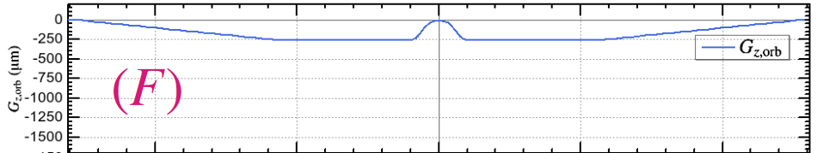
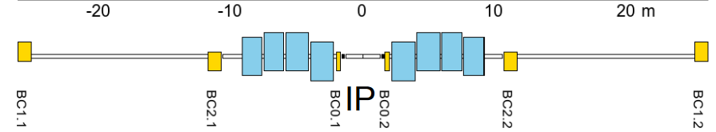
Non-local solenoid compensation geometry
Orbit around the IP – interleaved horizontal fields + solenoid(s).
Vertical bending due to solenoid + xing angle
~ -20 μrad
~ -20 μrad
~ +20 μrad
~ +20 μrad
~ +300 μrad each

Slide 20
Non-local solenoid compensation
No MADX version of the geometry is available on Git.
  In discussion with H. Burkhardt for some ad-hoc madx scripts – but they are for the LCC lattice, not for the GHC.
The following slides show a first look at the geometry and the possible impact on polarization.

Slide 21
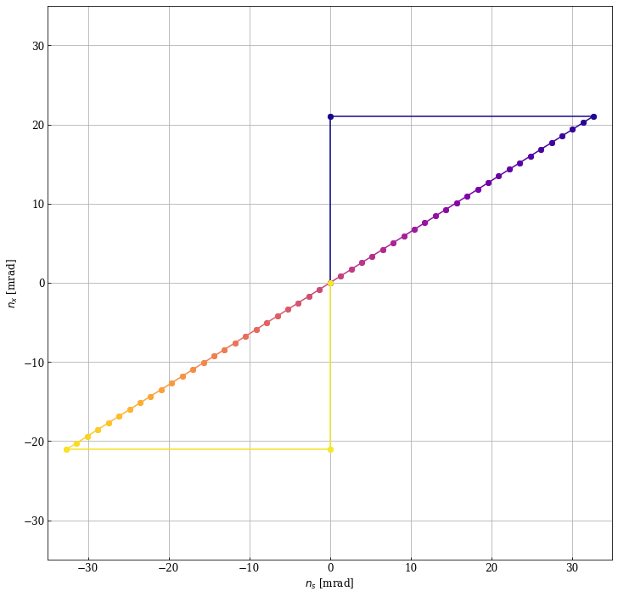
Spin vector tracking
Tracking the spin vector through left side compensation solenoid, vertical orbit corrector, solenoid (+hor crossing angle), right side vertical orbit corrector, compensation solenoid.
  Color coded from dark blue (start) to yellow (end).
Due to the compensation solenoids at ~10m, the vertical orientation is well preserved.
L-side vertical corrector
L-side Comp. solenoid
Solenoid
+ xing angle
R-side Comp. solenoid
R-side vertical corrector

Slide 22
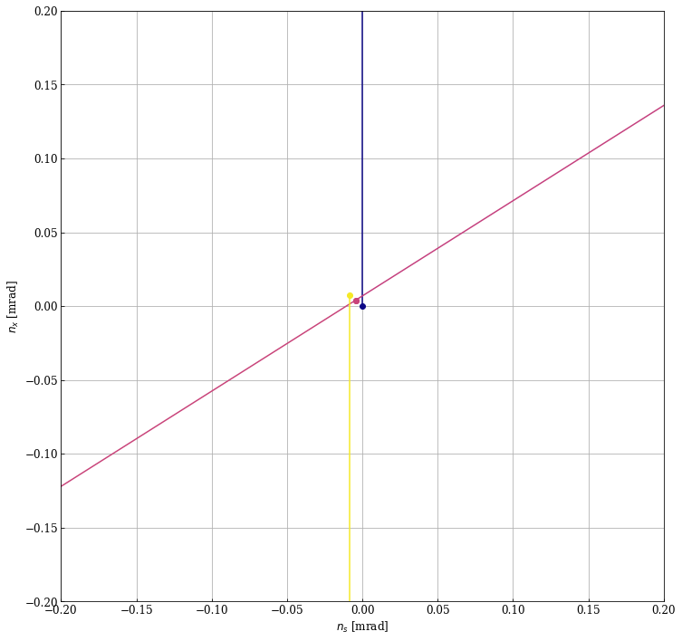
Spin vector tracking - zoomed
Tracking the spin vector through left side compensation solenoid, vertical orbit corrector, solenoid (+hor crossing angle), right side vertical orbit corrector, compensation solenoid.
  Color coded from dark blue (start) to yellow (end).
There is a small deviation of the spin from the vertical at the exit of the region by ~10 μrad.
  Simplified check with discretized spin rotations confirms the deviation magnitude.
Due to the small values of the shift, it is very sensitive to details – need to confirm with further studies / geometry checks.
Dark blue: entrance
Yellow: exit
magenta: IP

Slide 23
Discussion
The LEP solenoid compensation was used as benchmark to check / compensate the impact of the solenoids (+ compensation) for FCCee.
In the absence of a proper MADX sequence for the local solenoid compensation, a first exploratory investigation was performed.
  The spin deflections by the (compensation) solenoids are like those at LEP (~6-7 Tm vs 10 Tm).
  Despite the “not fully” local nature of the compensation, the compensation does also work for the polarization, leaving only a residual deviation of n₀.
  Compensating bumps can be small !
SAD tracking by K. Oide yields only ~1% residual polarization (4 IPs !) which looks a bit pessimistic for the small imperfection. Confirmation / cross-check with BMAD needed !

