Slide 1
Education, Communications & Outreach
Group Meeting – 11 November 2024
Arnaud Marsollier – Head Education, Communications & Outreach

Slide 2
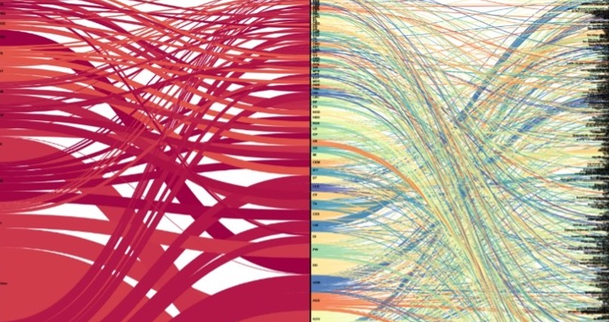
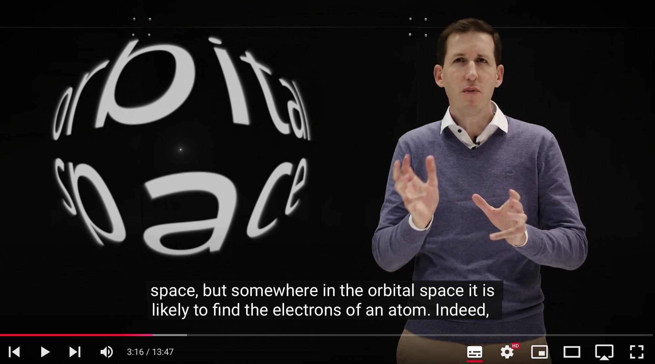
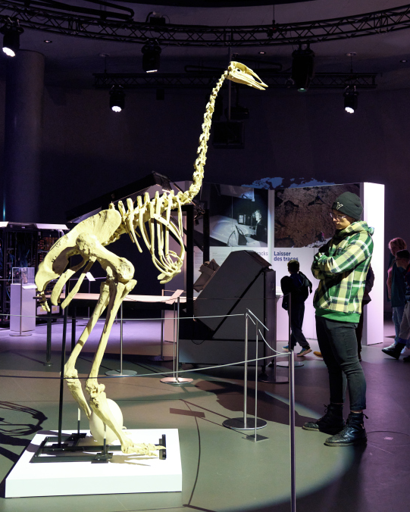

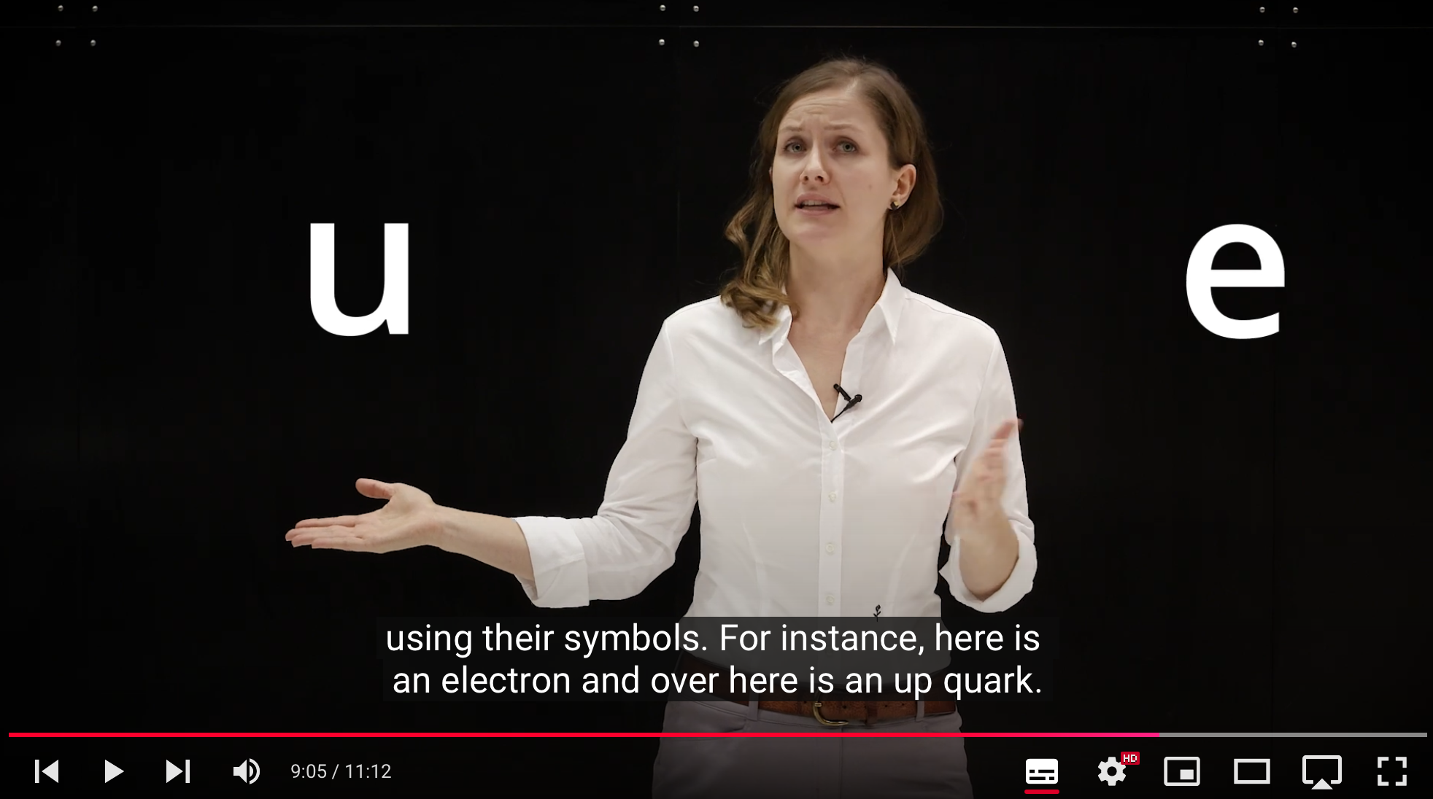
On the menu Today
Notes:
A very busy year

Slide 3
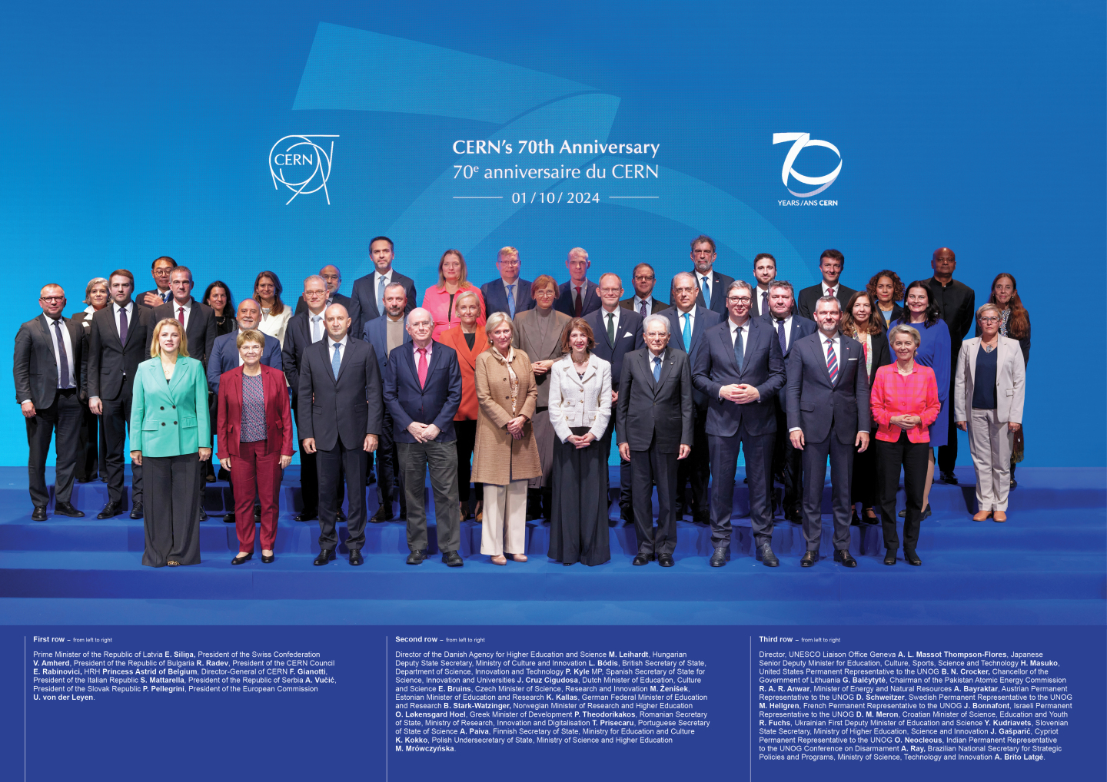
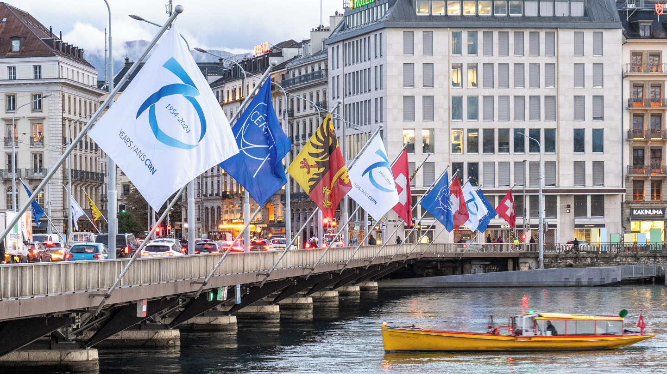
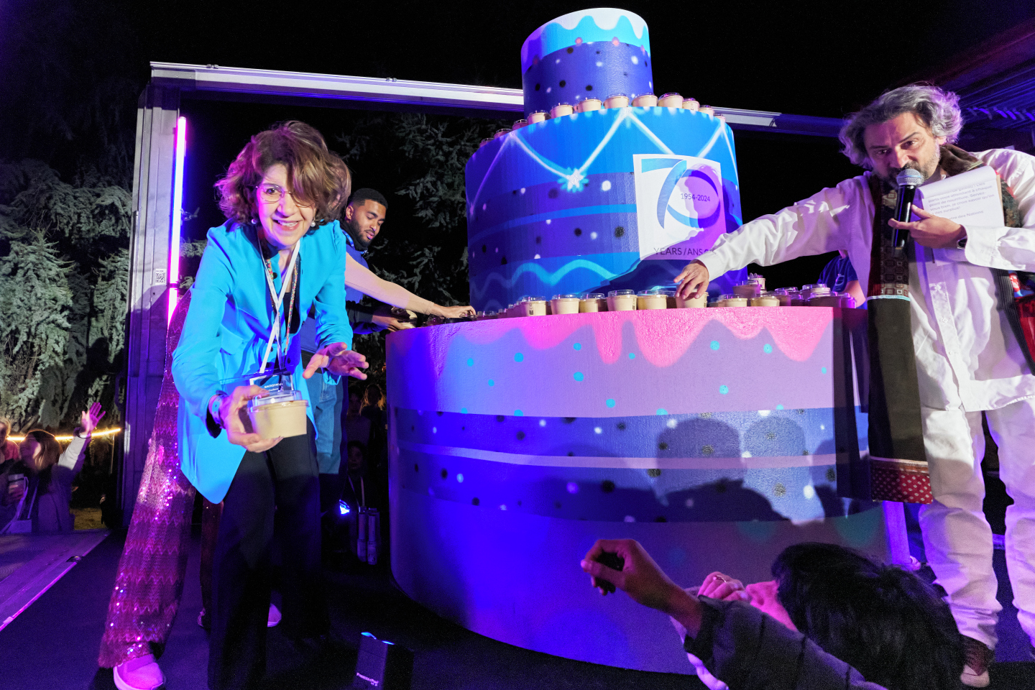
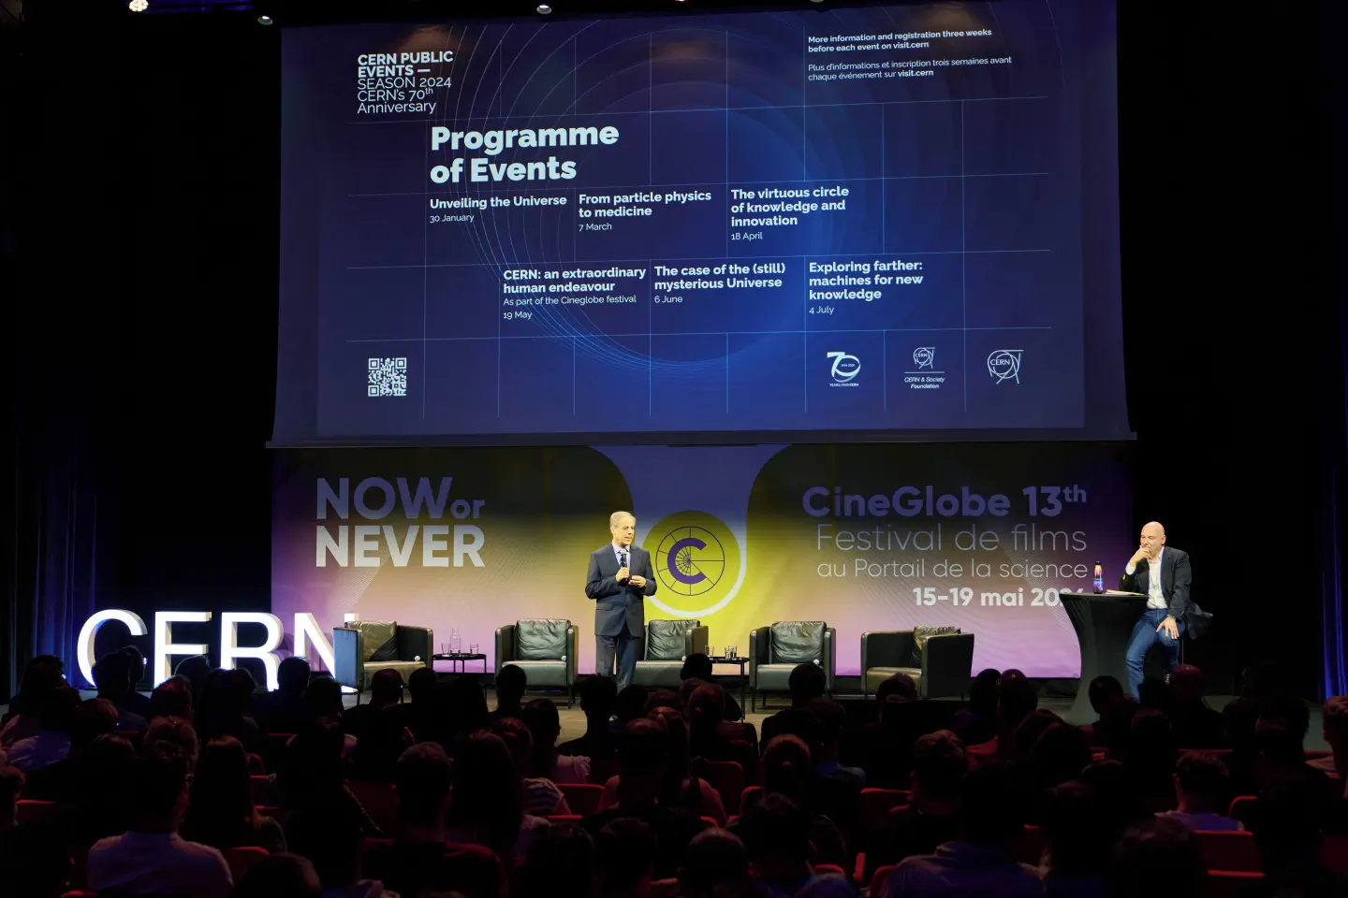
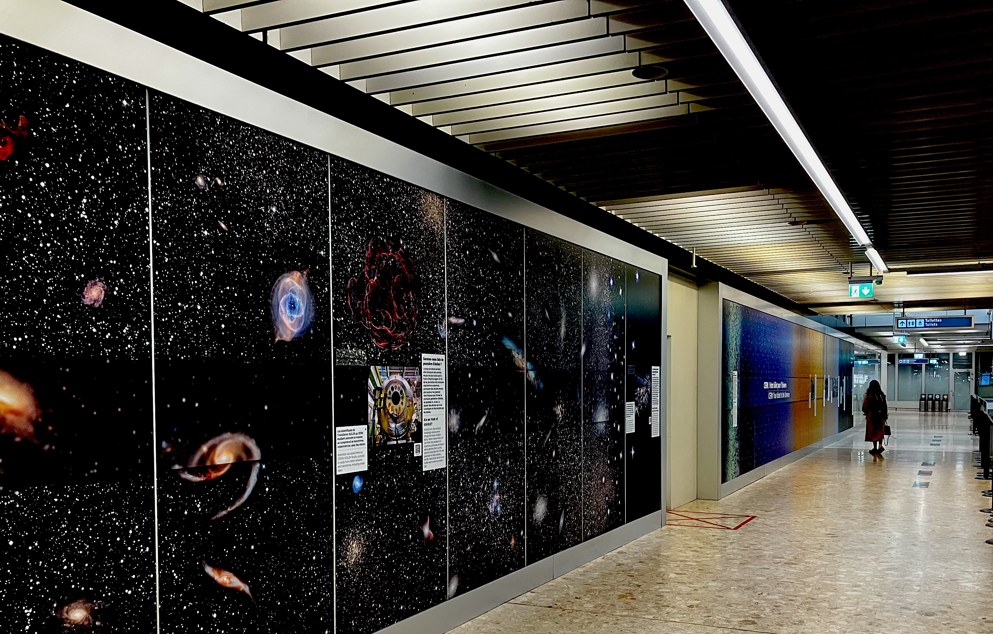
CERN70 – Thank You!
Notes:
A very busy year

Slide 4
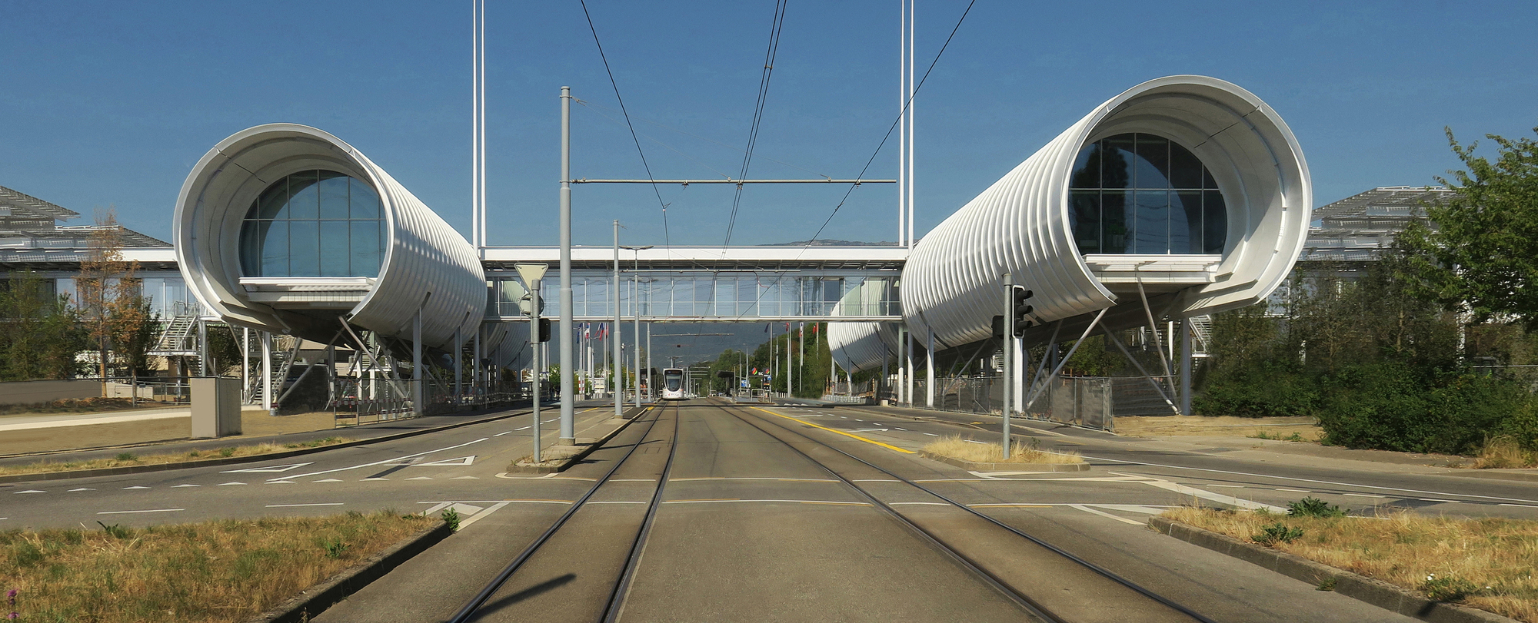
Science Gateway: > 400.000 visitors!
Notes:
A very busy year – Thanks to the teams of education, local events, exhibitions, volunteers and of course the whole team of the SGW

Slide 5
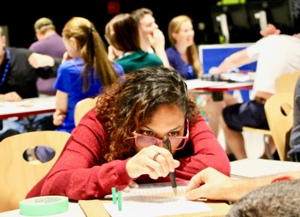
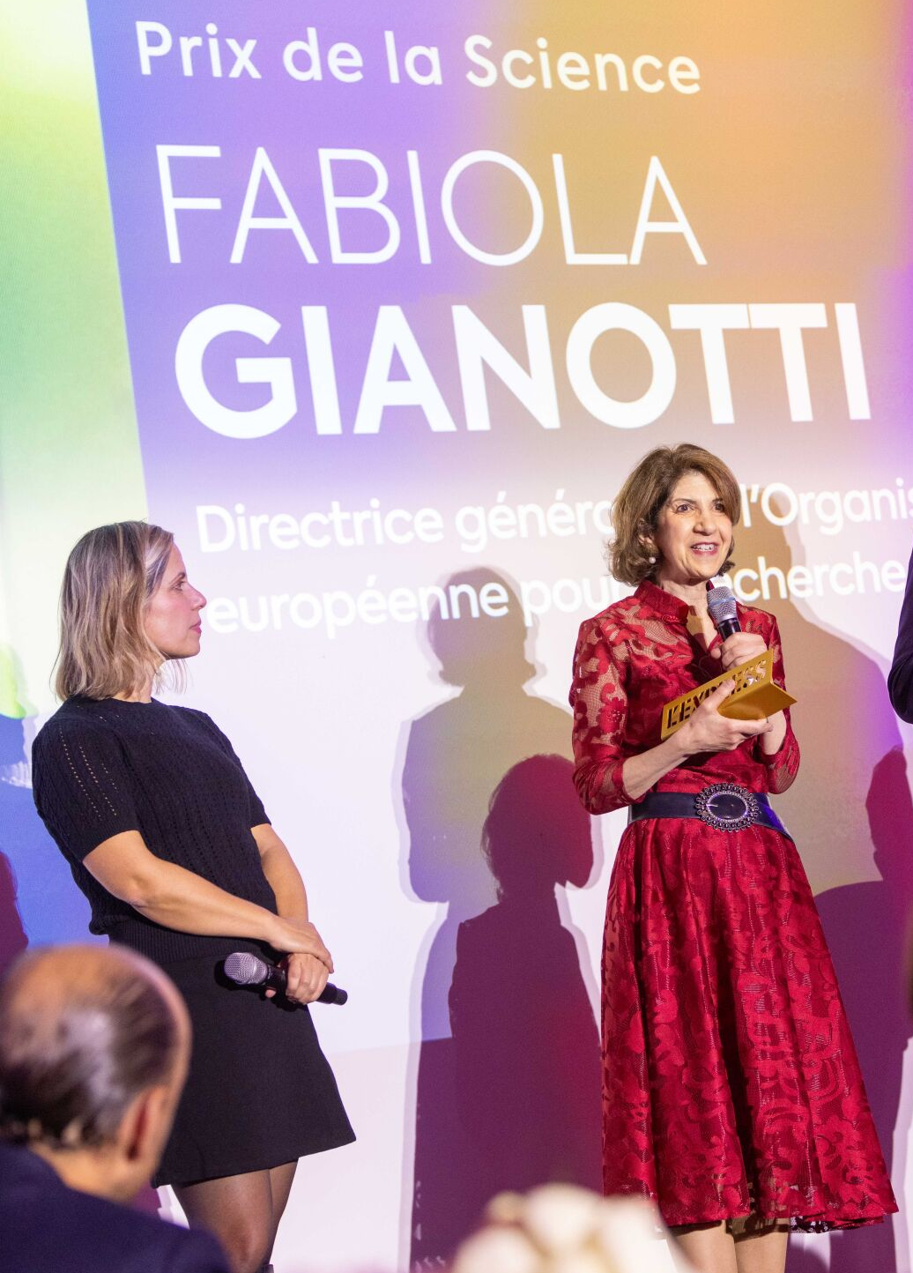
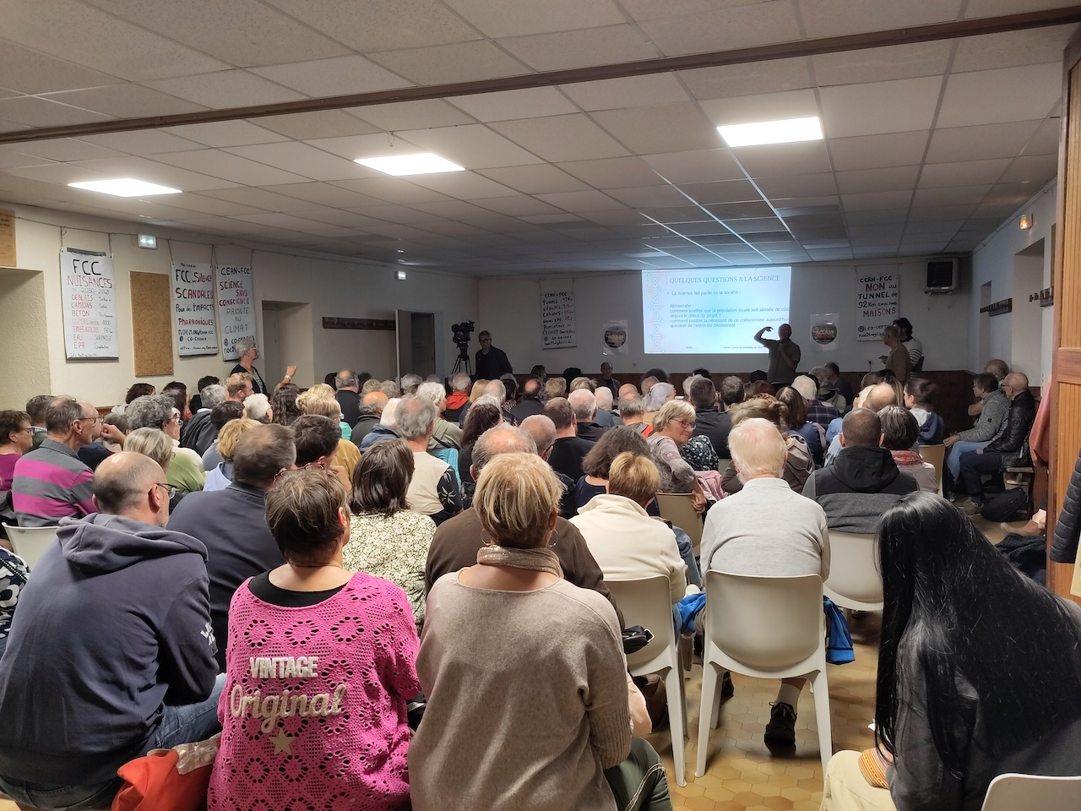
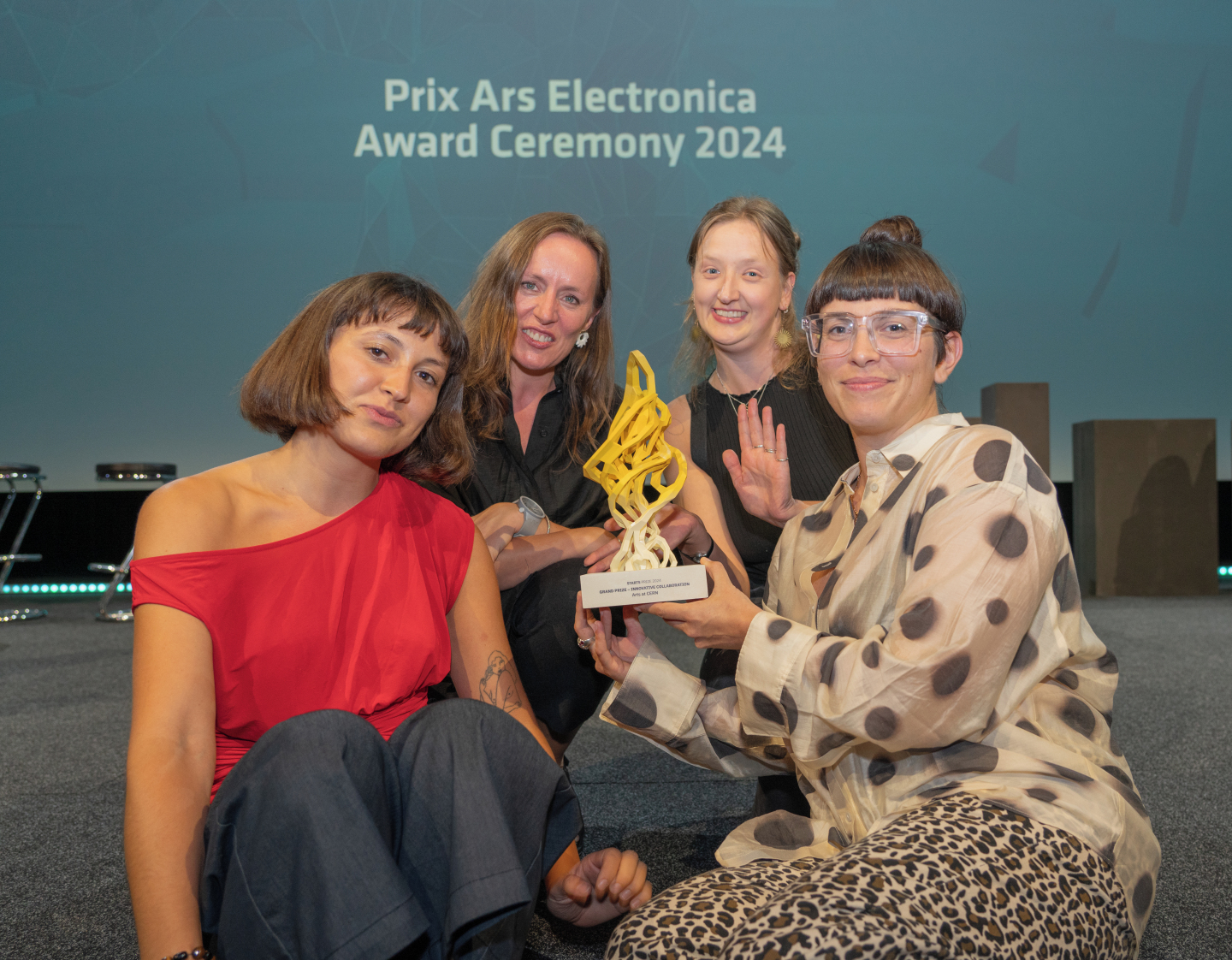

A few more highlights…
Notes:
Arts at CERN wins the European Commission’s S+T+ARTS Grand Prize for Innovative Collaboration
Cleo Abram - around 4.5 million views
Prix de l’express
15.000 teachers
Information meetings… FCC

Slide 6
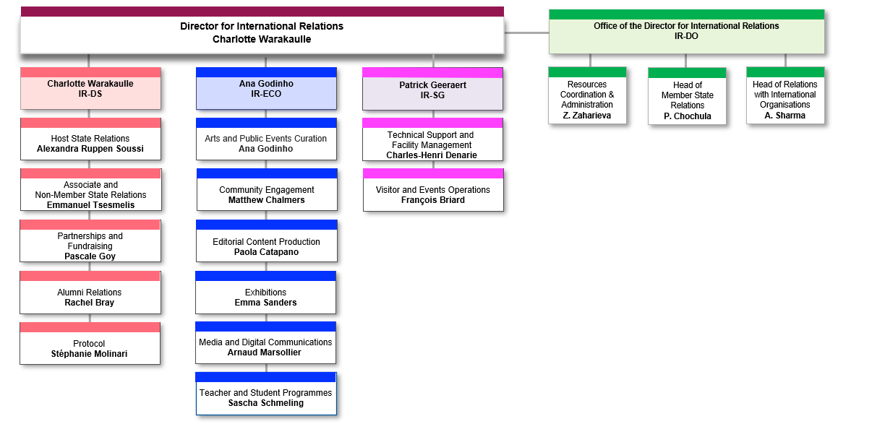
Some (small) Changes
Arnaud Marsollier
Paola remains Deputy Group leader
Sophie
Tesauri
Notes:
Sophie to lead PRD
A new team for local communications and local events
Arts@cern and local events moving to Matthew’s team
New editorial process
An FCC task force bringing together ECO and FCC
Gitlab
Sophie to lead PRD
A new team for local communications and local events
Arts@cern and local events moving to Matthew’s team
New editorial process
An FCC task force bringing together ECO and FCC

Slide 7
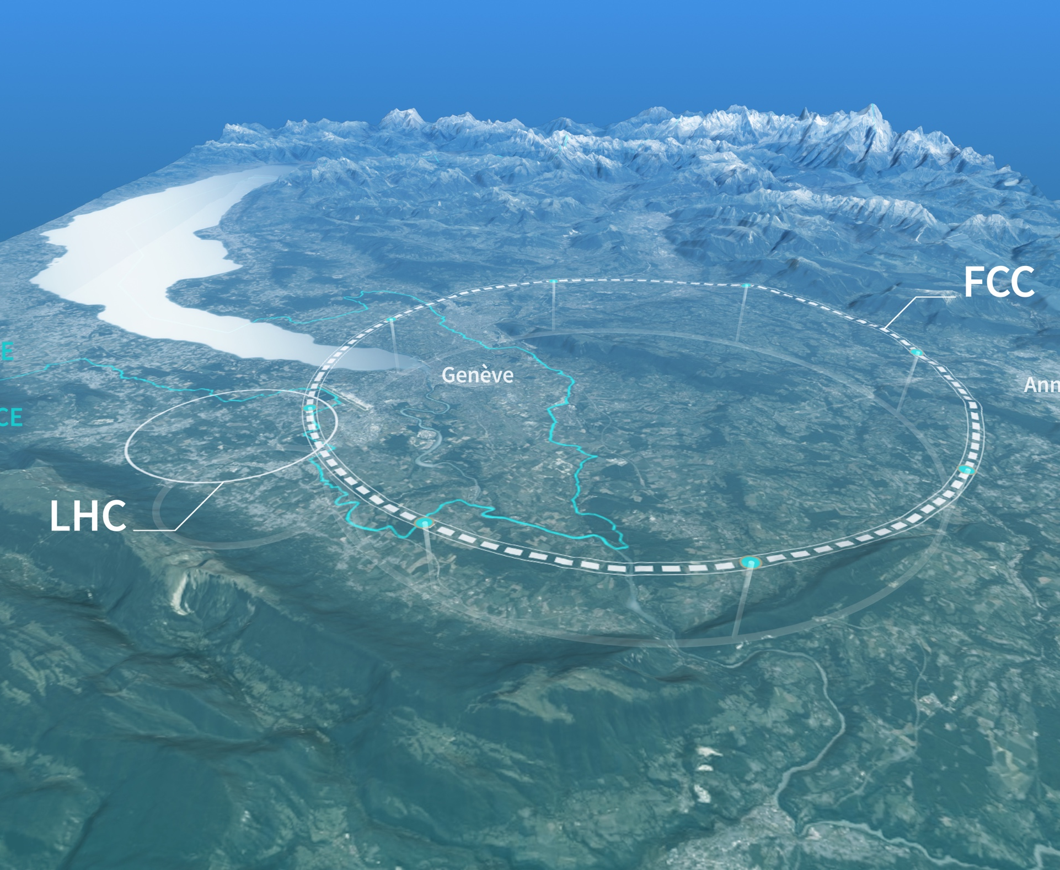
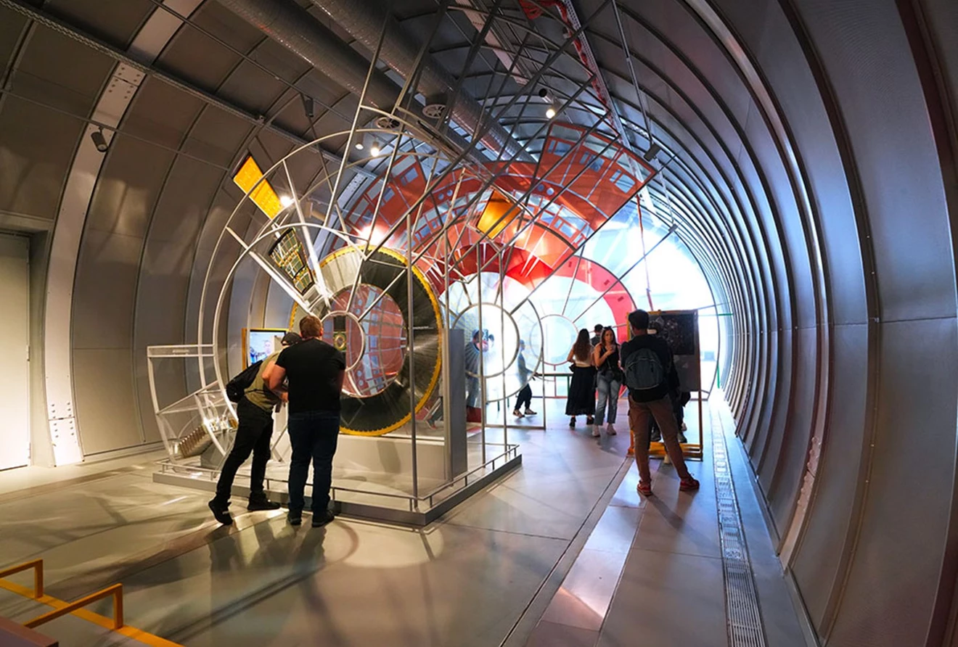
Reinforcing local communications
Two priorities:
Ramping up public events with first season - “Quantum” – develop more collaborations at local level
Accompany FCC local communications needs (short term and longer term)
Notes:
Melissa Gaillard to join and work with Dante and Zoe under Matthew’s leadership
Information local events on FCC + More outreach to Haute Savoie

Slide 8

A few priorities for next year
. The European Strategy for Particle Physics
(community and external)
. FCC final report (March)
. High-Lumi (need to increase awareness and ramp up comms here)
And some more projects that will be mentioned by the section leaders
Notes:
FCC and High-Lumi should be part of the same story

Slide 9
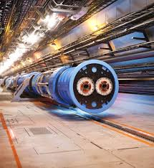
Editorial Process & FCC task force
. Adjusted editorial process ongoing discussions
  - “editor in chief” function
  - work on the concept of high-level campaigns
  - Balance strategic vs “news”
. The FCC task force will bring together a few key people from FCC and ECO
  - A brief weekly meeting to follow activities
  - A monthly meeting with more people to coordinate and plan
  Two main priorities for the FCC task force in the short term:
  - Accompany local information meetings
  - Prepare for the FCC final report
Notes:
Eidtor in Chief:
Sets editorial priorities and makes decisions
Brings together all writers as a single team
We will start with the SWOT analysis from last group meeting

Slide 10
Some ongoing staff recruitment
. Press & Digital: one press officer (to be published soon) and one press lead to replace Sophie
. Arts@cern: ongoing selection
. FCC – to join local communications: a civil society communications officer to deal with assocoations, NGOs and support local communications efforts
Notes:
Sophie to lead PRD
A new team for local communications and local events
Arts@cern and local events moving to Matthew’s team
New editorial process
An FCC task force bringing together ECO and FCC
Gitlab
Sophie to lead PRD
A new team for local communications and local events
Arts@cern and local events moving to Matthew’s team
New editorial process
An FCC task force bringing together ECO and FCC

Slide 11
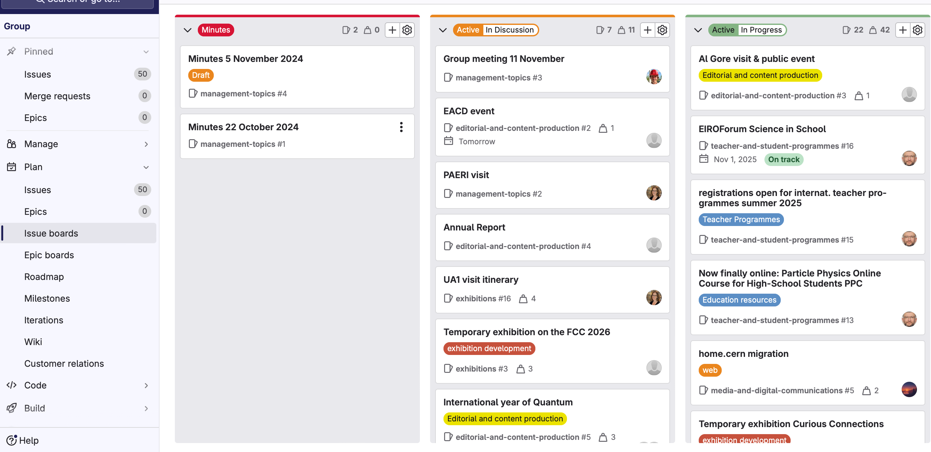
Gitlab for all: https://gitlab.cern.ch/groups/eco/-/boards
Projects discussed
at LSM
Ongoing
projects
Minutes

Slide 12
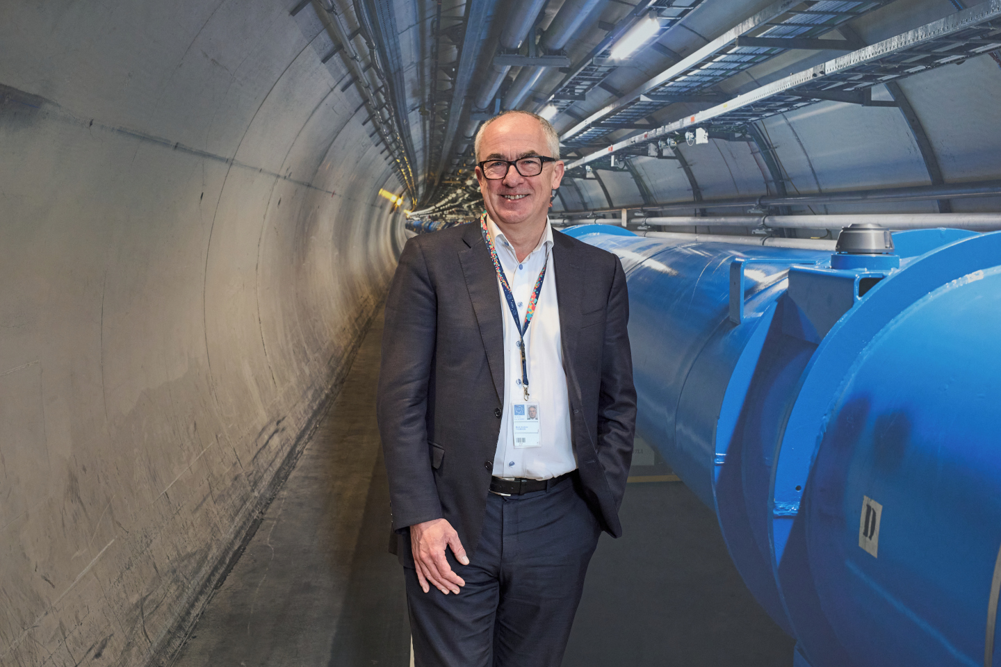
Also a transition year!

