Slide 1

Update of thermo-mechanical studies for TCTPs (Pb ions)
L. Puddu, F. Carra
BLM Thresholds Meeting (Pb run 2024)
29/10/24

Slide 2
Outline
Introduction
Case 1a (halo heating)
Scraping
Conclusions

Slide 3
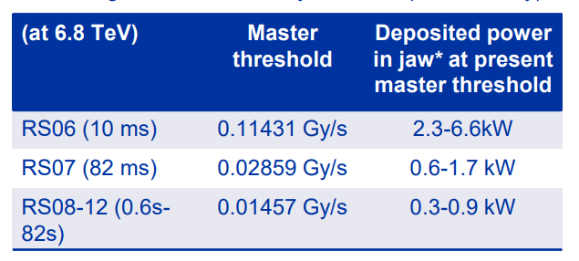
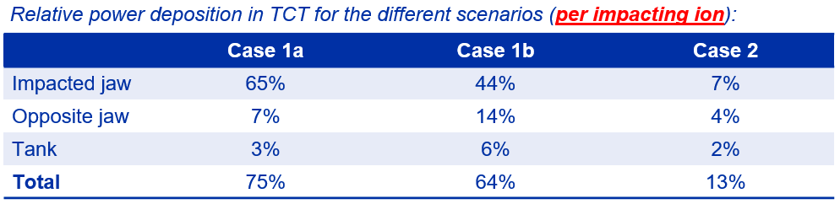
Introduction
Proposal: increase the Final TCT master thresholds from 2023 Pb run by a factor 3
Since, the thresholds for BPM are set on the impacting powers, the most conservative is case 1a (it maximizes the power deposition on the jaw for a set impacting power):

Slide 4
Introduction
Case 1: halo leakage of ions from IR7 to the TCTP collimator (TCTPV)
  A) impact of Gaussian beam (σ_{x/y}=0.425mm, 9mm impact parameter, half-gap=0.7mm)
  B) with tracking input: similar operational scenario, but based on real tracking simulations
Case 2: accidental case (direct beam scraping on the TCTP).
Time | Power deposited [kW] | Number of particles/second
10 ms | 20 | 3.43E+08
82 ms | 6 | 1.03E+08
82 s | 3 | 5.15 e7

Slide 5
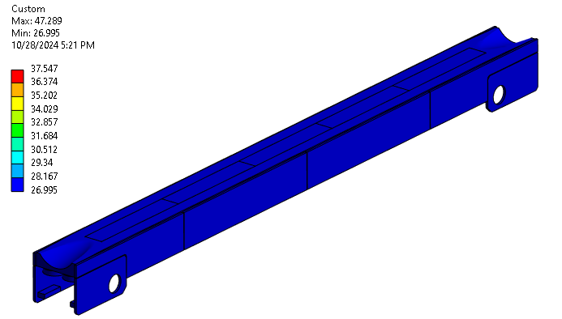
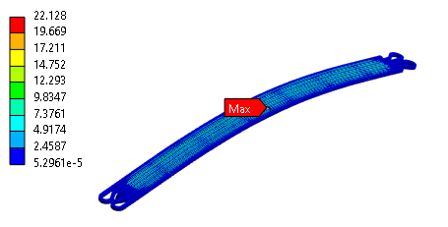
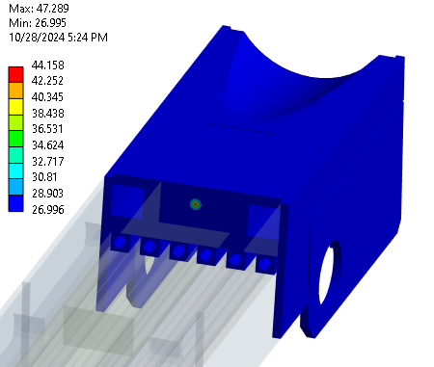
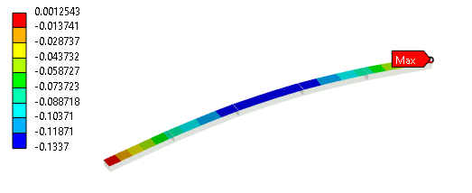
Results - Case 1a
20 kW – 10 ms
Equivalent stress [MPa]
Temperature [°C]
Directional def [mm]

Slide 6
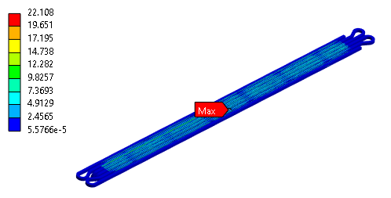
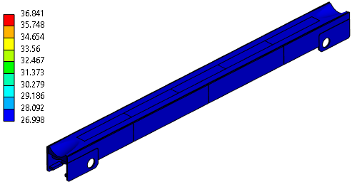
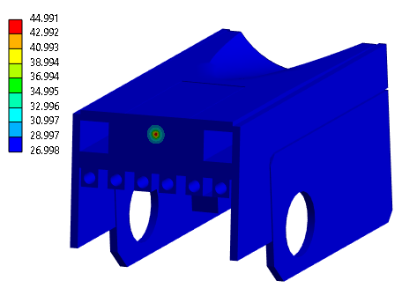
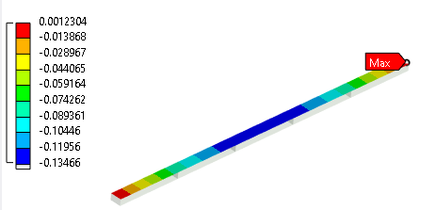
Results - Case 1a
6 kW – 82 ms
Equivalent stress [MPa]
Temperature [°C]
Max: 47.9 °C
Directional def [mm]

Slide 7
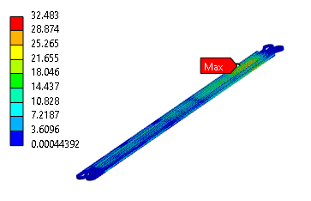
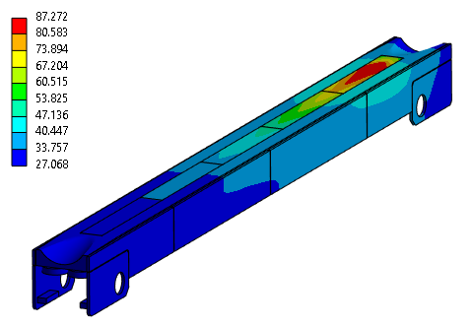
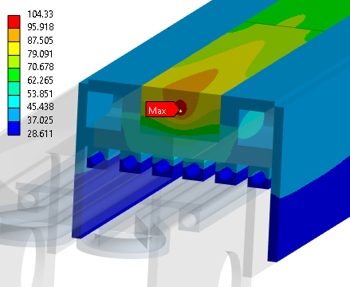
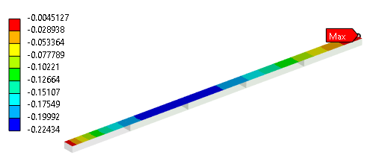
Results - Case 1a
3 kW – 82 s
Equivalent stress [MPa]
Temperature [°C]
Directional def [mm]

Slide 8
Results - Case 1a
Reminder:
Yield stress CuNi pipes = 120 MPa
Yield stress Inermet180 = 640 MPa
Deposited Power [kW] | Time [s] | Tmax jaw [°C] | T probe [°C] |  | Max deflection jaw [um] | Max stress [MPa]
 |  |  |  |  |  | Pipes | Blocks
20 | 10 e-2 | 47.3 | 27.0 | 27.0 | 133 | 22.1 | 18.0
6 | 82 e-3 | 47.9 | 27.0 | 27.0 | 133 | 22.1 | 21.5
3 | 82 | 105.5 | 31.9 | 44.6 | 220 | 32.5 | 65

Slide 9
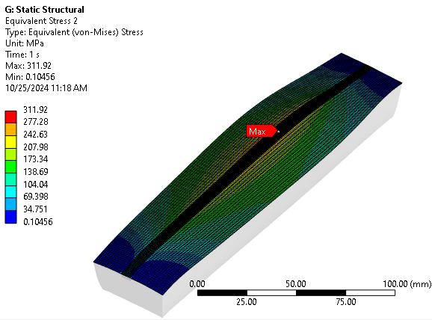
Scraping 3kW, 20 s – Results
Evaluation of stress on inermet:
Simplified (and conservative) sub-model
Map | Mesh size | Max Temp [°C] | Eq. Stress [MPa]
2 | 0.5 mm | 121
2 3 | 0.5mm (0.1mm) | 163 | 312
2 3 | 0.5mm (0.05mm) | 163
Mesh 1mm, 0.5mm

Slide 10
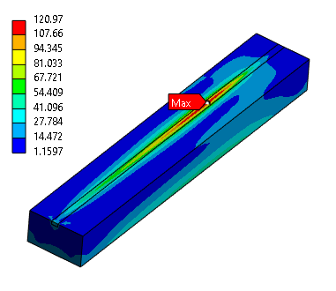
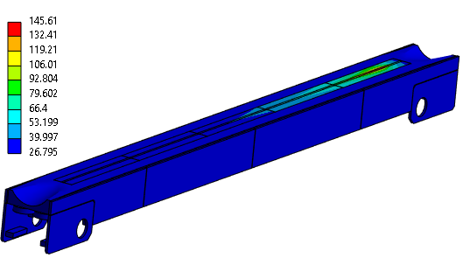
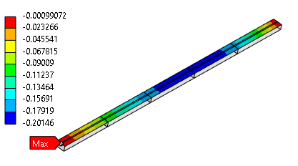
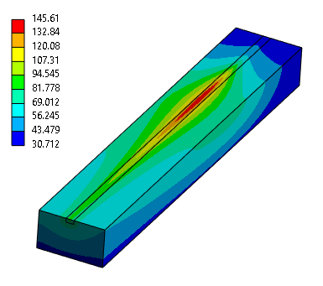
Scraping 3kW, 20 s – Results
Equivalent stress [MPa]
More accurate model:
Entire model with finer mesh at the power peak
Temperature [°C]
Mesh 2mm, 0.5mm
Directional def [mm]
Mesh: 0.5 mm, 0.05mm

Slide 11
Scraping fast losses (0.1 s) – Results
Deposited Power [kW] | Time [s] | Tmax jaw [°C] | T probe [°C] |  | Max deflection jaw [um] | Max stress [MPa]
 |  |  |  |  |  | Pipes | Blocks
9 | 10 e-2 | 60.3 | 27.0 | 27.0 | 130 | 24.5 | 58.8
3 | 10 e-2 | 38.1 | 27.0 | 27.0

Slide 12
Conclusions
After the analysis of case 1a, an increase in BPM thresholds by a factor of 3 does not present any thermo-structural issues.
For the scraping scenario, the stress analysis on the inermet, which was previously left incomplete, has now been concluded:
  with a deposited power of 3 kW for 20 s, we reach approximately 50% of the yield strength of the inermet (with the conservative sub-model).
  if the thresholds are set as discussed before, we actually dump at ~ 400W in the case of scraping, so almost 1/10 less than what was simulated

Slide 13
Thank you for your attention
Questions?

