Slide 1
Considerations about Q6 thresholds
Anton Lechner, Volodymyr Rodin, Belen Salvachua, Sara Morales Vigo
20/09/2024

Slide 2
Introduction
  The SC Q6 magnets in IR3 and IR7 (MQTLH, 4.5K) are exposed to showers from TCLAs
  Operational experience showed that the Q6 BLM thresholds pose a performance bottleneck for certain loss conditions:
      Losses in IR3 and IR7 at the beginning of the ramp (2022 and 2024)
      Fragment leakage in IR7 during Pb operation (2023)
  The Q6 BLM master threshold model is ignorant of collimation losses → assumes direct proton losses on the Q6 aperture
  As a consequence, several ad-hoc corrections had to be applied on top of the model to avoid premature dumps (→ several corrections in the 2023 Pb run)
  However, it is important to understand the actual quench margin we have for the Q6 for Pb collimation losses
  In this presentation, I analyse the observations of the 2023 Pb run and present a proposal for increasing the Q6 thresholds

Slide 3
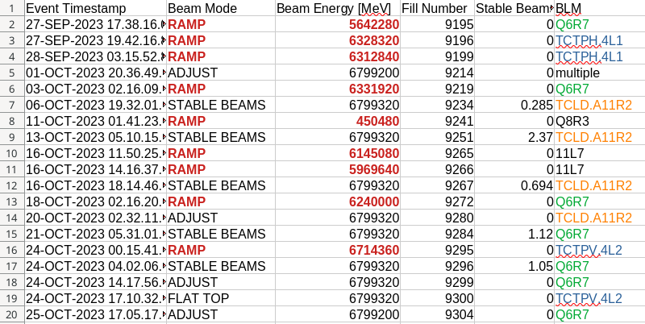
Recap: dumps in 2023 Pb run
2023 Pb run:
18 BLM dumps in physics fills (9 in ramp, 9 at top energy)
Mostly at Q6R7 (7x), TCLDs (4x) and TCTs (4x)
Q6 dumps:
5x RS06 (last 5 dumps)
1x RS08
1x RS10/11

Slide 4
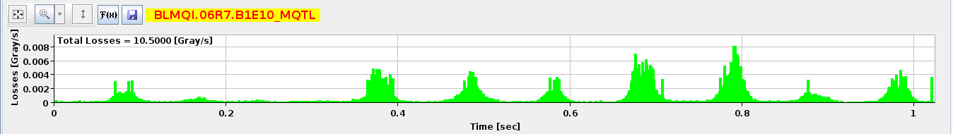
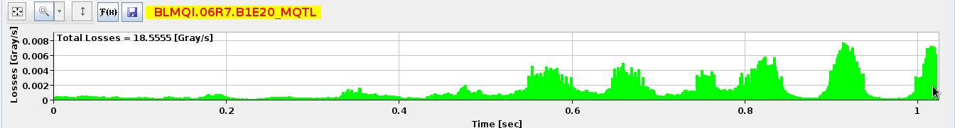
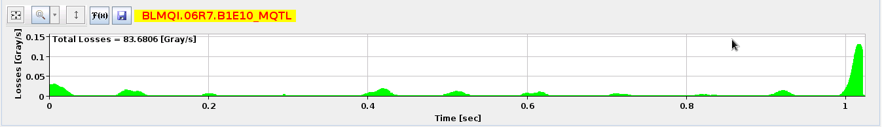
Q6 dump events in 2024 Pb run
27/09/2023, 5.64 TeV (dump in RS10/11)
03/10/2023, 6.33 TeV (dump in RS08)
18/10/2023, 6.24 TeV (dump in RS06)

Slide 5
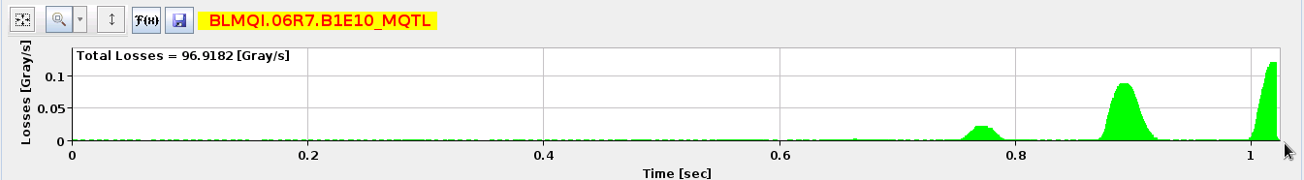

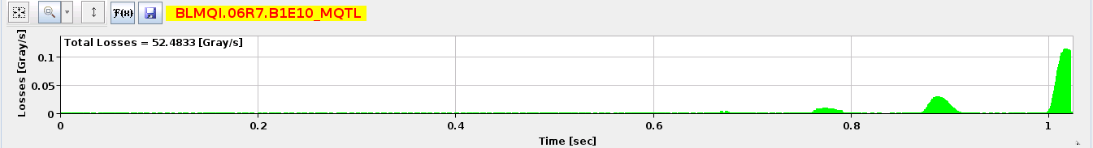
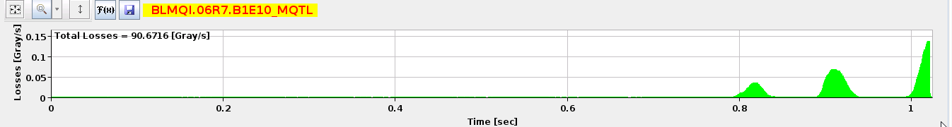
Q6 dump events in 2024 Pb run
21/10/2023, 6.8 TeV (dump in RS06)
24/10/2023, 6.8 TeV (dump in RS06)
24/10/2023 again, 6.8 TeV (dump in RS06)
25/10/2023, 6.8 TeV (dump in RS06)

Slide 6
Sig-thr ratio for Q6 dump events in 2023 (RS06)
18/10/2023 | Signal RS06 | Threshold RS06 | Ratio
BLMQI.06R7.B1E10_MQTL | 0.109145 | 0.108478 | 1.00615
BLMTI.06R7.B1E10_TCLA.C6R7.B1 | 0.172254 | 0.466303 | 0.369403
BLMTI.06R7.B1E10_TCLA.D6R7.B1 | 0.699897 | 1.94289 | 0.360234
BLMTI.05R7.B1E10_TCSG.E5R7.B1 | 0.106931 | 0.380572 | 0.280975
BLMQI.06R7.B1E20_MQTL | 0.0237612 | 0.108478 | 0.219042
21/10/2023 | Signal RS06 | Threshold RS06 | Ratio
BLMQI.06R7.B1E10_MQTL | 0.101734 | 0.100999 | 1.00728
BLMTI.05R7.B1E10_TCSG.E5R7.B1 | 0.196181 | 0.37926 | 0.517273
BLM2I.11R7.B1E24_MBB_MBB | 0.0384597 | 0.096694 | 0.397748
BLMTI.06R7.B1E10_TCLA.C6R7.B1 | 0.180442 | 0.466921 | 0.38645
BLMTI.06R7.B1E10_TCLA.D6R7.B1 | 0.699435 | 1.94547 | 0.35952
BLM2I.11R7.B1E23_MBB_MBB | 0.0320483 | 0.096694 | 0.331442
BLM2I.11R7.B1E23_MBA_MBA | 0.0195399 | 0.096694 | 0.20208
24/10/2023 | Signal RS06 | Threshold RS06 | Ratio
BLMQI.06R7.B1E10_MQTL | 0.10354 | 0.100999 | 1.02516
BLMTI.05R7.B1E10_TCSG.E5R7.B1 | 0.19745 | 0.37926 | 0.52062
BLM2I.11R7.B1E24_MBB_MBB | 0.0403276 | 0.096694 | 0.417066
BLMTI.06R7.B1E10_TCLA.C6R7.B1 | 0.17595 | 0.466921 | 0.37683
BLMTI.06R7.B1E10_TCLA.D6R7.B1 | 0.710402 | 1.94547 | 0.365158
BLM2I.11R7.B1E23_MBB_MBB | 0.0334288 | 0.096694 | 0.345719
BLM2I.11R7.B1E23_MBA_MBA | 0.0204838 | 0.096694 | 0.211842
24/10/2023 | Signal RS06 | Threshold RS06 | Ratio
BLMQI.06R7.B1E10_MQTL | 0.101628 | 0.100999 | 1.00623
BLMTI.05R7.B1E10_TCSG.E5R7.B1 | 0.173381 | 0.37926 | 0.457155
BLMTI.06R7.B1E10_TCLA.C6R7.B1 | 0.191589 | 0.466921 | 0.410324
BLM2I.11R7.B1E23_MBB_MBB | 0.0346923 | 0.096694 | 0.358785
BLMTI.06R7.B1E10_TCLA.D6R7.B1 | 0.695351 | 1.94547 | 0.357421
BLM2I.11R7.B1E24_MBB_MBB | 0.0335472 | 0.096694 | 0.346944
25/10/2023 | Signal RS06 | Threshold RS06 | Ratio
BLMQI.06R7.B1E10_MQTL | 0.101743 | 0.100999 | 1.00737
BLMTI.05R7.B1E10_TCSG.E5R7.B1 | 0.210411 | 0.37926 | 0.554793
BLM2I.11R7.B1E24_MBB_MBB | 0.038002 | 0.096694 | 0.393017
BLMTI.06R7.B1E10_TCLA.C6R7.B1 | 0.175218 | 0.466921 | 0.375262
BLMTI.06R7.B1E10_TCLA.D6R7.B1 | 0.69501 | 1.94547 | 0.357246
BLM2I.11R7.B1E23_MBB_MBB | 0.034451 | 0.096694 | 0.356292
BLM2I.11R7.B1E23_MBA_MBA | 0.020152 | 0.096694 | 0.208413
Tables include all BLMs, which exceeded 20% of thresholds in RS06
TCSG.E5R7 was about a factor 2 behind
Some DS magnets were a factor of 2.5 behind
TCLAs just upstream of Q6 were about a factor of 3 behind

Slide 7
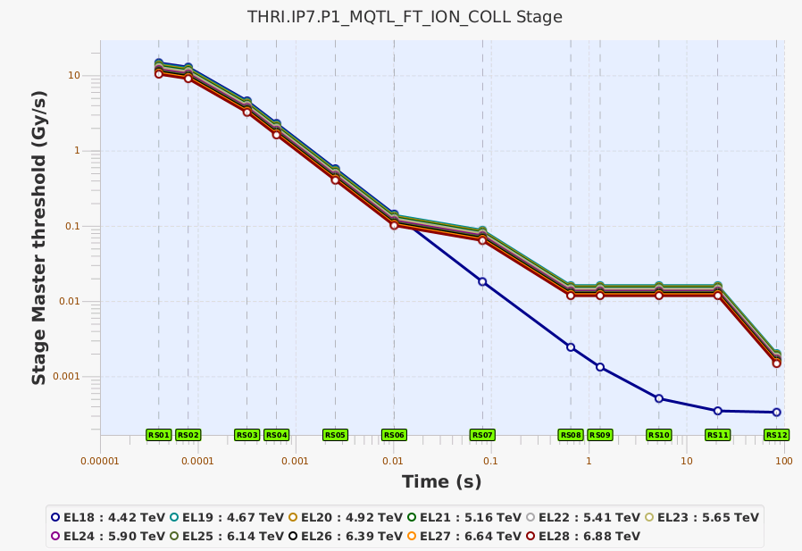
Why did we dump first on the Q6 in RS06?
For RS08-11, the Q6 thresholds were aligned to the “50-60kW” level like the collimators.
But:
For collimators, RS06 is 24x higher than RS08-11
For the Q6, RS06 is “only” 8x higher than RS08-11
→ Q6 was the bottleneck for 10ms losses
8x

Slide 8
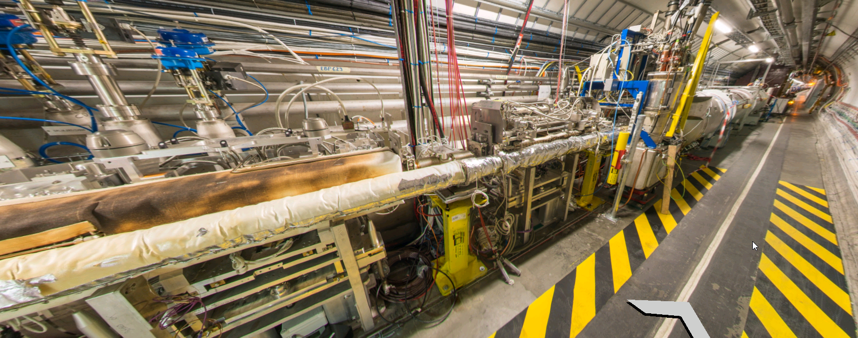
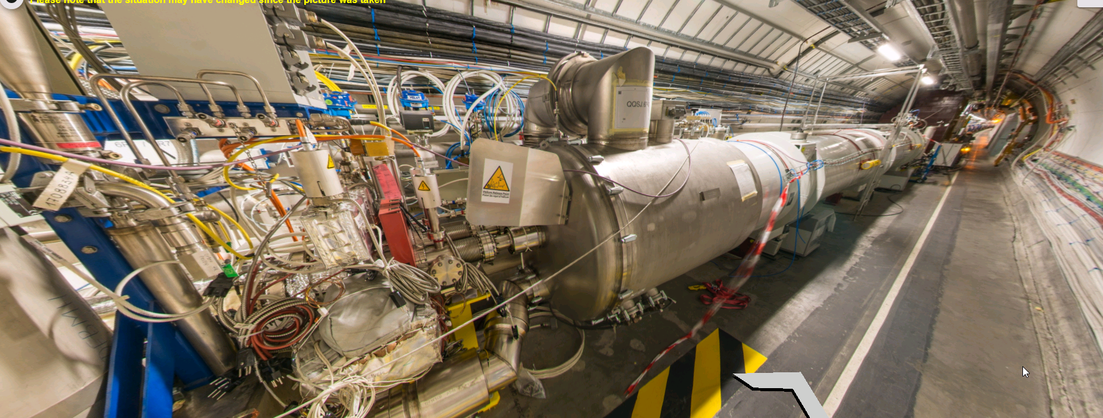
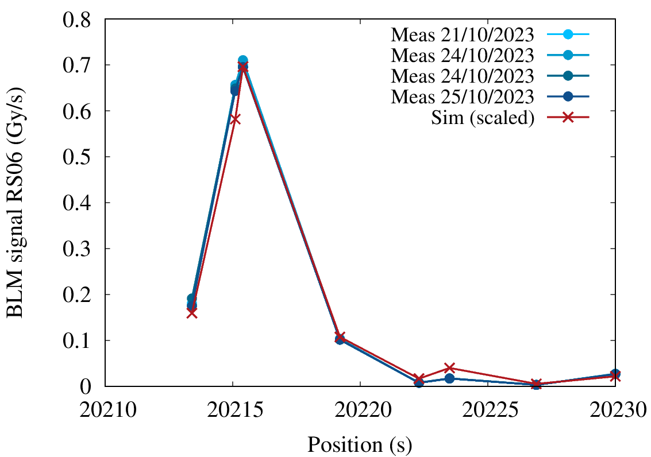
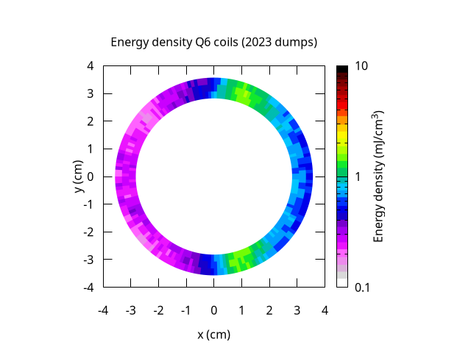
Energy deposition in Q6 coils during 2023 dumps
TCLA
2023 dumps:
Estimated peak energy density in Q6 coils was 1-2 mJ/cm³ (in 10 ms)
Quench level for 10 ms is around 20 mJ/cm3 (or likely even higher)
Factor of 10+ margin…
Q6 B1 P1
TCLA
Simulation reproduces BLM signal pattern quite well!

Slide 9
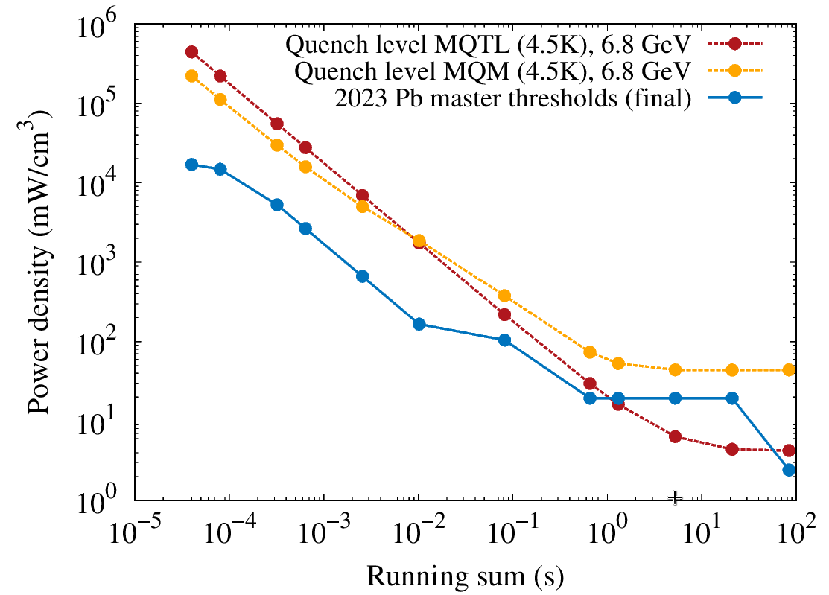
Energy deposition in Q6 coils during 2023 dumps
6.8 TeV
6.8 TeV
The figure compares:
Blue curve: the power density in Q6 coils we allow for with the present Q6 master thresholds (family THRI.IP7.P1_MQTL_FT_ION_COLL)
Red curve: the assumed quench level of the MQTL (4.5K) – likely too conservative for long RS
Yellow curve: the assumed quench level of the MQM (4.5K)
Note: for convenience the quench level is expressed in terms of power density for all loss durations

Slide 10
Possible increase of Q6 thresholds
Note: we were already at MF=1 at the end of 2023 → any increase must come from master threshold
6.8 TeV
6.8 TeV
Approach:
Let’s rather consider MQM quench levels as the reference (MQTL likely too low)
Could envisage a possible increase of master thresholds in the IR7 P1 and P2 Q6 ion coll families
(THRI.IP7.P1_MQTL_FT_ION_COLL and THRI.IP7.P1_MQTL_FT_ION_COLL):
Increase RS01-06 master thresholds by up to a factor of 5
Increase RS07-11 by a factor of 2
Align RS12 to RS07-11
At least, for all energy levels 18-28
Or increase even by higher factors and compensate with smaller MF?

Slide 11
Conclusion
  Q6 BLM thresholds:
    Have margin to increase Q6 for Pb collimation leakage → risk of quenching remains small
    Should converge this week about the exact factors
  What else?
    Depending on the loss maps, should also evaluate a possible increase of R06 at DS magnets

Slide 13
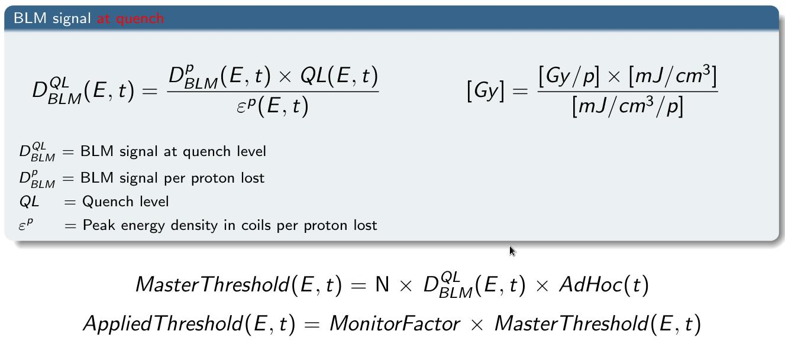
Recap of present Q6 BLM master threshold model
  Like for most superconducting magnets, the BLM master threshold model for the Q6 in IR3/7 was updated in LS1
  Remember: for each magnet type, a certain loss scenario was assumed - the thresholds where then based on following ingredients:
      QP3 predictions of quench levels (including corrections from Run 1 quench tests)
      FLUKA calculations of BLM response factors and the energy deposition in the coils
  For the Q6, the assumed scenario is a dynamic orbit bump with direct proton losses on the Q6 aperture
The practice was to set the master thresholds to three times the quench level for the given loss scenario.
This means, with MF=0.333 the applied thresholds are aligned with the quench level.

Slide 14
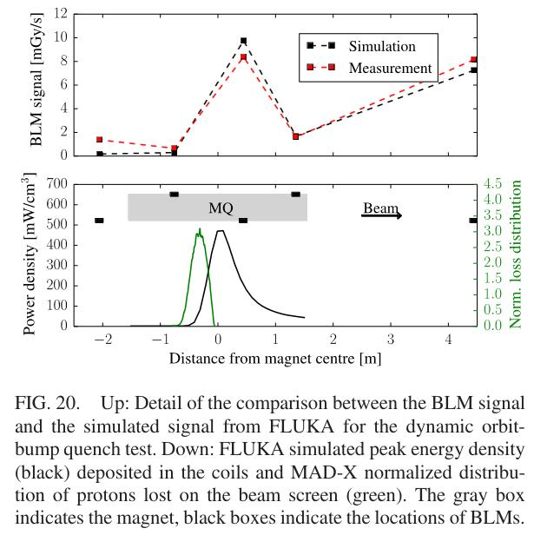
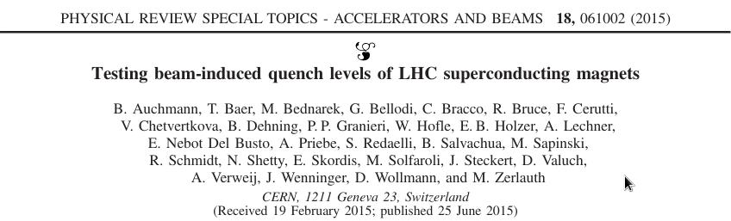
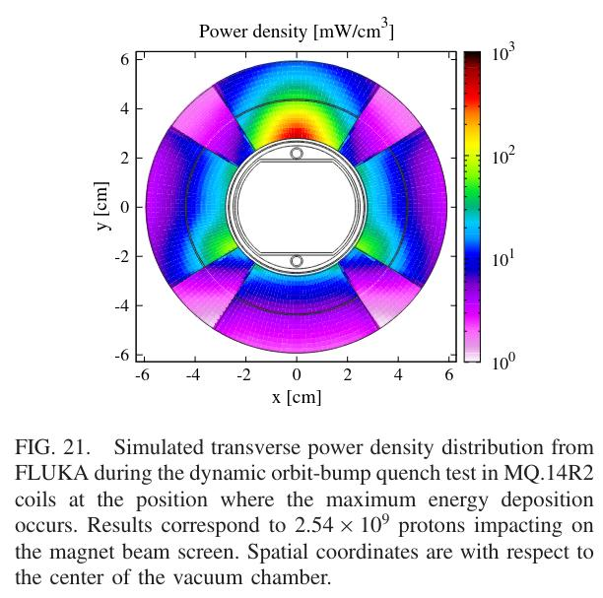
,Dynamic orbit bump’-scenario
  The DOB-scenario was one of the scenarios probed in the Run 1 quench tests (for an MQ)
  The scenario was then adopted for the BLM thresholds for multiple magnet types (considering of course magnet-dependent quench levels)
  Assumes a concentrated loss distribution (<1m) in one plane → gives rise to localized heating in the coils

Slide 15
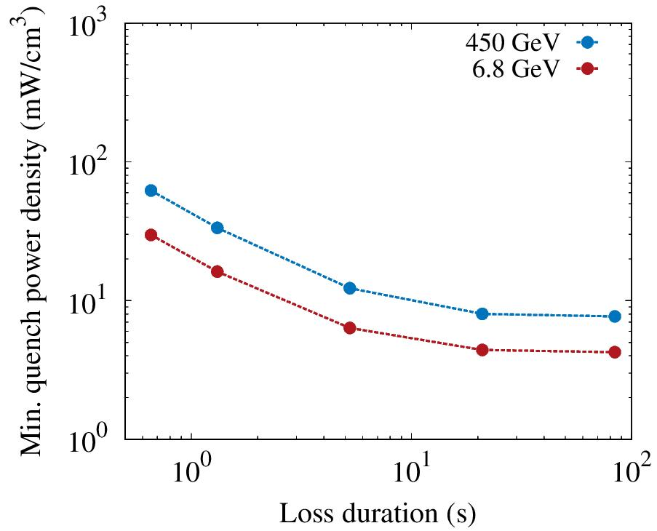
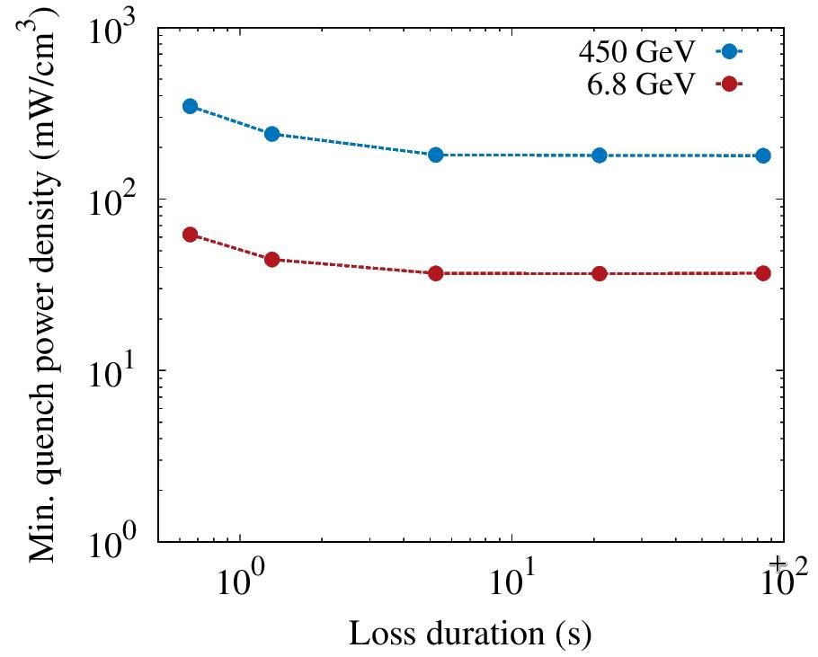
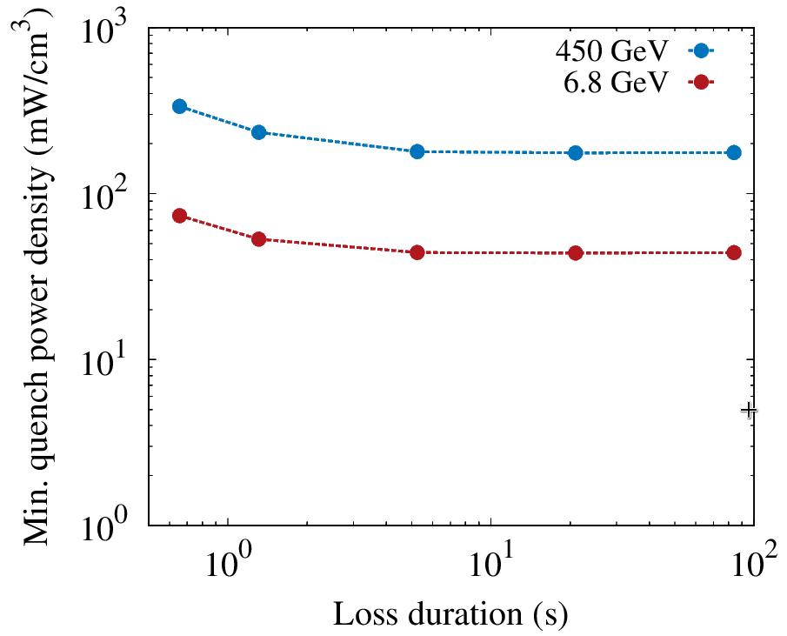
MQTL (Q6) vs MQY, MQM quench levels
Quench levels for MQTL (Q6), MQY and MQM magnets as implemented in the BLM thresholds (all for 4.5 K):
MQTL (Q6), 4.5K
MQY, 4.5K
MQM, 4.5K
  According to the QP3 calculations, the MQTL seems to have rather low quench levels compared to other magnets for long loss durations (>1s), e.g. for 1.3s@450GeV: MQTL=34mW/cm³, MQY/MQM=240mW/cm³
  This is one of the main reasons why the Q6 thresholds are quite low for RS08-12

