Slide 1
HEARTS
2nd Annual Meeting
WP6
January 20th-21st 2025
https://indico.cern.ch/event/1471638/
Christoph Schuy
GSI

Slide 2
Outline
WP6 Tasks
Status
Deliverables and Milestones
Conclusions

Slide 3
Tasks & Objectives
Quantitative estimates of shielding effectiveness with GCR/SPE simulator
Task 6.1: Standardized setup for the GCR/SPE simulation experiments (GSI, TAS, M1 – M24)
  Simulation of different space mission scenarios
  Studies on secondary radiation produced after shielding, including neutrons
Task 6.2: Quantitative measurement of shielding effectiveness (GSI, TAS, M12 – M36)
  Behind shielding of different materials and thickness
  Inside a phantom
Task 6.3: Radiobiological characterization (GSI, M24 – M48)
  Biological effectiveness of GCR/SPE simulator irradiations

Slide 4
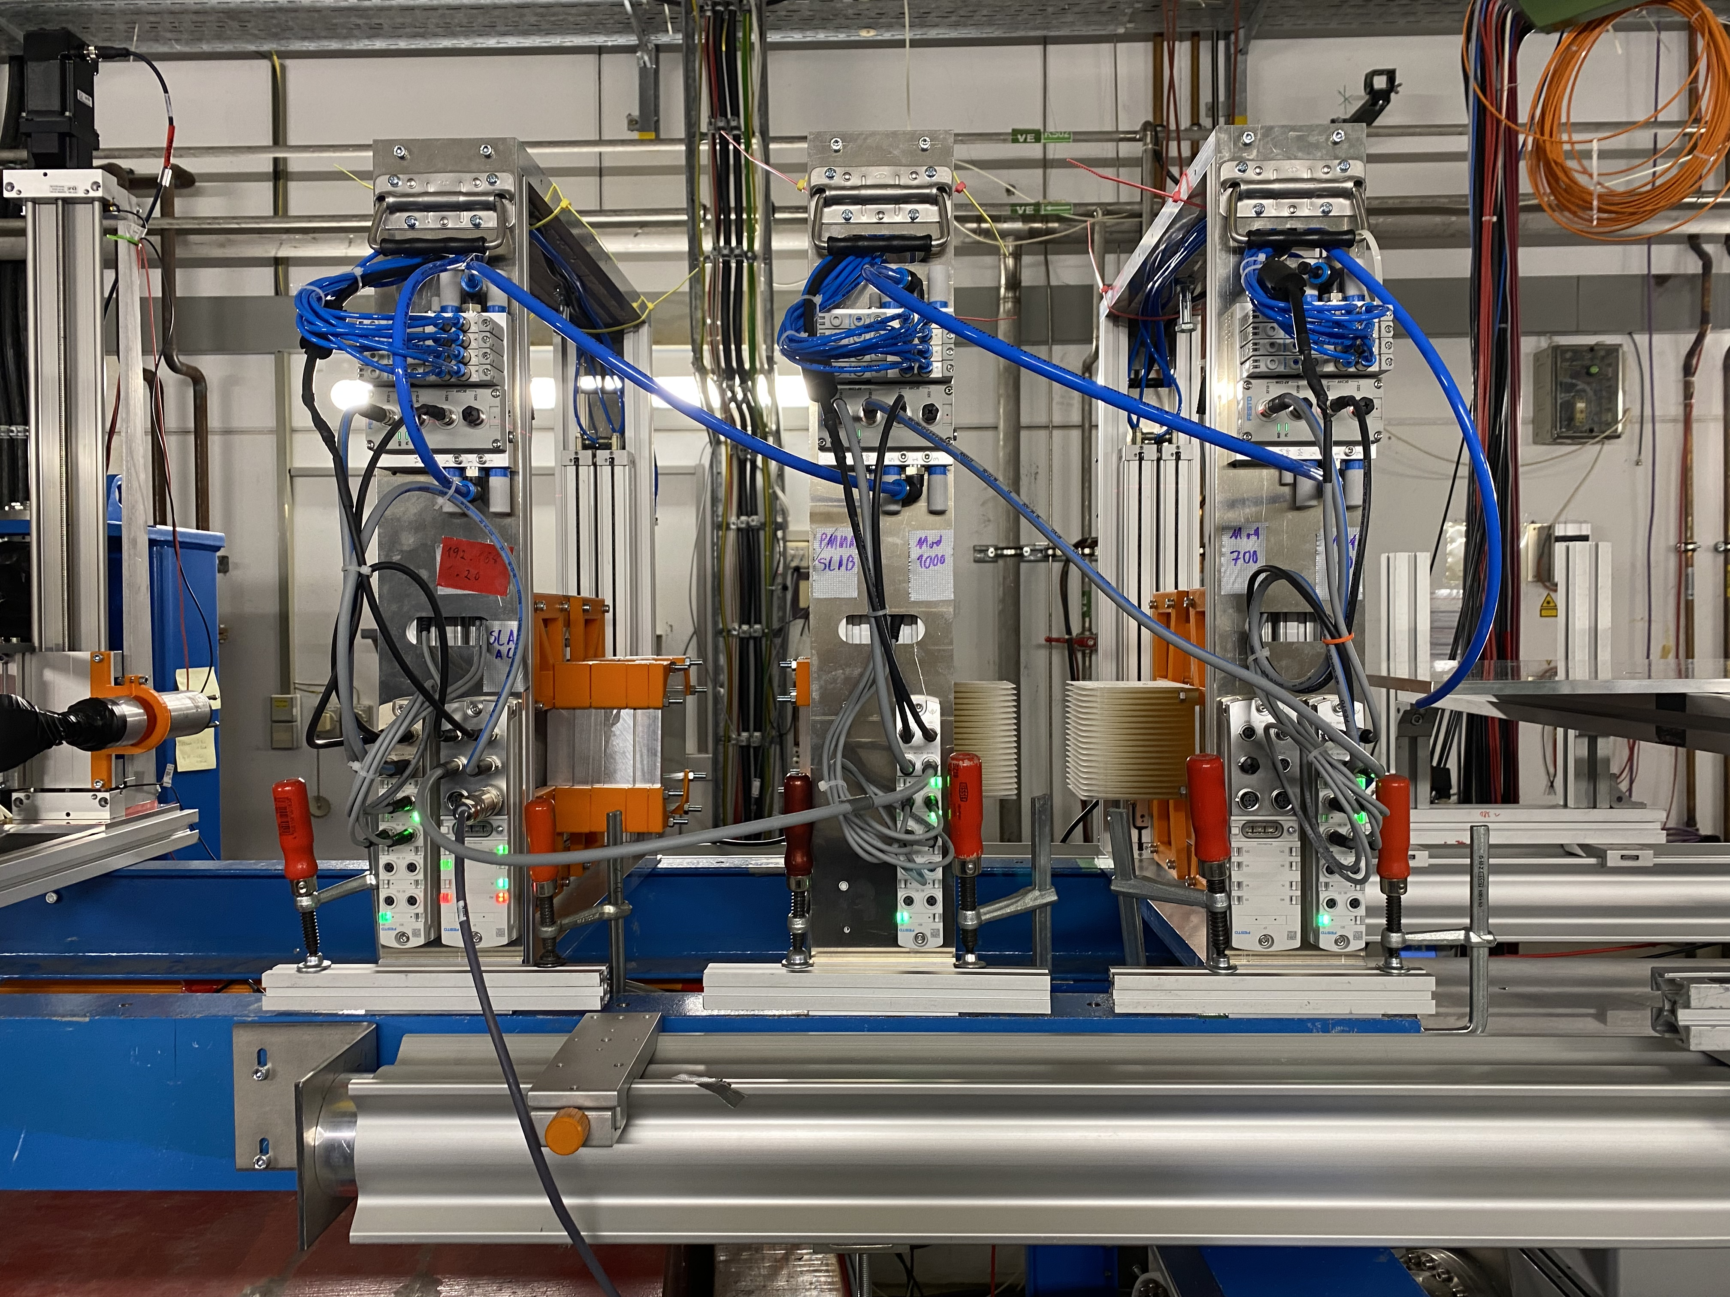
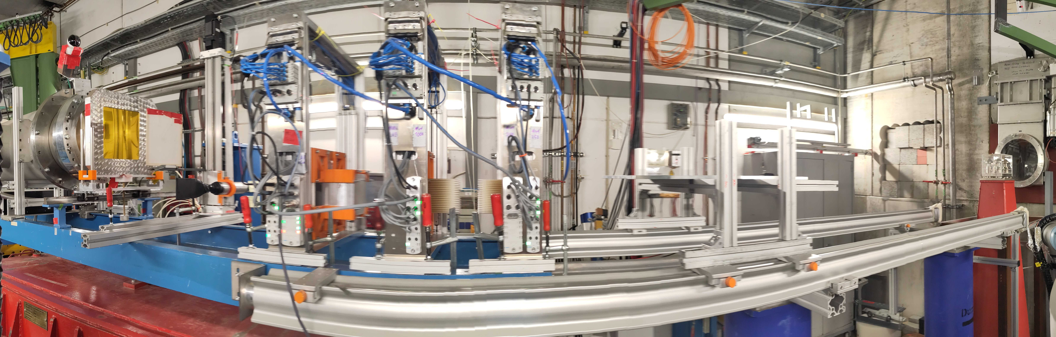
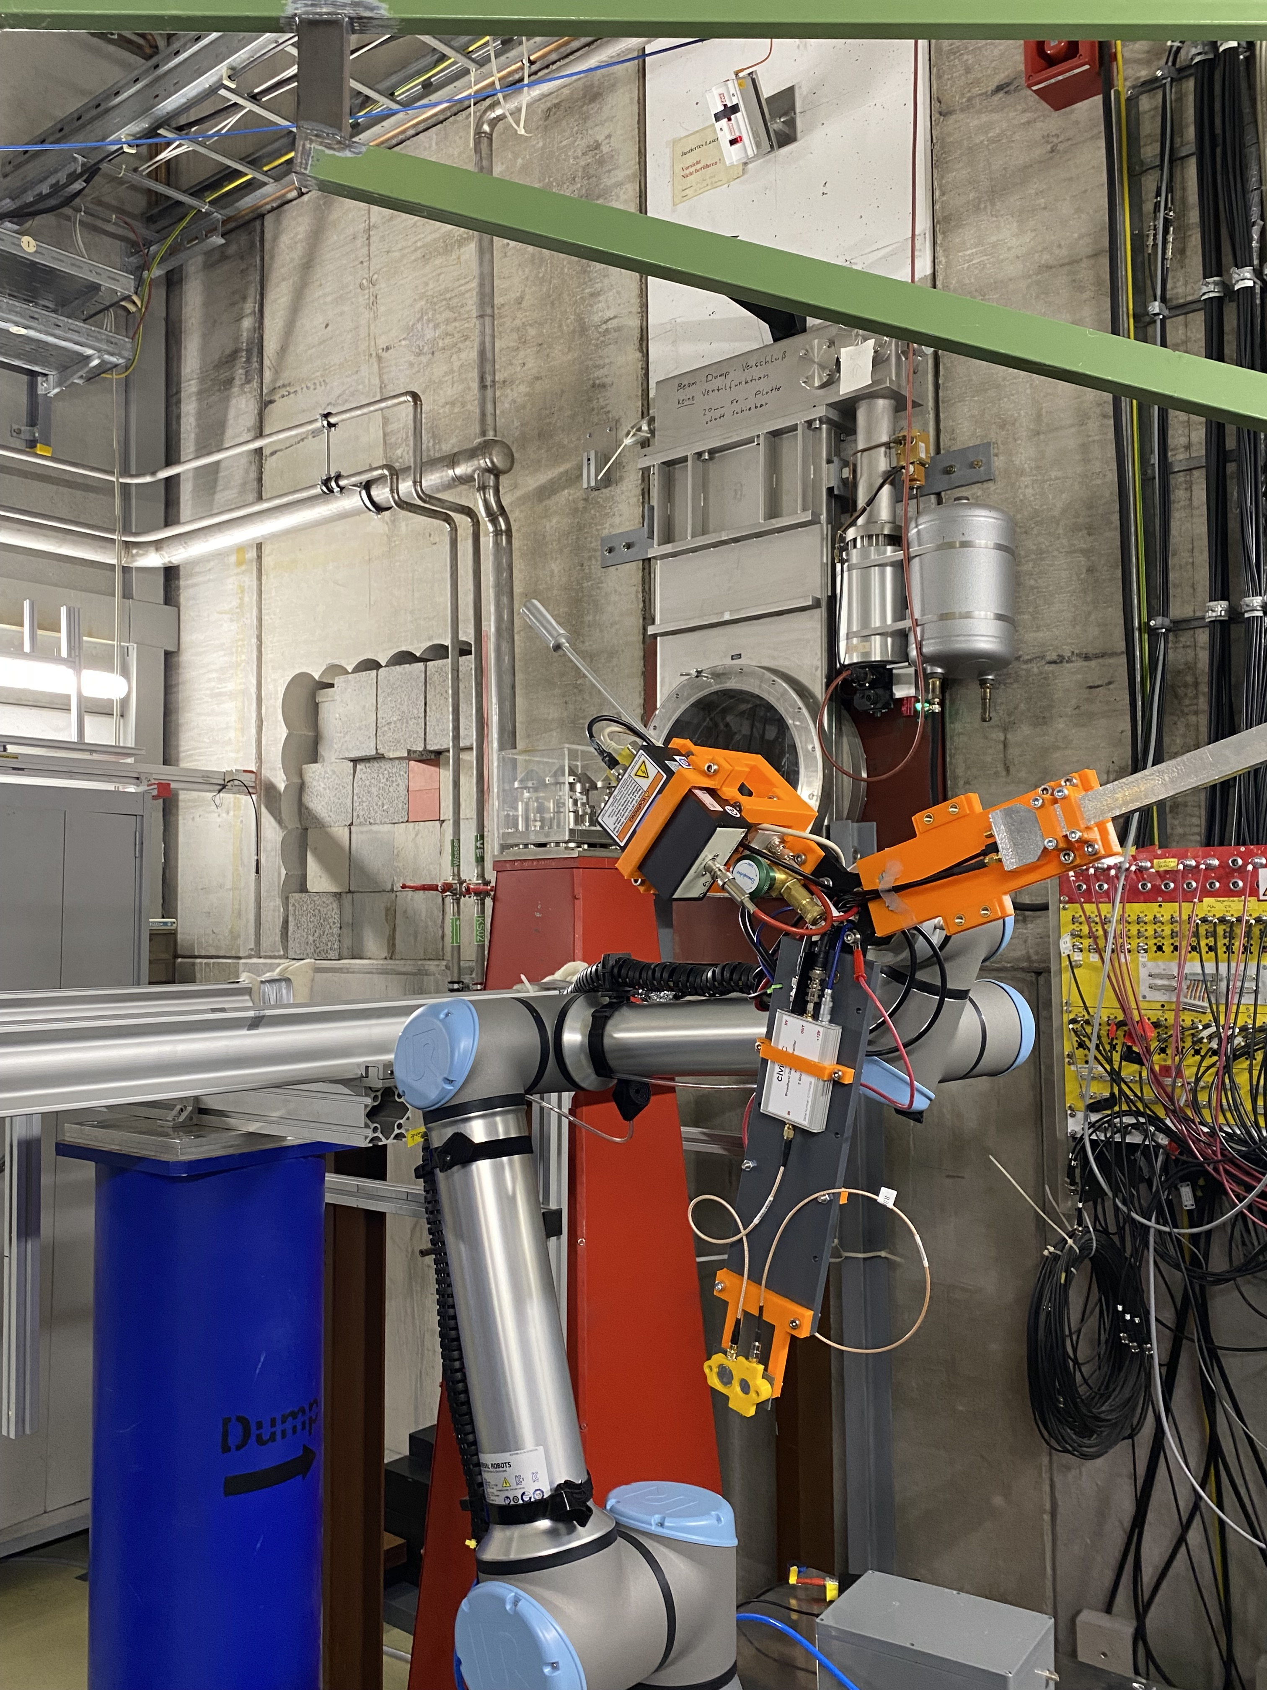
Task 6.1: Standardized setup for the GCR/SPE
TEPC detector
PMMA slab
350 MeV/n Modulator
Aluminum Slab
700 MeV/n Modulator
1 GeV/n Modulator
Irradiation Setups:
1
2
700 MeV/n ⁵⁶Fe
+
Modulator
3
350 MeV/n ⁵⁶Fe
+
Modulator
4
1 GeV/n ⁵⁶Fe
+
Al + PMMA slabs
5
700 MeV/n ⁵⁶Fe
+
Al slab
6
350 MeV/n ⁵⁶Fe
+
PMMA slab
1 GeV/n ⁵⁶Fe
+
Modulator

Slide 5
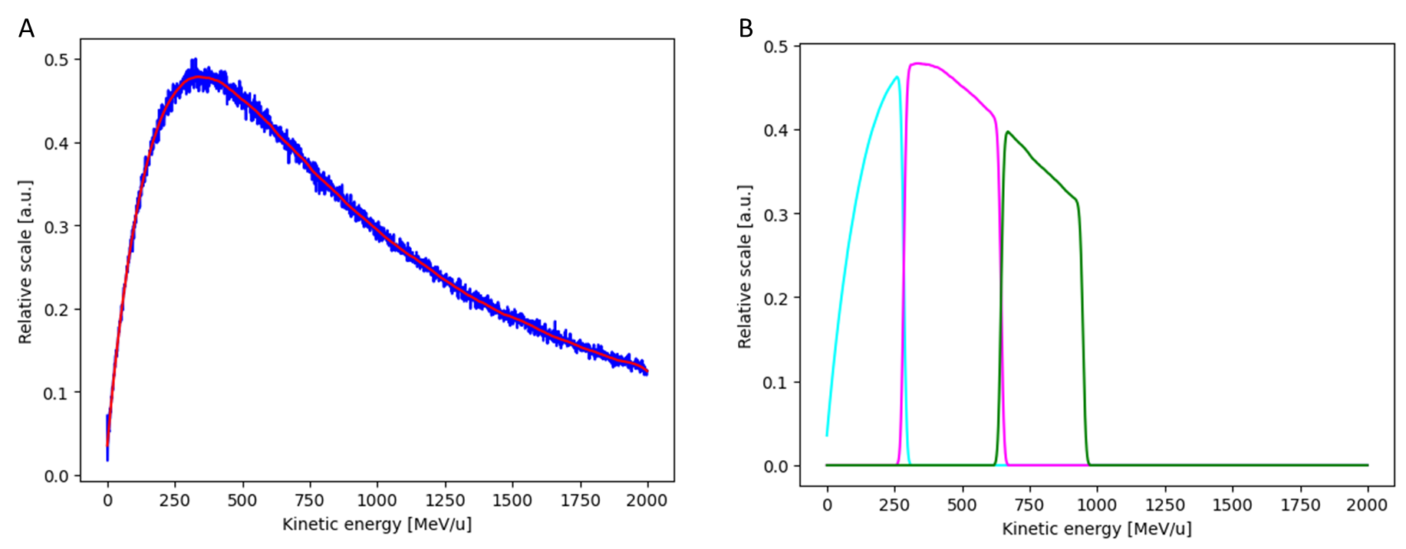
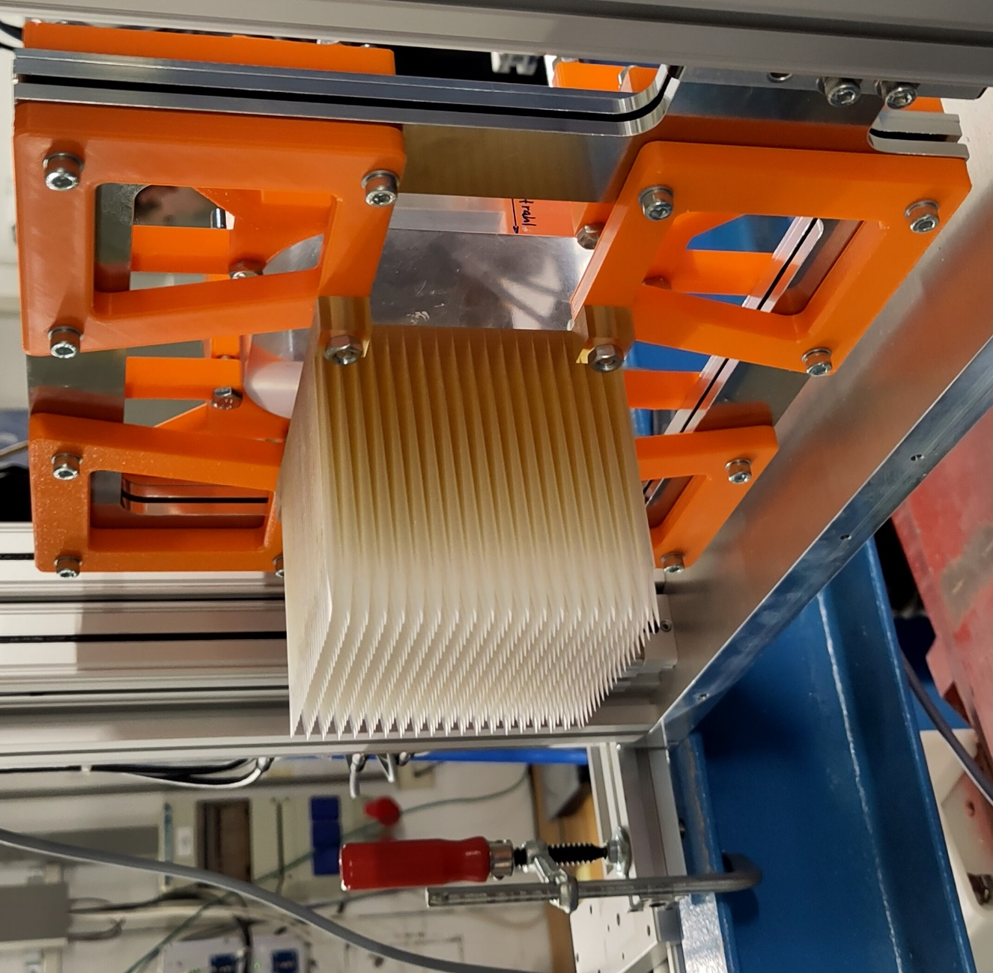
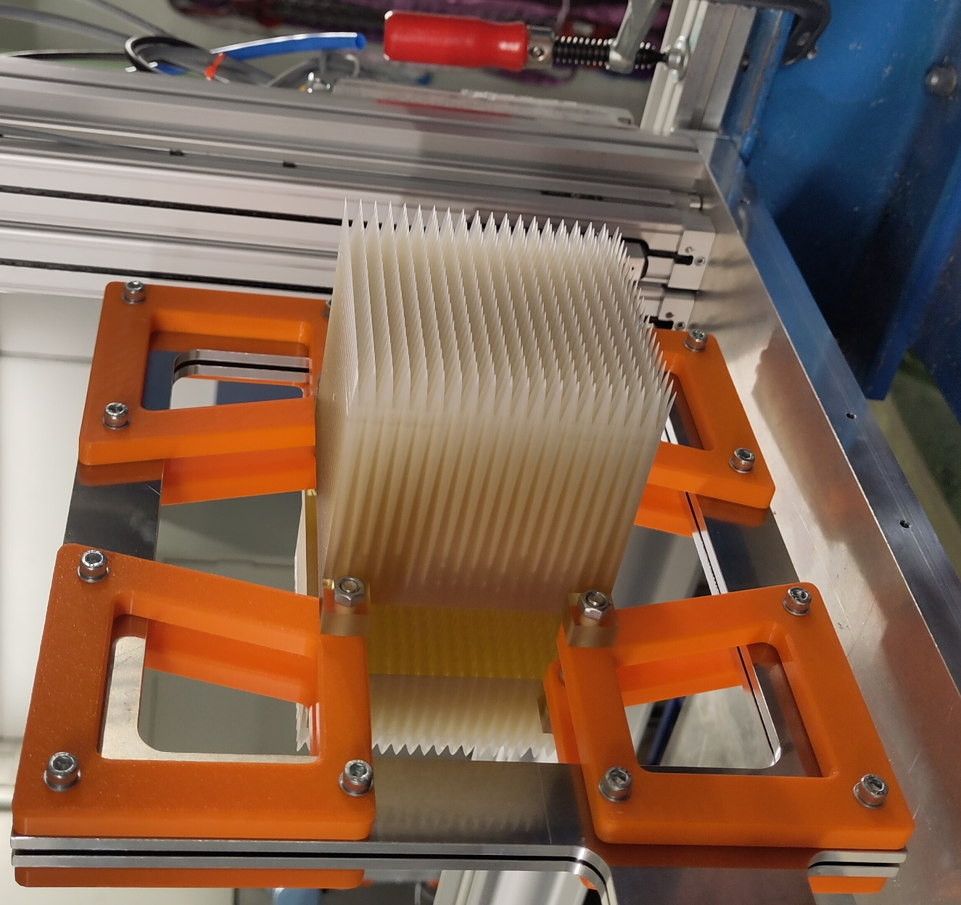
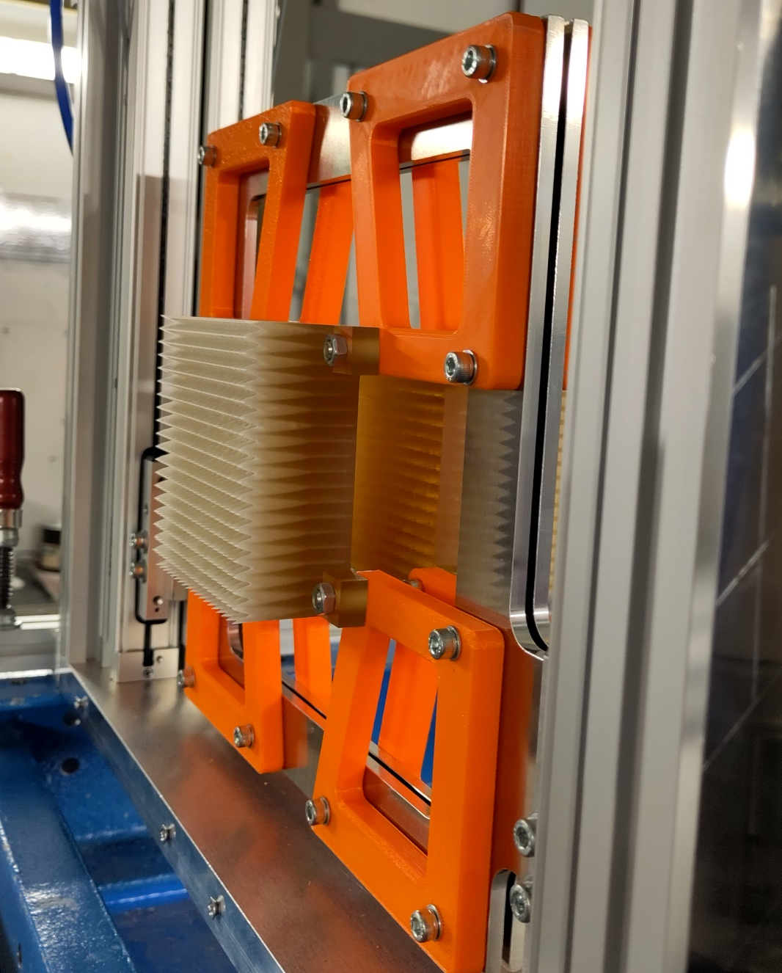
Task 6.1: Standardized setup for the GCR/SPE
1
2
700 MeV/n ⁵⁶Fe
+
Modulator
3
350 MeV/n ⁵⁶Fe
+
Modulator
1 GeV/n ⁵⁶Fe
+
Modulator

Slide 6

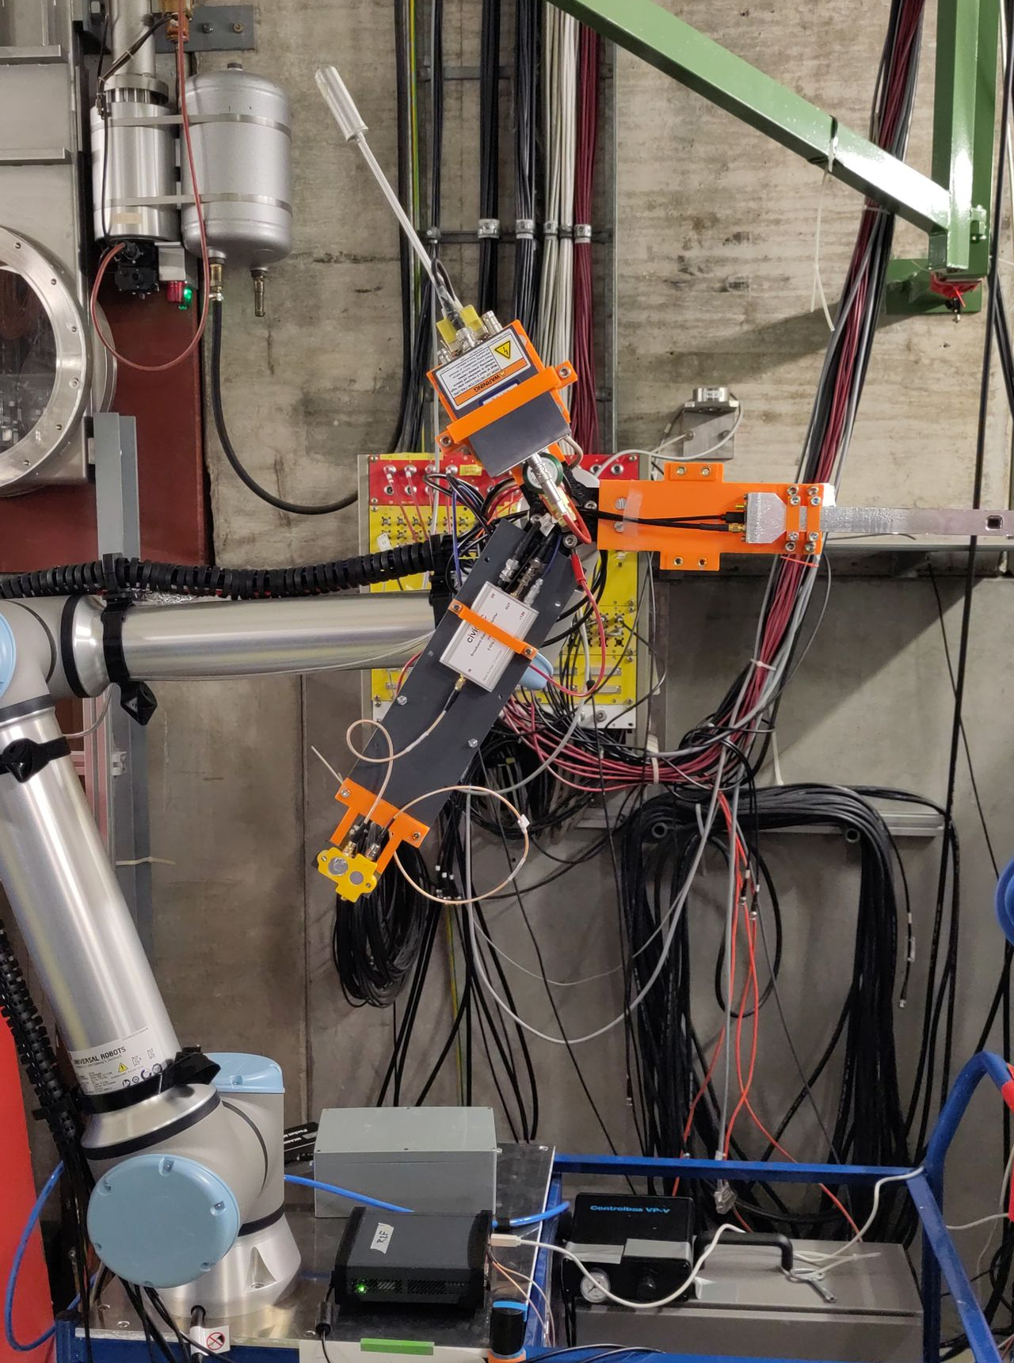


Task 6.1: Standardized setup for the GCR/SPE
TEPC
Silicon
microdosimeter
Diodes

Slide 7
Task 6.1: Standardized setup for the GCR/SPE

Slide 8
Task 6.1: Standardized setup for the GCR/SPE

Slide 9
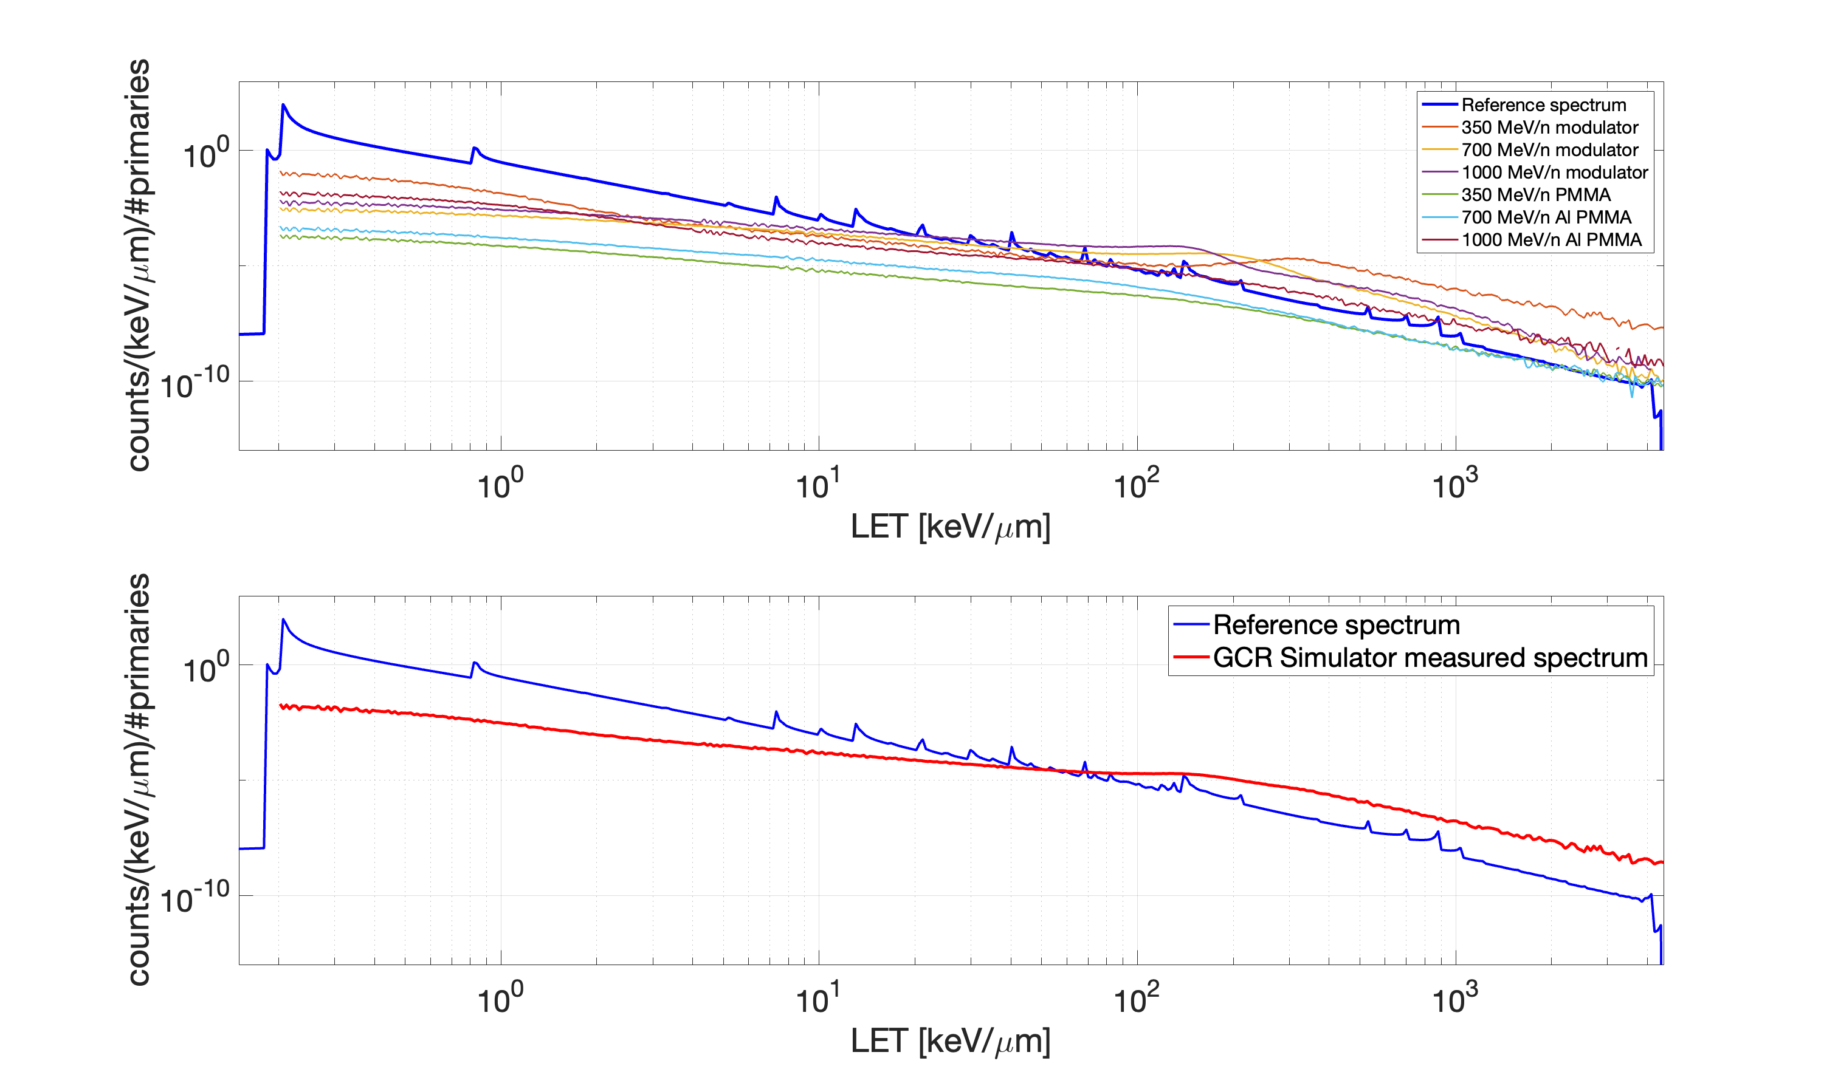
Task 6.1: Standardized setup for the GCR/SPE
Before the Optimization
Reference spectrum
6 components $$(Φ_{M})$$ of the GCR Simulator spectrum $${(Φ}_{tot})$$ as measured by the TEPC detector
GCR + 10 g/cm2 Al
Fragmentation (Slab) targets
did not produce enough light ions!
H
After the Optimization
6 weights ($$w_{i}, i=1, …,6)$$
GCR Simulator overall spectrum as measured by the TEPC detector
Iron peak is clearly visible
He
$$Φ_{tot}=\sum_{i=1}^{6}{w_{i}}⋅Φ_{M}$$
Fe
LET [keV/$$μm$$]

Slide 10
Task 6.1: Standardized setup for the GCR/SPE
GCR simulator 2025

Slide 11
Task 6.1: Standardized setup for the GCR/SPE
Outlook
TEPC detector
PE slab
350 MeV/n Modulator
Steel Slabs
700 MeV/n Modulator
1 GeV/n Modulator
Irradiation Setups:
1
2
3
4
5
6
1 GeV/n ⁵⁶Fe
+
Modulator
700 MeV/n ⁵⁶Fe
+
Modulator
350 MeV/n ⁵⁶Fe
+
Modulator
4
1 GeV/n ⁵⁶Fe
+
Al + PMMA slabs
1000 MeV/n ⁵⁶Fe
+
Steel 52 mm + PE 50 mm
350 MeV/n ⁵⁶Fe
+
Steel 52 mm + PE 100 mm
1 GeV/n ⁵⁶Fe
+
Steel 84 mm + PE 50 mm

Slide 12
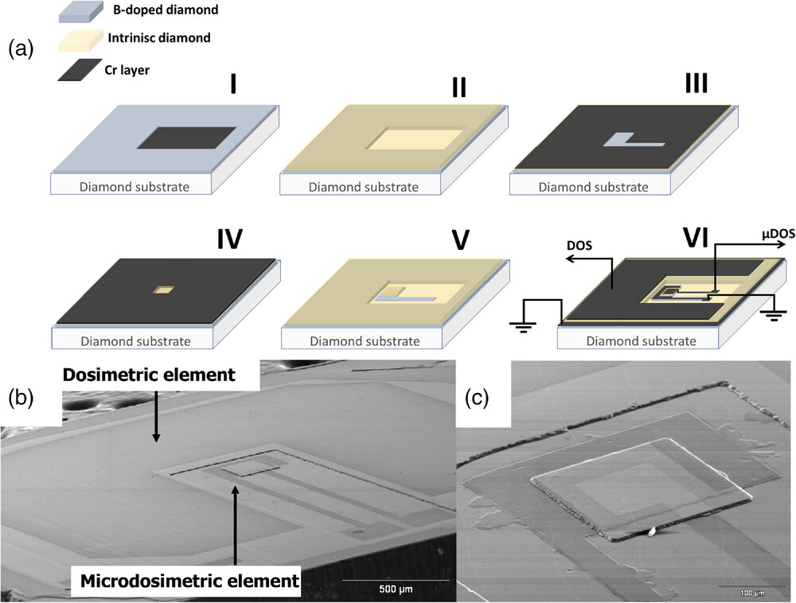
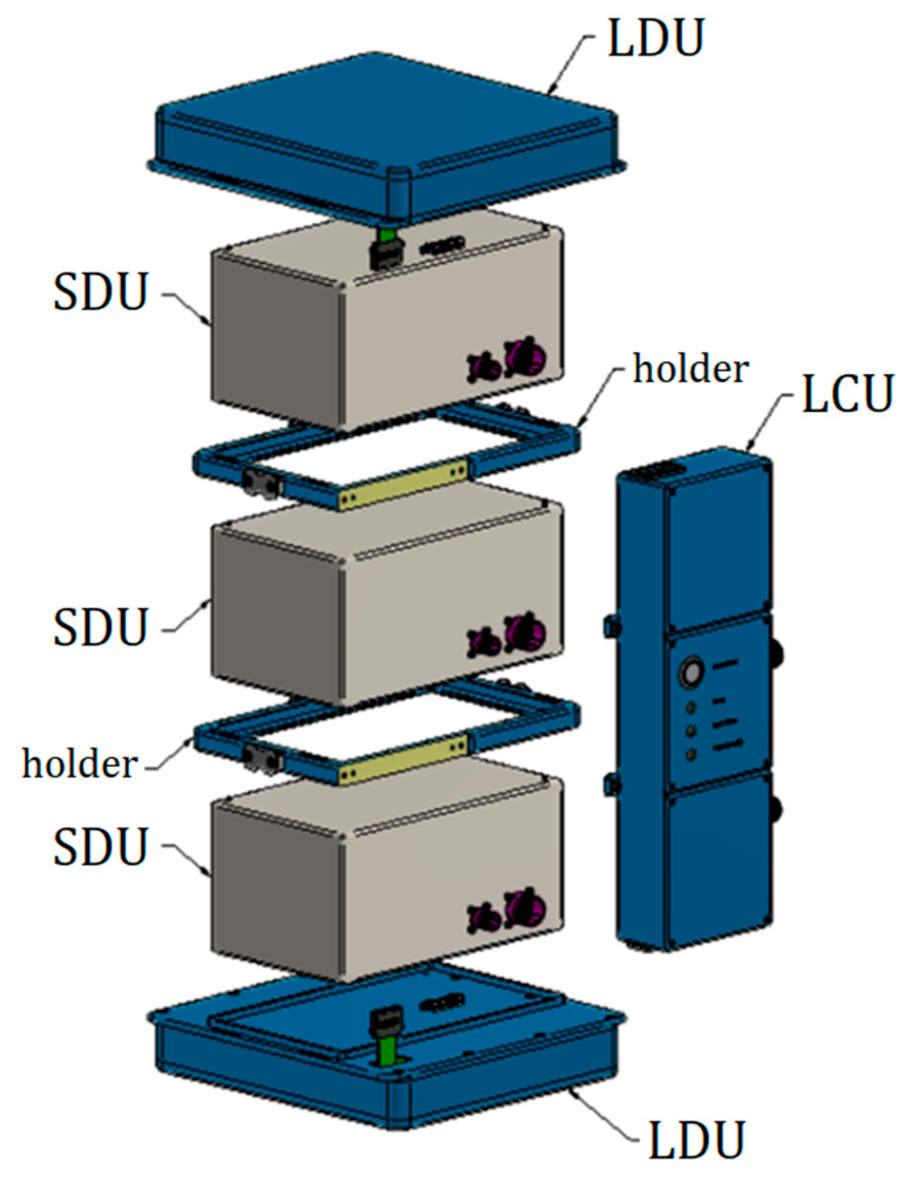
Task 6.1: Standardized setup for the GCR/SPE
Additional detectors will be tested
TEPC
Diamond microdosimeter
LIDAL
Silicon
microdosimeter
Diodes
Verona et. al. 2023, https://doi.org/10.1002/mp.16698
Romoli et. al. 2023,
https://doi.org/10.3390/s23073559

Slide 13
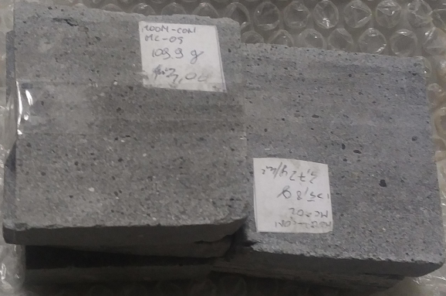
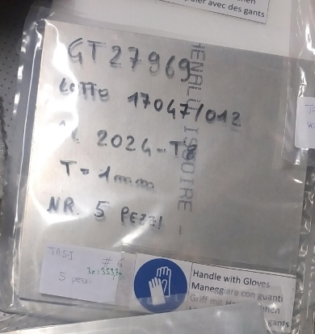
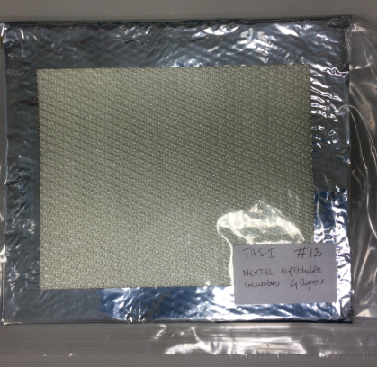
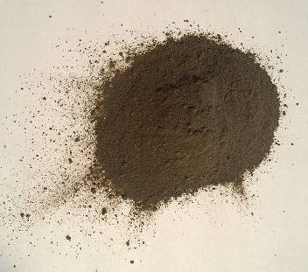
Task 6.1: Standardized setup for the GCR/SPE
TAS-I relevant materials survey
A survey of various potentially interesting materials to be tested has been carried out by TAS-I:
Structure materials
  Al6064
  Al7075
  Composite innovative materials
  Multilayer innovative materials
  Honeycomb panels (still under evaluation)
Materials with different functions
  MLI materials
  Polyethylene
  Inflatable materials
On-site available materials
  Lunar regolith (in PMMA container) and concrete
  Mars regolith (in PMMA container) and concrete
‘Standardized materials’ have to be characterized/tested
before they can be offered to users!
Example of ROSSINI space materials

Slide 14
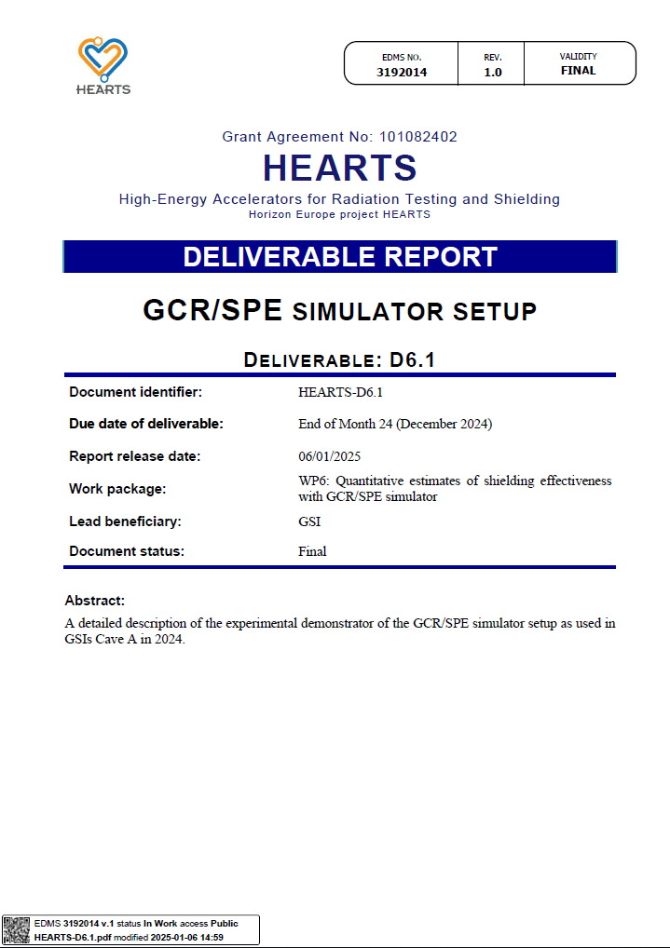
Task 6.1: Standardized setup for the GCR/SPE
Deliverable D6.1: „GCR/SPE simulator setup“
Reporting on the GCR/SPE simulator setup used in GSIs Cave A in 2024
  Description of the full setup
  Detailed description of each of the elements
  Preliminary results of the 2024 beamtime
  Experimental workflow and lessons learned during the 2024 beamtime

Slide 15
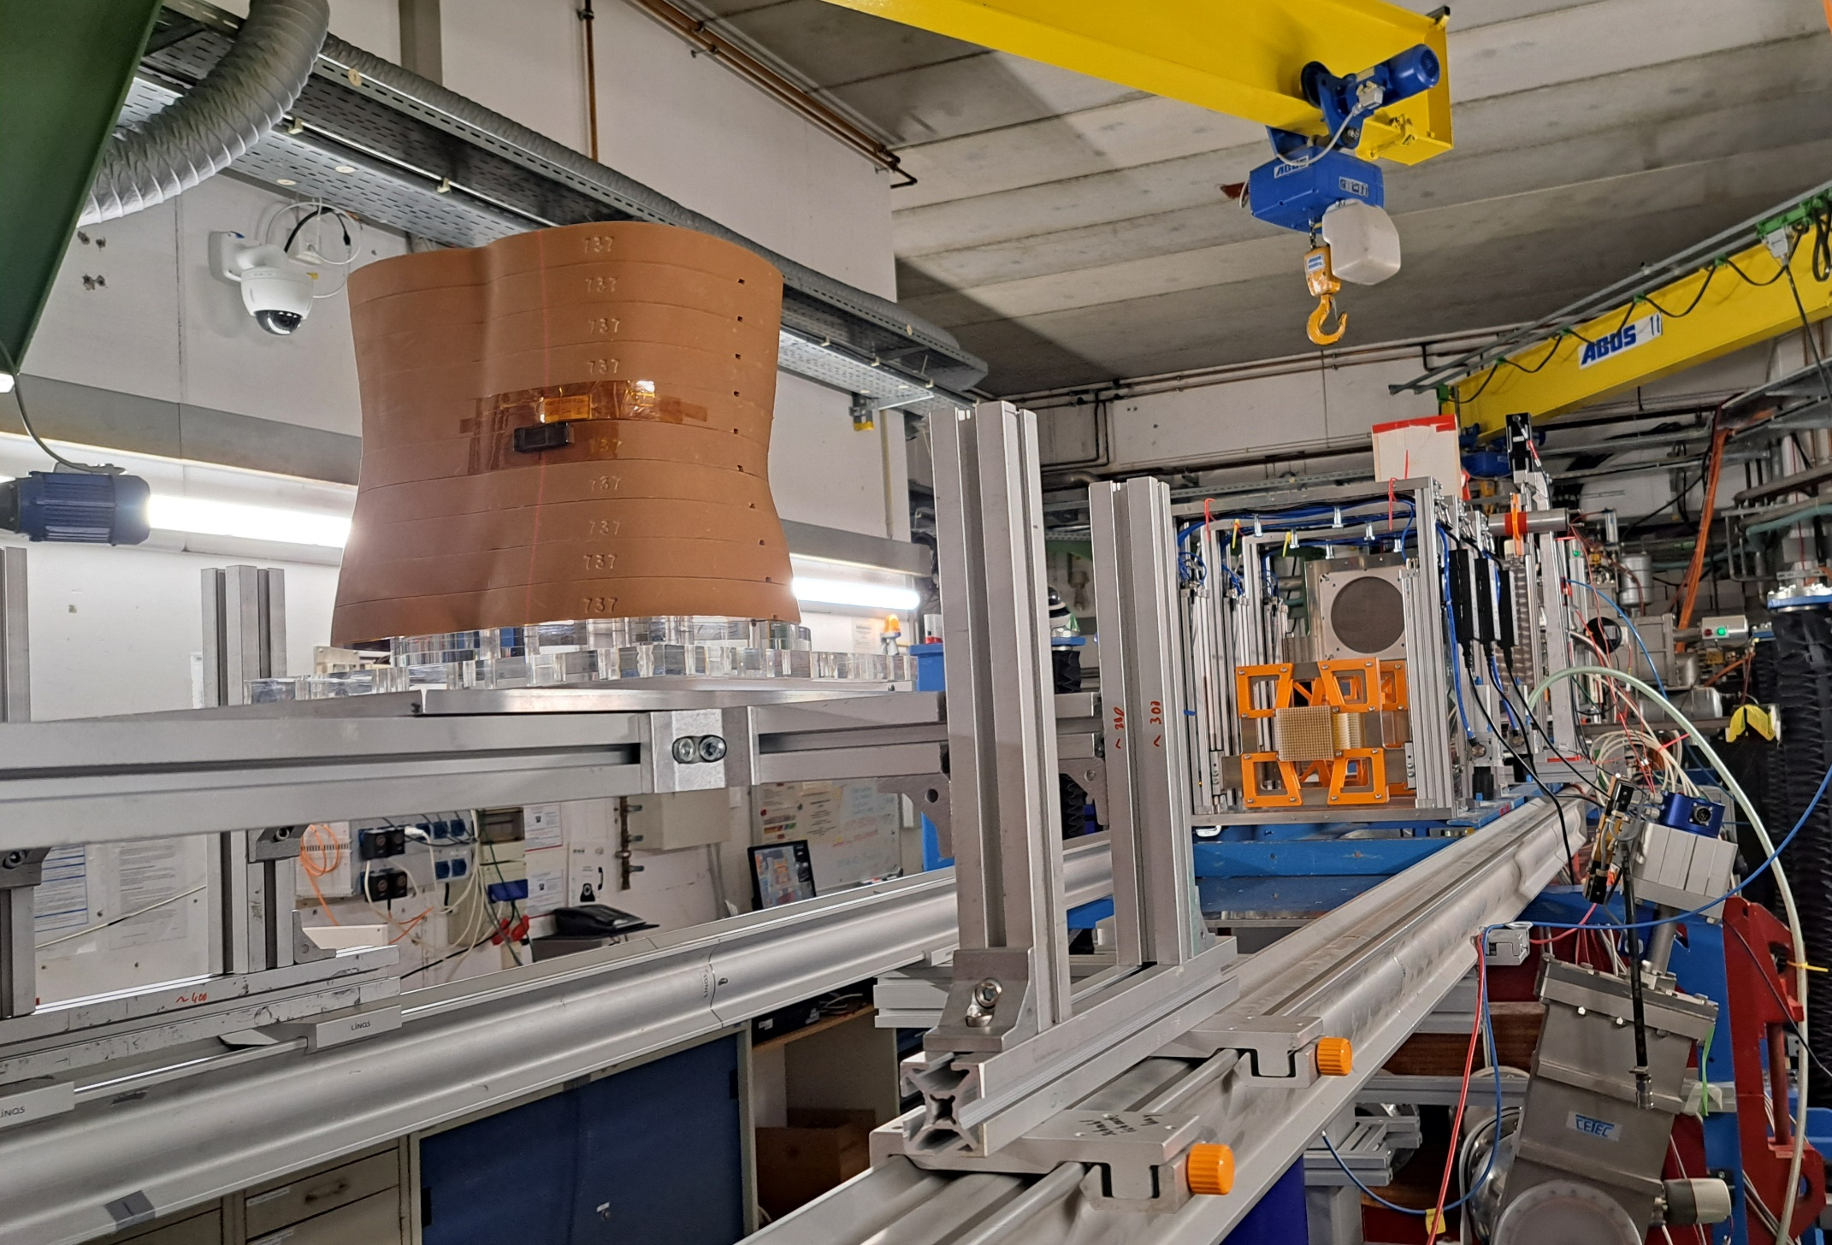
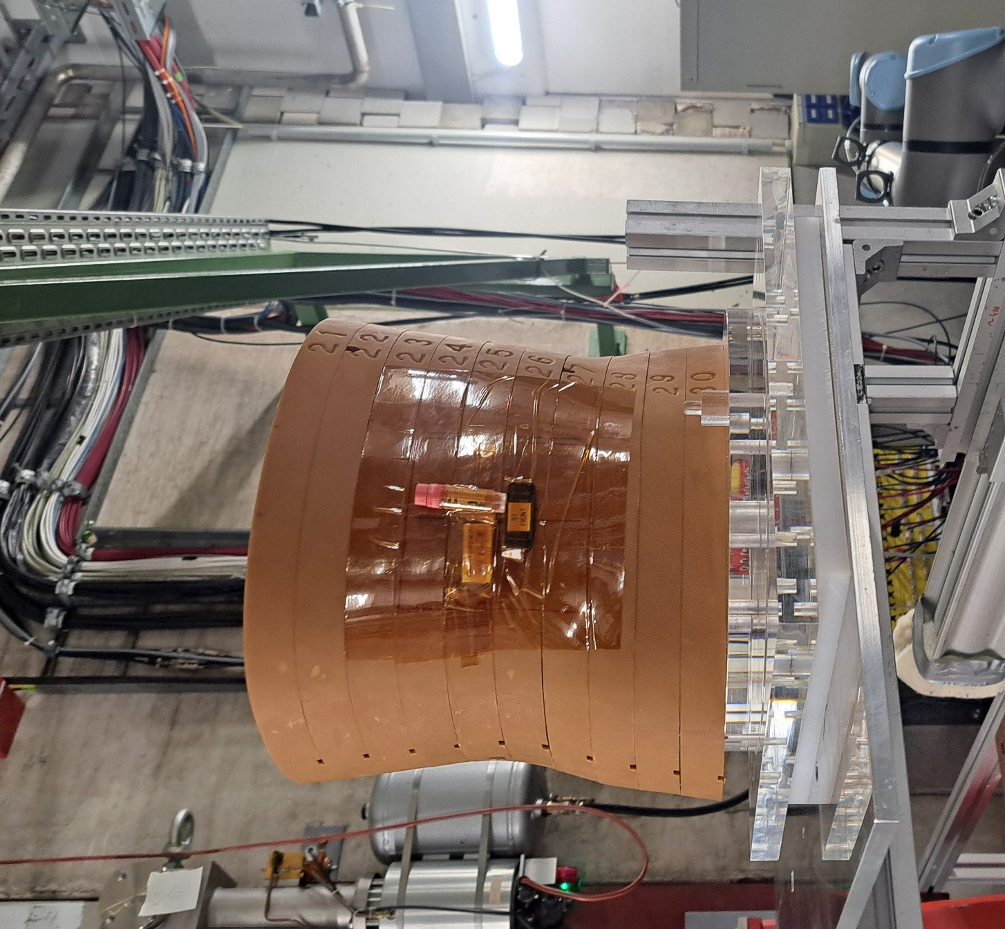
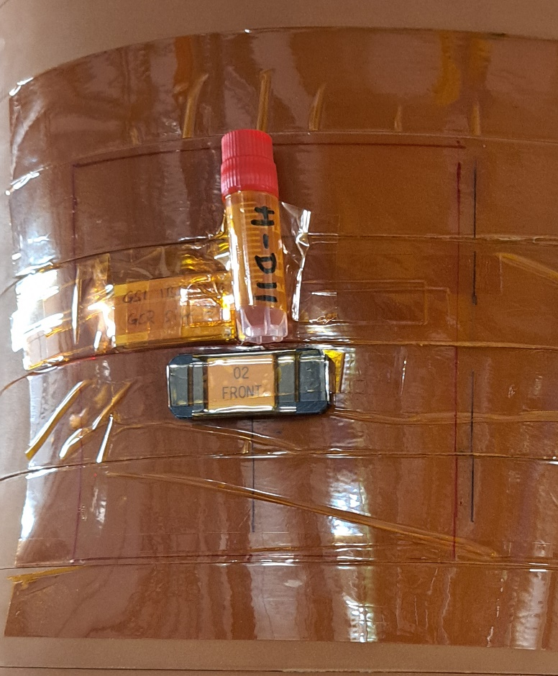
Task 6.2: Quantitative measurement of shielding effectiveness
Irradiation of biological samples with the GCR simulator on the skin and inside the Matroschka Phantom. (Doses: ~1 Gy and ~0.5 Gy)

Slide 16
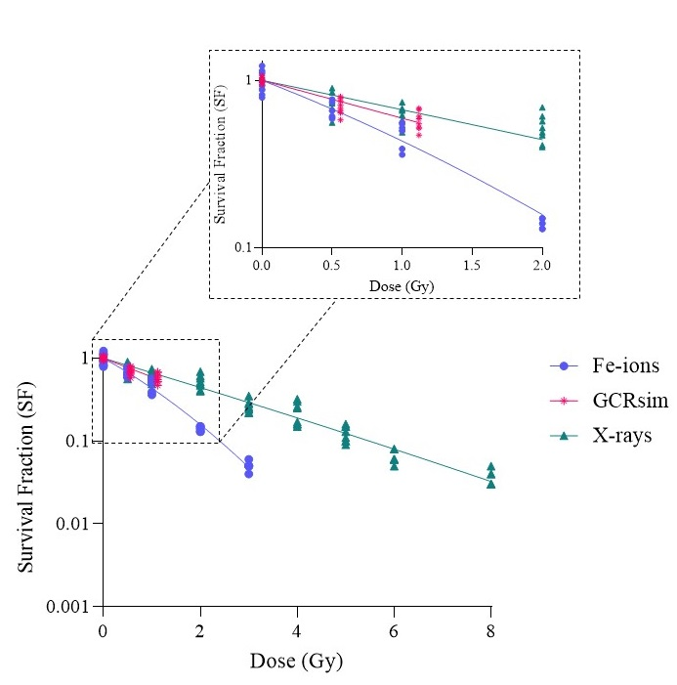
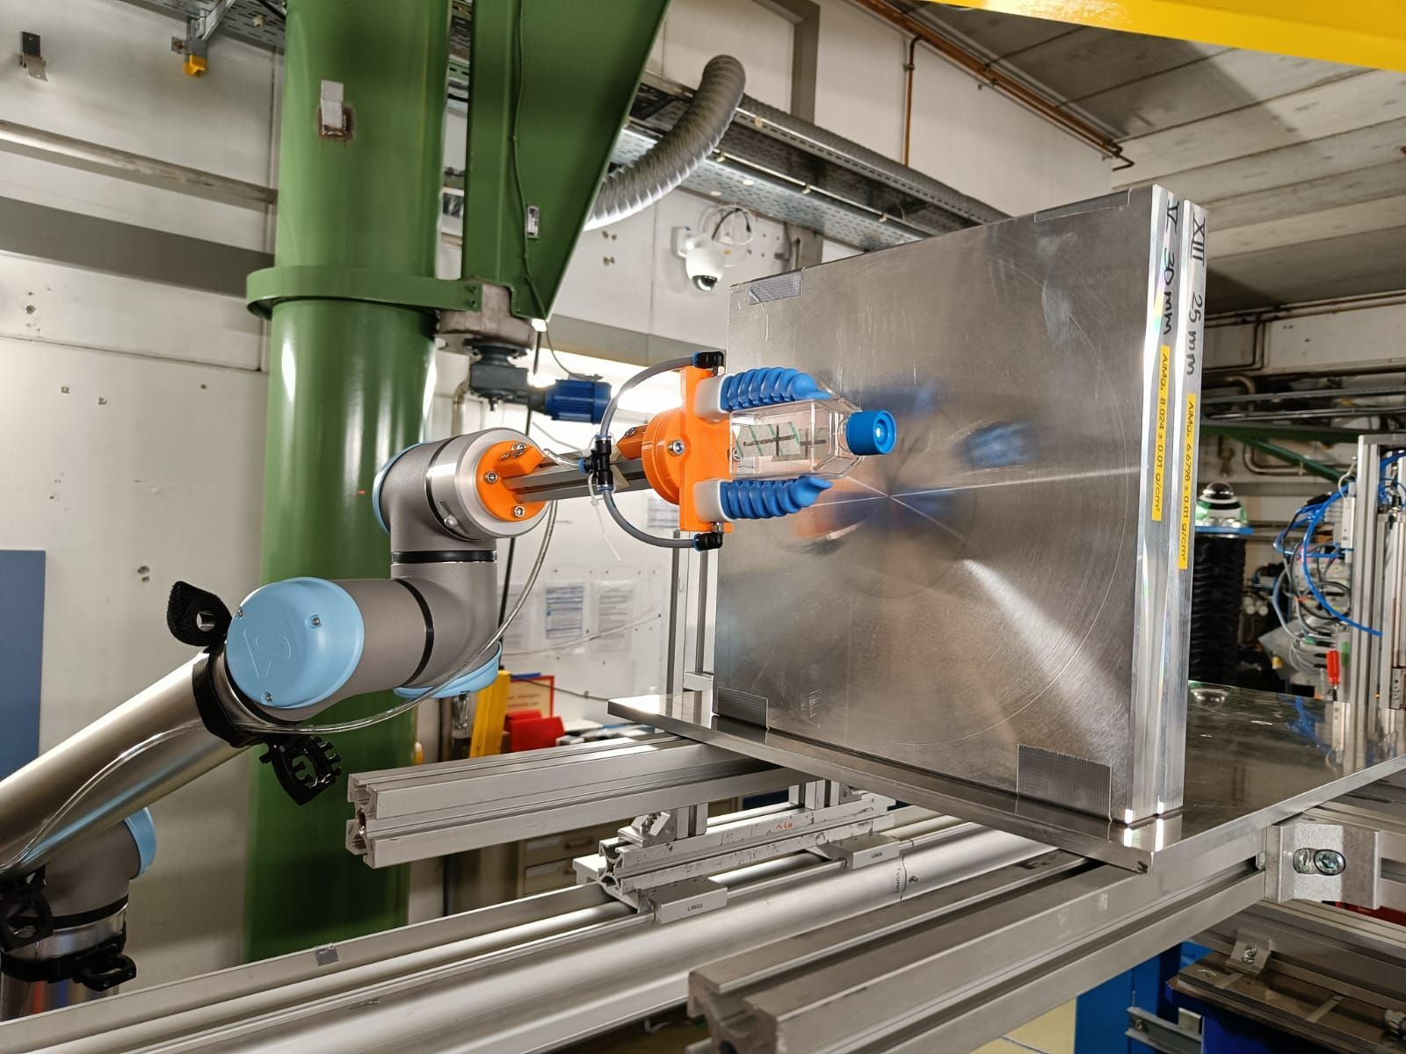
Task 6.3: Radiobiological characterization
Biological exposure
Primary iron beam
GCR simulator exposures (2 doses)
Exposure behind shielding (1 dose)
CHO clonogenic survival results following the irradiation with three modalities: 1 GeV ⁵⁶Fe-ions, GCRsim, and 250 kVp X-rays
approx. 15 g/cm2 alu

Slide 17
Deliverables due in Y2
Deliv. No. | Deliverable name | Due date | Status | Summary
D6.1 | GCR/SPE simulator setup | 2024-12-31 | Achieved | A detailed description of the experimental demonstrator of the GCR/SPE simulator setup used in GSIs Cave A in 2024.
Milest. No. | Milestone name | Due date | Status | Summary
- | - | - | - | -
The achieved deliverables are available on HEARTS website page: https://hearts-project.eu/project/deliverables/
The achieved milestones are available on HEARTS website page: https://hearts-project.eu/project/milestones/

Slide 18
Upcoming Deliverables & Milestones
Deliv. No. | Deliverable name | Due date | Status
D6.2 | Dosimetry of the GCR/SPE simulator with shielding | 2025-12-31 | Pending
D6.3 | Radiobiology of the GCR/SPE simulator with shielding | 2026-12-31 | Pending
Milest. No. | Milestone name | Due date | Status
MS18 | First experimental demonstration of dose increase behind thick shields in Europe | 2025-12-31 | Pending
MS19 | Achievement of TRL6-7 for the SIS18 GCR/SPE simulator | 2025-12-31 | Pending

Slide 19
Impact
Requests via BioPAC and ESA IBPER for the GCR simulator extremely high
  so far:
    all experiments were considered ‘tests’ and were supposed to help understand the system better
  next:
    characterization experiments
      Physics
      Biology
      Electronics?
    selected user experiments
  future:
    Ramp up experimental complexity and amount of external users

Slide 20
Open Science
Upcoming conferences
Challenges and performance of different detector systems in characterising the GCR-simulator at GSI, MMND 2025, Enrico Pierobon, GSI Helmholtzzentrum für Schwerionenforschung, Germany
Bringing space to earth: an insight into the (stage 2) GCR simulator at GSI/FAIR, MMND 2025, Luca Lunati, GSI Helmholtzzentrum für Schwerionenforschung, Germany
Conferences 2024
L. Lunati: “Bringing Space to Earth: an insight into the GCR Simulator at GSI-FAIR” (presentation), ESA RADSHIELD 2024 workshop in Noordwijk, Netherlands, 12-13 June 2024, https://indico.esa.int/event/501/contributions/9644/.
E. Pierobon: “Microdosimetric characterization of mixed radiation field from the novel GCR Simulator at GSI” (presentation), ESA RADSHIELD 2024 workshop in Noordwijk, Netherlands, 12-13 June 2024, https://indico.esa.int/event/501/contributions/9647/.

Slide 21
Follow-up of recommendations and comments from review
This will be covered in separate slides.

Slide 22
Plans for the future
Amount of request from the science community is immense
Characterize/benchmark new Cave A GCR simulator
  Freeze geometry/composition
Competitive analysis of QA strategies/detectors
  reproducible
  reliable
  fast
RBE measurements
Characterization of standardized shielding materials

Slide 23
Questions?

