Slide 1
Facility visit schedule
Time | Activity | Meeting Point
09:20 – 09:50 | FAIR viewpoint | GSI Canteen
10:00 – 10:25 | ESR tour | EX-Hall at the ESR entry
10:30 – 11:00 | Green IT Cube visit | In front of the Green IT Cube
11:00 – 12:00 | Cave A & M | In front of the Green IT Cube

Slide 2
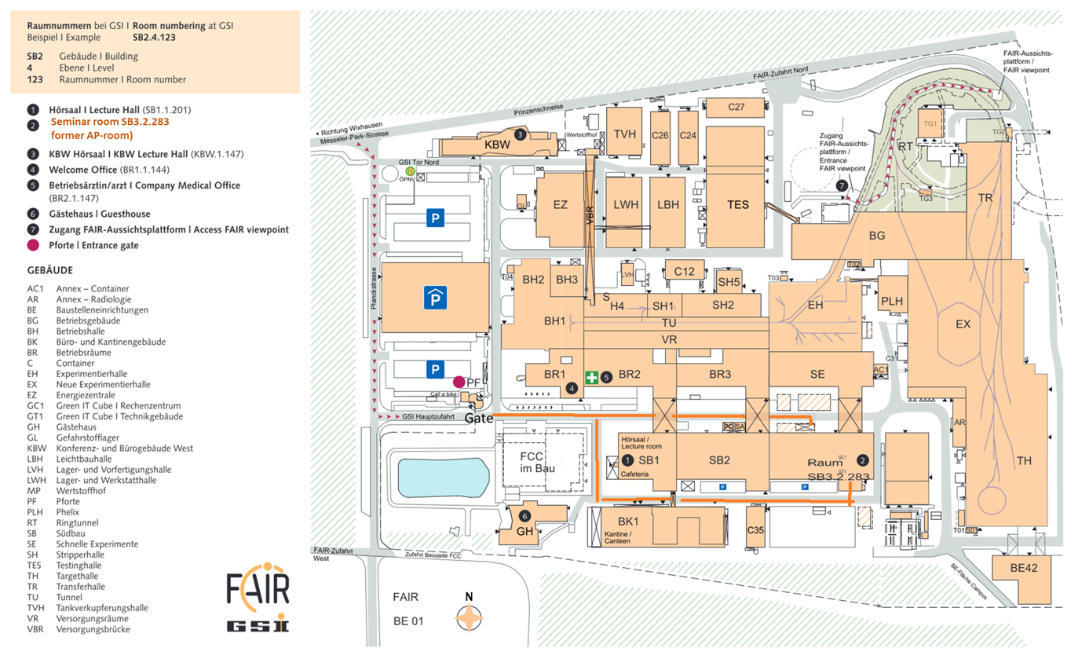
GSI Canteen
Meeting room

