Slide 1
Europe: Regional Strategy Meeting (Switzerland)
Séan Harris, Deputy Director General & Director Membership

Slide 2
Our plan - 2025
Notes:
Next iteration of the ICE Plan
Set out how it was created – direction set by trustee board
Provides direction for the whole organisation – if we do something it should be in the plan

Slide 3



Our 2025 activities focus on making us:
Stronger
Increasing our membership, and our reach and influence, especially in sustainable infrastructure.
Greener
Focusing on solutions that improve environmental performance alongside economic development.
More connected
Fostering connections to government, education, employers, thought leaders, and the public.
Notes:
For 2025’s plan we’ve thought about how our activities and programmes will improve the institution’s ability to serve members and the wider society and you’ll see this clearly marked in each area on the Plan. We’ve focused on making the ICE:
Stronger by increasing our membership, and our reach and influence especially in sustainable infrastructure
Greener by focusing on solutions that improve environmental performance alongside economic development
More connected through fostering connections to government, education, employers, thought leaders and the public.

Slide 4





Cross organisational projects
Strategy review 2025-2030
Board and governance review
Member engagement review
Infrastructure engineer
Connect
Notes:
These are projects that everyone should be aware of and support directly or indirectly through your individual roles.
Strategy review- In 2025, the executive team will work with trustees, council and principal committees to set the next ICE strategy 2025-2030. Some of the projects and activities in this plan form part of this work, including:
Stakeholder mapping and engagement plan
Consideration of our global regional focus including looking at the opportunity to support capability and capacity building in the Global South and learn from local best practice
Reviewing our membership offer
Strengthening our knowledge offer by pivoting to more focus on standards and guidance
Board and governance review - In line with SVP 2022 review, we’ll undertake the triennial trustee board effectiveness review (last one was 2022). Complete quinquennial governance review (last one was 2020).
Member engagement review – Aims to ensure the ICE remains relevant to existing and prospective members; members are clear about the opportunities to engage with the ICE, they take these up and they are clear how their contribution is acknowledged and valued; and members see the offer as relevant and contemporary .
Connect implementation – plan to launch April 2025 and across the year we will ensure that we stabilise the platform, train all CRM users and begin to realise the opportunities that the new platform offers us.
Infrastructure engineer - Widen Infrastructure Engineer grades to include EngTech registration. Define and explain the role of infrastructure engineers to industry and potential members.

Slide 5
Membership Division Mission
“Grow a broad, diverse and professionally qualified membership”
No financial targets placed upon the Division

Slide 6
Membership grades
Student – currently studying
Graduate (GMICE) - Young professionals on the way to professional qualification
Professionally Qualified (MICE) - Competence via Engineering Council registration:
Chartered Engineer (CEng)
Incorporated Engineer (IEng)
Engineering Technician (EngTech)
Fellow (FICE) - Through contribution to engineering
Associate Member (AMICE) - Non-civil engineer colleagues from allied professions
25,000
5,000
20,000
1,000
40,000

Slide 7


Membership - our plan - 2025
Membership Divisional Plan 2025 - Final e-booklet v2.pdf
Notes:
Membership Divisional Plan 2025 - Final e-booklet v2.pdf

Slide 8
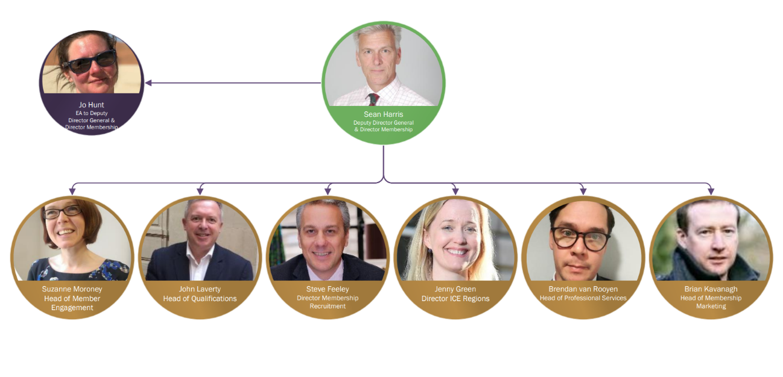
Membership leadership team

Slide 9
Focus: Membership growth
Growing Membership: Attracting, Recruiting, Developing, Qualifying, Supporting, Retaining & Recapturing
CPD: Events, Regional & International Activity and ‘The Offer’
Pre-19
Education Base + IPD -> PR
CPD / Fellowship
Attract
Recruit
Develop
Qualify
Support
Retain

Slide 10







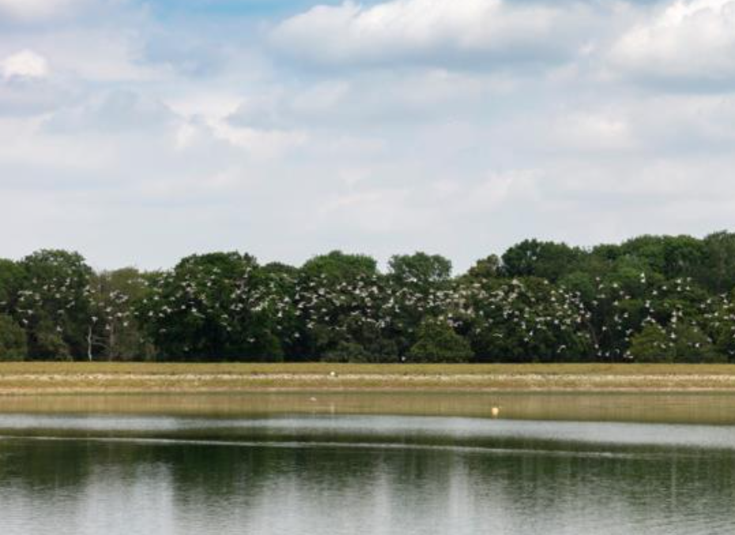

Membership 2025 programmes
Grow membership by 1%
Increase professional reviewers
Infrastructure Engineer Suite
Re-engaging members
AMICE campaign
Hong Kong Mutual Recognition Agreement
Apprenticeship – the “ICE Guide”
ICE Connects – women in fellowship
Notes:
Grow the membership by 1% - membership have a number of key organisational projects and will continue many activities as usual to drive membership growth, with a target of 1% growth.
Increase professional reviewers - To meet candidate demand for reviews and end point assessment without overstretching volunteer reviewers. This is particularly important in light of our ambition to increase our Infrastructure Engineer cohort.
Infrastructure Engineer Suite – support and recruit members
Re-engaging members – Institution-wide campaign to re-engage our membership
AMICE Campaign – recruit more AMICE members
HK MRA – renew our MRA with HKIE to protect a key market for us
Apprenticeships – “the ICE Guide” - Key opportunity for growth. Prepare for integrated degree apprenticeships.
ICE Connects: Women in Fellowship - initiative

Slide 11
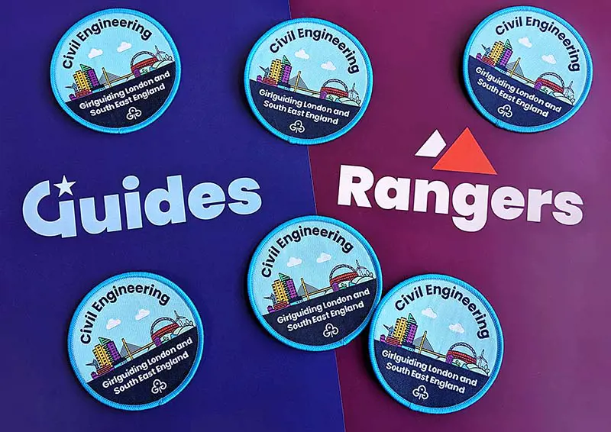







Membership 2025 programmes
Girlguiding partnership
Enhance digital engagement of 16–18-year-olds
Consolidate Academic and Corporate Partners
Devolved nations and regional insights
SocEnv campaign
Railway 200
Reservoir Safety Review
Australian Registers
Notes:
Girl Guiding partnership - The institution has formed a partnership with three Girlguiding regions to inspire young women to pursue civil engineering careers – expanding the programme.
Enhance digital engagement of 16-18 year olds – ICE Futures and CityZen - the game and competition for 16-18 year olds goes from strength to strength and is actively encouraging younger people to explore careers in civil engineers. Hundreds of schools are taking part every year and numbers continue to grow. The game has just won the Gold Award for Best Learning Game at the Learning and Technology Awards 2023.
Infrastructure Engineer Suite – support and recruit members
Devolved nations and regional insights – build on providing insights
SocEnv Campaign – recruit and support members – pilot dual CEng/CEnv reviews
Railway 200 – raise awareness of civil engineering, collaboration with others and community funding
Reservoir Safety Reform – ensure supply of reservoir engineers and establish high level advisory panel

Slide 12

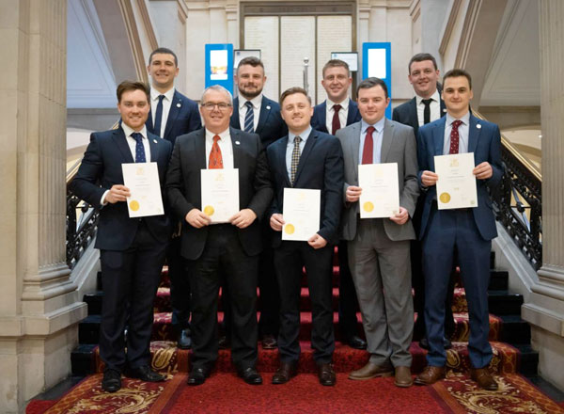


Secretariat & Membership Marketing programmes for 2025
President’s Future Leaders Scheme
Certificate Presentation Ceremony
ICE Rewards
Careers Guide App
Notes:
President’s Future Leaders programme
Certificate Presentation Ceremony
ICE Rewards scheme
President’s Reception
Membership Marketing – targeted projects across division
Subscriptions lapsing campaign management
Careers guide app
Certificates and grades
Member engagement programme (pan-ICE group)
Membership Committee
Investigate incorporating AI into workplan

Slide 13





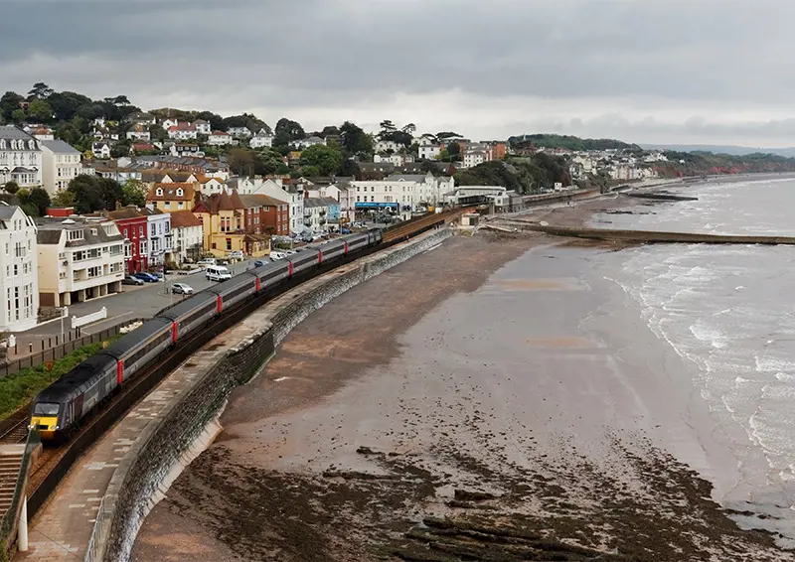
Engineering Knowledge
New Learning Hub
PAS2080
Design Champions
Breakwaters
Brunel lecture series
Resilience Champions
Notes:
New Learning Hub – Following months of hard work by colleagues, the new Earning Hub I in its testing phase. It will transform the way we present our knowledge and learning content to members.
PAS2080 – In April, we sponsored the publication by BSI of this globally applicable standard for managing carbon in buildings and infrastructure. It looks at the whole value chain and aims to reduce carbon and cost through intelligent design, construction and use. It is a significant step which we intend to strongly push the industry to adopt across the coming years.
Design Champions - The appointment of a design champion should be a legal requirement for all major infrastructure projects, according to the National Infrastructure Commission (NIC), The ICE’s research and role in further refining the role of the Design Champion was acknowledged in the 18 October launch of the NIC’s second National Infrastructure Assessment.
Breakwaters - First commercial event since COVID in Portsmouth focused on how maritime sector is addressing resilience and adaptability – great success with 400 people attending.
Brunel Lecture Series – Focused on resilience and was organised with ICSI with support of Global Covenant of Mayors and secured Mayors as keynote speakers - 818 people attended.
Resilience Champions – Launched in September, the programme recognises the efforts of those working across the built environment sector to make their infrastructure projects resilient, sustainable and inclusive by design.

Slide 14
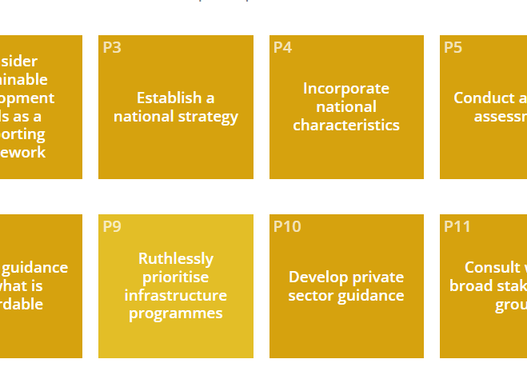
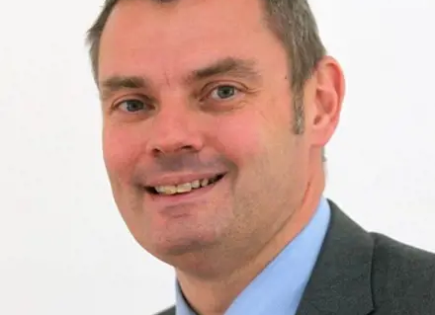
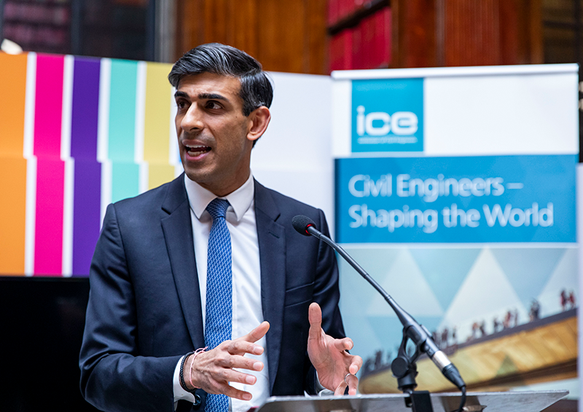
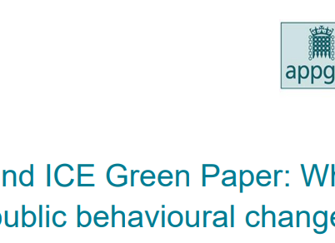

Policy and External Affairs
Enabling Better Infrastructure
Policy Fellows Network
Roundtables, breakfasts and policy events
Green paper and submissions
Media reach
Notes:
Enabling Better Infrastructure – This is a multi-stage programme that supports national policymakers by designing guidance and providing shared insight to support the long-term prioritisation and planning of infrastructure to meet sustainable development targets. Has had success in producing several briefing papers, blogs and joint sessions with UNEP briefing and Indonesia govt officials. A Good example of our international reach.
Policy Fellows Network – Building on existing foundations, policy fellows have been helping the PEA team to offer their insight by contributing to blogs, attending roundtables and townhalls, PEA Committee, helping to drive uses of our work over 20 times this year and over 30 request for support to end of Oct.
Roundtables, breakfasts and policy events – Successful year of influencing and offering insight to policymakers – Examples include Pres. roundtable on ‘what do civil engineers and infra professionals need from government to deliver SDG’s, ‘renewing electricity grid global lessons’, APPGIs including visit from Chancellor to OGGS, ICE dinner with Shadow Chief Sec to Treasury - Darren Jones MP
Green paper programme – Extensive green paper series across topics such as transport planning, public behaviour change, water and flooding, as well as representations to government on Autumn statement, offering submissions to calls for evidence.
Media reach – Very strong year for media with almost 60 tier one media hits including LBC, BBC, ITV and the Guardian, and nearly 500 trade and regional media hits.

Slide 15
Membership numbers

Slide 16
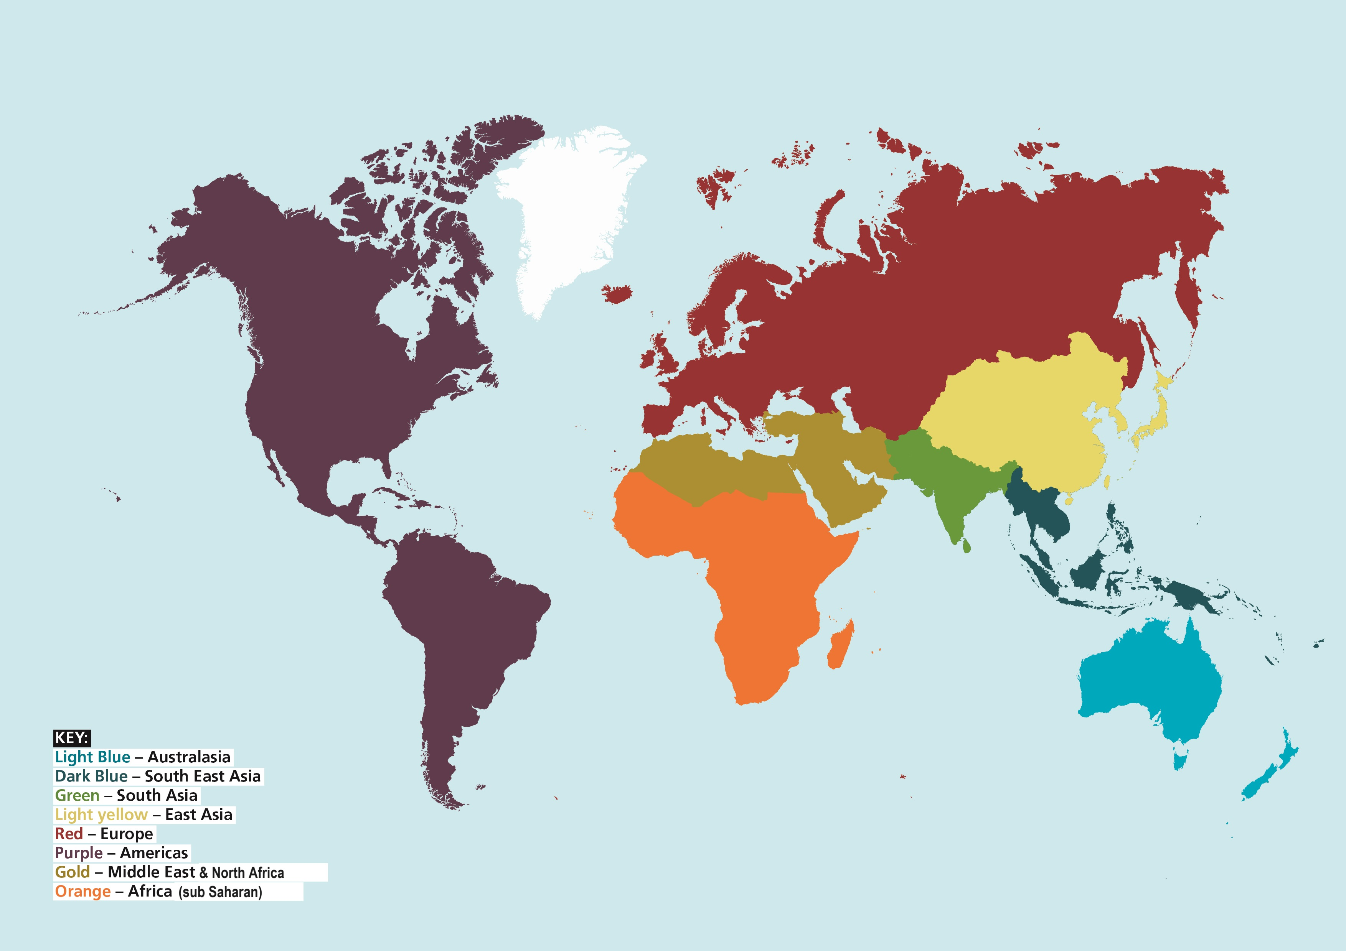
Global membership
2,270
72,812
504
1,455
8949
2,801
5,147
1,661
2,324
2,277
Data as at end of April

Slide 17
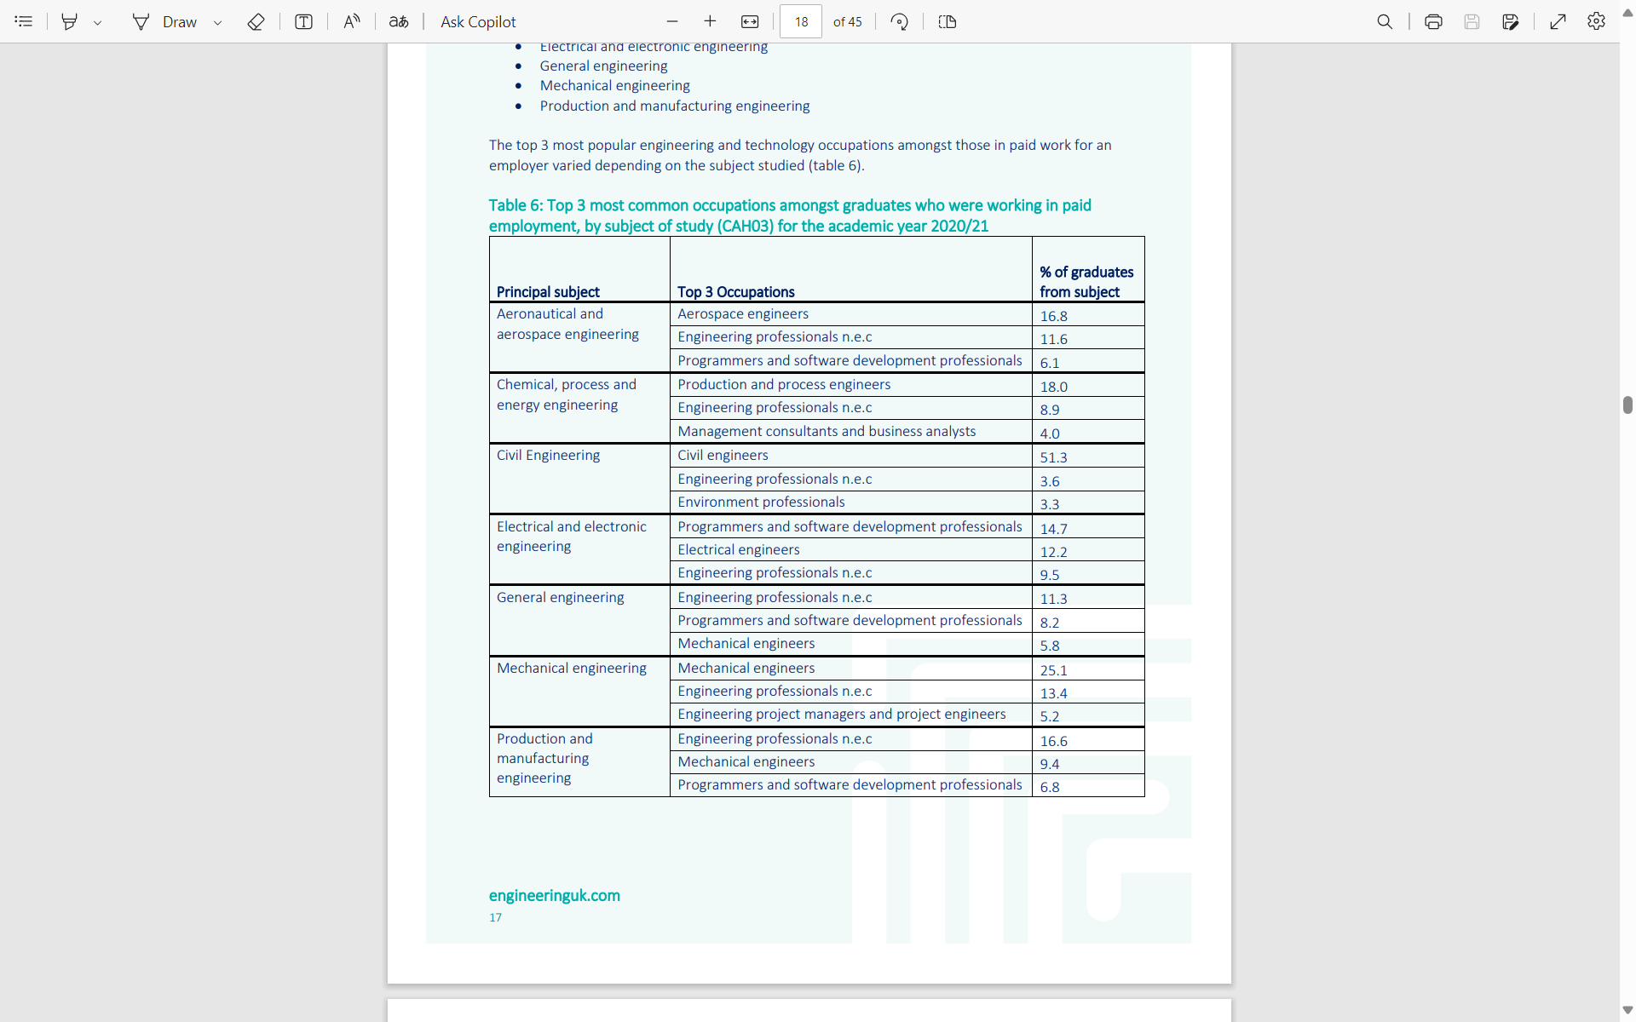
Converting students into engineers!
Significant transfer of students to graduate membership.
Twice as high as the nearest (mechanical engineers).
Rapidly increasing female percentage.

Slide 18
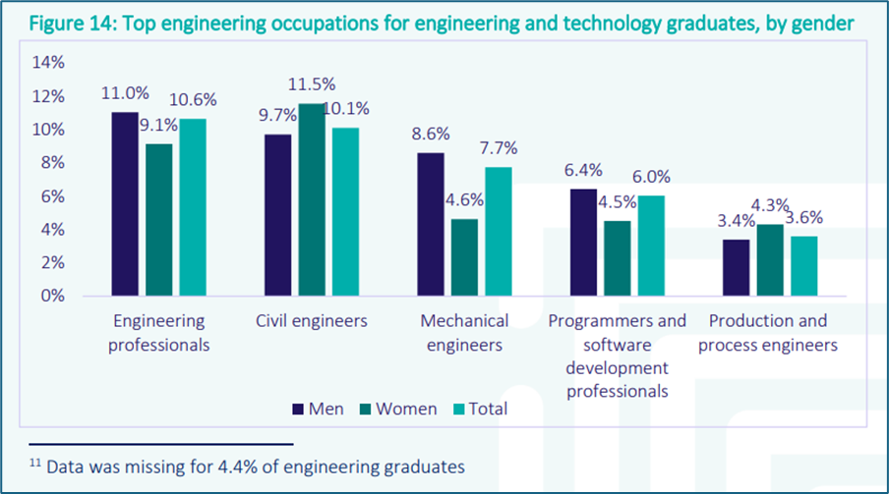
How are civils doing?

Slide 19
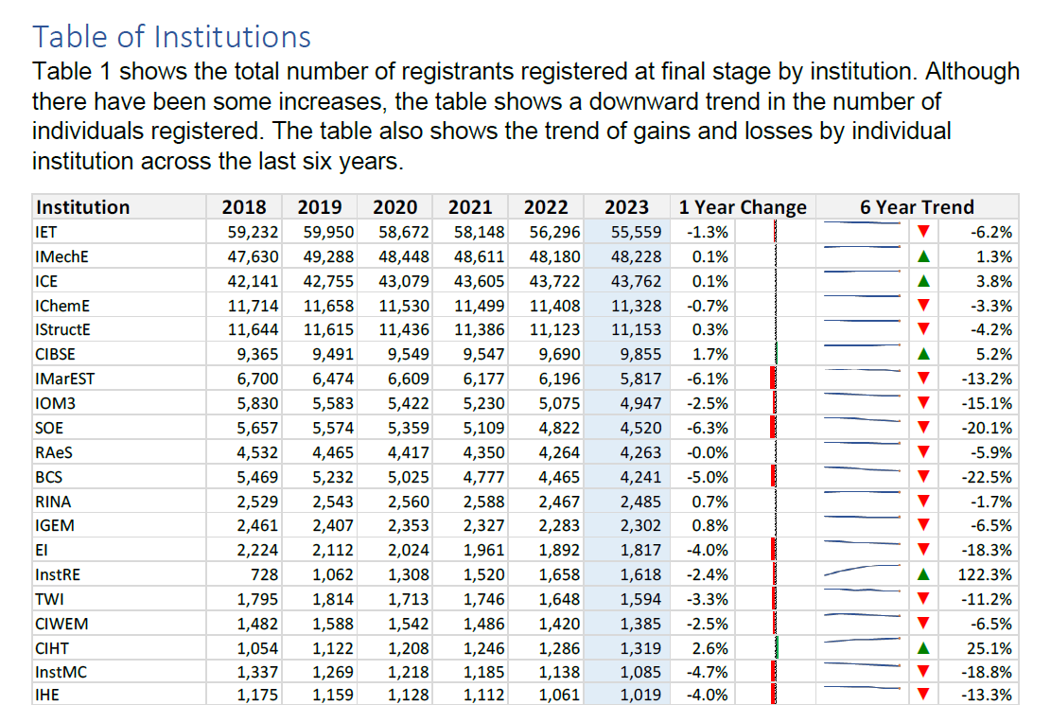
Registrants

Slide 20
Priorities for 2025

Slide 21

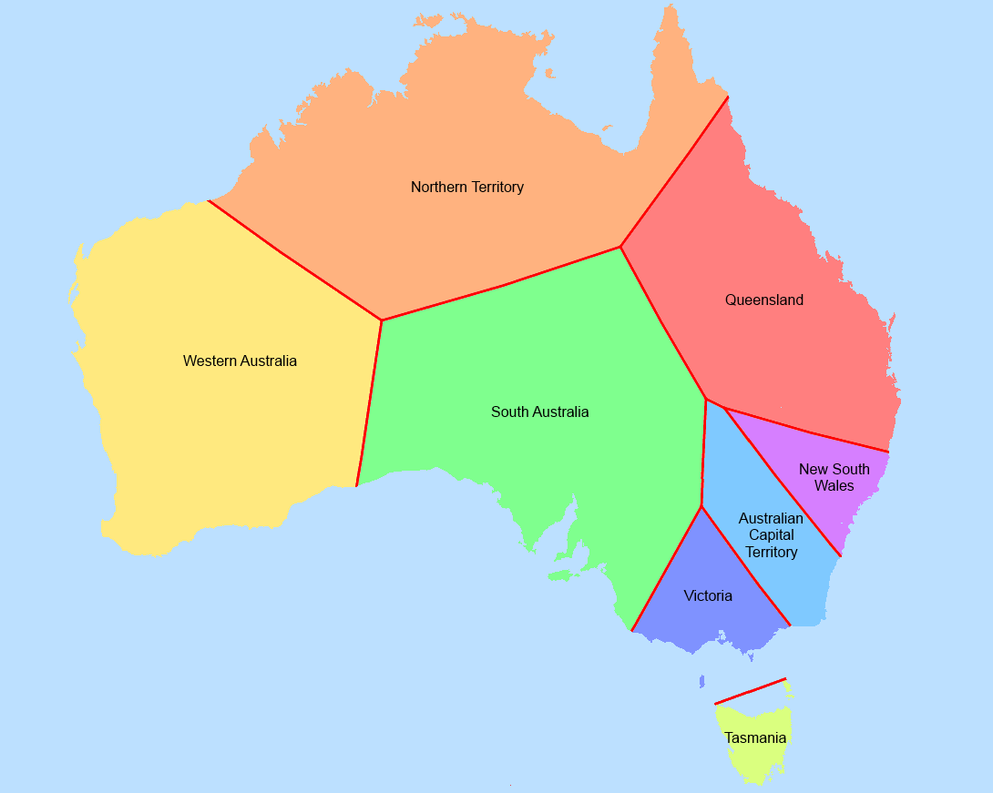

Professional Services programmes for 2025
Reservoir Safety Reform
Development of Martyn’s Law register
Australian Registers
Mentoring – post professional qualification
Notes:
Reservoir safety reform
Supply of reservoir engineers
Establish high level advisory panel
Registrations
Value proposition for current registers
Research into value propositions for new registers in areas where there is opportunity for specialism to be assured and recognised regulatory/best practice
Restructure and re-launch of ICE Health and Safety Register
Development of new Martyn’s Law register (security engineering for large venues) in partnership with RSES and the Cabinet Office
Connect – Professional Services
Australian Registers – new scheme for Western Australia and ad hoc requirements
Mentoring – post professional qualification
Develop quality of mentor relationships
Provide support and guidance for mentors and mentees

Slide 22
Member Engagement review 2025

Slide 23
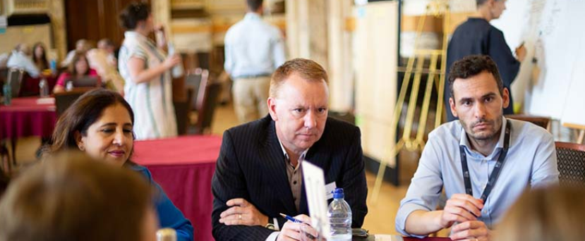
Member engagement review
Notes:
Without members we would not exist.
First and foremost, we provide essential and discretionary services to members to enable them to get qualified and stay qualified.
Through this they are also essential to our business model; we depend on them to be SCEs, mentors and professional reviewers to continue our qualified member growth.
We also look to members to provide expert impartial advice to government and other aligned stakeholders – members create, endorse and moderate knowledge creation.
More indirectly, we rely on them to inspire others to join the profession which they do at a tactical level such as schools outreach and at a strategic level such as media interviews, visible leadership of the profession within industry and parliament
A review of member engagement is essential to understand evolving member needs.
The review will help to optimise communication strategies and enhance value delivery.
It will assist in identifying areas for improvement in strengthening member retention and ensure that ICE remains competitive.
This review will lead to stronger member relationships, assist the Board and executive in adapting to changing trends, and sustain long-term organisational growth and success.

Slide 24
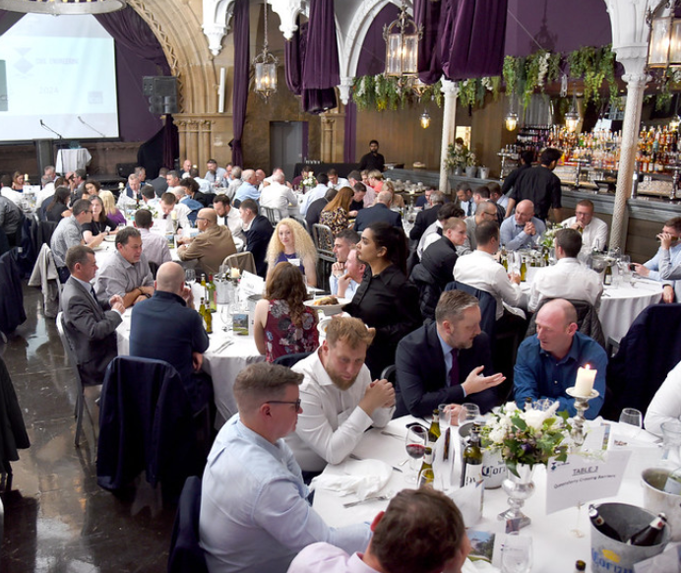
Member engagement review
Without members we would not exist
We do not pay members but return values through their member services
Our dependency on members means that we cannot be complacent about our member offer
Failure to continue to adapt to changing needs or technological advancements will also lead to irrelevance, eroding value and trust
Notes:
Without members we would not exist.
First and foremost, we provide essential and discretionary services to members to enable them to get qualified and stay qualified.
Through this they are also essential to our business model; we depend on them to be SCEs, mentors and professional reviewers to continue our qualified member growth.
We also look to members to provide expert impartial advice to government and other aligned stakeholders – members create, endorse and moderate knowledge creation.
More indirectly, we rely on them to inspire others to join the profession which they do at a tactical level such as schools outreach and at a strategic level such as media interviews, visible leadership of the profession within industry and parliament

Slide 25
Member engagement review
Q4 24 - Trustee Board to approve TOR
Q4 24 - Review Board established
Q1 25 to Q3 25 - initial review
Q3 25 - Trustee member engagement to comment on interim findings
Q3 25 - Audit Committee comment on interim findings
Q4 25 - Trustee member engagement to brief Trustee Board and Council
Q1 26 - Detailed implementation planning
Q2 26 - Implement agreed review recommendations

Slide 26
Membership Division’s key challenge

Slide 27
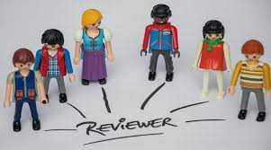
Reviewers and assessors

Slide 29
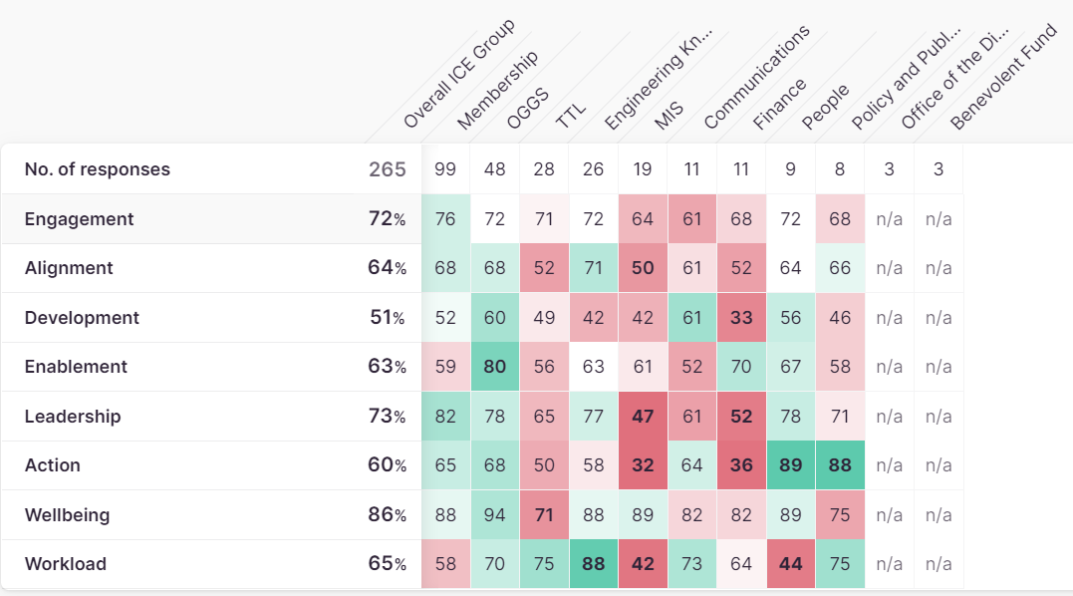
Divisions
Q2 24 Pulse survey

Slide 30
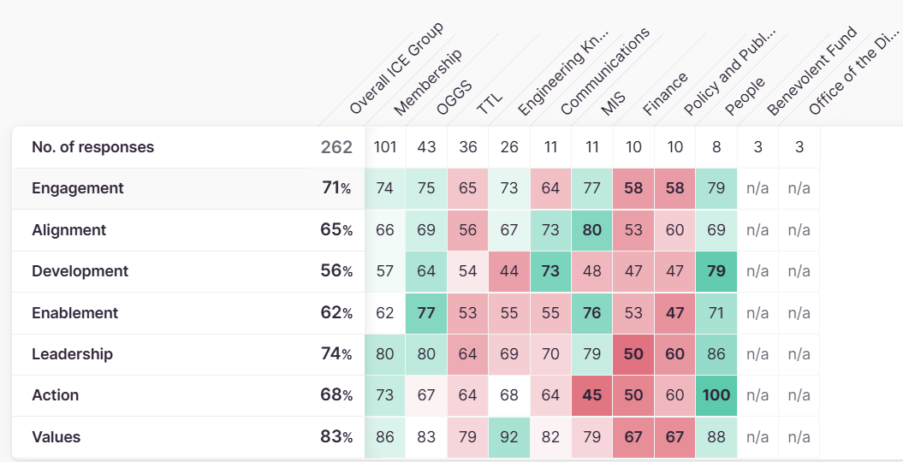
Q3 24 Pulse survey
Notes:
I won’t spend too much time on this heat map as we will go into this in more detail when you meet your people team partner to go through the results. But I did want to include this here so you have a heads up before that meeting.

