Slide 1
Pre-alignment voluntarily displacement
Vivien RUDE,
Vincent BARBARROUX
Patrick BESTMANN
2024-10-02

Slide 2
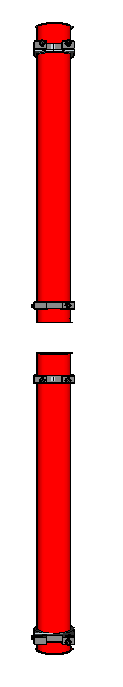
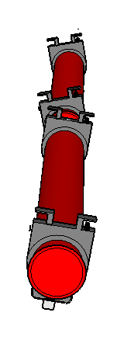
INPUT
Safety layers constraints :
  After the interconnections, the bellows can accept :
  1 mm of translation
  1 mrad of torsion
Range :
  FRAS range : +/- 2.5 mm
  Jack range : +/10 mm
  Baseline : When the interconnection is complete, the jacks should be positioned within the mid-range

Slide 3
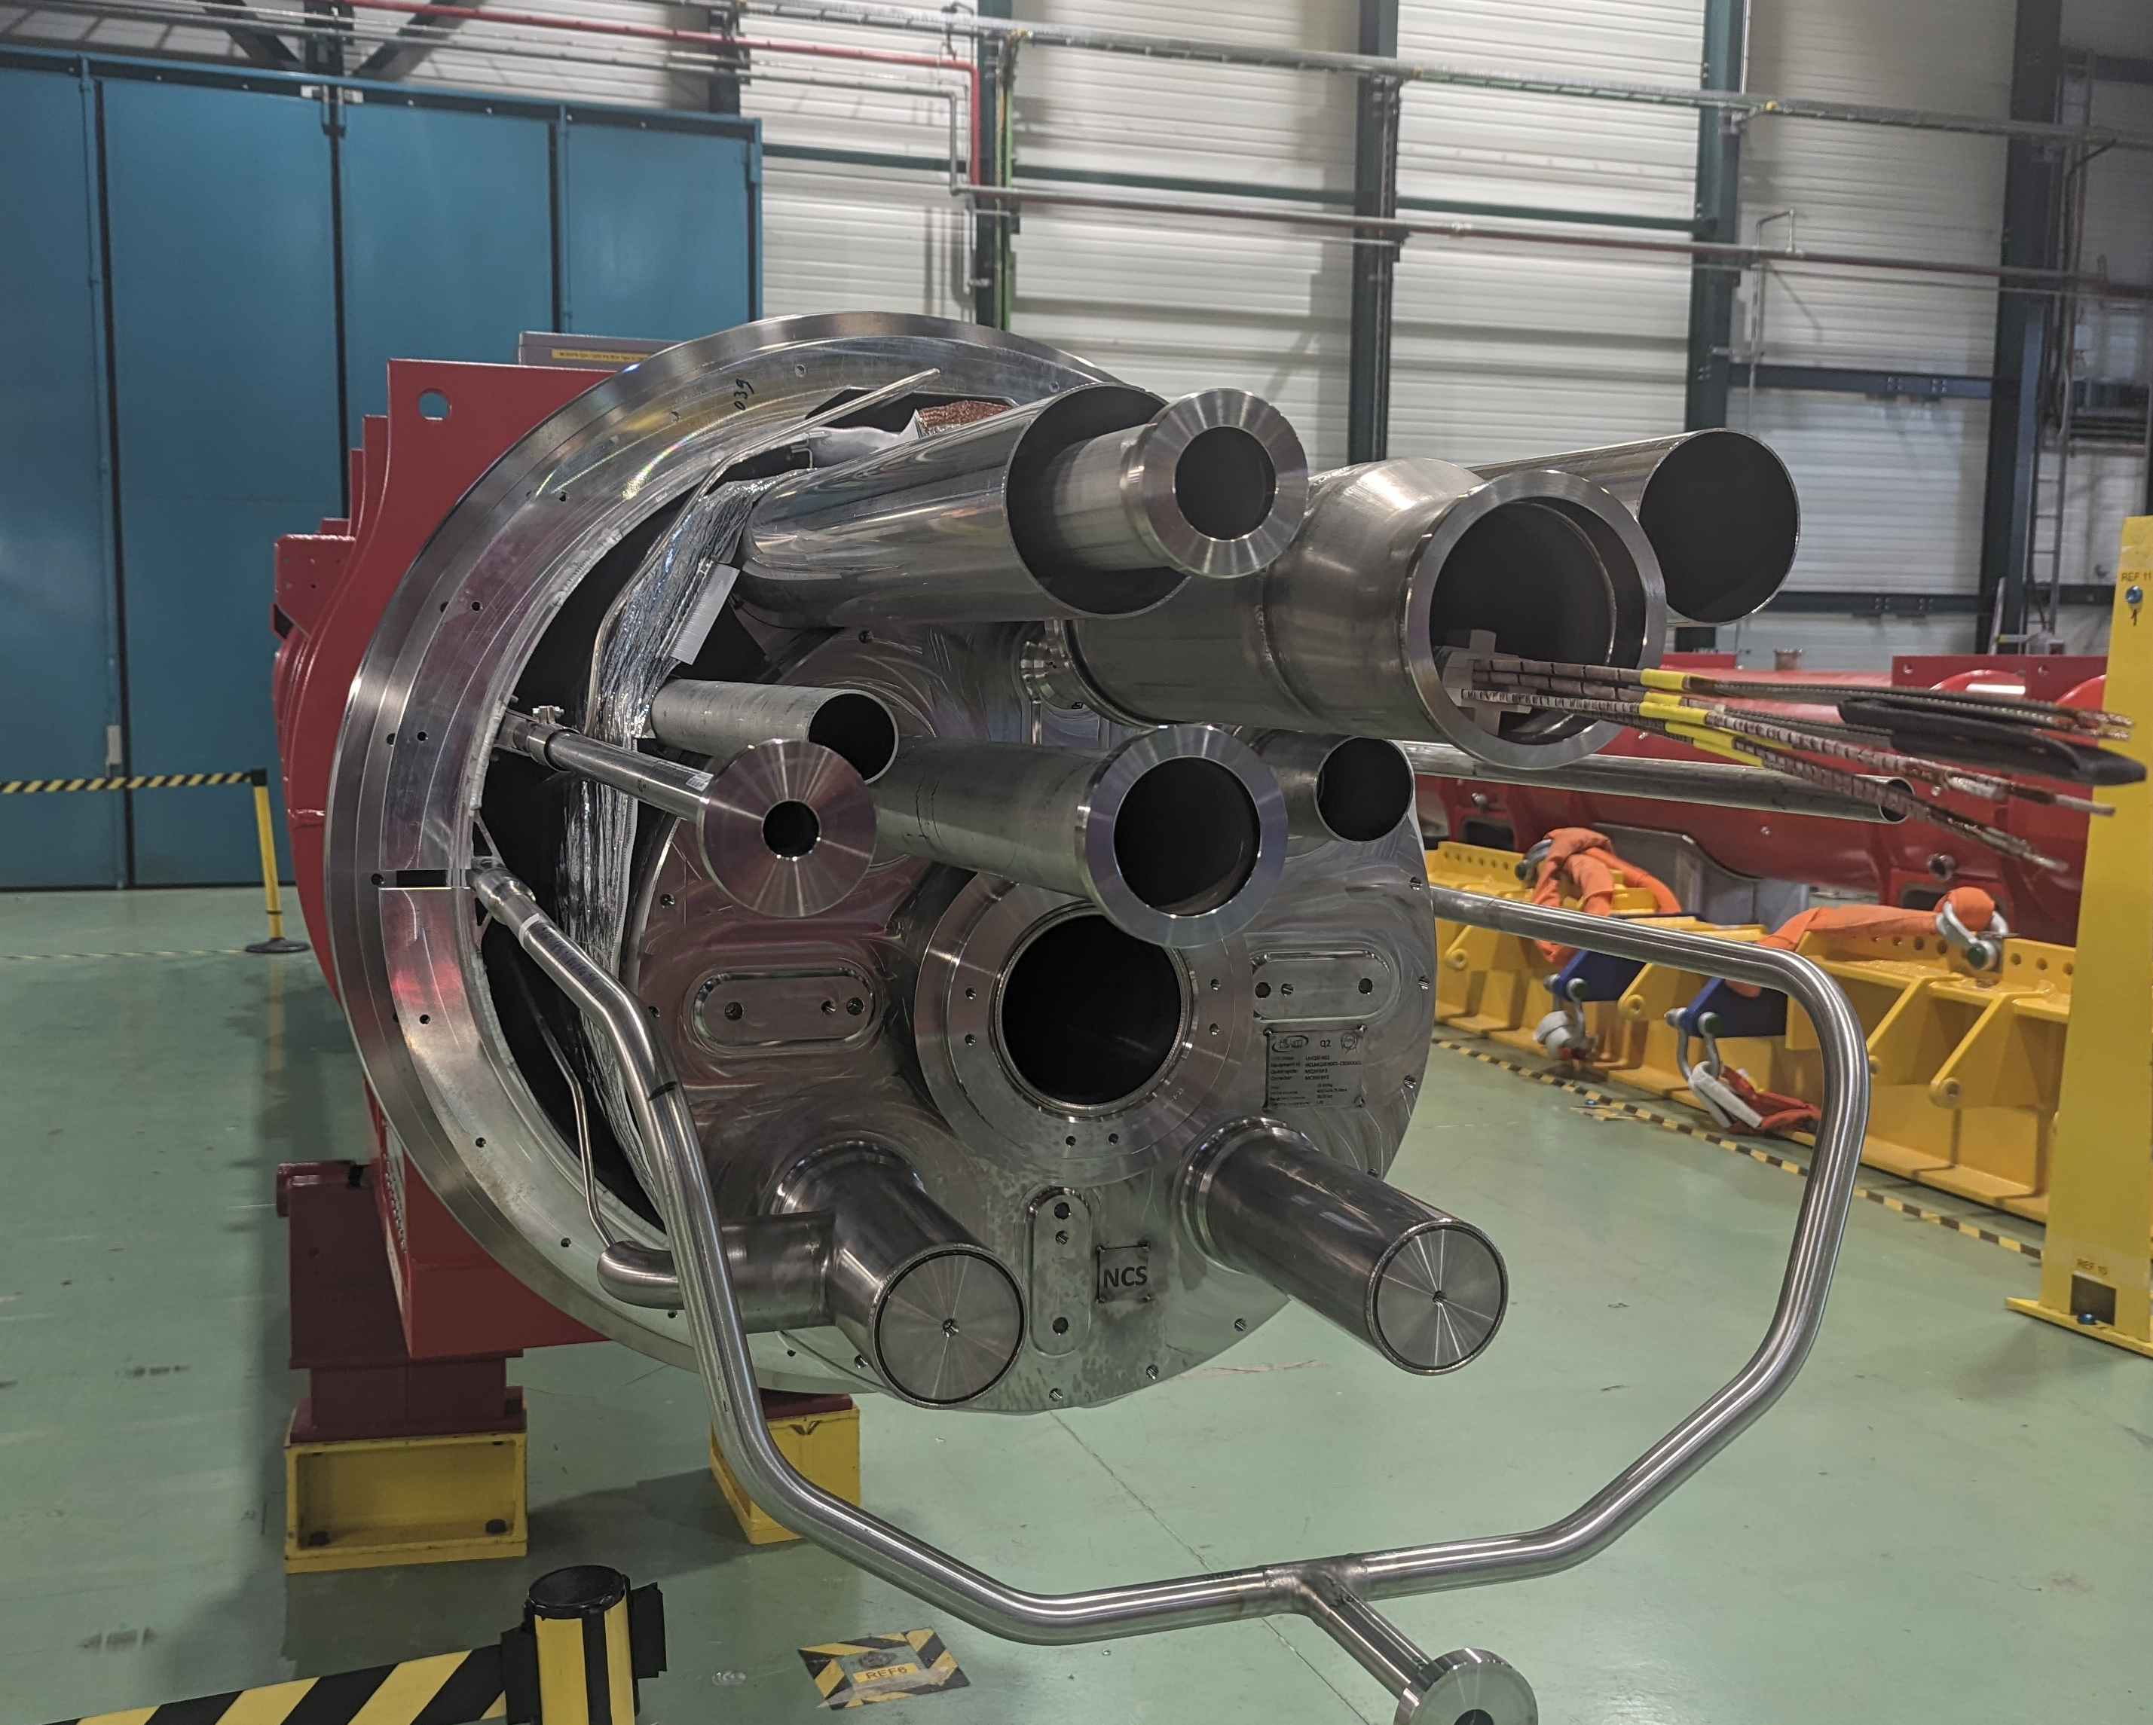
Mechanical Coordinate system
    Primary axis : Y : Regression line corresponding to the mechanical cold bore axis (determined from mechanical mole)
    Secondary axis : Z : Normal vector of the plane [Conn-D9, Conn-D10, NConn-D9, NConn-D10]
    Origin : Projection of the central cold feet on Y axis
NConn
D9
Cold bore measurement
NConn
D10
Regression line
Z
Y
X
D10
D9
Magnet | Maximum residual from the regression line (except flanges)
 | in radial (mm) | in vertical (mm)
Q2a P3 | 0.4 | 0.6
Q2a #03 | 0.3 | 0.6
Q2a #05 | 0.4 | 0.3
Q2b P2 | 0.4 | 0.4
Q2b #04 | 0.2 | 0.3
Q3 #01 | 0.5 | 0.5
Conn
D10
Conn
D9

Slide 4
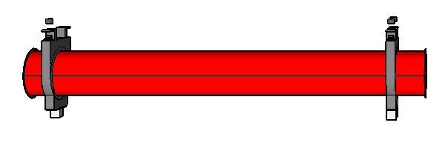
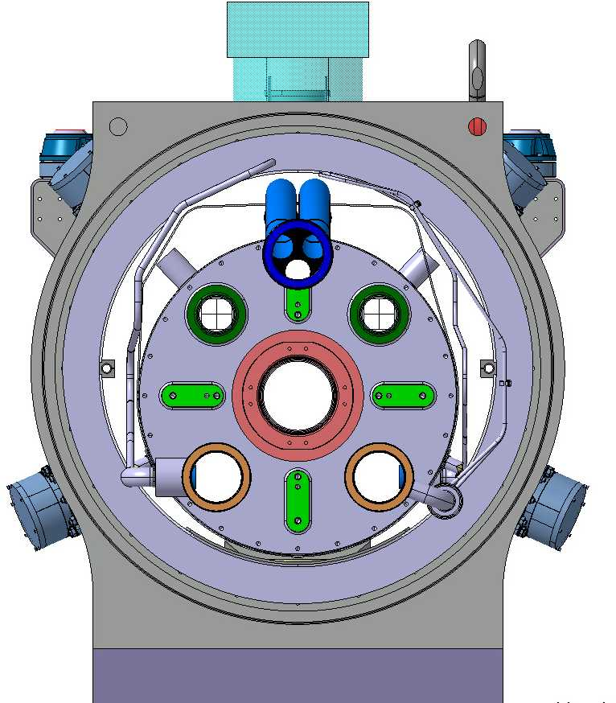
Delta Mechanical and Magnetic (axis and magnetic field)
Q3 #01
Mechanical axis
Y
Δ =-0.12mm
Top view
Δ =0.60 mm
X
Magnetic axis
Side view
Magnetic axis
Z
Δ =0.39 mm
Δ =0.31 mm
Mechanical axis
Y
Mechanical direction
(Z axis)
Magnetic
field
Mechanical direction
(Z axis)
Magnetic
field
This rotation also occurs between the end cover and the magnetic axis. All the auxiliary lines are installed with respect to the Z-axis.
+2.550 mrad
M
D11
Z
X

Slide 5
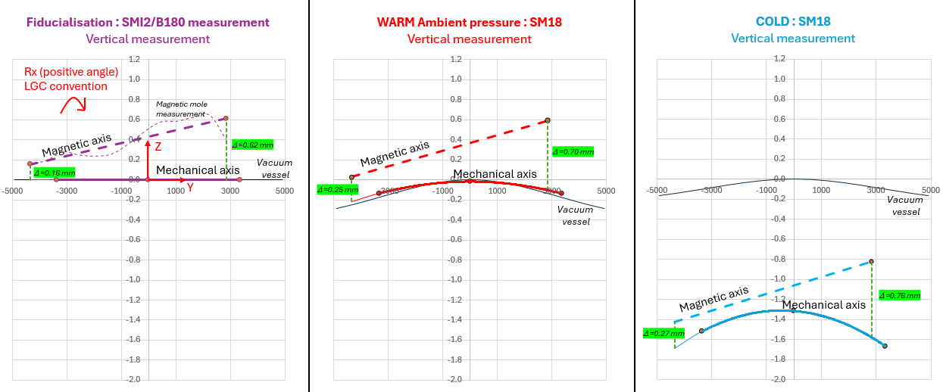
Delta Mechanical and Magnetic (Constant at warm and at cold)
Example : Q2#P3 in vertical

Slide 6
Mechancial or magnetic axis ?
Top view
Delta : close to 1 mm
Q1
Q2a
-0.12 mm
-0.26 mm
Mechanical axis
Mechanical axis
+0.60 mm
Magnetic axis
+0.53 mm
Magnetic axis
Mechanical direction
(Z axis)
Magnetic
field
Torsion : close to 3 mrad
-0.316 mrad
Z
Mechanical direction
(Z axis)
X
Magnetic
field
+2.550 mrad
Z
X

Slide 7
How to manage the different coordinate system ?
R-vacuum vessel
R-mechanical axis (warm)
R-mechanical axis (cold)
R-fiduciualisation
= R-mechanical axis (cold mass at warm)
= R-vacuum vessel
R-magnetic axis (at cold)
R-rst
Vacuum Vessel
Vacuum Vessel
Vacuum Vessel
R-vacuum vessel
Cold mass
R-cold mass at warm
ΔZ (warm-cold)
∼ 1.5 mm
Cold mass
Cold mass
R-mechanical axis
(cold mass at cold)
= R-vacuum vessel
R-vacuum vessel
Mad-X
R-rst
Mechanical axis warm
R-mechanical axis
(cold mass at cold)
Jack
R-magnetic axis (at cold)
Cold feet
Jack
Jack
Jack
Jack
Jack
Jack
Jack
Jack
Jack
floor
For cold element | R-vacuum vessel = R-mechanical axis (warm) |  | R-mechanical axis (cold) |  | R-magnetic axis (at cold) |  | R-rst
Tx (radial) |  | FSI or Tx = 0 |  | Tx = ... |  | Tx = 0
Ty (longitudinal) |  | FSI or Ty = 0 |  | Ty = 0 |  | Ty = …
Tz (vertical) |  | FSI or Tz = -1.5 mm |  | Tz = ... |  | Tz = 0
Rx (pitch) |  | FSI or Rx = 0 |  | Rx = ... |  | Rx = 0
Ry (roll) |  | FSI or Ry = 0 |  | Ry = ... |  | Ry = 0
Rz (Yaw) |  | FSI or Rz = 0 |  | Rz = ... |  | Rz = 0 or 180 °
Scale |  | FSI or Scale = … |  | Scale = 1 |  | Scale = 1
FSI or Constant
Constant
Constant

Slide 8
Open discussion
Before the interconnection phase, the elements should be installed in their nominal positions
The longitudinal shift from Mad-X (R-rst) to the fixed cold foot of each component should be implemented
The warm-cold delta should be taken into account prior to interconnection.
The mechanical-magnetic delta should be taken into account prior to interconnection.
The direction of magnetic field should be taken into account prior to interconnection.
How to manage the deltas ?
  By longitudinal shift → Longitudinal shift from R-magnetic axis at cold to Rrst
  By vertical shift → Warm-cold delta (anticipation)→ Be careful not to apply it twice (shift + FSI)
  By bump : Three bumps exist :
    Bump : Beam Base alignment
    Bump : Optimization displacements (aperture) → mechanical-magnetic delta (MAB validation)
    Bump : Mechanical constraints
This implementation is not yet done on geode → On going
String Test ?
  100% magnetic ?

Slide 9
Thank you
for your attention

