Slide 1
HL-LHC optics MD results
Yannis Angelis
HL-LHC WP2 Meeting, 04-11-24
All contributors to HL-LHC MDs:
Y. Angelis, R. Bruce, X. Buffat, F. Carlier, R. De Maria, J. Dilly, A. Donadon, L. Giacomel, P. Hermes, M. Hostettler, G. Iadarola, U. Kar, M. Le Garrec, V. Ferrentino, B. Lindström, E. Maclean, D. Mirarchi, M. Monikowska, N. Mounet, O. Naumenko, T. Pugnat, S. Redaelli, D. Rivorin, B. Salvant, M. Solfaroli, K. Skoufaris, R. Tomas, G. Trad, D. Veres, F. Wharton, J. Wenninger, P. Zisopoulos

Slide 2
Contents
Arc45, Arc81 corrections for Beam1
Arc45 correction for Beam2
Deeper Investigation of phase error
Focus only at a single β*, to compare before and after the applied corrections

Slide 3
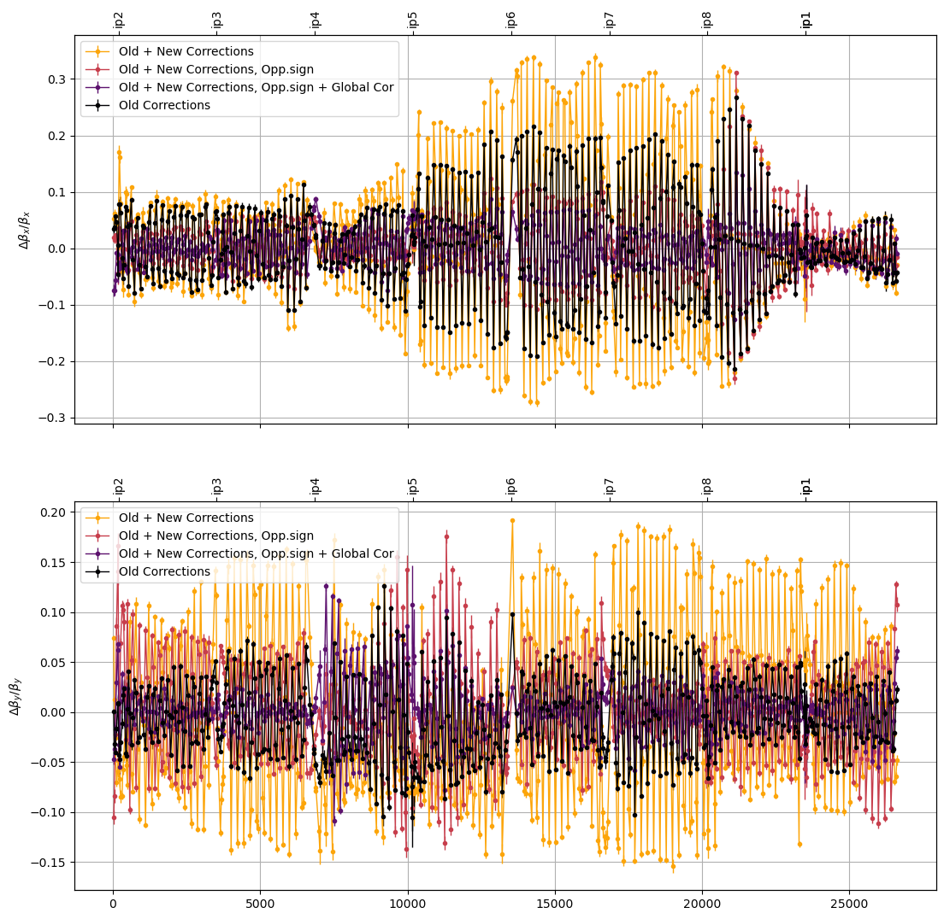
Arc corrections for Beam1
Analysis for the step: 165/84cm
Old corrections: Sextupole Bumps + Q10 + MQT, at Arc45, Arc81
New Corrections: Sextupole Bumps +MQT at Arc45, Arc81
‘Similarly’ for both arcs
Goal: Reduce β-beating by reducing the phase errors in the arcs

Slide 4
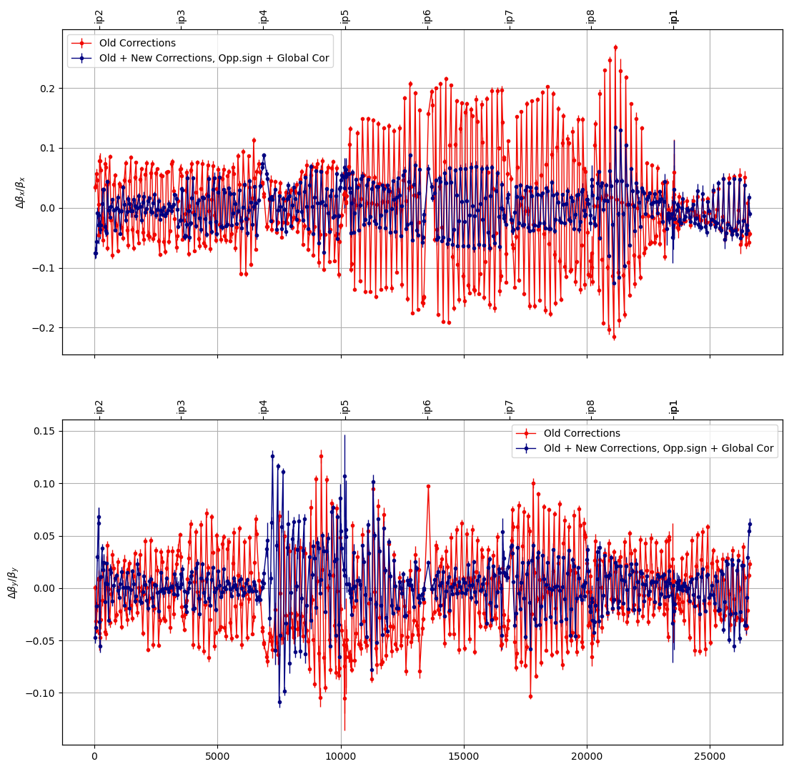
Arc corrections for Beam1
Analysis for the step: 165/84cm
Old corrections: Sextupole Bumps + Q10 + MQT, at Arc45, Arc81
New Corrections: Sextupole Bumps +MQT at Arc45, Arc81
Peak β-beat ~12% both planes
Goal: Reduce β-beating by reducing the phase errors in the arcs

Slide 5
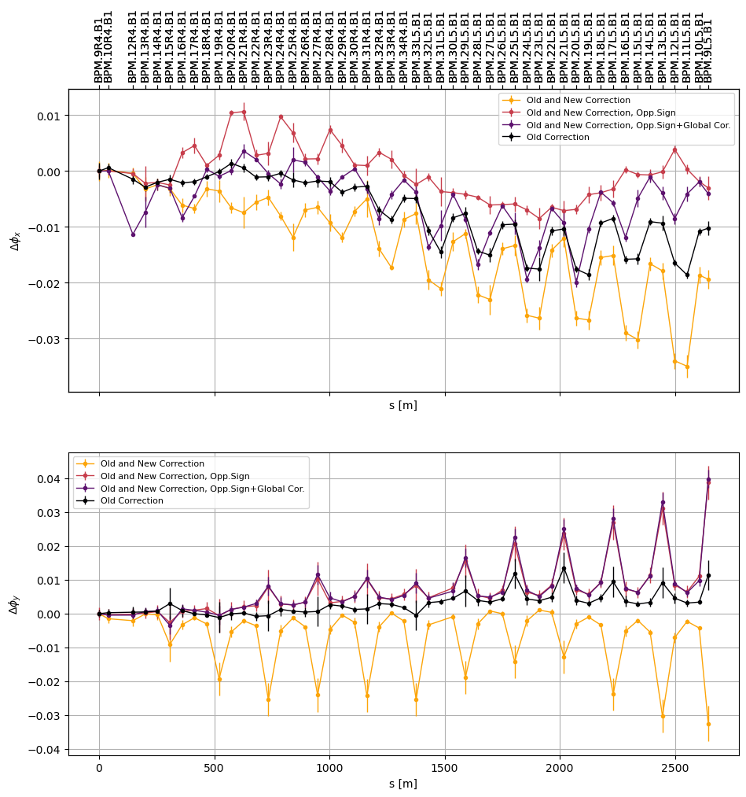
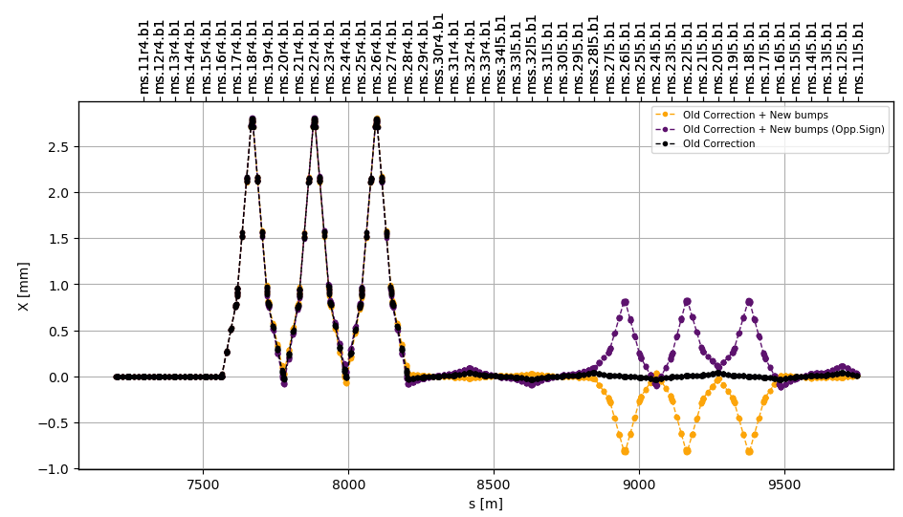
Arc45 corrections for Beam1
Sextupole bumps:
Old corrections: Left side of the arc
New Corrections: Right side of the arc

Slide 6
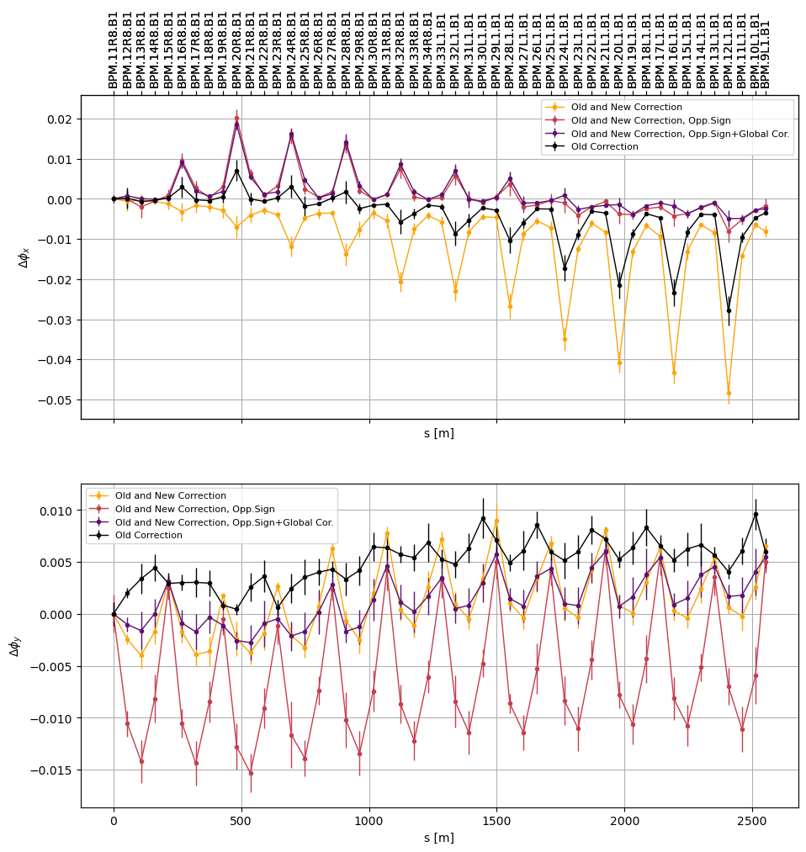
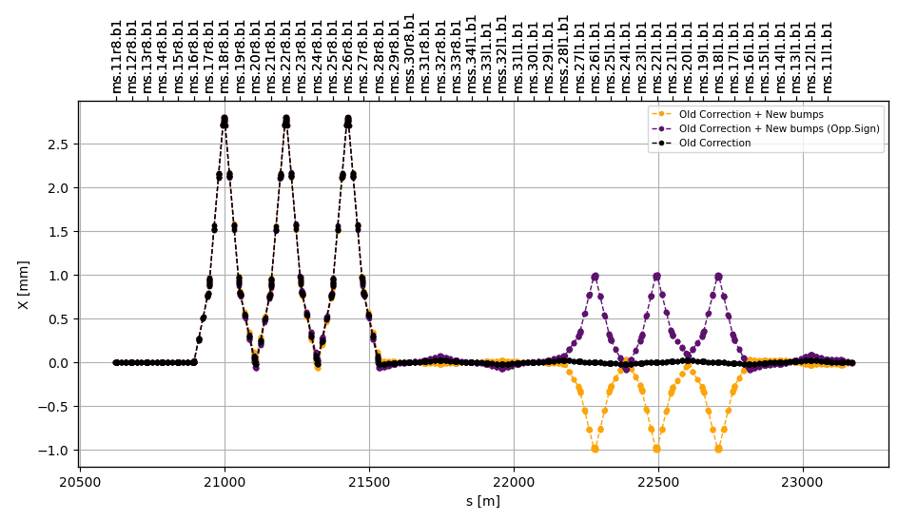
Arc81 corrections for Beam1
Sextupole bumps:
Old corrections: Left side of the arc
New Corrections: Right side of the arc

Slide 7
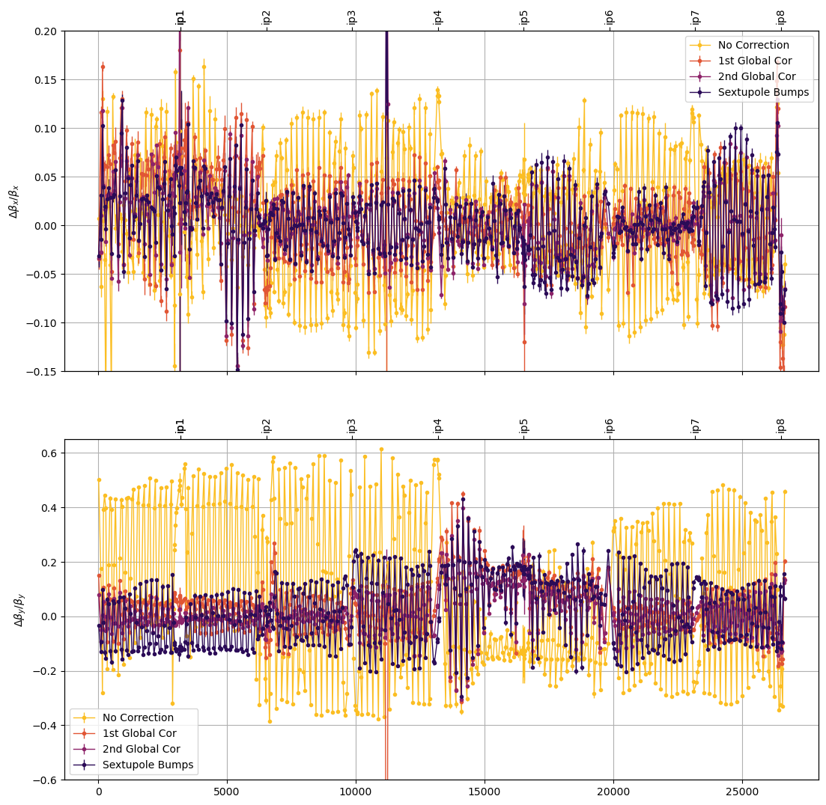
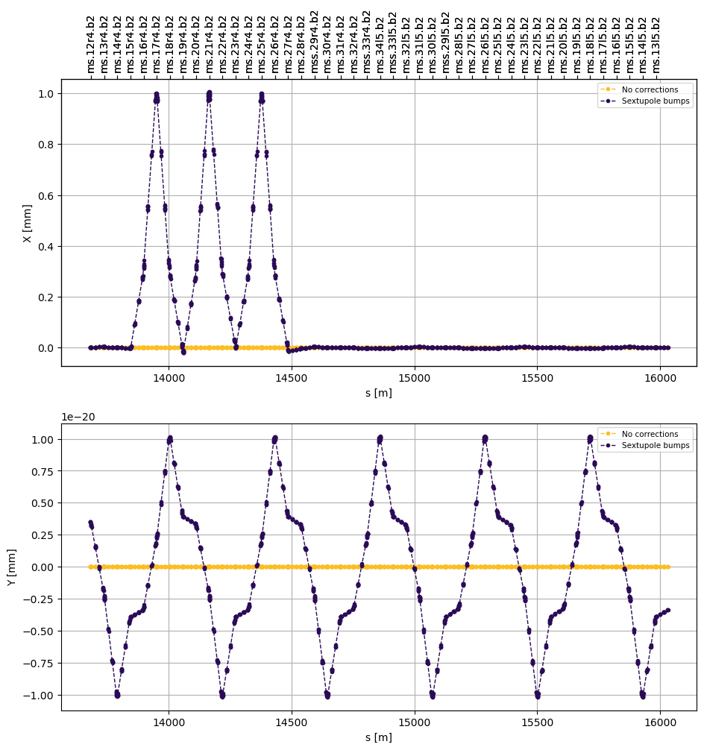
Arc45 corrections for Beam2
110/43cm
Sextupole bumps: Applied with the 1st iteration of Global corrections
2nd iteration did not improve arc45 beating
Correction: Sextupole bumps on the left side of the arc + KQTD.A45B2

Slide 8
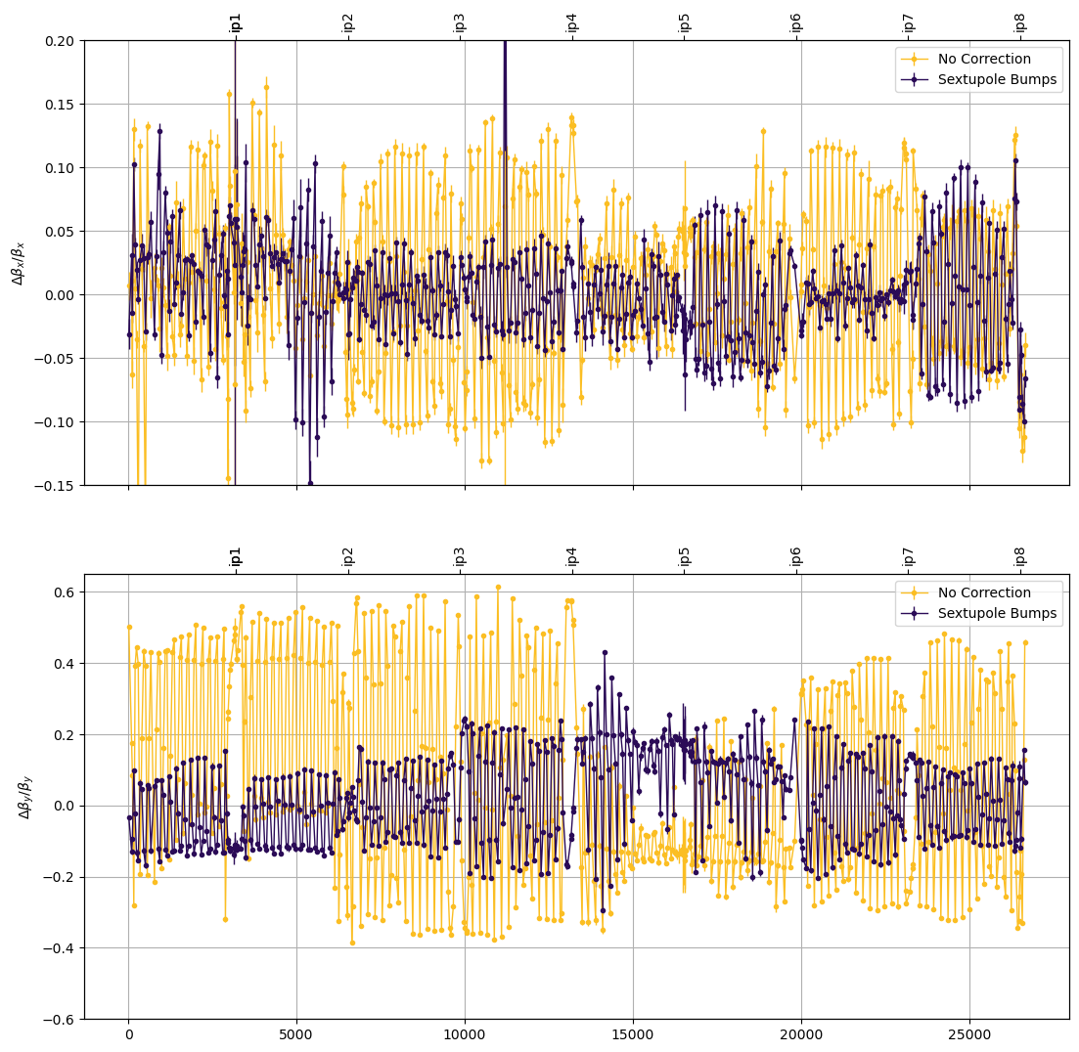
Arc45 corrections for Beam2
110/43cm
Very good control of the β-beat apart from Arc45 vertical
Reached the end of the MD before another iteration of corrections
New corrections and improvements could not be tested during MD5

Slide 9
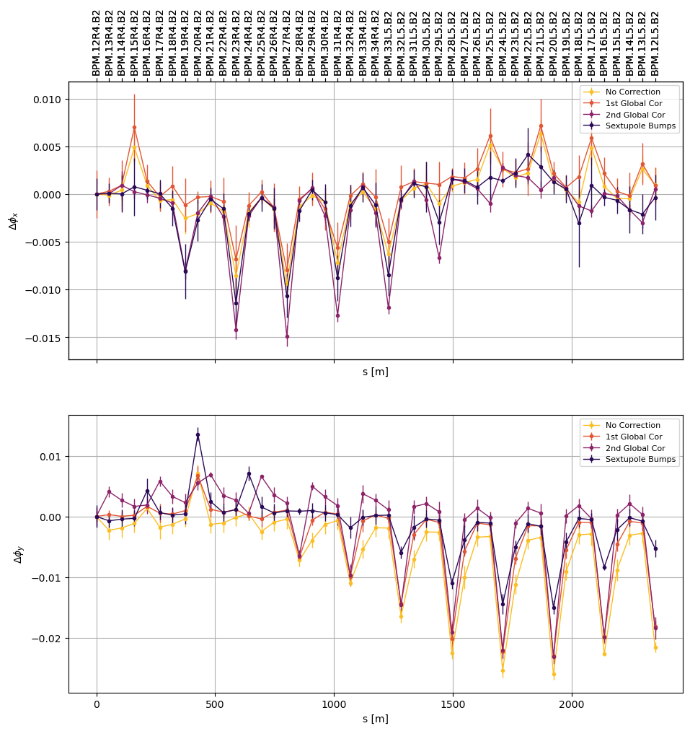
Arc45 corrections for Beam2
Correction: Sextupole bumps on the left side of the arc + KQTD.A45B2
Vertical Δφ reduction
BUT β-beat increased globally

Slide 10
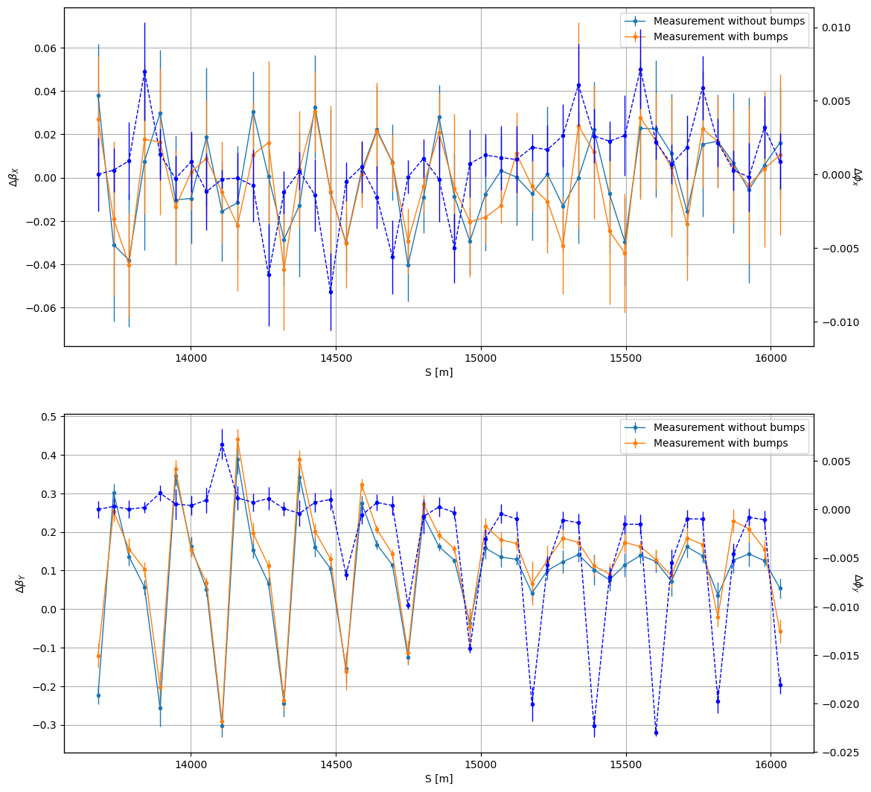
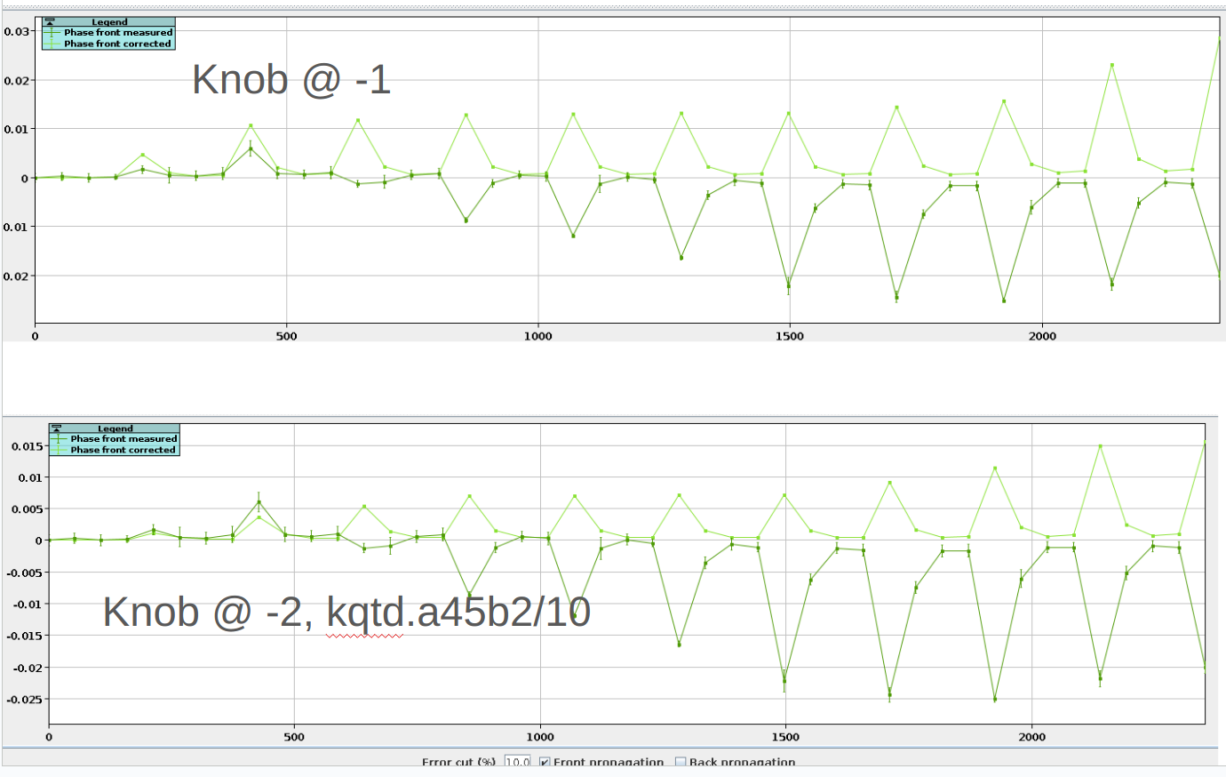
Arc45 corrections for Beam2
Simulation studies: Modification of the used knob to reduce the left peak
As used in the machine
Δφ peak at β-beat peak

Slide 11
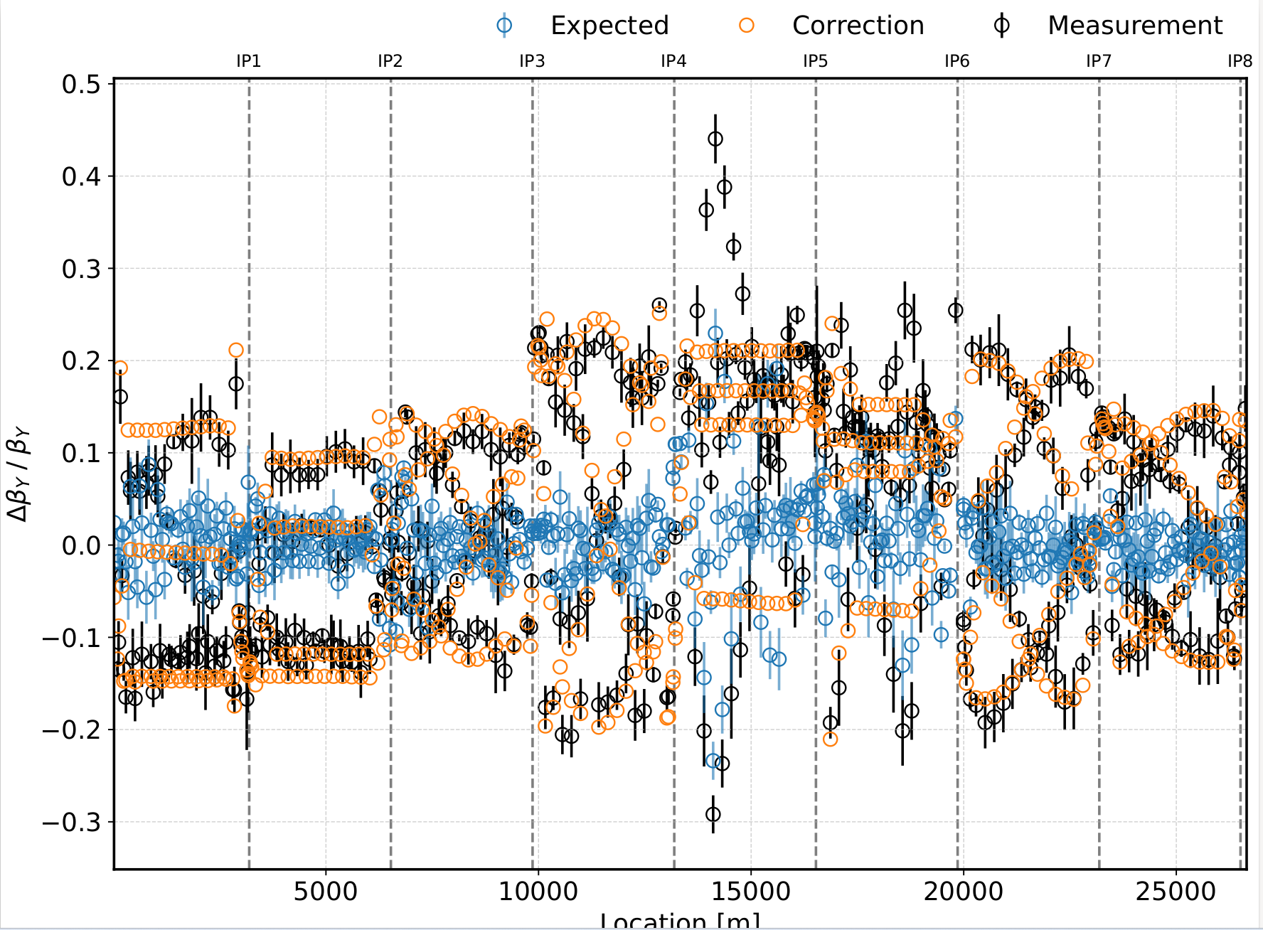
Arc45 corrections for Beam2
Simulation studies: New global corrections on top of the sextupole bumps
Peak vertical β-beat ~20% expected
NOTE: Due to limited time no global corrections were applied for Beam2 after the arc corrections
Courtesy of Joschua W. Dilly

Slide 12
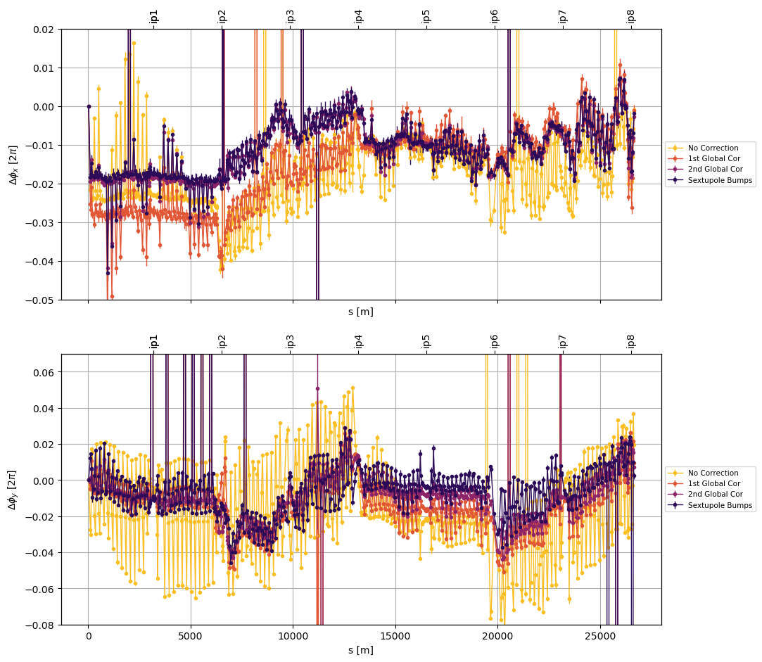
Arc45 Beam2
Investigating the phase error: Focusing around IP4
Vertical Δφ reduction
BUT β-beat increased globally

Slide 13
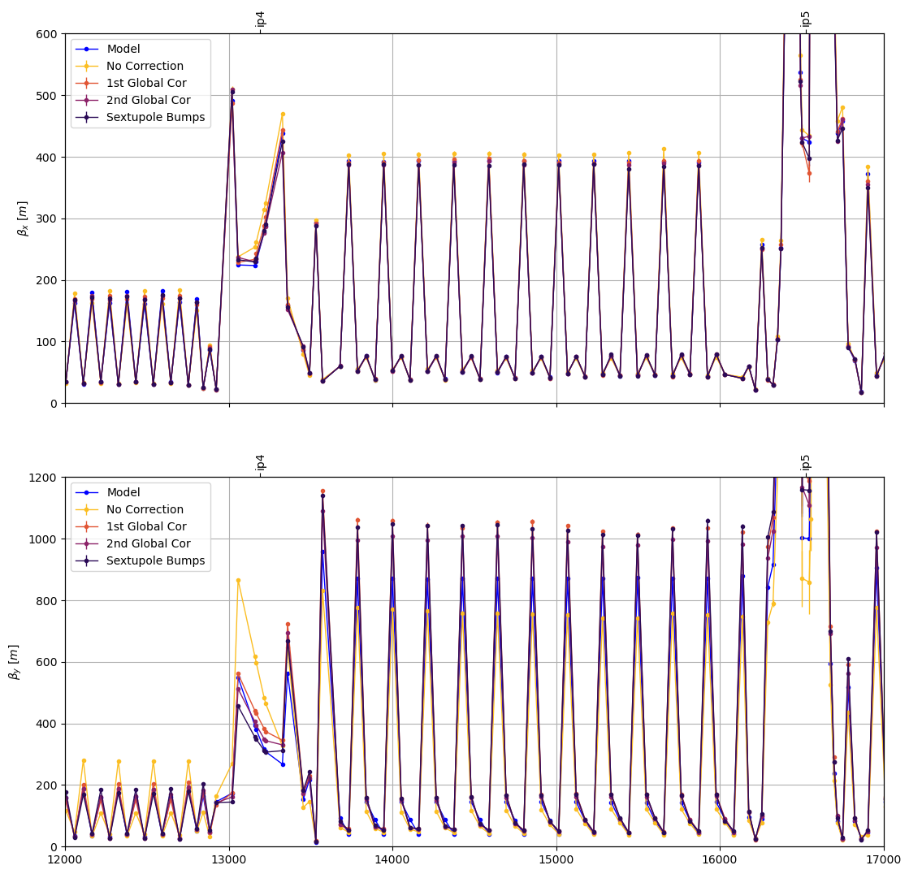
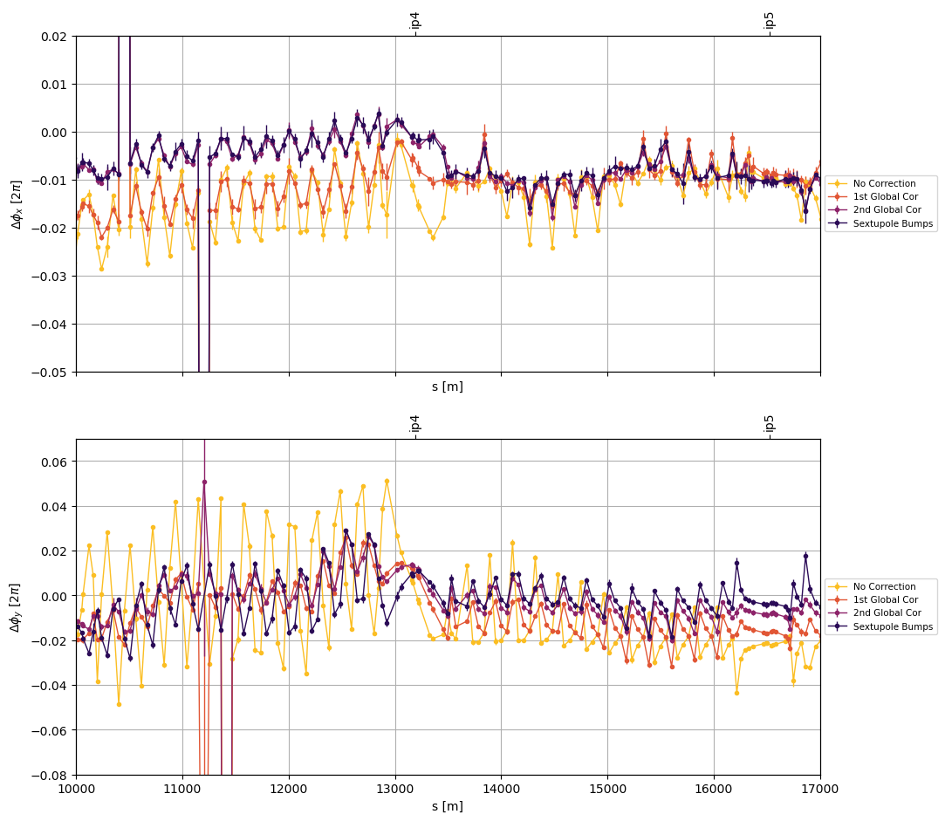
Arc45 Beam2
Investigating the phase error: Focusing around IP4
Visible difference in β

Slide 14
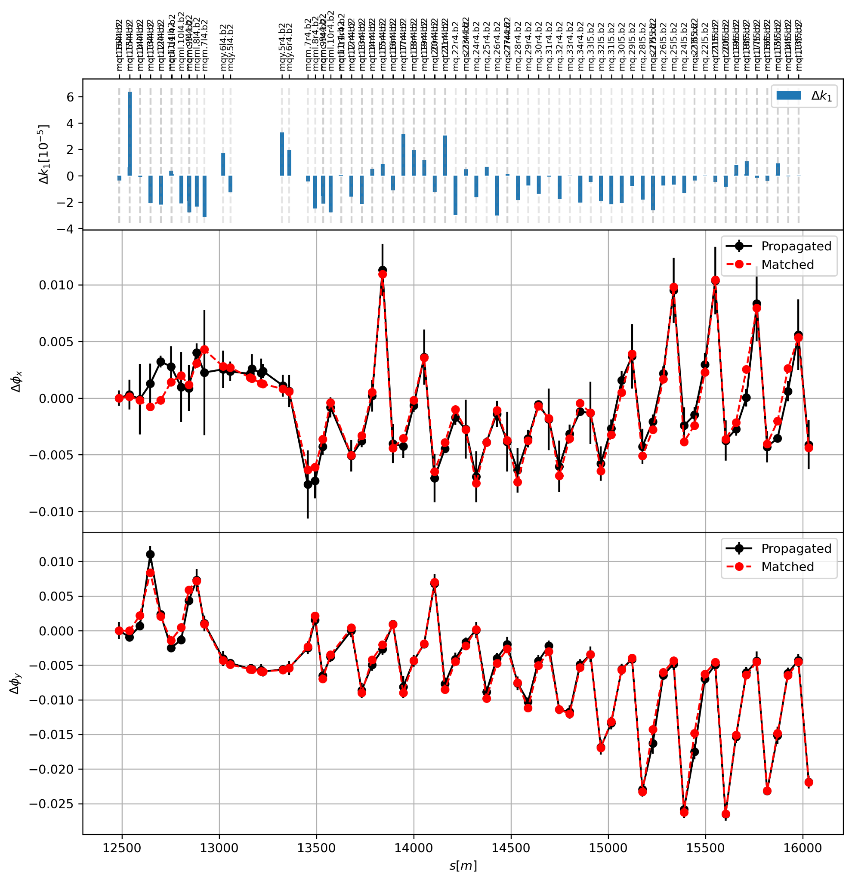
Arc45 Beam2
Investigating the phase error
Selection of quadrupoles in the segment
Each quadrupoles as individual powered
Response matrix for the phase error
Invert the system to extract quad strengths
Before Corrections

Slide 15
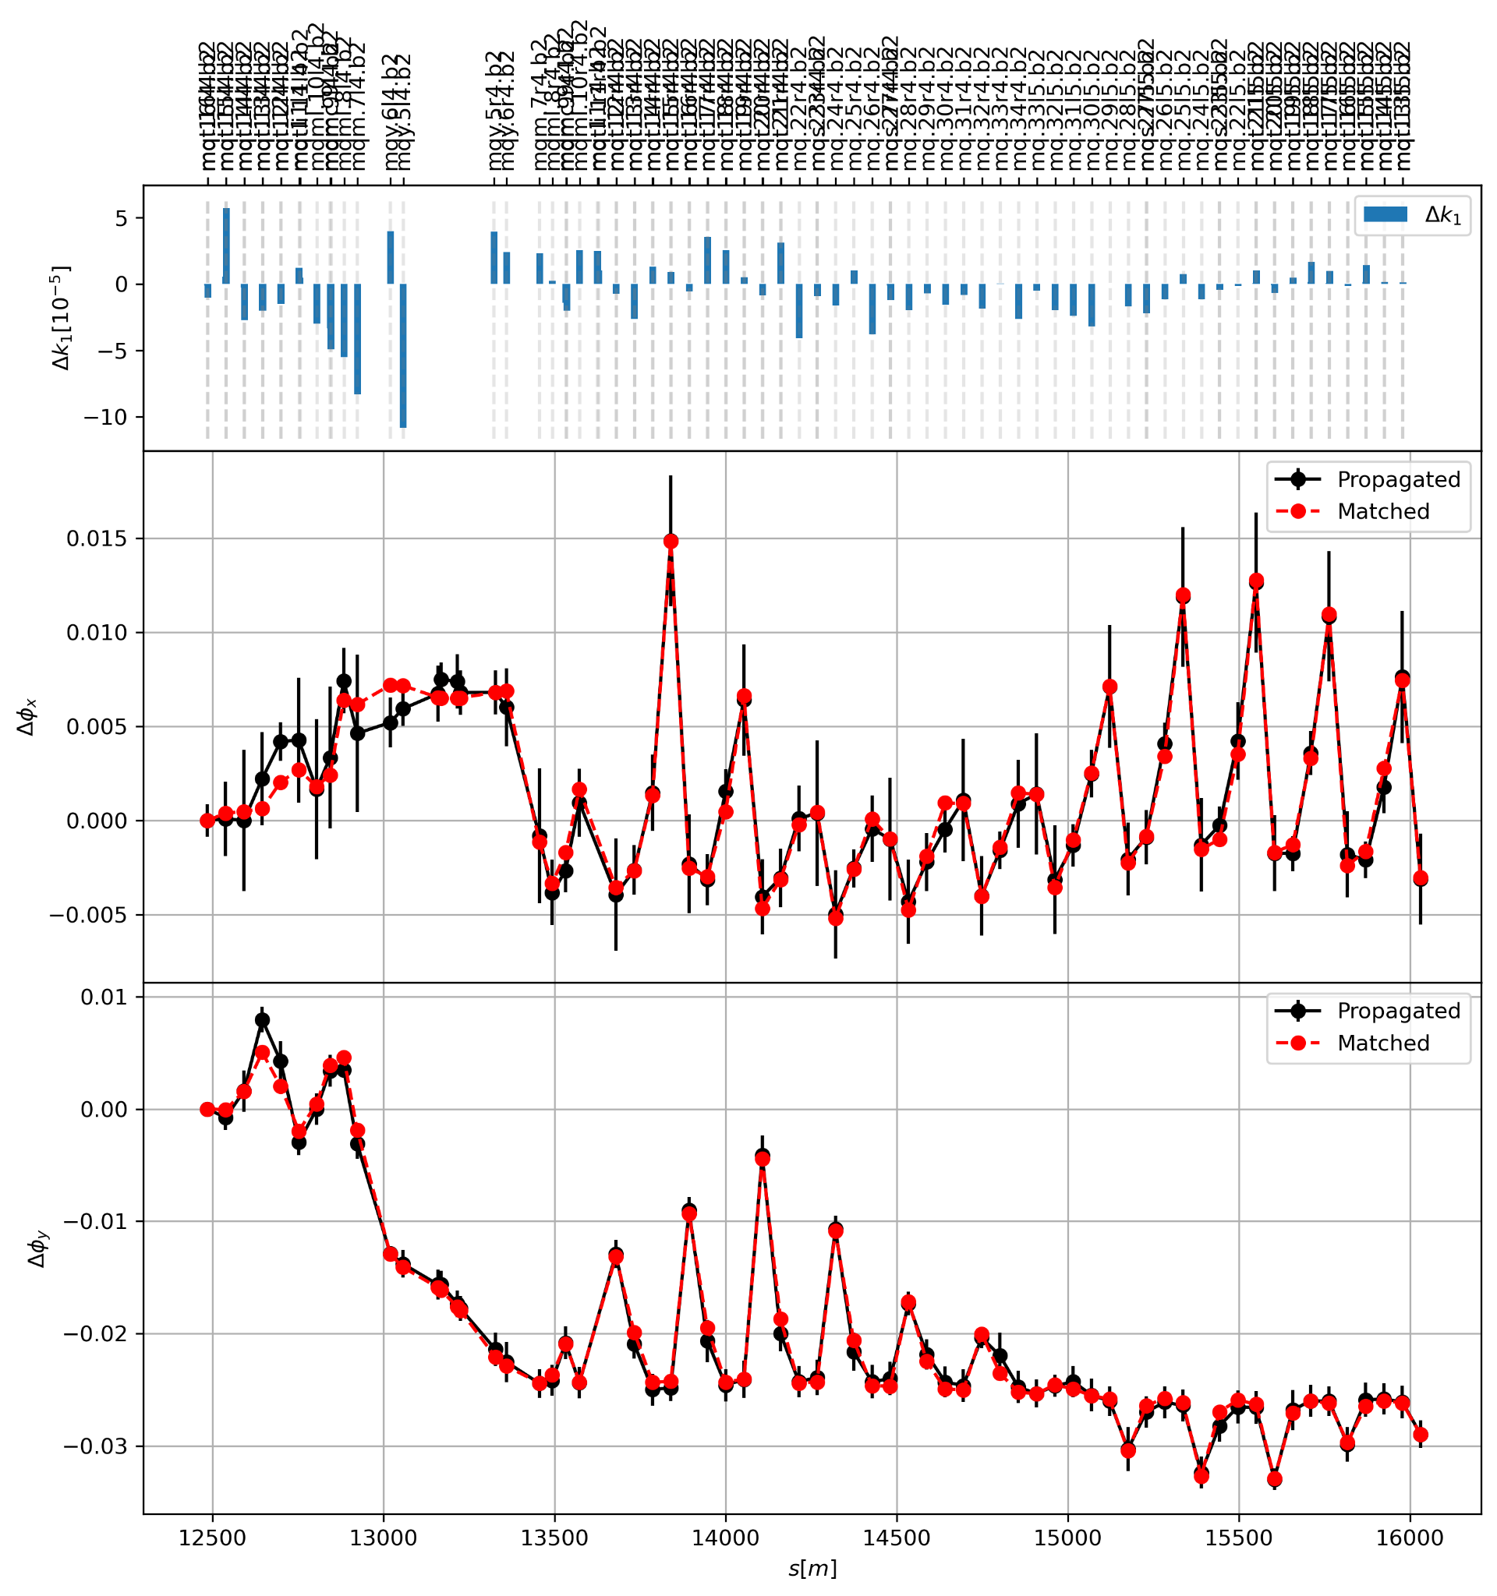
Arc45 Beam2
Comparing before and after
Before Corrections
After Arc Corrections

Slide 16
Arc45 Beam2
Investigating the phase error
Global corrections include kq5.l4b2
with strength ~ 8.6e-5
From the segment response, kq5 seems to generate a significant part of the phase error
After Arc Corrections
Possibility for a local correction for IP4 and/or removing kq5.l4b2 from the global corrections?

Slide 17
Conclusions
Successful optics corrections with local arc corrections for HL optics with high ATS factors
Beam1 corrections improve optics control with ~12% peak β-beat
Beam2 under control, apart from Arc45
MD5 part canceled, so no more studies could be performed
Simulated corrections for Beam2 show improvement

Slide 18
Spare slides

Slide 19
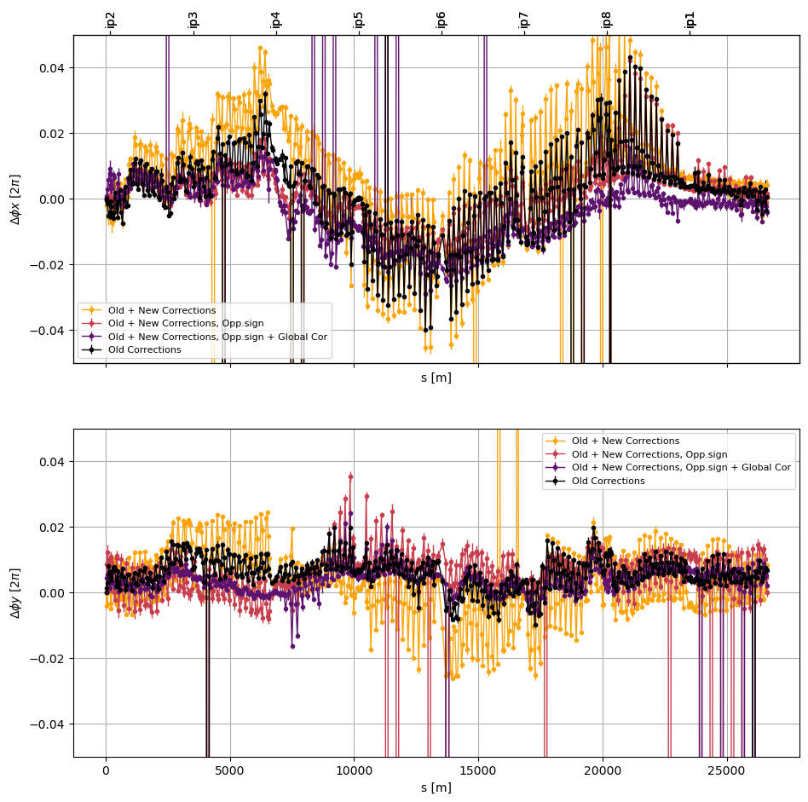
Arc45 Beam1
Arc 45 also has the peak β-beat for Beam1
Same issue with global corrections and kq5.l4?

Slide 20
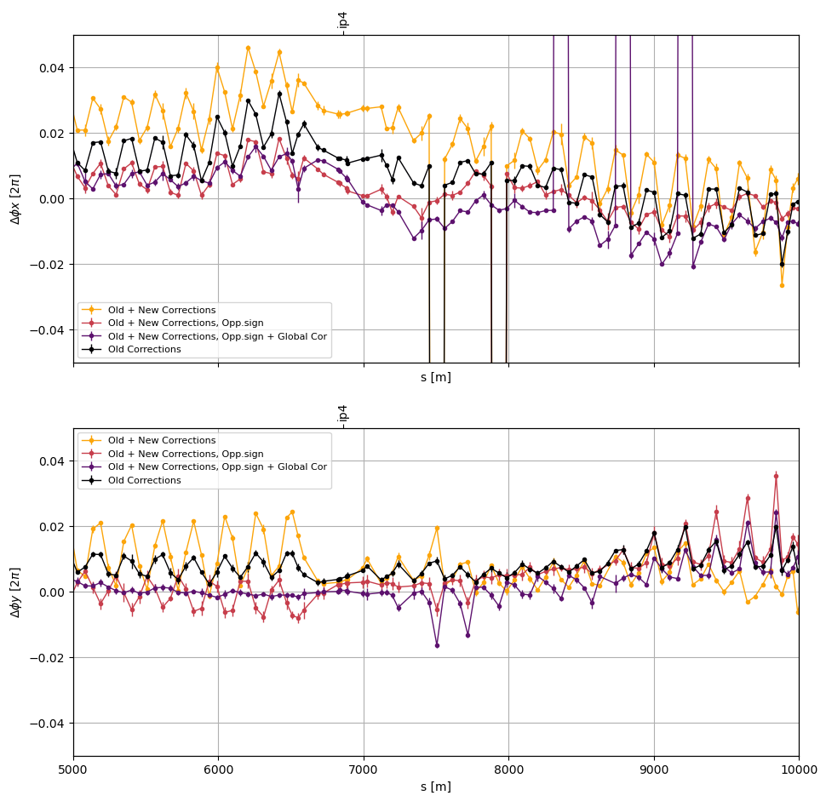
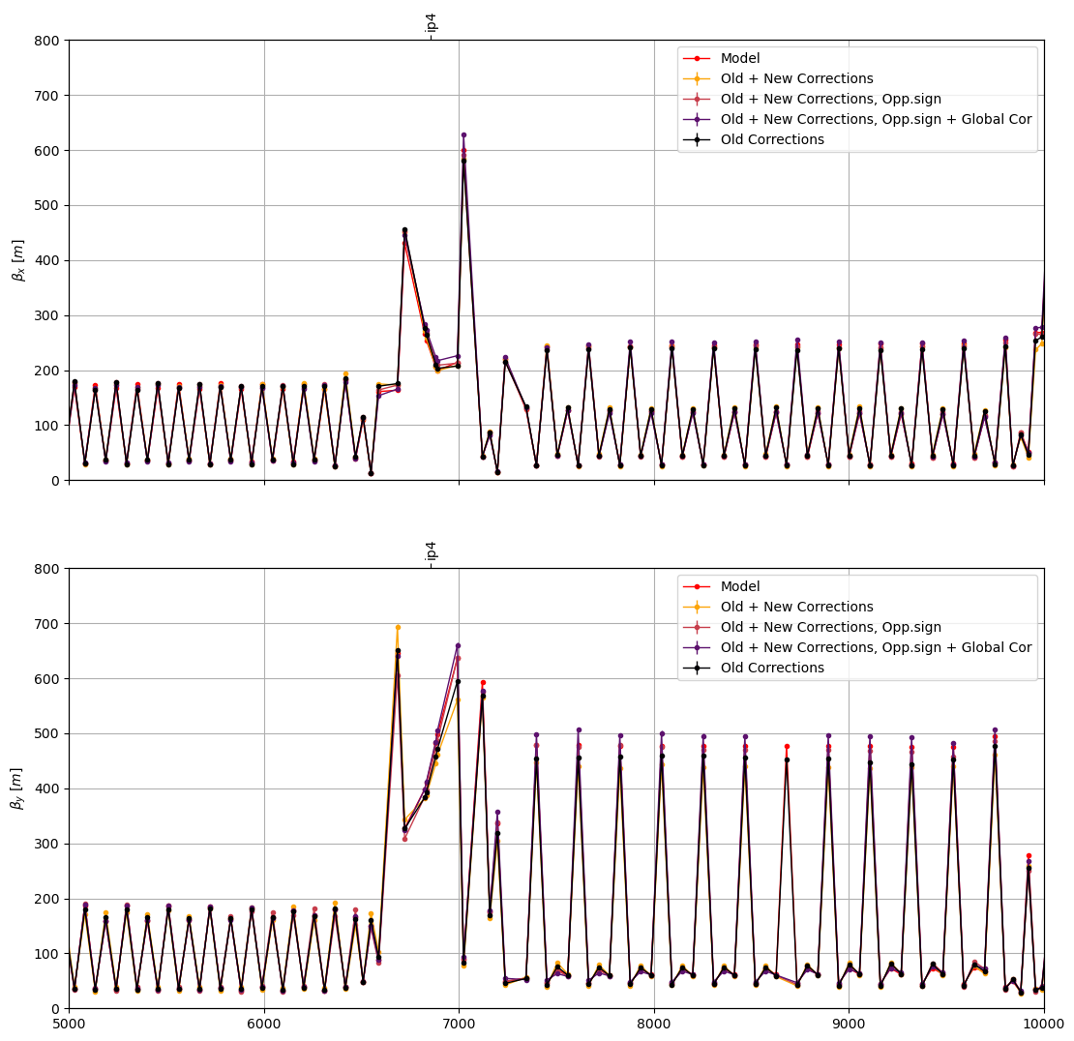
Arc45 Beam1

Slide 21
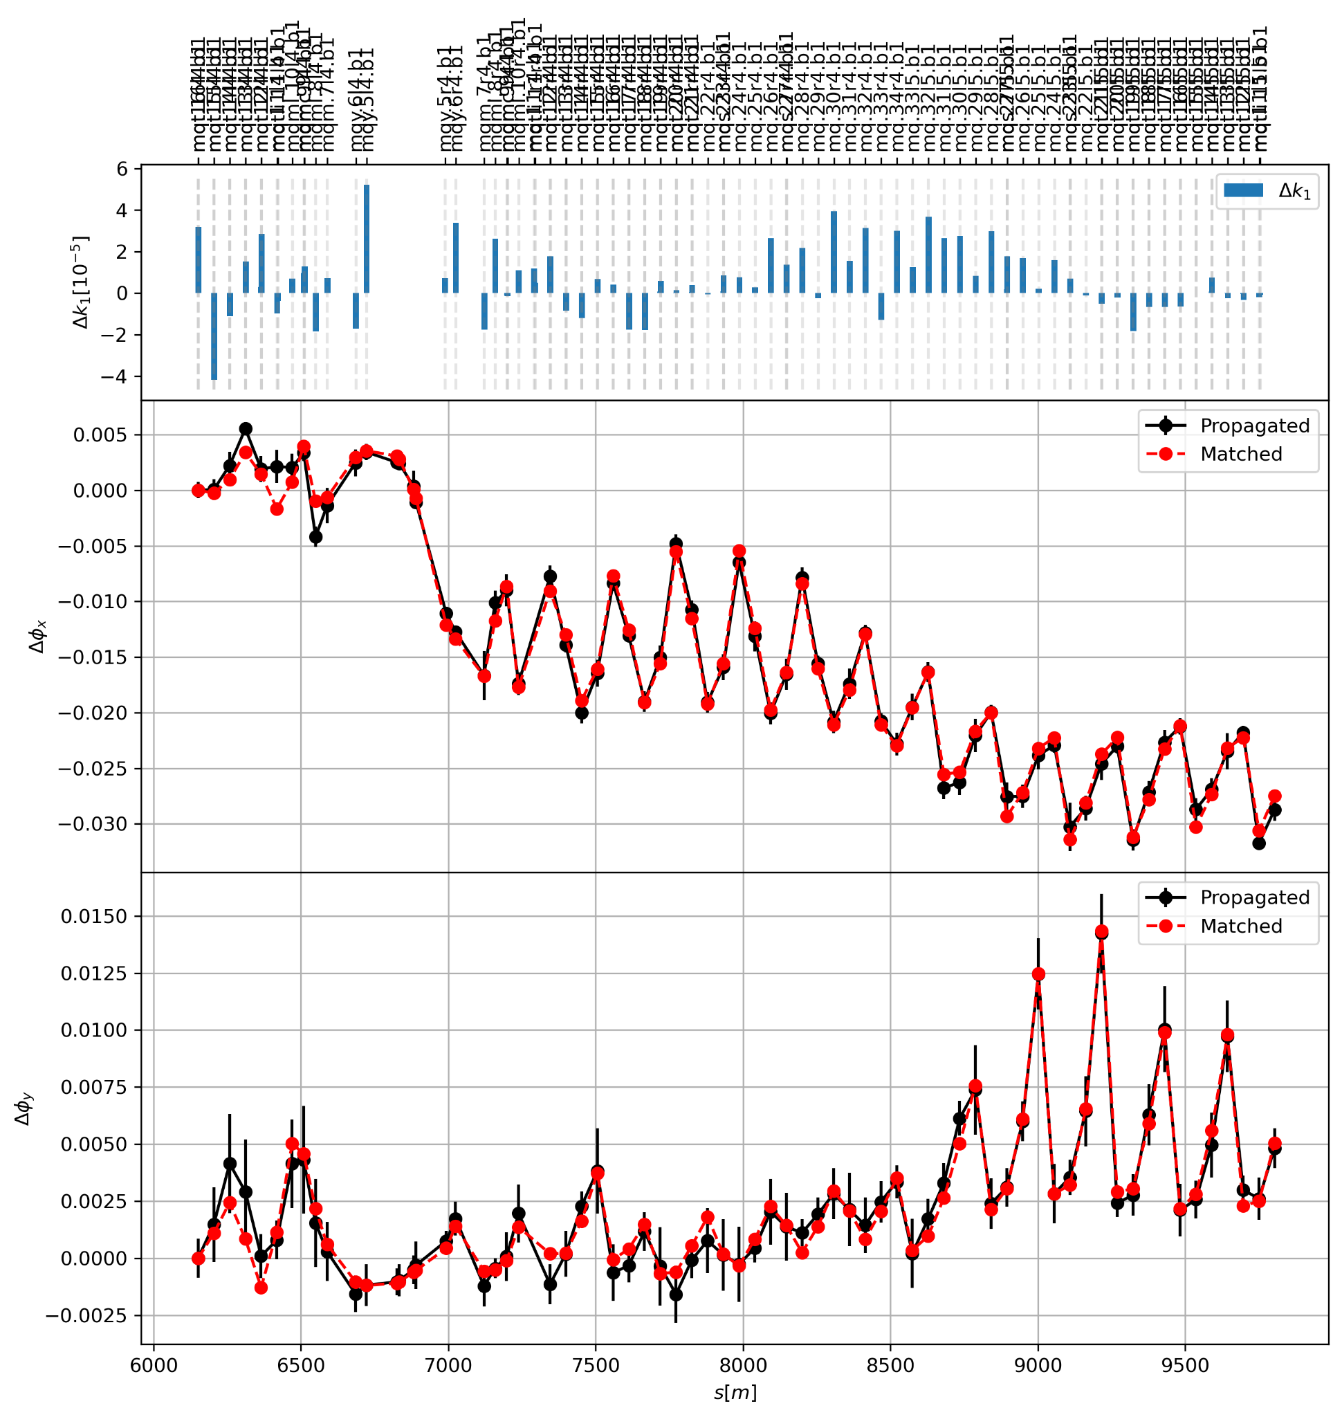
Arc45 Beam1
Investigating the phase error
KQ5.l4b1 included in the global corrections (~-3.4e-5)
After arc correction and global corrections

