Slide 1
Results from e-cloud MDs:
Negative octupole polarity at injection and
1000 bunches with 2.3e11 ppb
Konstantinos Paraschou, Lotta Mether,
Giovanni Rumolo, Benoit Salvant
HL-LHC WP2 Meeting
4th November 2024

Slide 2
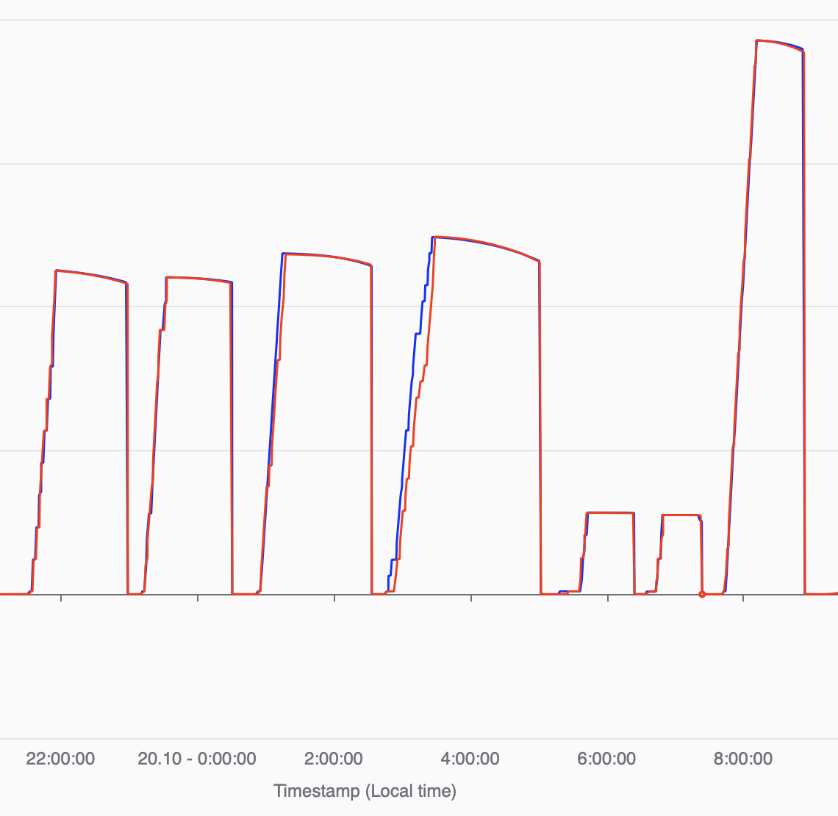
MDs Overview
Heat-load at injection
Short fills (trains of 2x48b) at:
2.3 10¹¹ p/b (972 bunches)
1.9 10¹¹ p/b (1164 bunches)
1.5 10¹¹ p/b (1548 bunches)
1.1 10¹¹ p/b (2124 bunches)
Negative octupole polarity
Find optimal tune and
stability threshold with:
Negative oct. polarity
Positive oct. polarity
and
Test LHC filling with negative octupole polarity
Heat-Load MD
2.3 10¹¹ p/b
1.9 10¹¹ p/b
1.5 10¹¹ p/b
1.1 10¹¹ p/b
1.6 10¹¹ p/b
Negative Octupole Polarity MD

Slide 3
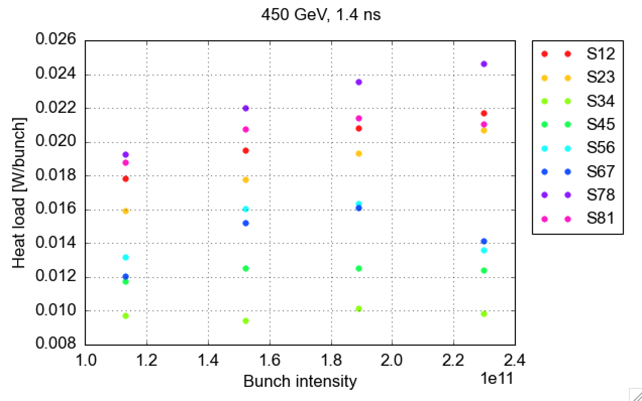


Heat load
High heat-load sectors (78, 81, 12, 23) show a trend that is increasing with bunch intensity.
Medium heat-load sectors (56, 67) have lower heat load at 2.3 10¹¹ p/b compared to 1.8 10¹¹ p/b.
Low heat-load sectors (34, 45) are rather constant at low heat loads (also larger uncertainty due to low absolute heat-load)
Compatible with expectations!

Slide 4
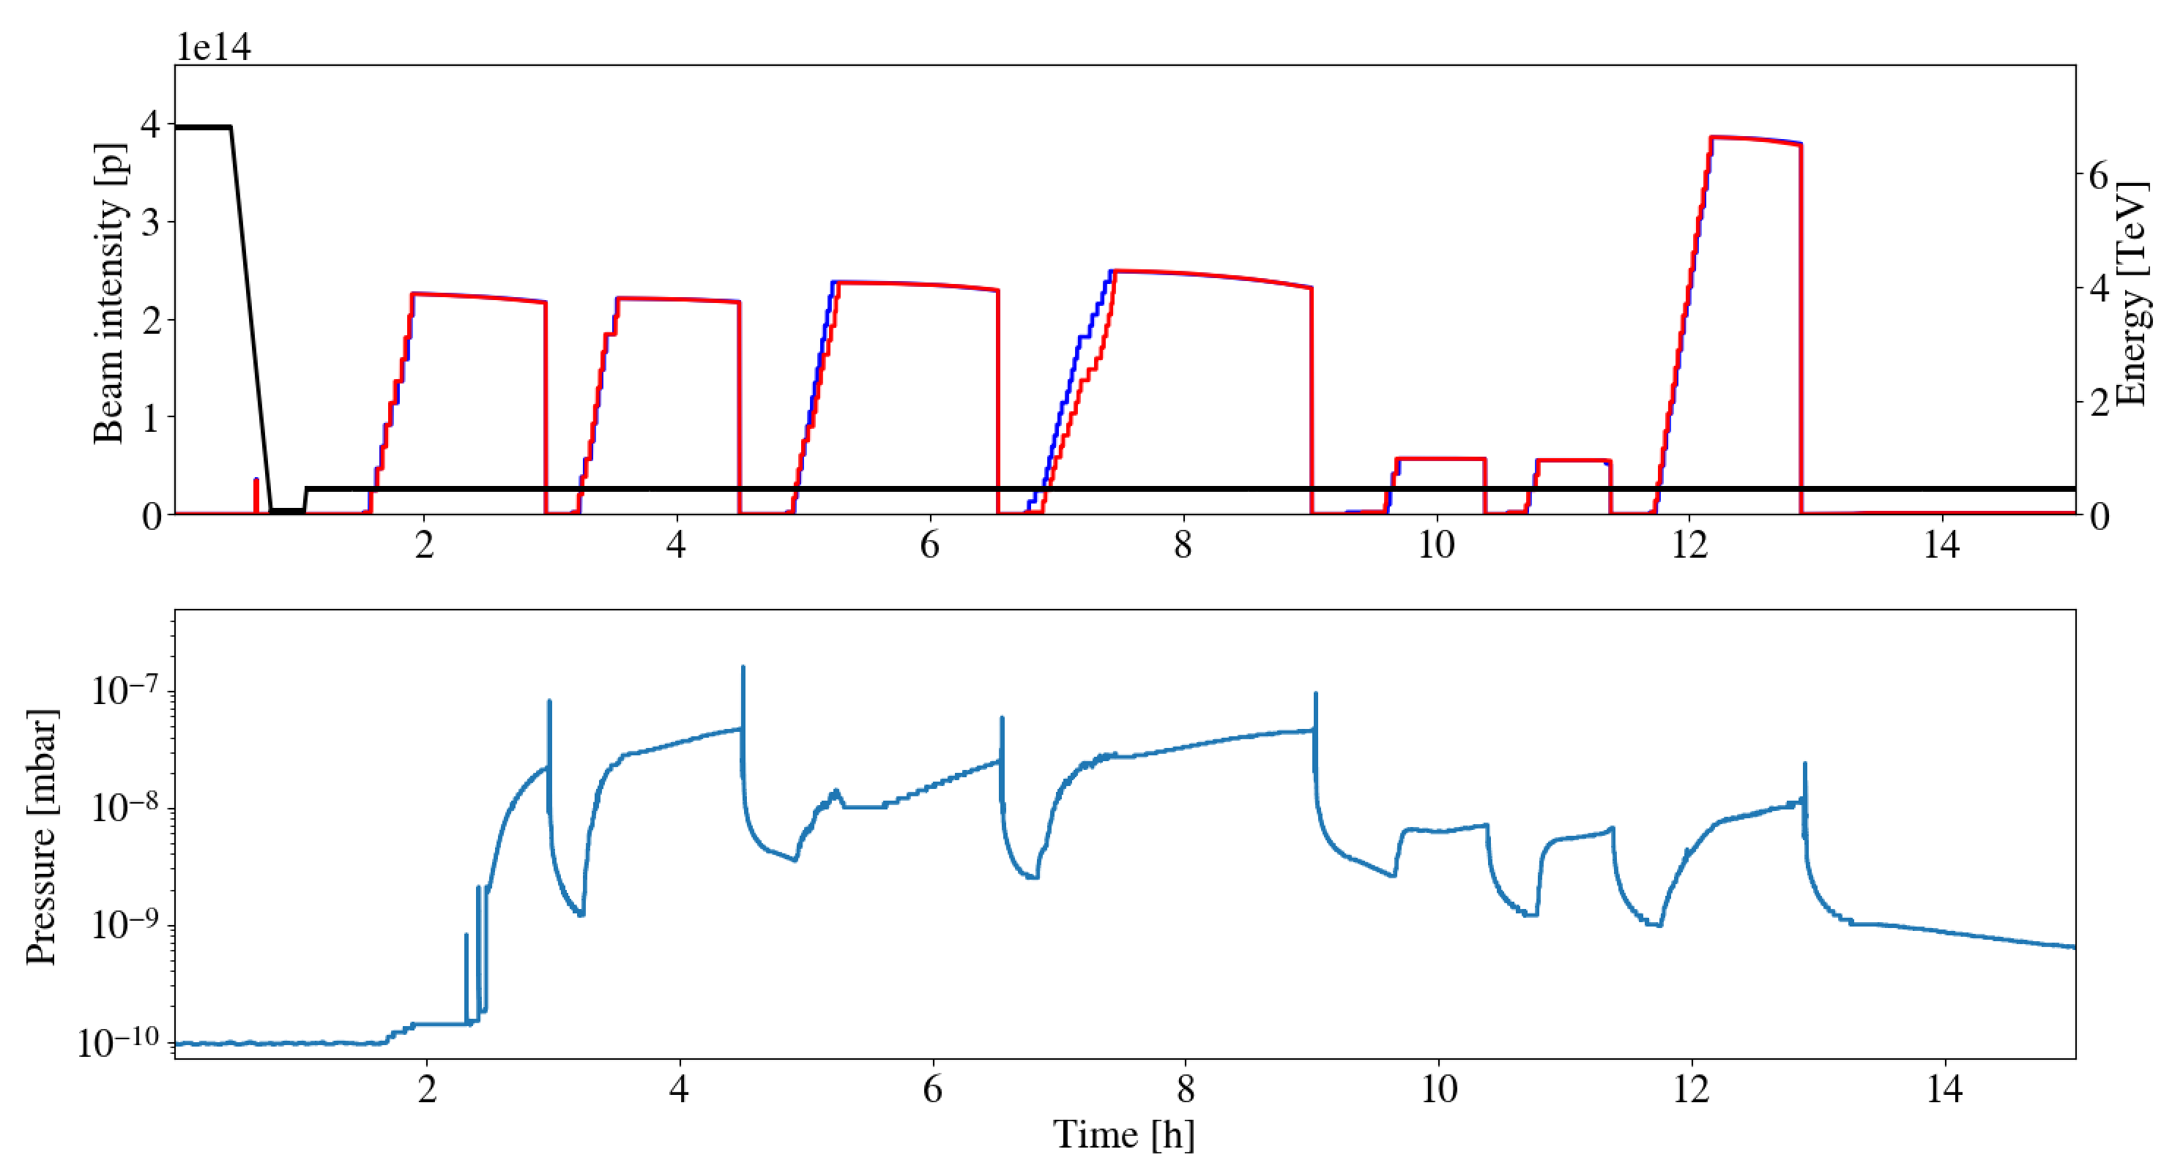
Pressure in VGPB.222.1L5.X.PR
Stronger than usual outgassing was observed left and right of IP5 in common chambers (VGPB.222.1L5.X.PR, VGPB.222.1R5.X.PR).
Small pressure spikes followed by
inrease of dynamic pressure, significantly delayed with respect to the injection of bunches.
Dynamic pressure remained in later fills even with lower bunch intensities

Slide 5
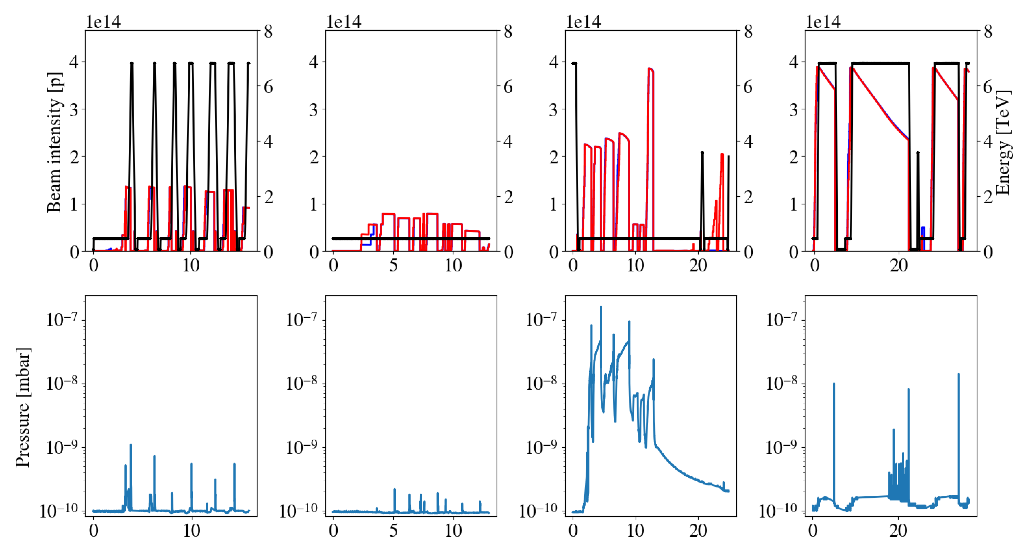
Pressure in VGPB.222.1L5.X.PR
2022 MD
1
2024 MD4
2
3
2024 LHC fills
4
2024 MD5
Time [h]
Small spikes during:
Small spikes during MD with 1.8 10¹¹ p/b at top energy (in 2022),
Tiny spikes during MD with 2.3 10¹¹ p/b at injection (350 bunches)
Larger spikes and dyn. pressure during MD with 2.3 10¹¹ p/b at injection (972 bunches)
Small dyn. pressure rise during latest LHC fills in 2024.
Larger dynamic pressure rise has not re-appeared in the 2024 pp reference run.

Slide 6
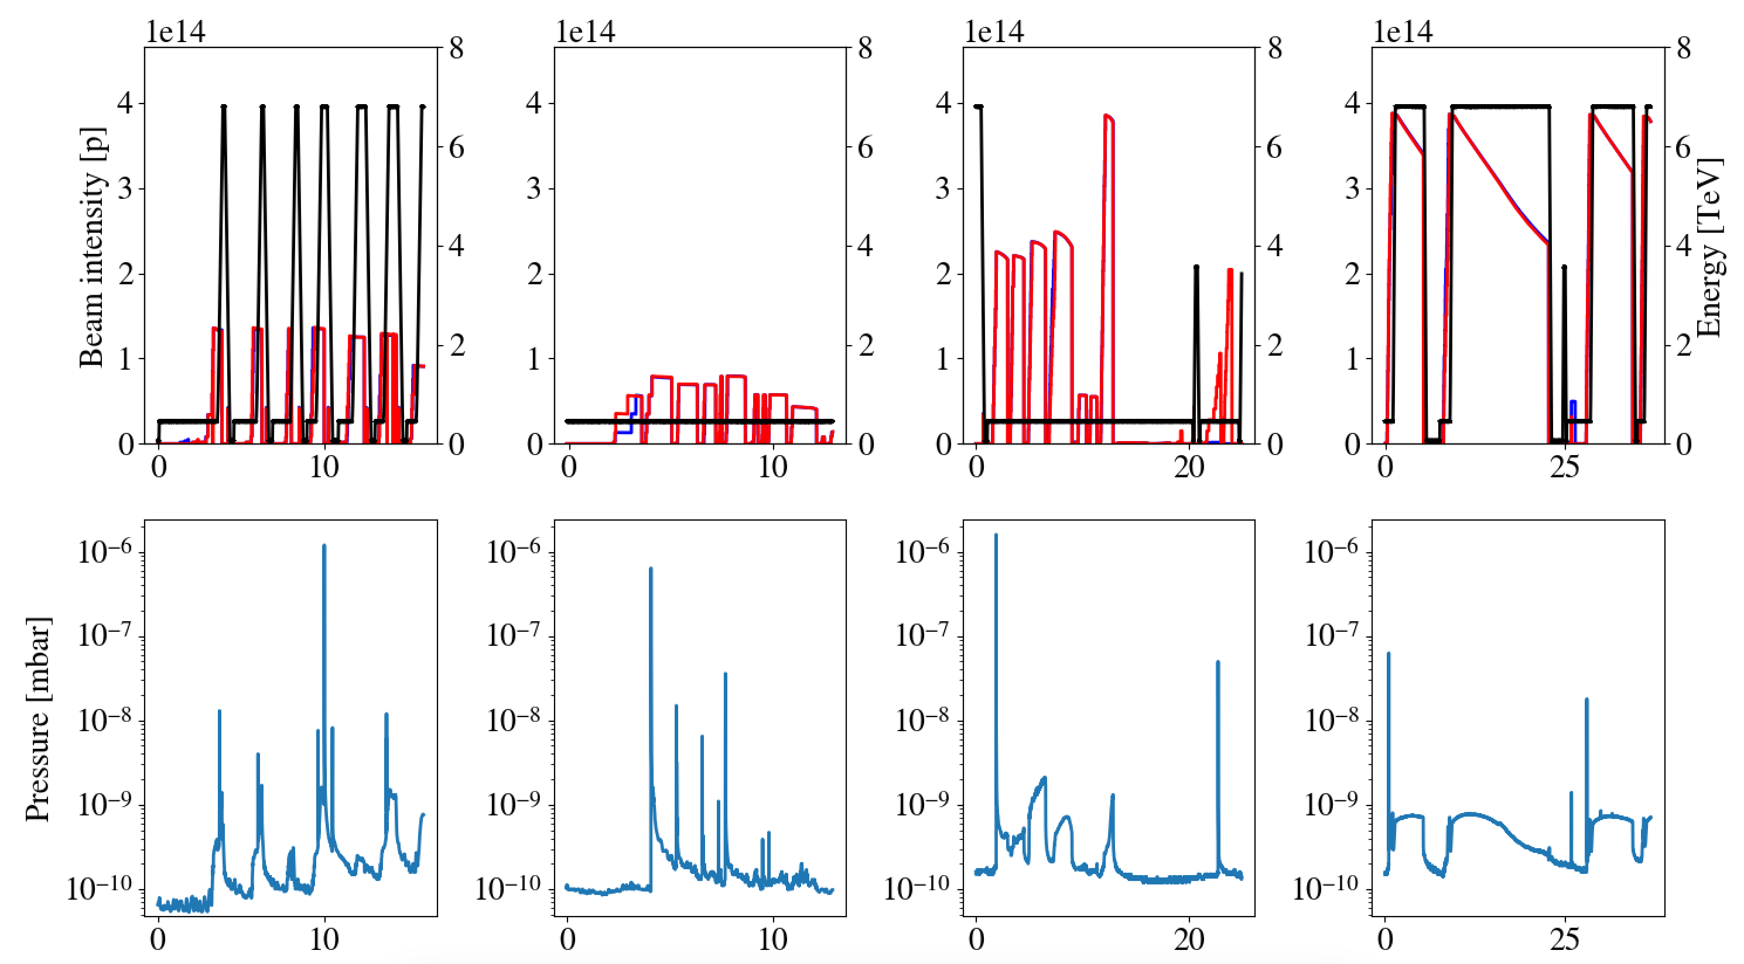
Pressure in VGPB.1175.5R4.R.PR
1
2
2024 MD5
3
4
2022 MD
2024 LHC fills
2024 MD4
Time [h]
Location in cell 5R4, B2 show large pressure spikes (~10⁻⁶ mbar) during all MDs and frequently during LHC fillings.

Slide 7
Summary (1/2)
Heat load MD – experience with 2.3 10¹¹ p/b:
Very succesful MD, no major issues encountered.
Heat load data confirm qualitative behaviours expected from e-cloud simulations. To be compared quantitatively in more detail.
Suspicious behaviour of pressure spikes and dynamic pressure rise in the common beam chambers left and right of IP5:
  Has not re-appeared in the pp reference run. Unlikely to have caused damage.
  Possibly related to high bunch intensity + large number of bunches.
  Possibly related to event during MD block, where loss of communication caused all vacuum valves to close around IP5.
  Pressure spikes in 5R4 - B2. Is being followed up.

Slide 8
MDs Overview
Negative octupole polarity:
Find optimal tune.
Decrease octupole slowly to find instability threshold.
Heat-Load MD
Positive octupole polarity:
Find optimal tune.
Decrease octupole slowly to find instability threshold.
Test LHC injection with negative polarity.
2.3 10¹¹ p/b
1.9 10¹¹ p/b
1.5 10¹¹ p/b
1.1 10¹¹ p/b
1.6 10¹¹ p/b
Negative Octupole Polarity MD

Slide 9
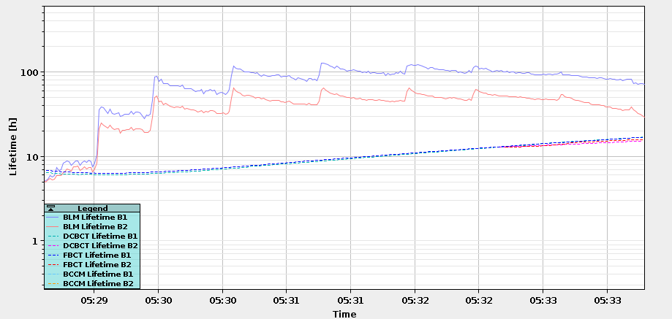
Negative octupole polarity
12 bunches
Smaller scan repeated around optimal tune after injecting trains
Optimal tune with trains was always equal to optimal tune with 12 bunches.
0.289/0.307
0.293/0.311
0.297/0.315
0.301/0.319
0.287/0.305
0.291/0.309
0.295/0.313
0.299/0.317
Process was repeated with positive octupole polarity to find that current tune (0.275/0.293) is optimal.

Slide 10
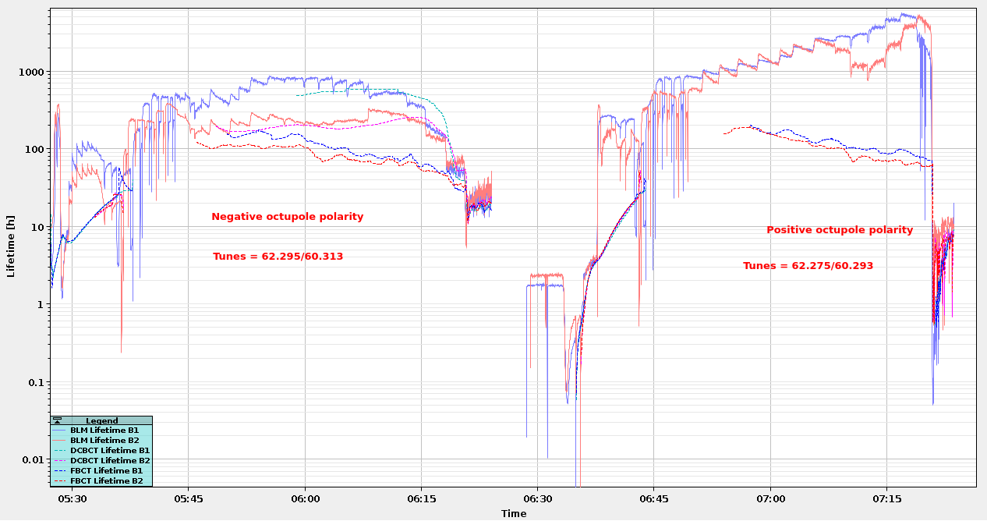
Lifetime comparing negative and positive octupole polarity
Scanning octupole current (starting from |I_{MO}| ~50 amps down to 0)
Lifetime with positive octupole polarity is almost always much better.

Slide 11
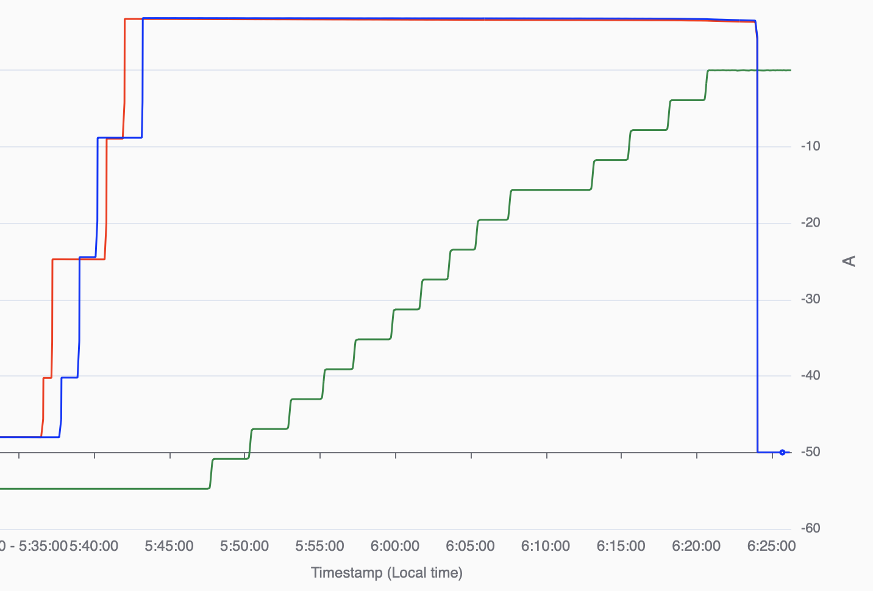
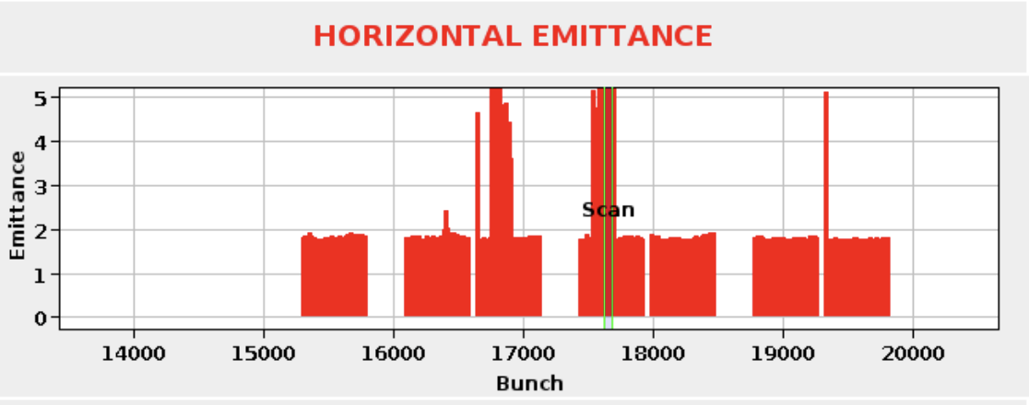
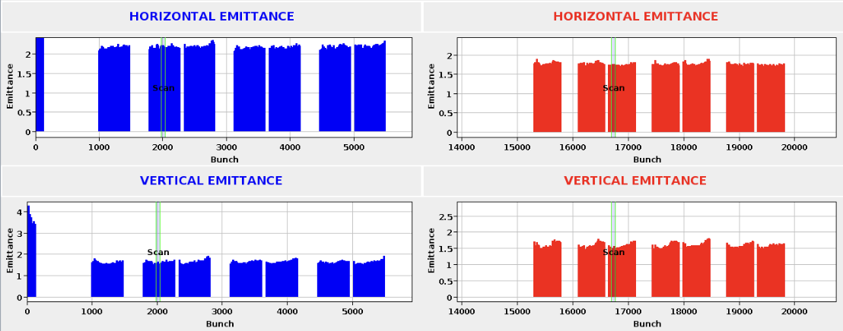
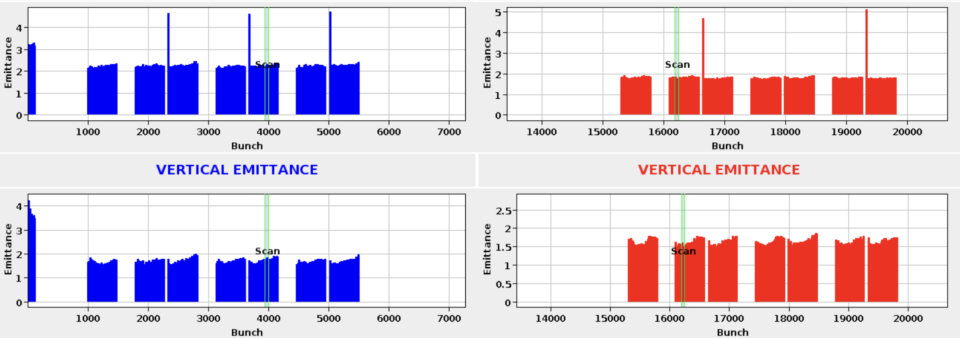
Negative octupole polarity – octupole scan
Violent instabilities (knob = 0)
steps of 0.3 in knob
(13 A per unit)
Lifetime started dropping (knob = 0.9)
Middle bunches instability (knob = 0.3)

Slide 12
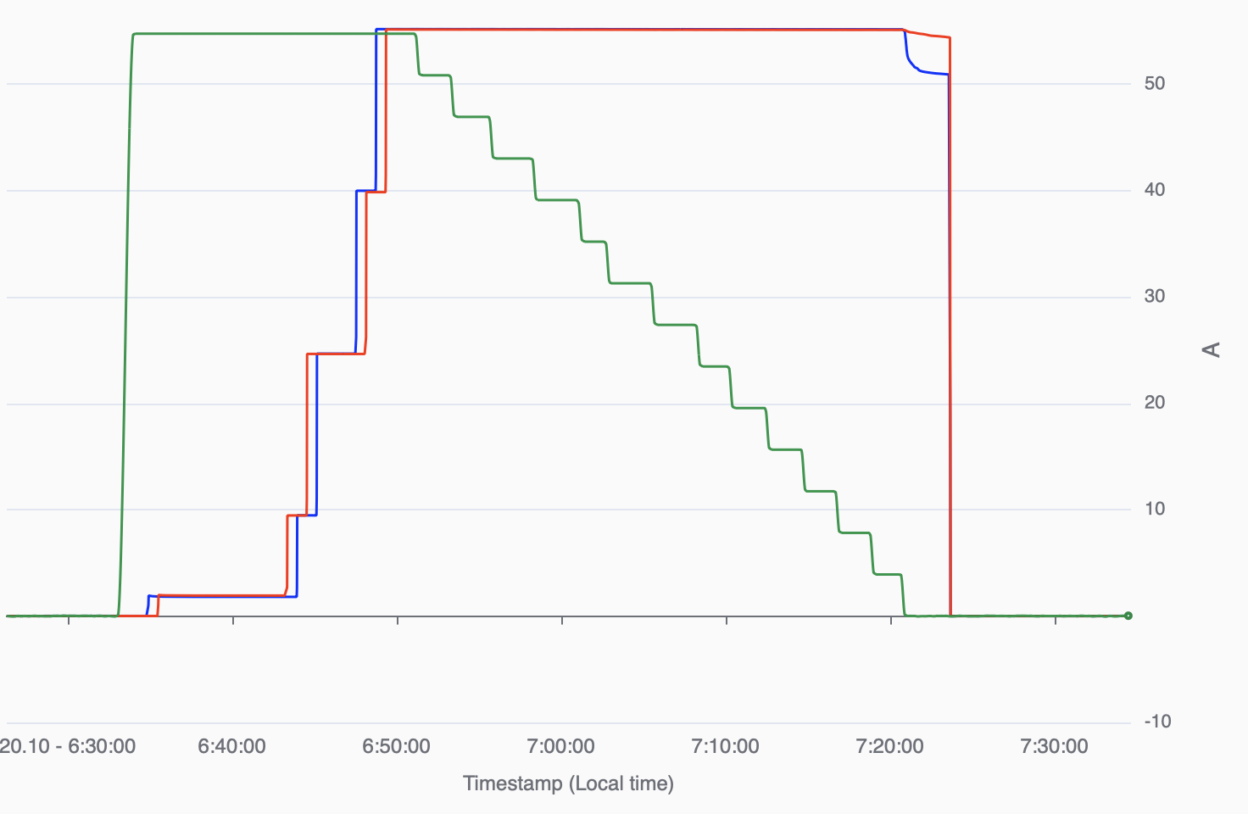
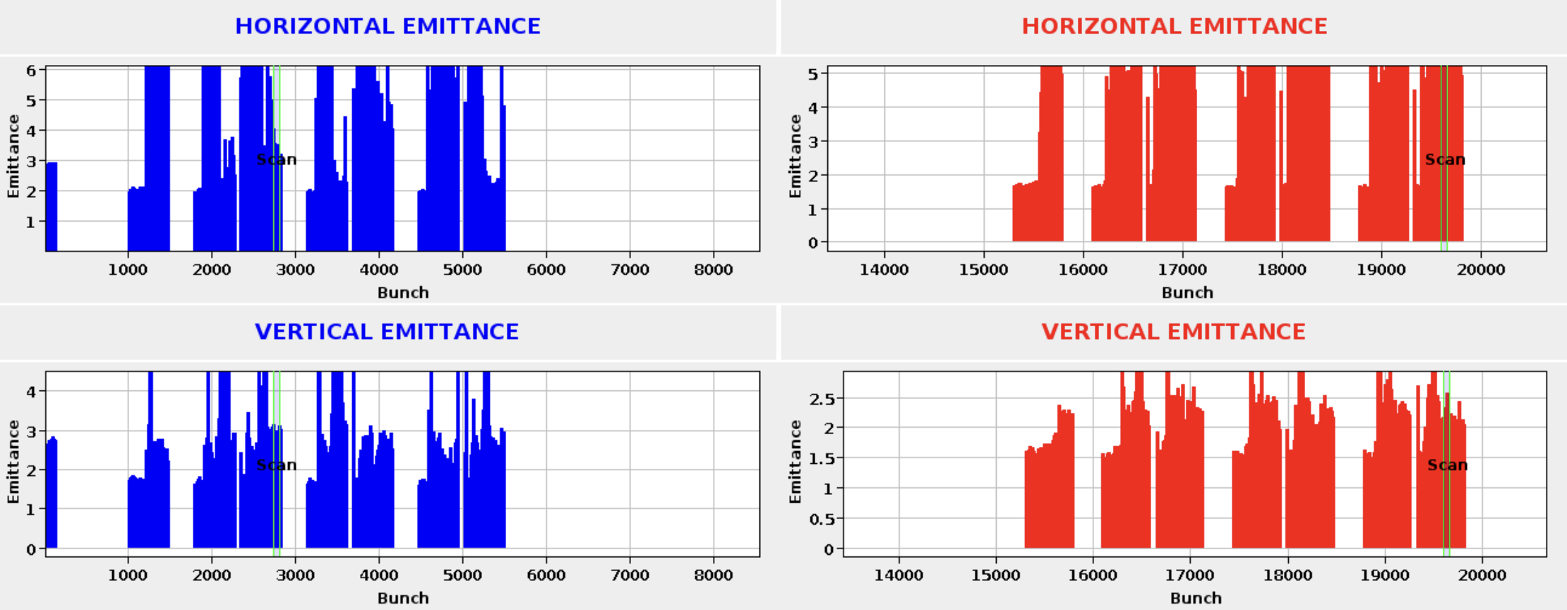
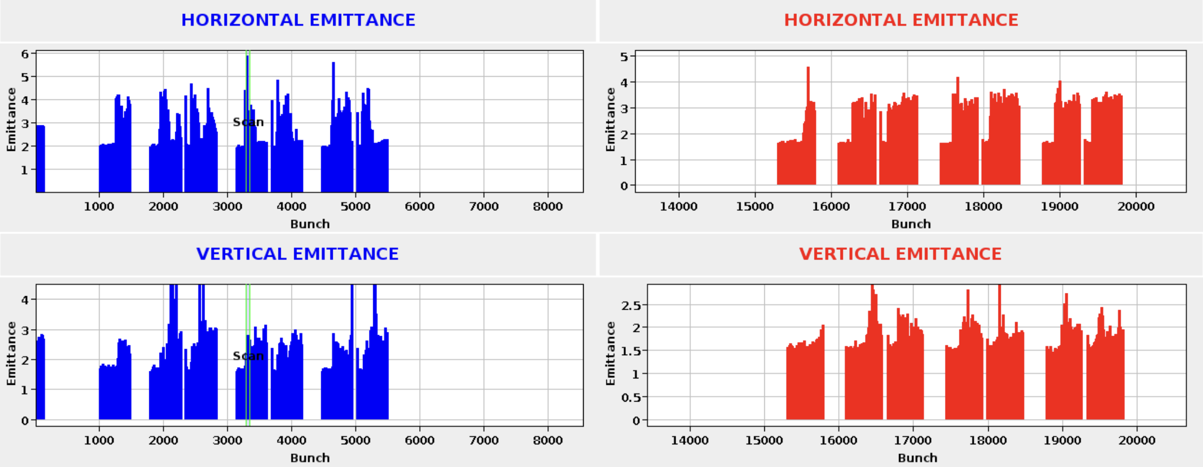
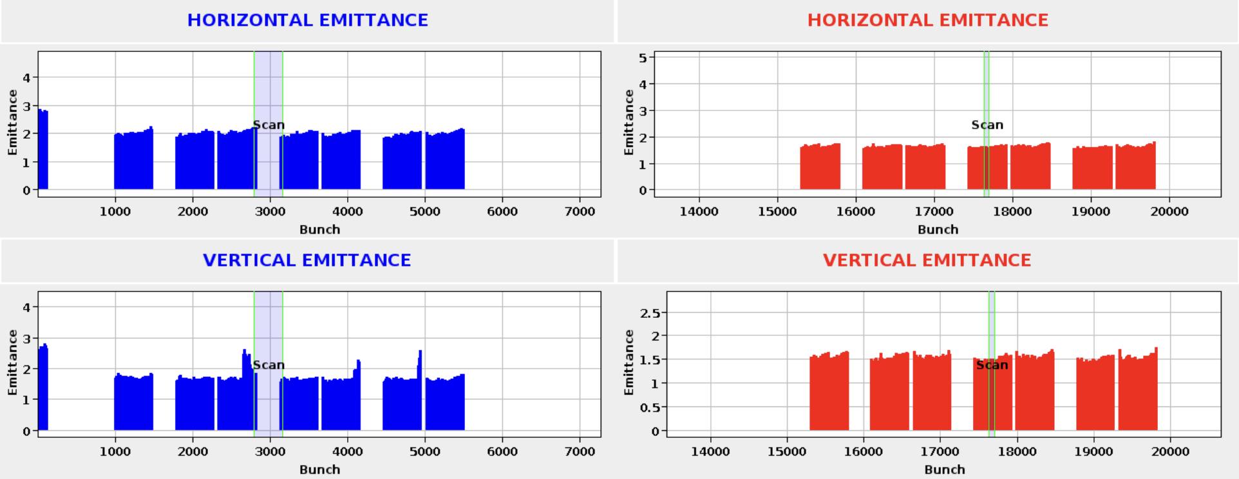
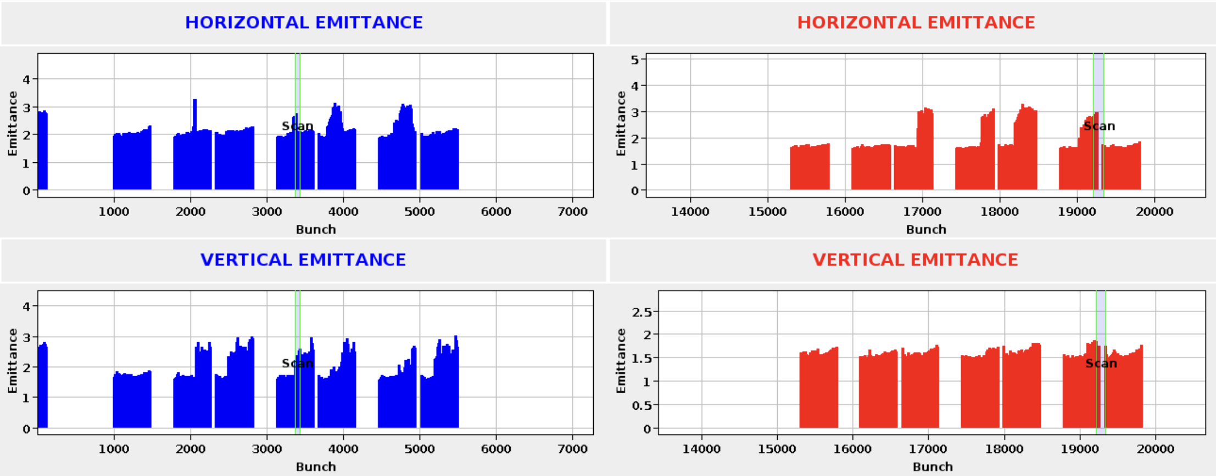
Positive octupole polarity – octupole scan
Violent instabilities (knob = 0)
And bigger (knob = -0.3)
Lifetime started dropping (knob = -1.8)
Mini instabilities (knob = -1.2)
Bigger instabilities (knob = -0.9)

Slide 13
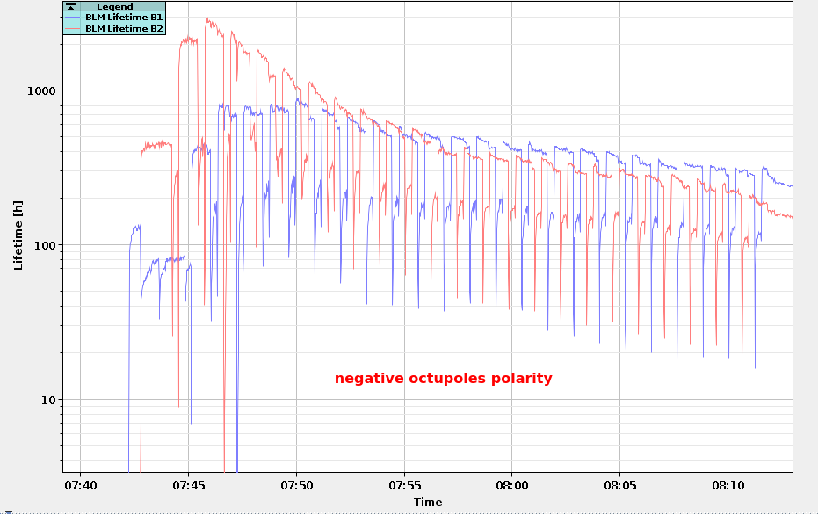
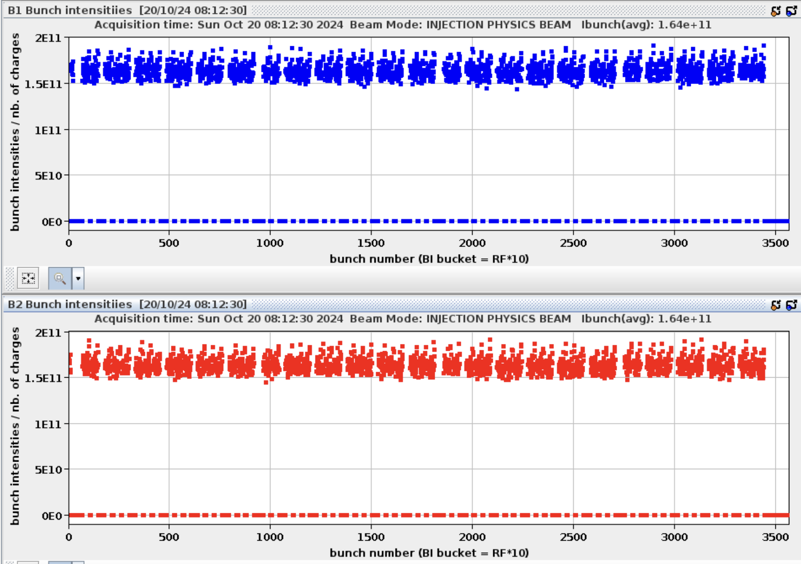
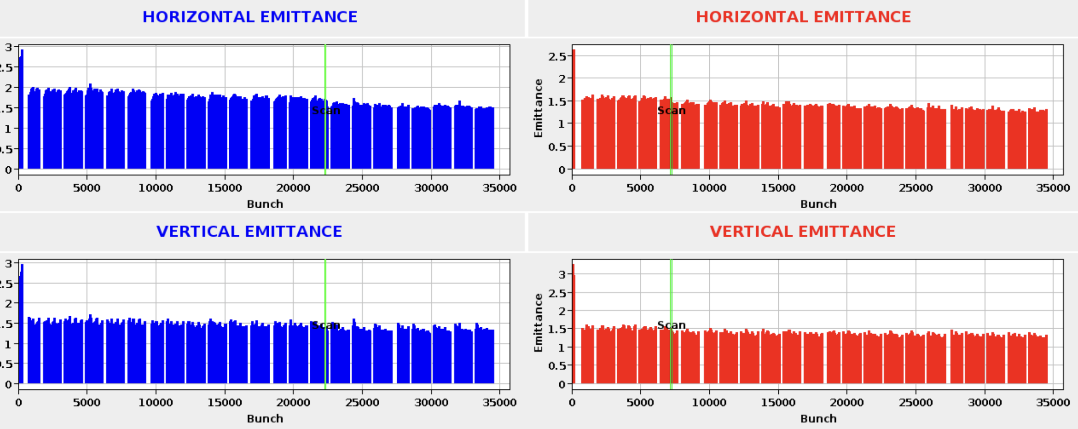
Test injection fill with negative octupole polarity
Operational octupole settings were:
B1 knob: -4.2
B2 knob: -3.5
Tunes at 62.275/60.293
Different from threshold that was found.
Possibly due to injection process being:
With constant injections
Magnetic decays changing coupling and chromaticity
Scrubbing?
Tested with octupole settings:
B1 knob: 3.2
B2 knob: 2.5
Tunes at 62.295/60.313

Slide 14
Summary
Heat load MD – experience with 2.3 10¹¹ p/b:
Very succesful MD, no major issues encountered.
Heat load data confirm qualitative behaviours expected from e-cloud simulations. To be compared quantitatively in more detail.
Suspicious behaviour of pressure spikes and dynamic pressure rise in the common beam chambers left and right of IP5:
  Has not re-appeared in the pp reference run. Unlikely to have caused damage.
  Possibly related to high bunch intensity + large number of bunches.
  Possibly related to event during MD block, where loss of communication caused all vacuum valves to close around IP5.
  Pressure spikes in 5R4 - B2. Is being followed up.
  Negative octupole polarity at injection energy:
  Optimal tune was found with negative octupole polarity: 62.295/60.313
  Instabilities appear at lower strength of octupoles with negative polarity.
  Lifetime is worse with negative octupoles compared to positive octupoles – but still acceptable (> 100h).
  LHC can run comfortably with negative octupole polarity at injection energy.
Thank you for your attention!
Konstantinos Paraschou

Slide 15
