Slide 1
HEARTS
WP Leaders Meeting #6
9 December 2024
https://indico.cern.ch/event/1472188/
Thomas Brent
CERN
WP2

Slide 2
Summary
Milestones and deliverables
Social media update
Article on CERN test run
P1 report feedback on WP2
Future plans

Slide 3
WP2 Upcoming milestones and deliverables
Deliv. No. | Deliverable name | Due date | Status
D2.3 | Knowledge transfer turnover report | 2025-12-31 | Pending
D2.4 | Final report on communication, dissemination, outreach and exploitation | 2026-12-31 | Pending

Slide 4
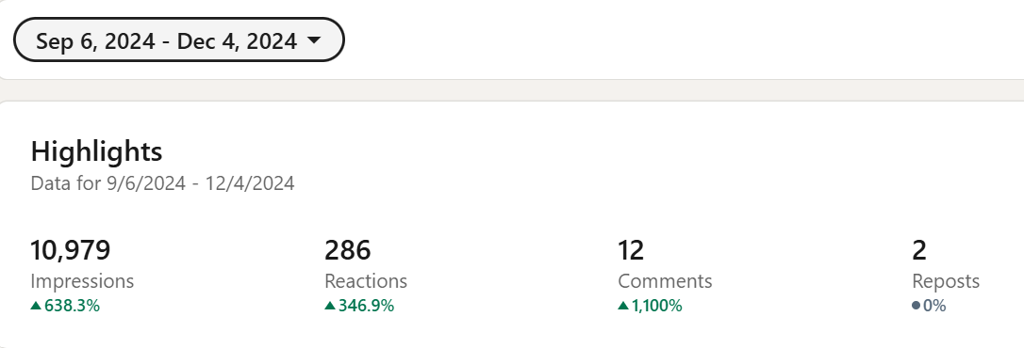
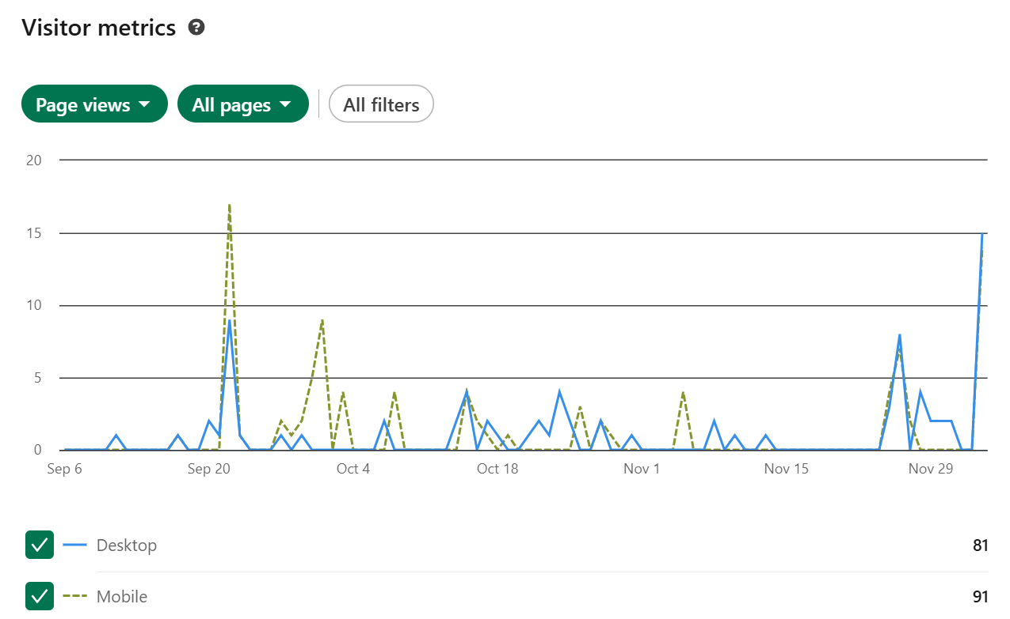
Social media - LinkedIn
September 2024: 354 followers
December 2024: 409 followers
55

Slide 5
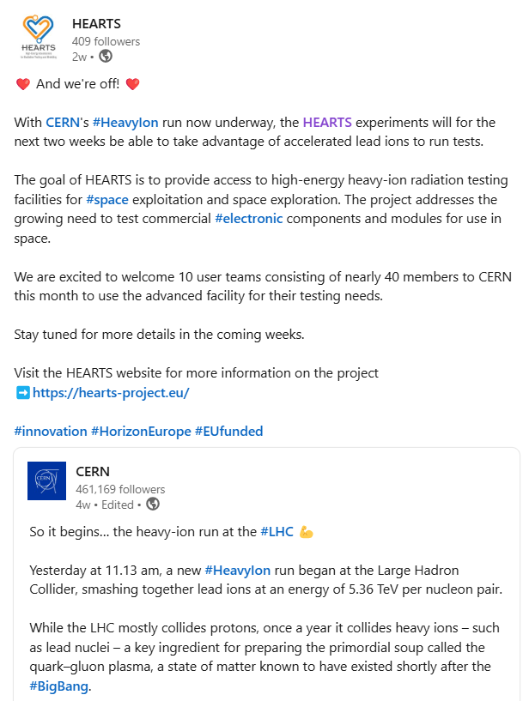
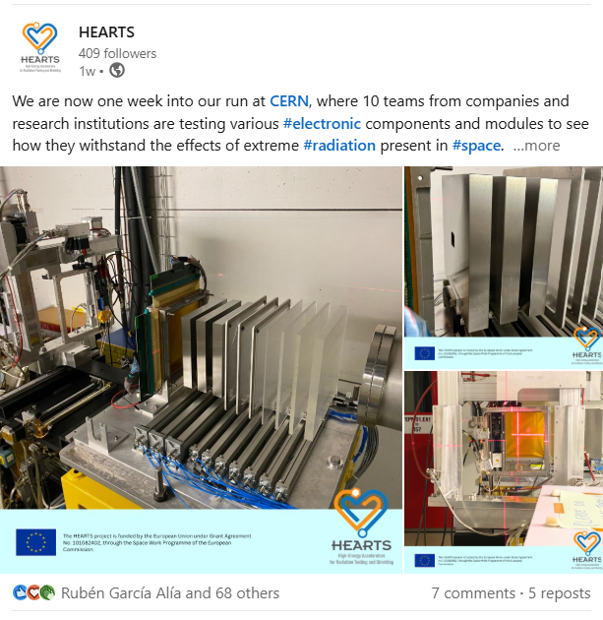
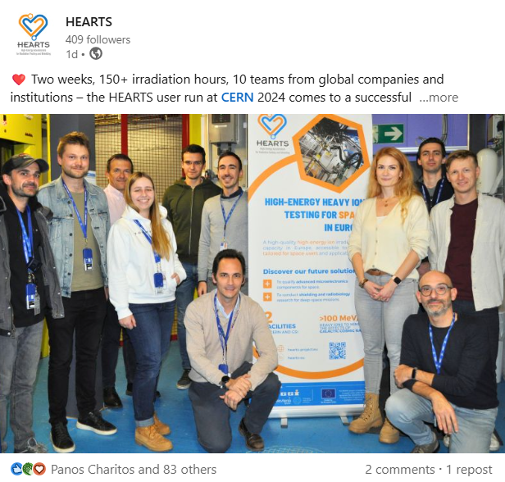
LinkedIn: CERN test run 2024
Beginning
Middle
End

Slide 6
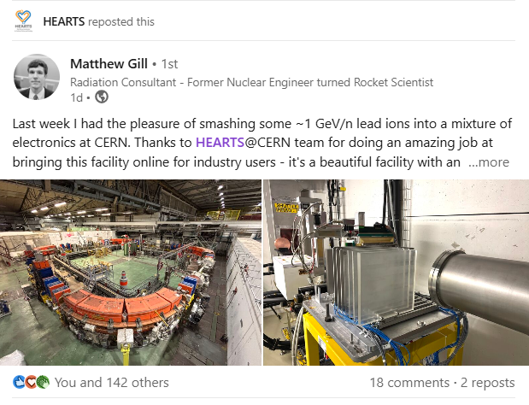
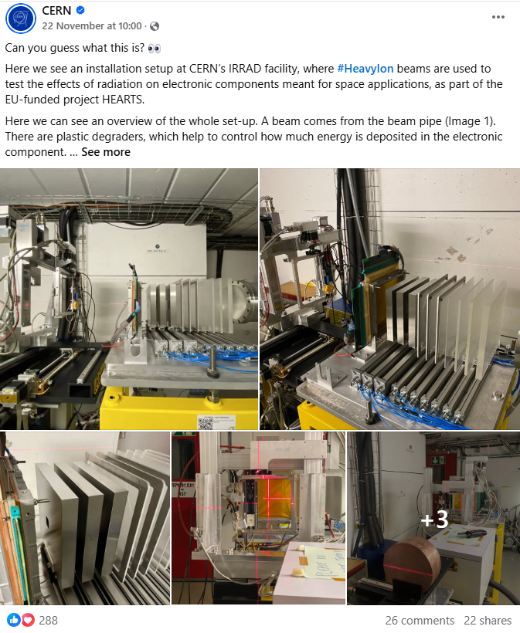
LinkedIn: CERN test run 2024

Slide 7
Article
Summarising the 2024 test run
With quotes from users
To be published on: HEARTS website, Accelerating News, EU Projects website and newsletter

Slide 8
Article (continued): User comments
“
“For space applications, if you cannot test a device, you cannot get it in the air. The HEARTS set-up provides unique testing capabilities, allowing users to expose components to very-high-energy heavy ions. We do not need such conditions for all of our testing needs, but for those that we do need them for, the CERN facility offers good potential.” - Renaud Mangeret, Airbus radiation expert
“…the results obtained during the test campaign will drive the design of next generation NaviLEO, NaviGEO and NaviMoon GNSS receivers, which are typically required to operate reliably in harsh radiation environments. This would have been almost impossible without CERN's high energy beam.” - Kévin Fischer, HW engineer at SPΛCEPNT
”

Slide 9
Article (continued): User comments
“
“We could do all the tests we had planned, the set up was as expected, it went smoothly and the flux was in the expected range. It’s hugely important to have testing facilities like this here in Europe.” - Mynaric AG team
“For the first ever user campaign, it went really well. The team really supported us, they were very flexible and responsive and took care of everything. It is becoming more important, technologically and politically, to have high penetration range testing for space applications in Europe.” – TESAT team
”

Slide 10
P1 review: Recommendations for communication
1. Having a description of the facilities on the project website as soon as possible would be highly beneficial for potential users, enabling interaction and providing them with the necessary information to plan their tests.
2. Beam Delivery: Clear communication regarding the specific types of VHE ion beams offered at each location, and to which types of tests they are meant is crucial.
3. As a recommendation the list of publications in the project’s website should be kept up to date. At the time of the review (September 25th) there is at least one recent paper (https://doi.org/10.1109/TNS.2024.3350667 published in January 2024) is missing.

Slide 11
Future Plans
Continue to grow LinkedIn audience through regular posting
Widely share article on CERN 2024 test run
Stay in contact with industrial users to share their results from the run
Foster future knowledge transfer activities through dissemination of project results
Promote project through external media

Slide 12
Thank you for your attention!
Questions?

