Slide 1
Conscious hiring at CERN
SCE DIO team - proposed implementation mechanisms in SCE

Slide 2

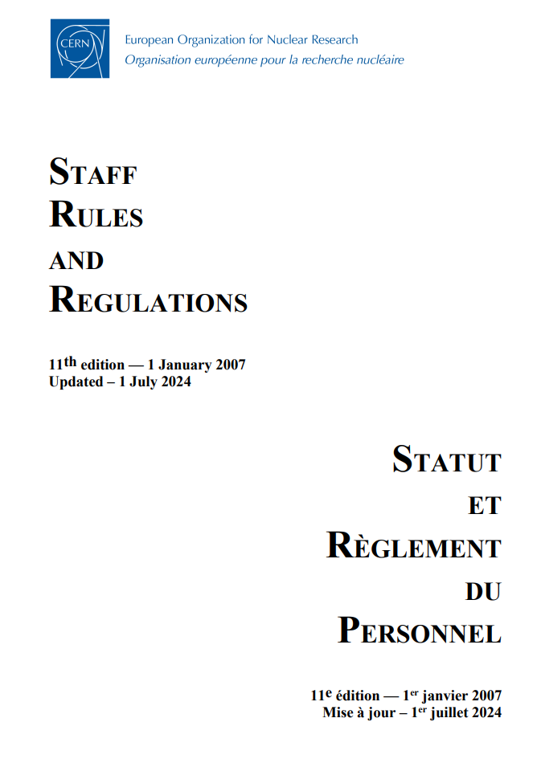
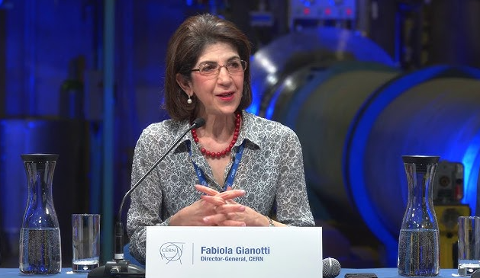
“
Several of the poorly balanced Member States have openly declared in the Finance Committee and the Council that their support for the FCC and CERN’s future more generally might be contingent upon an improvement in their personnel returns.
– Fabiola Gianotti, 30 April 2024
…initiatives to improve the human resources return for Member and Associate Member States … focus on “under-represented” countries
WHY?
  It’s a top priority part of CERN’s strategy
  We have a collective responsibility
  Our future depends on it
S II 1.04 “Director-General shall strive to ensure as fair a distribution as possible of nationals of the Member and Associate Member States and of gender”

Slide 3
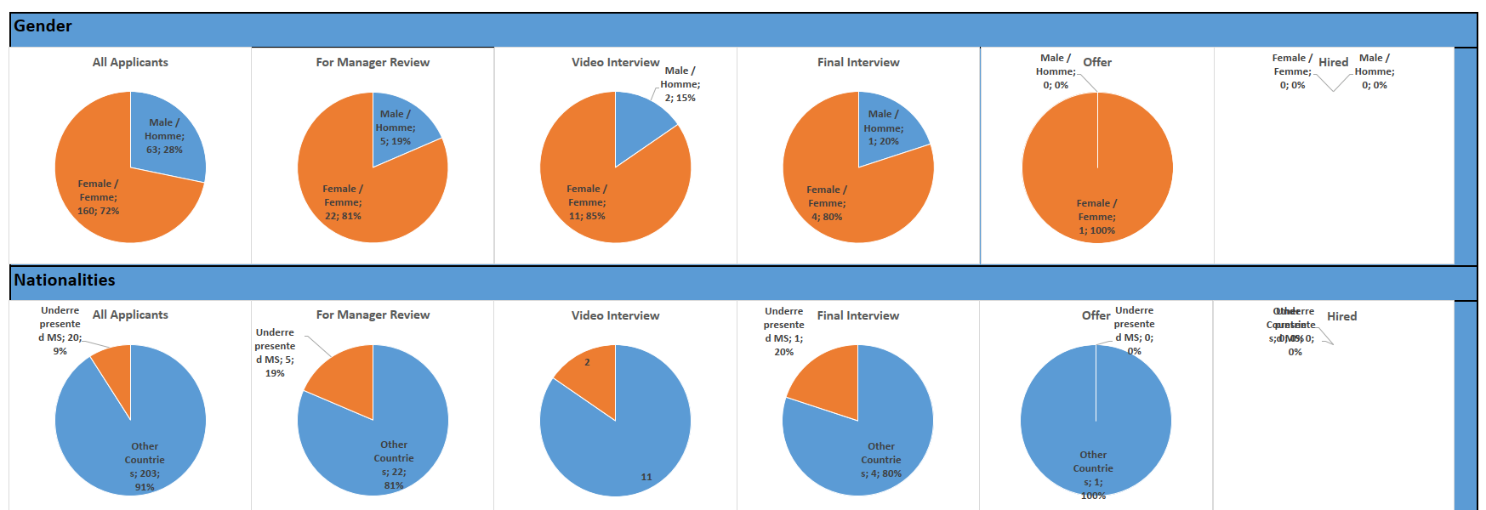
Staff: Ensure each stage includes PBMS
Responsible: Hiring department
Examples
  Departmental Representatives, involved in every staff hire, are to ensure diversity in the hiring, can voice concern and are partners for recruiters
  Last year in one department there was a massive outreach effort to have 25% from PBMS
Example: Selection Guidelines for Staff
Instructions to all groups to make every effort to improve diversity in LD hiring
Checkpoints at each stage (longlist, shortlist and final selection) with instructions that the pool/selection must be sufficiently diverse
Exceptions possible in specific cases, after discussion with DH
DH approval needed for insufficiently diverse selection (‘overrepresented’ categories), for long/short list composition or final selection
KEY to be honest to identify with the Departments the positions that are really open competition (without an internal candidate in mind) & focus efforts on those for diversity!
IMPORTANT CONSIDERATIONS
Shared ownership of this process between TA and Department
Under-Represented Categories (not only Nationalities)
HR should provide diversity info before closing of the vacancy notice (to allow for extensions)
HR should offer the TA diversity dashboard at every step of the recruitment
Risk to further delay the process, risk of losing good candidates
Need to quantify how many candidates
What happens if there is not enough diversity in the pool
Risk of tokenism
DH authorisation required for ORMS hiring

Slide 4
Staff: Exemption list for certain positions
Responsible: The hiring department
There are a number of positions at CERN requiring local knowledge & competencies
Departments will identify these positions in advance in their MPP
These positions will be exempt from all measures
As part of departmental workforce plan, DPO to identify posts that either require specific local competencies (eg legislation etc) or must have both languages from the outset.
Position to be cross-checked with HRA and list validated by sector director + FHR director
Director signoff of agreed positions

Slide 5



SCE recruitment process: LD Staff
PBMS: CZ, DE, DK, GB, IL, NL, NO, SE
ORMS: BE, BG, CH, FR, GR, IT, PL, PT
Stage | Identification of need + budget approval | VN drafting | VN publication in relevant channels | Applications received | Selection of eligible candidates (longlist) | Selection of candidates for video interview | Video interview & candidates for board (shortlist) | Pre board meeting | Selection board | Debriefing & candidate selection
Responsible | Hiring Manager(s) | Hiring Manager(s) + HR | HR, hiring managers, in their networks. Direct sourcing (HR) |  | HR (HR assures diversity in longlist & provides data on nationality of longlist) | Hiring Manager(s) | Hiring Manager(s) | HR, Hiring Managers | HR, Hiring Managers | HR, Hiring Managers
DIO role |  |  |  |  | Need to republish for greater diversity?
Max. 50% ORMS at LD board
DIO
checkpoint
DIO
checkpoint
DIO
checkpoint
DIO
checkpoint
DIO
checkpoint
DIOs input on diversity guidelines (as required) from RECR stage, with SCE Dept. Rep.
Is post exempt from diversity guidelines?
DIOs input on diversity guidelines (as required): tips for searching in SmartRecruiters to maximize diversity, challenge biases, search on key words
Hiring manager responsibility: Ensure PBMS are included in each stage of recruitment
DIOs as a Service in SCE: reassure, remind of responsibility & guidelines

Slide 6
Graduates: Ensure PBMS amongst finalists
Responsible: The hiring department
Example Selection Guidelines
Instructions to all groups to make every effort to improve diversity in LD hiring
Checkpoints at each stage (longlist, shortlist and final selection) with instructions that the pool/selection must be sufficiently diverse (not quantified)
Exceptions possible in specific cases, after discussion with DH
DH approval needed for insufficiently diverse selection (‘overrepresented’ categories), for long/short list composition or final selection
Process may be adapted to suit department’s needs
DH authorisation required for ORMS hiring

Slide 7
Students: Ensure PBMS amongst finalists
Responsible: The hiring department
Process may be adapted to suit department’s needs
Example selection Guidelines for Students
Step 1: Establish a list of the most suitable candidates, including:
    the most suitable female candidate;
    the most suitable male candidate; and
    the most suitable candidate from a PBMS if not already a candidate named above
  An explanatory note must be provided if no suitable candidate is identified in any category
Step 2: Select the preferred candidate among those identified under Step 1
  If the preferred candidate is not female or from a PBMS an explanatory note must be provided
Step 3: Select 2 reserve candidates
  If either or both reserve candidates is not female or from a PBMS an explanatory note must be provided
DH authorisation required for ORMS hiring

Slide 8
SCE recruitment process: Graduates & Students
PBMS: CZ, DE, DK, GB, IL, NL, NO, SE
ORMS: BE, BG, CH, FR, GR, IT, PL, PT
Stage | Identification of need + budget approval + role description | VN publication in relevant channels | Selection of eligible candidates (longlist) | Selection of candidates for video or phone interview | Video interview & top 3 candidates (1st choice + reserves
Responsible | Hiring Manager(s) | HR, hiring managers, in their networks. Direct sourcing (HR) | HR | Hiring Manager(s) | Hiring Manager(s)
DIO role | DIOs input on diversity guidelines (as required) from PRQ stage, with SCE Dept. Rep. Is post exempt from diversity guidelines? |  | HR assures diversity in longlist & provides data on nationality of longlist Need to republish for greater diversity? | DIOs input on diversity guidelines (as required): tips for searching in SmartRecruiters to maximize diversity, challenge biases, search on key words
DIO checkpoint
DIO checkpoint
DIO checkpoint
DIO checkpoint
Hiring manager responsibility: Ensure PBMS are included in each stage of recruitment
DIOs as a Service in SCE: reassure, remind of responsibility & guidelines

Slide 9
Guidelines for Hiring Managers
PBMS: CZ, DE, DK, GB, IL, NL, NO, SE
ORMS: BE, BG, CH, FR, GR, IT, PL, PT
Hiring manager responsibility: Ensure PBMS are included in each stage of recruitment
For all recruitments:
STEP 1: Establish a list of the most suitable sufficiently diverse candidates, including:
    the most suitable female candidate;
    the most suitable male candidate; and
    the most suitable candidate from a PBMS if not already a candidate named above
  An explanatory well-justified note must be provided if no suitable candidate is identified in any category
  Max. 50% ORMS at LD board
For Graduates & Students:
STEP 2: Select the preferred candidate among those identified under Step 1
  If the preferred candidate is not female or from a PBMS an explanatory well-justified note must be provided
STEP 3: Select 2 reserve candidates
  If either or both reserve candidates is not female or from a PBMS an explanatory well-justified note must be provided

Slide 10
Concrete actions + responsibilities
Theme | Action | Responsible | By when | Sign off
Drive Accountability | Document selection guidelines for increasing diversity for hiring managers | DIOs + GLs + HR-TA | End 2024 | DHO
Drive Accountability | Agree and publish new recruitment process(es) with increasing diversity as a goal (SY as template) | DIOs + GLs + HR-TA | End 2024 | DHO
Drive Accountability + Encourage Change | Write Flash News article on ED presentation + selection guidelines + new process for SCE | Dept. Comms | End 2024 | DHO
Drive Accountability | Deliver workshop for hiring managers on new process, guidelines + tips for hiring from PBMS | DIOs (Lucy) + GLs + HR-TA | Q1 2025 | DHO

Slide 11
Concrete actions + responsibilities
Theme | Action | Responsible | By when | Sign off
Monitor & Adapt | Document current recruitment challenges + list of roles exempt from guidelines incl. reasons for exemption; update yearly | DIOs + GLs + HR-TA | End 2024 | DHO
Monitor & Adapt | Document & share vision of all posts until end-2025: identify scope of possible diversity improvement (STAF LD + Retirements, GRAD, Students) | DIOs (Emeline) | End 2024 | DHO
Monitor & Adapt | Identify what dynamic data is available today to do “live” follow up of each recruitment stage + what more is needed | DIOs (Emeline) +GLs + HR-TA | End 2024 | DHO
Monitor & Adapt | Identify Trainee opportunities & foster collaborations between GLs & PBMS schools & universities | GLs + HR-TA | By end 2025 | DHO

Slide 12
Concrete actions + responsibilities
Theme | Action | Responsible | By when | Sign off
Encourage Change | Accompany GLs at group meetings to encourage & reassure hiring managers on new recruitment process | DIOs + GLs | End 2024 | GLs
Encourage Change | SCE DTO: training plan for hiring managers | DIOs (Vincent) + SCE DTO | End 2024 | DHO
Encourage Change | Document successes, publish in Flash News | DIOs + Dept. Comms + GLs | Ongoing until end 2025 | DHO
Encourage Change | Determine specific posts and do direct sourcing for PBMS candidates | GLs + HR-TA | Ongoing until end 2025 | GLs

Slide 13

Key Messages
DIOs as a Service in SCE:
To reassure hiring managers, remind of responsibility & guidelines
Recruitment partner, with HR, in increasing diversity in SCE
To support and monitor the new CERN conscious hiring strategy.

