Slide 1
Using the QA/QC Apps
Aubri Parris
11/2/24

Slide 2
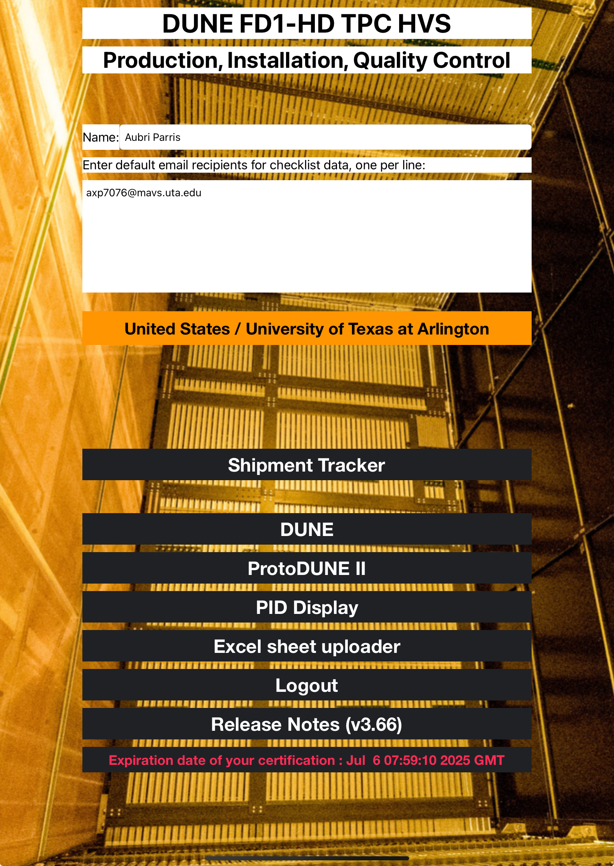
Introduction
Two different apps able to upload to HWDB
  One for Horizontal Drift
  One for Vertical Drift
Contains information on parts, QA/QC procedures, assembly, etc.
  Also some basic info on ProtoDUNE II

Slide 3
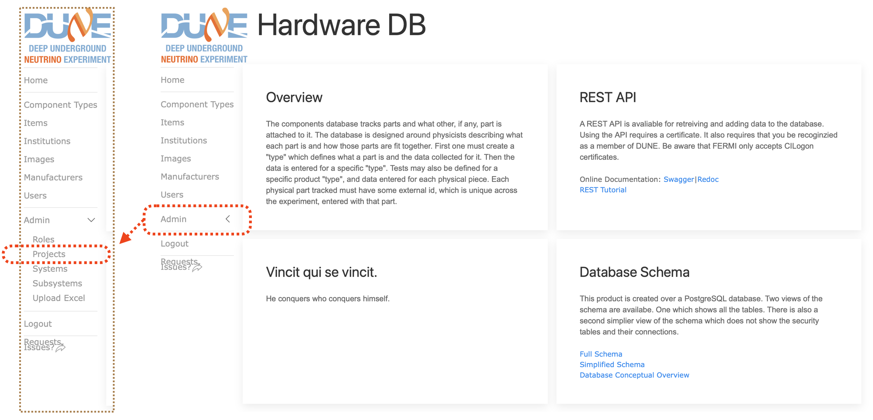
The HWDB
The Hardware Database shows information on all parts of the DUNE experiment
Manufacturing
Testing and QC
PIDs (Part Identifiers)
  Identifies all DUNE and LBNF components

Slide 4
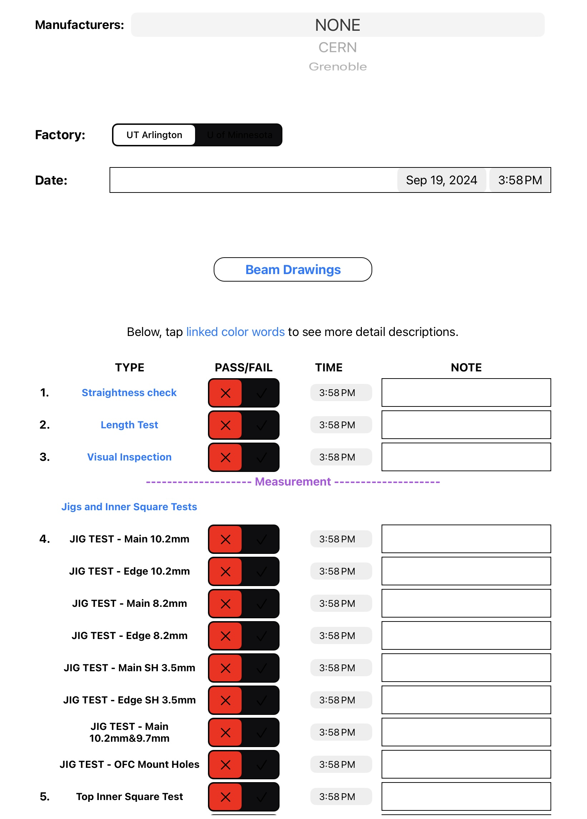
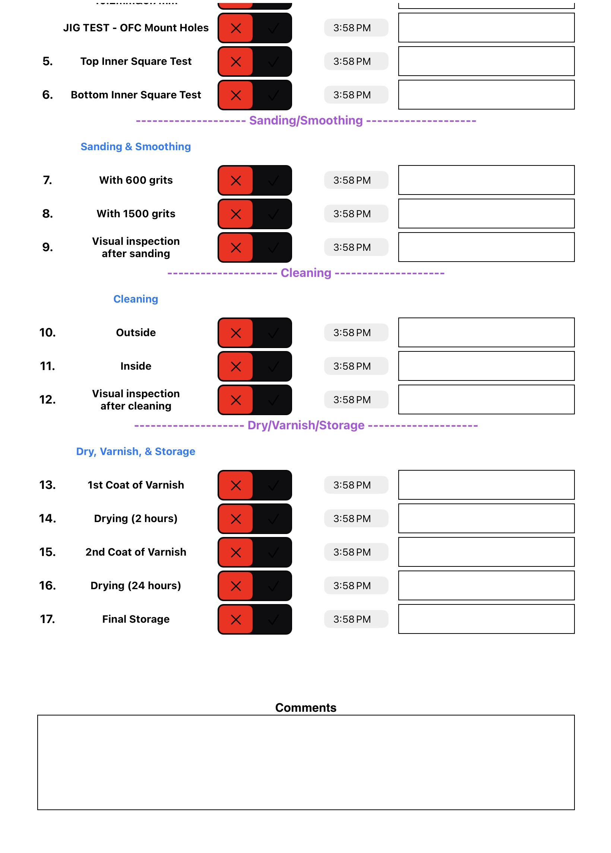
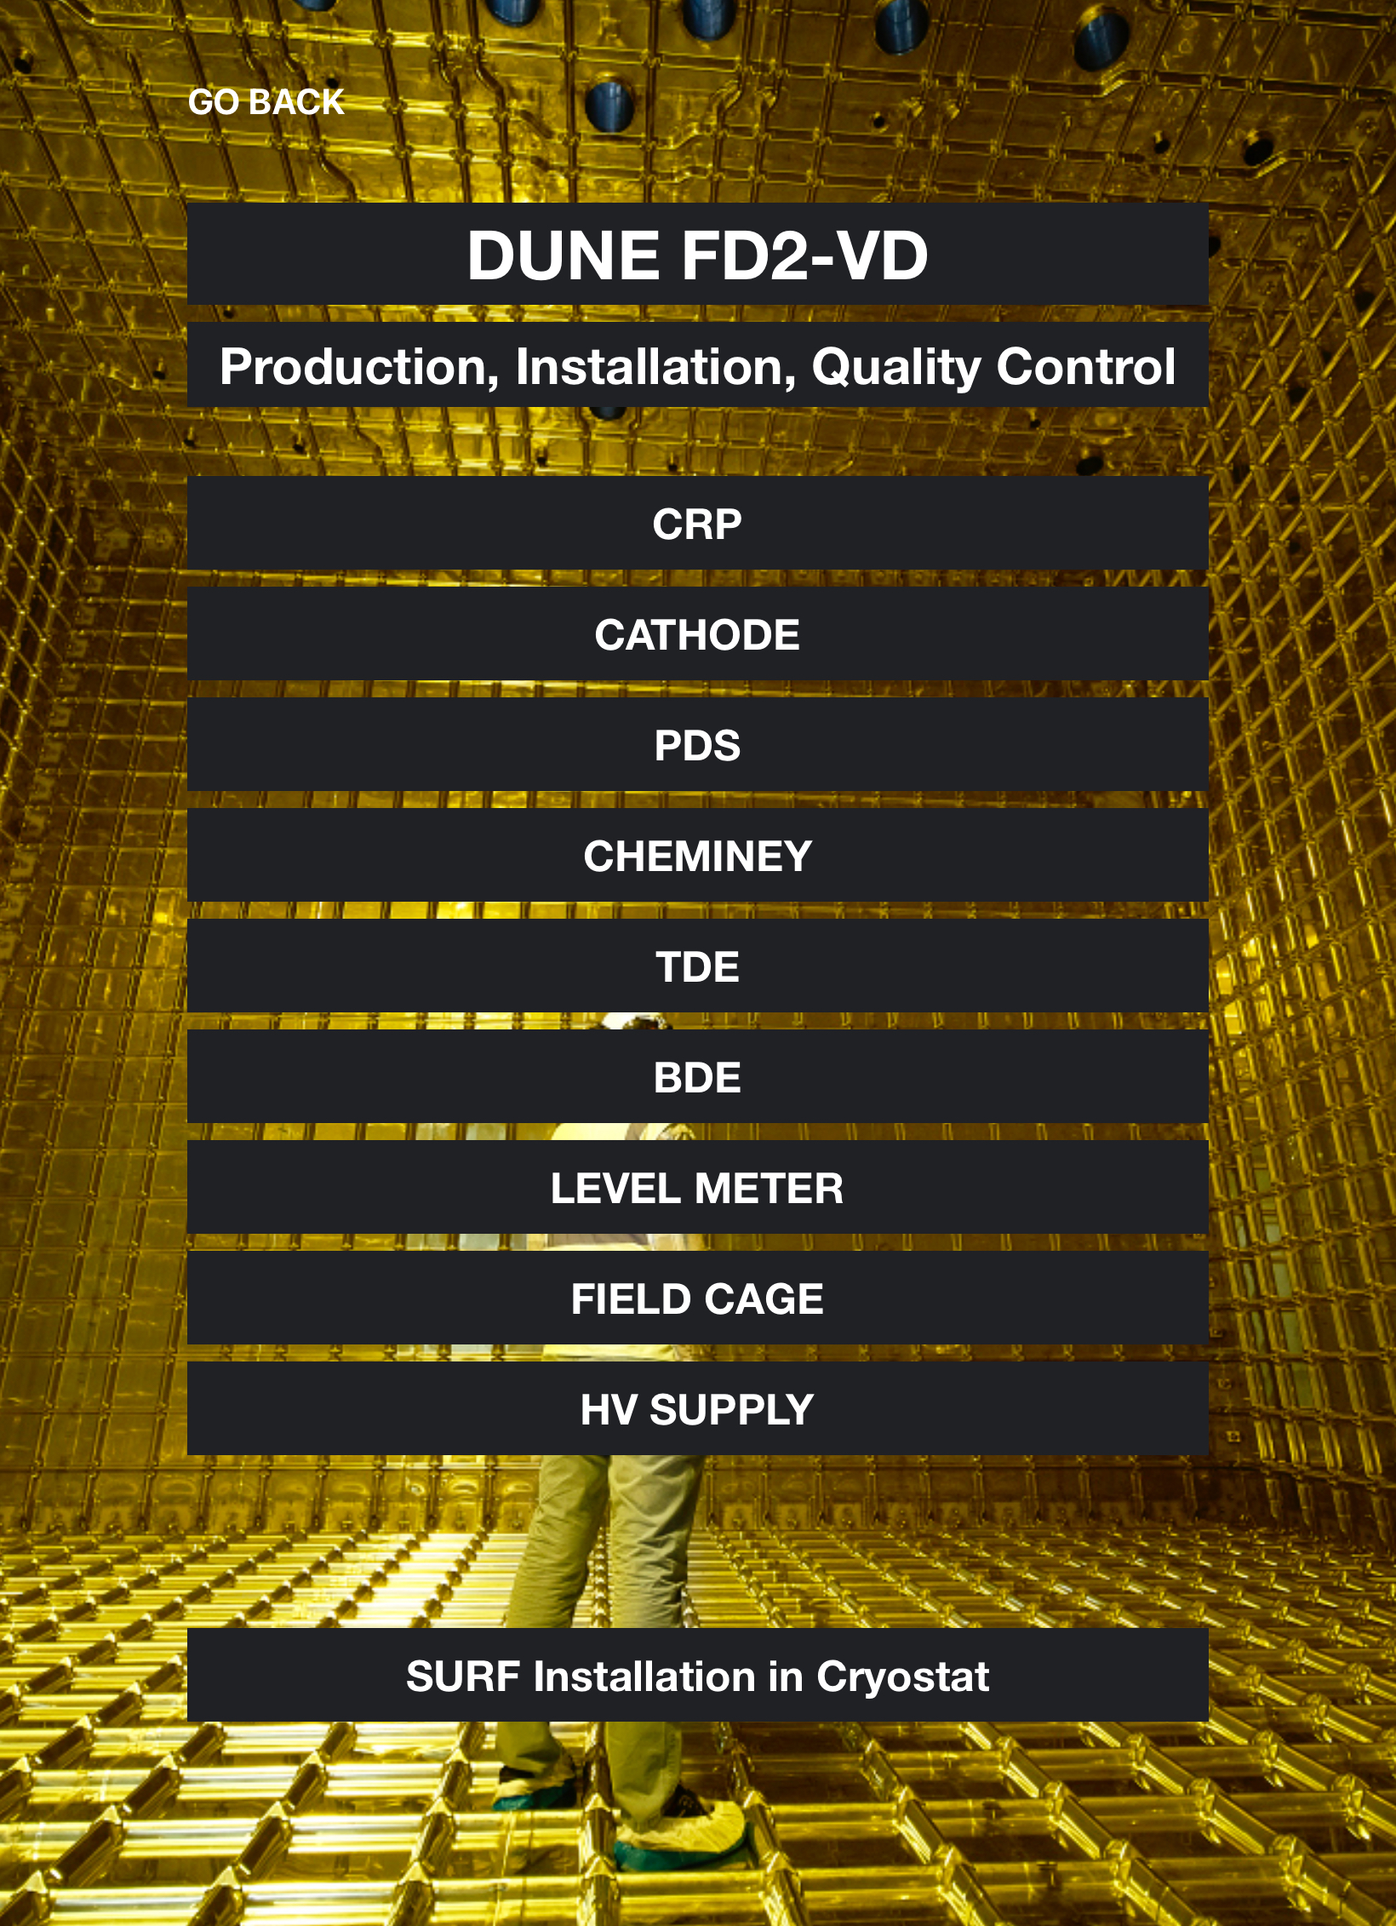
How to Use Them
Example of the user interface for VD —>
Need a Fermilab account to log any data
  Can access the app as a guest
Able to save data locally (to the iPad being used)
PIDs (Parts Identifiers) keep track of all hardware parts

Slide 5
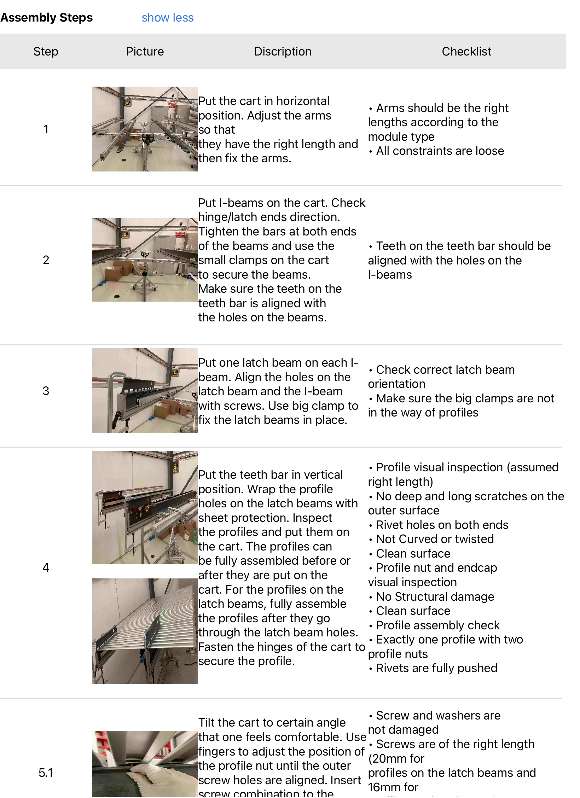
Assembly Procedure
Currently need an assembly procedure for the modules we’ll be building today
  Plan on using Brad’s plan unless something changes
PIDs for each RDB and termination board

Slide 6
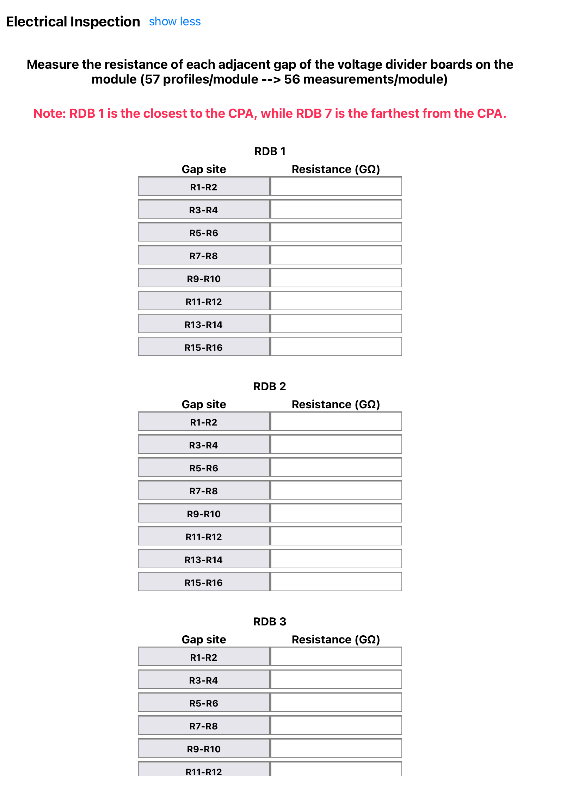
Things to Add to FD2
More details on some of the smaller parts
  PPE gear, torque screwdriver details,
Assembly and QC check post-assembly
Structural inspection
  Visual inspection after assembly
Electrical continuity
  Testing the resistance of the HVDB
    Copper strips (?)
  Brad mentioned using a multimeter
  Old method: measured resistance between gap sites of each divider board

Slide 7

UTA Logo on blue background

