Slide 1


DUNE FD VD
Field Cage Module Assembly Guide
Gajendra Gurung on behalf of UTA HV Team
Brad Brown, Samuel Blanchard, Akash Behanan & Rohit Raut

Slide 2
Required Tools and Parts
Torque Screwdriver (M2.5 bit, 30cN-m)
Screw, lock washer and flat washer
  M3 x 12mm for profile mounting, M3 x 8mm for divider board mounting
Right size Al profiles bent or not depending on the module to be assembled
Box Beams
Optical Fiber Conduits
  Rivet-nuts, M6 countersunk screws (if needed)
Divider boards
Slipnuts
End caps and their rivets
G10 Alignment Strips
G10 sheets for bent modules
  #8-32 screws, lock washer, flat washer, brass square nut used for mounting

Slide 3
Step 1: Align the Teeth
Use profiles and slip-nuts, picking random positions on the top, bottom, and middle to see if the slip-nuts holes align with the box beam holes.
Remove the box beams from the assembly table.

Slide 4
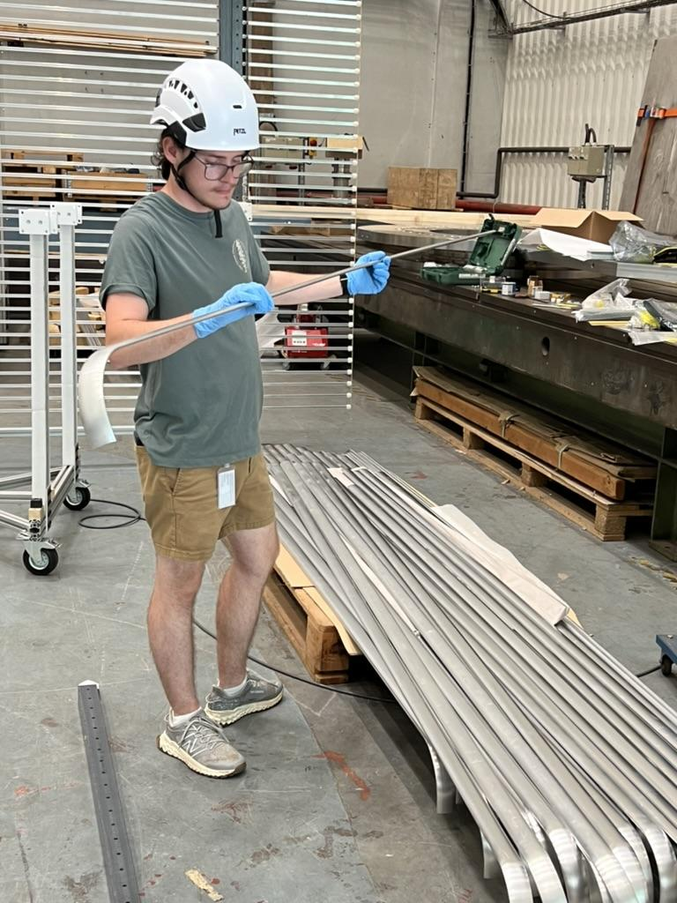
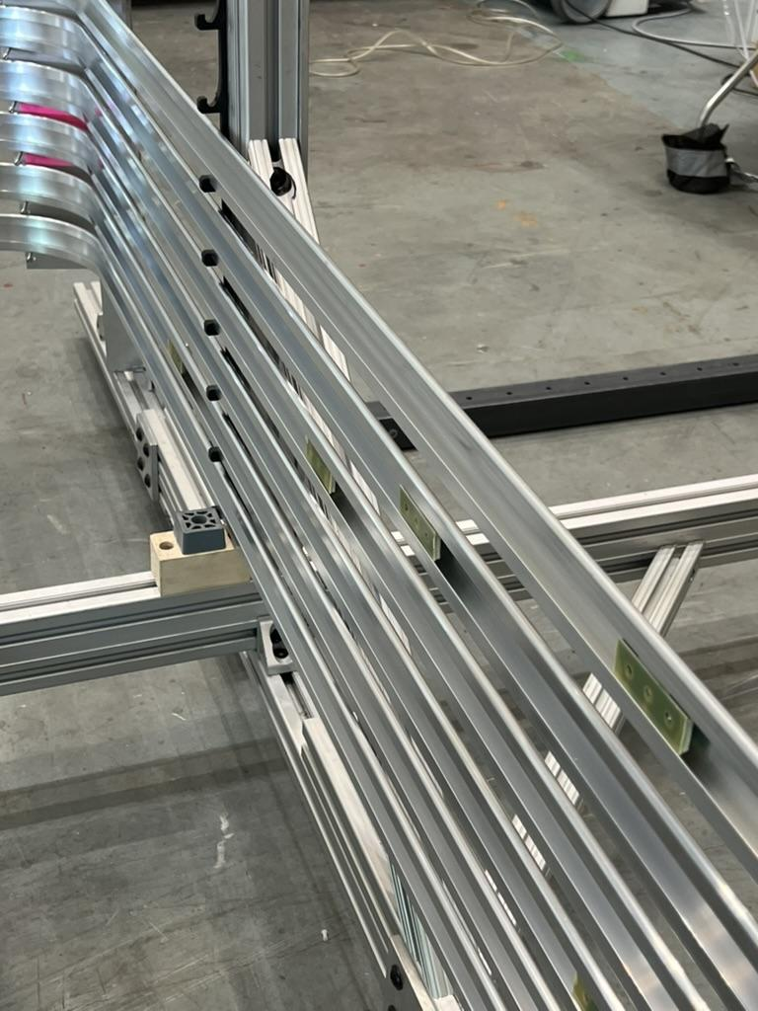
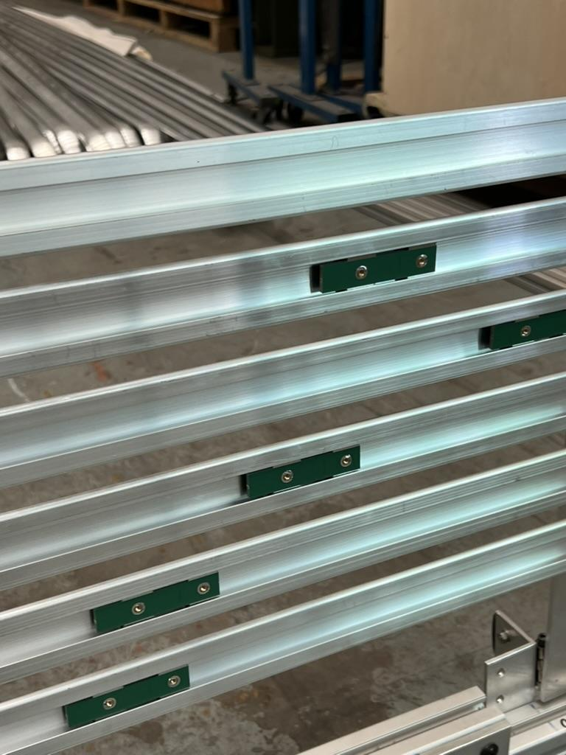
Step 2:Insert Slip-Nuts into the Al Profile & place them Assembly Table
Visual QC of profiles
Insert slip-nuts of the correct kind in the correct order
Place it on the Assembly Station
Done in 3 stages: Ground level, Stairs and Scaffolding

Slide 5
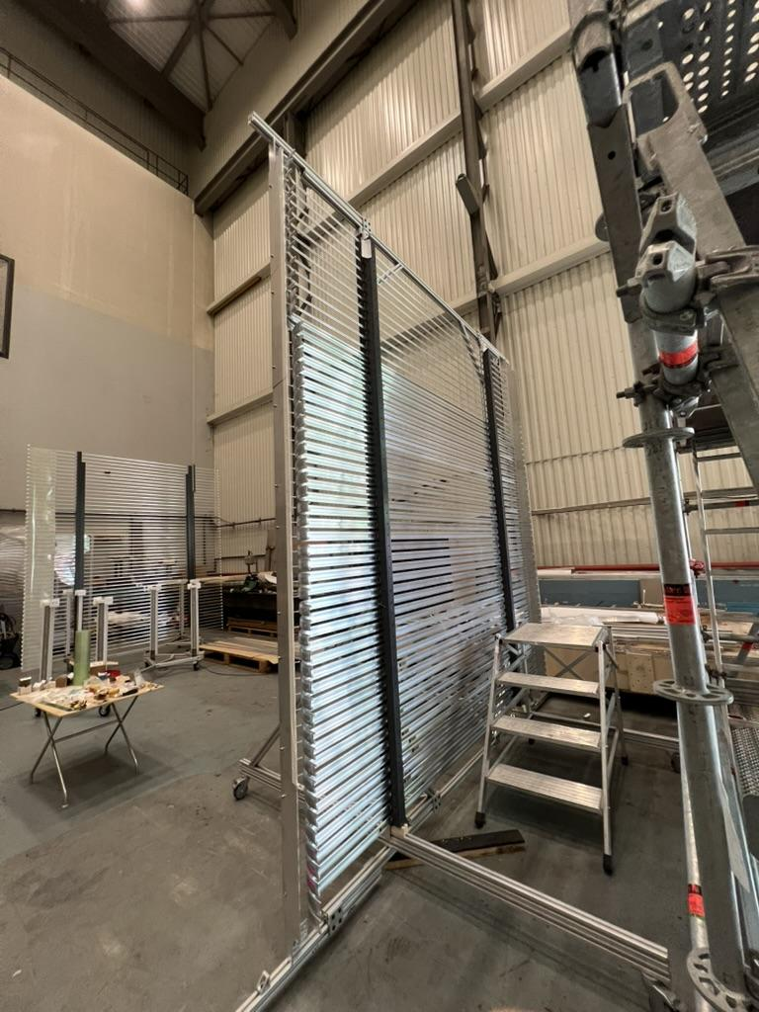
Step 3: Place the Right Box Beams on the
Assembly Table
Position the box beams on the assembly table; if the beam has a conduit, ensure that the threaded inserts face each other on the inside face of the beams.
Top box beams should have their cutout on the top of the assembly table
Bottom box beams should have their cutout on the bottom of the assembly table

Slide 6
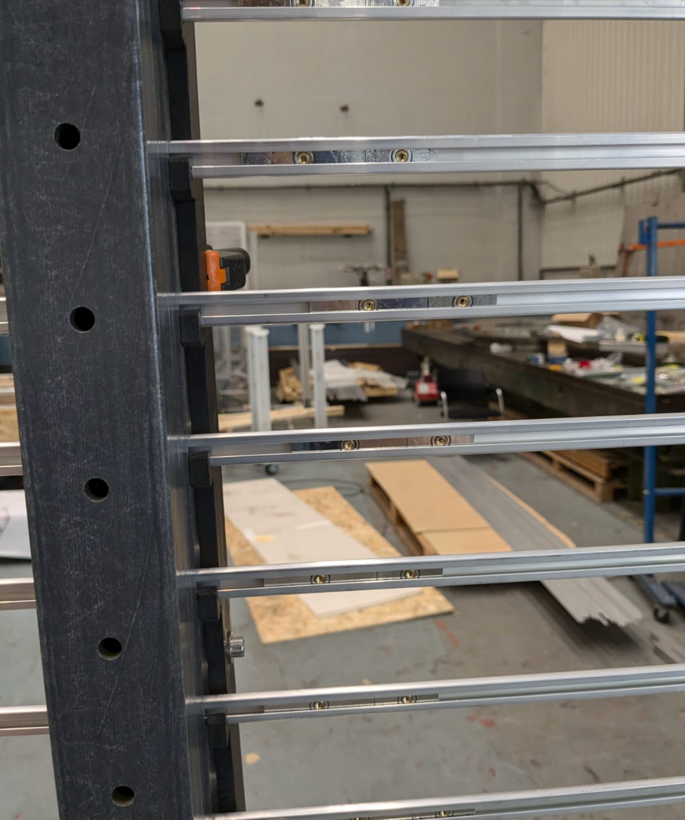
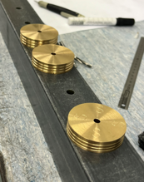
Step 4: Attach the Aluminum Profiles to the Box Beams
Screw in the slip-nuts until driver clicks with the right size screws (M3x12mm) to attach the aluminum profiles to the box beams

Slide 7
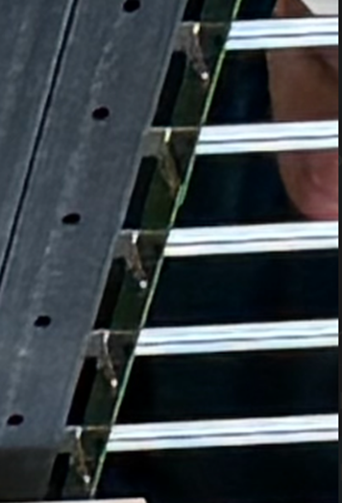
Step 6: Attach the Divider Boards
Attach the divider boards to the profiles with the component side facing away from the beam, overlapping boards on every 9th profile.
For top modules, the top board is a termination board mounted flat
  This requires normal slipnuts instead of combo

Slide 8
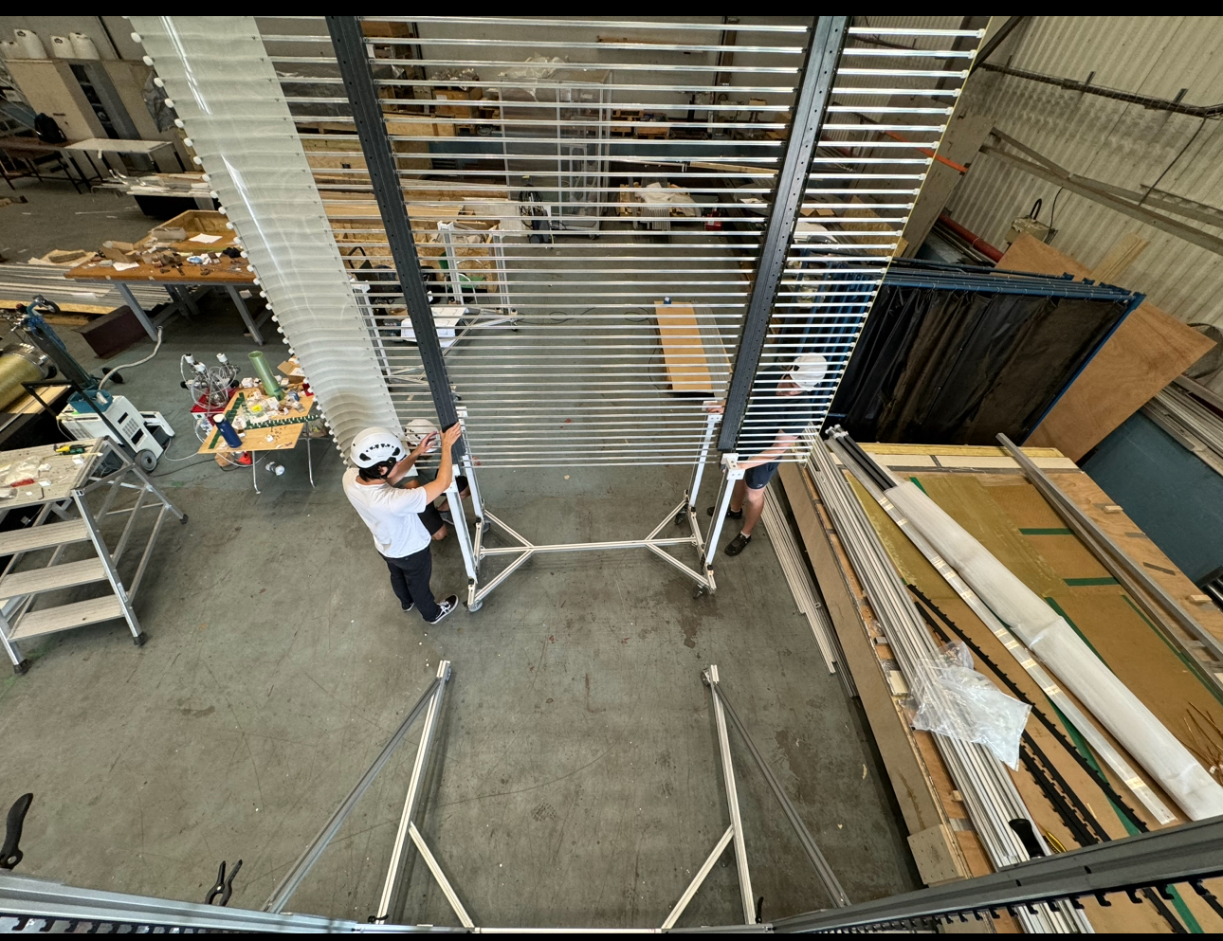
Step : Attach G10 Sheet
Use #8-32 screws and brass square nuts to mount the sheet, overlapping the first and last holes between sheets

Slide 9
Step 7: Place End Caps and Alignment Strips
Insert rivets by hand first, then finish rivet insertion with pliers or channel locks to secure the end caps.
G10 strips mount to the 3rd hole on the end caps, overlapping live HVDB and G10 sheeting

Slide 10
Step 8: Mount Optical Fiber Conduits
Mount optical fiber conduits if necessary

Slide 11
Step 9: Post-assembly checks
Ensure all screws are tightened. Inspect the aluminum profile for any damages such as scratches or bending that could have occurred during the assembly process.
Perform electrical continuity test to ensure all Al profiles are electrically connected with each other.

