Slide 1
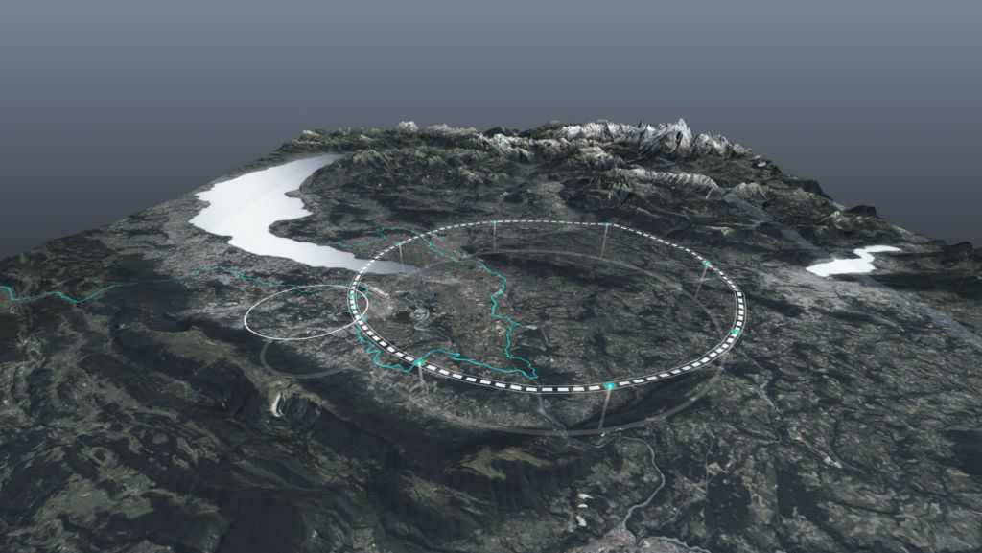









The FCC Integrated Program
Town hall meeting on Israeli Input to ESU’25, 18 December 2024
Michael Benedikt, Frank Zimmermann, CERN
on behalf of FCC collaboration & FCCIS DS team
http://cern.ch/fcc
Work supported by the European Commission under the HORIZON 2020 projects EuroCirCol, grant agreement 654305; EASITrain, grant agreement no. 764879; iFAST, grant agreement 101004730, FCCIS, grant agreement 951754; E-JADE, contract no. 645479; EAJADE, contract number 101086276; and by the Swiss CHART program
photo: J. Wenninger

Slide 2

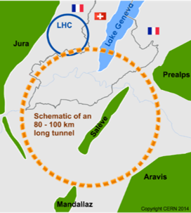
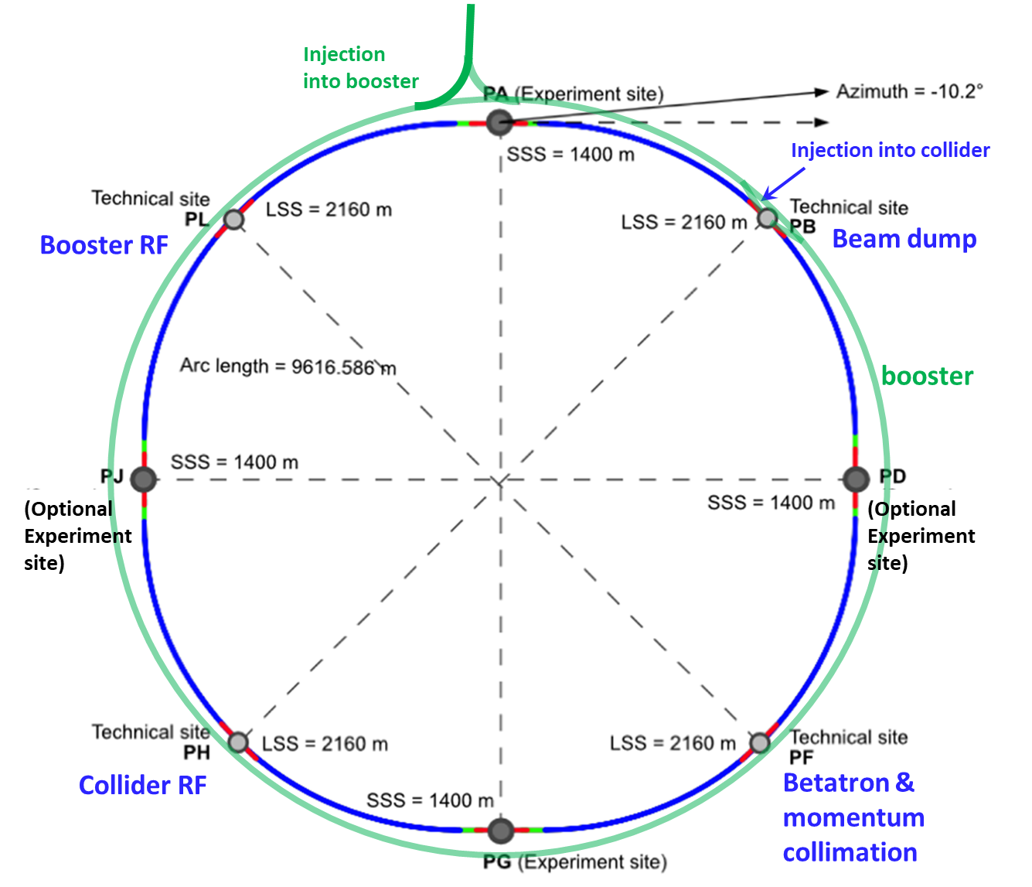
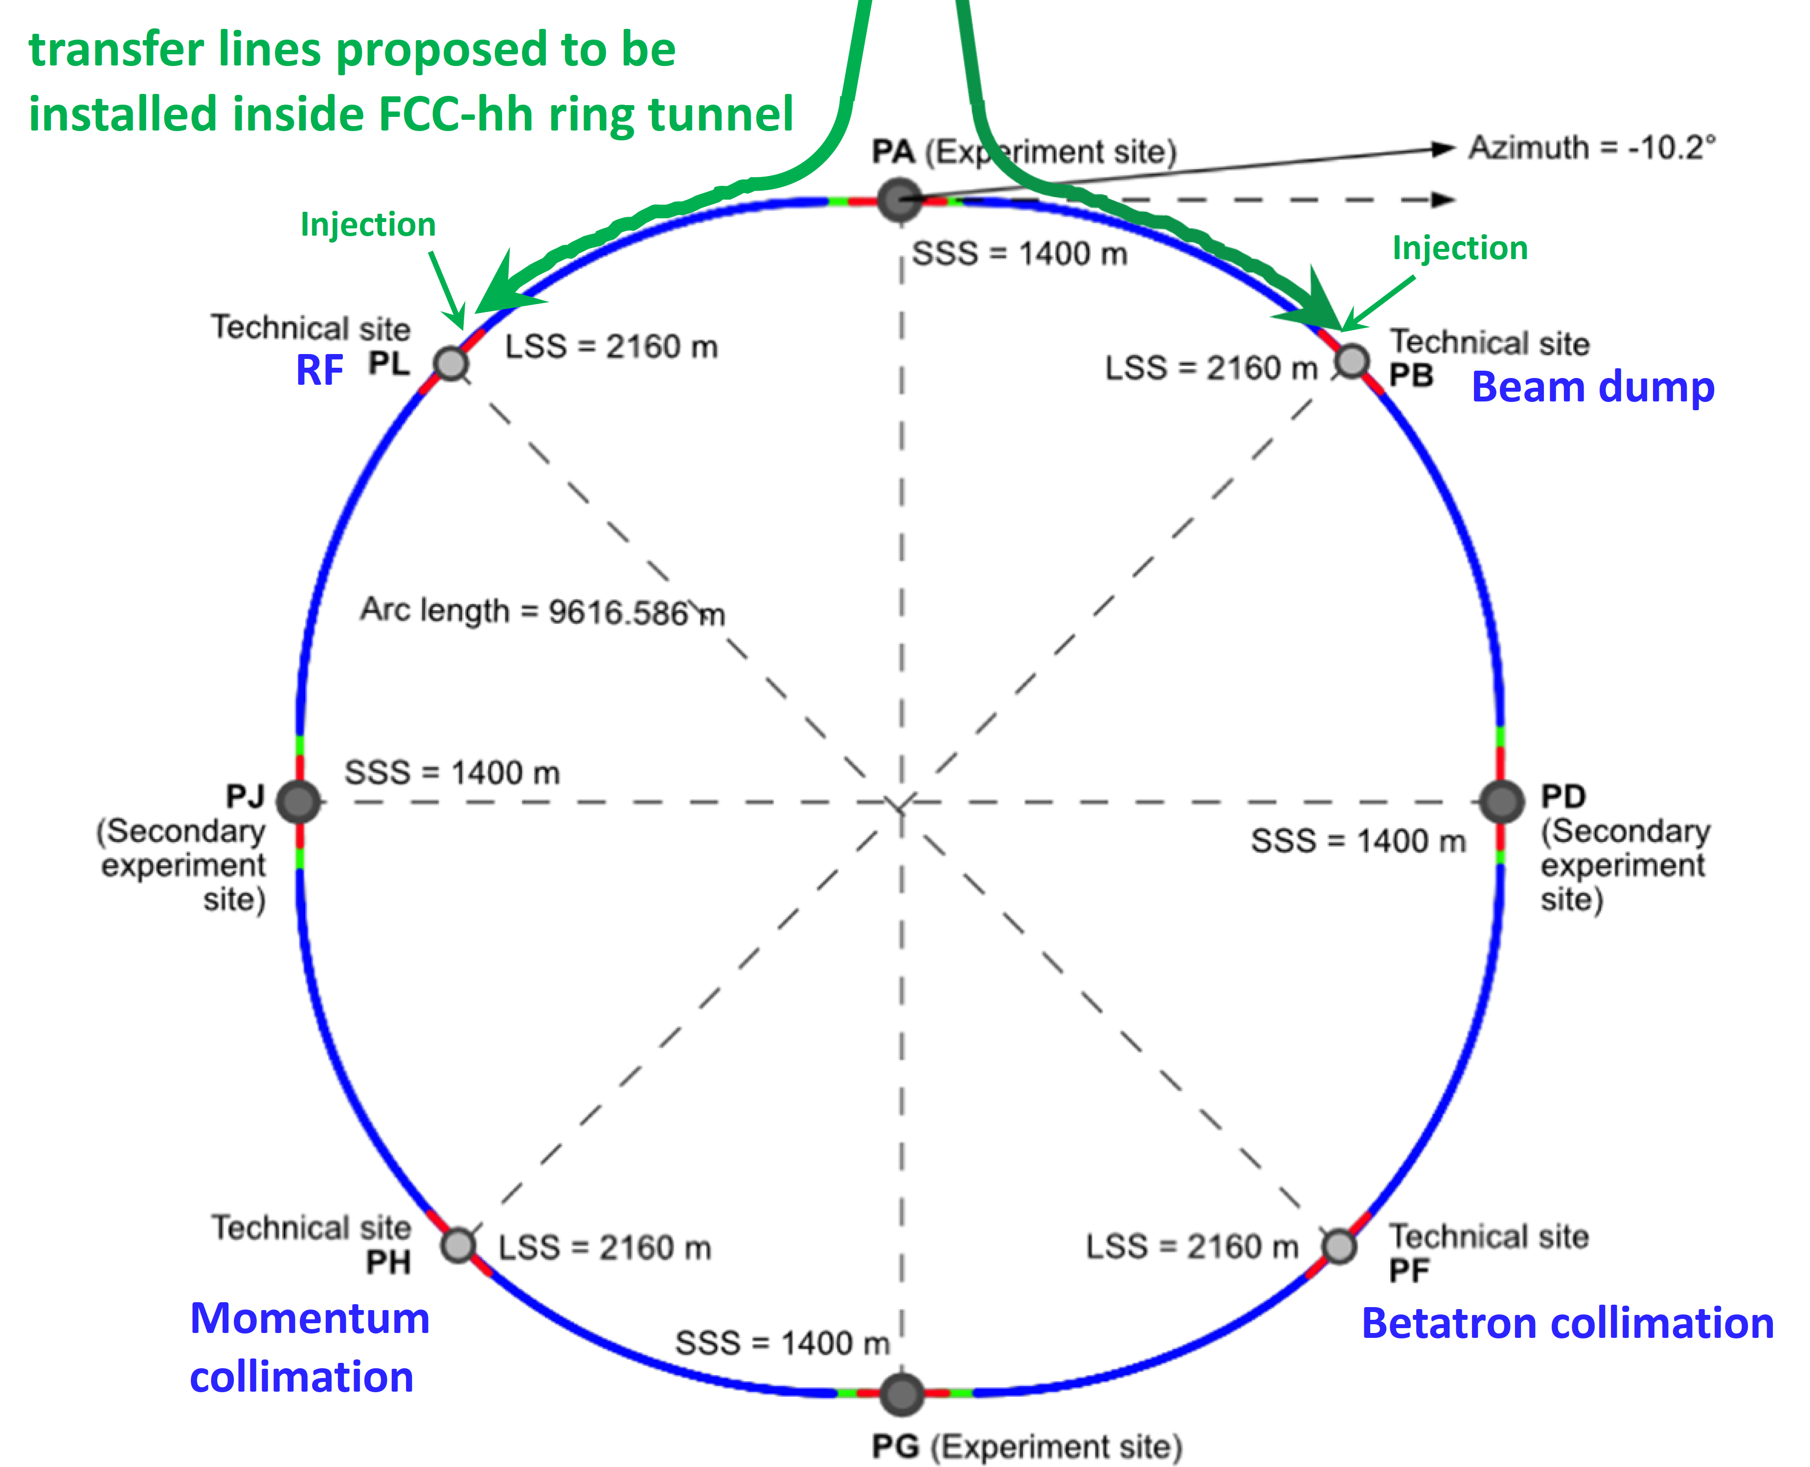
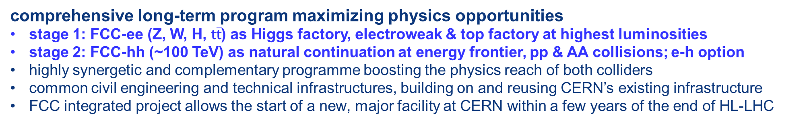
FCC integrated program
comprehensive long-term program maximizing physics opportunities
stage 1: FCC-ee (Z, W, H, $\text{t}\overline{\text{t}}$) as Higgs factory, electroweak & top factory at highest luminosities
stage 2: FCC-hh (~100 TeV) as natural continuation at energy frontier, pp & AA collisions; e-h option
highly synergetic and complementary programme boosting the physics reach of both colliders
common civil engineering and technical infrastructures, building on and reusing CERN’s existing infrastructure
FCC integrated project allows the start of a new, major facility at CERN within a few years of the end of HL-LHC
FCC-ee
FCC-hh
2020 - 2045
2045 - 2065
2070 -

Slide 3




Feasibility Study Report for March 2025
Structure:Three Volumes
Vol. 1: Physics, Experiments and Detectors (~200 pages)
Vol. 2: Accelerators, Technical Infrastructures, Safety Concepts (~400 pages)
Vol. 3: Civil Engineering, Implementation & Sustainability (~200 pages)
- Executive Summary of the FCC Feasibility Study: ~40 pages
In addition:
a. Documentation on Cost Estimate – Funding Models
b. Environmental Report
Input for Update of European Strategy for Particle Physics
to be prepared with Overleaf & published by EPJ (Springer-Nature) – FCCIS members

Slide 4
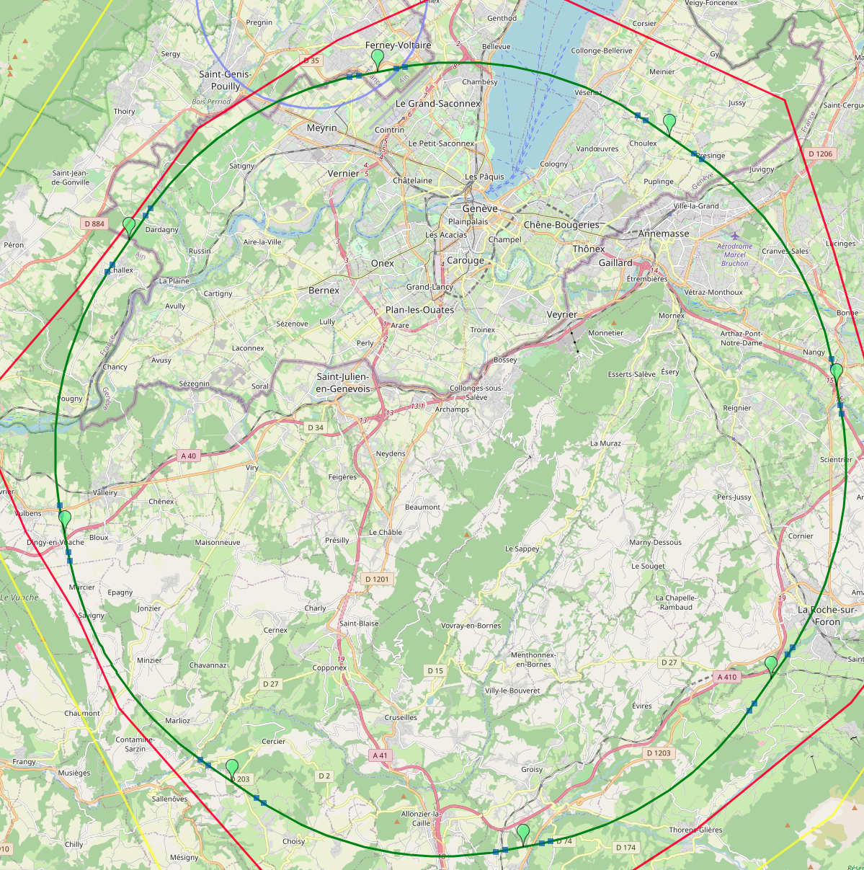
Reference layout and implementation: PA31 - 90.7 km
V. Mertens,
J. Gutleber
Layout chosen out of ~ 100 initial variants, based on geology and
surface constraints (land availability, access to roads, etc.), environment, (protected zones), infrastructure (water, electricity, transport), machine performance etc.
“Avoid-reduce-compensate” principle of EU and French regulations
PA: Experiment
PB: technical
PL: technical
Overall lowest-risk baseline: 90.7 km ring, 8 surface points,
4-fold symmetry
Number of surface sites | 8
Surface requirements | ~40 ha
LSS@IP (PA, PD, PG, PJ) | 1400 m
LSS@TECH (PB, PF, PH, PL) | 2032 m
Arc length | 9.6 km
Sum of arc lengths | 76.9 m
Total length | 90.7 km
PD: experiment
PJ: experiment
4 experiments
PF: technical
PH: technical
4
PG: experiment

Slide 5
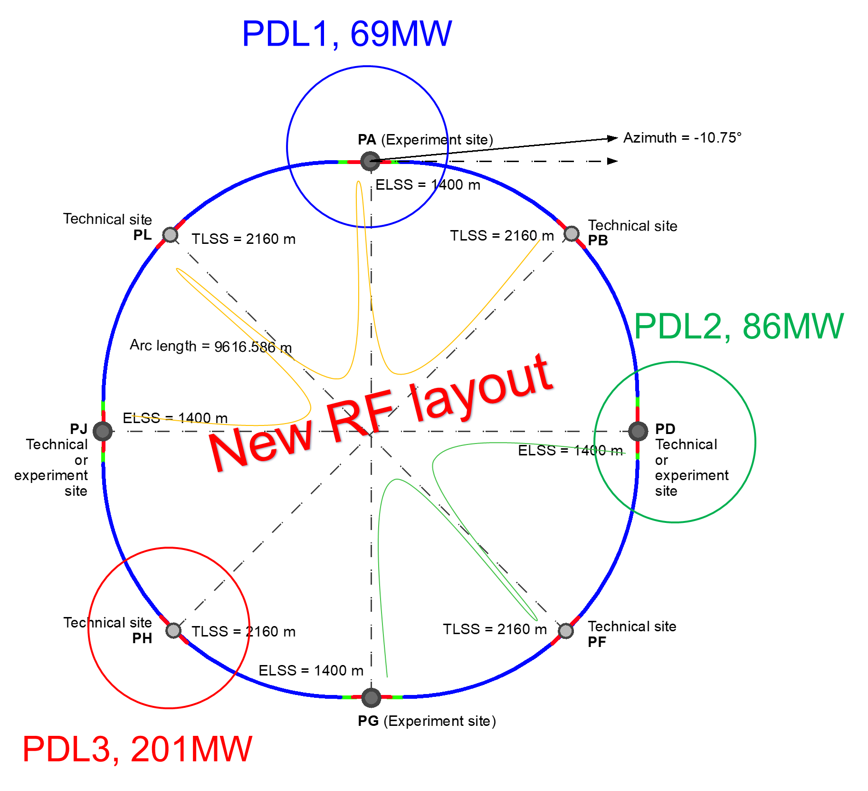
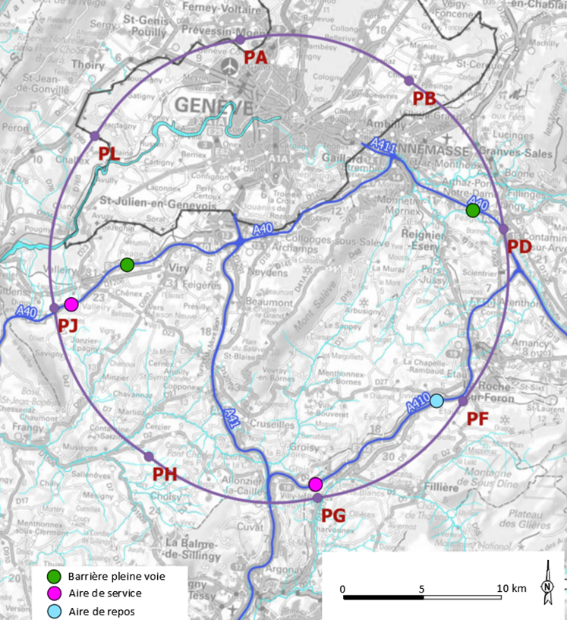
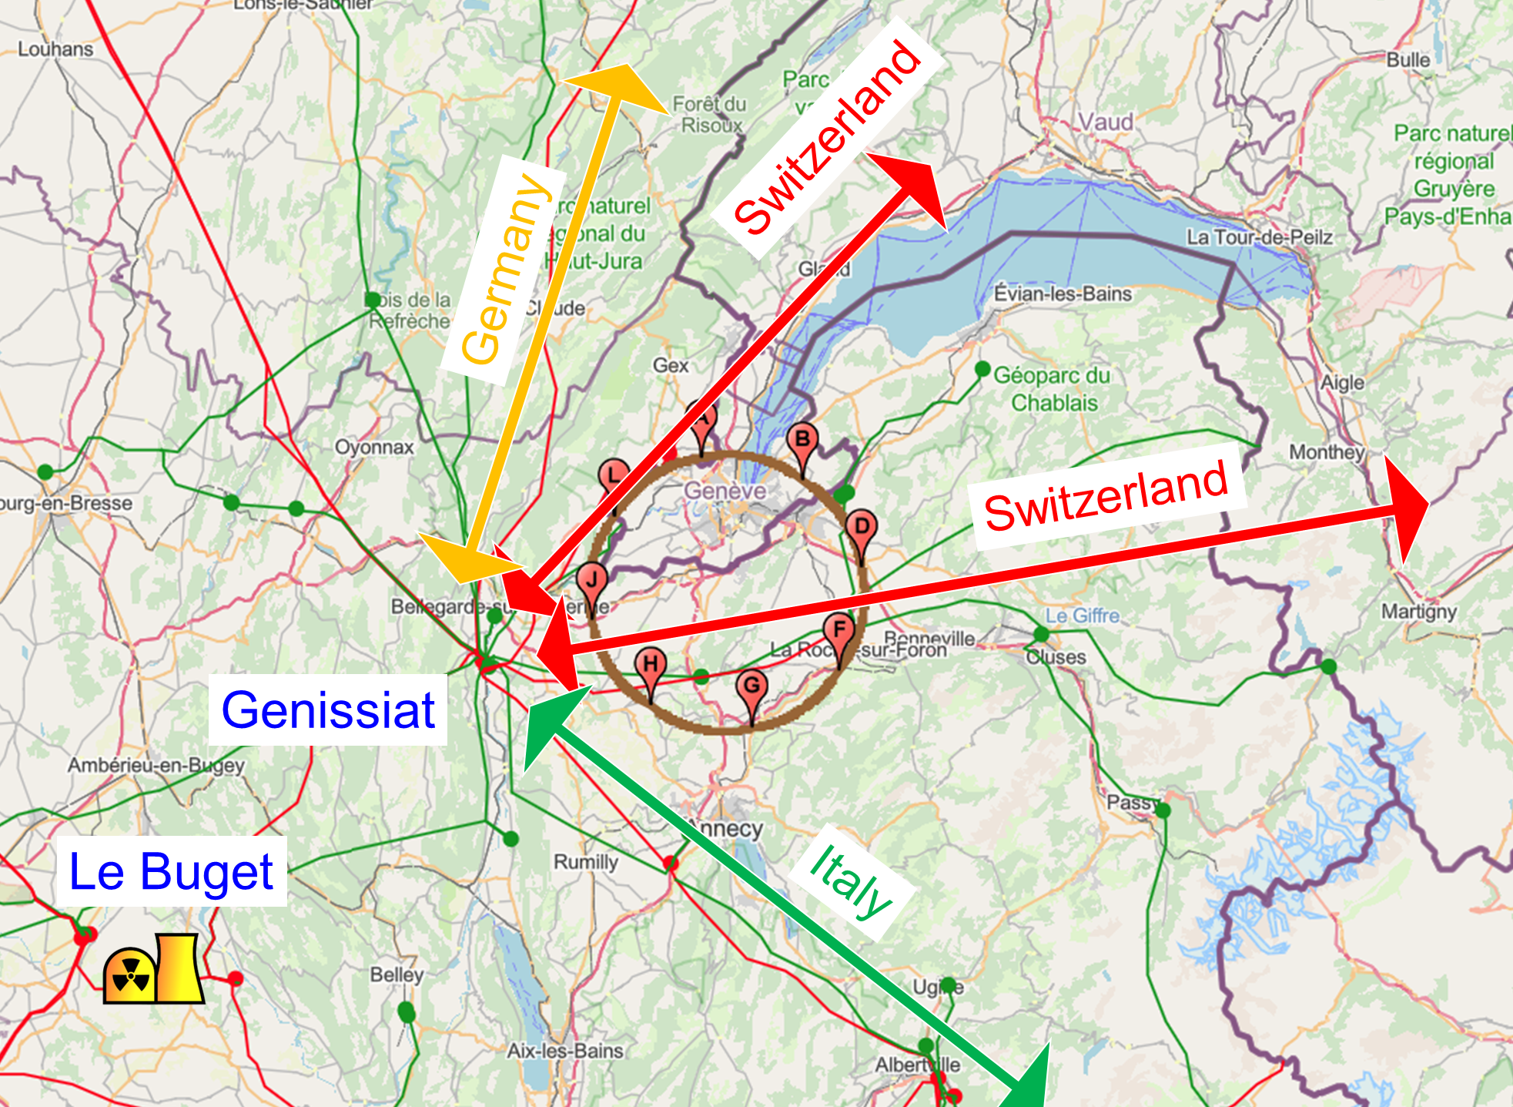
Integration with regional infrastructures
Road accesses developed for all 8 surface sites
Four possible highway connections defined
Less than 4 km of new roads required
Connections to
French electricity grid
connections with
highway network
Electrical connection concept developed with RTE (French electricity grid operator)
Three HV supply points, two new stations & CERN Prevessin
➔ requested loads have no significant impact on grid
R&D efforts aiming at reduction of the energy consumption of FCC-ee and FCC-hh

Slide 6
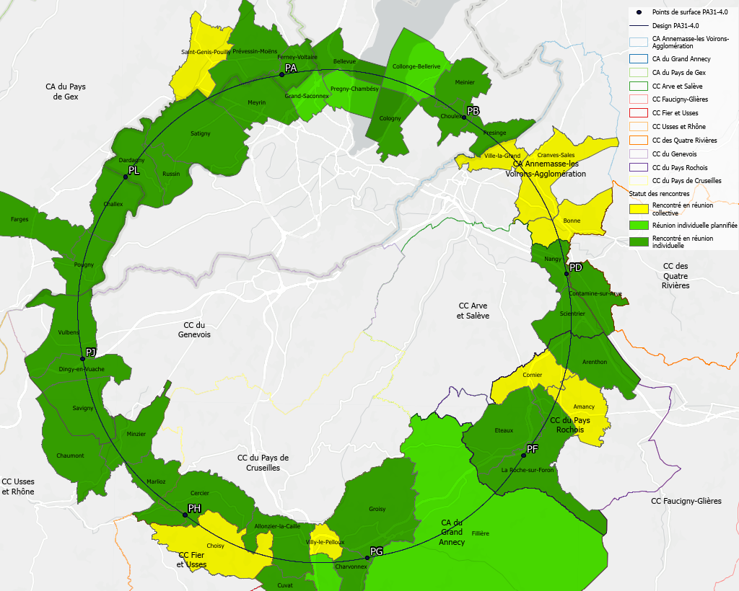
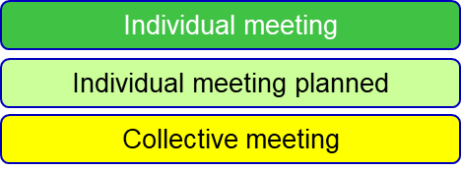
Regional implementation activities
Meetings with municipalities concerned
in France (31) and Switzerland (10)
PA – Ferney Voltaire (FR) – experiment site
PB – Présinge/Choulex (CH) – technical site
PD – Nangy (FR) – experiment site
PF – Roche sur Foron/Etaux (FR) – technical site
PG – Charvonnex/Groisy (FR) – experiment site
PH – Cercier (FR) – technical site
PJ – Vulbens/Dingy en Vuache (FR) experiment site
PL – Challex (FR) – technical site
Detailed work with municipalities and host states
identify land plots for surface sites
understand specific aspects for design
identify opportunities (waste heat, tec.)
reserve land plots until project decision
Status 1 June 2024
The support of the host states is greatly appreciated and essential for the study progress!

Slide 7
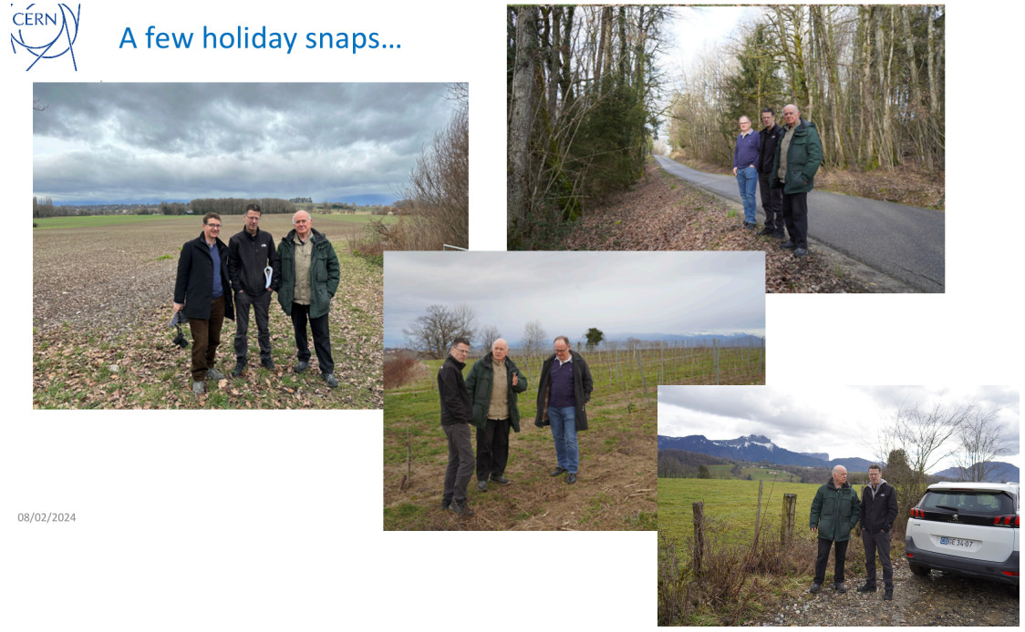
Eliezer Rabinovici,
Johannes Gutleber,
Mike Lamont, and
Michael Benedikt
visited all surface site locations

Slide 8

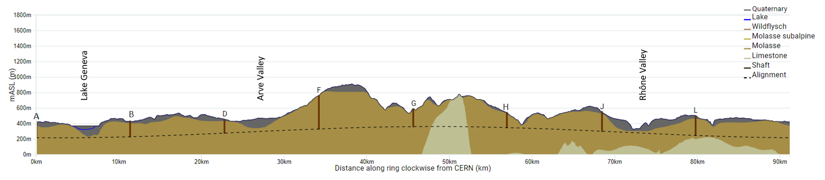
FCC tunnel implementation- geological conditions
FCC inclined at 0.5% gradient to minimise depth of point F
Limestone unavoidable between G-H
FCC passes below Lake Geneva moraines
FCC above limestone
  Tunneling mainly in moraine layer (soft rock), well suited for fast, low-risk TBM construction.
  6 million m³ excavated volume → 8.5 million m³ excavation material on surface
  CE Designs of all underground structures developed
  To fix the vertical position of the tunnel, interfaces between geological layers have to be known

Slide 9
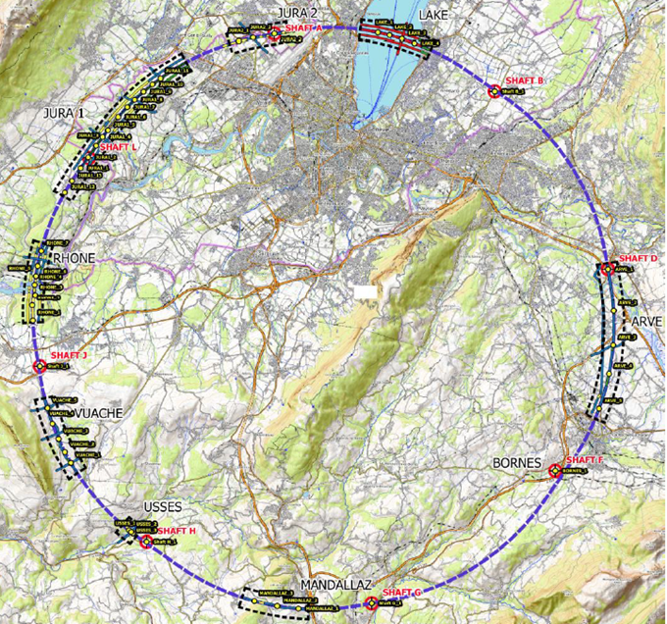
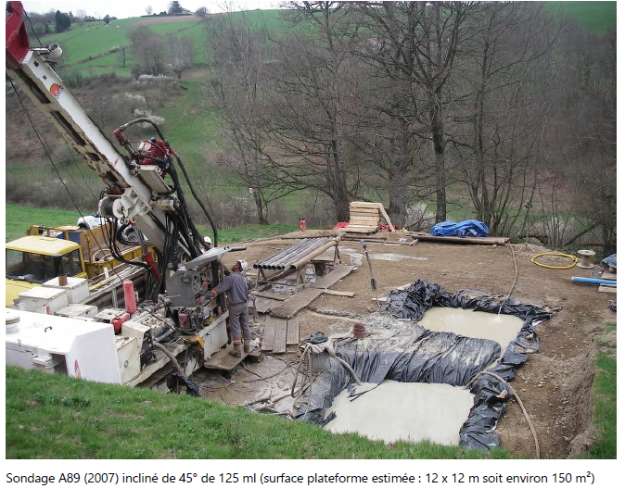
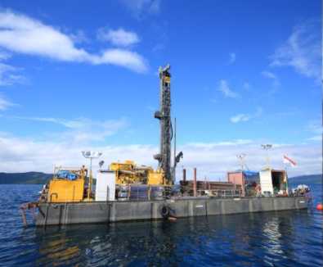
First series of site investigations
Site investigations to identify exact location of geological interfaces:
Molasse layer vs moraines/limestone
~30 drillings and ~90 km seismic lines
→ Vertical position and inclination of tunnel
example of drilling works on a lake the lake

Slide 10
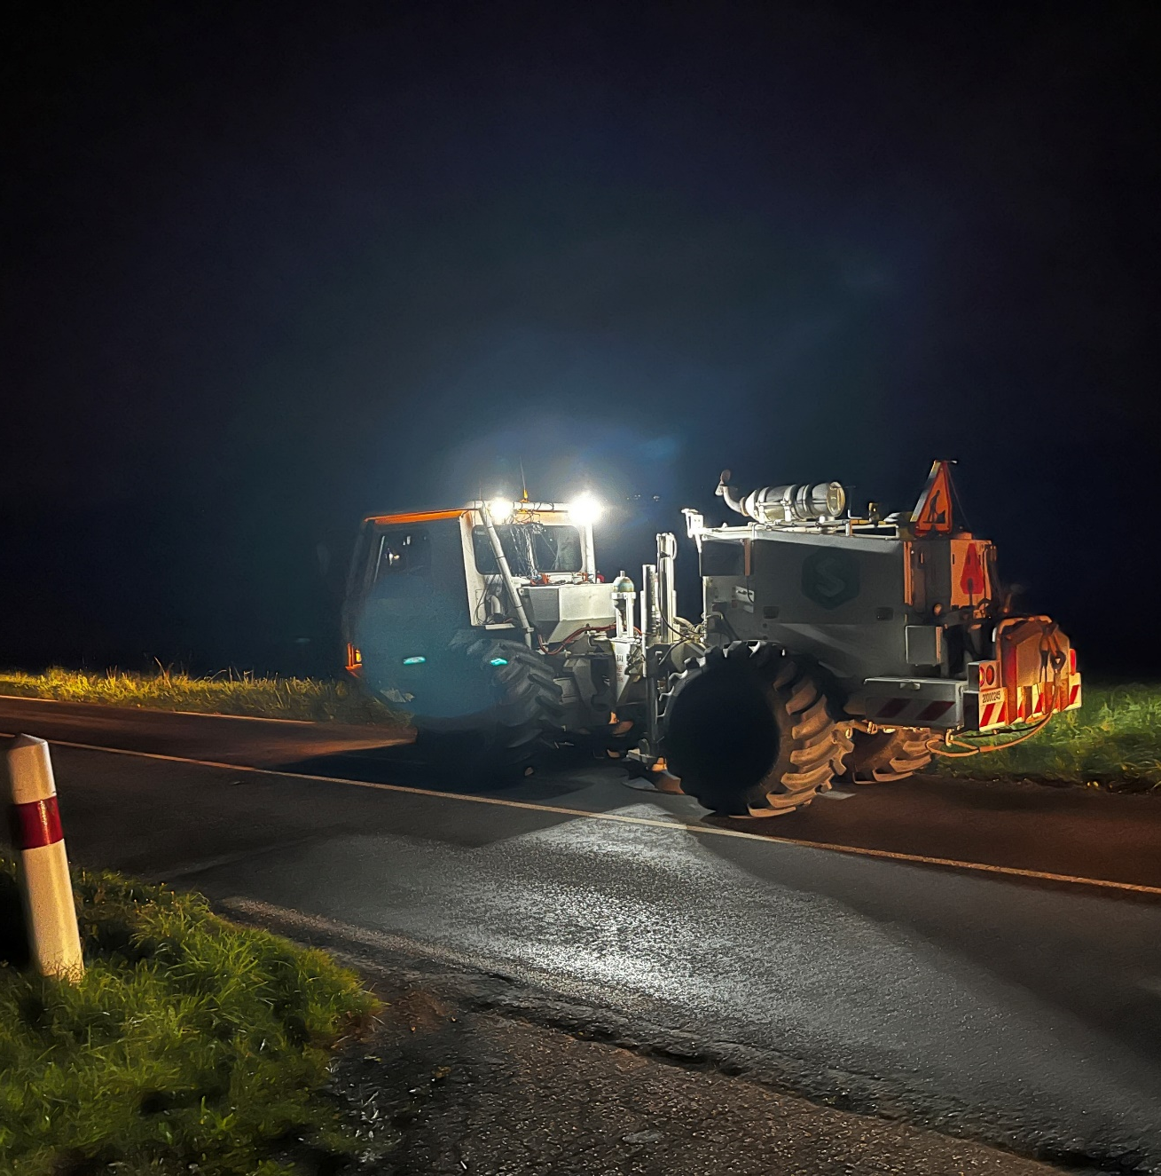
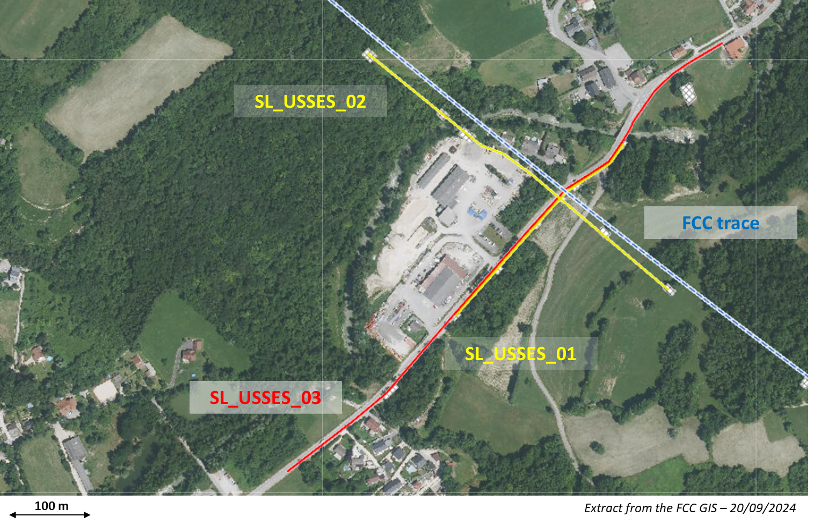
Start of site investigations – seismic investigations
First seismic line :
Second seismic line :
Seismic line SL_USSES_02 :
Acquisition date : 01/10/2024
Length : 480 meters
Method(s) : Explosive and Seismic gun
Geophones : 96 units (5 meters of spacing)
Shot points : 13 shot points in total
Seismic line SL_USSES_01 :
Acquisition date : 02/10/2024
Length : 300 meters
Method(s) : Weight drop
Geophones : 60 units (5 meters of spacing)
Shot points : 15 shot points in total

Slide 11
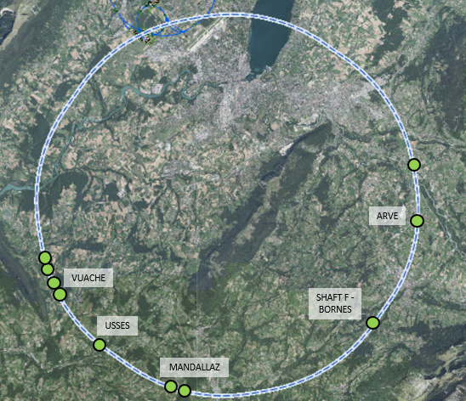
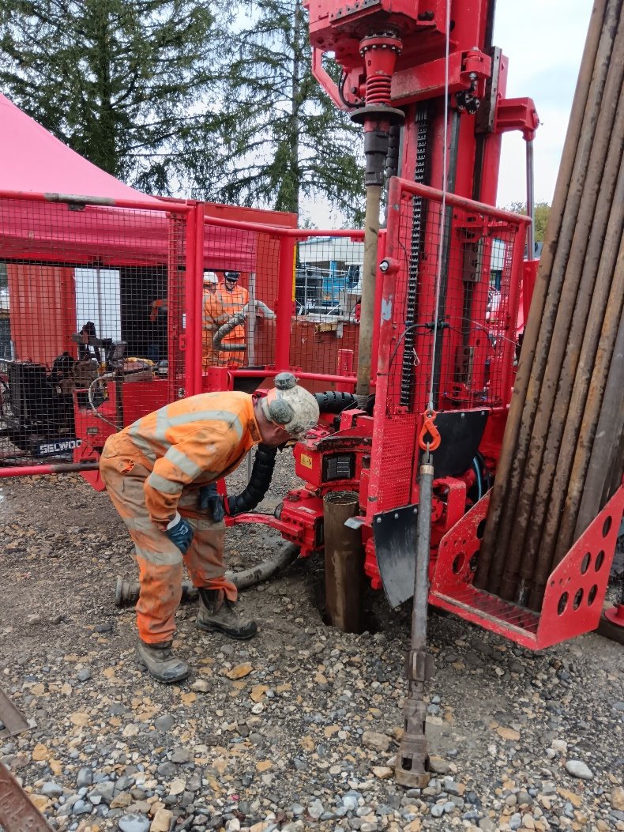
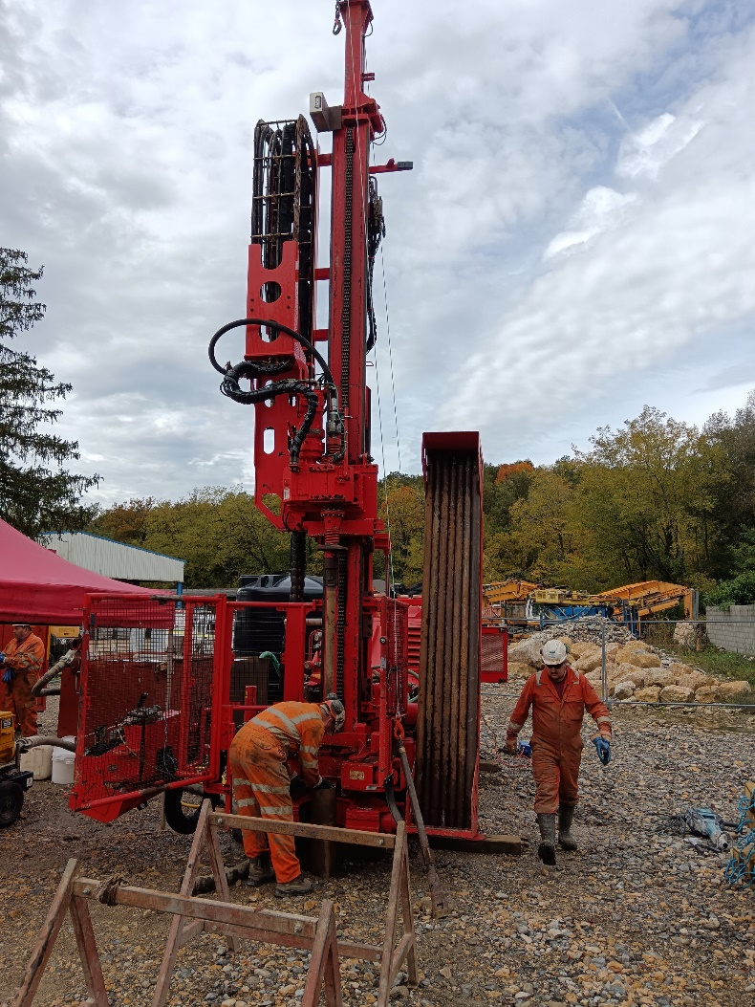
Status of site investigations – drillings
  Drilling for first borehole commenced on 14/10/2024
  The drilling (USSES 2) is within the commune of Marlioz
  The drill site is located within the storage yard of a private construction company (Besson).
  Drilling Depth = 70m
  Fully cored recovery
  Drill time should be about 2 weeks
  Equipped with Piezometer

Slide 12
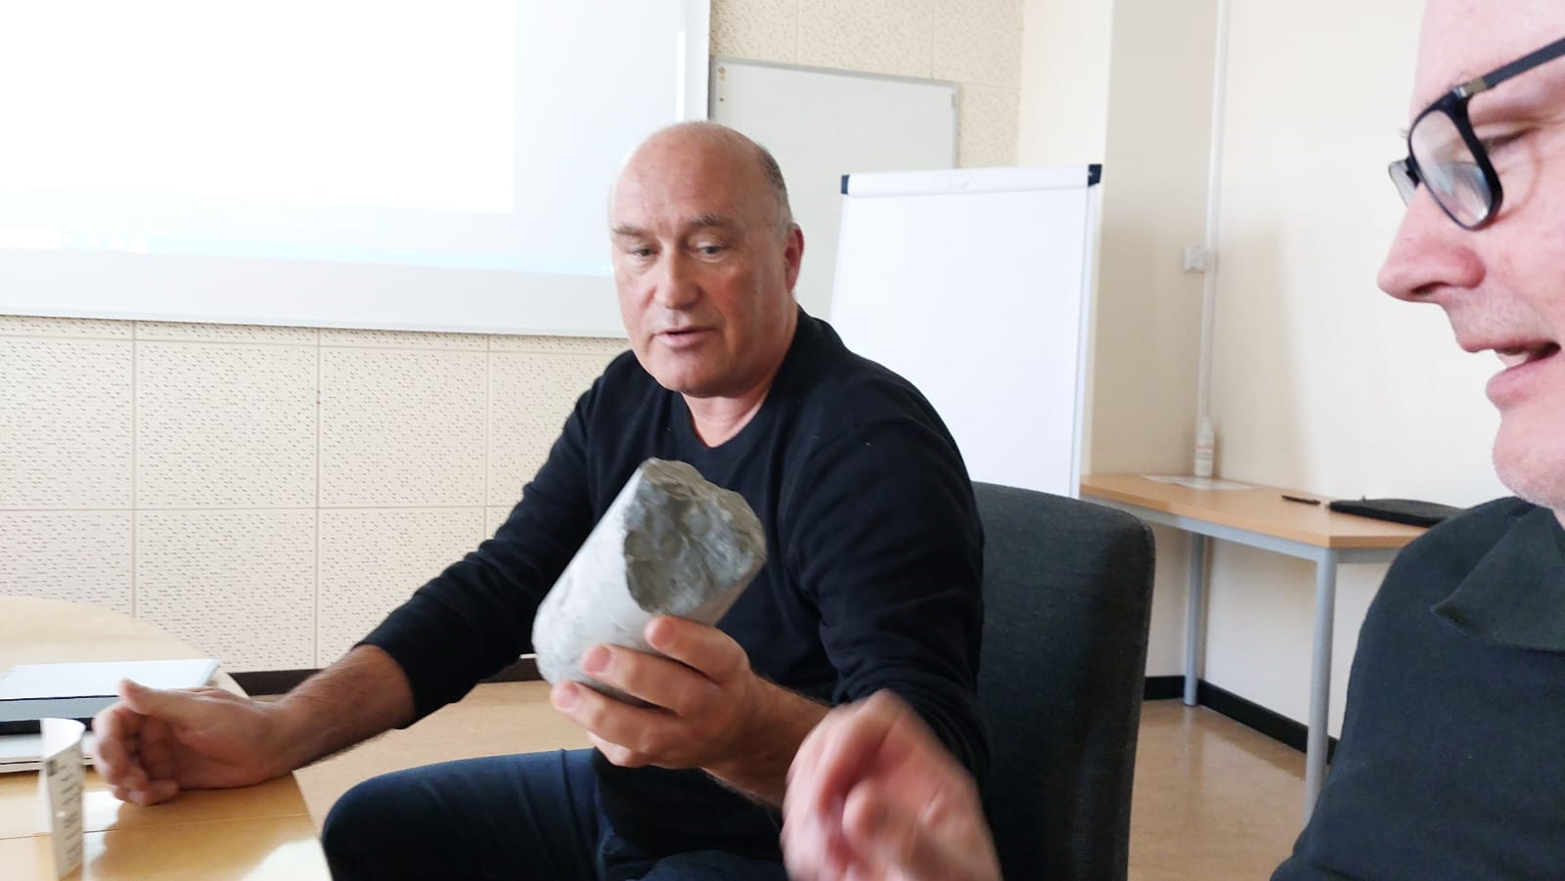
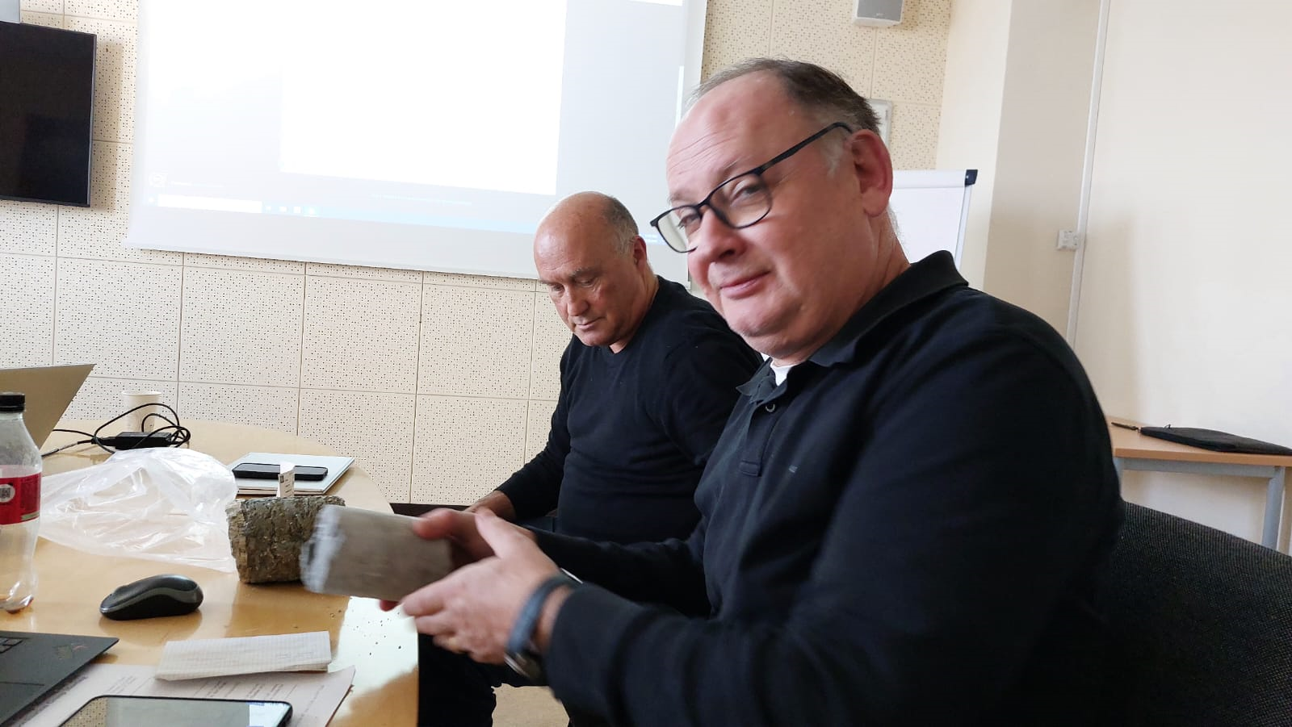
a few days ago – first drill cores presented (now in Israel)
limestone
molasse
T. Watson and M. Benedikt

Slide 13
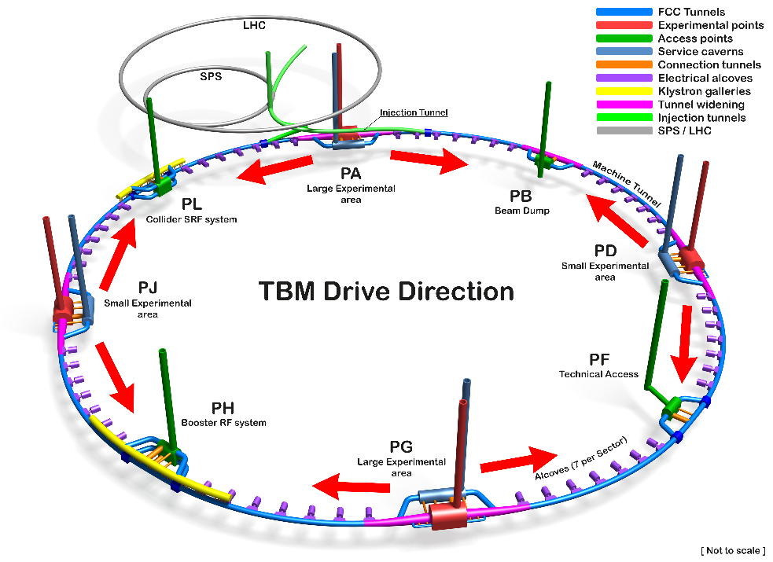
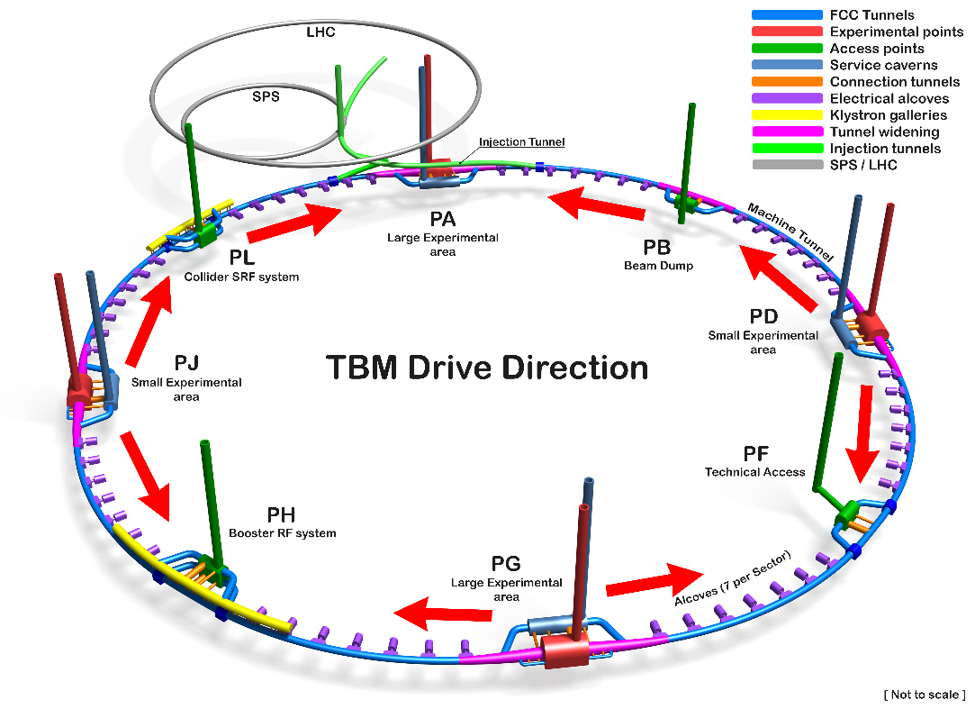
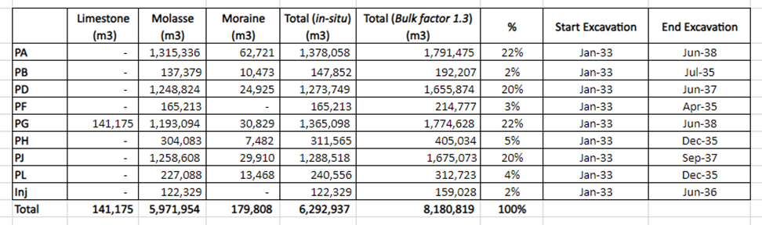
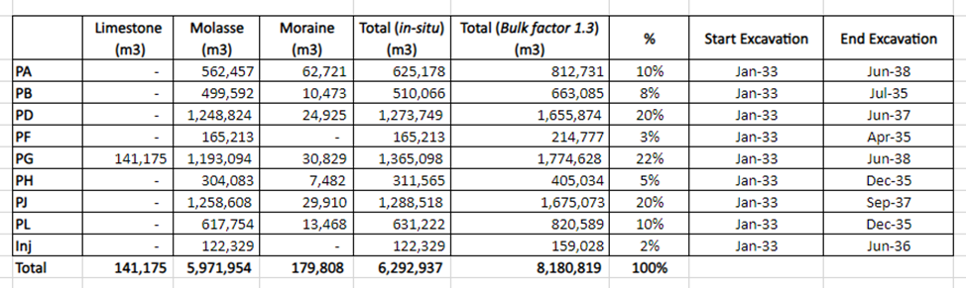
Studies on excavation strategy and material quantities
2 TBMs from each experimental point Alternative with no TBMs from PA

Slide 14
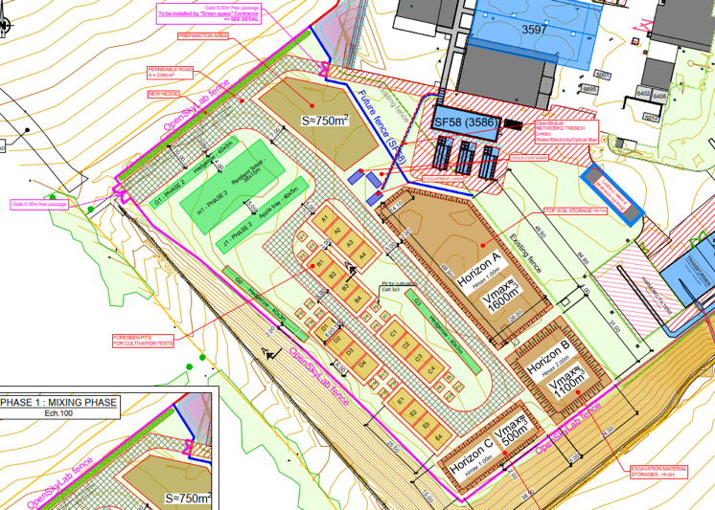









Development of excavation material re-use opportunities
OpenSkyLab: academic and industrial collaboration @LHC P5 CMS
Transformation of Molasse (FCC ~8 Mm³ volume) into fertile soil for agricultural and other uses
Materials: Molasse from the HL-LHC construction
Duration: 4+ years (2024 - )
Trials with 5 000 t molasse
  Soil fertilisation process (micro-organisms, mixing with fertile soil, etc.)
  Development of fertilisation mix products
  Development of quality managed processes
  Experimental phase w. scientific protocol, field monitoring and control system support

Slide 15
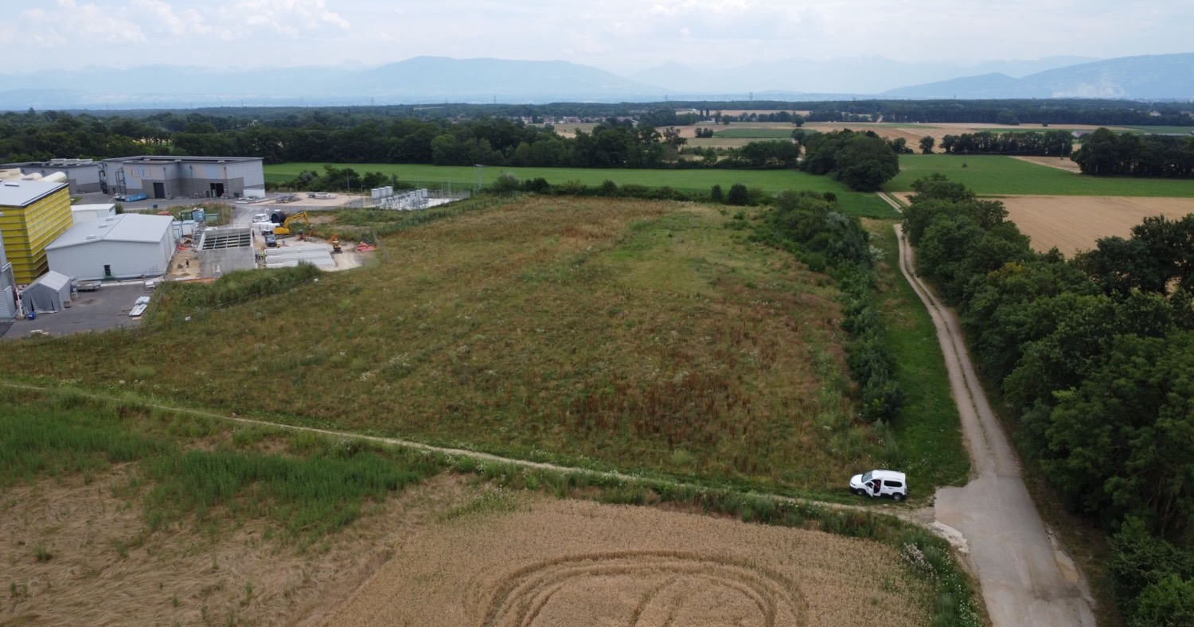
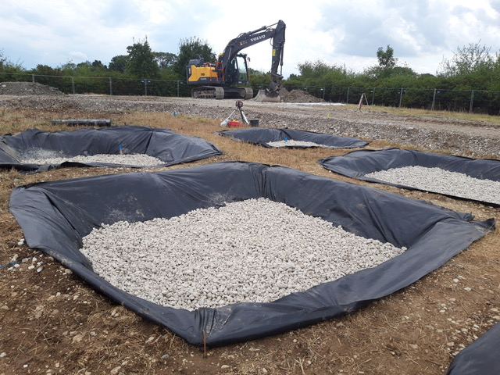
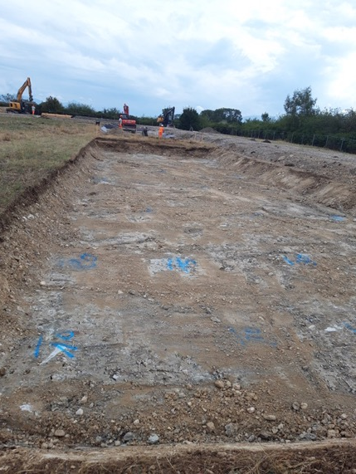
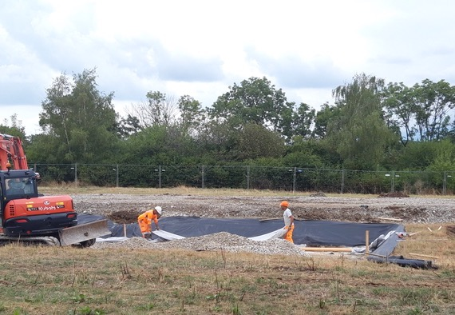
OpenSkyLab status and progress

Slide 16
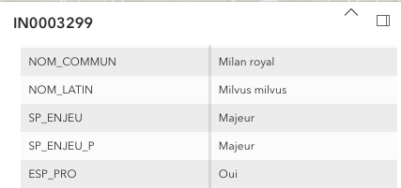
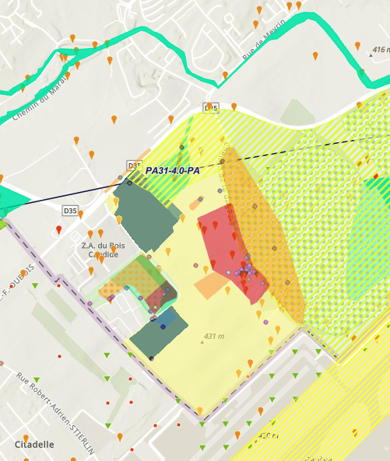
Environmental studies to document
present status of potential FCC surface site areas
Short term goals for FCC Feasibility Study:
Establish a state of the current environmental conditions at the surface site locations based on the actual situation, complementing the map and database investigations
Confirm the territorial feasibility in principle
Support the environmental impact studies for the geotechnical and geophysical investigations (i.e. boreholes and seismic lines)
Long term goals anticipating impact assessment works:
Comply with the regulatory reporting requirements in the frame of the authorisation process
Identify and document the environmental stakes exhaustively
Definition of environmental strategy and guiding principles for Ecodesign to be considered by infrastructure and equipment designers in technical design phase.

Slide 17
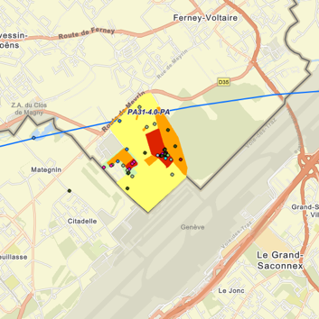
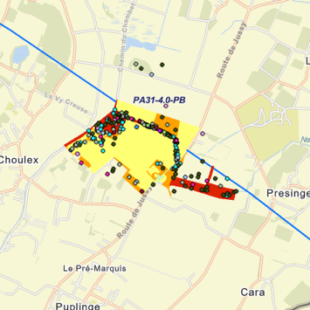
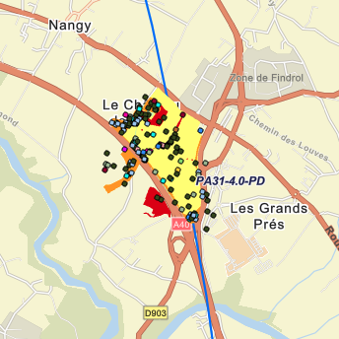
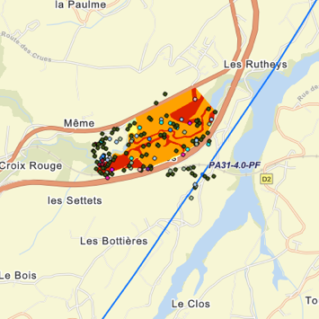
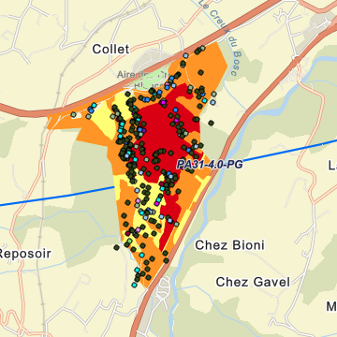
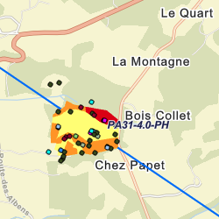
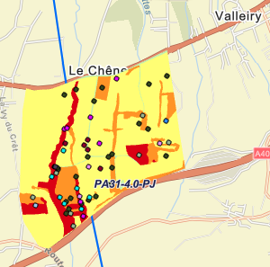
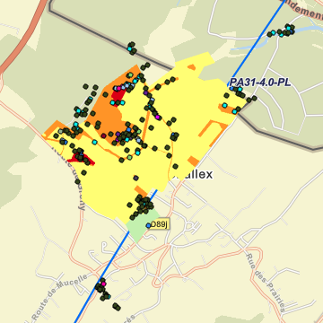
Environmental studies around surface areas
PA
PB
PD
PF
Total area investigated in 2023/24: 585 ha over 4 seasons
PG
PH
PJ
PL

Slide 18
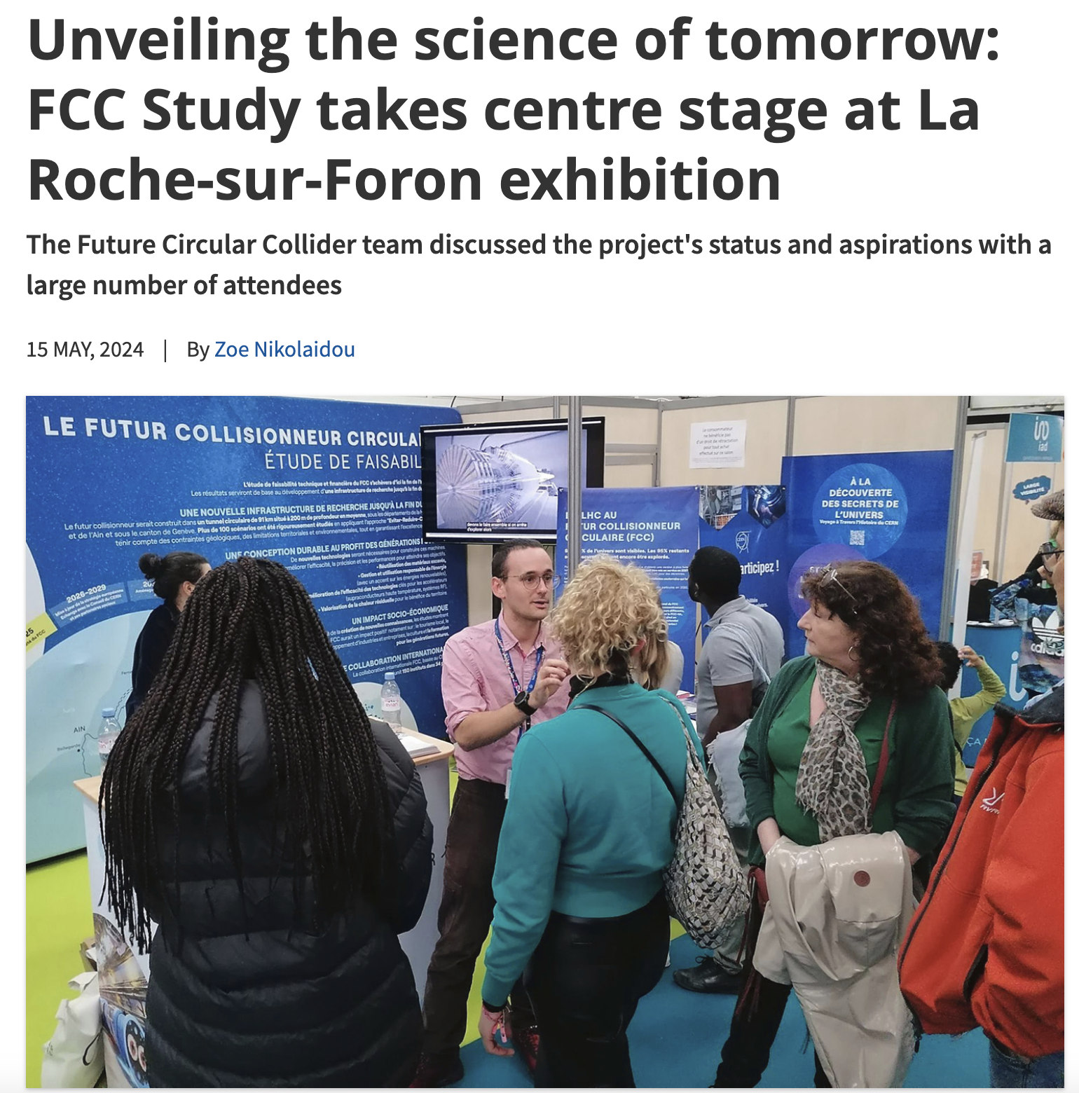
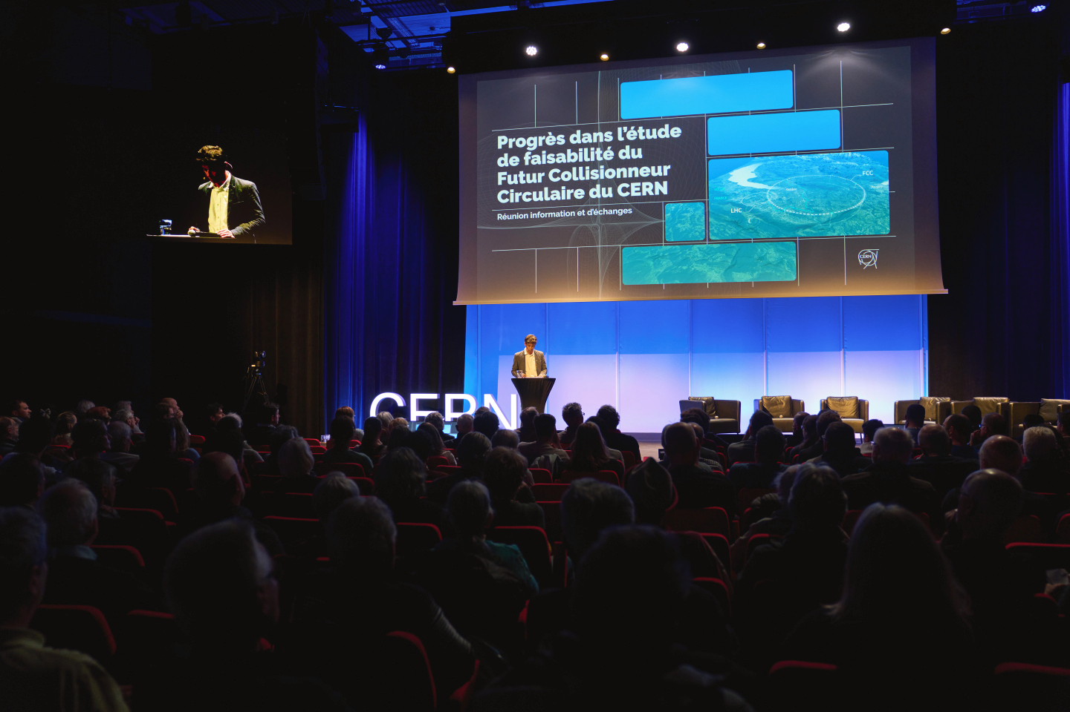
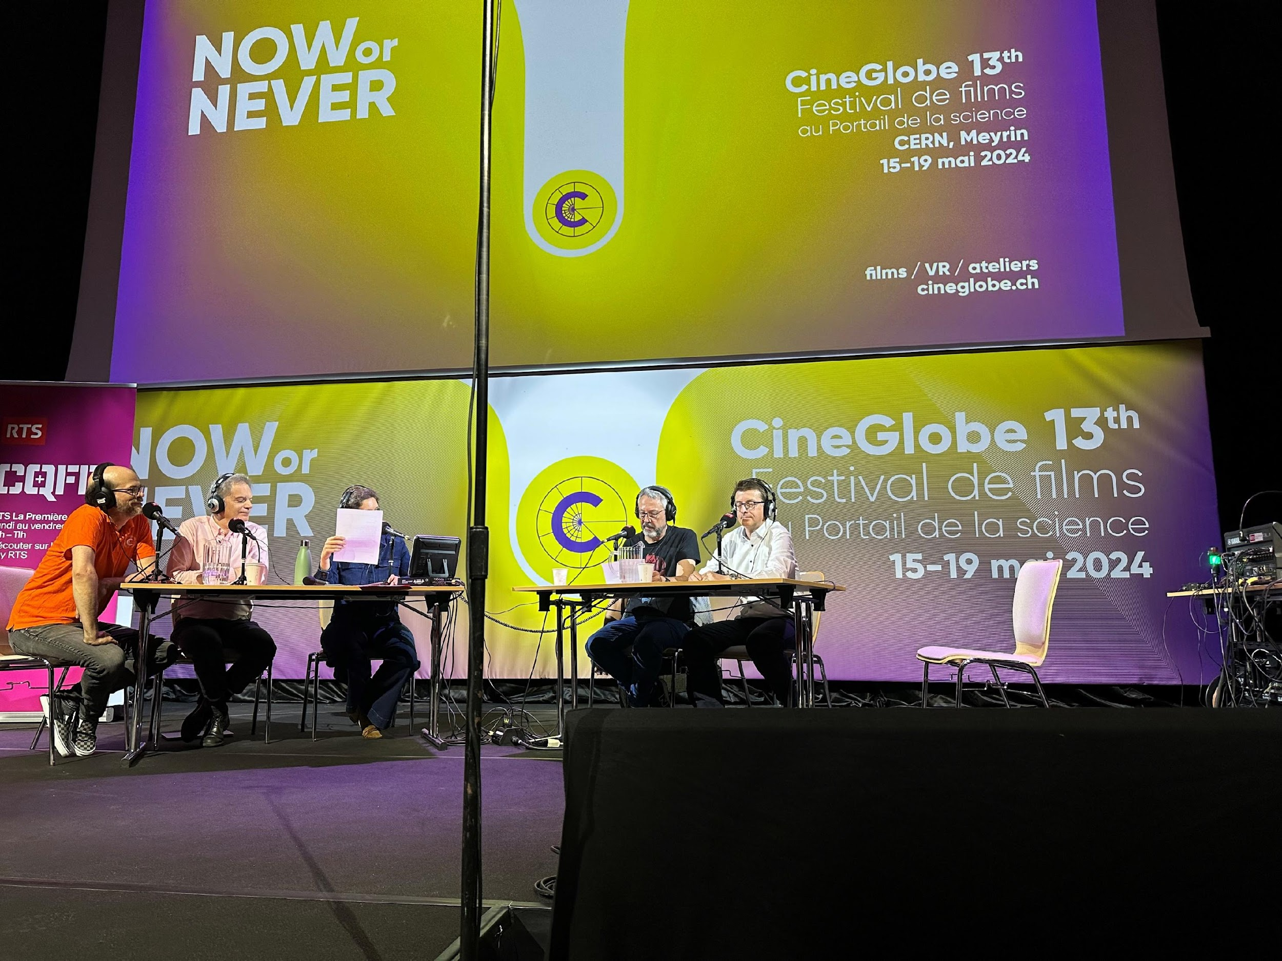
Start of public information & engagement sessions
First public information and discussion meeting at the Science Gateway on the 24th April at CERN.
The meeting was organised for the local community of our Host States, France and Switzerland, in the Science Gateway.
The "Progress of the feasibility study of the Future FCC circular collider" was followed by a discussion with the participants.
La Roche-sur-Foron - Haute Savoie international fare April 27 to May 6
CERN’s participation in the International Fair of Haute-Savoie/Mont Blanc, enhanced by the valuable help of volunteers from the FCC team, resulted in meaningful discussions with more than 2000 members of the local community on topics ranging from the required technological advancements to sustainability measures.
On 15 May, RTS (Radio Télévision Suisse) broadcasted a special program celebrating CERN’s 70th anniversary and hosted at CERN’s Science Gateway.
The event featured a comprehensive look at CERN's illustrious history, groundbreaking achievements, and future ambitions, including the prominently featured Future Circular Collider (FCC) project with study experts interacting with the audience.

Slide 19
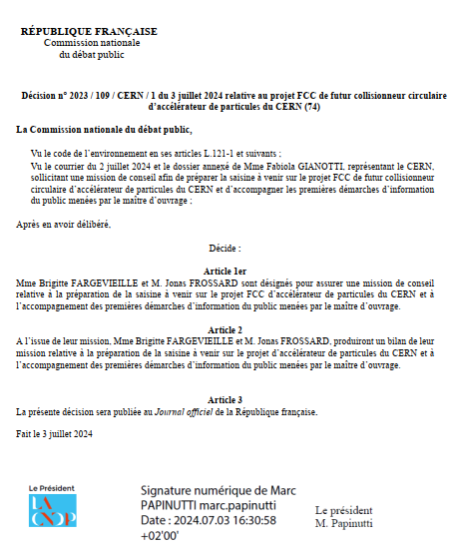
Commission Nationale de Debat Public (CNDP)
mission and public information meetings
The CNDP, created in 1995, is an independent French authority that ensures public participation in the definition and decision process of major projects in France, impacting the environment by providing a neutral and transparent framework for discussions between decision-makers and citizens.
On July 2, 2024, the CERN DG requested the CNDP to undertake an advisory mission on public participation for the FCC. On July 3, the president of the CNDP appointed two guarantors to:
Assist CERN in preparing the first information meetings on the ongoing studies in the region.
Provide non-binding advice to CERN on the next steps for public participation regarding the FCC.
CNDP decision for the Advisory Mission

Slide 20
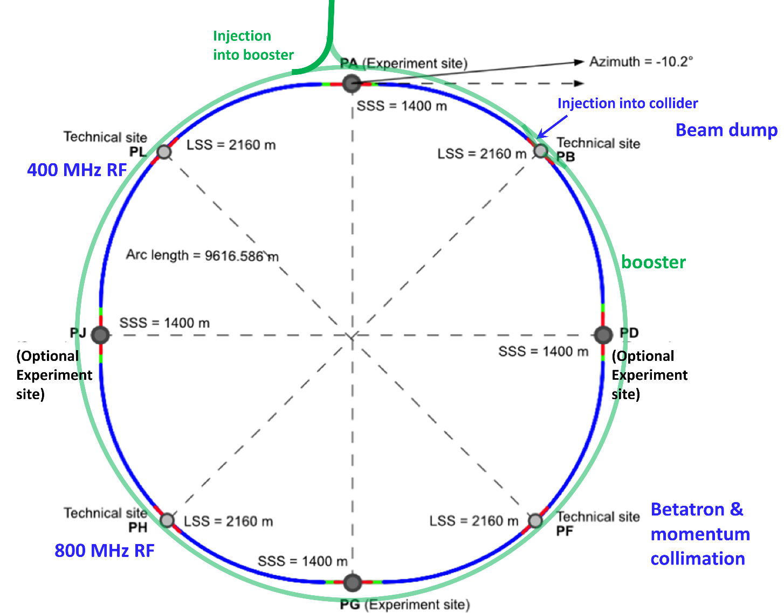
FCC-ee basic design choices
Double ring e⁺e⁻ collider
Common footprint with FCC-hh,
Asymmetric IR layout and optics to limit synchrotron radiation towards the detector
Perfect 4-fold superperiodicity allowing 2 or 4 IPs; large horizontal crossing angle 30 mrad, crab-waist collision optics
Synchrotron radiation power 50 MW/beam at all beam energies.
Top-up injection scheme for high luminosity Requires booster synchrotron in collider tunnel

Slide 21
FCC-ee main machine parameters
Parameter | Z | WW | H (ZH) | ttbar
beam energy [GeV] | 45.6 | 80 | 120 | 182.5
beam current [mA] | 1283 | 135 | 26.8 | 5.0
number bunches/beam | 11200 | 1852 | 300 | 64
bunch intensity [10¹¹] | 2.16 | 1.38 | 1.69 | 1.48
SR energy loss / turn [GeV] | 0.0390 | 0.369 | 1.86 | 9.94
total RF voltage 400/800 MHz [GV] | 0.079/0 | 1.0/0 | 2.09/0 | 2.1/9.2
long. damping time [turns] | 1171 | 218 | 65.4 | 19.4
horizontal beta* [m] | 0.11 | 0.22 | 0.24 | 0.9
vertical beta* [mm] | 0.7 | 1.0 | 1.0 | 1.4
horizontal geometric emittance [nm] | 0.7 | 2.16 | 0.66 | 1.51
vertical geom. emittance [pm] | 1.9 | 2.0 | 1.0 | 1.36
vertical rms IP spot size [nm] | 36 | 47 | 40 | 51
beam-beam parameter ξ_{x} / ξ_{y} | 0.0022/0.0977 | 0.013/0.129 | 0.0108/0.130 | 0.065/0.136
rms bunch length with SR / BS [mm] | 5.57 / 15.6 | 3.46 / 5.28 | 3.26 / 5.59 | 1.91 / 2.32
luminosity per IP [10³⁴ cm⁻²s⁻¹] | 143 | 20 | 7.5 | 1.38
total integrated luminosity / IP / year [ab⁻¹/yr] | 17 | 2.4 | 0.9 | 0.17
beam lifetime rad Bhabha + BS [min] | 15 | 12 | 12 | 11
Design and parameters to maximise luminosity at all working points:
allow for 50 MW synchrotron radiation per beam.
Independent vacuum systems for electrons and positrons
full energy booster ring with top-up injection, collider permanent in collision mode
4 years
5 x 10¹² Z
LEP x 10⁵
2 years
> 10⁸ WW
LEP x 10⁴
3 years
> 2 x 10⁶ H
5 years
2 x 10⁶ tt pairs
x 100 improvements on all EW observables
up to x 10 improvement on Higgs coupling (model-indep.) measurements over HL-LHC
x10 Belle II statistics for b, c, τ
indirect discovery potential up to ~ 100 TeV
direct discovery potential for feebly-interacting particles over 5-100 GeV mass range
Up to 4 interaction points → robustness,
statistics, possibility of specialised detectors
to maximise physics output
F. Gianotti

Slide 22
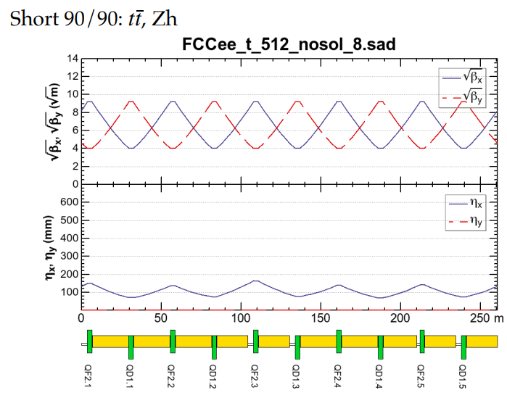
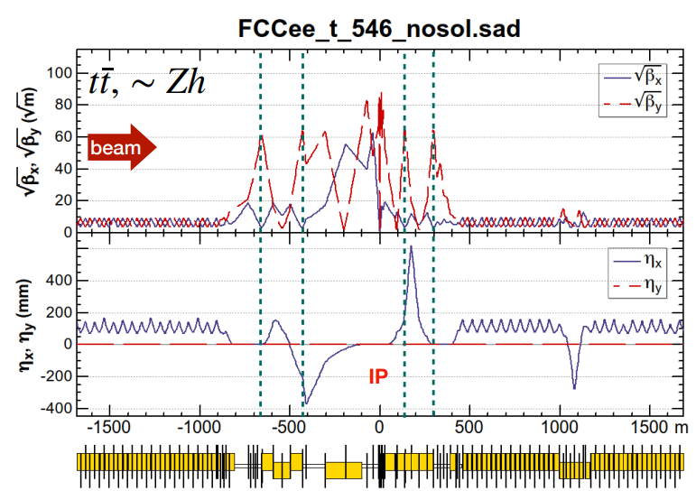
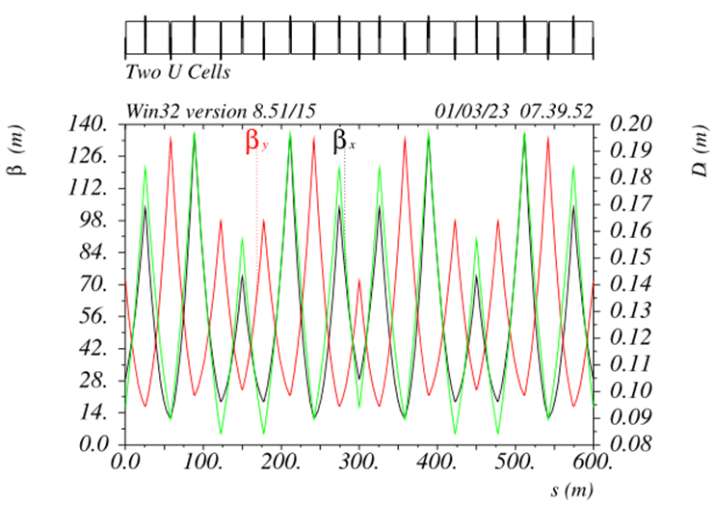




FCC-ee optics baseline & further evolution(s)
regular arc
K. Oide
interaction region
K. Oide
optimisation goals:
reduced power consumption
lower SR energy loss
increased momentum acceptance
relaxed tolerances
larger dynamic aperture
simplified powering schemes
FODO lattice, many -I sext pairs; periodic unit cell length $\sim$260 m
“1.5” sext.s per final focus,
asymmetric
P. Raimondi
P. Raimondi
hybrid FODO lattice,
with few sext. families,
periodic unit cell length$\sim$300 m
5 sext.s per final focus, modular
C. Garcia,
R. Tomas, et al.

Slide 23


Optimisation for operation: 400 MHz SRF and beam switchyard
Beam switching between (Z, W) and ZH operation
2-cell 400 MHz cavities for all three working points, identical configuration
ES separators + magnetic field for switching beams
Allows quasi “instantaneous” switching between Z, W, ZH
 | Energy (GeV) | Current (mA) | RF voltage (GV)
Z | 45.6 | 1280 | 0.08
W | 80 | 135 | 1
H | 120 | 26.7 | 2.08
ttb | 182.5 | 5 | 11.67
Collider RF integration at point H
(Z, WW and ZH operation)
Beam crossing and combination
at RF section in point H
Z, W
ZH
33 CM
33 CM
33 CM
33 CM
Beam 1
400 MHz
400 MHz
400 MHz
400 MHz
Beam 2
E&M
sep.1
E&M
sep. 2a
E& M
sep. 2b
extra year of operation thanks to single RF system

Slide 24






RF R&D activities
RF system R&D is key for increasing energy efficiency of FCC-ee
Nb on Cu 400 MHz cavities (KEK as R&D partner), seamless cavity production, coating techniques
Bulk Nb 800 MHz cavities and cryomodule, surface treatment techniques (JLAB, FNAL as R&D partners)
RF power source R&D in synergy with HL-LHC.
5-cell 800 MHz cavity development collaboration with JLAB
high-efficiency klystron R&D
400 MHz
monoblock prototype

Slide 25
Optimized injector concept and parameters
2023/24 mid-term review recommendations to reduce gradients and repetition rate → new linac optimization in terms of cost and power density
  Overall power consumption (for linacs) is reduced by more than a factor 3 by means of:
    new accelerating structures with higher shunt impedance;
    lower gradient (29.5 MV/m → 22.5/20.5 MV/m);
    lower repetition rate (200/400 Hz → 100 Hz).
  Repetition rate of 100 Hz with 4 bunches per rf pulse
  New layout: Damping Ring at higher energy 2.86 GeV, no common linac with 2x repetition rate.

Slide 26



Optimised injector implementation at Prevessin site
Good integration with existing CERN Prevessin Site and strongly reduced visibility from outside.
Ideal connection to existing experimental halls.
Good conditions for construction.
High Energy LINAC
Damping
Ring
CERN Fenced Area
Entrance CERN Prevessin Site

Slide 27
FCC-hh main machine parameters
parameter | FCC-hh | HL-LHC | LHC
collision energy cms [TeV] | 81 - 115 | 14
dipole field [T] | 14 - 20 | 8.33
circumference [km] | 90.7 | 26.7
arc length [km] | 76.9 | 22.5
beam current [A] | 0.5 | 1.1 | 0.58
bunch intensity [10¹¹] | 1 | 2.2 | 1.15
bunch spacing [ns] | 25 | 25
synchr. rad. power / ring [kW] | 1020 - 4250 | 7.3 | 3.6
SR power / length [W/m/ap.] | 13 - 54 | 0.33 | 0.17
long. emit. damping time [h] | 0.77 – 0.26 | 12.9
peak luminosity [10³⁴ cm⁻²s⁻¹] | ~30 | 5 (lev.) | 1
events/bunch crossing | ~1000 | 132 | 27
stored energy/beam [GJ] | 6.1 - 8.9 | 0.7 | 0.36
Integrated luminosity/main IP [fb⁻¹] | 20000 | 3000 | 300
With FCC-hh after FCC-ee: significant amount of time for high-field magnet R&D,
aiming at highest possible collision energies
Target field range for cryo-magnet R&D
Formidable challenges:
high-field superconducting magnets: 14 - 20 T
power load in arcs from synchrotron radiation: 4 MW → cryogenics, vacuum
stored beam energy: ~ 9 GJ → machine protection
pile-up in the detectors: ~1000 events/xing
optimization of energy consumption: → R&D on cryo, HTS, beam current, …
Formidable physics reach, including:
Direct discovery potential up to ~ 40 TeV
Measurement of Higgs self to ~ 5% and ttH to ~ 1%
High-precision and model-indep (with FCC-ee input)
measurements of rare Higgs decays (𝛄𝛄, Z𝛄, µµ)
Final word about WIMP dark matter
F. Gianotti

Slide 28



Key activities on FCC-hh: cryo magnet system, optics design
Optics design activities:
adaptation to new layout and geometry
shrink β collimation & extraction by ~30%
optics optimisation (filling factor etc.)
betatron collimation straight
experimental straight
M. Giovannozzi. G. Perez, T. Risselada
High-field cryo-magnet system design
Conceptual study of cryogenics concept and temperature layout for LTS and HTS based magnets, in view of electrical consumption.
Update of integration study for the ongoing HFM designs and scaling to preliminary HTS design.
  → Confirmation of tunnel diameter!
HFM R&D (LTS and HTS) on technology and magnet design, aiming also at bridging the TRL gap between HTS and Nb₃Sn.
Collider Center
F. Valchkova

Slide 29




Possible timeline till start of construction
2024 |  |  |  | 2025 |  |  |  | 2026 |  |  |  | 2027 |  |  |  | 2028 |  |  |  | 2029 |  |  |  | 2030 |  |  |  | 2031 |  |  |  | 2032 |  |  |  | 2033
Q1 | Q2 | Q3 | Q4 | Q1 | Q2 | Q3 | Q4 | Q1 | Q2 | Q3 | Q4 | Q1 | Q2 | Q3 | Q4 | Q1 | Q2 | Q3 | Q4
Feasibility Study
Pre-TDR Phase
TDR Phase
Construction →→→
FS Report
cost update
ESPPU
2025/26
pre TDR
cost update
TDR
cost update
Project Decision
accelerator design, technical infrastructure design, R&D, towards TDR
engineering design →
Environmental Impact study & Authorization Process
Phase 1 Site Investigations
Phase 2 Site Investigations
CE Concept Design update
CE Tender Design
Construction Design
Start construction
Detector EOI submissions
FC³ formation, call for CDRs
Detector CDRs submitted to FC³

Slide 30

Construction and installation planning stage 1
Baseline stage 1 FCC-ee schedule
Q1 2033, Start of CE construction work
Q2 2041, Completion of last lot of CE construction
Q2 2043, Overall completion of TI installation
Q4 2044, Accelerator installation completed
Q4 2045, HW commissioning completed
Q1 2046, First beams
Q1 2048, Start of nominal operation
Q3 2041 – Q3 2044, Experiment installation
Q1 2046, Start beam commissioning
Civil eng. works
Experiment. install.
Accelerator HWC
Shaft works
Geodetic install.
TI HWC
TI installation
Machine install.
Shaft release
First alcove release

Slide 31



Status of FCC global collaboration
Increasing international collaboration as a prerequisite for success:
→ links with science, research & development and high-tech industry will be essential to further advance and prepare the implementation of FCC
FCC Feasibility Study:
Aim is to further increase the collaboration,
on all aspects, in particular on
Accelerator and Particle/Experiments/Detectors
155 Institutes
36 countries
+
CERN

Slide 32


FCC Week 2024 - San Francisco – 10 to 14 June
449 participants, 50 public sessions, 216 oral presentations, 32 posters
US efforts getting organized, towards completing the FS by March 2025

Slide 33

Supporting statements at CERN’s 70 anniversary
“….No European country alone could have built the world’s largest particle collider. CERN has become a global hub because it rallied Europe and this is even more crucial today.
I am proud that we have financed the feasibility study for CERN’s Future Circular Collider (FCC). This could preserve Europe's scientific edge and could push the boundaries of human knowledge even further. And as the global science race is on, I want Europe to switch gears. To do so, European unity is our greatest asset. ….”
Ursula von der Leyen, President of the European Commission

Slide 34
FCC Main Goals for Coming Years
Upcoming milestone for FCC is the completion of the Feasibility Study by March 2025 as input for the Update of the ESPP.
The following pre-TDR phase should prepare for a possible project approval by 2027-2028 and enable the subsequent start of CE design contract:
  Updated cost and schedule studies
  specifications to enable CE tender design by mid 2027
  refined input for environmental evaluation and project authorisation process
  requires overall integration study and designs based on technical pre-design of accelerators, technical infrastructure and detectors
Possible start of CE construction would then be 2032-33:
  CE groundbreaking
  TDR to enable prototyping, industrialization towards component production
Great momentum - Strong international collaboration is essential for success!

Slide 35

FCC Week 2025 - Vienna
Venue: Hofburg Palace, a historical and cultural landmark in Vienna, Austria.
Dates: Monday 19 to Friday 23 May 2025
Presentation of the Feasibility Study Report and review of its findings and opportunities for future R&D projects
Please save the date and join us in Vienna

Slide 36
spare slides

Slide 37


FCC integrated program - timeline
Note: FCC Conceptual Design Study
started in 2014 leading to CDR
in 2018
Ambitious schedule taking into account:
past experience in building colliders at CERN
approval timeline: ESPP, Council decision
that HL-LHC will run until 2041
project preparatory phase with adequate
resources immediately after Feasibility Study
2027/28
~2033
~2046
~2070

Slide 38



European Strategy for Particle Physics
2013 Update of European Strategy for Particle Physics:
“CERN should undertake design studies for accelerator projects in a global context, with emphasis on proton-proton and electron-positron high-energy frontier machines.”
→ FCC Conceptual Design Reports (2018/19)
2020 Update of European Strategy for Particle Physics:
“Europe, together with its international partners, should investigate technical and financial feasibility of a future hadron collider at CERN with a centre-of-mass energy of at least 100 TeV and with an electron-positron Higgs and electroweak factory as a possible first stage.”
  Vol 1 Physics, Vol 2 FCC-ee, Vol 3 FCC-hh, Vol 4 HE-LHC
  CDRs published in European Physical Journal C (Vol 1) and ST (Vol 2 – 4)
  EPJ C 79, 6 (2019) 474 , EPJ ST 228, 2 (2019) 261-623 , EPJ ST 228, 4 (2019) 755-1107 , EPJ ST 228, 5 (2019) 1109-1382

Slide 39


FCC FS Council Documents, June ‘21
Organisational Structure of the FCC Feasibility Study
http://cds.cern.ch/record/2774006/files/English.pdf
Main Deliverables and Timeline of the FCC Feasibility Study
http://cds.cern.ch/record/2774007/files/English.pdf

Slide 40

FCC FS mid-term review
Mid-term review setup and deliverables are defined in CERN/SPC/1183/Rev.2:
the scientific and technical results be reviewed by the FCC FS Scientific Advisory Committee, augmented by additional experts as needed;
the cost and financial feasibility, which will focus on the first-stage project (tunnel, technical infrastructure, FCC-ee machine and injectors), be reviewed by a committee including external experts, as proposed in CERN/3588;
FCC Scientific Advisory Committee
Riccardo Bartolini (DESY), Alain Chabert (Société Française du Tunnel Routier Fréjus),
Heinz Ehrbar (HEP), Brigitte Fargevieille (Électricité de France), Belen Gavela Legazpi (UAM), Gudrun Hiller (Dortmund), Srinivas Krishnagopal (BARC), Peter Krizan (Ljubljana), Philippe Lebrun (CERN, retired), Peter McIntosh (STFC), Michiko Minty (BNL),
Andrew Parker (Chair, Cambridge), Kyo Shibata (KEK), Roberto Tenchini (Pisa)
FCC Cost Review Panel
Carlos Alejaldre (Fusion for Energy), Austin Ball (CERN, retired), Umberto Dosselli (INFN), Heinz Ehrbar (HEP)
Vincent Gorgues (CEA), Norbert Holtkamp (Chair, Stanford), Christa Laurila (National Audit Office, Finland), Ursula Weyrich (German Cancer Research Centre), Jim Yeck (BNL), Thomas Zurbuchen (ETH Zürich)

Slide 41

Feasibility Study Mid-Term Review passed !
The goal of the FCC FS mid-term review is to assess the progress of the Study towards the final report.
Deliverables approved by the Council in September 2022:
https://indico.cern.ch/event/1197445/contributions/5034859/attachments/2510649/4315140/spc-e-1183-Rev2-c-e-3654-Rev2_FCC_Mid_Term_Review.pdf
Full Report
8 Chapters/Deliverables
~ 700pp document
~ 16 editors
~ 500 contributors
Deliverables:
D1 : Definition of the baseline scenario
D2 : Civil engineering
D3 : Processes and implementation studies with the Host States
D4 : Technical infrastructure
D5 : FCC-ee accelerator
D6: FCC-hh accelerator
D7: Project cost and financial feasibility
D8: Physics, experiments and detectors
Many thanks to the SAC, CRP, SPC, FC and the Council for the very useful reviews!
Documents:
Mid-term report (all deliverables except D7)
Executive Summary of mid-term report
Updated cost assessment (D7)
Funding model (D7)
Review process:
Oct 2023: Scientific Advisory Committee (scientific and technical aspects)
and Cost Review Panel (ad hoc committee; cost and financial aspects)
Nov 2023: SPC and FC
2 Feb 2024: Council
All deliverables met, no technical showstoppers
→70-80 recommendations

Slide 42
FCC Feasibility Study (2021-2025): high-level objectives
demonstration of the geological, technical, environmental and administrative feasibility of the tunnel and surface areas and optimisation of placement and layout of the ring and related infrastructure;
pursuit, together with the Host States, of the preparatory administrative processes required for a potential project approval to identify and remove any showstopper;
optimisation of the design of the colliders and their injector chains, supported by R&D to develop the needed key technologies;
consolidation of the physics case and detector concepts for both colliders
elaboration of a sustainable operational model for the colliders and experiments in terms of human and financial resource needs, as well as environmental aspects and energy efficiency;
development of a consolidated cost estimate, as well as the funding and organisational models needed to enable the project’s technical design completion, implementation and operation;
identification of substantial resources from outside CERN’s budget for the implementation of the first stage of a possible future project (tunnel and FCC-ee);
Results will be summarised in a Feasibility Study Report to be released in March 2025
F. Gianotti

Slide 43



CE underground and surface progress
Full 3D model of all underground structures as basis for costing and scheduling exercises with external consultant.
Experiment Site (PA)
Generic study of experiment site and technical site done by FNAL
bills of quantities extracted from FNAL designs
basis for cost estimate by consultant with experience on industrial constructions in CH-FR area.

Slide 44



Progress on international collaboration
26 April 2024
White House Office of Science and Technology Policy Principal Deputy U.S. Chief Technology Officer Deirdre Mulligan signed for the United States while Director-General Fabiola Gianotti signed for CERN.

Slide 45

EU Competitiveness Report
edited by Mario Draghi, and officially handed over to Ursula von der Leyen in September 2024
“One of CERN’s most promising current projects, with significant scientific potential, is the construction of the Future Circular Collider (FCC): a 90-km ring designed initially for an electron collider and later for a hadron collider.
Refinancing CERN and ensuring its continued global leadership in frontier research should be regarded as a top EU priority, given the objective of maintaining European prominence in this critical area of fundamental research, which is expected to generate significant business spillovers in the coming years.”
https://commission.europa.eu/topics/strengthening-european-competitiveness/eu-competitiveness-looking-ahead_en

Slide 46
Summary from Feasibility Study
In 2021 CERN Council launched FCC feasibility study to provide input by 2025, in view of a potential project decision by end 2027/beginning 2028
Focus on implementation scenario developed with host state authorities
  Surface site areas identified and individual landplots reserved
  Electrical supply concept developed with FR and CH grid operators
  Road and highway connections identified and designs established
  Environmental initial state analysis for all surface sites completed
  Critical site investigations started
Colliders and technical infrastructures
  Two collider lattice variants established, optimization ongoing
  R&D activites started on main technologies (RF for FCC-ee, HFM for FCC-hh)
  Injector design optimized and implementation at CERN Prevessin site developed
  Technical infrastructures (EL, CV) system layouts developed
Cost estimate (by FCC FS) and funding model (CERN Council and Directorate)

