Slide 1
Simulating HEP Workloads with SimGrid
ATLAS TIM – 01/23/25 – Stony Brook University
Fred Suter
Oak Ridge National Laboratory

Slide 2
A Brief History of SimGrid

Slide 3
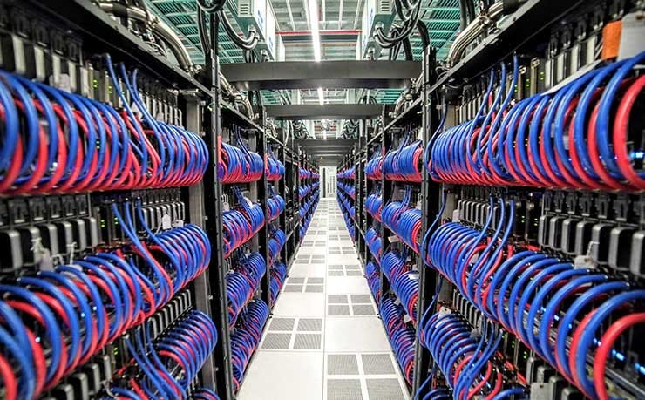
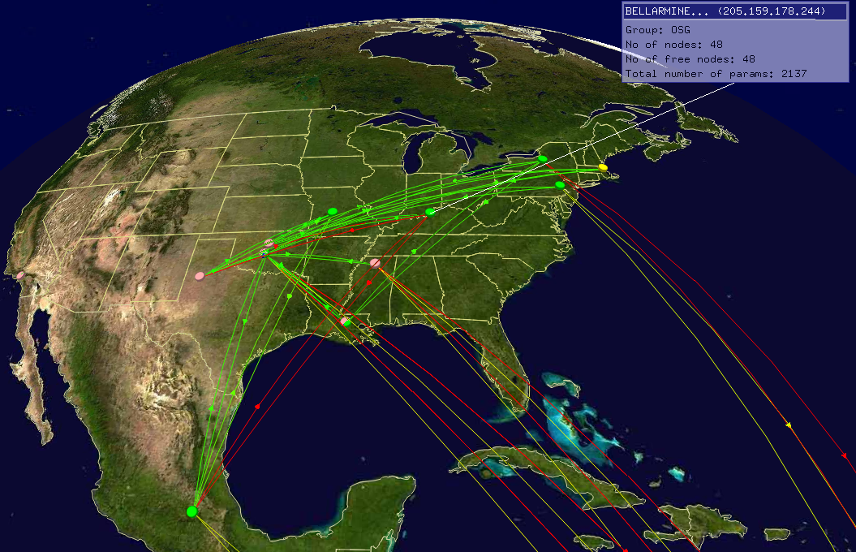
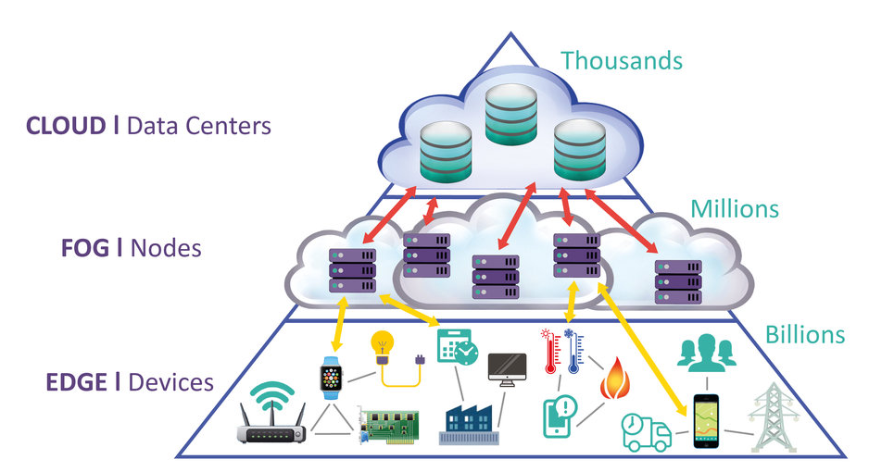
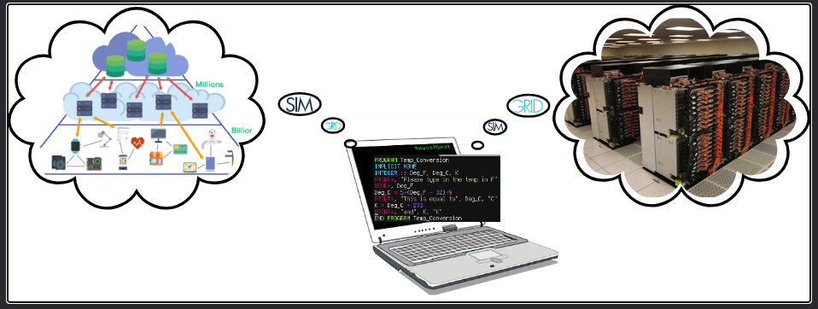
Our Scientific Objects: Distributed Systems
Clusters, supercomputers, peer-to-peer systems, grids, clouds, . . .
How to study these systems and their applications on my laptop?

Slide 4
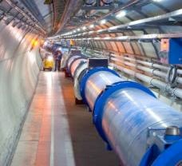
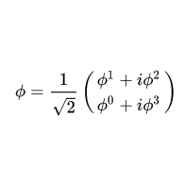
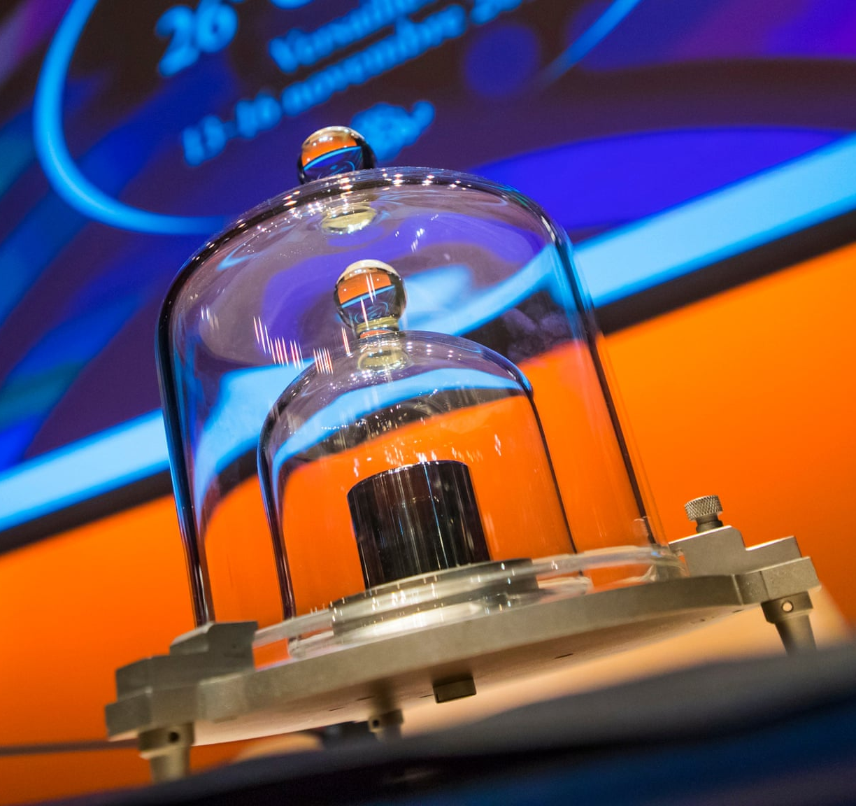
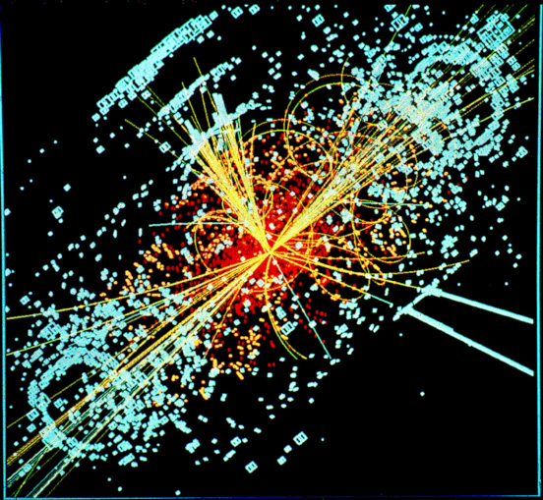
A Physics Approach of Computer Science
Theory: Informs on what should happen
Observations: Real applications on real systems
Emulation: Real applications on system models
Simulation: Application models on system models
Simulation: Fastest way from idea to data
Challenges
Accuracy Versatility
Utilisability
Scalability Extensivity

Slide 5
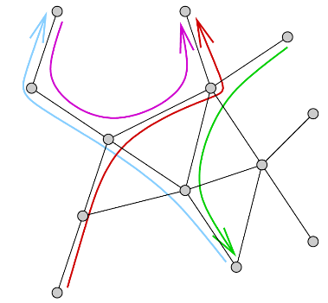
SimGrid in a Nutshell
Discrete Event Simulator (sequential, but fast)
Base Abstractions
Simulation kernel main loop
  Compute share of resource allocated to every activity (resource sharing algorithms)
  Compute the earliest finishing activity, advance simulated time
  Remove finished activity
  Loop back to 2
Flow-level models
  Boils down to solve a linear max min problem
  Good tradeoff between speed and accuracy
  Mutiple optimization techniques and specializations
Actors
Activities
Resources
Program anything you want/need
Computation, communication, I/O
CPUs, Links, Disks, …
Mailboxes / MessageQueues
  Rendez-vous points between actors

Slide 6




SimGrid History
1998 – 2001: Factor student code (DAG scheduling)
Casanova, H. Simgrid: a toolkit for the simulation of application scheduling
2001– 2005: CSP and improved network models
Legrand, A., Marchal, L., Casanova H.
Scheduling distributed applications: the simgrid simulation framework
SG1
SG2
SG3
SG4
2005– 2014: Versatility, Accuracy, Scalability
Casanova, H., Legrand, A., Quinson, M.
Simgrid: A generic framework for large-scale distributed experiments
Casanova, H., Giersch, A., Legrand, A., Quinson M., Suter, F.
Versatile, scalable, and accurate simulation of distributed applications and platforms
2014– 2025: Utilisability and Extensibility
Casanova H., Giersch A. Legrand, A., Quinson M, Suter, F.
Lowering Entry Barriers to Developing Custom Simulators ofDistributed Applications and Platforms with SimGrid

Slide 7
SimGrid and HEP Workloads

Slide 8
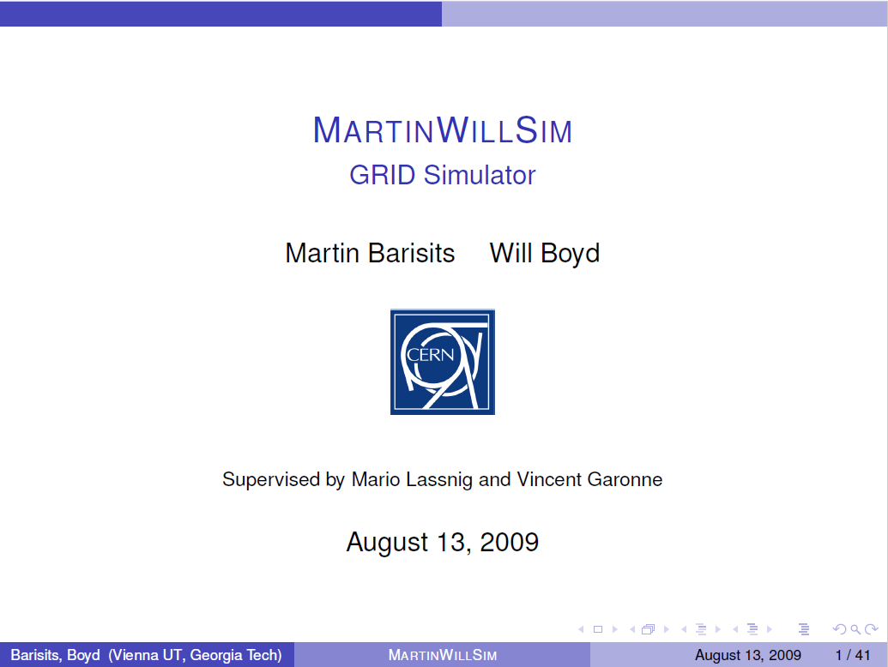
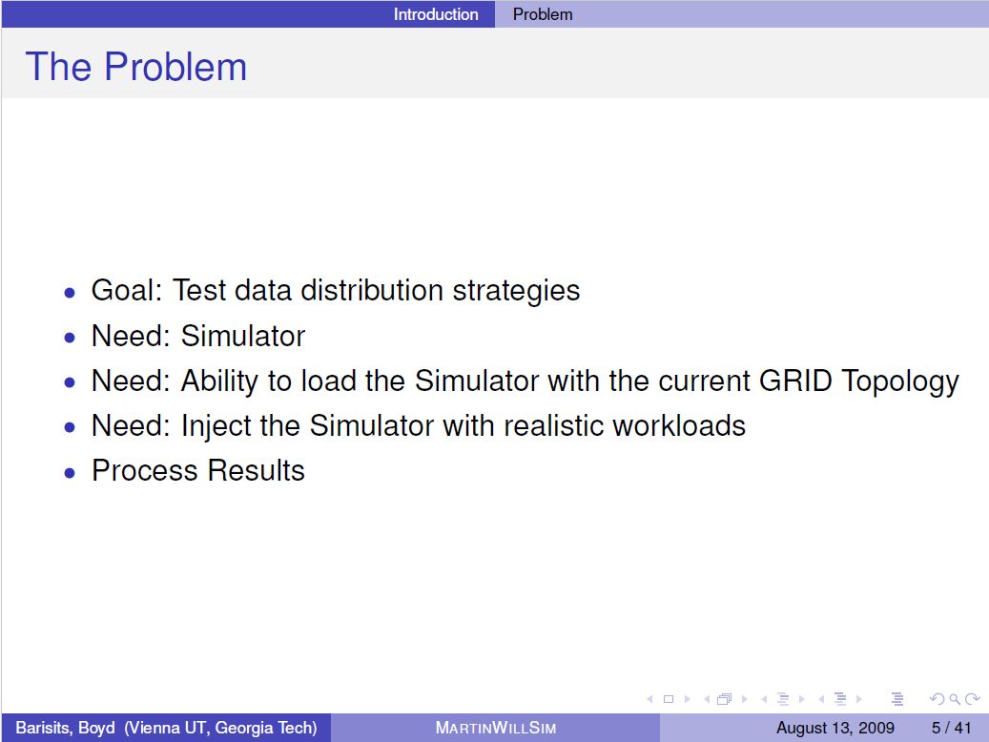
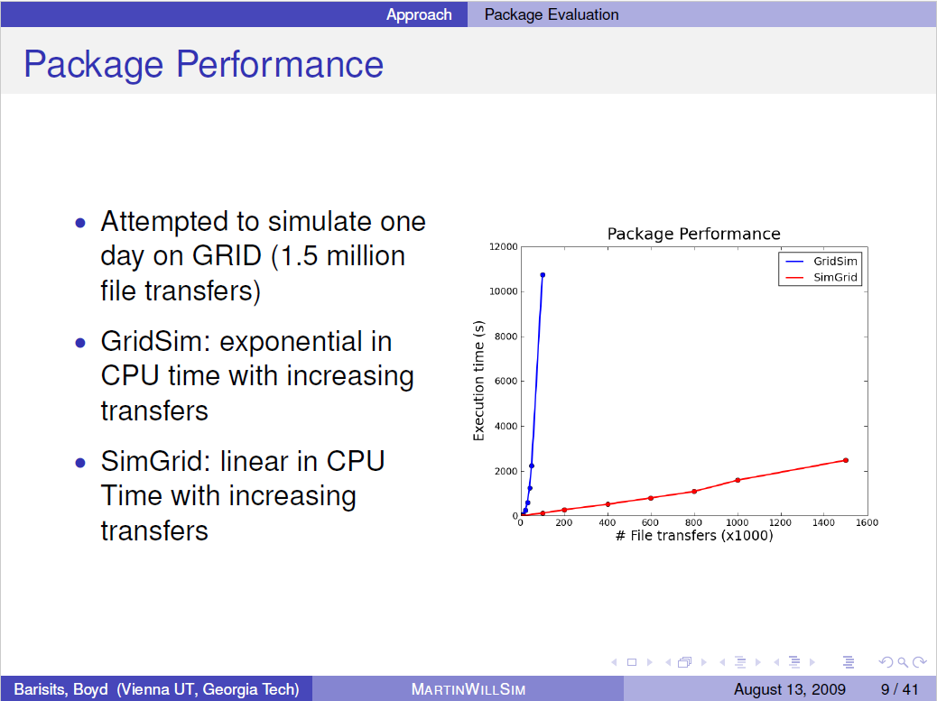
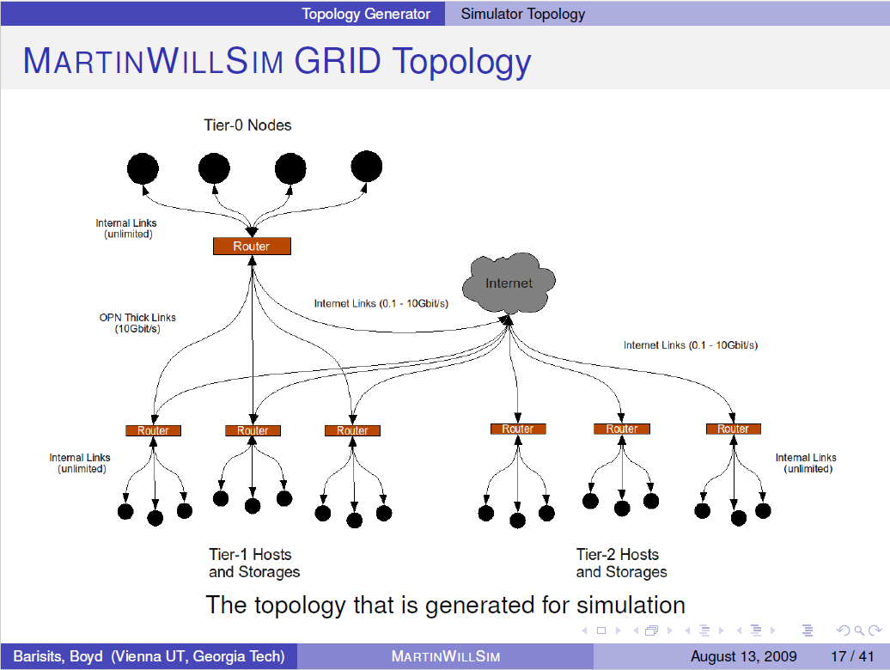
MartinWillSim (ca. 2009)

Slide 9
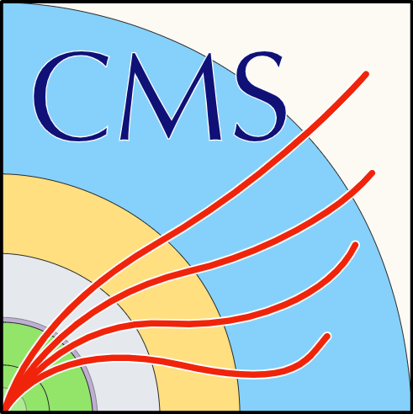

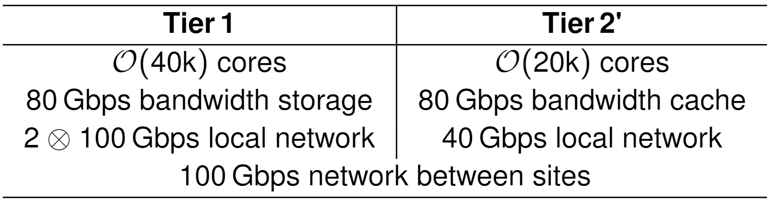
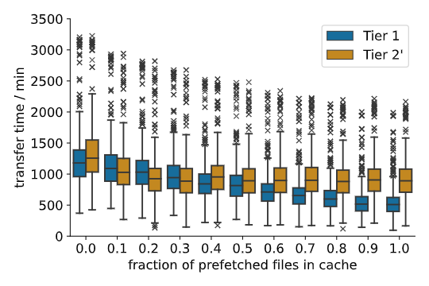
Planning a Computing and Storage Infrastructure for HEP
Study hypothetical interplay of
  A Tier 1 center
  A Tier 2 with grid storage replaced by cache (Tier 2’)
Prefetch a fraction of the files from cache
  ρ = 0: Every file is transferred from Tier 1
  ρ = 1: Every file is fetched from the cache on Tier 2’
Horzela, M., Casanova, H., Giffels, M., Gottmann, A. Hofsaess, R., Quast, G., Rossi Tisbeni, S., Streit, A., Suter, F.
Modeling Distributed Computing Infrastructures for HEP Applications, EPJ Web of Conf., 295 (2024) 04032

Slide 10
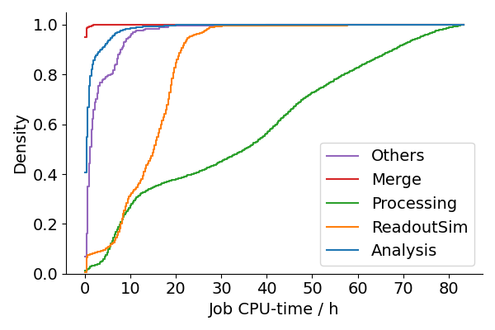
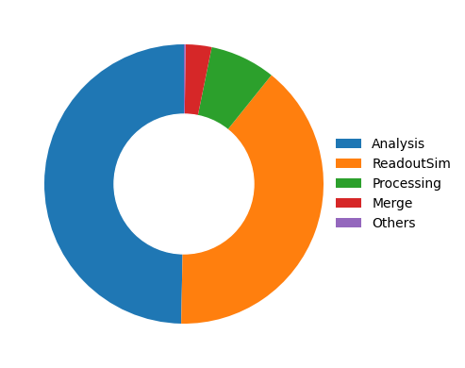
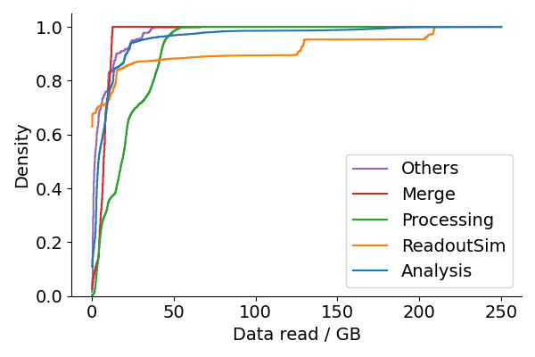

DCSim: Implementation of (HEP) Extensions and Simulator
Define workloads of jobs
  Number of operations to execute
  Memory
  Size of input and output files
  Submission time
Define platform (network & hosts)
  properties: #cores, CPU-speed, RAM, disk, bandwidth
  role: worker, storage, data cache, scheduler, …
Instantiate initial deployment of files on storage systems
Start the simulation!
  Jobs are scheduled and run
  Input-files are streamed and cached
  Caches evict files if necessary
  Job dynamics are monitored
https://github.com/HEPCompSim/DCSim

Slide 11
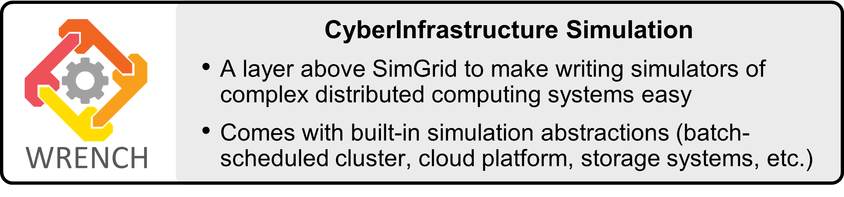
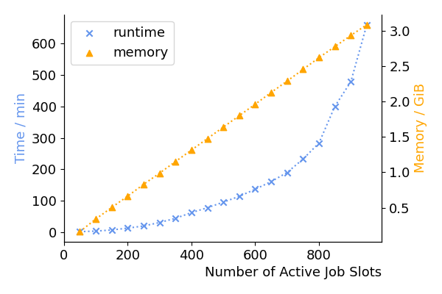
DCSim: A Scalability Headache!
Led to new developments in SimGrid
  Message queues
  I/O streams
  Compound activities
  File System module
And many optimizations in WRENCH
  Memory and Speed
  Automated calibration

Slide 12
SimGrid and REDWOOD

Slide 13
History repeats itself …

Slide 14
Questions?
Thank you for your attention

