Slide 1
ATLAS Software and Computing and ADC
SDCC meeting
Alexei Klimentov (BNL)
January 23, 2025

Slide 2
Welcome ATLAS
Software and Computing Coordinators :
      Edward Moyse and David South
Distributed Computing Coordinators :
Mario Lassnig and Andreu Pacheco Pages
Workflow Management System Co-Coordinator :
Rodney Walker
Fabrics Coordinator :
Ivan Glushkov

Slide 3
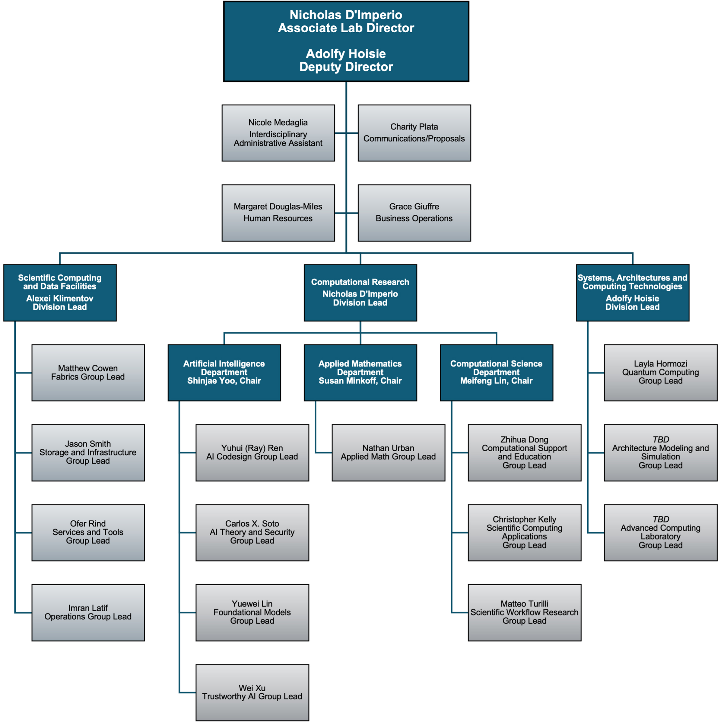
Computing and
Data Sciences
Directorate
Organization
Matt Cowan
Fabrics
Group Lead
Jason Smith
Storage&Infrastructure
Group Lead
Ofer Rind
Services&Tools
Group Lead
Imran Latif
Operations
Group Lead
Former SDCC at NPP
Directorate

Slide 4
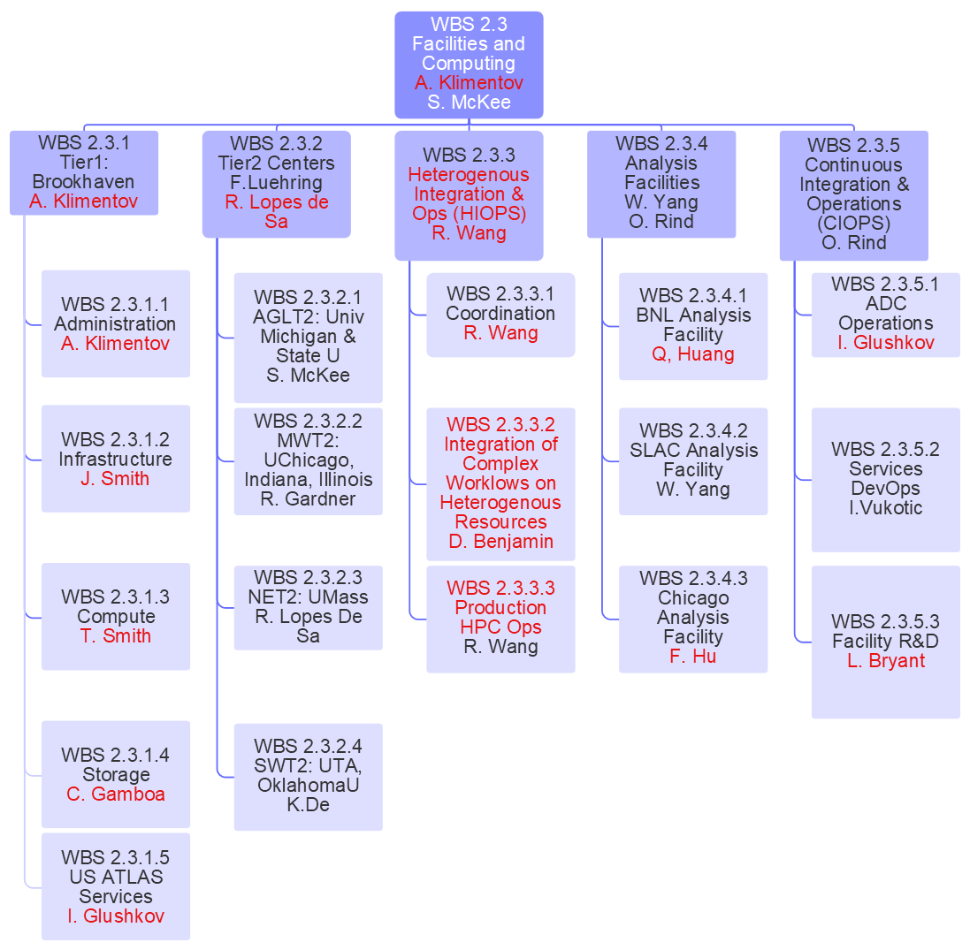
Changes to personnel and work areas for FY24 to FY25
are in red font
In green circle – SDCC staff

