Slide 1

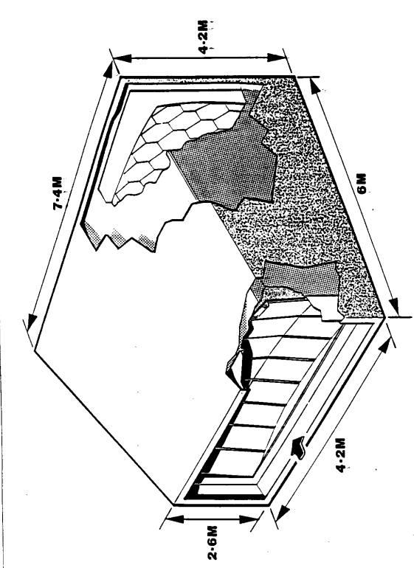
V, P, Matprops
“Green radiators”: Update on (thoughts on) gas radiator development
(based on previous presentations: see next slide)
* See also the talk of Fulvio Tessarotto, Tuesday morning WP3 meeting
(https://indico.cern.ch/event/1536396/contributions/6465189/attachments/3047336/5384716/
tessarotto_radiator_gas_system_DRD4_WP3_2025_04_08.pdf)
G. Hallewell
Aix Marseille Université,
CNRS/IN2P3, CPPM, Marseille, France
.
DRD4 Collaboration Meeting,
WG-2 session: CERN, April 11 2025
1
Notes:
1

Slide 2
This is a follow-on from previous presentations in this vein:
(too much for here): for more information see:
“Green radiators”: Controlling refractive index & reducing Cherenkov gas radiator GWP: a challenge in an era of diminishing fluorocarbon availability
Related paper: https://link.springer.com/article/10.1140/epjp/s13360-023-04703-w
Also DRD4 meeting, May 2023 https://indico.cern.ch/event/1263731/contributions/5398511
ATLAS sustainability forum CERN, Jan 26 2024
https://indico.cern.ch/event/1371158/contributions/5773321/attachments/2788215/4861759/G_Hallewell_ATLAS_sustainability_forum_Jan_26_2024_v2.pptx
Sustainable HEP 2024 https://indico.global/event/4744/contributions/39611/
ICHEP2024 (July 2024): https://indico.cern.ch/event/1291157/contributions/5900402
DRD4 meeting Oct. 2024: https://indico.cern.ch/event/1456663/sessions/566400/#20241024
.
2
G. Hallewell: Green Cherenkov gas radiators DRD4 WG-2 session: 11/04/2025
Notes:
2

Slide 3
COMPASS, LHCb use C₄F₁₀ & CF₄ Cherenkov gas radiators.
These Saturated Fluorocarbons (C_{n}F_{(2n+2)}) have high GWPs (5000-9000*CO₂)
➔ impetus at CERN to reduce their use;
Fluoro-olefins (or fluoro-ketones: C_{n}F_{2n}O) can offer similar optical performance, with GWPs equivalent to CO₂ (or zero);
But GWPs are geometry-specific: closed molecular rings with O atom link have GWPs as high as SFCs. Reactivity & toxicity likely to be geometry dependent;
Legislation may limit SFC & F-K PFAS (*Per- and polyfluoroalkyl substances) availability, leaving “holes” in the C_{n}F_{x} “spectrum”, unfilled by C_{n}F_{2n}O equivalents;
Blending low molar concentrations of heritage-stock higher-order SFCs
or C₅F₁₀O (GWPzero) with light gases, N₂, Ar, CO₂… would reduce overall
radiator volume GWP “load” and mean less FC liquid mass stockage;
Sound velocity measurement was used in real-time C₅F₁₂ /N₂ & C₄F₁₀ /N₂ blending. Valuable in future to meet optical & low GWP constraints of blended Cherenkov gas radiators
also in continuously sensitive real-time leak detection (ATLAS Si tracker).
G. Hallewell: Green Cherenkov gas radiators DRD4 WG-2 session: 11/04/2025

Slide 4
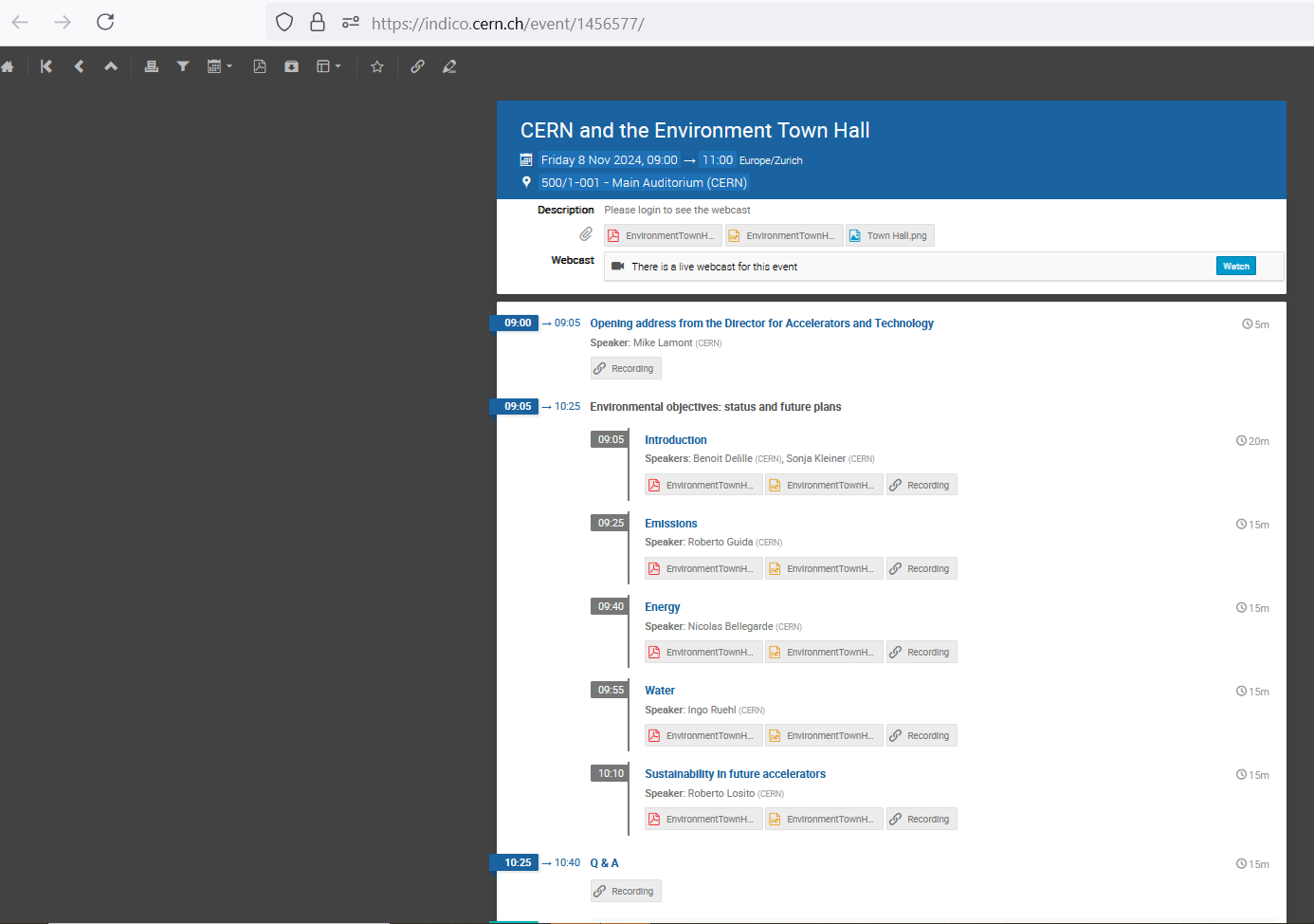

The CERN Green Scene: Fairly recently:
(Cherenkov gas radiators a small part of overall thematic...)
Watch this (CEPS) space
- and GET SB MEMBERSHIP
- to represent the
Cherenkov detector
community and its needs!
G. Hallewell: Green Cherenkov gas radiators DRD4 WG-2 session: 11/04/2025

Slide 5
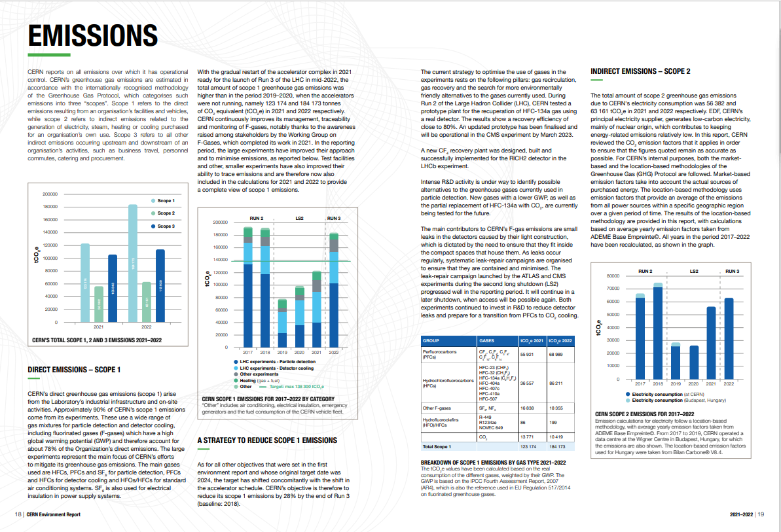
https://doi.org/10.25325/CERN-Environment-2023-003
But no mention at all of the ATLAS ultrasonic fluorocarbon leak monitor system !
G. Hallewell: Green Cherenkov gas radiators DRD4 WG-2 session: 11/04/2025

Slide 6

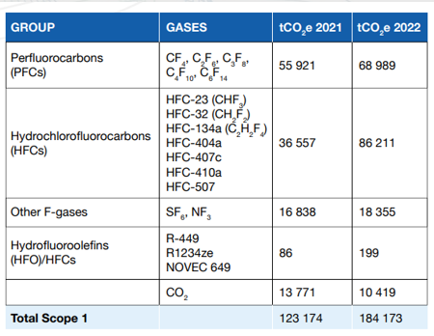
This latest CERN environmental report https://doi.org/10.25325/CERN-Environment-2023-003
Collective loss of SFCs only around 10 tonnes (whole of LHC + expts)
(compare that to mass-loss at a ‘grande surface’ supermarket!)
R449: (CFH blend) GWP=1397
R1234 (HFO): GWP = 7
NOVEC 649 (C₆F₁₂O): GWP=0
G. Hallewell: Green Cherenkov gas radiators DRD4 WG-2 session: 11/04/2025

Slide 7
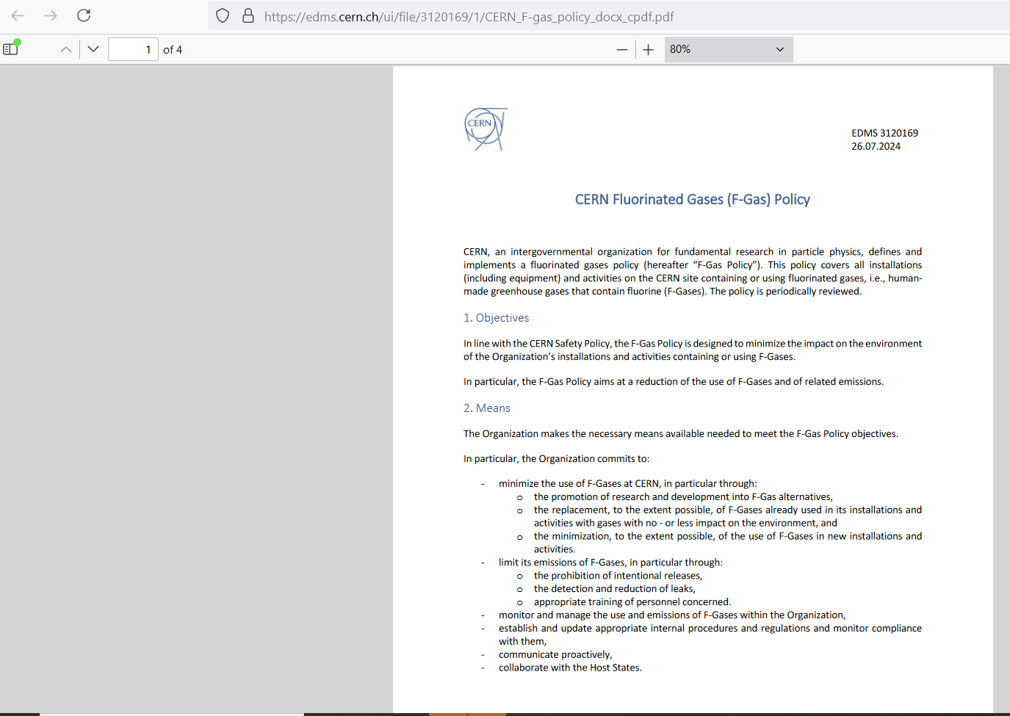
CERN F-gas policy document on EDMS (July 2024)
https://edms.cern.ch/ui/file/3120169/1/
CERN_F-gas_policy_docx_cpdf.pdf
Page 1 of 4
G. Hallewell: Green Cherenkov gas radiators DRD4 WG-2 session: 11/04/2025

Slide 8
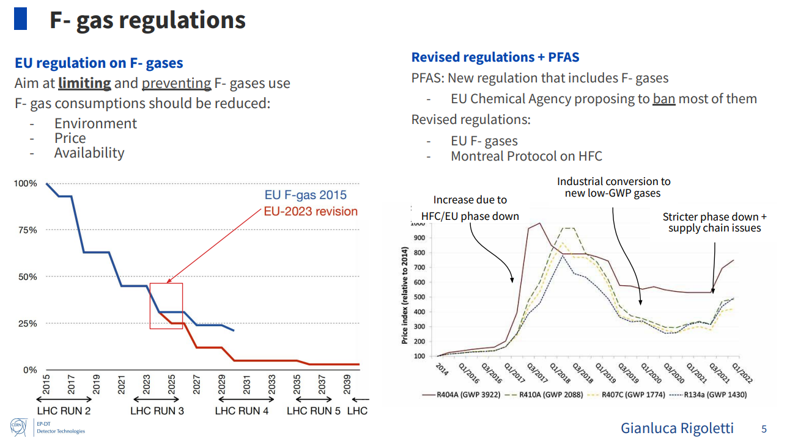
EU strategy to reduce Fluronated (PFAS) compound production and use
(includes also fluorinated plastics not shown here: see back-up material)
Dynamic price hiking :
like Trimposing demand-dependent tariffs…?
Projected Usage
From: ICHEP2024
G. Hallewell: Green Cherenkov gas radiators DRD4 WG-2 session: 11/04/2025

Slide 9
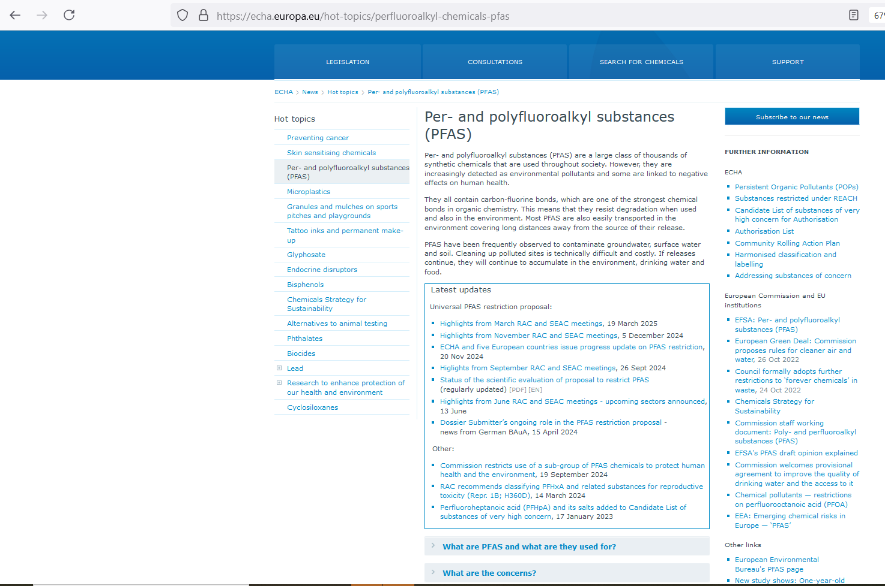
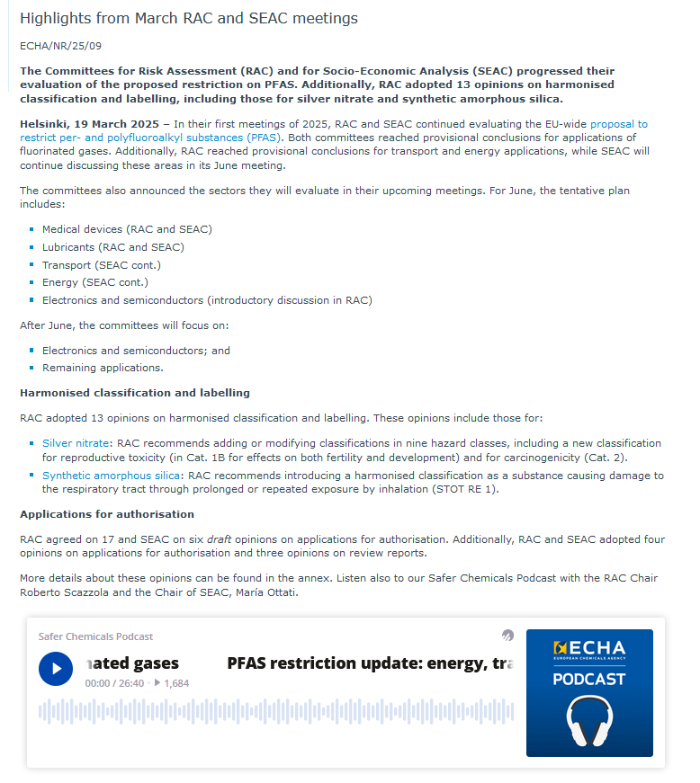
G. Hallewell: Green Cherenkov gas radiators DRD4 WG-2 session: 11/04/2025

Slide 10
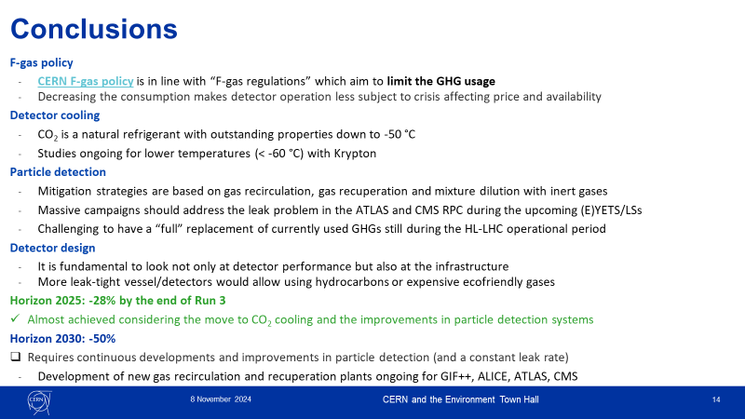
CERN and the Environment (what?)Town Hall meeting 8 November 2024
Watch this (CEPS) space
- and GET SB MEMBERSHIP
- to represent the
Cherenkov detector
community and its needs!
(from Guida talk)
G. Hallewell: Green Cherenkov gas radiators DRD4 WG-2 session: 11/04/2025

Slide 11
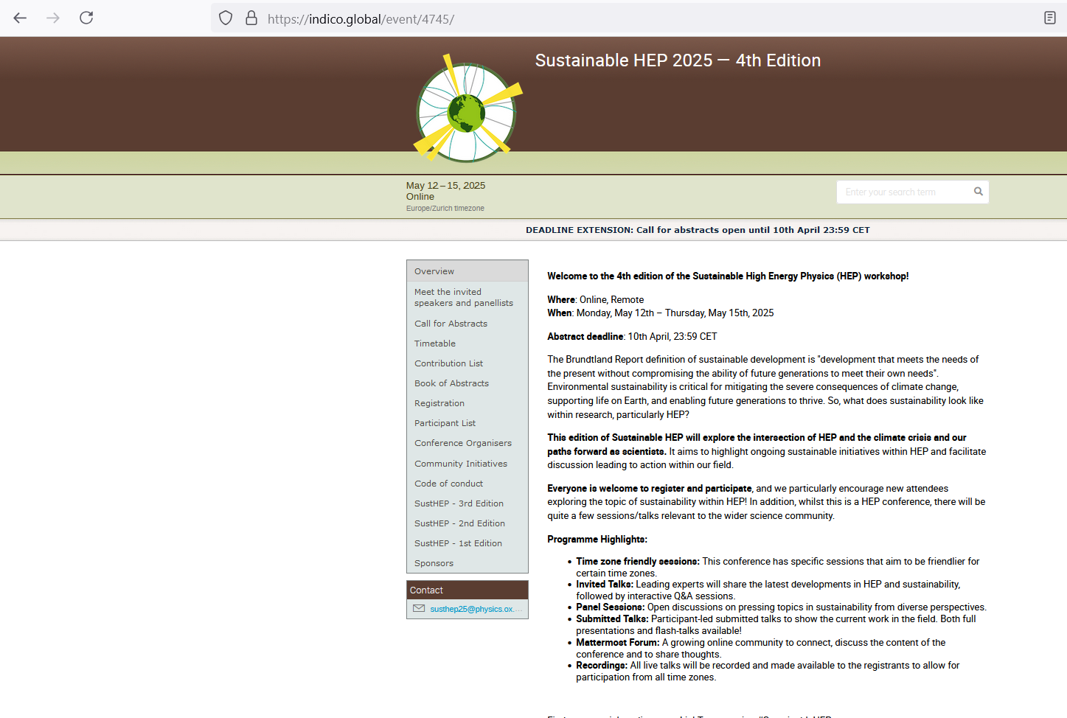
And coming up soon…
G. Hallewell: Green Cherenkov gas radiators DRD4 WG-2 session: 11/04/2025

Slide 12
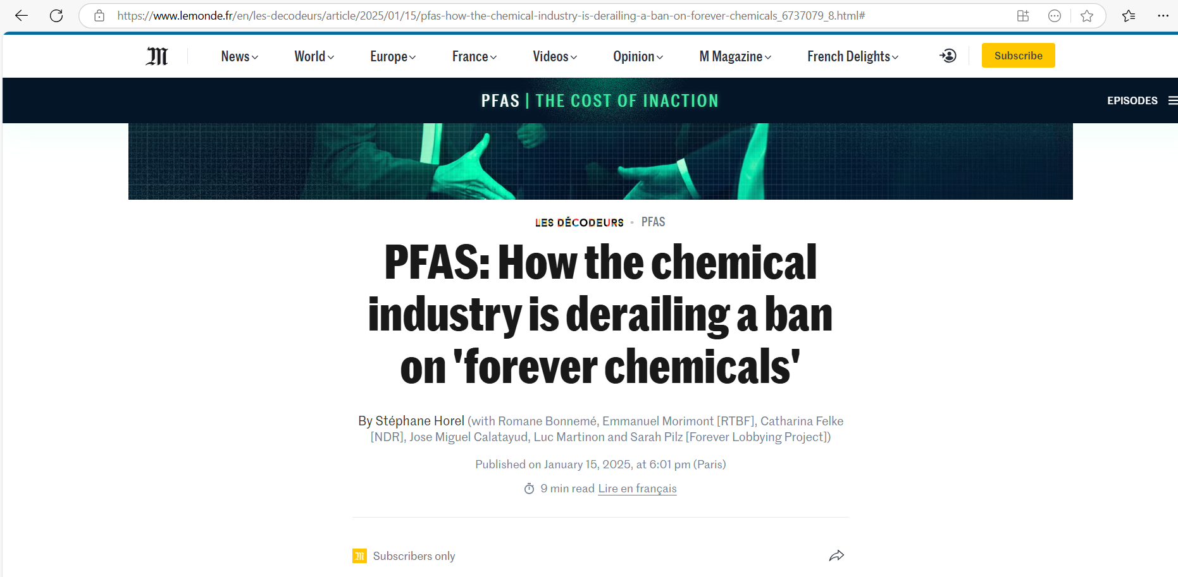
Is the Chemical industry dragging its feet
(3M plans to stop PFAS production in 2025: …other companies filling the gap?)
Is a ban even realistic (semiconductor industry…?)
G. Hallewell: Green Cherenkov gas radiators DRD4 WG-2 session: 11/04/2025

Slide 13
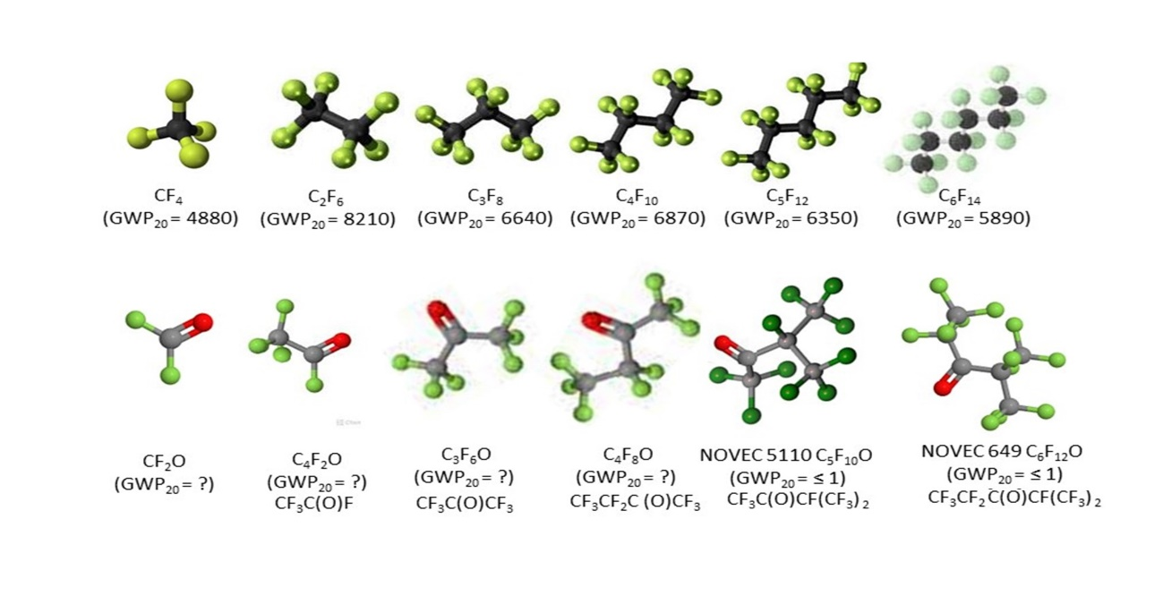
Molecular shapes, GWP & toxicity
Cherenkov
Radiator
Cherenkov
Radiator
(hist.)
Si cooling
(Evap.)
Cherenkov
Radiator
Cherenkov
Radiator
(hist.)
Cherenkov
Radiator
(hist.) + Cooling (Liq.)
Ih.T. H335
Ih.T. H335
Ih.T. H335
Ih.T. H335
Ih.T. H335
Ih.T. H335
C₂F₄O
Ih.T H330, reactive
Ih.T H331,
reactive
Ih.T H331,
reactive
Ih.T. H335
COOLING (Liq.)
Ih.T. H335
Ih.T. H335
Upper: molecular shapes of SFCs, including common gaseous Cherenkov radiators.
Lower: shapes of some non-cyclic C_{n}F_{2n}O analogues (20-year GWPs & GHS inhalation toxicities (source www.synquest.com
G. Hallewell: Green Cherenkov gas radiators DRD4 WG-2 session: 11/04/2025

Slide 14
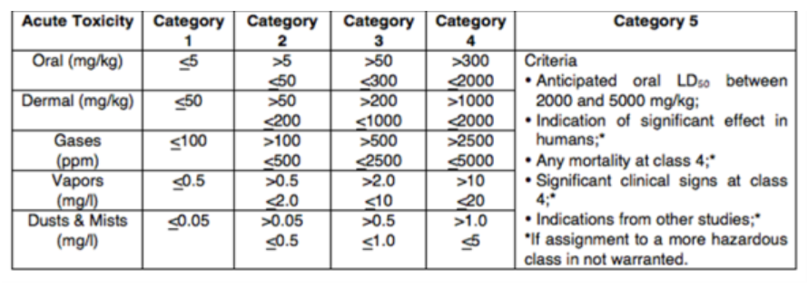
GHS Classification Criteria for Inhalation & skin Toxicity
Global Harmonized System of Classification and Labelling of Chemicals (GHS). 10th revision, United Nations (2023}
About the GHS | UNECE https://unece.org/about-ghs
H330 | Fatal if inhaled
H331 | Toxic if inhaled
H332 | Harmful if inhaled
H333 | May be harmful if inhaled
H334 | May cause allergy or asthma symptoms or breathing difficulties if inhaled
H335 | May cause respiratory irritation
H336 | May cause drowsiness or dizziness
H310 | Fatal in contact with skin
H311 | Toxic in contact with skin
H312 | Harmful in contact with skin
H313 | May be harmful in contact with skin
H314 | Causes severe skin burns and eye damage
H315 | Causes skin irritation
G. Hallewell: Green Cherenkov gas radiators DRD4 WG-2 session: 11/04/2025

Slide 15
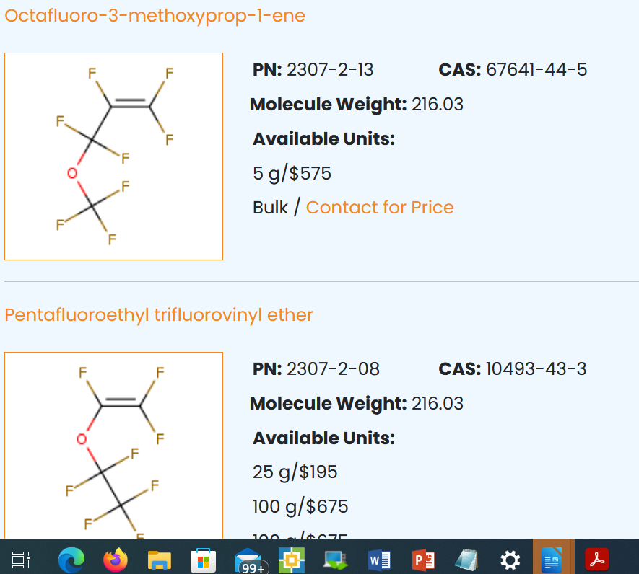
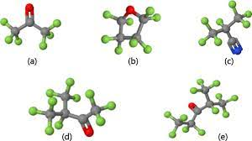
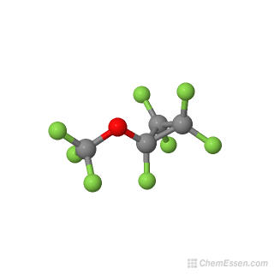
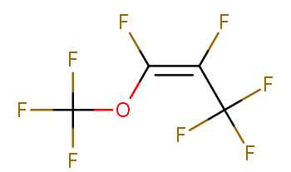
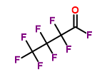
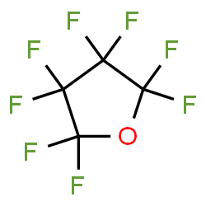
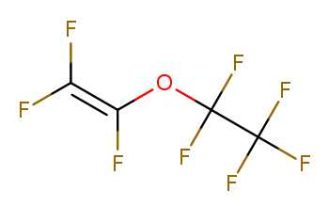
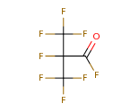
Molecular shape is important for GWP and toxicity
Cyclic, non-cyclic & non-cyclic double c-bonded C₄F₈O isomers
☺
GWP ?
Octafluoro-2-butanone
(GWP₂₀ = ?) [H335]
Optical performance similar
to C₄F₁₀: (BTeV & ALICE VHMPID)
High GWP!!
GWP ?
Octafloro-1-methoxyprop-1-ene
(GWP₂₀ = ?) [H332, 335, 336]
Heptafluorobutyryl fluoride
(GWP₂₀ = ?) [H331]
GWP ?
C₄F₈O
Cyclic
Perfluorotetrahydrofuran,
Octofluorotetrahydrofuran
(GWP₂₀ = 8975) [ref EPJP]
[H335]
Pentafyoroethyltrifluorovinyl ether
(GWP₂₀ = ?) [H332, 335]
Heptafluoroisobutyryl fluoride
(GWP₂₀ = ?) [H335]
C₄F₈O Linear with Oxygen atom as
internal link and double carbon
bonded link
C₄F₈O Linear & iso, with
Oxygen atom on external spur
G. Hallewell: Green Cherenkov gas radiators DRD4 WG-2 session: 11/04/2025

Slide 16
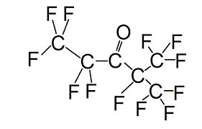
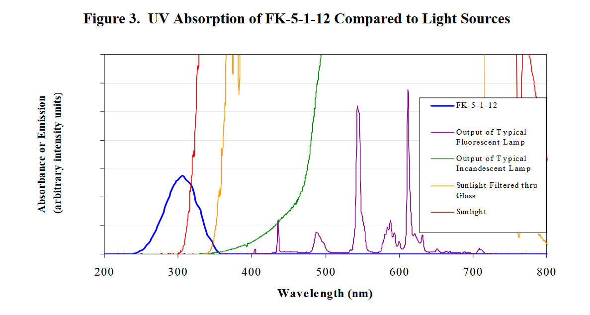
Q: What gives NOVEC 649/1230 its low GWP?
https://www.nist.gov/system/files/documents/el/fire_research/R0301570.pdf
[15]
Problematic UV absorbance
band for Cherenkov
light detection?
Scission by UV photons of λ around 300 nm
In the atmosphere (low pressure, high UV): the fragments do not reassociate* into saturated fluorocarbons of the type C_{n}F_{(2n+2)} (which would have high GWP)
*The Environmental Impact of CFC Replacements HFCs and HCFCs
T. WALLINGTON et al Environ.Sci.Technol.1994(28)7 320A https://doi.org/10.1021/es00056a714
16
G. Hallewell: Green Cherenkov gas radiators DRD4 WG-2 session: 11/04/2025

Slide 17
- Use Fluoro-ketone substitites for SFCs where possible (evaluation of C₅F₁₀O/CO₂ planned: Antonello di Mauro) ➔;
- Better ‘husbandry’ of SFCs if we must continue with them
(better leaktightnes, blend & leak monitoring, reduced losses in circulation & purification) ➔ lower FC stocks;
- GWP Load lightening: blending a low concentration of a heavy SFC or F-K with N₂ to replicate refractive index of a lighter SFC at high concentration;
- No to flammable substitutes (you’ll see why…);
- Avoidance of pressures > 10⁵ hPa (PV stored energy)
Cherenkovgreenicity
G. Hallewell: Green Cherenkov gas radiators DRD4 WG-2 session: 11/04/2025

Slide 18
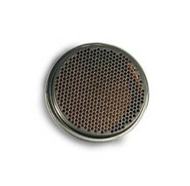
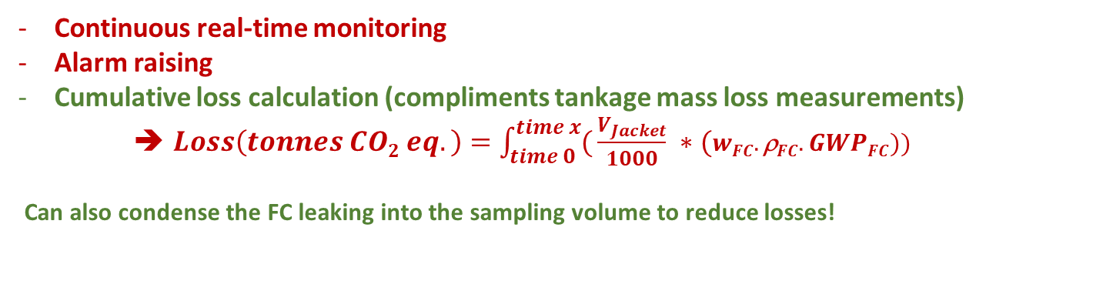
Surrounding a Fluorocarbon RICH radiator with a thin (for example: N₂) -purged leak sniffing jacket equipped with ultrasonic monitoring of FC molar mass
Internal placement of ultrasonic transducers?
Aspiration to analyser: membrane pumps & tubes?
Aspiration from the bottom best: hydrostatics of heavier FC
Care with volume calculation if jacket walls are flexible:
(Hydrostatic bowing with heavy FCs)
SensComp
(ex-Polaroid) 50 kHz
Ultrasonic transducer
https://senscomp.com
Continuous real-time monitoring
Alarm raising
Cumulative loss calculation (compliments tankage mass loss measurements)
➔ $Loss\left(tonnes CO2 eq.\right)=\int_{time 0}^{time x}{(}\frac{V_{Jacket}}{1000} ∗(wFC.\text{r}FC.GWPFC))$
Can also condense the FC leaking into the sampling volume to reduce losses!
G. Hallewell: Green Cherenkov gas radiators DRD4 WG-2 session: 11/04/2025

Slide 19
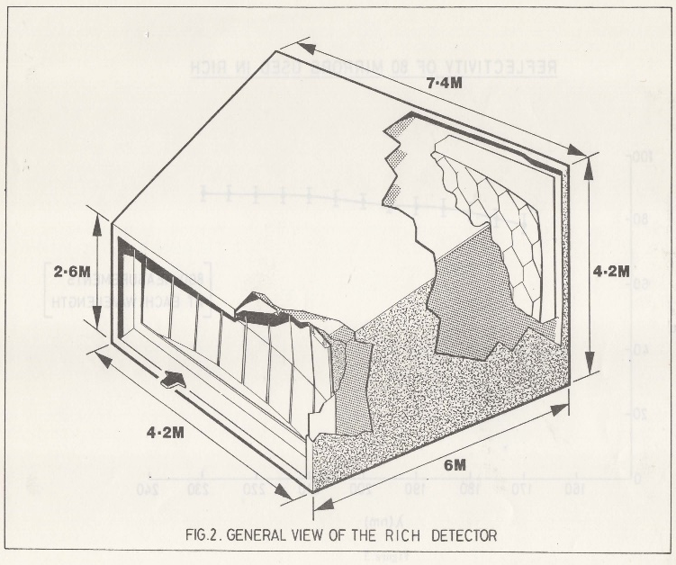
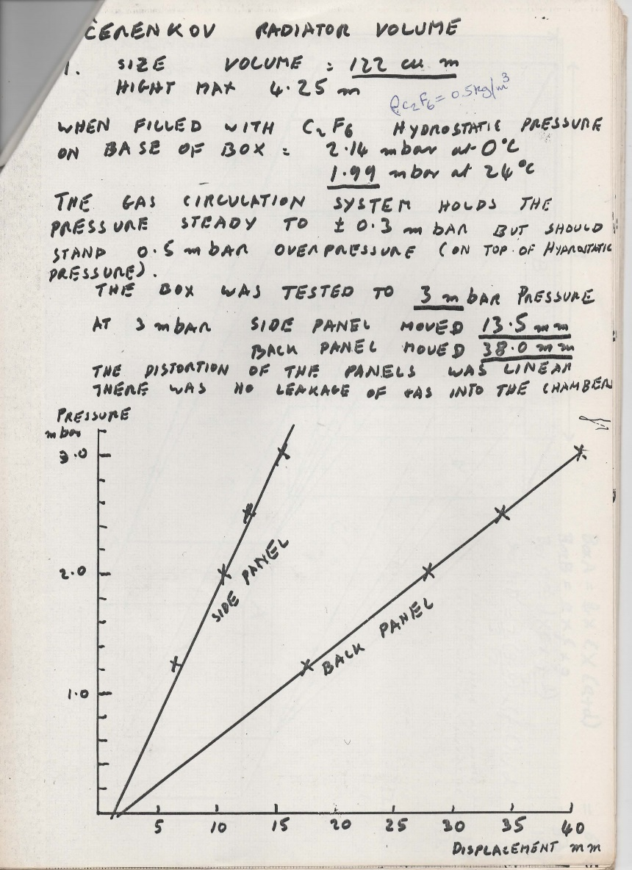
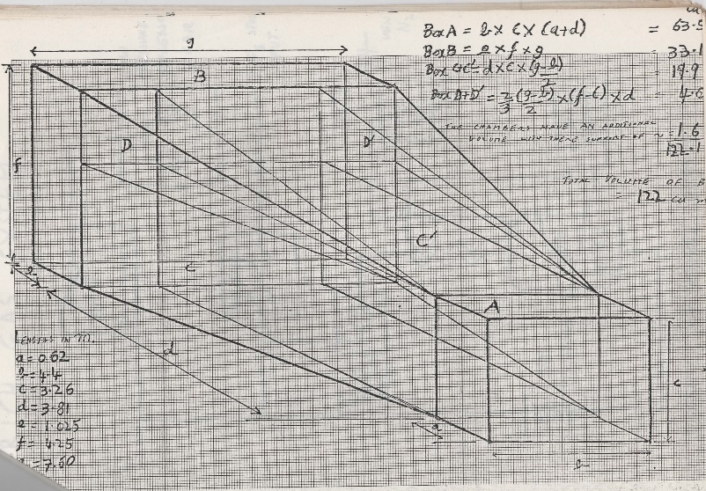
Buffer volume changes: an issue to consider & mitigate…
Calculations & measurements made by Paul Flower (RAL-CLRC) in 1980s for wall deflections of the 122m³ OMEGA RICH gas radiator vessel (originally ran with N₂)
for conversion to C₂F₆, using a new gas circulation system by Michel Bosteels
G. Hallewell: Green Cherenkov gas radiators DRD4 WG-2 session: 11/04/2025

Slide 20
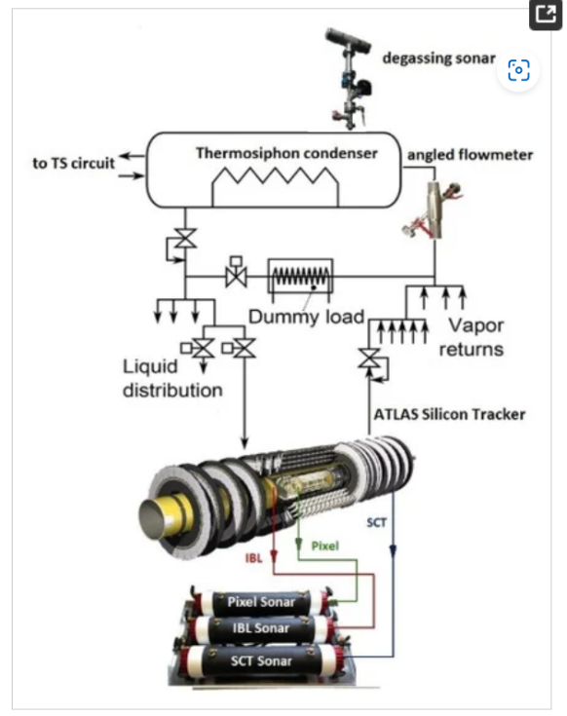
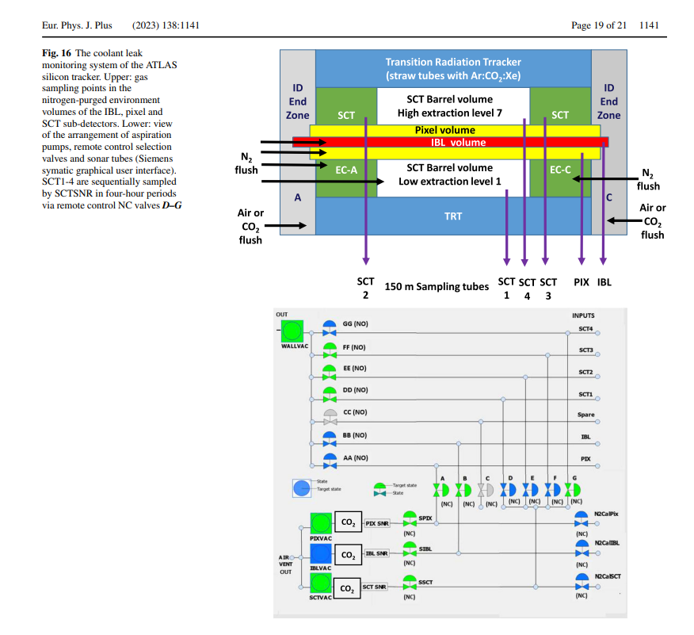
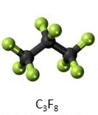
Example of Ultrasonic gas analysis in a process environment with multiple background gases
https://www.mdpi.com/2410-390X/5/1/6
Gas aspirated through
150m tubes from
silicon tracker
N₂ environmental
volumes to
‘sonar’ devices
to look for C₃F₈
leak rates
(C₃F₈ in N₂ )
G. Hallewell: Green Cherenkov gas radiators DRD4 WG-2 session: 11/04/2025

Slide 21
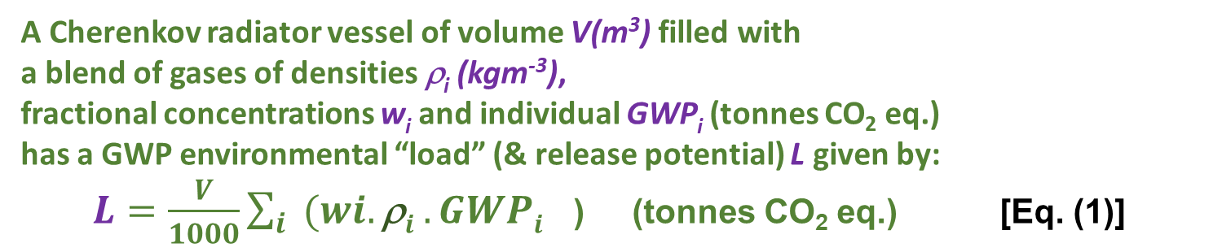
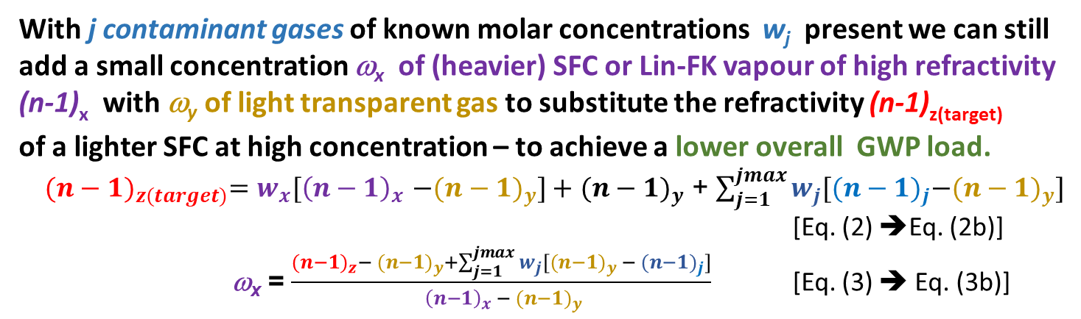
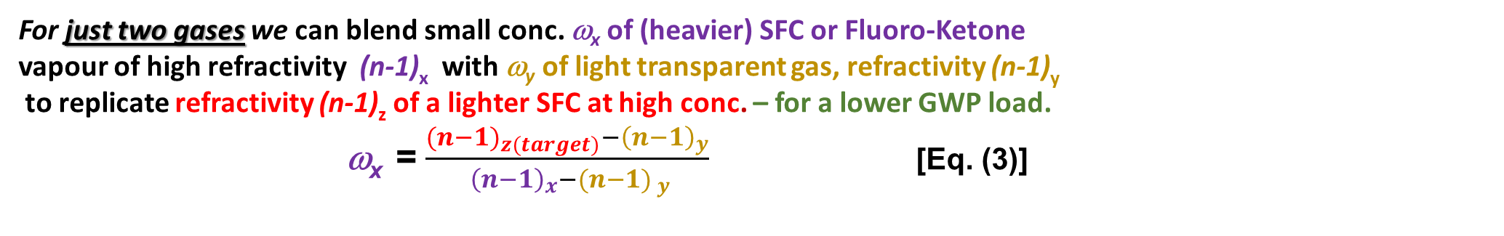
Refractive index & GWP ’load’ in a Cherenkov Gas Radiator
3 large RICH detectors currently in operation at CERN:
using saturated fluorocarbon gas volumes:
C₄F₁₀ (COMPASS: 100m³, LHCb RICH 1: 4m³): GWP₂₀ = 4880,
CF₄ (LHCb RICH 2: 100m³): GWP₂₀ = 6870
V,ρ
A Cherenkov radiator vessel of volume V(m³) filled with
a blend of gases of densities ρ_{i} (kgm⁻³),
fractional concentrations w_{i} and individual GWP_{i} (tonnes CO₂ eq.)
has a GWP environmental “load” (& release potential) L given by:
$L=\frac{V}{1000}\sum_{i}{{(wi.\text{r}i .GWPi}^{}}$) (tonnes CO₂ eq.) [Eq. (1)]
With j contaminant gases of known molar concentrations w_{j} present we can still
add a small concentration ω_{x} of (heavier) SFC or Lin-FK vapour of high refractivity
(n-1)_{x} with ω_{y} of light transparent gas to substitute the refractivity (n-1)_{z(target)}
of a lighter SFC at high concentration – to achieve a lower overall GWP load.
${{(n−1)}_{z(target)}=w_{x}[\left(n−1\right)}_{x}$ ${−(n−1)}_{y}]+$ ${(n−1)}_{y}$ + $\sum_{j=1}^{jmax}{w_{j}[{{(n−1)}_{j}−(n−1)}_{y}]}$
[Eq. (2) ➔Eq. (2b)]
ω_{x} = $\frac{{{(n−1)}_{z}− (n−1)}_{y}+\sum_{j=1}^{jmax}{w_{j}[{{(n−1)}_{y} − (n−1)}_{j}]}}{{ {\left(n−1\right)}_{x} − (n−1)}_{y}}$ [Eq. (3) ➔ Eq. (3b)]
The corresponding radiator gas mixture refractivity is given by :
$\text{(}\text{n}\text{−1)}rad =\sum_{i}{{(wi.\text{(}\text{n}\text{−1)}i}^{}}$) [Eq. (2)]
For just two gases we can blend small conc. ω_{x} of (heavier) SFC or Fluoro-Ketone
vapour of high refractivity (n-1)_{x} with ω_{y} of light transparent gas, refractivity (n-1)_{y}
to replicate refractivity (n-1)_{z} of a lighter SFC at high conc. – for a lower GWP load.
ω_{x} = $\frac{{{(n−1)}_{z(target)}−\left(n−1\right)}_{y}}{{ {\left(n−1\right)}_{x}−(n−1)}_{ y}}$ [Eq. (3)]
G. Hallewell: Green Cherenkov gas radiators DRD4 WG-2 session: 11/04/2025

Slide 22
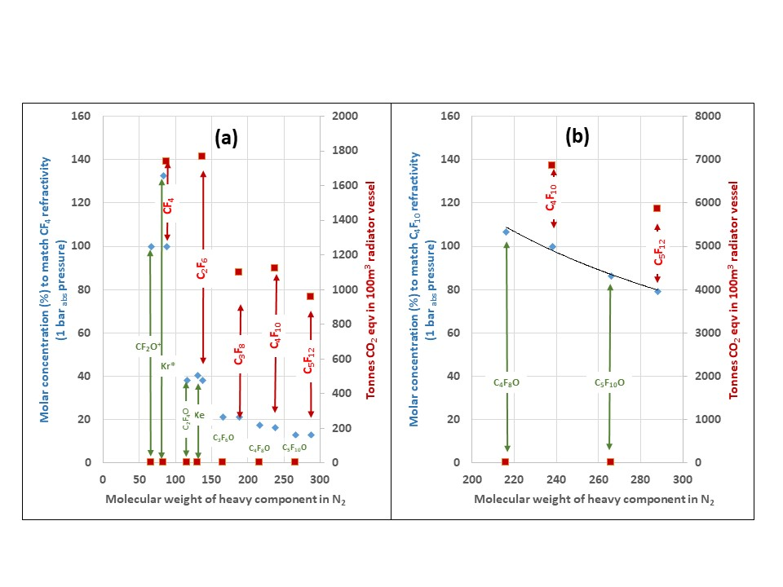
Targeting the refractivity of CF₄ & C₄F₁₀ (100 m³: examples) at 1 bar_{abs} with gases of differing molecular weight in varying fractional concentrations with N2
(conc. > 100% indicate need for overpressure): includes hypothetical fluoro-ketones
CF₄
C₄F₁₀
G. Hallewell: Green Cherenkov gas radiators DRD4 WG-2 session: 11/04/2025

Slide 23
Cherenkov threshold: C₅F₁₀O/N₂ & (heritage) C₅F₁₂/N₂ blend
and GWP load comparison for LHCb RICH2 (100m³ CF₄)
C₅F₁₂ SFC/N₂ and NOVEC5110 (C₅F₁₀O) /N₂ will be very similar (MW 266 vs. 288)
LHCb RICH 2: CF₄ thresholds
GWP load = (0.95 molar*4880*V.ρ)
~ 14% molar C₅F₁₀O
gives a GWP load reduction of 1737 tonnes:
Even substituting CF₄ with ~ 13% molar heritage stock C₅F₁₂ reduces GWP load by ~800 tonnes
C₅F₁₂ or C₅F₁₀O concentration (%)
LHCb RICH 2 with C₅F₁₀O/N₂
GWP load = (0.13 molar*1*V.ρ)
23
G. Hallewell: Green Cherenkov gas radiators DRD4 WG-2 session: 11/04/2025

Slide 24
Cherenkov threshold in C₅F₁₀O/N₂ mixtures
and GWP load comparison with COMPASS RICH (100m³)
COMPASS (& LHCb RICH 1): C₄F₁₀ thresholds
COMPASS RICH GWP load = (6849 tonnes)
N₂-NOVEC5110 (C₅F₁₀O) very similar to C₅F₁₂ (MW 266 vs. 288)
85% Novec 5110 gives a huge GWP load reduction of 6849 tonnes
C₅F₁₀O concentration (%)
24
G. Hallewell: Green Cherenkov gas radiators DRD4 WG-2 session: 11/04/2025

Slide 25
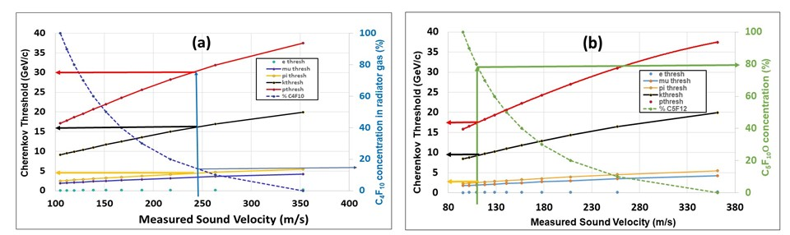
Other (heritage/legacy) options (in N₂)
C₅F₁₂
    Legacy C₄F₁₀ replacing CF₄ in the context of LHCb RICH-2
    Legacy C₅F₁₂ replacing C₄F₁₀ for COMPASS and LHCb RICH-1.
Sound velocity in C₅F₁₂ and C₄F₁₀ is based on extensive thermodynamic data:
corresponding required concentrations for C₅F₁₀O and C₄F₈O
will be slightly higher due to their lower densities.
G. Hallewell: Green Cherenkov gas radiators DRD4 WG-2 session: 11/04/2025

Slide 26
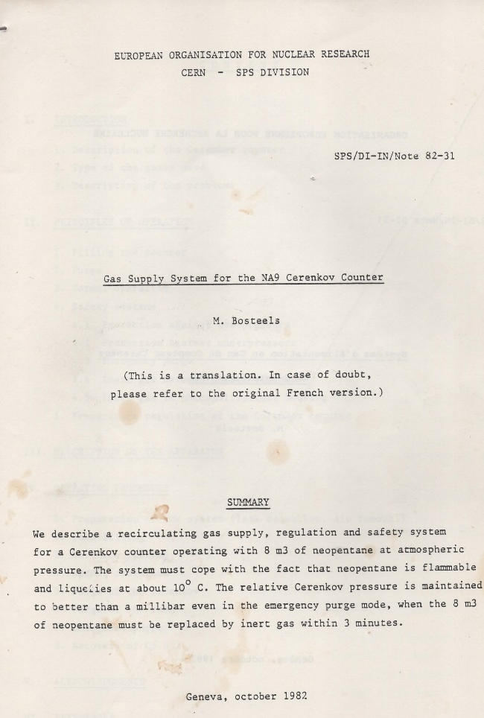
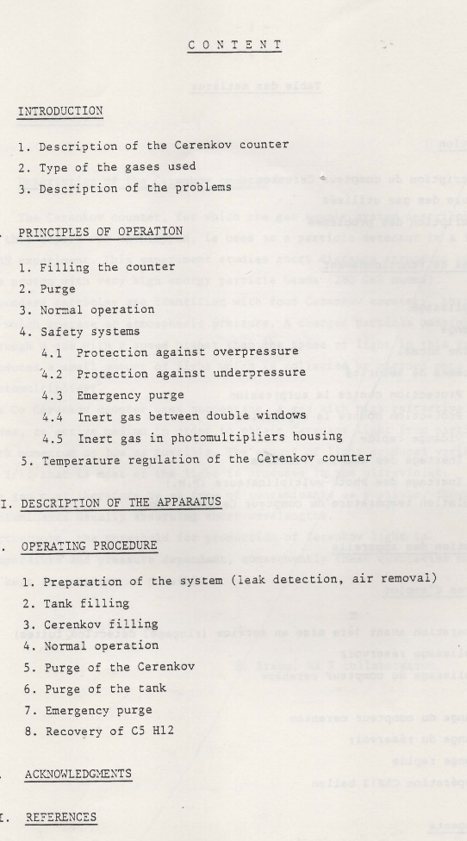
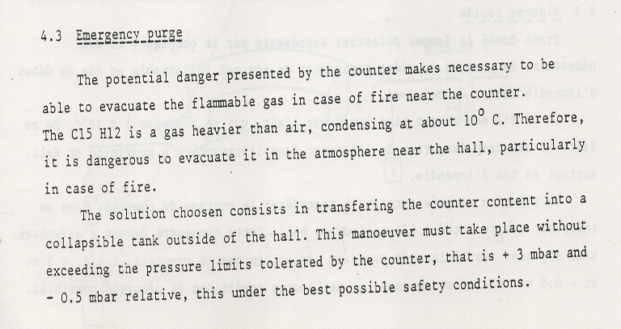
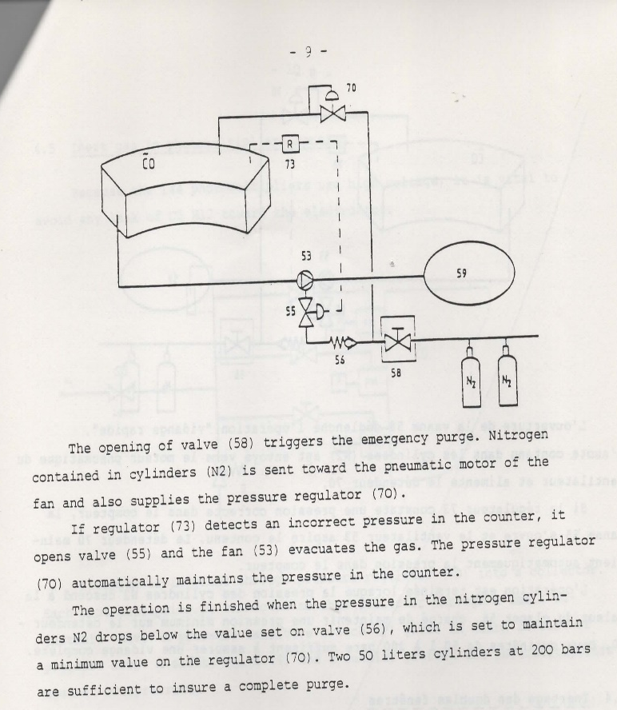
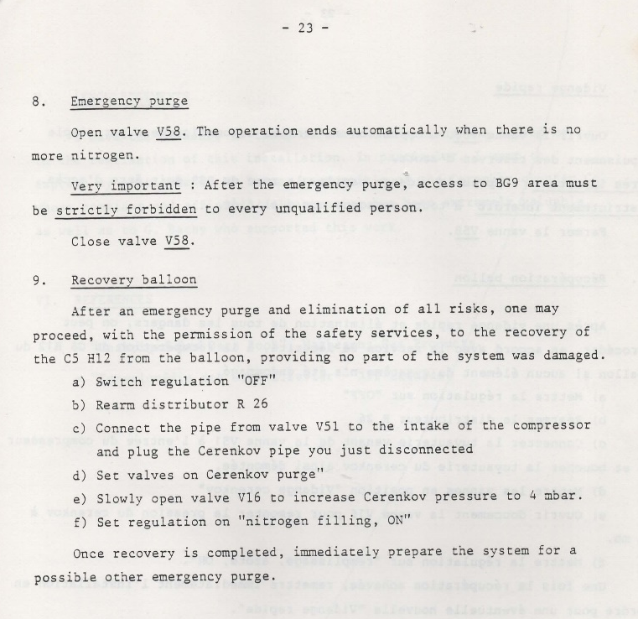
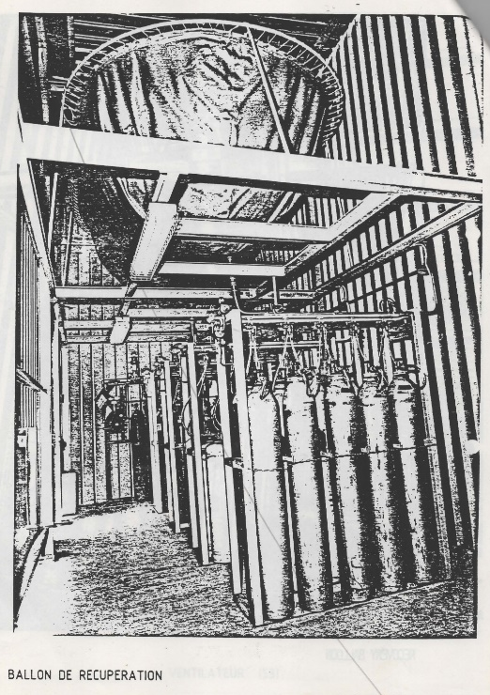
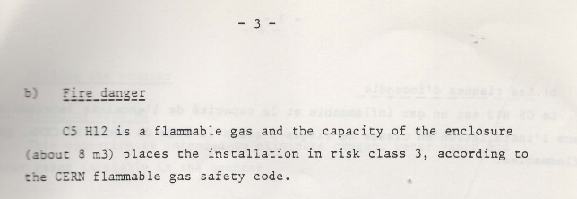
NA9 8m³ Cherenkov C₅H₁₂ (!!!) recirculation – the constraints of
flammable radiator gas usage – in a SURFACE building!!
Can we now forget thinking
of using large flammable
gas radiators
in underground areas?
G. Hallewell: Green Cherenkov gas radiators DRD4 WG-2 session: 11/04/2025

Slide 27
The high pressure issue: considering a 100m³ radiator vessel with cheap
N₂ or CO₂ simulating the refractive index of CF₄ & C₄F₁₀
(Source of pressure slopes: V. P. Zrelov book (1968))
C₄F₁₀ match
(n-1) = 1450E-6
N₂ matching CH₄
(n-1)=488E-6
CF₄ match
(n-1) = 488E-6
N₂ matching C₄F₁₀
(n-1) = 1450E-6
CO₂ matching C₄F₁₀
(n-1) = 1450E-6
Cost/risk assessment for use of elevated pressures,
particularly for index-matching large C₄F₁₀ volumes
G. Hallewell: Green Cherenkov gas radiators DRD4 WG-2 session: 11/04/2025

Slide 28
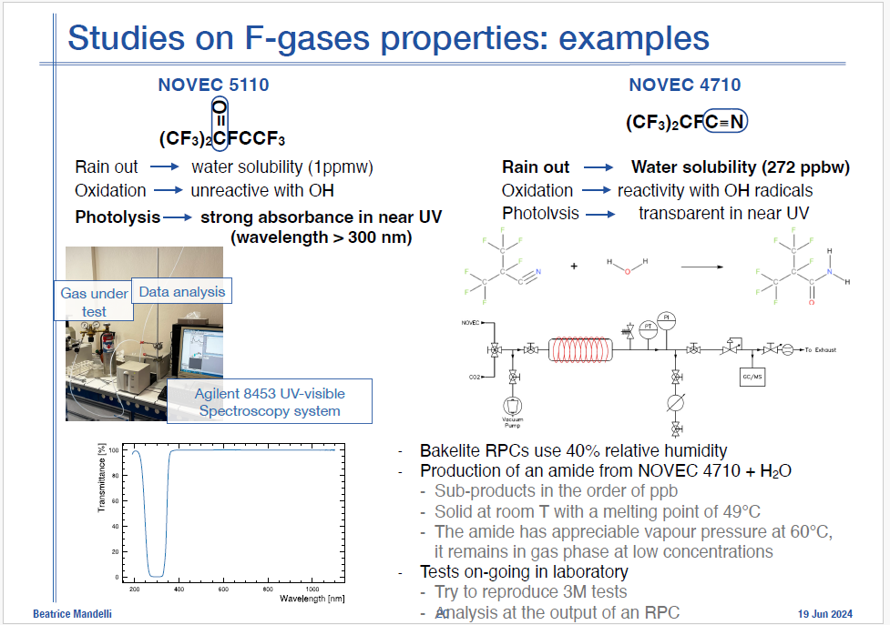
From 1st DRD4 Meeting: 17-20 June 2024
Antonello di Mauro has since started a study of C₅F₁₀O
as a Cherenkov radiator
Real? Repeatable?
very crude device,
lacking details
G. Hallewell: Green Cherenkov gas radiators DRD4 WG-2 session: 11/04/2025

Slide 29

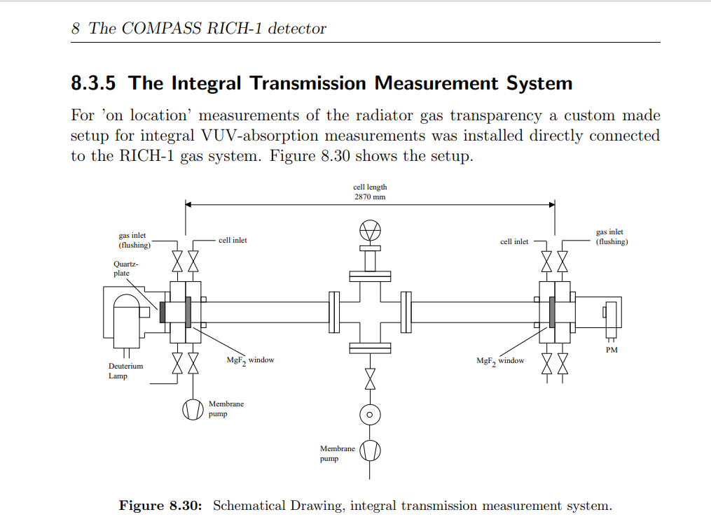
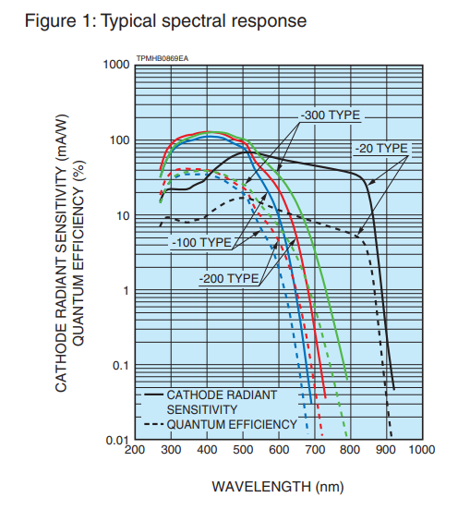
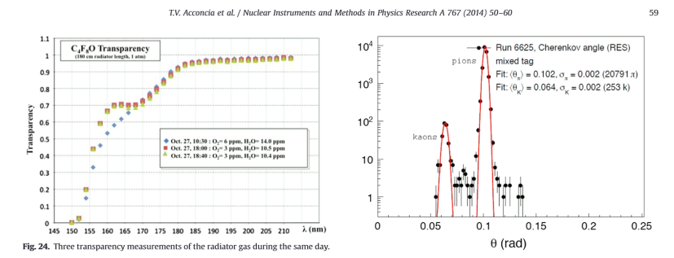
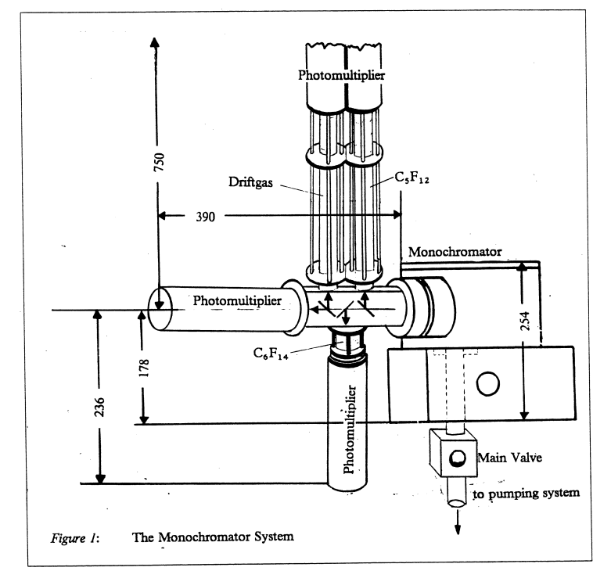

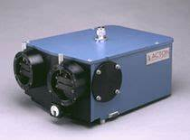
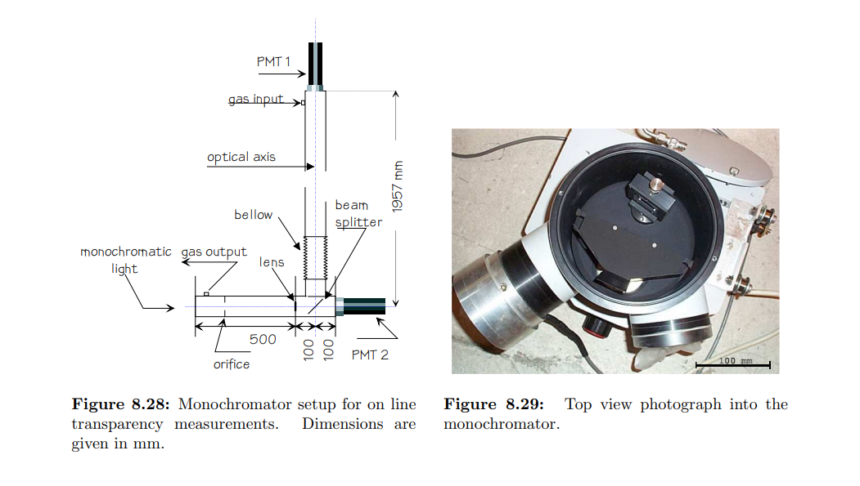

UV transparency, refractivity, cmhemical stability & compatibility studies needed
for different C_{n}F_{2n}O molecular shapes.
RICH detector community very competent & equipped for detailed UVT & (n-1)
- much ex-DELPHI RICH diagnostic equipment at CERN for example
A
Minuteman Model 302 VM.
ALICE VHMPID: transparancy
measurements in c-C₄F₈O
Octafluorotetrahydrofuran
CAS: 773-14-8
Synquest Inc. FL, USA
Most probable PC spectral range
in new build gas RICH detectors
DRD4 Collaboration Meeting, WG-2: CERN Oct 21-25 2024

Slide 30
C_{n}F_{2n}O fluid selection search criteria
Bibliographic
Materials tests
Optotests
Start(ed)
Next C_{n}F_{2n}O fluid
(order & isomer)
to evaluate
Y
Non-
Flammable
(MSDS)
?
Y
Non-
Oxone-
depleting
?
Y
Non-toxic
(MSDS)
?
N
N
N
N
Low GWP!
?
Y
N
N
N
Acid
formation
with H₂O
?
Y
Y
Rad.
Tolerant
(more for
cooling)
?
Y
N
Y
Materials/
purifier
Compatible
?
Dielectric
?
Y
N
Recirc.
Thermo-
dynamics
OK
?
Y
UV-Vis
transparency
OK
?
Y
(n-1) &
Chrom. Disp.
OK
?
Y
Accept
fluid
N
N
N
DRD4 Collaboration Meeting, WG-2: CERN Oct 21-25 2024

Slide 31

Fulvio gave an excellent presentation on Tuesday, detailing the COMPASS RICH radiator and the issues of FC circulation, purification & monitoring, recovery & replacement with passivation gas. He also discussed a possible new CO₂/C₂F₆ radiator
The roots of this system are in an earlier system that Michel Bosteels built for C₂F₆ circulation in the OMEGA RICH (Haug SOGX oil-free compressors)

Slide 32



System built by Michel Bosteels for C₂F₆ circulation in the OMEGA RICH (Haug SOGX oil-free compressors): - mid 1980’s
Paul Flower
(RAL-CLRC)
I have no report or nice photos of this system ☹,
just notebook entries by Paul Flower (RAL-CLRC) and Michel Bosteels.
System mostly scrapped in 1990’s: ☹ ☹ :
compressors ended up at a carosserie for paint spraying:
M.B. MOST upset: typical CERN wastebin wastage policy
by Michel Bosteels
Haug
compressors
Passivation
gas
Purifier
C2F6
trapping
C2F6
trapping
C2F6
storage
Haug
compressors
C2F6
storage
Purifier
G. Hallewell: Green Cherenkov gas radiators DRD4 WG-2 session: 11/04/2025

Slide 33

Also from Fulvio’s talk: A possible new CO₂/C₂F₆ radiator…
G. Hallewell: Green Cherenkov gas radiators DRD4 WG-2 session: 11/04/2025

Slide 34





Circulation can involve bi-component condensation/evaporation in closed system
(for reduced FC losses)
Pressure enthalpy plots by NIST RefProp DB23 (BWR EOS + Helmholtz corr.)
Fulvio has started a study of (quasi-azeotropic) C₂F₆, CO₂
(Azeotropic behavior makes bi-component circulation easier)
C₂F₆ (mw=138)
CO₂ (mw=44)
Purification
Evaporation
P
Radiator
vessel
P
Pure components: condensation & evaporation isotherms are isobaric
Condensation
h
h
25%C₂F₆, 75% CO₂
50%C₂F₆,50%CO₂
75%C₂F₆, 25% CO₂
P
P
P
Azeotropic blends:
condensation & evaporation isotherms
aimed to be almost isobaric
But here Azeotropicity is reduced:
condensation & evaporation isotherms
less isobaric: thermal “glide” exhibited
h
h
h
G. Hallewell: Green Cherenkov gas radiators DRD4 WG-2 session: 11/04/2025

Slide 35




Antonello di Mauro has started a study of (quasi-azeotropic) C₅F₁₀O, CO₂
(These mixtures are likely to be zeotropic with noticeable thermal glide:
behavior makes bi-component circulation easier)
Note: C₅F₁₀O (mw: 266) P-h curves likely to be similar to C₅F₁₂ (mw: 288)
for which NIST-REFPROP can be used to calculate mixtures with CO₂
C₅F₁₂
75%C₅F₁₂, 25% CO₂
P
P
h
h
50%C₅F₁₂, 50% CO₂
25%C₅F₁₂, 75% CO₂
Zeotropicity and significant thermal “glide” exhibited over the blend range: “throwaway mode” for the
CO₂ component may be best
P
P
h
h
G. Hallewell: Green Cherenkov gas radiators DRD4 WG-2 session: 11/04/2025

Slide 36


It is possible to circulate a zeotropic blend in a closed circuit, however…
25%C₂F₆ :75% C₃F₈ (ATLAS Si tracker cooling study)
https://iopscience.iop.org/article/10.1088/1748-0221/10/03/P03027/pdf
Paper also discusses procedure for mass➔molar
mixing of 2 liquids in refrigerated reservoir &
Ultrasonic analysis of circulating vapour mixture
G. Hallewell: Green Cherenkov gas radiators DRD4 WG-2 session: 11/04/2025

Slide 37




https://iopscience.iop.org/article/10.1088/1748-0221/10/03/P03027/pdf
Procedure for mixing of 2 liquids in refrigerated reservoir &
Ultrasonic analysis of circulating vapour mixture
G. Hallewell: Green Cherenkov gas radiators DRD4 WG-2 session: 11/04/2025

Slide 38


Experience in distillation-separation of liquifable co-circulants @ CERN (DELPHI RICH)
Might be applicable to C₂F₂/CO₂ or C₅F₁₀O/CO₂ (or just mix with
N₂ and let the N₂ escape from -100 °C condenser tank (SLAC SLD) CRID
G. Hallewell: Green Cherenkov gas radiators DRD4 WG-2 session: 11/04/2025

Slide 39

SLD Barrel CRID C₅F₁₂/N₂ gas radiator: continuous thermodynamic recirculation
Low temperature (-80°C)
N₂ gas-induced condensation (B):
of C₅F₁₂ fromC₅F₁₂/N₂ radiator gas (flow~1m³/hr, negligible C₅F₁₂ loss)
followed by (C) electric re-evaporation
(1-1.5m below condenser liq. level)
Cold N₂ gas (‘conditioned’ by
counter-flow with boil-off LN₂
from liquid argon calorimeter: (A))
Ultrasonic (speed of sound) – aided
“on-the fly” mixing of typical
17%N₂ /83%C₅F₁₂ (molar) radiator gas mixture (D)
A
B
D
C
G. Hallewell: Green Cherenkov gas radiators DRD4 WG-2 session: 11/04/2025

Slide 40

SLD Barrel CRID C₅F₁₂/N₂ gas thermodynamic recirculator
(A) C₅F₁₂ Condenser
(cooled with GN₂)
(B) C₅F₁₂ storage tank
and N₂ separator
LN₂ conditioner
(Chills GN₂ in counterflow with LN₂
from liquid argon calorimeter source)
(C) C₅F₁₂ Evaporator
G. Hallewell: Green Cherenkov gas radiators DRD4 WG-2 session: 11/04/2025

Slide 41

SLD CRID C₅F₁₂ circulation
SLD CRID C₅F₁₂ Thermodynamic circulation: Pressure-Enthalpy
Liquid
ρgh of 1.5m C₅F₁₂ !
(C) Electric heating
of liquid C₅F₁₂
Electric evaporation of C₅F₁₂
(δh ~ 1.3m)
Vapour
Changing Phase
(D) N₂ addition (C₅F₁₂ p.p. reduction)
& flow through CRID Radiator vessel
1bar_{abs} condenser
Headspace (& CRID
radiator vessel)
pressure maintained
by N₂ in return radiator gas & condenser N₂
vent to atmosphere
Pure C₅F₁₂@ -80C from
bottom of tank
Collapsing C5F12 partial pressure
& some condensation in precooler (A)
Condensation in tank (B) @ varying temperature ➔
down to “keep-cold” temp of -80°C (P_{C5F12} ~ mbar),
drastically reduces C₅F₁₂ loss by evaporation
G. Hallewell: Green Cherenkov gas radiators DRD4 WG-2 session: 11/04/2025

Slide 42
-
Conclusion:
(Quoting W. Churchill & Peter Sharp)
Cherenkov-greeni-city
is a ‘House of Many Mansions’
(too many to include in this talk*:
so please see ongoing back-up material & links)
*But we need a thermodynamic circulation
working group…
G. Hallewell: Green Cherenkov gas radiators DRD4 WG-2 session: 11/04/2025

Slide 43
Back up stuff
“Green radiators”: Controlling refractive index & reducing Cherenkov gas radiator GWP: a challenge in an era of diminishing fluorocarbon availability
Related paper: https://link.springer.com/article/10.1140/epjp/s13360-023-04703-w
Also DRD4 meeting, May 2023 https://indico.cern.ch/event/1263731/contributions/5398511
ATLAS sustainability forum CERN, Jan 26 2024
https://indico.cern.ch/event/1371158/contributions/5773321/attachments/2788215/4861759/G_Hallewell_ATLAS_sustainability_forum_Jan_26_2024_v2.pptx
Sustainable HEP 2024 https://indico.global/event/4744/contributions/39611/
ICHEP2024 (July 2024): https://indico.cern.ch/event/1291157/contributions/5900402
DRD4 meeting Oct. 2024: https://indico.cern.ch/event/1456663/sessions/566400/#20241024
G. Hallewell: Green Cherenkov gas radiators DRD4 WG-2 session: 11/04/2025

Slide 44
Back up stuff
(ALICE, BTeV) experiences
with C₄F₈O as a substitute for C₄F₁₀
Cherenkov radiator gas
44

Slide 45




F O F
F – C
C – F
F – C
l
F
C – F
l
F
octafluorotetrahydrofuran
MW = 216: GWP=12000
a.k.a.
c-octafluoro-oxolane
45

Slide 46





Shapes of C_{n}F_{2n}O molecules and GWP:
c-octafluorooxolane (C₄F₈O),
MW = 216: GWP = 12000 BTEV stuff?
Perfluortetrahydrofuran – the probable BTeV choice
From June 2000 3M datasheet
https://repository.library.noaa.gov/
044ed5ad-93ae-40e3-9420-d78
a4729ff0f
3M Specialty Gas PFG-3480 is a high-performance chamber cleaning gas that has environmental advantages and can help reduce operating costs. PFG-3480 reduces emissions of global warming compounds by 90 percent when compared to the traditional plasma enhanced chemical vapor deposition(PECVD) cleaning gas, C2F6. The replacement does not require changes to existing processes
46

Slide 47



Shapes of C_{n}F_{2n}O molecules and GWP:
Octafluortetrahydrofuran – the probable ALICE VHPID config
F O F
F – C
C – F
F – C
l
F
C – F
l
F
C₄F₈O acquired from Synquest : reported by Antonello di Mauro:
47

Slide 48

SynQuest Labs Inc.,
13201 Rachael Boulevard Rt 2054, Alachua, FL 32615, USA
48
DRD4 Collaboration Meeting, WG-2: CERN Oct 21-25 2024

Slide 49



SynQuest Labs, Inc. Can manufacture different C₄F₈O configurations
The cyclic molecule seems to be cheaper for SynQuest to manufacture:
whereas 3M make NOVEC 649, which is non-cyclic
49
DRD4 Collaboration Meeting, WG-2: CERN Oct 21-25 2024

Slide 50




Historical: The SLD barrel CRID gas radiators (SLAC: 1990s)
87% C₅F₁₂/13%N₂
gas radiator
Sonar transducer
6 transducer pairs
@ 3 different heights
(hydrostatics)
50
DRD4 Collaboration Meeting, WG-2: CERN Oct 21-25 2024

Slide 51

Maintaining C₅F₁₂/N₂ refractive index
through sonar-based active mixture control
(In this paper submitted to IEEE TNS)
Flowmeter
analyzer in supply line
to tune the blend by
hardwired 4-20mA
links to mass flow controllers
51
DRD4 Collaboration Meeting, WG-2: CERN Oct 21-25 2024

Slide 52
SLD-CRID: Cherenkov threshold in C₅F₁₂/N₂ mixtures
vs. measured speed of sound in radiator gas mixture (1)
Typical mix 87%C₅F₁₂,13%N₂
C₅F₁₂ concentration (%)
52
DRD4 Collaboration Meeting, WG-2: CERN Oct 21-25 2024

Slide 53

SLD-CRID: Cherenkov threshold in C₅F₁₂/N₂ mixtures
vs. measured speed of sound in radiator gas mixture (2)
So.. from (“acoustic”) c to β…
Cherenkov Threshold (GeV/c)
β = 1/n
Measured Sound Velocity (m/s)
53
DRD4 Collaboration Meeting, WG-2: CERN Oct 21-25 2024

