Slide 1




Performance of an Optical TPC Geant4 Simulation with Opticks GPU-Accelerated Photon Propagation
Ilker Parmaksiz, Krishan Mistry, and Erich Church
University of Texas at Arlington

Slide 2
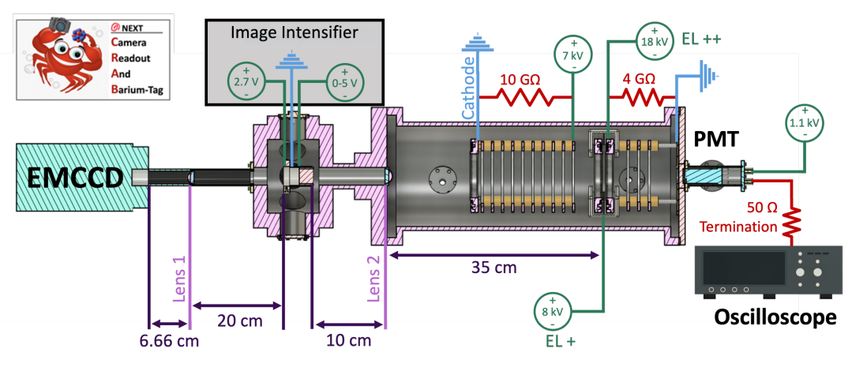
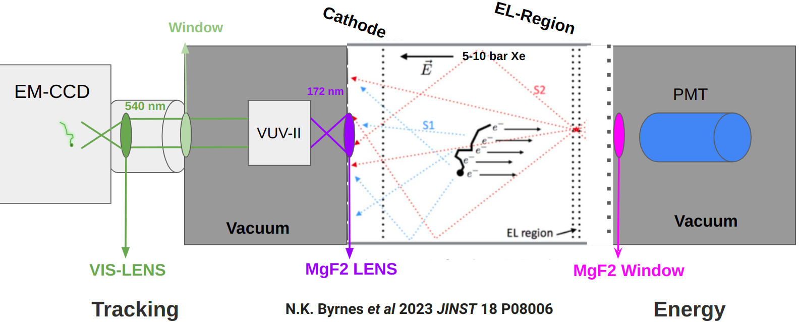
CRAB0 Prototype
An optical time projection chamber that is coupled with a VUV image Intensifier (II) and an EM-CCD camera.
Motivated by improving tracking sensitivity for neutrinoless double beta decay in high pressure xenon TPCs like NEXT.
S2 is amplified by electroluminescence.
Snaps images of particle tracks
  S2 light (172 nm) is focused to VUV II by a MgF2 lens.
  VUV II amplifies and converts S2 photons to 540 nm.
  540 nm photons are focused to EM-CCD by an objective lens
N.K. Byrnes et al 2023 JINST 18 P08006

Slide 3
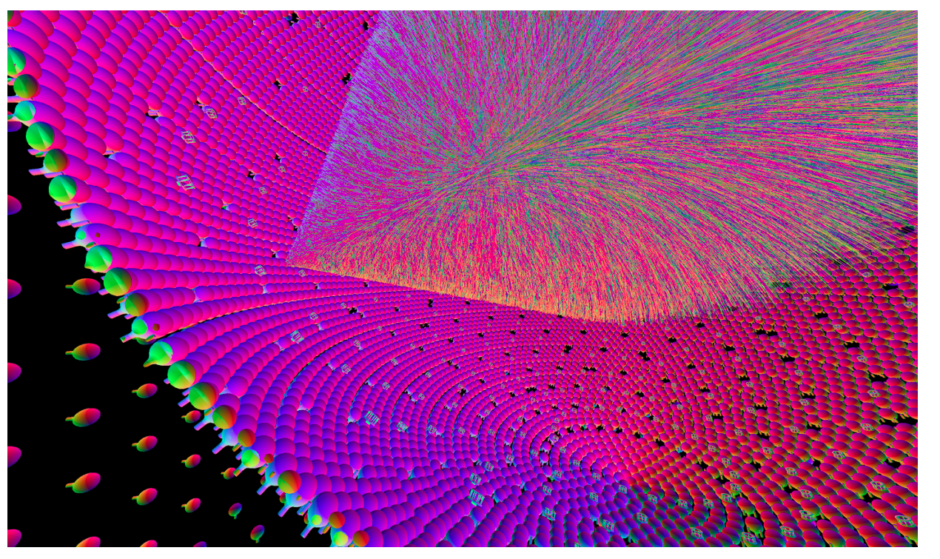
About Opticks
GPU-based photon simulation tool
Actively developed by Simon Blyth
Promises up to 1000x photon simulation speed
improvements over Geant4
Works with NVIDIA GPUs that support CUDA (11.5) and NVIDIA Optix (7.5)
Hybrid Workflow
  Geant4 processes primary particles
  Geant4 geometry is translated into NVIDIA Optix (7.5)
    Includes surfaces, optical material properties.
  Supports both Scintillation and Cherenkov processes.
  Wavelength shifting is currently not implemented.
JUNO

Slide 4
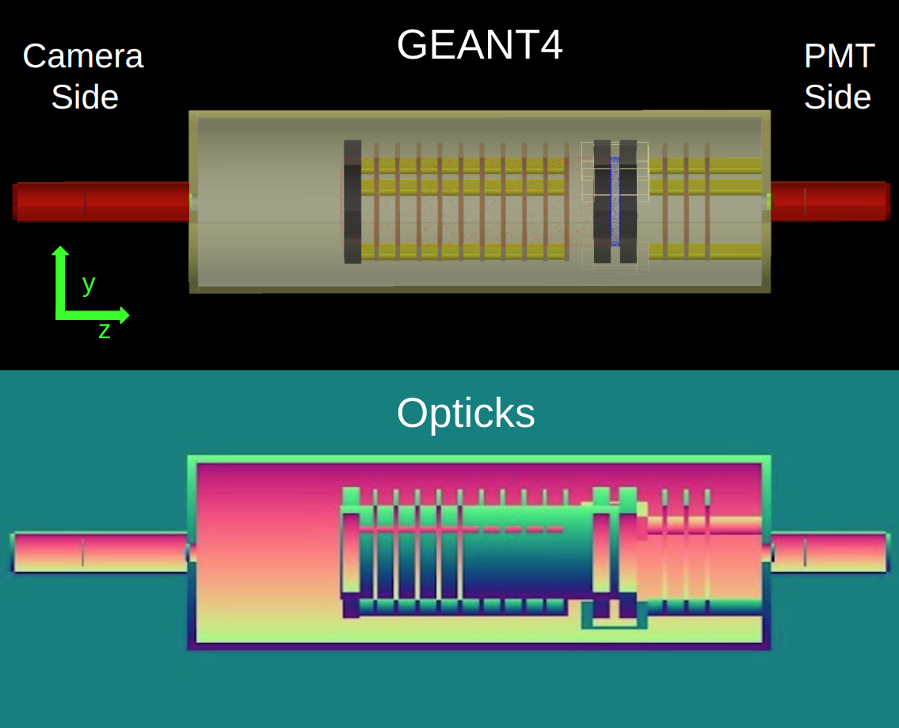
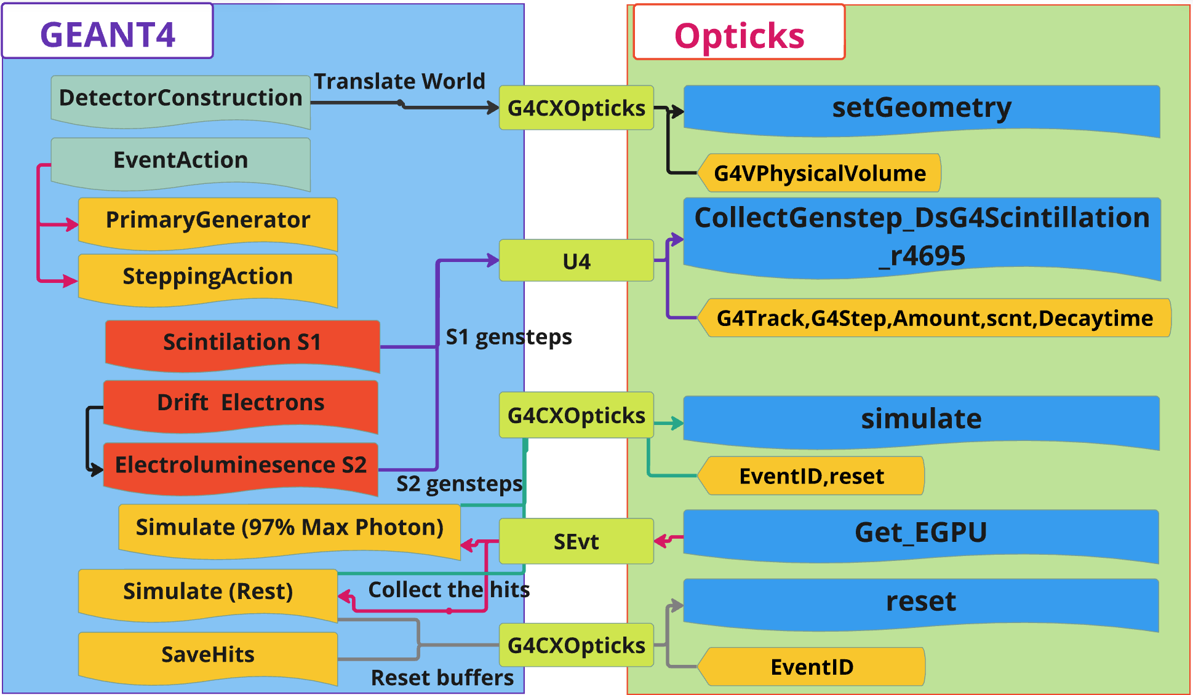
Opticks Integration
Opticks has been successfully integrated into NEXUS, a Geant4 simulation framework developed by the NEXT Collaboration.
Opticks classes used for integration
  G4CXOpticks
    Top Level Geant4 geometry interface
  U4
    Collects gensteps
  SEvt
    Returns hits
https://arxiv.org/abs/2502.13215

Slide 5
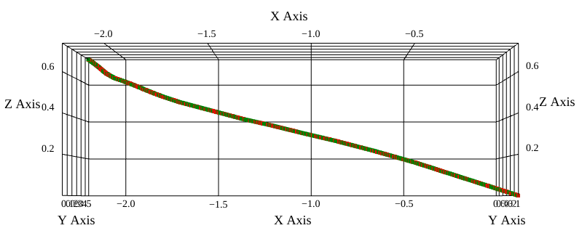
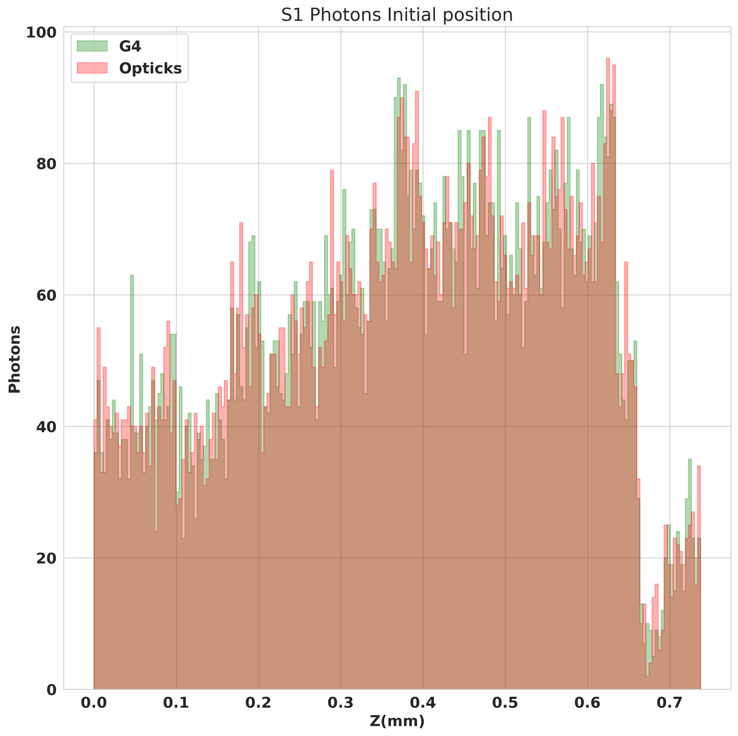
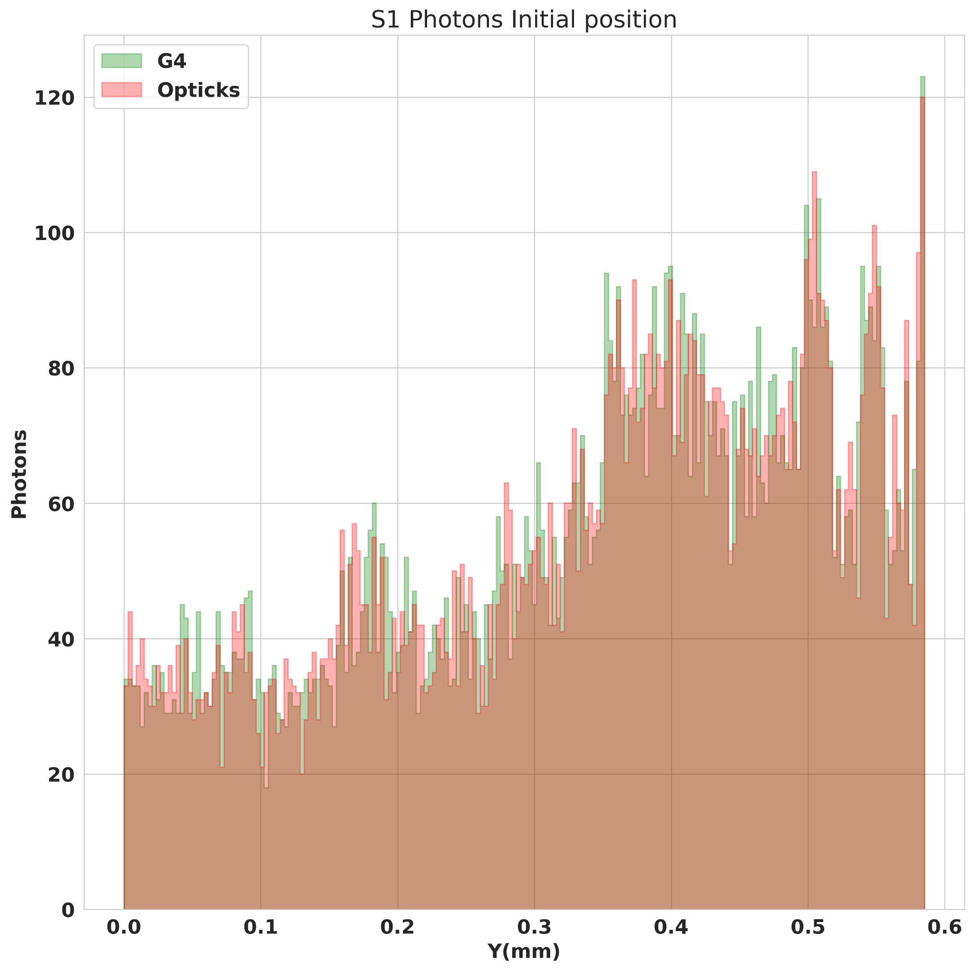
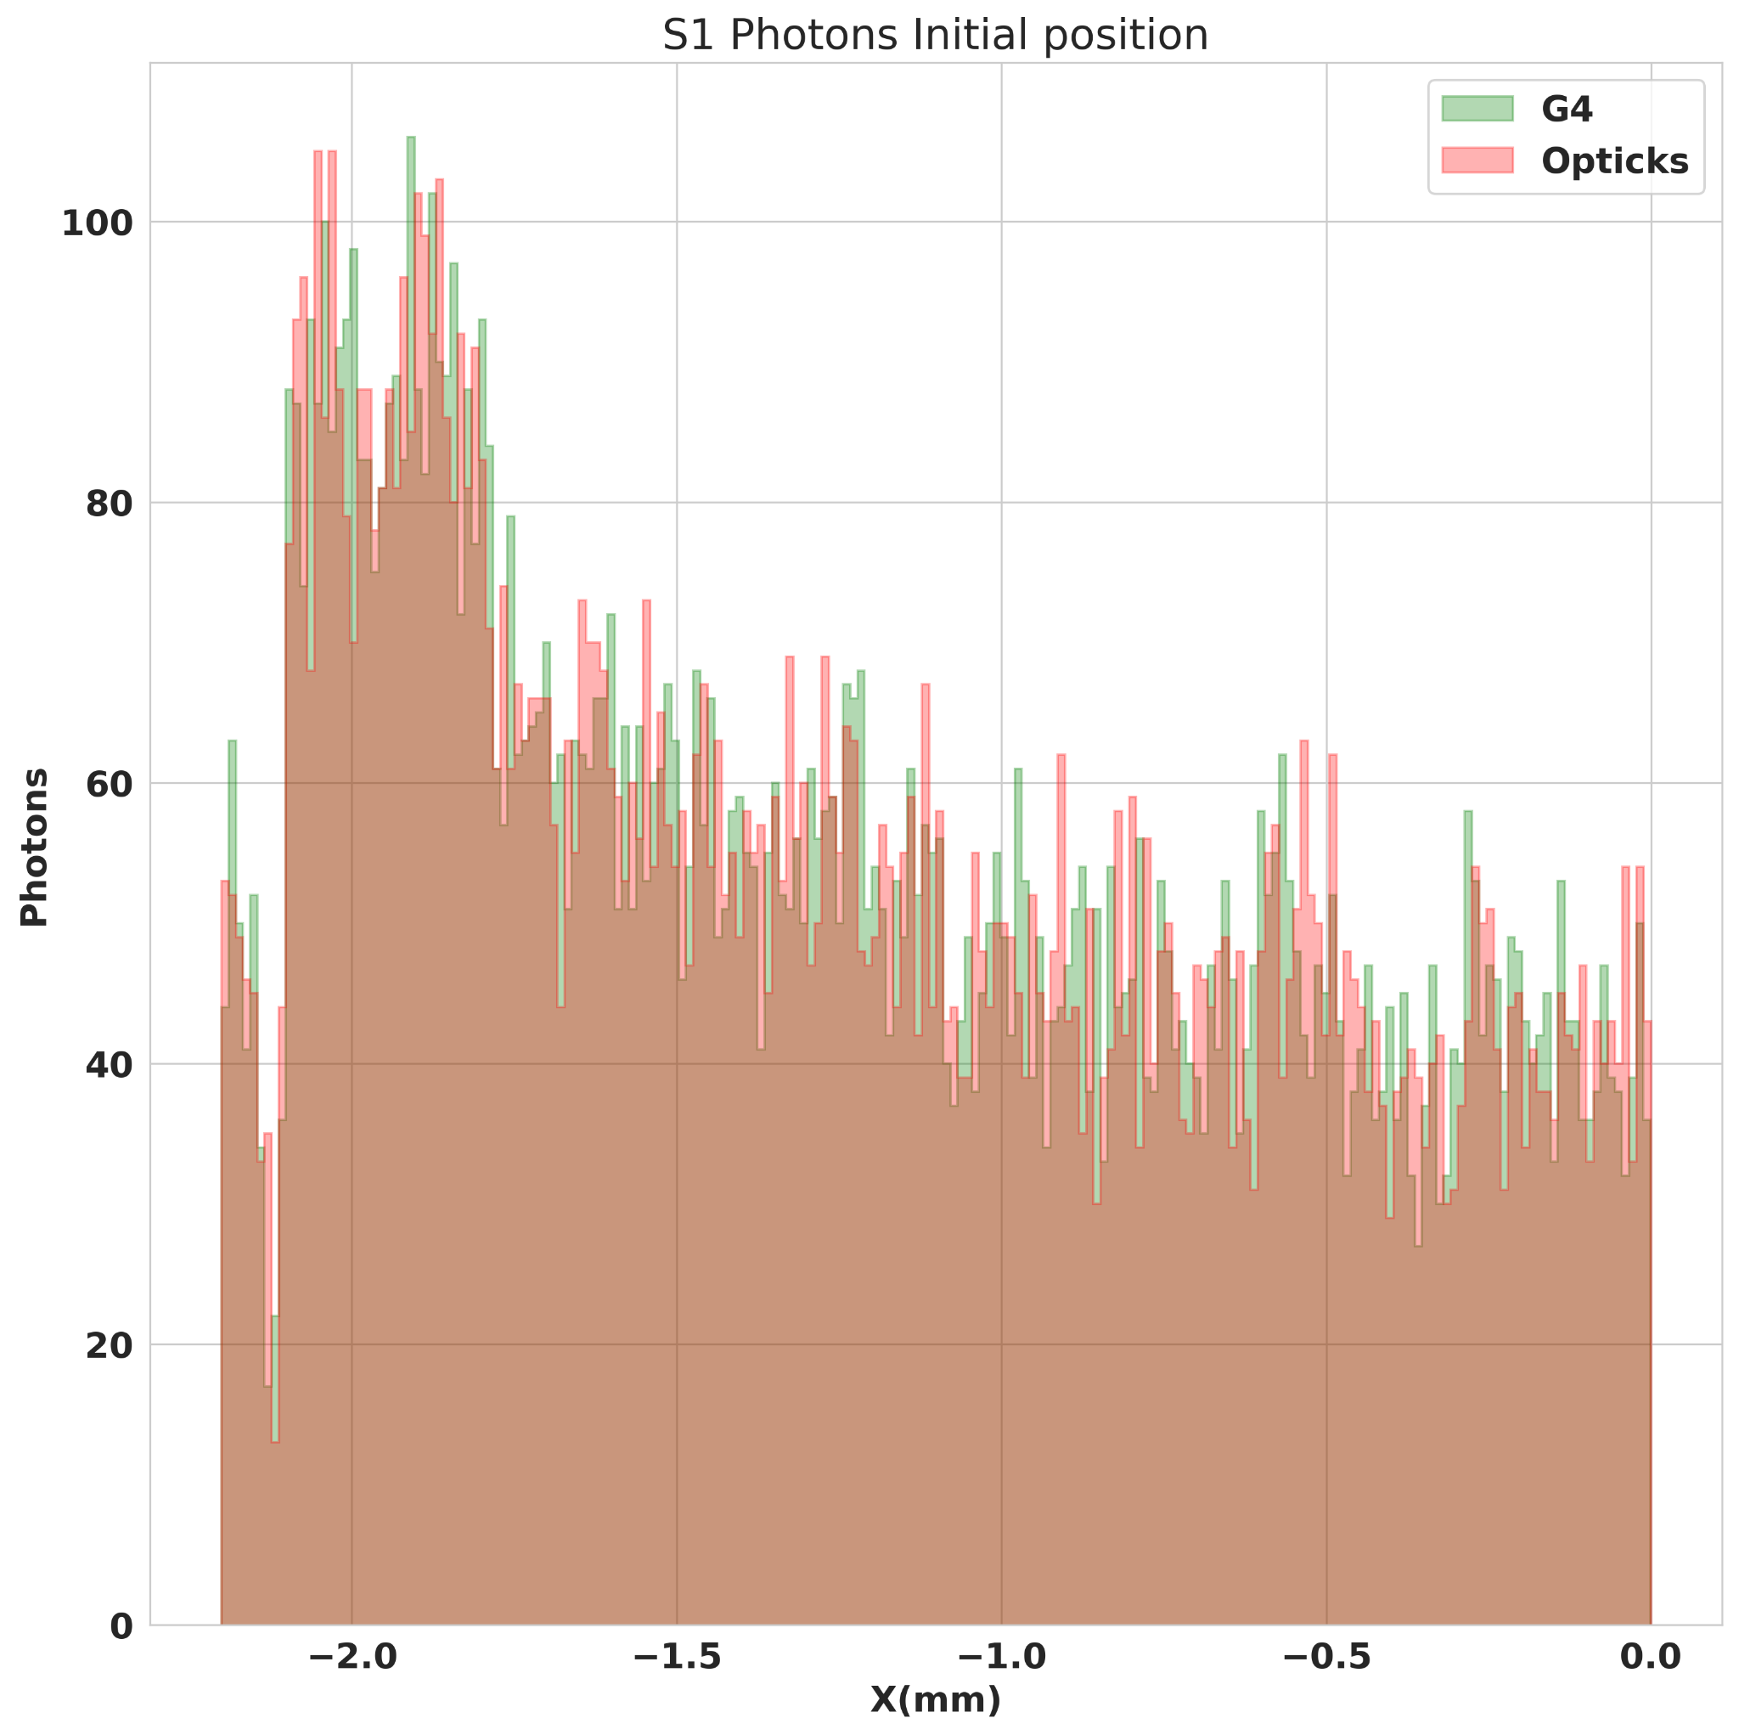
S1 Photon Position Comparison
Opticks
G4
An 5.3 MeV alpha track in 8-bar xenon.
  S1 initial photon coordinates show good agreement between Opticks and Geant4.

Slide 6
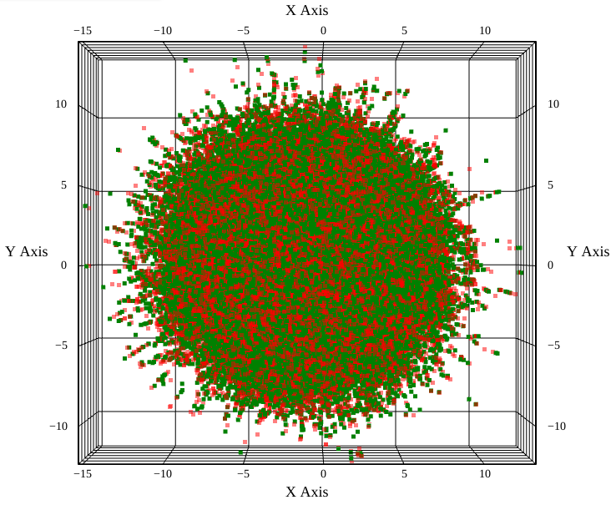
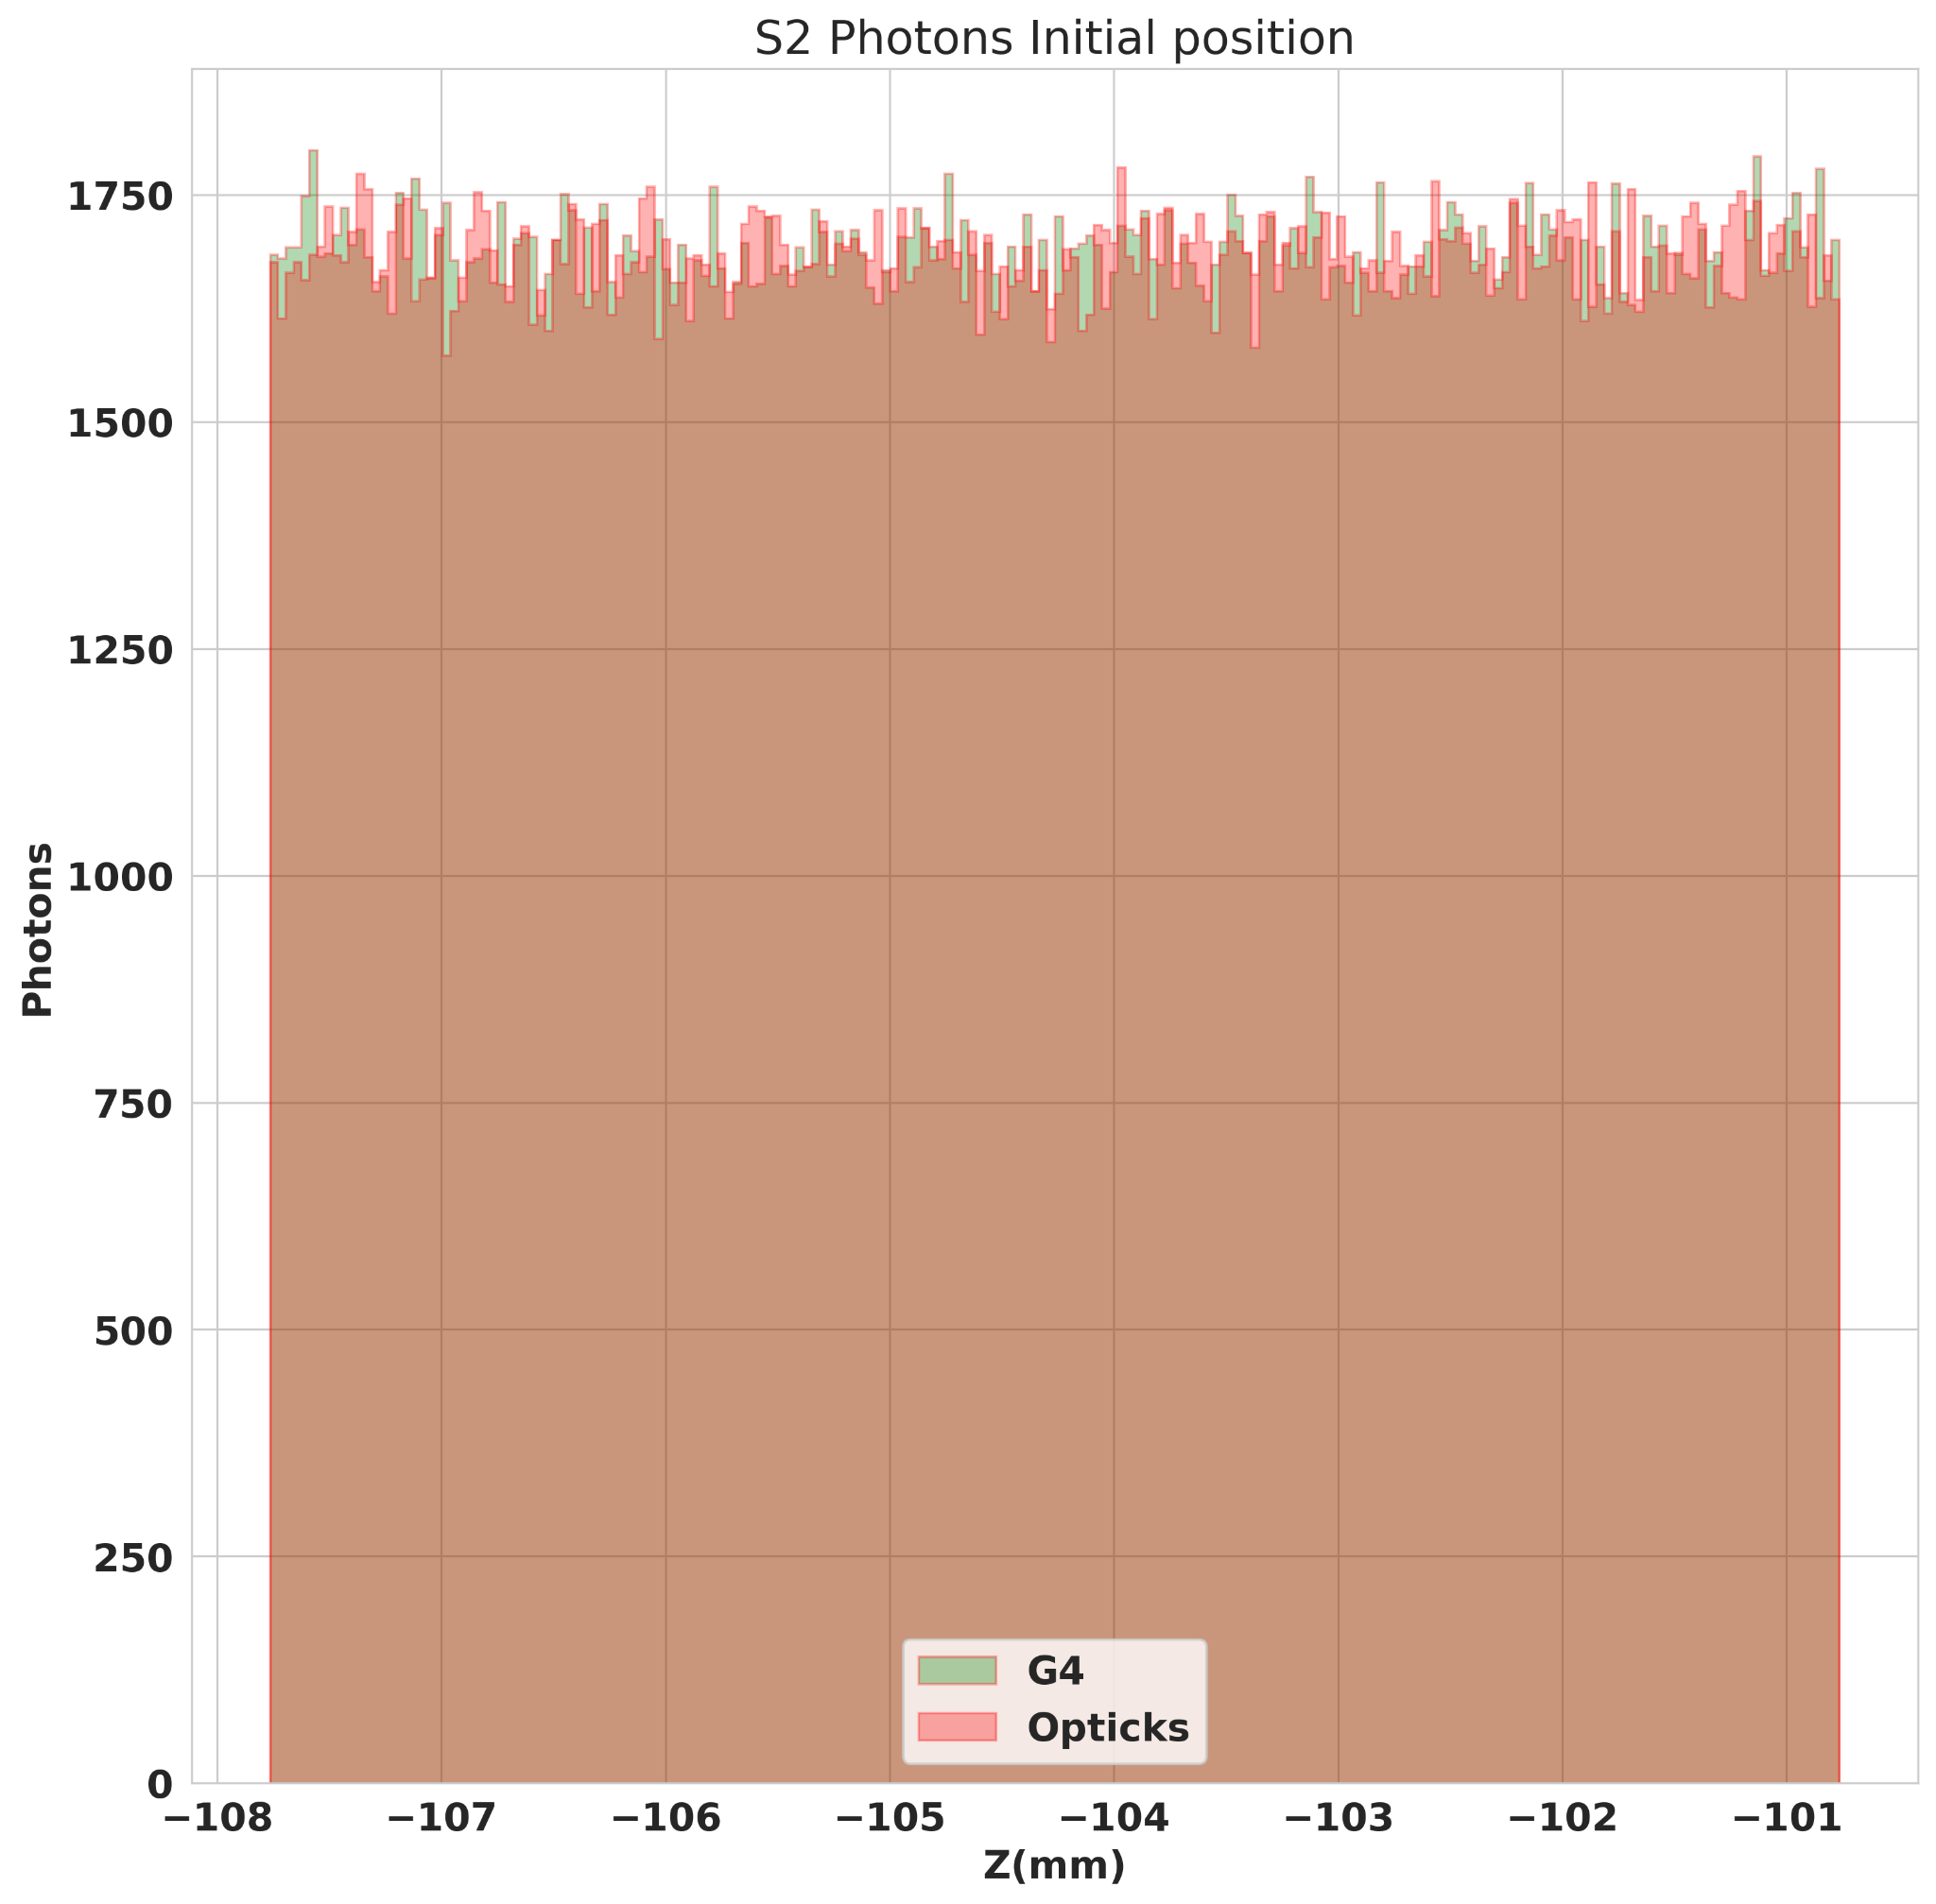
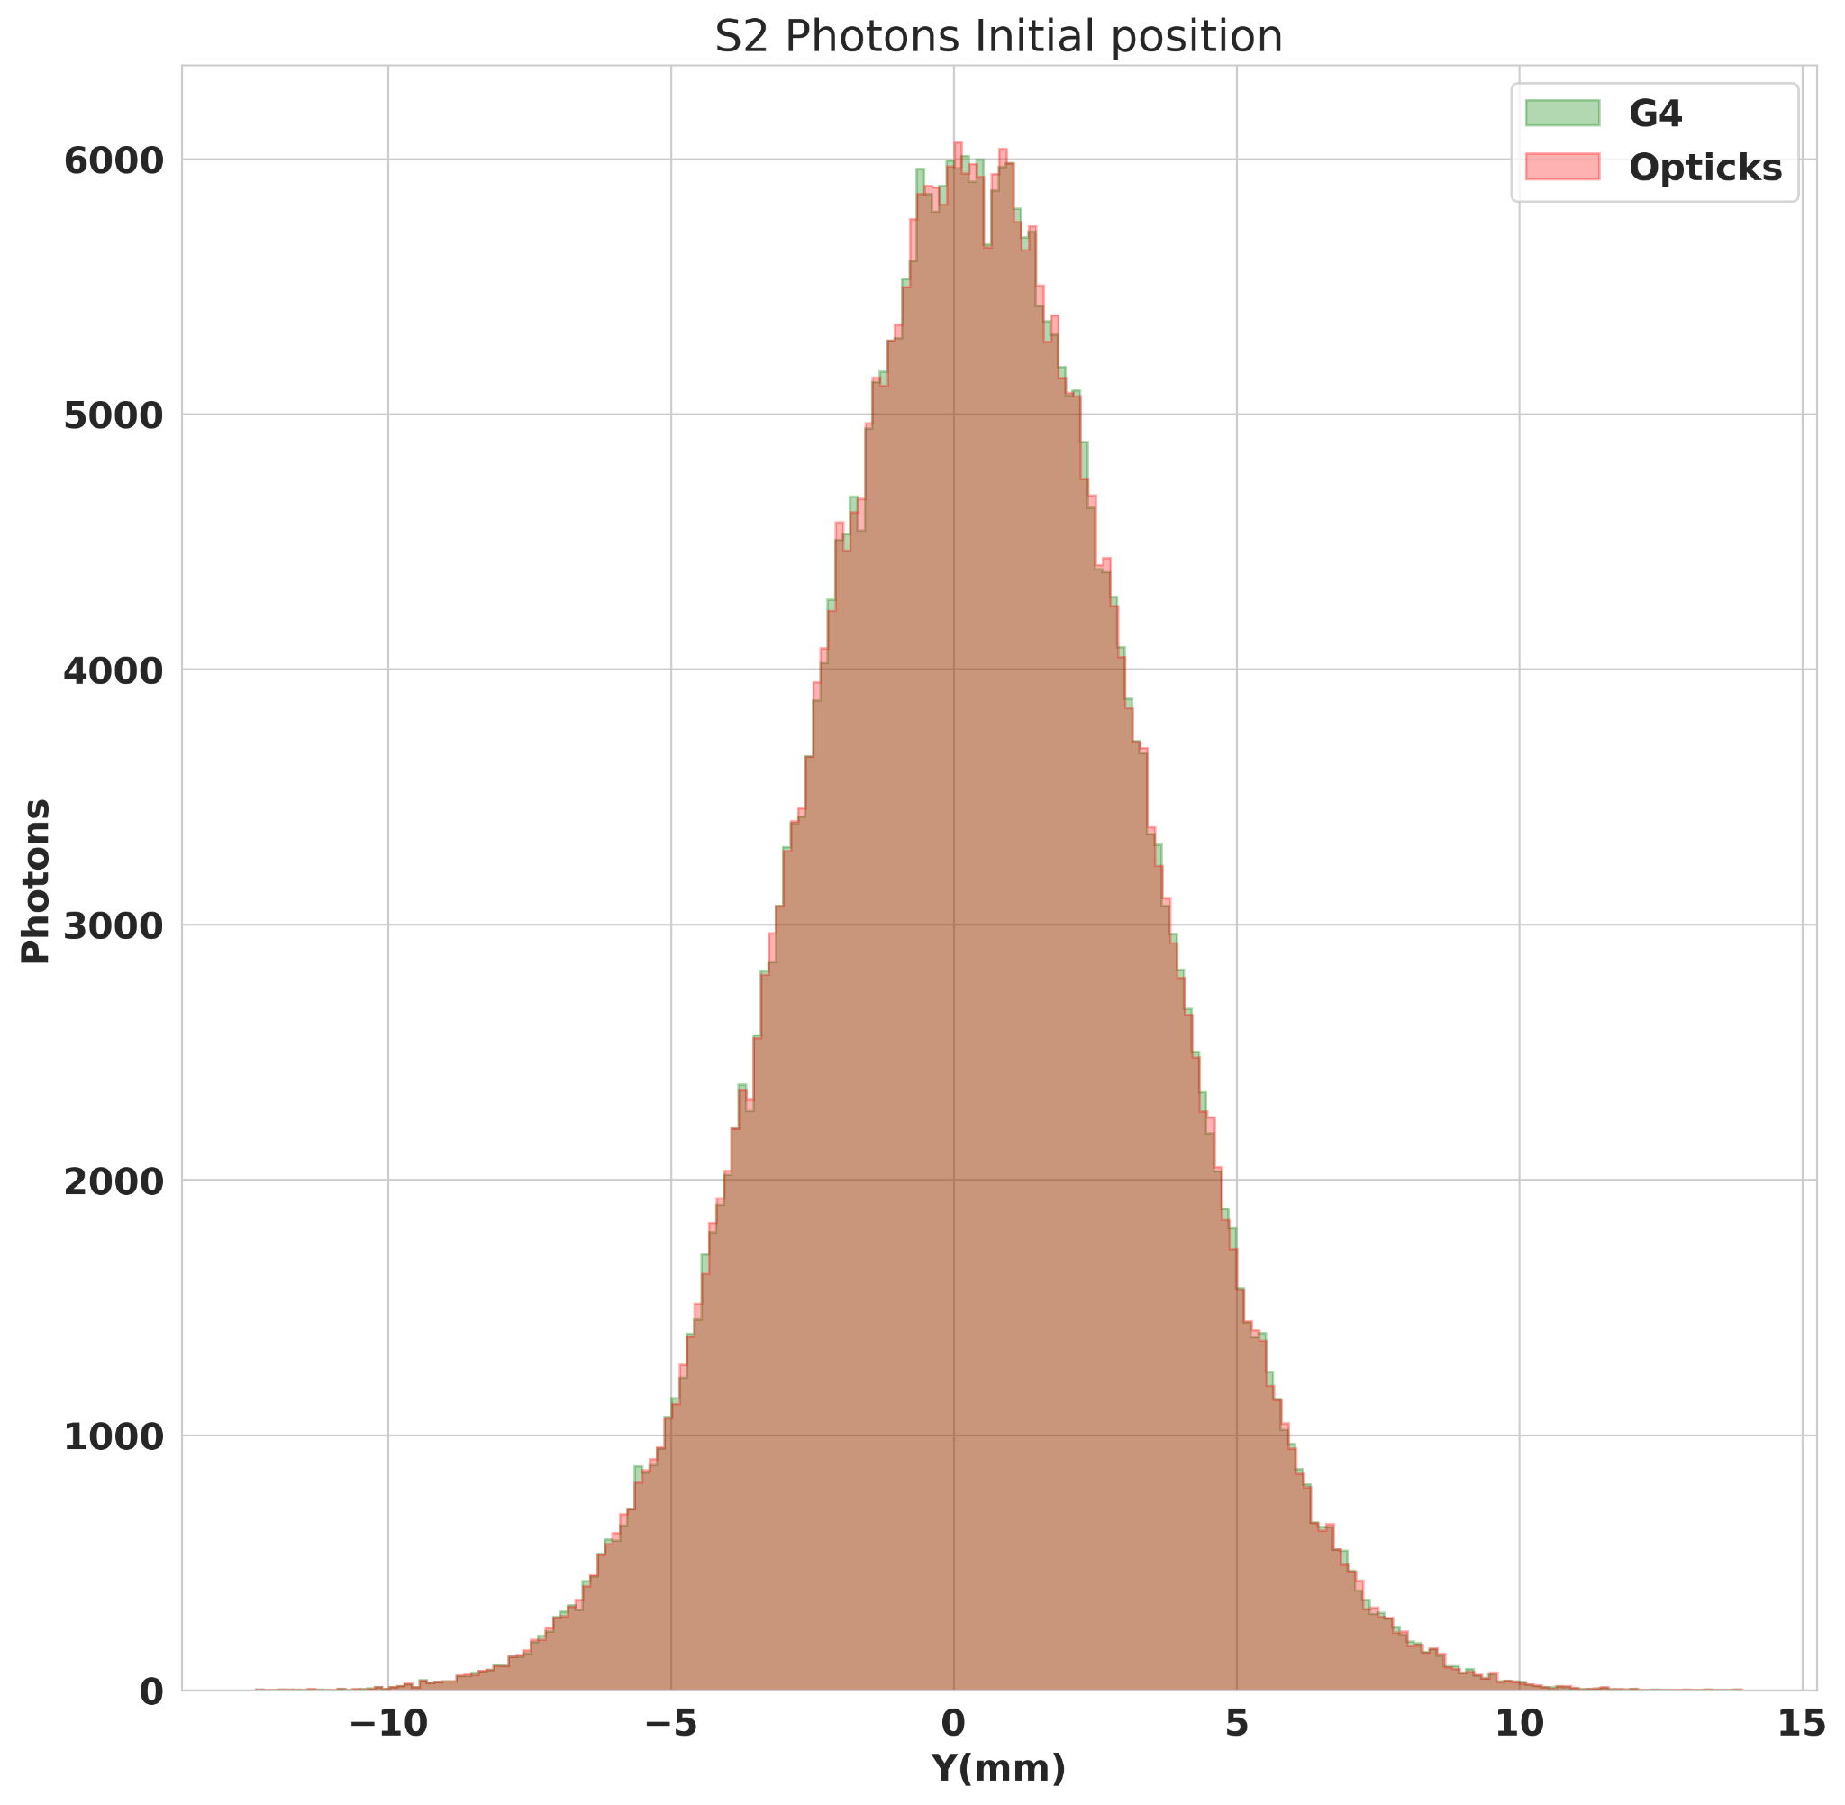

S2 Photon Position Comparison
Opticks
G4
Ionization electrons drift toward a 0.7 cm gap, where photons are uniformly produced.
S2 initial photon coordinates exhibit strong agreement between between Opticks and Geant4.

Slide 7
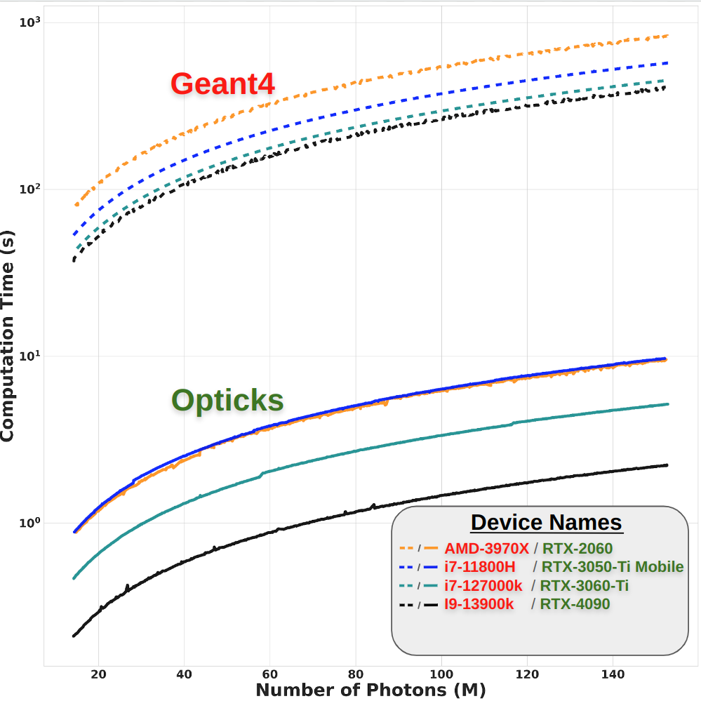
Performance Comparison
Simulated photons between 14M to 154M
Speed improvements over Geant4 (single thread)
  Range: 58.47 ± 0.02 to 181.39 ± 0.28.
Primary particle and electron drift contribution
    GPU: 15.49 ± 7.24%
    CPU: 0.16 ± 0.01%
GPU generational comparison
  Average speed factor improvement of
  2.09 ± 0.36 between two successive generations.

Slide 8
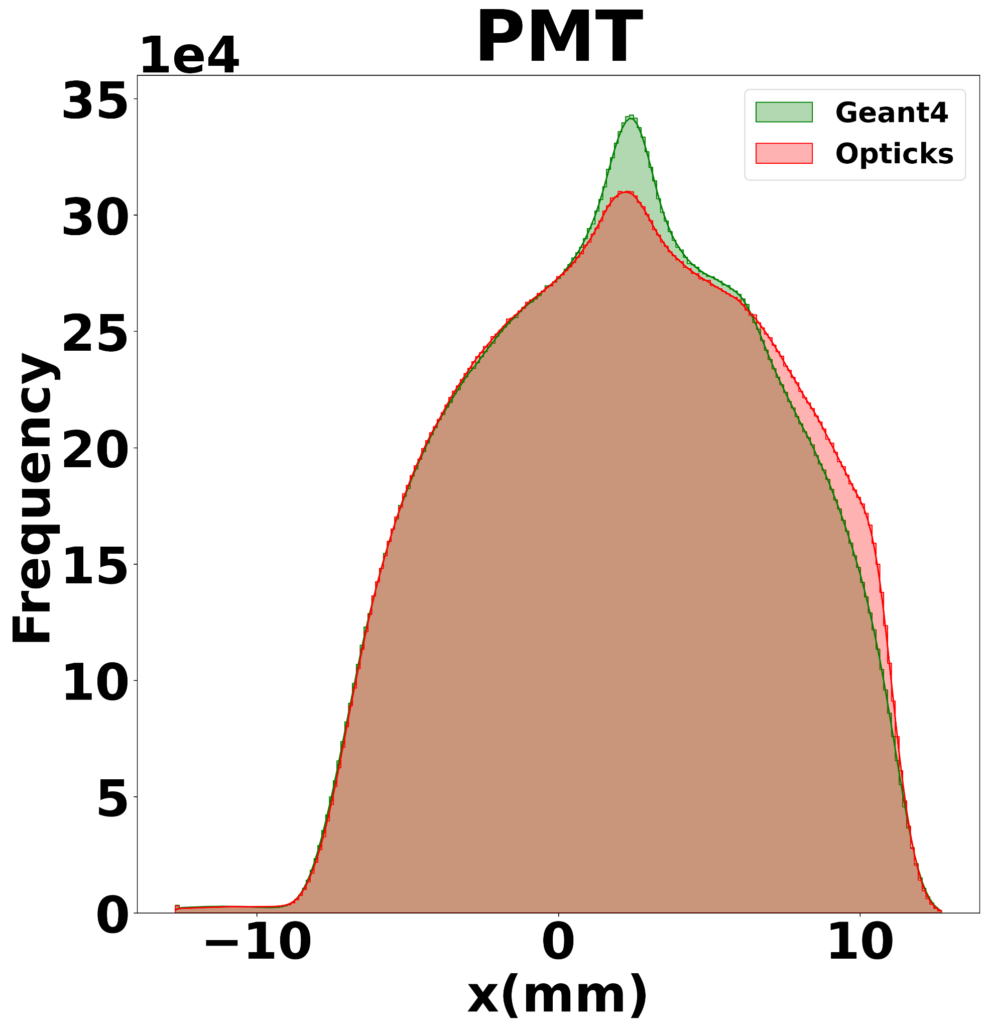
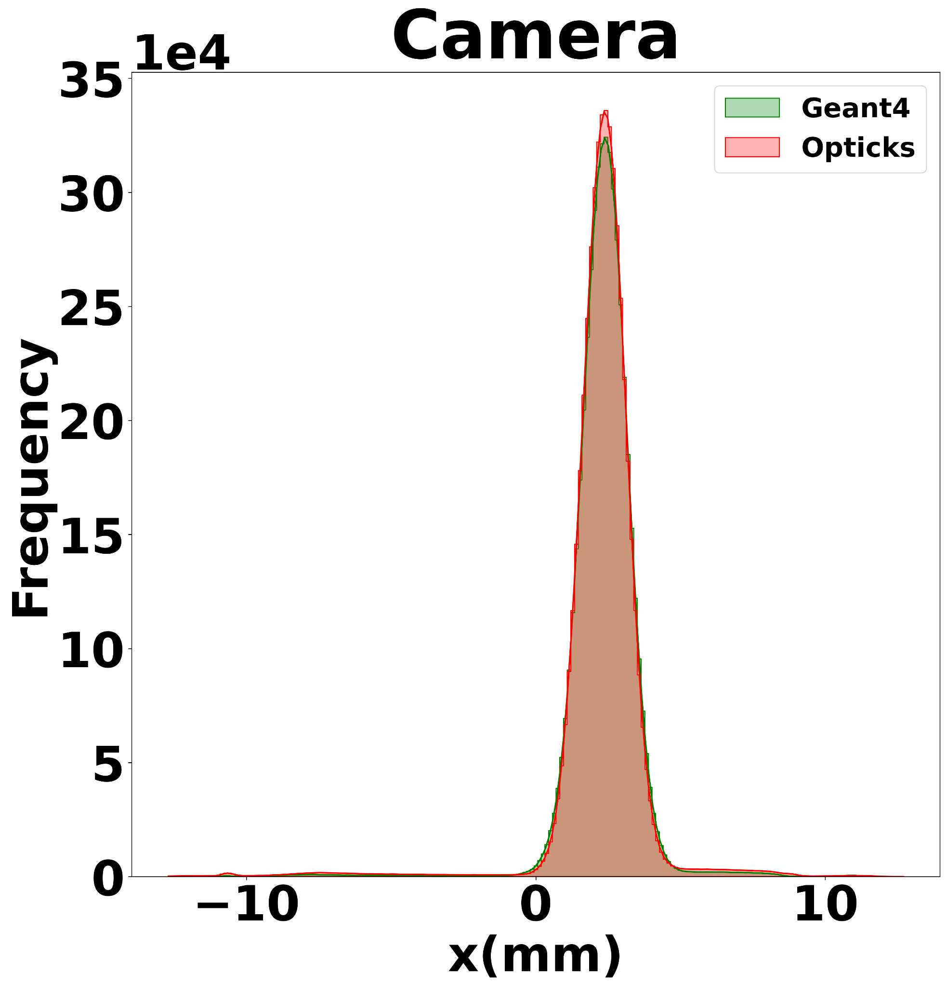
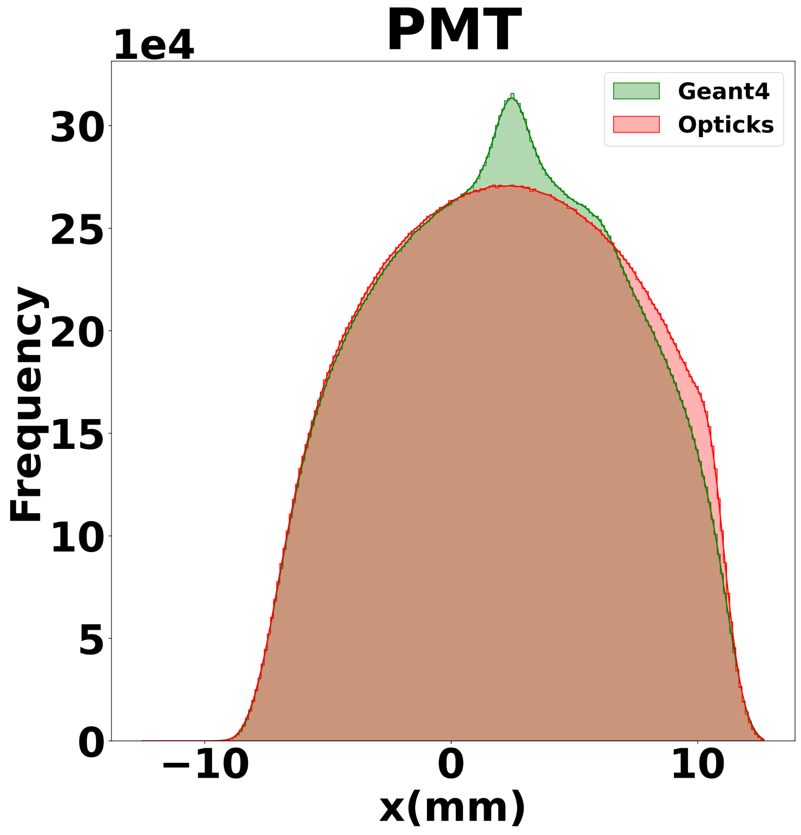

Comparison of Hit Position (X-Coordinate)
With Reflections
With and without reflections
  Results are comparable for both
  detectors
PMT results
  Geant4 shows a central bump in a distribution both cases.
  Opticks exhibits this bump only when reflections are included.
Camera results
  Show similar behaviour across both frameworks.
Ongoing investigation
  The differences are being analyzed.
Without Reflections

Slide 9
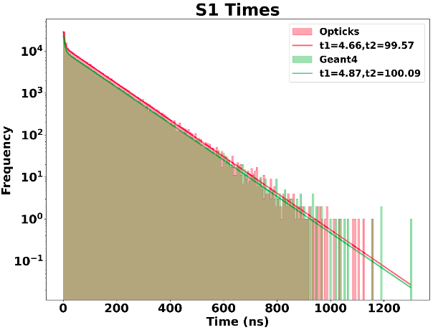
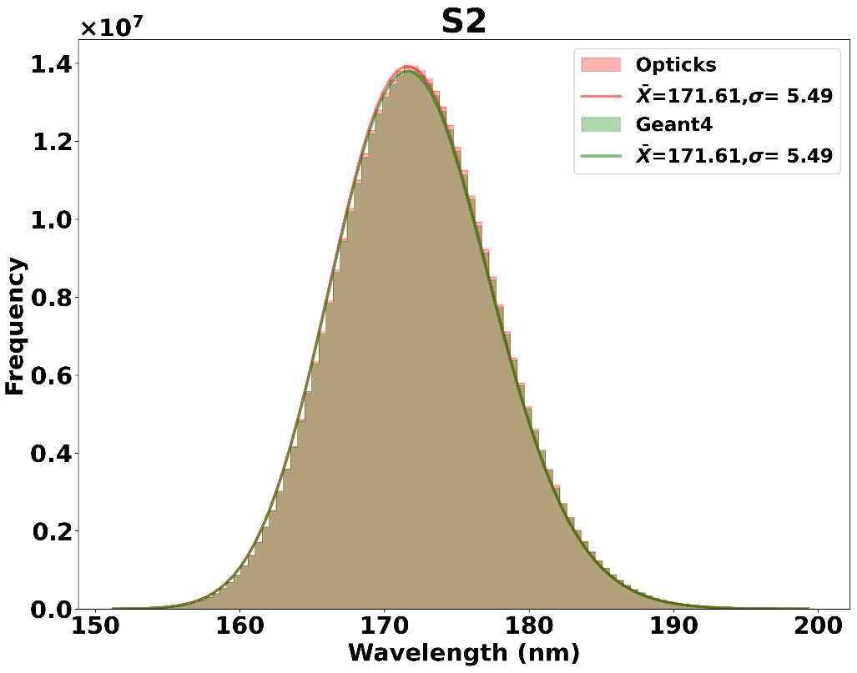
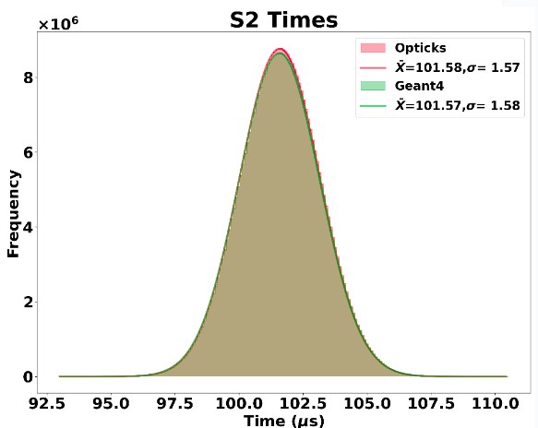
Photon Arrival Times and Wavelength
S1 and S2 photon comparison
  Arrival times are in good agreement with and without reflections.
  Similarly, wavelength of detected photons are in good agreement.
Wavelength

Slide 10
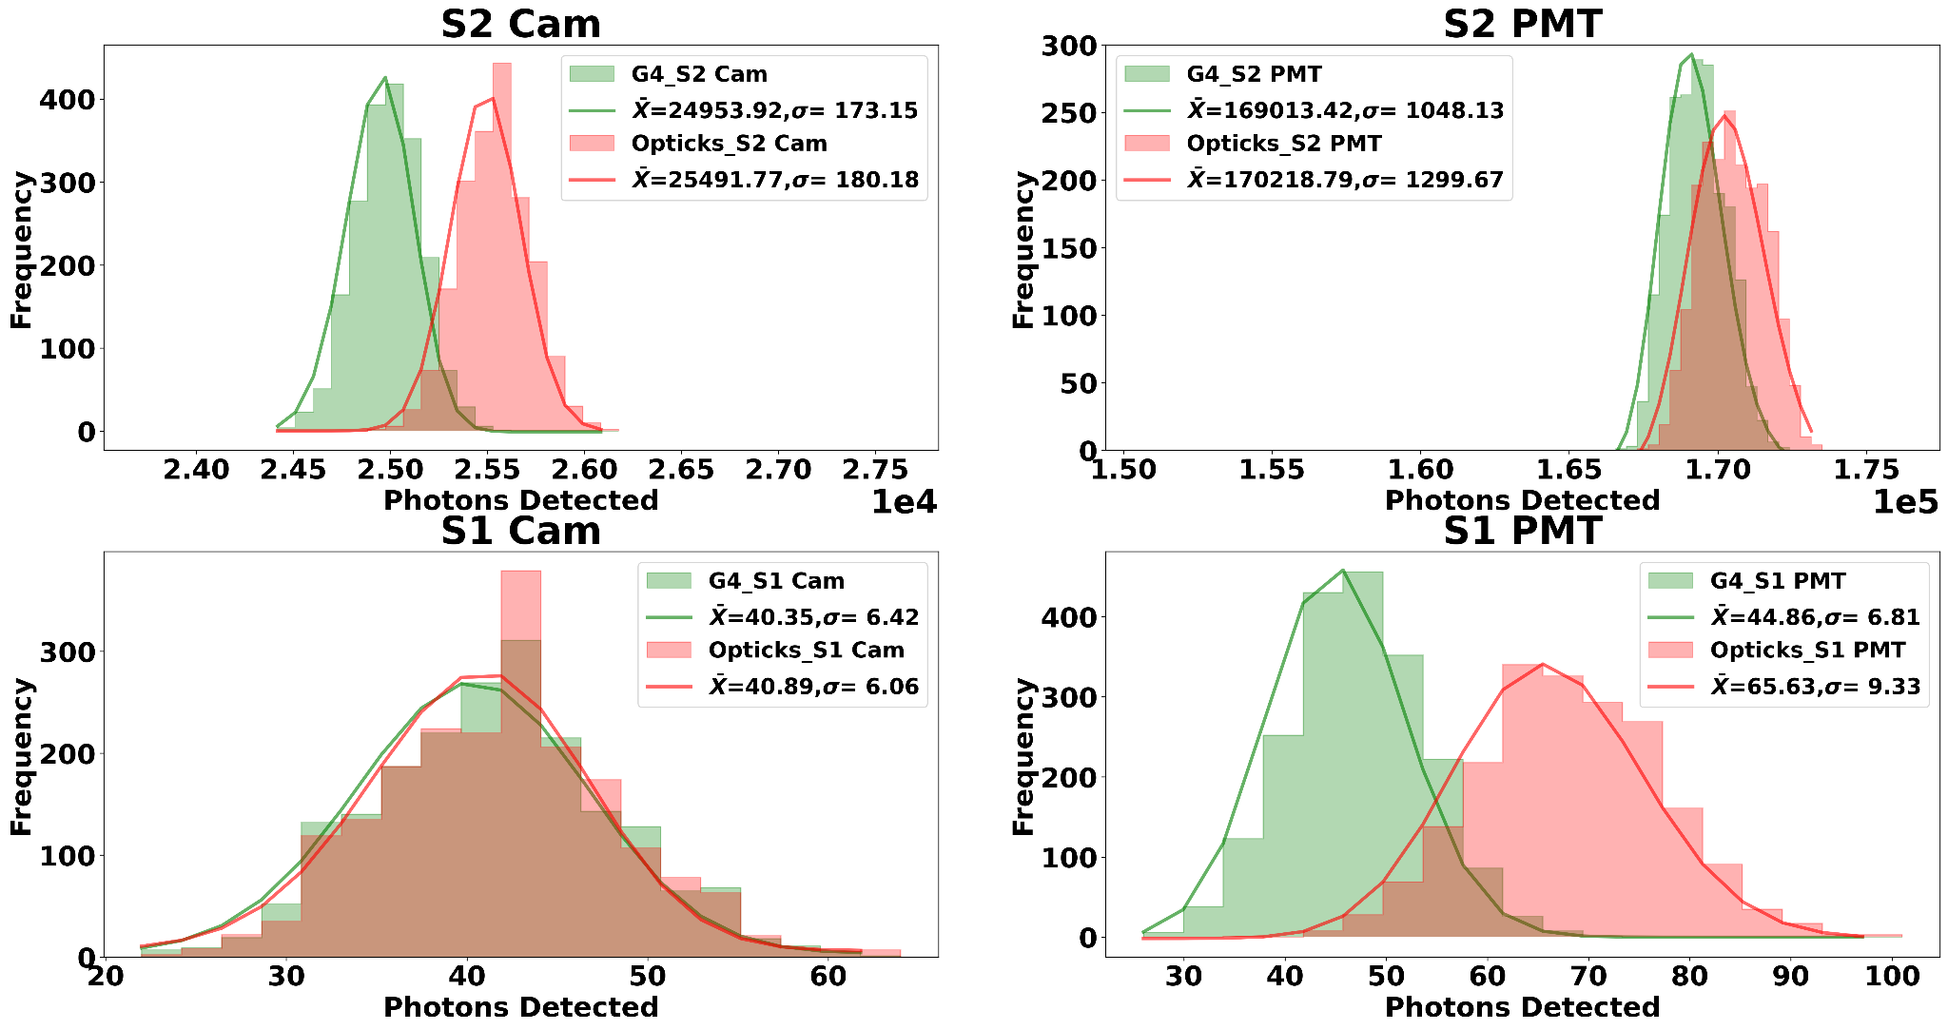
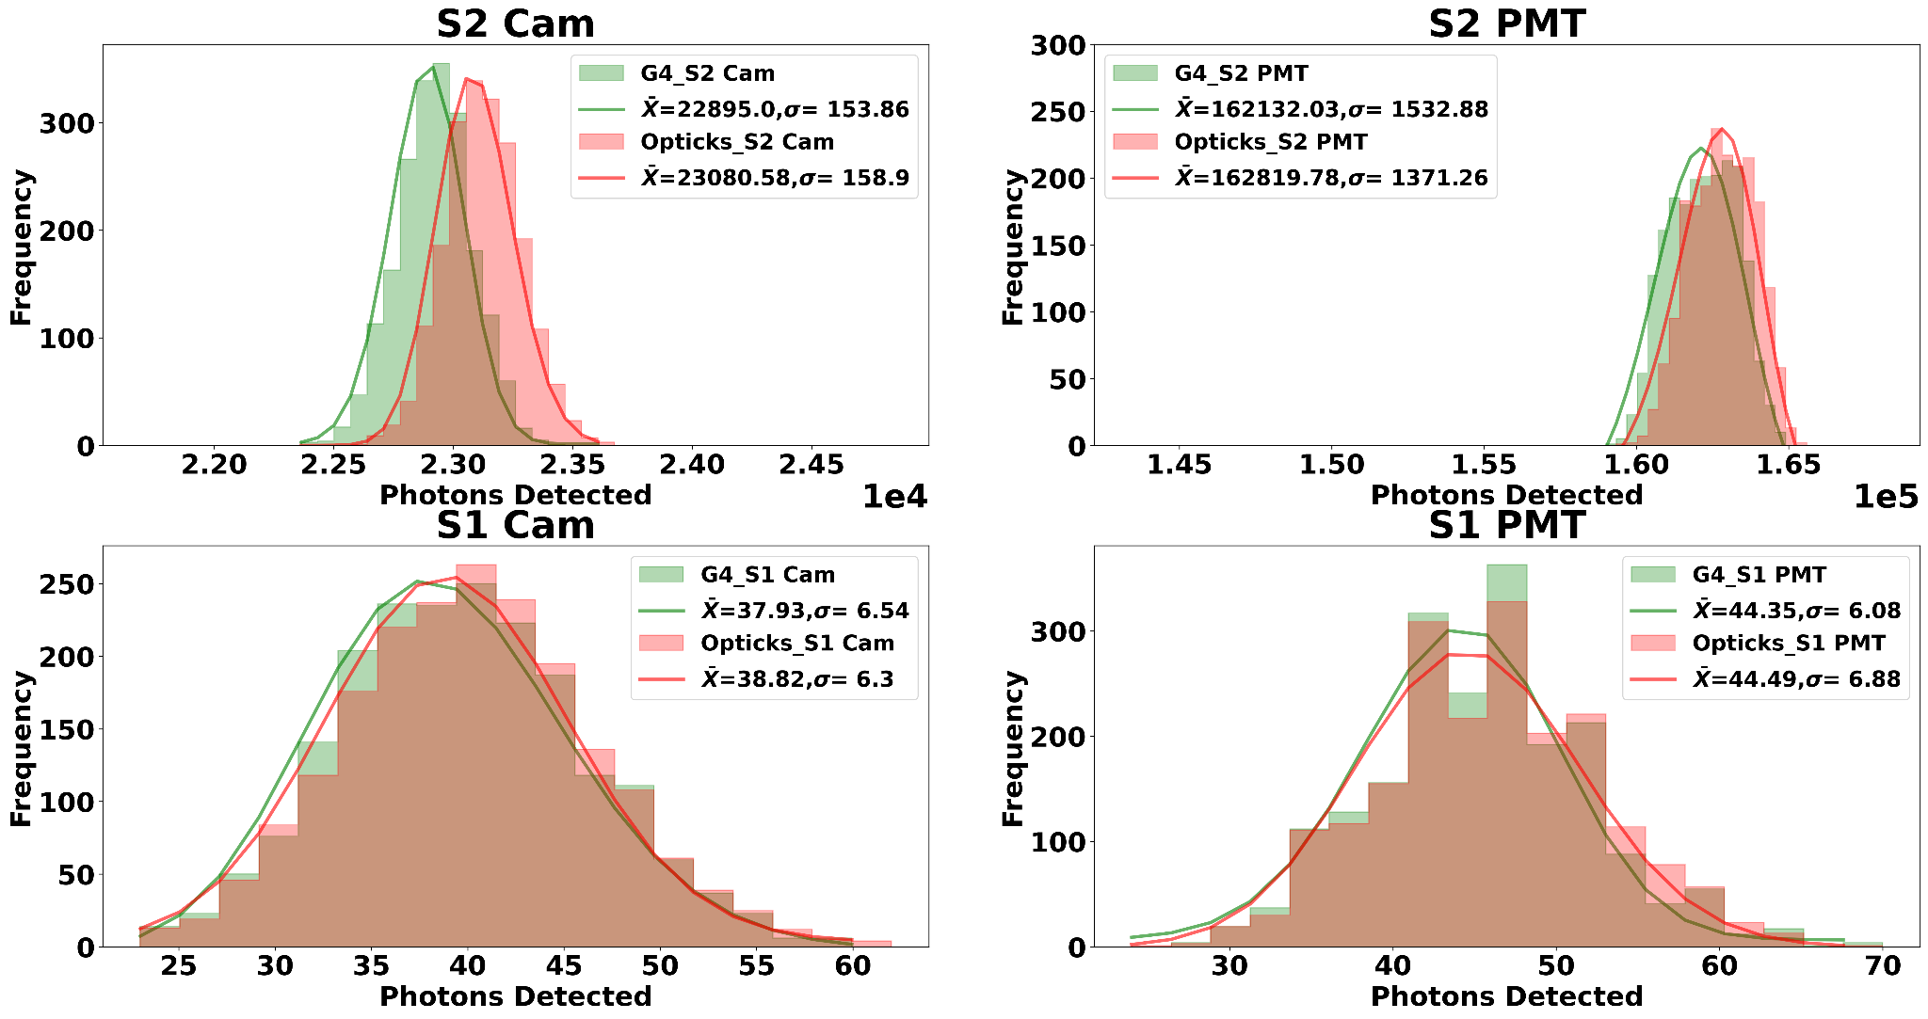
Hit Comparison
With Reflections
The number of photons detected per event with and without reflections are compared .
Results show much better agreement when
reflections are not involved.
Largest variations observed for S1 PMT when reflections are included
Without Reflections

Slide 11
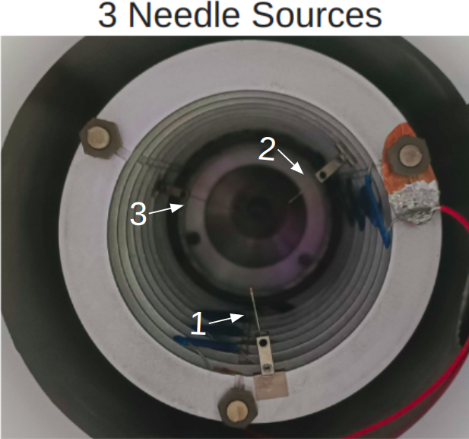
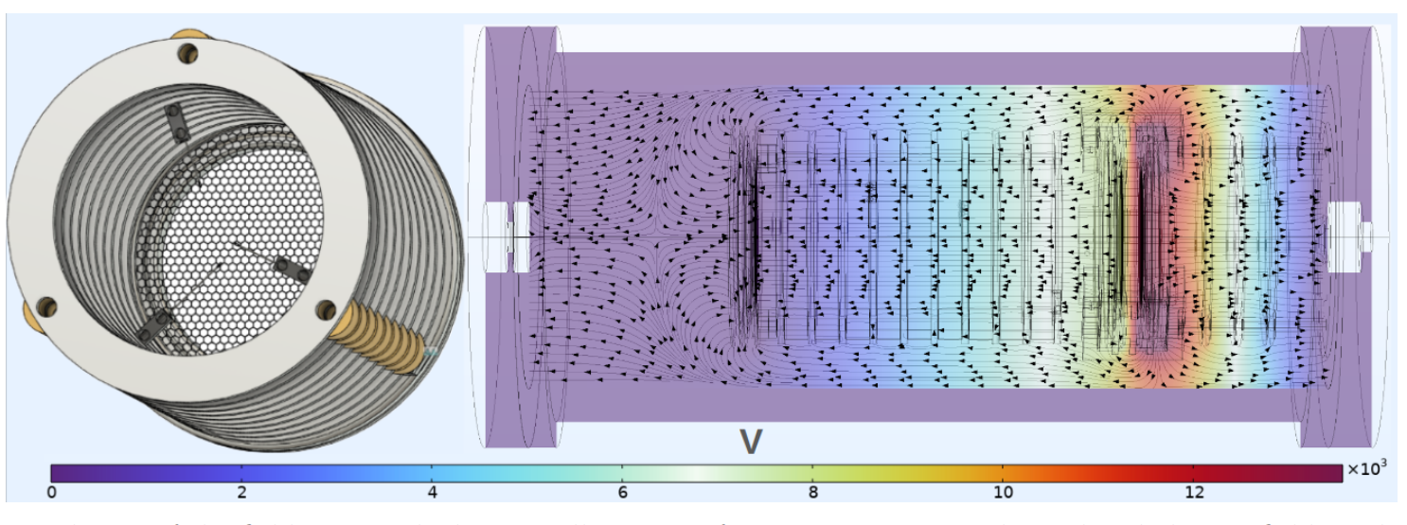
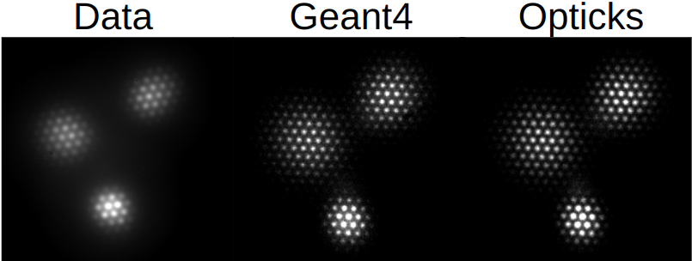
Geant4/COMSOL/Garfield/
The camera response to three alpha particles (5.4 MeV) produced at different distances within the field cage is comparable among Data, Geant4, and Opticks.
  Realistic detector response.
Tools used for simulation
  COMSOL
    Modeling electric fields
  Garfield++
    Imports COMSOL electric fields
    Imports Magboltz gas files
    Drifts ionization electrons.
GEANT4

Slide 12
Summary
Integration of Opticks
  Achieved 58x to 181x speed improvements over Geant4.
  Speeds expected to improve with next-gen GPUs.
Simulation comparison results
  Better agreement when reflections are not involved.
  Investigation underway to understand why the large differences when reflections are included.
Integration of Garfield++
  Predicts realistic detector behavior under COMSOL simulated electric fields
Opticks shows promising results.
  https://arxiv.org/abs/2502.13215

Slide 13
Important links
Main Page: https://simoncblyth.bitbucket.io/
Forum for Questions: https://groups.io/g/opticks
Detailed info about Opticks (Outdated yet informative)
https://simoncblyth.bitbucket.io/opticks/index.html
Installation guide and debugging: https://docs.google.com/document/d/1dEGLSMZWgbARayXikQR63GqEBl2TxBieSrb8njberlg/edit?tab=t.0

Slide 14
Thank you !

