Slide 1
Reviewing the Performance of Photek's Single Photon Timing Detectors.
Markfort¹, T. M. Conneely¹, A. Davidson², A. Duran¹, M. Kreps²,
J. Milnes¹, T. Blake³
1. Photek Ltd, 26 Castleham Rd, TN38 9NS, UK
2. University of Warwick, Coventry
3. University of Victoria, Victoria, Canada
03/04/2025
DRD4 Compendium and Collaboration, CERN

Slide 2
Photek’s Photomultiplier Tubes
Photek’s custom TORCH photon detector
Transit Time Spread Measurements of PMT products
Summary

Slide 3
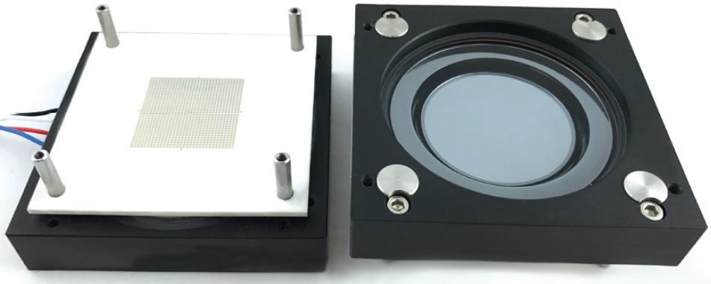
Photek's PMTs - History
Microchannel Plate Photomultiplier Tubes
Photek have manufactured single channel MCP-PMTs since it began in 1991
10 mm to 40 mm diameter working areas
Used in both analogue and counting modes
Around 2010 developed first AuraTek multichannel PMT using multi-layer anode with pads to achieve high channel density
Standard unit MAPMT228 has 26.5 × 26.5 mm working area and an anode array of 32 × 32
Targeted for counting mode
2012 to 2017 saw the square PMT development for the TORCH project
Standard unit MAPMT253 has 53 × 53 mm working area and an anode array of 64 × 64
Targeted for counting mode
Notes:
Update 228 image

Slide 4
Photek’s Photomultiplier Tubes
TORCH PID Photek’s custom detector
Transit Time Spread Measurements of PMT products
Summary

Slide 5
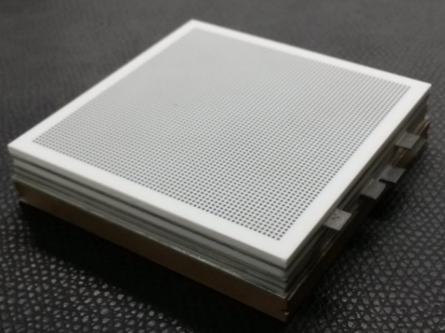
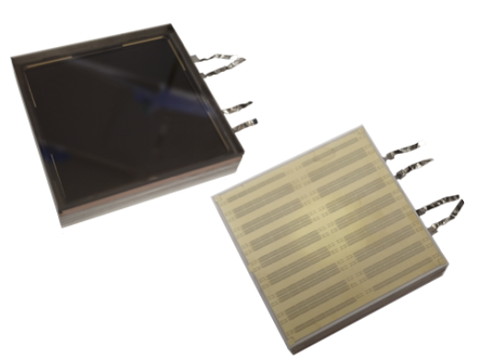
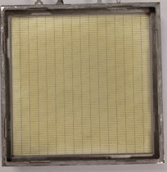

TORCH (Time Of internally Reflected CHerenkov) Photon Detector
Features:
Unique build provides tight Cathode – MCP in gap (1.5 – 2 mm) and MCP out – anode (3 mm) gap
16×96 Anode layout, 53×53 mm² active area
Fine pitch required in one direction
  0.552 mm pitch
  • Used to measure angle – enables Cerenkov/chromatic aberration correction
  • Also helps to reduce occupancy under high-rate conditions
Coarse direction: 3.312 mm pitch
A 64×64 anode square MCP-PMT
Notes:
The device seen here on the left is an MAPMT253 – multianode Photmulitiple tube and it was derived fromt the TORCH project, with the PMT being part of an R&D effort to develop a new Particle Identification Detector proposed for the upgrade of the LHCb facility at CERN. We believe this device has a unique build which allows for tight gaps on either side of the MCP stack when compared to similar available devices.

Slide 6
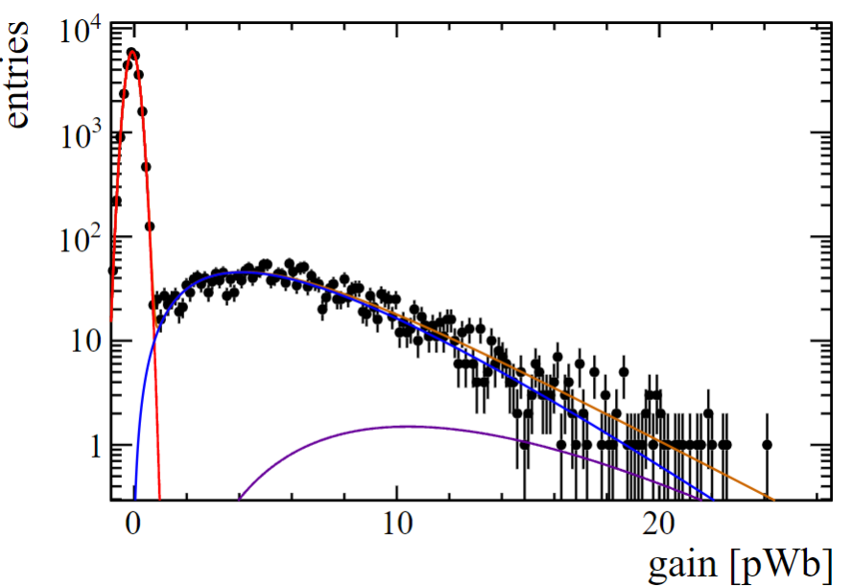
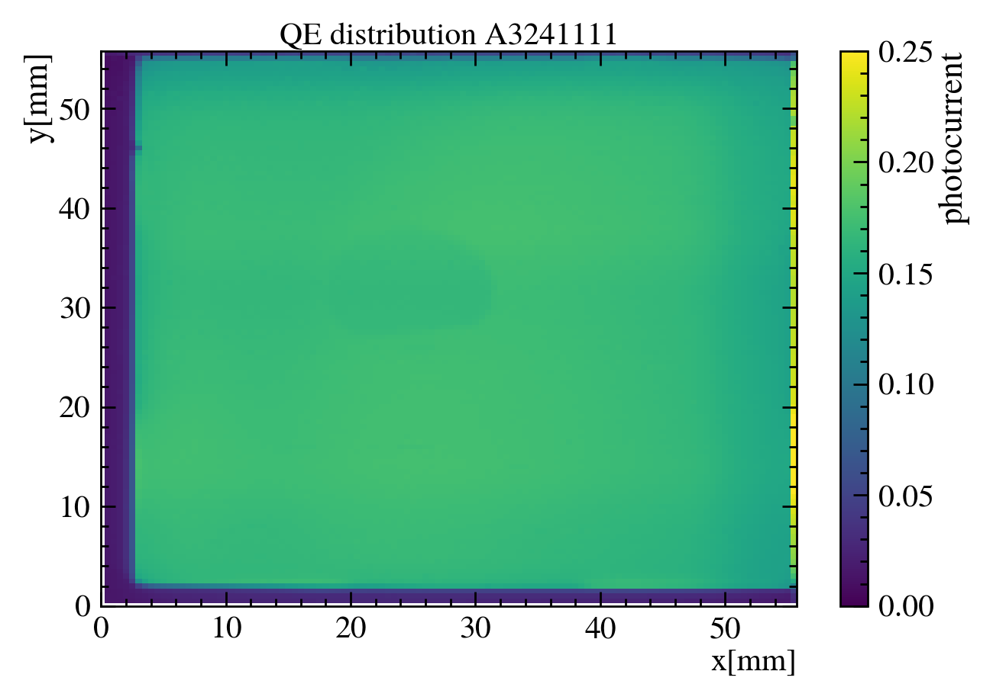
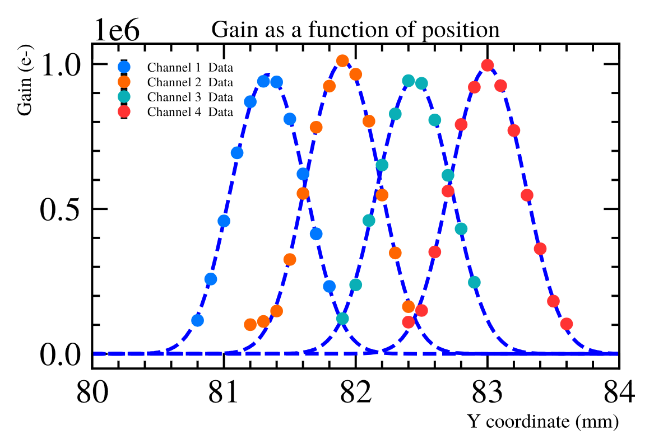

TORCH Detector
pedestal
single photon
two photons
Uniformity and Crosstalk Measurements :
Photocathode Quantum Efficiency
Fitting a gaussian convolved with a top hat of the pixel size yields a FWHM of ≈ 0.65 mm
PD24, Vancouver, November 2024: “Next generation microchannel plate detectors for high spatial and temporal resolution”
Notes:
The first analysis looks at electron gain uniformity. This curve shows the gain distribution for single photons for different anode locations on an 8 x 8 array.

Slide 7
Photek Photomultiplier Tubes
TORCH PID Photek’s custom detector
Transit Time Spread Measurements of PMT products
Summary

Slide 8
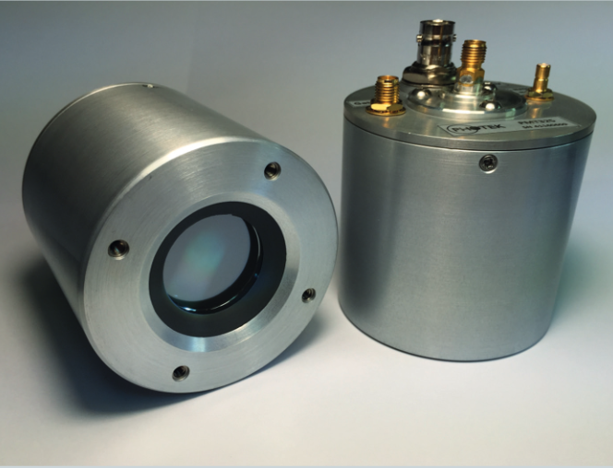
Transit Time Spread (TTS) Measurement
The following data demonstrates the TTS for the following Photek products:
- PMT210 – 2 MCP’s, active area diameter = 10 mm, single channel anode.
- PMT225 – 2 MCP’s, active area diameter = 25 mm, single channel anode.
- PMT310 – 3 MCP’s, active area diameter = 10 mm, single channel anode.
- TORCH MAPMT253 – 2 MCP’s, active area width = 53 mm, 96 x 16 multi-pixel readout anode
Experimental questions:
Does the number of MCP’s affect the transit time spread?
Does the MCP pore size affect the transit time spread?

Slide 9




Transit Time Spread (TTS) Measurement
Setup:
Using Poisson’s statistics if the P(γ) = 5%, P(2γ) ~ 0.1%.
Using count rate electronics, if the laser trigger rate = 100kHz, the signal count rate of the PMT should be dark count rate + 5k counts.
Ensure experimentally you are at single photon rate!
Dark Box
4 channel, 8GHz 40GS/s Scope
Photodiode
PMT
Laser
Delay Generator
ND Filters
Mirror
Notes:
The data was taken by splitting a pulsed laser signal and sending part to a photodiode to act as
a reference, and the rest to the instrumented MCP-PMT. From the skew measurement of the two
pulses, we infer the time it takes for a photoelectron generated at the cathode to produce a pulse at
the anode.

Slide 10
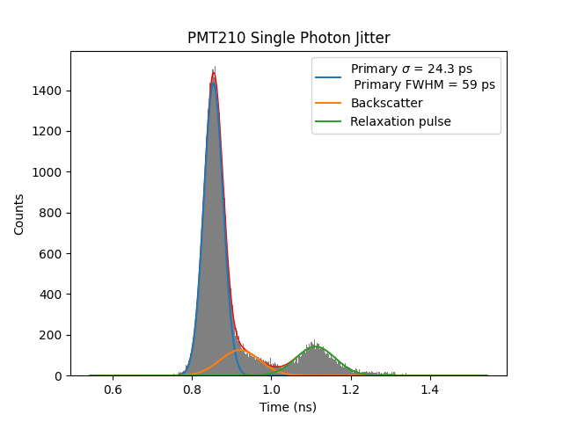
PMT210 TTS with PiLAS laser PiL063X– tune 30%
200 V from photocathode to MCP input
Gain ~ 1.6 × 10⁶
1 photon per ~ 20 laser pulses
PiLas 30% tune – FWHM 22.9 ps
LeCroy Wavemaster 808Zi-A (8 GHz, 40 GS/s)
Time stamped at 50% of peak amplitude to correct for amplitude variation
3 µm MCP pore size

Slide 11
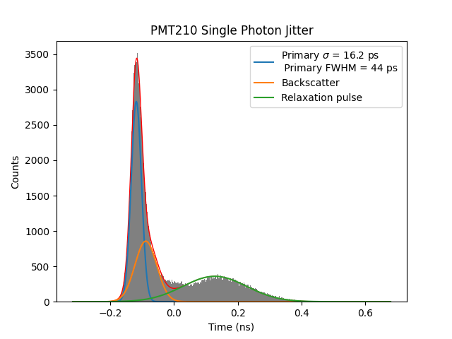
PMT210 TTS with Photek’s LPG650 laser
200 V from photocathode to MCP input
Gain ~ 1.6 × 10⁶
1 photon per ~ 20 laser pulses
LeCroy Wavemaster 808Zi-A (8 GHz, 40 GS/s)
Photek’s LPG-650 laser source ~ 40 ps FWHM
Time stamped at 50% of peak amplitude to correct for amplitude variation
3 µm MCP pore size
Notes:
Same range on x axis
Pd010 tweaked tuning resistor on the LPG405 – tuning the two current sources in the LPG with oscilloscope- fine tuned driving pulse

Slide 12
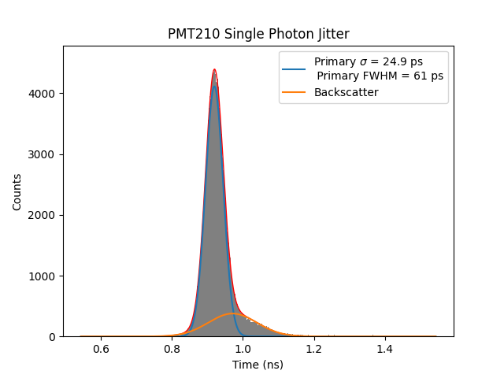
PMT210 TTS with PiLAS laser PiL063X – tune 50% → removes relaxation pulse
PiLas 50% tune – FWHM 25.9 ps
Notes:
Ignoring the relaxation pulse - justification

Slide 13
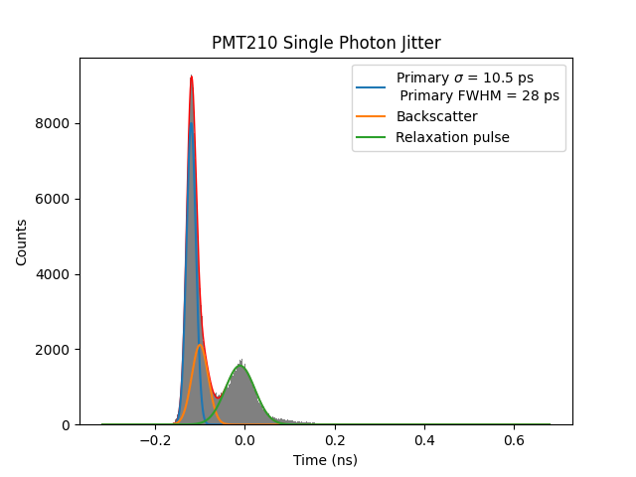
PMT210 TTS with Photek’s LPG405 laser
Improved Laser Results – improved tuning of LPG405
200 V from photocathode to MCP input
Gain ~ 1.6 × 10⁶
1 photon per ~ 20 laser pulses
LeCroy Wavemaster 808Zi-A (8 GHz, 40 GS/s)
Photek’s LPG-405 laser source ~ tuned for performance FWHM unknown
Time stamped at 50% of peak amplitude to correct for amplitude variation
3 µm MCP pore size

Slide 14
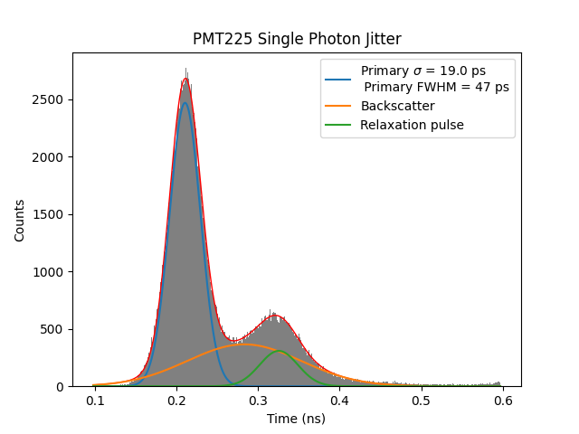
PMT225 TTS with Photek’s LPG405 laser
Does the MCP pore size affect the transit time spread?
200 V from photocathode to MCP input
Gain ~ 1.6 × 10⁶
1 photon per ~ 20 laser pulses
Photek’s LPG-405
LeCroy Wavemaster 808Zi-A (8 GHz, 40 GS/s)
Time stamped at 50% of peak amplitude to correct for amplitude variation
10 µm MCP pore size

Slide 15
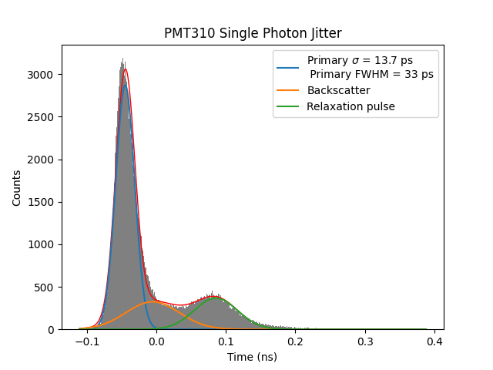
PMT310 TTS with Photek’s LPG405 laser
Does the number of MCP’s affect the transit time spread?
200 V from photocathode to MCP input
Gain ~ 1.6 × 10⁶
1 photon per ~ 20 laser pulses
Photek’s LPG-405 laser source
LeCroy Wavemaster 808Zi-A (8 GHz, 40 GS/s)
Time stamped at 50% of peak amplitude to correct for amplitude variation
3 µm MCP pore size
Notes:
First bounce is more important therefore no of plates doesn’t matter
time delay between signal and backscatter -64.91847590811226
time delay between backscatter and relaxation -31.413097543755846
time delay between signal and backscatter -96.3315734518681

Slide 16
MAPMT253 TTS Measurement with Photek’s LPG405
15 µm pore MCPs
MAPMT253 – 6 and 15 µm
200 V from photocathode to MCP input
Gain ~ 2 × 10⁶
1 photon per ~ 20 laser pulses
Photek LPG-405 laser source ~ 40 ps FWHM
LeCroy Wavemaster 808Zi-A (8 GHz, 40 GS/s)
Time stamped at 50% of peak amplitude to correct for amplitude variation
Referenced against laser trigger
PMTs configured with 8×8 readout pattern, single channel analysed
6 µm pore MCPs

Slide 17
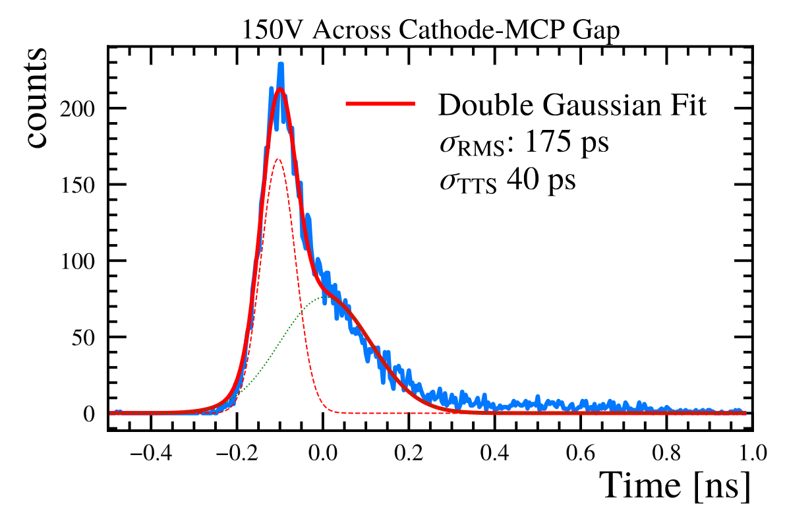
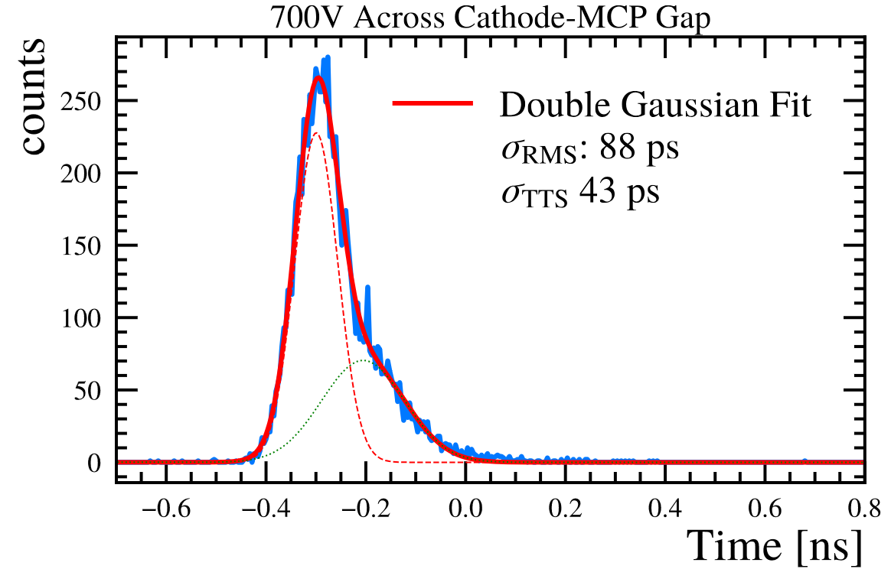
TORCH TTS Measurement with PiLAS laser PiL063X – tune 50%
Impact of Photocathode to MCP Voltage on TTS:
“Next generation microchannel plate detectors for high spatial and temporal resolution”

Slide 18
Summary of PMT's TTS performance
Detector | Laser | MCP pore diameter (µm) | TTS σ (ps) | TTS FWHM (ps)
PMT210 | LPG405 | 3 | 10 | 28
PMT225 | LPG405 | 10 | 19 | 47
PMT310 | LPG405 | 3 | 13 | 33
MAPMT253 | LPG405 | 6 | 30 | 78
MAPMT253 | LPG405 | 15 | 32 | 86
TORCH PID 96 x 16 | Pilas 50% | 15 | 40 | 95
Main insights:
The spread in transit time is primarily influenced by MCP pore size, while the number of MCPs plays a less significant role.

Slide 19
Photek Photomultiplier Tubes
TORCH PID Photek’s custom detector
Transit Time Spread Measurements of PMT products
Summary

Slide 20
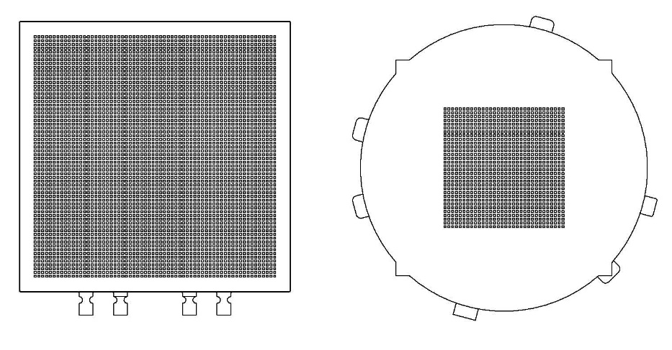
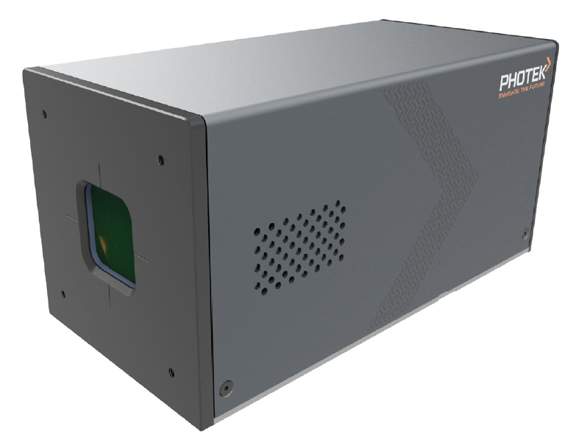
AuraTek PCS
TOFPET2 Integration with multi-anode MCP-PMT
TOFPET2d is an ASIC with 64 channels of integrated pre-amplifier, discriminator and time to digital convertor from PETsys Electronics
  Each channel can timestamp signals with a 30 ps TDC bin
  Maximum rate of 480 kHz per channel
We have developed the AuraTek PCS; a 256-channel photon counting system incorporating an MAPMT228 and 4x TOFPET2d ASICs
The MAPMT228 is a sibling device to the MAPMT253; round format, 32x32 anode pattern, tighter photocathode to MCP gap ~ 0.2 mm
For this device we gang anodes to reduce the 32x32 pattern to 16x16
AuraTek PCS now commercially available
MAPMT253
MAPMT228
Notes:
As the name suggests the TOFPET ASIC from PETsys electronics is designed for time-of-flight PET using silicon PMs. We have assessed various versions of the TOFPET ASIC with multi-anode MCP-PMTs and the TOFPET2d version has produced some very good results. The PCS-256 system that we have put together uses 4 ASICs to produce 256 channels, and this is used with an MAPMT228, which is the circular sibling PMT of the square MAPMT253, and has a native 32x32 anode pattern ganged down to 16x16, you can see the relative dimensions of the PMTs here.

Slide 21
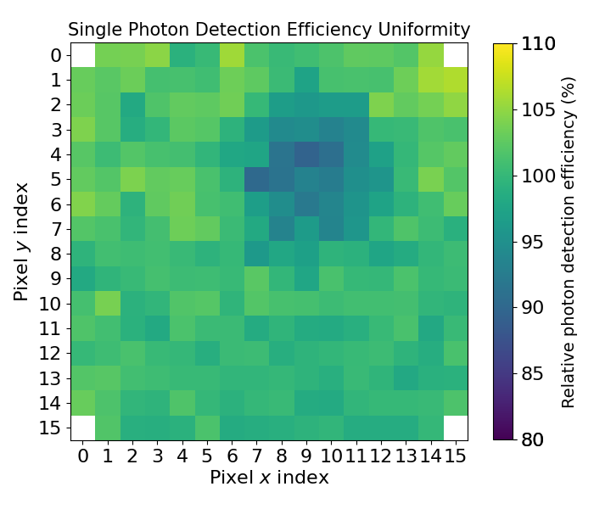
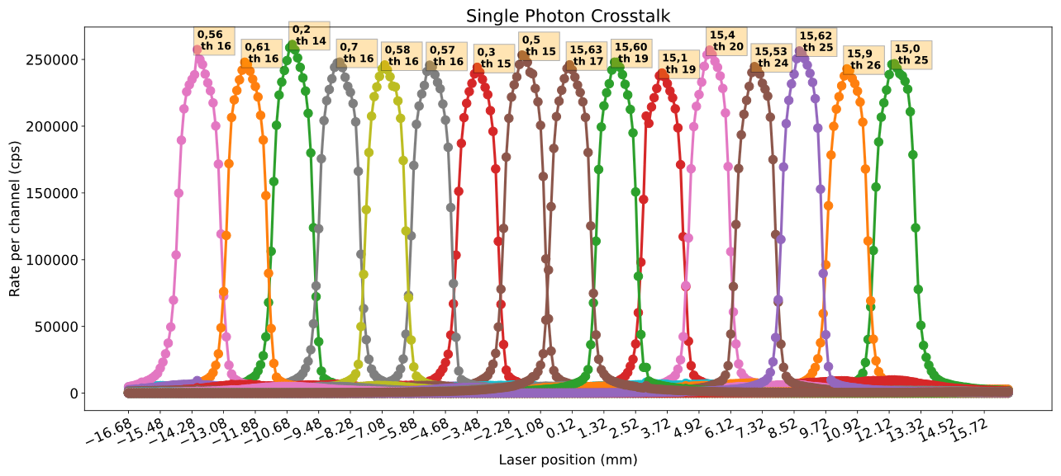
AuraTek PCS
Response Uniformity and Crosstalk
Each channel has an independent threshold and zero level which is adjusted to normalise the response
A linear scan of a 0.2 mm laser spot attenuated to single photon level shows the inter-channel crosstalk
Notes:
One of the issues with the earlier TOFPET1 ASIC was poor consistency in the counting efficiency between channels, partly caused by the control of the input threshold being on too coarse a scale. This is much improved in the 2d version as shown here, the image on the left is from a uniform flood fill of the active area, and the 1-D scan on the right is the count rate response when a short pulse laser, operating at single photon levels, is stepped through each channel in turn. Having a finer control on the threshold allows us to normalise the counting efficiency of each channel.

Slide 22
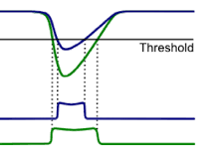
AuraTek PCS
Timing Calibration
The timing information for each photon event is logged by the TDC in each channel
The raw timing data is degraded by the amplitude walk caused by the gain variation in the single photon response of MCPs
Using the Time-over-Threshold technique restores the timing information
  The amplitude variation is captured by the pulse width
  This enables a correction to be implemented
Accumulated timing data is fitted to a double Gaussian by an automated function
The shift in the peak of the first fitted pulse is then fitted to a quadratic to apply the correction
Notes:
The TOFPET ASIC has an in-built TDC that logs the arrival time and also the pulse width for each event. MCPs are known to have a wide gain variation for single photons, and this has the effect of degrading the timing accuracy by adding jitter to the leading edge as shown here. By using the time-over-threshold technique we can capture the gain variation in the pulse width and apply a correcting factor to restore the timing accuracy. The upper graph shows the arrival time vs pulse width, and the 3D data shows a secondary artifact caused by a reflection in our dark box, but that is obscured when the raw data is collapsed into a 2D histogram as shown on the lower graph. By applying a polynomial correction factor we can significantly improve the timing accuracy and properly resolve the artifact, the fitted gaussian shown here has a sigma of 56 ps.

Slide 23
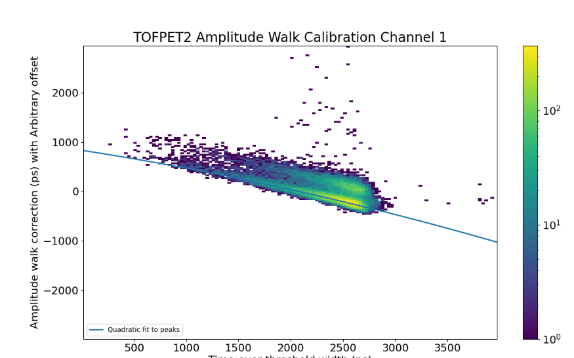
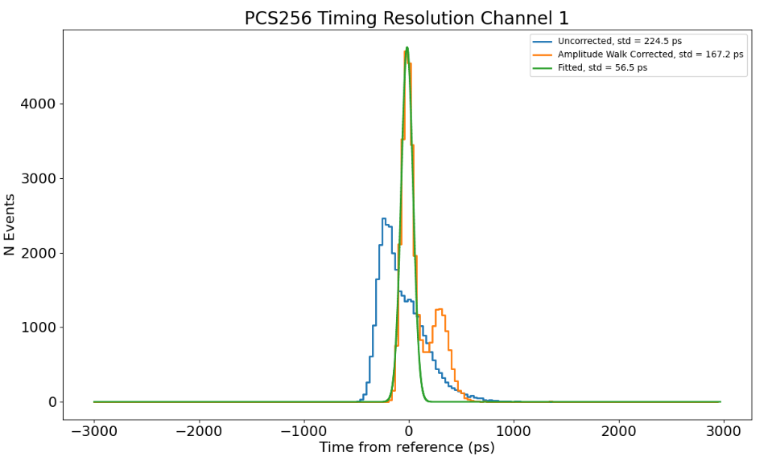
AuraTek PCS
Timing Calibration
Uncorrected rms = 224.5 ps
Corrected rms = 167.2 ps
Fitted rms = 56.5 ps
Arrival Time with arbitrary offset (ps)
Time over threshold width (ps)
Notes:
The TOFPET ASIC has an in-built TDC that logs the arrival time and also the pulse width for each event. MCPs are known to have a wide gain variation for single photons, and this has the effect of degrading the timing accuracy by adding jitter to the leading edge as shown here. By using the time-over-threshold technique we can capture the gain variation in the pulse width and apply a correcting factor to restore the timing accuracy. The upper graph shows the arrival time vs pulse width, and the 3D data shows a secondary artifact caused by a reflection in our dark box, but that is obscured when the raw data is collapsed into a 2D histogram as shown on the lower graph. By applying a polynomial correction factor we can significantly improve the timing accuracy and properly resolve the artifact, the fitted gaussian shown here has a sigma of 56 ps.

Slide 24
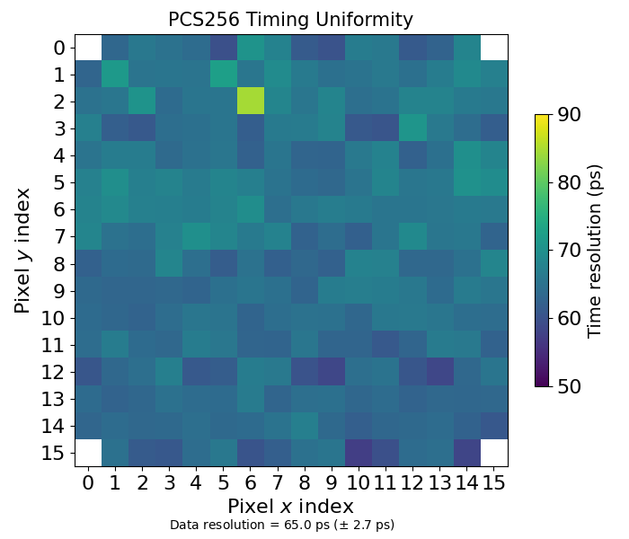
PCS-256
Timing Uniformity
The uniformity of the timing response was measured by scanning the 40 ps laser pulse across each channel and using Time-over-Threshold to correct for amplitude walk
This example shows an average σ of 65 ps
Notes:
This image just shows the uniformity of the timing accuracy by stepping a 40 ps laser pulse at single photon levels through each channel. The average sigma after time-over-threshold correction is 65 ps.

Slide 25
Photek Photomultiplier Tubes
TORCH PID Photek’s custom detector
Transit Time Spread Measurements of PMT products
Summary

Slide 26
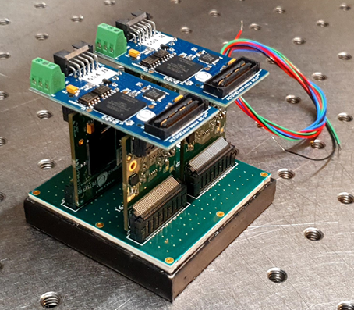
Summary
Summary of transit time spread measurements for a range of Photek’s detectors
Preliminary measurements of crosstalk for TORCH PID
Thanks to Ayse Duran from Photek R&D for the measurements.
Prototype PCS Electronics with MAPMT253

Slide 28
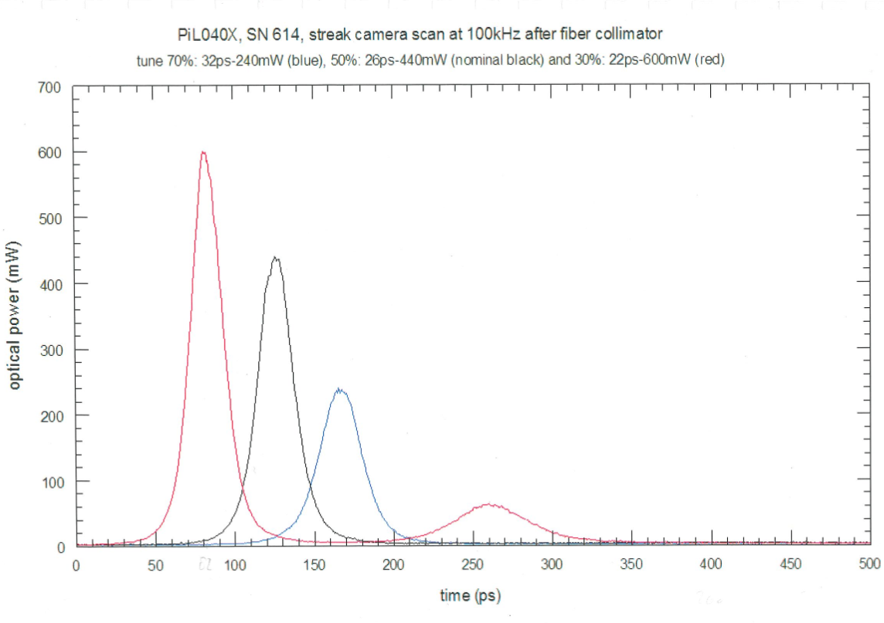

Slide 29
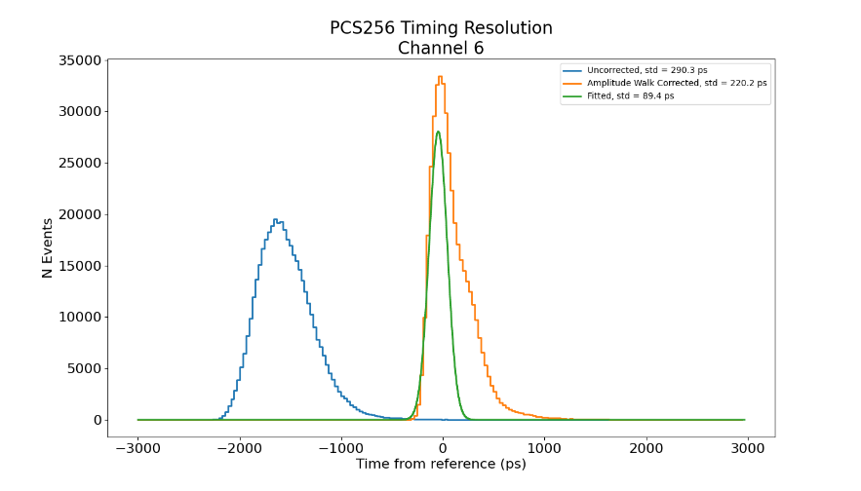

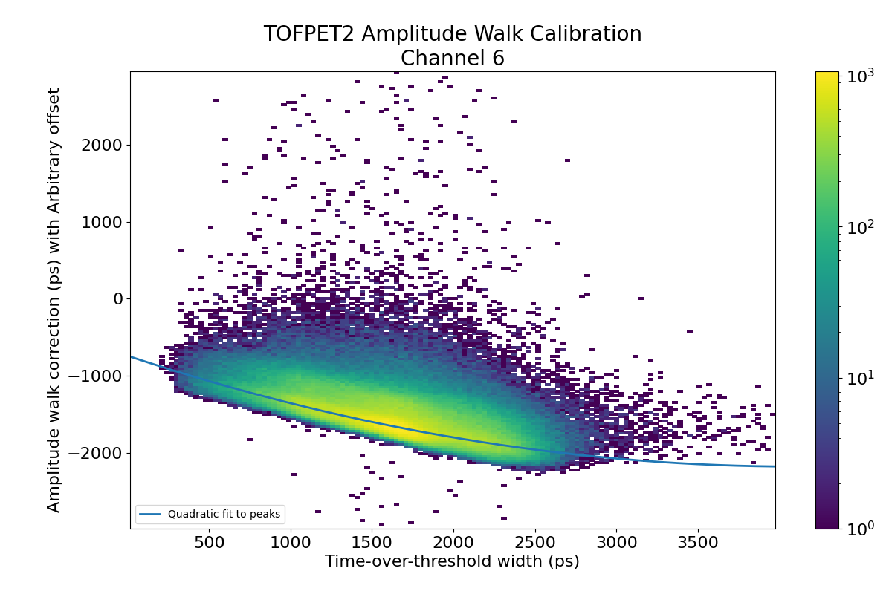
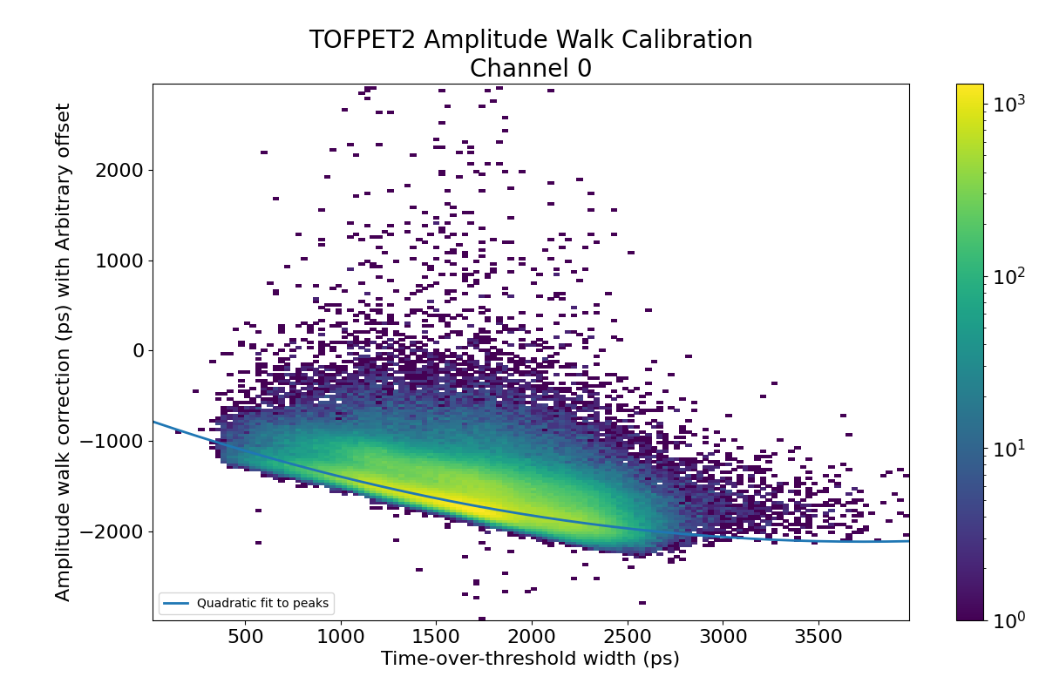
MAPMT253 & PCS
Examples of 256 channel Time-over-Threshold corrections
Notes:
The outer envelop of the TOFPET2d front-end, the section that needs to be close to the PMT, fits into the same dimension as the square PMT. The rest of the readout can be located remotely as shown by the blue ribbon cables. We can envisage a 16x16 channel modular construction that easily allows tilling on all 4 sides.

Slide 30
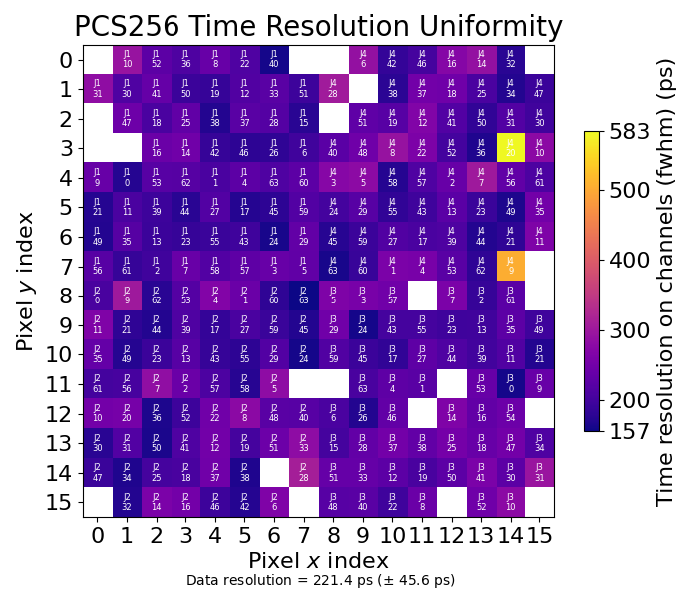
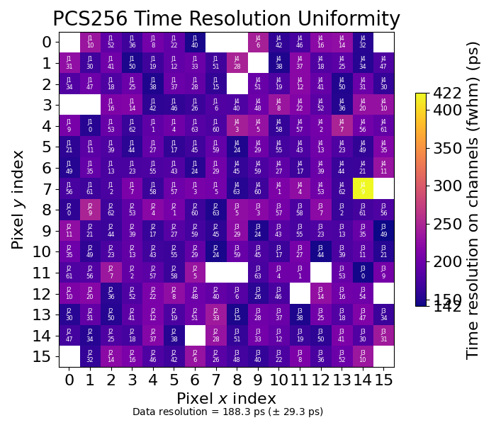
MAPMT253 & PCS
Time Resolution Map – FWHM of Fitted Peak
PC – MCP: 200 V
PC – MCP: 700 V
Notes:
The outer envelop of the TOFPET2d front-end, the section that needs to be close to the PMT, fits into the same dimension as the square PMT. The rest of the readout can be located remotely as shown by the blue ribbon cables. We can envisage a 16x16 channel modular construction that easily allows tilling on all 4 sides.

Slide 31

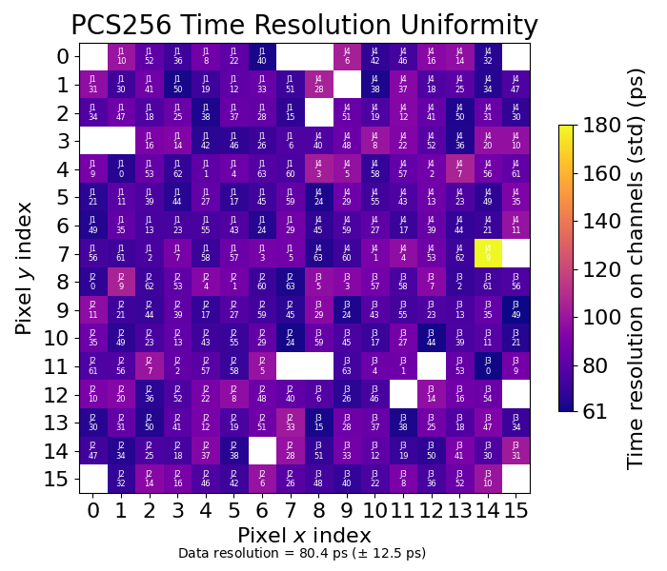
MAPMT253 & PCS
Time Resolution Map – rms of Fitted Peak
PC – MCP: 200 V
PC – MCP: 700 V
Notes:
The outer envelop of the TOFPET2d front-end, the section that needs to be close to the PMT, fits into the same dimension as the square PMT. The rest of the readout can be located remotely as shown by the blue ribbon cables. We can envisage a 16x16 channel modular construction that easily allows tilling on all 4 sides.

