Slide 1

Large-Area MCPs: Performance, Limitations and Next-Generation Developments
Mark Popecki
Incom, Inc.
Charlton, MA, USA

Slide 2
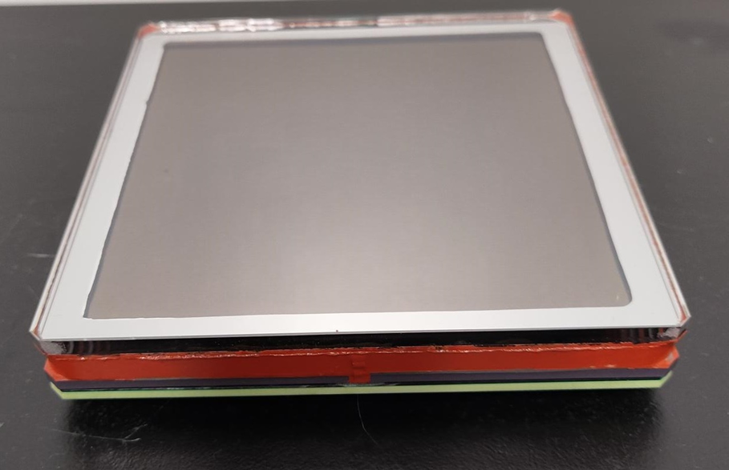
Large Area MCP-PMTs
Internal Structure of MCP-PMTs
Performance
Limitations for MCP-PMTs
Future developments

Slide 3
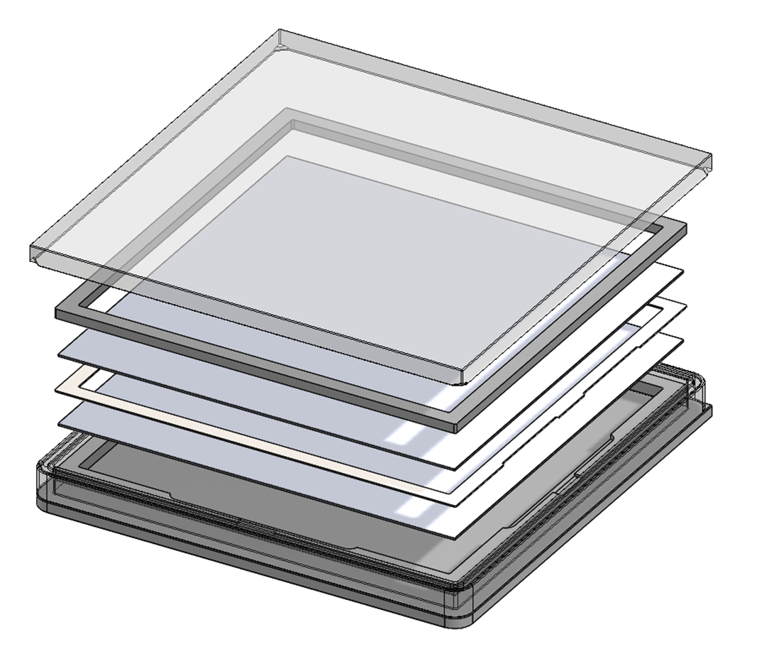
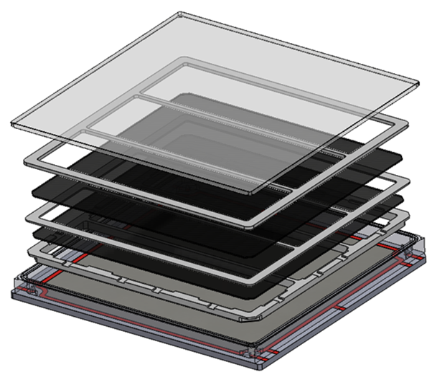
LAPPD and HRPPD Components
Photocathode:
  Bialkali, with peak QE sensitivity at 365 nm, ~30%
Windows: fused silica, borosilicate, sapphire
MCPs: 20 or 10 um microchannels, with 6 um in development
Anode:
  Capacitively coupled to any pixelated circuit board, both styles.
  DC coupled for HRPPD only
High voltages
  External connections to each surface of the MCPs and photocathode
  Photocathode is biased separately
  Operation with different MCP voltages extends photocathode lifetime
Window
Spacers
MCP
Anode
LAPPD Exploded View
HRPPD Exploded View

Slide 4
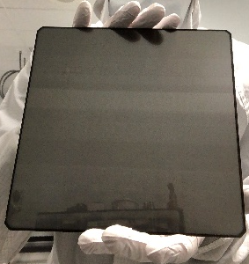
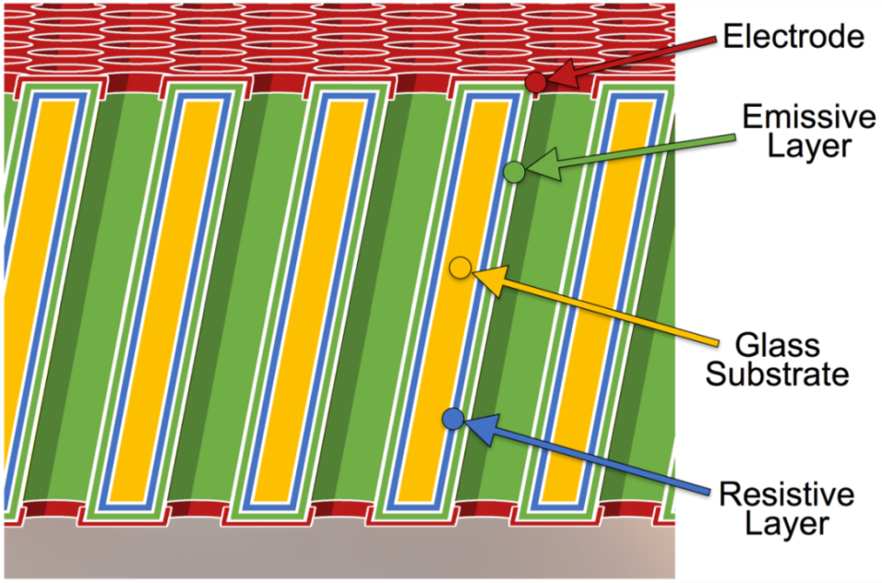
Components: ALD/Glass Substrate MCPs
Incom MCPs are made with:
Glass microchannel substrate
  Drawn and fused as hollow tubes – no core removal needed
  Usually borosilicate or aluminosilicate glass, but lead oxide and others may be used.
Resistive layer applied with Atomic Layer Deposition
  Incom ALD process developed at Argonne National Laboratory
  Two types in use: “Chem 1” and “Chem 5”.
Emissive layer on top of the resistive layer, usually MgO or Al₂O₃
However, details matter:
  Alkalis or other elements in glass can migrate,
    This can damage the ALD layers – use a barrier layer between glass and ALD layers if necessary.
  Thickness of ALD layers can affect the:
    gain and
    maintenance of gain as a function of rate
  Cascade electrons are removed from the emissive layer, and replenished from below it by the current in the resistive layer.
  Very thin lead oxide glass substrates could bend during ALD layer application, depending on the composition of the ALS materials.
  Resistive layer can chemically interact with the emissive layer.
MCP
GCA
Popecki, M. A., et al. (2016), Microchannel plate fabrication using glass capillary arrays with
Atomic Layer Deposition films for resistance and gain, J. Geophys. Res. Space Physics, 121,
7449–7460, doi:10.1002/2016JA022580.

Slide 5
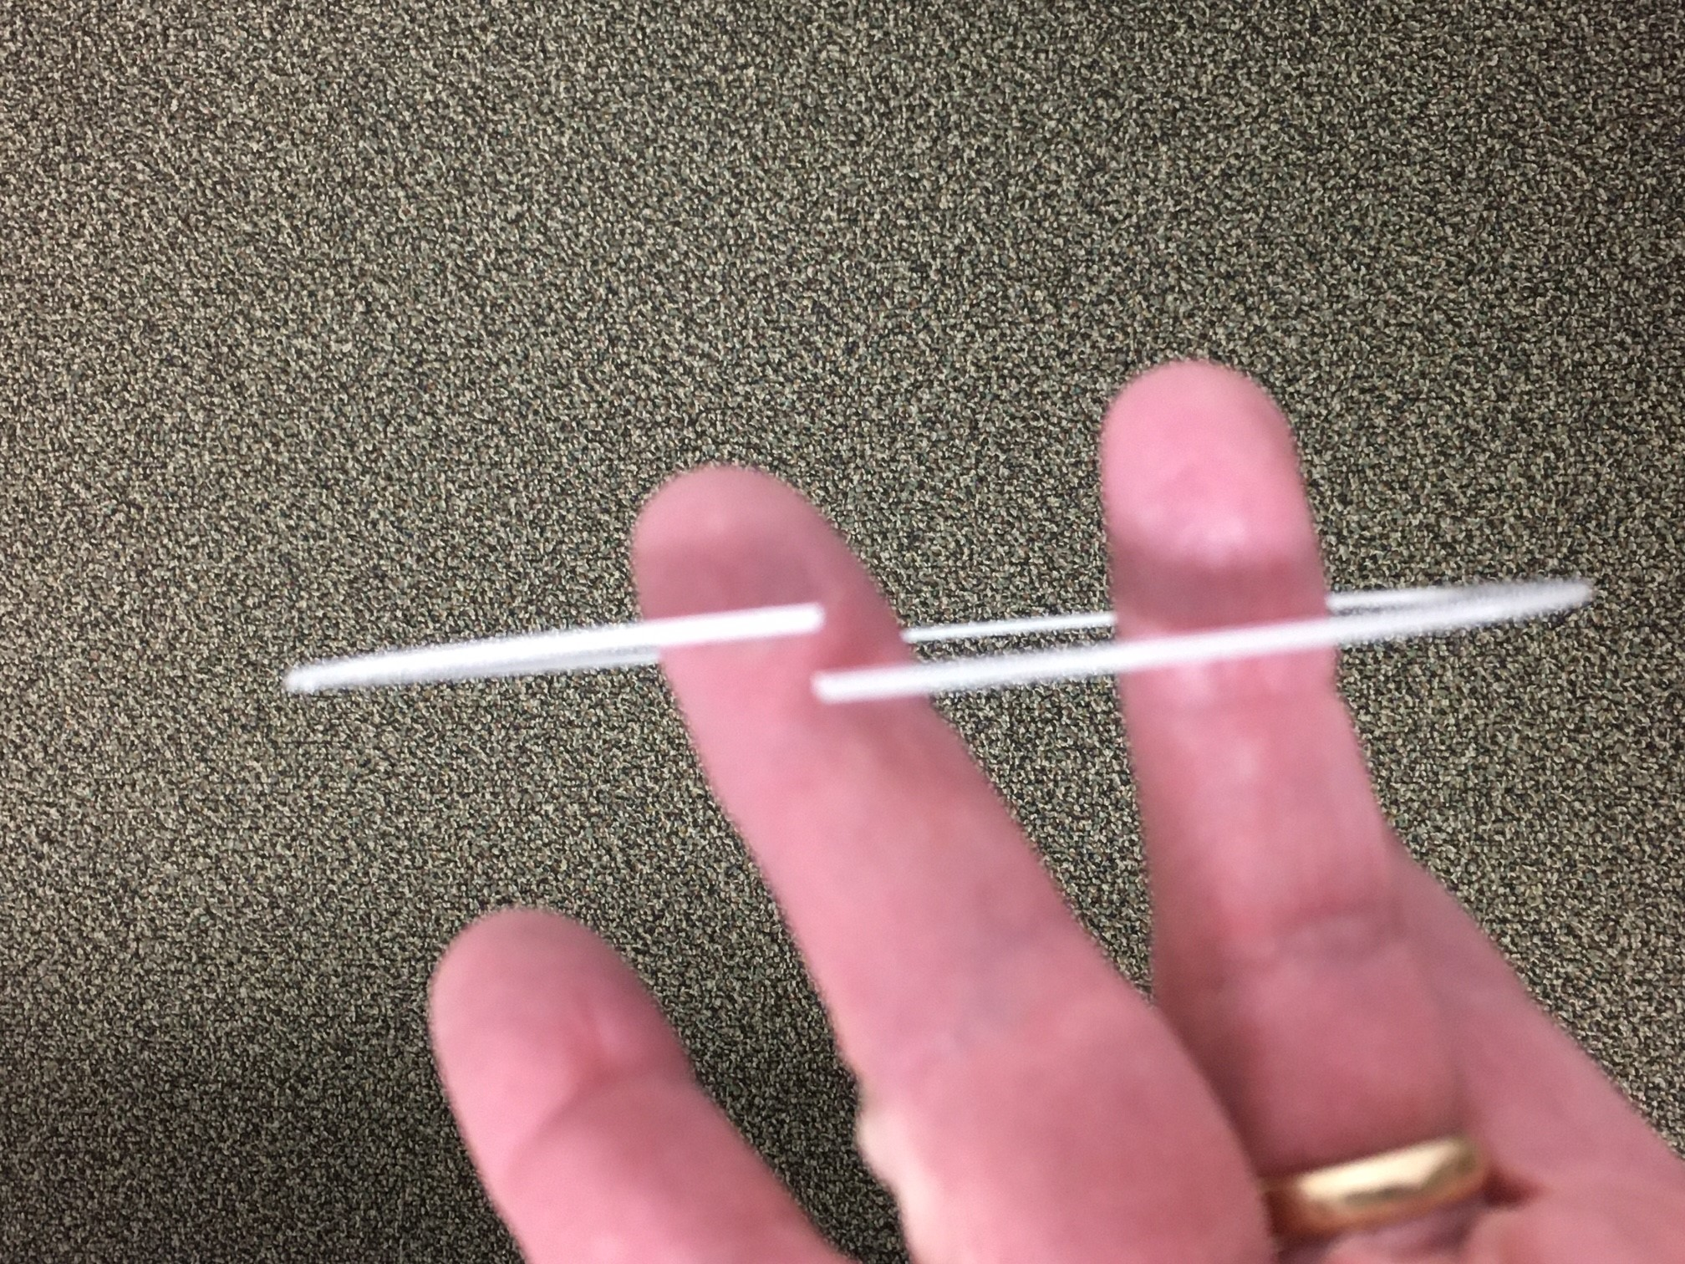
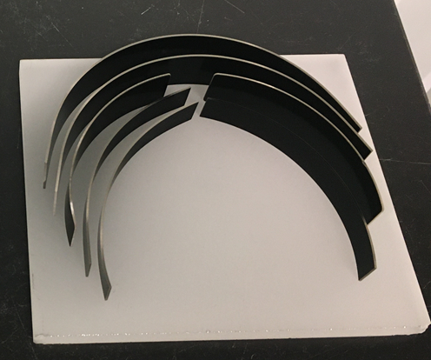
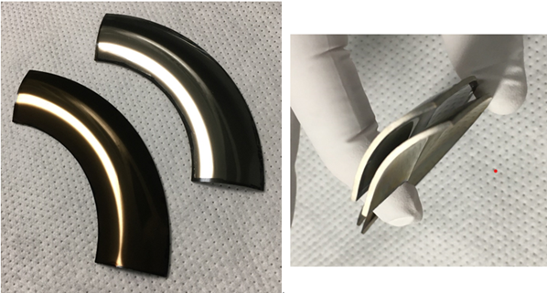
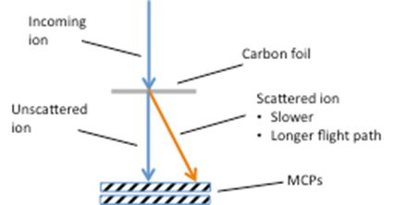
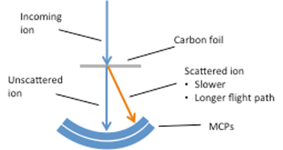
ALD/Glass Substrate MCPs
Aluminosilicate glass is mechanically strong, but somewhat flexible.
  This enables large area MCPs with low brittleness.
  203 mm square are the largest in production but larger areas are possible.
Microchannel diameters: 20, 10 and in development: 6 um.
Glass substrates can be bent to the shape required by the physical measurement, then coated with ALD layers to form MCPs.
  See example at right – toroidal MCP to equalize flight paths for ions in a TOF measurement.
MCP-PMTs need not be flat!

Slide 6
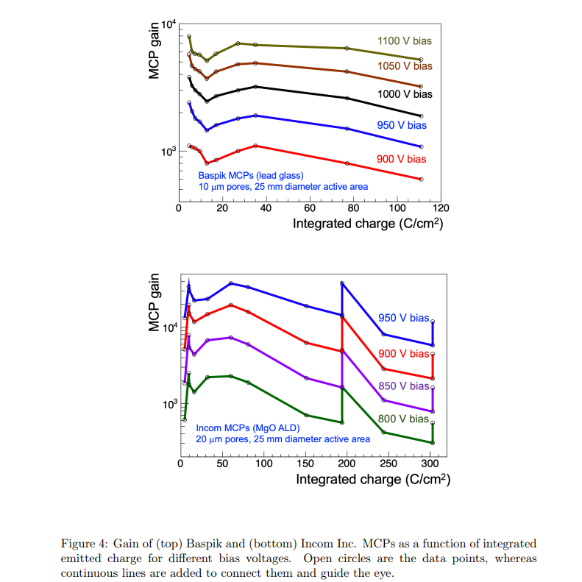
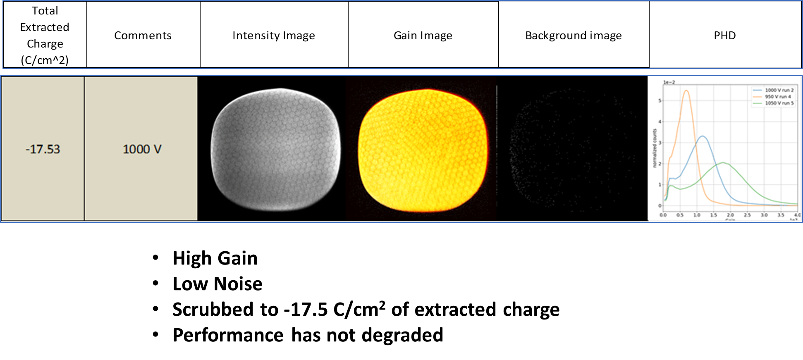
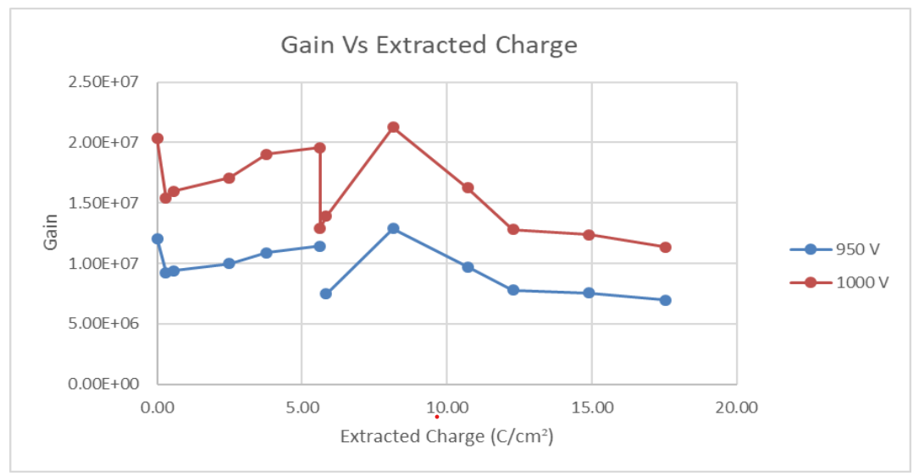
ALD/Glass Substrate MCPs: Lifetime
“Measurement of MCP ageing at large emitted charge”, Marco Angelucci, subm NIMA 2023
Baspik lead oxide
Aluminosilicate “C14” MCPs exhibit good lifetime without alkali migration issues
Life testing of Incom 20 um C14 MCPs went to 300 C/cm² with a gain reduction to 10% of original value (Vagnoni et al.).
At 300 C/cm², gain is recoverable with a ~100 volt increase in MCP voltage.
Restart charge extraction in 1E-6 torr vacuum
Incom Aluminosilicate + ALD
C14 glass, Chem 1 Resistive layer, MgO SEE layer

Slide 7
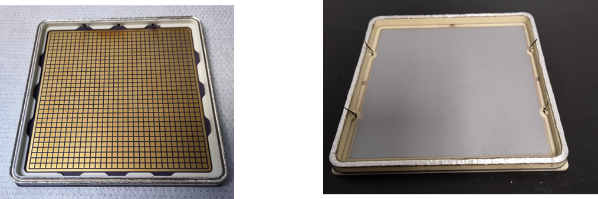
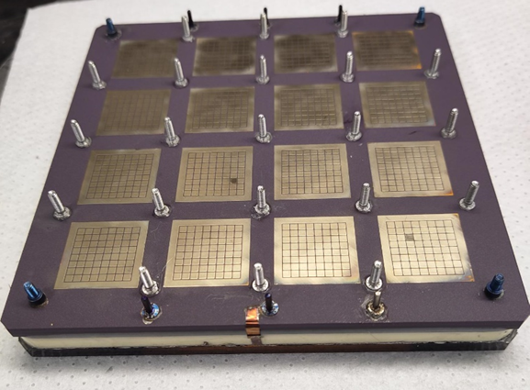
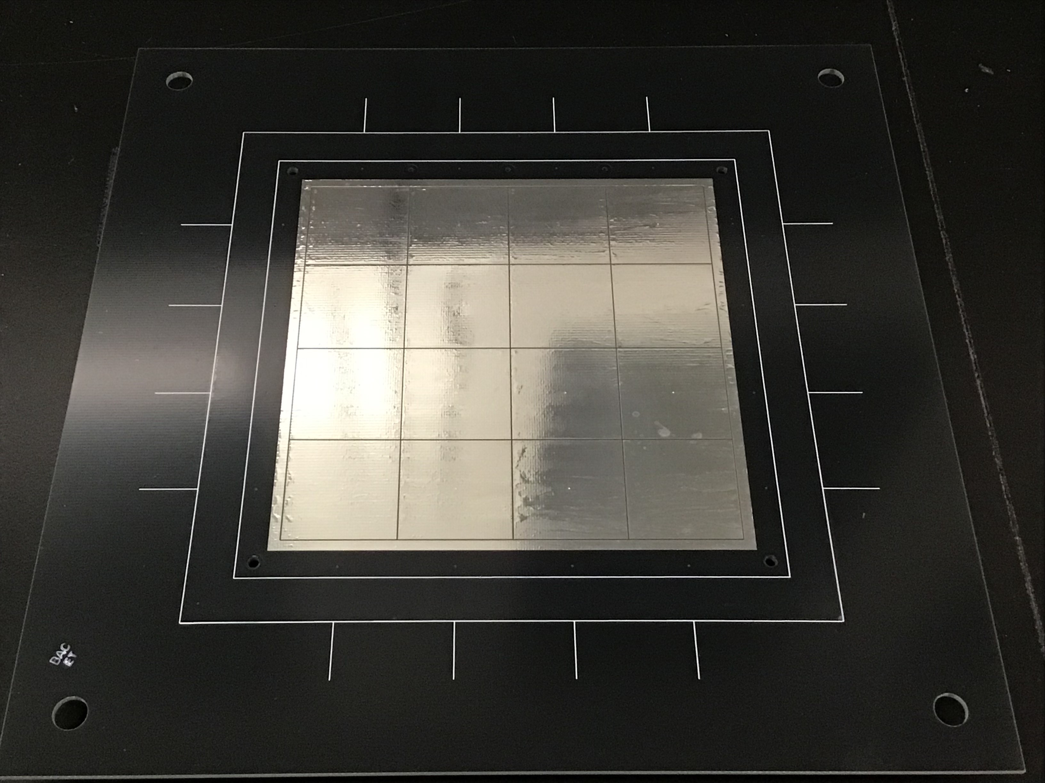
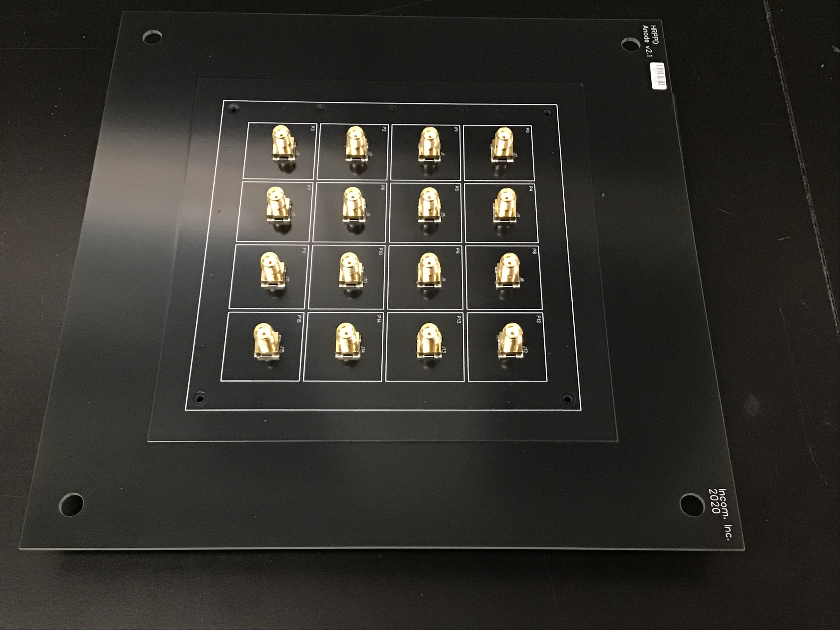
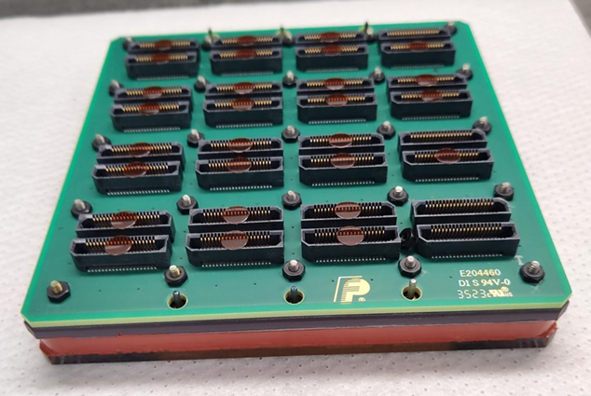
Components: Anode
DC-coupled, co-fired, ceramic anode
Resistive anode for capacitive coupling
Inside
Inside
Anodes are either:
Capacitively-coupled with a resistive surface inside
  Resistance may be 20-100 kohms/square
  MCP signal footprint is partly defined by: MCP to anode gap and voltage, and anode thickness
  Signal board pixel pattern may be changed by customer.
  Readout is flexible
  Various pixel sizes possible on one board
DC-coupled with the “co-fired” ceramic process
  10-15 layers of ceramic and metal foil, vacuum-tight
  Multi-layer structure permits signal routing to:
    preserve 50 ohm impedance and
    gathering of signals to dense connectors.
    Ceramic anode is similar to a multilayer signal board.
  Overall size limit is ~10 cm square.
  32x32 3 mm pixel pattern
  Inside pixel pattern routed outside to 8x8 patterns compatible with interposers and a signal board with Samtec dense connectors…or a signal board with asics for signal processing.
Outside
Outside signal board

Slide 8
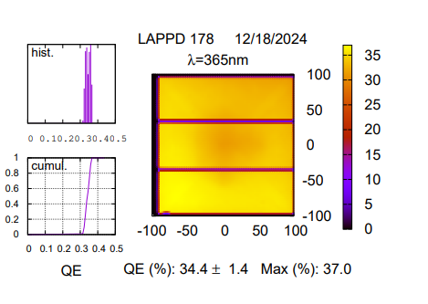
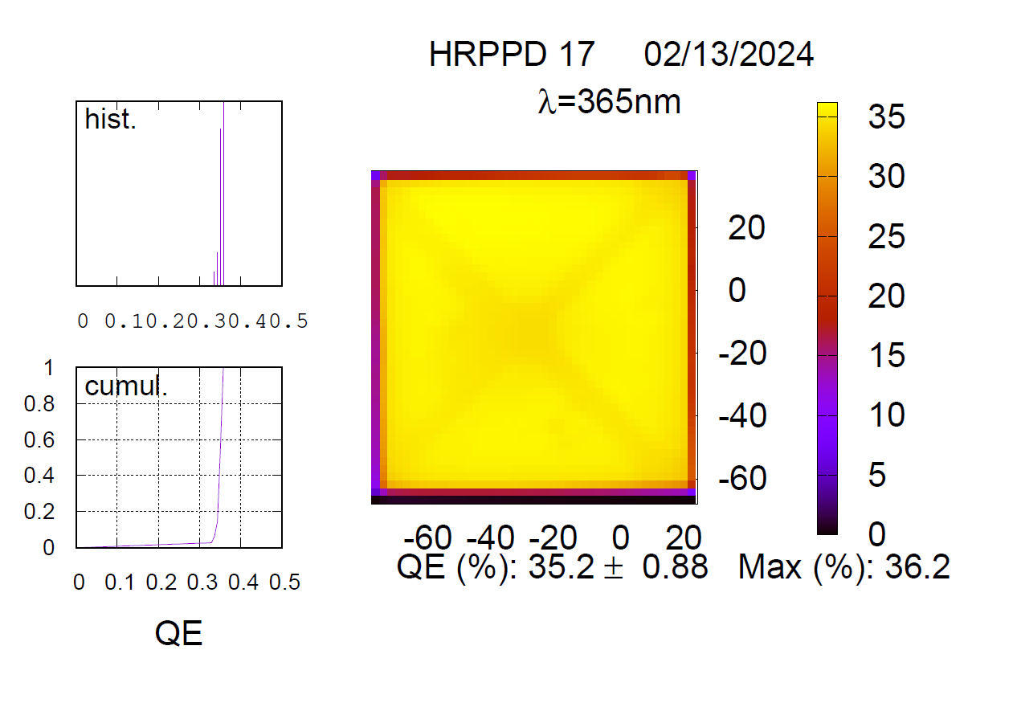
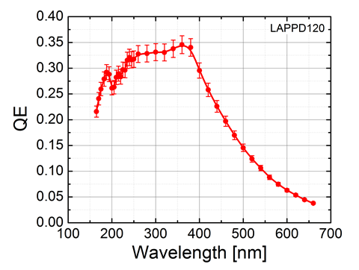
Performance: Quantum Efficiency
20 cm square window
10 cm square window
Quantum efficiency is ~30% at 365 nm.
Spatial uniformity is good, ~2% or less variation across a 10 cm or 20 cm square window.
Similar spatial uniformity for the LAPPD.
QE response peaks at 365 nm, then declines into the green region.

Slide 9
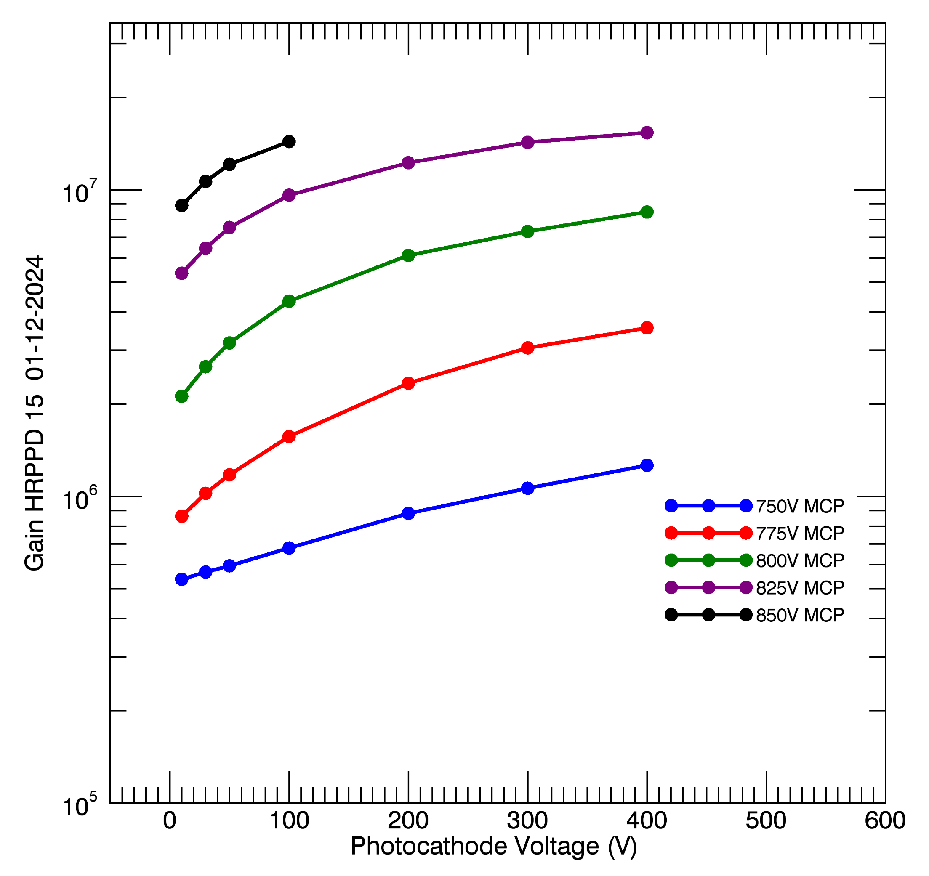
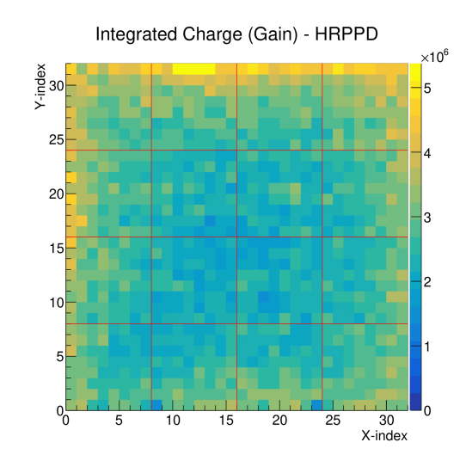
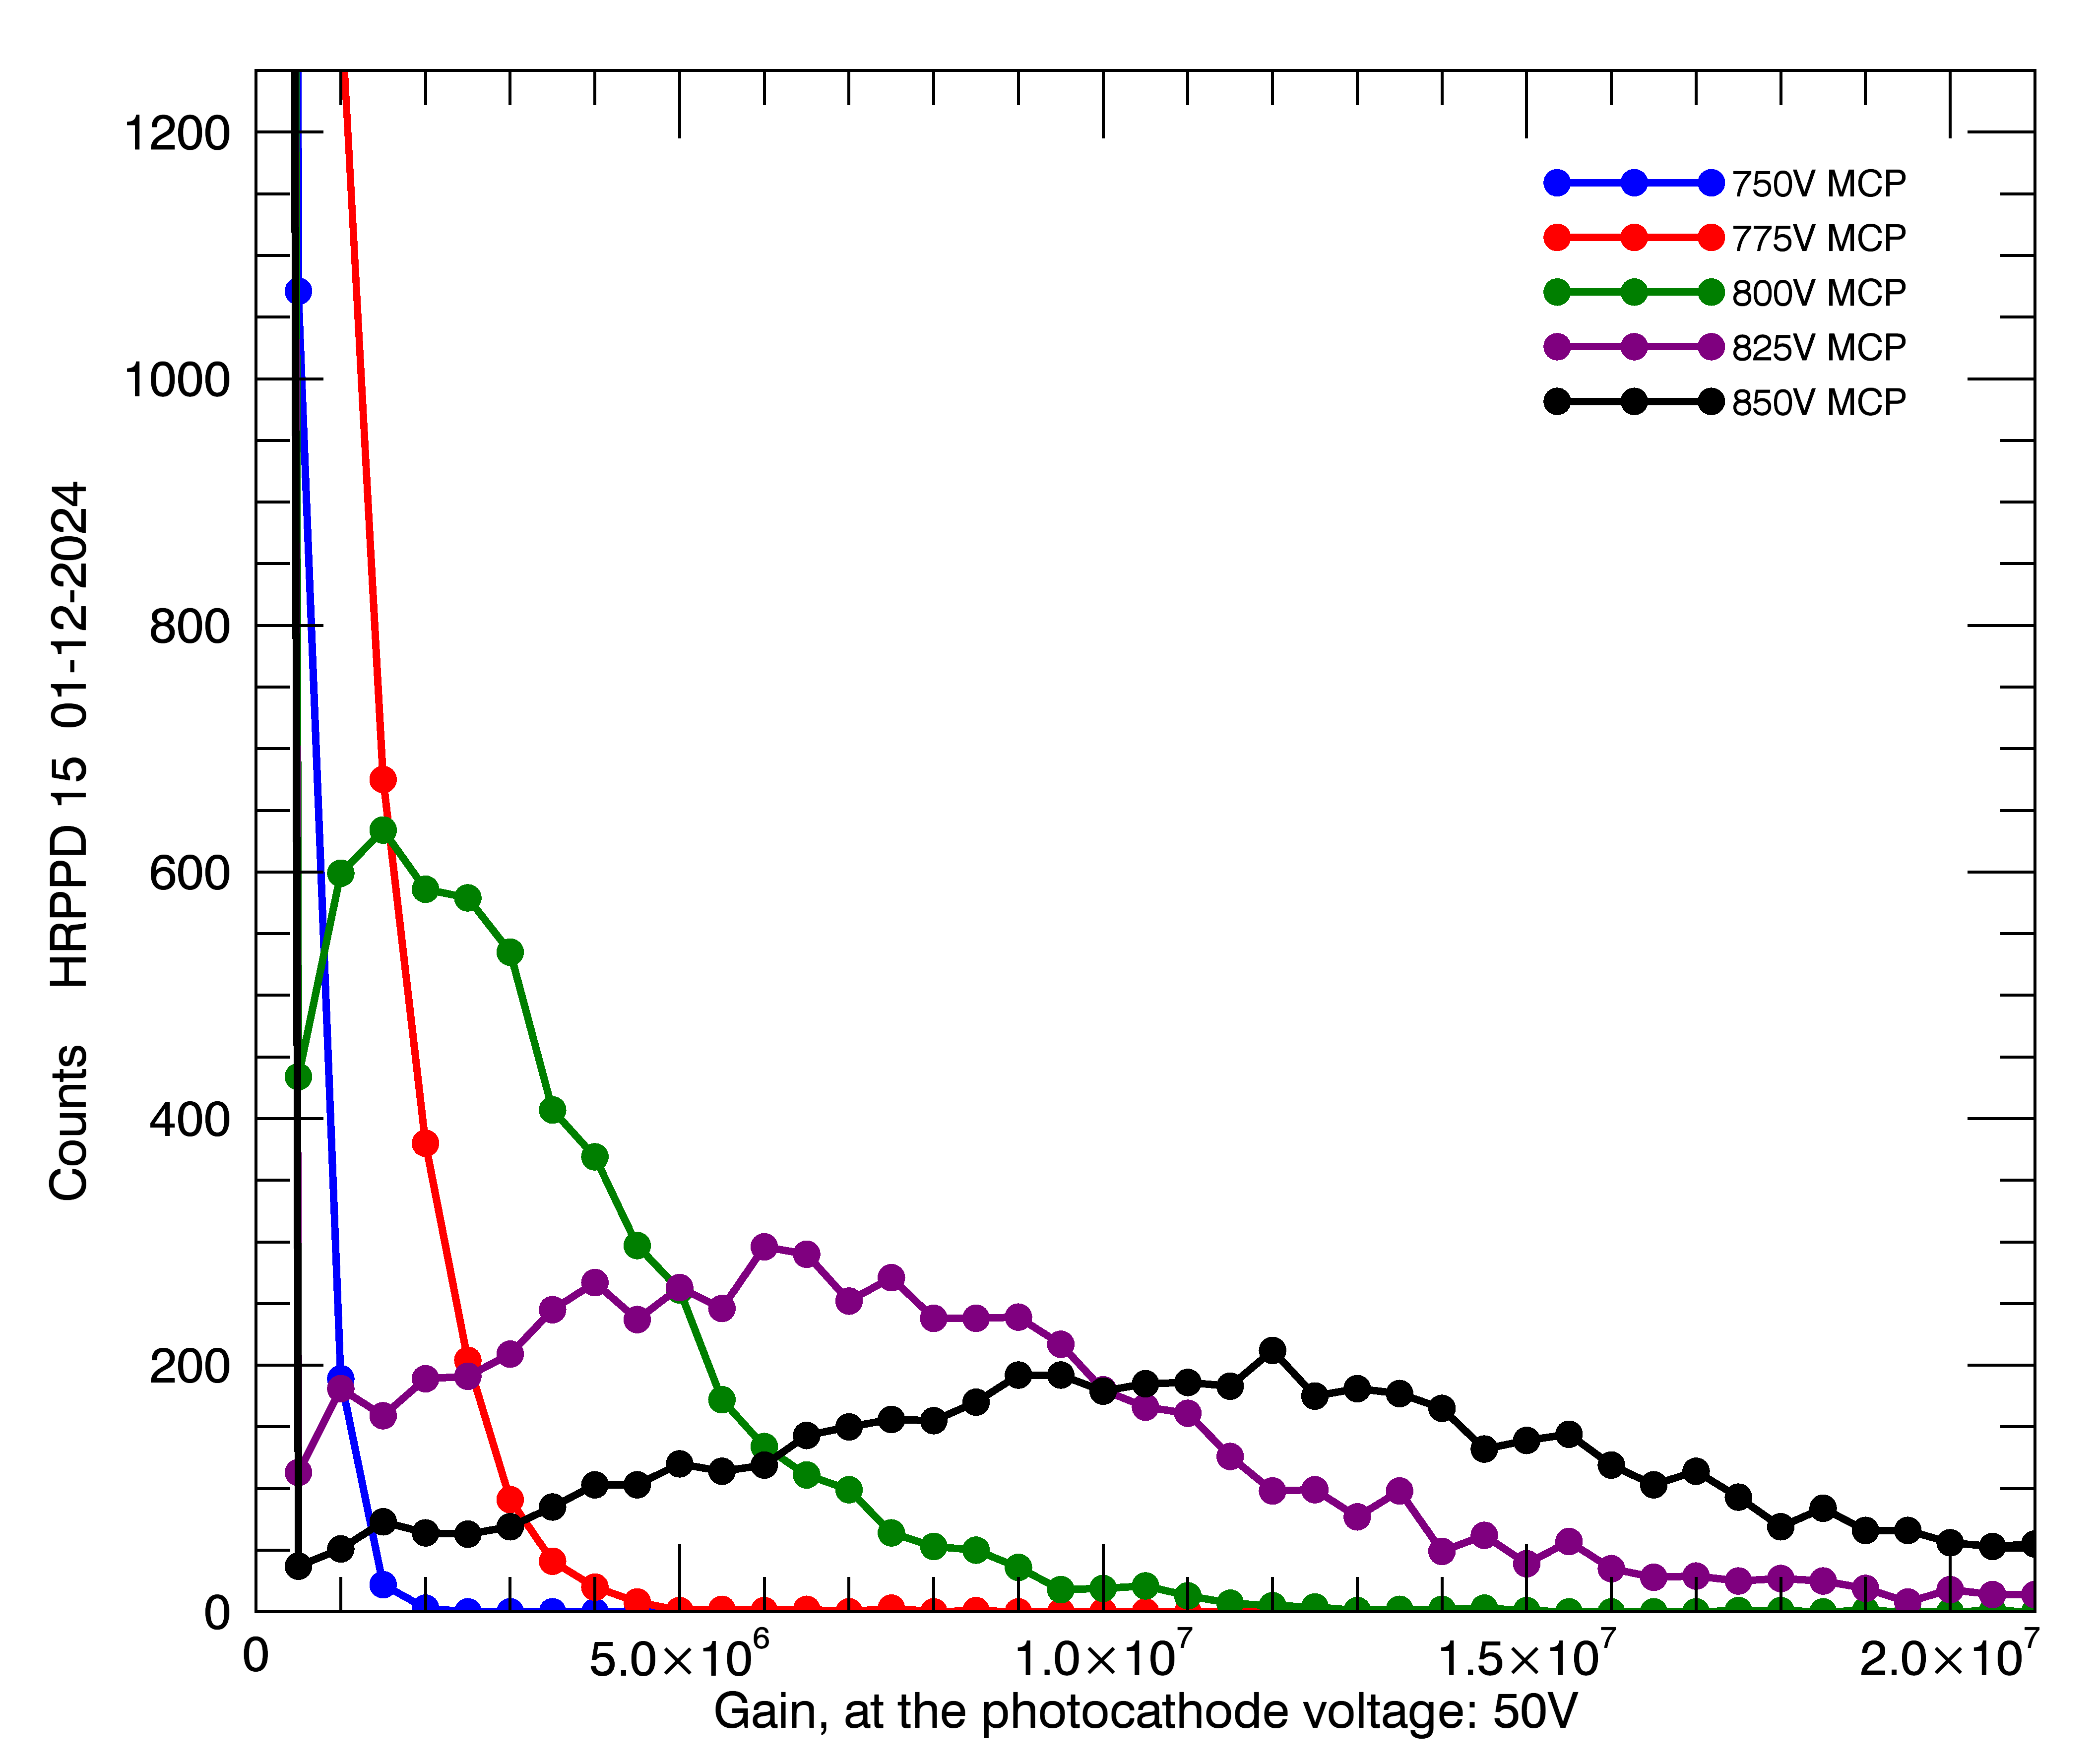
Performance: Gain
Gain can go as high as 8E6.
The combination of the Chem5 resistive layer and MgO emissive layer produces an unusually high gain in a sealed device.
MCPs may be operated at lower voltages:
  lower power dissipation and lower afterpulse rate.
High gain may be used as needed for:
  Operation in a strong magnetic field
  Driving long signal cables to remote electronics
HRPPD 16
2025, A. Kiselev, B. Azmoun, Y. Jin, B. Page, M. Purschke, S. Stoll, C. Woody – Brookhaven National Laboratory, USA;
Preliminary result.

Slide 10
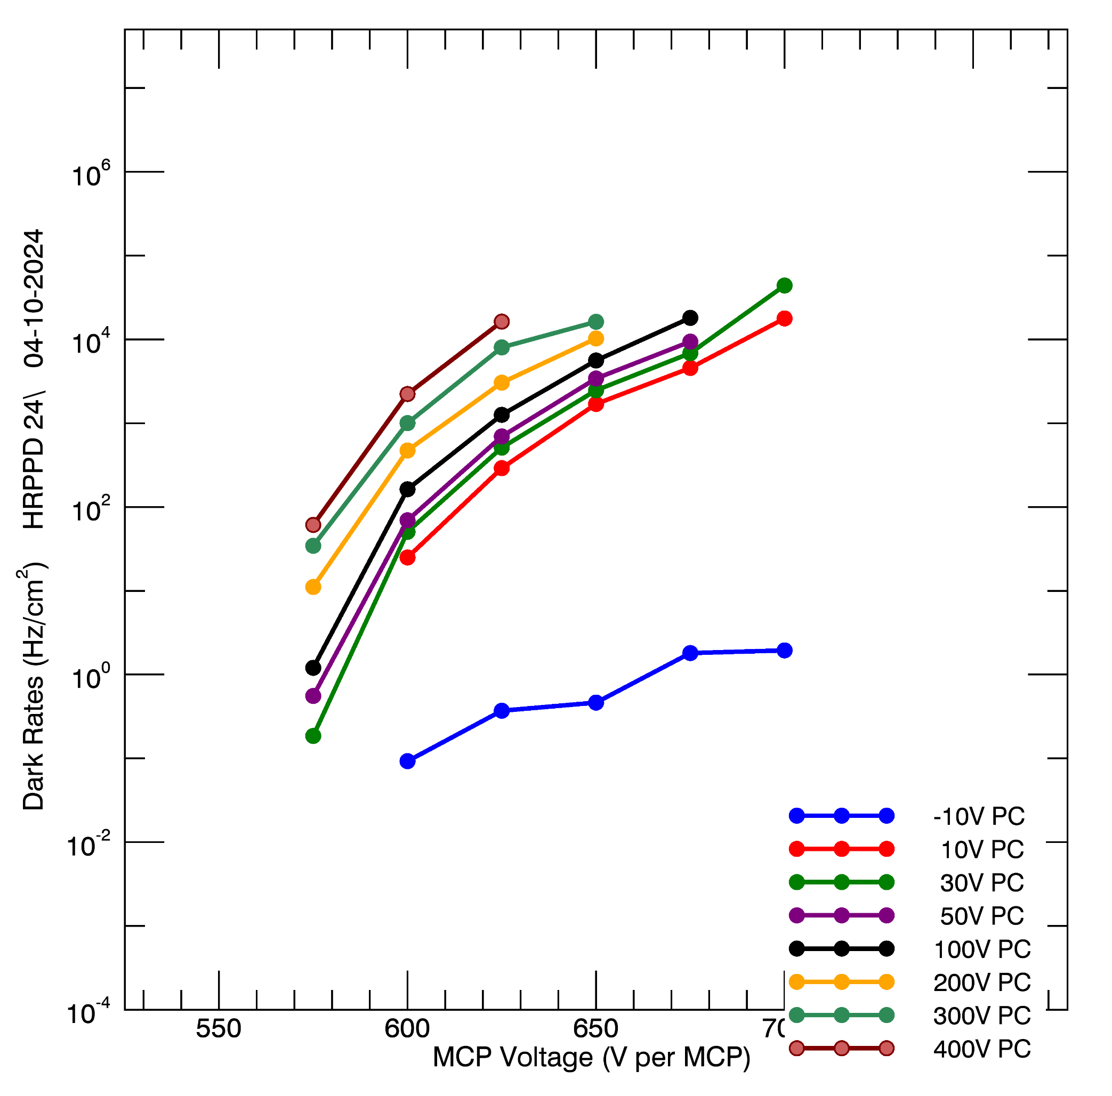
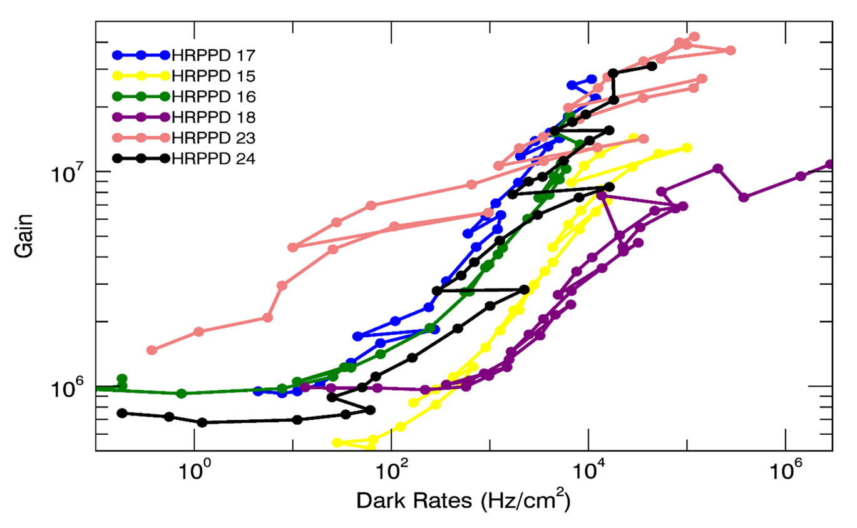
Performance: Dark Rates
Photocathode dark rates are much higher than the MCP dark rates.
Gain vs. dark rates shown at right for several HRPPD MCP-PMTs.
Dark rates at a gain of 5E6:
  50 – 10,000 Hz/cm².
MCP only

Slide 11
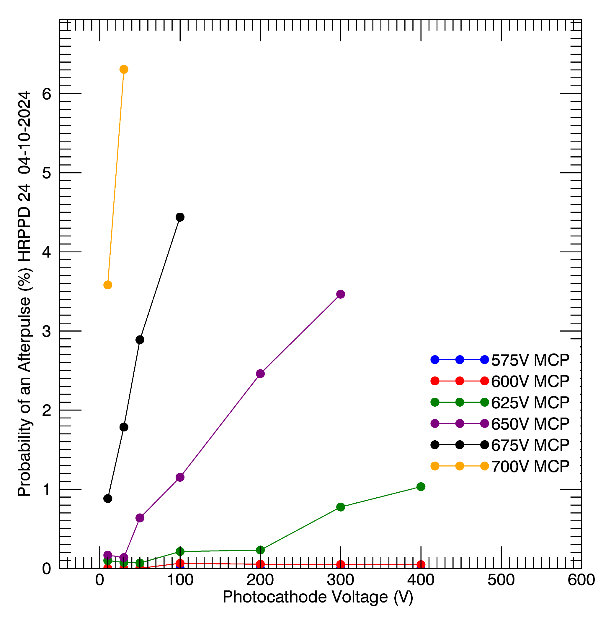
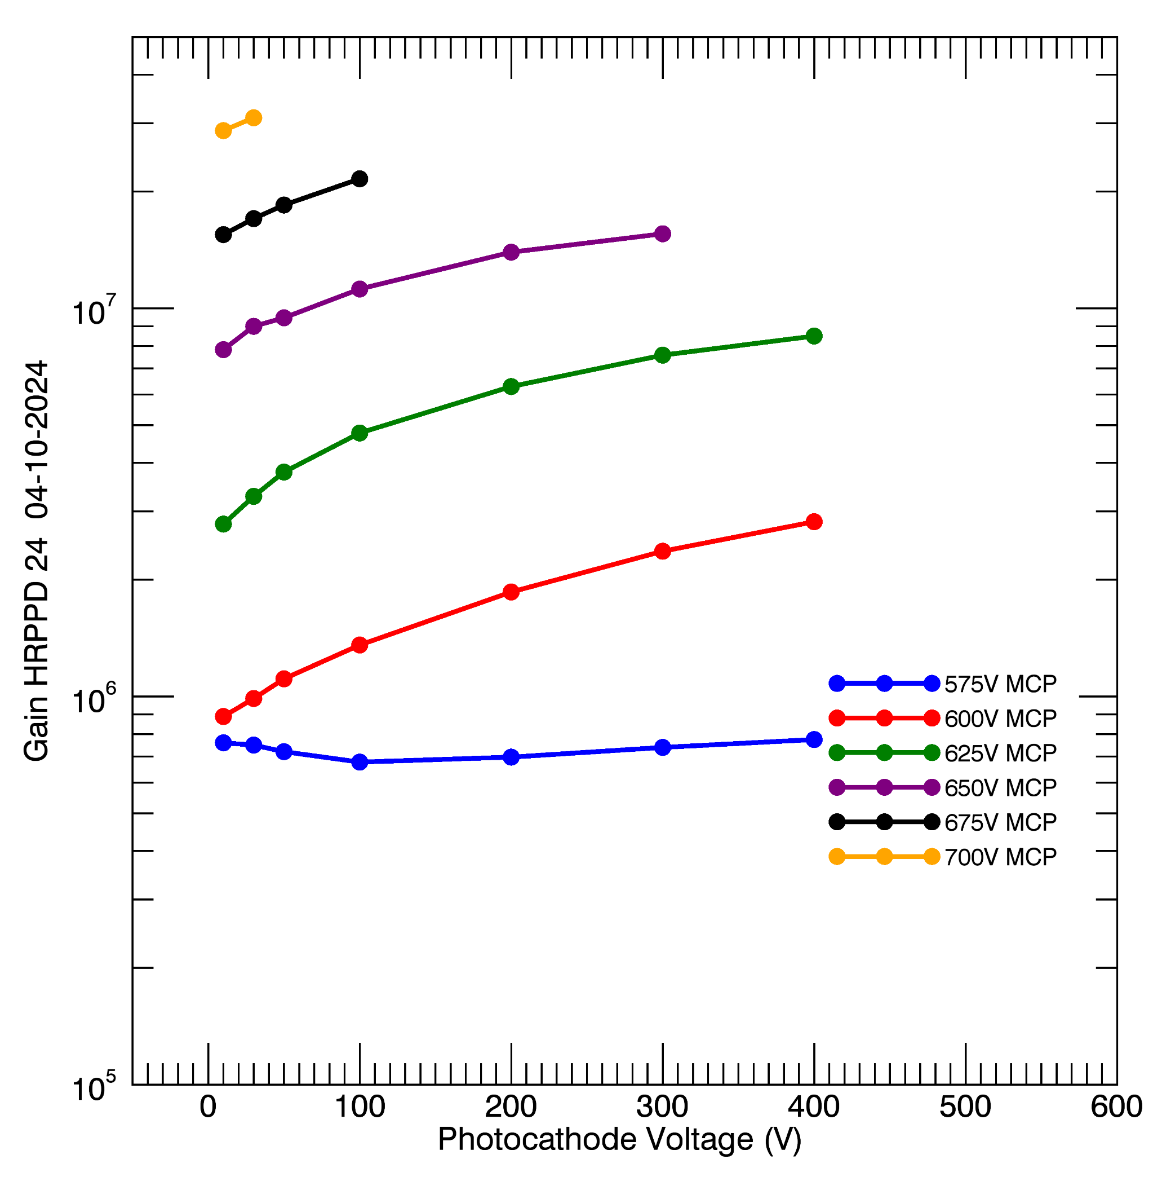
Performance: Afterpulses
700 V/MCP
Afterpulse rates have been reduced by:
  Improved bakeout and scrubbing technique
  Lower operational voltages with the combination of Chem5 and MgO
Afterpulse probability at 625 V/MCP and 400 V to the photocathode are ~1%
Efforts are underway to further reduce these rates for extended photoc
625 V/MCP

Slide 12
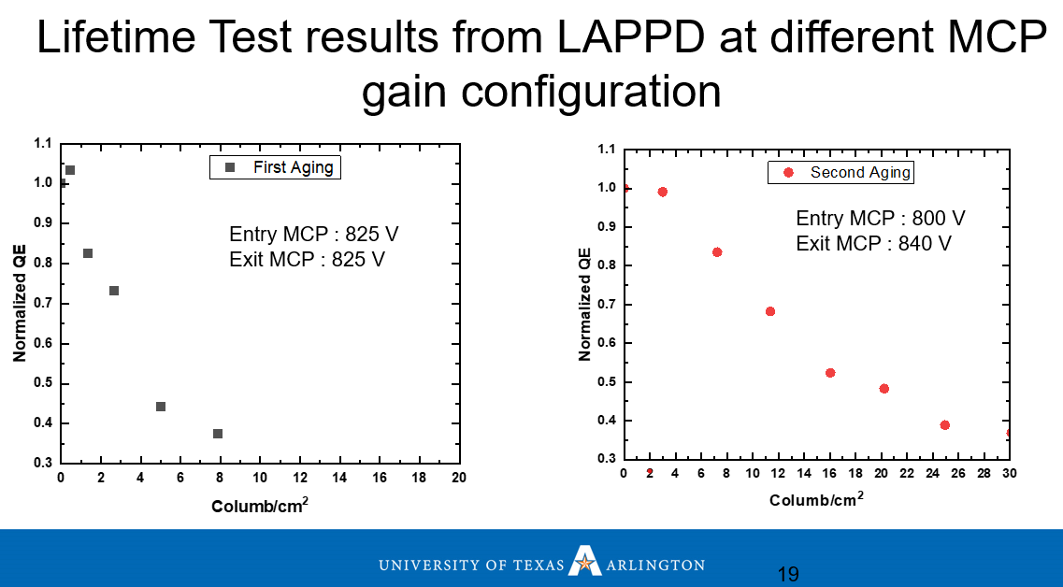
Performance: Use of Unbalanced MCP Voltages to Extend Photocathode Life
Tzoka, et al. 2023 performed a lifetest on two regions of an LAPPD with a high afterpulse rate.
They demonstrated longer photocathode lifetime when the MCP near the photocathode was operated at a lower voltage than the other MCP.
External connections to all surfaces in the LAPPD and HRPPD permit differential MCP voltage operation for longer photocathode life.
I. Tzoka,V. A. Chirayath, L. Moore, J. Asaadi, A. Brandt
UT Arlington
2023 CPAD

Slide 13
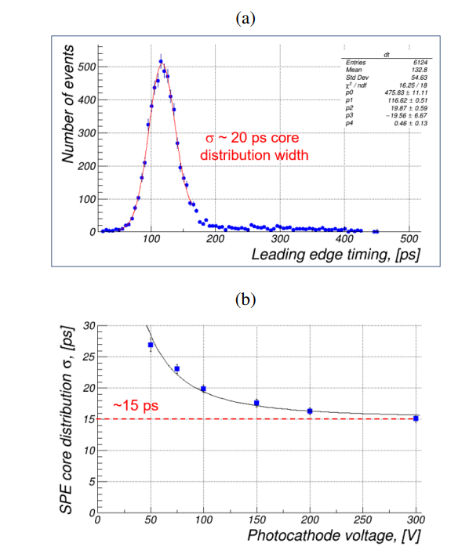
Performance: Time Resolution
Time resolution was measured for an HRPPD by A. Kiselev et al. Brookhaven National Laboratory, USA.
10 um microchannels
Timing was measured with a fast oscilloscope (Tektronix MSO66B scope (50 GS/s, 8 GHz) and a femtosecond laser.
A time resolution of ~15 ps was measured at 775 V/MCP and 300 V to the photocathode.
775 V/MCP, 100 V to photocathode
775 V/MCP, various voltages to the photocathode
Kiselev, B. Azmoun, Y. Jin, B. Page, M. Purschke, S. Stoll & C. Woody – Brookhaven National Laboratory, USA;
VCI 2025 meeting.

Slide 14
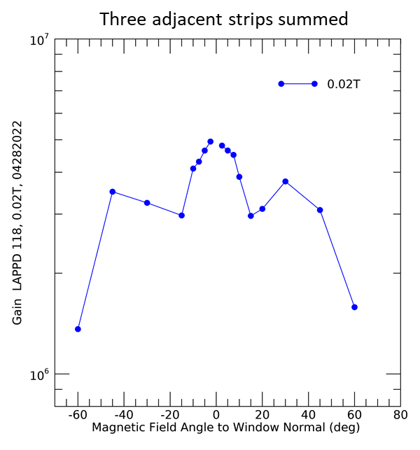
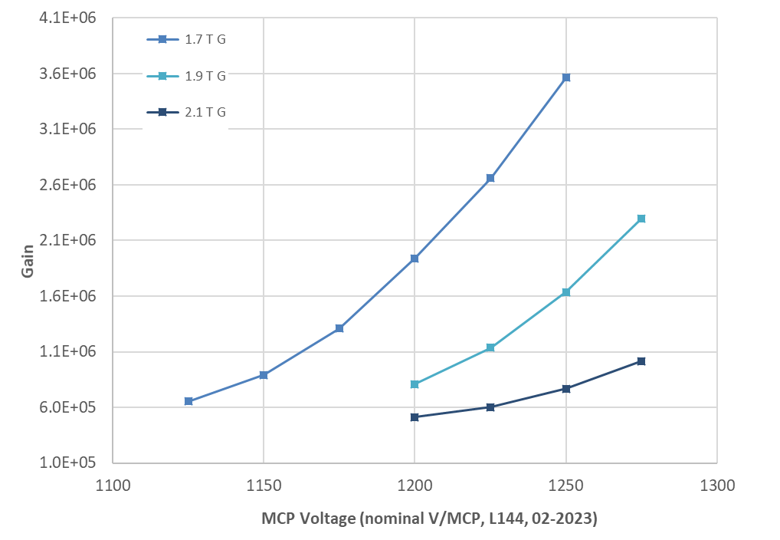
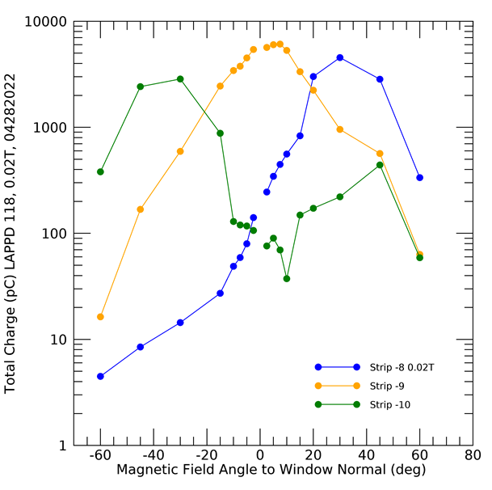
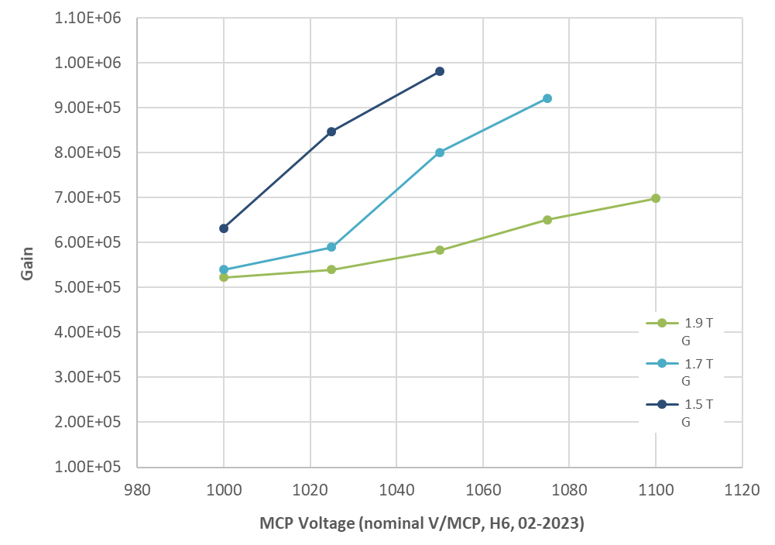
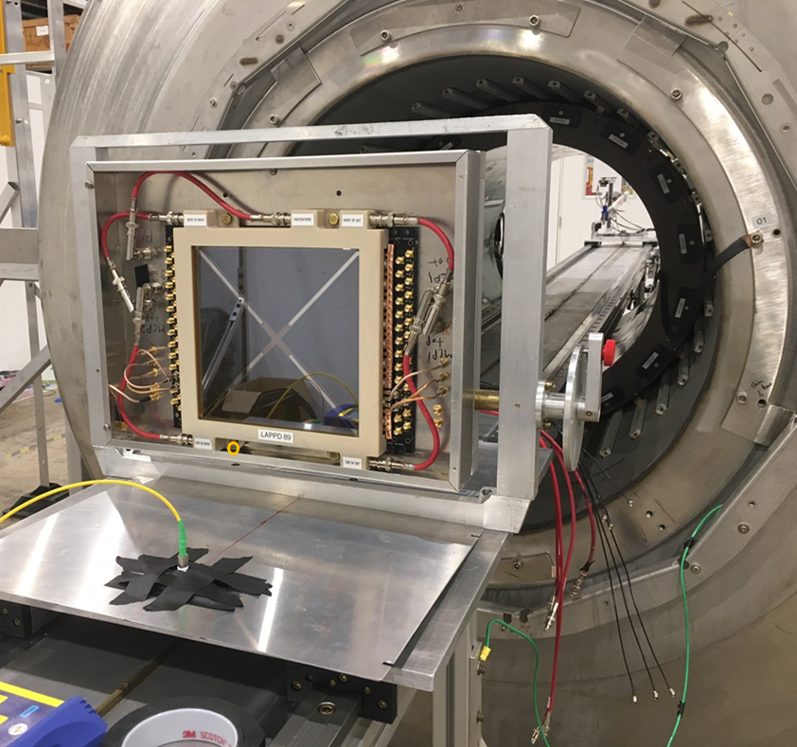
Performance: Magnetic Field
Stripline LAPPD 118
20 um LAPPD 144
In a ~1T magnetic field perpendicular to the MCP-PMT window, gain can be recovered by increasing the MCP voltage.
The HRPPD used here was one of the first made. HRPPDs made later have superior high voltage stability and gain performance.
Gain decreases when the field is not perpendicular to the window.
1.7 T
1.9 T
1.0 E6
2.1 T
10 um HRPPD 6
1.5 T
1.0 E6
1.7 T
1.9 T

Slide 15
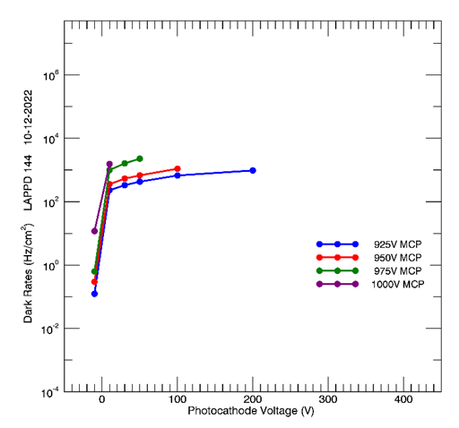
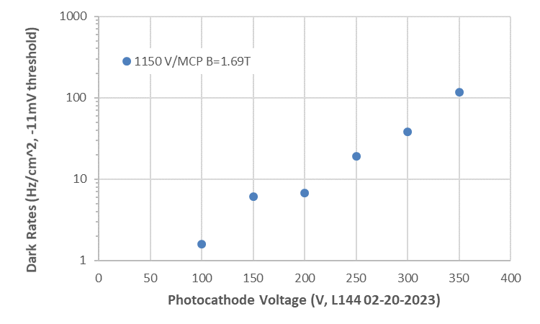
Magnetic Field: Dark Rates vs. Photocathode Voltage
Dark rates increased with photocathode voltage.
Rates are lower at 1.69 T than at the Earth’s field.
Is the magnetic field reducing the emission from the photocathode more than it reduces the gain?
10³
-11 mV threshold
1.69T
-4 mV threshold
Earth’s B field

Slide 16
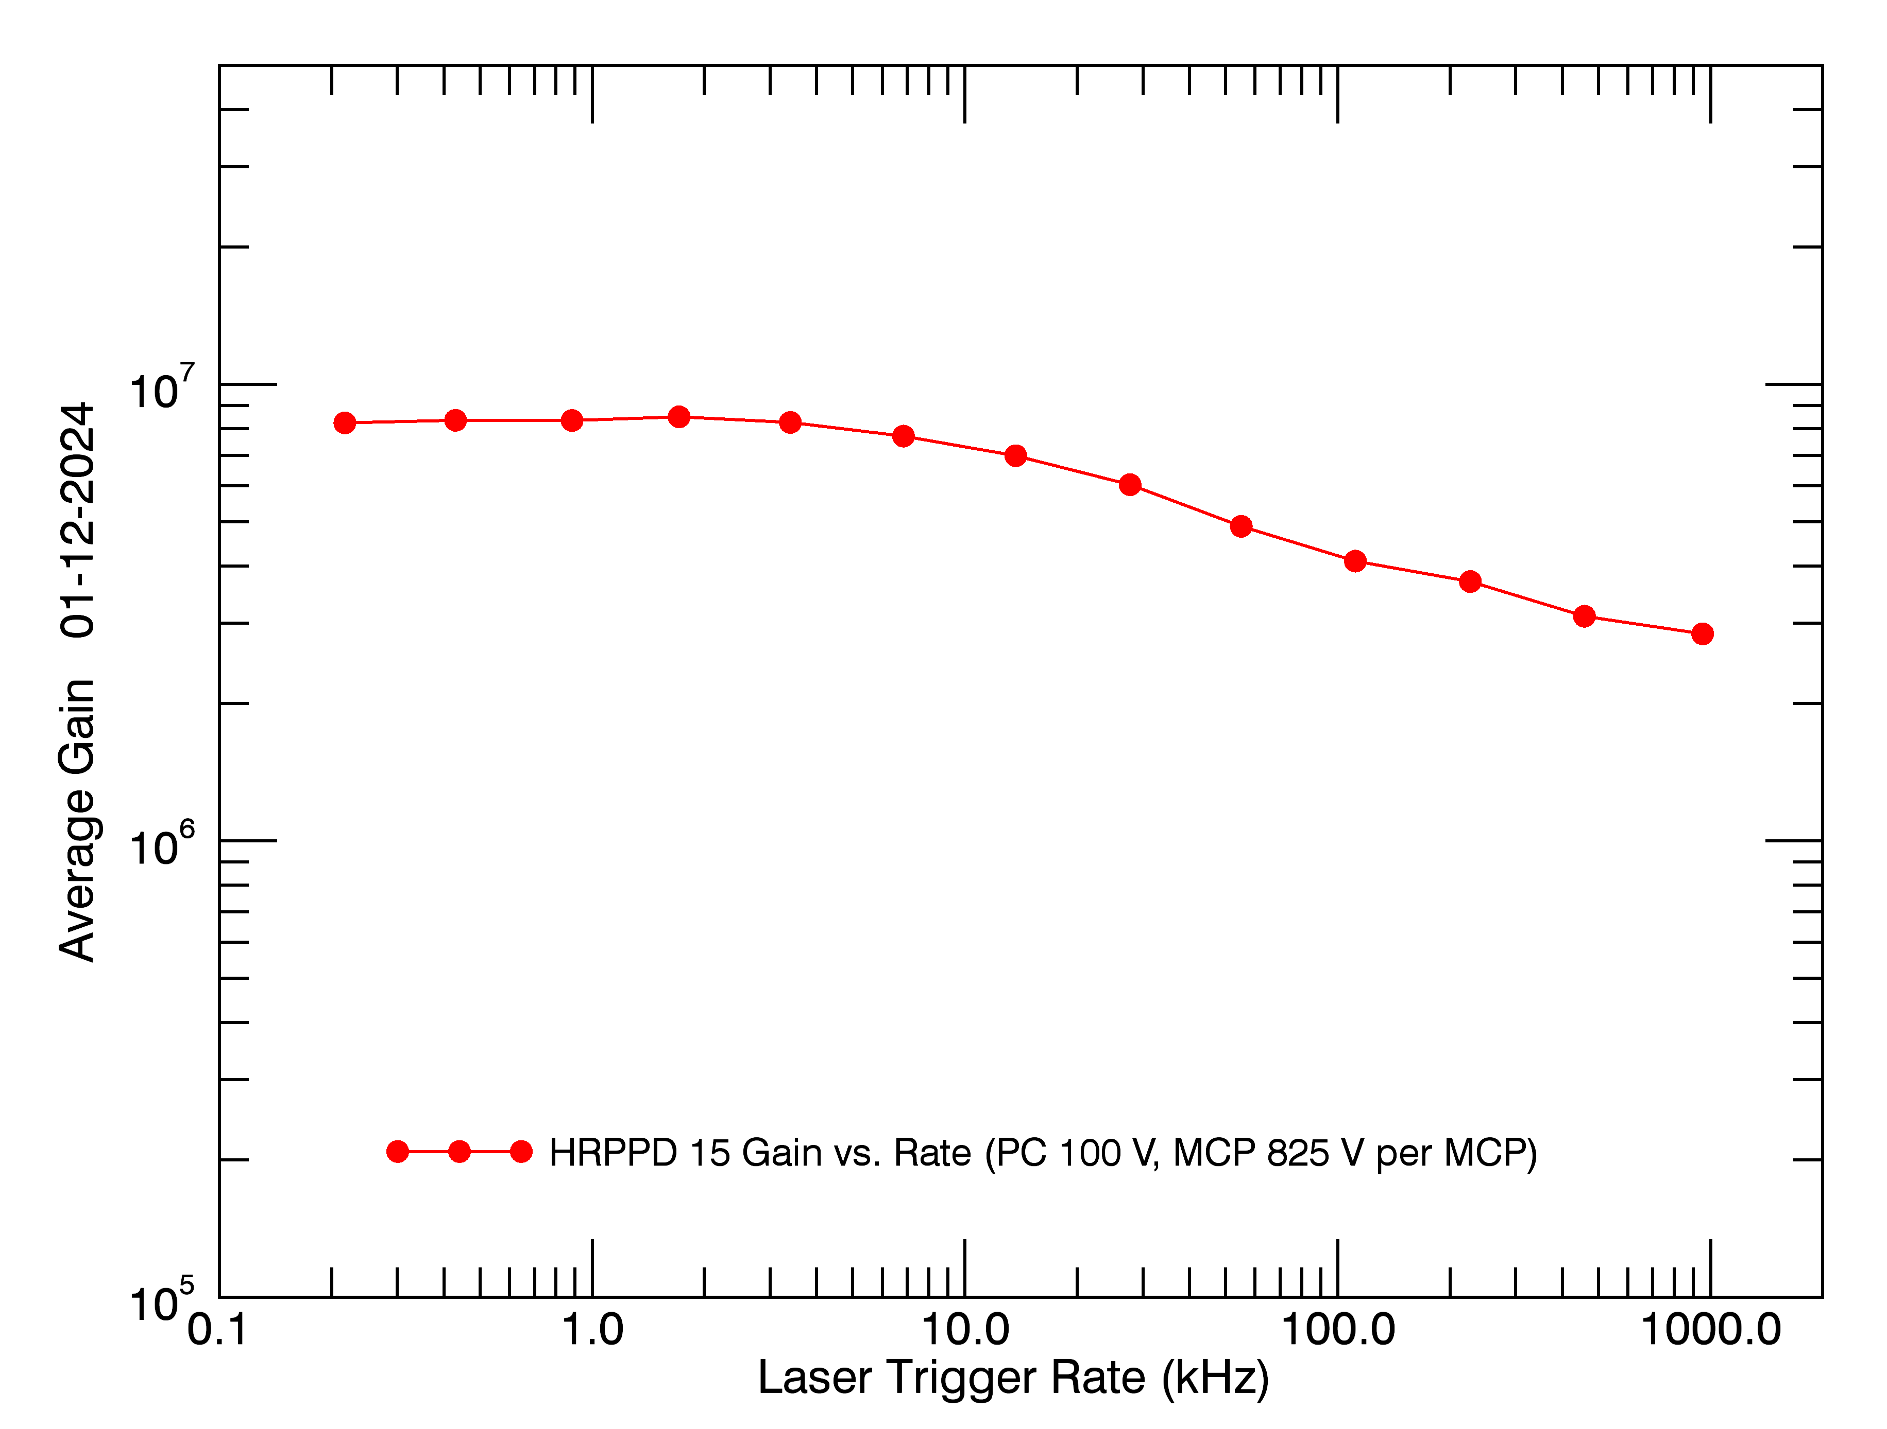
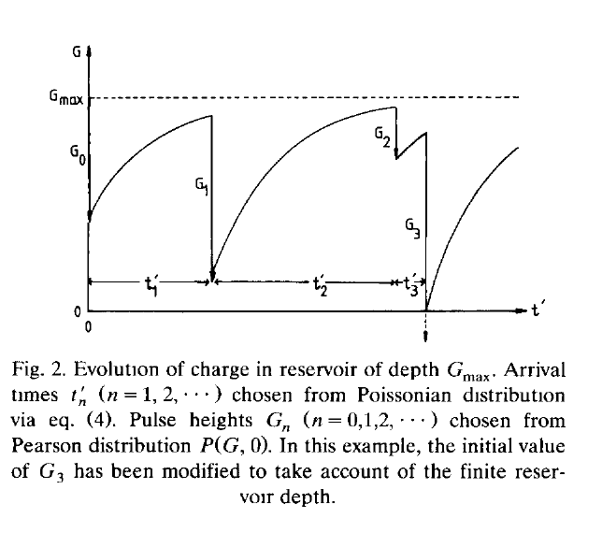
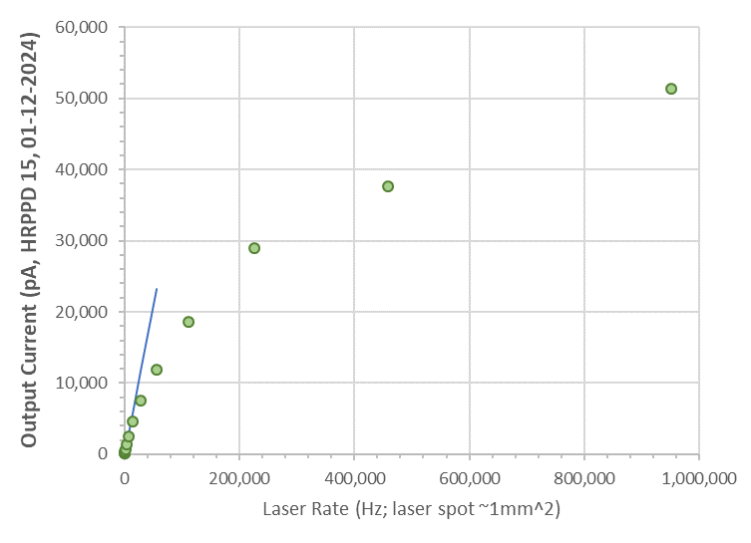
Performance: Rate vs. Gain
At high rates, the MCP gain declines as the microchannels are struck before they can recharge.
This can be mitigated using:
  A low gain
  A low MCP resistance
Gain vs. rate is shown using a laser in the single photoelectron mode, illuminating a spot of 1 mm diameter.
Gain begins to fall off at ~7 kHz/mm²
When the MCP pulses are interpreted as anode current, the linear regime extends up to a laser rate of ~6.8 kHz/mm².
Fraser, et al., 1992

Slide 17
Limitations for MCP-PMTs
High rate response
  Microchannels need time to recharge, ~10-15 ms per channel
  Use small diameter channels to reduce the probability of hitting the same microchannel twice before recharge.
  Use low resistance MCPs
Thermal coefficient of resistance
  MCP resistance decreases with increasing temperature
  Plan for thermal conditions in operation, choose room temperature resistance to obtain desired resistance in use.
Lateral light spreading in window
  Light spreading could reduce position resolution
  Use a thin window.
  Thickness is governed by window material, restrictions on unsupported window area
Timing tails visible with single photoelectron timing distributions
  Tails are created when photoelectrons strike interstitial spaces between microchannels.
  Tails reduces time resolution
  Tail events for natural, non-laser phenomena may be recognized by lower pulse amplitude (Vagnoni, others)
  Decrease gap between the photocathode and MCP
  Create a funnel shape on the microchannels – possible effect on time resolution
  Trap the photoelectrons striking the interstitial spaces by applying a suitable coating on the MCP entry face.

Slide 18
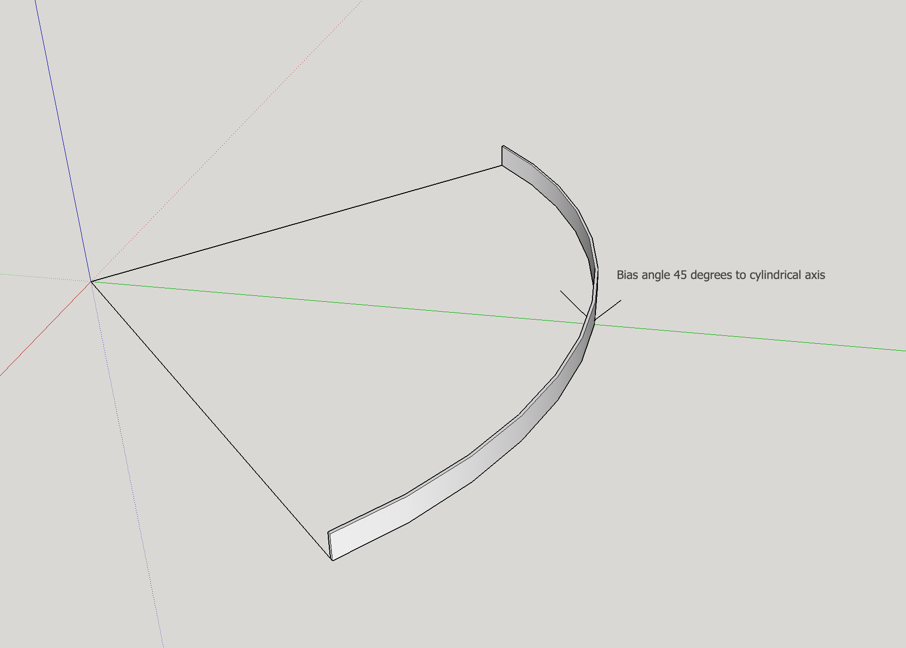
Future developments at Incom
6 um MCPs
Alternative ALD emissive materials:
  Four new candidates are under development at Argonne National Laboratory
Improvements on direct-coupled anodes
  Simulation of pulse propagation through the ceramic co-fired anode is underway at Brookhaven National Laboratory
  Improved high voltage connections on the ceramic anode.
Not yet under development, but in the future:
  Variation of resistance as a function of depth in the microchannel
Large bias angle MCPs for large angle magnetic fields
  Increase the bias angle from 13 deg to a much larger value to better align with the imposed field.
  Increase the operational range of field angles.
Antireflection films on windows to improve QE, internal reflections
Photoelectron traps on interstitial spaces on MCP near photocathode
|B| = 1T

Slide 19
Summary
Internal Structure
  MCPs – glass substrate then ALD films
  Choices of ALD films
  Anodes
Performance
  Gain
  Dark rates
  Timing
  Quantum Efficiency
  Magnetic field behavior: PNNL and possible design modification of MCPs in tilted field
Limitations
  High rate response
  TCR
  Lateral light spreading in window
  Timing tails visible with single photoelectrons
Future developments
  6 um MCPs
  ALD emissive materials
  Improvements on direct-coupled anodes
  Variation of resistance as a function of depth in the microchannel
  Large bias angle MCPs for large angle magnetic fields
  Antireflection films on windows
  Photoelectron traps on interstitial spaces on MCP near photocathode

