Slide 1
Digital SiPM in compendium
Fabrice Retiere for Nicola D‘Ascenzo
Due to emergency situation we have not discussed this content

Slide 2
A rapidly evolving technology
PHILIPS digital Single Photon Counter – pre 2010
  May have been too early for its time. Trigger logic not flexible
Emergence of several academic solutions (non-exhaustive)
  AQUA (EPFL, Lausanne Switzerland), Edinburgh (UK), Sherbrooke (Canada), Heidelberg (Germany)
  Also Hamamatsu made a digital SiPM but work was discontinued
With the availability of PDK for SPAD+CMOS many group are joining
Also, big players have join the fun: SONY and CANON
For compendium:
  discuss evolution of technology + make figure of tech evolution

Slide 3
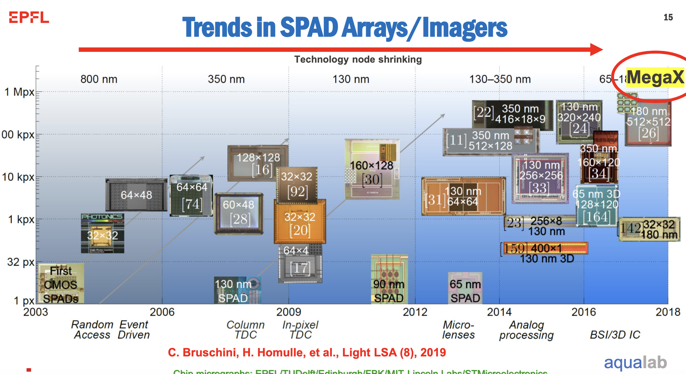

Slide 4
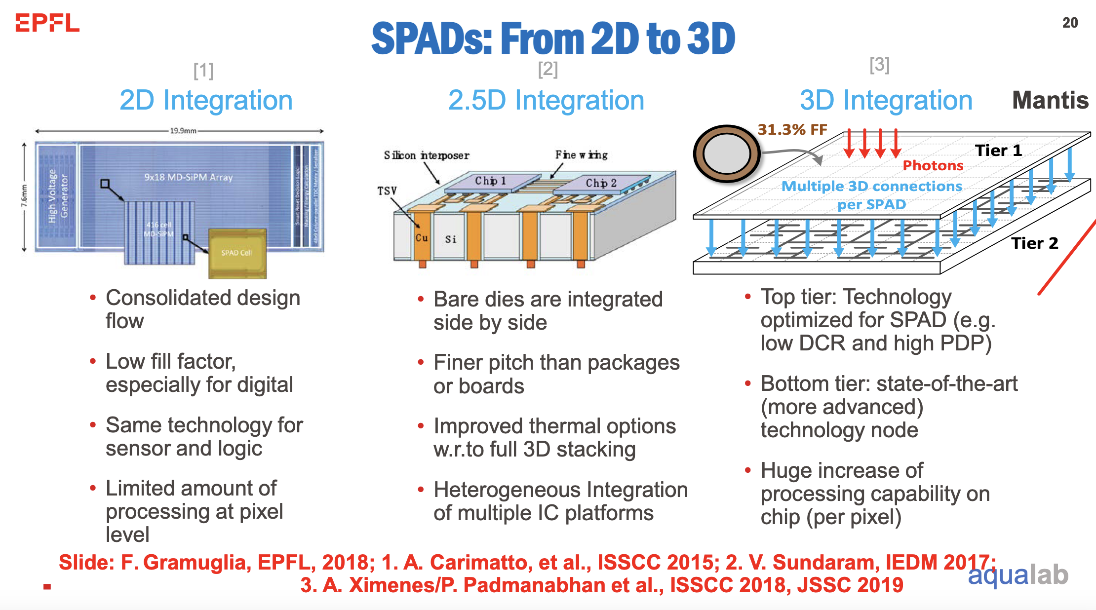
2D to 3D – again from Claudio

Slide 5
Manufacturing capabilities
2D facilities
  Lfoundry, Global foundry, AMS, X-FAB, TSMC, Fraunhofer IMS…
    Would be great to have a comprehensive survey
3D facilities
  Teledyne-DALSA
  Fraunhoffer IMS?
  …

Slide 6
Comparison metric for digital SPAD
Is it different from analog SiPMs?
  Fill factor becomes at the chip level
Some more in-depth studies are possible
  Single SPAD information: PDE, dark noise rate, timing resolution
  DCR distribution for all SPADs is a special
  Dark noise rate vs chip level (including disabled SPAD) efficiency

Slide 7
Electronics architecture
As many as applications, or almost. Some commonalities:
  Quenching circuit
  SPAD enable/disable
  … Anything else?
My proposal is to chose a few applications to explain in details
  High fill factor. Peter Fischer
  350nm solution for astro-particle. Sherbrooke
  Fast timing for PET. EPFL?
  … Your own. Nicola’s?

Slide 8
Making things happen
By the end of April 2025
  Identify leads of section and sub-sections
  Please come to me
By October 2025, next DRD4 collaboration
  Draft of all (ideally) sections/sub-sections
  Identify missing information and organization shortcomings
  Finalize the section organization and setup review process (i.e. at least 1 reviewer per subsection)
Have a publishable draft by the end of 2026
  May hide subsections that are not ready
Finalize document by collaboration meeting one year from now

Slide 9
Thank you

