Slide 1
WordPress at CERN
A next-generation content management system
Web Team
Infrastructure Team version 1.5
last revised 10-APR-2025
Notes:
J

Slide 2
Agenda
Project Development
  What is WordPress?
  Why did we choose WordPress?
  Where are we with development?
CERN Theme
  Vision
  Features
  Limitations
Migration
Validation
Success stories
Notes:
J

Slide 3
Wordpress at CERN
What, Why and Where

Slide 4
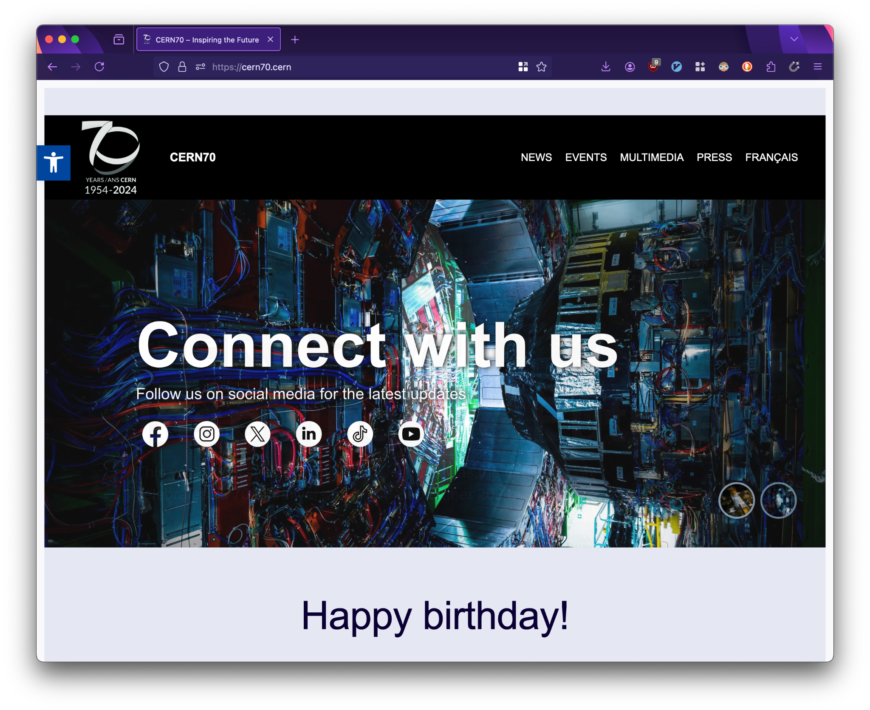
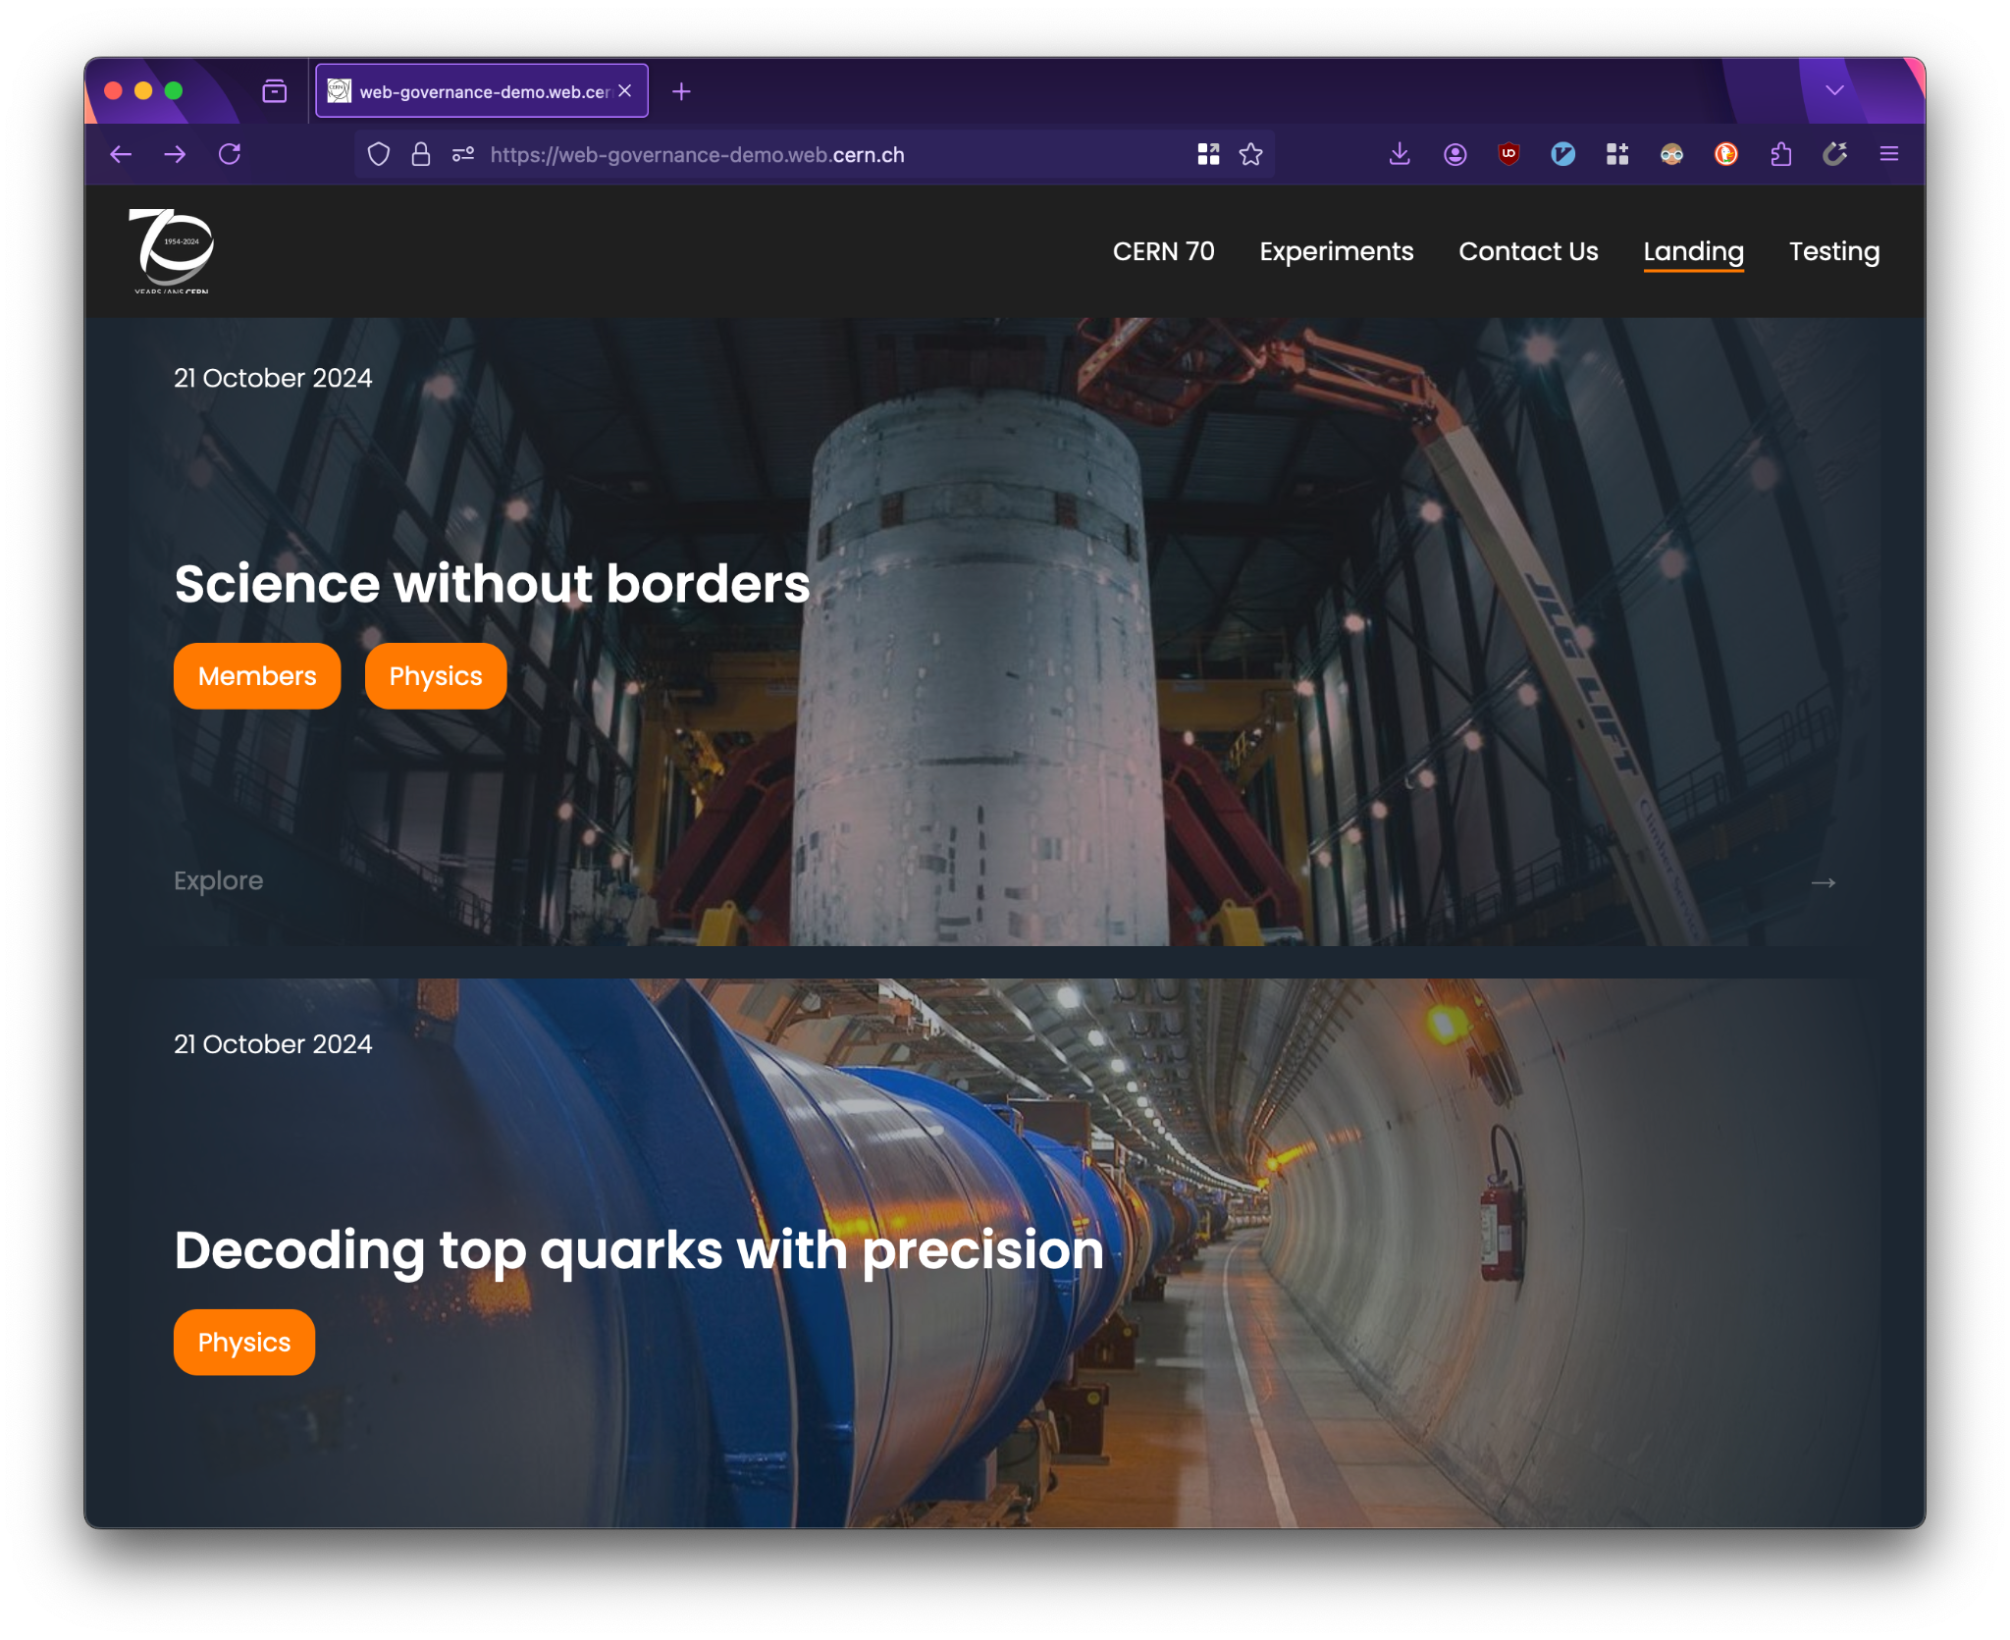
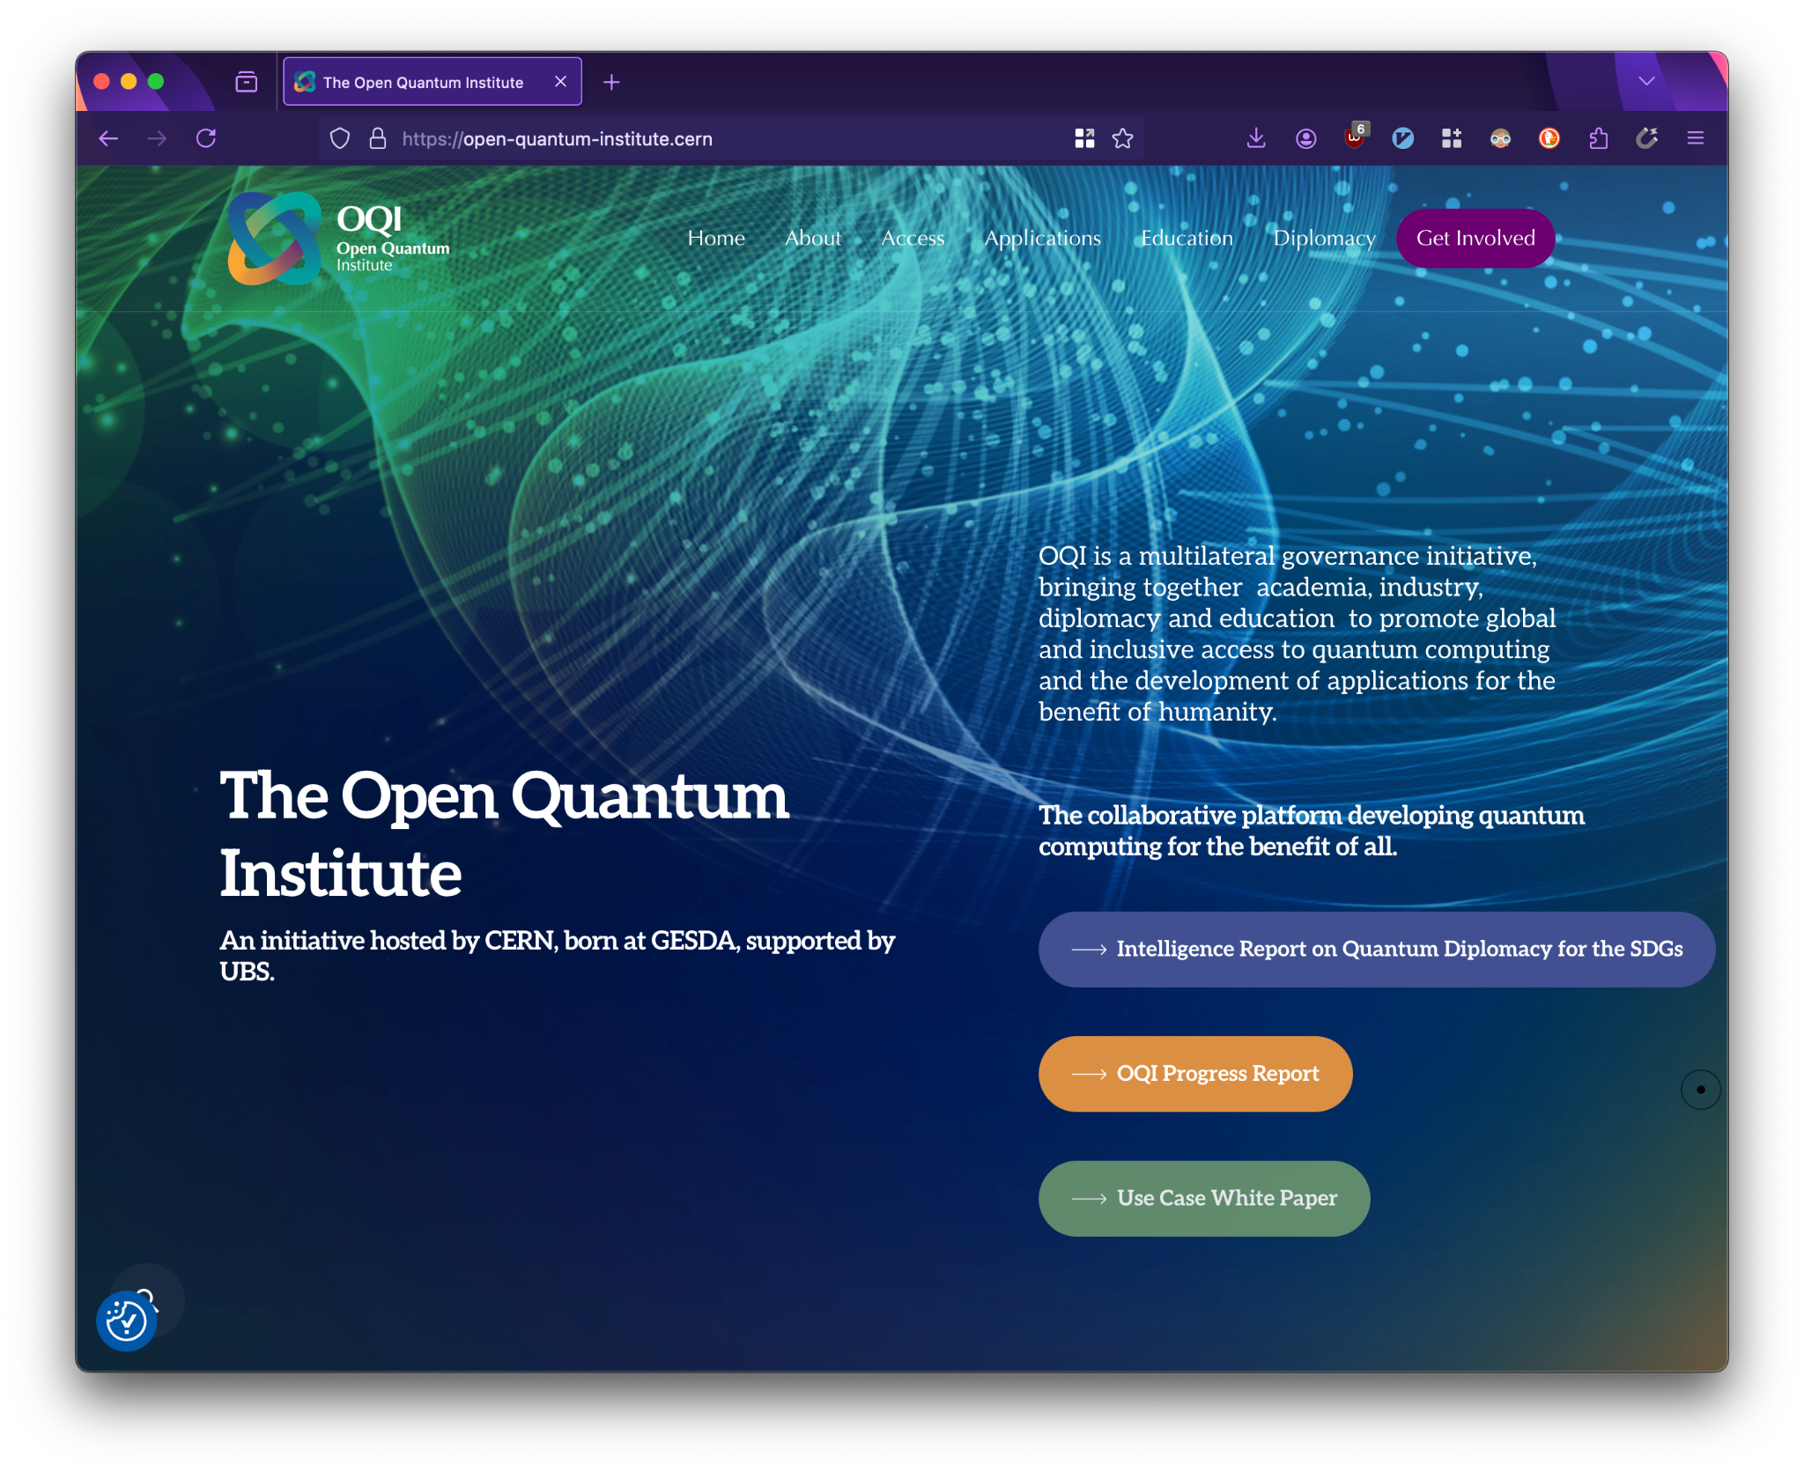
What is WordPress?
WordPress is a content management system (CMS)
User-friendly and requires no development experience
Open-source with a strong ecosystem, widely used across all types of websites
Notes:
J

Slide 5
Why did we choose WordPress? (1/5)
13 years ago, CERN officially adopted Drupal
Back then, it was a good choice, but today we must ask: is it still the right choice?
Choosing Drupal: ENTICE Meetings: https://indico.cern.ch/category/3101/
Notes:
J

Slide 6
Why did we choose WordPress? (2/5)
13 years ago, CERN officially adopted Drupal
Back then, it was a good choice, but today we must ask: is it still the right choice?
Today:
Steep learning curve
Substantial work in maintenance (>8.4 FTEs in Drupal 8 to 9 migration)
Dwindling ecosystem
Poor responsiveness and accessibility
Notes:
J

Slide 7
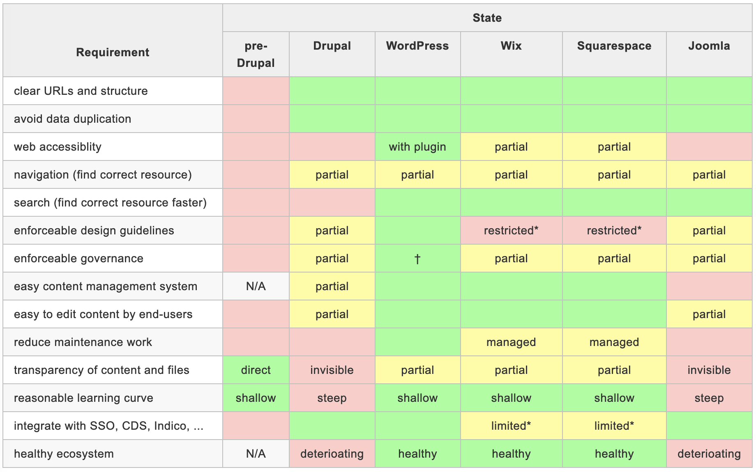
Why did we choose WordPress? (3/5)
The Future of CERN’s Web Presence: https://edms.cern.ch/ui/file/3095459/1/the_future_of_cerns_web_presence.pdf
Notes:
J

Slide 8
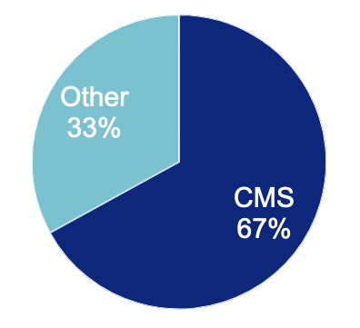
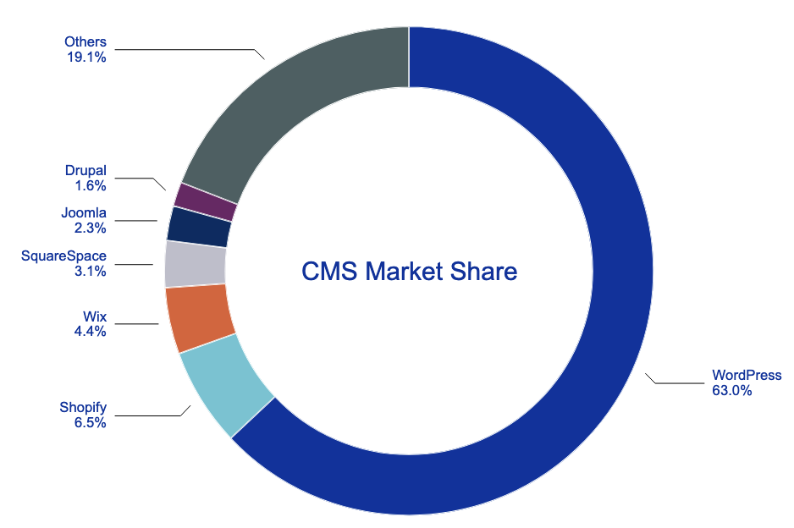
Why did we choose WordPress? (4/5)
Market Distribution
https://truelist.co/blog/cms-market-share/ and https://w3techs.com/technologies/history_overview/content_management
Notes:
J

Slide 9
Why did we choose WordPress? (5/5)
WordPress shifts website owners from web developers to content creators,
allowing you to focus on what matters: your content.
The Future of CERN’s Web Presence: https://codimd.web.cern.ch/s/GQJJY5zVc#
CERN’s Online Presence: An Evaluation of WCMS: https://codimd.web.cern.ch/s/0vGLgq87N#
Notes:
J

Slide 10
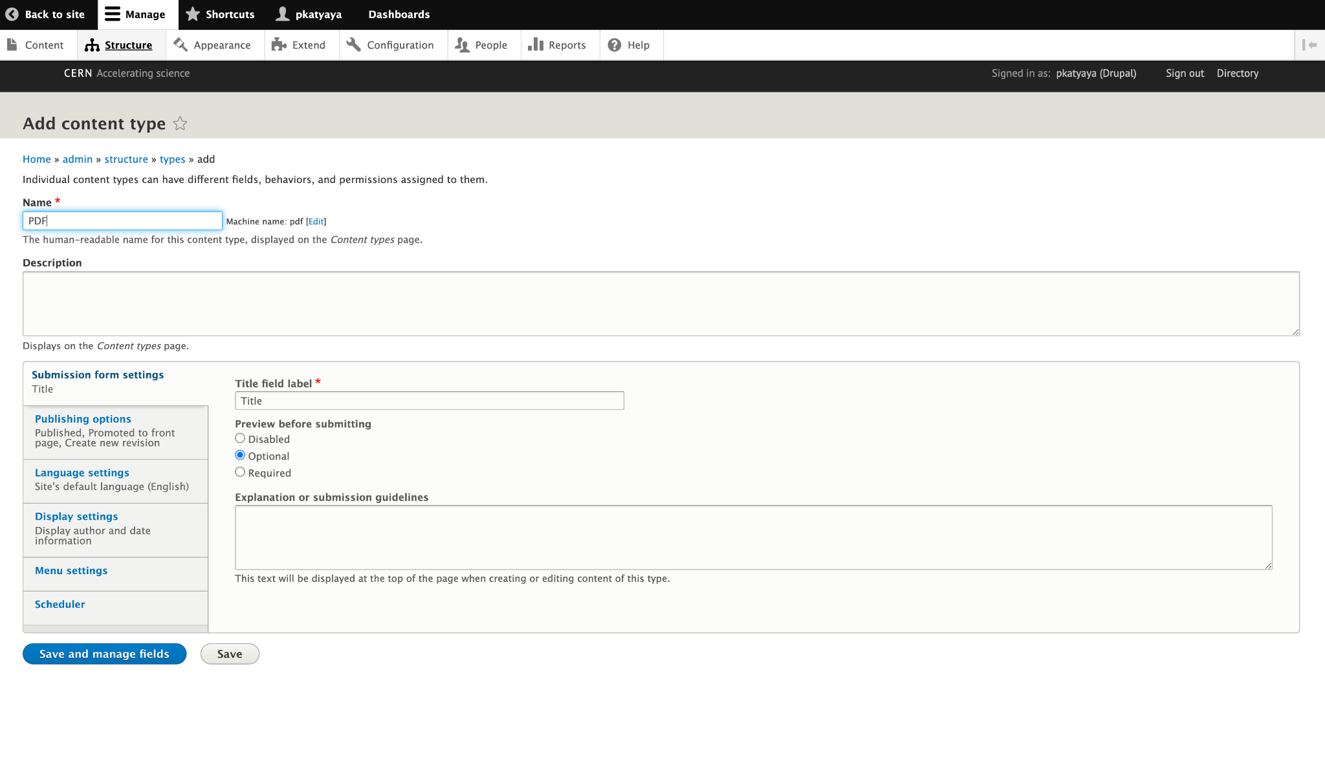
Example: Managing Content in Drupal
Notes:
J

Slide 11
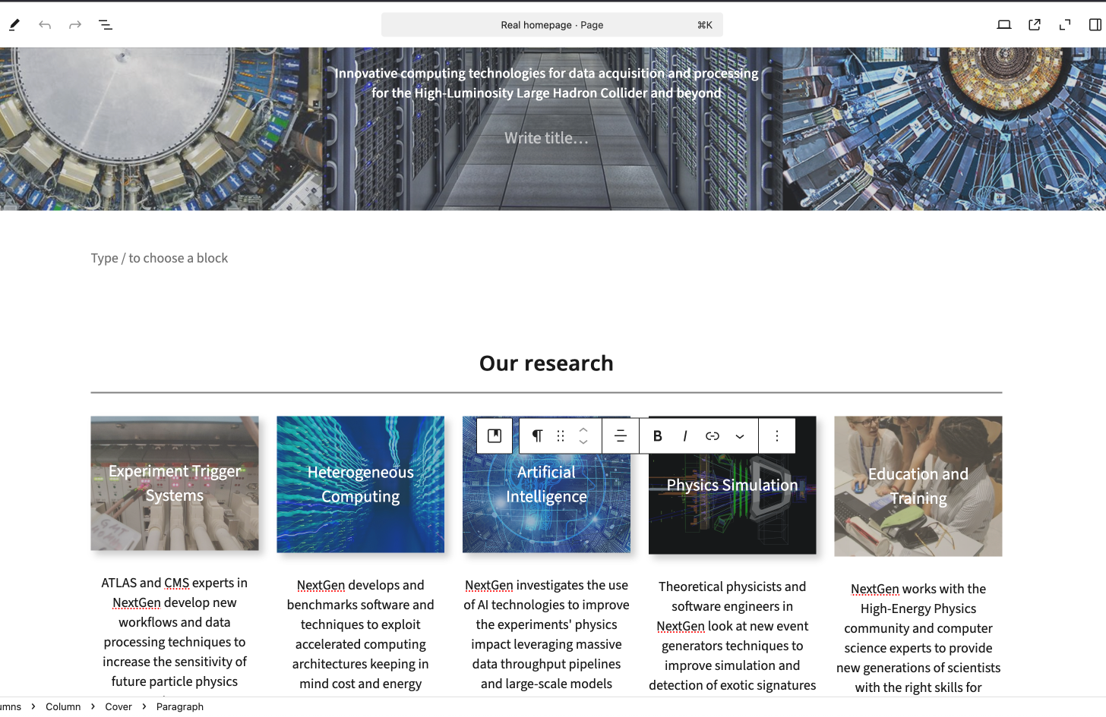
Example: Managing Content in Wordpress
Notes:
J

Slide 12
Drupal
Wordpress
Notes:
J

Slide 13
Where are we?
WordPress is in active development — joint effort between IR and IT
WordPress Lite, a lightweight version, has been available since October ‘24
  Includes a CERN WordPress theme and core functionality such as
    headings, paragraphs, quotes, lists, tables, videos, images, galleries
    interactive elements such as action buttons, sliders, CDS and Indico
    post filtering by tag and/or category, social media integration
    countdown widgets, and more…
Read more about WordPress Lite via https://wordpress.docs.cern.ch/
Notes:
J

Slide 14
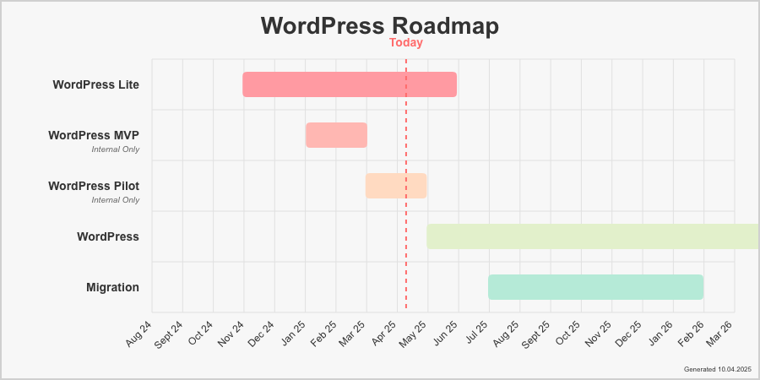
What is our roadmap?
See https://wordpress.docs.cern.ch/roadmap/ for more information
Notes:
J

Slide 15
What are our goals?
Users will be content creators, not developers
Updates, security patches, and tweaks all managed centrally
Customisations allowed only for well-justified cases
See https://wordpress.docs.cern.ch/roadmap/ for more information
Notes:
J

Slide 16
CERN Wordpress Theme
Vision, Features and Limitations

Slide 17
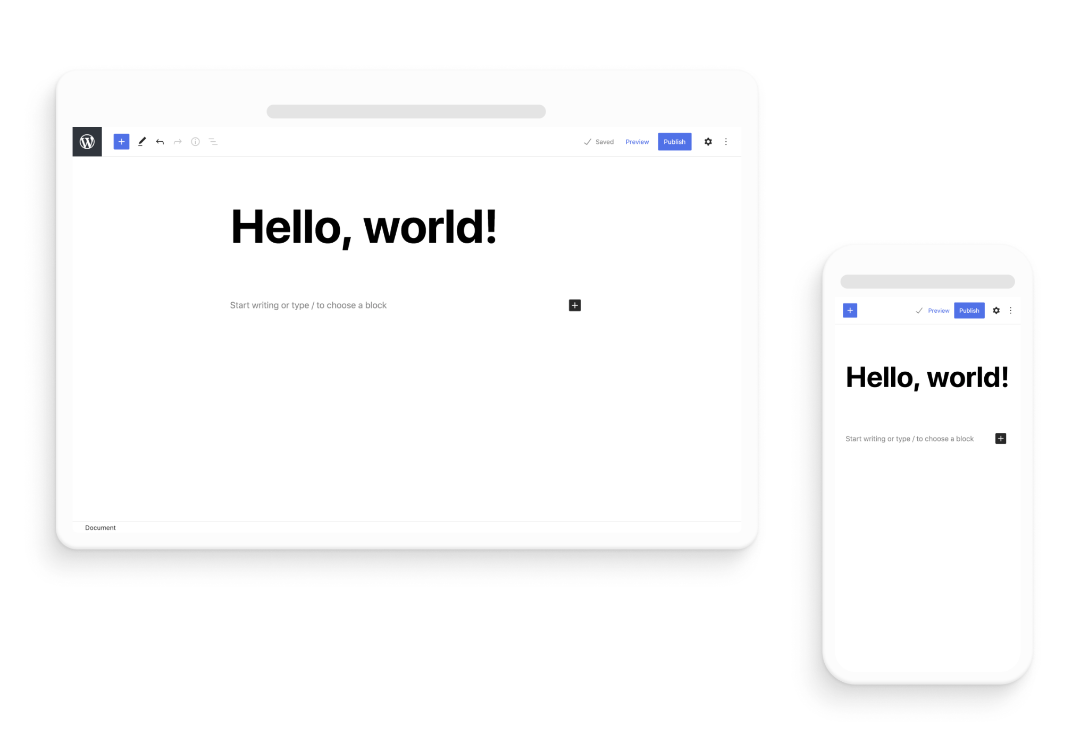
CERN Theme: Vision
Based on Gutenberg
  Blocks as the Universal Unit
  Intuitive User Experience
  Developer-Friendly Environment
See https://wordpress.docs.cern.ch/roadmap/ for more information
Notes:
J

Slide 18
CERN Theme: Features
See https://wordpress.docs.cern.ch/roadmap/ for more information
Notes:
J

Slide 19
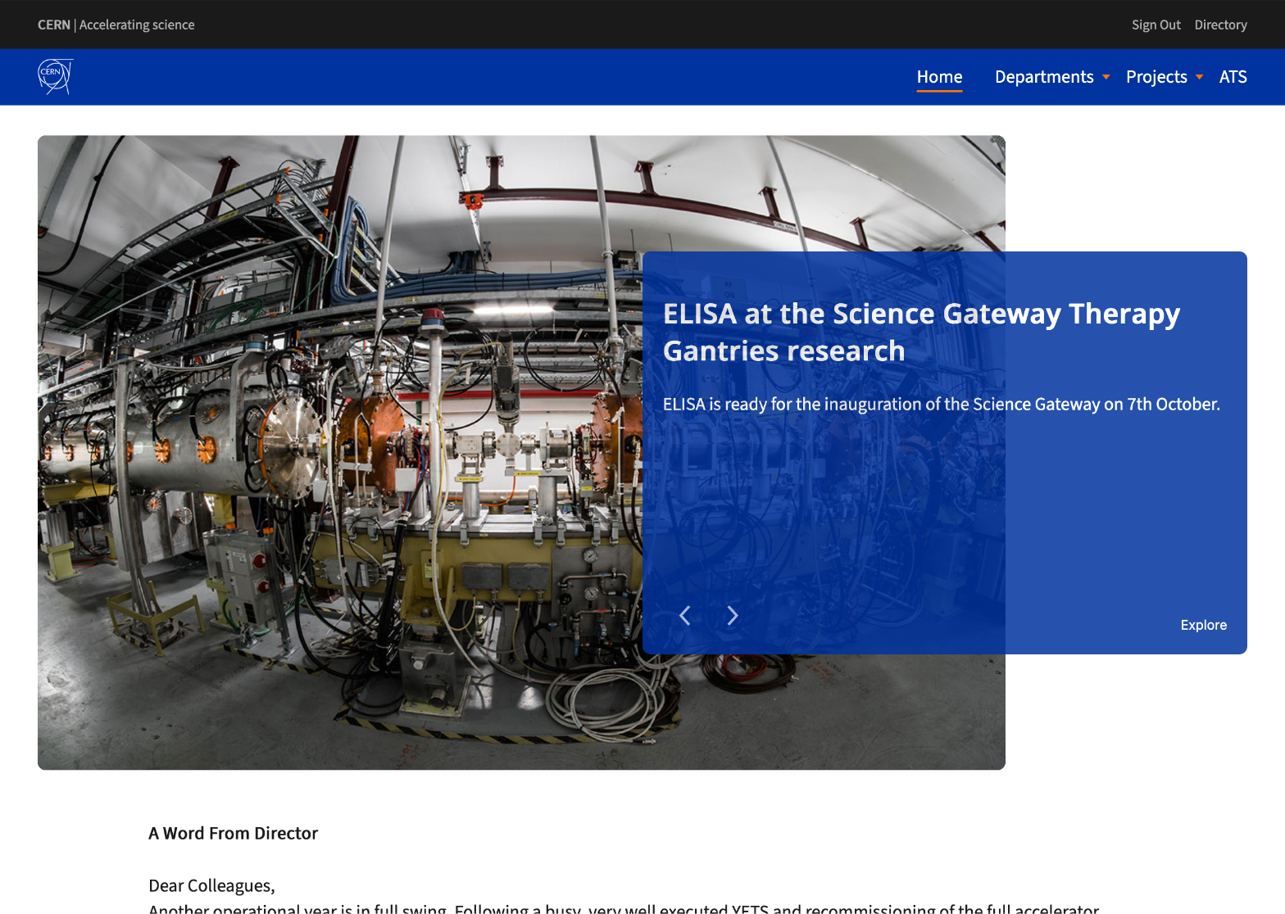
CERN Theme: Features - Blocks
Extension of Core Blocks
New blocks for common use Cases
  Slider
  News
  Countdown
Notes:
J

Slide 20
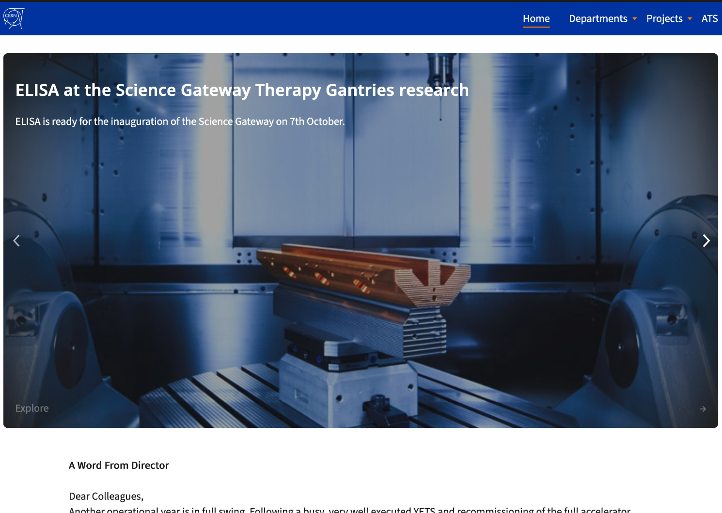
CERN Theme: Features - Slider
Two available layouts
Adapted to color palette
Developed for accessibility and performance
Notes:
J

Slide 21
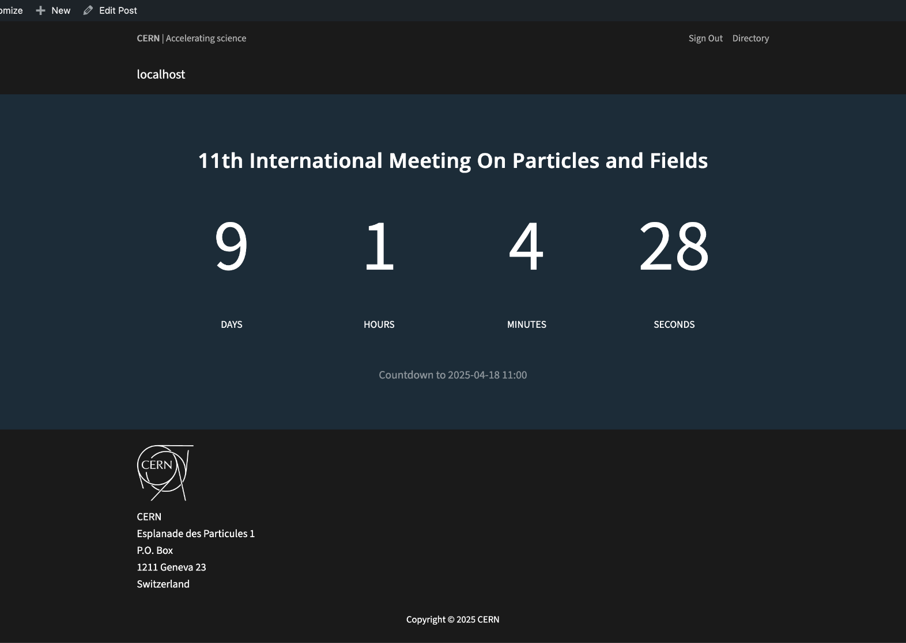
CERN Theme: Features - Countdown
Dynamic real-time countdown to event
Automatically linked with Indico
Notes:
J

Slide 22
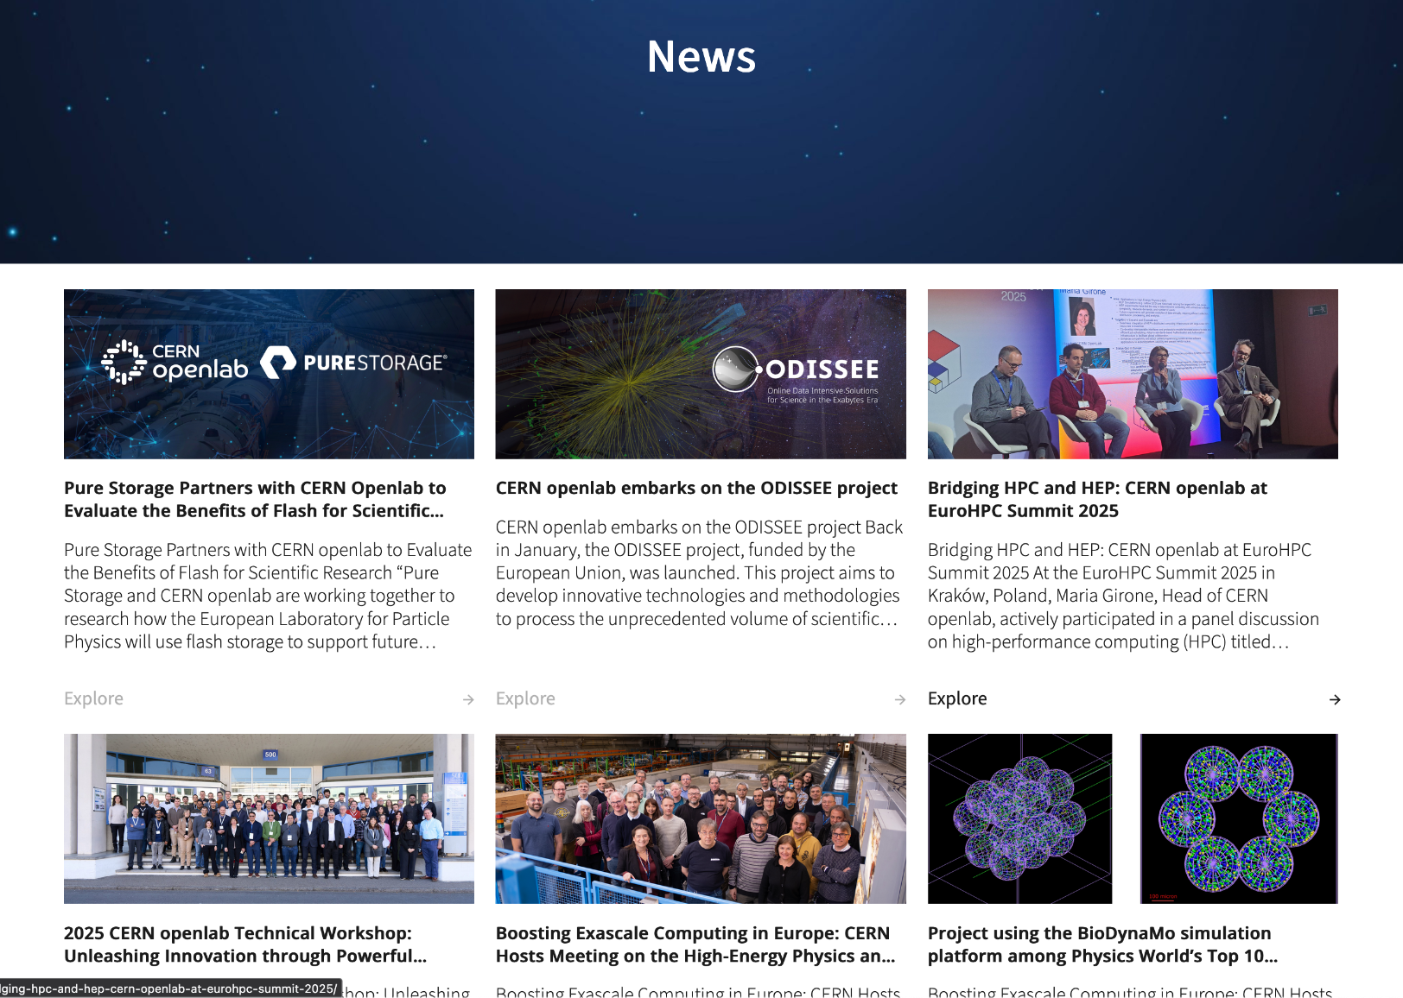
CERN Theme: Features - News
Automatically fetches latest posts
Filtering by tag / category / author
Development of more advanced filters
Notes:
J

Slide 23
CERN Theme: Features - Future Blocks
Indico Block
RSS Feeds
Open to proposals
See https://wordpress.docs.cern.ch/roadmap/ for more information
Notes:
J

Slide 24
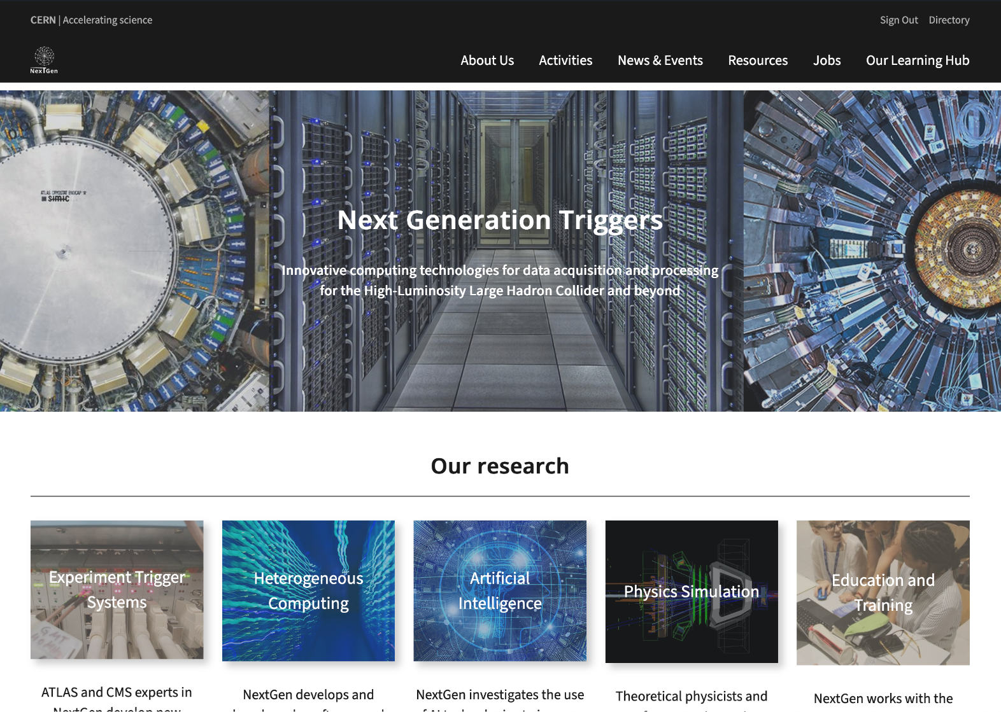
CERN Theme: Features - Patterns
Groups of blocks bundled together
Saves design and creation time
Future Wordpress pattern library
See https://wordpress.docs.cern.ch/roadmap/ for more information
Notes:
J

Slide 25
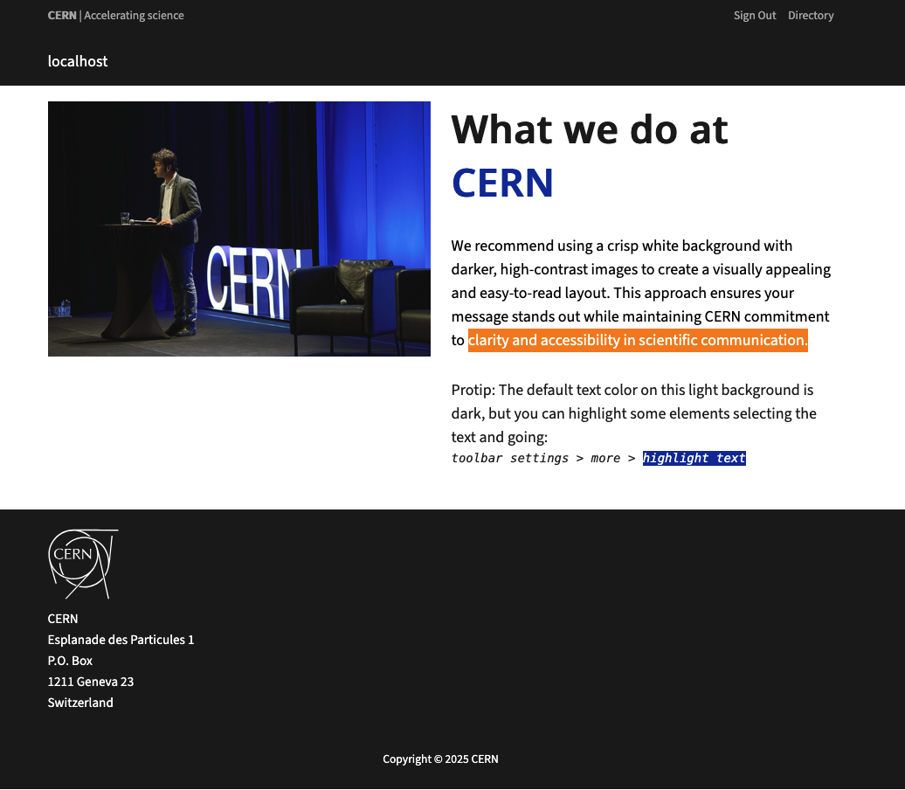
CERN Theme: Features - Branding
Use of predefined palettes
  CERN Color Palette
  Alternative Palettes for experiments / collaborations
Standardized fonts and icons
Notes:
J

Slide 26
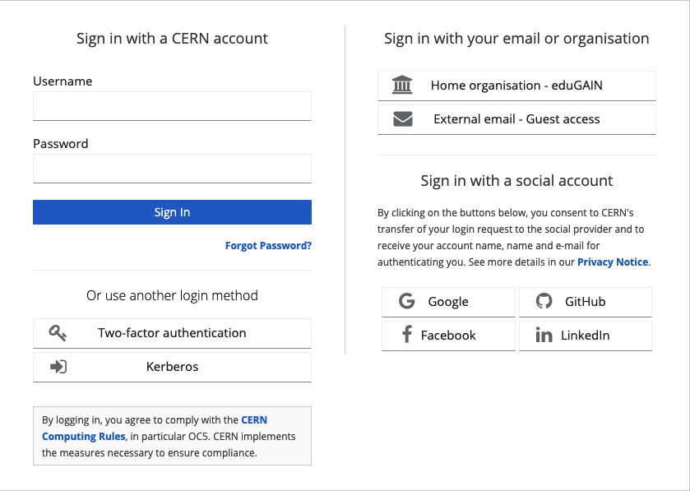
CERN Theme: Features - Privacy
Public Websites
Private Websites behind CERN SSO
  Possibility to filter websites behind certain E-groups
All security handled centrally without action on the user
Notes:
J

Slide 27
What does NOT come with CERN Theme
Notes:
J

Slide 28
What does NOT come with CERN Theme
Explain to us your use case:
if it is useful to the CERN Community, we will implement and support it
Custom plugins
Custom roles
BY DEFAULT
Accessibility
Responsiveness
Security
Maintenance
Best practices
More than 8000 unique roles in Drupal
Maintenance mess
Redundant set of permissions
Null Naming conventions
See https://wordpress.docs.cern.ch/wp-lite/create-website/ for more information
Notes:
J

Slide 29
Migration
How to migrate 1200+ webpages and 20+ years of content

Slide 30
Migration to WordPress (1/2)
In general, we deal with two types of websites
Websites without customisation: no action necessary
  Migrated in batches throughout 2025, starting from July
  We programmatically verify that all content has been migrated
  DRD4 is in this category
Websites which have been customised: action necessary!
  All website owners contacted with information about customisation
  Removing customisation qualifies you for automated migration
  Contact us if you have any questions or need assistance

Slide 31
Migration to WordPress (2/2)
The following flow applies to all migrations:
Content is automatically migrated onto WordPress
  It is possible to migrate selectively if desired; contact us!
  It is also possible to opt to start from scratch on WordPress; contact us!
Website owner(s) review and verify the WordPress website
Once verified and confirmed, promote to production
Your Drupal website will continue to be supported throughout 2025
Only once approved will WordPress become public

Slide 32
Validation
How we make sure things actually work

Slide 33
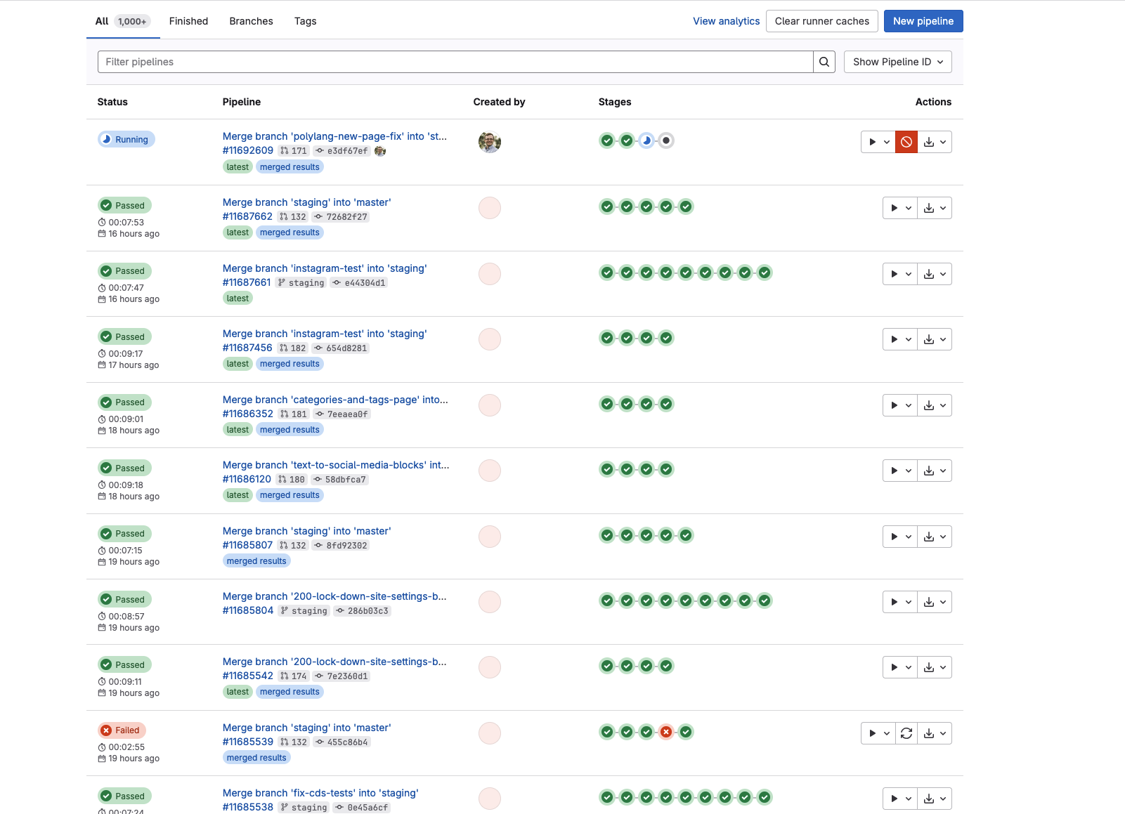
Validation: CI Pipeline
5 stage CI Pipeline:
  Code linting
  Secret Detection
  Frontend Testing
    Functional Testing
    Screenshot Testing
  Release Packaging
Notes:
J

Slide 34
Success Stories
Real world examples of Wordpress at CERN

Slide 35
CERN theme: Collaborations
Collaborations summary
Site | Dept | External company involved | Status
Openlab | IT-FTI |  | Completed ✅
NextGenTriggers | IT-FTI | - | On going ⏱️
Ats-news | ATS-DO | - | Completed ✅
Kt-report-2024 | IPT-KT | Eversis | Completed ✅
Staff-association | IR-ECO | - | On going ⏱️
Mechlab | EN-MME | - | On going ⏱️

Slide 36
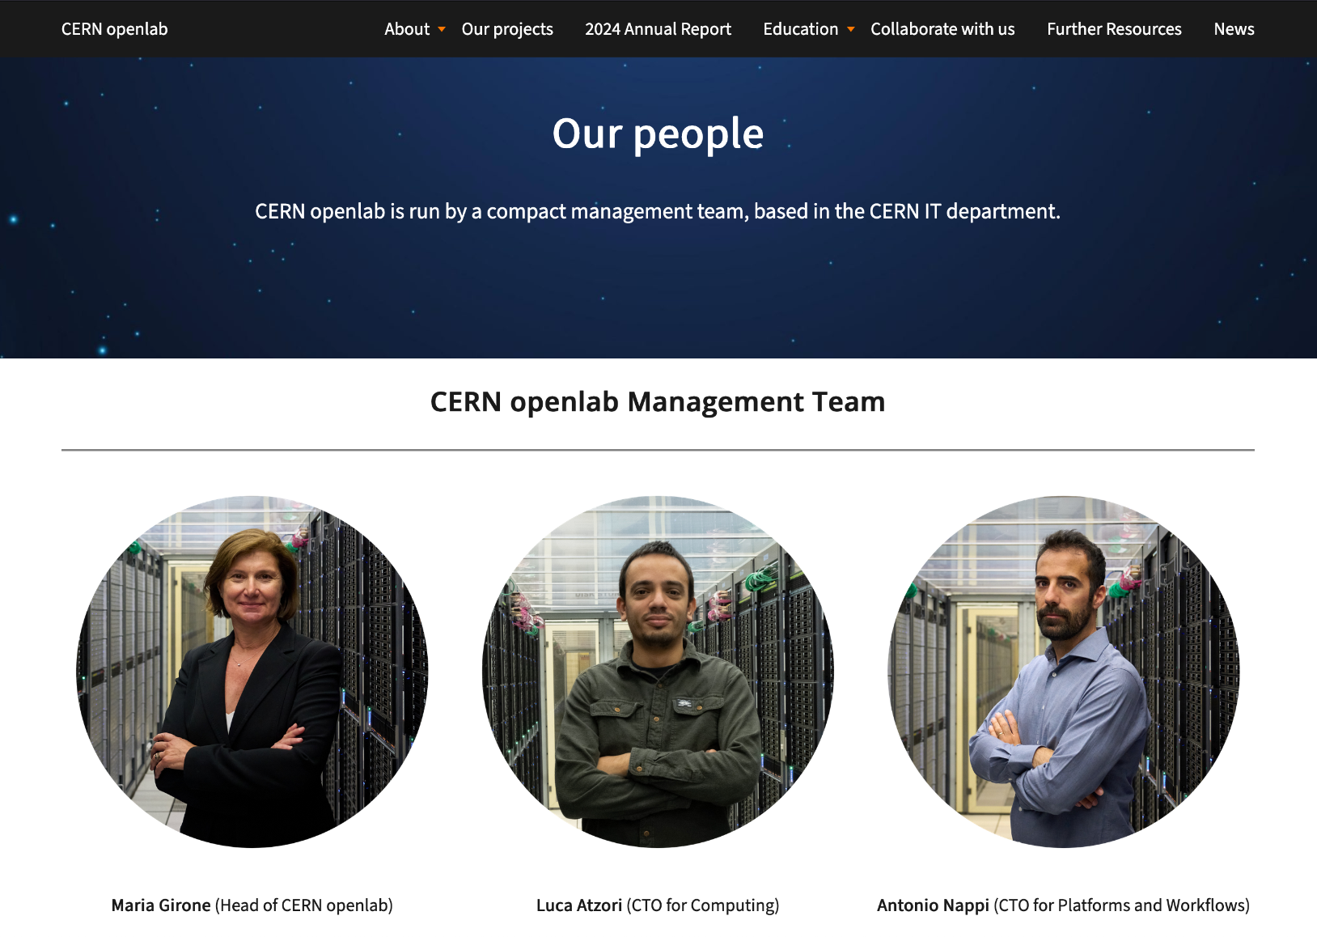
Success Stories: CERN Openlab
No previous website / design
No previous experience with Wordpress
Very fast development time
Clean and polished informative website
Notes:
J

Slide 37
Success Stories: ATS News
Previous website made with Wordpress outside CERN
Manual migration of the content
Stripped out all customization
Notes:
J

Slide 38
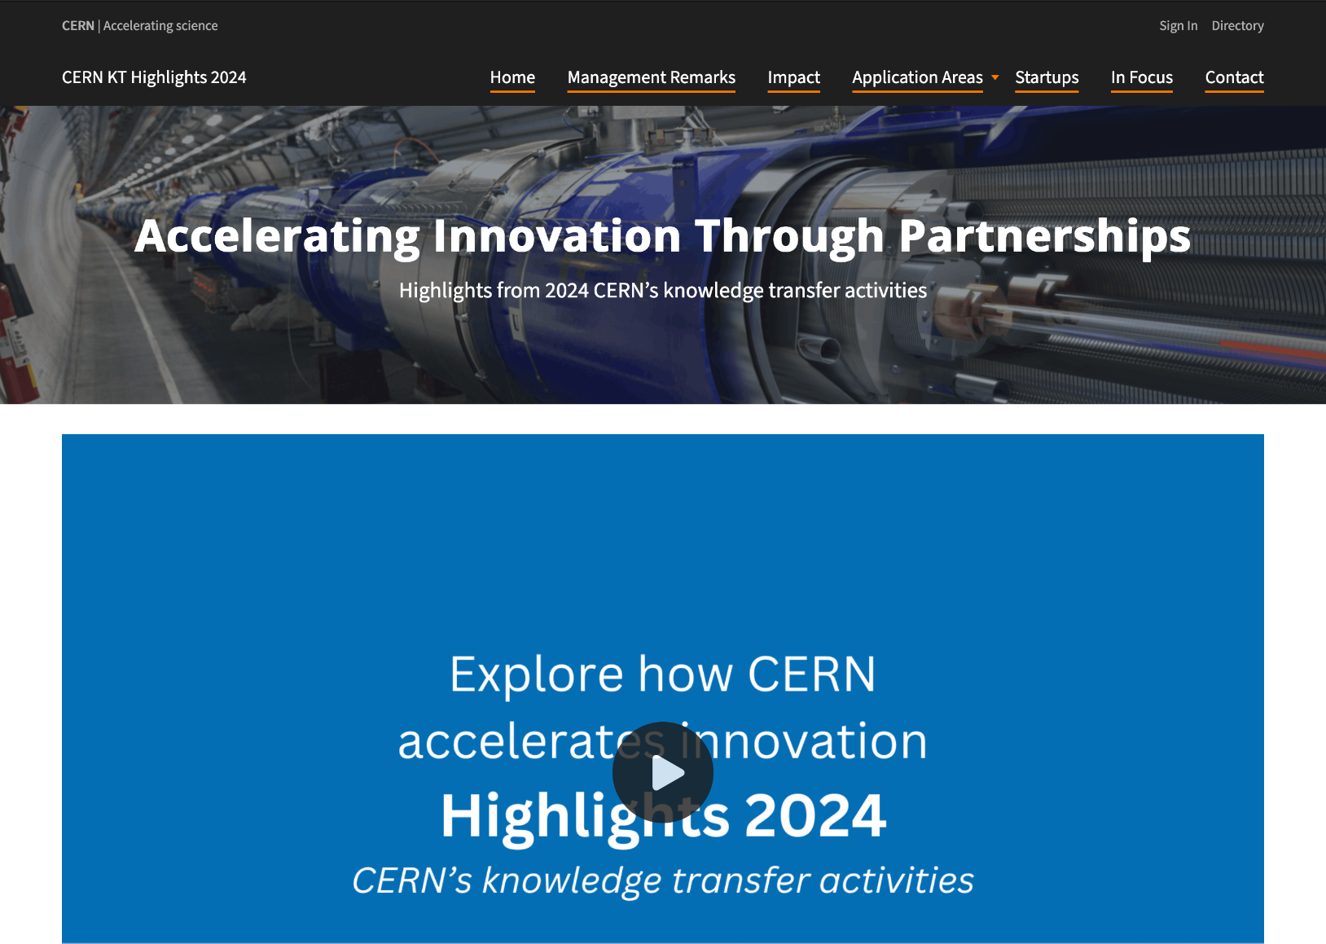
Success Stories: KT Report
Previous website made with Wordpress outside CERN
Manual migration of the content
Stripped out all customization
Notes:
J

Slide 39
Additional Resources
WordPress information: https://wordpress.docs.cern.ch
Web Team contact information: web-team@cern.ch
WordPress contact information: wordpress-feedback@cern.ch
See https://wordpress.docs.cern.ch/roadmap/ for more information
Notes:
J

Slide 40
Allowing you to focus on what matters: your content.

