Slide 1
WP1: FCCee injector linacs status report
Alexej Grudiev on behalf of the WP1
S. Bettoni, P. Craievich, S. Doebert, A. Kurtulus, A. Latina, J.-Y. Raguin, Y. Zhao, et. al.
5/12/2024

Slide 2
New baseline layout (4 AS/module, 4 bunches@100 Hz)
WP1: e-source, linacs, HEC
WP3: target, capture
WP4: DR, TL, EC, BC
2.8 GHz, 215m
2.0 GHz, 319m
DR @ 2.86 GeV
G
e-linac
C
p-linac
EC
2.8 GHz, 1080m
HEC
HE-linac
BC
20 GeV
Max. Klystron Power: 80 MW, Operating Klystron Power: 64 MW i.e. 20 % Margin
Linac | <a/λ> | Bunch Charge [nC] | Kly. power per structure [MW] | Loaded acc. gradients [MV/m] | Nb. modules | Linac lengths [m] | Oper. power consumptions [MW] | Max. power consumptions [MW]
e-linac * | 0.15 | 5 | 14.2 | 19.5 | 14+1 | 215 | 2 | 2.5
p-linac** | 0.2 | 15 | 15.4 | 13.3 | 22 | 319 | 8 | 9
HE-linac * | 0.12 | 5 | 14.2 | 21.1 | 72 | 1080 | 9.5 | 11.5
* 3 µs RF pulse length, 6 µs HV pulse length
Assumes 25 m WR284 waveguide system length for one RF module
** 5 µs RF pulse length, 8 µs HV pulse length,
Assumes 25 m WR510 waveguide system length for one RF module
Assumes 6 structures (2 modules) for Capt. Linac, 20 structures (5 modules) for S1 Linac and 260 solenoids

Slide 3
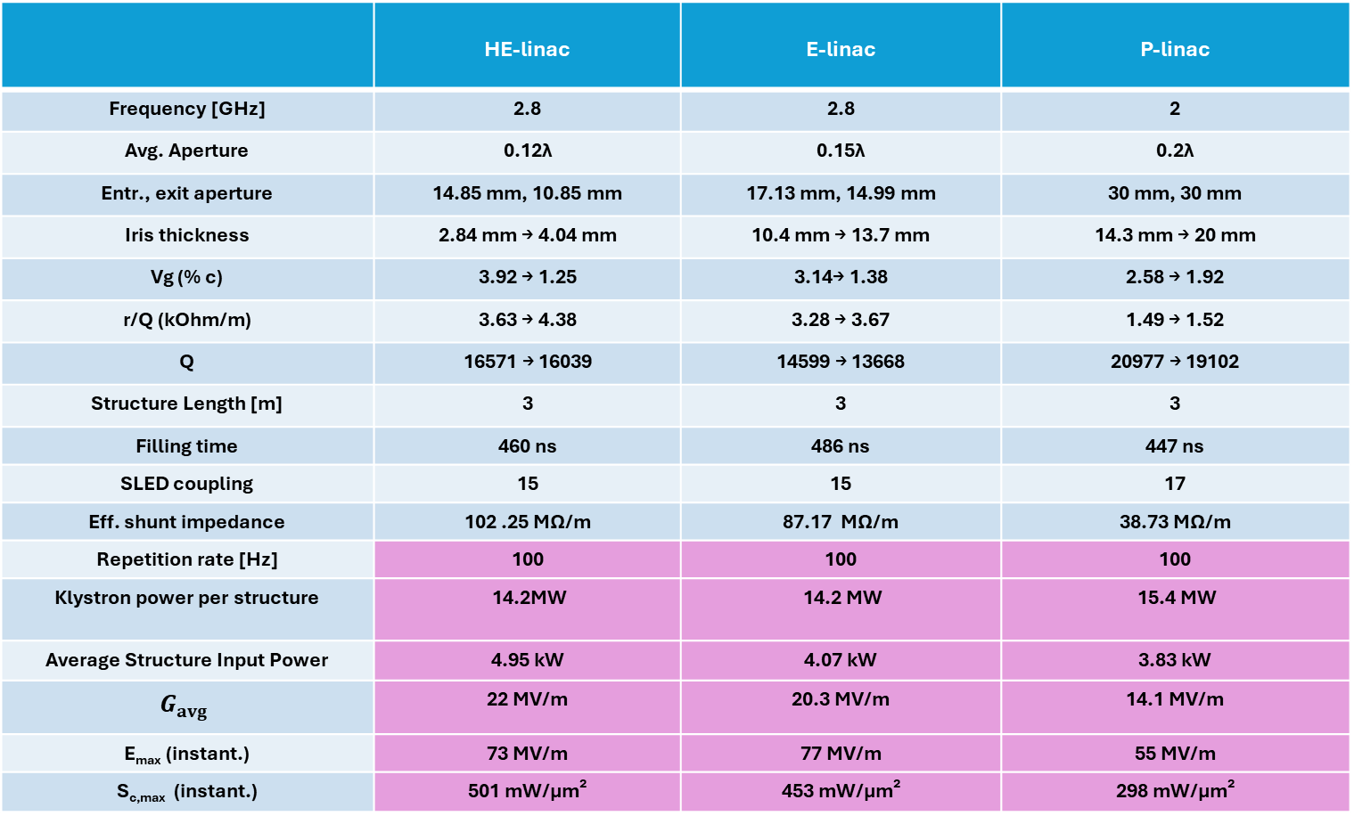
Acc. Structure parameters
Structure parameters are calculated for the single bunch case.
 | HE-linac | E-linac | P-linac
Frequency [GHz] | 2.8 | 2.8 | 2
Avg. Aperture | 0.12λ | 0.15λ | 0.2λ
Entr., exit aperture | 14.85 mm, 10.85 mm | 17.13 mm, 14.99 mm | 30 mm, 30 mm
Iris thickness | 2.84 mm → 4.04 mm | 10.4 mm → 13.7 mm | 14.3 mm → 20 mm
Vg (% c) | 3.92 → 1.25 | 3.14→ 1.38 | 2.58 → 1.92
r/Q (kOhm/m) | 3.63 → 4.38 | 3.28 → 3.67 | 1.49 → 1.52
Q | 16571 → 16039 | 14599 → 13668 | 20977 → 19102
Structure Length [m] | 3 | 3 | 3
Filling time | 460 ns | 486 ns | 447 ns
SLED coupling | 15 | 15 | 17
Eff. shunt impedance | 102 .25 MΩ/m | 87.17 MΩ/m | 38.73 MΩ/m
Repetition rate [Hz] | 100 | 100 | 100
Klystron power per structure | 14.2MW | 14.2 MW | 15.4 MW
Average Structure Input Power | 3.72 kW | 3.76 kW | 3.68 kW
 | 22 MV/m | 20.3 MV/m | 14.1 MV/m
E_{max} (instant.) | 73 MV/m | 77 MV/m | 55 MV/m
S_{c,max} (instant.) | 501 mW/μm² | 453 mW/μm² | 298 mW/μm²

Slide 4
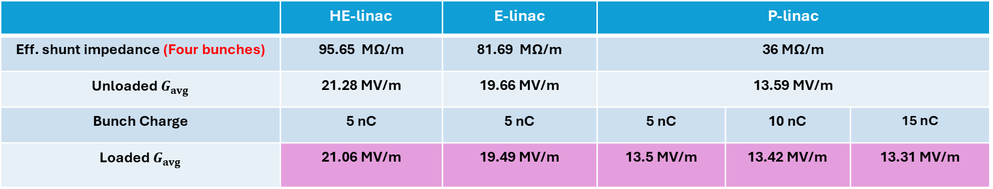
Acc. Structure parameters
Structure parameters are calculated for the four bunches case.
 | HE-linac | E-linac | P-linac
Eff. shunt impedance (Four bunches) | 95.65 MΩ/m | 81.69 MΩ/m | 36 MΩ/m
Klystron power per structure | 14.2MW | 14.2 MW | 15.4 MW
 | 21.28 MV/m | 19.66 MV/m | 13.59 MV/m
Bunch Charge | 5 nC | 5 nC | 5 nC | 10 nC | 15 nC
 | 21.06 MV/m | 19.49 MV/m | 13.5 MV/m | 13.42 MV/m | 13.31 MV/m

Slide 5
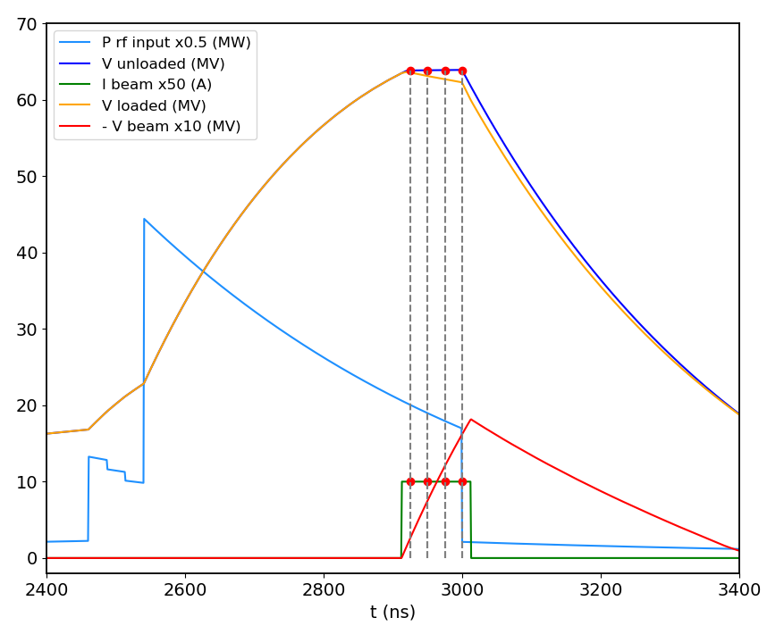
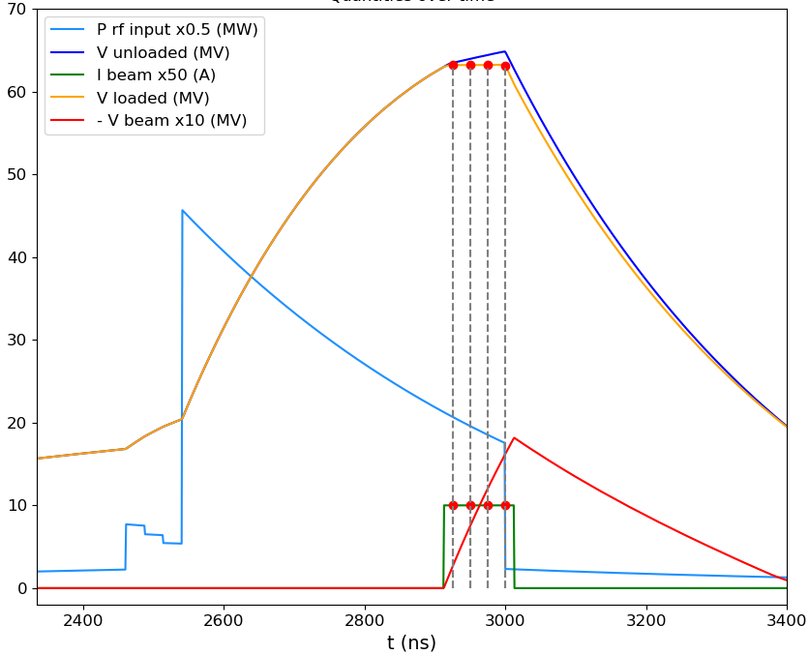
Compansated
HE Linac:
4 Bunches case:
Unloaded Voltages | 1st Bunch | 2nd Bunch | 3rd Bunch | 4th Bunch | Rsh
Single Bunch | 66 MV |  |  |  | 102.25 MΩ/m
4 Bunches | 63.81 MV | 63.84 MV | 63.86 MV | 63.82 MV | 95.65 MΩ/m
P_klys = 14.2 MW
3m structure
G = V/L
Loaded Voltages | 1st Bunch | 2nd Bunch | 3rd Bunch | 4th Bunch
Single Bunch | 65.75 MV
4 Bunches | 63.19 MV | 63.19 MV | 63.20 MV | 63.16 MV
For bunch charge: 5 nC
25 ns of bunch spacing
Maximum difference between 4 bunches:
0.08% energy spread
Maximum difference between 4 bunches:
0.06% energy spread
Unloaded
Loaded

Slide 6
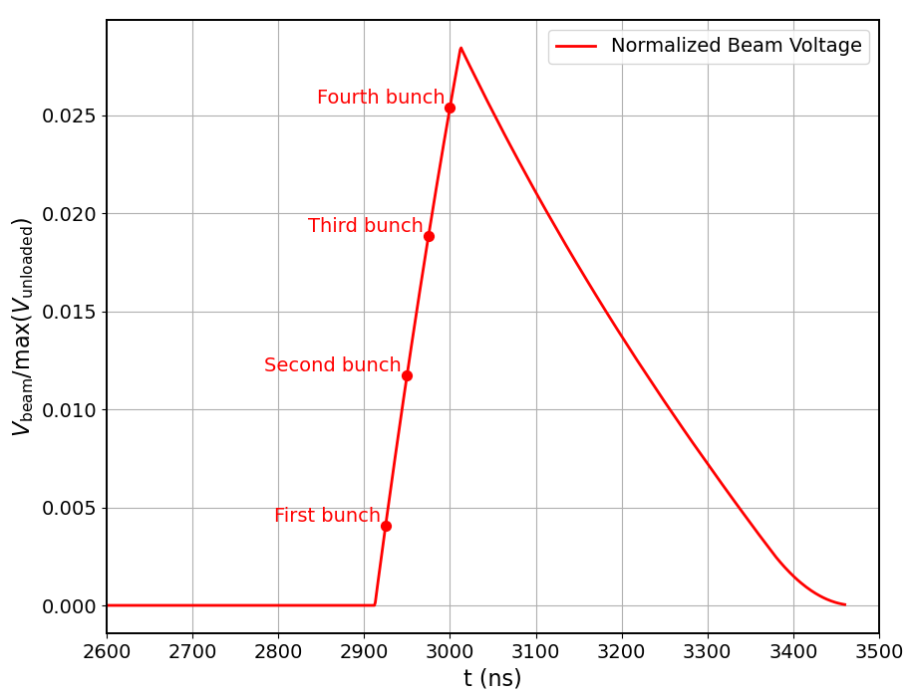
HE Linac:
4 Bunches case:
Beam loading effect
For bunch charge: 5 nC
25 ns of bunch spacing
Max Beam-Loading: 2.54 %

Slide 7
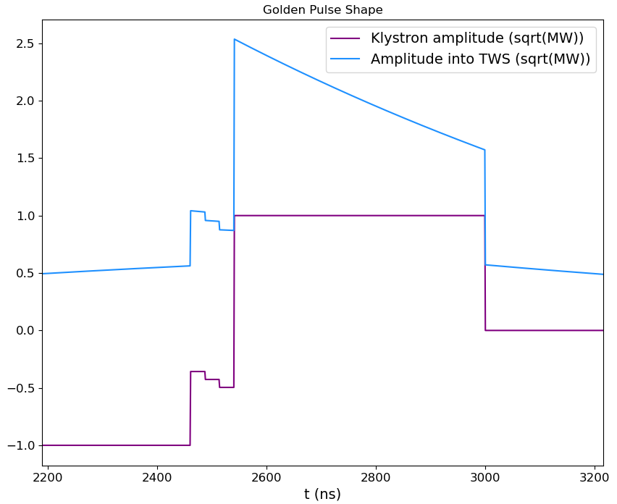
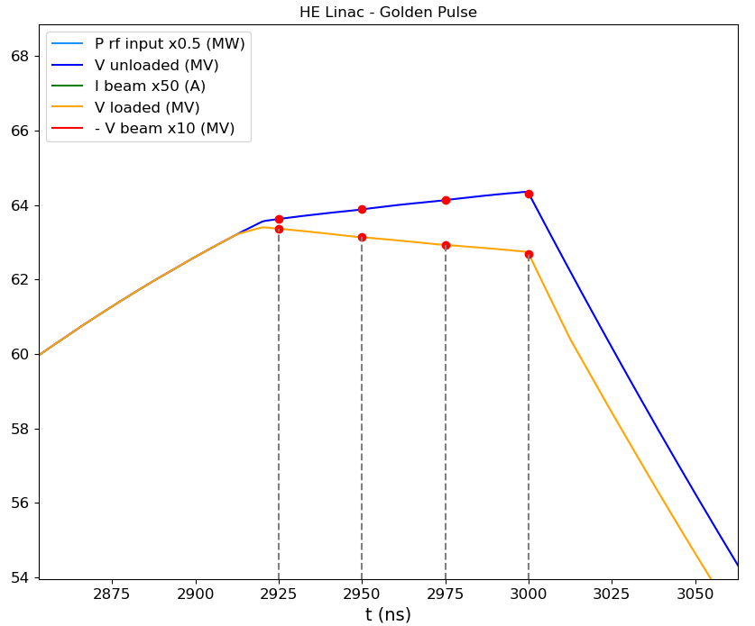
Golden pulse applied
HE Linac:
4 Bunches case:
Unloaded Voltages | 1st Bunch | 2nd Bunch | 3rd Bunch | 4th Bunch
Single Bunch | 66 MV
4 Bunches | 63.63 MV | 63.89 MV | 64.13 MV | 64.30 MV
+1.1% energy spread
Loaded Voltages | 1st Bunch | 2nd Bunch | 3rd Bunch | 4th Bunch
Single Bunch | 65.75 MV
4 Bunches | 63.37 MV | 63.14 MV | 62.93 MV | 62.68 MV
For bunch charge: 5 nC
25 ns of bunch spacing
-1.1 % energy spread

Slide 8
e- and HE linac: static effects
Sensitivity to static misalignments
  Assumed rms Gaussian distributed misalignments: 50 um for quadrupoles, 100 um per RF structures, and 30 um per BPM
  Applied one-to-one correction and DFS (including 10 um resolution) in cascade
  More than the 98% of the good seeds considered in the calculation of the emittance growth
e- linac:
  Emittance good enough for the positron production (e-linac)
  Emittance expected to be good enough for the injection to DR (tbc by the DR group)
HE linac:
  Emittance growth fulfilling the booster requirements
Emittance growth under control
ε_{x} (mm.mrad) |  | ε_{y} (mm.mrad)
Maximum | Design | Maximum | Design
20 | <12 | 2 | 1.6

Slide 9
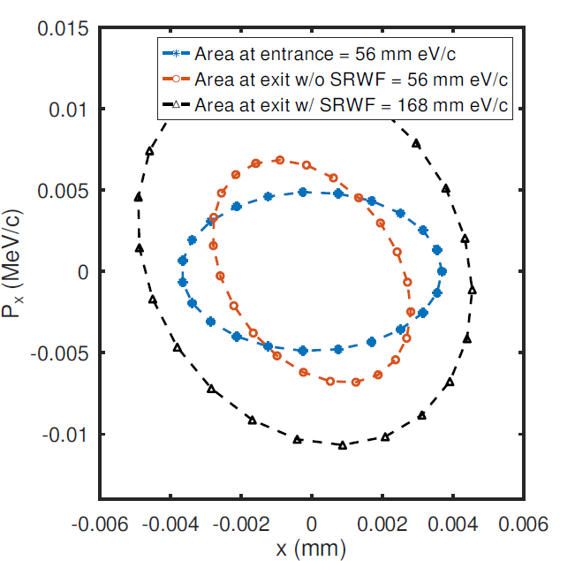

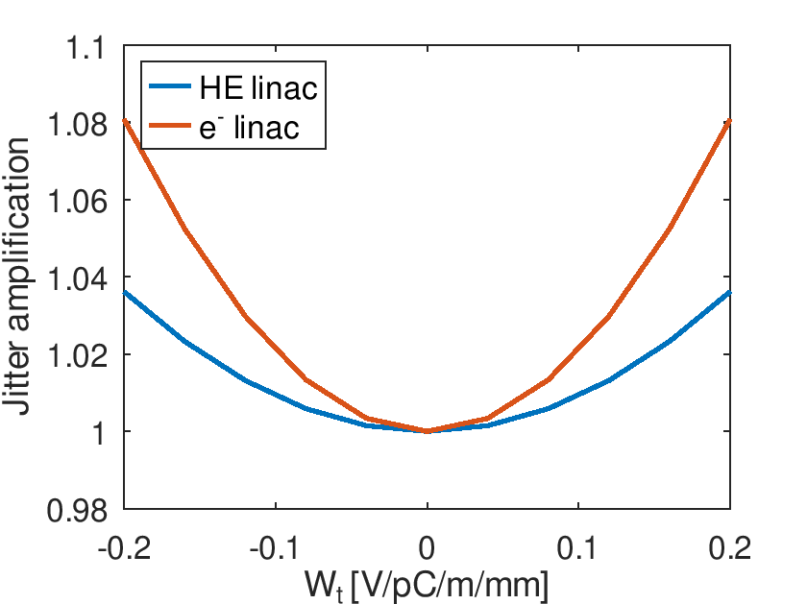
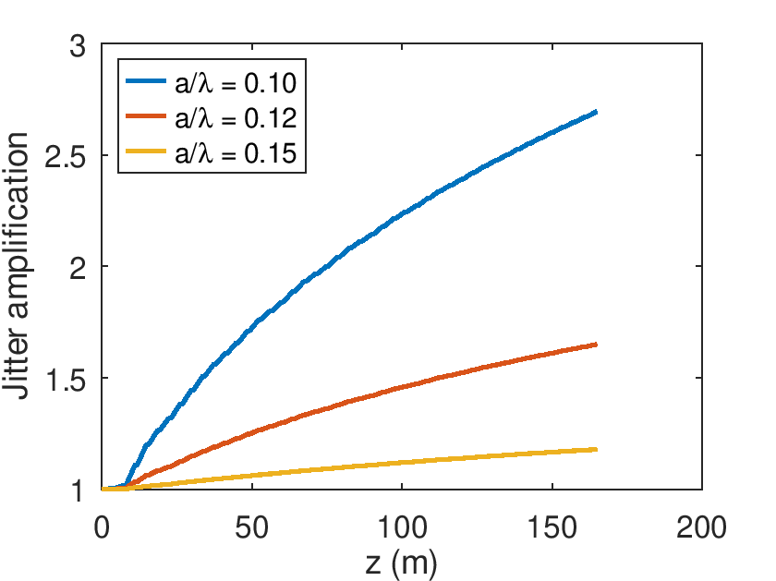
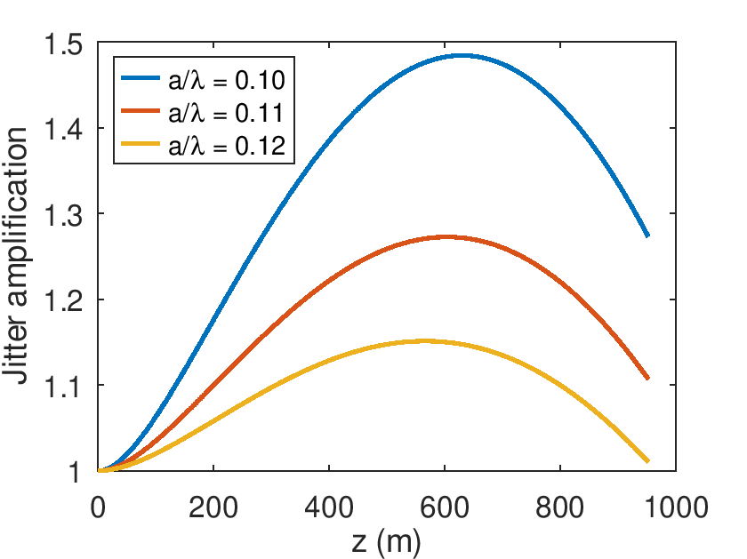
e- and HE linac: dynamics effects
e- linac |  | HE linac
Multi-bunch | Single bunch | Multi-bunch | Single bunch
1.03 | 1.18 | 1.02 | 1.01
Multi-bunch
Single bunch
HE linac
(a/λ = 0.12)
e- linac
(a/λ = 0.15)
From the previous design RF optimized for a maximum kick=0.11 V/pC/m/mm
Positron production→ok 0.15
Damping ring→ waiting for an answer
Booster→ok
No showstoppers identified

Slide 10
Longitudinal phase space manipulation:
“golden” pulse and energy compressor (EC)
0.7% chirp residual from BC included. More is possible.
R₅₆ ~ 0.6 m
f2 = 2.8 GHz
V = 645 MV
Q = 5 nC, σ_{z0} = 4 mm, DE/E = 0.12-0.15%
DE_{cen} /E < 0.05%
f1 = 2.8 GHz
HE linac
RF EC
σ_{z0} = 0.8 mm
σ_{z0} = 0.8 mm
DE/E = 0.6%
Max DE_{cen} /E = 2.1%
σ_{z0} = 4 mm
DE/E = 0.6%
Max DE_{cen} /E < 0.05%
Q = 5 pC, σ_{z0} = 1 mm, DE/E = 0.14-0.15%
DE_{cen} /E < 0.05%
  Total length <100 m including matching sections upstream and along EC
  On-crest operating phase to optimize the transverse beam quality and maximize the acceleration efficiency
  For the top-up operation with variable (0-100%) charges in each of the 4 bunches, LLRF used to generate a unique golden pulse
  EC is used to match both the single- and multi- bunch target parameters, see below
Q = 5 nC: DE/E~0.1-0.15%. Factor 3 smaller DE/E possible (single-bunch)
Q = 5 pC → machine settings unchanged vs the high Q mode
 | Bunch 1 | Bunch 2 | Bunch 3 | Bunch 4
Single bunch DE/E (%) | 0.15 | 0.15 | 0.14 | 0.12
Rms bunch length (mm) | 4.04 | 4.05 | 4.07 | 4.09
DE/E centroid from bunch 1 (%) | 0 | -0.003 | -0.007 | -0.019
Dt from bunch 1 (ps) | 0 | 5.7 | 10.9 | 17.2
 | Bunch 1 | Bunch 2 | Bunch 3 | Bunch 4
Single bunch DE/E (%) | 0.14 | 0.15 | 0.14 | 0.14
Rms bunch length (mm) | 1.03 | 1.02 | 1.02 | 1.02
DE/E centroid from bunch 1 (%) | <0.011 | 0.011 | 0.030 | 0.049
Dt from bunch 1 (ps) | 0 | -0.6 | -1.2 | -1.6
Dt from bunch 1 absolute (ps) | -28.9 | -29.5 | -30.1 | -30.5
These parameters seem to be acceptable by the booster

Slide 11
p-linac design
Section 1 (S1)
  Structure a=30mm, L = 3m and solenoids
  N = 20, G = 13.3 MV/m, φ = -10° (optimized for max. yield)
  Average energy (around bunch core) at exit: 931.7 MeV
Section 2 (S2)
  Structure a = 30mm, L = 3m
  Periodic FODO cells. 2 structures per FODO cell. FODO phase advance: 76.345° (optimized for min. beta)
  Quadrupole length: 0.4 m. Quadrupole-Structure distance: 0.15 m. Quadrupole spacing: 3.3 m
  N = 52, G = 12.756 MV/m, φ = 5° (optimized for max. yield)
  Average energy (around bunch core) at exit: 2.866 GeV
Parameter | Value
Collective effects considered | Space charge; Short-range wakefield
Primary electron bunch charge assumed for collective effects [nC] | 5.0
Bunch length (around bunch core) at PL exit [mm] | 3.0
Energy spread (around bunch core) at PL exit [%] | 0.95
Total positron yield (all positrons) at PL exit | 3.41
Expected DR accepted yield with ±2% energy acceptance at PL exit | 3.01
Normalized X, Y emittances (accepted positrons) at PL exit [mm*rad] | 13.1, 13.0
Geometric X, Y emittances at (accepted positrons) PL exit [mm*mrad] | 2.34, 2.32

Slide 12
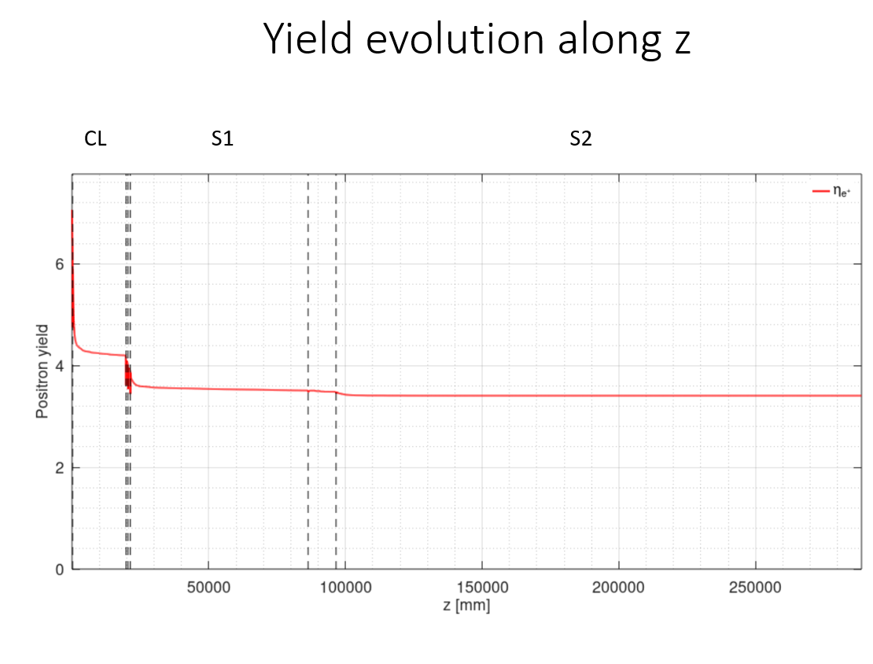
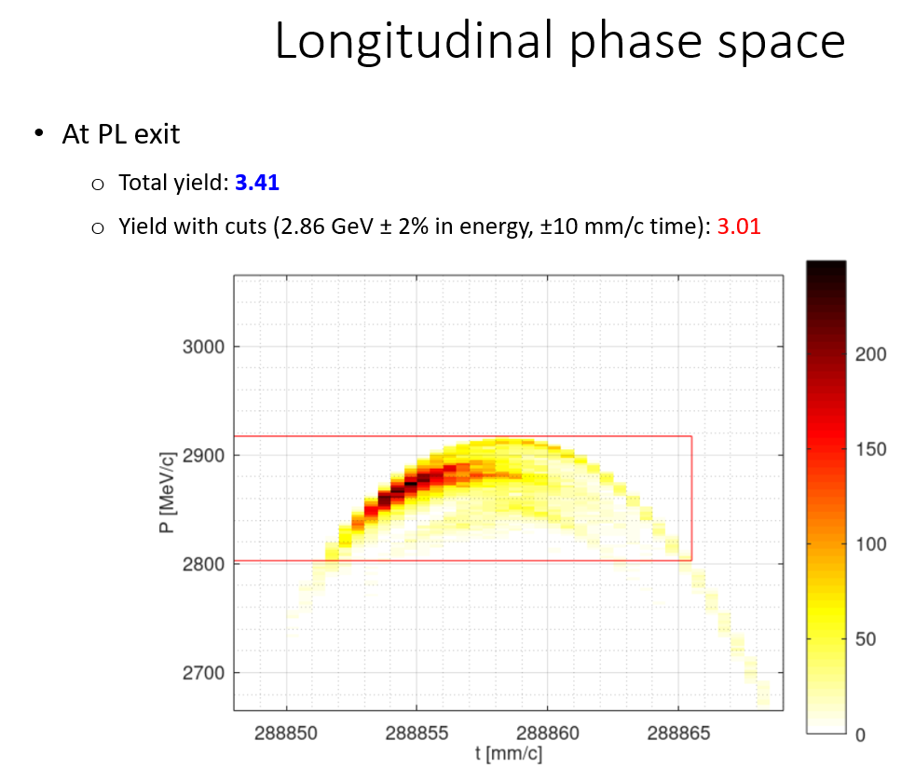
in p-linac transmission and yield

Slide 13
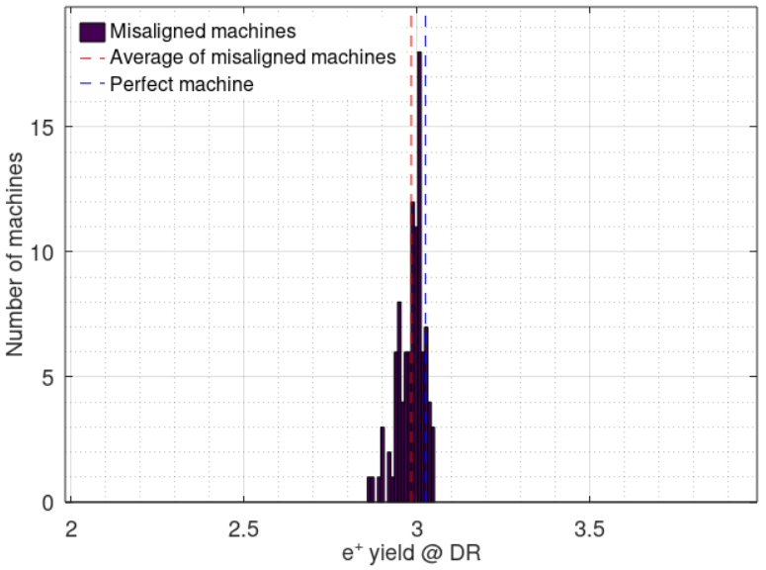
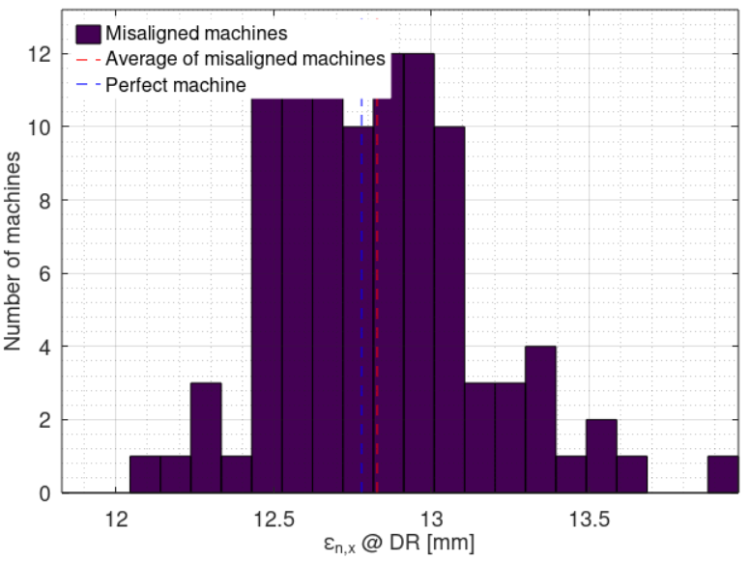
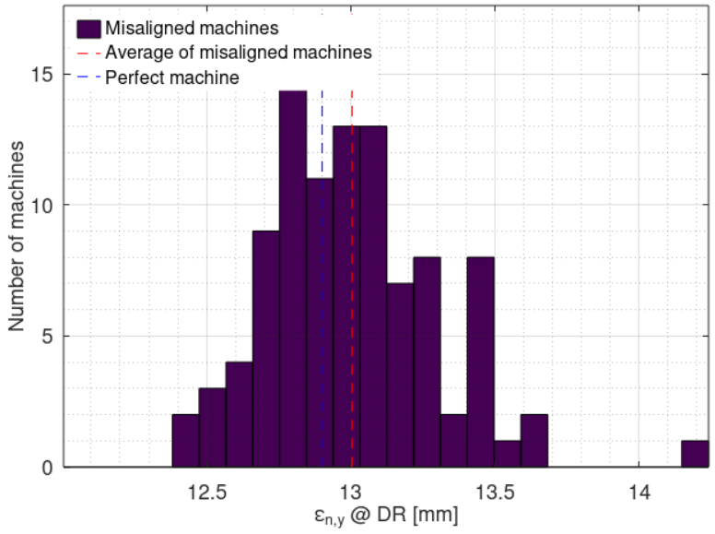
p-linac imperfections
Imperfections considered
  Position error (x, y): σ = 100 um for all elements
  Angular error (roll, pitch, yaw): σ = 100 urad for all elements, except that σ = 200 urad for all NC solenoids and dipoles
  Magnatic strength error: σ = 0.1% for all magnets
  RF gradient error: σ = 1% for all RF structures
  RF phase error: σ = 0.1° for all RF structures
  Beam position jitter (x, y): σ = 100 um for e⁺ beam from target
  Beam angular jitter (x’, y’): σ = 100 urad for e⁺ beam from target
100 random machines with imperfections
Compared with perfect machine:
  Average DR accepted e+ yield reduction: 1.3% (3.01 → 2.97)
  Average normalized X / Y emittance increase: 0.4% / 0.8% (13.1 / 13.0 mm → 13.2 / 13.1 mm)
Impact of considered imperfections is negligible

Slide 14
Conclusion and outlook
Solid design of the linacs. Ready for documenting in FS report.
Few minor points on the top-up operation with “golden” pulse to be checked:
  Bunch-to-bunch energy spread in e- and p-linac and DR acceptance
  Bunch-to-bunch energy spread in e-linac and impact on positron production
Next steps for 2025 pre-TDR phase,
  Move to 3GHz
  Fit in the CERN site constrains
…

