Slide 1
WP3 update
Positron Source: Target and Capture System
Iryna Chaikovska
on behalf of the WP3 team
05 December 2024

Slide 2
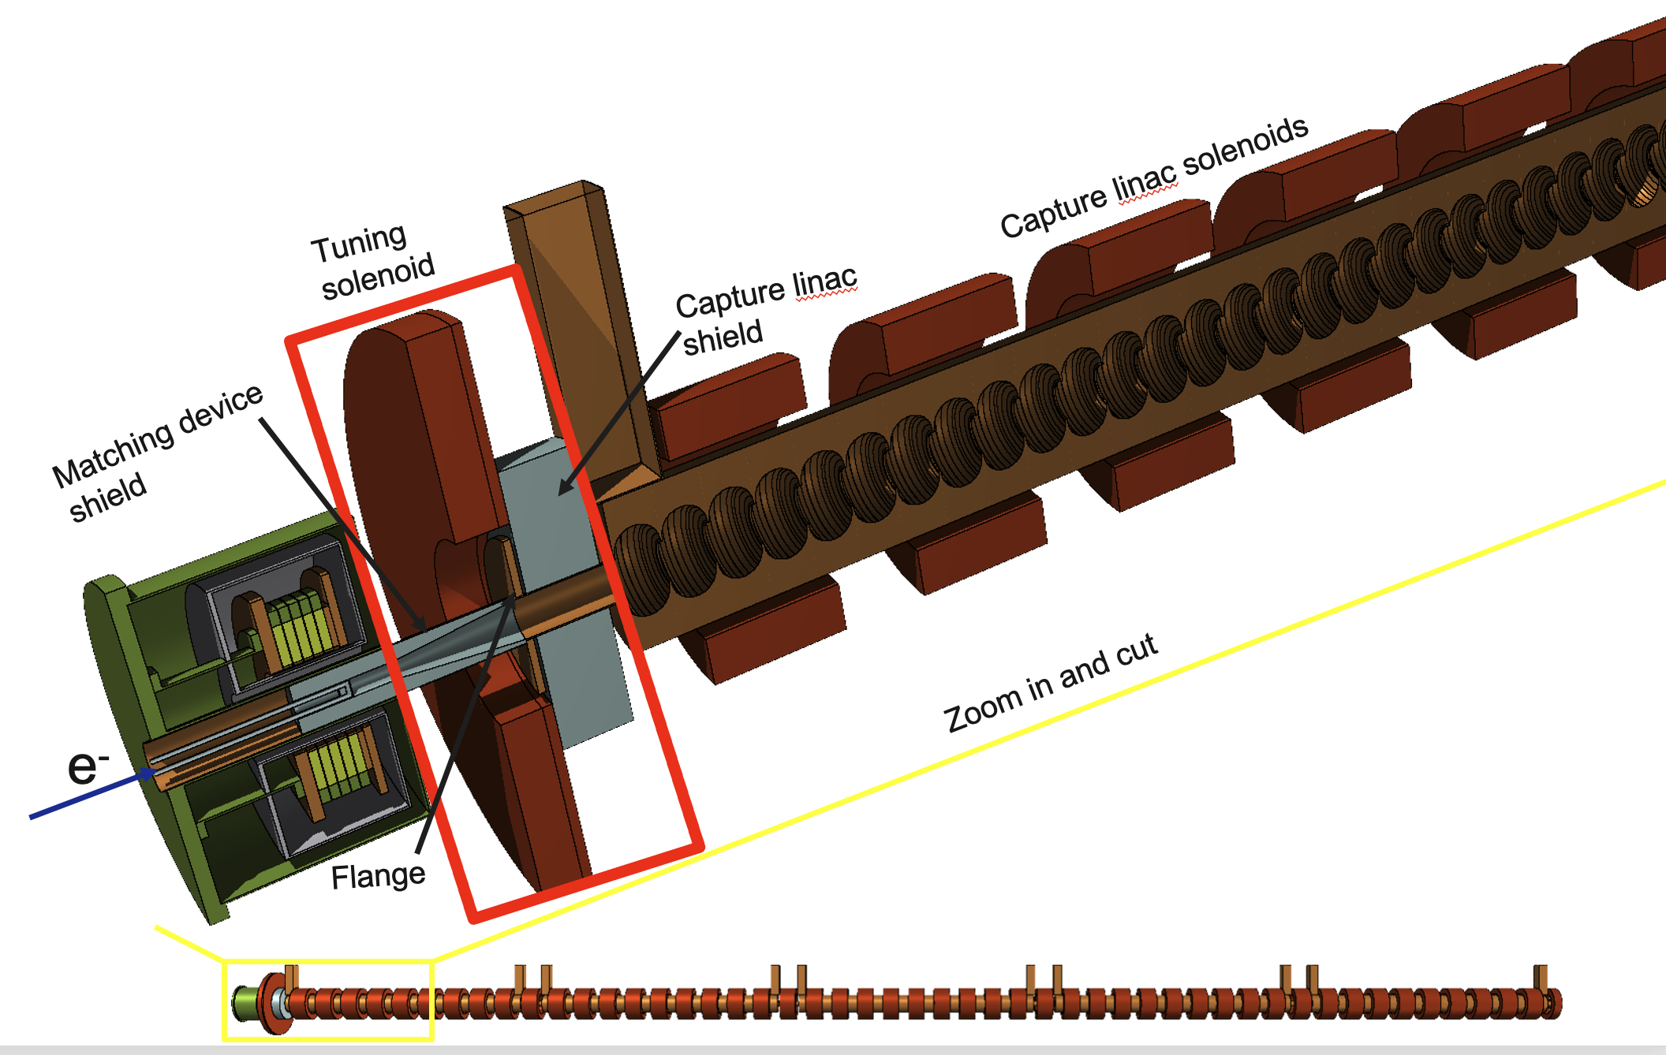
Towards FS report
Baseline design relies on the HTS solenoid. The accepted e⁺ yield is ~3 N_{e+}/N_{e-}. So far, no showstoppers found that prevent a SC solenoid matching device (proof-of-principle with P³ experiment @PSI in 2026).
For 2.86 GeV injector option, to fulfil the requirements for positron bunch charge, higher e⁻ drive beam charge is needed (~4.5 nC).
The results are based on start-to-end simulations from production target to the DR using the realistic fieldmaps including collective effects and machine imperfections. The preliminary studies show negligible impact of typical imperfections (~1 % reduction in e⁺ yield and < 1% emittance increase).
Radiation load studies with FLUKA and target design.
FLUKA model of the e⁺ source

Slide 3

FCC-ee positron source: current requirements
The complete filling for Z running => Requirement ∼2.75 ⨯ 10¹⁰ e⁺/bunch (4.4 nC) at the linac end
or 5.4 nC accepted in the DR
N_{e-}/bunch ⨯ η^{e+}_{Accepted} ≥ 5.4 nC/bunch ⨯ 2.5
13.5 nC
*A safety margin of 2.5 is currently applied for the whole studies (50% losses for injection in the DR + 20 % losses from target up to the end of the e+ linac )
Accepted e⁺ yield is a function of primary beam characteristics + target + capture system + DR acceptance
Beam energy | 2.86 GeV
Bunch charge | ∼5.6 nC (max)
Bunch length | 1 mm
Bunch transverse size | ≳ 0.5 mm
Nb of bunches per pulse | 4
Bunch separation | 25 ns
Repetition rate | 100 Hz
Beam power | ~ 6.4 kW (max)
e⁻ drive beam
➜ positron flux of ∼1.3⨯10¹³ e⁺/s (⨯2.5). Demonstrated at SLC (a world record for existing accelerators): ∼6 ⨯10¹² e+/s

Slide 4
e- drive beam parameters (to be used for e+ generation)
Energy = 2.86 GeV
Beam size (x, y) rms = 1 mm
Beam position (x, y) = 0 mm
Bunch length rms = 1 mm
Energy spread rms = 5e-3
Divergence (xp, yp) = 0.715 μrad, (px, py) = 2.04 KeV/c.
Normalized emittance (x, y) = 4 μm rad.
Statistics (Geant4) = 50k
Simulation performed w/o mesh.
Beam matching section upstream the target (flexibility in beam size @Target)

Slide 5
Positron source physics design
HTS solenoid – based option => baseline
E = 2.86 GeV
Q = 13.5 nC (considering 60% losses for transport, collimation and injection into DR)
2.86 GeV electron beam
from e- linac
Capture linac 2 GHz, 13.3 MV/m
100 Hz, 6 RF structures
Positron linac 2 GHz, 13.3 (12.8) MV/m
100 Hz, 20+52 RF structures
Positron/Electron
Separation at 200 MeV
Target & cryostat
DC solenoid
Injection section
E = 2.86 GeV
Q = ~4.5 nC
Damping Ring
E = 2.86 GeV
Q_{b} = 5.4 nC
DC solenoid
Electron/Photon dumps
Energy collimator
and compressor
Capture system (~ 20 meters)
509.5 mm
105 mm
72 mm
3000 mm
200 mm
240 mm
346 mm
Positron production : conventional scheme (e- beam size on target = 1 mm rms ). Target exit located at 40 mm w.r.t. HTS solenoid peak field.
Matching device is based on the SC solenoid (5 HTS coils, ∅ 60 mm 72 mm bore, ∅ 60 mm including shielding)
Capture linac is based on the 6 L-band TW RF structures ( 2 GHz, ∅ 60 mm, 3-m long)
NC solenoid B = 0.5 T (realistic conventional design based on the short coils B = 0.31 T) + short “tuning” solenoid B = 0.25 T before the 1st RF structure

Slide 6
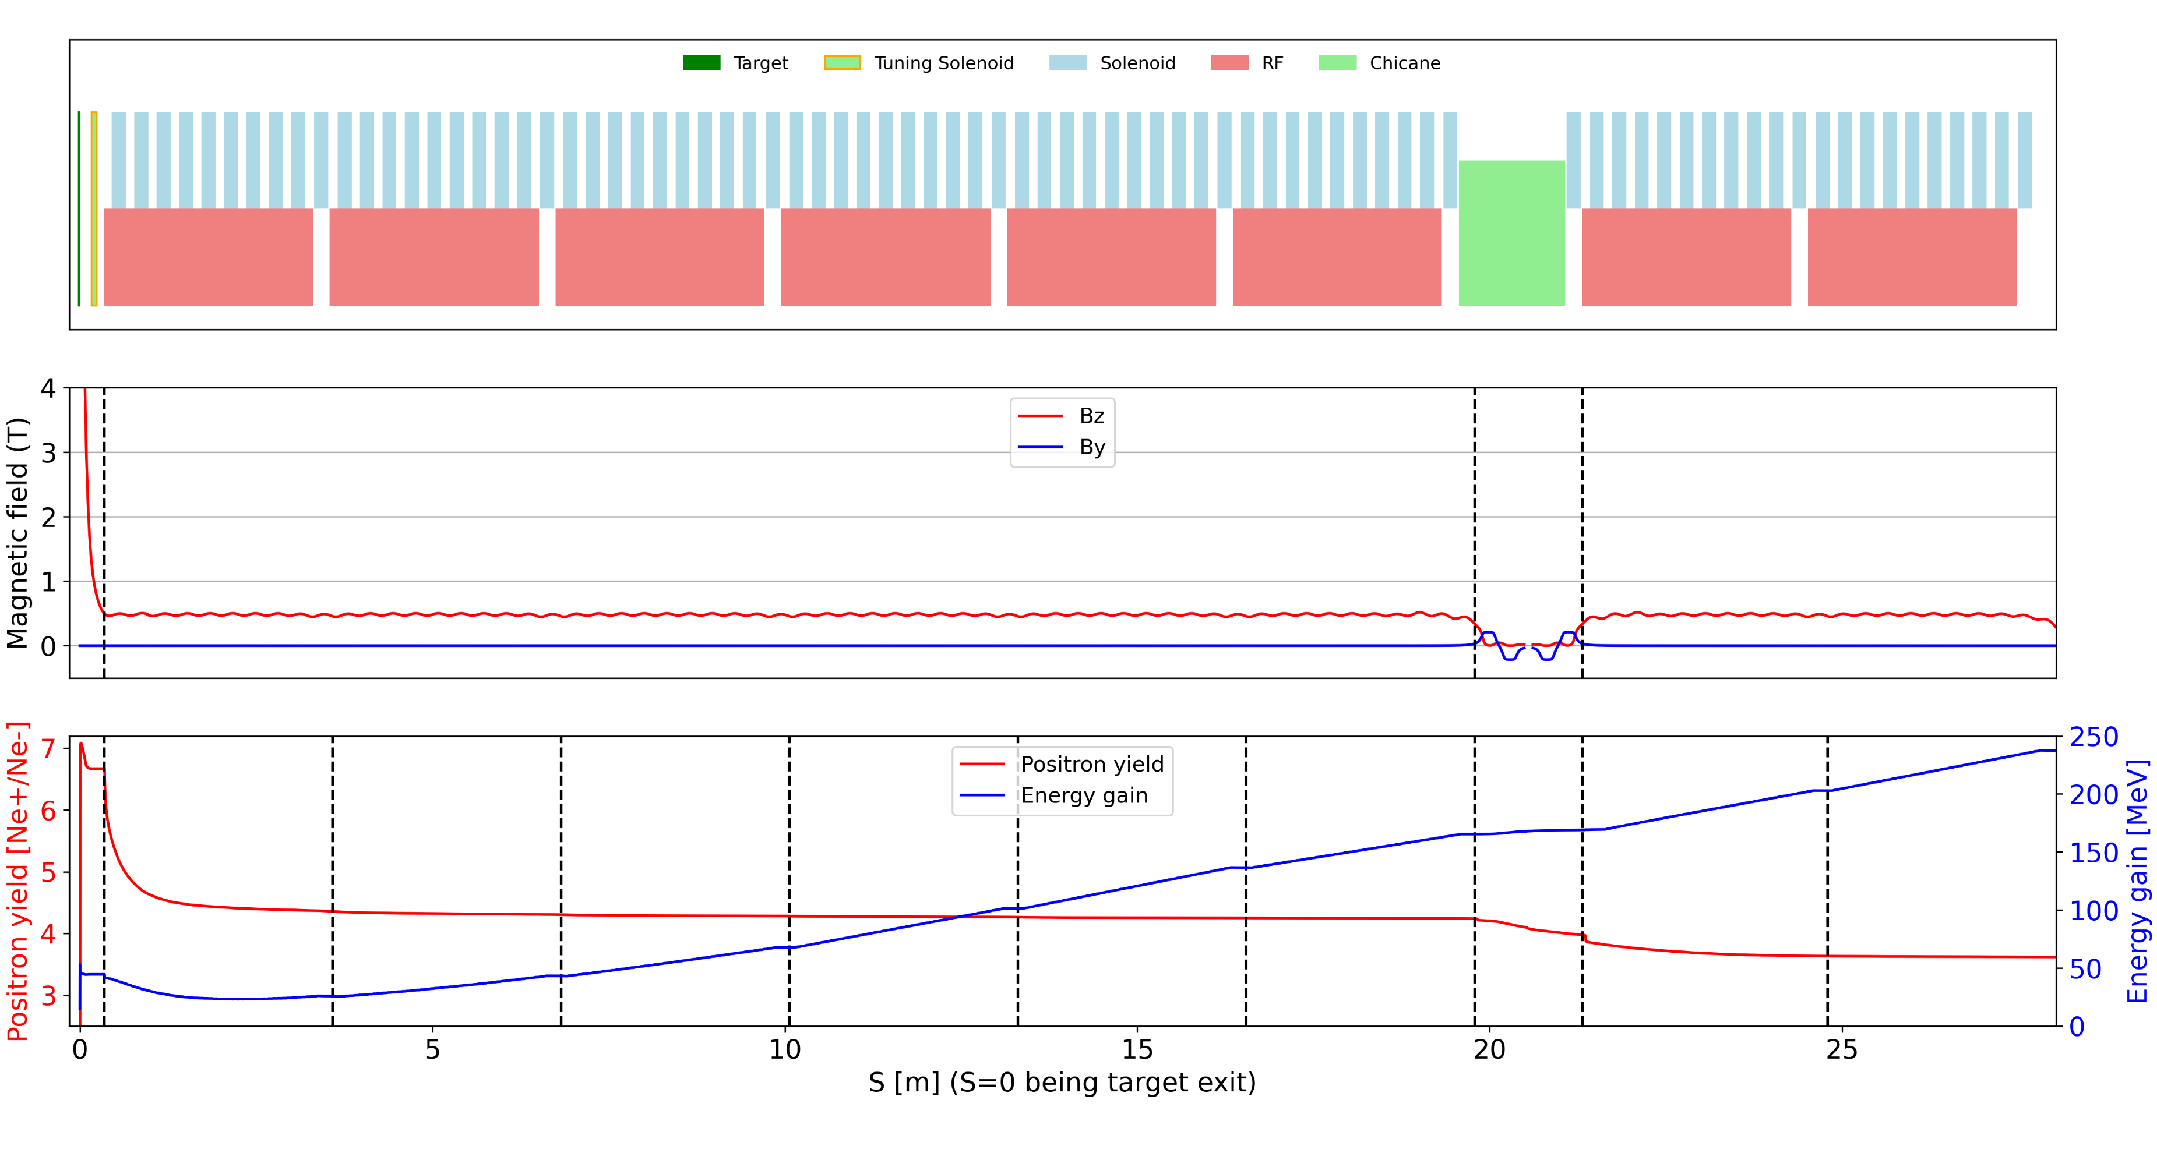
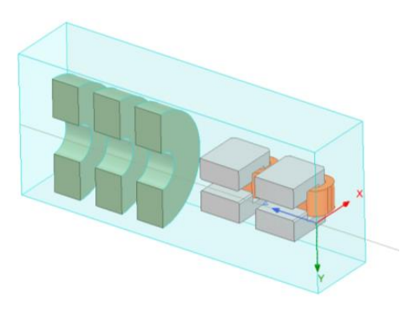

Capture Section design and performance
- RF structures: 2GHz L-band with aperture (2a) = 60 mm , 3 m-long and 13.3 MV/m.
- Solenoids: 10 NC short solenoids surrounding each RF structure to create 0.5 T magnetic channel.
- Chicane: 4 dipoles (0.2 T) to separate e- and e+, with electron stopper at the middle.
$$1/4 view of chicane region$$
F. Alharthi. Y. Wang

Slide 7
Positron source physics design
HTS solenoid – based option => baseline
E = 2.86 GeV
Q = 13.5 nC (considering 60% losses for transport, collimation and injection into DR)
2.86 GeV electron beam
from e- linac
Capture linac 2 GHz, 13.3 MV/m
100 Hz, 6 RF structures
Positron linac 2 GHz, 13.3 (12.8) MV/m
100 Hz, 20+52 RF structures
Positron/Electron
Separation at 200 MeV
Target & cryostat
DC solenoid
Injection section
E = 2.86 GeV
Q = ~4.5 nC
Damping Ring
E = 2.86 GeV
Q_{b} = 5.4 nC
DC solenoid
Electron/Photon dumps
Energy collimator
and compressor
Positron linac (~ 280 meters)
Separator chicane : Rectangular beampipe and hor./vert. collimators, Dipole peak field: ~0.2 T
Section 1 : up to ~ 930 MeV. Same RF structure with Capture Linac (CL). 20 structures. G = 13.3 MV/m
Matching section : 5 quadrupoles. Quadrupole (0.4 m long)
Section 2 : up to 2.86 GeV. Same RF structure with CL. 52 structures. Quadrupole (0.4 m long), 2 structures per FODO cell. G = 13.3 MV/m
Capture Chicane Positron linac - Section 1 Matching section Positron linac - Section 2
section
3000 mm
200 mm
500 mm
350 mm

Slide 8
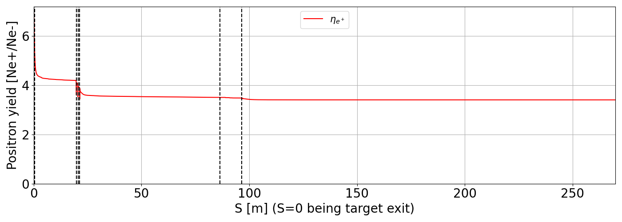
Positron linac design and performance
Capture
Linac
Section 1
Section 2
Y. Zhao

Slide 9
Summary of the simulation results
Parameter | Unit
e⁻ beam energy | GeV | 2.86
Number of bunches |  | 4
Repetition rate | Hz | 100
e⁻ bunch charge | nC | 4.01
e⁻ beam power | kW | 5.1
Target thickness | mm | 15
Beam size, x/y | mm | 1
Positron yield @ Target | Ne⁺/Ne⁻ | 7.1
Positron yield @ CS * | Ne⁺/Ne⁻ | 4.2/3.9/3.6
Positron yield @ PL** | Ne⁺/Ne⁻ | 3.37
Positron yield @ DR*** | Ne⁺/Ne⁻ | 2.97
Target deposited power | kW | 1.2
Target PEDD | J/g | 6.8
e⁺ beam emittance, ε_{n} x/y | mm.rad | 13.5/13.6
* Yield before chicane/ after chicane/ @ s1 point (2 RF structures after chicane)
** full beam
*** Estimated with the cut window
Emittance is estimated for the full e⁺ beam
DR acceptance window: (Energy : 2.86 GeV ± 2 % ; Time : ± 10 mm/c)
F. Alharthi. Y. Wang, Y. Zhao

Slide 10
Beam emittances at the end of the positron linac
For the latest 2.86 GeV: date (09/10/24)
Beam Emittances:
em_x = 2.38e-06 m*rad
em_y = 2.38e-06 m*rad
Beam normalized Emittances:
em_x_n = 13.3 mm*rad
em_y_n = 13.3 mm*rad
For the latest 1.54 GeV (6 GeV e- drive beam): (03/06/24)
Beam Emittances:
em_x = 3.52e-06 m*rad
em_y = 3.72e-06 m*rad
Beam normalized Emittances:
em_x_n = 10.6 mm*rad
em_y_n = 11.2 mm*rad
For the latest 2.86 GeV: date (06/12/24)
Beam Emittances:
em_x = 2.41e-06 m*rad
em_y = 2.43e-06 m*rad
Beam normalized Emittances:
Normalised Emitt_X : 13.5 mm*rad
Normalised Emitt_Y : 13.6 mm*rad

