Slide 1





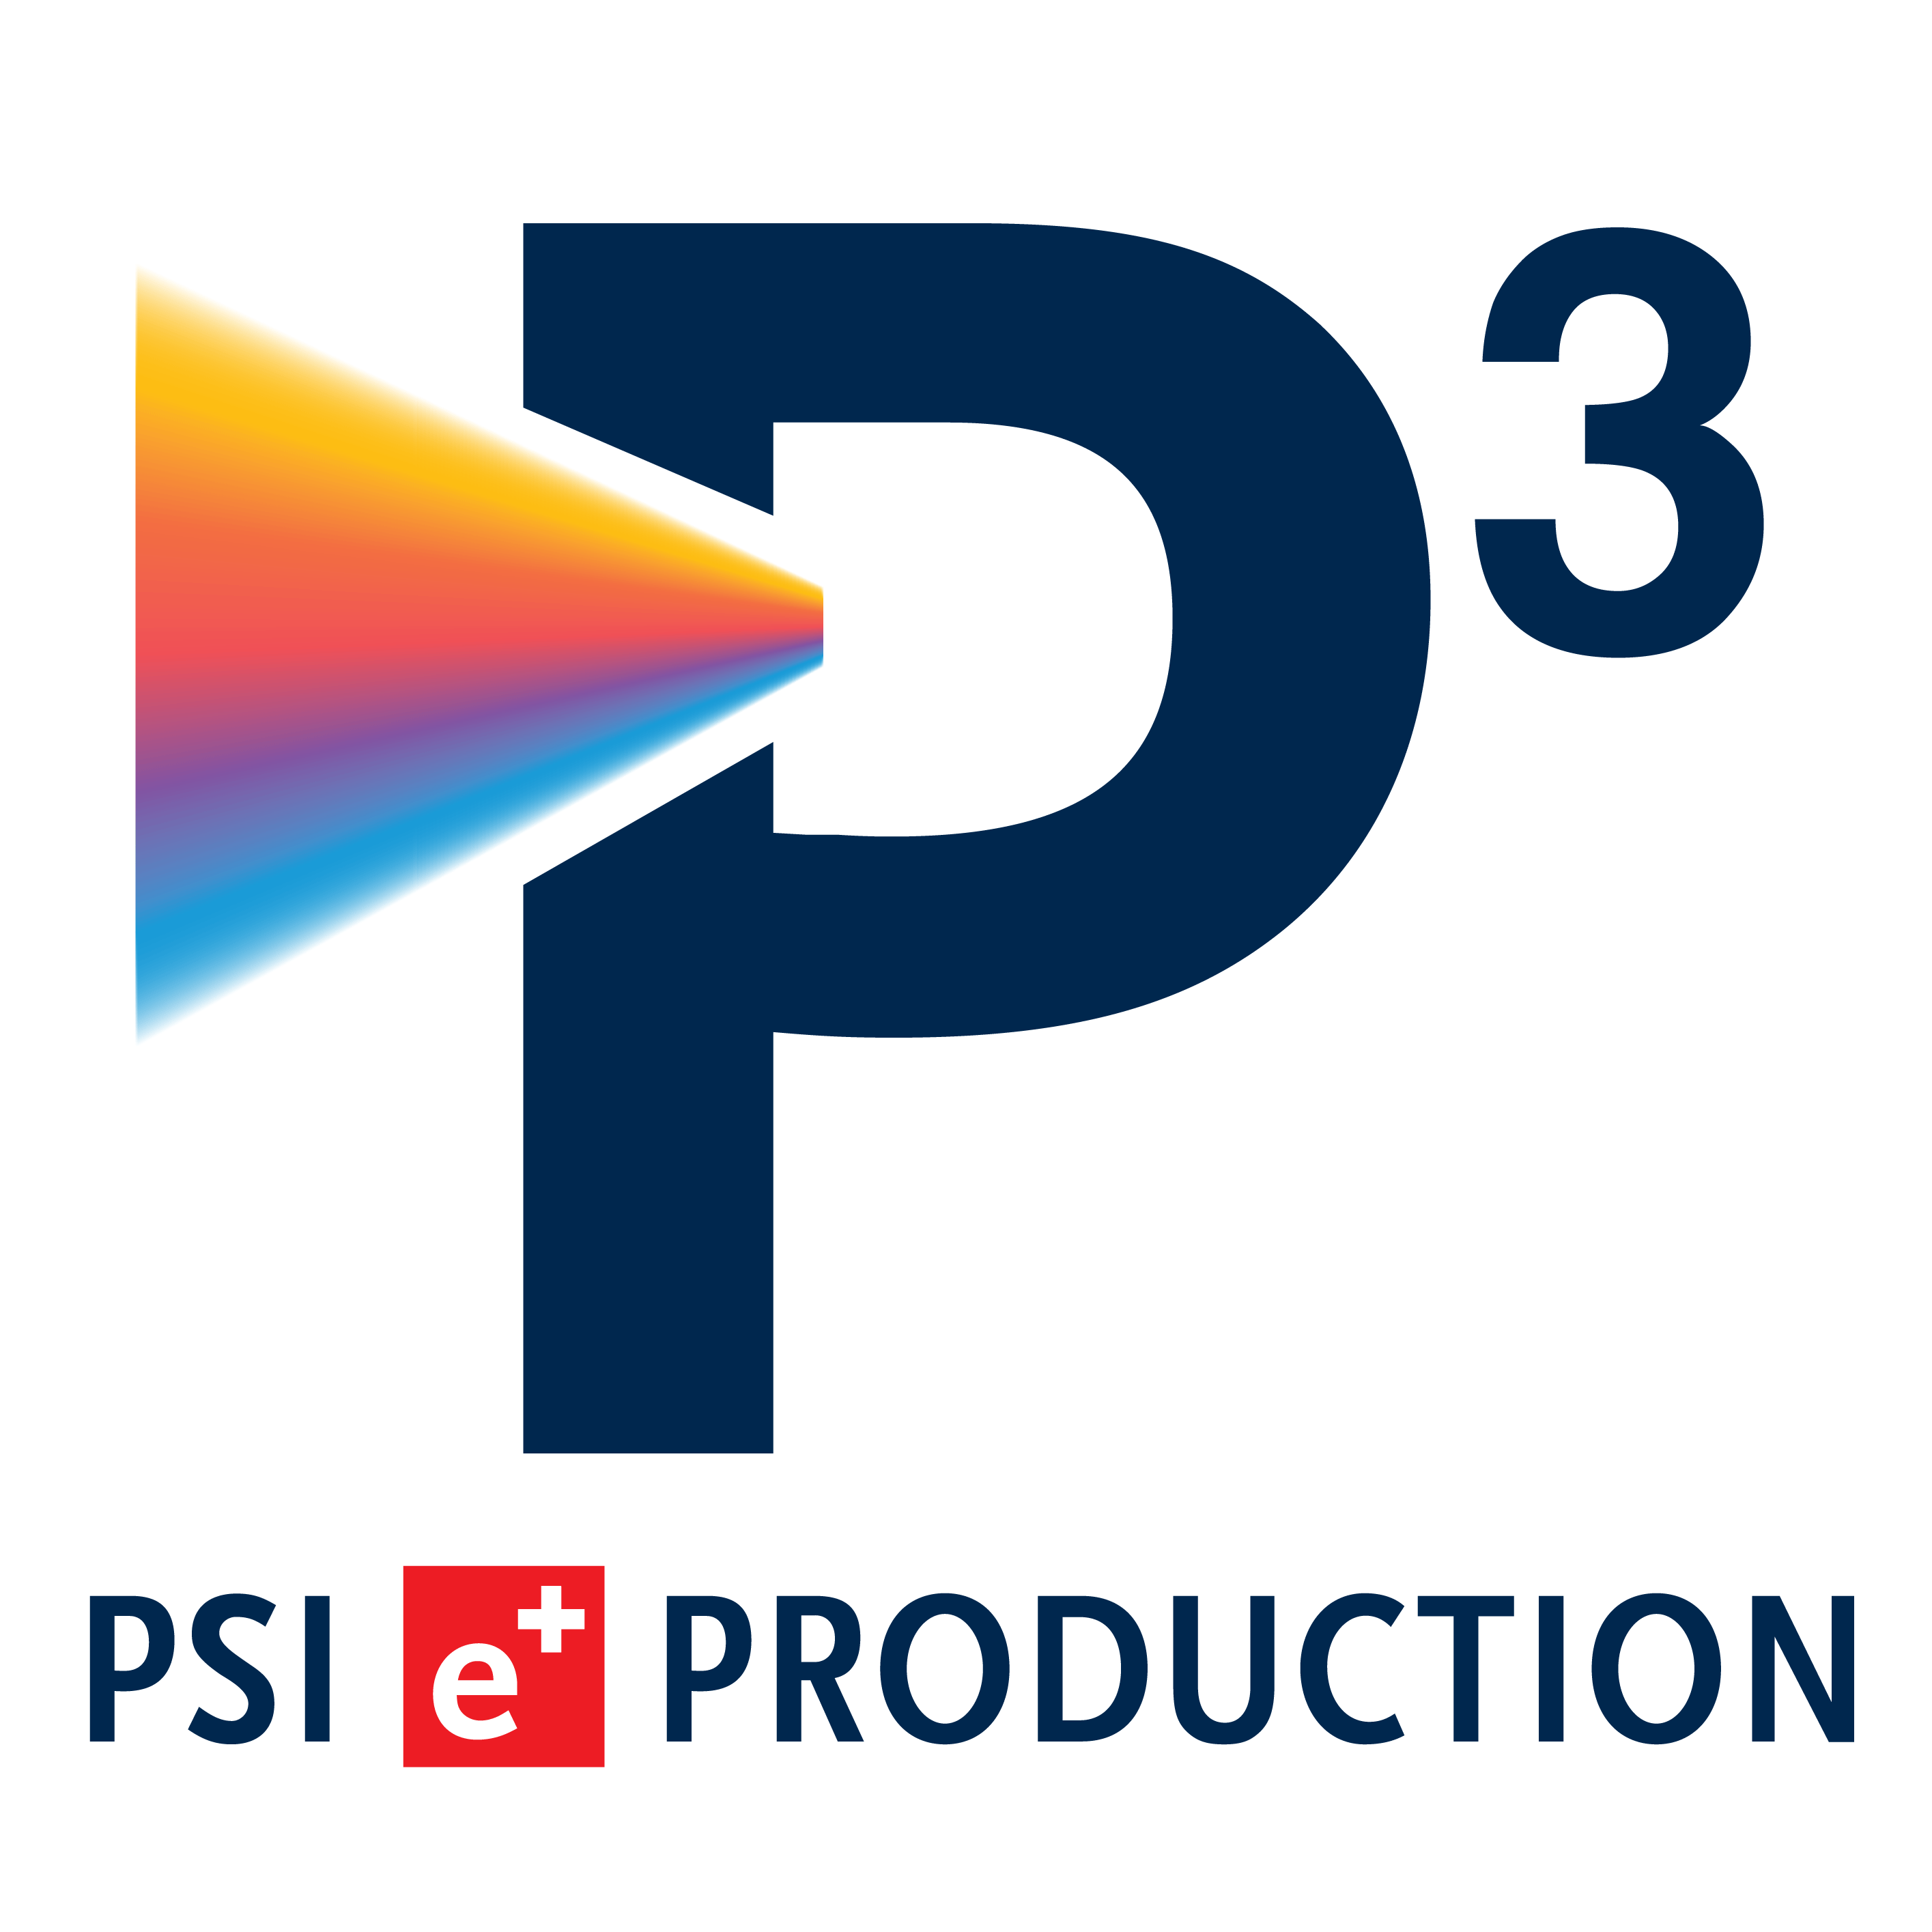
FCC-ee Pre-Injector study coordination meeting #20
P. Craievich – 05.12.2024

Slide 2
Agenda
WP0 - General information (P. Craievich)
HE Linac to Booster ring (LTB) transfer line (P. Arrutia)
WP1 - e+/e- Injector Linacs: electron-, positron- and HE-linac (A. Grudiev)
WP3 - Positron source and capture system (I. Chaikovska)
WP4 - DR at 2.86 GeV: status and outlook (A. De Santis)
WP6 - P-cubed experiment at PSI (R. Zennaro)
WP6 - Target development at CERN (J.-L. Grenard)

Slide 3
SAC meeting, 18-20 November 2024
Slides on the Indico.
Green light to proceed with the FS report, slides are also the guideline for the FS report
Some topics discussed during SAC:
  Length of injector and DR siting, length for FS report is 1.2 km. Further discussion in post-FS.
  Compensation scheme for beam loading and rf pulse shape with ‘golden’ pulse. Well received.
  DA at the injection into the booster: this point should be further explored. Input (‘real’) distribution from injector for booster simulations.
  Place the HE Compressor (HEC) just before booster injection to control parameter changes in the TL and eventually use R56 of the transfer line. Decision: The HEC remains at the HE linac end for the FS report.
  Iryna’s statement on positron source: “we expect the positron flux to be twice the current world record of SLC”. Comment: however, it remains one of the most challenging parameters for the project (Paolo: together with the overall transmission efficiency).
  DR: positron acceptance should be included in the FS report. Strong impact on the overall positron production. Presently we have a margin of ~2.5 on the positron production.

Slide 4
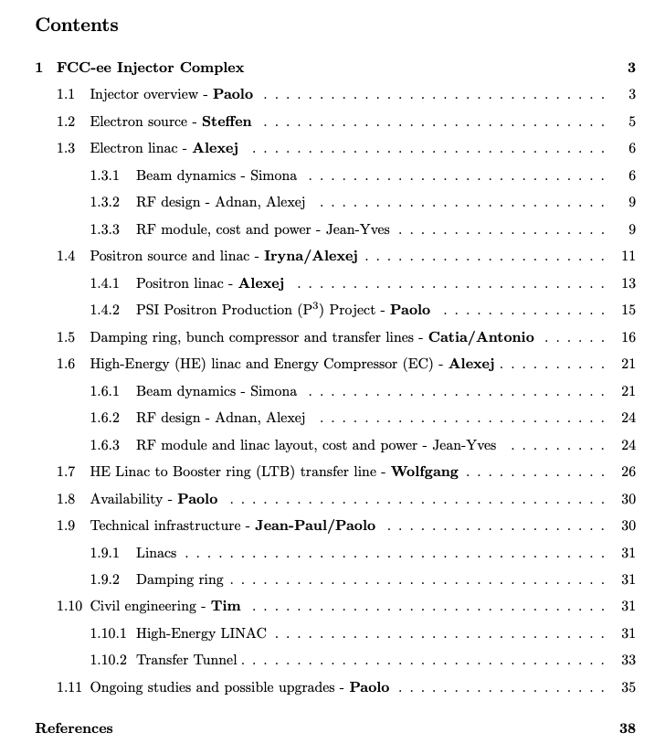
Final Report of the FCC Feasibility Study
Volume 2: Accelerators, TI and Safety
IV, Chapter 7: Injector complex
Submission Timeline for Vol. 2
First draft by 20.12.2024
Submission to FCC (main) editors by 3.2.2025
Submission to Directorate by 25.2.2025
Collect comments by Directorate by 7.3.2025
Finalize volumes for publication/submission to European Strategy by 17.3.2025
Circulate to editors for any final remarks by 24.3.2025
Submit to the European Strategy Update: 31.3.2025

Slide 5
Other documents to be submitted
Risk management
  Excel file (for the risk register) with the identified risks related to the injector complex including proposal for mitigation measures for further discussions.
  First draft submitted.
Update of the cost estimate, with a view of reducing the uncertainty level from cost class 4 to cost class 3, when relevant;
  First draft almost ready, to be submitted in the next days.
Environment aspect report for the FS also needs to feature a chapter describing the injector complex
  Report for non-technical readers and authorities
  not started yet

Slide 6
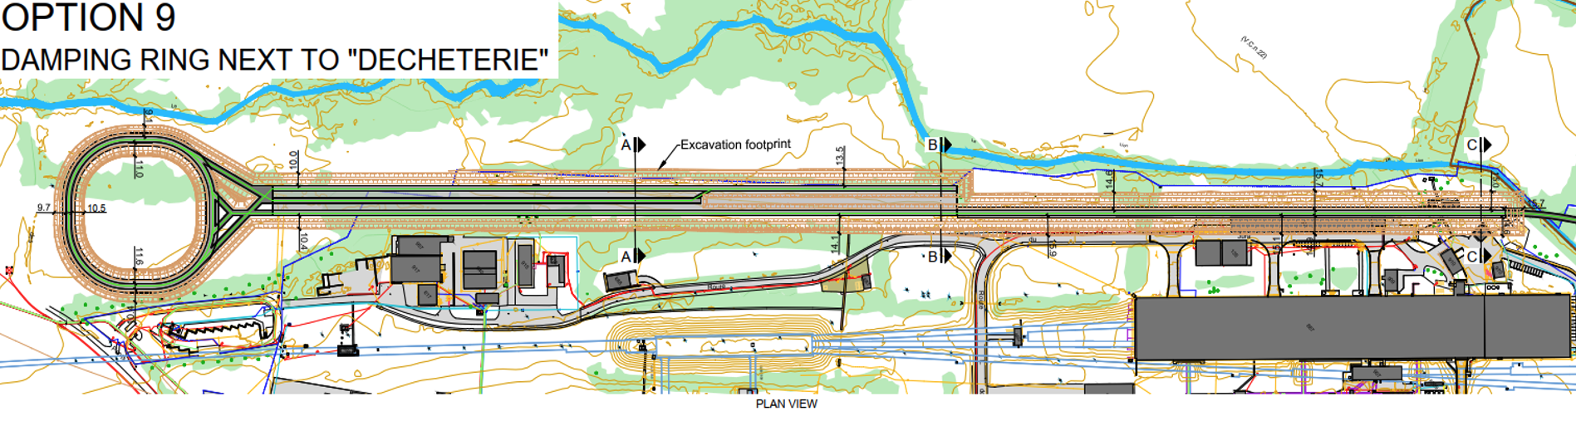
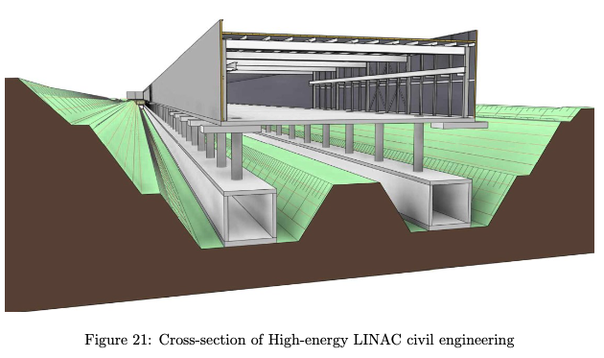
Recap: Baseline layout: 4 ASs for module, 4 bunches (25 ns), 100 Hz
The schematic will be changeg to reproduce the CE
Courtesy of Tim Watson

Slide 7
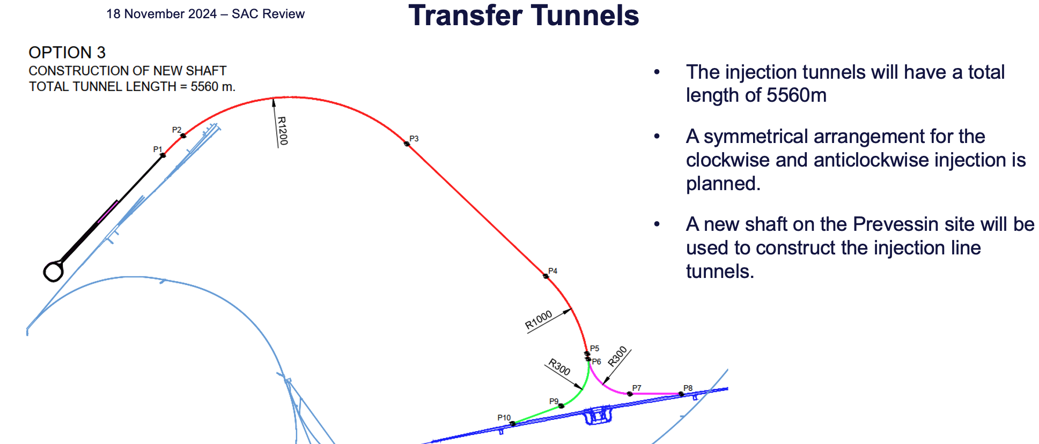
Courtesy of Tim Watson and Wolfgang Bartmann (SAC meeting)

Slide 8
Recap: Collider and booster parameters related to the Injector
Sources: C. Carli, SAC meeting (Nov 2024) and H. Bartosik, Other Science Opportunities at the FCC-ee (Nov 2024)
Running mode | Z | W | ZH | tt bar | Unit
Number bunches in collider | 11200 | 1856 | 300 | 64
Nominal bunch charge in collider | 34.40 | 22.08 | 27.04 | 23.68 | nC
Allowable charge imbalance | 5 | 3 | 3 | 3 | %
Booster cycle/number of bunches | 10x1120 | 2x928 | 1x300 | 1x64
Injector duty cycle | 73% | 40% | 19% | 5%
Max injected bunch charge | 3.43 | 1.6 | 1.6 | 1.6 | nC
Number of bunches | 4 | 4 | 2 | 2
Linac rep. rate | 100 | 100 | 50 | 50 | Hz
Bunch spacing | 25 |  |  |  | ns
Beam energy at BR | 20 |  |  |  | GeV
Norm. emittance (x, y) (rms) (BR) | <20,2 |  |  |  | mm mrad
Bunch length (rms) (BR) | ~4 |  |  |  | mm
Energy spread (rms) (BR) | ~0.1 |  |  |  | %
8

Slide 9
Open questions for the post-FS
Working RF frequency for the linacs (from 2.8 GHz to 3 GHz): The power source (klystron) with a commercial S-band frequency can be used if slightly different time separations (presently around 25 ns) between bunches in the injector and booster can be accepted, otherwise, the klystron should be slightly tuned, e.g., from ~2999 to ~3006 MHz.
Positron capture and linac (from 2.0 GHz to commercial rf frequency): New optimization using commercial frequencies will be performed. Some options to be discussed, i.e., an option could be the re-use low-temperature SC solenoids around the rf structures (also a reduction in energy consumption, currently 4-5MW!) or recovery the yield increasing the drive beam energy (new layout is flexible for this) or using 1.5 GHz frequency for capture rf structures
  Optimization MUST include dynamic acceptance and aperture in the DR! Start-to-end simulations from target to DR.
Reliability and availability of the injector complex to be estimated based on high-power rf test on rf prototypes.
Photocathode RF gun (electron source) for collider top-up operation: some options under discussion between PSI and CERN for the bunch-by-bunch charge variation (4 bunches at 100 Hz) changing the laser intensity on the photocathode
  DR for electrons → can we exclude the use of another type of electron sources and intensity modulation schemes?
Polarized positrons (and electrons) from the injector. Impact on the present layout, i.e., dedicated DR?, OR polarized electron source?

Slide 10
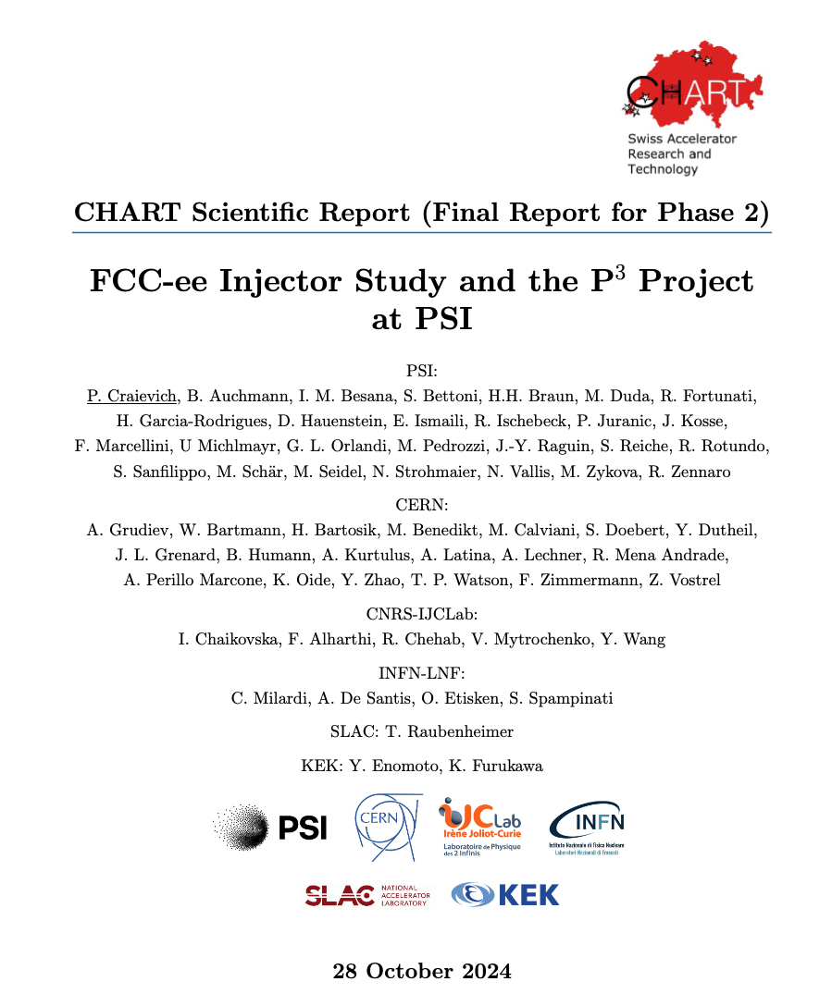
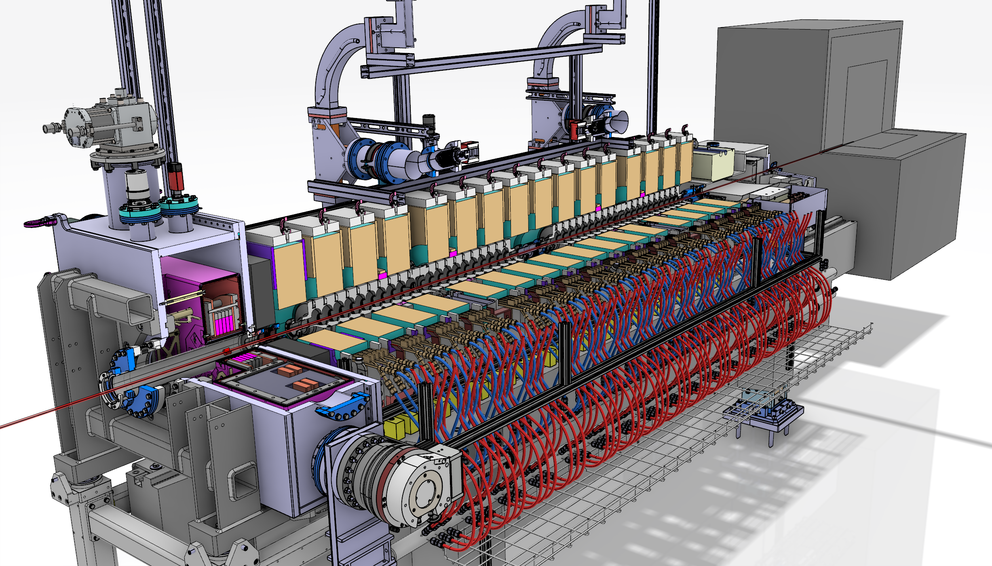
CHART 2020-2024
This work was done under the auspices of CHART (Swiss Accelerator Research and Technology) Collaboration, https://chart.ch - CHART Scientific Report: https://chart.ch/reports/
FCCIS: 'This project has received funding from the European Union's Horizon 2020 research and innovation programme under the European Union's Horizon 2020 research and innovation programme under grant agreement No 951754.'

Slide 11
Post-FS: CHART 2025-2028
FCC-ee Injector: Technical Design Report, 2025-2028:
Following the completion of the Feasibility Study phase (March 2025), a preliminary technical design report (pre-TDR) will be produced by mid-2027.
The objective of the pre-TDR is to provide detailed specifications for the accelerator and technical infrastructure requirements necessary for the initial phase of the civil engineering (CE) design.
By the end of 2028, the final Technical Design Report (TDR) for both the accelerator and the technical infrastructure will have been completed.
Injector Project schedule (as proposed by Michael Benedikt in preliminary discussion)
Start 2028 – end 2030 CE design and tendering (3 years)
Start 2029 – end 2031 Accelerator engineering and technical infrastructure designs
Start 2030 – end 2033 Civil construction (4 years)
Start 2031 – end 2040 Component production (assuming similar production rates for RF structures as for SwissFEL)
Start 2034 – end 2036 Technical infrastructure installation
Start 2035 – end 2040 Component installation and testing
Start 2042 beam commissioning

Slide 12
Main topics (under discussion):
Drafting of the TDR
Proof of principle for the electron source
Prototype of the RF structures (BDR)
High power test with power source
Positron linac at 3 GHz
Perform the p-cubed experiment
Design of the DR
Technical system interfaces and integration in the CERN enviroment
Goals:
Industralization process for linac production (~ 450 rf structures)
Start CE design in 2028 (pre-TDR by 2027)
Final TDR by 2028

Slide 13

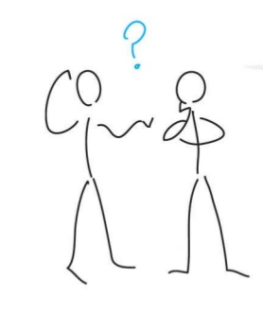
Any question?

