Slide 1


P³ Target - Update
Fcc-ee Injector Design (CHART Proposal) Coordination Meeting #20
J-L Grenard, R. Mena, A. Perillo Marcone - CERN SY-STI
5/12/2024

Slide 2
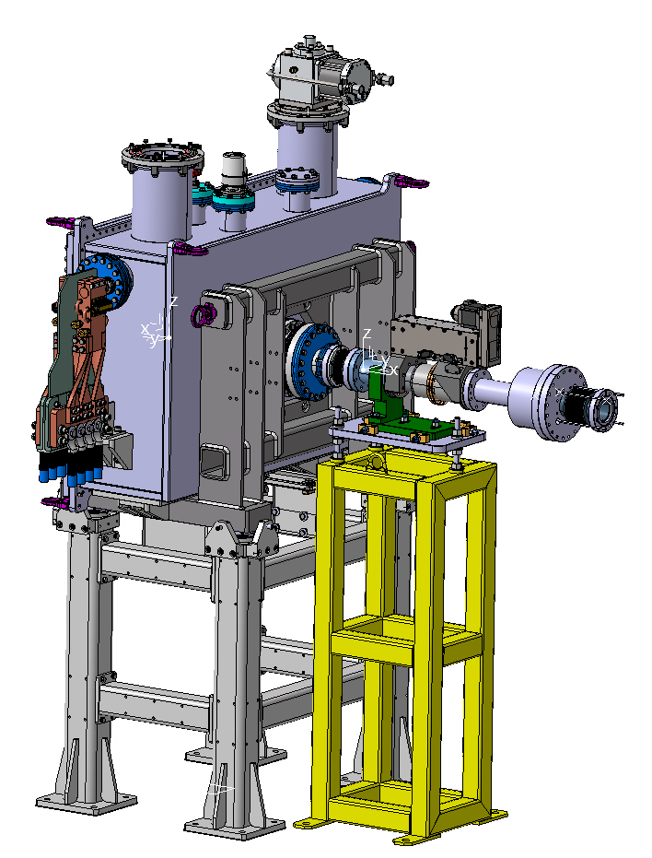
P³ target holder design – general overview
Water feedthroughs
Interface with
vacuum chamber
Capture solenoid
Junction bellow
Target holder
Vacuum actuator
±50mm stroke
Junction bellow
Alignement table
Support feet

Slide 3
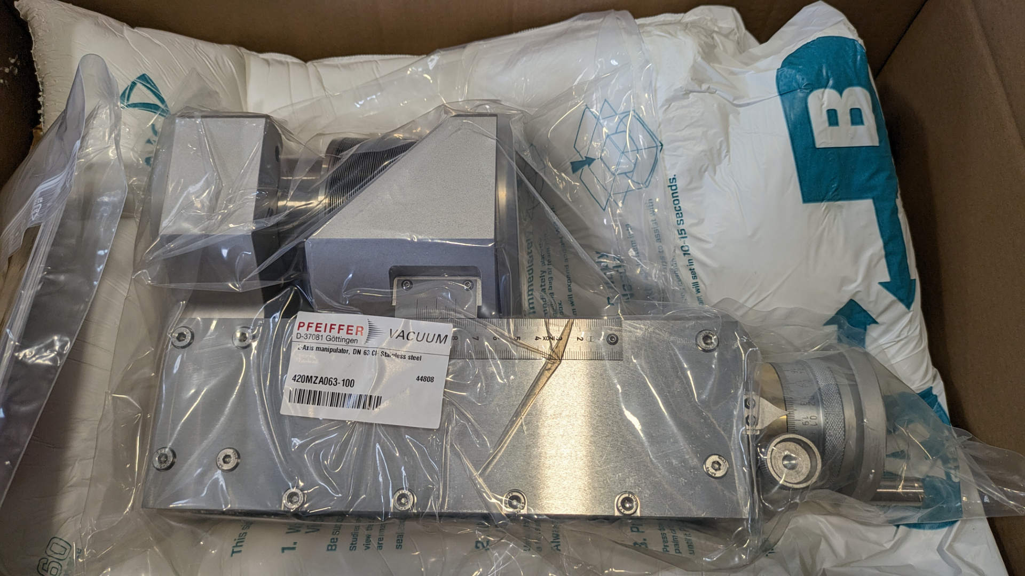
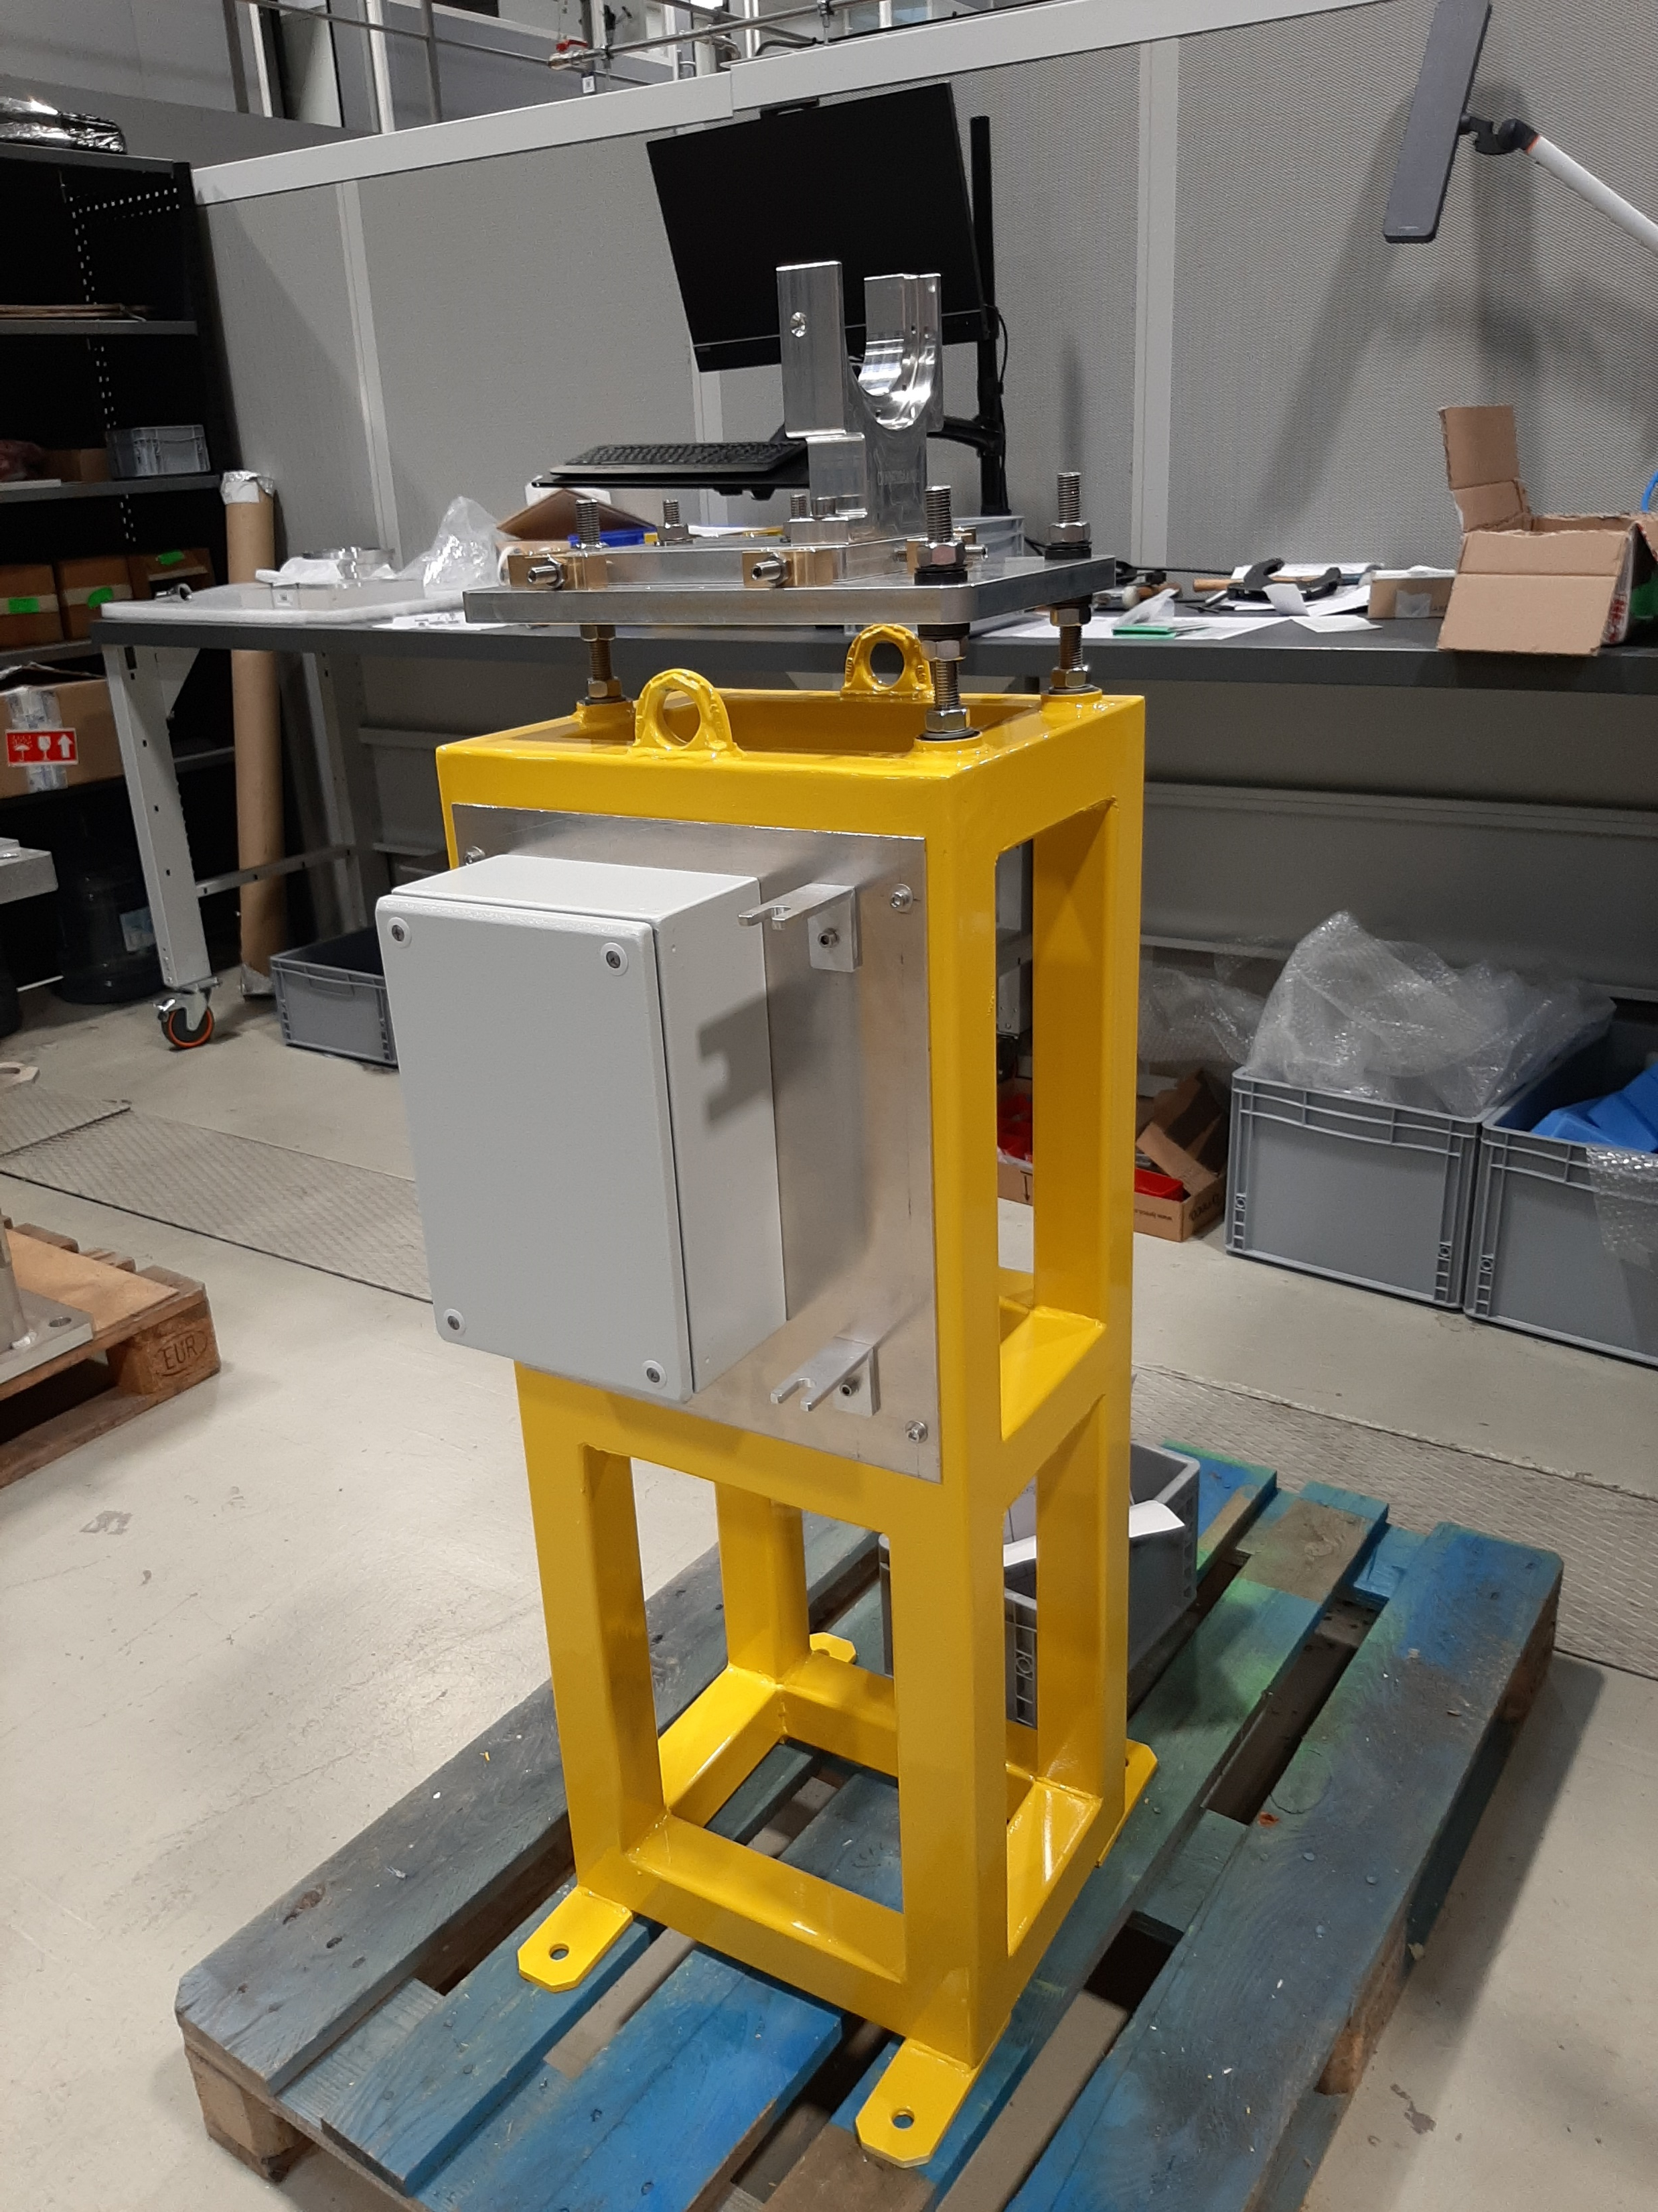
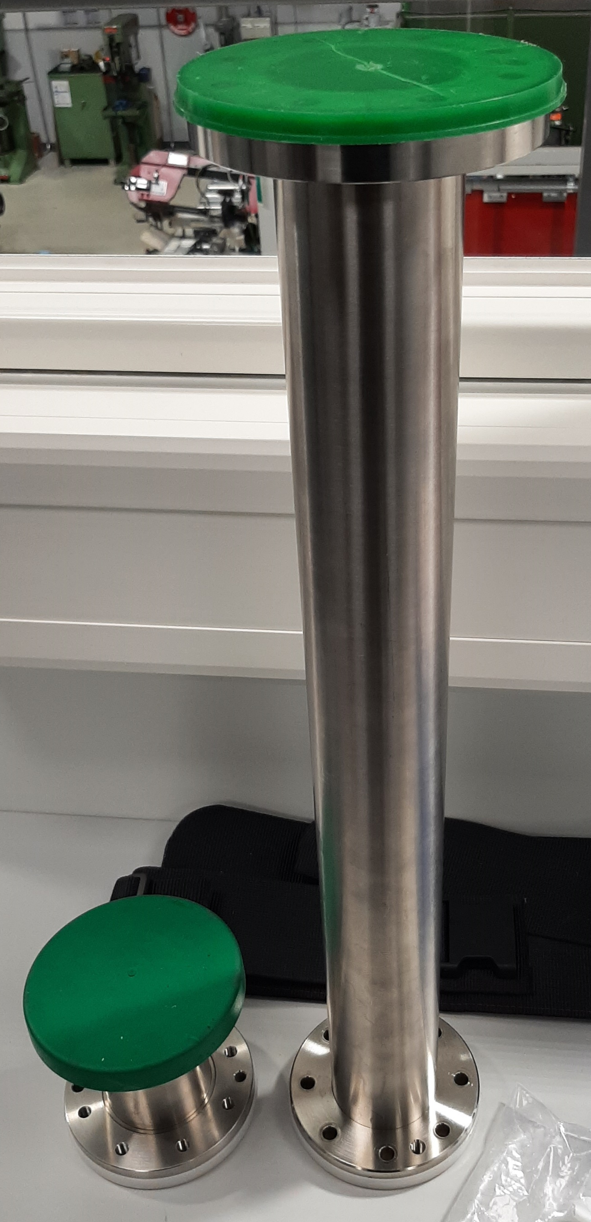
P³ target holder production status
Support and alignment frame completed
Vacuum actuator delivered
W Targets prototypes without cooling
Vacuum chambers (including test chambers) manufacturing ongoing
→ Readiness Feb of 2025
Commissioning at CERN Q1 2025

Slide 4
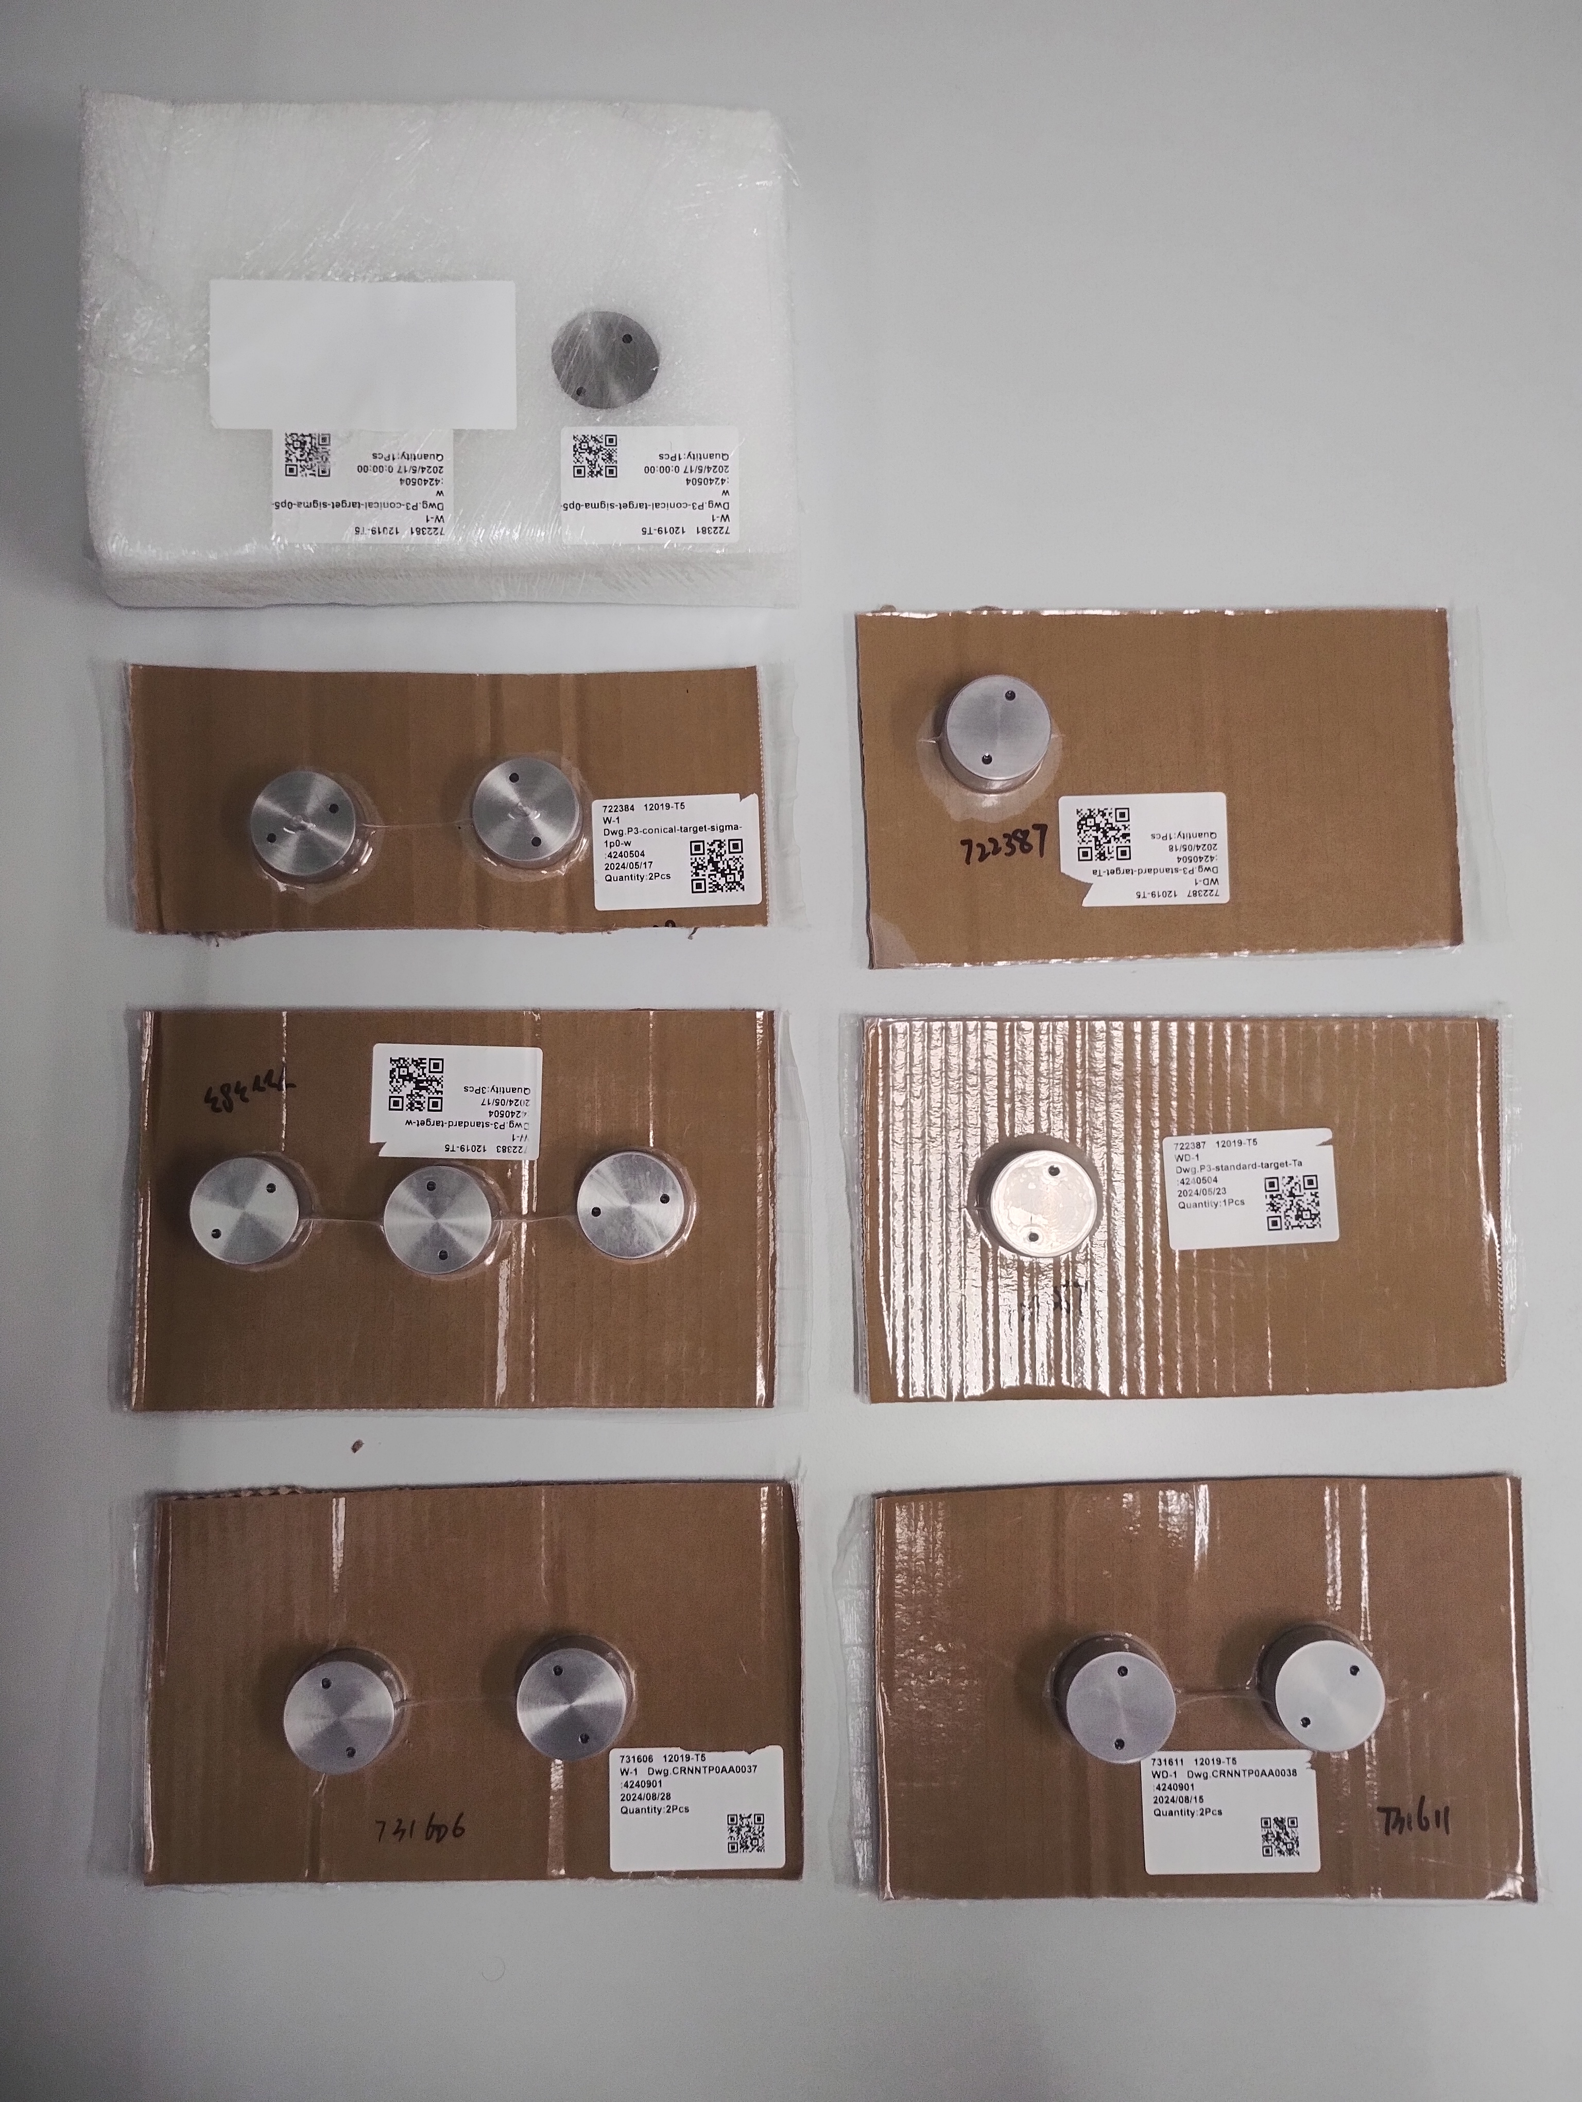
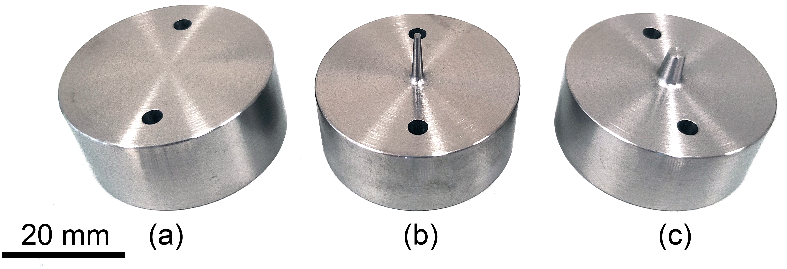
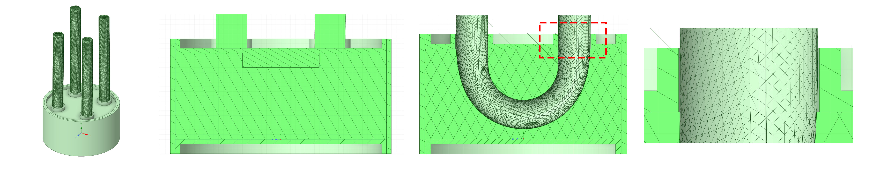
P3 Target update
W Ta
Fig. P3 target prototypes:
Current available models
without cooling →
6 GeV
2.86GeV
Documentation
  Paper written with N.Vallis about the conical targets (NIM-B)
  Under internal review
Manufacturing:
  2.86GeV: 2 x 2 target units without cooling available (W and Ta)
  Vacuum chamber for P3 (in progress)
R&D activities:
  Manufacturing of P3 target with cooling
  Welding tests for joining the tantalum pipes with the HIP capsule (ongoing)
  HIPing capsules manufacturing (under quotation)
Fig. P3 target prototypes (a) baseline
(b) σx=0.5 mm and (c) σx=1mm conical,
3
φ16
φ44
Fig. P3 target prototypes:
HIPping capsule design →

Slide 5
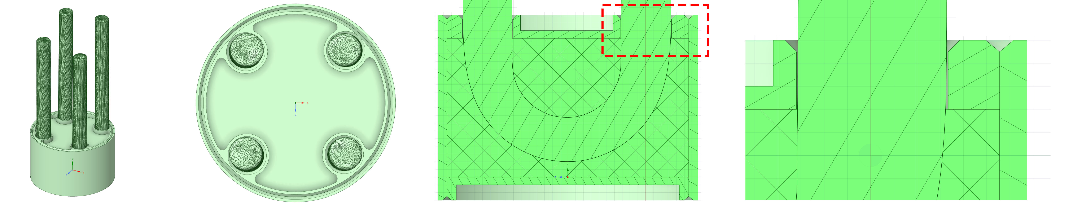
2. Target prototyping: HIPing capsule (3/4)
Option 2: Ta-Ta
(+) This option is made of pure tantalum (i.e no dissimilar materials to join).
(+) The target thickness (18mm) is enough to host the distorted elbow of the cooling pipes.
φ6.56
18
2
φ37
a) 3D model b) top view c) cross section (x=-10 mm) d) gap between pipes and top cover
Fig. Ta-Ta capsule

Slide 6
2. Target prototyping: HIPing capsule (4/4)
Option 3: W-Ta with inserts
To extend 3mm the target only in a region around the cooling pipes
Target diameter (for the capsule) φ44
To separate the pipes supports to the capsule
Selected design
Next steps:
TIG welding test
Capsule and target parts manufacturing
Capsule preparation by EBW and HIPing
φ16
3
φ44
φ6.56
a) 3D model b) cross section (x=0 mm) c) cross section (x=-10 mm) d) gap between pipes and top cover
Fig. W-Ta capsule with inserts

Slide 7


