Slide 1
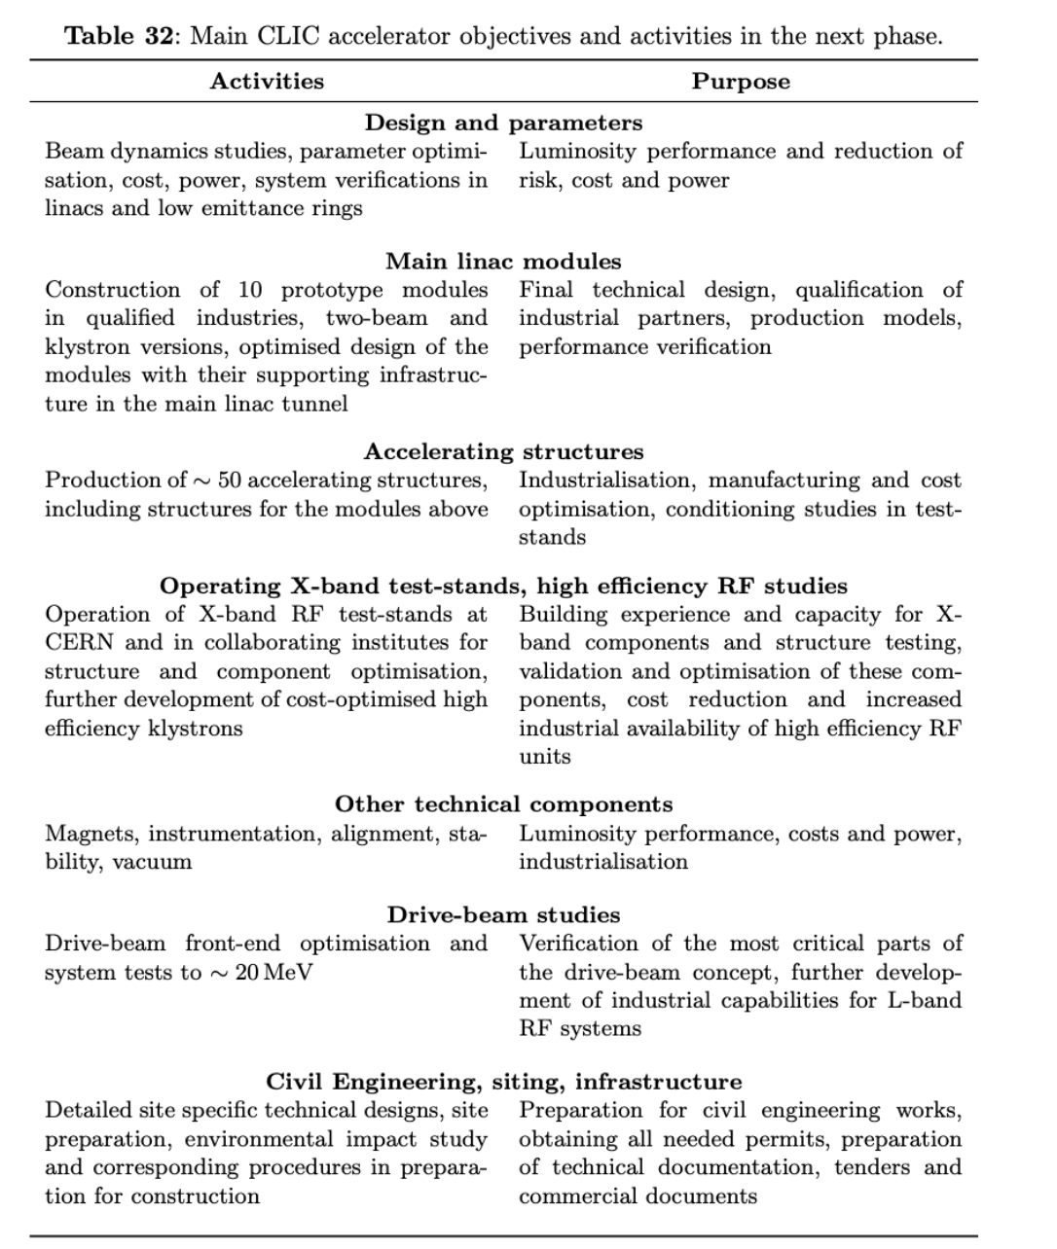
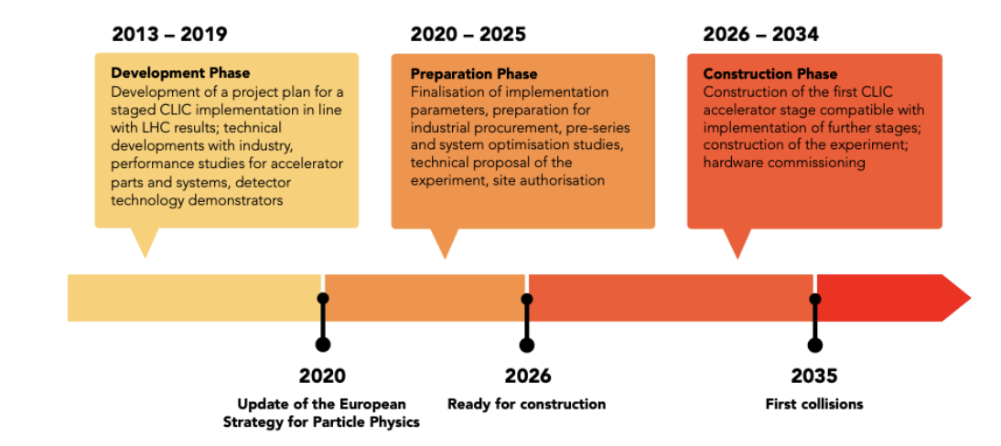
Next phase
Update the two following

Slide 2
New elements
This chapter will need to cover design and technology work for the next period (see table earlier), but also:
The environmental studies and CE studies needed (learn from the FCC) – good confidence in ground conditions but shafts and caverns to be fixed – 2-3 years
Preparation needed at CERN for infrastructures, test-facilities and expertise. Longer term
Related: A budget estimate and personnel estimate is also needed for this phase. This is difficult but is partly covered in R&D table and operational personnel estimate.
Consider also extras for Physics Beyond Collider beams (maybe not in this chapter but mentioned here for future work)

