Slide 1
CLIC Civil Engineering Design Updates
11th Dec 2024
Edward MacTavish, John Osborne
With thanks to Angel Navascues Cornago and Amine Mejri for the drawings.
SCE-SAM-FS

Slide 2
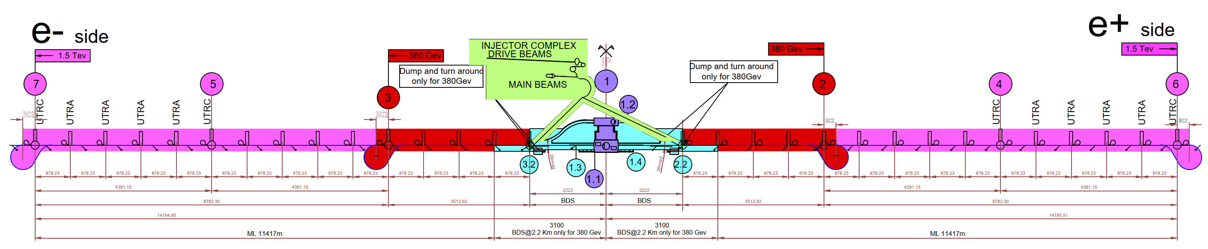
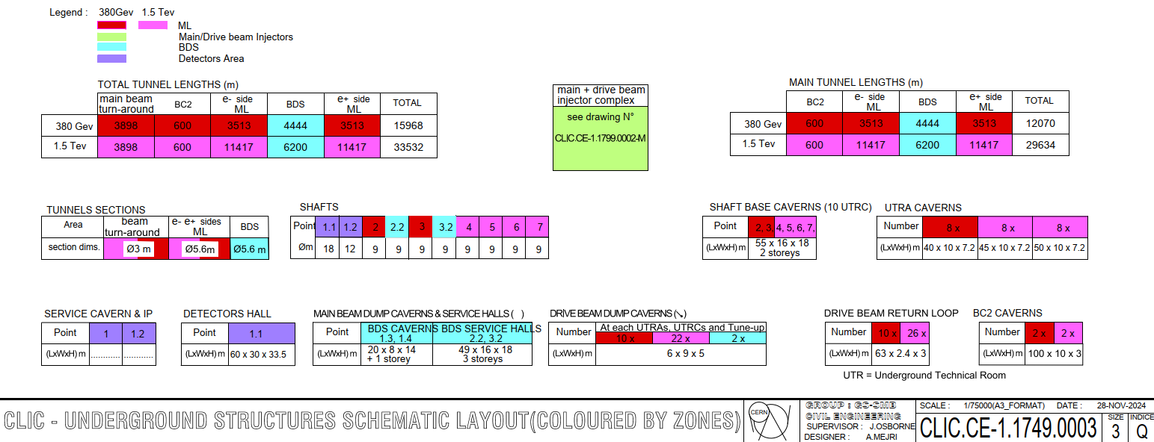
Underground Structures Schematic
Now only considering the Drive Beam option and not the Klystron option.
The 3TeV stage is no longer being considered.
Laser Straight
380GeV Main Tunnel length of 12.1Km
(Displayed in Red).
1.5TeV Main Tunnel length of 29.6Km
(Displayed in Pink).

Slide 3
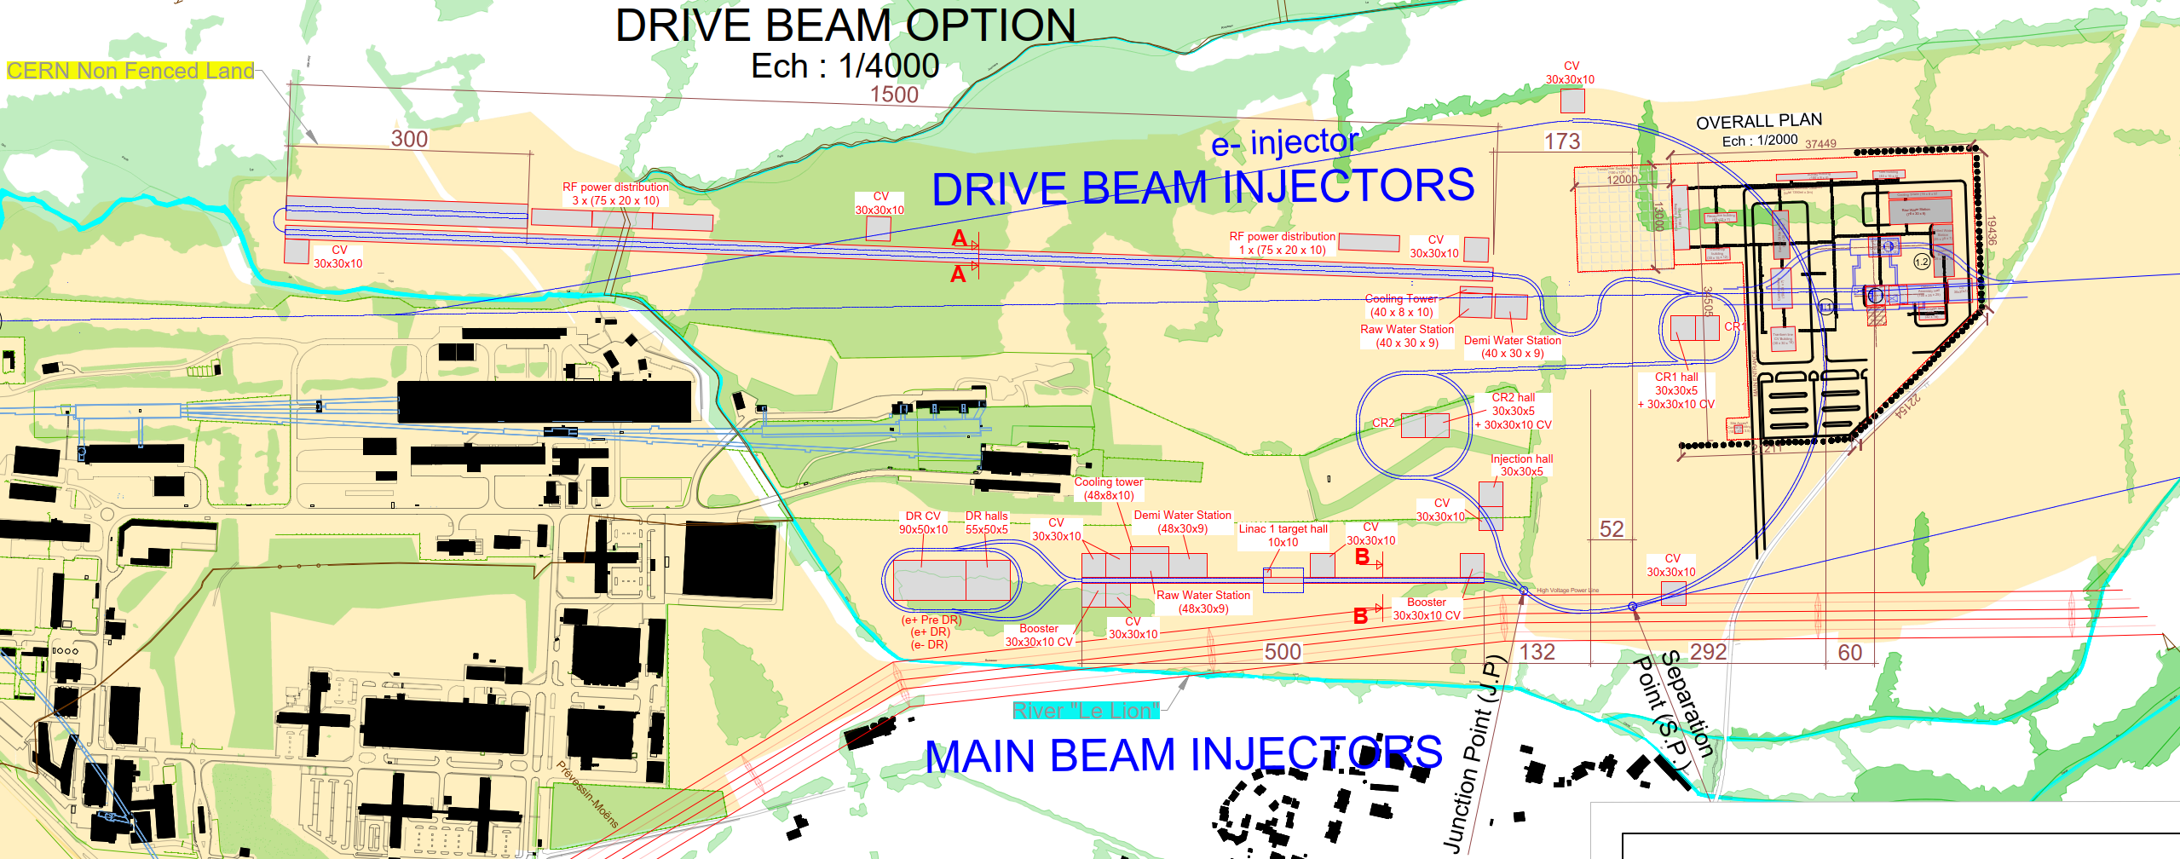
Injector Complex Layout on Prévessin Site
Whole Injector Complex is located on CERN land.
The complex now avoids all existing CERN infrastructure.
Drive Beam Injectors Location has been adjusted to avoid the river ‘Le Lion’.
Booster has been integrated into the Main Beam Injector, alongside the stacking of the damping rings.

Slide 4
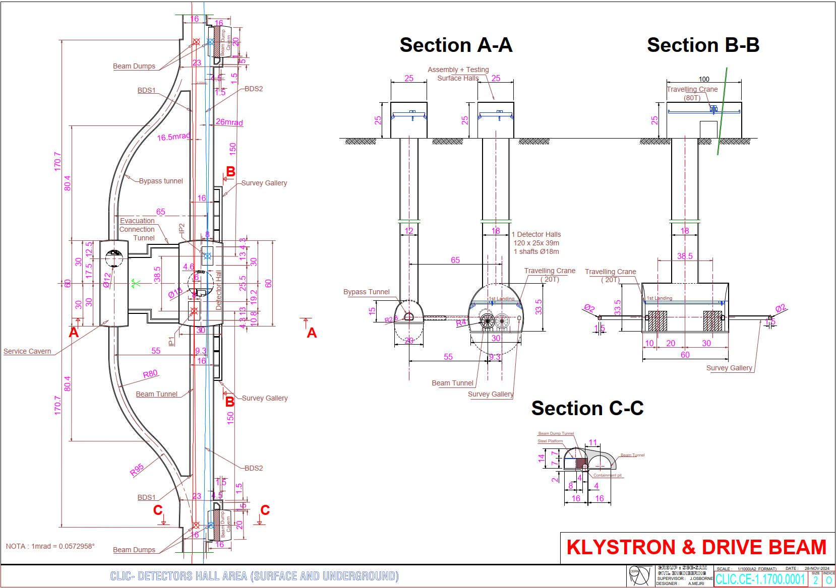
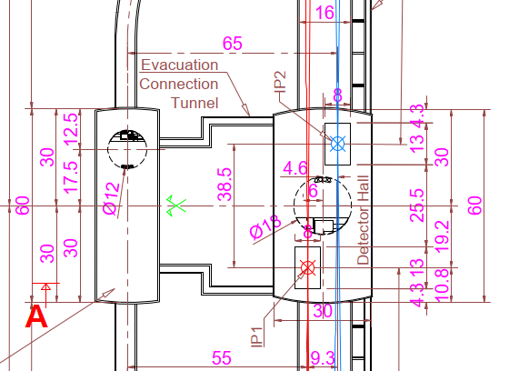

Interaction Region
Updated to facilitate 2 Detectors.
A 30m x 60m Detector Hall facilitates both detectors with their centers separated by 38.5m.
Main LINAC’s have a 20mrad crossing angle and the Beams have crossing angles of 16.5mrad and 26mrad.
BDS Tunnel has been widened to 16m to account for both beam lines and the 9.3m separation between them.
Tunnel Widening occurs over 2km either side of the Detector hall.

Slide 5
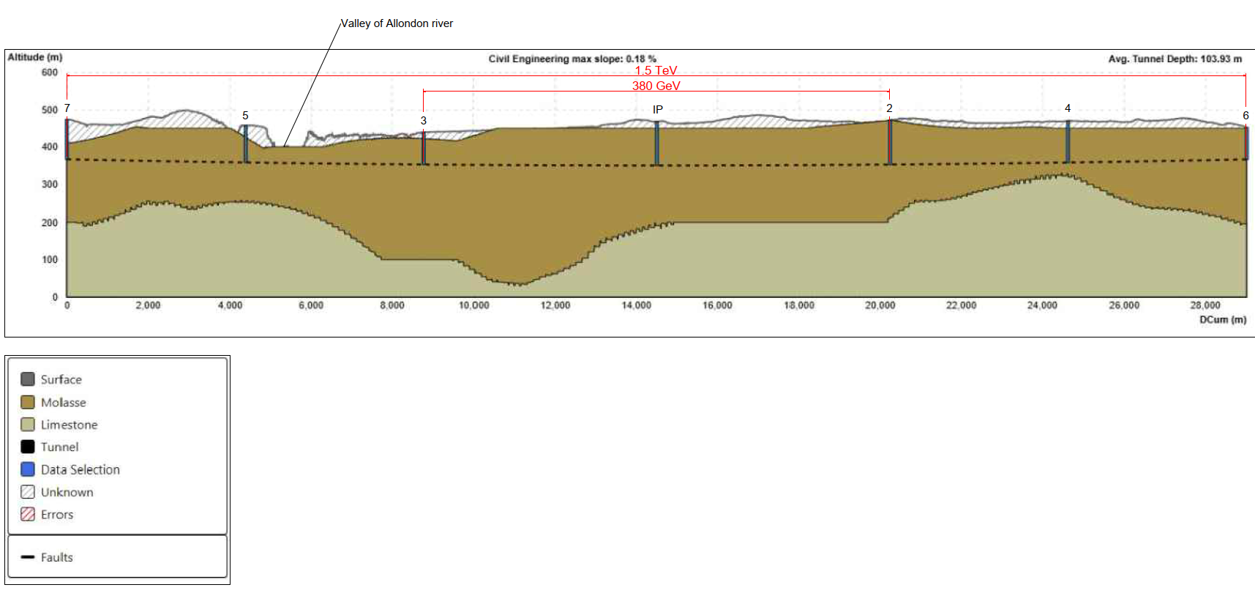
Geological Profile
Geological Profile for 380GeV and 1.5TeV stages with 3TeV removed.
Comfortably housed within good Molasse rock. (no need for site investigation to confirm this)
Gland Depression is no longer an issue, thus there is scope to reduce the shaft depths.
There is also an ongoing exercise to share the same shaft locations and alignment for CLIC and ILC.
With these drawings nearly frozen, we are in a position to complete an updated costing for the Civil Engineering works.

Slide 6
Additional Civil Engineering Slides
11th Dec 2024

Slide 7
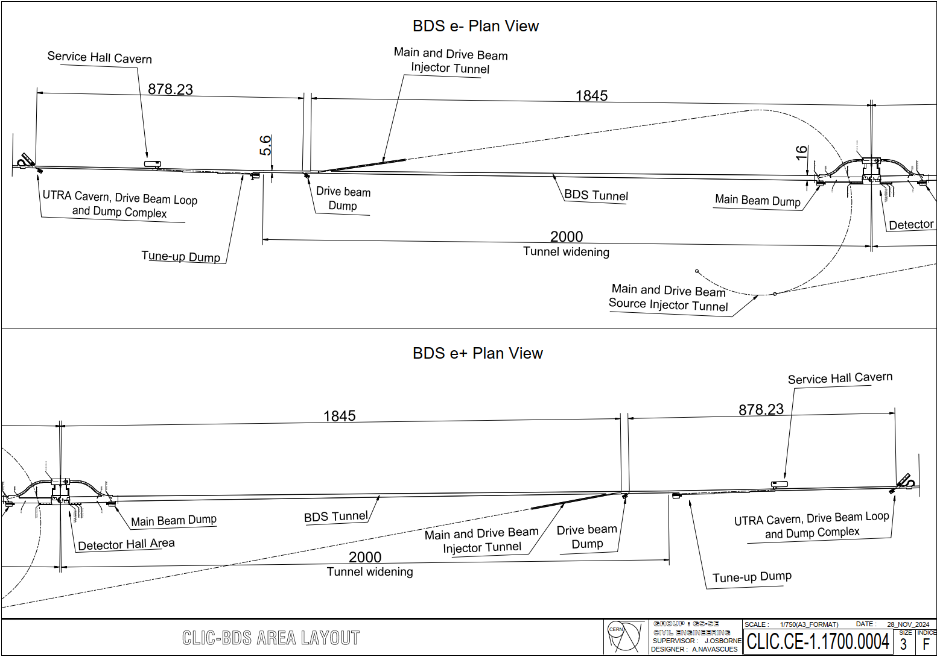
BDS Area Layout
Tunnel widens linearly from 5.6m internal diameter to 16m internal diameter.
Beginning 2km both sides from the center of the detector hall.
Notes:
The BDS area layout drawing shows the tunnel widening linearly from 5.6m internal diameter to 16m internal diameter.
The widening begins 2km either side of the center of the detector hall.

Slide 8
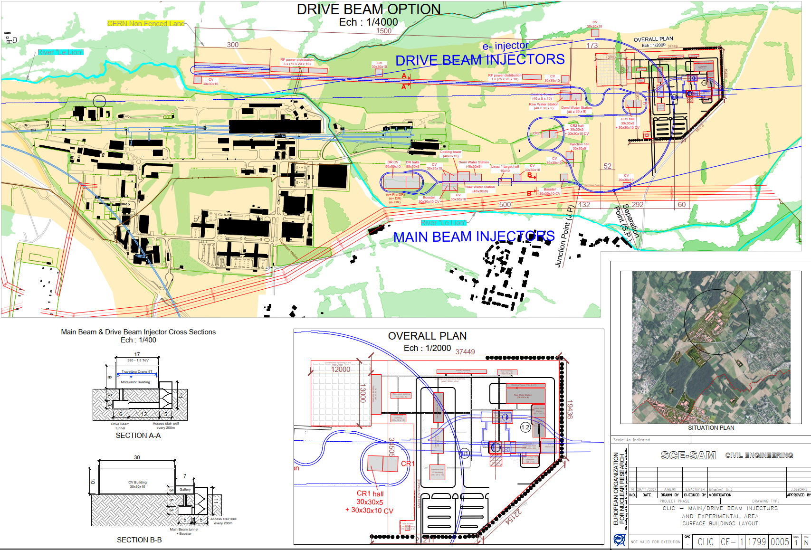

Slide 9
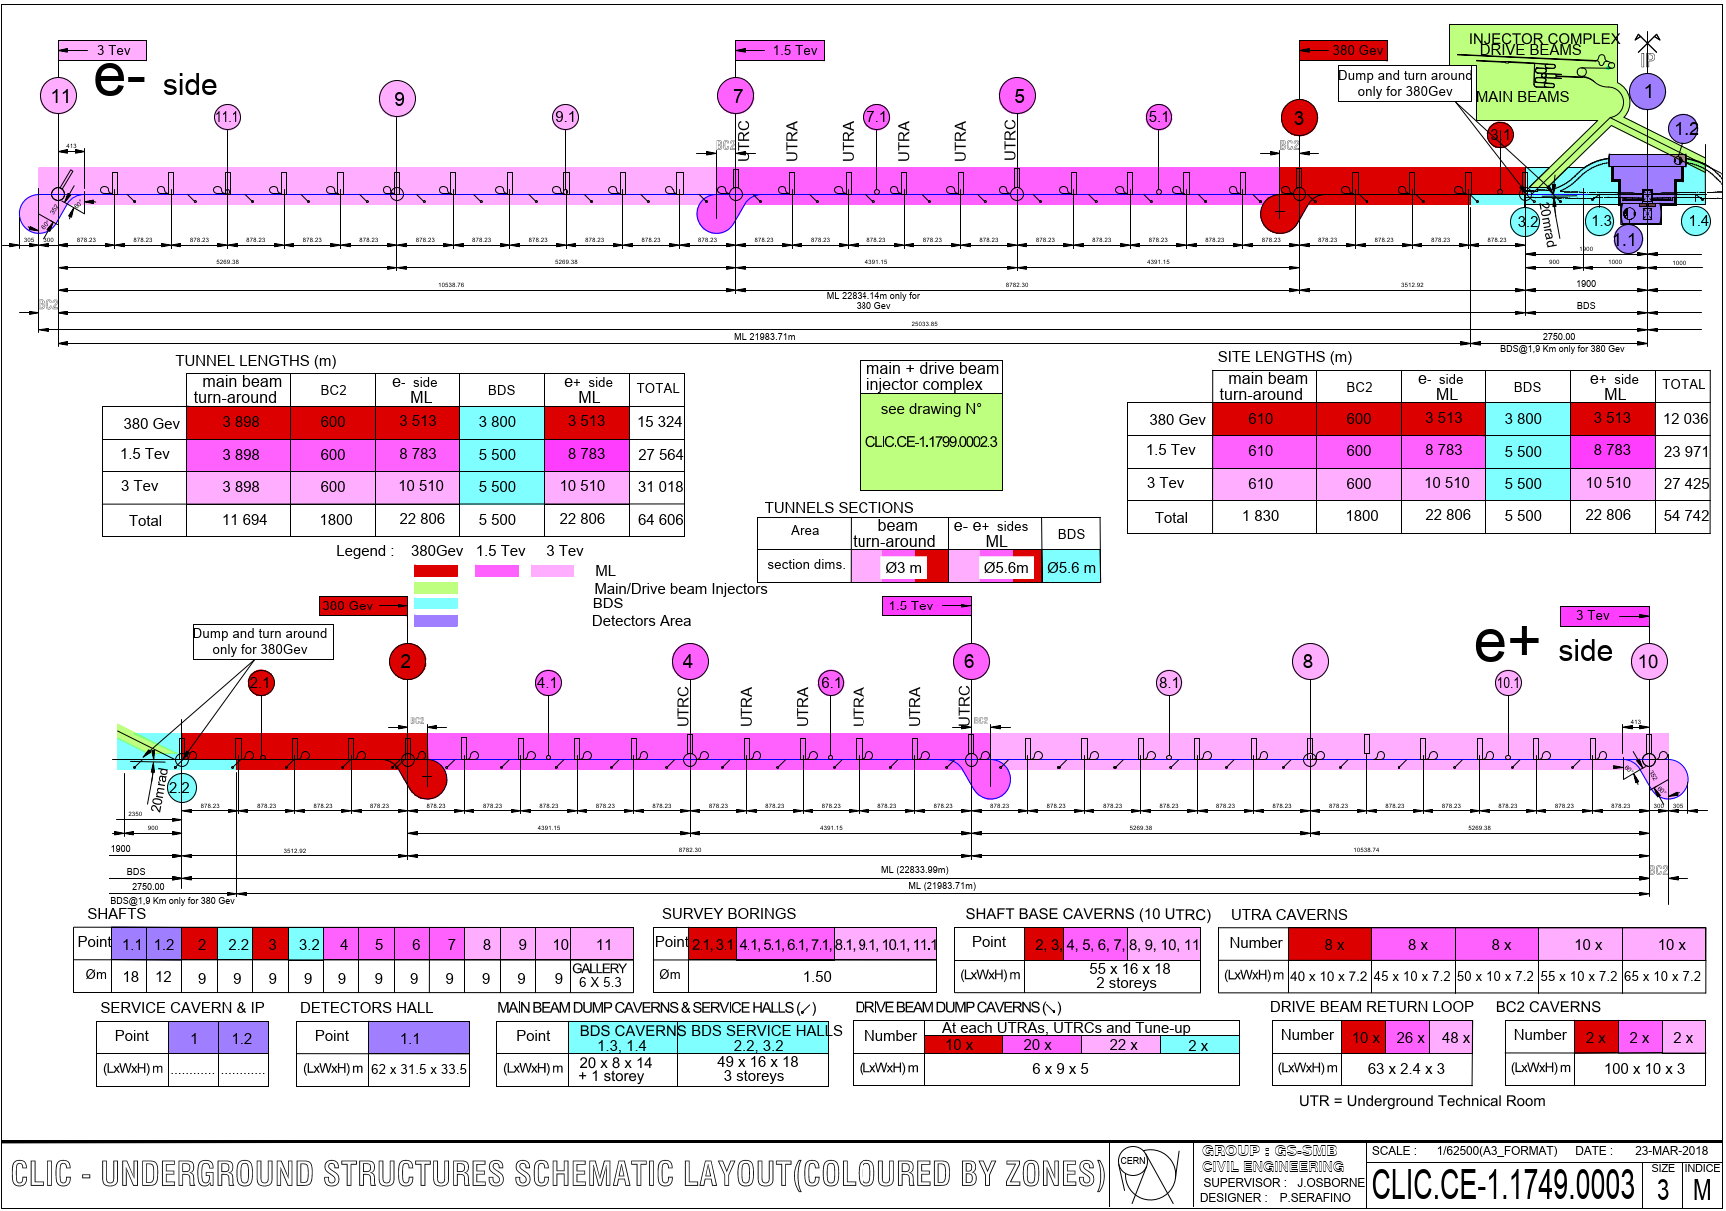

Slide 10
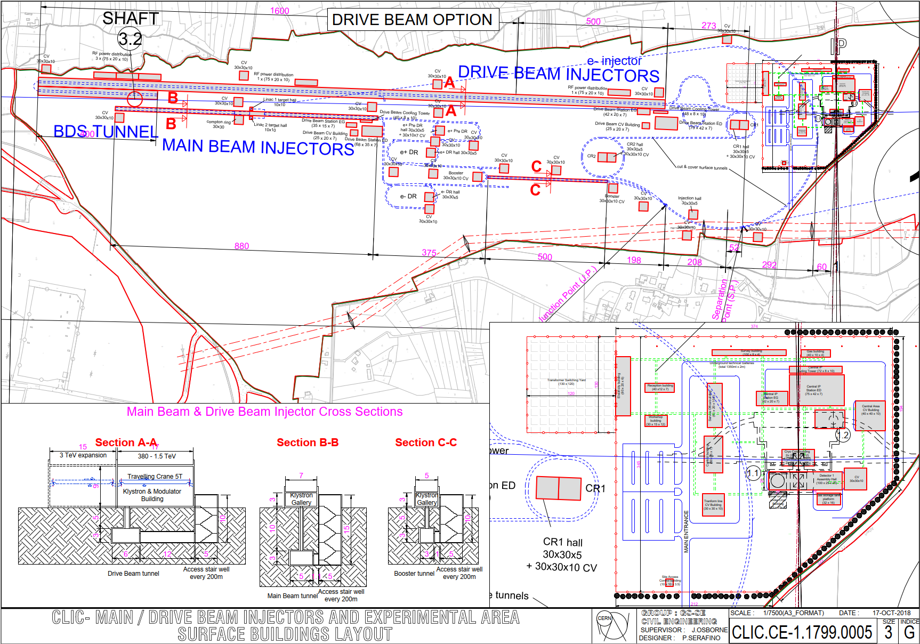

Slide 11
