Slide 1
Implementation
Five main parts
Schedule (next page)
Cost (slide from Carlo)
Power (Alexej - close to 380 ok, more work on 250 and 1.5)
Civil Engineering (Edward)
Infrastructure (revise and check) – EL, CV, transport and installation, safety and rad protection, access etc

Slide 2
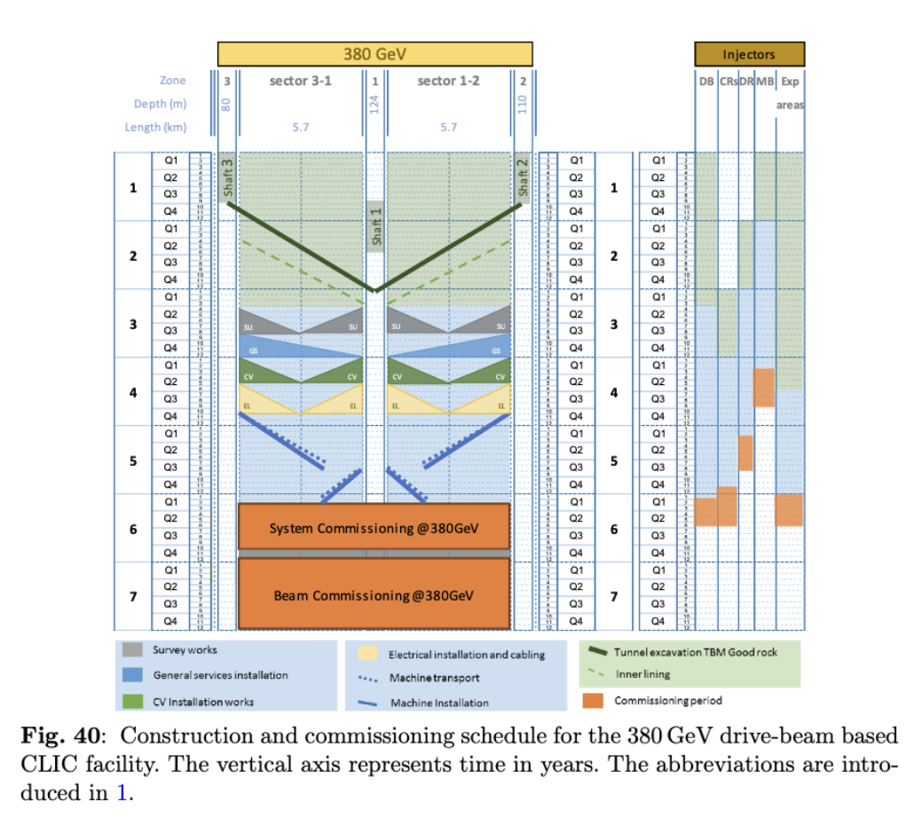
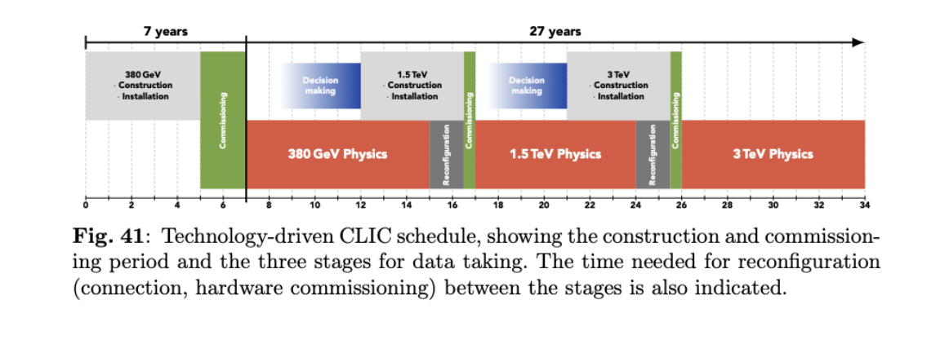
Key schedule figures:
Check 380 (changes needed?), figure and text for 1.5, update figure below for new runplan

Slide 3
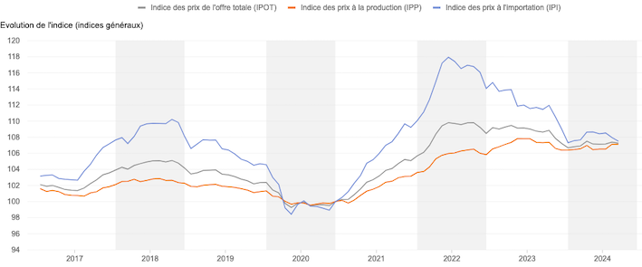
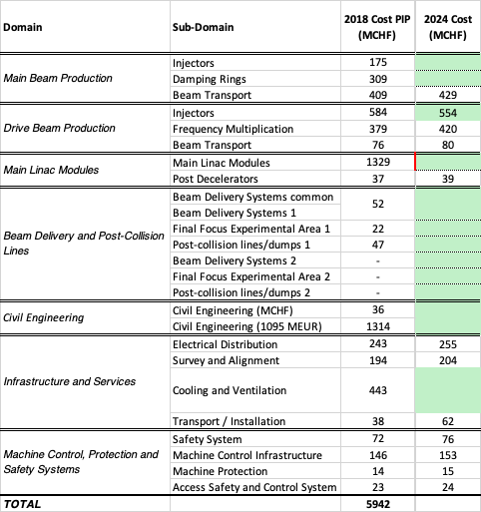


Status of CLIC cost review – Dec 2024
Swiss price Indexes
import
production
Starting from CLIC PIP 2018 – 380 GeV
+3 % to +5 %
+3 % to +5 %
Design upgrade in progress
Klystron power and RF efficiency reconsidered
Ongoing review for RF module learning curves
New design of the BDS, also for compatibility with 2nd detector
New facility layout and new building sizes
30% Reduction of power needs and building size
All figures in white cells were increased by +5%

Slide 4
Personnel and operation costs
As before for construction (formula) FTEy=15.7 VALUE^{0.75}
(VALUE in 2010 MCHF)
Operation cost also similar: might adjust percentages used for spares (1-5% for various parts)
Operation personnel: rough estimate to be made
(LHC operation estimated to 5% of construction costs: material + personnel)
(ILC500 estimated at 640 persons)
Move klystron version costing to separate table ?

Slide 5
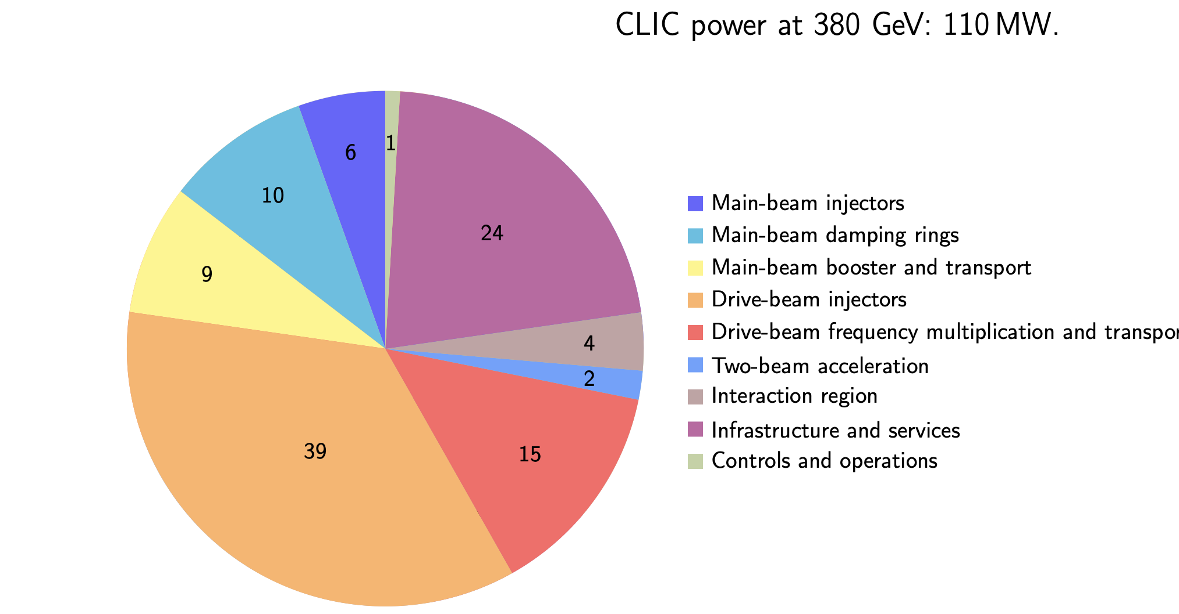
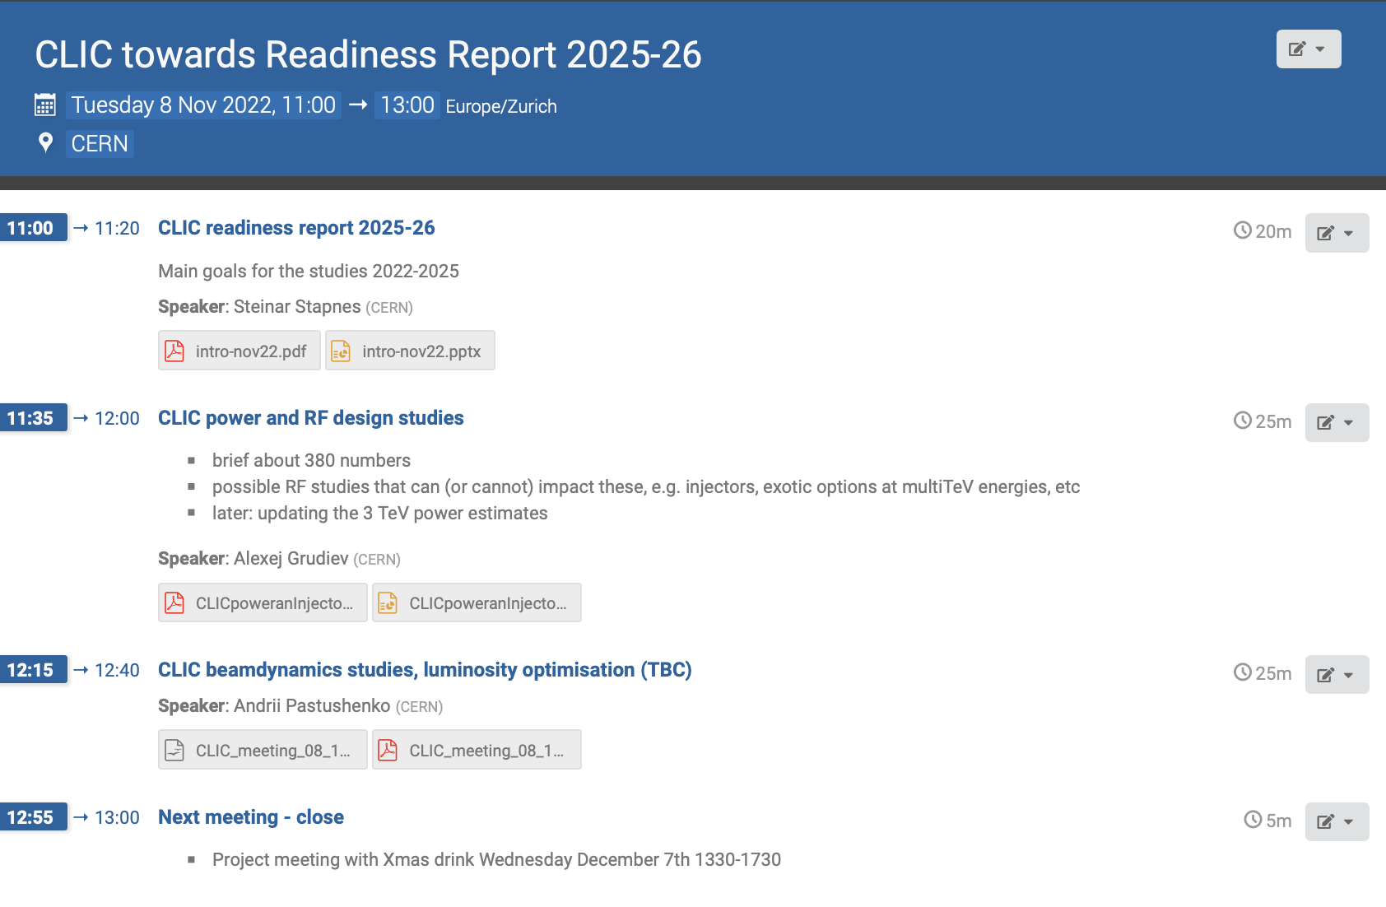
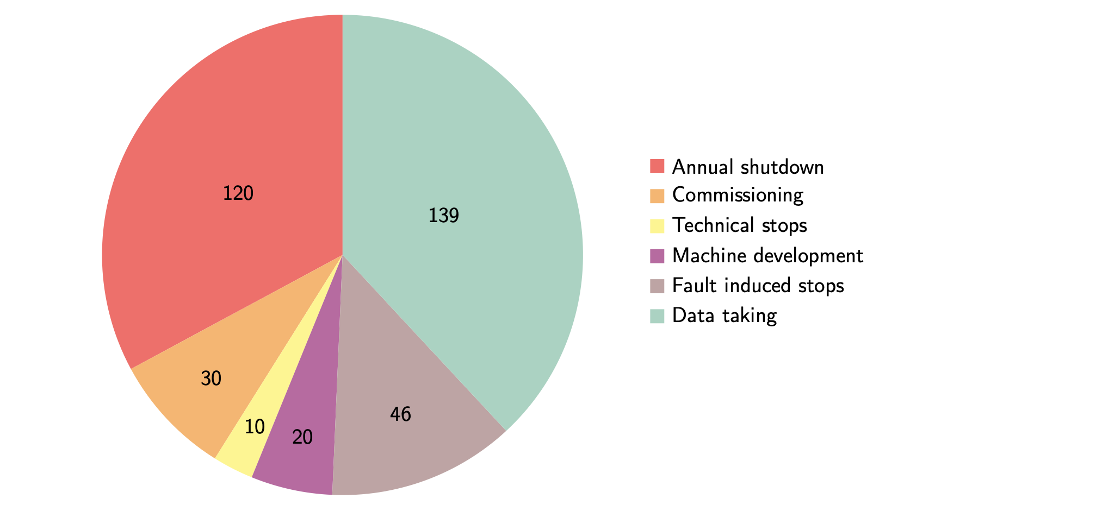
Power and energy
https://indico.cern.ch/event/1212765/contributions/5101243/attachments/2543342/4379308/CLICpoweranInjectorEtc_20221104_CLIC_PRR.pptx. (Alexej Grudiev)

