Slide 1
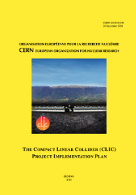
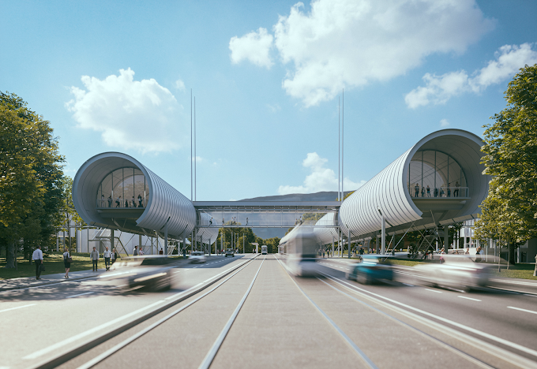
Readiness Report,
The systems chapter
Overview of the chapter
Main changes with respect to the PIP report
Conclusion
CLIC Readiness Report 2025
CLIC Project Meeting Dec. 11th 2024
Steffen Doebert on behalf of all the chapter contributors

Slide 2
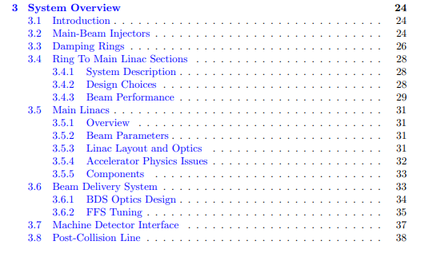
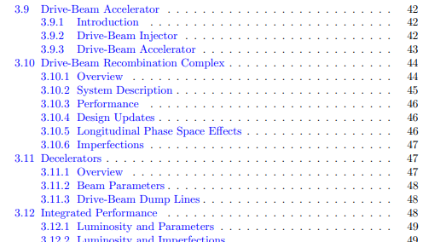
Chapter 3, Systems Overview
Contributions by: Yannis, Andrea, Yongke, Daniel, Vera, Rogelio, Raul, Alexej, Adnan, Igor…

Slide 3
Main intended changes
Redesign of the main beam injector complex, aim to save cost and electricity.
New RF structure design, focus on 380 GeV, higher positron yield, lower drive linac energy, new layout
New drive beam klystron, higher efficiency, number of klystrons, RF-structure parameters, some updates in the beam dynamics of the combination complex and decelerators
DR updates, new 2 GHz RF-system integrated, updated performance
RTML optimization, new bunch compressors, performance optimization, new booster accelerating structure
Luminosity performance updates, emittance bumps and machine tuning
Beam delivery: Performance and layout updates (here only 380 GeV)
Not much new in: Main linac, post collision line and machine-detector interface

Slide 4
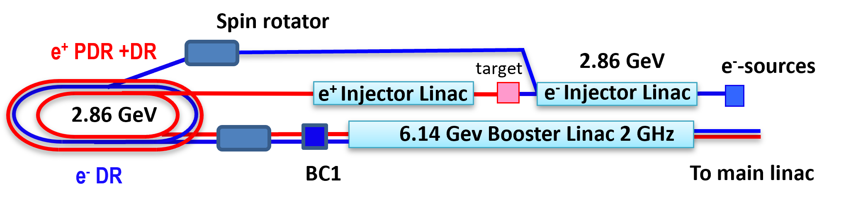
Main Beam Injectors
New design and layout
More details by Adnan and Yongke

Slide 5
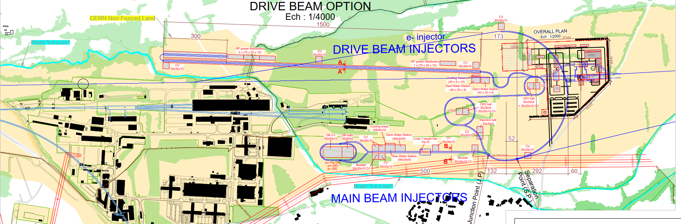
Main Beam Injectors
New design and layout
Edward Fraser Mactavish et al.

Slide 6
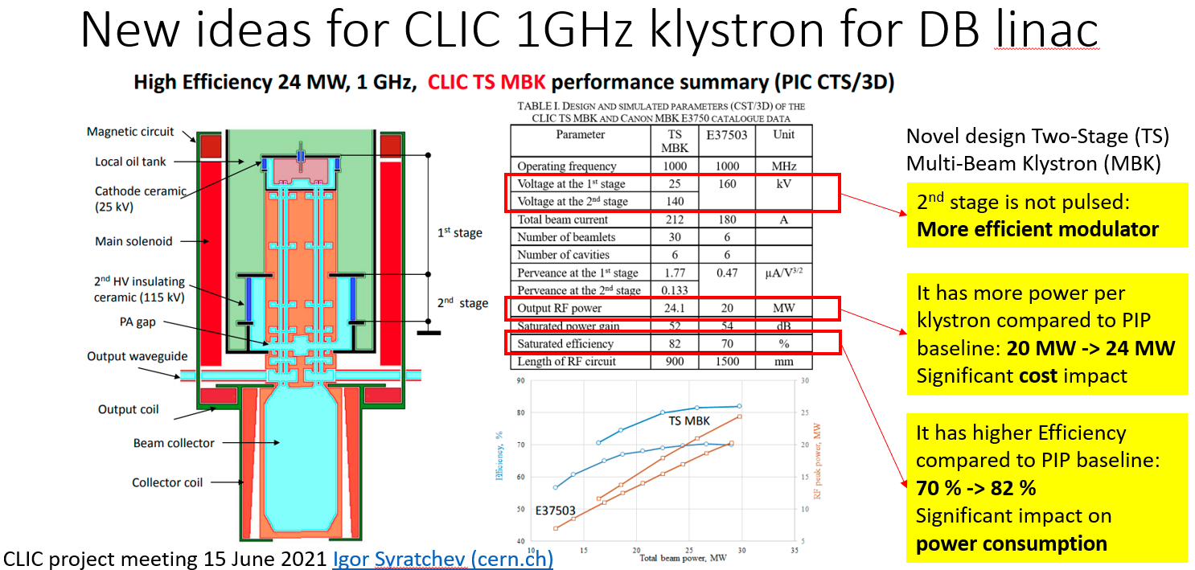
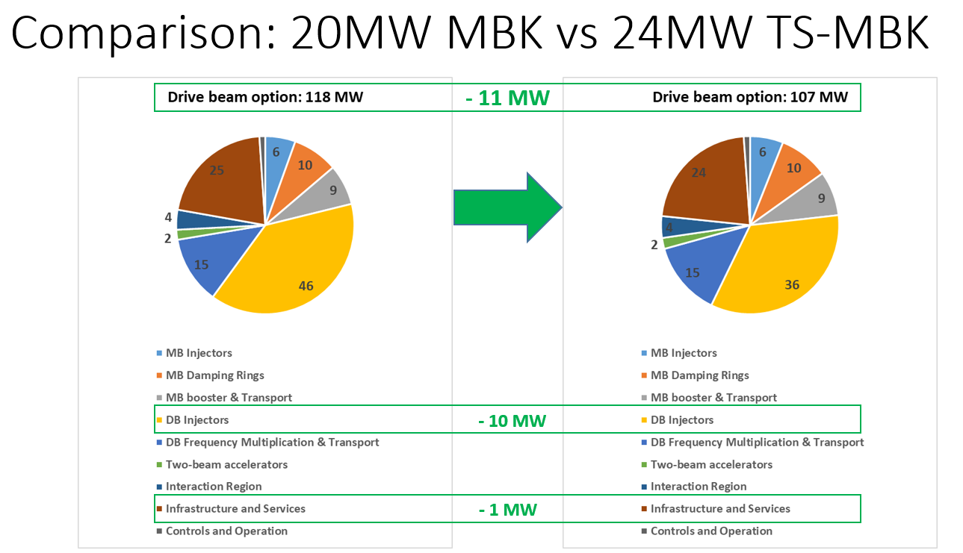
Drive Beam
New klystron, beam dynamics update
Details: Alexej Grudiev, CLIC Mini Week, Dec. 2023

Slide 7
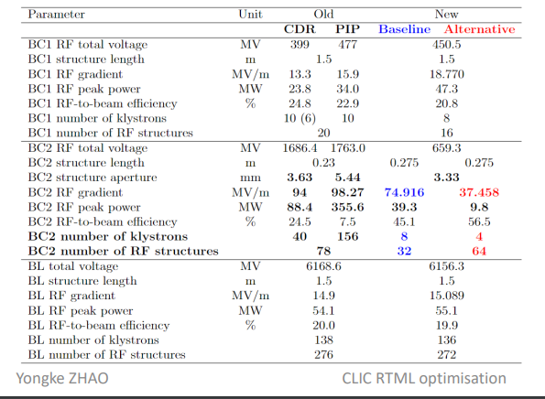
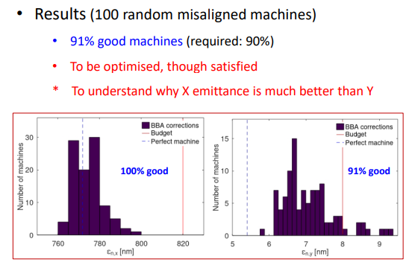
RTML,
New optimized bunch compressors, booster linac, BBA and beam transport
Details: Yongke Zhou, CLIC Project Meeting March 2024

Slide 8
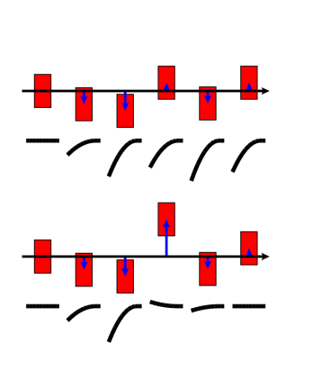
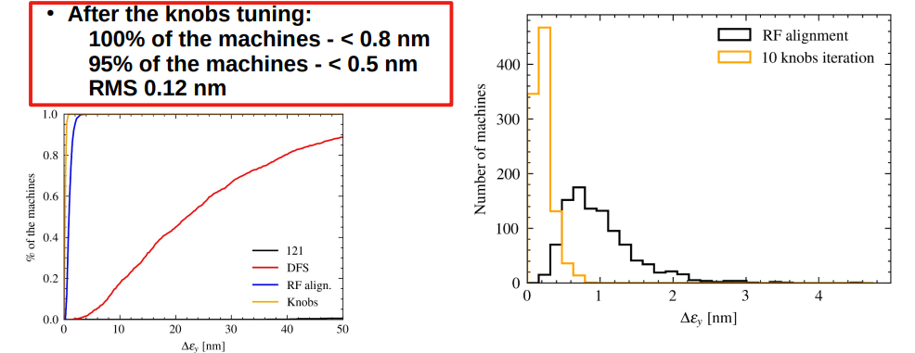
Main LINAC,
Emittance tuning Bumps, BBA performance
Details: A. Pastushenko, internal CLIC Meeting

Slide 9
Conclusions
The chapter should be ready on time but of course last minute !

