Slide 1
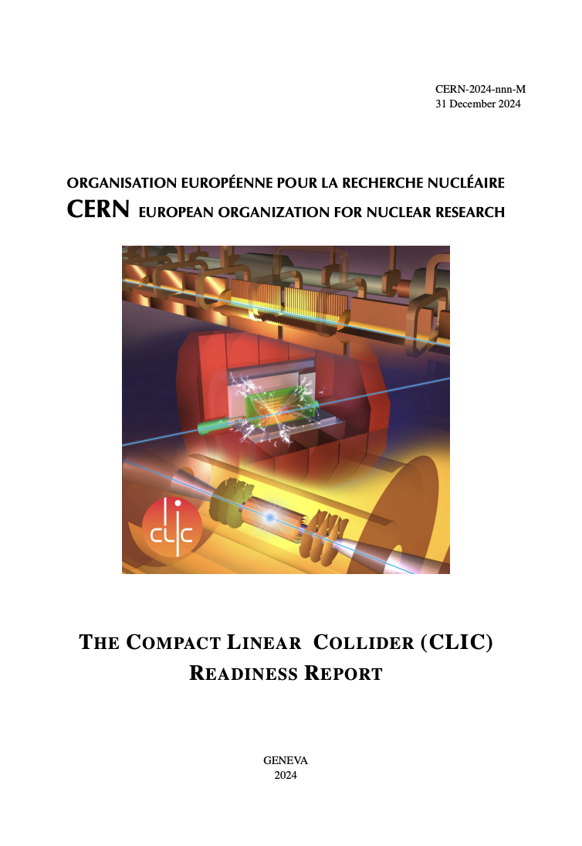


CLIC Readiness Report (RDR)
Project Meeting Update
Erik Adli, Steinar Stapnes, Mick Draper
and all contributors
December 11, 2024

Slide 2
What to deliver
As support to the ESPPU, and as a future reference for CLIC:
The CLIC readiness report (RDR). Long document.
Much based on the 2018 Project Implementation Plan (PIP)
Updated where needed (parameters, energy options, new developments)
Completed with implementation details not found in the PIP
RDR will be published as an European Physical Journal article (template)
Author list – still TBD – but will be inclusive :
  current collaboration?
  + earler lists from PIP+Snowmass with an opt-out?
As input to the ESPPU:
A 10 pages summary.
Based on the updated RDR.

Slide 3
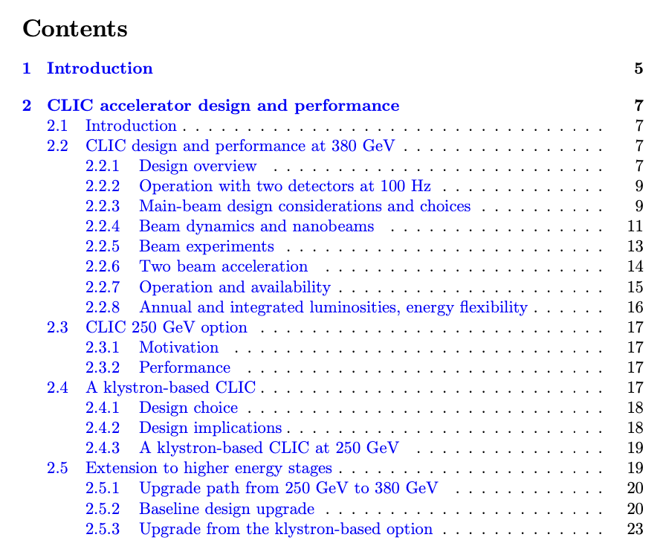
Baseline vs options
Baseline: 380 GeV machine - “low-energy machine”
  Main parameters, system overview and technology details should primarly refer to 380 GeV. Base luminosity 50% higher than in the PIP (see next talk)
  Keep details on klystron options, no further development planned
  Option: 100 Hz, with 65% higher power
  At 100 Hz: two BDS and IPs
Option: 250 GeV
High-energy machine: 1.5 TeV
  Re-use previous studies
  Mention up to 2 TeV with a single drive-beam, 3 TeV with two drive-beams
  No work planned for the 3 TeV machine, but one can refer to the CDR when needed

Slide 4
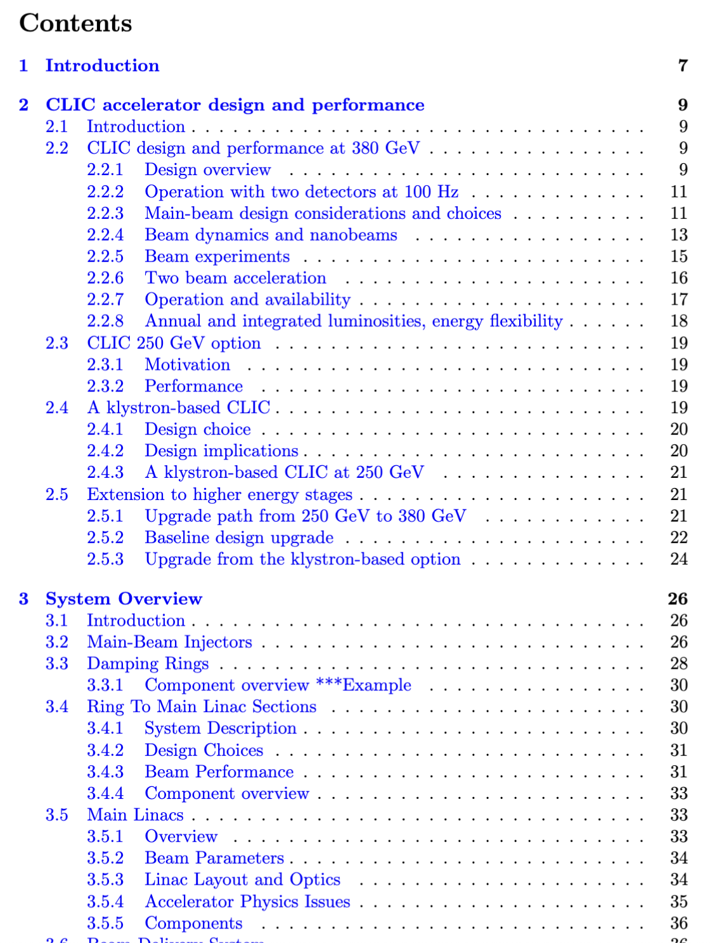
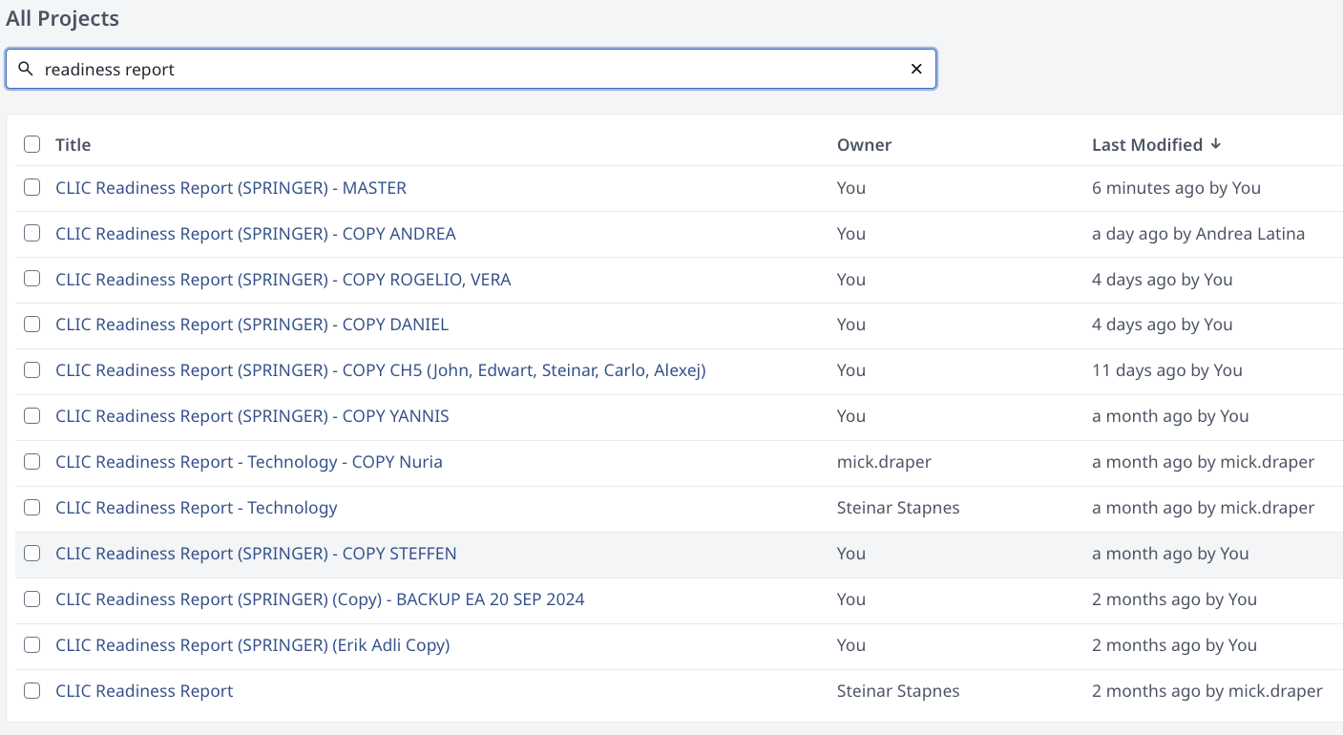
Workflow
One master document
Copy to all authors for specific updates
Plan is to merge...

Slide 5
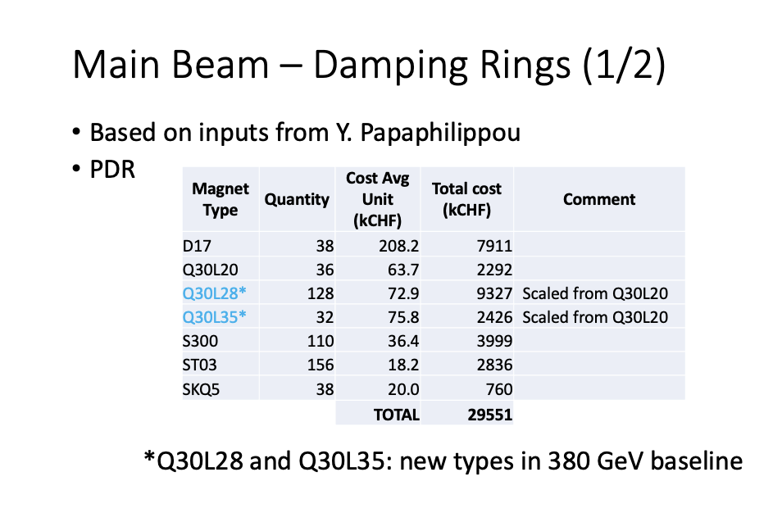
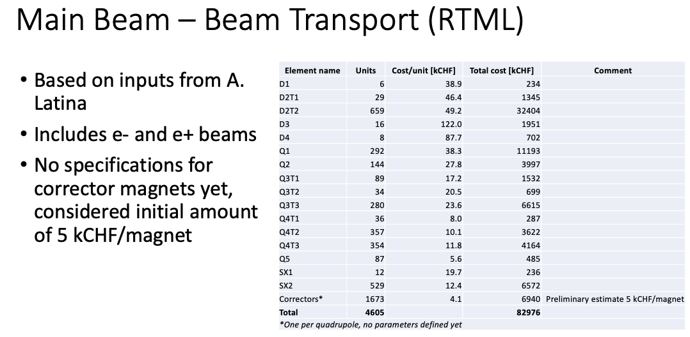
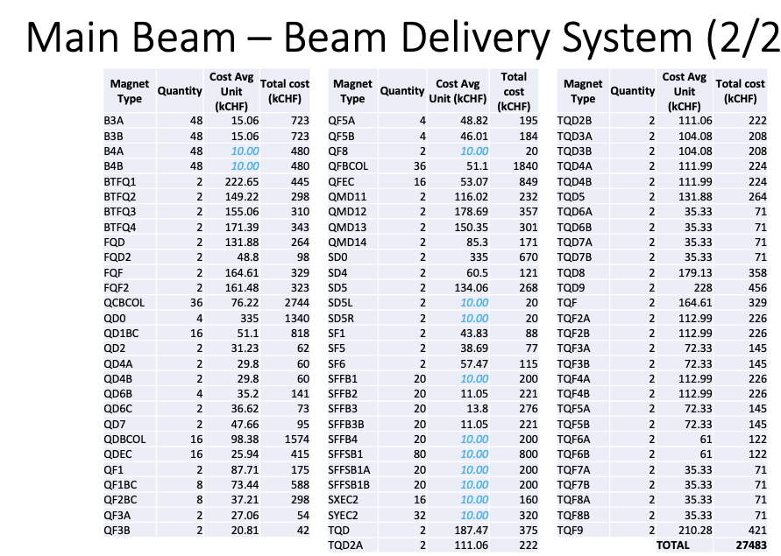
Addition of component overview
Examples:
Details of subsystem component exist, but are sometimes not included in PIP (or any other formal doc)
Goal: add a subsection with component summary for each subsystem
  magnets
  RF (# structures, klystrons, modulators)
  instrumentation
  etc.
Example: magnet system summaries in
2018 CLIC PBS External Review

Slide 6
Deadlines
Status report from (some) authors: Wed 11 Dec, 2024
Completed input from authors: January 15, 2024
Complete draft of RDR: February 15, 2025
Final draft of 10 page summary: Mar 1, 2025
10 page summary submission: Mar 31, 2025
  Complete RDR available together 10 page summary as supporting document
EPJ review process starts for RDR
Submission of RDR by Summer 2025

