Slide 1


Update on CERN Xboxes and X-Band technologies
P. Alonso Arias, on behalf of the Xboxes team
CLIC Project Meeting #47, Dec 11 2024

Slide 2

Xboxes Update
KLYSTRON TO BE REPAIRED
XBox2
XBox3
XBox1
OPERATIONAL
OPERATIONAL
Waiting for the 50 MW CPI Klystron to be repaired
Conditioning of Two TD31 accelerator structures
Testing campaign of High Efficiency X-band klystrons
CLIC Project Meeting #47, Dec 11 2024
01/20

Slide 3
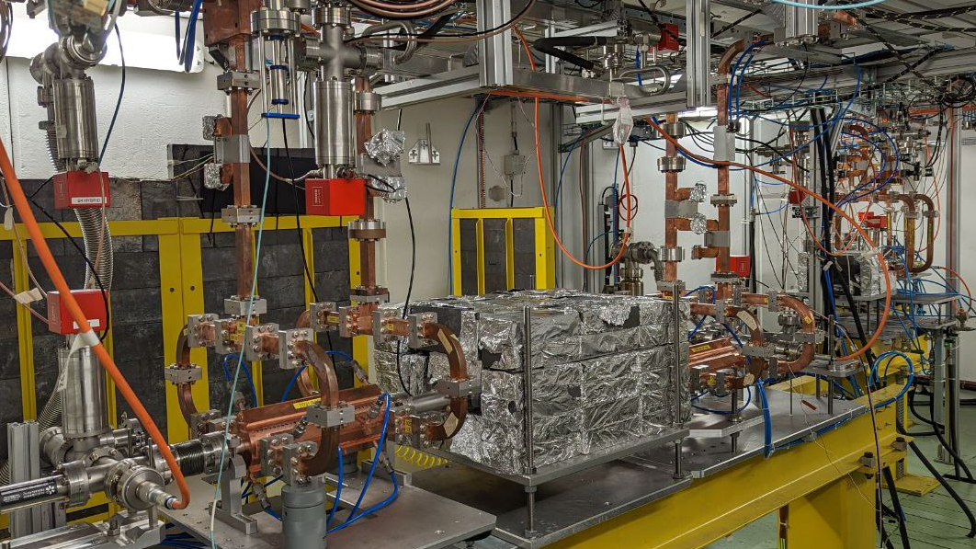
Xbox 2
XBOX2
Conditioning of TD31N3 and N4
Breakdown and missing energy studies

Slide 4
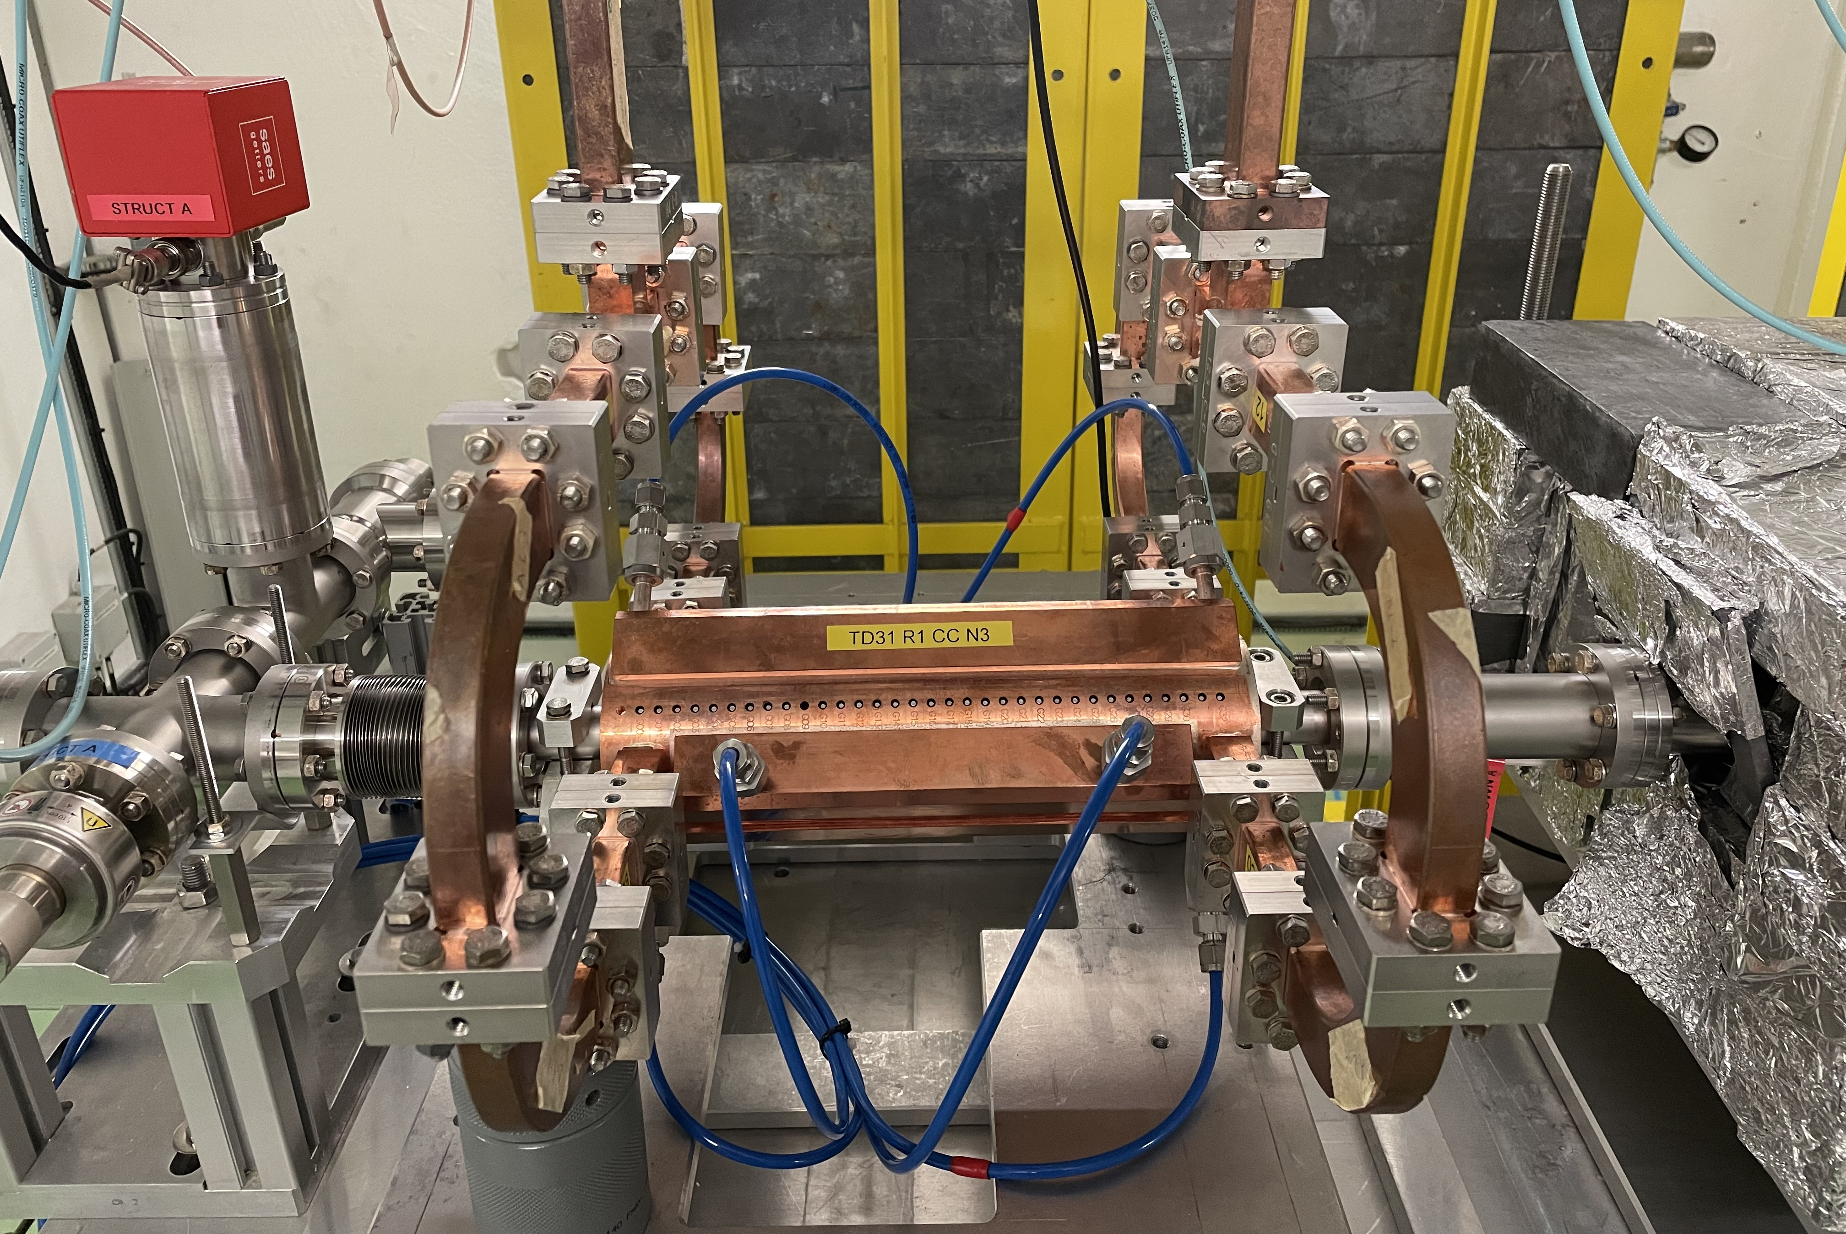
Xbox 2: TD31 for CLIC380
P_{in} [MW] for <G=72MV/m>
Unloaded = 36.1 MW
P_{in} [MW] for <G=92MV/m>
Loaded = 59.2 MW
Four structures manufactured and installed in Xboxes. Conditioning started by the end of 2022
N3 and N4 in Xbox 2
N1 and N2 installed in Xbox3
CLIC Project Meeting #47, Dec 11 2024
03/20

Slide 5
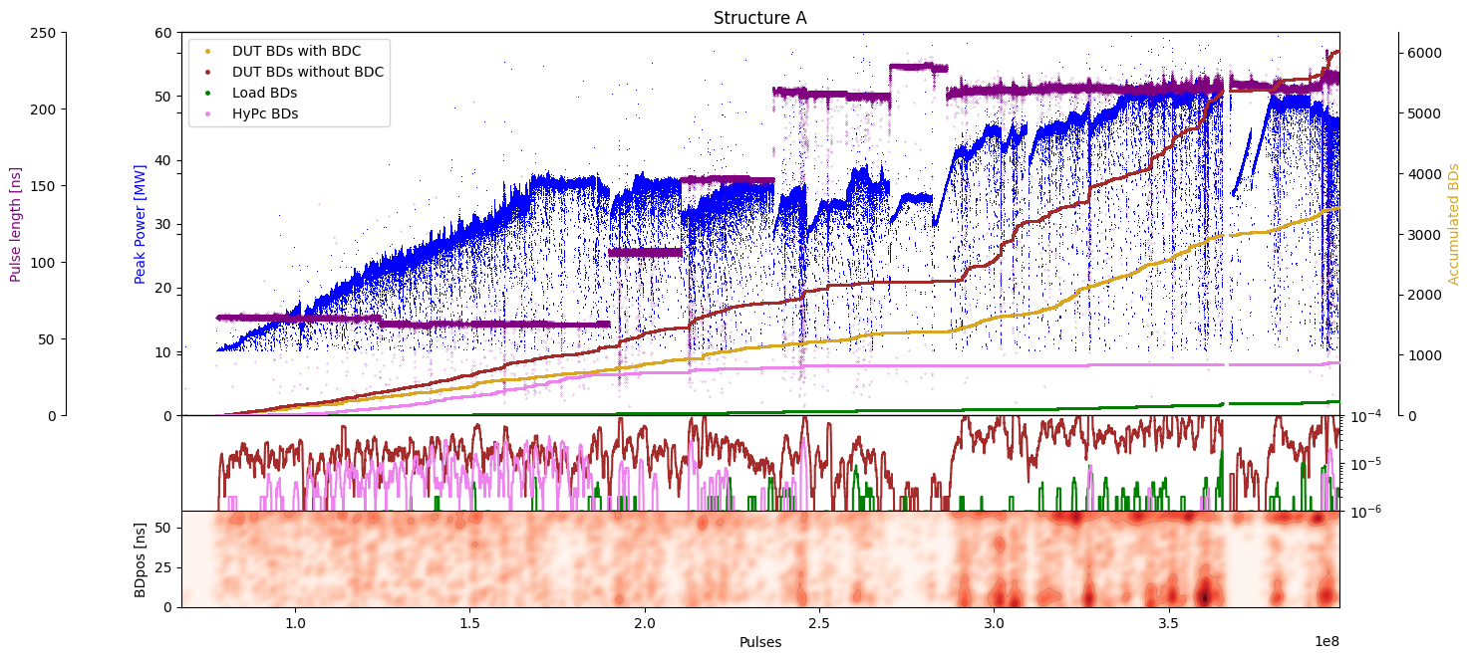
Xbox 2 TD31
TD31N3 conditioning history
Structure A/B 50:50
Structure A 100:1
Achieved unloaded Peak Power 36.1MW
Max. Peak Power achieved 50MW (~80 MV/m)
CLIC Project Meeting #47, Dec 11 2024
04/20

Slide 6
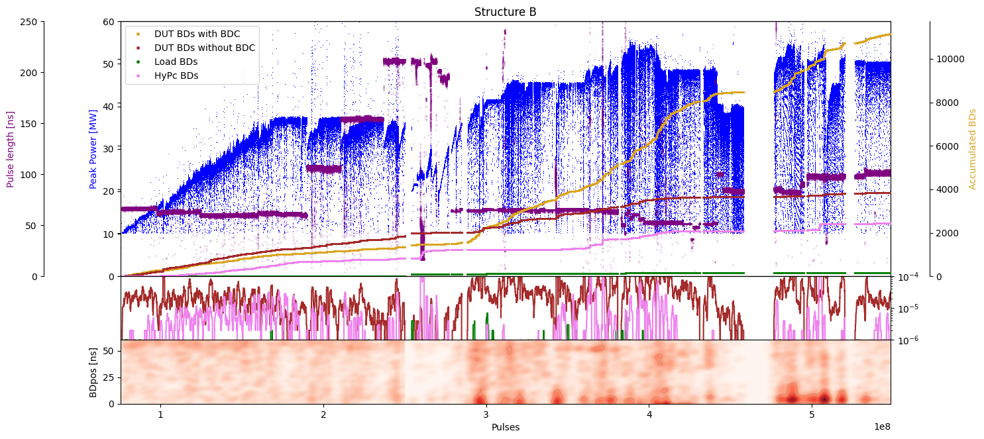
Xbox 2 TD31
TD31N4 conditioning history
Structure A/B 50:50
Structure B 1:100
Achieved unloaded Peak Power 36.1MW
Max. Peak Power achieved 54MW (~89 MV/m)
CLIC Project Meeting #47, Dec 11 2024
05/20

Slide 7
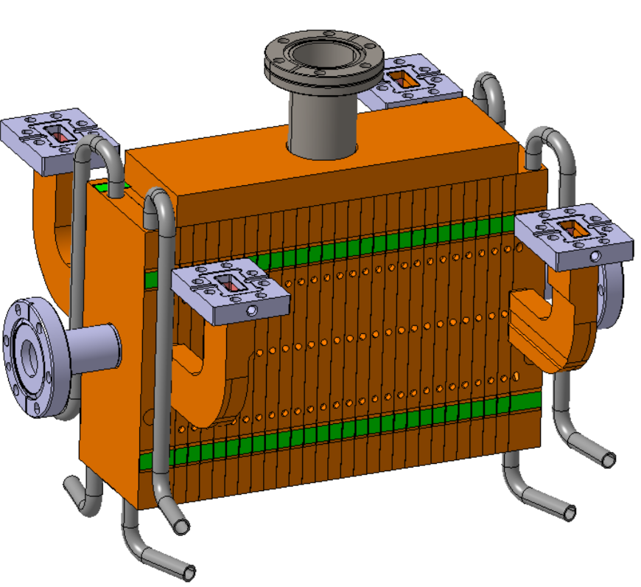
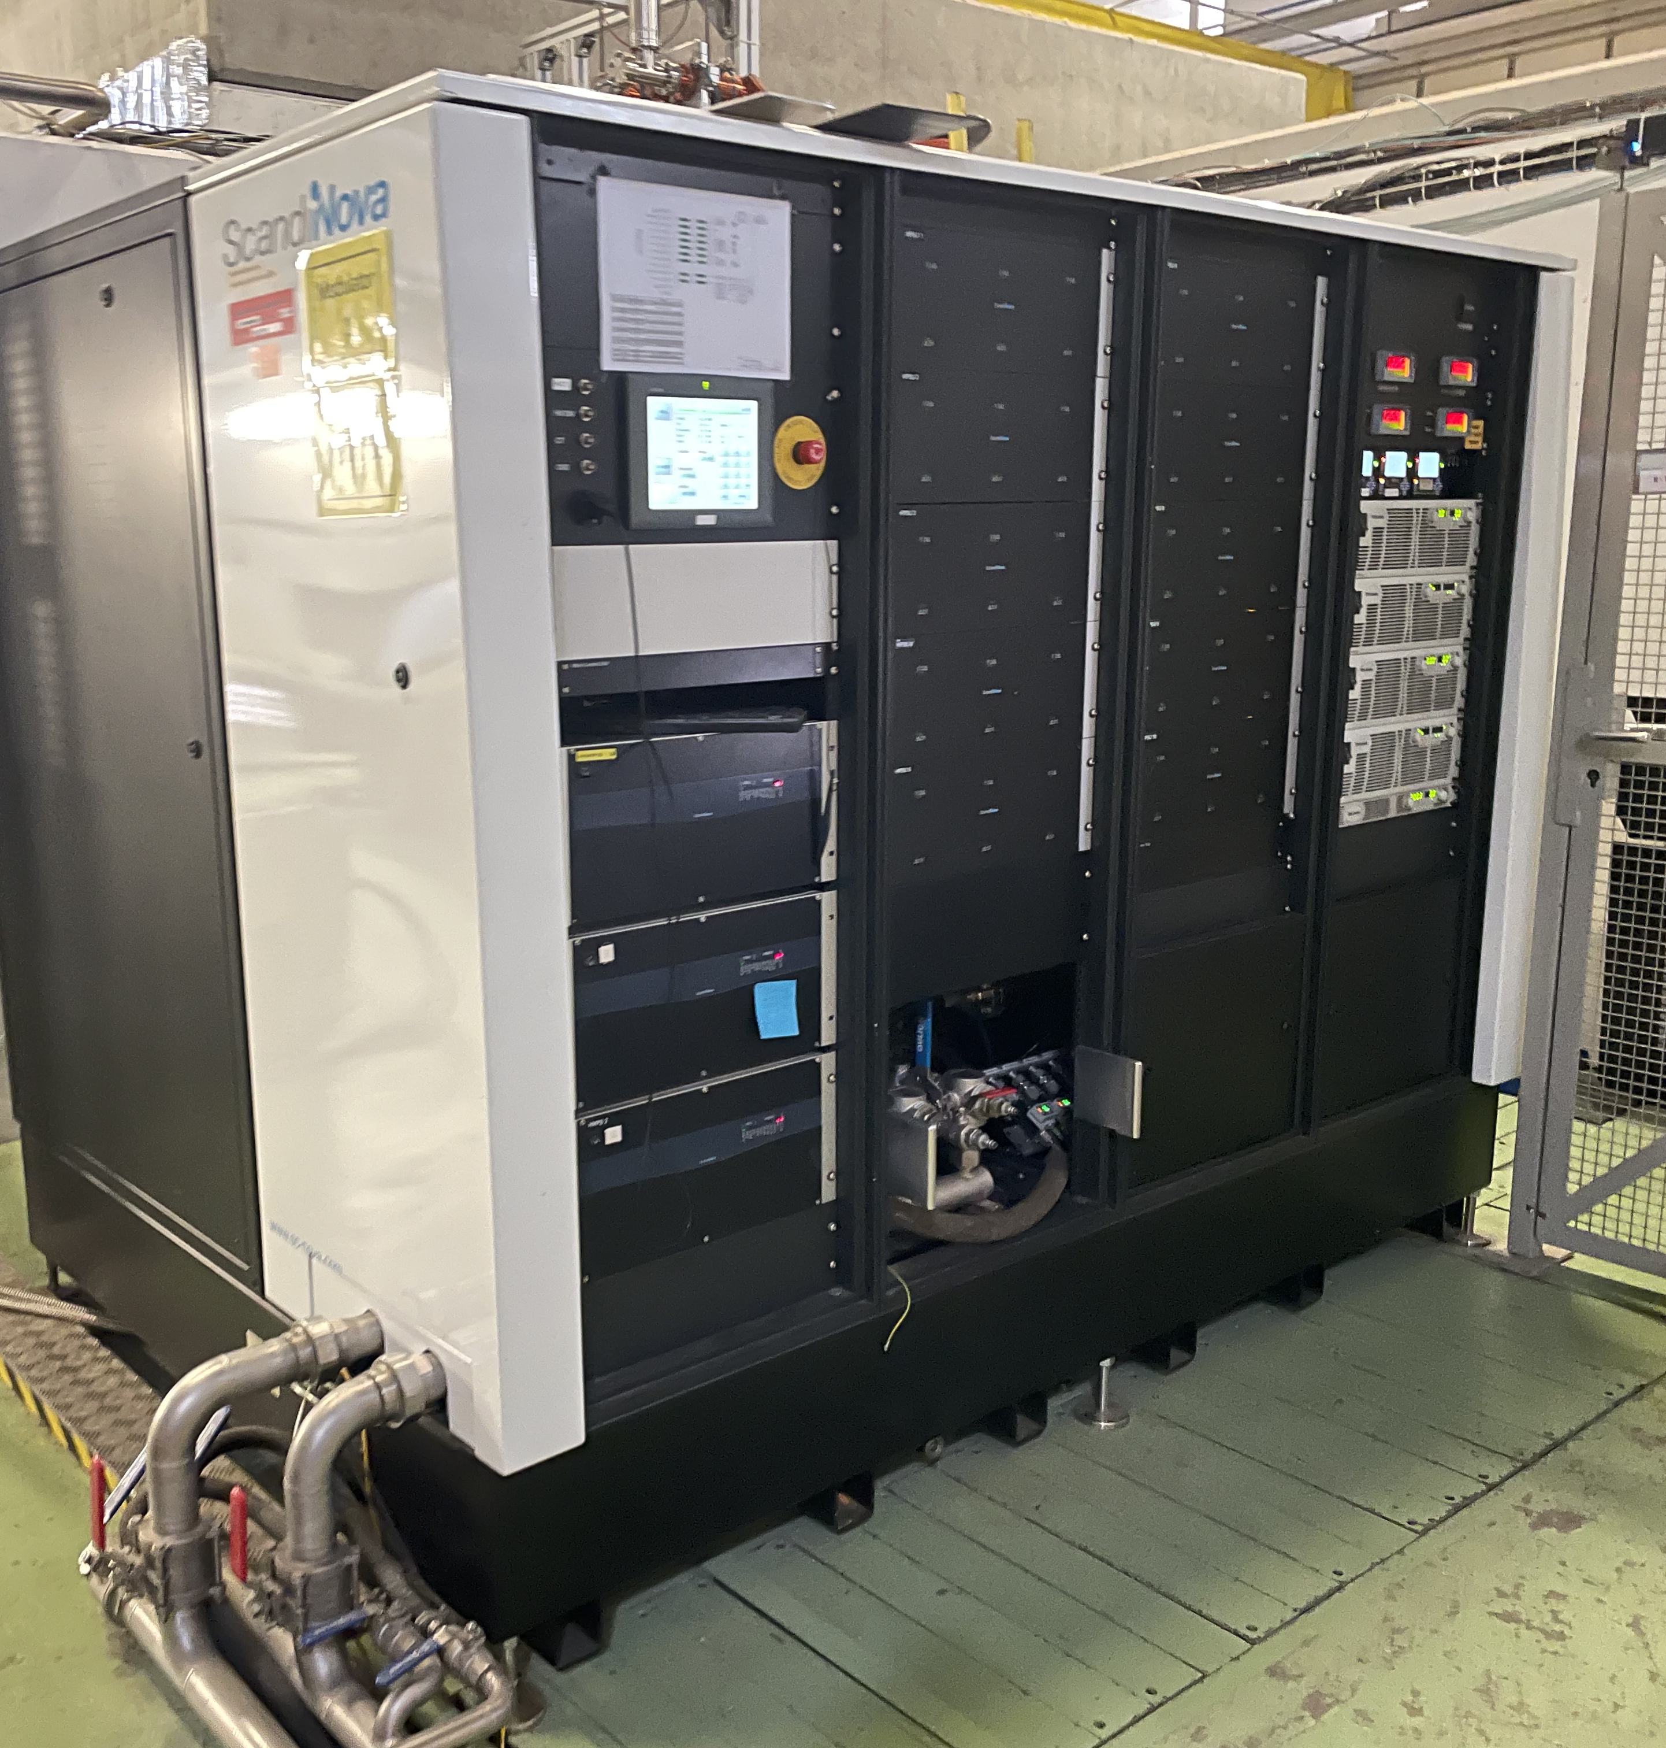
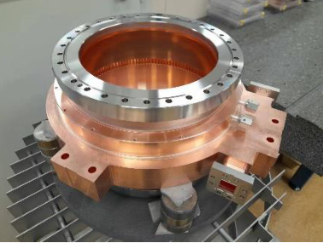
Xbox 2 future plans
Refurbishment of Scandinova modulator to improve operation at higher voltages
Integration of Barrel Open Cavity pulse compressor for high power testing
Integration and high power testing of Smartcell
CLIC Project Meeting #47, Dec 11 2024
06/20

Slide 8
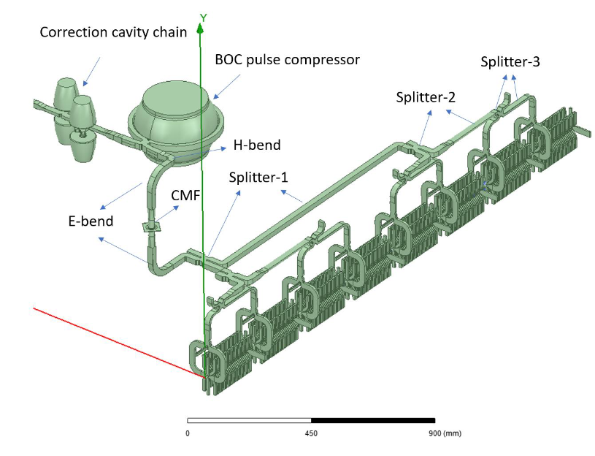
Xbox 2 future plans
BOC for klystron-based CLIC
Pulse compressor system based on the BOC design + 4 correction cavities optimised to obtain a power gain of 3.82 for the CLIC-K structure pulse shape
Prototype already manufactured and ready for integration in Xbox2 for high power testing
RF design of the pulse compression system for the klystron-based CLIC main linac; Ping Wang; Alexej Grudiev JACoW. IPAC2023, WEPA115. 2023. Available on-line at: <doi:10.18429/JACoW-IPAC2023-WEPA115>
CLIC Project Meeting #47, Dec 11 2024
07/20

Slide 9
Xbox 2 future plans
BOC for klystron-based CLIC
Pulse compressor system based on the BOC design + 4 correction cavities optimised to obtain a power gain of 3.82 for the CLIC-K structure pulse shape
Prototype already manufactured and ready for integration in Xbox2 for high power testing
RF design of the pulse compression system for the klystron-based CLIC main linac; Ping Wang; Alexej Grudiev JACoW. IPAC2023, WEPA115. 2023. Available on-line at: <doi:10.18429/JACoW-IPAC2023-WEPA115>
CLIC Project Meeting #47, Dec 11 2024
08/20

Slide 10
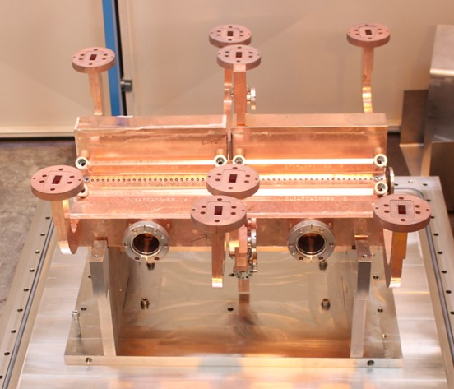
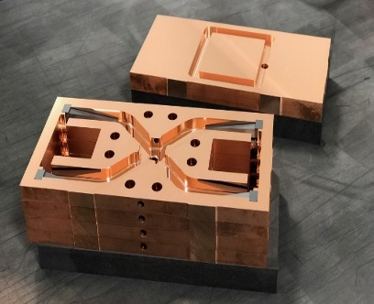
Xbox 2 future plans
SmartCell prototype
Redesigned to evolve from pure bonding to bonding+brazing and reducing steps
The new design integrates the RF area, HOM loads, the cooling circuits, and part of the vacuum system in one part
More info here: P. Morales, Normal Conducting High Gradient prototype manufacturing
CLIC Project Meeting #47, Dec 11 2024
09/20

Slide 11
Xbox 2 future plans
SmartCell prototype
Redesigned to evolve from pure bonding to bonding+brazing and reducing steps
The new design integrates the RF area, HOM loads, the cooling circuits, and part of the vacuum system in one part
Disk in production, will be assembled in 2025
More info here: P. Morales, Normal Conducting High Gradient prototype manufacturing
CLIC Project Meeting #47, Dec 11 2024
10/20

Slide 12
Xbox 2
XBOX3
Setup modified for klystron testing
Canon E37117 klystron tested

Slide 13


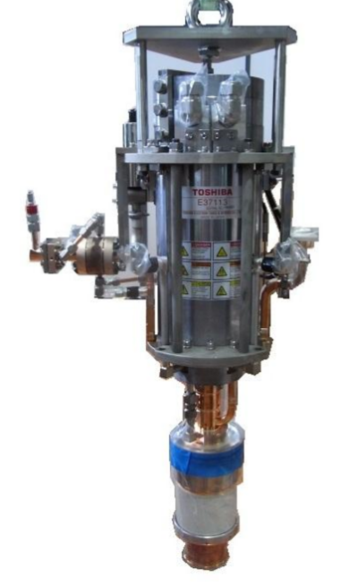
Xbox 3 High Efficiency Klystrons
Refurbishing of 6 MW Canon E37113 (re-used solenoid and cathode; same modulator; new RF window)
Retrofit design with a COM circuit+ 2nd harmonic cavities
First testing campaign at the end of 2023
Second testing campaign just finished
Operating frequency | 11.994 GHz
Peak RF Output Power | 8.1 MW
Peak RF Input (Drive) Power | 121 W
RF Pulse length | 1us
Pulse repetition rate | 400 Hz max.
Load VSWR | 1.2 max.
HV Pulse length | 6.4 us max
Beam Voltage | 157 kV
Beam Current | 96.8 A
Perveance uPe | 1.56
Efficiency | 53.3%
Filament Current | 9.5 A
Filament Power | 138 W
Main Coil Current | 32 A
Counter Coil Current | 7 A
J. Cai and I. Syratchev, "Design Study of X-band High Efficiency Klystrons for CLIC," 2020 IEEE 21st International Conference on Vacuum Electronics (IVEC), 2020, pp. 121-122, doi: 10.1109/IVEC45766.2020.9520585.
CLIC Project Meeting #47, Dec 11 2024
12/20

Slide 14
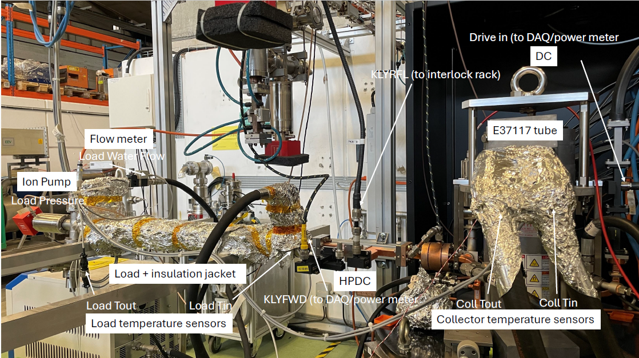
Xbox 3 Test bench modification
CLIC Project Meeting #47, Dec 11 2024
13/20

Slide 15
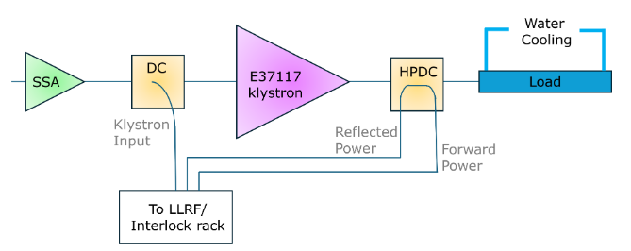
Xbox 3 Test bench modification
Addition of channels to acquire high-voltage pulses from the modulator
Addition of temperature sensors and flow meters for calorimetry measurement
Improvement of interlocking system to protect klystrons
Calibration load in collaboration with Scandinova
Load return loss better than -40dB in <100 MHz bandwidth
LLRF error in frequency of ~hundreds of kHz
CLIC Project Meeting #47, Dec 11 2024
14/20

Slide 16
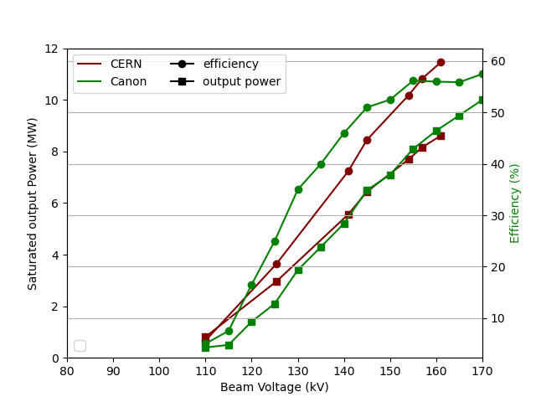
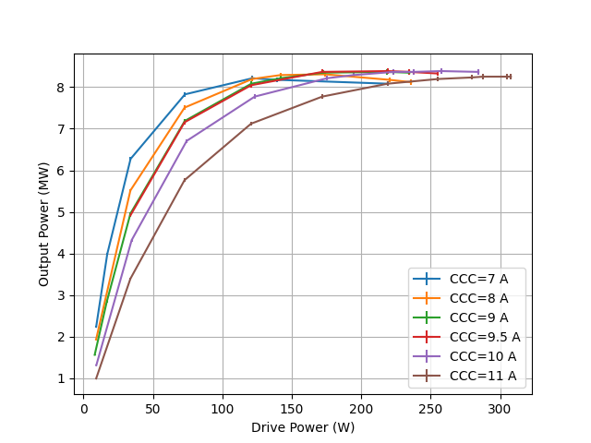
Xbox 3 HEK test results
22M001
CLIC Project Meeting #47, Dec 11 2024
15/20

Slide 17
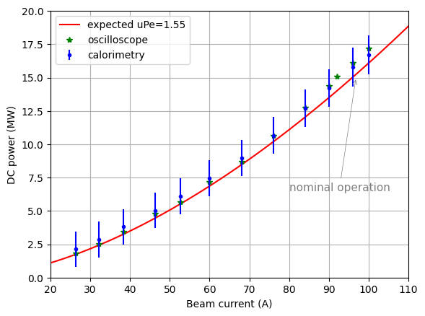
Xbox 3 HEK test results
22G002
Perveance uPE reported by Canon | 1.55
Perveance uPE from meas. with oscilloscope | 1.394
Perveance uPE from calorimetry | 1.398
At nominal beam voltage of 157 kV, we have measured a DC peak power of 15.6 MW, i.e., a 6.4% more of what we expected
CLIC Project Meeting #47, Dec 11 2024
16/20

Slide 18
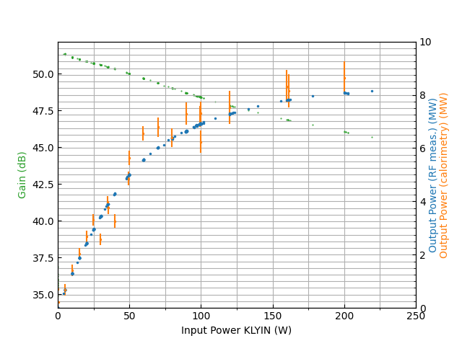
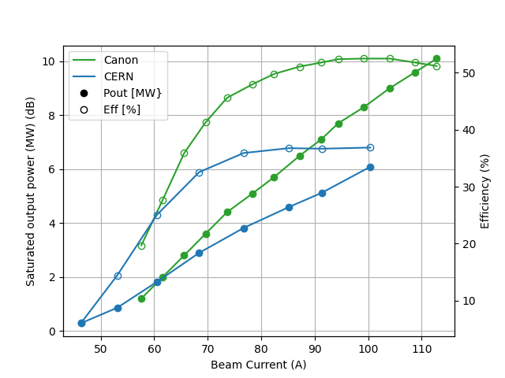
Xbox 3 HEK test results
22G002
Saturation power at nominal operation (157 kV) is 2MW lower than expected (meas. by Canon)
Higher power is restored at 20 MHz below nominal frequency (11.994GHz)
CLIC Project Meeting #47, Dec 11 2024
17/20

Slide 19
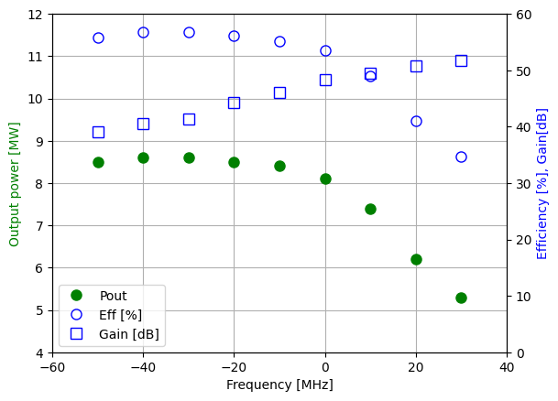
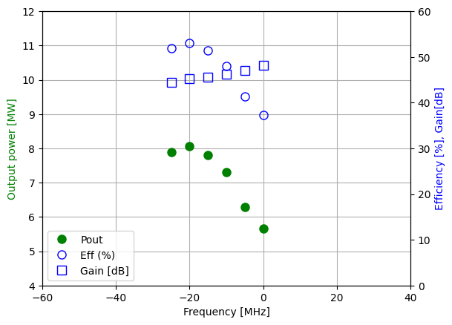
Xbox 3 HEK test results
22G002
Canon results
CERN results
CLIC Project Meeting #47, Dec 11 2024
18/20

Slide 20
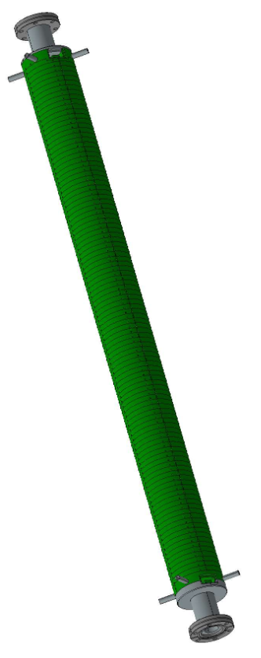
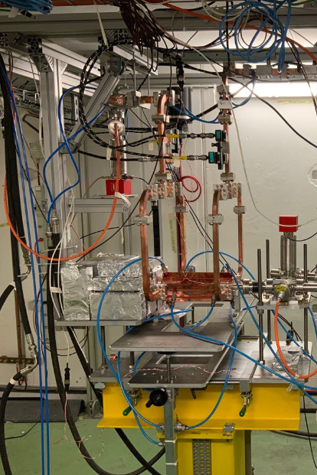

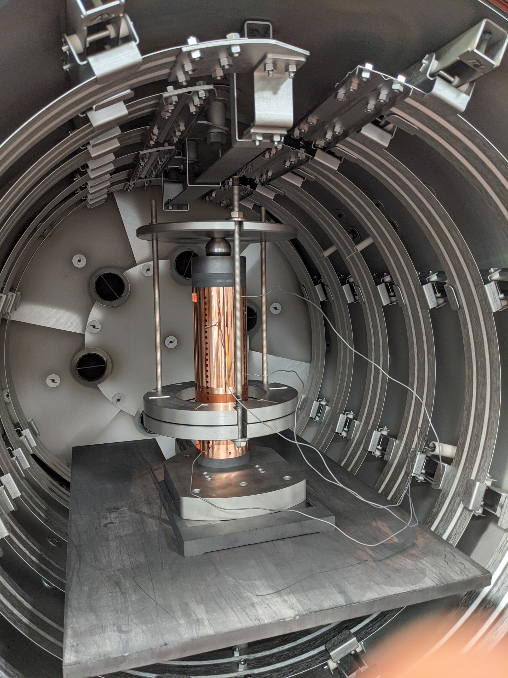
Xbox 3 future plans
Continue conditioning of TD31 N1 and N2
Integration and conditioning of structures TD26 from CIEMAT
Integration and conditioning of iFast accelerating structure
CLIC Project Meeting #47, Dec 11 2024
19/20

Slide 21
Summary
KLYSTRON TO BE REPAIRED
XBox2
OPERATIONAL
XBox3
XBox1
OPERATIONAL
Waiting for the 50 MW CPI Klystron to be repaired
(Almost) ready for the integration and testing of the BOC pulse compressor
Manufacturing Smartcell has been approved
Canon E37117 HE Klystron campaign is finished
Ready for integration of structures TD31, TD26 and iFAST
CLIC Project Meeting #47, Dec 11 2024
20/20

Slide 22
Update on CERN Xboxes and X-Band technologies
Special thanks to all the people who have contributed with their work and advice during this year, including N. Catalán Lasheras, A. Baig, M. Boronat, A. Chauchet, S. Curt, A. Grudiev, S. González-Antón, C. Marrelli, P. Martínez-Reviriego, L. Millar, P. Morales Sánchez, D. Soriano, I. Syratchev, M. Volpi, P. Wang, B. Woolley, W. Wuensch…
CLIC Project Meeting #47, Dec 11 2024

Slide 23
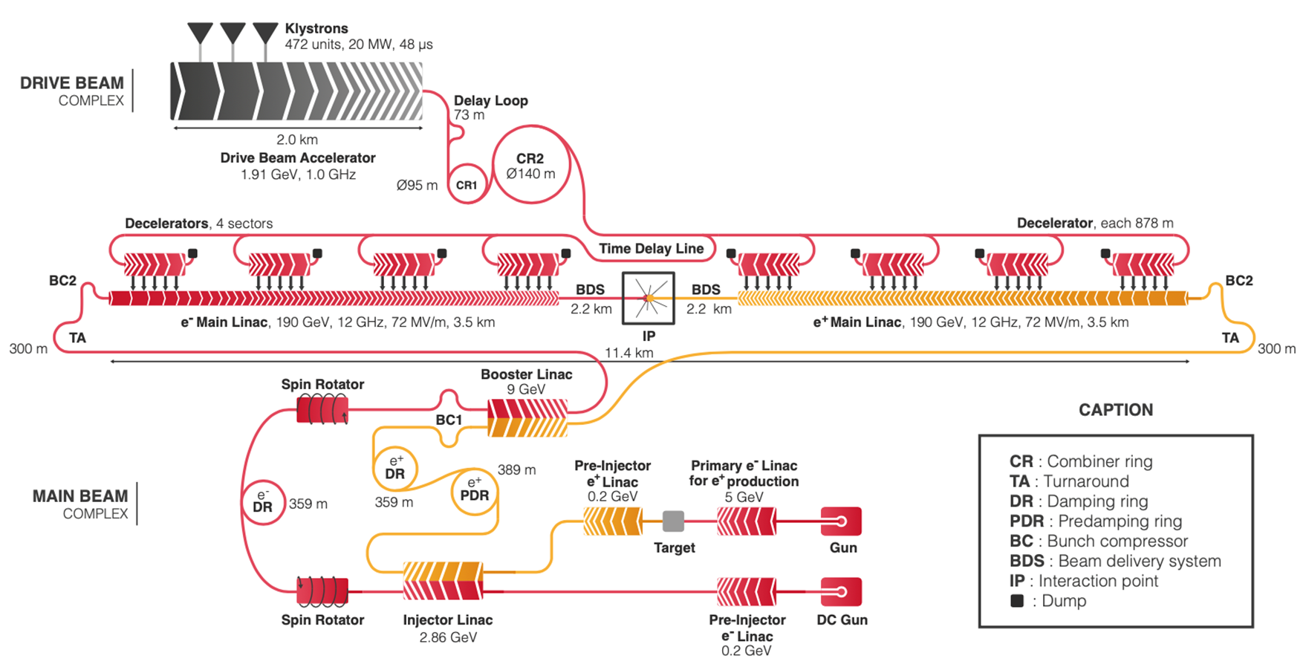
Xbox 2: TD31 for CLIC380
CLIC Project Meeting #47, Dec 11 2024

Slide 24
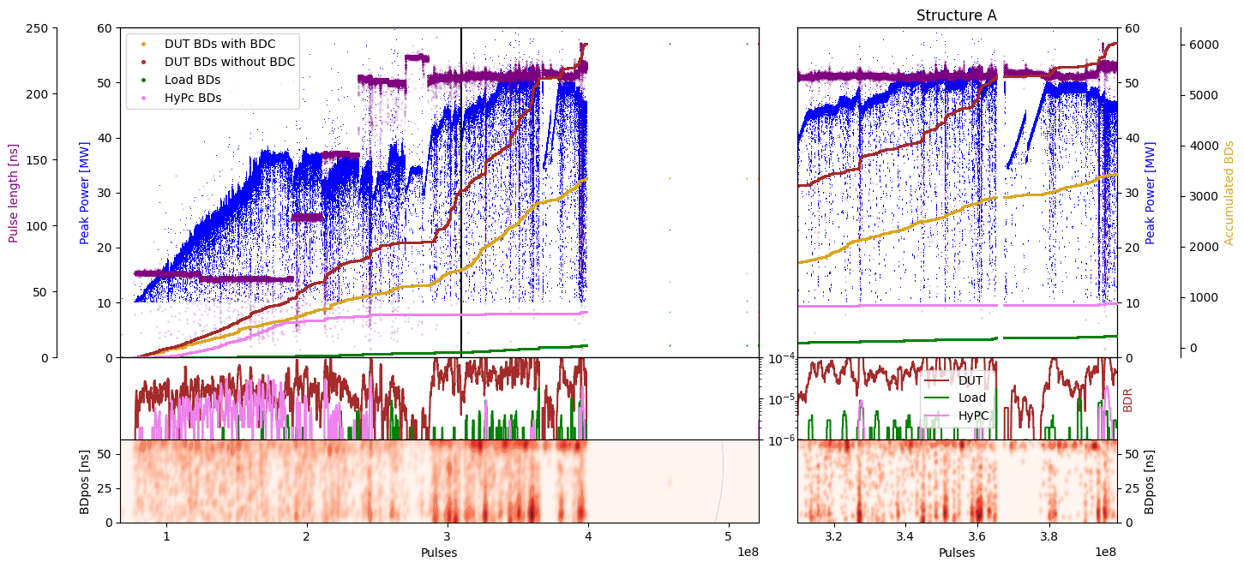
Xbox 2 TD31
TD31N3 conditioning history
Structure A/B 50:50
Structure A 100:1
Structure B 1:100
CLIC Project Meeting #47, Dec 11 2024

Slide 25
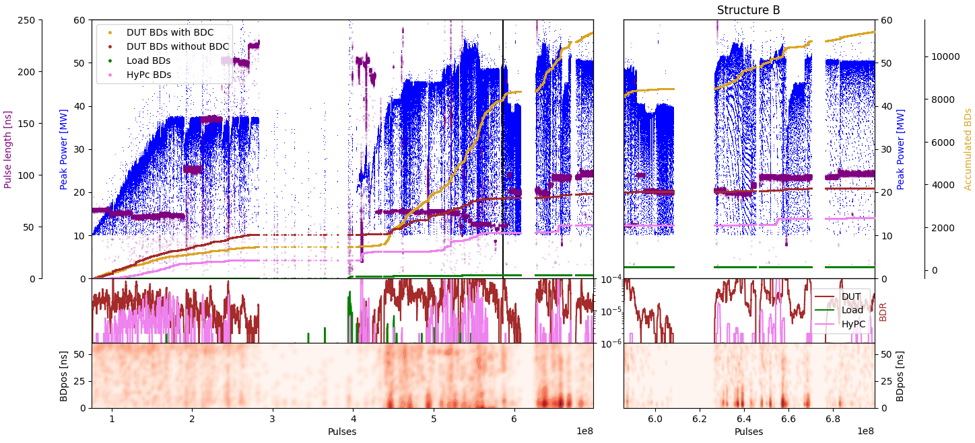
Xbox 2 TD31
TD31N4 conditioning history
Structure A/B 50:50
Structure A 100:1
Structure B 1:100
CLIC Project Meeting #47, Dec 11 2024

Slide 26
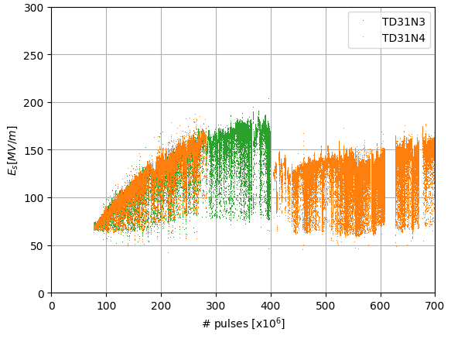
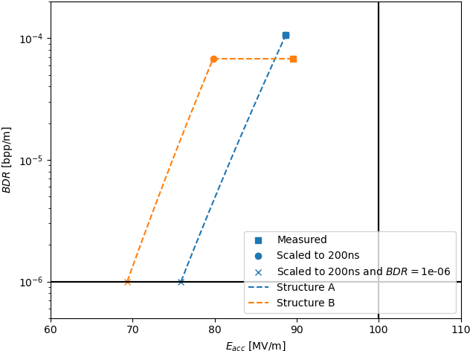
Xbox 2 TD31
Conditioning history comparison
CLIC Project Meeting #47, Dec 11 2024

