Slide 1
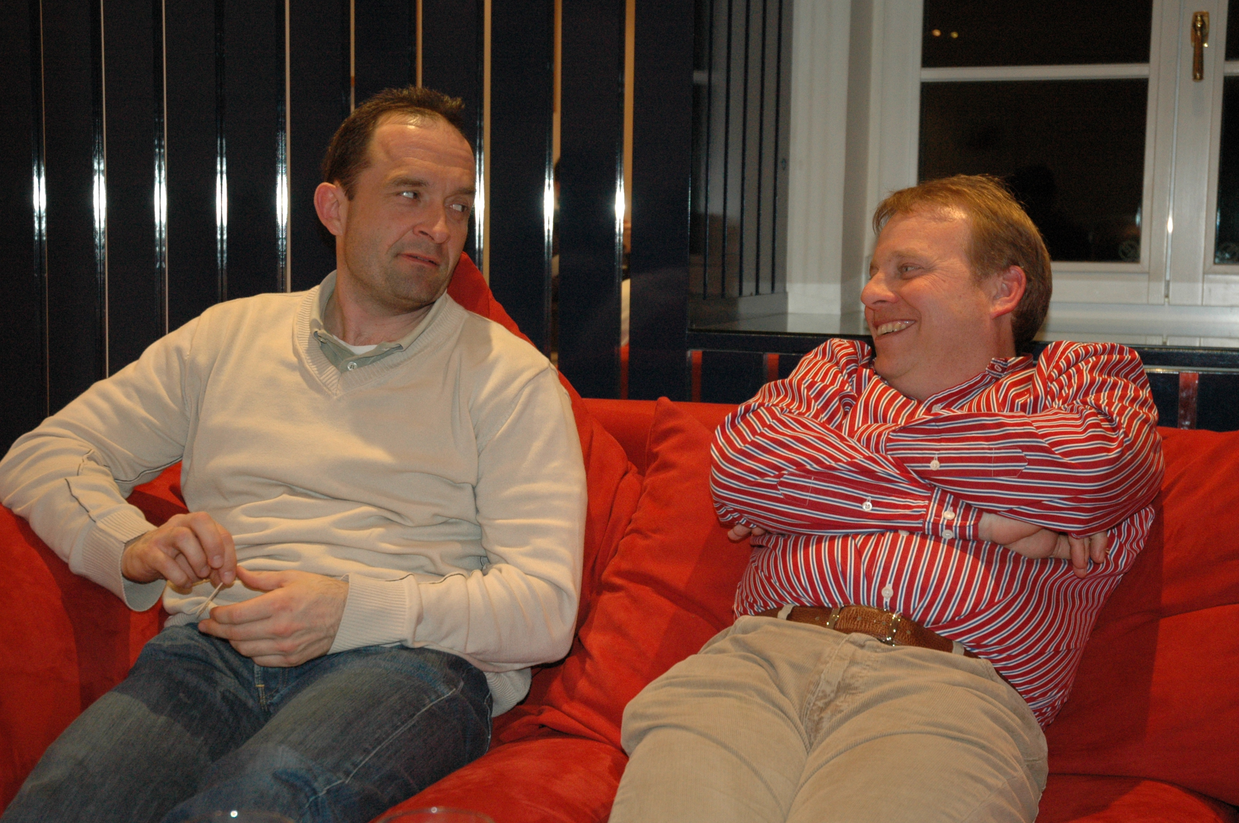
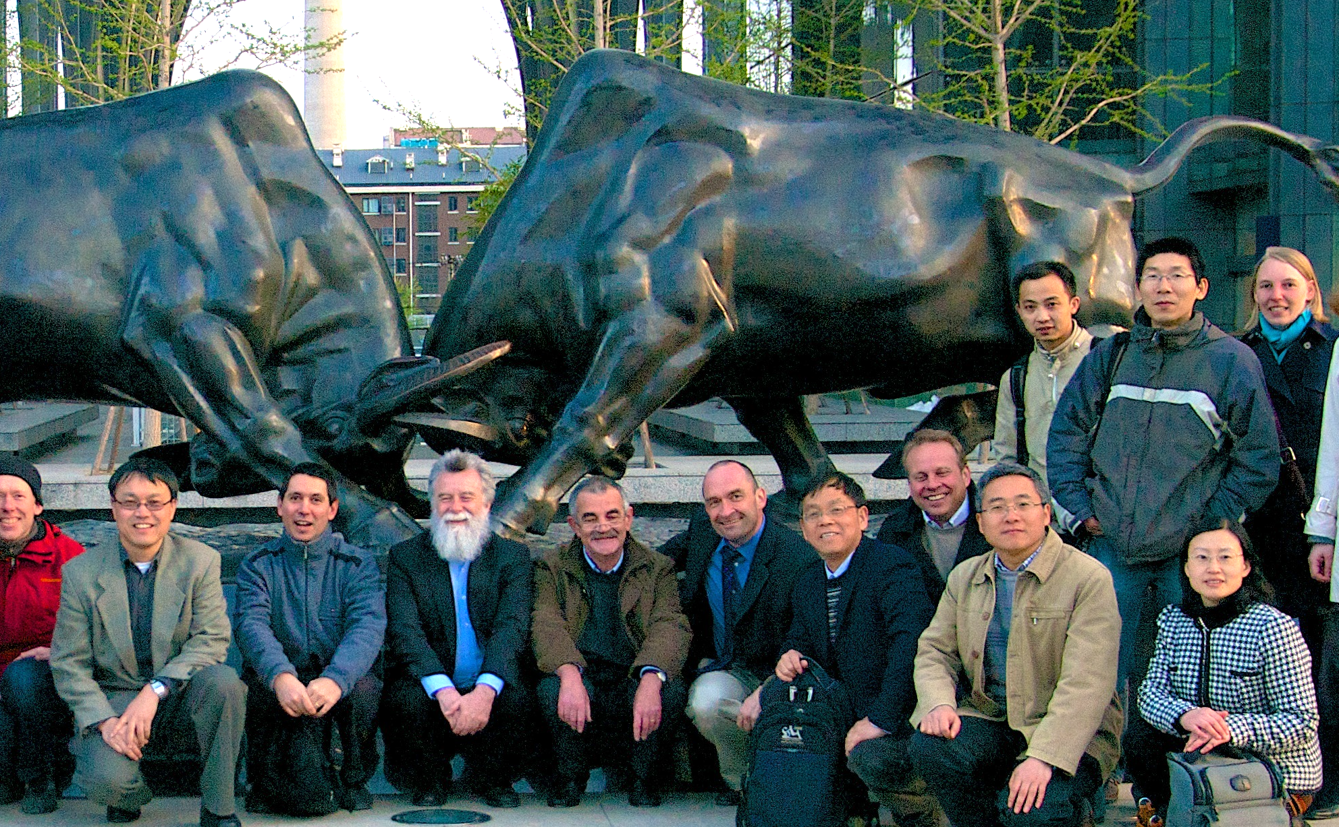
Carsten, Dirk and me
1992 summer, my first trip to Europe, Aachen “ QCD 20 years later”
2009, Jan-March, part of my sabbatical leave in Frankfurt
Beijing, April 2013
Party at my apartment in Villa Giersch March 21, 2009
2013, Worked on German-Sino Joint CRC proposal
2024 --, host of my Humboldt Research Award visit

Slide 2
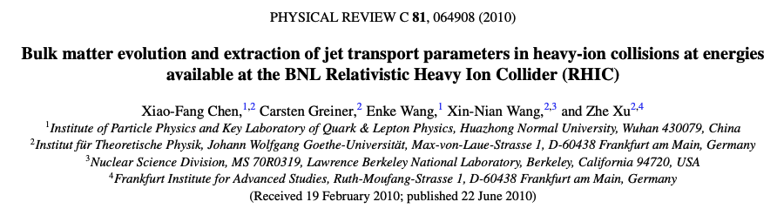
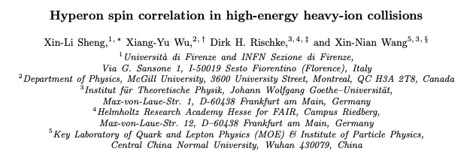
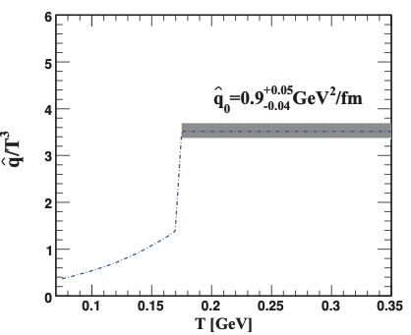
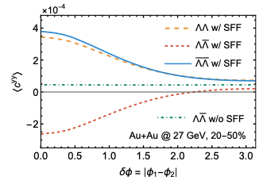
Our Collaboration
arXiv:2508.03496
X. G. Huang, P. Huovinen and X.-N. Wang, ``Quark Polarization in a Viscous Quark-Gluon Plasma,'' Phys. Rev. C 84, 054910 (2011)

Slide 3
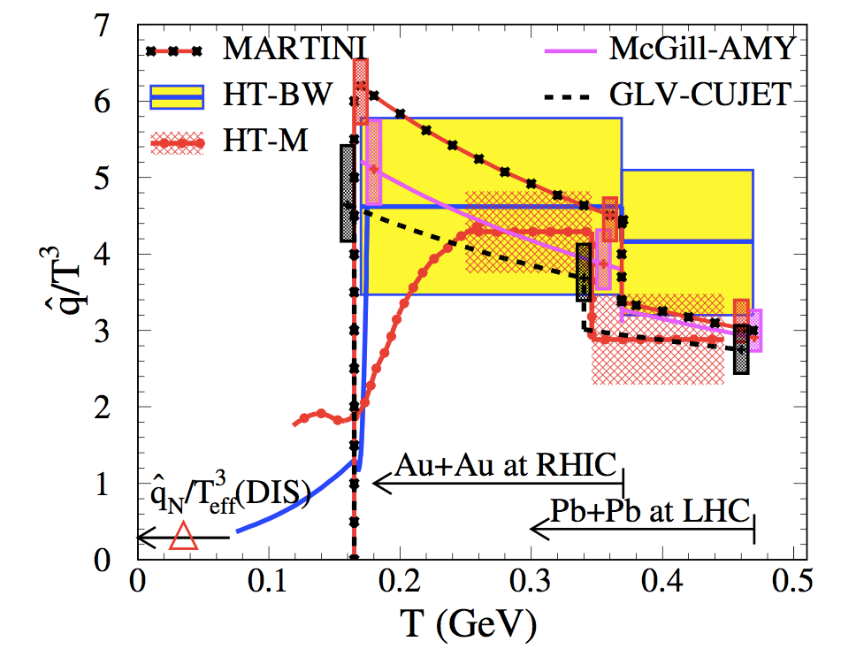

(DOE) JET Collaboration 2010-2015
Phys. Rev. C 90, no.1, 014909 (2014)

Slide 4

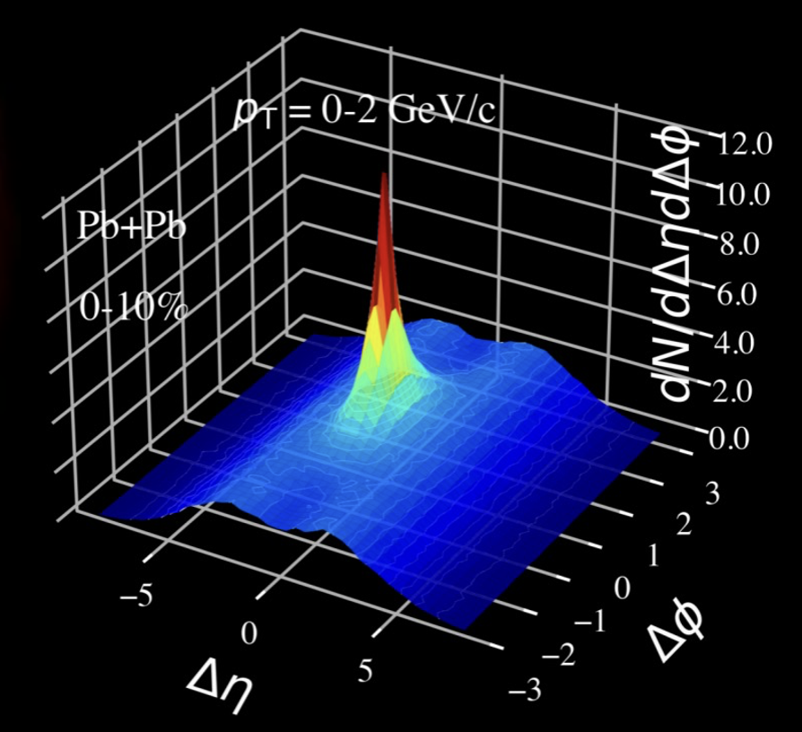
Chromo-dynamics of Jet-Fluid Interaction
Collective Dynamics in Little Big Bang, Aug 6-8, 2025, Geothe Univ Frankfurt
Xin-Nian Wang
Central China Normal University

Slide 5
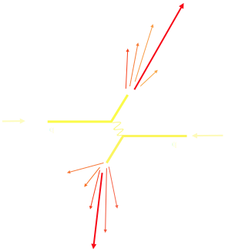
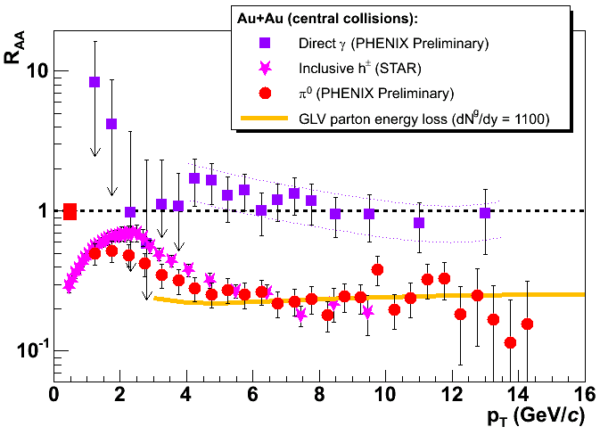
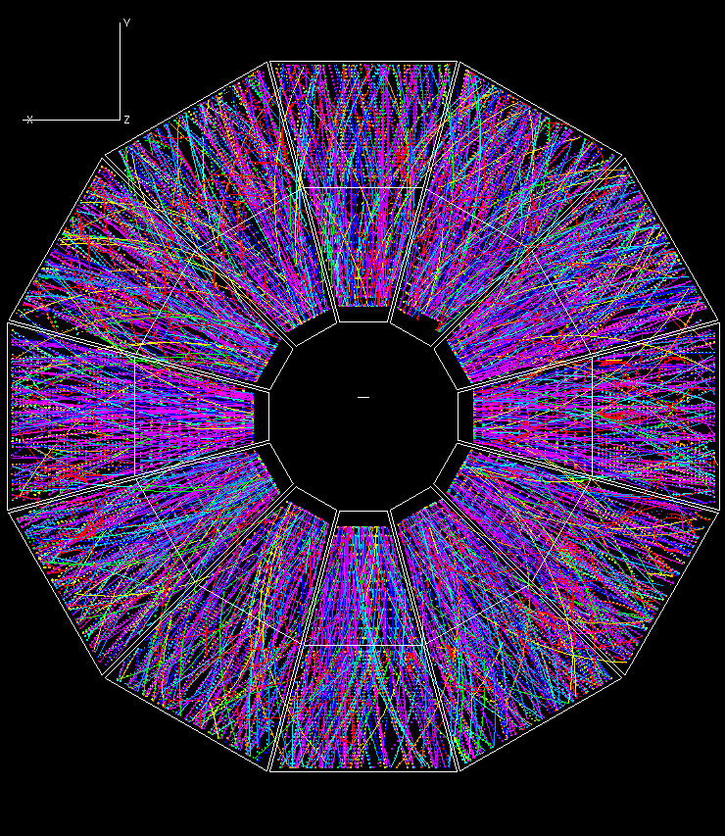
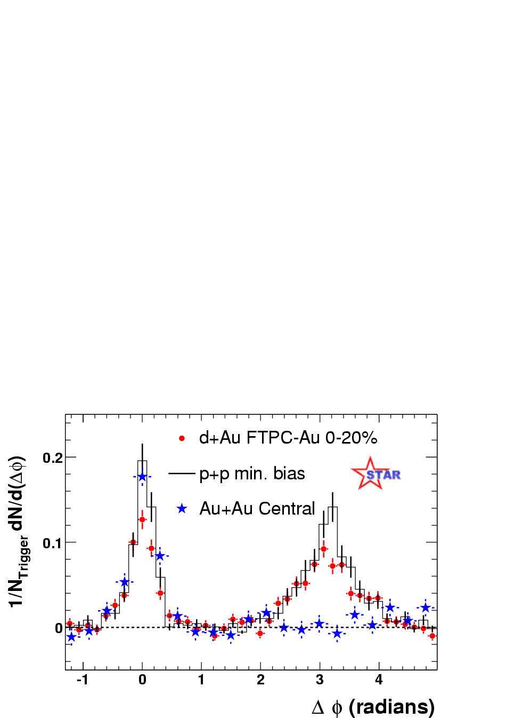
Jet Quenching established since 2001
Where does the lost energy loss go?
How is the lost energy redistributed?
Pedestal&flow subtracted
Notes:
RHIC experiments marked a milestone for jet quenching, from a theoretical concept to a reality.

Slide 6

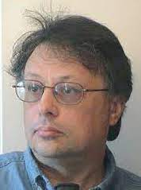


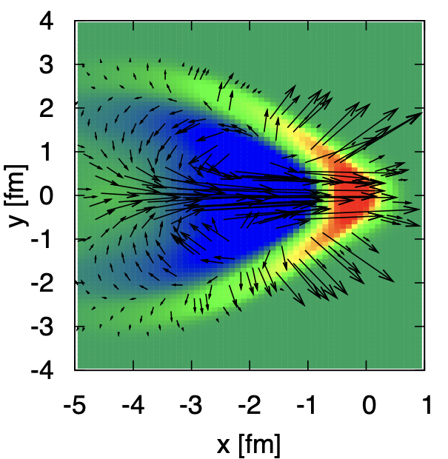
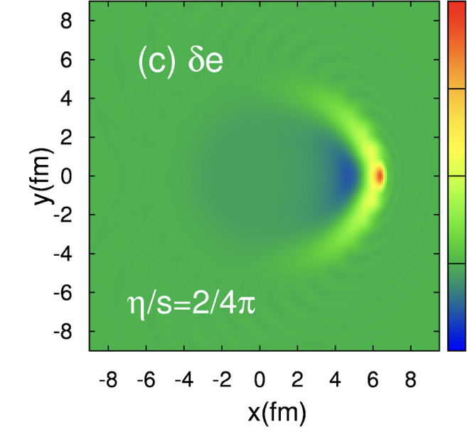
Jet-induced medium excitation
Casalderrey-Solana, Shuryak & Teaney (2005), Stoecker (2005)
Jet induced Mach-cone in QGP
c_{s}
v
Hydrodynamic approach
energy-momentum
deposited by jet
Betz, Noronha, Giorgio, Gyulassy,
Mishudtin, Rischke (2009)
Li Yan, S. Jeon, C. Gale (2018)
Diffusion wake

Slide 7
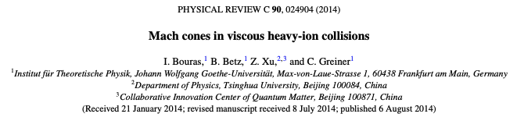
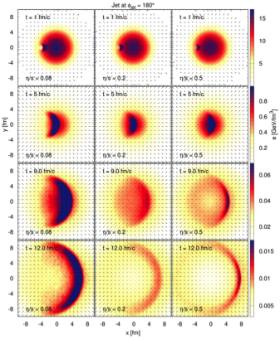
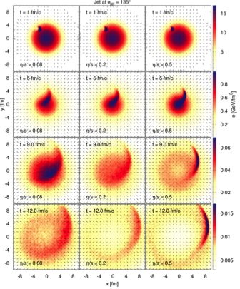
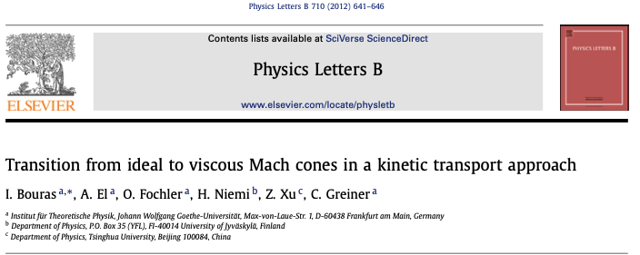
Mach cones in BAMPS

Slide 8
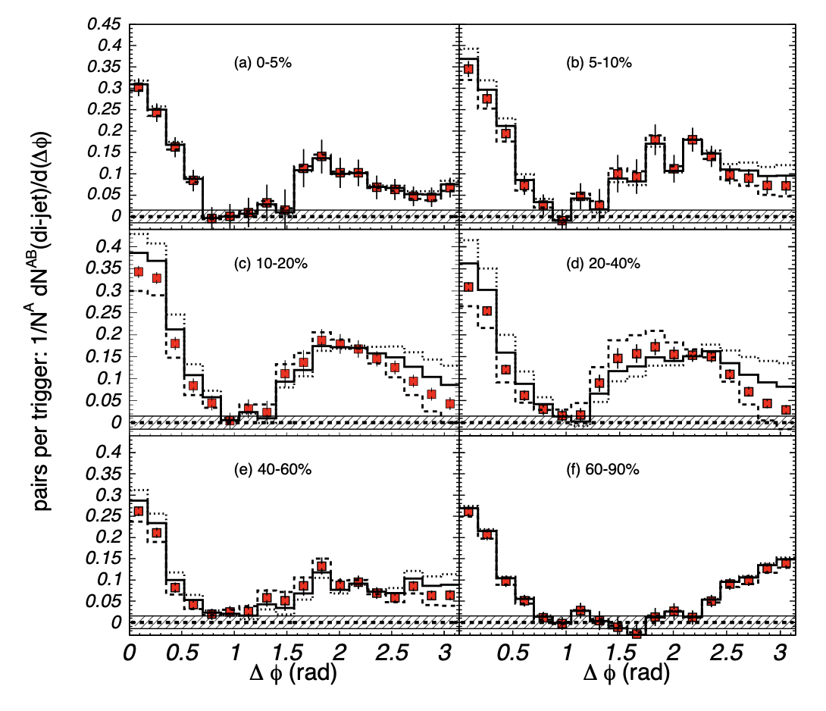
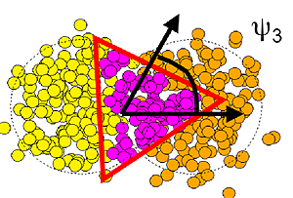
Fake Mach-cone
Di-hadron correlation
θ
Mach-cone?
Triangular
flow
Alver and Roland, Phys. Rev. C 81, 054905 (2010)
PHENIX, Phys. Rev. Lett. 97, 052301 (2006)
No such angular structure from numerical simulations of Mach-cone !

Slide 9
Resurrection of jet-induced Mach-cone
One must consider Contribution to the energy within the jet cone from medium-response
jet cone
Notes:
Argument for jet measurement: not affected by hadronization, but

Slide 10
Microscopic picture of Mach wake
LBT: Linear Boltzmann Transport
Induced radiation
jet parton
pQCD elastic and radiative processes (high-twist)
Transport of medium recoil partons ( and back-reaction)
CLVisc 3+1D hydro bulk evolution
Back-reaction
(particle hole)
recoil parton
He, Luo, Zhu & XNW, PRC 91 (2015) 054908
Notes:
f_i(p_i)=\frac{1}{e^{p_i\cdot u/T}\pm 1} (i=2,4)
f_i(p)=(2\pi)^3\delta^3(\vec p_i-\vec p_0)\delta^3(\vec x-\vec x_0-t\vec v_i) [i=1,3]
\frac{dN_g}{dzd^2k_\perp dt}=\frac{2\alpha_s N_c}{\pi k_\perp^4} P(z)
(\hat p\cdot u) \hat q \sin^2(\frac{t-t_0}{2\tau_f})
p_1\cdot \partial f_1=-\int dp_2dp_3dp_4(f_1f_2-f_3f_4)|M_{12 \rightarrow 34}|^2(2\pi)^4\delta^4(\sum_i p_i) + {\rm inelastic}
\frac{dN_g}{dzd^2k_\perp dt} \approx \frac{2C_A\alpha_s}{\pi k_\perp^4}P(z) \hat q (\hat p\cdot u) \sin^2\frac{k_\perp^2 (t-t_0)}{4z(1-z)E}

Slide 11
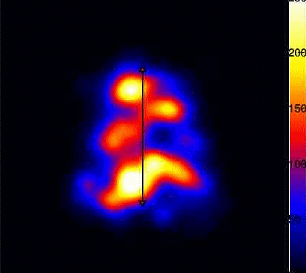
CoLBT-hydro
(Coupled Linear Boltzmann Transport hydro)
Concurrent and coupled evolution of bulk medium and jet showers
LBT for energetic partons (jet shower and recoil)
Hydrodynamic model for bulk and soft partons: CLVisc
Parton coalescence (thermal-shower)+ jet fragmentation
Hadron cascade using UrQMD
Chen, Cao, Luo, Pang & XNW, PLB777(2018)86
Notes:
\partial_\mu T^{\mu\nu}(x) = j^\nu (x)
\delta f(p,x) \ll f(p,x)
j^\nu(x) = \sum_i p^\nu_i \delta^{(4)}(x-x_i) \theta(p^0_{cut}-p\cdot u)
j^\nu(x) = \sum_a\int \frac{d^3p}{(2\pi)^3}\frac{p^\nu}{p^0}f_a(p)\theta(p\cdot u - p^0_{cut})
p\cdot \partial f(p) =- C(p) \;\;\; p\cdot u > p_{cut}^0

Slide 12
Medium response of Z/γ-jet in CoLBT-hydro
Before
After hydro background subtraction

Slide 13
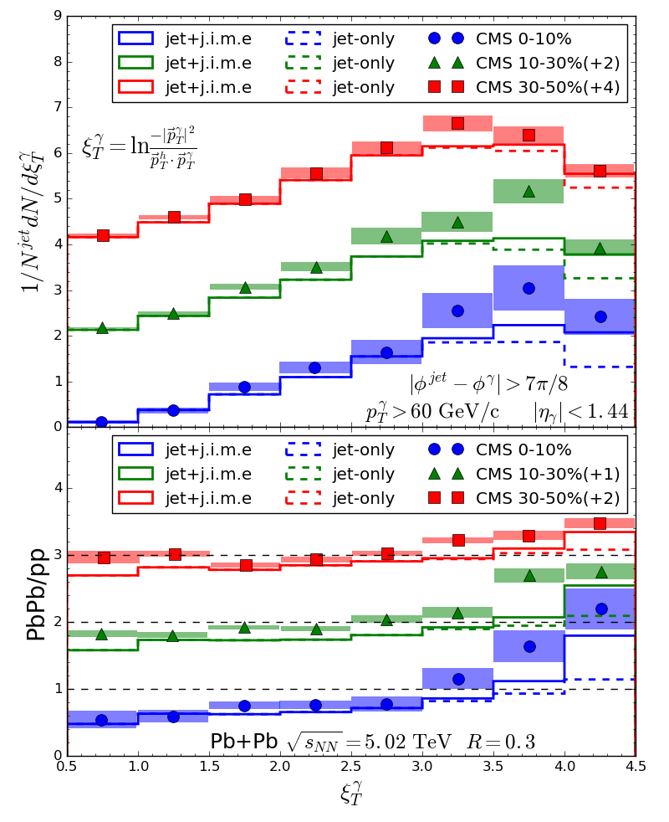
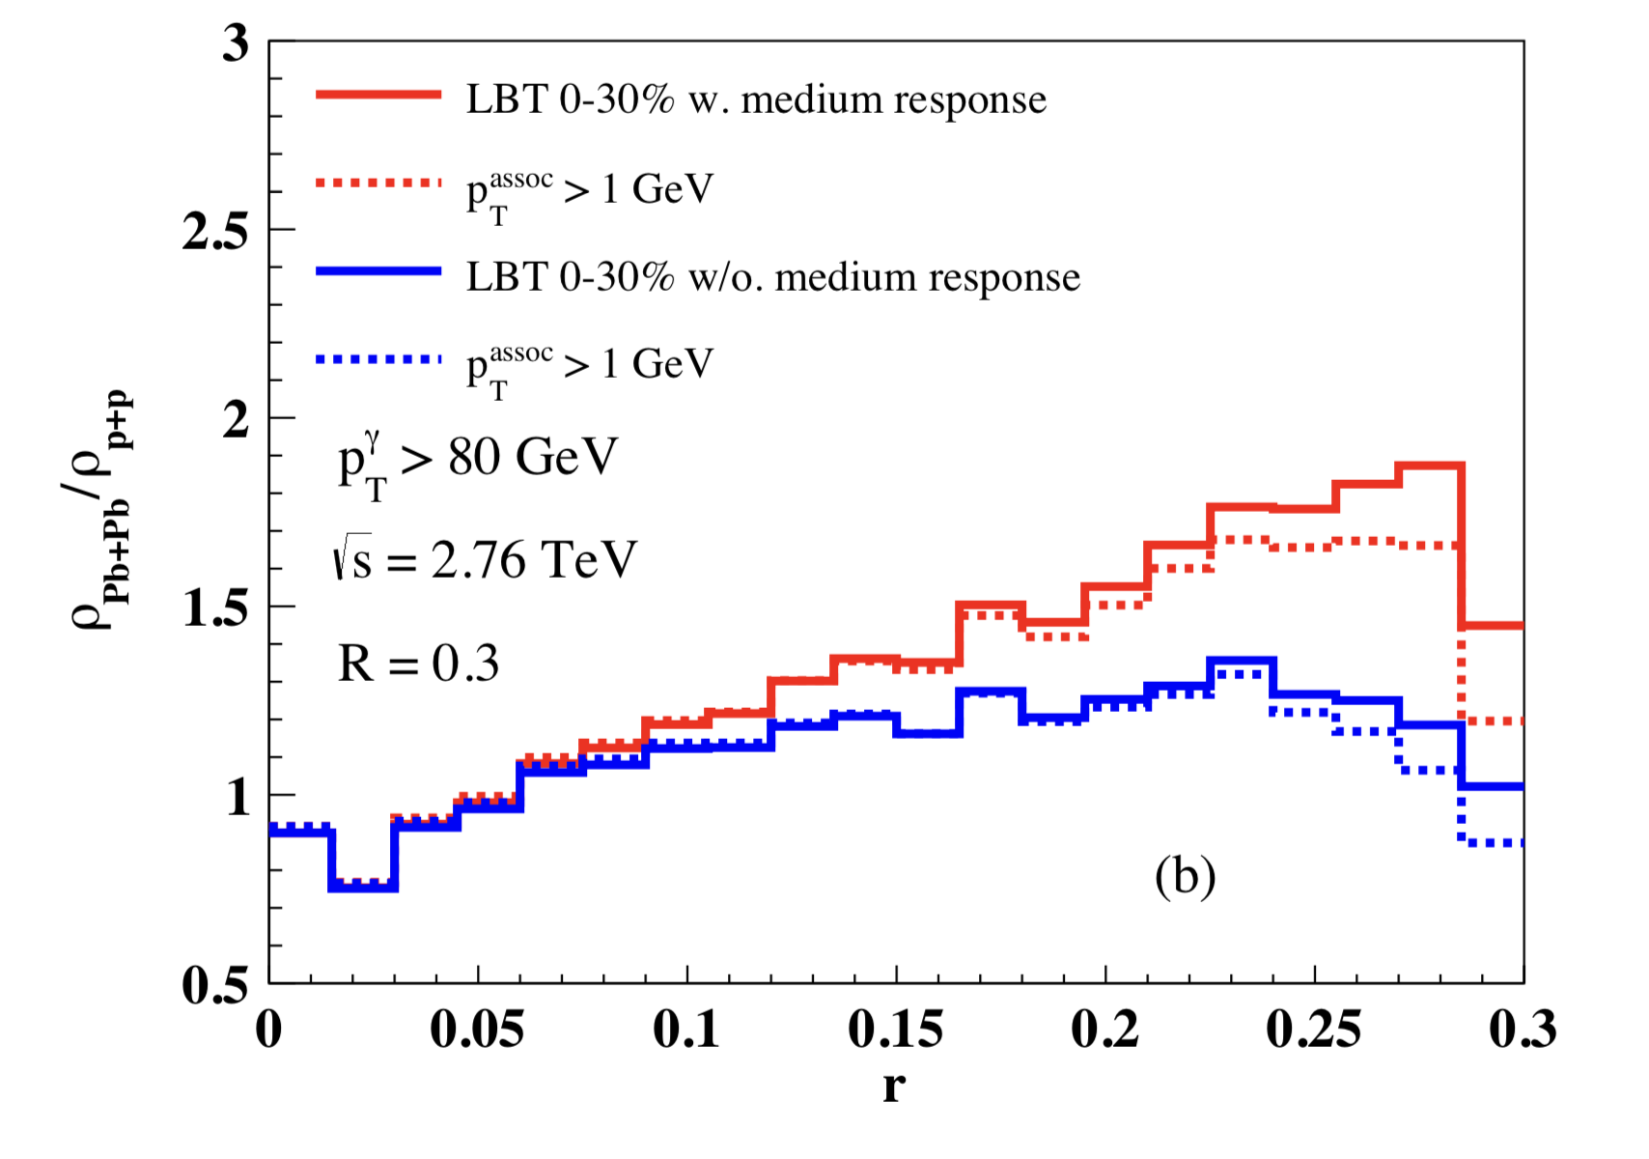
Medium modification of γ-jets
Enhancement of soft hadrons in large angles
r
With recoil
w/o recoil
Luo, Cao, He & XNW, arXiv:1803.06785
Chen, Cao, Luo, Pang & XNW, 2005.09678

Slide 14
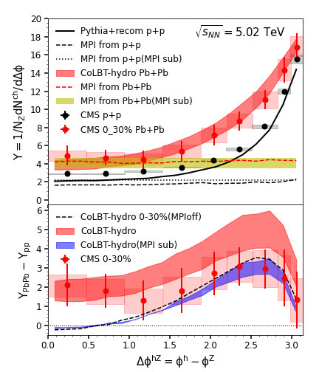
MPI background and diffusion wake in Z-jets
Mixed event subtraction
Chen, Yang, He, Ke, Pang and XNW, PRL 127 (2021) 8, 082301

Slide 15
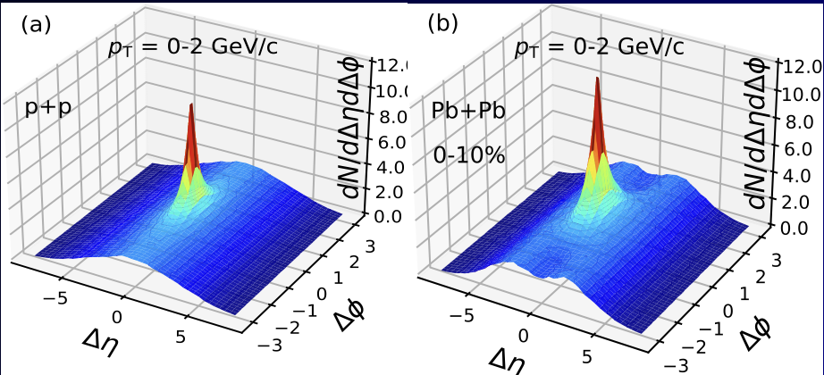
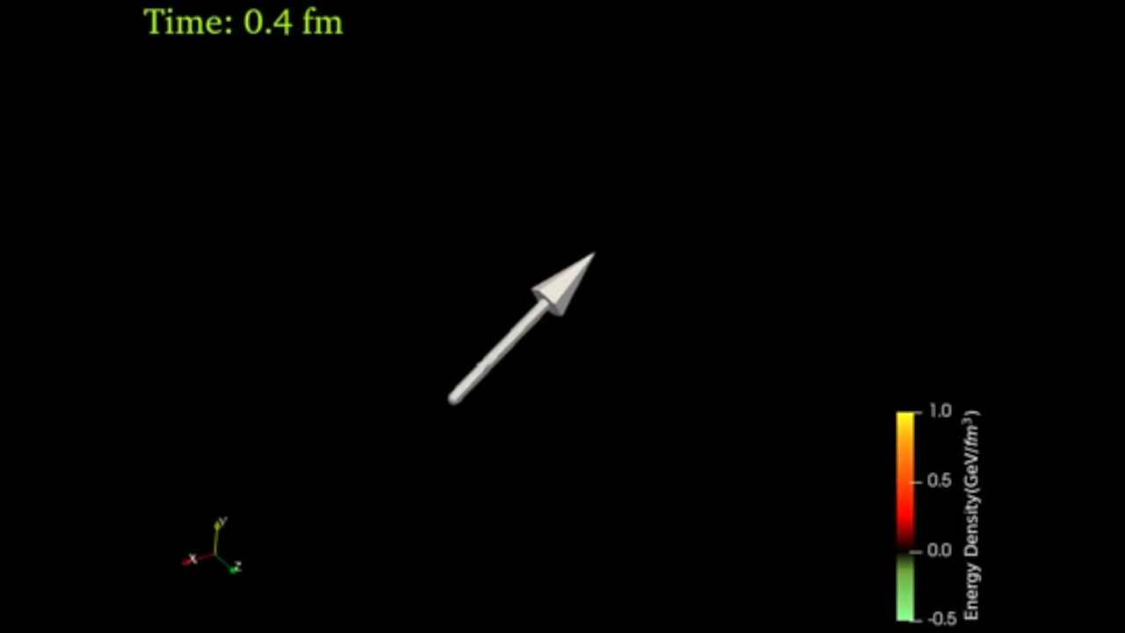
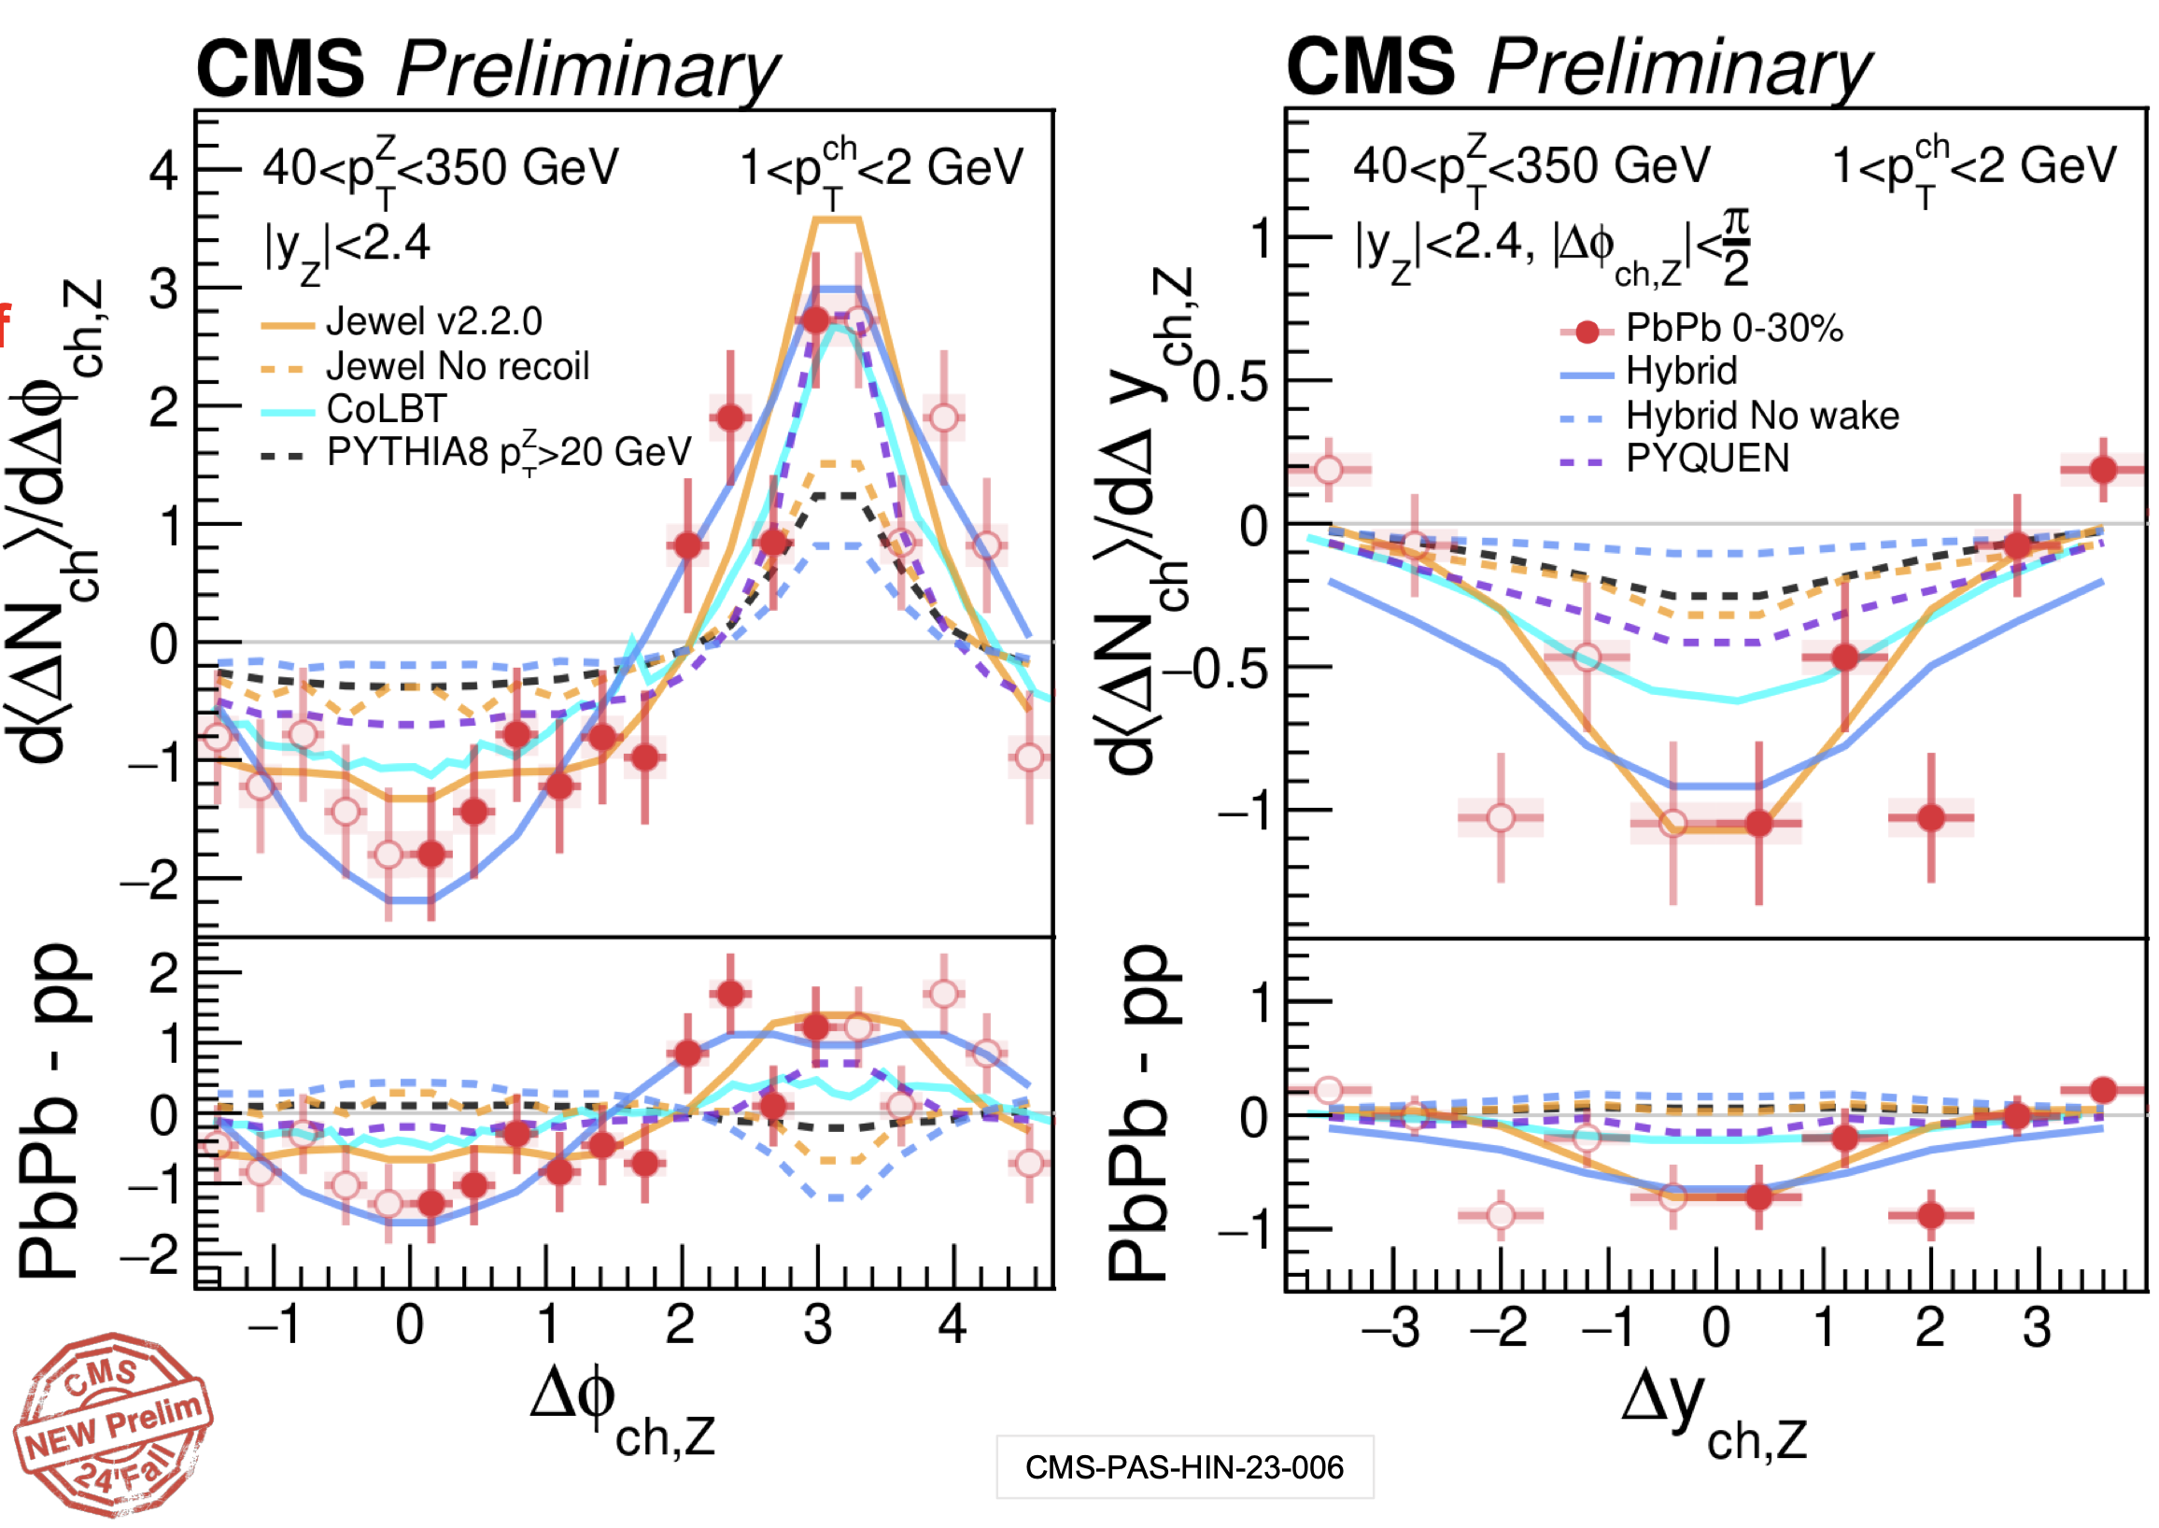
3D structure of diffusion wake
Jet-hadron correlation in γ/jet events
MPI ridge: independent multiple mini-jets
Diffusion wake → rapidity valley
on top of the MPI ridge
Yang, Luo, Chen, Pang and XNW, PRL 130, 052301 (2023)
Y. Lee
talk at
HP24

Slide 16
Diffusion wake and jet energy loss
Longitudinal tomography
γ-jet asymmetry p_{T}^{jet}/p_{T}^{γ} : proxy of jet energy loss
p_{T}=1-2 GeV/c
Yang, Luo, Chen, Pang and XNW, PRL 130, 052301 (2023)
Zhang, Owens, Wang and XNW, PRL 103, 032302 (2009)

Slide 17
Diffusion wake in di-jets
Rapidity ordering convention:
Jet-hadron correlation without rapidity gap

Slide 18
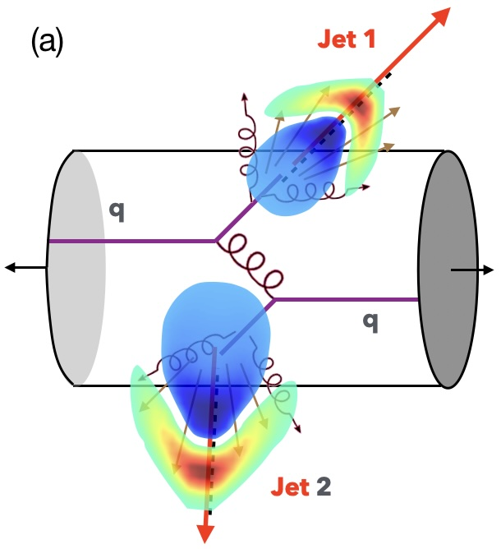
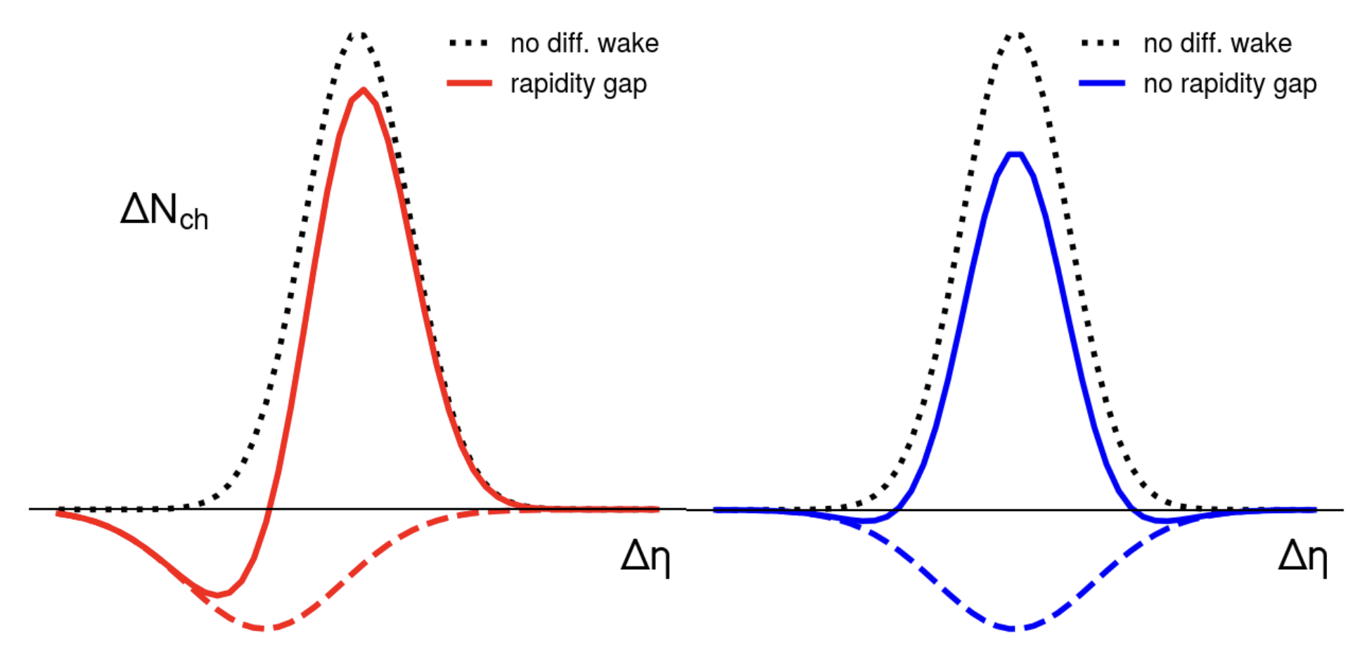
Diffusion wake in di-jets
Jet-hadron correlation in
di-jets with and without rapidity gap

Slide 19
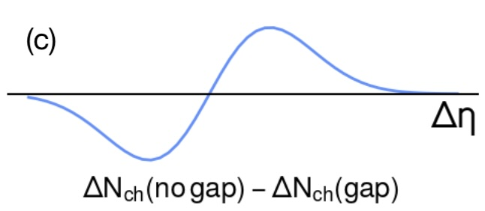
Diffusion wake in di-jets
Jet-hadron correlation in
di-jets with rapidity gap

Slide 20
A background-free signal of diffusion wake
Medium modification of jet-hadron correlation
Rapidity Asymmetry
Zhong Yang and XNW, 2501.03419
Notes:
\Delta N_{\rm AA}=\int d\Delta\phi\left[\frac{dN_{\rm AA}}{d\Delta\phi d\Delta\eta} - \frac{dN_{\rm pp}}{d\Delta\phi d\Delta\eta}\right]

Slide 21
Diffusion wake in γ-jets
γ-hadron correlation in
γ-jet with/without rapidity gap
N(|η_{jet}|>0.8) - N(|η_{jet}|<0.8)
γ
γ
p_{T}^{γ}>120 GeV, p_{T}^{jet}>60 GeV

Slide 22
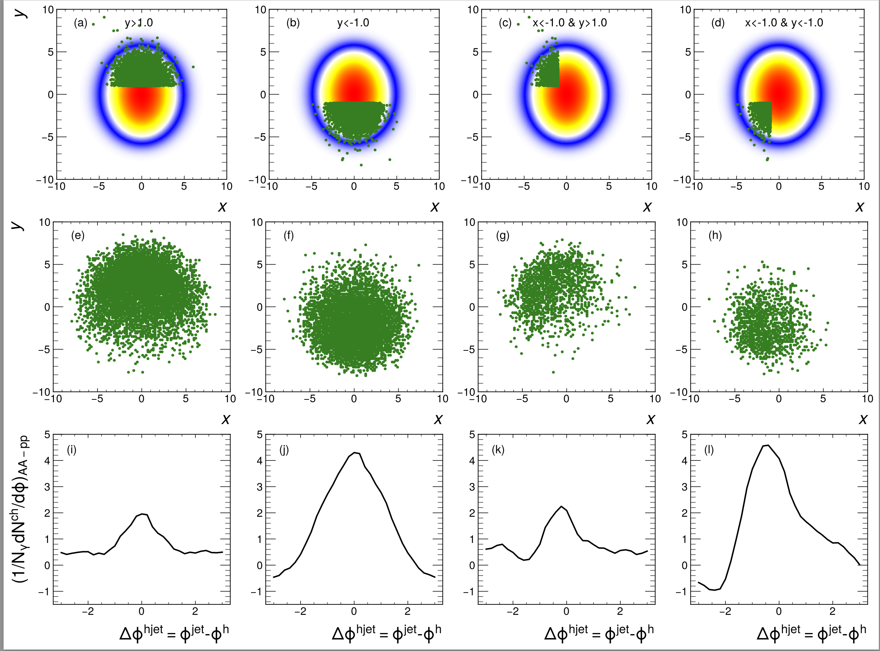
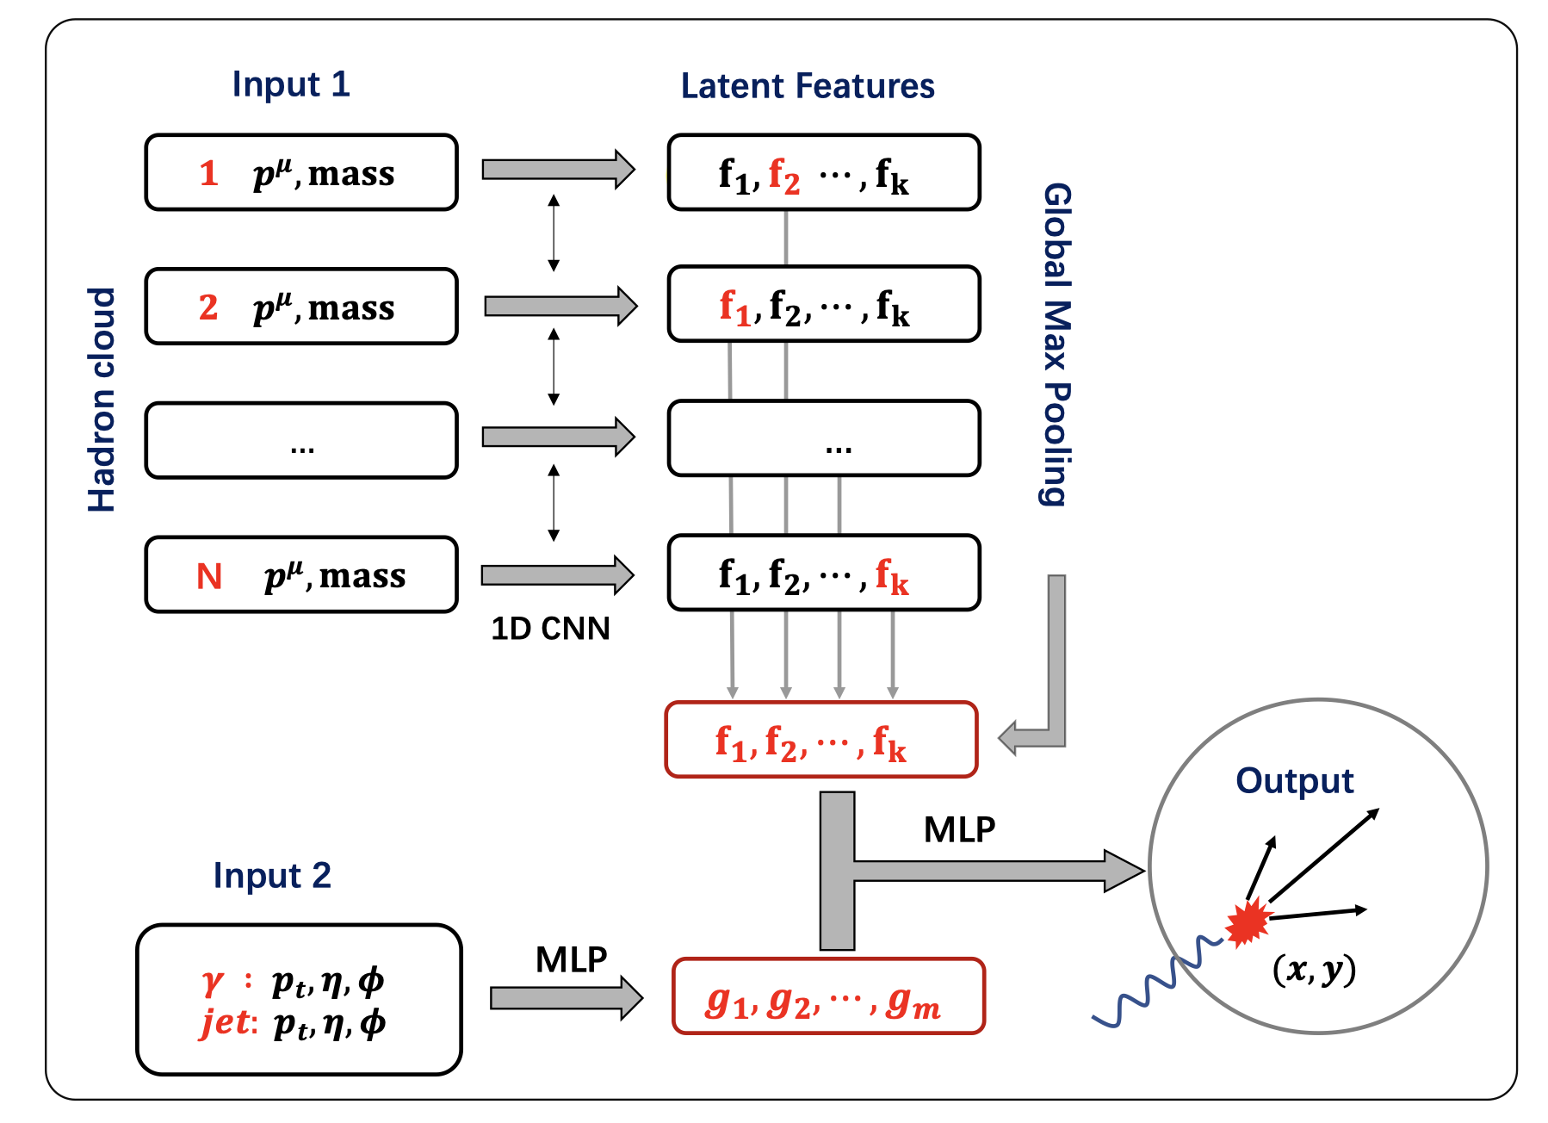
Deep learning assisted jet tomography
PCN (point cloud network)
DL network selection
Actual distribution
Eur.Phys.J.C 83 (2023) 7, 652
γ-soft hadron correlation
Yang, He，Chen，Ke，Pang & XNW
Notes:
Recently, the point could network as been applied to predict the transverse position of the initial jet production vertices

Slide 23
Summary
Medium response leads to
  enhancement of soft hadrons in jet direction
  depletion of soft hadron on the away side
Unique 3D structure of diffusion wake
Use 2D jet tomography to reveal the angular structure of Mach-cone excitation
Rapidity asymmetry as a robust signal of diffusion wake
Future studies: ML improved 2D tomography and constraint on EoS, transport coefficients

Slide 24
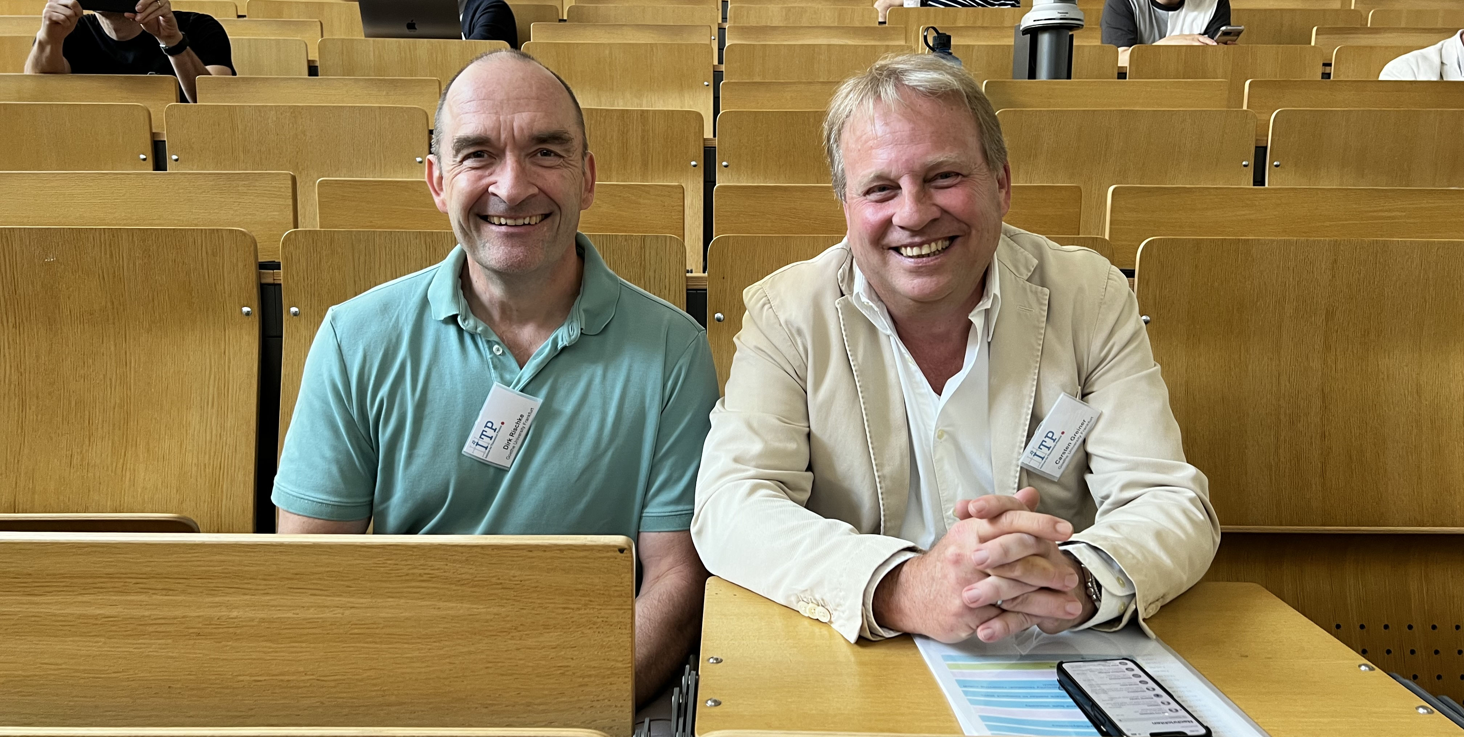
Happy 60th Birthday!

