Slide 2


FALCOND CERN Structural analysis working meeting
FALCON-D Structural analysis update (HFM RD3 WP3.1)
CERN, October 29th 2024
MSC-SMT Arnaud Foussat, Nicola Sala and Sachin Gowrishankar.

Slide 3
Outline
Introduction
Cable features properties
Roadmaps
Status of mock ups, model M1 FE analysis progress
Next activities
Summary
Notes:
As an outline, I will start with a brief introduction of the context of this work and give an update of the Wp3.1 technical scope related to the development of Cos theta 12T dipole . Then I will summarize the related achievements, agreements within the INFN – CERN collaboration with the updated deliverables of WP3.1. In the end I will present the deliverables and development plan focusing over 2024 2026 and summarise.

Slide 4
Introduction
HFM program entrusted CERN WP3.1 to developed a 12T Nb₃Sn Cos-theta dipole based on models (< 2 m) by 2028, as potential technology for further prototype ( ∼ 5 m long), 14T dipole magnet design by horizon 2030. (indico/1430998/)
Uniformized HFM design parameters applied in update design :
  Operation at 12T around 80%.Iss loadline operation at 1.9K
  Mid plane stress @RT < 120 Mpa, 150 Mpa @ 4K,
  Target pole stress max. 10 Mpa, 1/3 detachment @ 12T
  Current design J_{c} ( 16T @4.2K) = 1200 A/mm²
  50 mm aperture, 40 mm equivalent 60° sector width
  Structure designed at 13.5 T e.m loads.

Slide 5
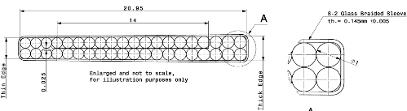
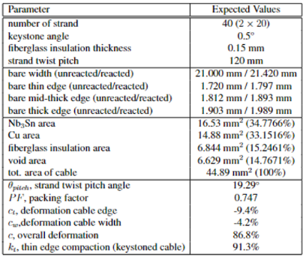
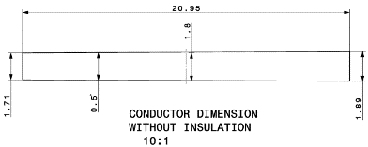

FalconD cable features
Non reacted conductor dimensions
Table 1: FalconD DEM-1 conductor type parameters
Assumed 4.5% (thickness) and 2 % (width) HT expansion residual coeff.

Slide 6
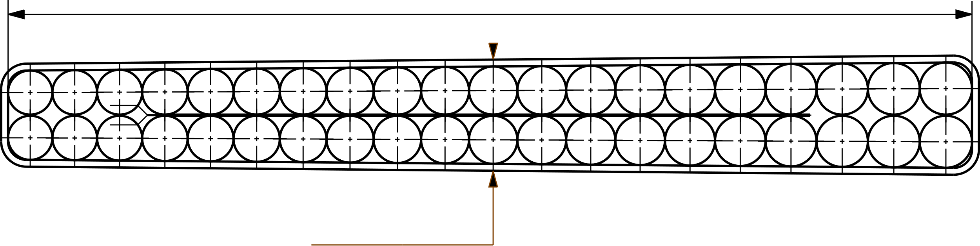
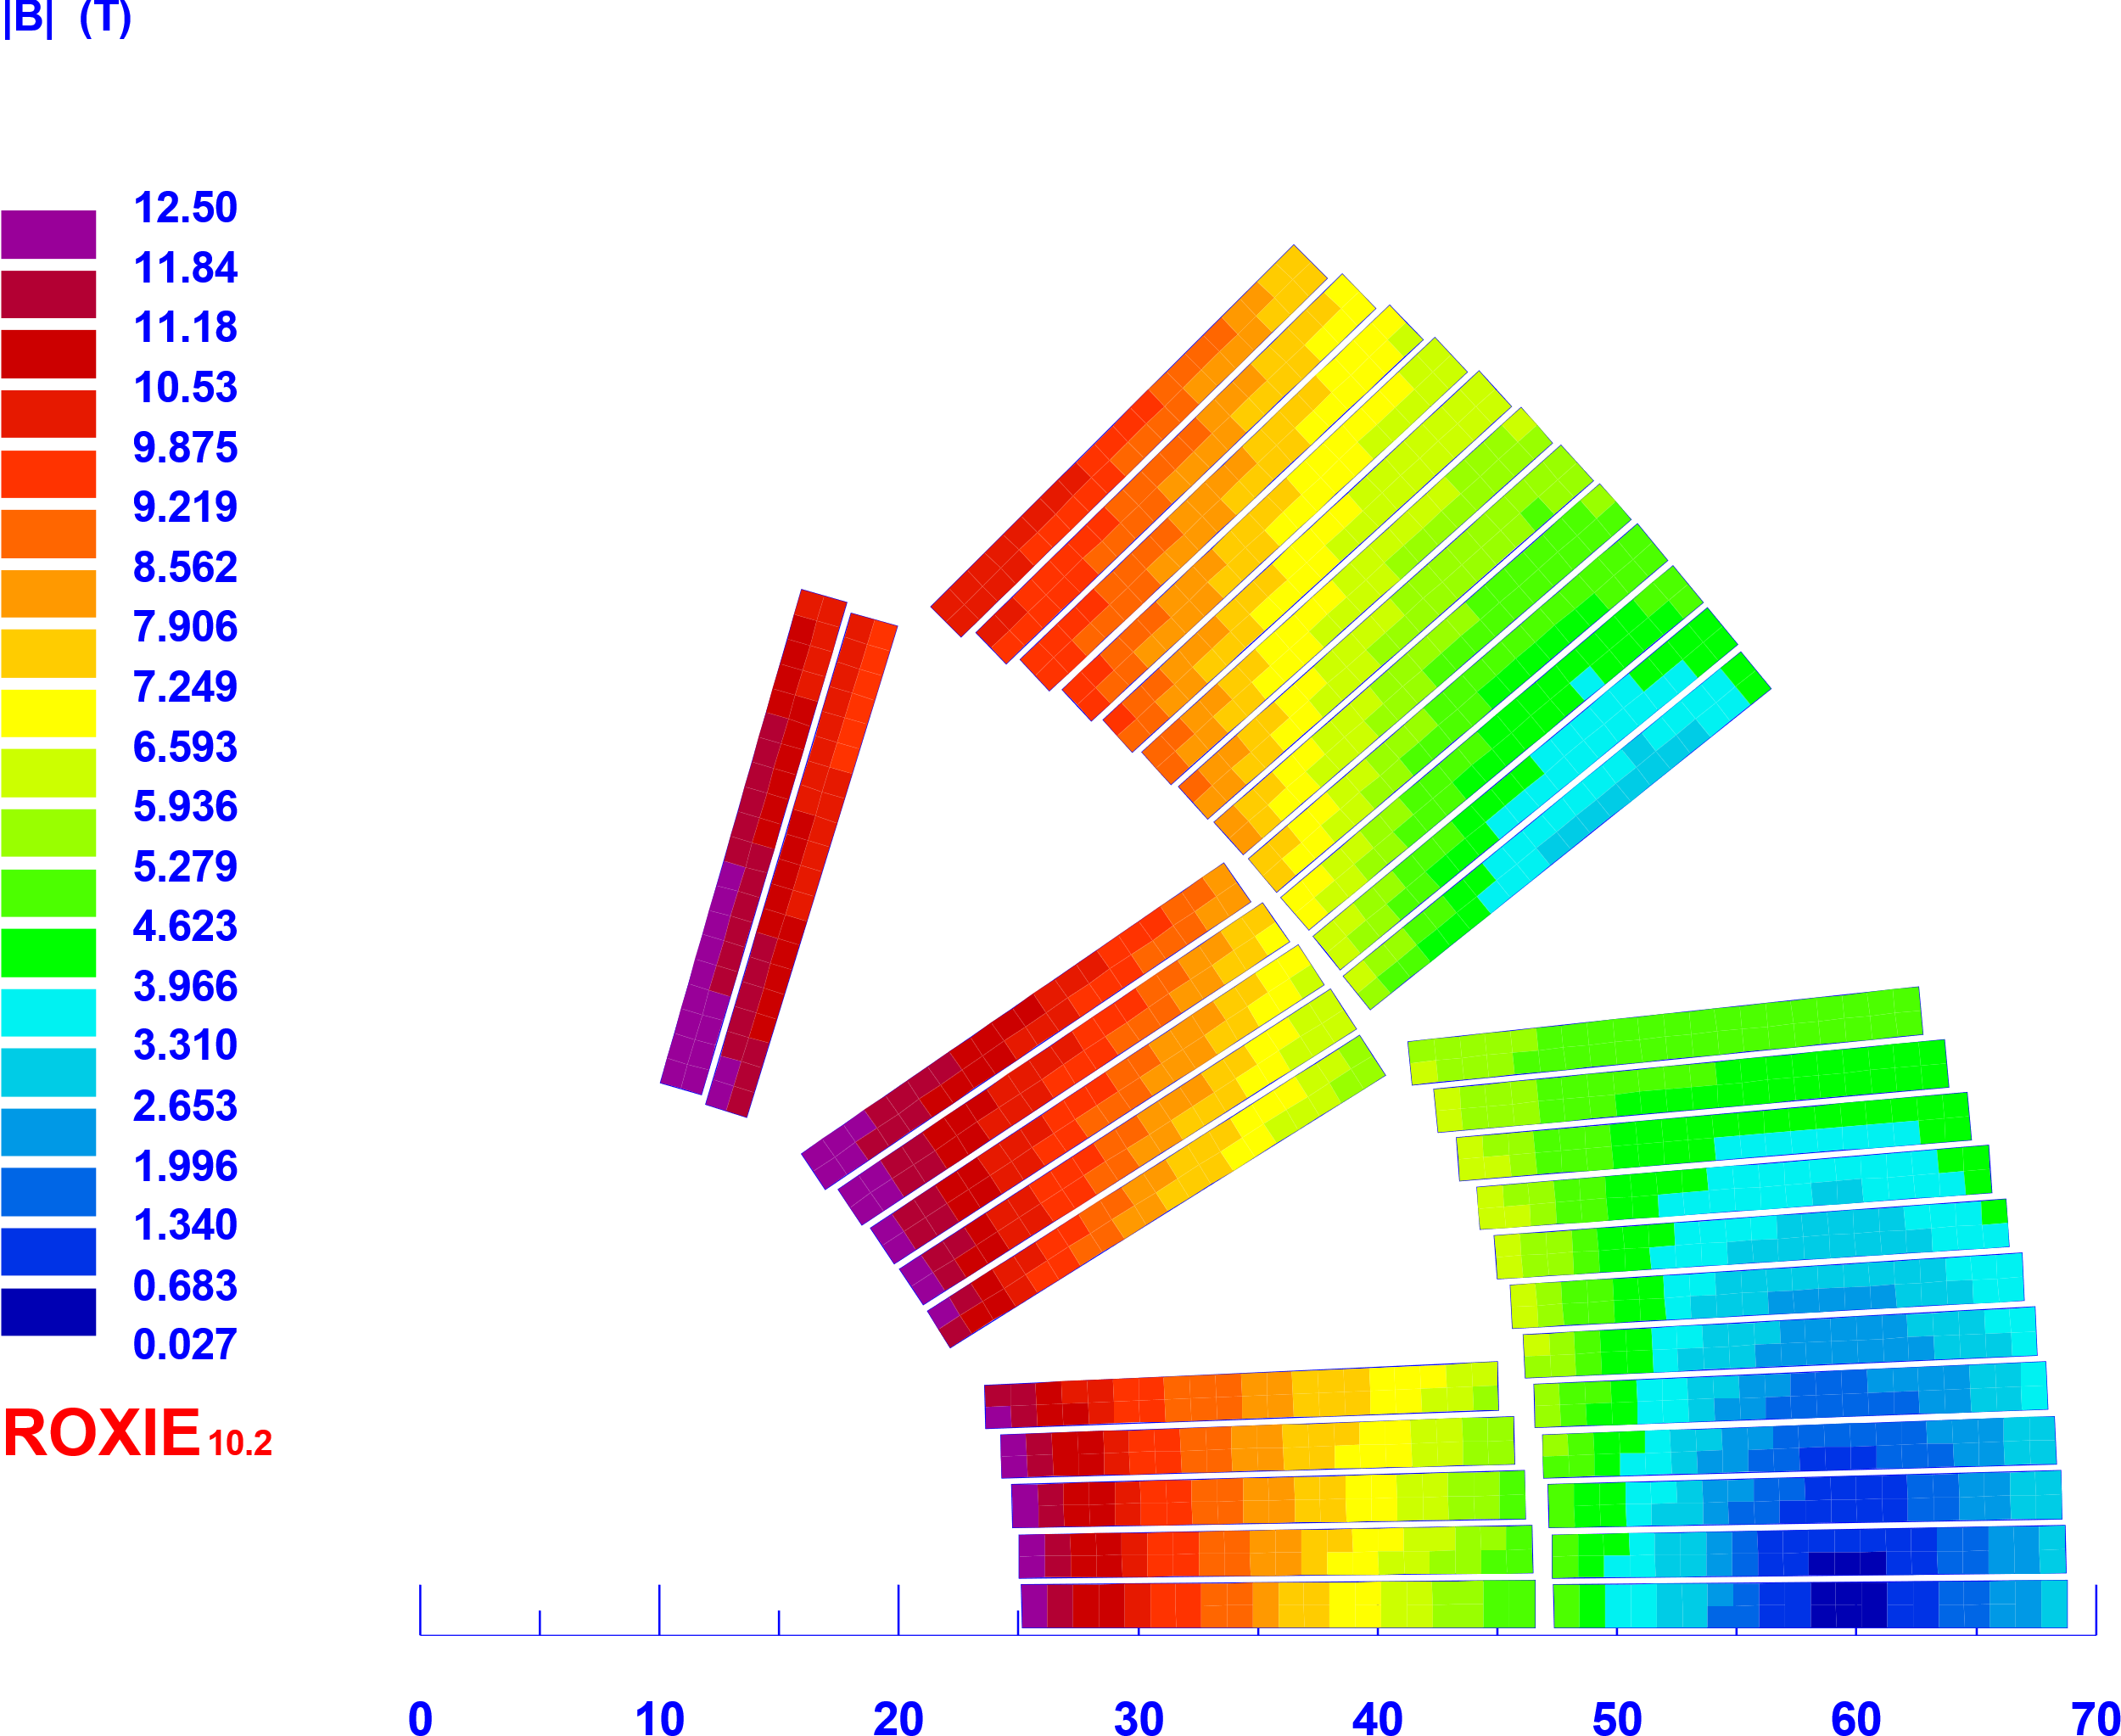



FALCOND WP3.1 12T design parameters
Coil |  | 12T cos | Falcon D 1-in-1
No. of turns per pole |  | 15+22 = 37 | 12+24 = 36
No. Blocks |  | 6 | 5
Insulated cable surface | [mm²] | 5259 | 6859
Equivalent coil width | [mm] | 31.0 | 37.5
Physical length | [m] | 1.5 | 1.5
Coil efficiency | [T.mm/A] | 0.00078 | 0.00071
21.42 mm
1.89 mm
Fig.1 Reacted DEM1 conductor size
Magnet |  | 12T collar. (2023) | Falcon 12T b&k (2024) | 1-in-1 Falcon 12T collar. (option) | 1-in-1 Falcon Ult. 14T b&k | 2-in1 Falcon D 12T
Aperture / interbeam | [mm] | 50 | 50 | 50 | 50 | 50 / 220
Operating temperature | [K] | 1.9 | 1.9 | 1.9 | 1.9 | 1.9
Outer diameter | [mm] | 620 | 640 | 640 | 640 | 640
Nominal current | [kA] | 17.750 | 20.991 | 20.400 | 24.906 | 20.400
Strand eng. Je | [A/mm²] | 782 | 668 | 650 | 793 | 650
Overall Je | [A/mm²] | 489 | 454 | 454 | 554 | 454
Nominal field | [T] | 12.01 | 12.00 | 12.00 | 14.00 | 12.3
Peak field | [T] | 12.42 | 12.53 | 12.55 | 14.63 | 12.56
Ap. to peak field ratio | [%] | 3.4 | 4.4 | 4.5 | 4.5 | 4.5
Load line fraction | [%] | 83.2 | 77 | 76 | 91 | 76.1
Temperature margin | [K] | 4.3 | 5.11 | 5.17 | 2.72 | 5.14
Inductance | [mH/m] | 2.64 | 2.24 | 2.23 | 2.19
Stored energy | [MJ/m] | 0.451 | 0.543 | 0.52 | 0.741 | 1.04
Hot spot temp. adia. | [K] |  | < 300 K | < 300 K | < 300 K | < 300 K
Horizontal force (per quadr) | [MN/m] | 3.32 | 3.57 | 3.75 | 4.920 | 3.88
Vertical force (per quadr) | [MN/m] | -2.40 | -1.78 | -1.76 | -2.580 | -1.77
Fig. 2 5 blocks Falcon D coil section
Fig.3 LR and LE end, Roxie API models
Fig.4 Falcon D 3D machined spacer vs R&D 3D printed development
Notes:
The magnet operation point at 12T in the bore must be less than 80% on the loadline at 1.9 K, which means around 5 K of temperature margin. The dipole must have an aperture of 50 mm in diameter and considering the strain sensitive characteristic of the Nb3Sn rutherford cables, the maximum stress on coil should be lower than 150 MPa, which is considered a threshold for critical current degradation.

Slide 7
Cos-ϴ dipole development plan
CERN-MSC and INFN-Ge, LASA proposed from 2024 the synergetic plan below towards a twin-aperture 12 T, 1.5 m long Nb₃Sn dipole design by 2028.
Date | Description | Length | Remarks | Goals | Institute
Q2-2026 | 1-in-1 demonstrator magnet (WP3.2) | 1.5 m | Construction at INFN LASA, test at INFN, CERN | Cable technology Coil technology Quench performance New b&k structure design | INFN WP3.2
Q3-Q4 2025 | Long mechanical mock ups | < 0.5 m | CERN B&K & collars coils section mock up assembly ( use 11T coils) | Benchmarked concepts of mechanical cross section structures at RT and cold. Measurement of residual stress | CERN WP3.1
Q3- 2026 | 1-in-1 demonstrator magnet M1 | 1.5 m | CERN B&K coils magnet assembly | Novel dipole b&k structure design | CERN WP3.1
Q2-Q4 2027 | 1-in-1 demonstrator magnet M2a – (option M2b) | 1.5 m | CERN B&K coils magnet assembly (CERN collared coils magnet assembly optional) | Optimization of b&k structure design Reproducibility Structure pro’s & con’s vs scale up | CERN WP3.1
Q2-2028 | 2-in-1 demonstrator magnet M3 | 1.5 m | CERN B&K coils 2-in-1 magnet assembly, structure around 12T coils | New 2-in-1 structure, Field optimization, fabrication process, scale-up design inputs for 14T design | CERN WP3.1

Slide 8

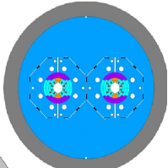
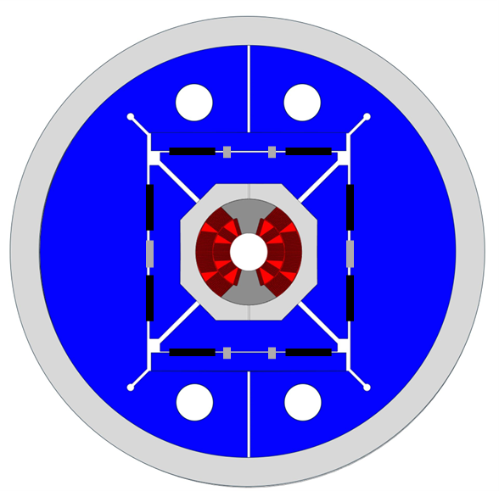
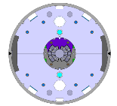
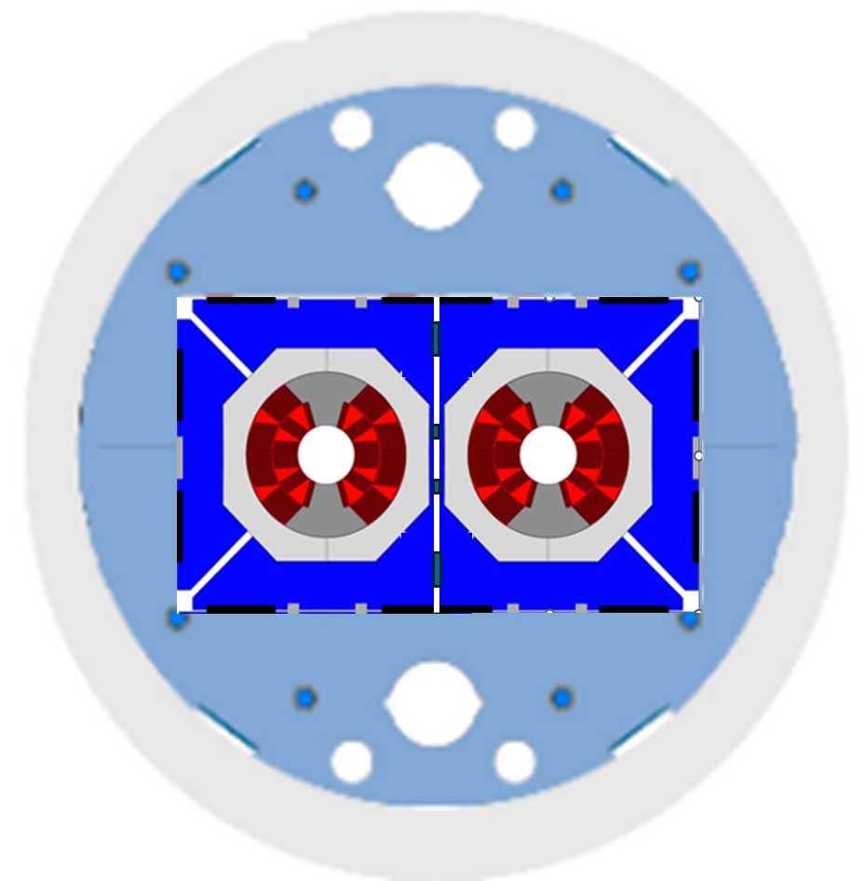
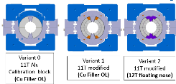
WP3.1 FalconD 12T dipole roadmap
Baseline B&K structure with Alu ring tested on mechanical mockups (ex: QXF, US-MDP concepts) versus collars with SS shell + Alu bars
Future optimization on single magnet design of 1-in-1 models towards 2-in-1 dipole
Single Aperture
B&K magnet models
Double aperture B&K 12T dipole magnet
Long mechanical mock ups
LMK1,2
M1,2
M3
Short mechanical mock up
2-in-1 magnet models b&k options
SMKs
Notes:
Gradual approach

Slide 9
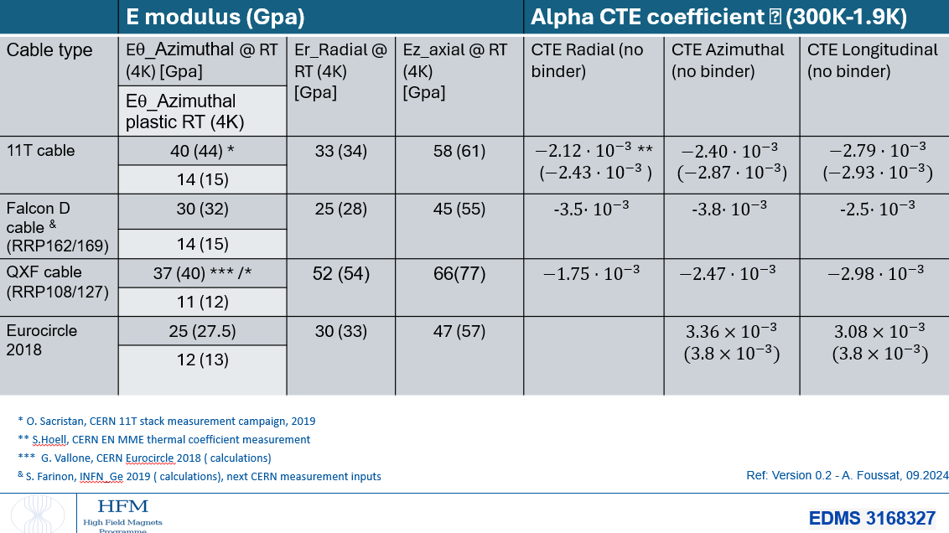
Cable material properties update
Unified Falcon D material properties based on measurement campaign used for FE inputs and 3D smeared calculation
Coming Falcon-D cable ten stack measurement ( E-modulus, CTE) at CERN

Slide 10
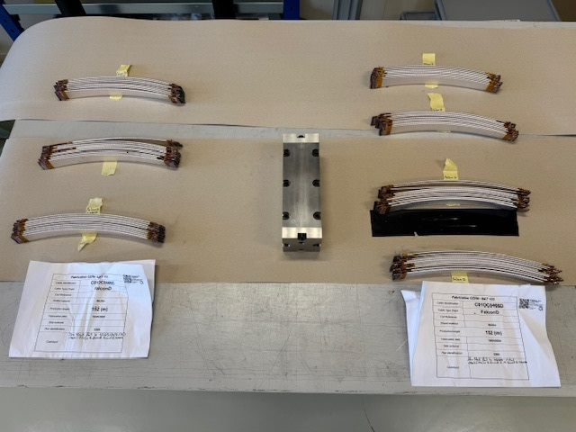
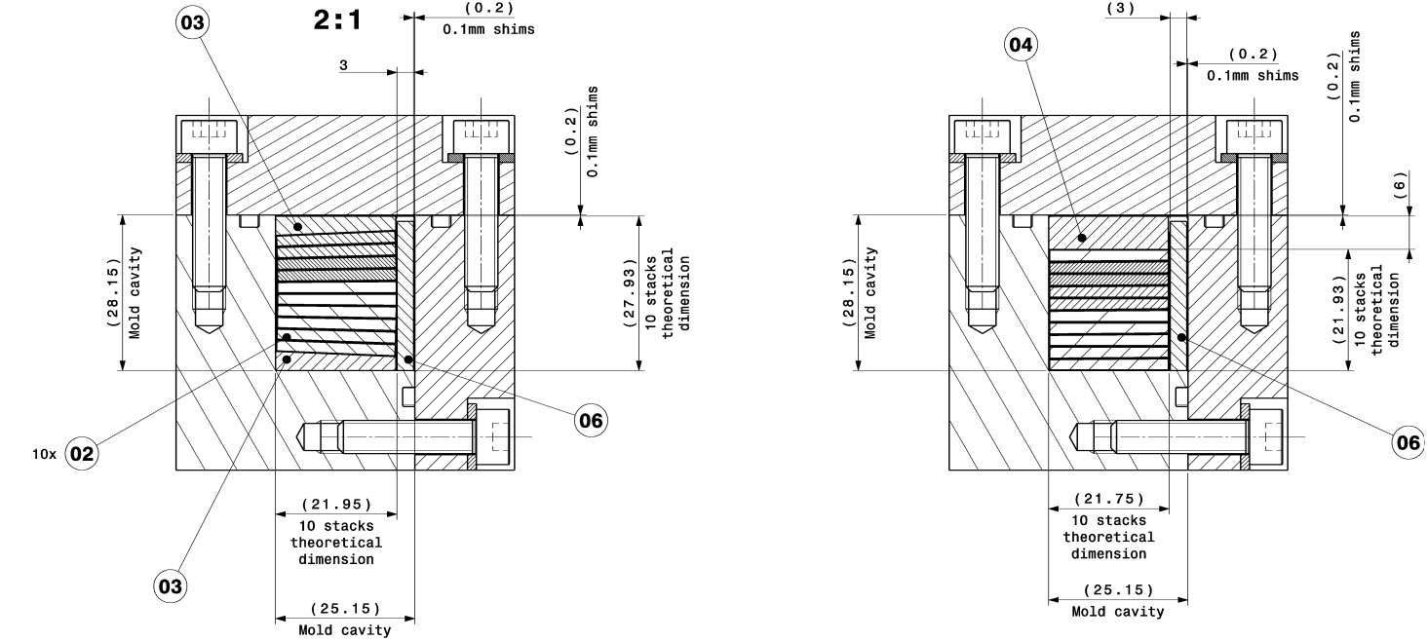
Ten stack thermo mechanical samples
Cable samples prepared for construction of 7 ten stacks
Investigation of two thermal expansion coefficient cases (thickness): 3.7% – 4.4%
Use of first MQXF HT at B180, next on 12.11
Once Falcon D HT cycle is confirmed, final ten stack measured

Slide 11
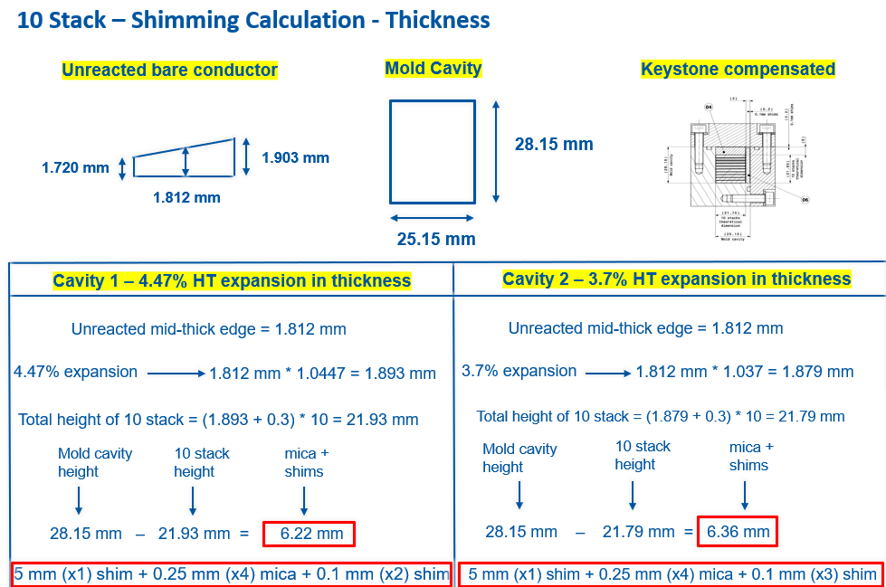
Cavity shimming preparation

Slide 12
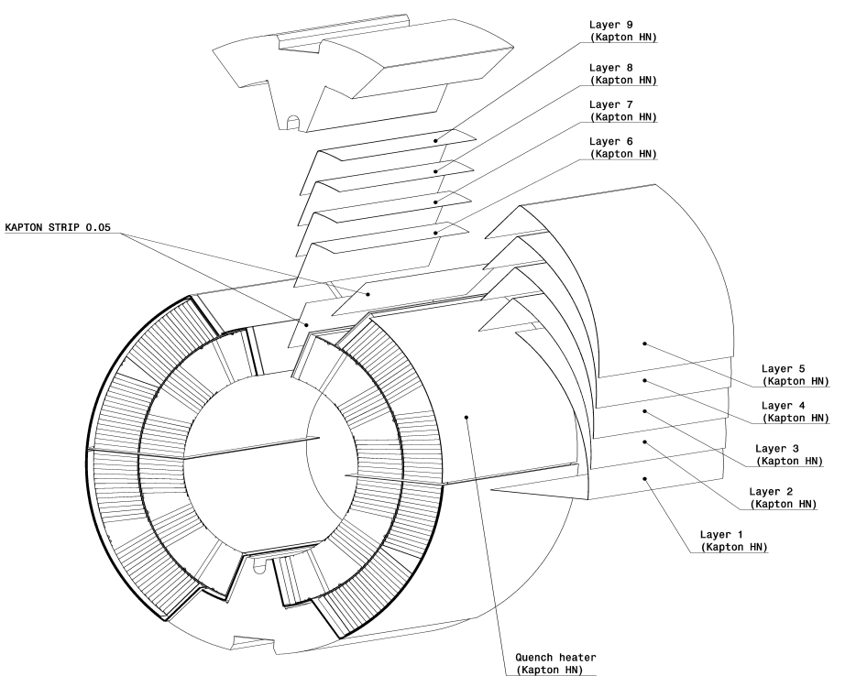
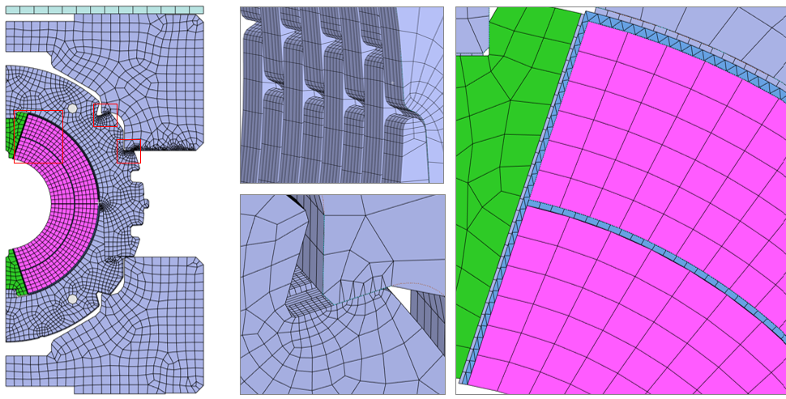
Short Mock ups (MK) variants
All shimming insulation sheets, Alu blocks and loading plate ready for next assembly
FE modelling benchmark of loading case with shimming plan on going
Next load test under press of benchmarked Al-blocks
EN MME, N Veijnovic

Slide 13
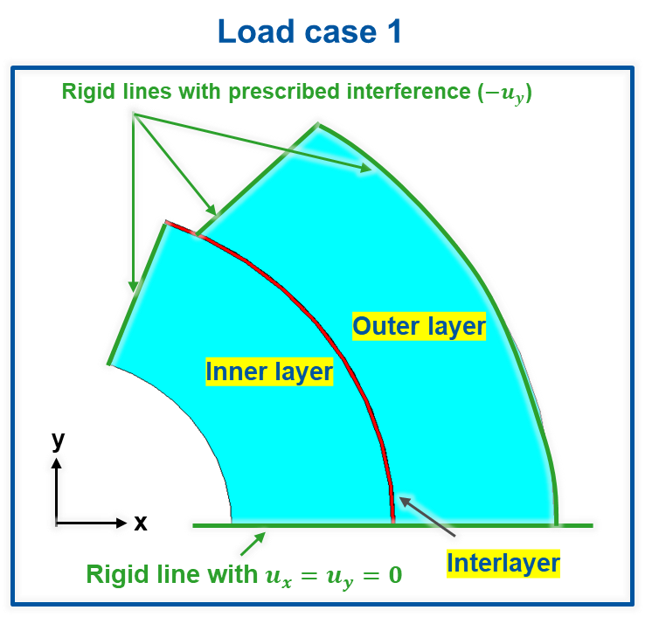
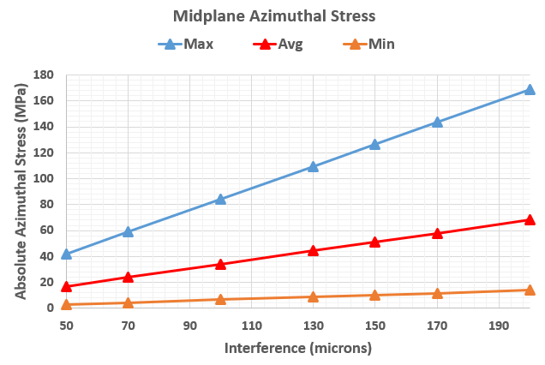
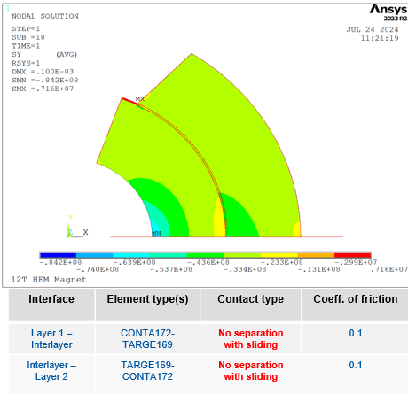
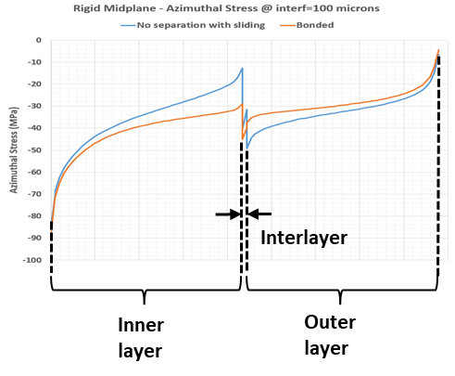
Simplified boundary FE model
Isotropic sector with collar rigid interference, mid plane symmetry, pole interference
Relative study of non separated / separated layers
S. Gowrishankar

Slide 14
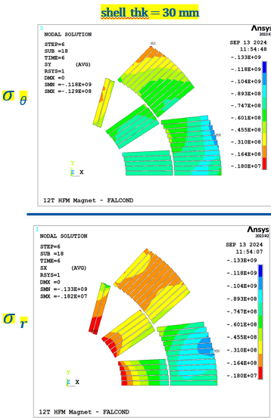
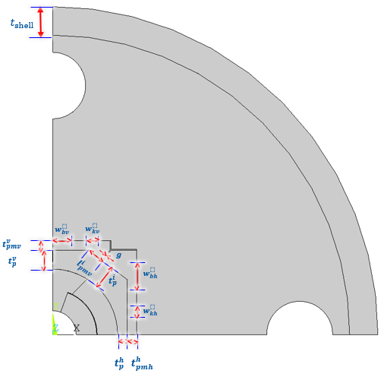
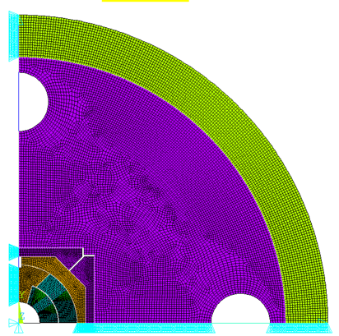
Parametrized FE B&K model
S. Gowrishankar
To study in parametrized model the influence of main structure components as a reference model
S. Gowrishankar

Slide 15
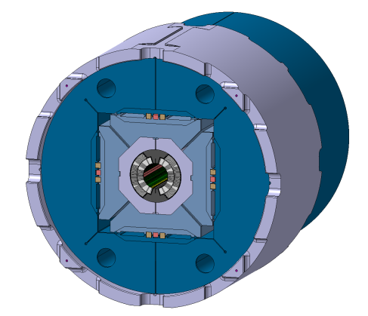
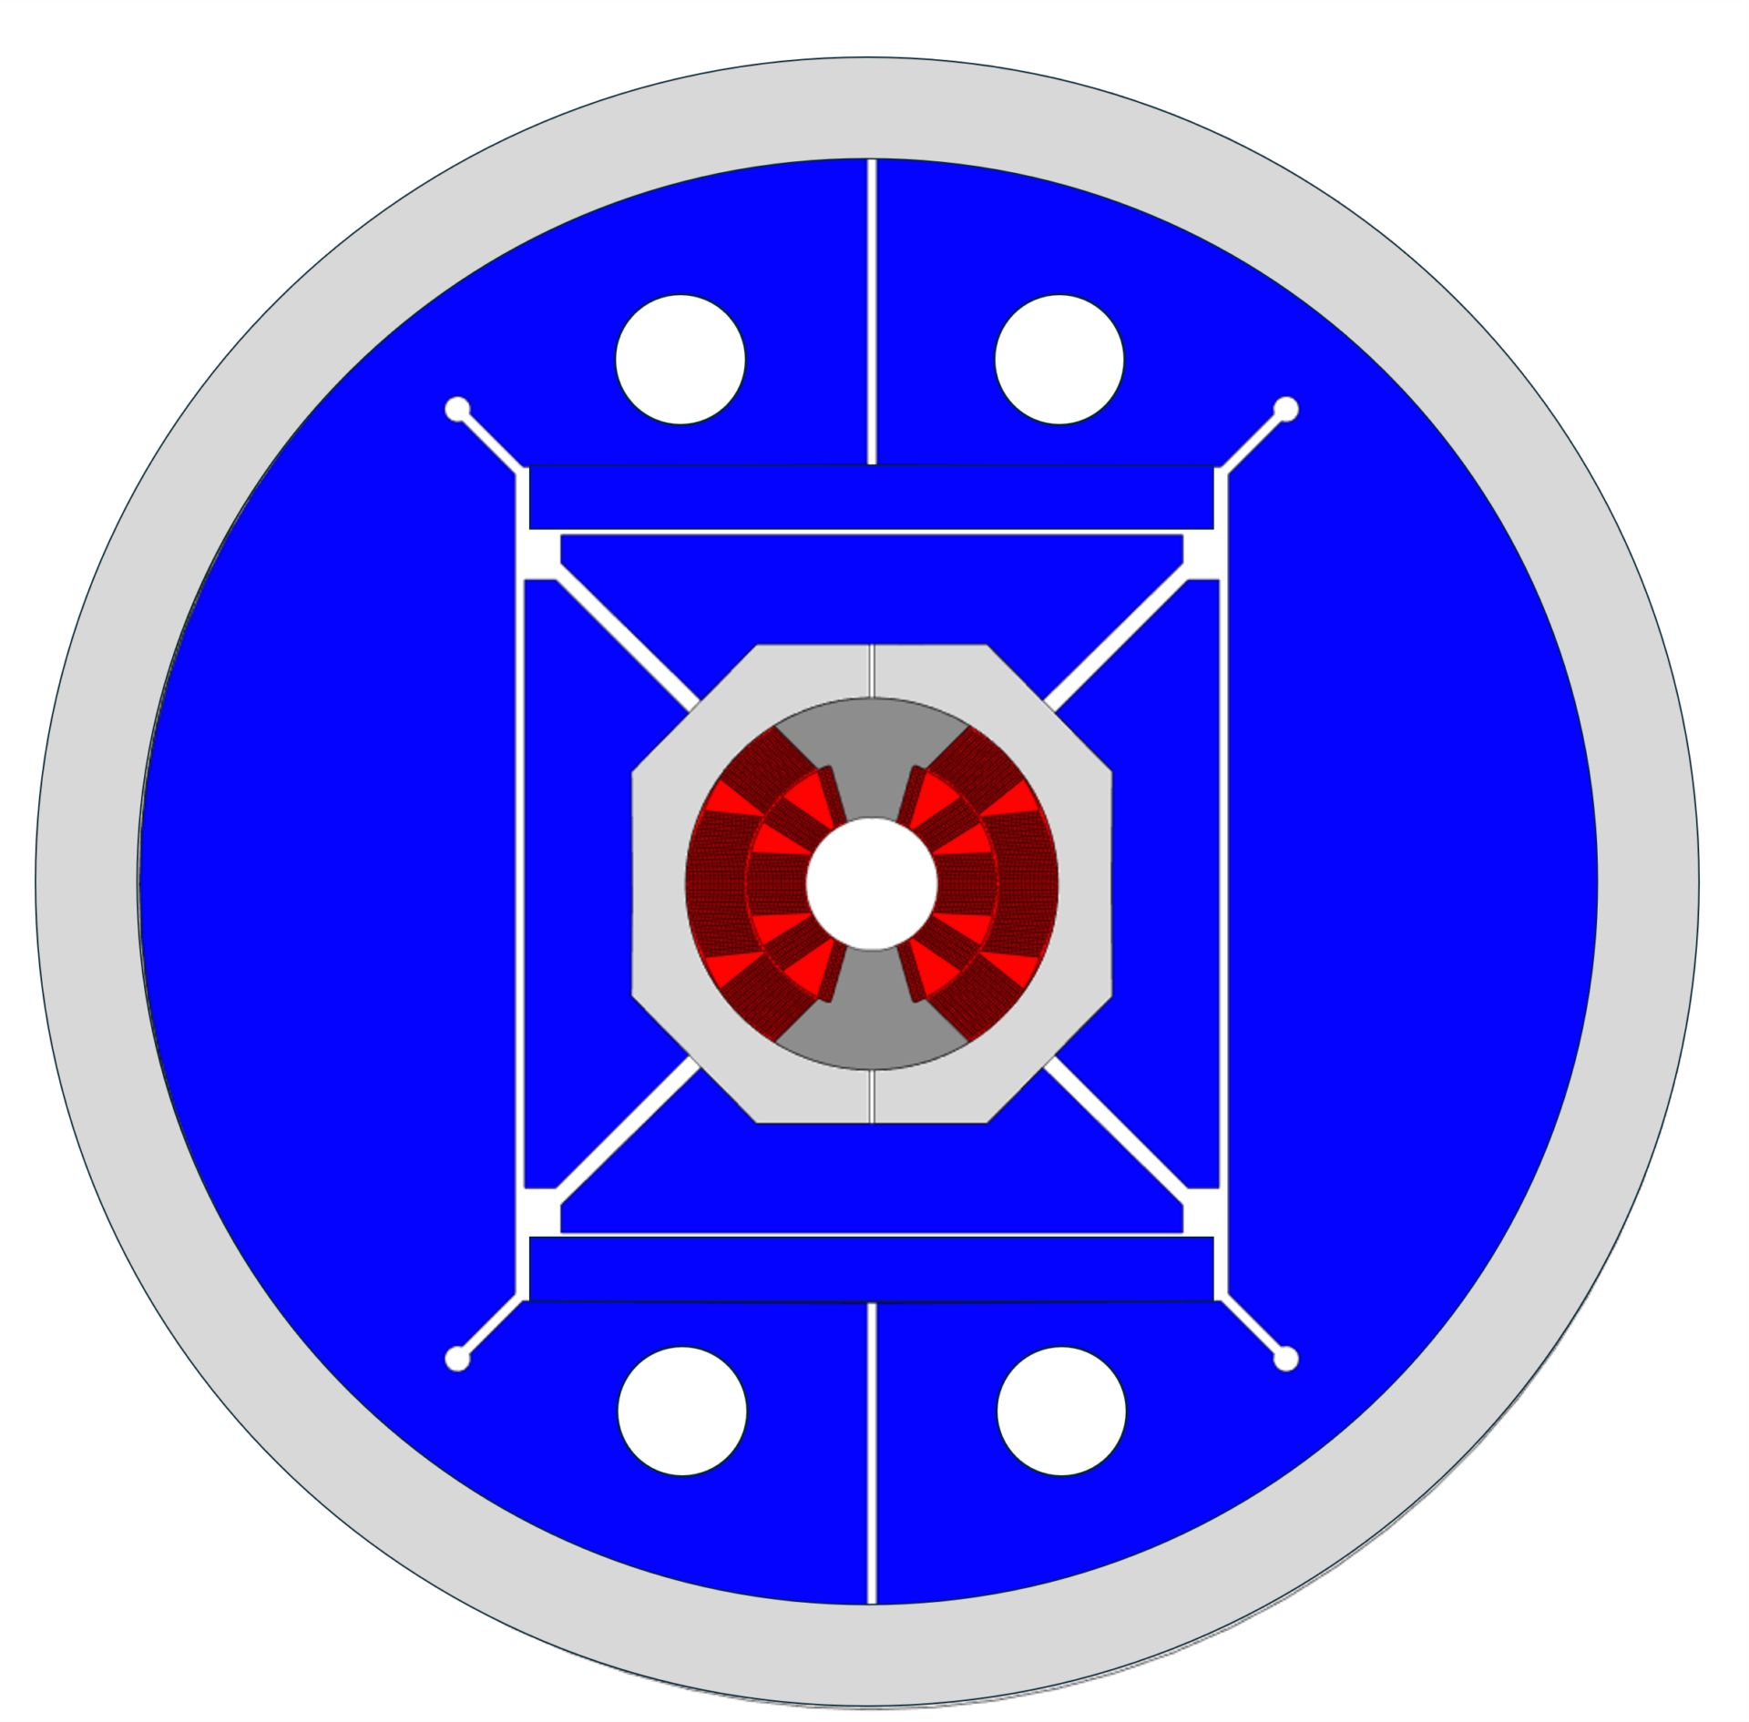
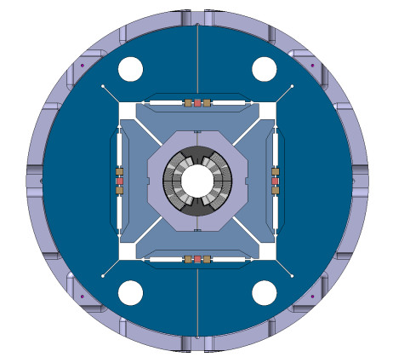
WP3.1 CERN FalconD structure variants
  Study of Horizontal and Vertical key interferences level and sequence to minimize coil peak stress at RT, and provide low detachment of pole at cold within stress limits
                Alu collar, pads and iron master.
                Mid plane pad supported, collar shoe
                Separated nose ( similar QXF)
                B&K technology
                Vertical iron yoke slit with/wo 45 deg or 0 deg slits to tune iron stiffness
                Assessment of yoke pre-loading impact on coil peak stress across the full slits
                Alternative V&H iron slit
                Al6081 outer ring
                Length max 600 mm
M1 dipole design variant 1 (b&k)
LMK1 mechanical mock up for test at 77K
MSC-SMT N.Sala, A.Foussat

Slide 16
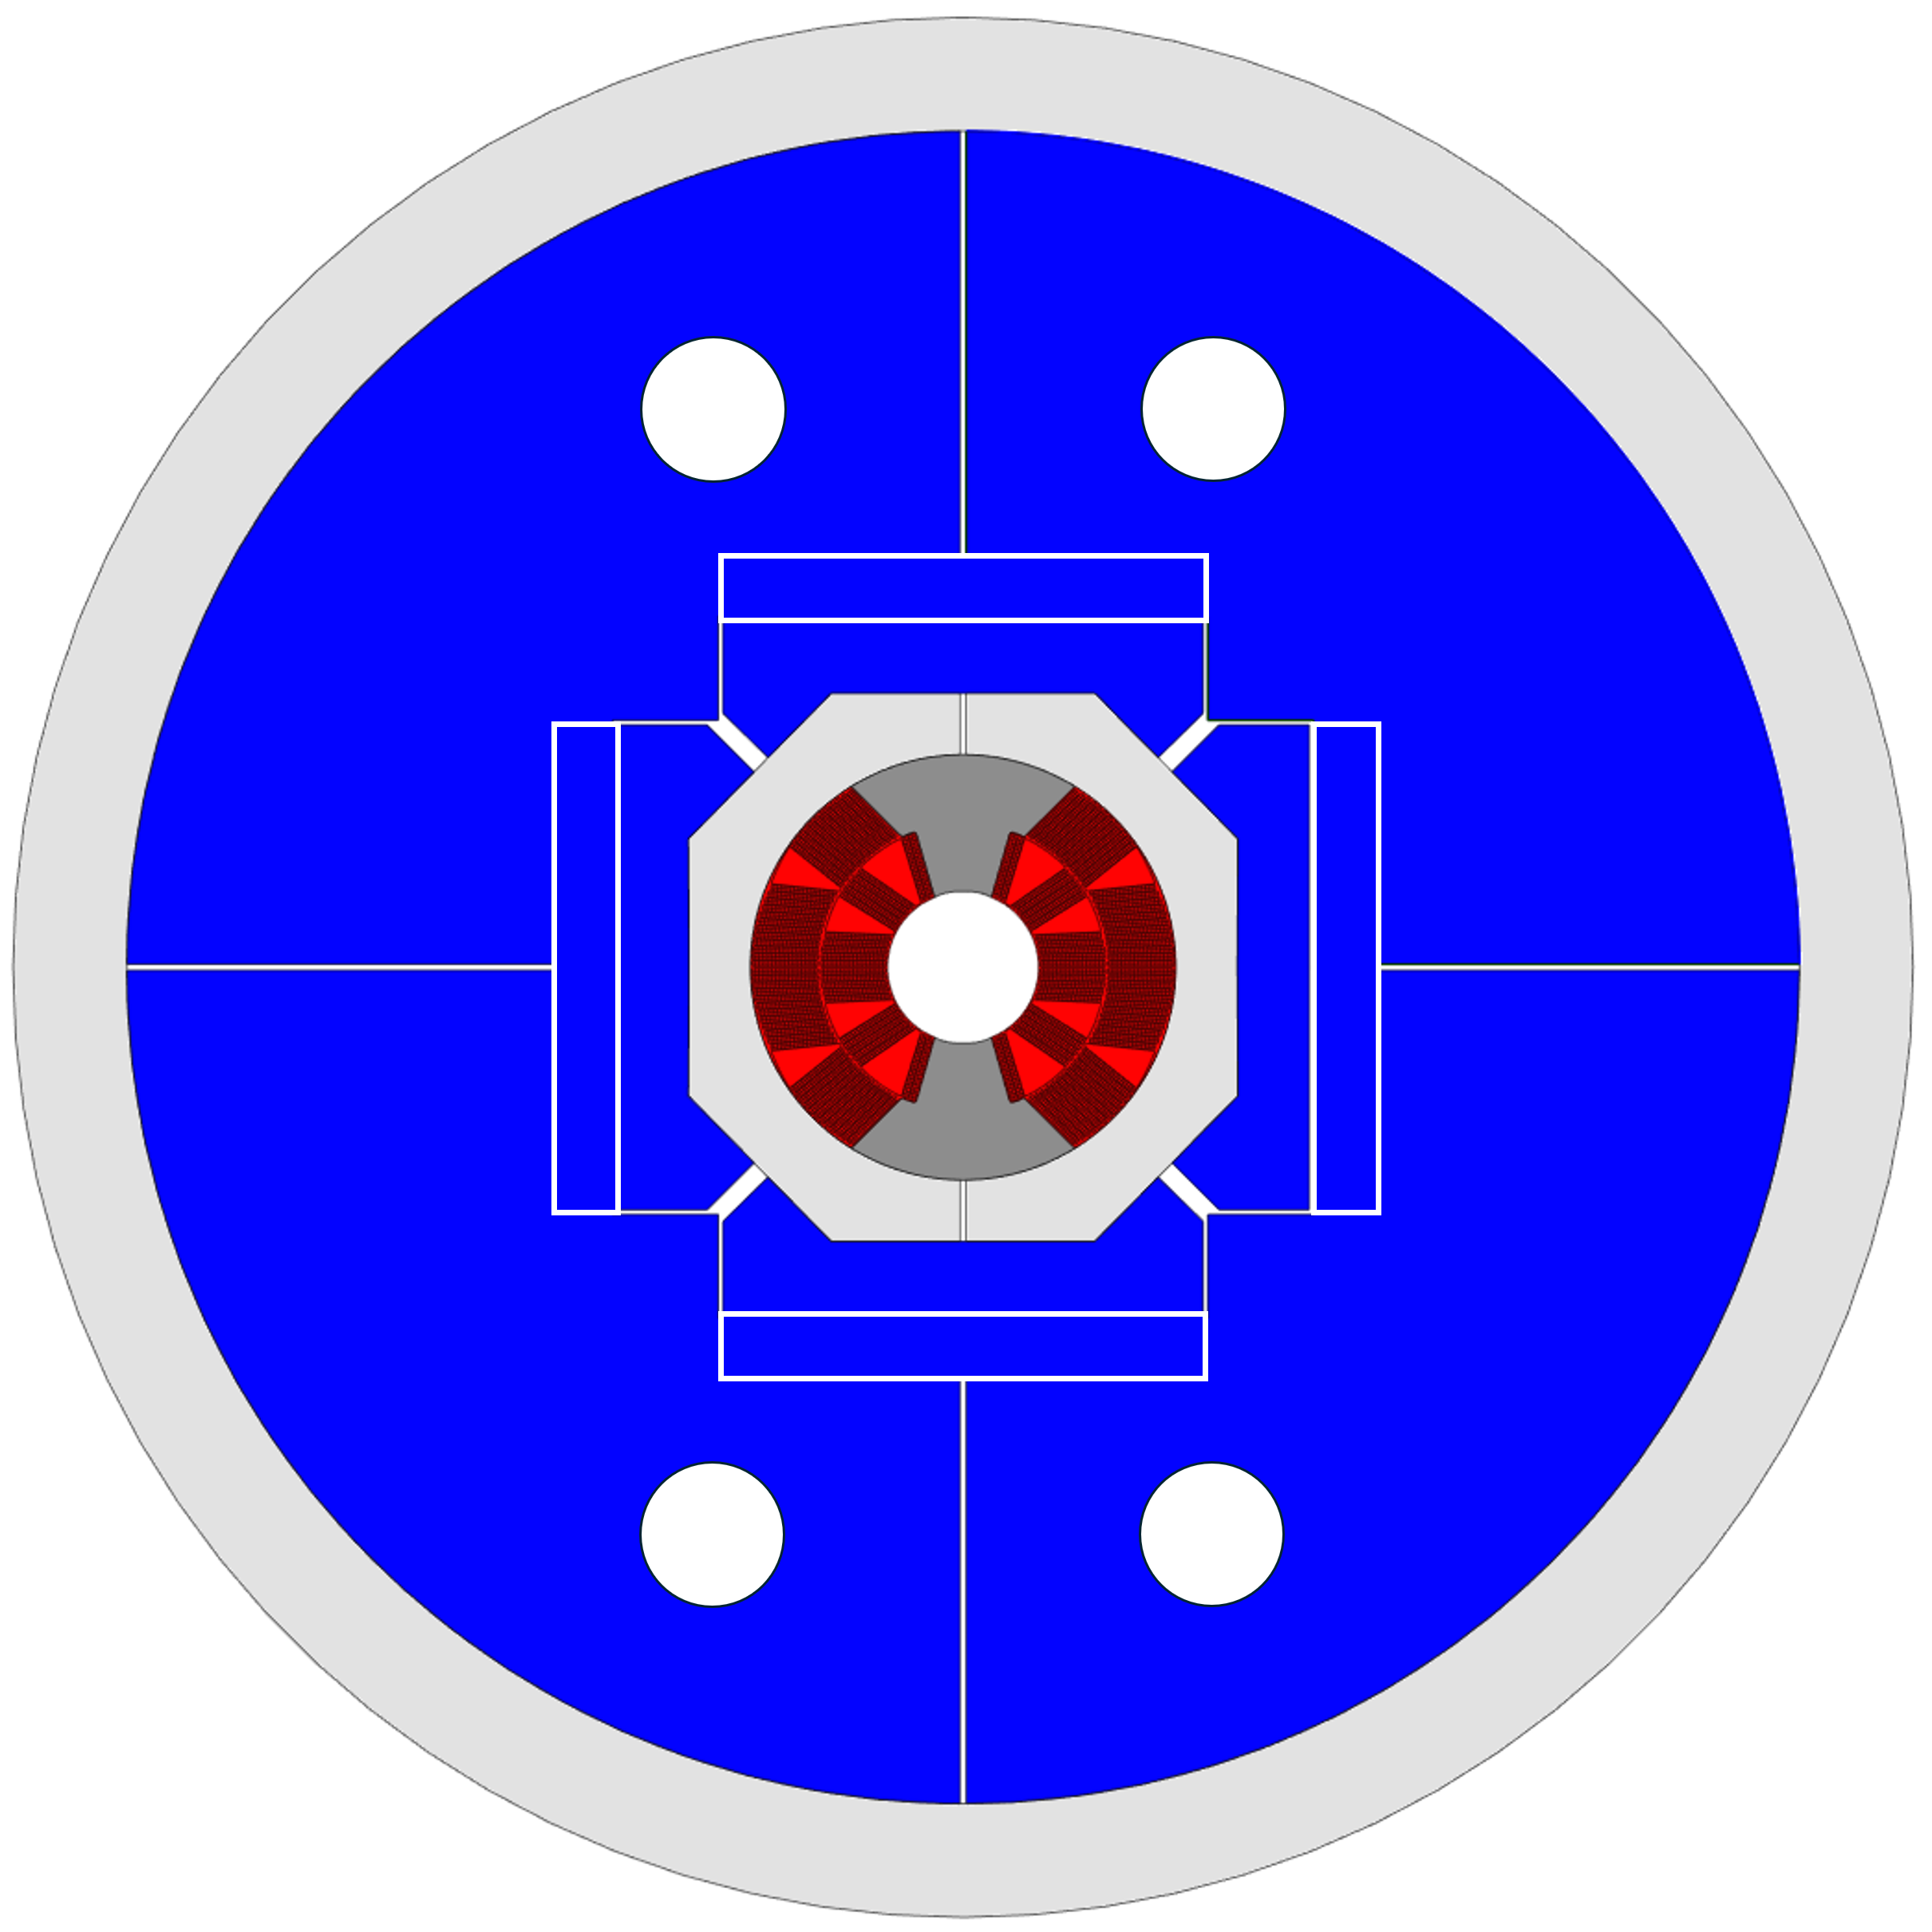
M1 dipole design variant 2
Second variant with 0-90 deg split in case of lower structure requirement
Assessment of iron preloading step onto coil stress state

Slide 17
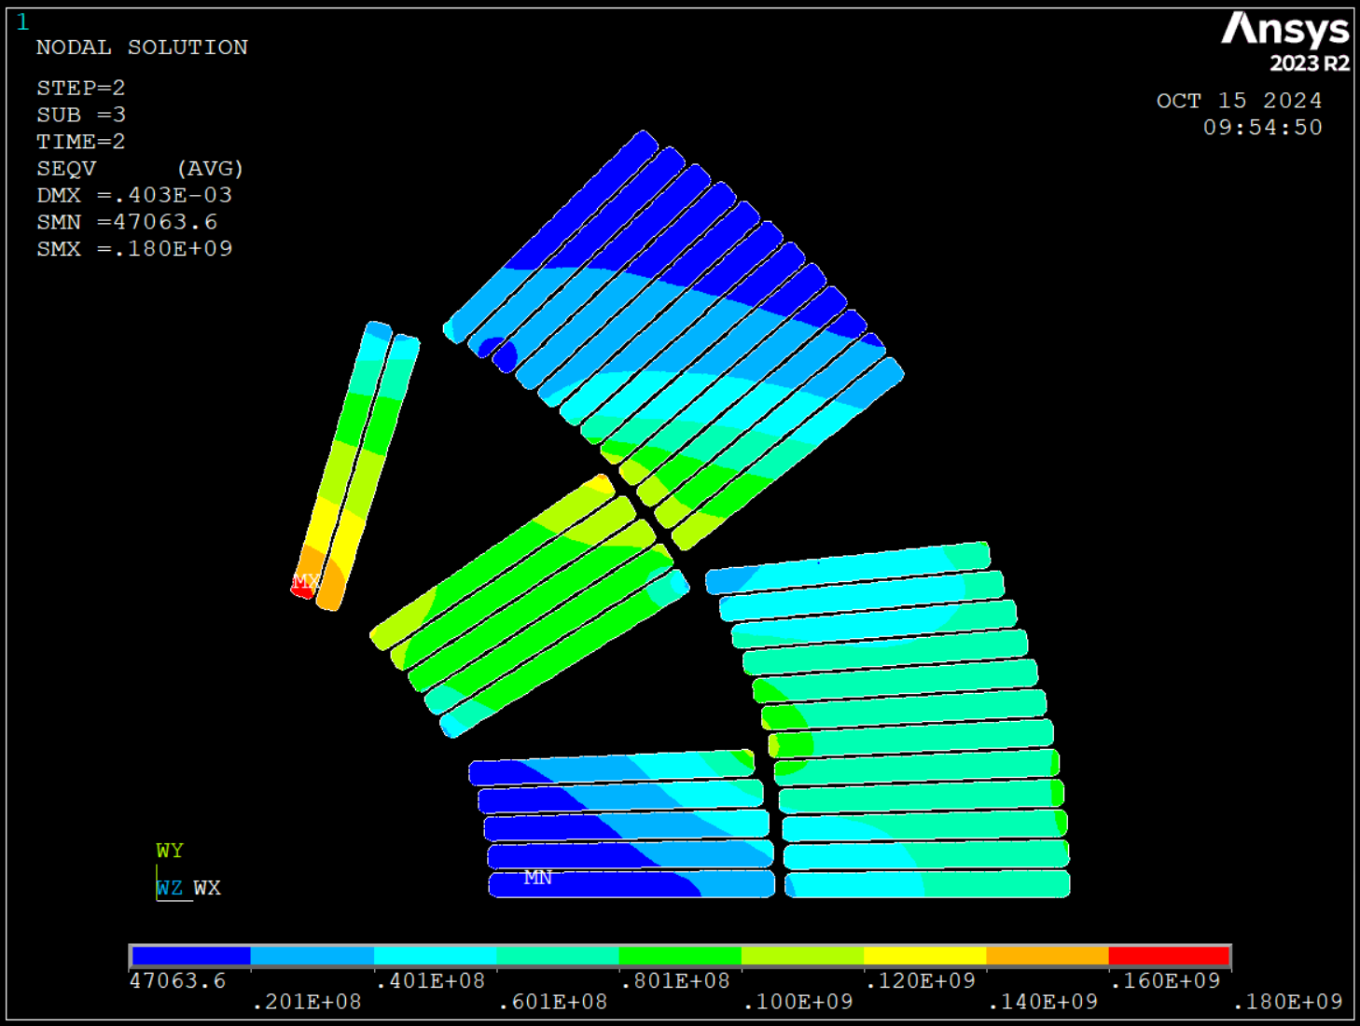
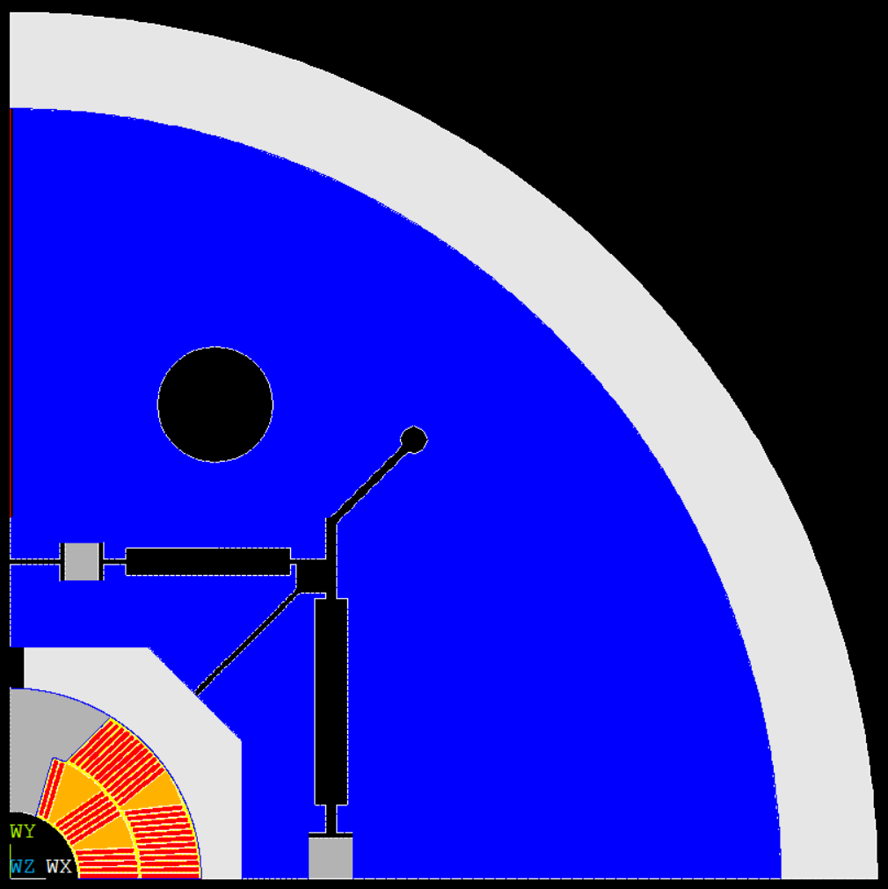
Structural design of M1 model, LMK1
N. Sala
FE design based on B&K, pads, masters, 2 yoke halves
Impact assessment of master dimensions and key position on Variant 1 model .
  First geometry FE analysis of Falcon D aperture with vertical keys aligned to pole: 50 Mpa at RT but too high stress ( < 160 Mpa) in the coil at 4K

Slide 18
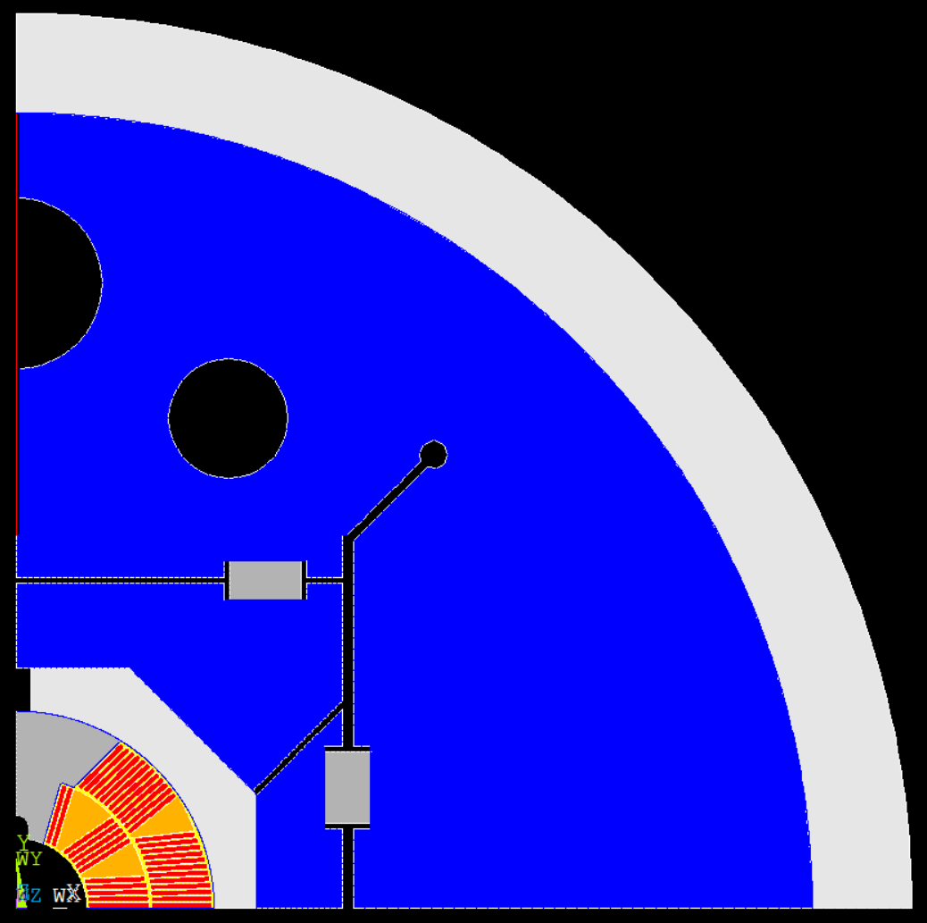
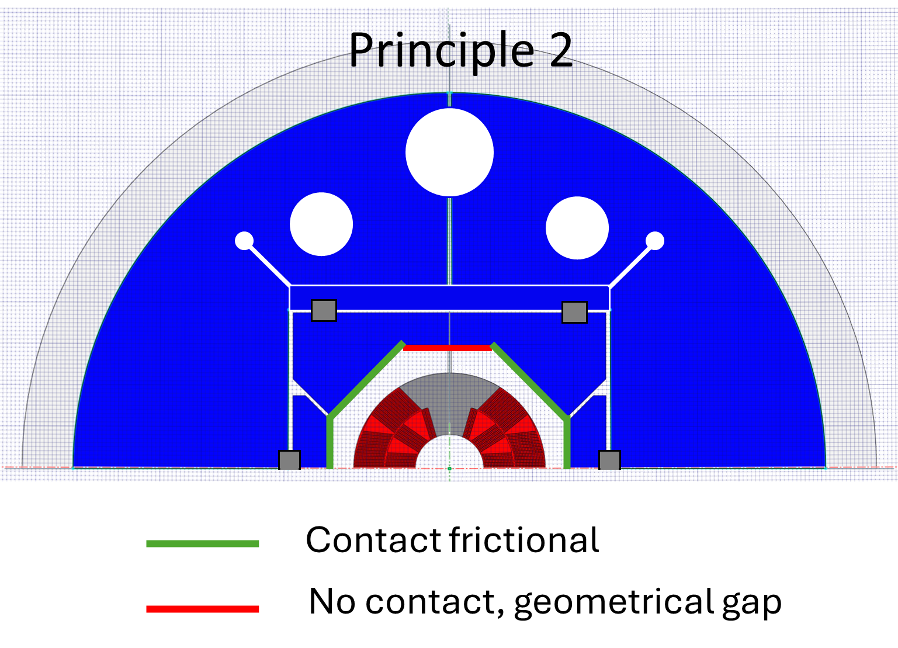
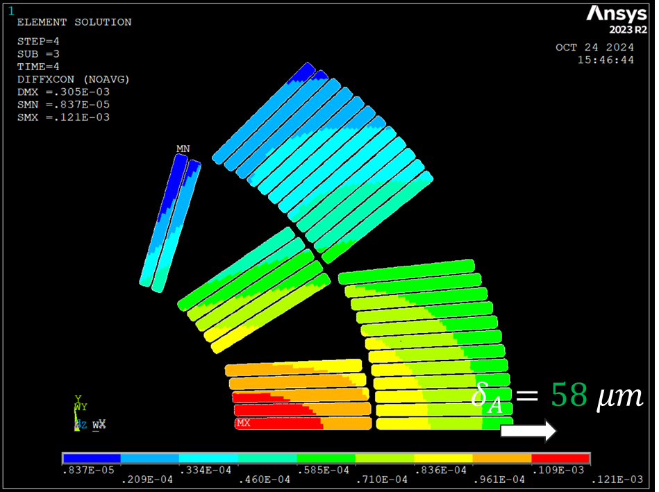
M1 model, variant 1
P2 model is investigating to move the keys away from poles and use of the master stiffness to apply.
Keys interferences V: 0 mm, H: 0.2 mm (0.2 mm overshoot)
On going progress on the optimization of keys position, bladders position, thickness of masters
Courtesy of N. Sala

Slide 19
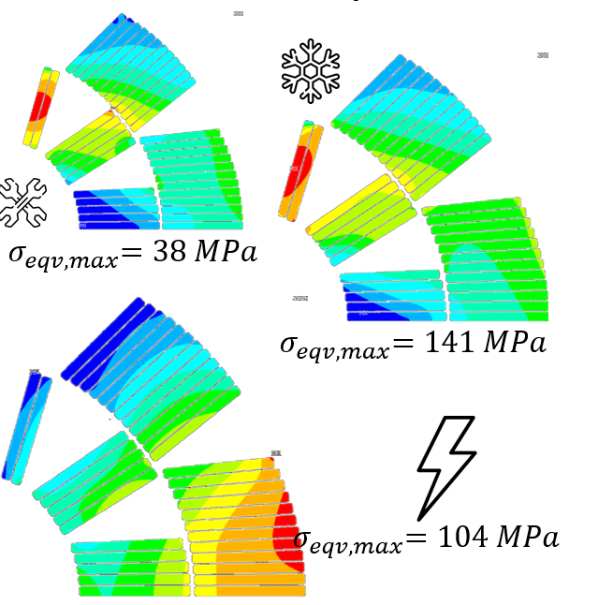
M1 model variant (P2)
The optimized position of vertical key peak stress on coil at 4K is reduced to 140 Mpa
Next
  Bladder pressure, dimensioning and positions
  yoke gap design closed at 4K
  Alu ring thickness optimization
  Pole shimming and detachment

Slide 20
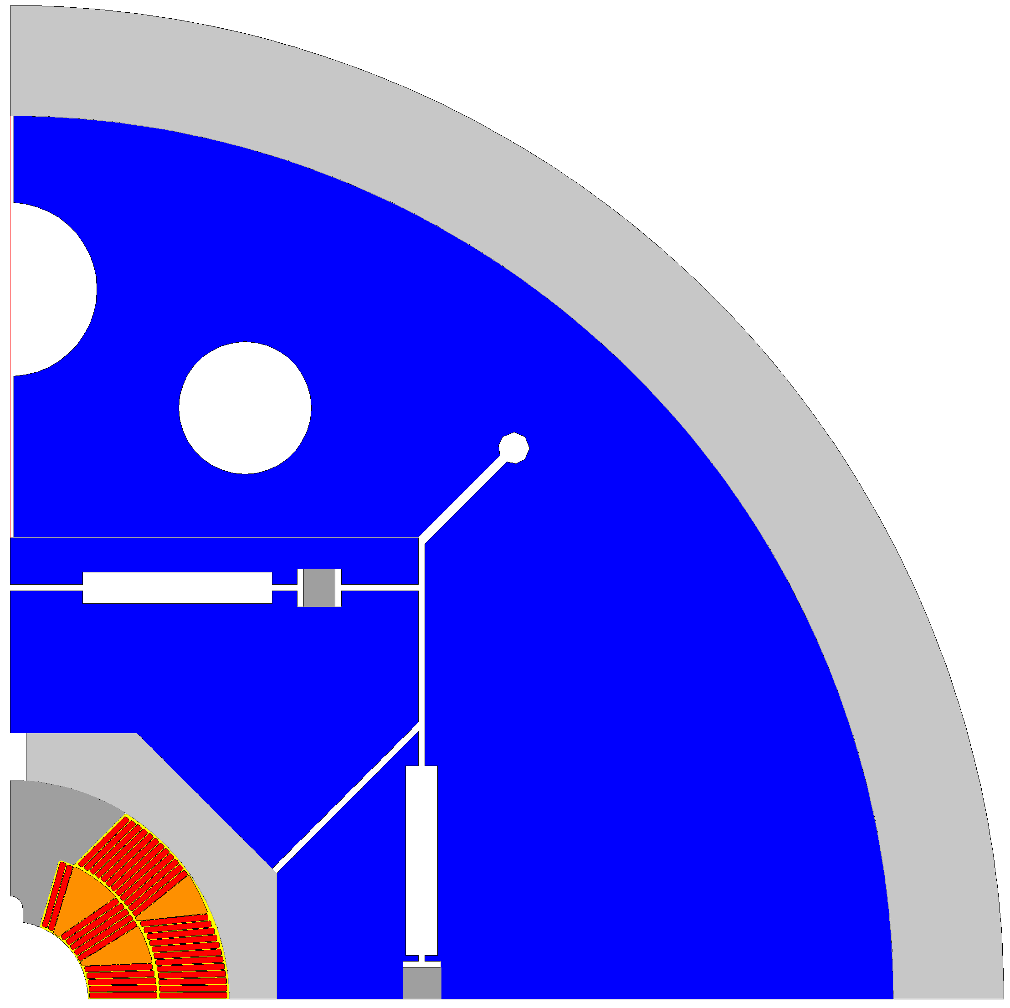
Nicola Sala analysis plan Oct. 24 update
(fellowship started last Sep 2024)
On going activities. plan for next 4 months:
Define a final configuration for M1
(Vertical Split, masters’ shape,
Al shell thickness, Bladders&Key) – in progress
2D principles to be benchmark on the 11T coils LMK1 (Assembly peak stress due to overshoot, cooldown with V.S. on Cos theta coils)
Fine tuning of LMK1
3D model of LMK1
Rough dimensioning of the 2-1 M1
12T Configuration “Variant_1”
Al shell 35 mm thick
SS pole removable (or W&R)
Al pad 15 mm thick
Masters in ARMCO

Slide 21
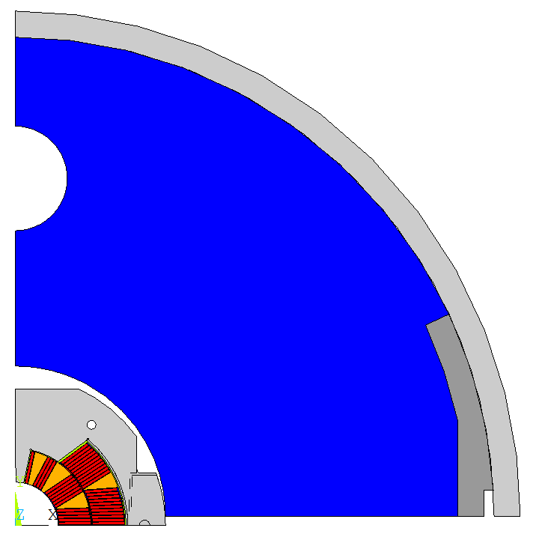
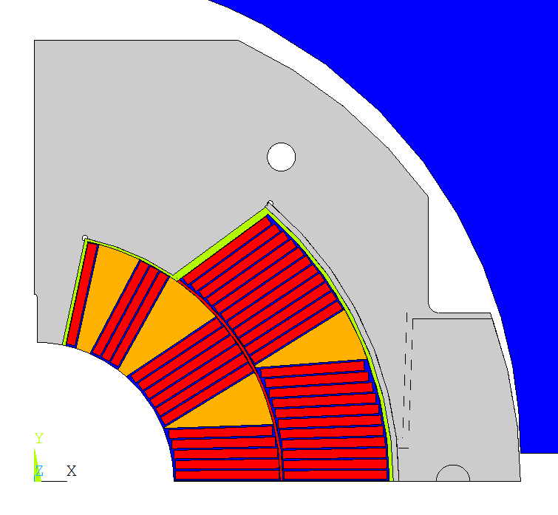
LMK2 mechanical mock up cross section (Geometry - quadrant)
Shell (Stainless Steel)
Yoke (Iron)
Collar (Stainless Steel)
Turn insulation (fiberglass)
Wedges (Copper)
Coils (Nb₃Sn)
Stopper (Aluminum)

Slide 22
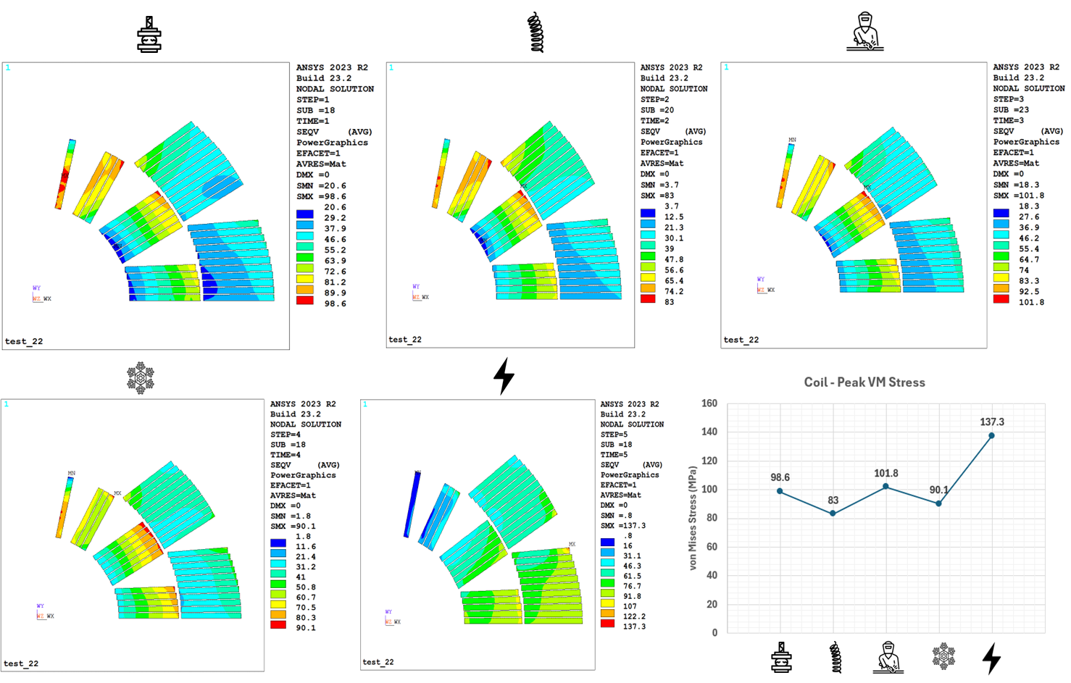
Coils Von Mises stress, plan
Coil stresses along load steps within allowable.
Optimization of collar size, pole shims, shell thickness, welding, Alu stopper size
Next, model scale up of LMK2 11T coil geometry, CAD design
[P Wachal / S. Gowrishankar ]

Slide 23
Summary
The details of short mock ups fabrication have been clarified, first calibration dummy block assembly starts.
Ten stacks samples assembly preparation starts and follow QXF coil HT schedule ( next 12.11)
The Falcon D magnet M1 model design with B&K is in progress optimizing the preloading elements size and position, assembly features
  Next, scale down on long mechanical mock up LMK1, CAD design.
LMK2 alternative collared coil structure with Al bars being designed, to issue a CAD design compatible check with Falcon D coils geometry.

Slide 24


Thank you for your attention

Slide 25



Nb₃Sn RRP wire for FALCON D WP3.1
Cable | Units | Past WP3.1 12T cos theta | 2024 baseline WP3.1 & WP3.2 12T FALCON D (1-in-1)
Material |  | Nb₃Sn (RRP 108/127) | Nb₃Sn (RRP 162/169)
Strand type name |  | MQXF | DEM 1 (ERMC-1)
No. strand |  | 40 | 40
Strand diam. | [mm] | 0.850 ± 0.003 | 1.000 ± 0.003
Cu/NonCu |  | 1.2 ± 0.1 | 0.9 ± 0.2
Keystone | [º] | 0.4 | 0.5
Jc (@4.2K, 16T) | [A/mm⁻²] | 1200 | 1200
Heat treat. |  | 665 °C 50 h | 650 °C 50 h
Ic (A) | 4.22 K, 12.0 T | > 590
 | 4.22 K, 15.0 T | > 331 | > 508
Bare cable th. (R) | [mm] | 1.59 | 1.893
Bare cable wd. (R) | [mm] | 18.500 | 21.420
RRR | Round | > 150 | > 150
Insulation th. | [mm] | 0.150 | 0.150
Filling factor |  | 0.29 | 0.35
Reference S Hopkins et al. : doi: 10.1109/TASC.2023.3254497
Notes:
New strand 162/160 with 1 m diameter and 0.9 cu ncu ratio offering a design at 76 %ISS

