Slide 1
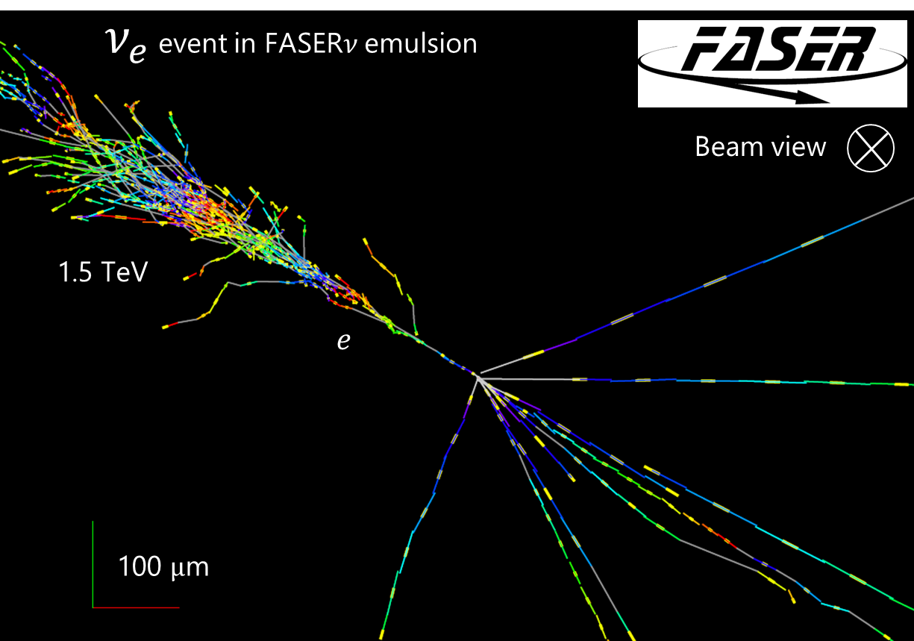


FASER$ν$2
https://doi.org/10.1103/PhysRevLett.133.021802
Tomoko Ariga (Kyushu)
for the FASER$ν$2 group

Slide 2
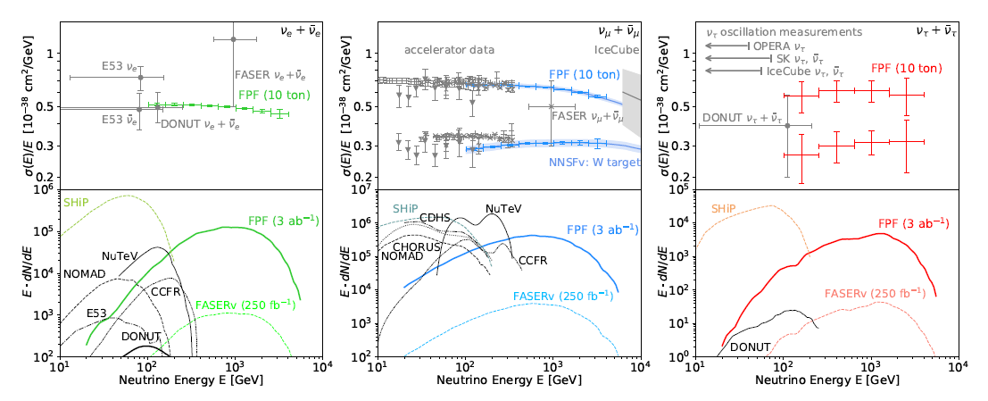
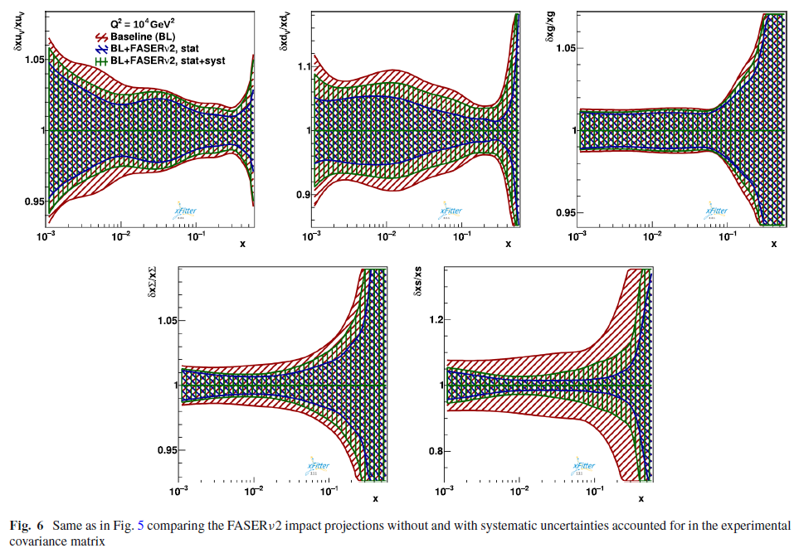


Physics motivations
FASER$ν$ @LHC (1.1 tons)
  First evidence for neutrino interaction candidates produced at the LHC, reported in 2021
  First measurements of the $ν_{e}$ and $ν_{μ}$ interaction cross sections at TeV energies, reported in 2024
  More measurements to come
    cross section and flux measurements in an unprobed energy window, tau neutrinos at highest energies ever observed, …
FASER$ν$2 @HL-LHC ($∼$20 tons)
  Precision tau neutrino measurements and heavy flavor physics studies, testing lepton universality in neutrino scattering and new physics effects, as well as providing important input to QCD and astroparticle physics
PDF uncertainties for strangeness PDFs
via $ν s→l c$
“The LHC as
a Neutrino-Ion Collider”,
Eur. Phys. J. C 84 (2024) 369

Slide 3
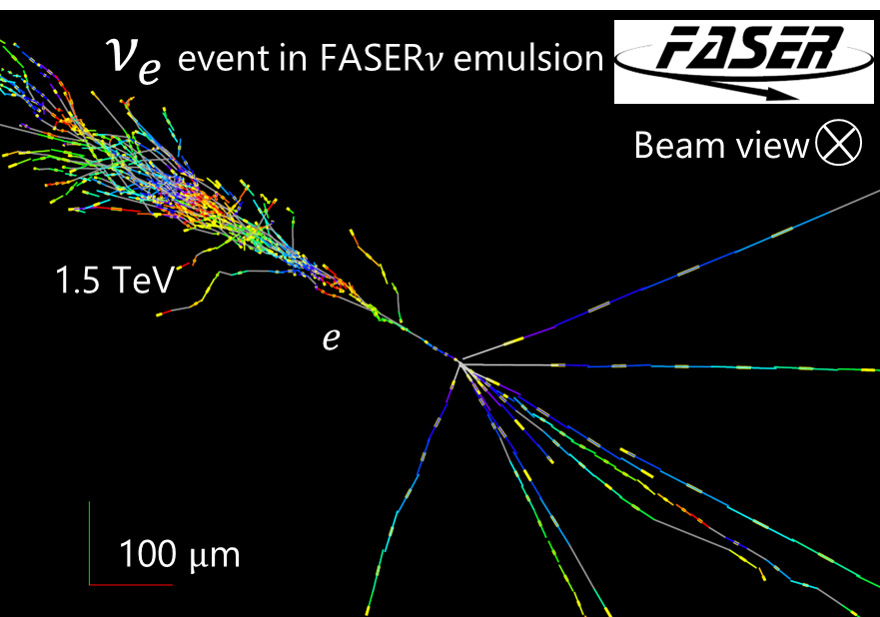
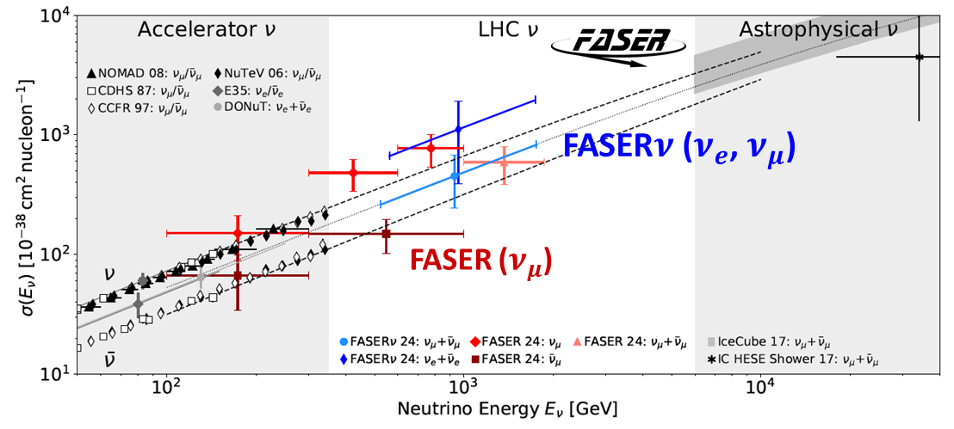


Progress in FASER$ν$
First measurements of the $ν_{e}$ and $ν_{μ}$ interaction cross sections at TeV energies
  Phys. Rev. Lett. 133, 021802 – Published on 11 July 2024, PRL Editors’ Suggestion
  Research Highlight in Nature
We will continue the operations and physics analyses.
https://doi.org/10.1103/PhysRevLett.133.021802

Slide 4
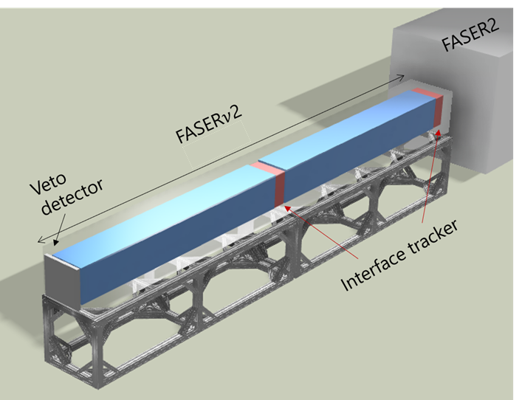
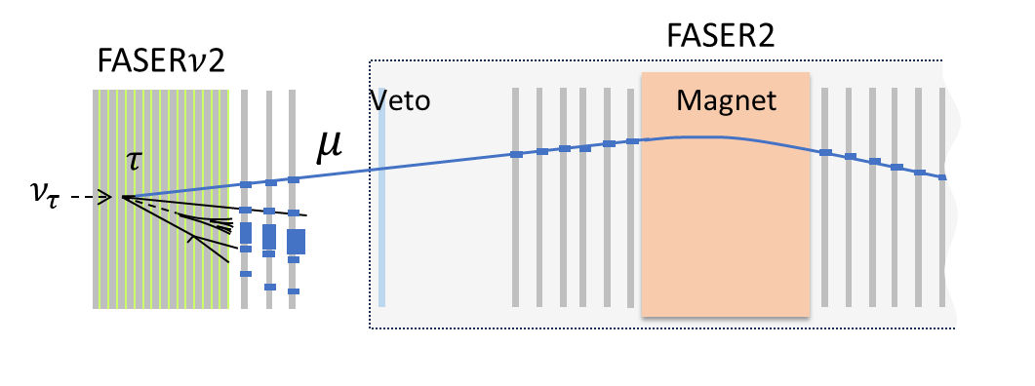
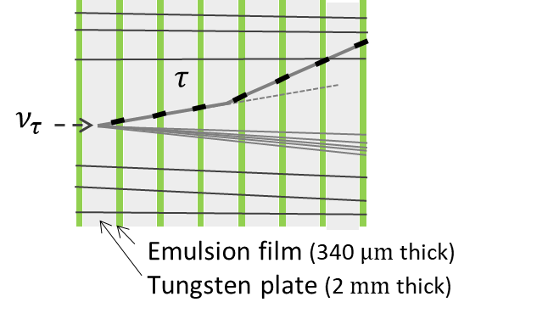

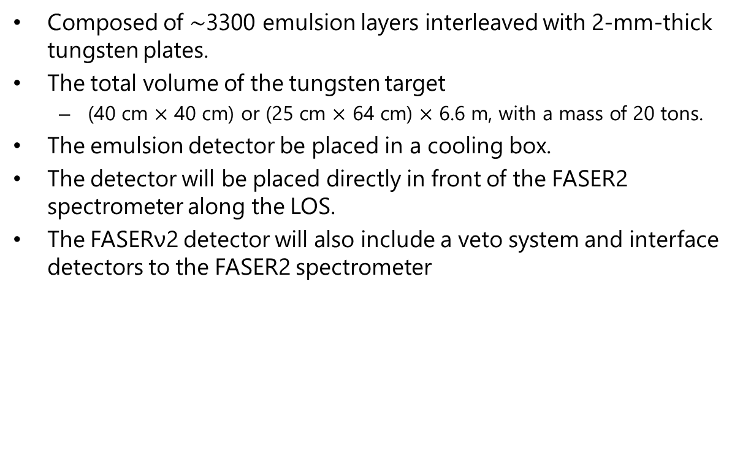
FASER$ν$2 detector
Composed of $∼$3300 emulsion layers interleaved with 2-mm-thick tungsten plates.
The total volume of the tungsten target
  (40 cm $×$ 40 cm) or (25 cm $×$ 64 cm) $×$ 6.6 m, with a mass of 20 tons.
The emulsion detector be placed in a cooling box.
The detector will be placed directly in front of the FASER2 spectrometer along the LOS.
The FASERν2 detector will also include a veto system and interface detectors to the FASER2 spectrometer

Slide 5
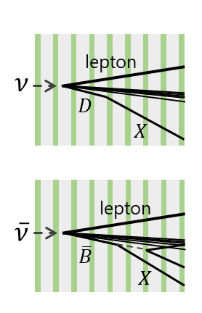
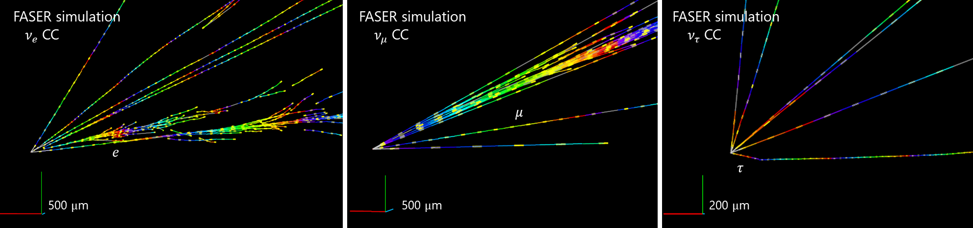
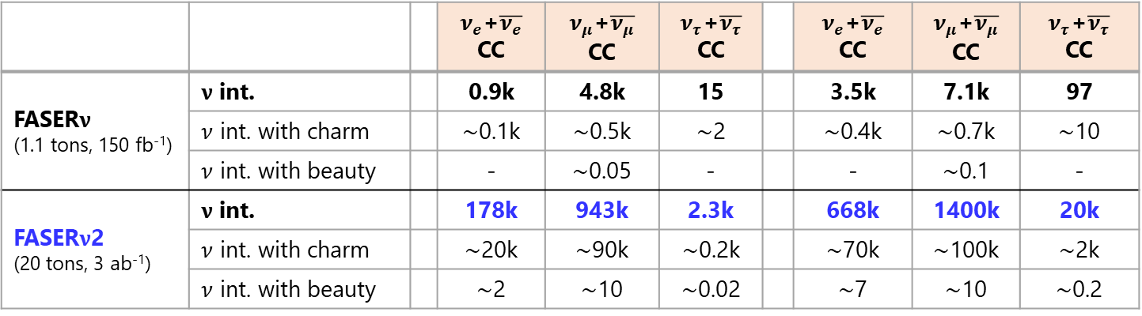
Expected number of events
Based on “F. Kling and L.J. Nevay, Forward Neutrino Fluxes at the LHC, Phys. Rev. D 104, 113008”
and “J.L. Feng et al., The Forward Physics Facility at the High-Luminosity LHC, arxiv:2203.05090”
$ν$ int. rate estimated using Sibyll 2.3d DPMJET 3.2017
 |  |  | $ν_{e}$+$\overline{ν_{e}}$ CC | $ν_{μ}$+$\overline{ν_{μ}}$ CC | $ν_{τ}$+$\overline{ν_{τ}}$ CC |  | $ν_{e}$+$\overline{ν_{e}}$ CC | $ν_{μ}$+$\overline{ν_{μ}}$ CC | $ν_{τ}$+$\overline{ν_{τ}}$ CC
FASER$ν$ (1.1 tons, 150 fb⁻¹) | $ν$ int. |  | 0.9k | 4.8k | 15 |  | 3.5k | 7.1k | 97
 | $ν$ int. with charm |  | $\sim$0.1k | $\sim$0.5k | $\sim$2 |  | $\sim$0.4k | $\sim$0.7k | $\sim$10
 | $ν$ int. with beauty |  | - | $\sim$0.05 | - |  | - | $\sim$0.1 | -
FASER$ν$2 (20 tons, 3 ab⁻¹) | $ν$ int. |  | 178k | 943k | 2.3k |  | 668k | 1400k | 20k
 | $ν$ int. with charm |  | $\sim$20k | $\sim$90k | $\sim$0.2k |  | $\sim$70k | $\sim$100k | $\sim$2k
 | $ν$ int. with beauty |  | $\sim$2 | $\sim$10 | $\sim$0.02 |  | $\sim$7 | $\sim$10 | $\sim$0.2

Slide 6
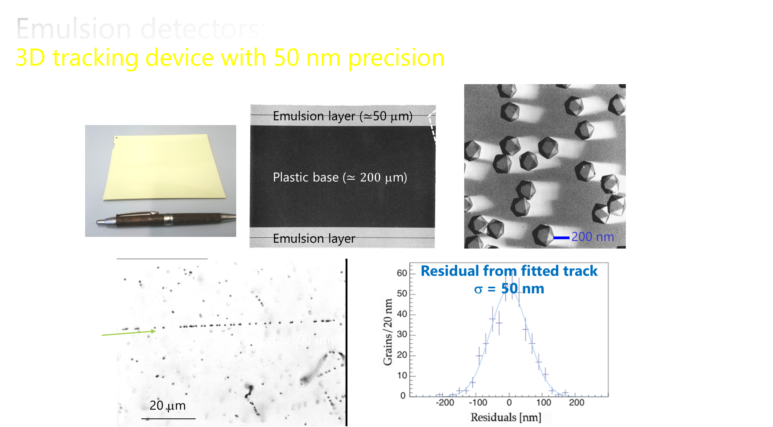

Slide 7
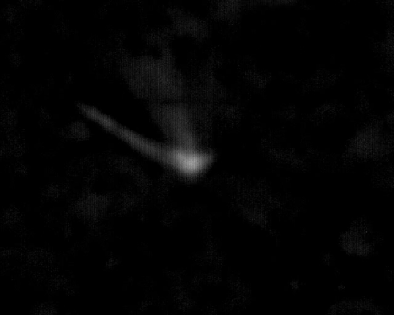
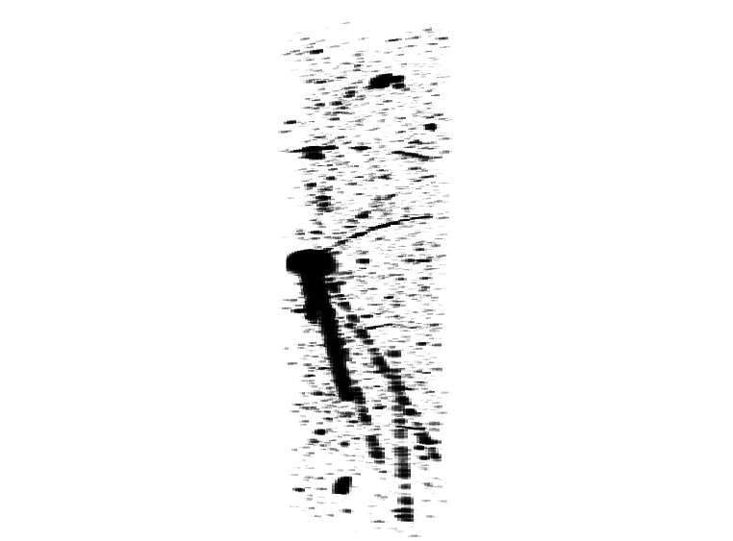


Emulsion raw data: 3D microscope images
Antiproton annihilation taken in AEgIS 2012
150 $μ$m x 120 $μ$m x 50 $μ$m
The latest scanning system read-out
the data at a throughput of 48 Gbytes/sec
200 $μ$m

Slide 8

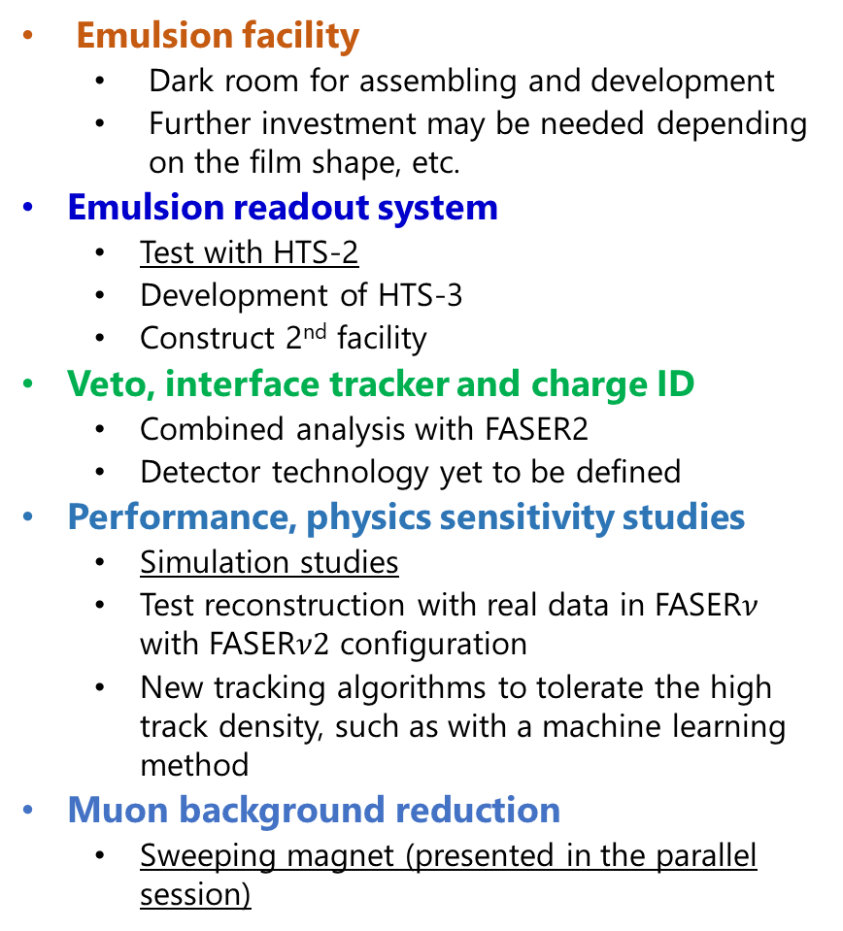
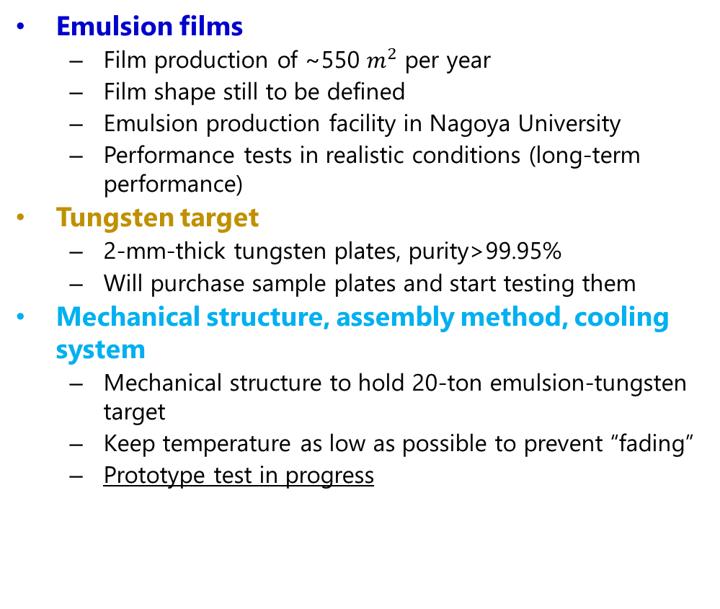
Status of FASER$ν$2 tasks
Emulsion facility
  Dark room for assembling and development
  Further investment may be needed depending on the film shape, etc.
Emulsion readout system
  Test with HTS-2
  Development of HTS-3
  Construct 2nd facility
Veto, interface tracker and charge ID
  Combined analysis with FASER2
  Detector technology yet to be defined
Performance, physics sensitivity studies
  Simulation studies
  Test reconstruction with real data in FASER$ν$ with FASER$ν2$ configuration
  New tracking algorithms to tolerate the high track density, such as with a machine learning method
Muon background reduction
  Sweeping magnet (presented in the parallel session)
Emulsion films
  Film production of ~550 $m^{2}$ per year
  Film shape still to be defined
  Emulsion production facility in Nagoya University
  Performance tests in realistic conditions (long-term performance)
Tungsten target
  2-mm-thick tungsten plates, purity>99.95%
  Will purchase sample plates and start testing them
Mechanical structure, assembly method, cooling system
  Mechanical structure to hold 20-ton emulsion-tungsten target
  Keep temperature as low as possible to prevent “fading”
  Prototype test in progress

Slide 9
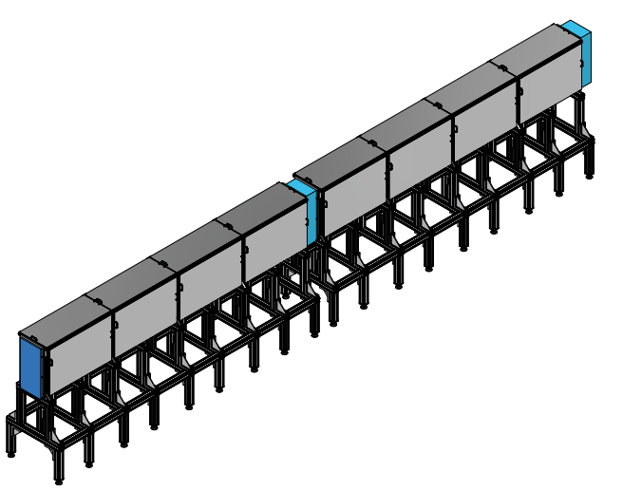
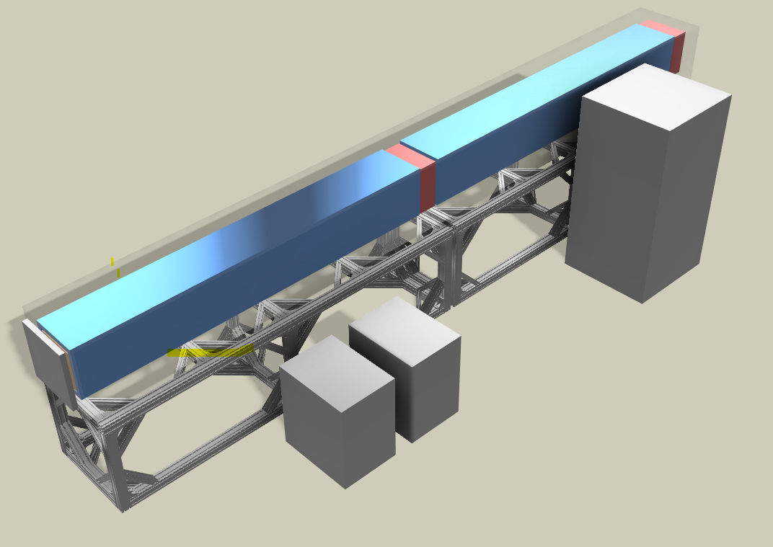
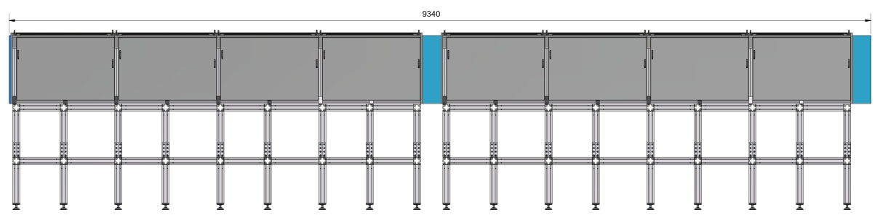
New drawings with more realistic design
Silas Bosco
9.340 m

Slide 10
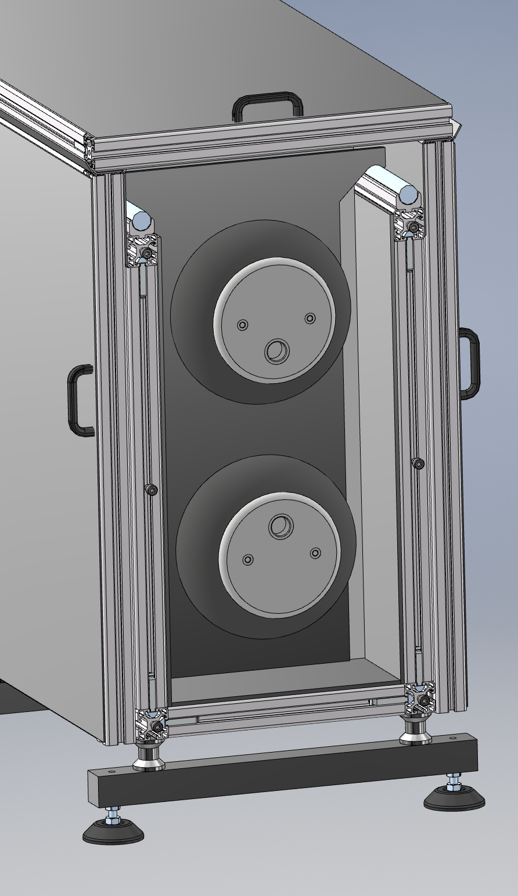
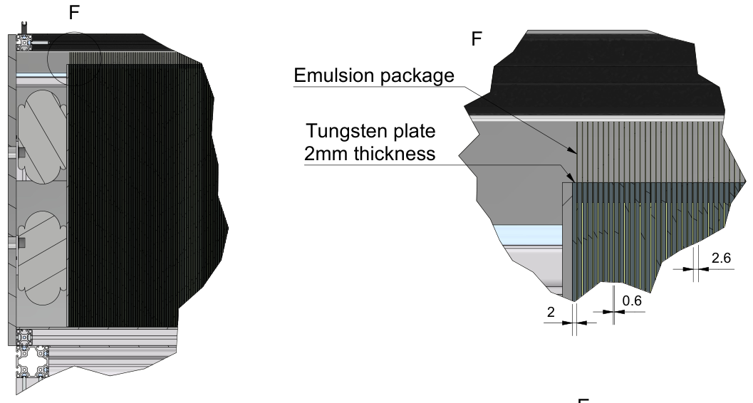
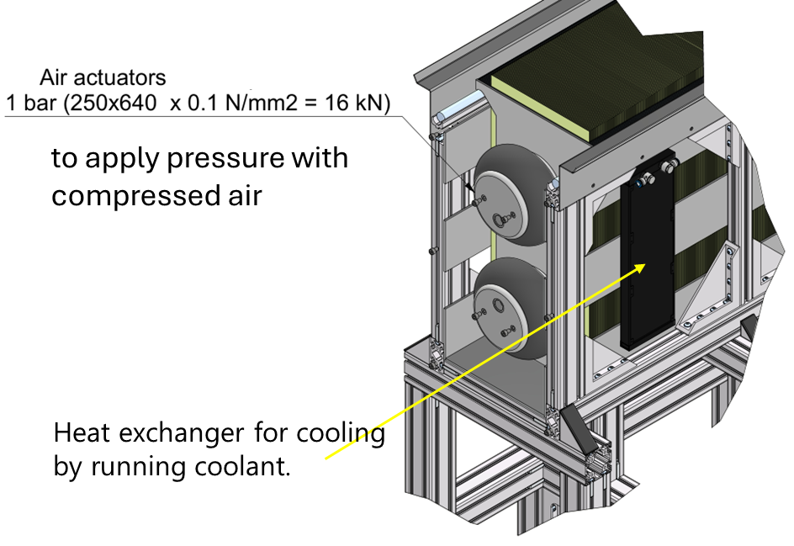
Silas
T-shirt shape tungsten plate
64 cm x 25 cm
on a rail

Slide 11
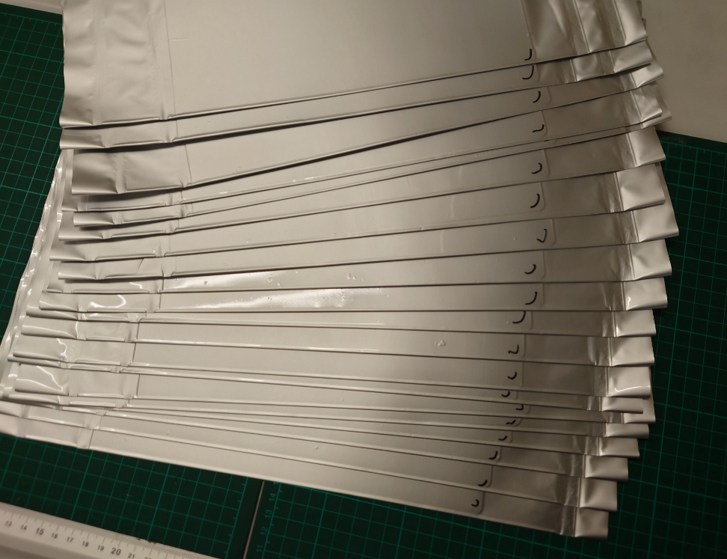
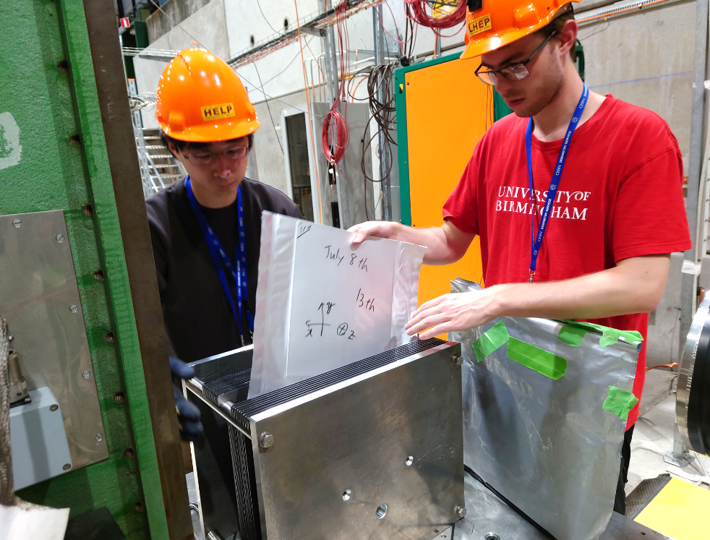

FASER$ν$2 prototype test
Silas, Aki
Currently, 1.3-ton detector is transported between the surface lab and the LHC tunnel for emulsion film exchange.
Difficult to do the same for 20-ton detector → Assemble in FPF under room light
Prototype structure was made at U. Bern to test
  Basic idea of the mechanical structure: T-shirt shape target plates on a rail
  Operation at the experimental site: Assembling single-packed films under room light (10-20 sec/film)
  Alignment and reconstruction

Slide 12
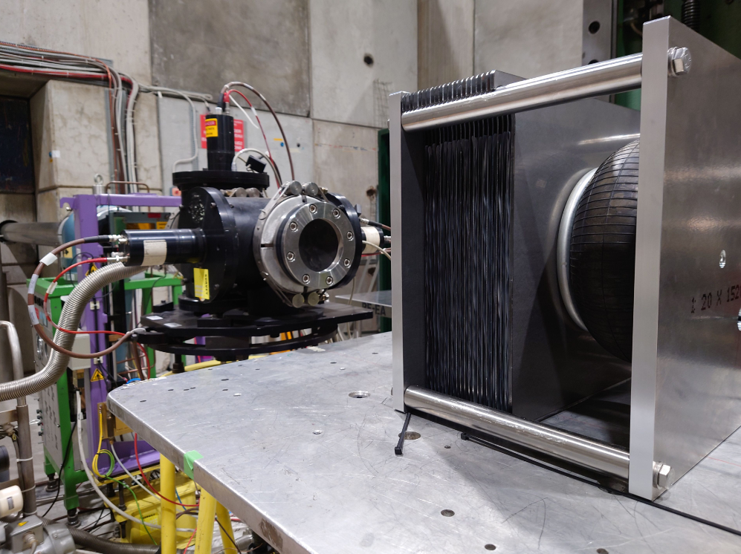
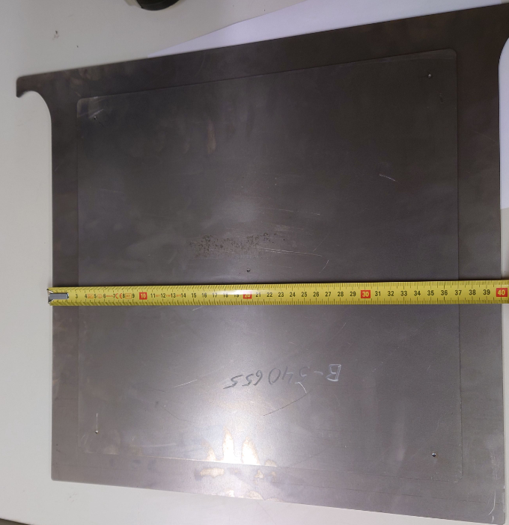
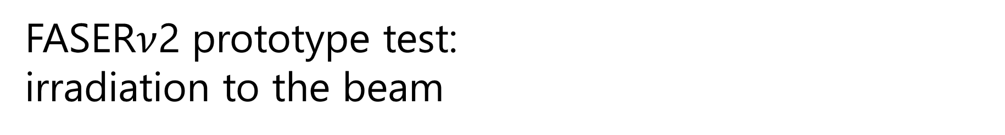
FASER$ν$2 prototype test: irradiation to the beam
Ken, Jeremy
A test beam experiment was performed in July 2024 at the SPS-H8 beamline.
Efficient on-site assembling was confirmed.
Successful application of pressure by a balloon system
20 emulsion films and 20 iron plates
T-short shape iron plates
(3-mm thick, 34 x 34 cm²)
Applying pressure with compressed air
4 bar in balloon
= 1 bar between films

Slide 13
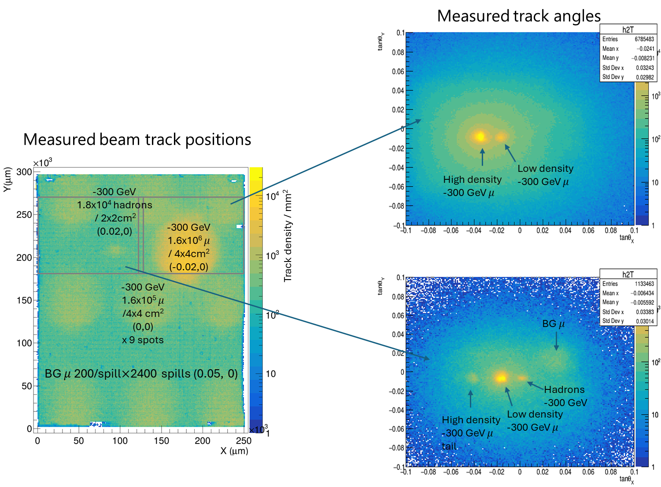

FASER$ν$2 prototype test: scanned data
Kohei, Aki
The analysis of the samples is ongoing.

Slide 14
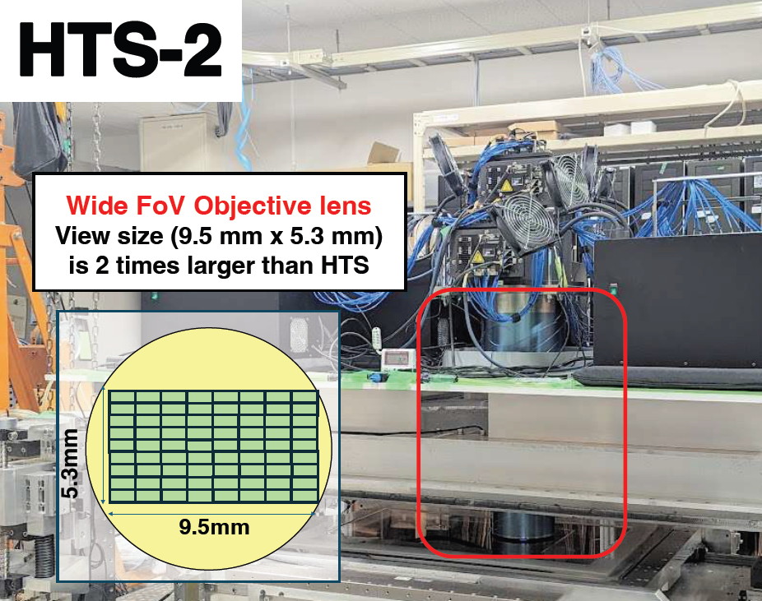
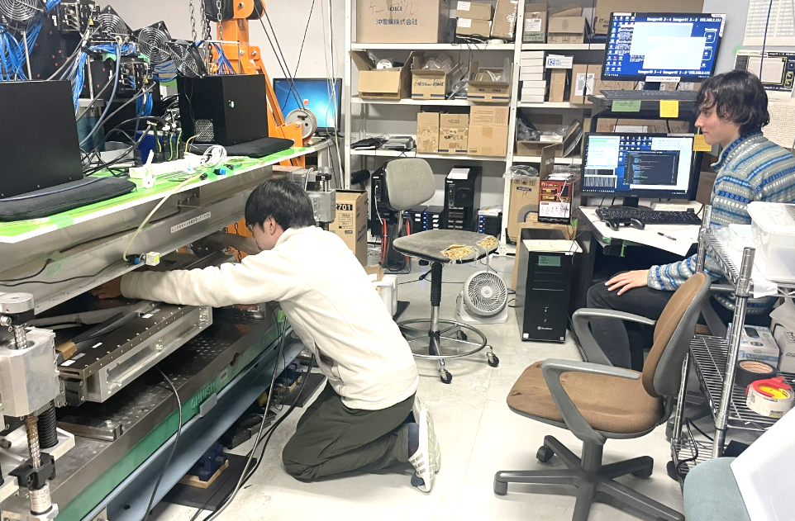
Update on the scanning systems
Nakano
HTS-1 scanning system
  Can read out ∼0.5 m² per hour, or 1,000 m² per year.
HTS-2 scanning system
  An upgraded HTS system
  Recently became operational with about two times faster speed.
HTS-3 scanning system
  Less powerful but affordable
  Start constructing a system in Chiba in 2025

Slide 15
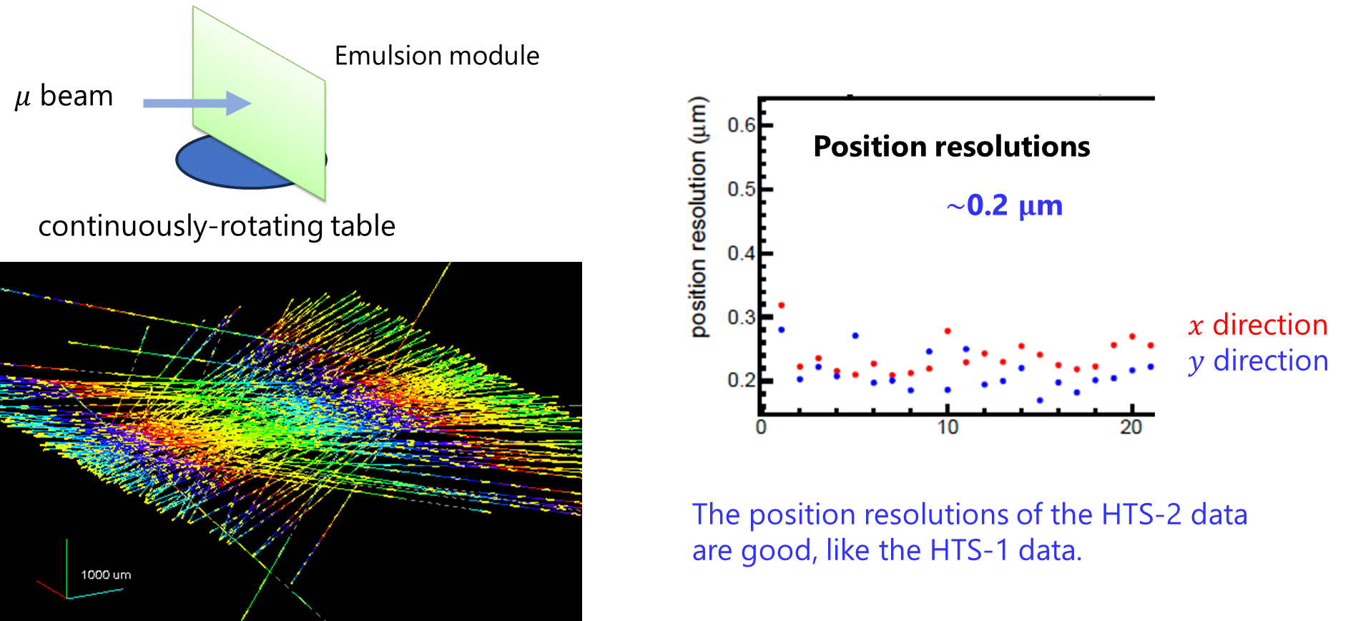
Test beam sample and scanning with HTS-2
Hiroaki, Tomoko

Slide 16
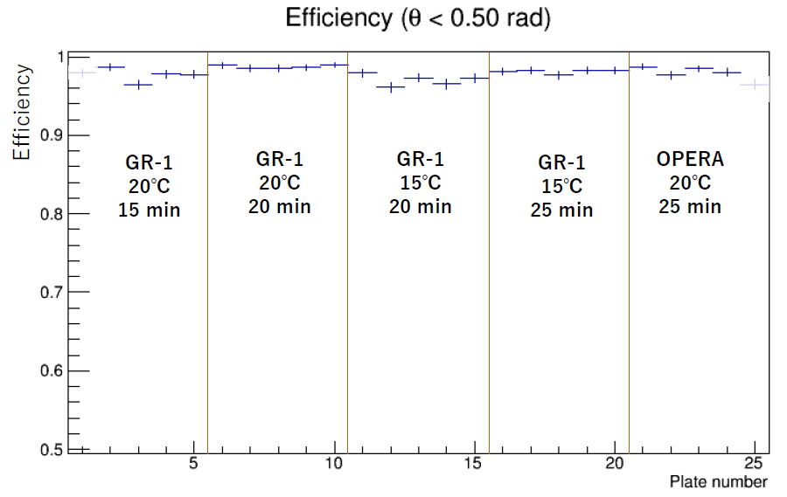
Track hit efficiency with HTS-2
Elena, Hiroaki, Tomoko,
Rokujo, Sato
Track hit (base-track) efficiency with HTS-2
Test a new type of photo-development solution, which increases the gain of chemical amplification, which can help maximize the readout speed of the emulsion detector.
Track hit efficiency of 90% corresponds to an efficiency of 99.98% for detecting tracks with three hits in seven films.
GR-1 is a new type of developer.
The efficiency of HTS-2 scanning is good for both developers.

Slide 17
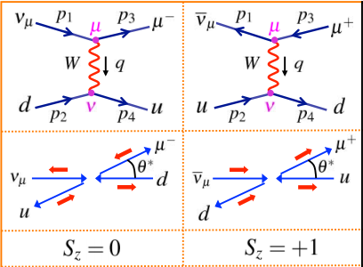
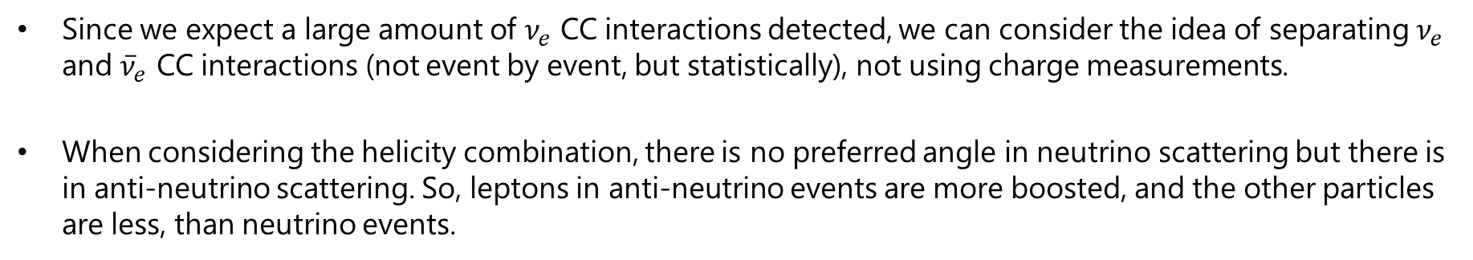

$ν_{e}$ prospects: investigating the separation of $ν_{e}$ and ${\overline{ν}}_{e}$ CC interactions
Since we expect a large amount of $ν_{e}$ CC interactions detected, we can consider the idea of separating $ν_{e}$ and ${\overline{ν}}_{e}$ CC interactions (not event by event, but statistically), not using charge measurements.
When considering the helicity combination, there is no preferred angle in neutrino scattering but there is in anti-neutrino scattering. So, leptons in anti-neutrino events are more boosted, and the other particles are less, than neutrino events.

Slide 18
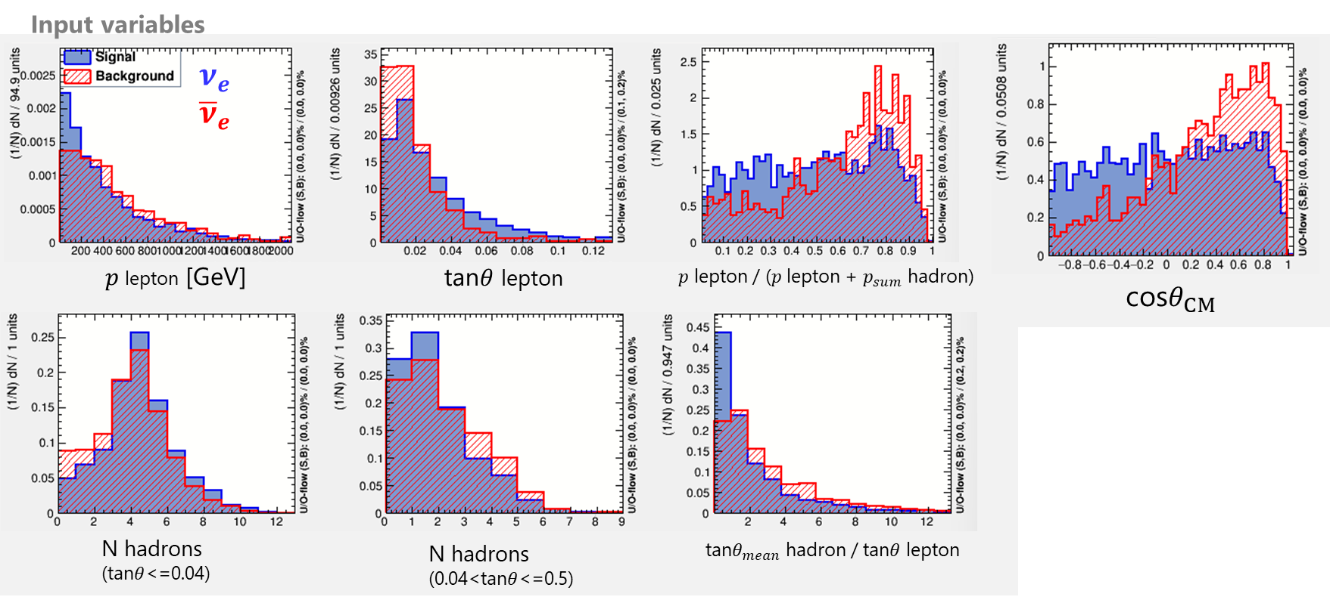
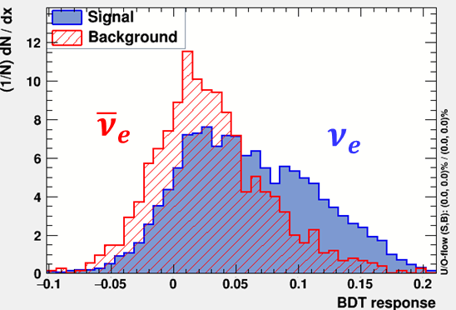
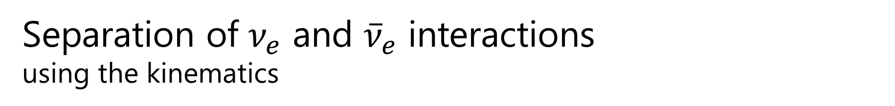
Separation of $ν_{e}$ and ${\overline{ν}}_{e}$ interactions using the kinematics
Tomoko
Measure neutrino and anti-neutrino interactions by fitting the data with the expected shapes?
Will check the performance with reconstructed MC, considering p and E resolutions.
Will check the performance for each $E_{ν}$ bin.

Slide 19
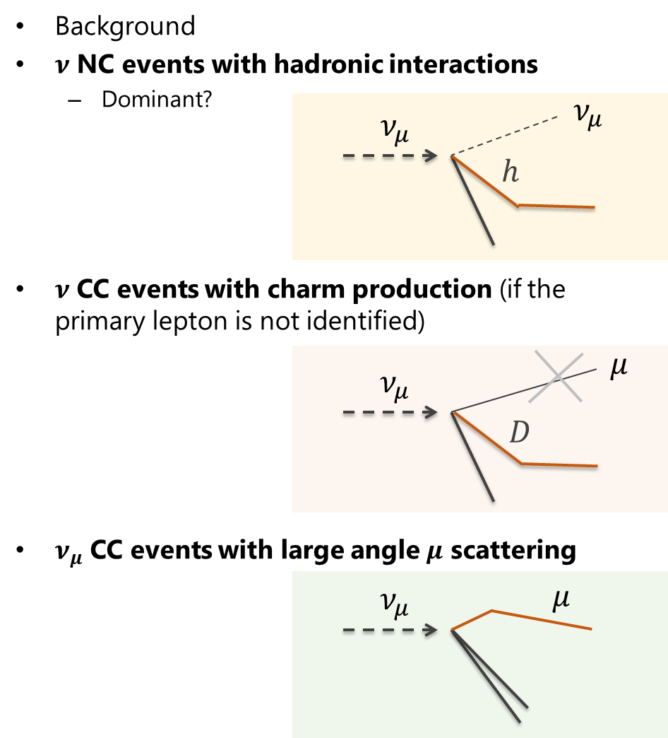
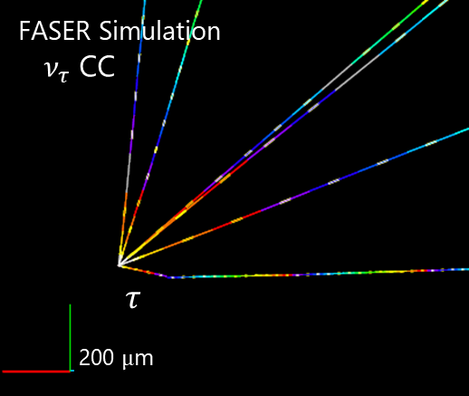
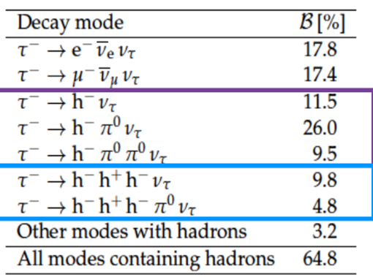
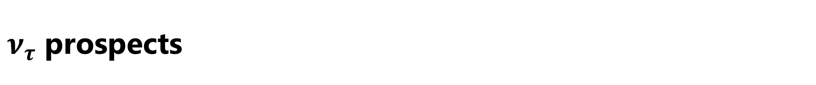
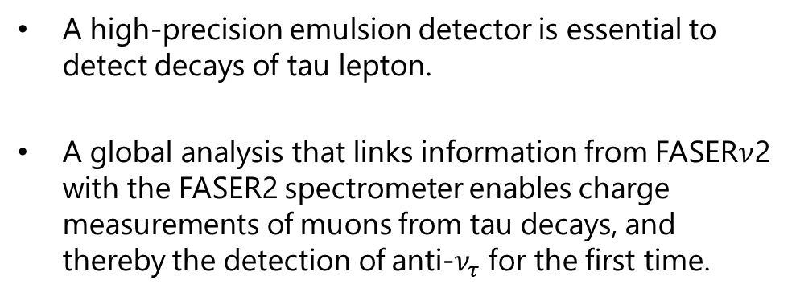
$ν_{τ}$ prospects
A high-precision emulsion detector is essential to detect decays of tau lepton.
A global analysis that links information from FASER$ν$2 with the FASER2 spectrometer enables charge measurements of muons from tau decays, and thereby the detection of anti-$ν_{τ}$ for the first time.

Slide 20
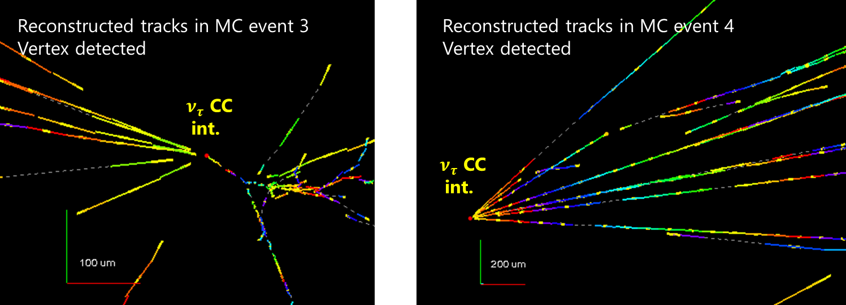
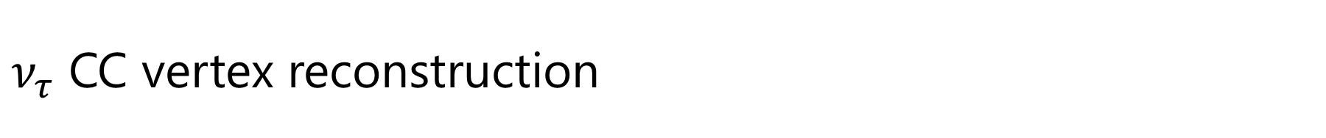
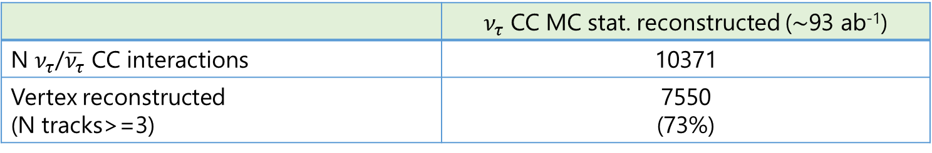
$ν_{τ}$ CC vertex reconstruction
Keiko, Simon, Tomoko, Umut
 | $ν_{τ}$ CC MC stat. reconstructed ($∼$93 ab⁻¹)
N $ν_{τ}$/$\overline{ν_{τ}}$ CC interactions | 10371
Vertex reconstructed (N tracks>=3) | 7550 (73%)

Slide 21
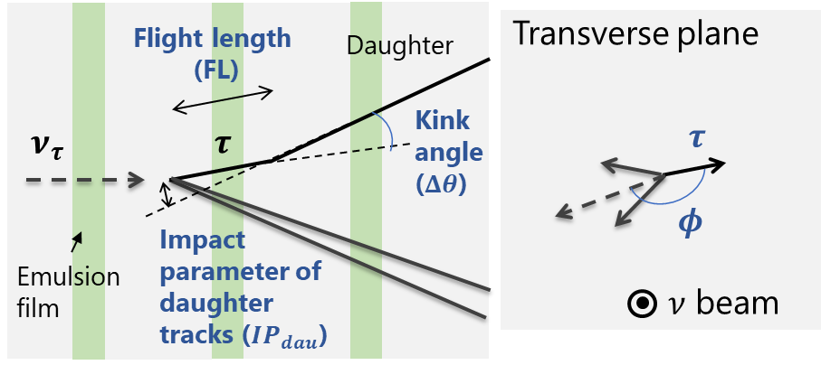
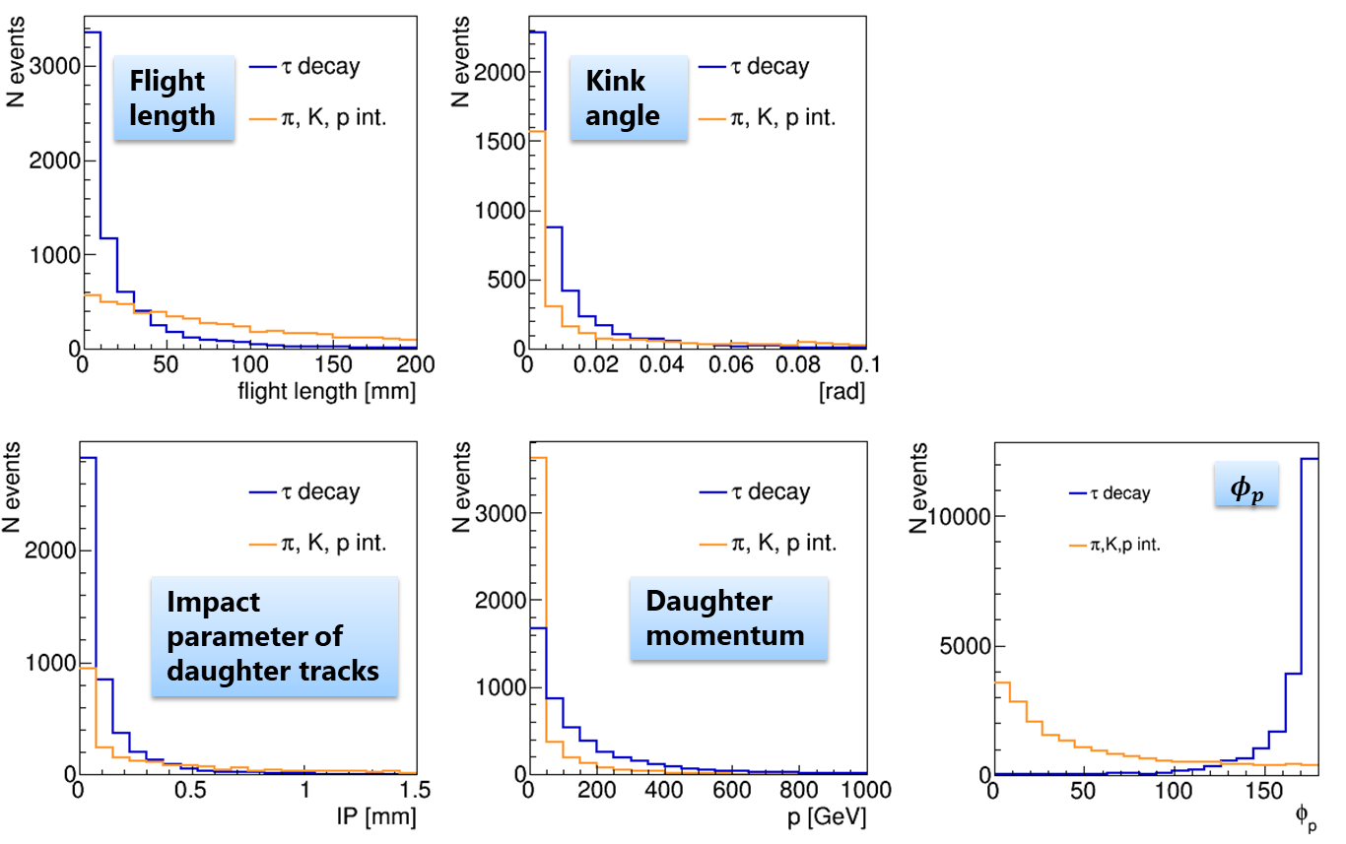

$τ$ decays and secondary hadron interactions (1-prong channel)
Keiko, Simon, Tomoko, Umut
Kink angle>0.002 rad, flight length<100 mm
applied before BDT
More detailed studies on decay detection and background studies are in progress.

Slide 22

Muon background reduction
Presented by Kohei in the parallel session: https://indico.cern.ch/event/1473651/contributions/6302871/

Slide 23

Timeline (ideal case)

Slide 24
Summary
FASERν2 has a clear and broad physics target.
The detector is based on a well-tested technology for muon neutrino, electron neutrino, tau neutrino, and short-lived particle detection.
Further studies are being carried out to optimize the detector performance, the detector operational environment, and the installation scheme.

Slide 25
Backup

Slide 26


Film shape
$40 cm×40 cm$ film cannot be produced by the current film production machine
Two options
  $2×40 cm×20 cm$
    Stay close to LoS ☺
    Dead area in the middle ☹
    Double the number of films ☹
  $25 cm×64 cm$
    Keep number of films and area ☺
    Cover wider $η$ range ☺
    No dead area ☺
    Decrease # of interactions ☹
Both options are to be considered wrt physics performances

Slide 27

Vertices not detected by the cut, N tracks>=3
(showing all tracks reconstructed from the events, not requiring vertex selection)
3 out of 15 events that were checked with the event display
Although more charged particles are in the MC truth, low momentum particles are not reconstructed with the standard tracking. We may consider a dedicated search for particles with p<~1 GeV.

Slide 28







$ν$ detection and acceptance
Additional inefficiencies for $ν_{μ}$
400 mm tungsten from the most downstream layer would be used for $μ$ ID (400 mm/3300 mm = 12%).
In addition, $\sim$5.4% of $μ^{−}$ ($\sim$3.5% of $μ^{+}$) will go side out before passing through enough material for the muon ID.
Vertex detection efficiency after requiring at least 5 charged particles
  Using charged tracks and $γ$ rays with $p$ > 0.3 GeV and $tanθ$ < 1 (relative to the neutrino direction)
  $→$ change to $p$ > 1 GeV and $tanθ$ < 0.5
$$μ$$
Green: passing through >400 mm
before leaving the emulsion detector

Slide 29



Detection of tau decays
Special resolution of hits in the emulsion
  0.5 $μ$m (measured in the FASER$ν$ pilot run data)
$→$ Angular resolution with the arm length of 10 mm = 0.5$×\sqrt{2}$/10000 = ~0.1 mrad
To detect a kink,
  tau should cross at least one emulsion layer,
  kink angle should be larger than four times the angular resolution and more than 0.5 mrad
  reasonable efficiency for $τ$ decays (75% for 1-prong decays)
flight length / kink angle
mean flight length $≃$ 30 mm
kink detection efficiency 75%

Slide 30



Neutrino energy reconstruction
Jeremy Atkinson
at the 14th LHC students' poster session
Lepton momentum 1/$tanθ_{lepton}$ Sum of charged hadron momenta
Will investigate different methods to improve the energy reconstruction performance

