Slide 1

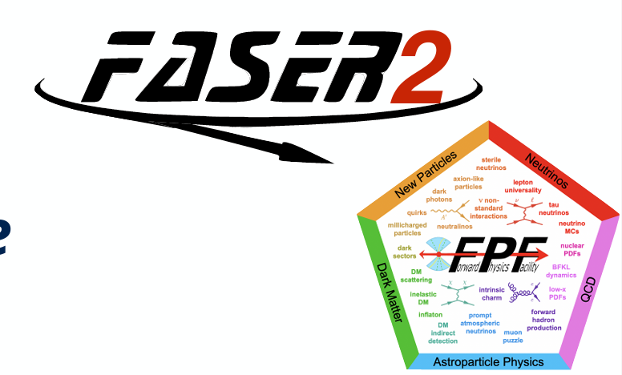

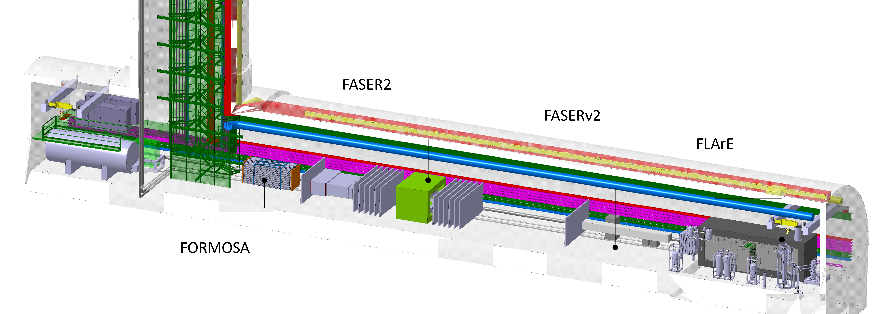
Alan Barr
On behalf of the FASER2 collaboration
FPF8
22/1/25

Slide 2
beam

Slide 3
Independent tracking spectrometer
Muon spectrometer for upstream detectors
beam

Slide 4
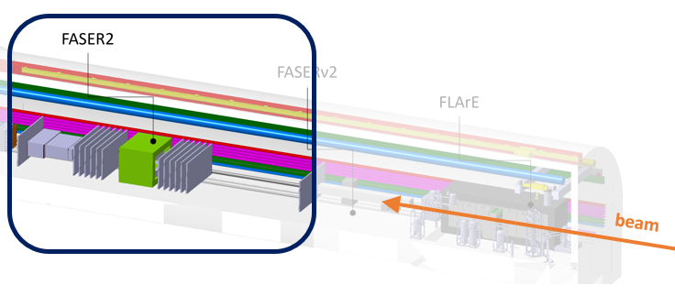
Purpose of the detector
Independent spectrometer:
BSM physics
Muon ID & spectrometer
600 times larger decay volume than FASER
Sensitive to benchmark models
including:
  Dark Higgs
  Dark Photons
  Heavy Neutral Leptons
  Axion-like particles
  Inelastic Dark Matter
For FLArE
For FASERν2

Slide 5
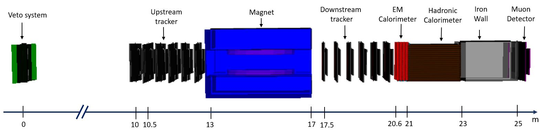
Design [baseline]
beam
Tracker:
Based on LHCb's SciFi tracker
SiPM and scintillating fiber design
Detector resolution: ~ 100 µm
m
Magnet:
Large aperture
s
3m wide X 1m gap (*)
Superconducting technology
Magnetic Field : 2 Tm
m
Based on the SAMURAI magnet
Calorimeter:
Based on dual-readout calorimetery
Spatial resolution: 1-10 mm
m
All possible with existing
detector technologies
(*) A more square (e.g., 2 m × 1.5 m) aperture is also under consideration, as it improves the acceptance of muons from FLArE by 5-10% without a significant degradation in LLP sensitivity.

Slide 6
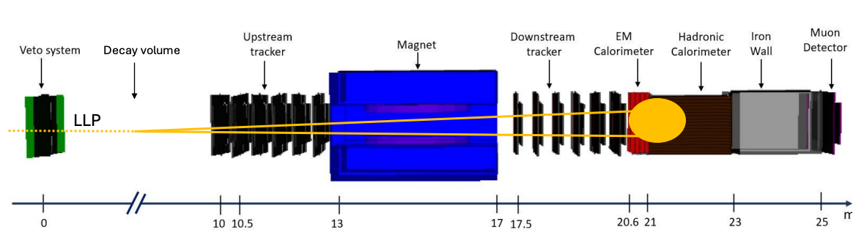
Discovery sensitivity
Examples of key parameters:
  Decay volume
  Tracking resolution
  Magnetic field integral
  EM calorimeter granularity
  Calorimeter E threshold
Rate/reach
momentum, mass, pointing
Separation of photons
Soft/near-degenerate decays

Slide 7
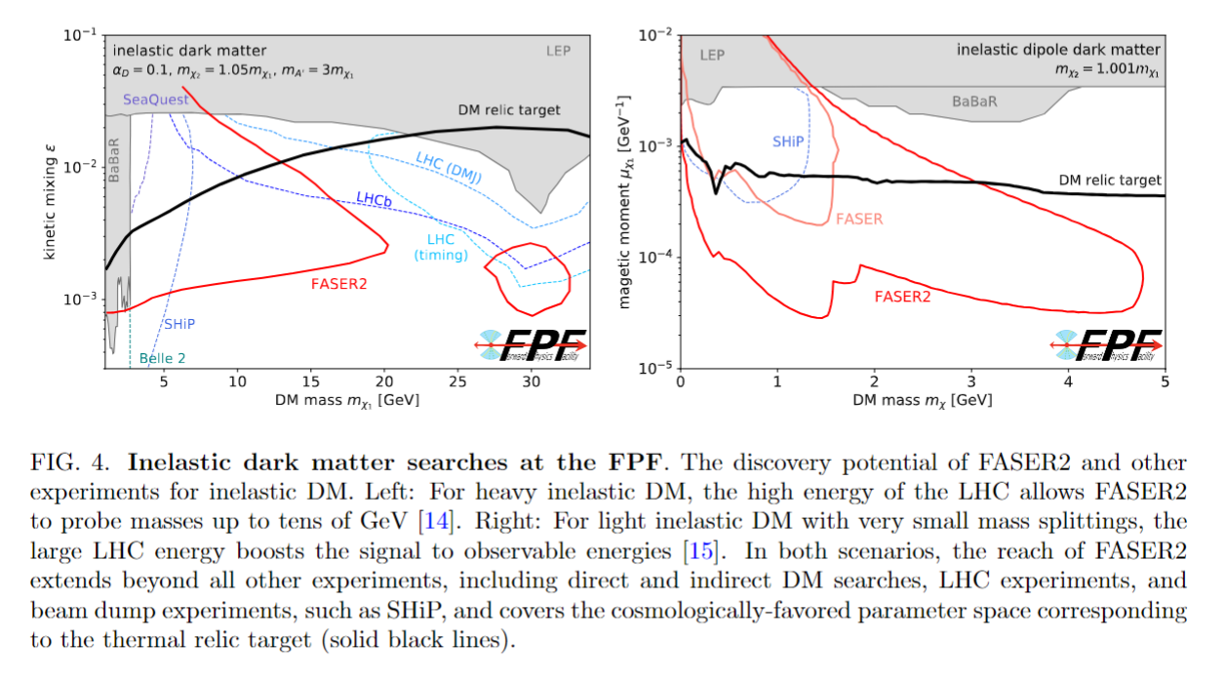
Example of BSM performance from 2411.04175, “Science and project planning for the FPF…”
Unique sensitivity (not available at any other experiment)
See also very nice talk on iDM from yesterday’s session by Peter Reimitz

Slide 8
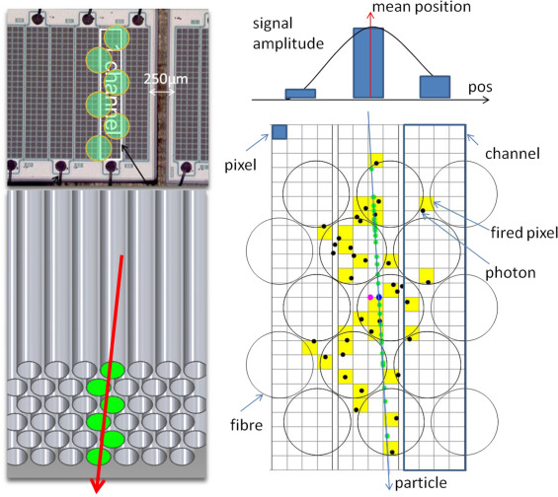
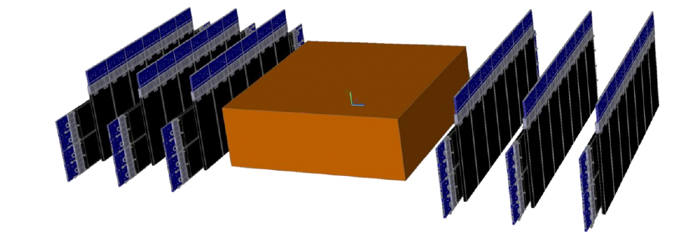
FASER2 Tracker: SciFi technology
Based on SciFi detector installed in LHCb in LS2
  SiPM + Scintillating fibre design
  Resolution ~ 80 µm (fibres diameter 250 µm)
  Each module consists mat of 4 fibres with > 99% efficiency
  Power consumption: 10 kW
FASER2 tracking station layout
  Active area of 3m X 1m
  Composed of vertical and horizontal fibre layers
  Stations relatively rotated angle of ~1°
Number of tracker layers required under investigation: 6+6 in baseline – checking down to 3+3

Slide 9
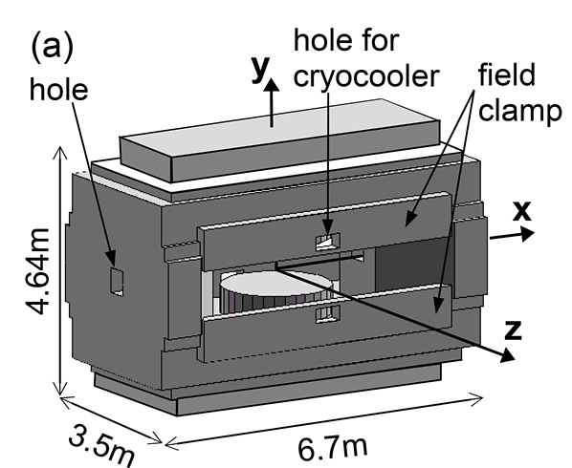
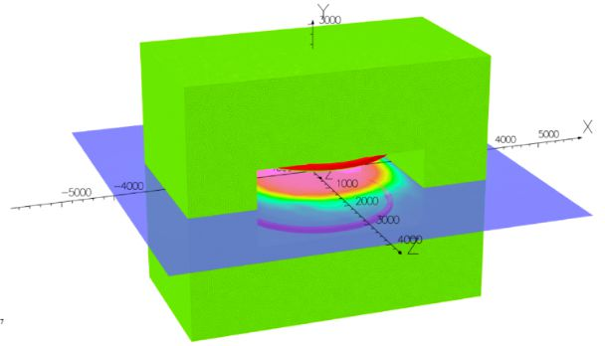
FASER2 Magnet: SAMURAI style magnet
SAMURAI Dipole Magnet as a reference
  Aperture: 88cm X 340cm
  Field integral 7 Tm
Made by Toshiba for RIKEN
FASER2 magnet based on SAMURAI:
  Dimension: 3m wide X 1m gap X 4m along LOS
  Integrated field: 2 Tm (*) down from 4Tm
  Stored energy: ~3.5 MJ
  Superconducting: Cryogenic infrastructure needed
(*) This is optimised based on simulations that demonstrate that the required charged particle separation, momentum resolution, and charge identification are obtained for the BSM and neutrino programme, while keeping the field strength to an acceptable minimum to reduce cost.

Slide 10
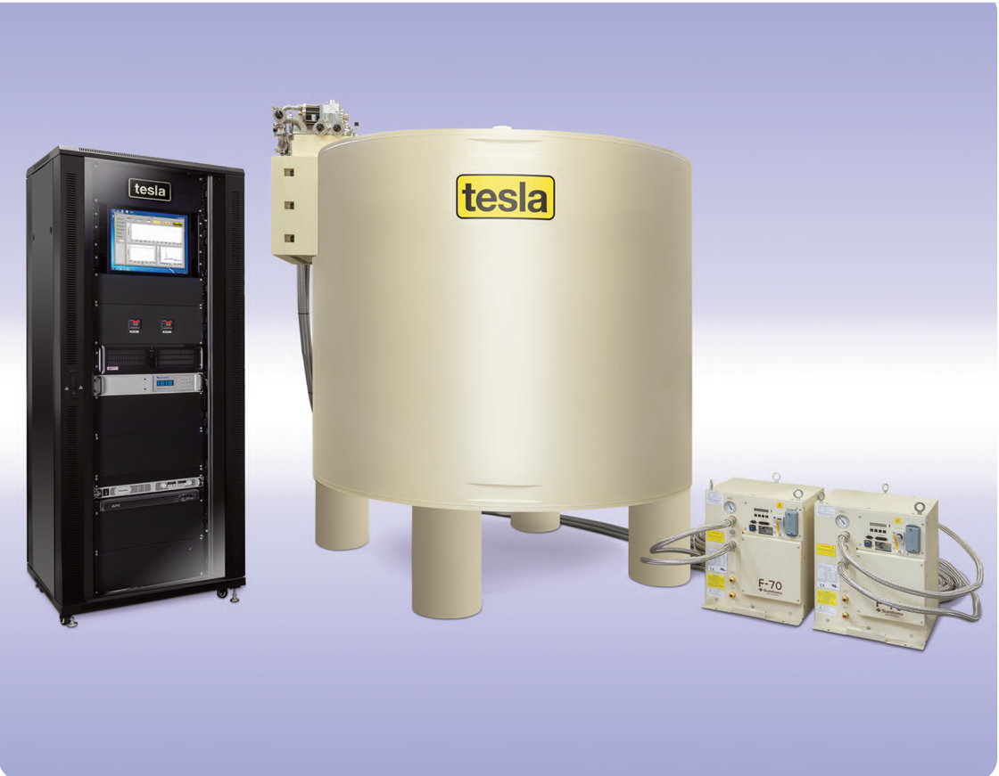
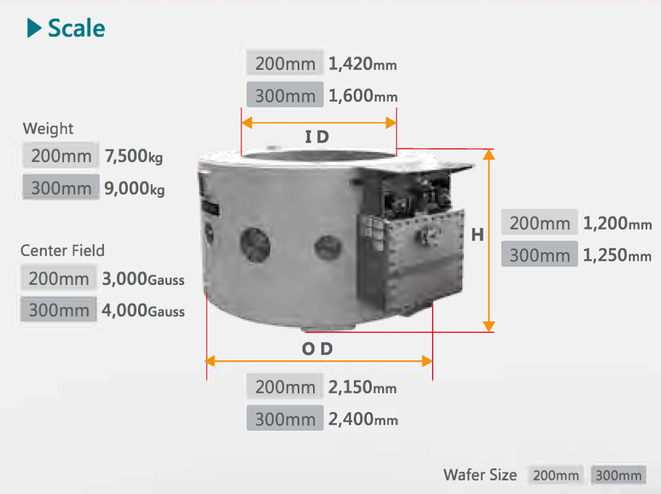
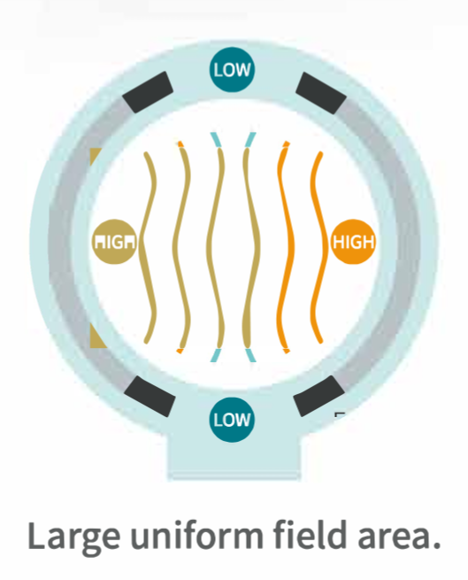
FASER2 Alternative design: Crystal puller magnet
Possibility to use off-the-shelf crystal puller magnets from Toshiba (Japan) or TESLA electronics (UK)
TESLA
Toshiba
Both of those Industrial Crystal puller magnet:
  Central field of 0.4 - 0.5 T, 0.7 Tm integrated field
  Can be chained together to have increased integrated magnetic field (considerable forces)
  Aperture diameter of 1.6 m
  Advantages: Off the shelf, no R&D needed, cryo system integrated into design
Performance comparison in performance talk yesterday by Olivier Salin et al.

Slide 11
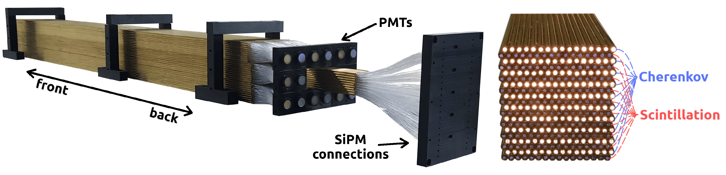
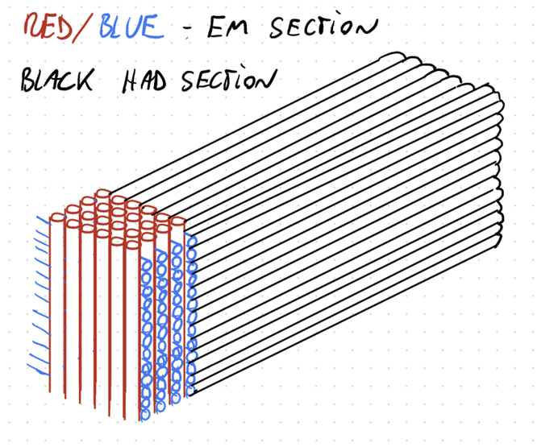

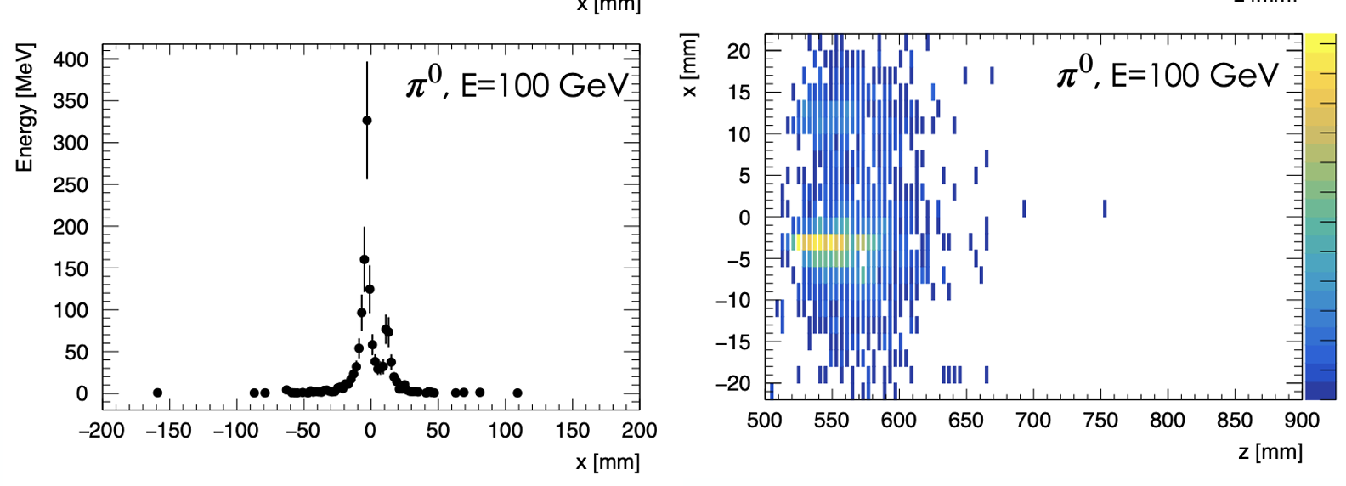
FASER2 Calorimeter: Dual-readout technology
Design based on dual readout calorimeter prototype
  Prototypes for Higgs factory detector
  EM prototype and HiDRa prototype – INFN: test beam
FASER2 calorimeter design:
  Fibre diameter 1 mm, 2 mm brass collar
  Spatial resolution: ~ 5 mm
  EM energy resolution:
  Power consumption: ~ 3 kW (EM), ~ 1.3 kW (Hadronic)
  Less granular for outer regions of the detector
    Reduce number of channels
Calorimeter performances Geant4 simulation
  Simulation π0 -> yy
Ideal testbed for such calorimeters

Slide 12
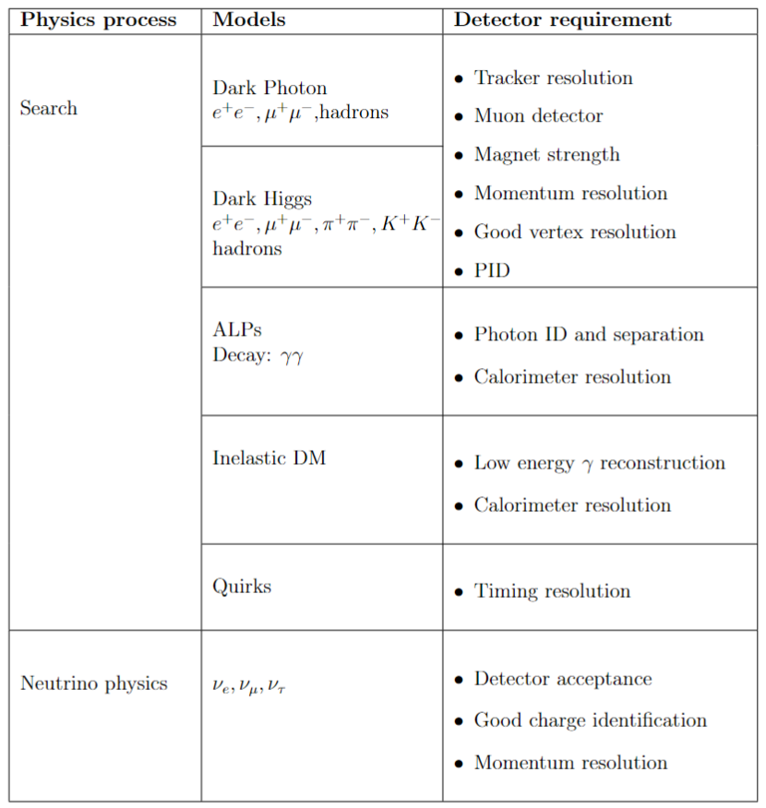
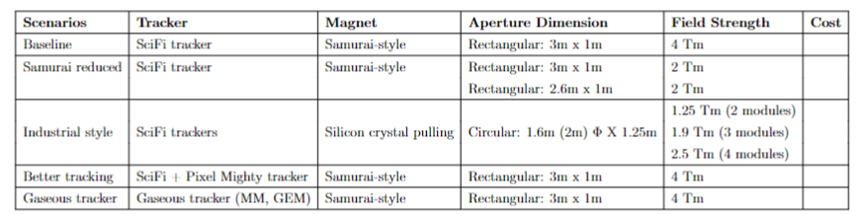
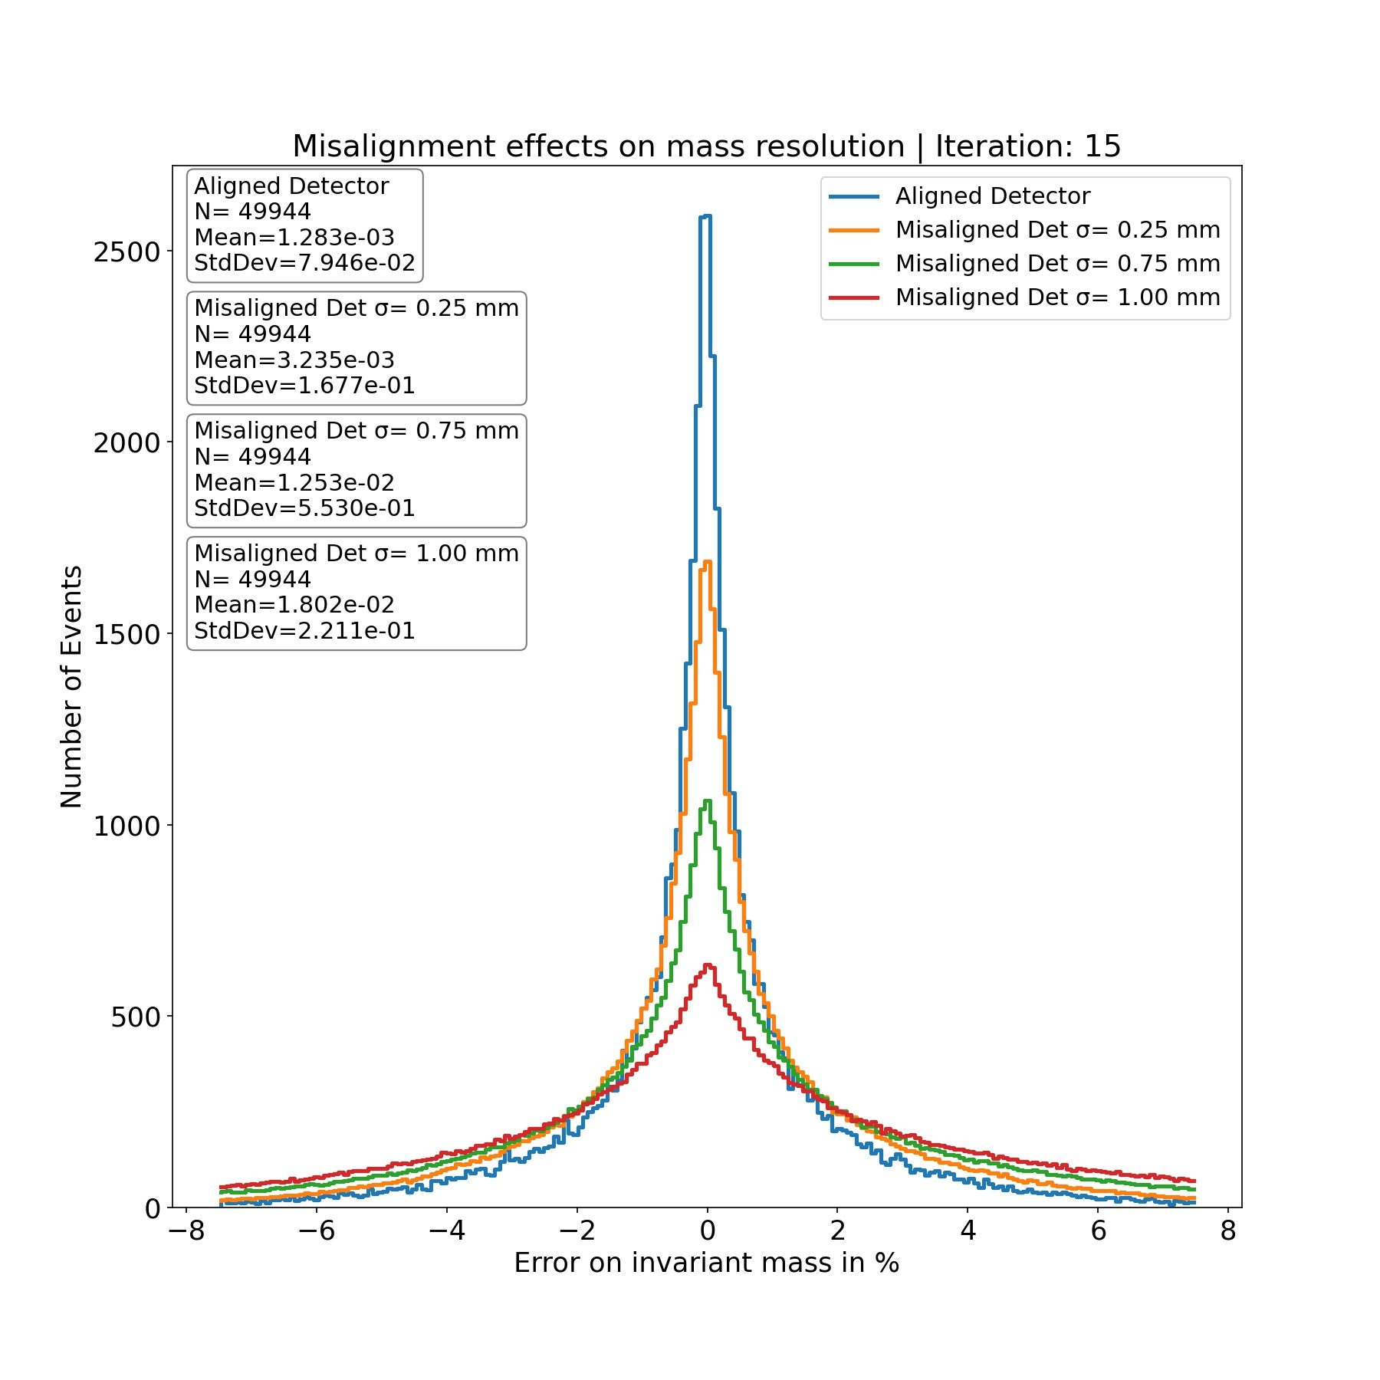
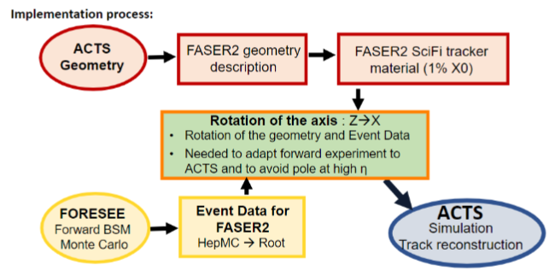
Simulation & optimisation
Scenarios
Benchmarks
Software
Alignment
Described in detailed performance talk yesterday by Olivier Salin et al.

Slide 13
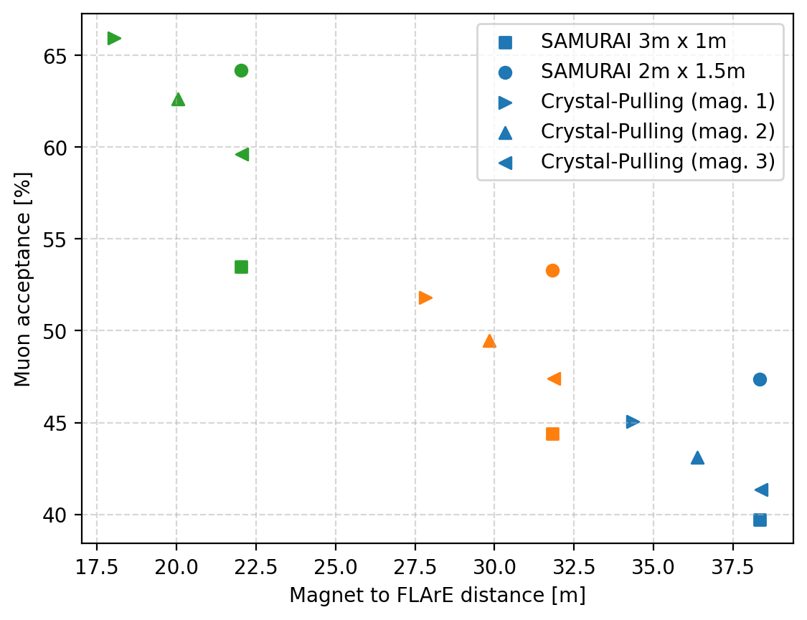
Acceptance: muons from FLArE

Slide 14
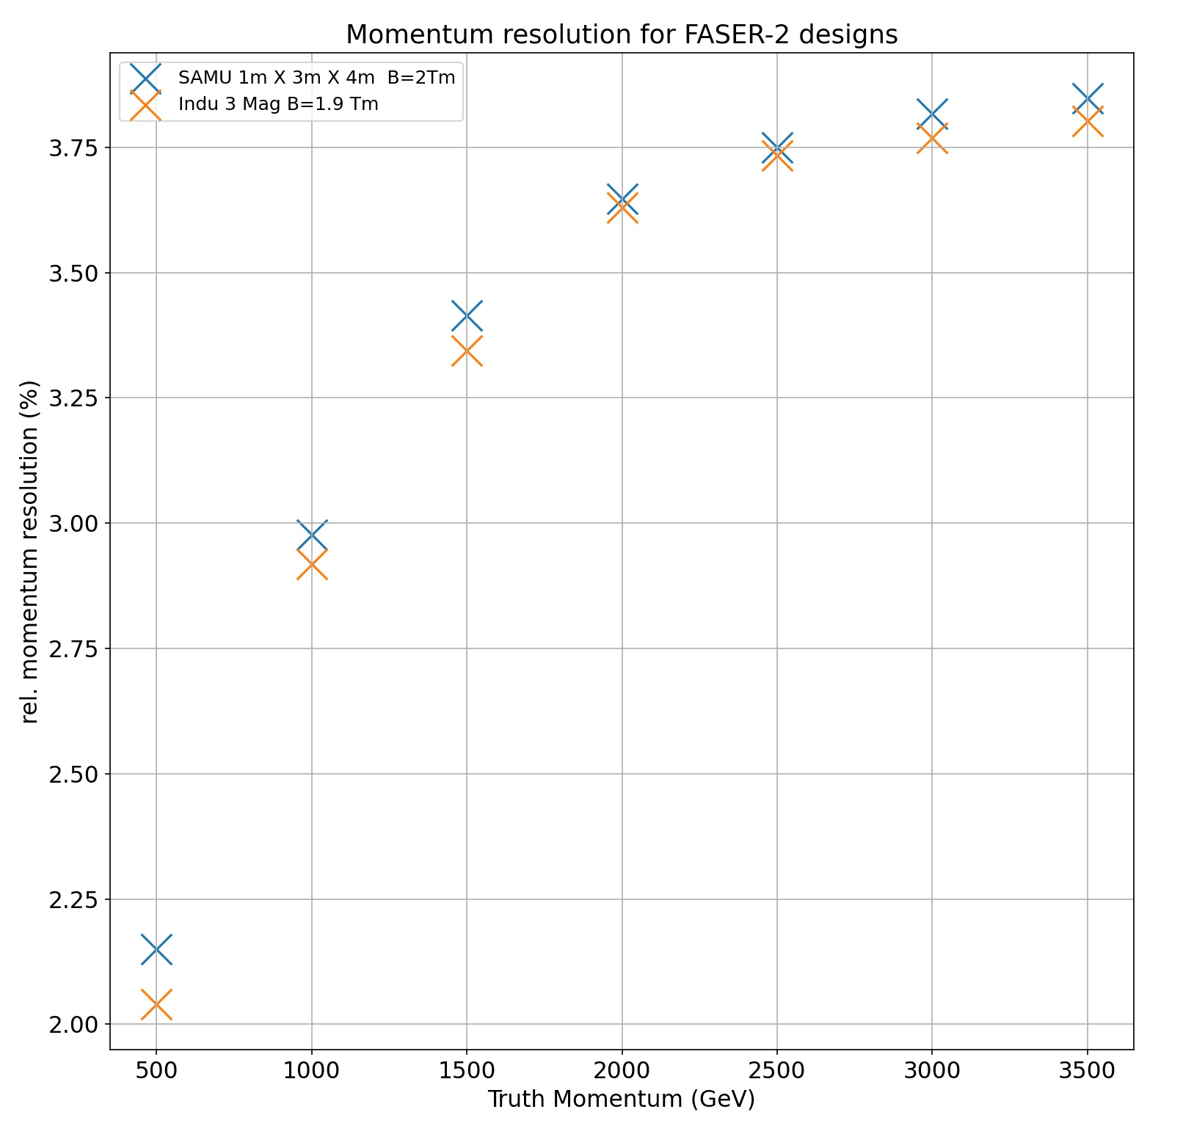
Crystal puller vs Samurai - resolution

Slide 15
Further studies todo/in progress
Crystal-puller magnet mechanics
Calorimeter options
Background rates
Quirk simulation
Detailed simulation of
Inelastic Dark Matter
Services, engineering and installation
Neutrino interactions in air
(Case for vacuum/He gas vessel?)
Detail of veto system

Slide 16
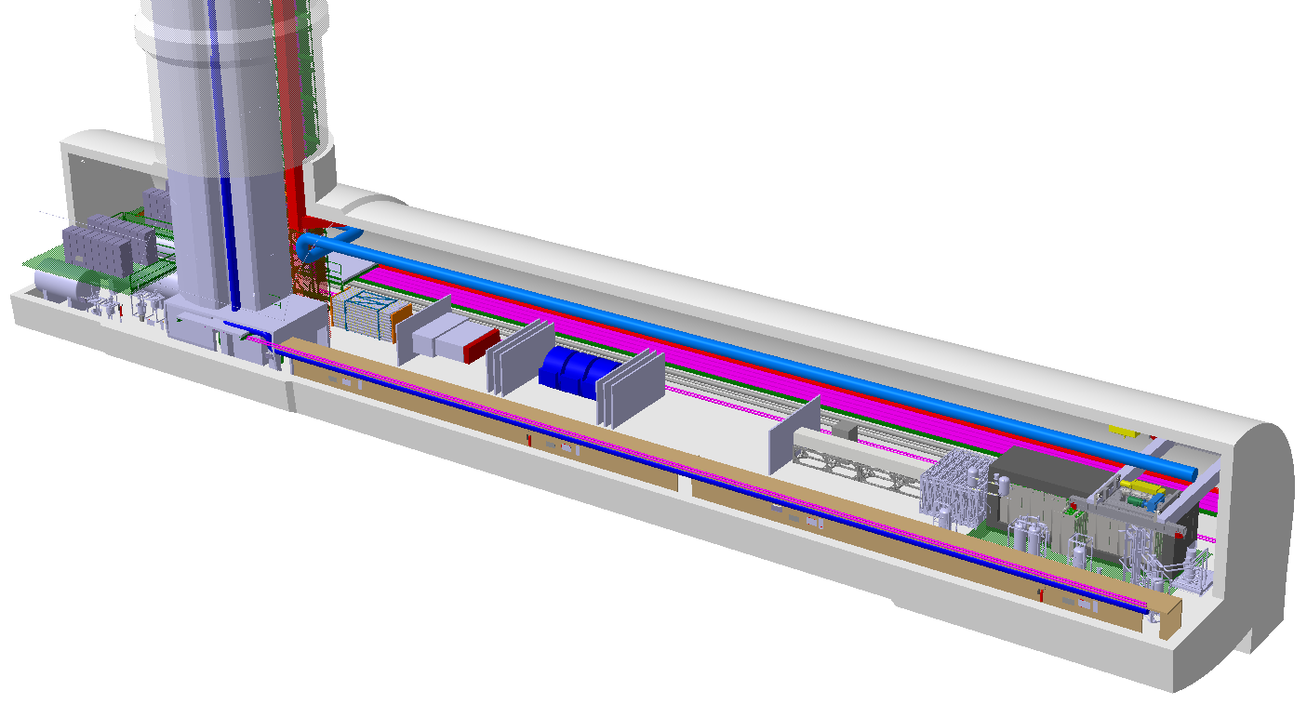
Baseline updates incorporated into FPF CAD
3 + 3 SciFi planes
3 crystal-puller magnets

Slide 17
FASER2 community (FPF7)
We are working to build and consolidate the community and possible funding routes for FASER2
UK interest and involvement – FPF UK meeting (11/10/23):
  Oxford, Sussex, Liverpool, Manchester, RAL, Sheffield
  Dual Readout/ Tracking/ Support structures/ Simulation and data analysis
  Preparing statement of interest with STFC
Geneva: Investigating options within Switzerland
Japan: FASER2 & FASERnu2 in process of being included in one of Grand Vision summarised
by Science Council of Japan
US: FASER groups to look at applying for NSF funds for FASER2 work
  UCI, Washington, Oregon
Serbia: Activities on FASER2 studies
  Belgrade group: Marija Vranješ Milosavljević, Nenad Vranješ
Expected increased involvement from existing FASER collaboration

Slide 18
FASER2 community
We are working to build and consolidate the community and possible funding routes for FASER2
UK interest and involvement – FPF UK meeting (11/10/23):
  Oxford, Sussex, Liverpool, Manchester, RAL, Sheffield
  Dual Readout/ Tracking/ Support structures/ Simulation and data analysis
  Preparing statement of interest with STFC
Very successful in widening
UK engagement
France: ENS – simulation, performance
Geneva: Investigating options within Switzerland
Japan: FASER2 & FASERnu2 in process of being included in one of Grand Vision summarised
by Science Council of Japan
US: FASER groups to look at applying for NSF funds for FASER2 work
  UCI, Washington, Oregon
Serbia: Activities on FASER2 studies
  Belgrade group: Marija Vranješ Milosavljević, Nenad Vranješ
Expected increased involvement from existing FASER collaboration
Major contributors to
performance note
This is happening

Slide 19
Making the case
Science
  TeV Neutrinos
  Unique BSM opportunities
  QCD
  DIS
  Cosmic rays
Technology
  Demonstrators for
  collider detectors
Sustainability
  Maximise use of existing facilities (LHC)
  Fully exploit LHC science
  Building on 70 years of accelerators at CERN
  Very small emissions (C02)
People & skills
  Training ground for larger experiments
  Skills pipeline in experiment design, commissioning, operation
Timeliness
  Unique opportunity during operation of HL-LHC
  Continuity between large projects
Cost
  Modest cost
  About the same as a building

Slide 20
Summary
FASER2 detector can meet FPF requirements:
  BSM searches – FASER x600
  FLArE & FASERv2 spectrometer
Detailed physics analysis checking alternative designs
“Off the shelf” crystal puller magnet performance suffices
  Mechanical design to be checked
Simulation software state-of-the-art
Active collaboration
  With room for new entrants

Slide 21
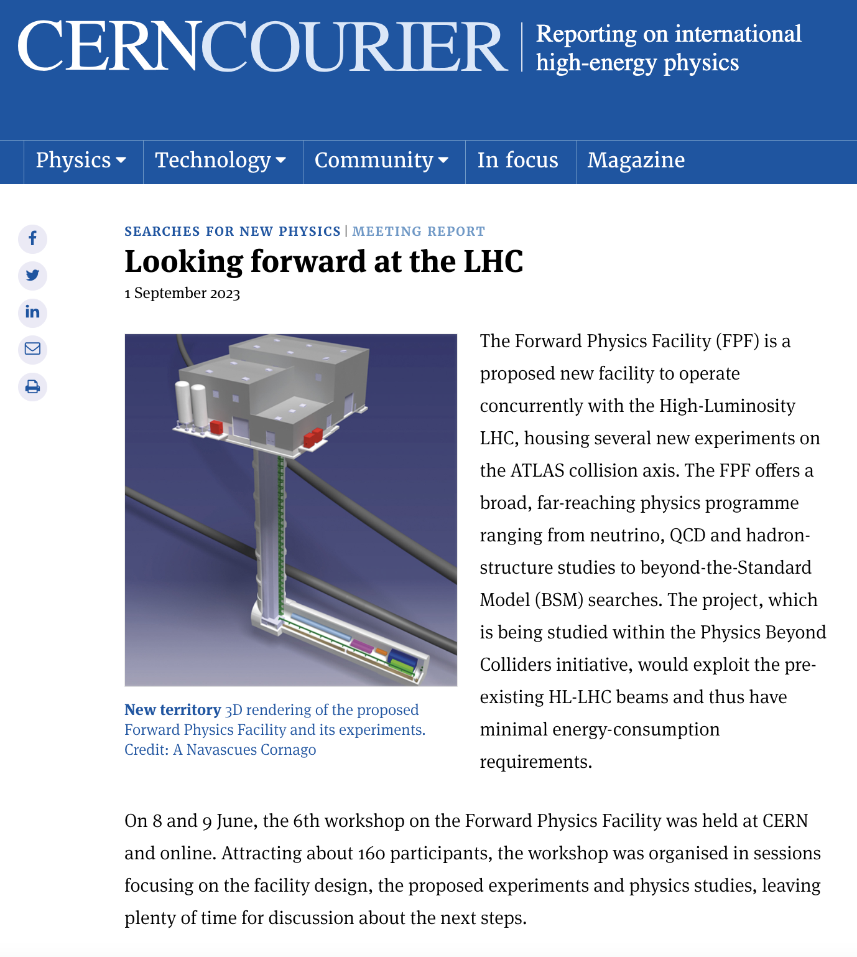
EXTRAS

Slide 22
