Slide 1


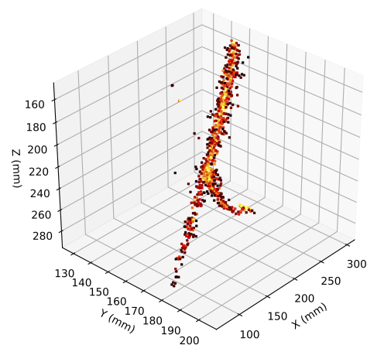
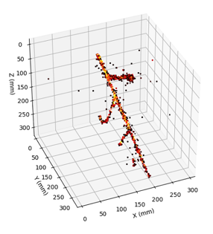
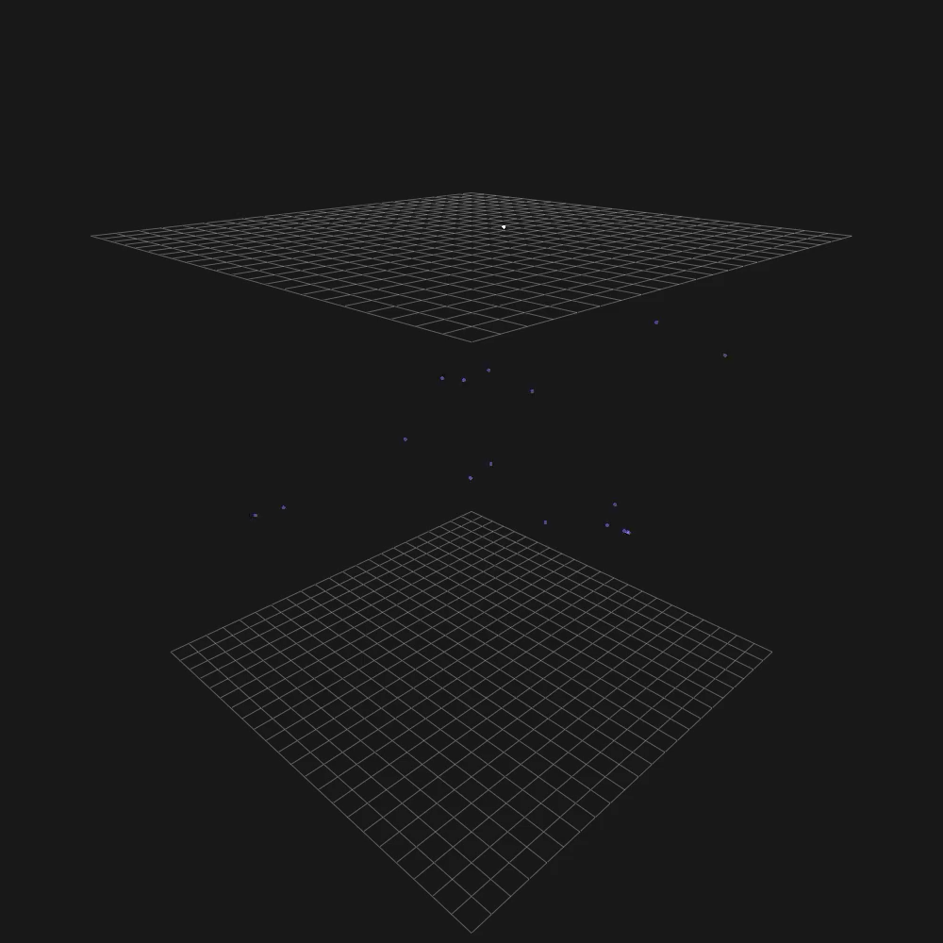

ARIADNE⁺ Results,
Optical FLArE TPC Option & Cylindrical Cryostat Study
+
http://hep.ph.liv.ac.uk/ariadne
Kostas Mavrokoridis
k.mavrokoridis@liv.ac.uk
FPF Collaboration meeting Jan 20 2025

Slide 2
Talk Outline
Background to the ARIADNE program
  TPX3Cam results taken with the ARIADNE 1-ton dual phase LAr detector
ARIADNE⁺: Larger scale demonstration using the CERN “Cold Box” at the Neutrino Platform
  Results and informing next generation designs
Conceptual FLArE TPC design based on TPXCam optical readout
Cylindrical Cryostat option for Optical TPC

Slide 3
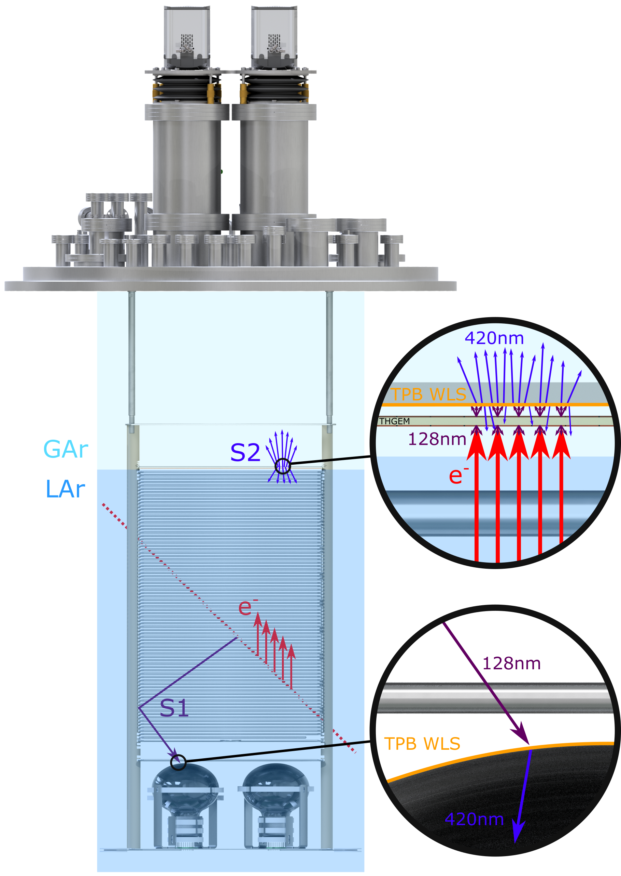
ARIADNE Detection Principle
Cameras
ARIADNE has demonstrated light readout as a viable alternative to charge in dual-phase TPC neutrino experiments
Benefits over previous charge readout techniques:
High resolution
Sensitivity to low energies
Very low noise, decoupled from TPC
Ease of access
Cost efficient
Incoming particles ionise LAr and create prompt scintillation light (S1)
Electrons drift towards the extraction grid situated below the liquid level
A THGEM (THick-Gaseous Electron Multiplier) amplifies drift charge (capable of >30 kV/cm in LAr) generating secondary scintillation light (S2)
WLS (Wavelength Shifting) before imaging with ultrafast Timepix3 camera
Full 3D optical TPC
TPX3 provides simultaneous time-over-threshold (ToT) and time-of-arrival (ToA). Complete (x,y,z,E) event reconstruction using a single device.
https://iopscience.iop.org/article/10.1088/1748-0221/14/06/P06001
https://www.mdpi.com/2410-390X/4/4/35
ARIADNE (ARgon ImAging DetectioN chambEr)

Slide 4
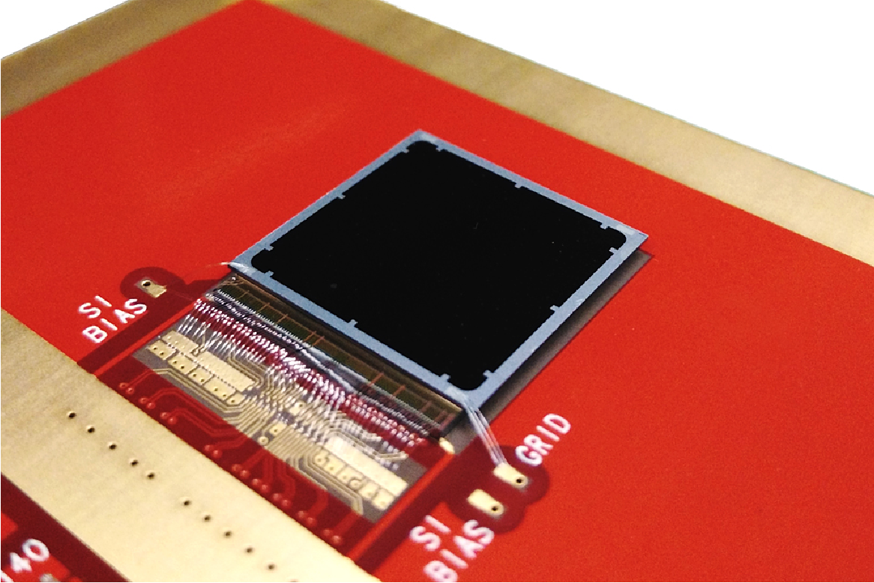
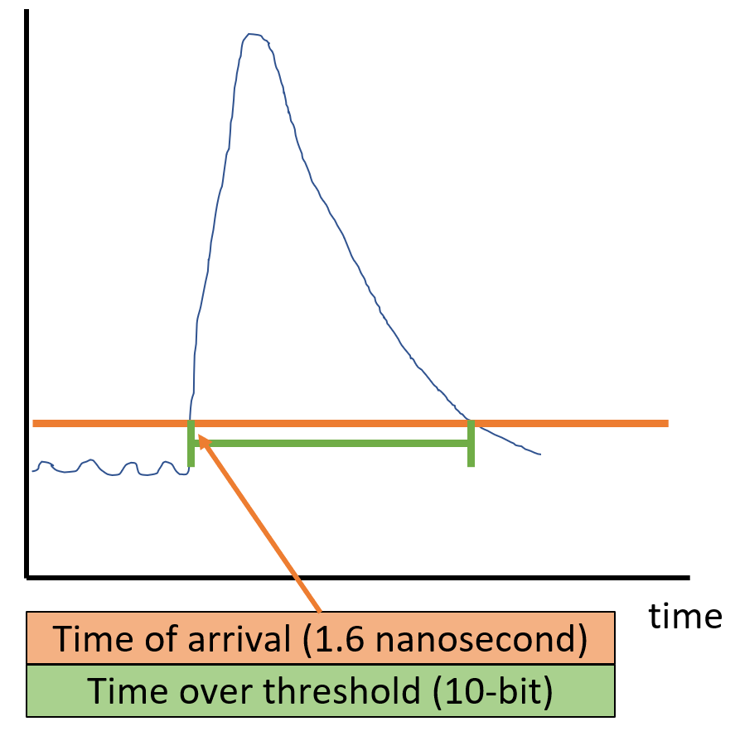
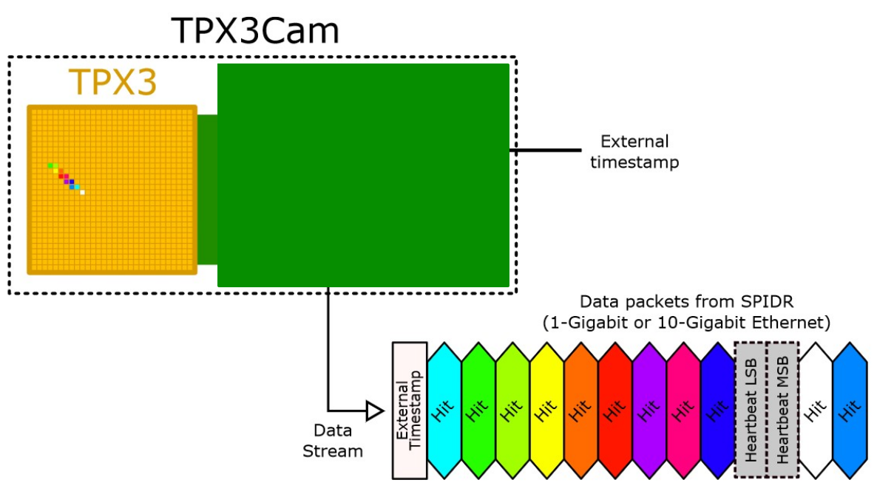
2D-> Full 3D Optical Readout
Silicon pixel readout chip developed by the Medipix collaboration. Very well established technology at CERN.
TPX3 ASIC bonded to optical sensor
TPX3 provides simultaneous time-over-threshold (ToT) and time-of-arrival (ToA). Complete (x,y,z,E) event reconstruction using a single device.
Time over threshold provides intensity / energy measurement ->10-bit resolution.
Time of arrival provides z (drift) axis position information -> 1.6 nanosecond resolution.
Data driven readout -> Event streaming with native zero suppression.
Efficient raw data storage. Triggerless operation.
Sensor resolution | 256x256 pixels
Pixel size | 55µm x 55µm
Max readout rate | 40Mhits•cm⁻² •sec⁻¹
Time resolution | 1.6 ns

Slide 5
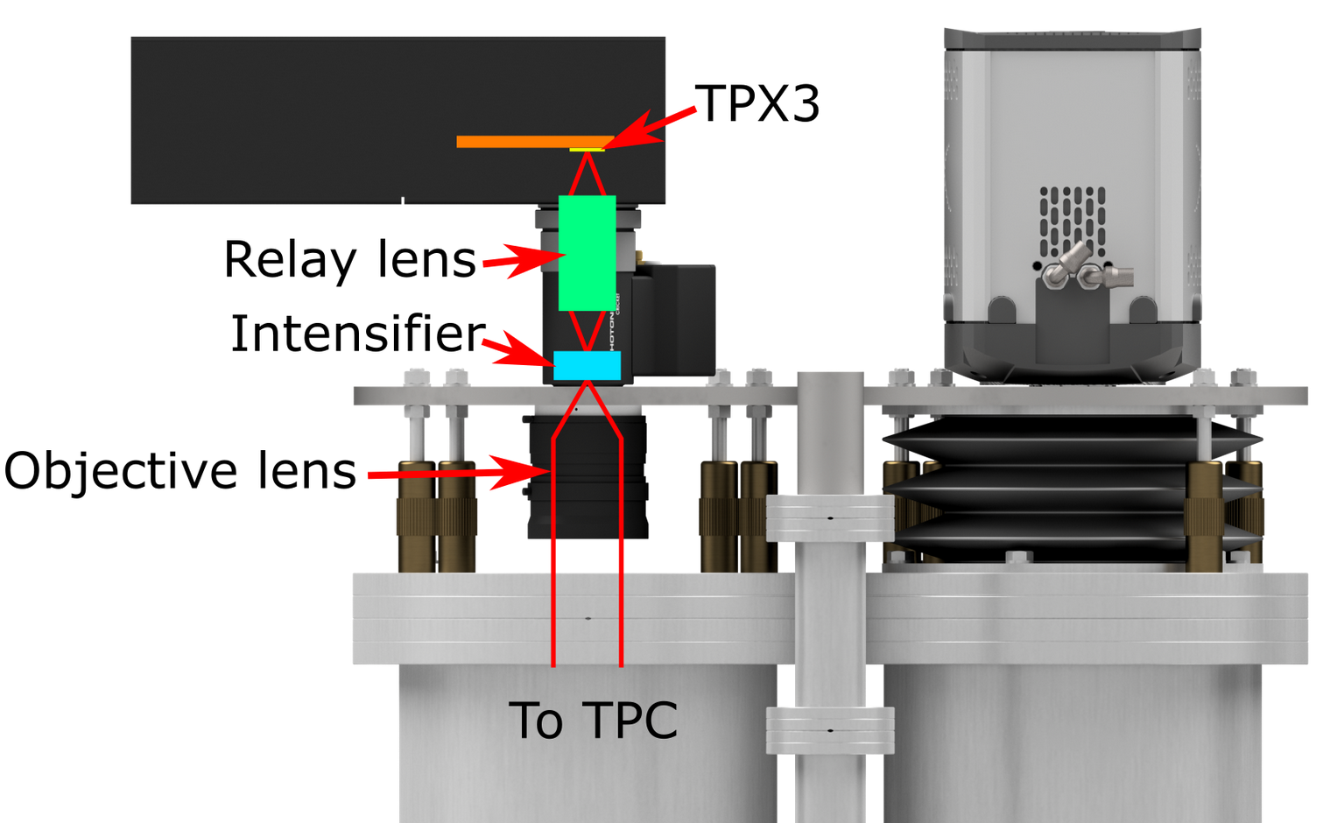
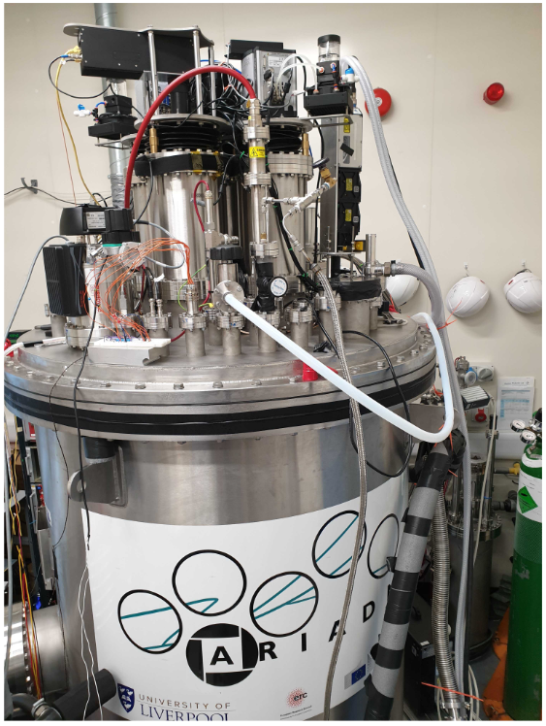
TPX3Cam Optical Readout
Single photon sensitivity when combined with image intensifier.
Intensifier gain ~1E6 photons/photon.
Relay lens couples intensified image onto light sensitive
sensor which is bump bonded onto TPX3 ASIC.
Intensifier provides flexibility -> Many photocathode options are available to customise spectral sensitivity.
– Now also Direct VUV!
Timepix3 camera installed in place of an EMMCD camera.
~ 30cm x 30cm field of view
Photonis Cricket image intensifier with Hi-QE green photocathode.
30% quantum efficiency at 430nm (TPB peak emission)
Coldbox Intensifier
ARIADNE results
TPB emission

Slide 6
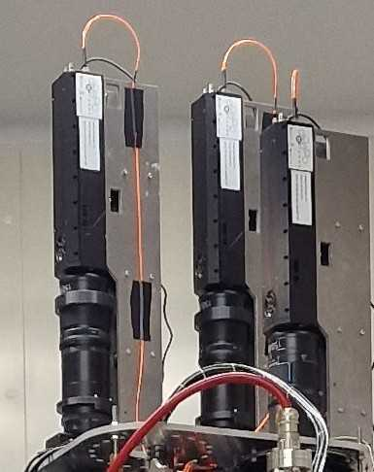
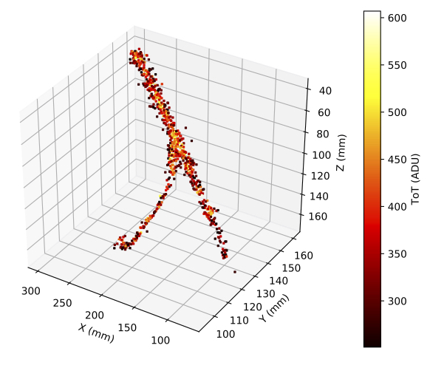
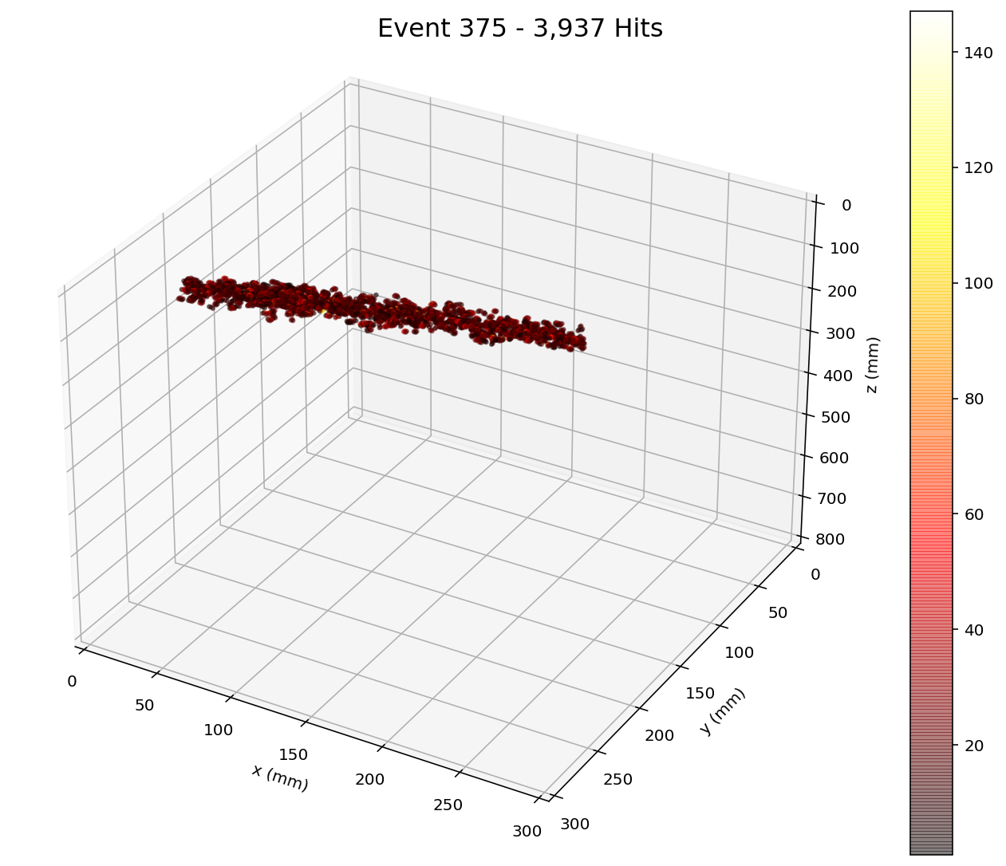
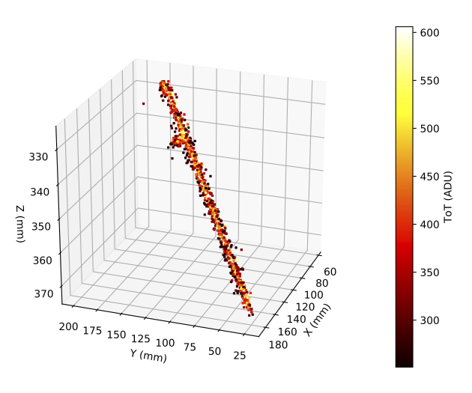
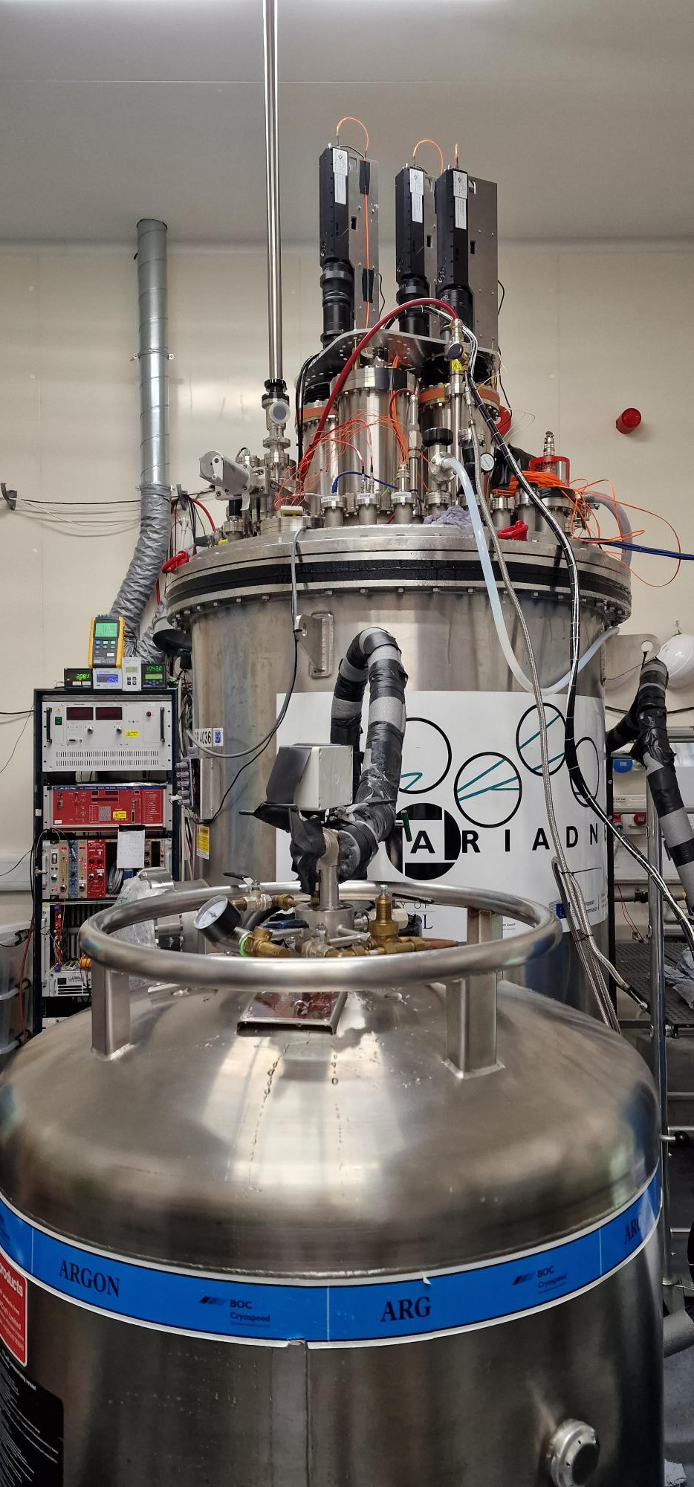
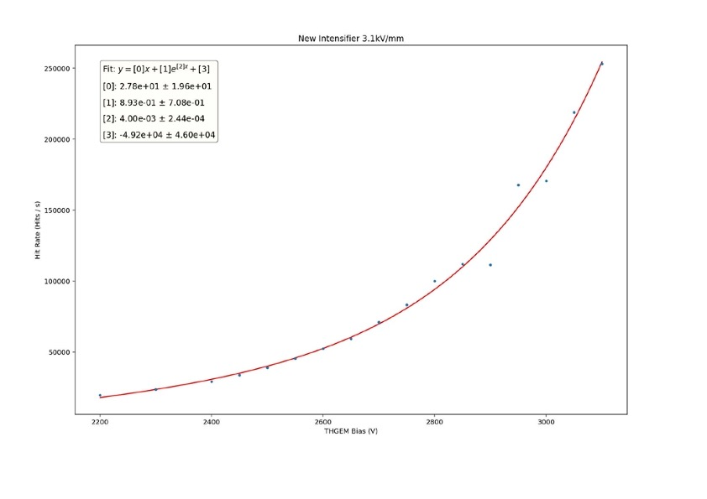
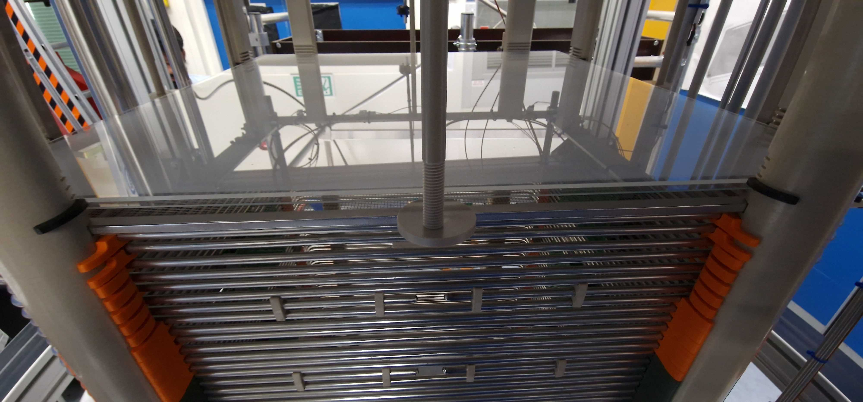
ARIADNE 1-ton LAr Tracks

Slide 7
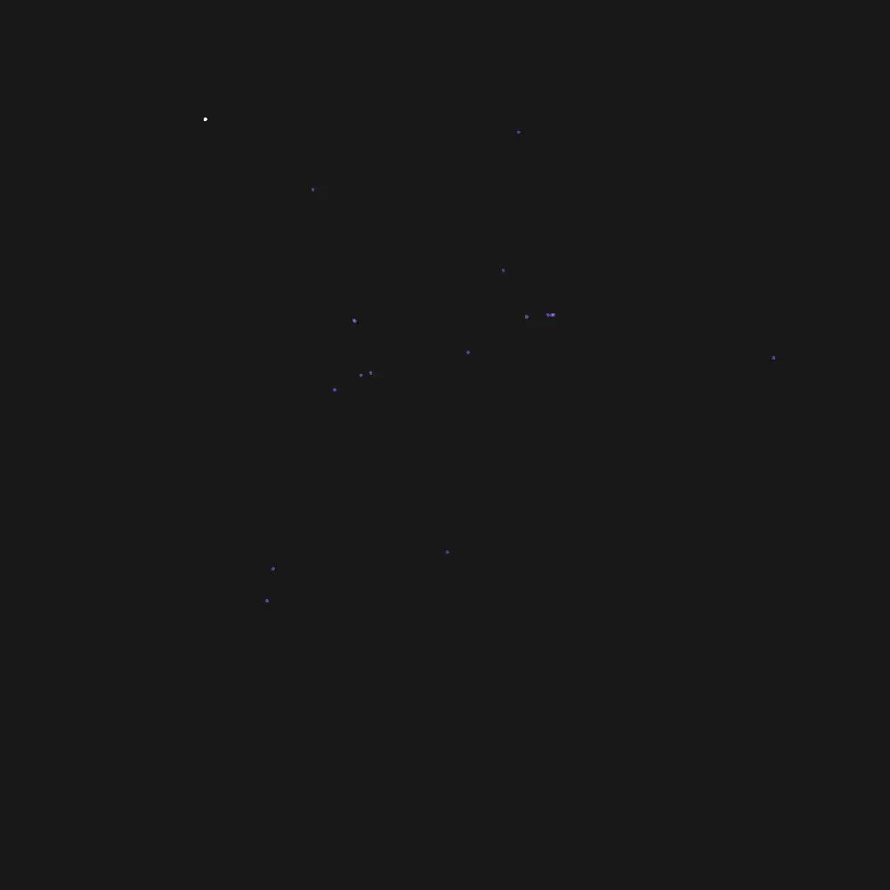
TPX3Cam 3D Cosmics LAr
Continuous streaming, 10 msec slice (playing 1ms jump per frame)
Side View
Top View

Slide 8



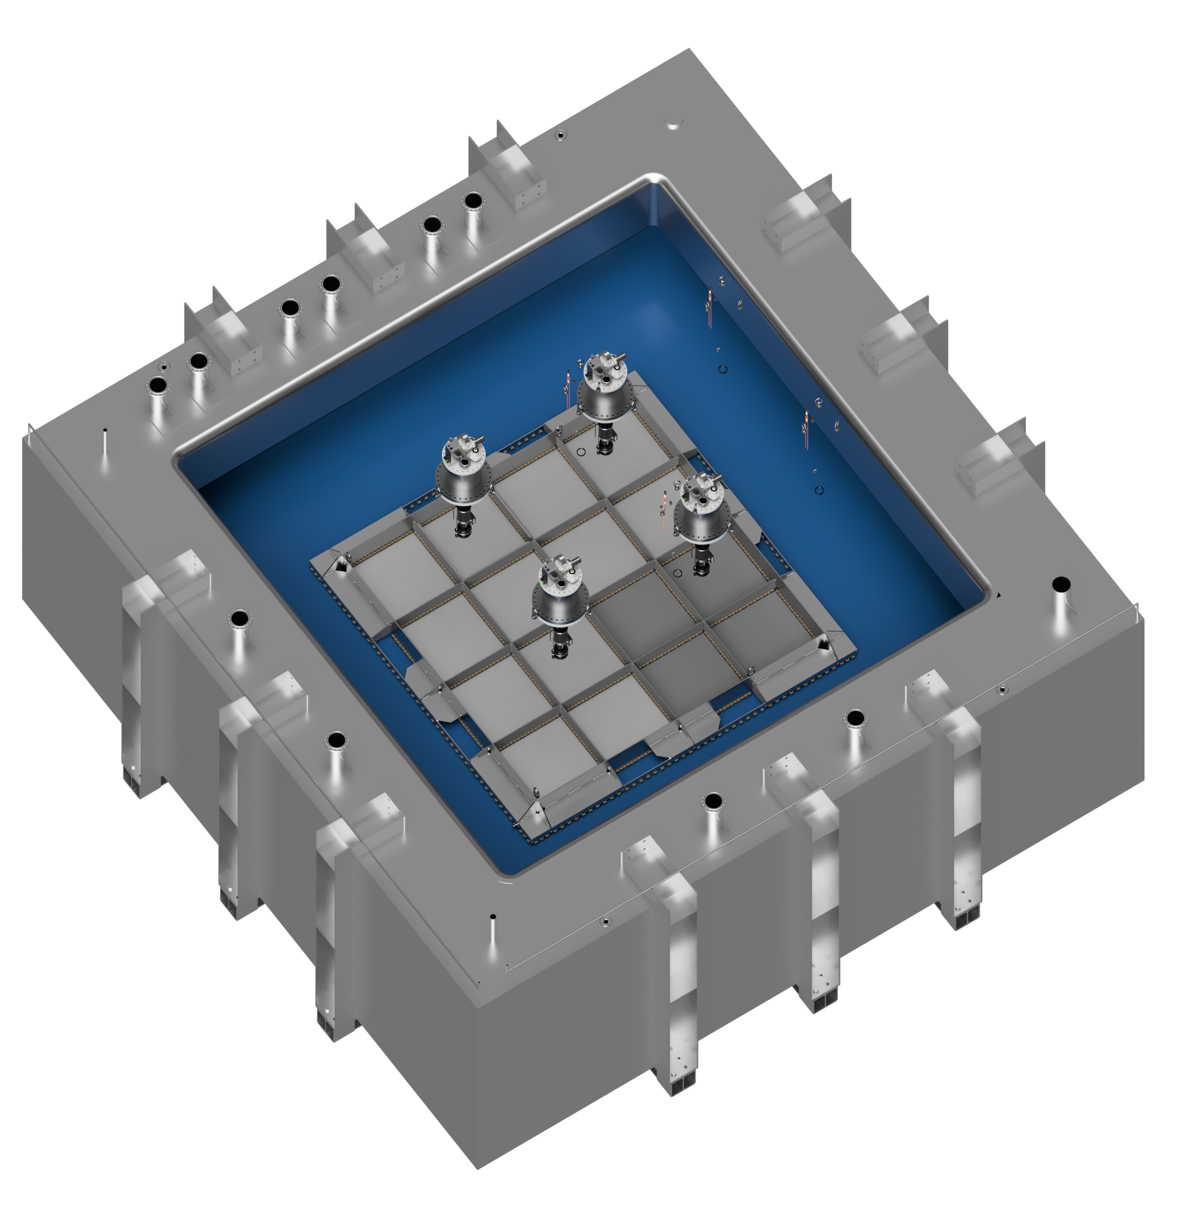
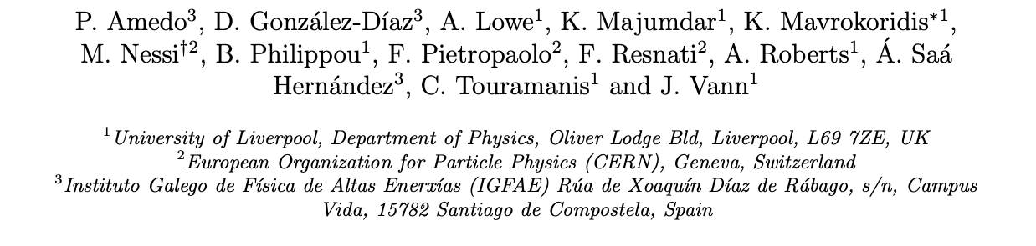
Larger Scale Demonstration at the CERN Neutrino Platform
Operation March/April 2022
Test optical readout on a scale relevant for DUNE using the existing cold box
CERN LOI: https://cds.cern.ch/record/2739360

Slide 9
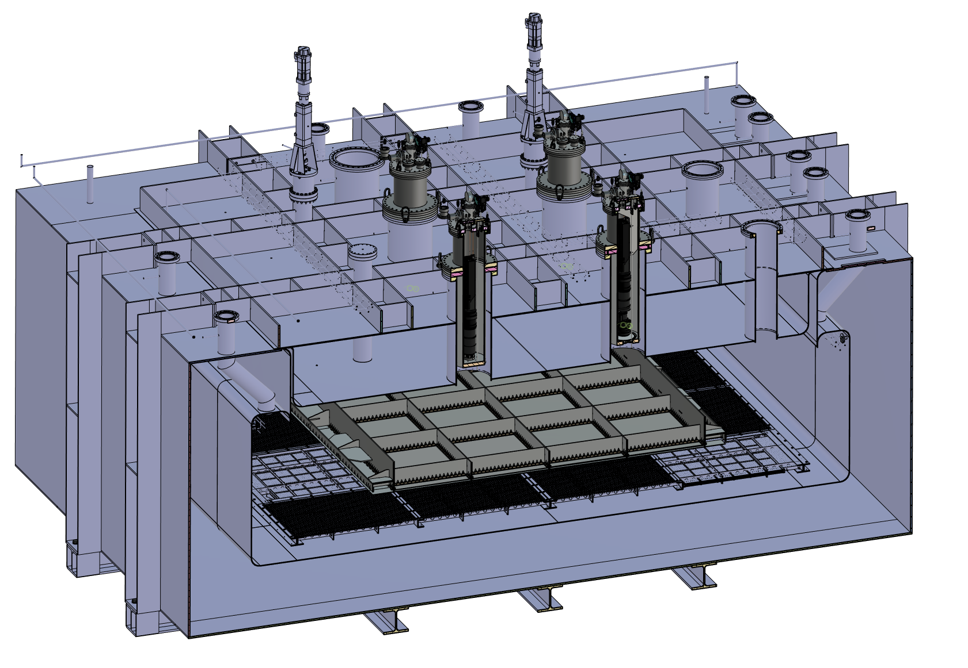
ARIADNE⁺: Cryostat Optical Configuration
TPX3 Camera
Assembly (1 x VUV)
TPX3 Camera
Assembly (3 x visible)
Large scale test of ARIADNE optical readout principle for dual-phase LArTPCs.
Four Timepix3 based cameras, each covering 1m x 1m readout area.
Three cameras detect visible light (wavelength shifter installed above THGEMs)
One camera directly detects VUV.
Light Readout Plane (LRP)
Cathode

Slide 10
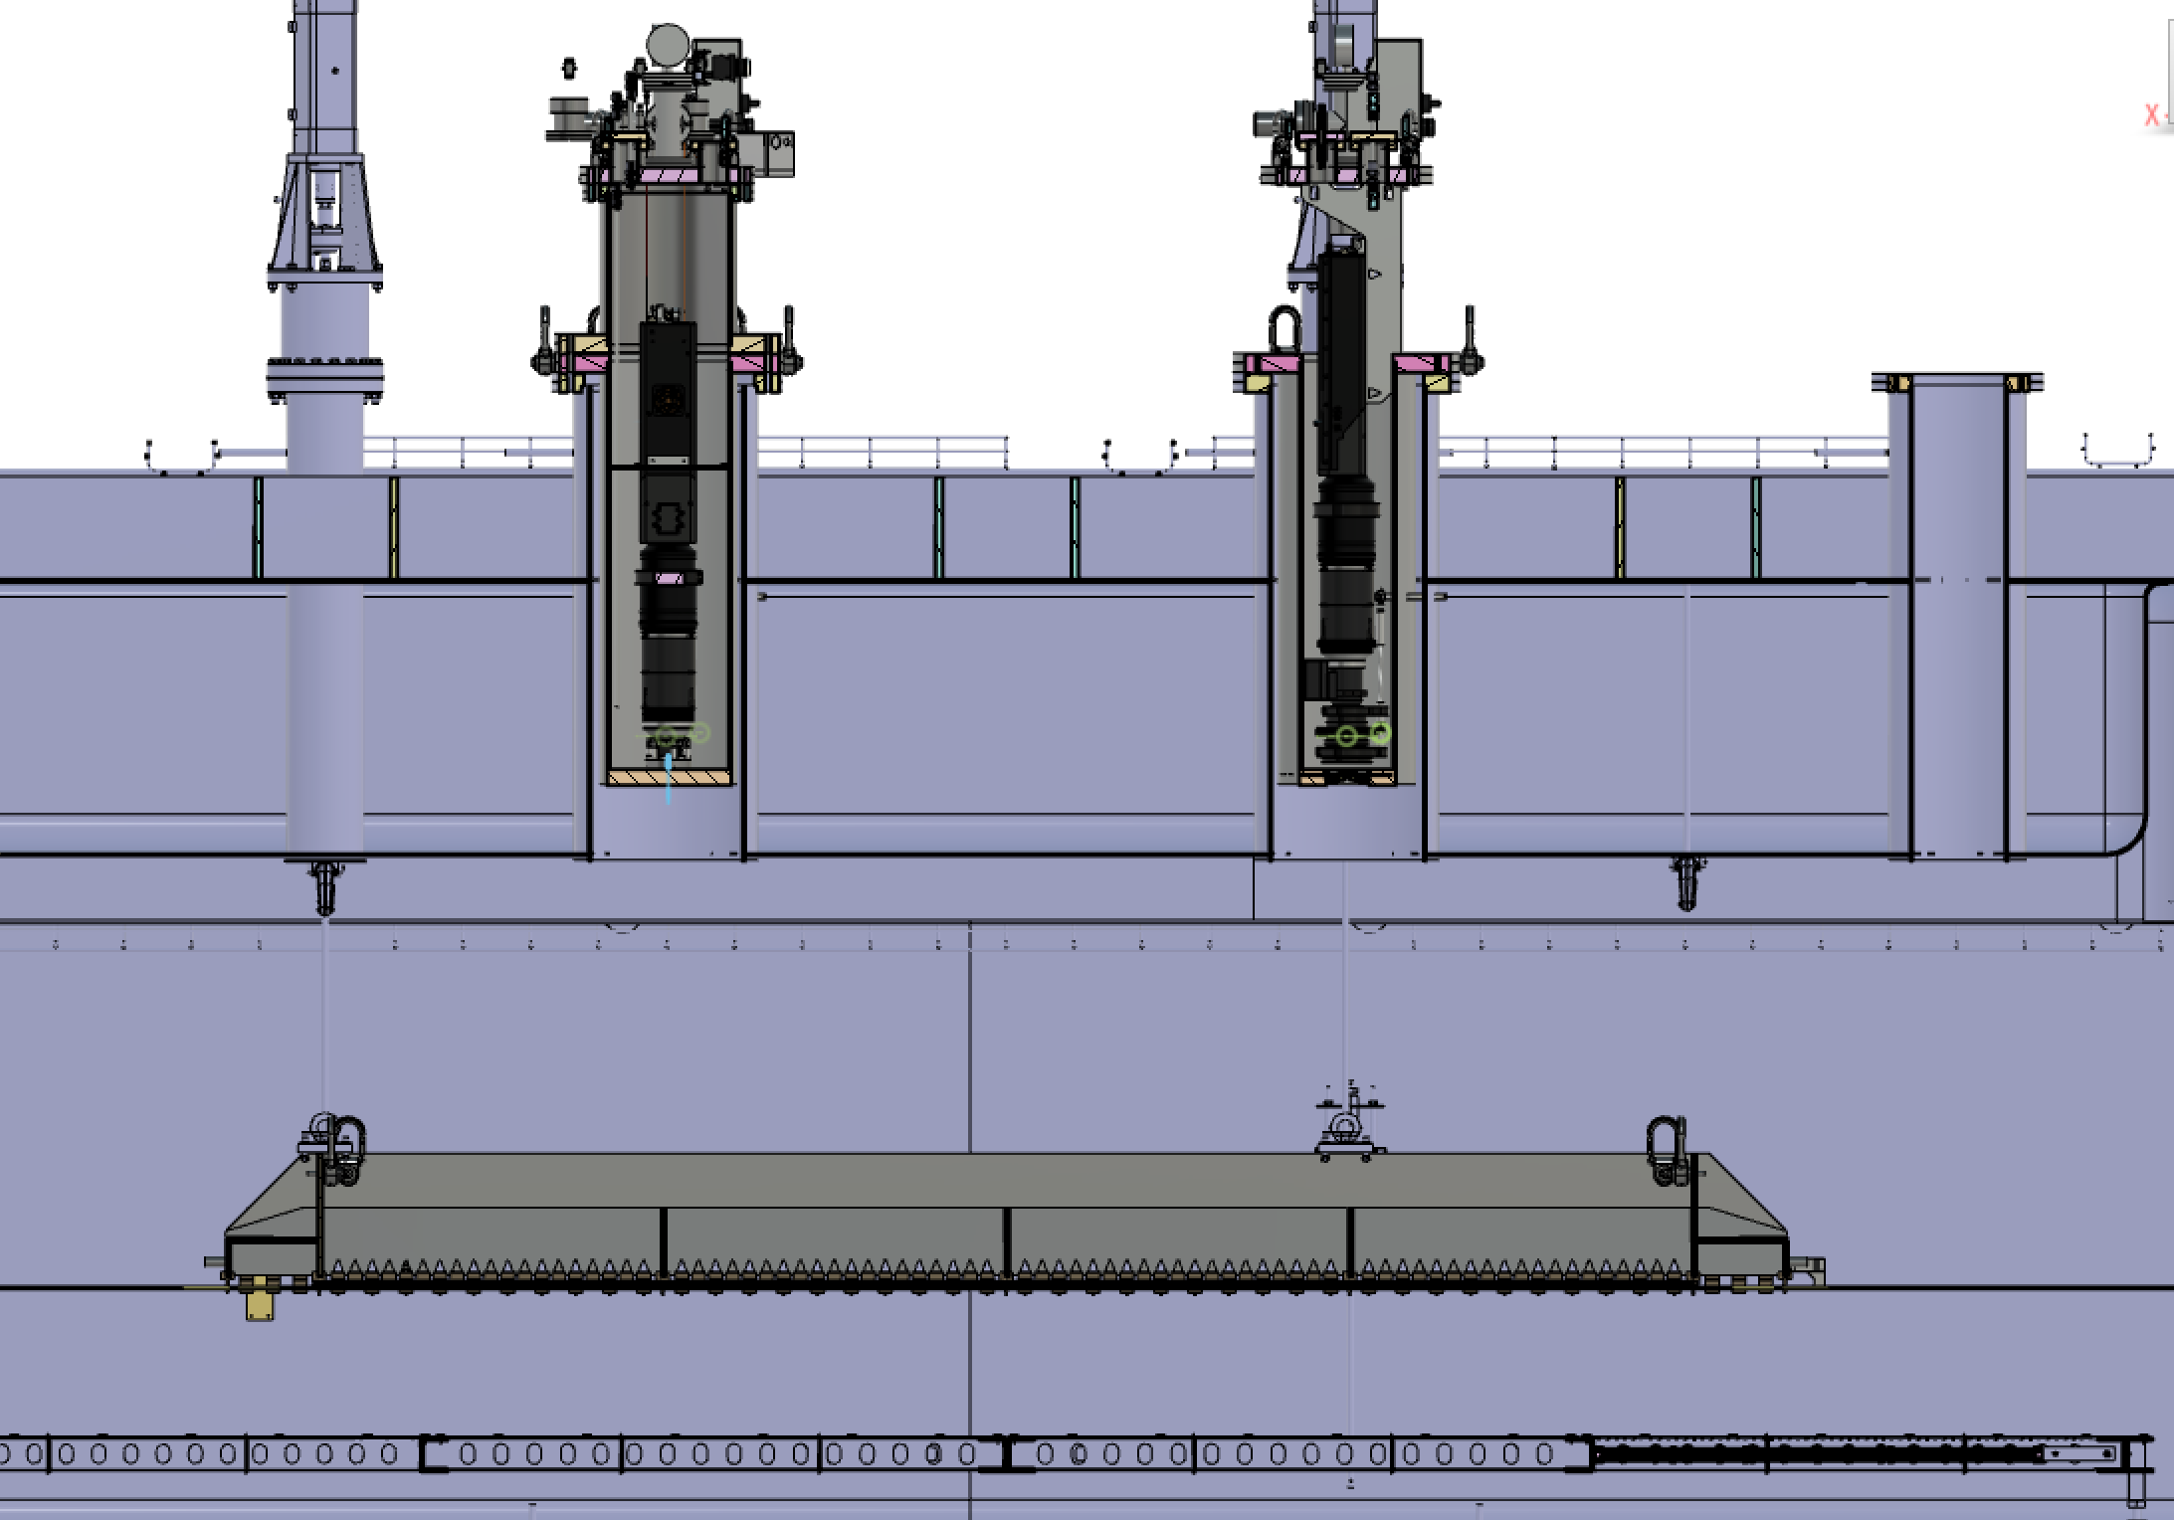
ARIADNE⁺: Cryostat Optical Configuration
Re-entrance viewports, cameras in gas nitrogen
20 cm electron drift

Slide 11
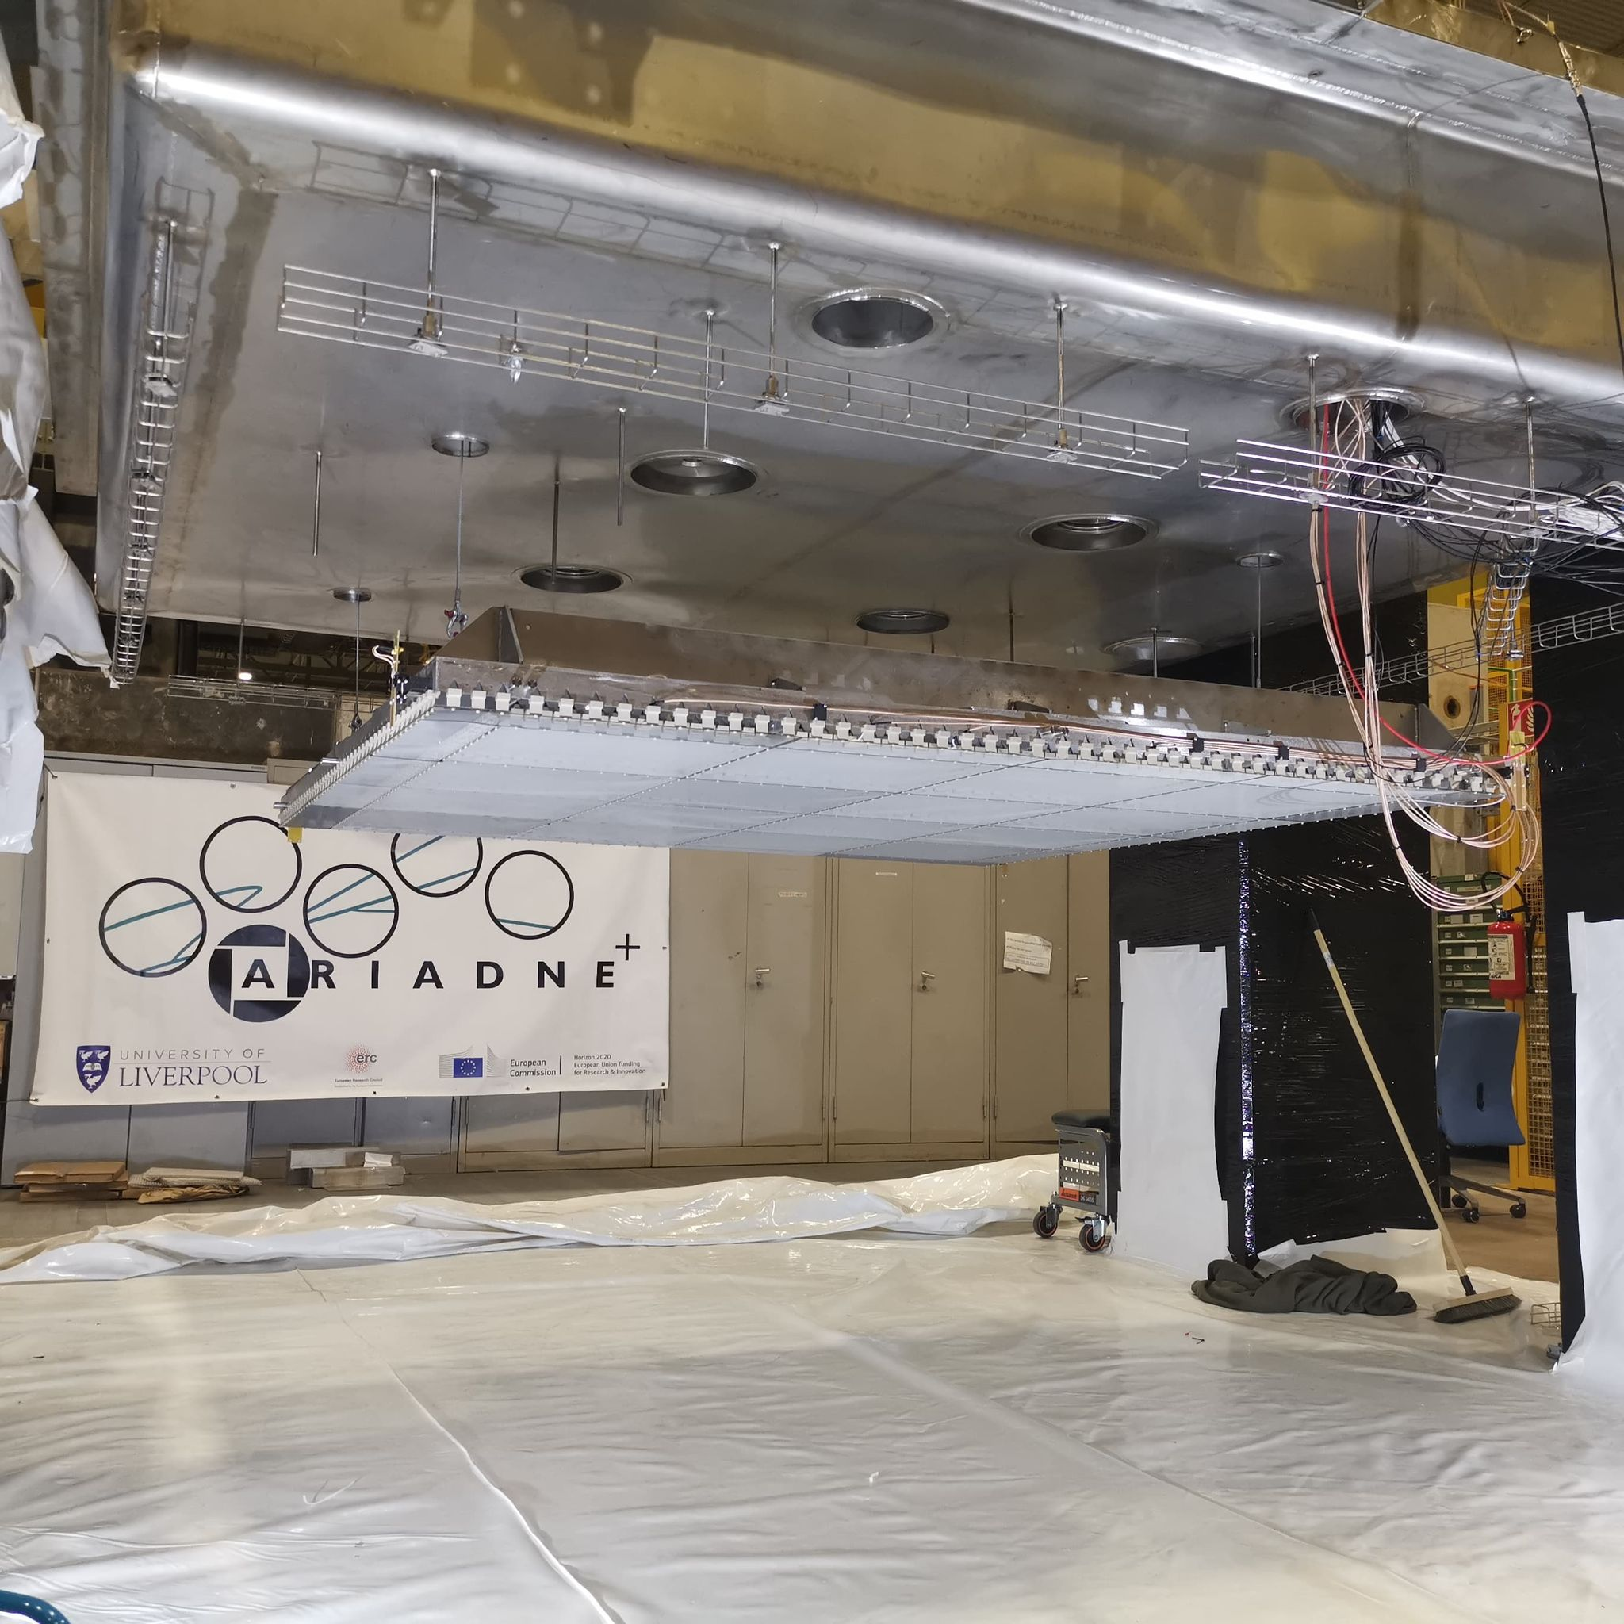
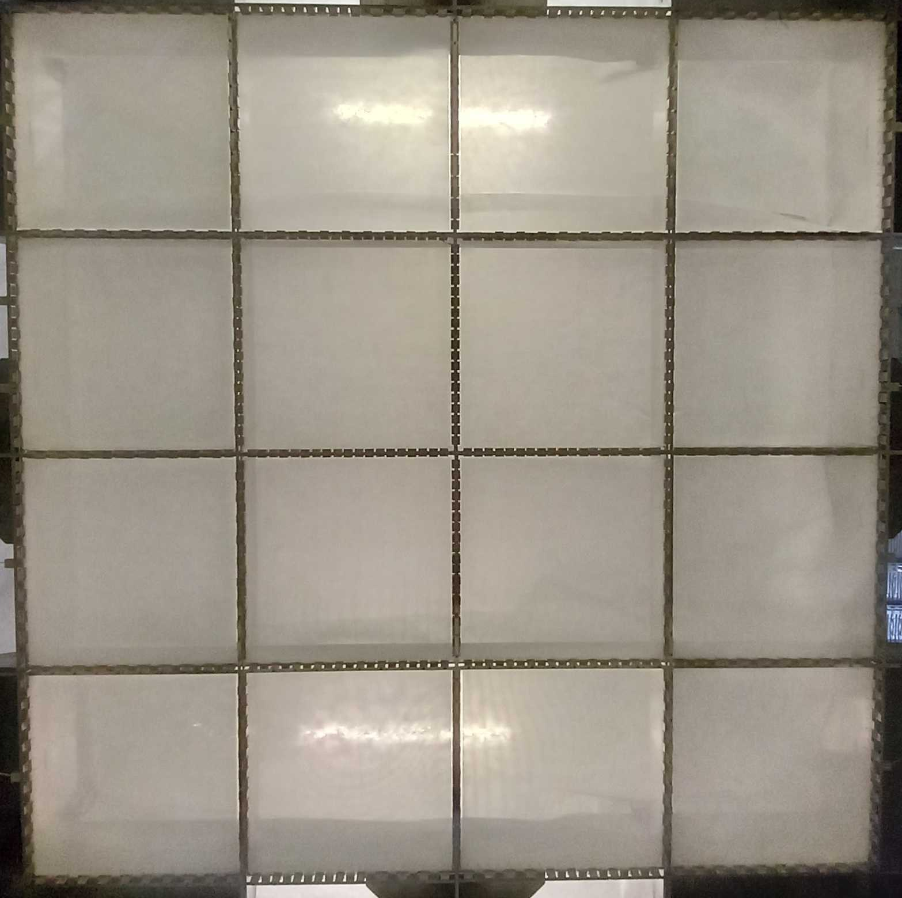
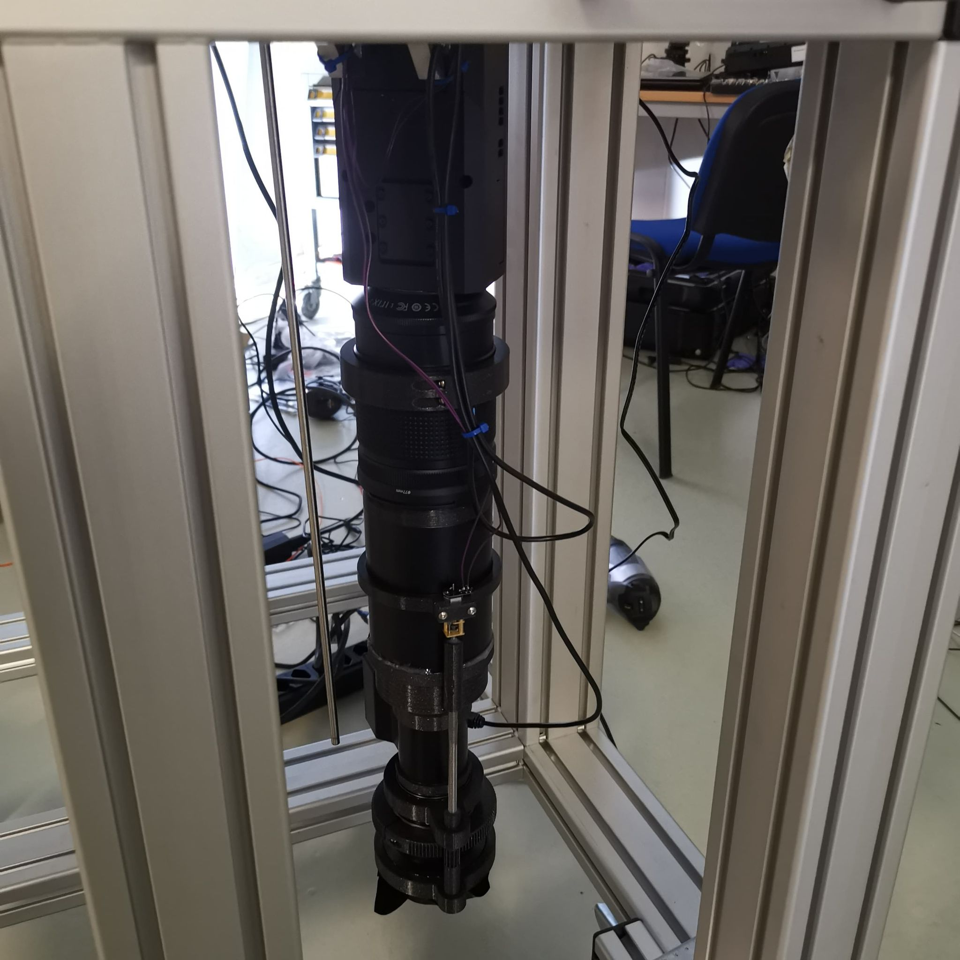
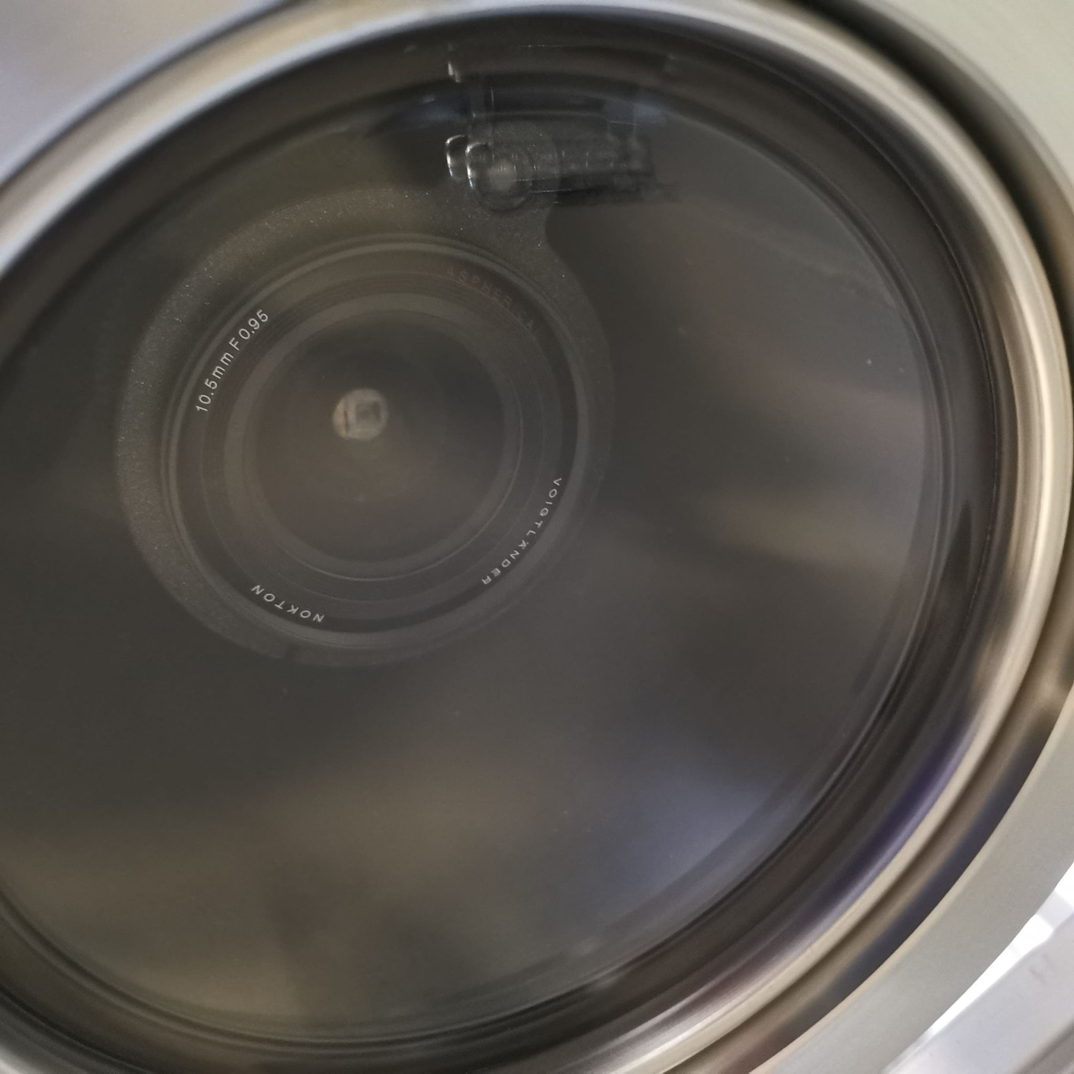
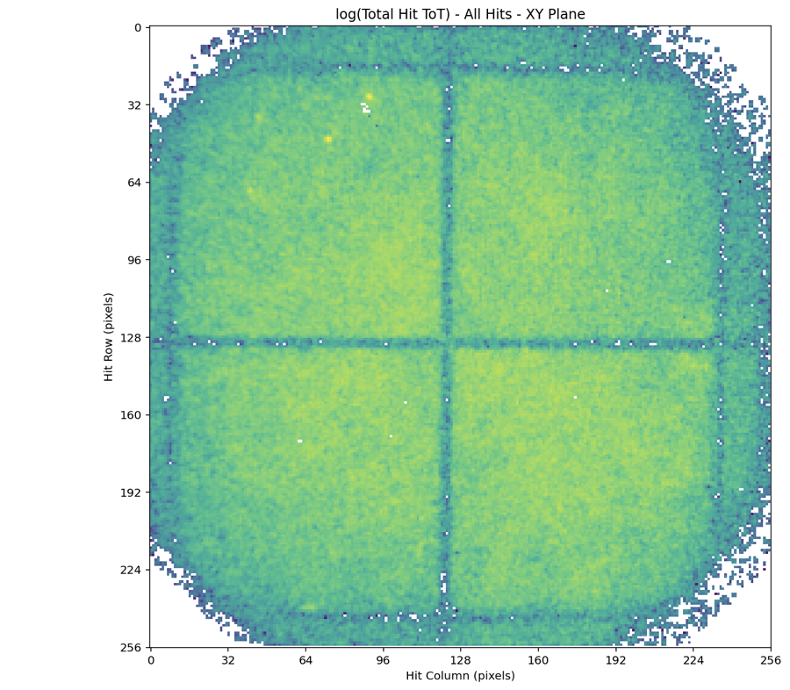
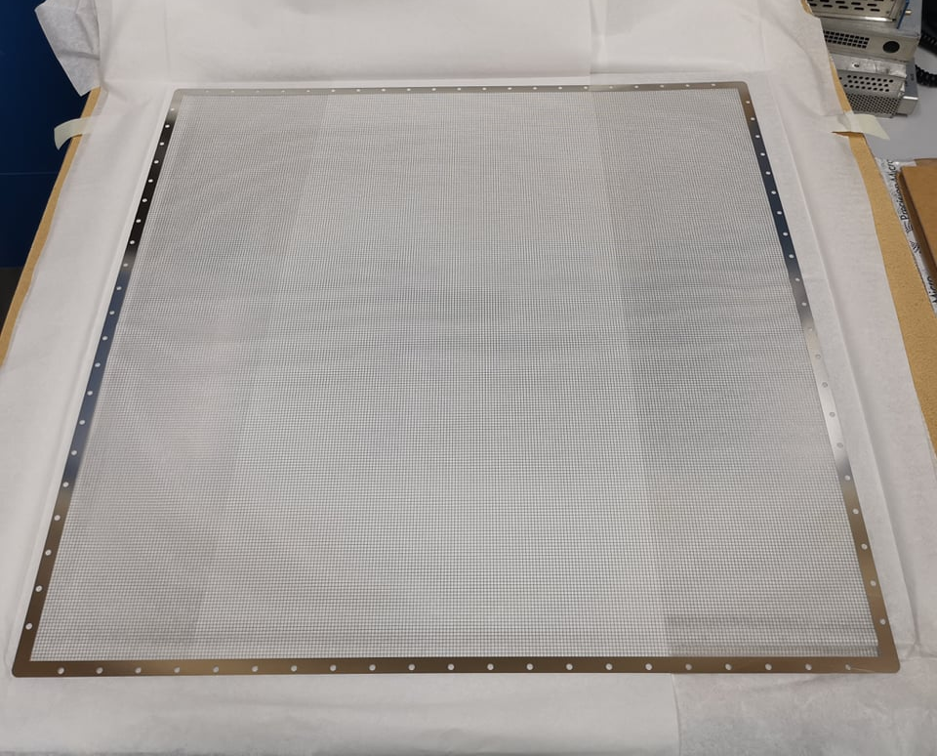
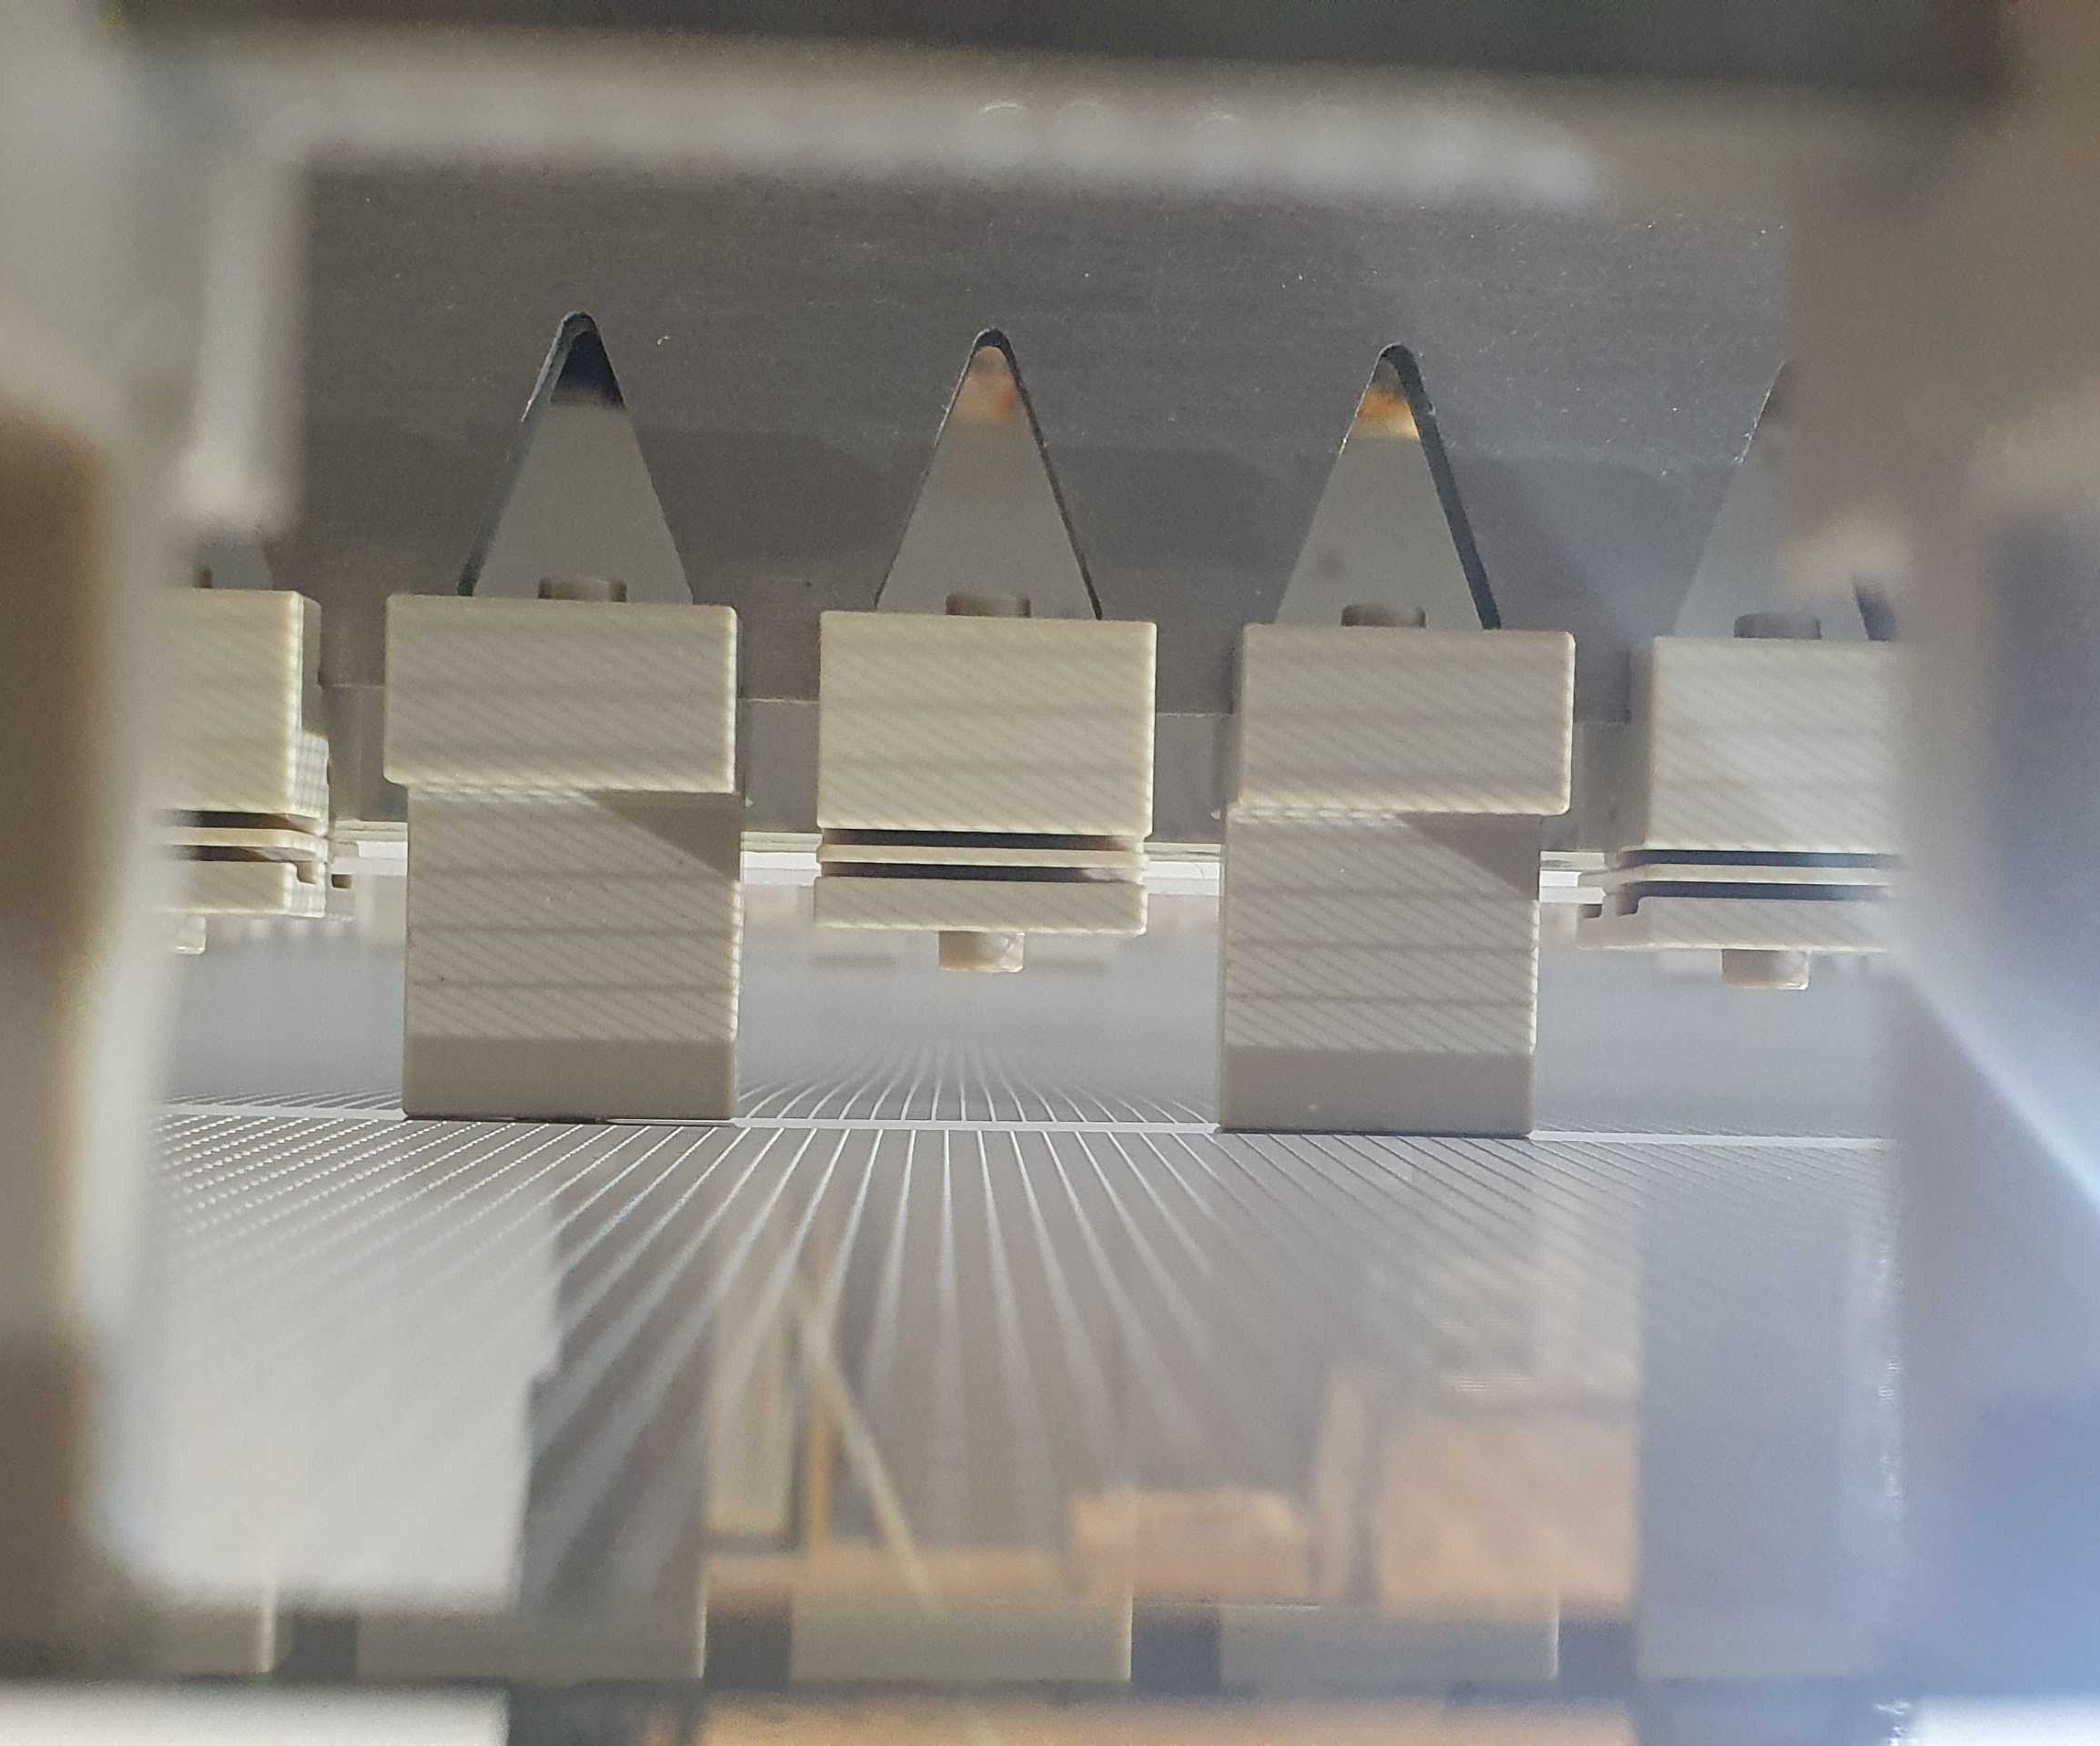
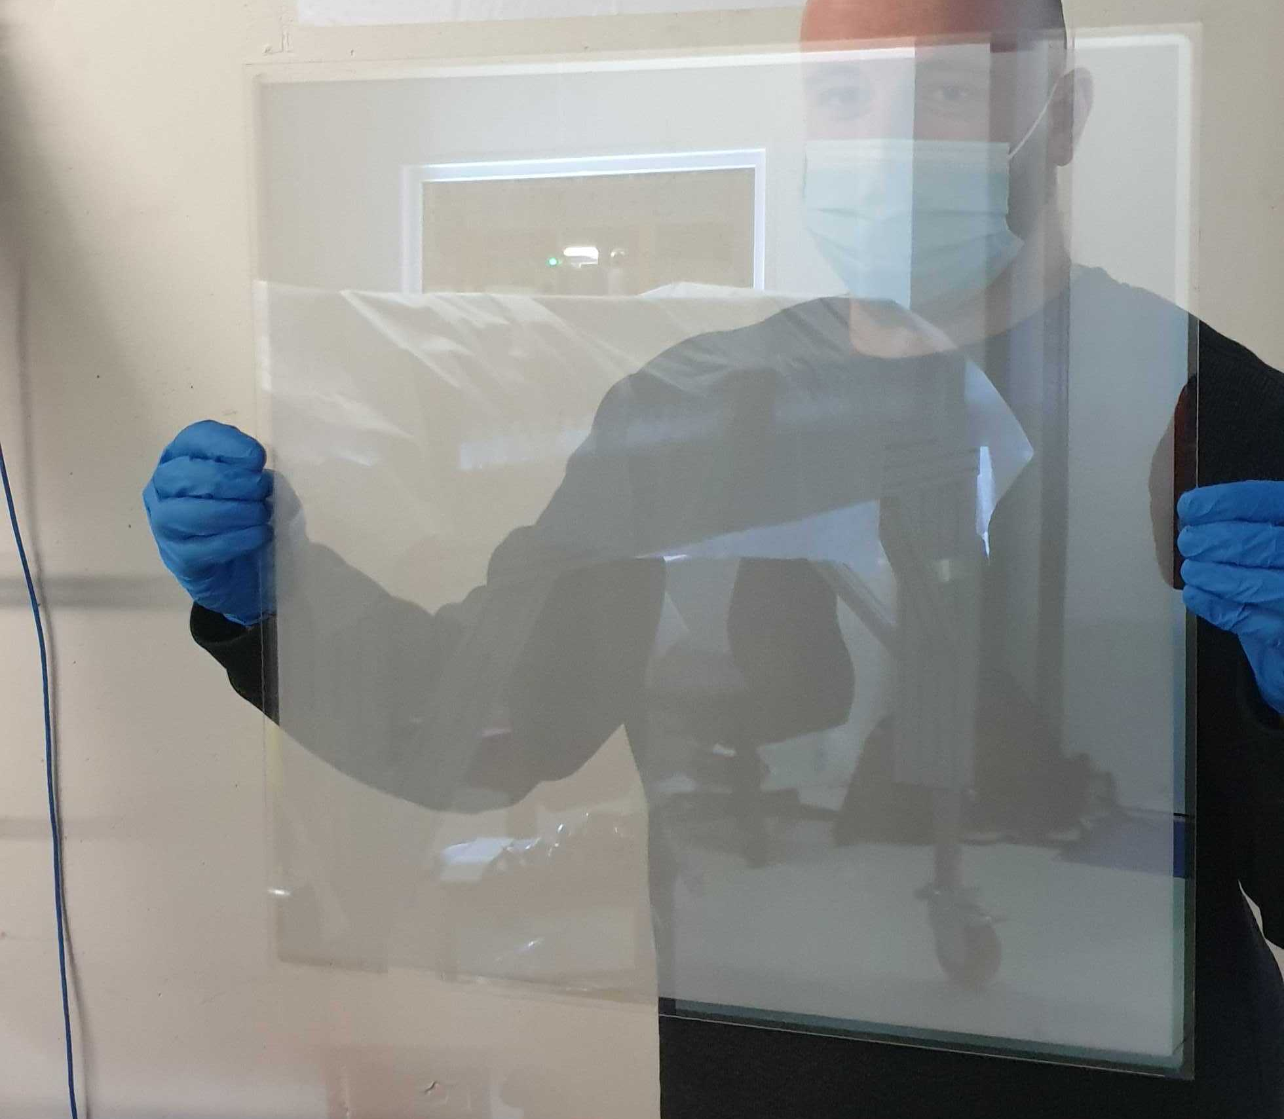
ARIADNE⁺: Key components
Visible lenses (f0.95, 10.5 mm
TPX3Cam
Cosmics 30 sec integral
2mx2m LRP G-THGEMs from underneath
Photochemically etched extraction grids, 15mm extraction region
1.1mm 50cm² glass THGEM
https://arxiv.org/pdf/2301.02530v2.pdf

Slide 12
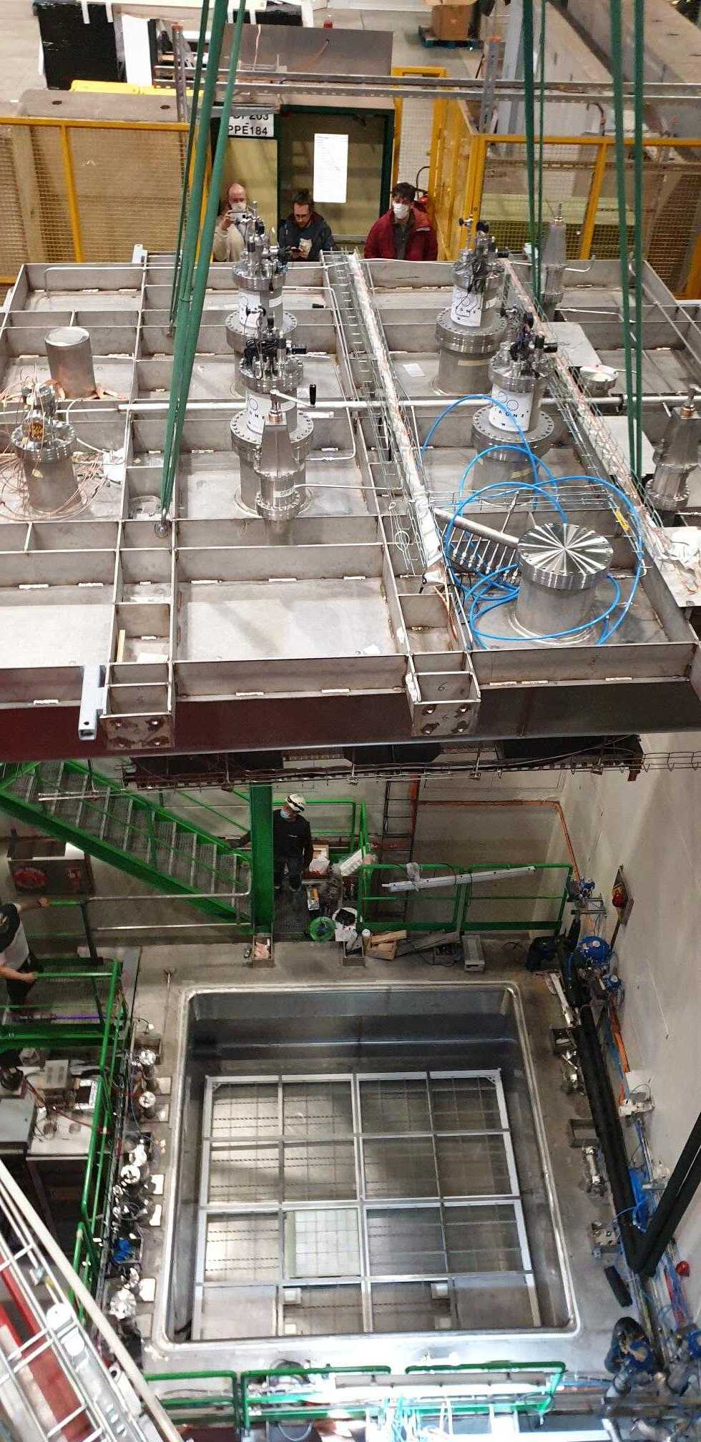
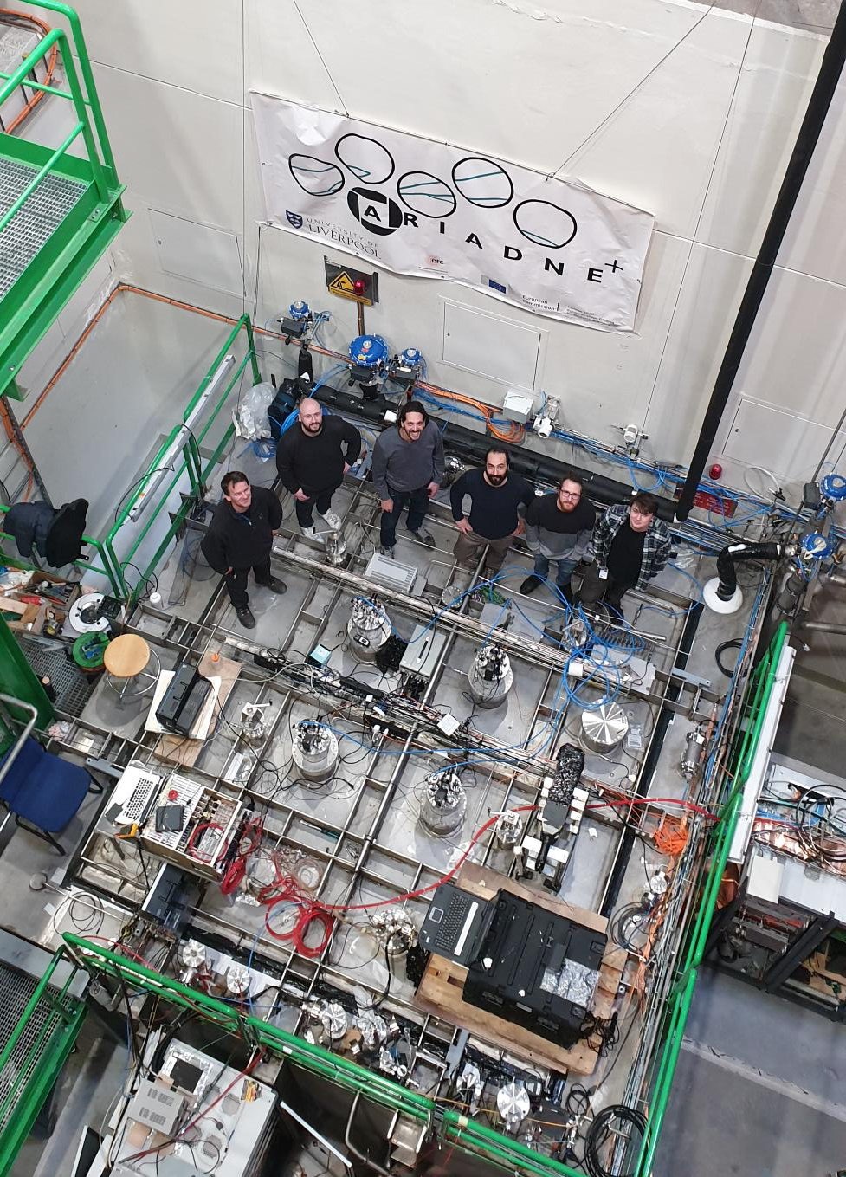
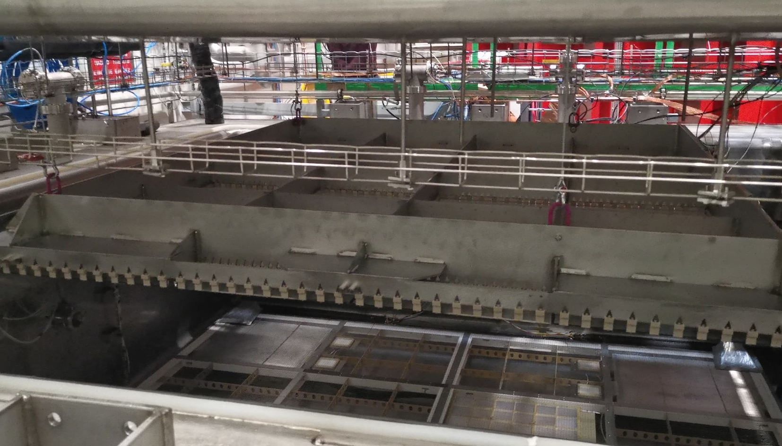
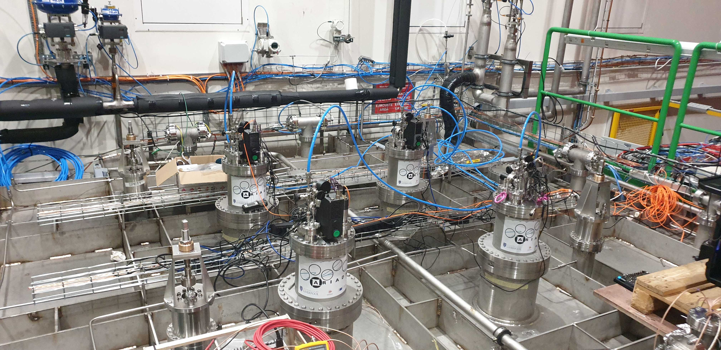
Commissioning at CERN
3 weeks data collection

Slide 13
Using ARIADNE optical readout system for FLArE TPC

Slide 14
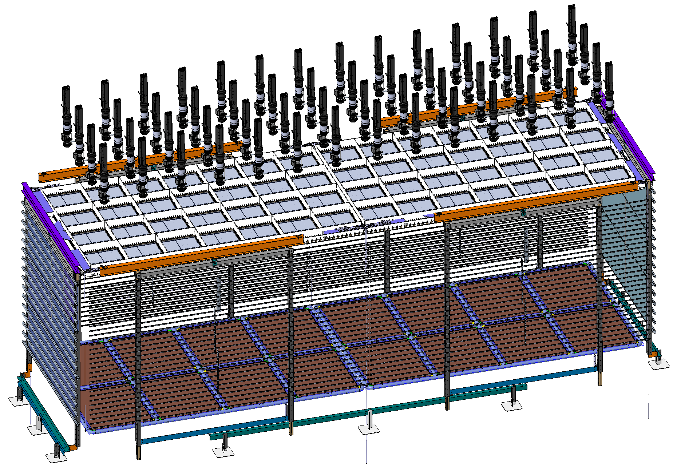
Optical FLArE Overview Design
Assumes ProtoDune type field cage assembly approach
56 TPX3 Cams in cryostat ports. This will provide 1.8mm/pixel resolution
Two invar LRPs with 56 glass THGEMs, similar to the ARIADNE cold box test
Aluminum profile Field Cage (similar to ProtoDUNE)
Two CPAs (same size as LRPs)
Total instrumented LAr volume 20000 litres/32 tons
CAD by G.Stavrakis

Slide 15
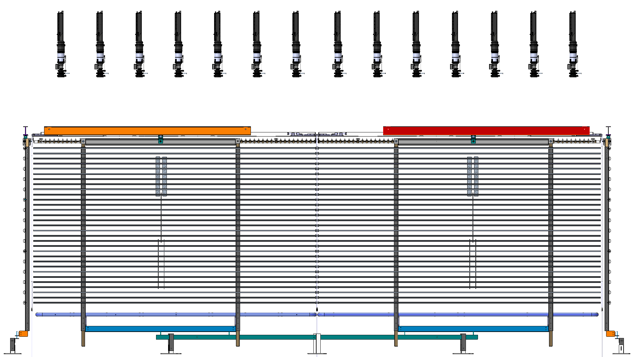
Side view & Bias
For 1.8m e drift
0.5 kV/cm
1 kV/cm
THGEMs 25-30kV/cm
Extraction grid: 5kV
5kV
Cathode: 95kV
185kV
(current successfully operated HV 300kV)

Slide 16
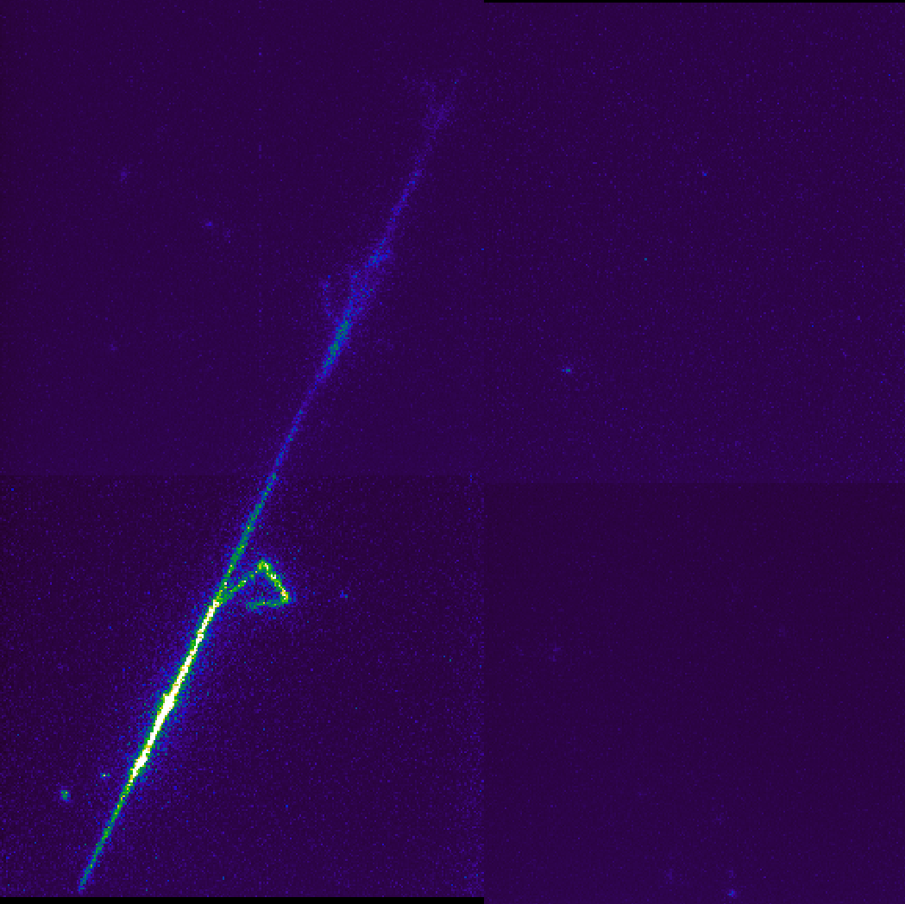
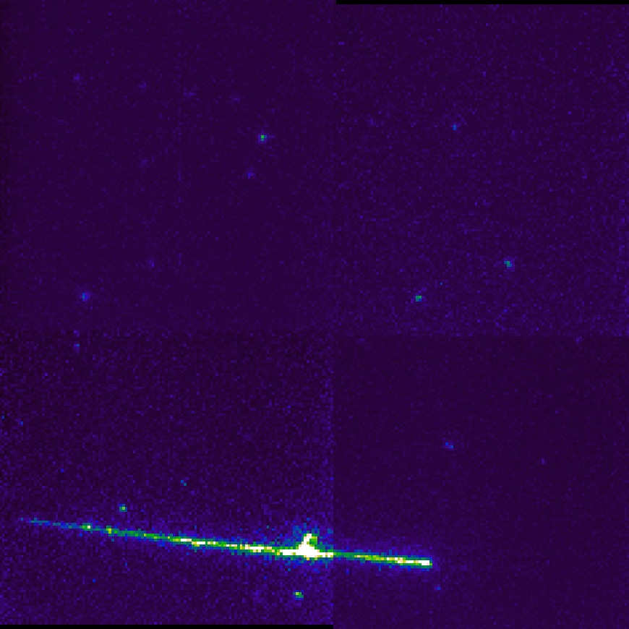
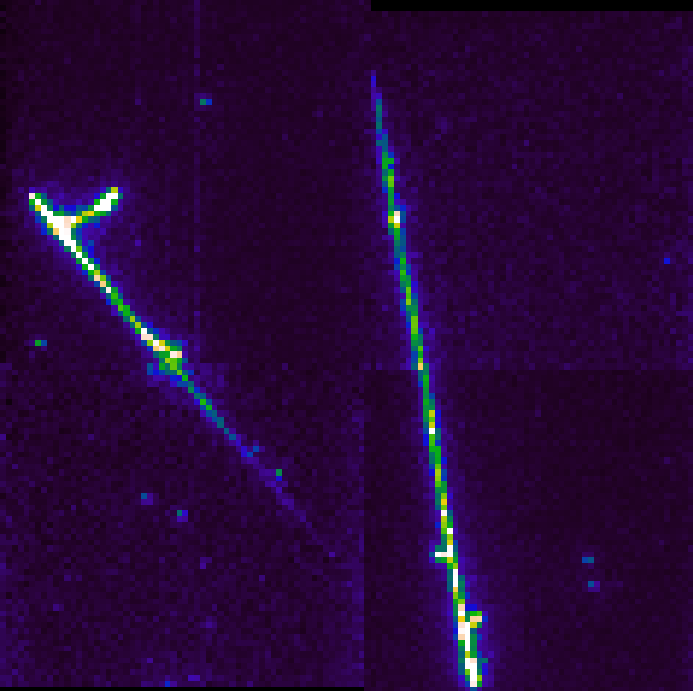
Resolution examples - EMCCD
Changing EMCCD binning
LAr Cosmic interactions collected @0.5kV/cm electron drift
0.5 m
4x4 (1.1mm/pix)
8x8 (2.2 mm/pix)
16x16 (4.4mm/pix)

Slide 17
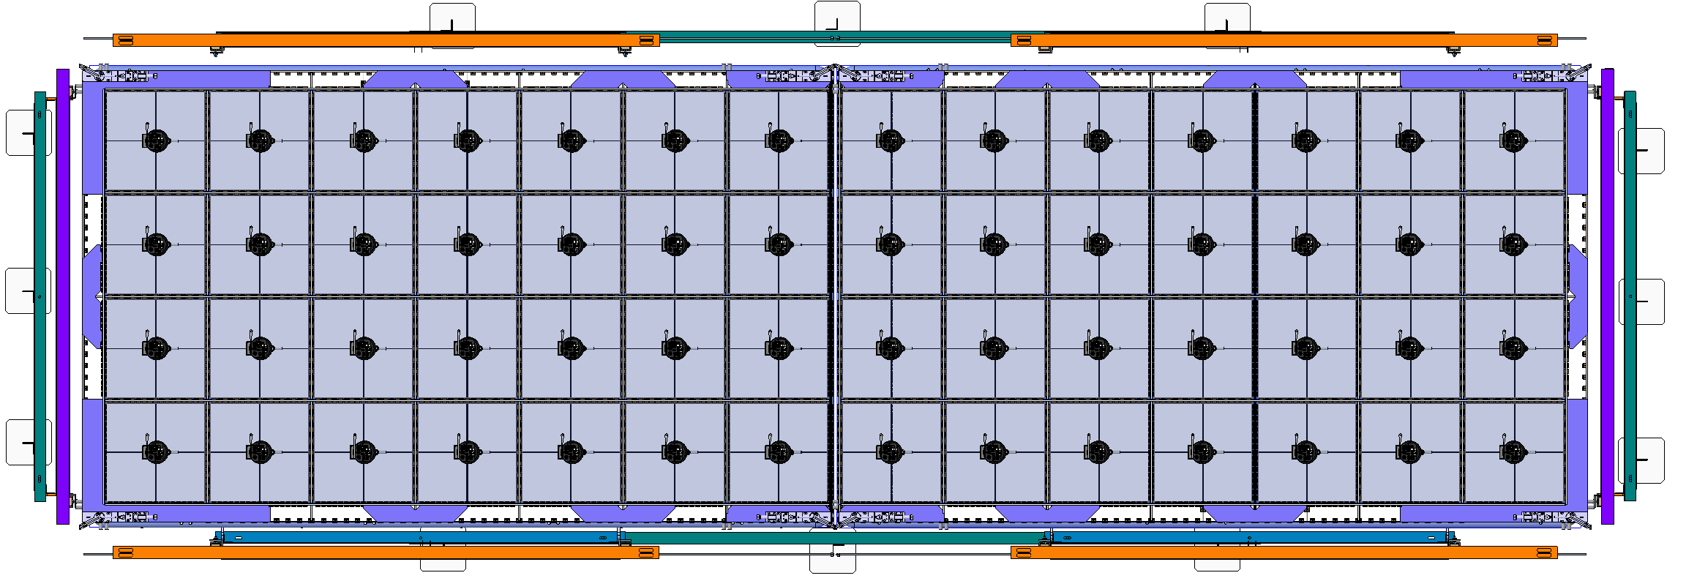
TOP view
Each camera is looking a 45x45cm glass THGEM (active area 1.8m x 6.4m, 56 cameras)

Slide 18
TOP view
In red box 1mx1mx6.4m fiducial area and 28 cameras with ~2mm/pixel

Slide 19
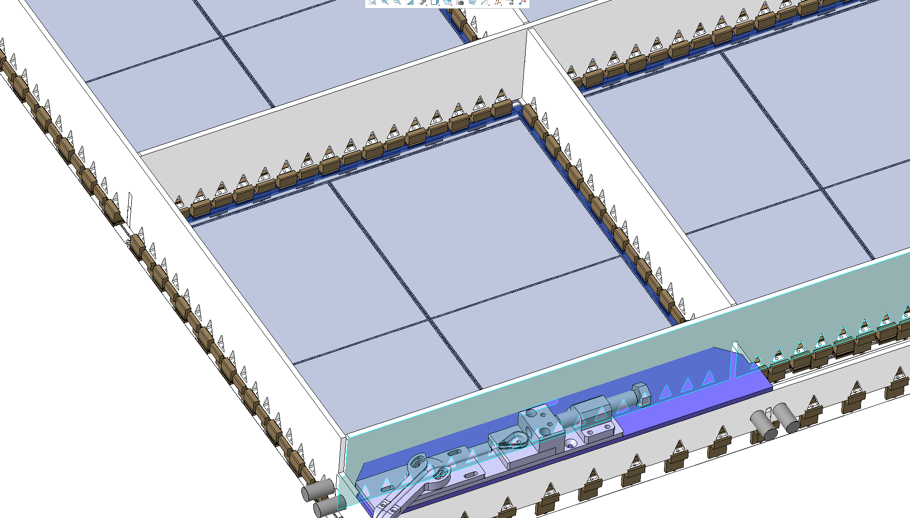
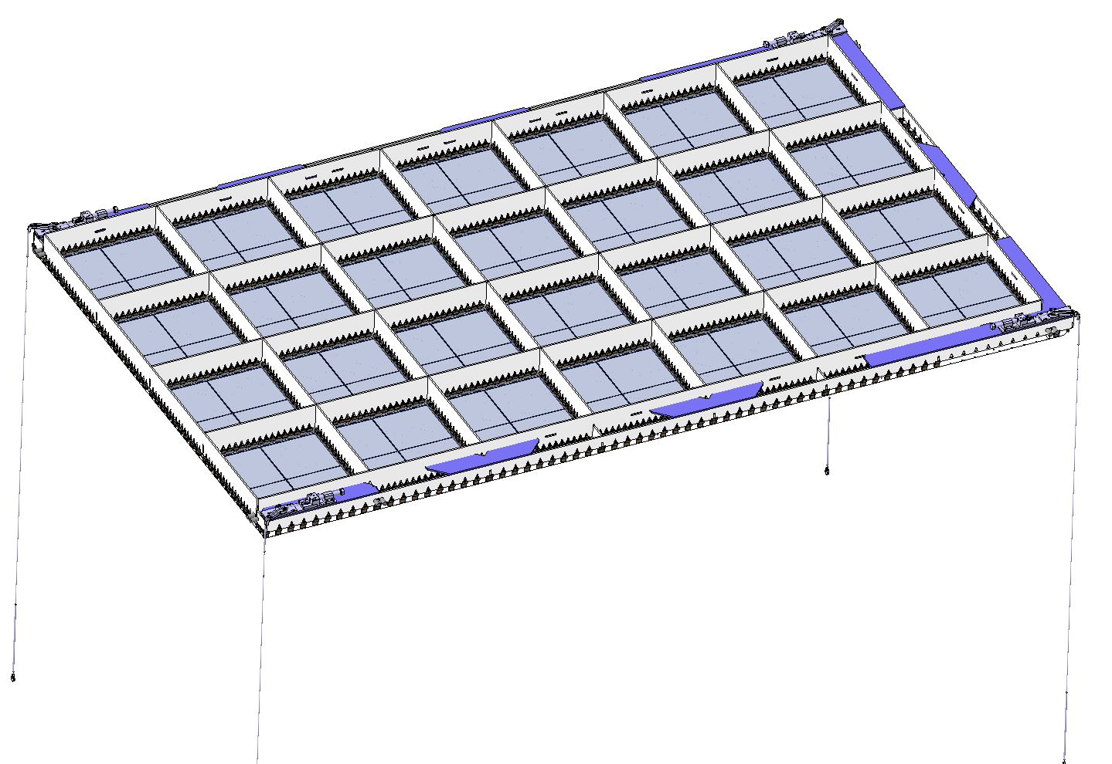
LRP Design
CAD by G.Stavrakis
3290mm
One LRP to contain 7x4 Glass THGEMS (similar to ARIADNE LRP)
Made out of Invar
Will hang from 4/6 top cryostat ports and will be able to move up down using levelling motors

Slide 20
LRP Design
3.4 m
Size of LRP designed in order to fit within the CERN cold box to allow for QA before installation to FLArE

Slide 21
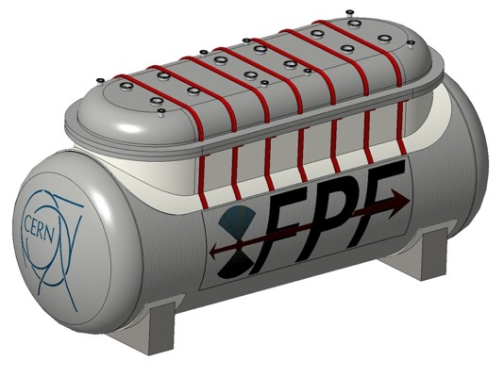
FLArE Cylindrical Cryostat with Removable Lid for Optical Readout Option
CAD Models by George Stavrakis

Slide 22
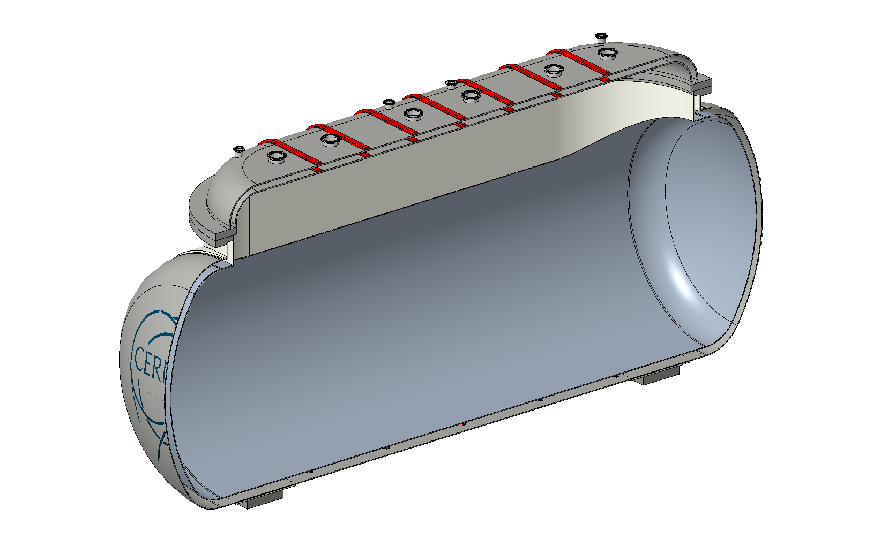
Double vac jacketed cryostat

Slide 23
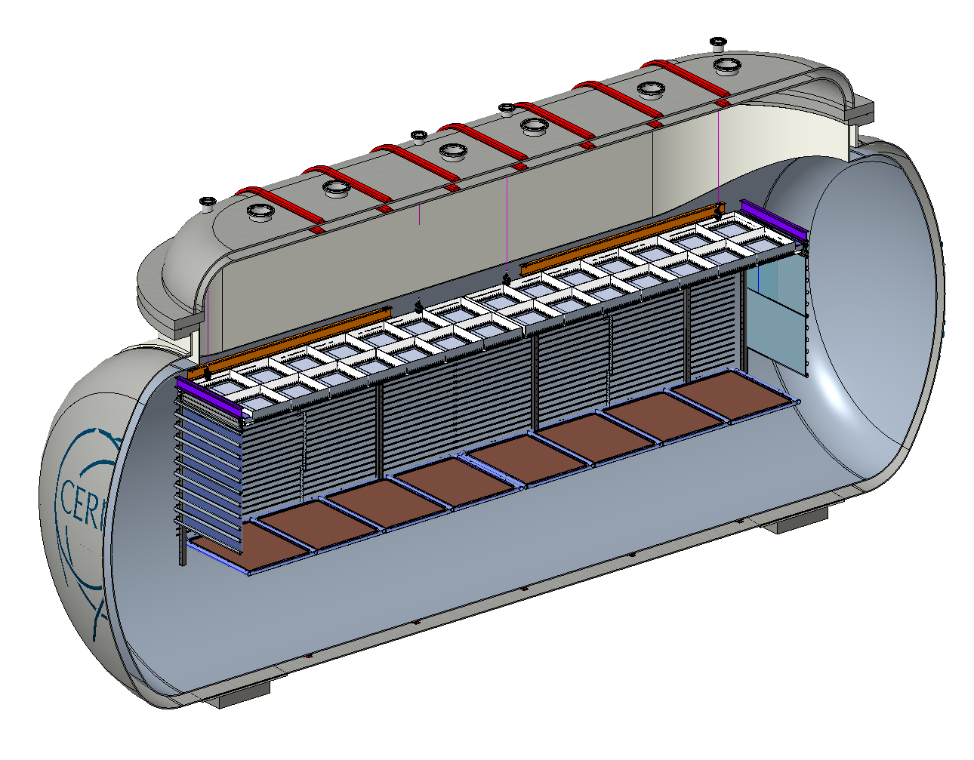
Double vac jacketed cryostat
TPC hangs from cryostat ports

Slide 24
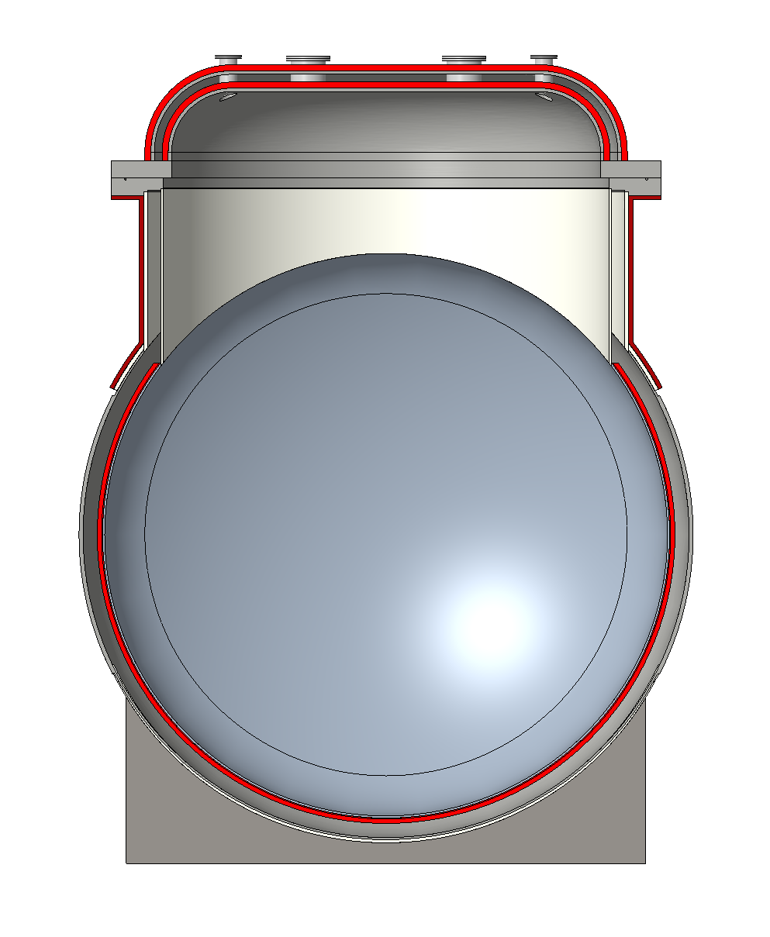
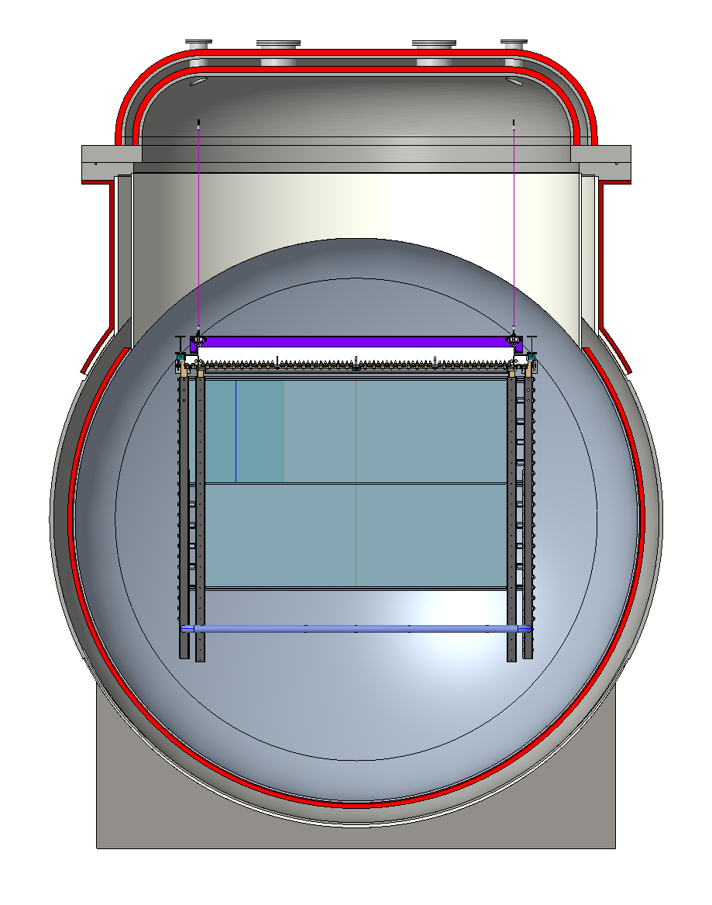
Double vac jacketed cryostat

Slide 25
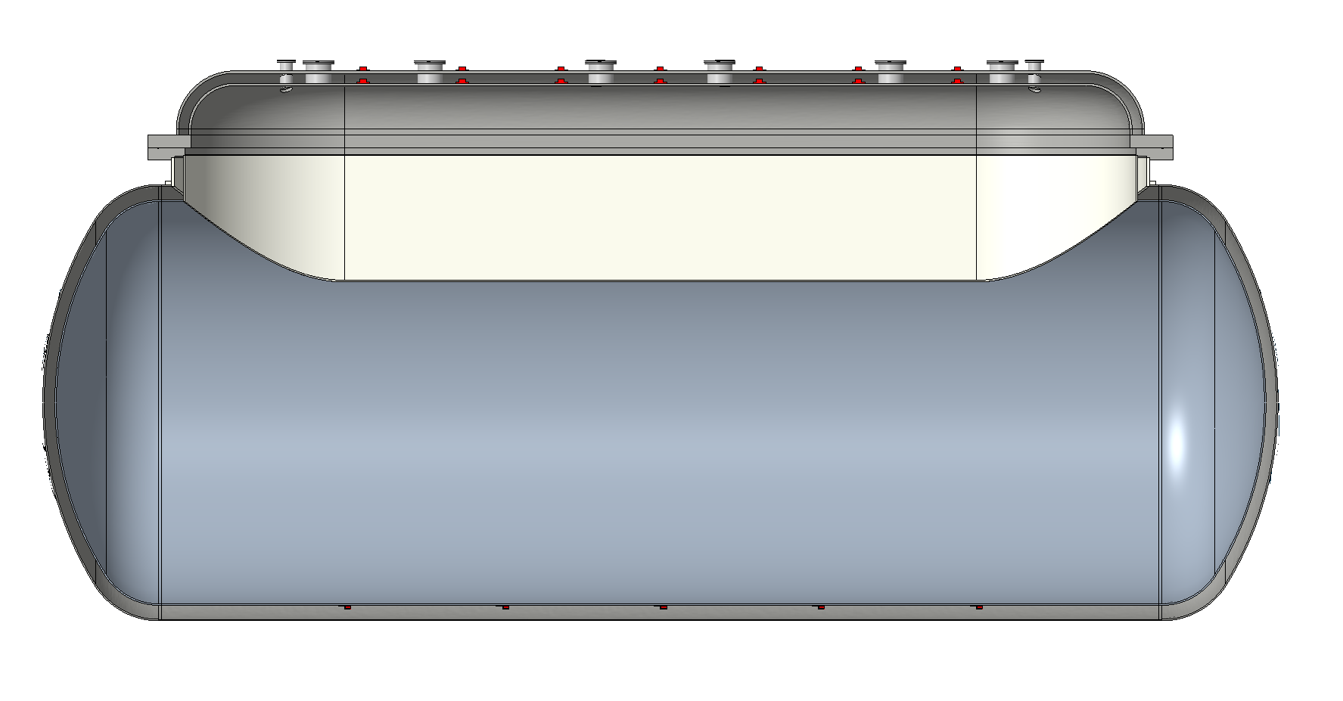
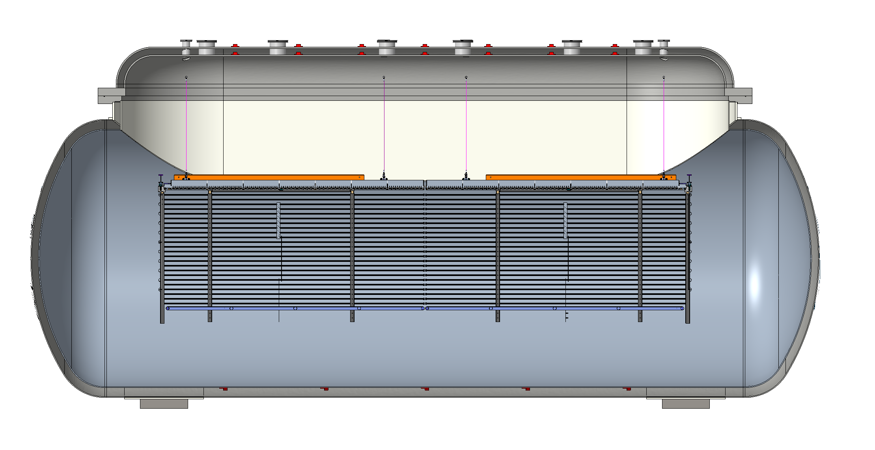
Double vac jacketed cryostat

Slide 26
Weight at this configuration:
Flange 15t
Cylindrical vessel 30t

Slide 27
Preliminary FEA Analysis

Slide 28
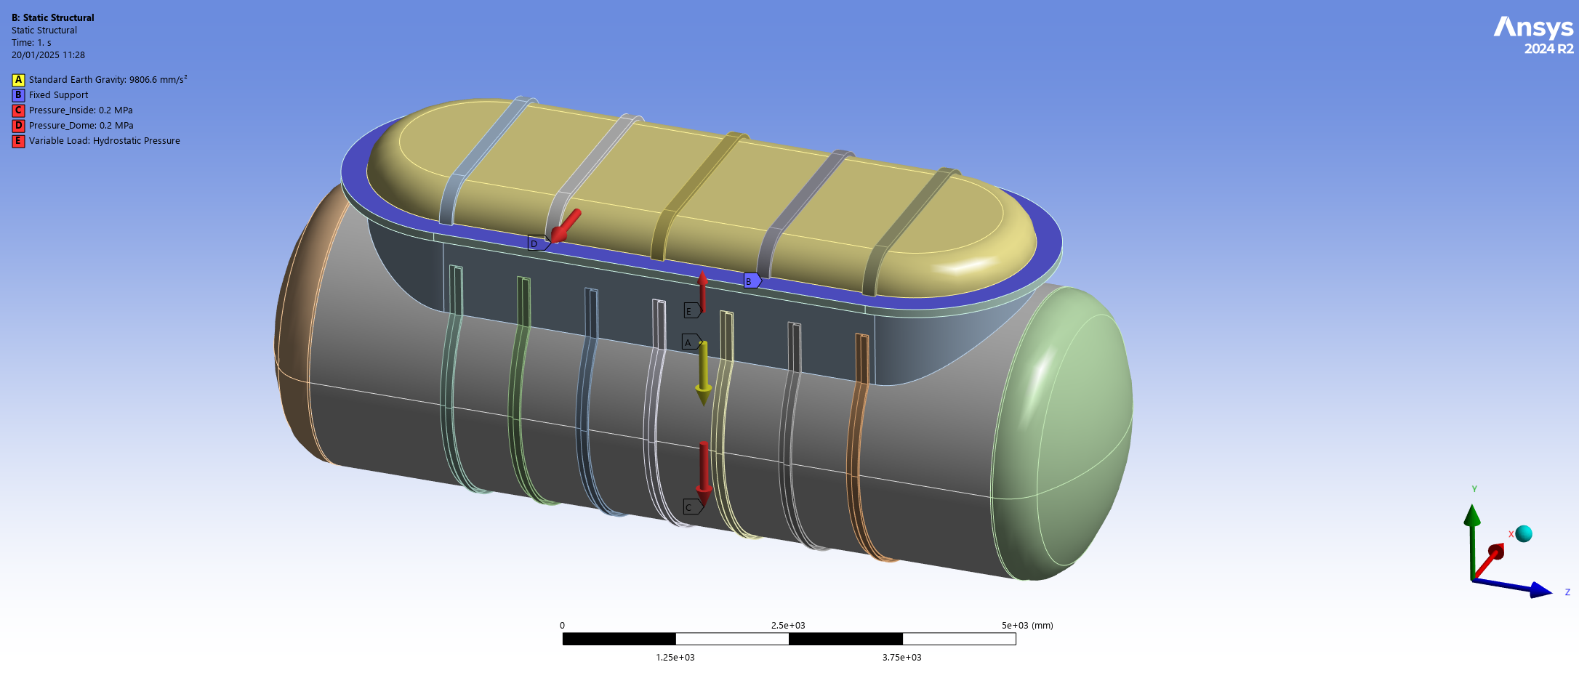
FEA inner cylinder with stiffening rings
FEA inputs:
Considering 15 mm thick
Stiffening rings
2 bar pressure (1b vac, 1b positive)

Slide 29
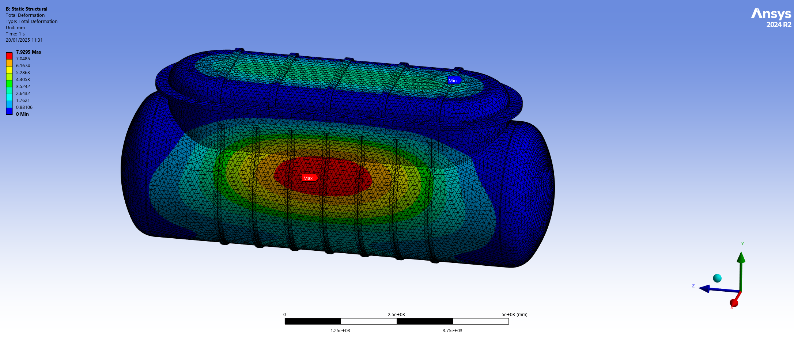
FEA: Deformation inner cylinder
8 mm deflection@2bar

Slide 30

FEA: Hydrostatic inner cylinder
0.3 bar

Slide 31

FEA: Stress inner cylinder

Slide 32

Access to tunnel checks
Possible to take down at 60 degrees (before install lift and stairs in the shaft)
Lower cryostat without lid keeping the weight below 25t (currently is 30t for 15mm thick skin )

Slide 33

Access to tunnel checks
Shaft top view
Possible to take down at 60 degrees (before install lift and stairs in the saft)
Clearance around 90 cm from each side

Slide 34

cylindrical cryostat removable lid
Many thanks to Julien Prosic for providing the cad models of the cavern

Slide 35

cylindrical cryostat removable lid
Entire TPC assembly hangs from the top lid

Slide 36

cylindrical cryostat removable lid

Slide 37

cylindrical cryostat removable lid

Slide 38

cylindrical cryostat removable lid
Cavern top view

Slide 39

Installation procedure
Use Hydraulics, since crane has no clearance
CAD by H. Frandini
https://hyquip.co.uk/tdm-double-acting-telescopic-cylinders-/4726-double-acting-telescopic-cylinders-type-tdm-series.html

Slide 40


cylindrical cryostat removable lid

Slide 41

cylindrical cryostat removable lid

Slide 42
Summary & Remarks
3D Optical TPC
Cryostat
Optical readout achieved with stable detector conditions has been demonstrated at the larger scale (CERN Neutrino Platform Cold Box). Proposal also for implementation at ProtoDUNE NP02 cryostat.
Dual phase extraction region (new design) very stable at large scale!
Can provide the required mm resolution
Cost efficient
TPX3 and Glass THGEM technology is ready for deployment now
Commercial construction, with know how
Cost to be determined (likely cheaper than membrane cryostat)
Avoids liquid seals
Very good vac insulation, avoids foam
Flexible, easy TPC access
Will need hydraulics to lift the lid
Study is preliminary needs more design optimizations for the cryostat and TPC
Needs further discussion with Wessington Cryogenics to understand better the cost and feasibility

Slide 43
Extra Slides

Slide 44


TPX3 -> TPX4

Slide 45

TPX3 QUAD
You could have 4 tpx3 ASICs together creating a 512x512 pixels sensor.
Has been done, but not bonded to an optical Si sensor. Will need some R&D
https://inspirehep.net/files/0d645abf22e9e30063b70a74b69b0b6e

Slide 46

LRP Installation Rectangular Cryostat
For a ~3mx2.5m membrane type cryostat we will need to reduce the LRP size to 2mx2.3m in order to fit from the side.
Side entrance is welded similar to protoDUNE
CAD by H. Frandini

Slide 47

LRP Installation Rectangular Cryostat
CAD by H. Frandini

Slide 48
Conceptual FLArE TPC dimensions

Slide 49

Simulated TPC & requirements

Slide 50




Novel G-THGEM Production
G-THGEM: https://www.mdpi.com/2076-3417/11/20/9450
FR4 THGEM with Copper electrodes and holes formed by mechanical drilling.
Borofloat 33 substrate G-THGEM
G-THGEM with ITO electrodes and holes formed by abrasive machining.
Abrasive machining vs drilled holes with chemically etched rims.

Slide 51



G-THGEM Characterisation
THGEM charging behaviour
Bi-conical holes lead to “upwards” charging over time.
Straight wall holes lead to “downwards” charging over time
The charging behaviour of fused silica THGEMs results in greater light production for the same applied field.
All circle hole glass THGEMs produced more light than the equivalent FR4 THGEM.
THGEM bias scan
https://www.mdpi.com/2076-3417/11/20/9450

Slide 52


50cm Glass THGEMs
Novel Glass THGEMs developed at Liverpool (Patent accepted GB2019563.2)
Sixteen 50cm x 50cm glass THGEMs
1.1mm thick,
500μm ID holes,
800μm pitch hexagonal array
See for more details:
https://www.mdpi.com/2076-3417/11/20/9450

Slide 53


THGEM S2 light production
VUV (126nm) light produced through de-excitation of Argon gas.
TPB Wavelength shifter above THGEM converts to 430nm.
At low field (<2kV/cm), S2 light production is linearly proportional to THGEM field. No charge gain. Very stable operation without discharges. No ion production.
At higher fields, electron multiplication occurs (Townsend avalanche).
Exponentially increasing S2 light production -> Improved sensitivity/threshold
Simulation

Slide 54


PEN WLS
Two grades of TEONEX PEN foil investigated Q51 and Q53.
Thinner PEN consistently found to have a better conversion efficiency than thicker sheets (surface interaction).
Q51 consistently found to have a better conversion efficiency than Q53.
50cmx50cm Q51 25μm PEN film glued on glass panel

