Slide 1
Link AFT – EAM
EN-CV proposal
S. Deleval – EN/CV
2024-11-08

Slide 2
AFT fault
Collect fault affecting Machines and Experiments
Measure downtime
EAM Logbook event
Keep track of investigations
Degraded mode
EAM Hxgn work order(s)
Detail about a specific intervention
Number of hours spent
Associated document, pictures,..
Action plan definition
Actions follow-up
Invoicing
Spare parts
..
Equipment
Assess the group responsible for the fault
Cause
Creation
CCC-PS, SPS, LHC, Experimental areas control rooms
CCC-TI and EN-CV staffs
CCC-TI and EN-CV staffs
Filling
Automatic filling from EAM Logbook
EN-CV staffs
EN-CV staffs and CV contractors

Slide 3
Machines control rooms or Experiment control rooms (CCC-PS, CCC-SPS, CCC-LHC, Isolde control room,..)
Infrastructure control room (CCC-TI)
Equipment expert (AA, ACE, CV, EL, HE)
AFT Working Group
Check problem alarms
Fault potentially linked to infrastructure
Contact TI
Request modification of attribute
Assess equipment responsible in collaboration with groups concerned, and TIOC
Create AFT faults with the suspected equipment in agreement with TI
No
Contact Machines / Exp
Yes
Fault confirmed for the equipment
Automatic notification
Yes
Create an Event for TIOC analysis linked to the AFT fault
Pass to status Fault reviewed

Slide 4
Machines control rooms or Experiment control rooms (CCC-PS, CCC-SPS, CCC-LHC, Isolde control room,..)
Infrastructure control room (CCC-TI)
Equipment expert (CV, EL, HE)
AFT Working Group
Check problem alarms
Fault potentially linked to infrastructure
Contact TI
Request modification of attribute
Assess equipment responsible in collaboration with groups concerned, and TIOC
Create AFT faults with the suspected equipment in agreement with TI
No
Contact Machines / Exp
Yes
Fault confirmed for the equipment
Automatic notification
Yes
Change the status of AFT Fault (reviewed)
Fill the logbook event (filling automatically the AFT)
Create additional work orders
Define action plan (followed at the TIOC)
Create:
a logbook event for CV
A work order for the intervention

Slide 5
AFT fault
Duration
EAM Logbook event
TI major event ID (obsolete)
Event detail
Fault type
System (defined by class and categories)
Equipment code
Cause
Description
TI major event ID
Same request as EL : Possibility to link EAM logbook to several AFT faults

Slide 6
System definition
Category | Description | Code Systeme | Code Fonction | Class
FSGACP | Systeme General Production Air Comprime | F$G | AC | FSYSG
FSGACD | Systeme General Distribution Air Comprime | F$G | AC | FSYSG
FSGACPD | Systeme General Production et Distribution Air Comprime | F$G | AC | FSYSG
FSACP | Station Production Air Comprime | F$S | AC | FSYS
FSACD | Station Distribution Air Comprime | F$S | AC | FSYS
FSACPD | Station Production et Distribution Air Comprime | F$S | AC | FSYS
FSGBRP | Systeme General Production Temper - Brine | F$G | BR | FSYSRG
FSGBRD | Systeme General Distribution Temper - Brine | F$G | BR | FSYSRG
FSGBRPD | Systeme General Production et Distribution Temper - Brine | F$G | BR | FSYSRG
FSBRP | Station Production Temper - Brine | F$S | BR | FSYSR
FSBRD | Station Distribution Temper - Brine | F$S | BR | FSYSR
FSBRPD | Station Production et Distribution Temper - Brine | F$S | BR | FSYSR
FSGEBP | Systeme General Production Eau Brute | F$G | EB | FSYSG
FSGEBD | Systeme General Distribution Eau Brute | F$G | EB | FSYSG
FSGEBPD | Systeme General Production et Distribution Eau Brute | F$G | EB | FSYSG
FSEBP | Station Production Eau Brute | F$S | EB | FSYS
FSEBD | Station Distribution Eau Brute | F$S | EB | FSYS
FSEBPD | Station Production et Distribution Eau Brute | F$S | EB | FSYS
FSGEBOD | Systeme General Distribution Eau Boree | F$G | EBO | FSYSRG
FSGN2PD | Systeme General Production et Distribution Azote | F$G | N2 | FSYSRG
FSEBOD | Station Distribution Eau Borée | F$S | EBO | FSYSR
FSN2PD | Station Production et Distribution Azote | F$S | N2 | FSYSR
FSGECRL | Systeme General Relevage Eau Claire | F$G | EC | FSYSG
FSGECRJ | Systeme General Rejet Eau Claire | F$G | EC | FSYSG
System
Cooling and Ventilation | Compressed air | Compressed air
 | Cooling | Chilled water system
 |  | Demineralised water system
 |  | Detector system
 |  | Primary water system
 |  | Raw water system
 |  | Rejected water system
 | Ventilation | Air pressurisation
 |  | HVAC
 |  | Smoke extraction
164 Categories in EAM
Not all categories concerning the Machines
Need a review of the AFT system

Slide 8
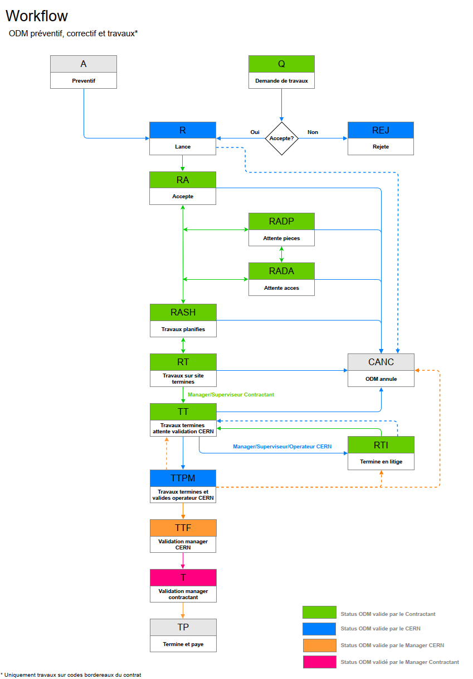
Work Order Workflows

