Slide 1
Rise time instability: Introduction
25/11/2024 FCC-ee Collimation Meeting
Giulia Nigrelli
1
The ring impedance can generate an instability that leads the beam to be lost within few turns.
A feedback system is under development to dump the beam in case of rising instability.
However, feedback failures might happen and need to be investigated.
Effects on machine and detectors need to be understood to avoid damage and backgrounds.
Collimation system must protect the machine/detectors also in this scenario.
If not, both collimation and feedback systems must be improved.

Slide 2
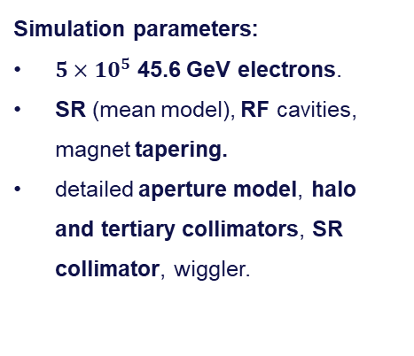
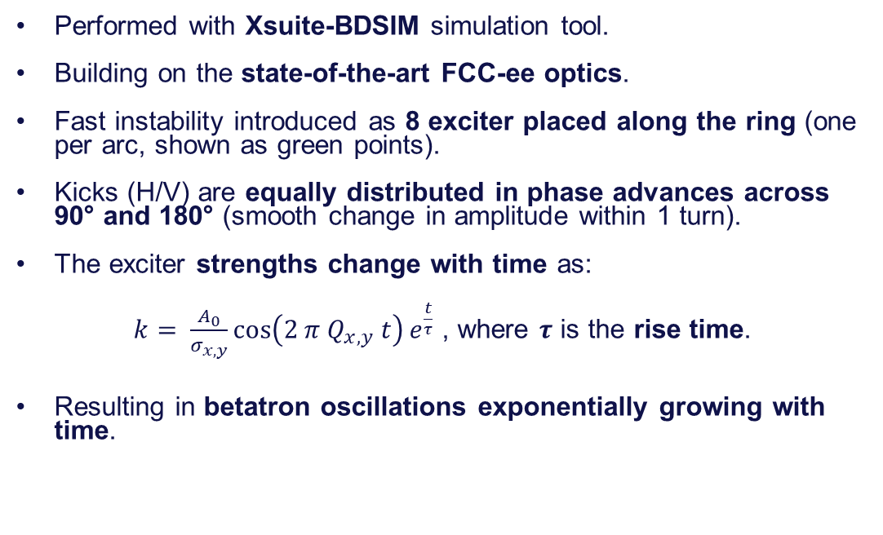
Simulation setup
25/11/2024 FCC-ee Collimation Meeting
Giulia Nigrelli
IPA
2
IPB
Performed with Xsuite-BDSIM simulation tool.
Building on the state-of-the-art FCC-ee optics.
Fast instability introduced as 8 exciter placed along the ring (one per arc, shown as green points).
Kicks (H/V) are equally distributed in phase advances across 90° and 180° (smooth change in amplitude within 1 turn).
The exciter strengths change with time as:
$k= \frac{A_{0}}{σ_{x, y}}\cos\left(2 π Q_{x,y} t\right)e^{\frac{t}{τ}}$ , where $τ$ is the rise time.
Resulting in betatron oscillations exponentially growing with time.
IPJ
IPD
IPF
IPG
Simulation parameters:
$5×10^{5}$ 45.6 GeV electrons.
SR (mean model), RF cavities, magnet tapering.
detailed aperture model, halo and tertiary collimators, SR collimator, wiggler.

Slide 3
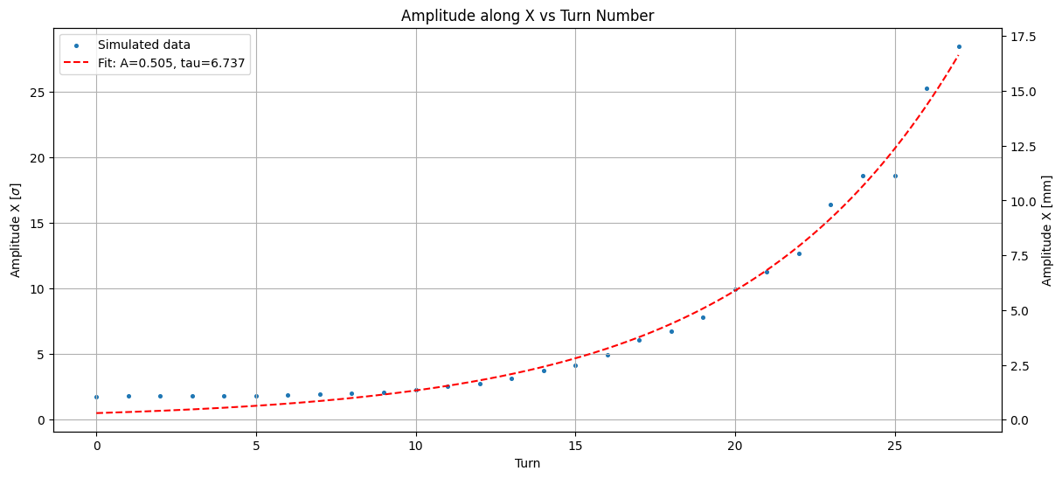
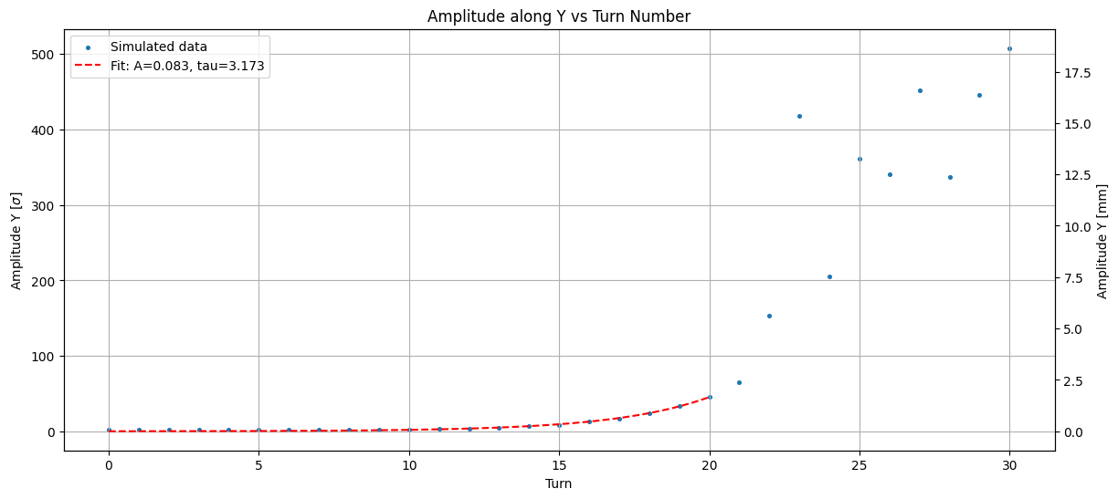

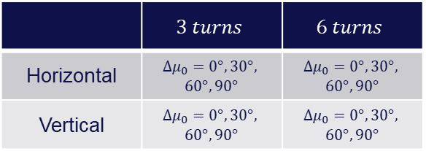
Case studies
25/11/2024 FCC-ee Collimation Meeting
Giulia Nigrelli
3
Horizontal: 6 turns
Since the instability can start at any point, it is relevant to explore the phase dependence.
Exciters shifted along the ring to have four different phase advances between the first exciter and the primary collimator.
16 different cases have been investigated:
Vertical: 3 turns
 | $$3 turns$$ | $$6 turns$$
Horizontal | $${Δμ}_{0}=0°, 30°,$$ $$60°, 90°$$ | $${Δμ}_{0}=0°, 30°,$$ $$60°, 90°$$
Vertical | $$Δμ_{0}=0°, 30°,$$ $$60°, 90°$$ | $$Δμ_{0}=0°, 30°,$$ $$60°, 90°$$
$$A_{x}[σ]=\frac{\sqrt{2 J_{x}β_{x}}}{σ_{x}}$$

Slide 4
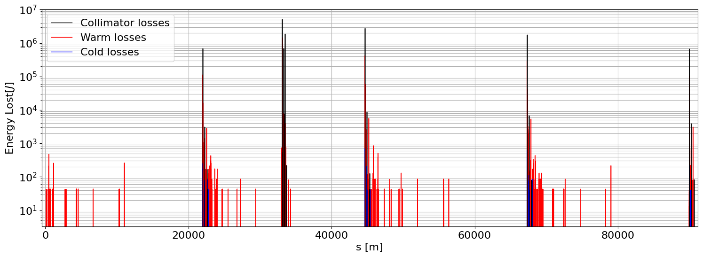
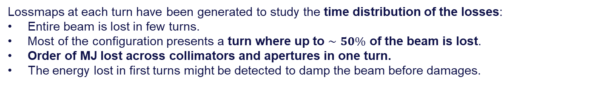
Preliminary results
25/11/2024 FCC-ee Collimation Meeting
Giulia Nigrelli
4
Lossmaps at each turn have been generated to study the time distribution of the losses:
Entire beam is lost in few turns.
Most of the configuration presents a turn where up to $∼50\%$ of the beam is lost.
Order of MJ lost across collimators and apertures in one turn.
The energy lost in first turns might be detected to damp the beam before damages.
Horizontal 90°
3 turns

Slide 5
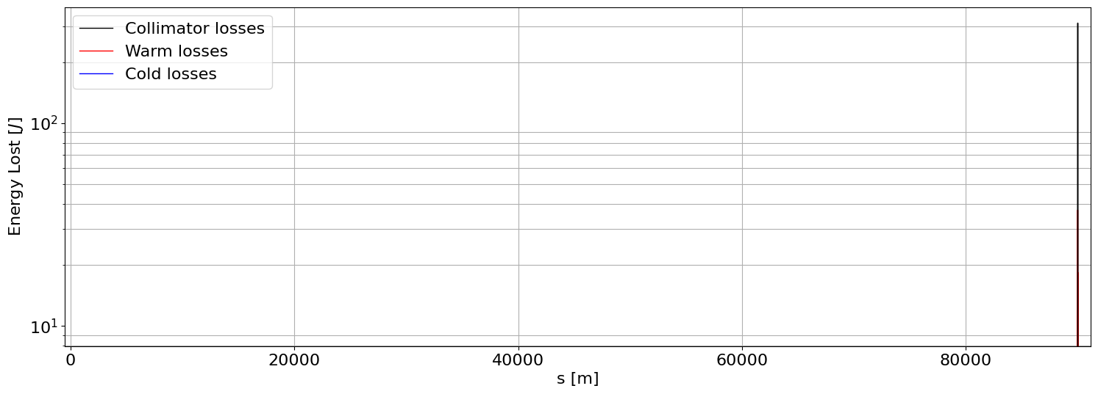
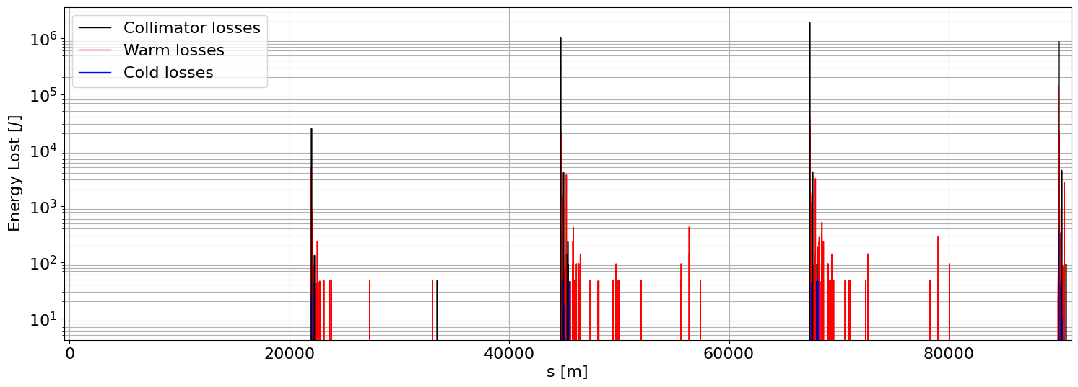


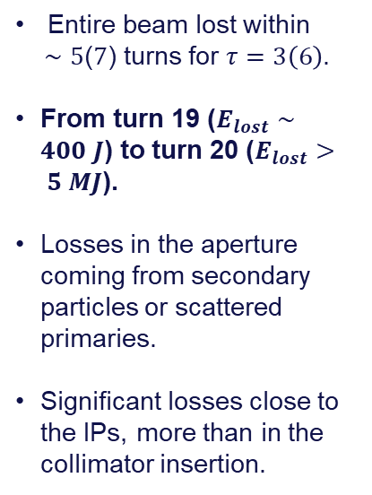
Horizontal instability: worst case
25/11/2024 FCC-ee Collimation Meeting
Giulia Nigrelli
5
$$\text{Turn}\text{ 1}\text{9} \text{H} \text{0°} τ=3$$
Entire beam lost within
$∼5$($7$) turns for $τ=3\left(6\right)$.
From turn 19 ($E_{lost}∼400 J$) to turn 20 ($E_{lost}> 5 MJ$).
Losses in the aperture coming from secondary particles or scattered primaries.
Significant losses close to the IPs, more than in the collimator insertion.
$$\text{Turn} \text{20} \text{H} \text{0°} τ=3$$

Slide 6
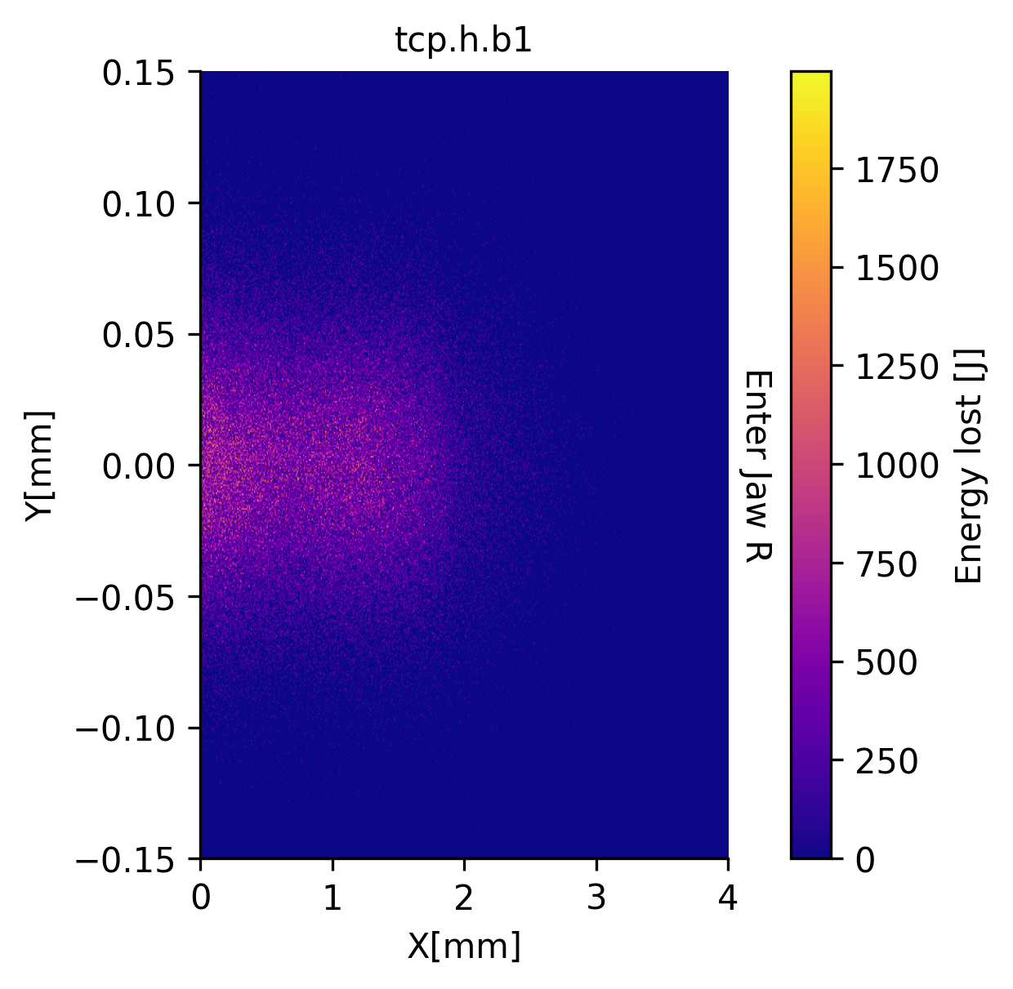
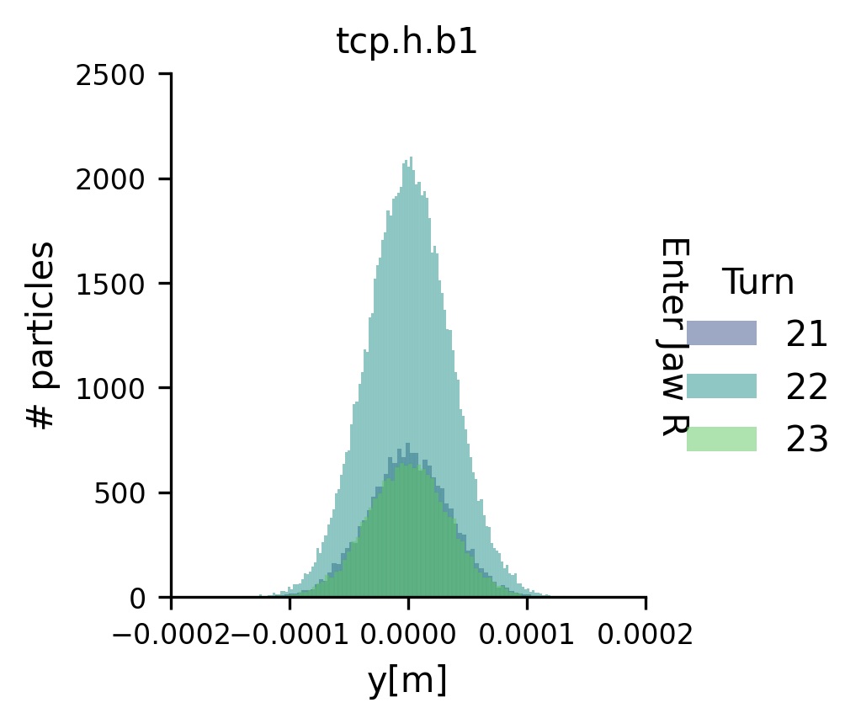
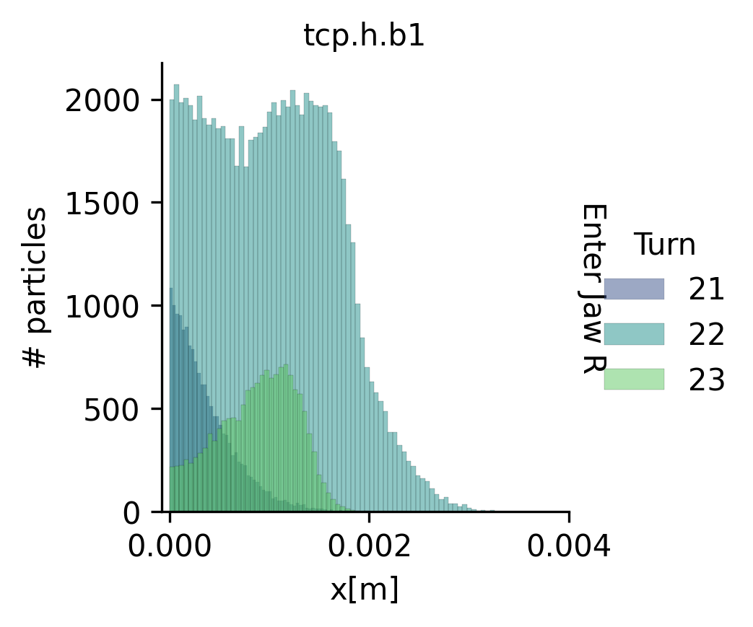

Horizontal instability: collimator impacts
25/11/2024 FCC-ee Collimation Meeting
Giulia Nigrelli
6
Considering the configuration $μ= \text{0°} τ=3$:
anchor
Note: Axes are with respect to the collimator system

Slide 7
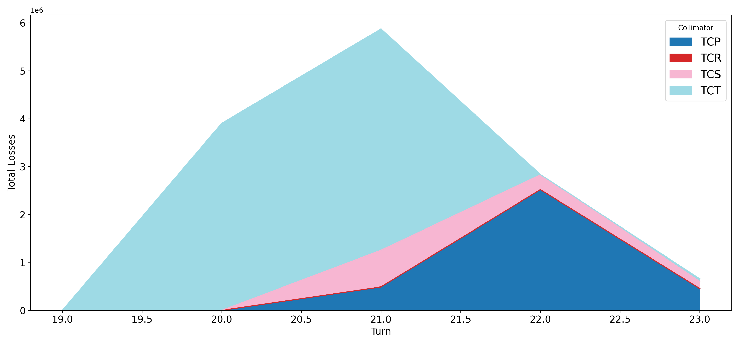
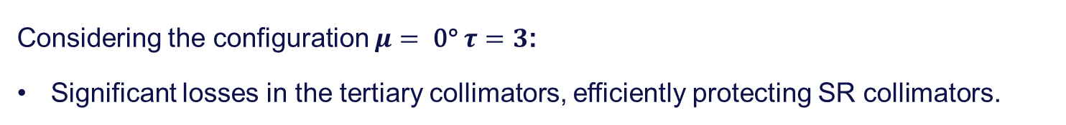
Horizontal instability: losses across collimators
25/11/2024 FCC-ee Collimation Meeting
Giulia Nigrelli
7
Considering the configuration $μ= \text{0°} τ=3$:
Significant losses in the tertiary collimators, efficiently protecting SR collimators.
anchor

Slide 8
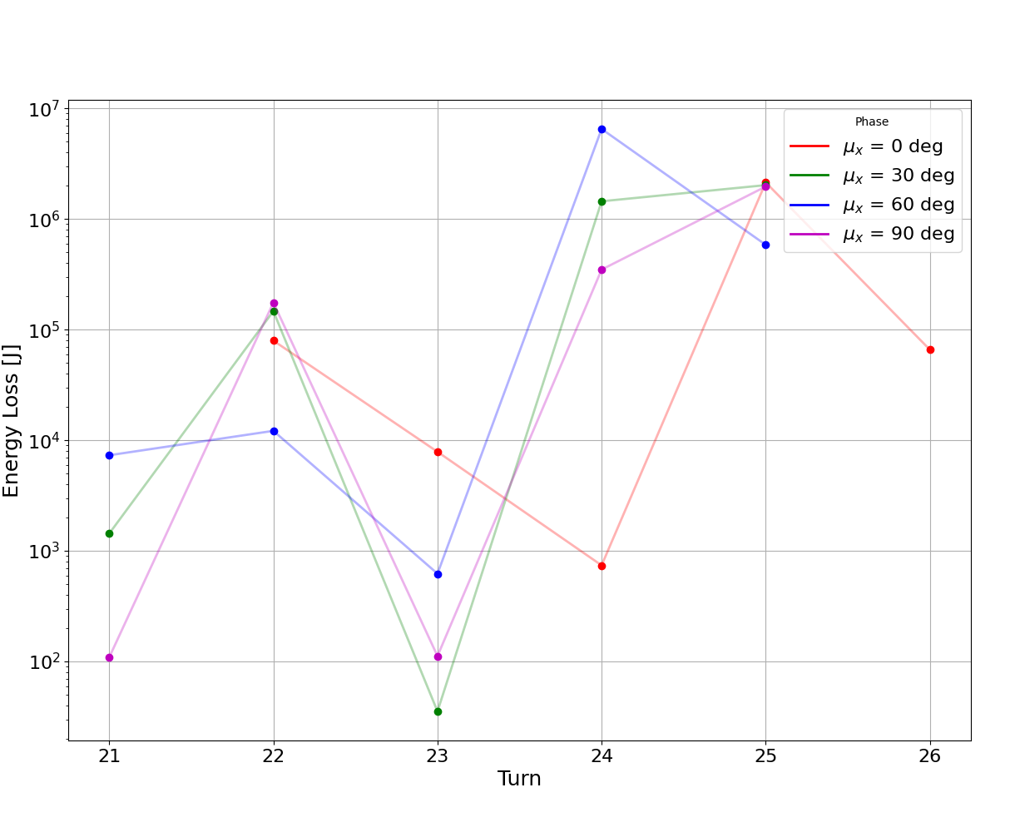
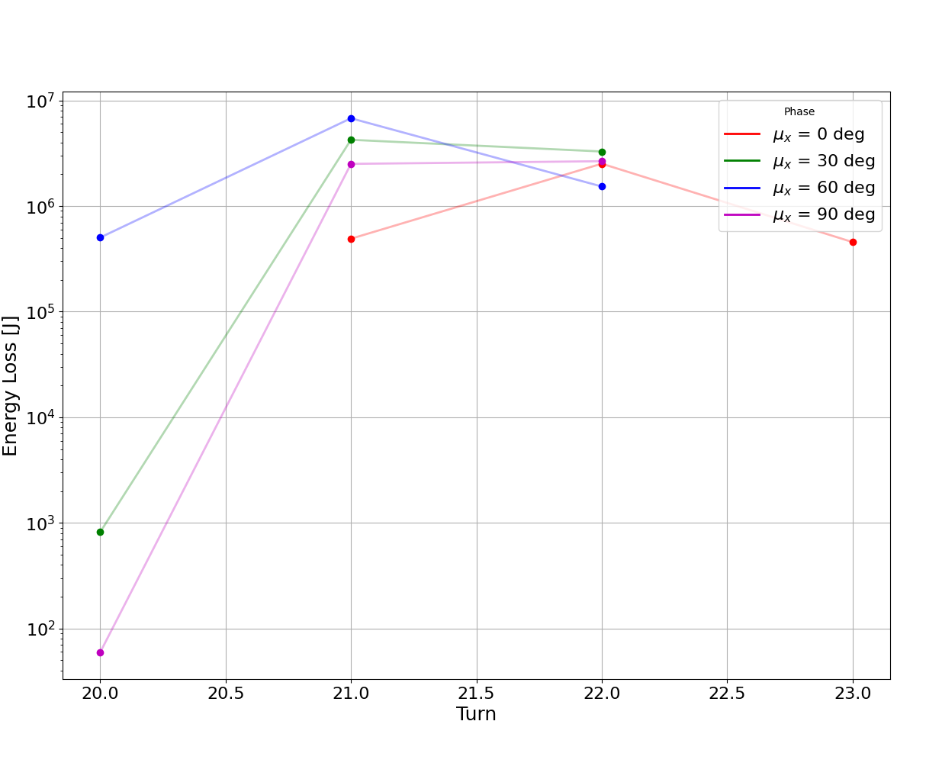

Losses at the primary collimators: horizontal
25/11/2024 FCC-ee Collimation Meeting
Giulia Nigrelli
8
To compare the various cases is useful to look at the losses in the primary wrt time:
$$τ=6$$
$$τ=3$$

Slide 9
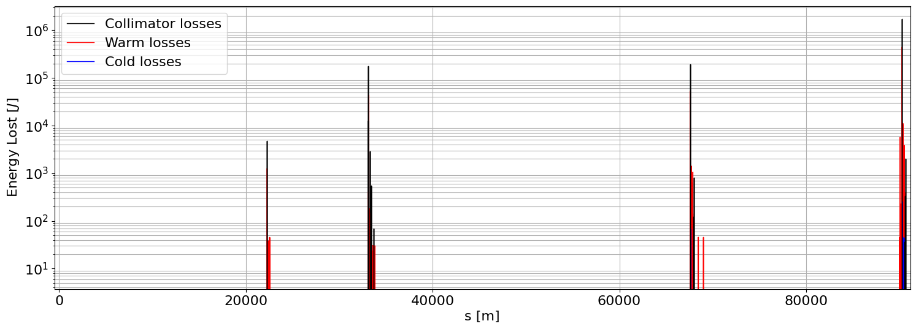
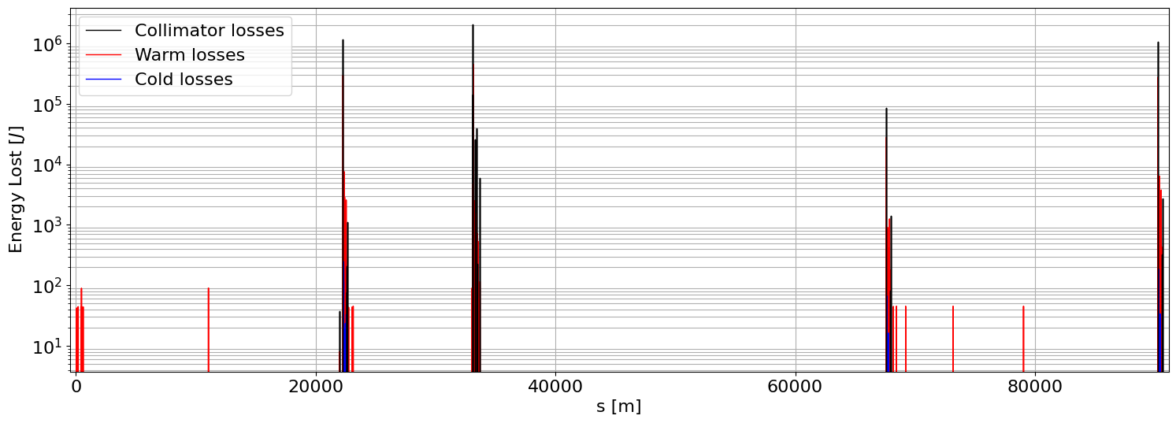


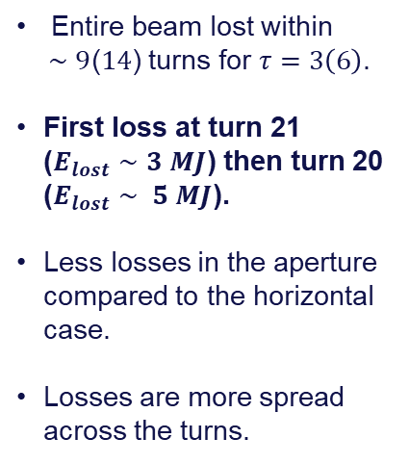
Vertical instability: worst case
25/11/2024 FCC-ee Collimation Meeting
Giulia Nigrelli
9
$$\text{Turn} \text{21} \text{V} \text{0°} τ=3$$
Entire beam lost within
$∼9$($14$) turns for $τ=3\left(6\right)$.
First loss at turn 21 ($E_{lost}∼3 MJ$) then turn 20 ($E_{lost}∼ 5 MJ$).
Less losses in the aperture compared to the horizontal case.
Losses are more spread across the turns.
$$\text{Turn} \text{22} \text{V} \text{0°} τ=3$$

Slide 10
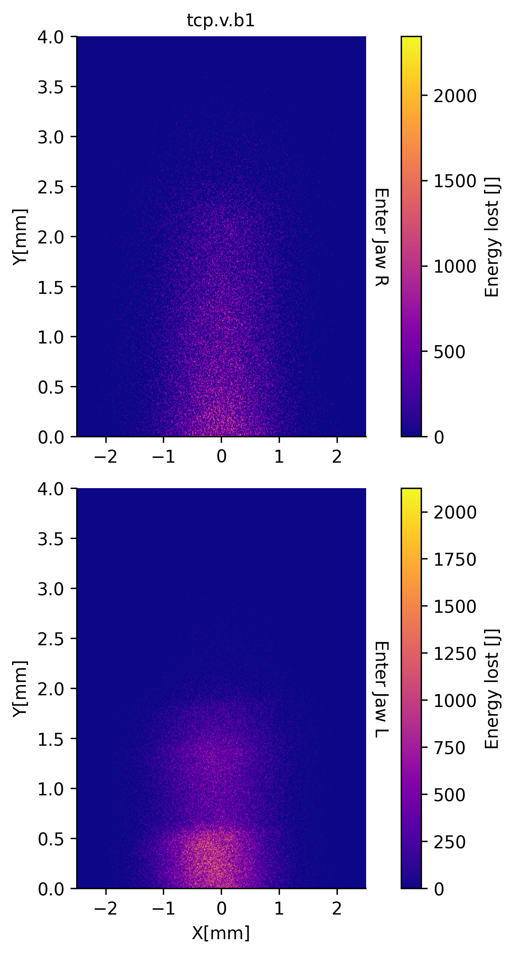
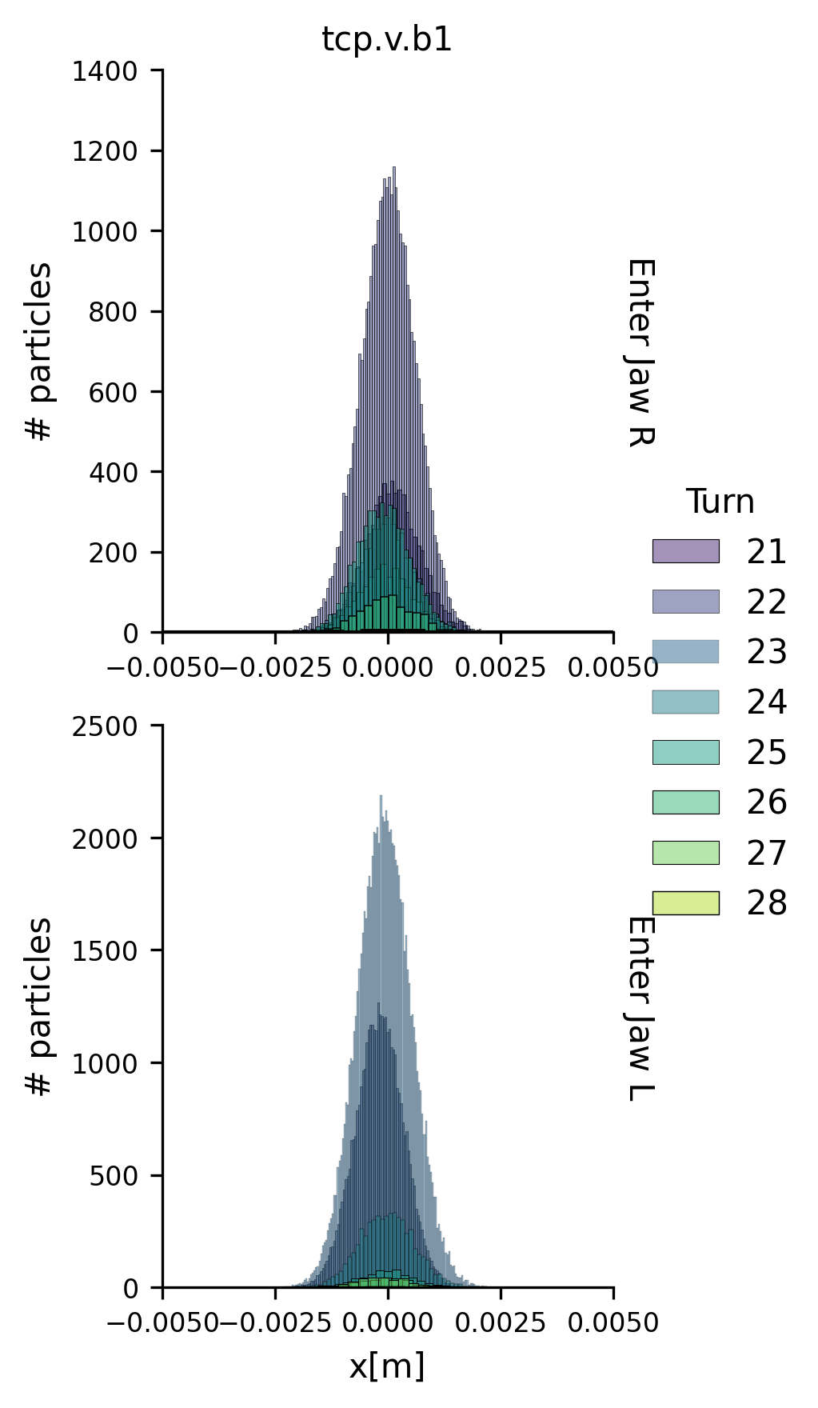
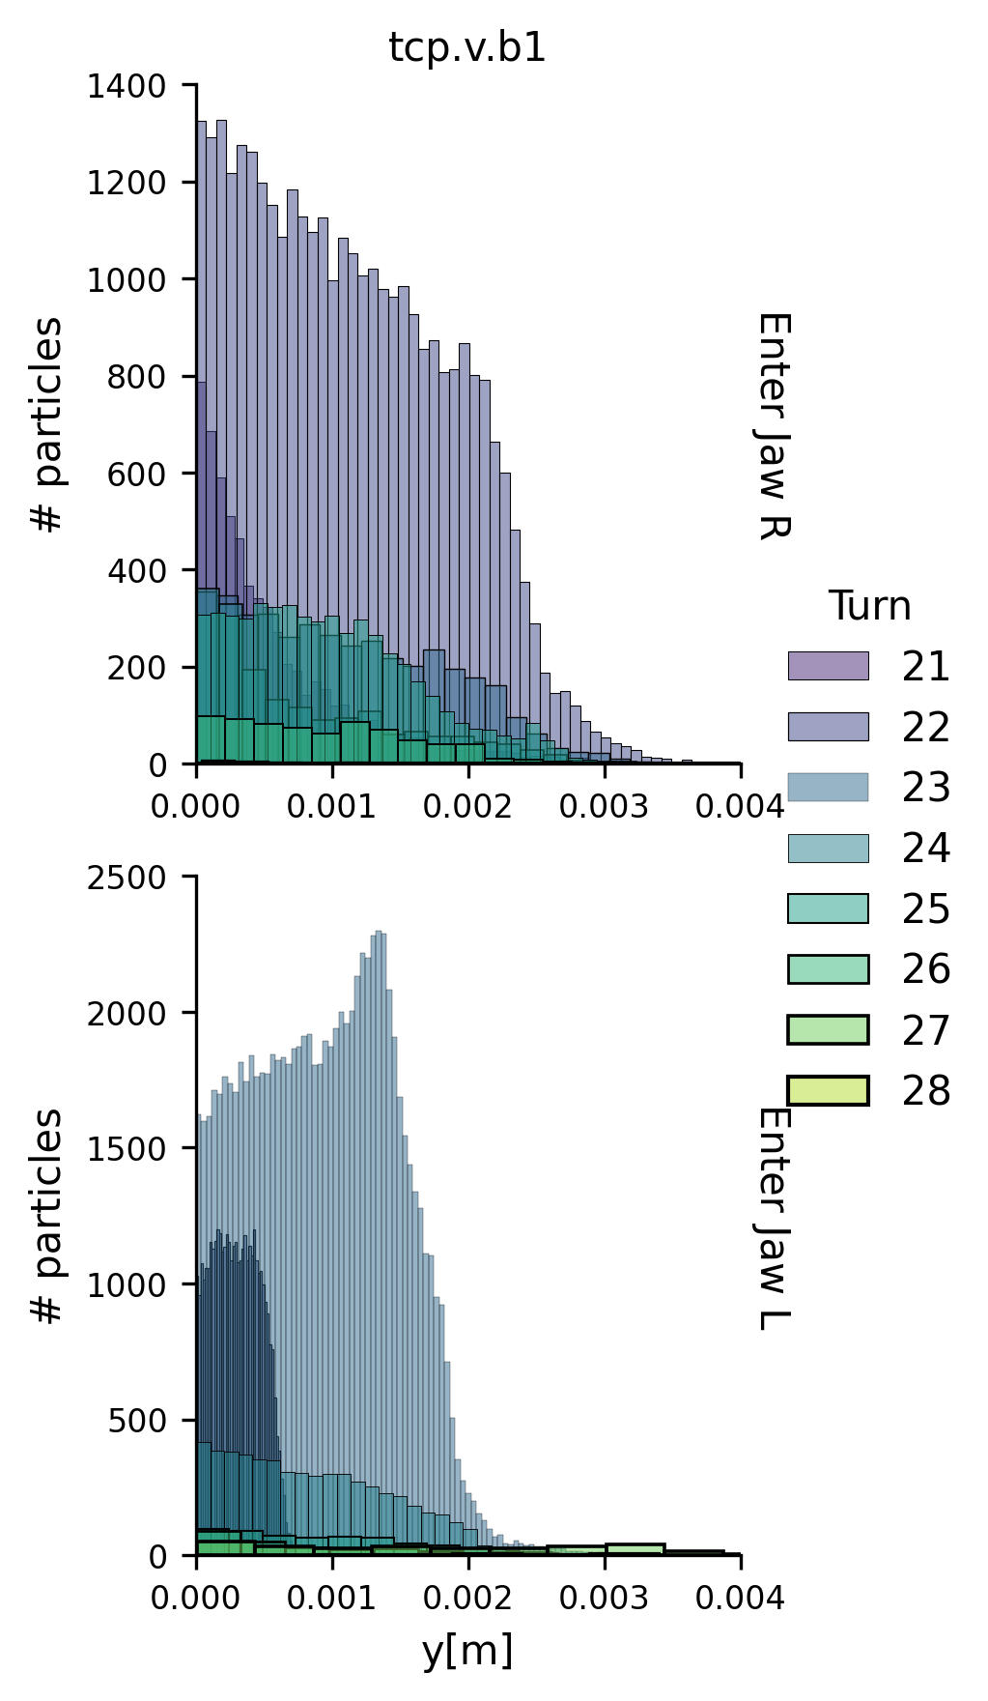
Vertical instability: collimator impacts
25/11/2024 FCC-ee Collimation Meeting
Giulia Nigrelli
10
Considering the configuration $μ= \text{0°} τ=3$:
Note: Axes are wrt to the collimator system

Slide 11
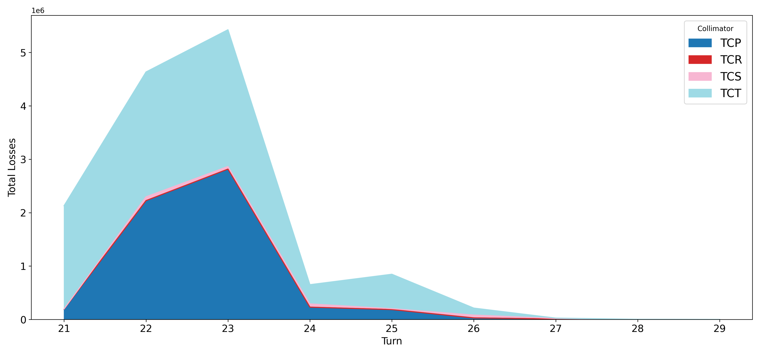

Vertical instability: losses across collimators
25/11/2024 FCC-ee Collimation Meeting
Giulia Nigrelli
11
Considering the configuration $μ= \text{0°} τ=3$:
Significant losses in the tertiary collimators, efficiently protecting SR collimators
anchor

Slide 12
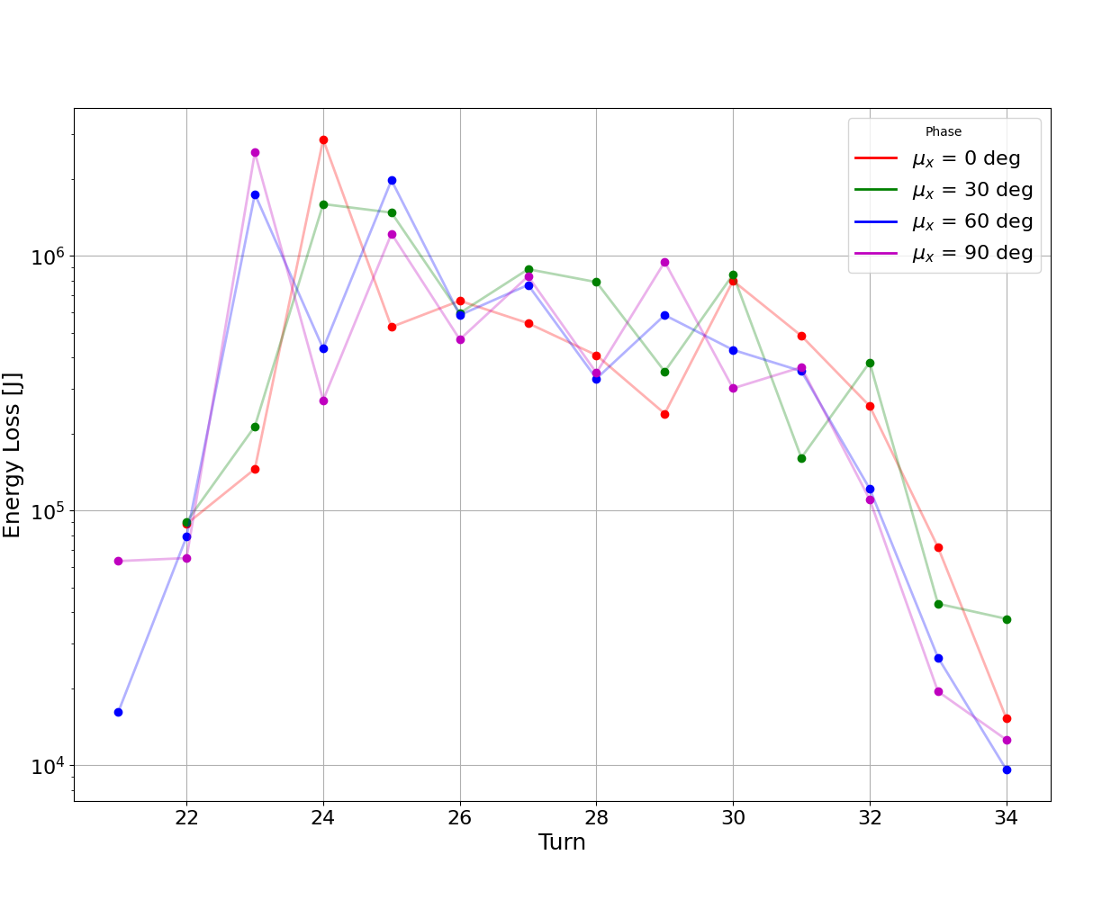
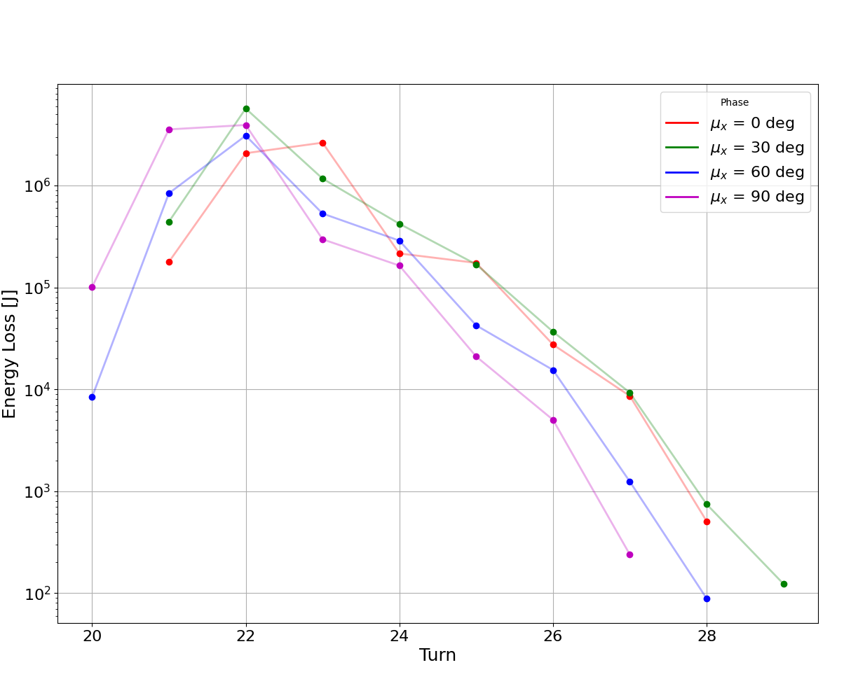
25/11/2024 FCC-ee Collimation Meeting
Giulia Nigrelli
12
Losses at the primary collimators: vertical
To compare the various cases is useful to look at the losses in the primary collimator wrt time:
$$τ=6$$
$$τ=3$$

Slide 13
Conclusions
25/11/2024 FCC-ee Collimation Meeting
Giulia Nigrelli
13
The fast instability could be dangerous if the feedback system fails.
  This instability can cause damage both at the machine and detectors, as well as increasing backgrounds.
  Chances of damaging collimators/detectors. The beam is lost within few turns, almost 50% of beam energy lost in one turn.
  The effect depends also on the phase advance.
  High losses nearby experiments, shower calculation in the detector region is needed.

Slide 14
Thank you for your attention.
25/11/2024 FCC-ee Collimation Meeting
Giulia Nigrelli

Slide 15
Backup

Slide 16
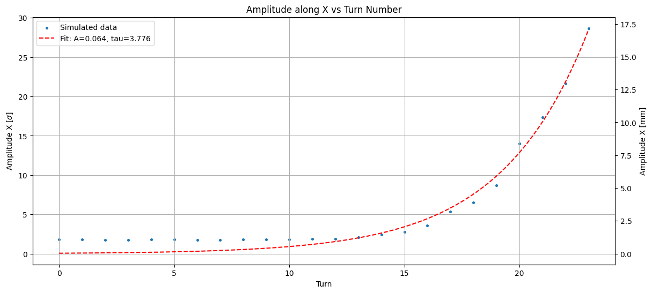
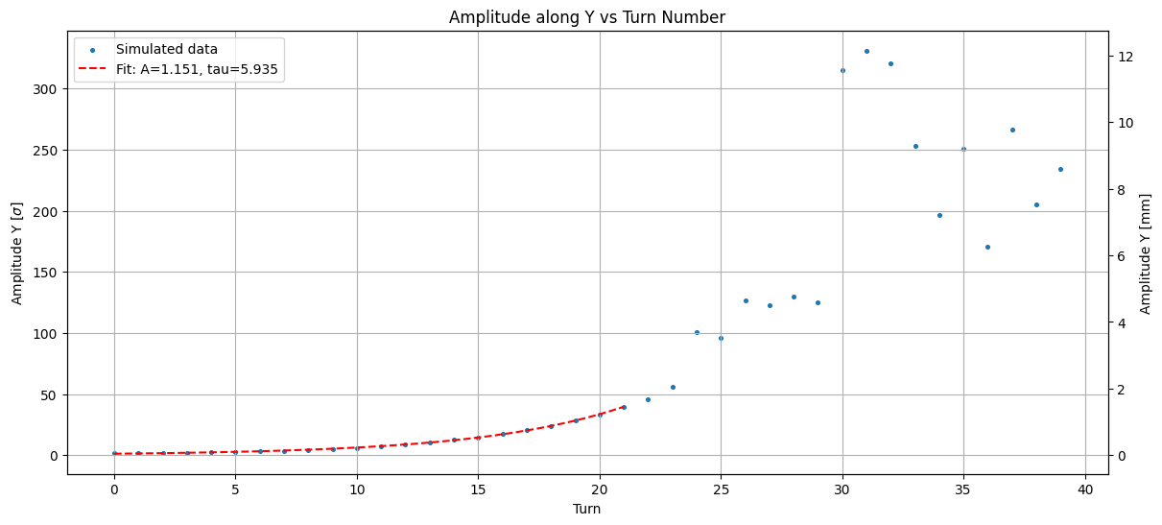
Horizontal: 3 turns
Giulia Nigrelli
16
At primary collimator.
Vertical: 6 turns

Slide 17
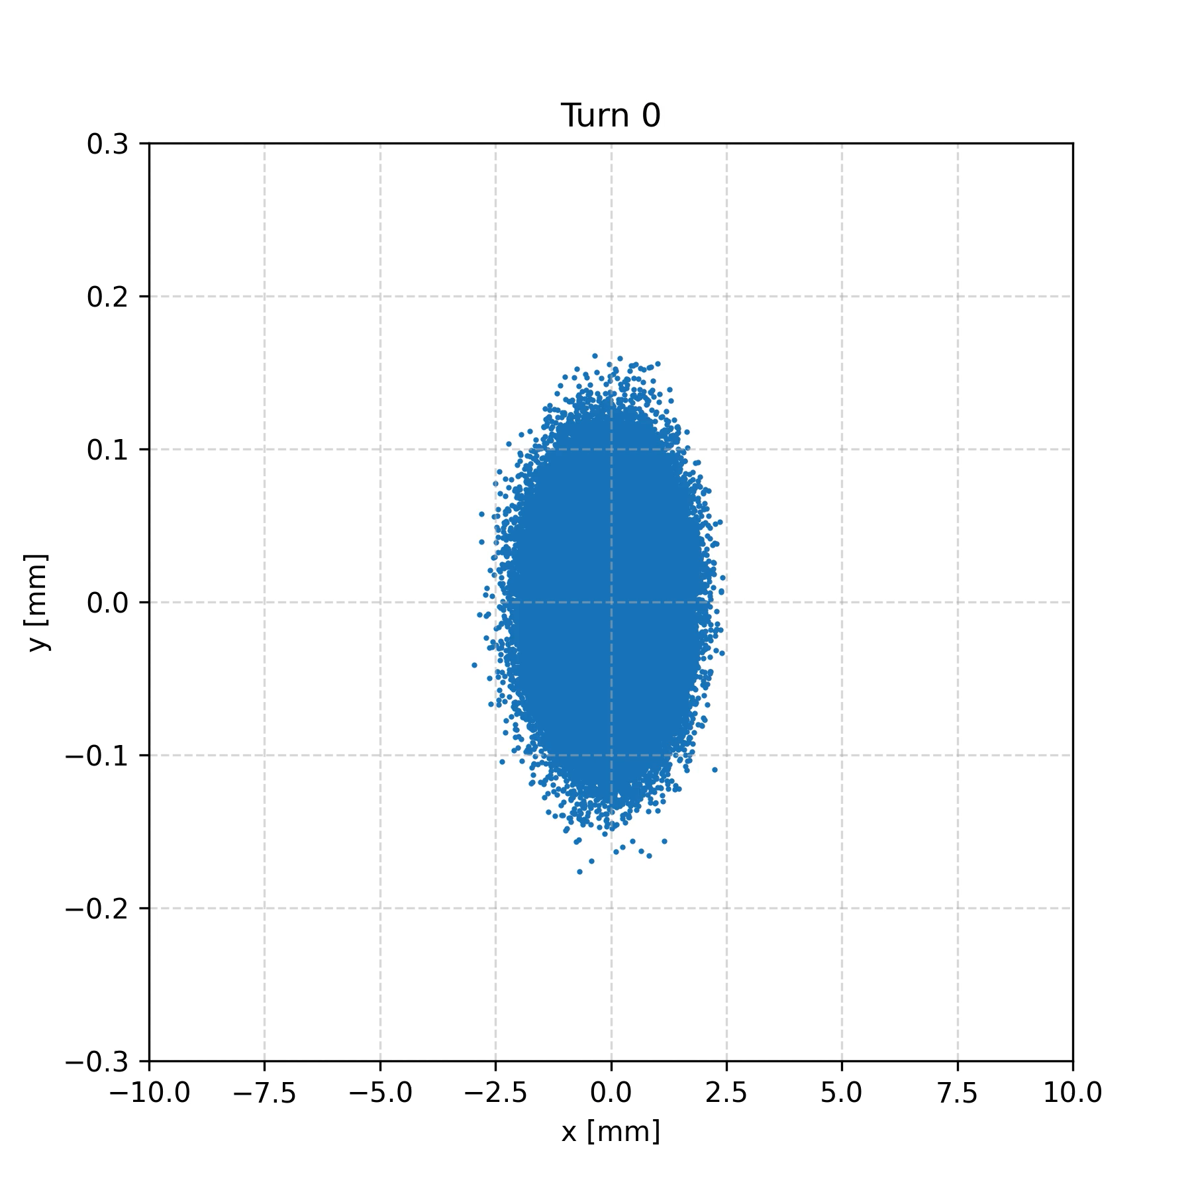
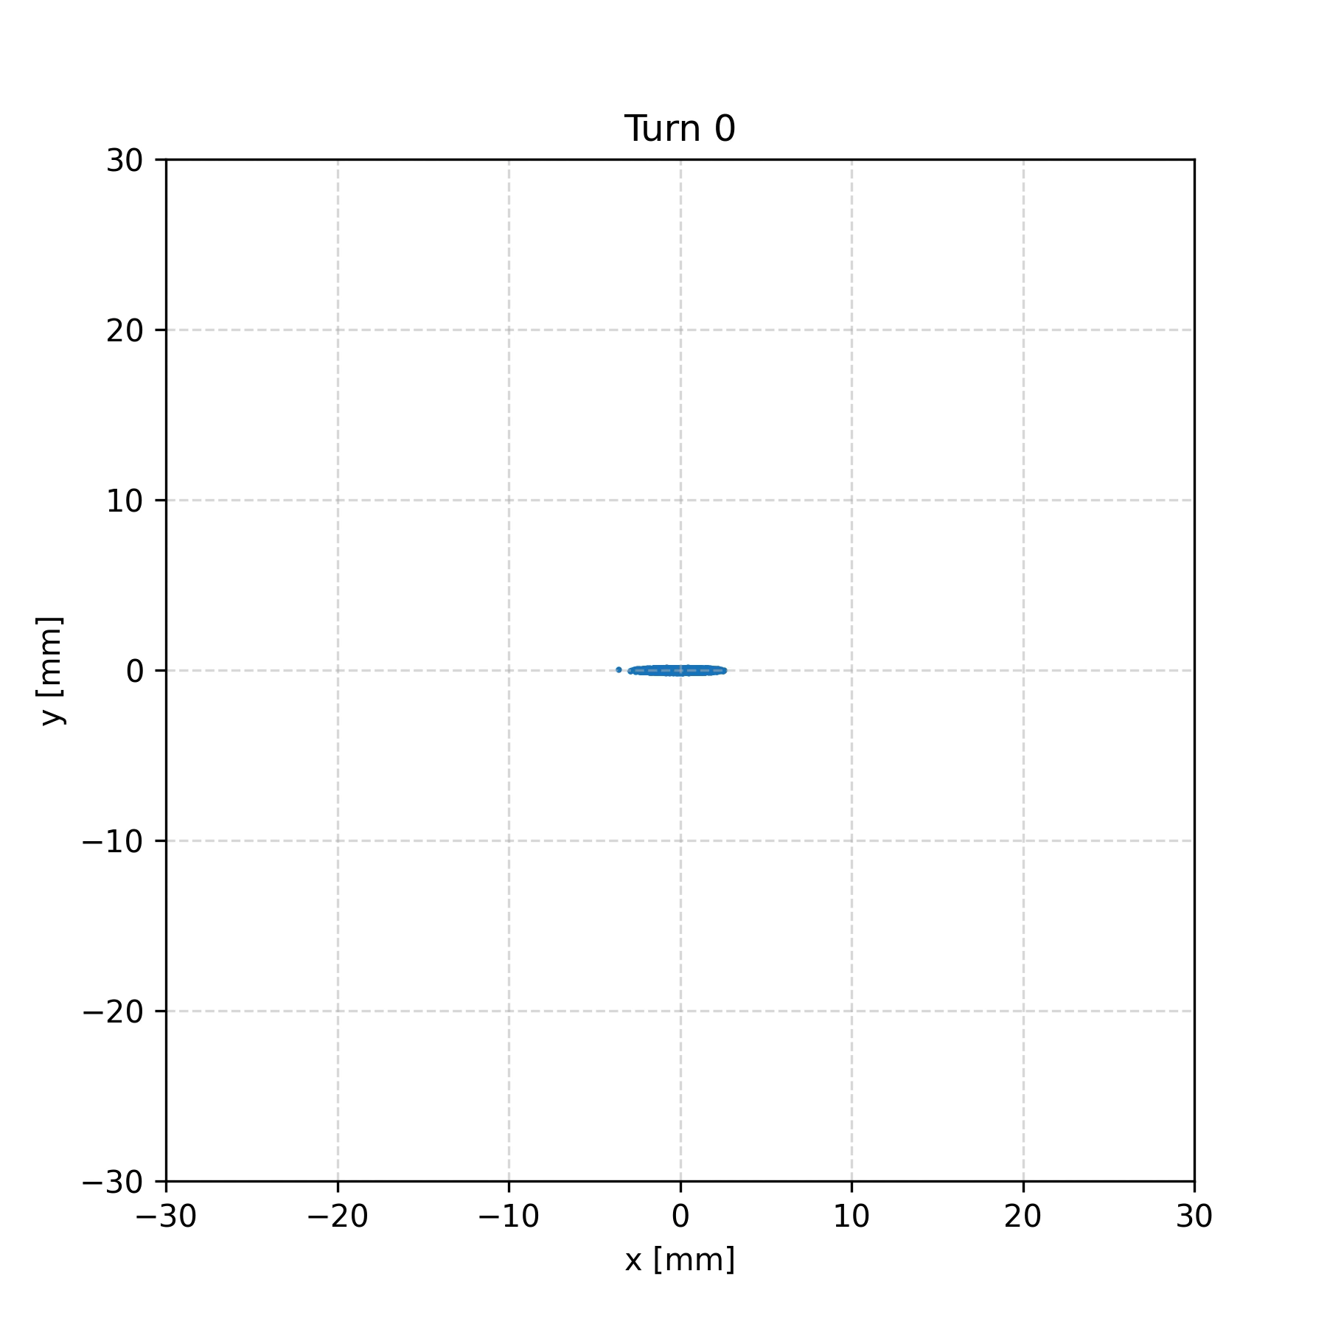


Transverse beam position over turns
17
$$\text{H} \text{0°} τ=3$$
$$\text{V} \text{0°} τ=3$$
The broad distribution are reasonable if we look at the oscillation during the looses turn
This animation does not include scattering in the collimators, so the distribution would be even more spread.
Notes:
EXAMPLES PICTURES OF WORST TURN FOR BOTH VERTICAL/HORIZONATLA ND 3/6 TURNS
HIGLITH THAT 50% OF THE ENRìTIRE BEAM IS LOST IN 1 TURN
Highligth that the entire beam is lost within 20 turn but losses are observed only uring the last few turn
GIVE RANGE OF ENERGY LOST BEFORE THE BOOM, IS IT DETECTABLE?

Slide 18
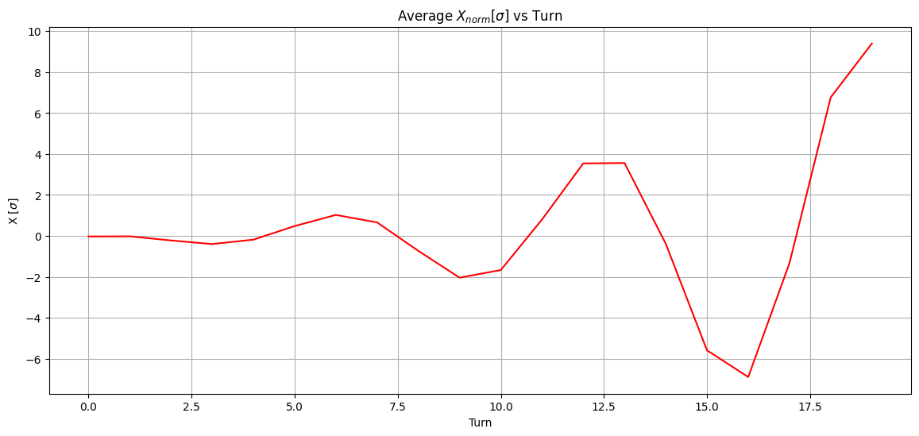
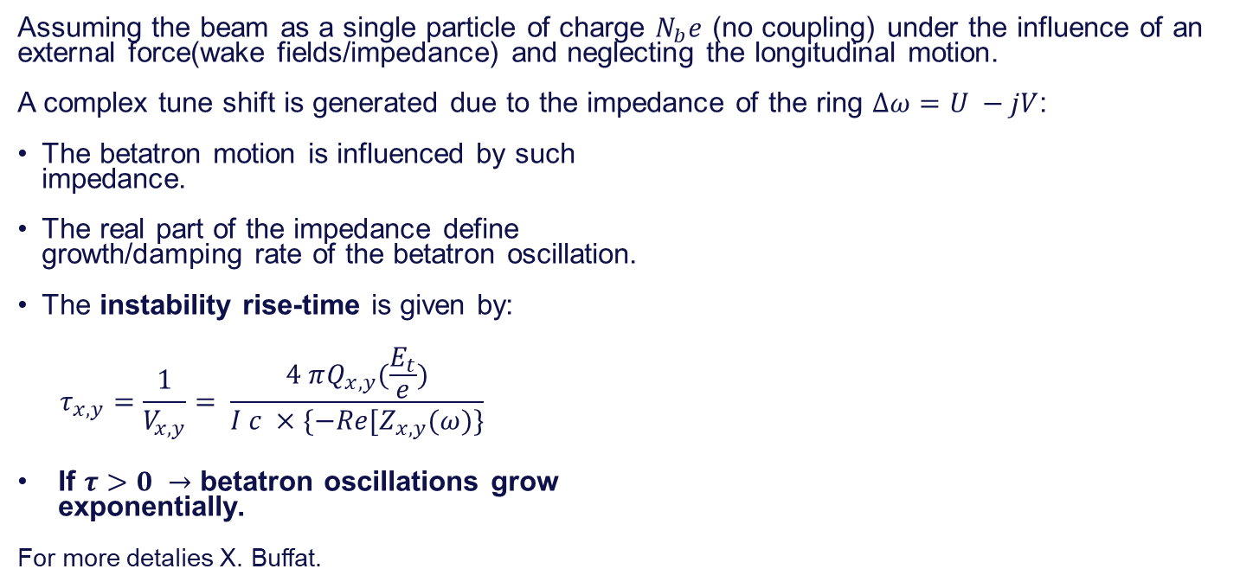
Fast instability: Introduction
04/11/2024 / 2nd FCC Italy & France Workshop
Giulia Nigrelli
18
Assuming the beam as a single particle of charge $N_{b}e$ (no coupling) under the influence of an external force(wake fields/impedance) and neglecting the longitudinal motion.
A complex tune shift is generated due to the impedance of the ring $Δω=U −jV$:
The betatron motion is influenced by such
impedance.
The real part of the impedance define
growth/damping rate of the betatron oscillation.
The instability rise-time is given by:
$$τ_{x,y}=\frac{1}{V_{x,y}}= \frac{4 πQ_{x,y}(\frac{E_{t}}{e})}{I c ×\{−Re[Z_{x,y}(ω)\}}$$
If $τ>0 →$ betatron oscillations grow
exponentially.
For more detalies X. Buffat.

Slide 19
Colors
Backgrounds
Background Blue
Background Purple
Background Yellow
Background Grey
Use for Layout
Radiant Blue
Flash
Energy
Green
Red
Deep
Blue

Slide 20
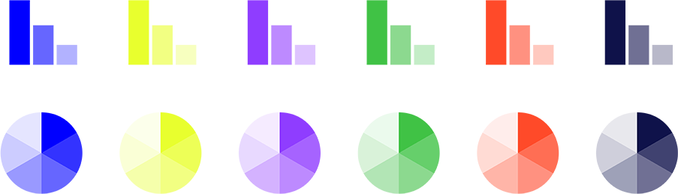
Graphical Elements
Badges
This information is a badge because it is important!
This information is a badge because it is important!
Separation lines 1.5 pt
Arrows
Use blue badges on light backgrounds
Infographics
This information is a badge because it is important!
This information is a badge because it is important!
Use light badges on dark backgrounds

