Slide 1

MAPP Electronics Status November 2024
Paul Davis
University of Alberta

Slide 2
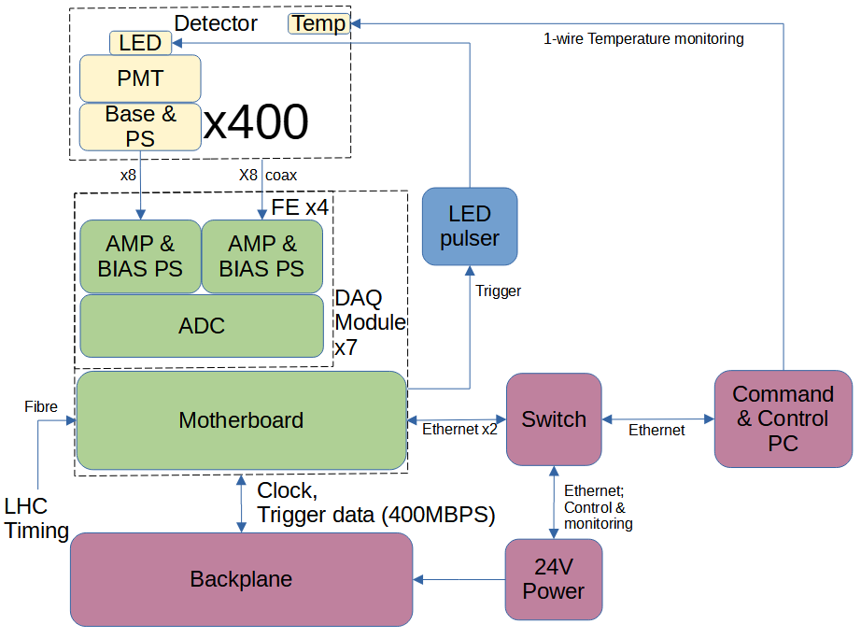
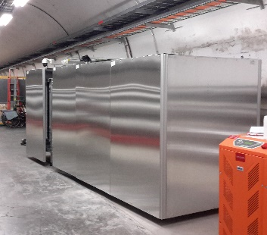
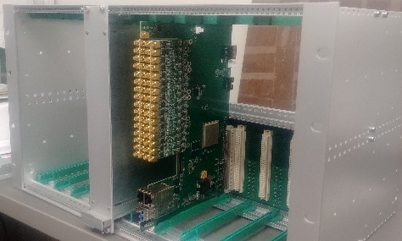
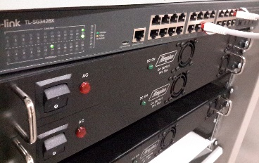
System Overview

Slide 3
Hardware Requirements
 |  | MAPP | Outrigger
 | Ready | Required | Required
PMT | 400 | 400 | 80
Power supply and base | 256 | 400 | 80
Amplifier | 51 | 50 | 10
ADC | 30 | 25 | 5
Motherboard | 5 | 7 | 1*
Card cage and backplane | 1 | 1 | 0*
* Increase by 1 if not shared with MAPP

Slide 4
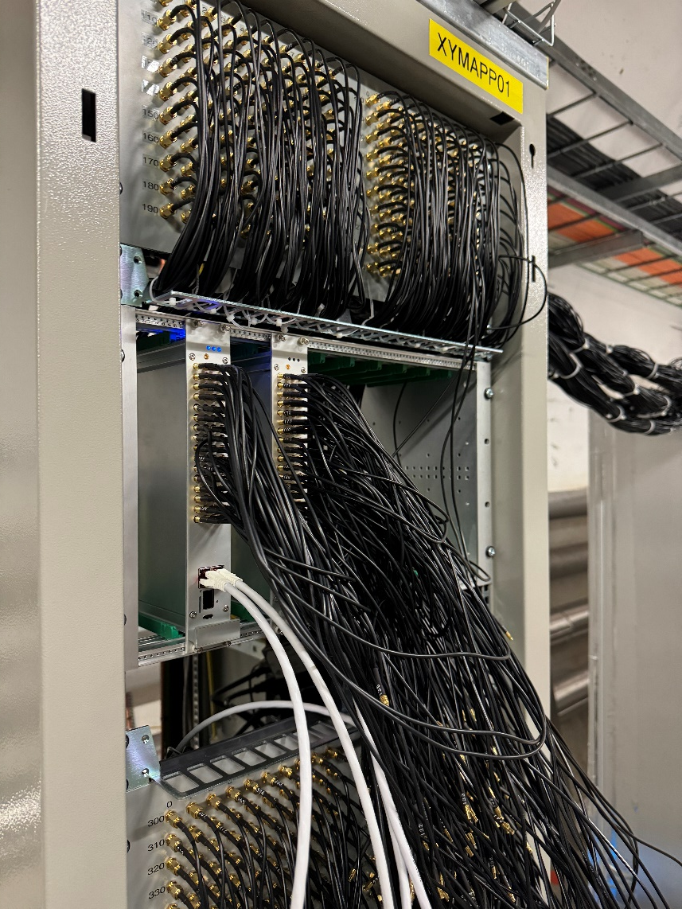
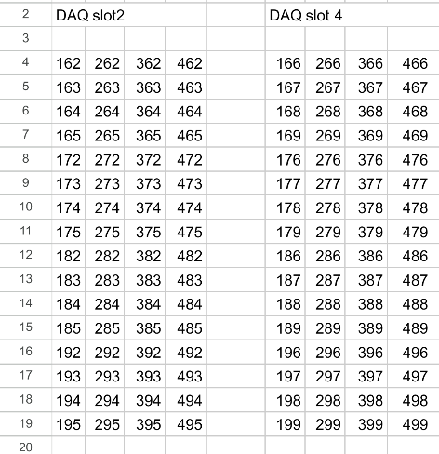
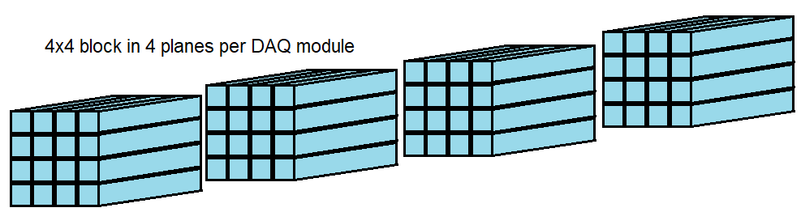
TS2 Activities
Only 2 days to get all work done
Card Cage Installed
Power supplies wired and tested
Ground bonding added
2 DAQ Modules Installed & wired

Slide 5
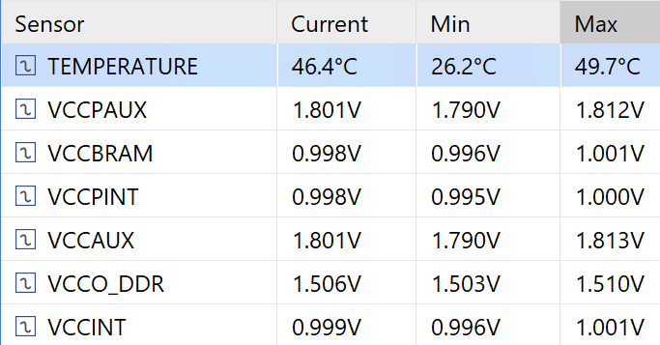
DAQ Status
DAQ Computer accessible
DAQ boards accessible
State of health readout functioning
Working on commissioning with channel readout

Slide 6
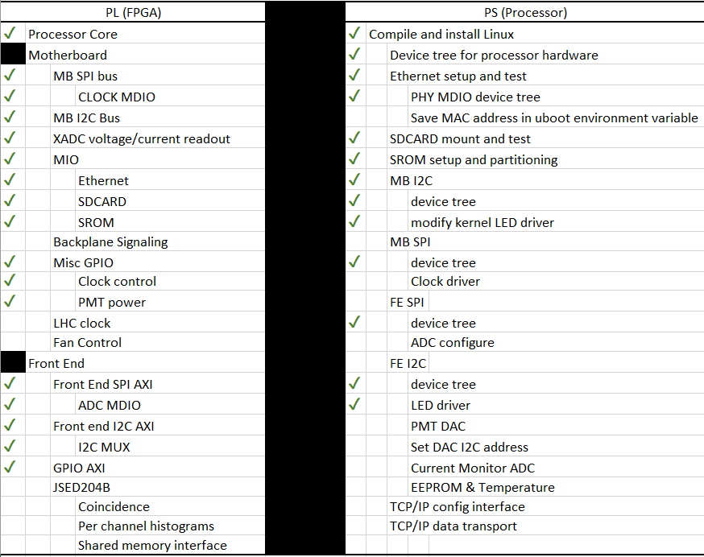
Software Status

Slide 7
Schedule
Tasks to complete at YETS
Tasks to complete before end of run
Prep 3 more DAQ modules for installation
Finish installation of the remainder of bases & PMTs
Install 6 DAQ modules & cable
Install temperature sensors
Install LED pulser cables
Finish readout software
Analyze muons from beam and cosmics

