Slide 1
MAPP TS2 2024 status
Richard Soluk – MoEDAL Collaboration (Technical Coordinator) University of Alberta

Slide 2

TS2 2024
MoEDAL
TS2 was scheduled for Oct 21-23, 2024
Goals
  Replace all the NTD plastic for MoEDAL around the LHCb VELO alcove
  Replace TPX power supply just outside of the VELO alcove
  Reconfigure MAPP in UA83 so that all 4 scintillator frames had a 7x7 array of scintillator blocks with PMTs and all cabling connected
  Close MAPP and complete all requirements for a safety inspection to receive run clearance
  Install MAPP electronics and commission data readout of partial detector

Slide 3
Actual Schedule TS2 2024
MoEDAL
PM85 lift required a cable replacement on Oct 21, zone not cleared by RP until 16:30 allowing approximately 1 hour of access
  UA83 access Oct 22 and Oct 23 (only till 5PM)
Part of VELO alcove now has radiation levels that raised it from a supervised to a controlled area limiting access
  People without controlled area training could still work in the area outside the VELO alcove

Slide 4
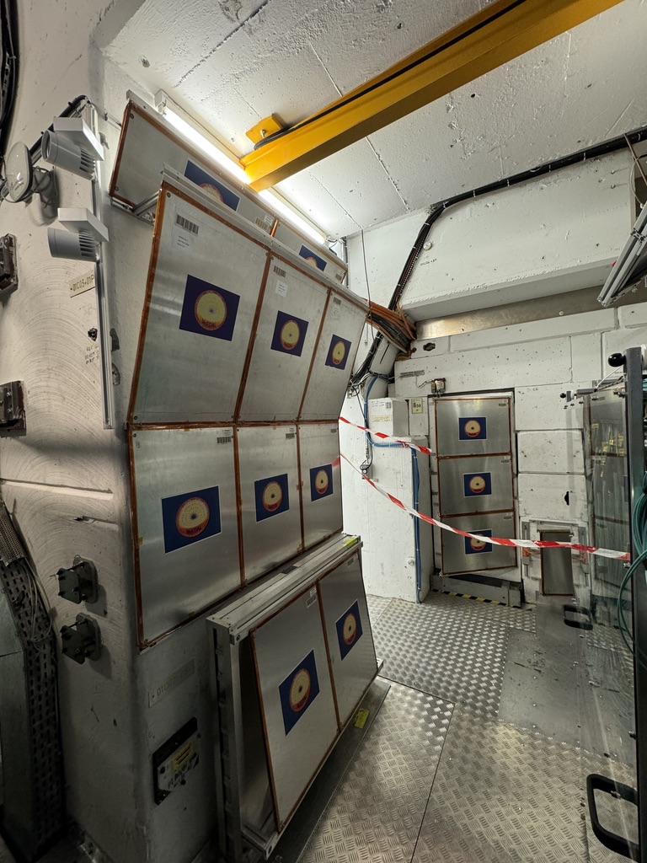
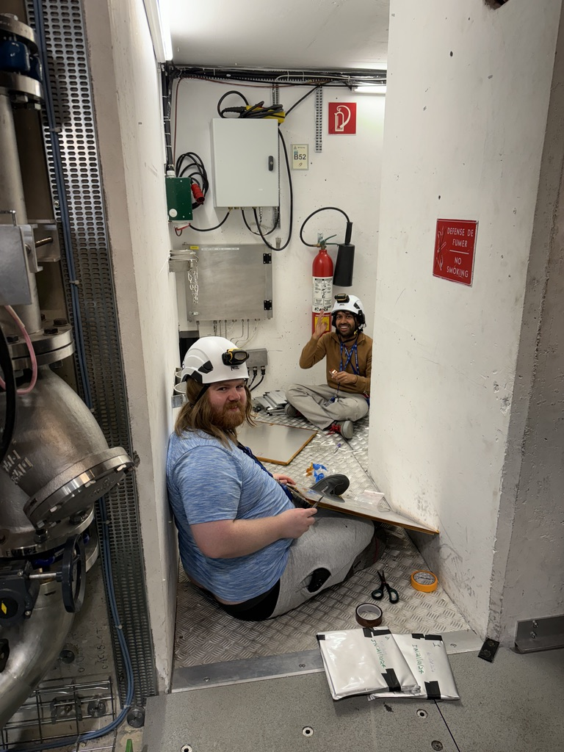
MoEDAL TS2 2024
MoEDAL
NTD replacement over 3 days
  Oct 21 Jack Lindon, Abhinab Mukhopadhyay, Richard Soluk
  Oct 22 Jack Lindon, Richard Soluk
  Oct 23 Jack Lindon, Richard Soluk
TPX power supply repair
  Oct 22 Martin Farkas
All NTDs replaced and new temporary TPX power supply installed for use until YETS

Slide 5
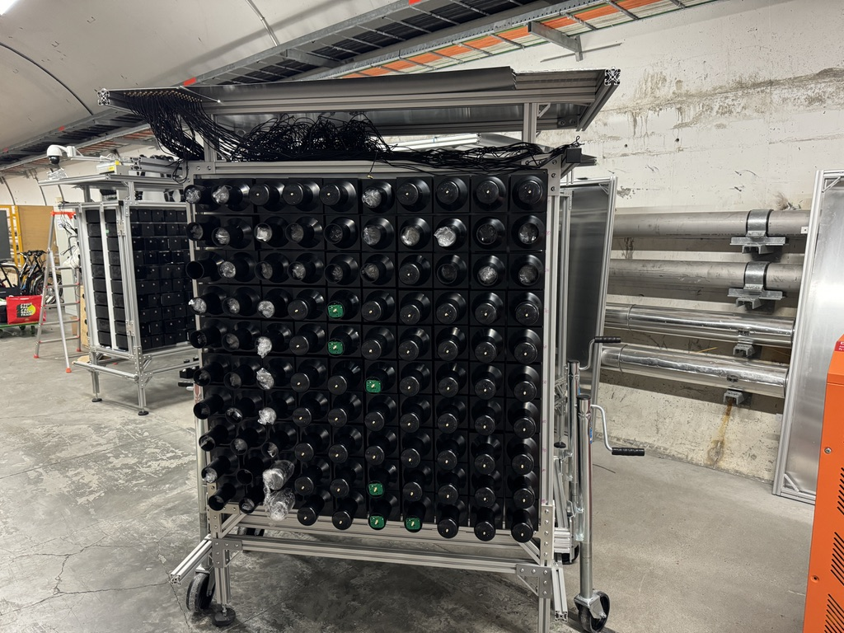
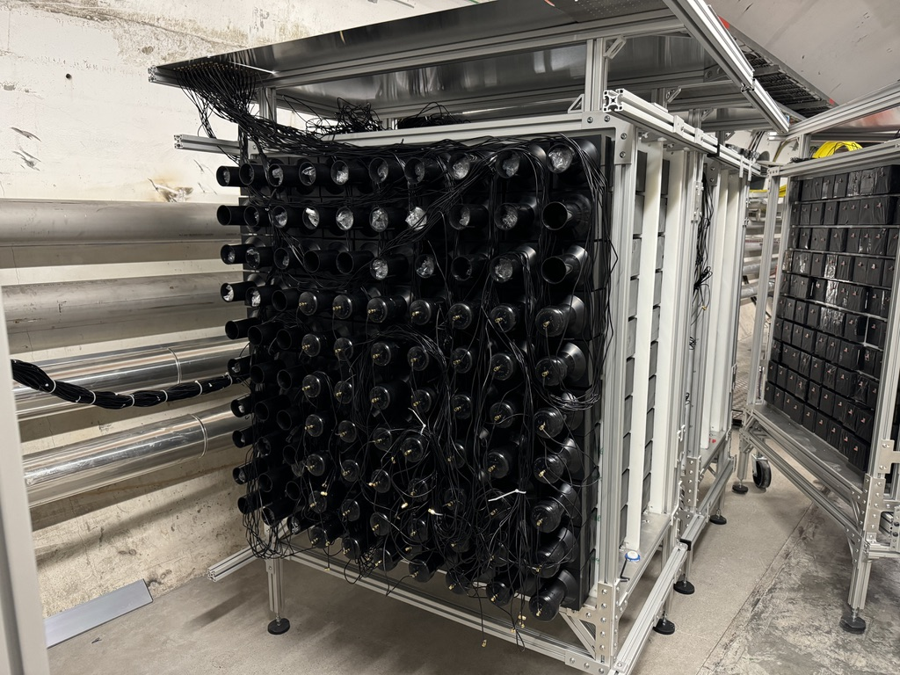
MAPP UA83
MoEDAL
Flame shield removal
  Oct 21 brief access Mukhopadhyay, Soluk
Detector frames moved (>1 ton)
Scintillator bars reconfigured to 7x7 array with PMTs and colinear between frames
Cabling done on both sides of detector patch panel
Flame shield reinstalled and all seams sealed
  Oct 22 Subash Behera, Mukhopadhyay, Soluk
  Oct 23 Behera, Soluk

Slide 6
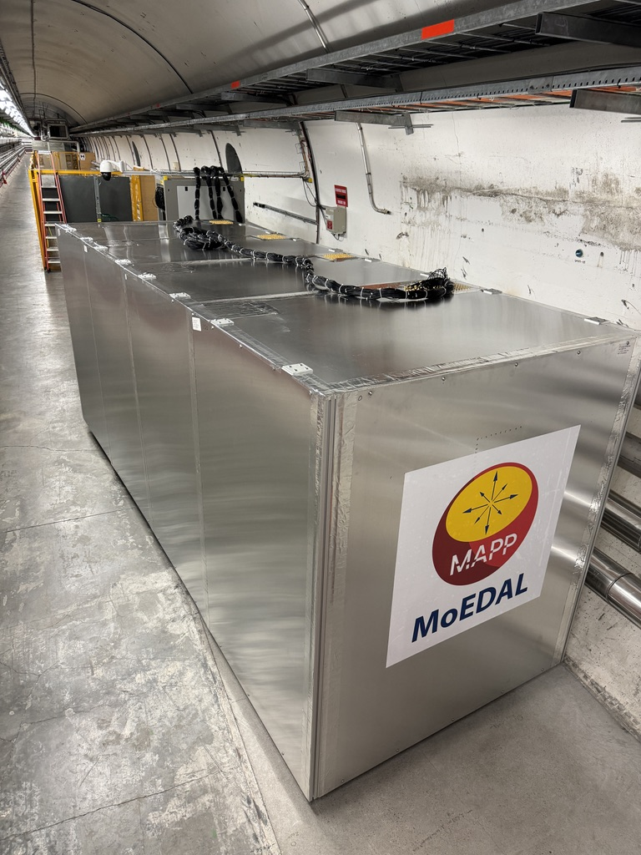
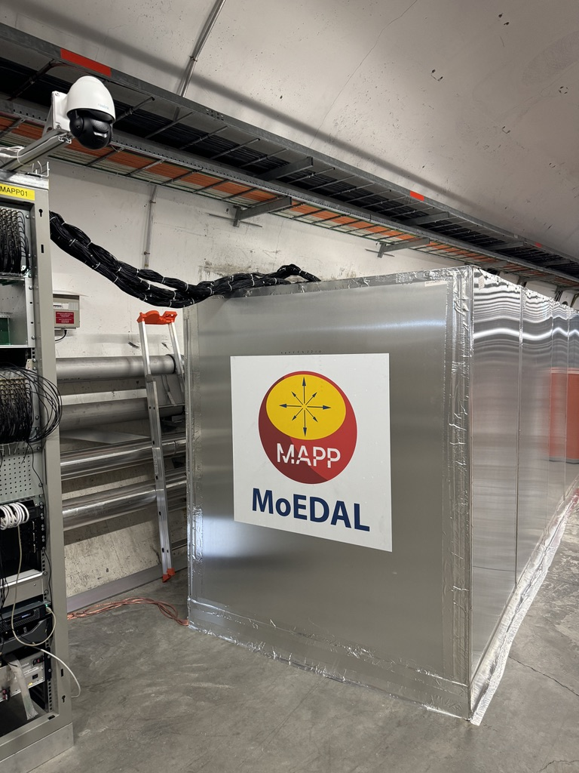
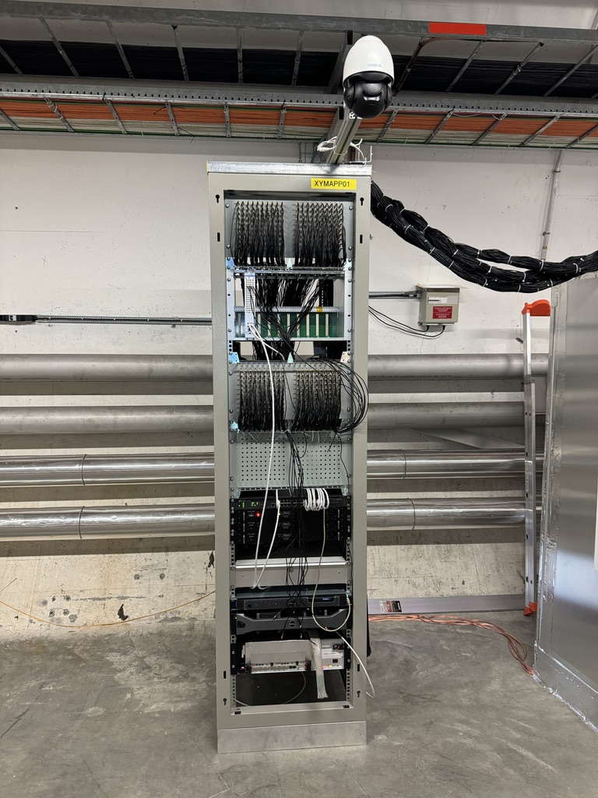
MAPP Electronics
MoEDAL
Electronics installation and rack configuration
All detector frames individually grounded
  Oct 22, 23 Paul Davis
Safety inspection done 12:30 Oct 23
  Special thanks to Evelyne Dho and James Devine for making the safety inspection possible

Slide 7
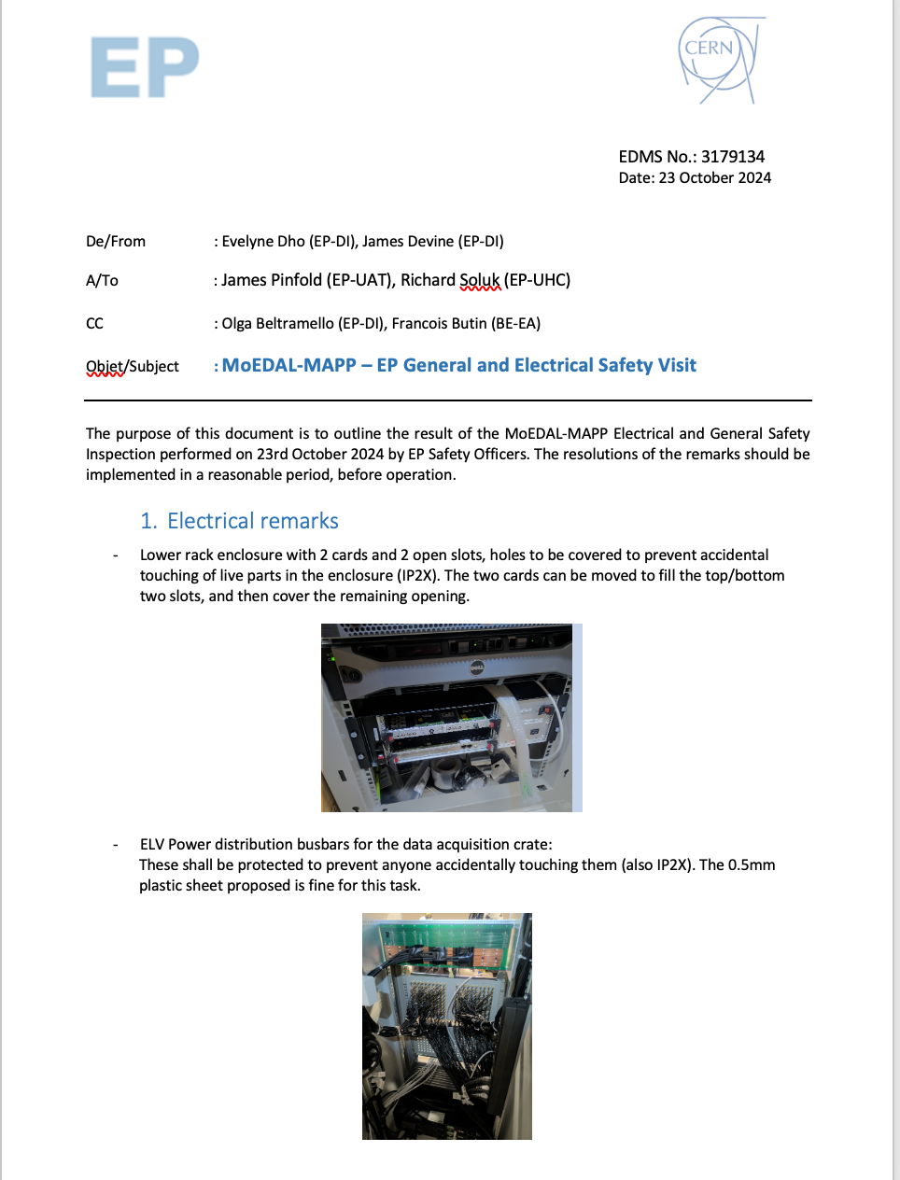
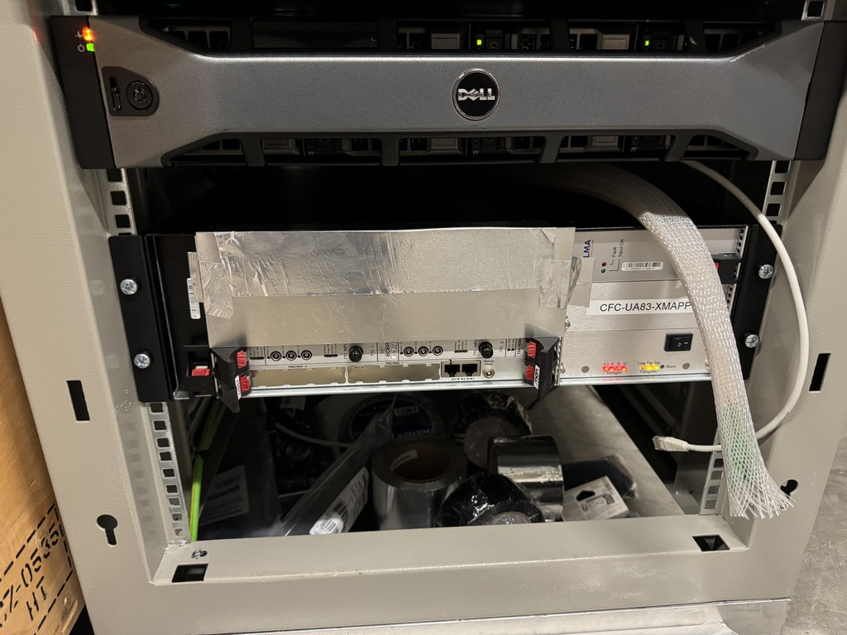
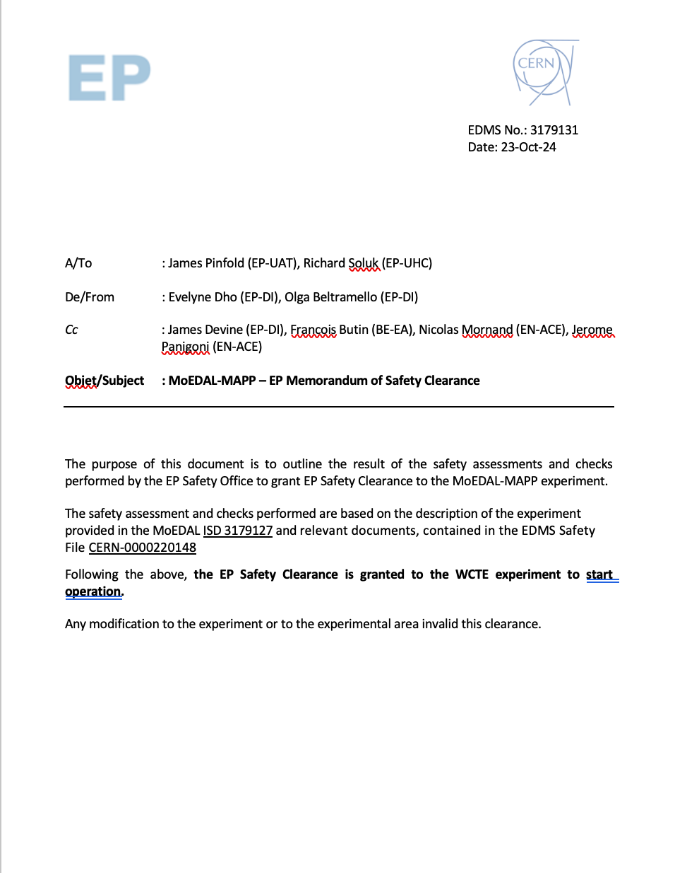
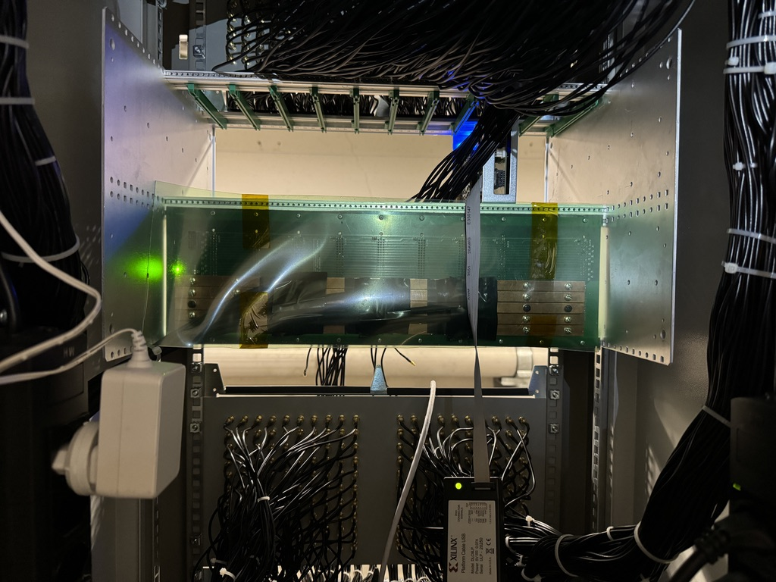
MAPP Electronics
MoEDAL
Minor modifications needed to satisfy safety requirements
  Mainly IP2X requirement that electronic components could not accidentally be touched
Run certificate granted

Slide 8
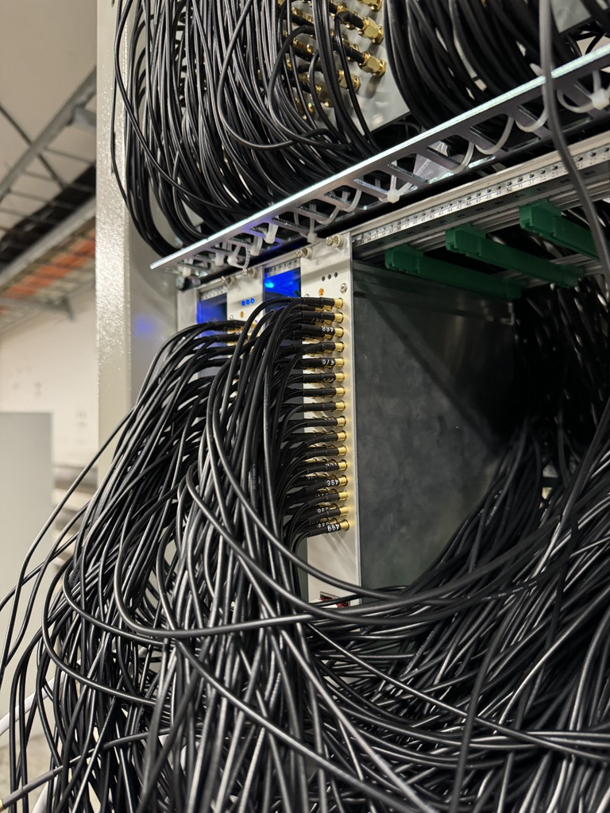
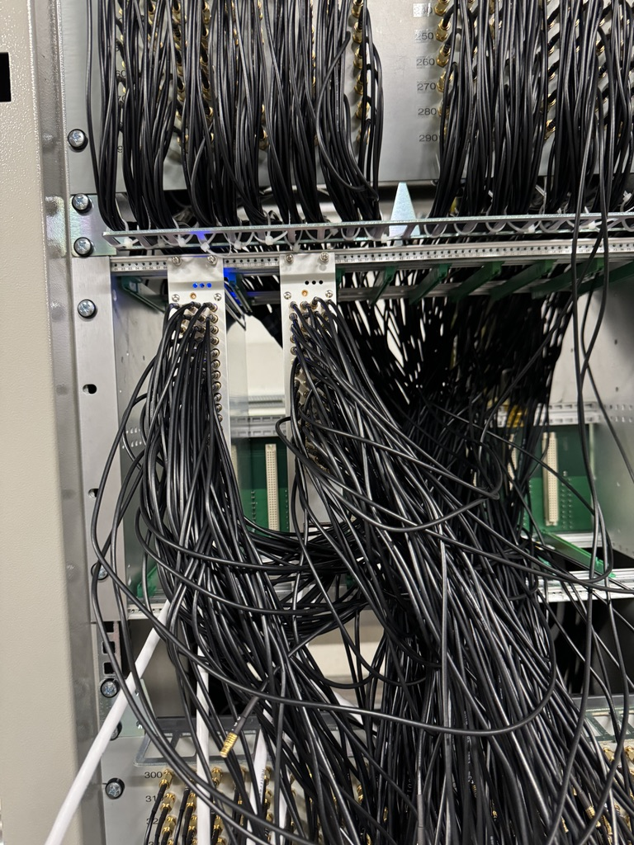
Electronics Cabling
MoEDAL
Oct 23 access ran out before electronics-side cabling could be done or second ADC board installed
Oct 24 short access granted, warned it could be as short as 20 minutes
Installed 64 channels on first ADC board
Installed second ADC board and connected additional 64 channels

