Slide 1
WG4 Progress Report
R. Santoro, A. Tauro

Slide 2
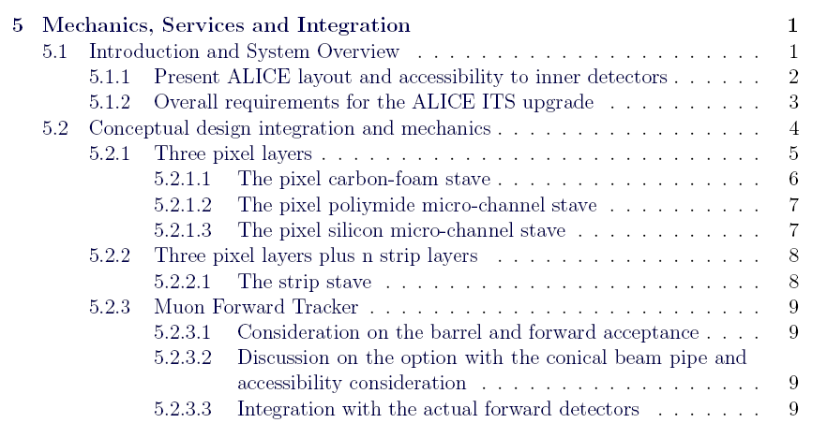
Chapter V (I)

Slide 3
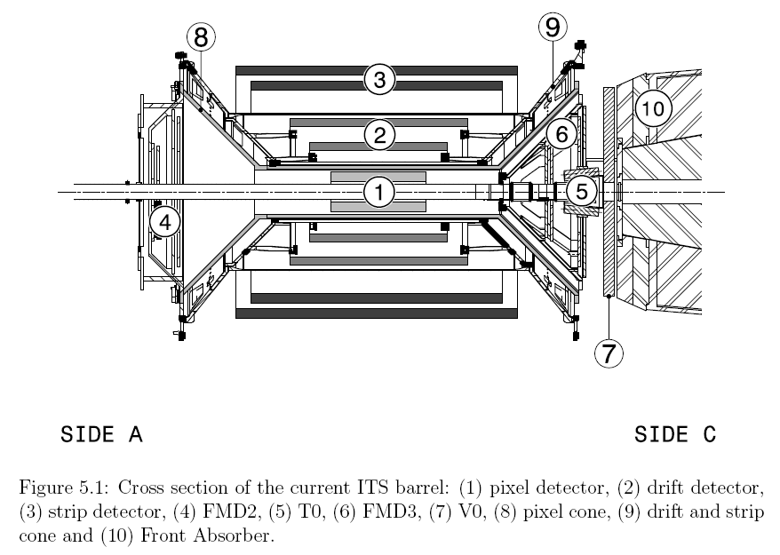
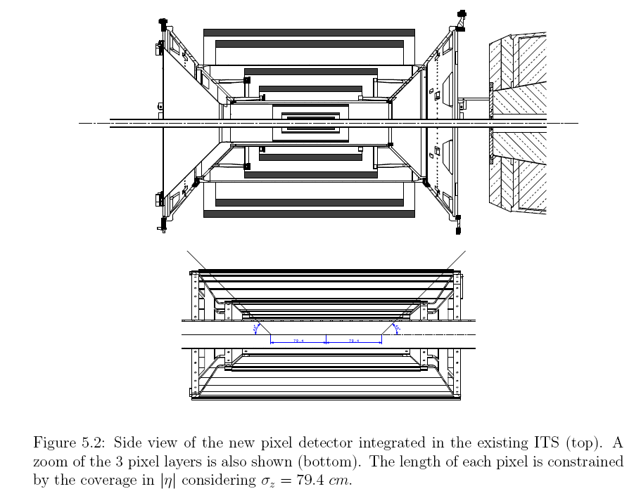
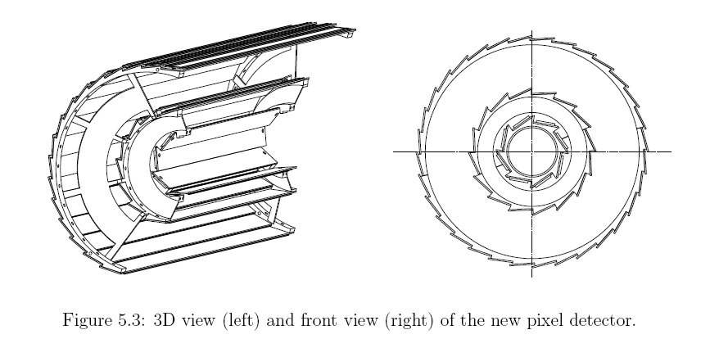
Present ITS
New Pixel layers

Slide 4
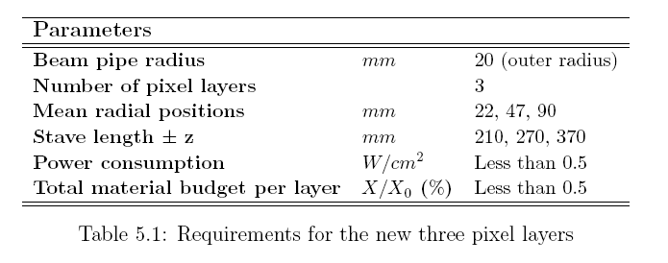
Requirements: 1st scenario
Requirements are crucial to define the right strategy especially if we aim for 0.3% of X/X0 on the first layers
  What is the optimal sensor dimension in rφ?
  (discussion on-going with Stefan: https://indico.cern.ch/getFile.py/access?contribId=7&resId=0&materialId=slides&confId=131413 )
  Are the overlap really needed?
  What is the expected rigidity from the mechanical point of view?
  What is the acceptable gradient in temperature along the sensor?

Slide 5
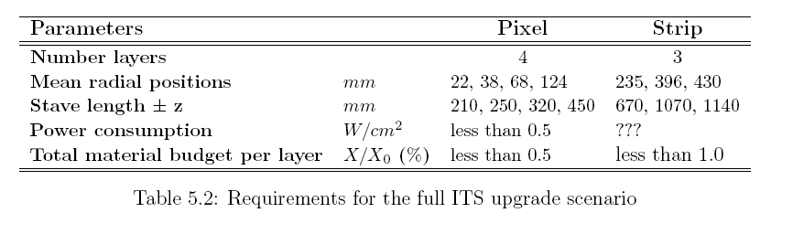
Requirements: 2nd scenario
At the moment we didn’t started yet with mechanical studies
Preliminary discussions have been carried out with the group of Nantes

Slide 6
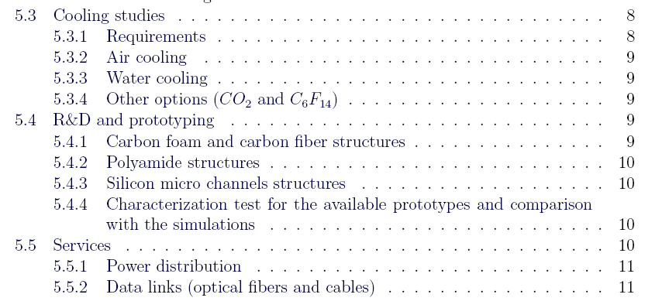
Chapter V (II)
At this stage different cooling options are taken in consideration
There are simulations on the table for some mechanical structures and we are starting the prototyping phase for some of those
  Poliymide micro-channel: first samples under test
  Structure with carbon foam: material under procurement

Slide 7
Chapter V (III)
Power distribution considerations are needed

Slide 8
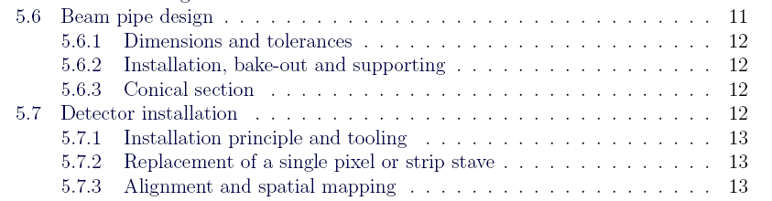
Chapter V (IV)
Beam pipe:
  Very preliminary discussions have been started
Detector installation:
  Conceptual studies have been started:
  https://indico.cern.ch/getFile.py/access?contribId=4&resId=0&materialId=slides&confId=143327
  More detailed drawings will come soon

Slide 9
Summary
Abstract: completed
Draft version of text: is still on-going
The first figures are coming …
The interaction with the other WGs is very important!!!

Slide 10
Spares

Slide 11
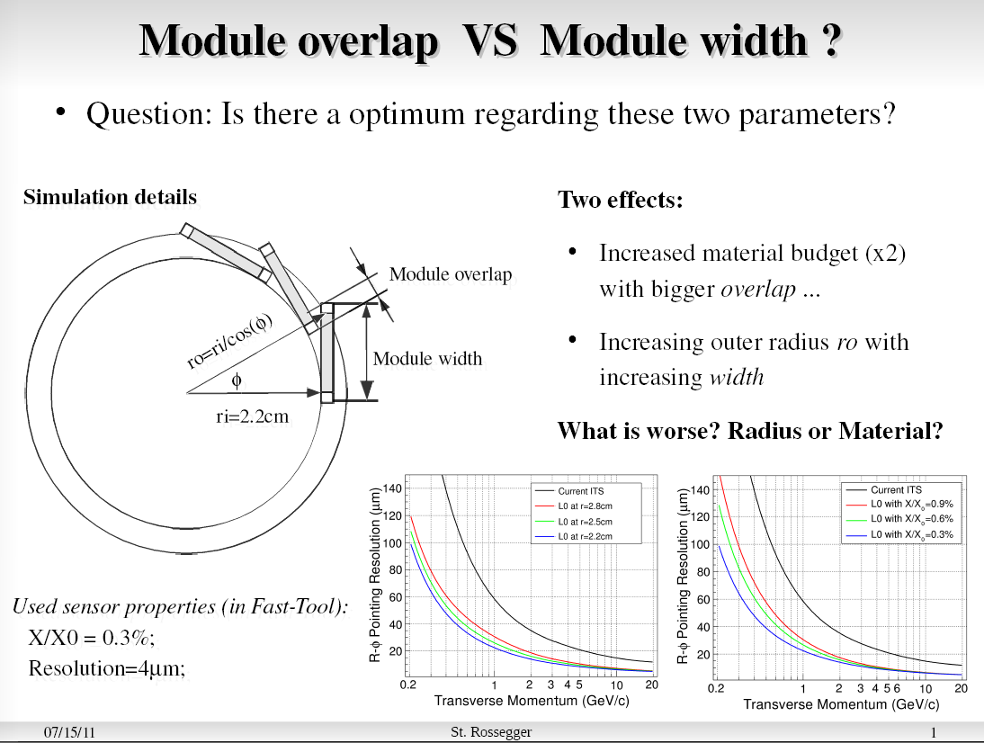

Slide 12
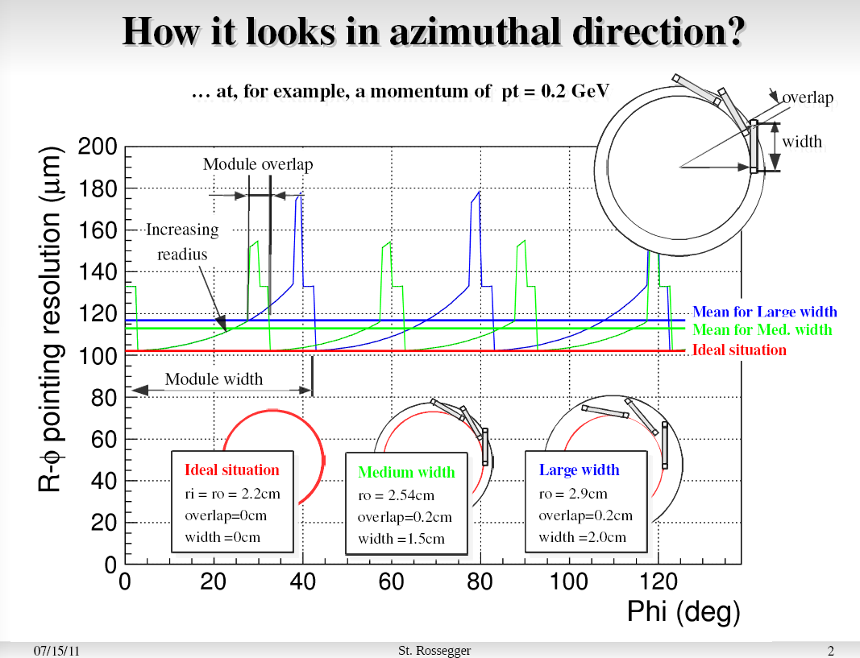

Slide 13
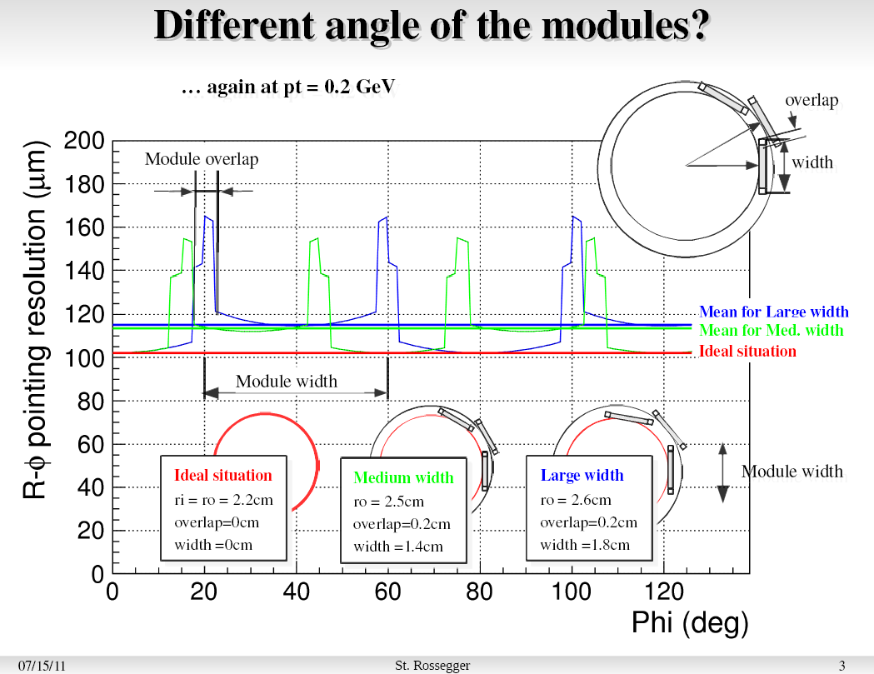

Slide 14
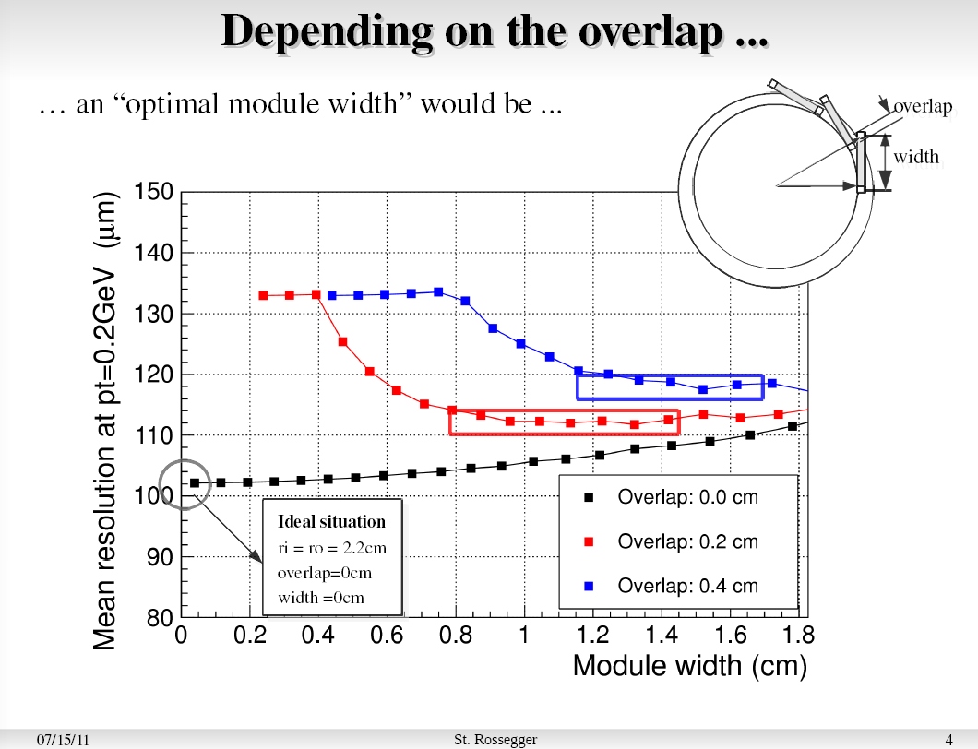

Slide 15
