Slide 1
MWPC Consolidation Strategy
Inaki Ortega, Jean Cenede, Jan Buesa, Christophe Vuitton
177th EATM - 5 November 2024

Slide 2
MWPC Status
Large chambers (XWCM):
  Critical: only 1 spare available (recently repaired, although with a few dead channels).
  Several beamlines depend on these: M2, K12, CHARM.
Small chambers (XWCA):
  Not critical: a few units ready. Their failure rate is lower because they’re not installed in high-radiation areas.
Local electronics:
  Not critical: we produced 2 years ago sufficient electronics
VME electronics:
  Not critical: boards are failing due to ageing and we’re not able to repair them.
  However, these do not break often + the new generation of boards is being designed.

Slide 3
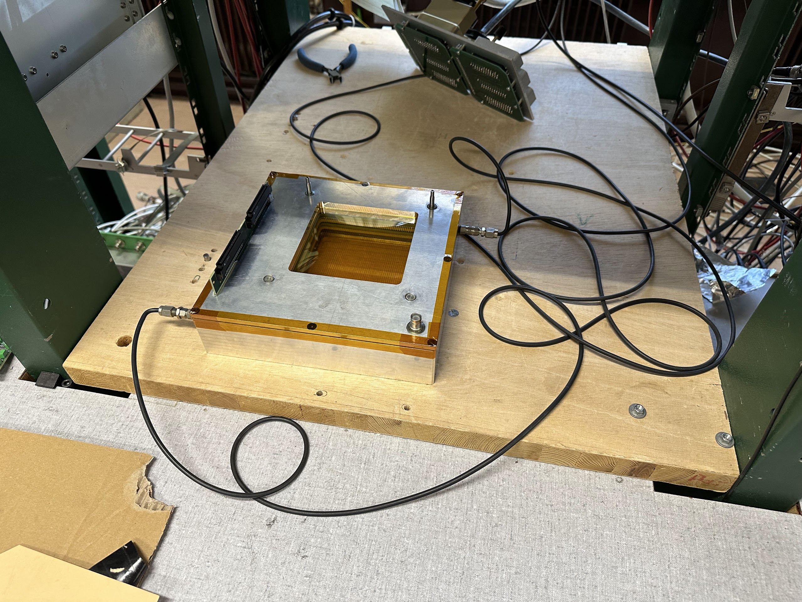
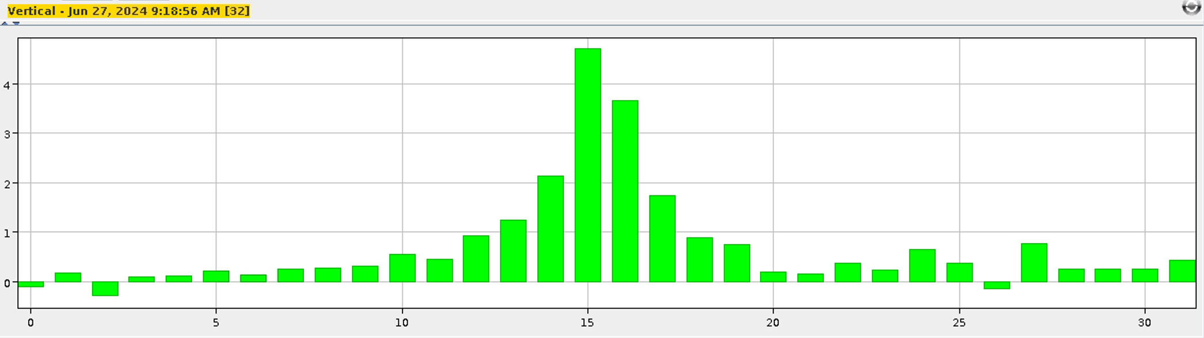
First prototype status
We successfully tested the first 10cm x 10cm prototype in the lab.
  However, it took longer than expected to produce.
    Issues with the weaving machine
    Many small problems with the prototype
  We have learnt a lot from this prototype, and we feel confident about going for the 20cm x 20cm chamber.

Slide 4
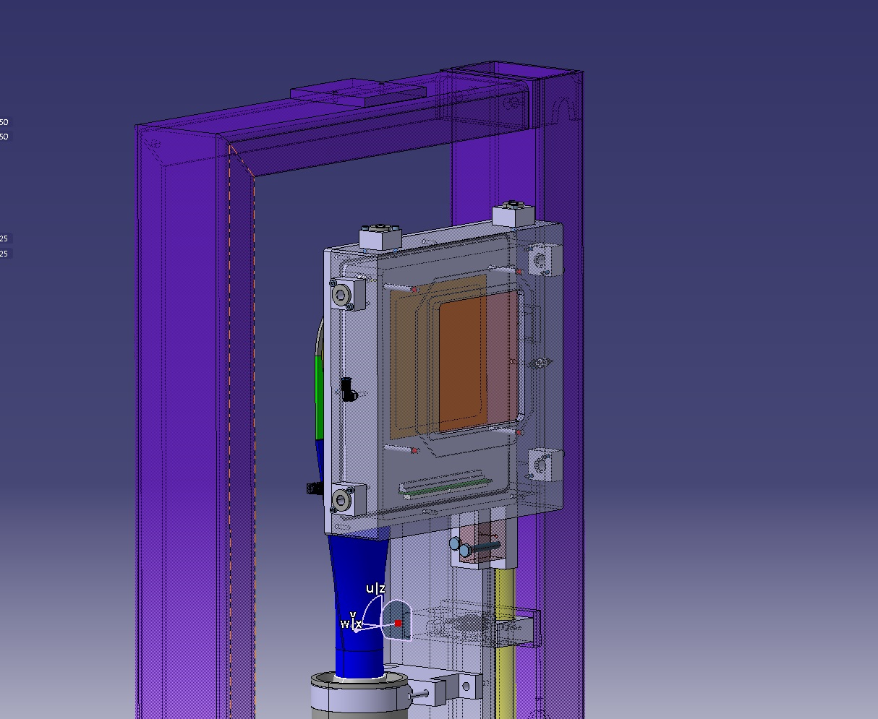
A second iteration is being produced, also
including feedback from the survey team

Slide 5
MWPC refurbishment outlook
Due to the critical situation of spares, we should aim for a second prototype for April 2025
  Critical Spare situation recently presented at IEFC and Budget Change Request submitted a few weeks ago to ensure funding for the next units:
    SPSX-PM-BC-0023 v.0.1 "Budget Change Request for WP3.2.4 MWPCs" by Inaki Ortega Ruiz. Link: https://edms.cern.ch/comment/3173076/0.1
    3173094 v.0.1 "Multi-Wire Proportional Chambers - Critical Spares" by Inaki Ortega Ruiz. Link: https://edms.cern.ch/comment/3173094/0.1
  At the moment we’re only 2 people working on it -> slow progress.
    Based on our experience, we need more people working on this to achieve our goal.
    A new Fellow physicist from the SY-BI group is joining us.

Slide 7
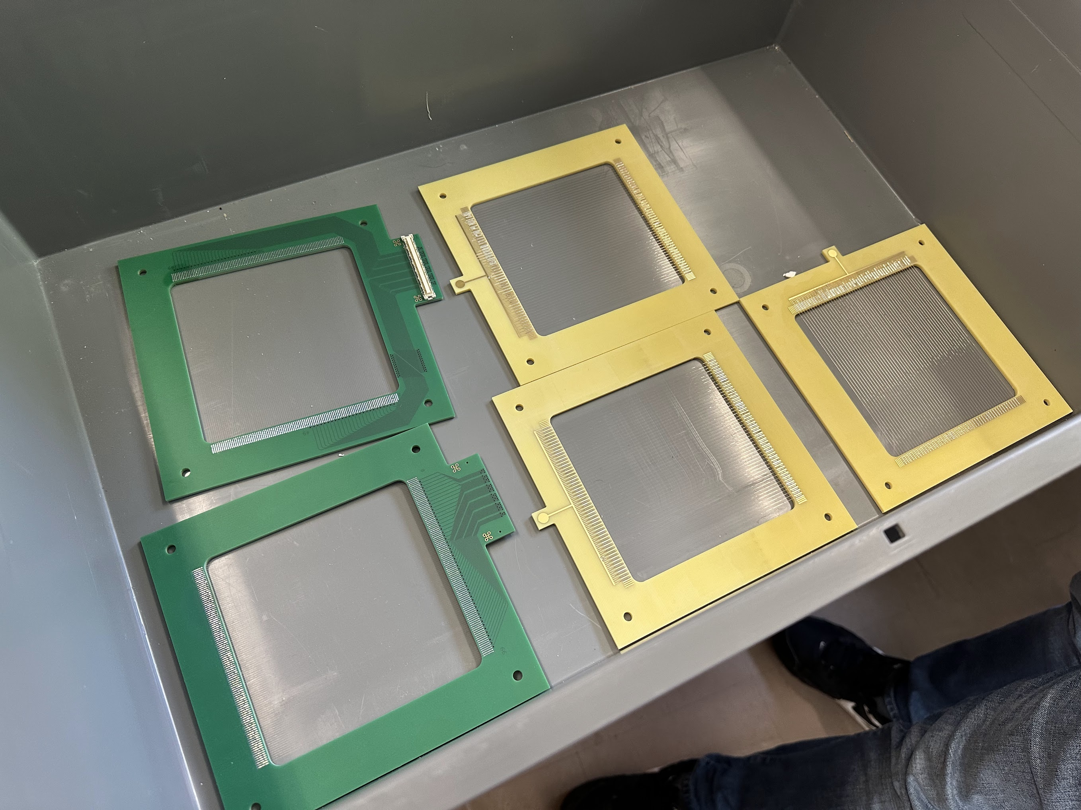
First prototype production and testing
Assembly of the first prototype has been strongly delayed due to the “unavailability” of the weaving machine.
Around March 2024 we finally got all wire planes and started assembly.
This has been quite a journey – I’ll try to transmit the experience to you

Slide 8
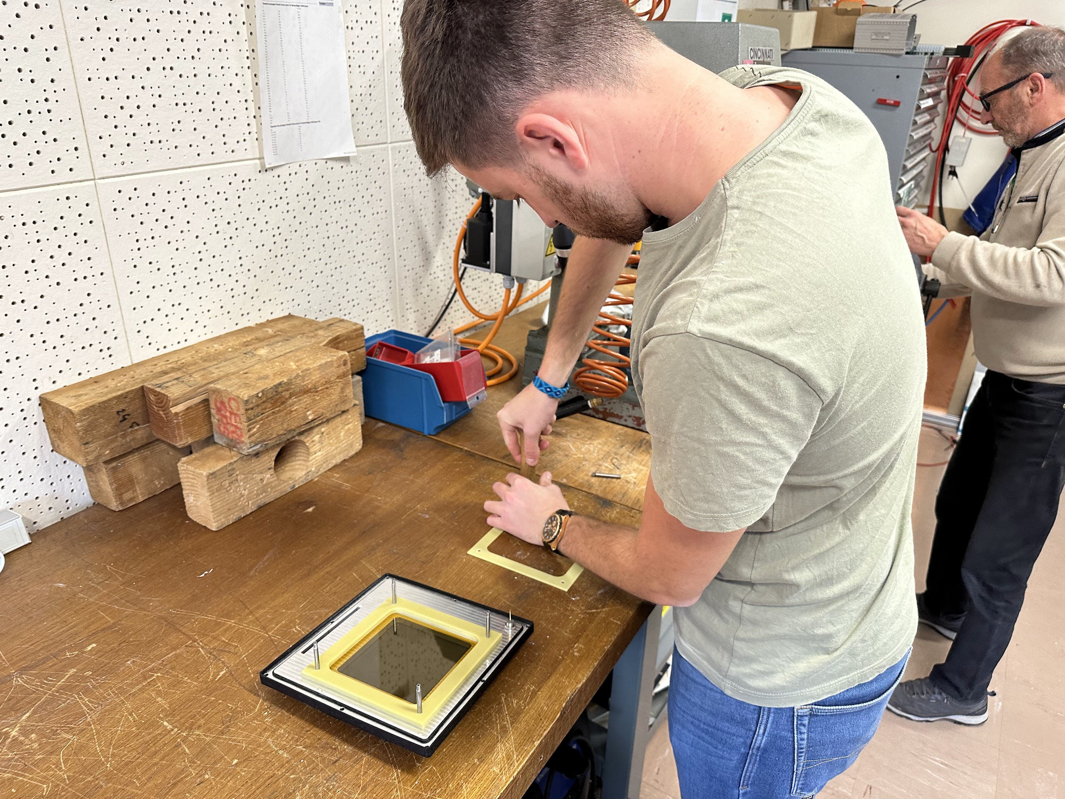
Mechanical tweaks

Slide 9
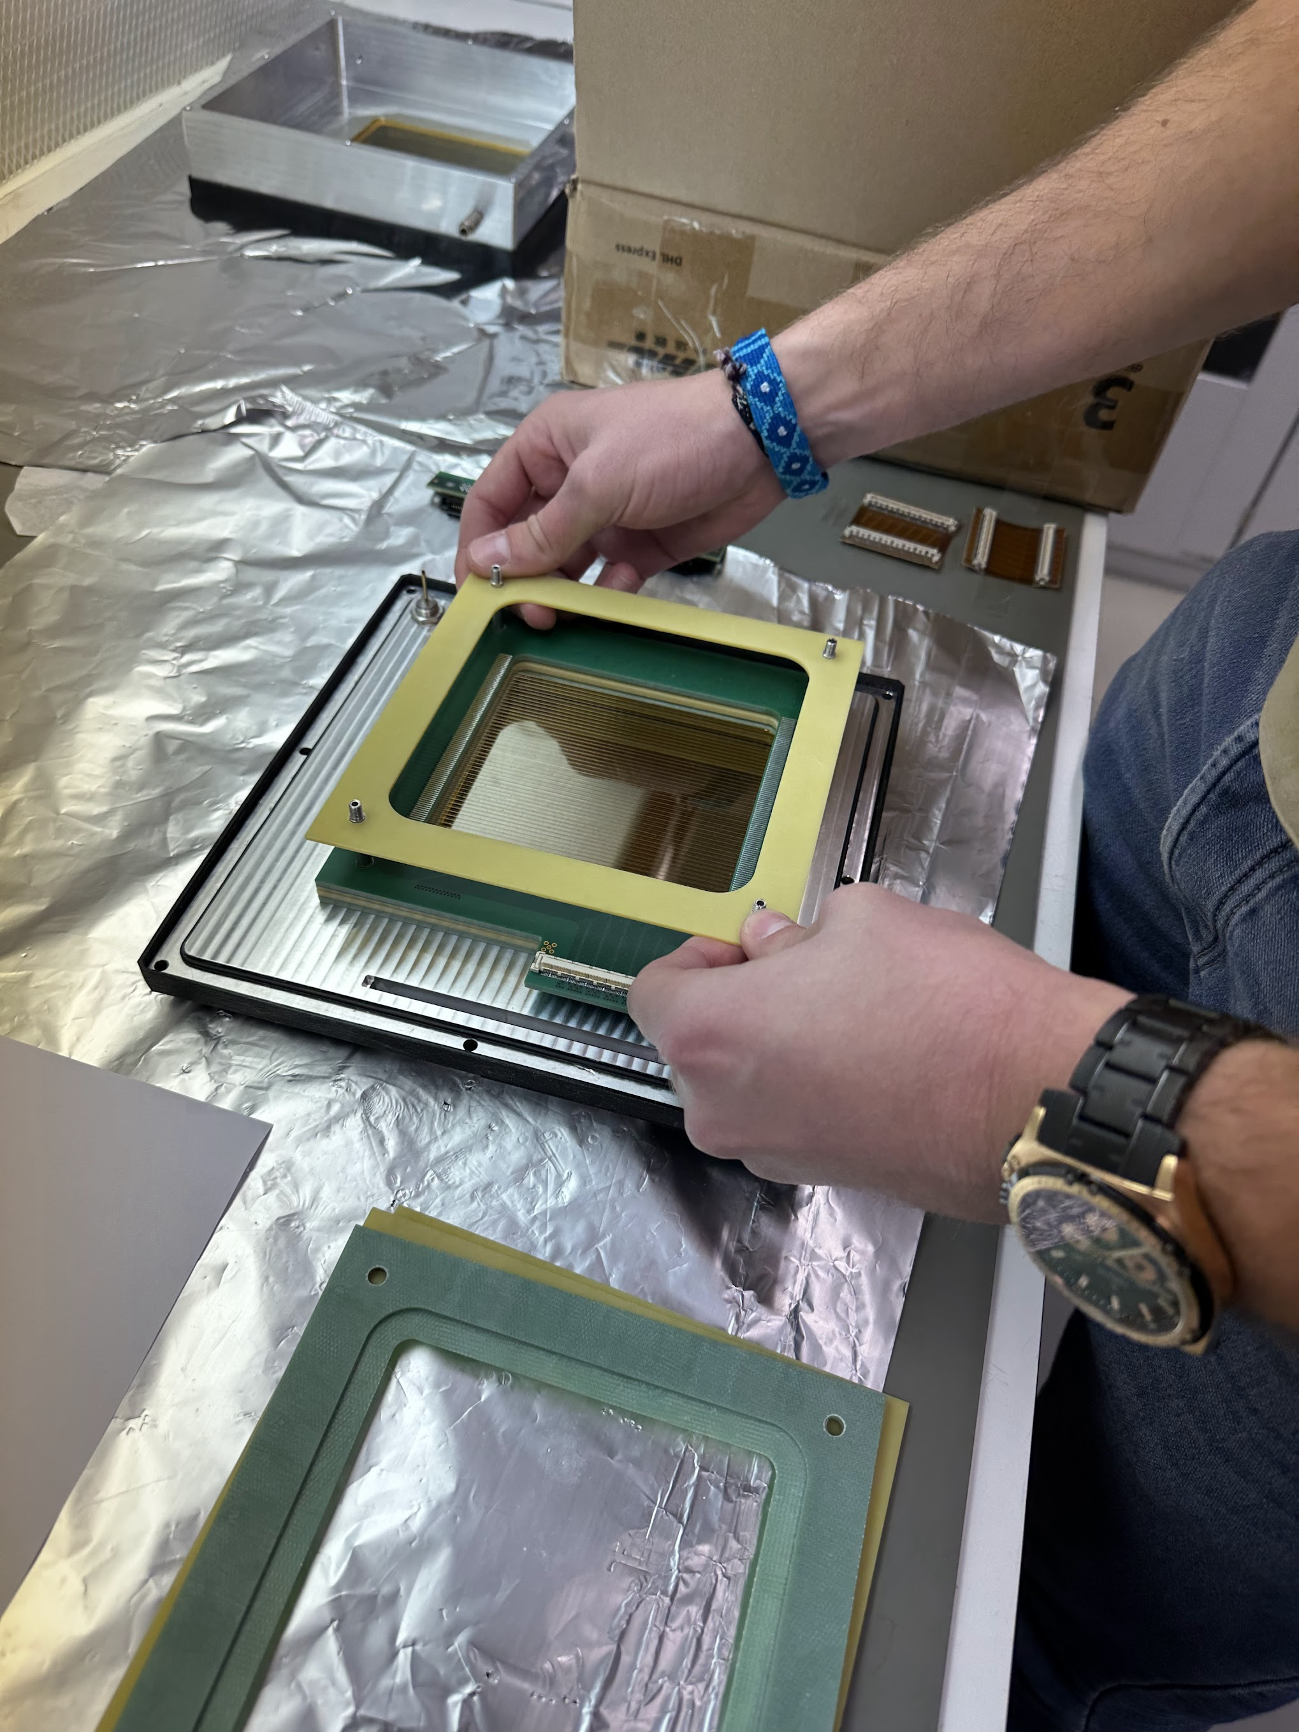
Assembly in the
laminar flow
chamber

Slide 10
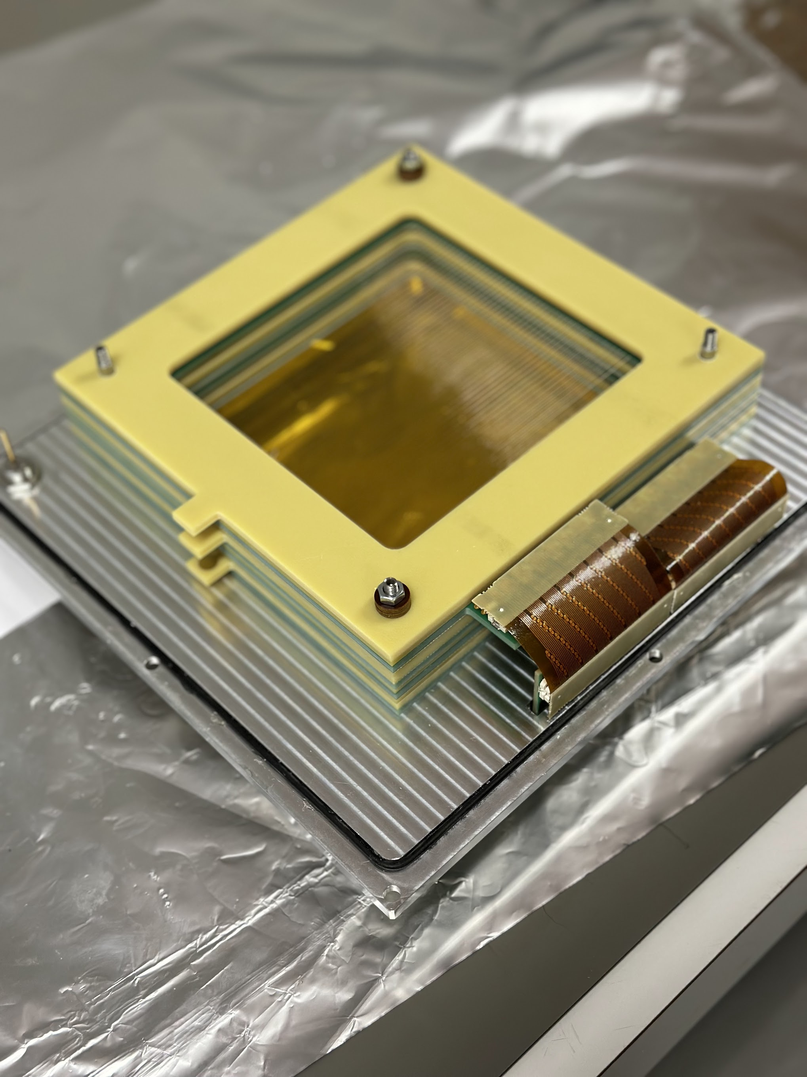
Full stack assembled

Slide 11
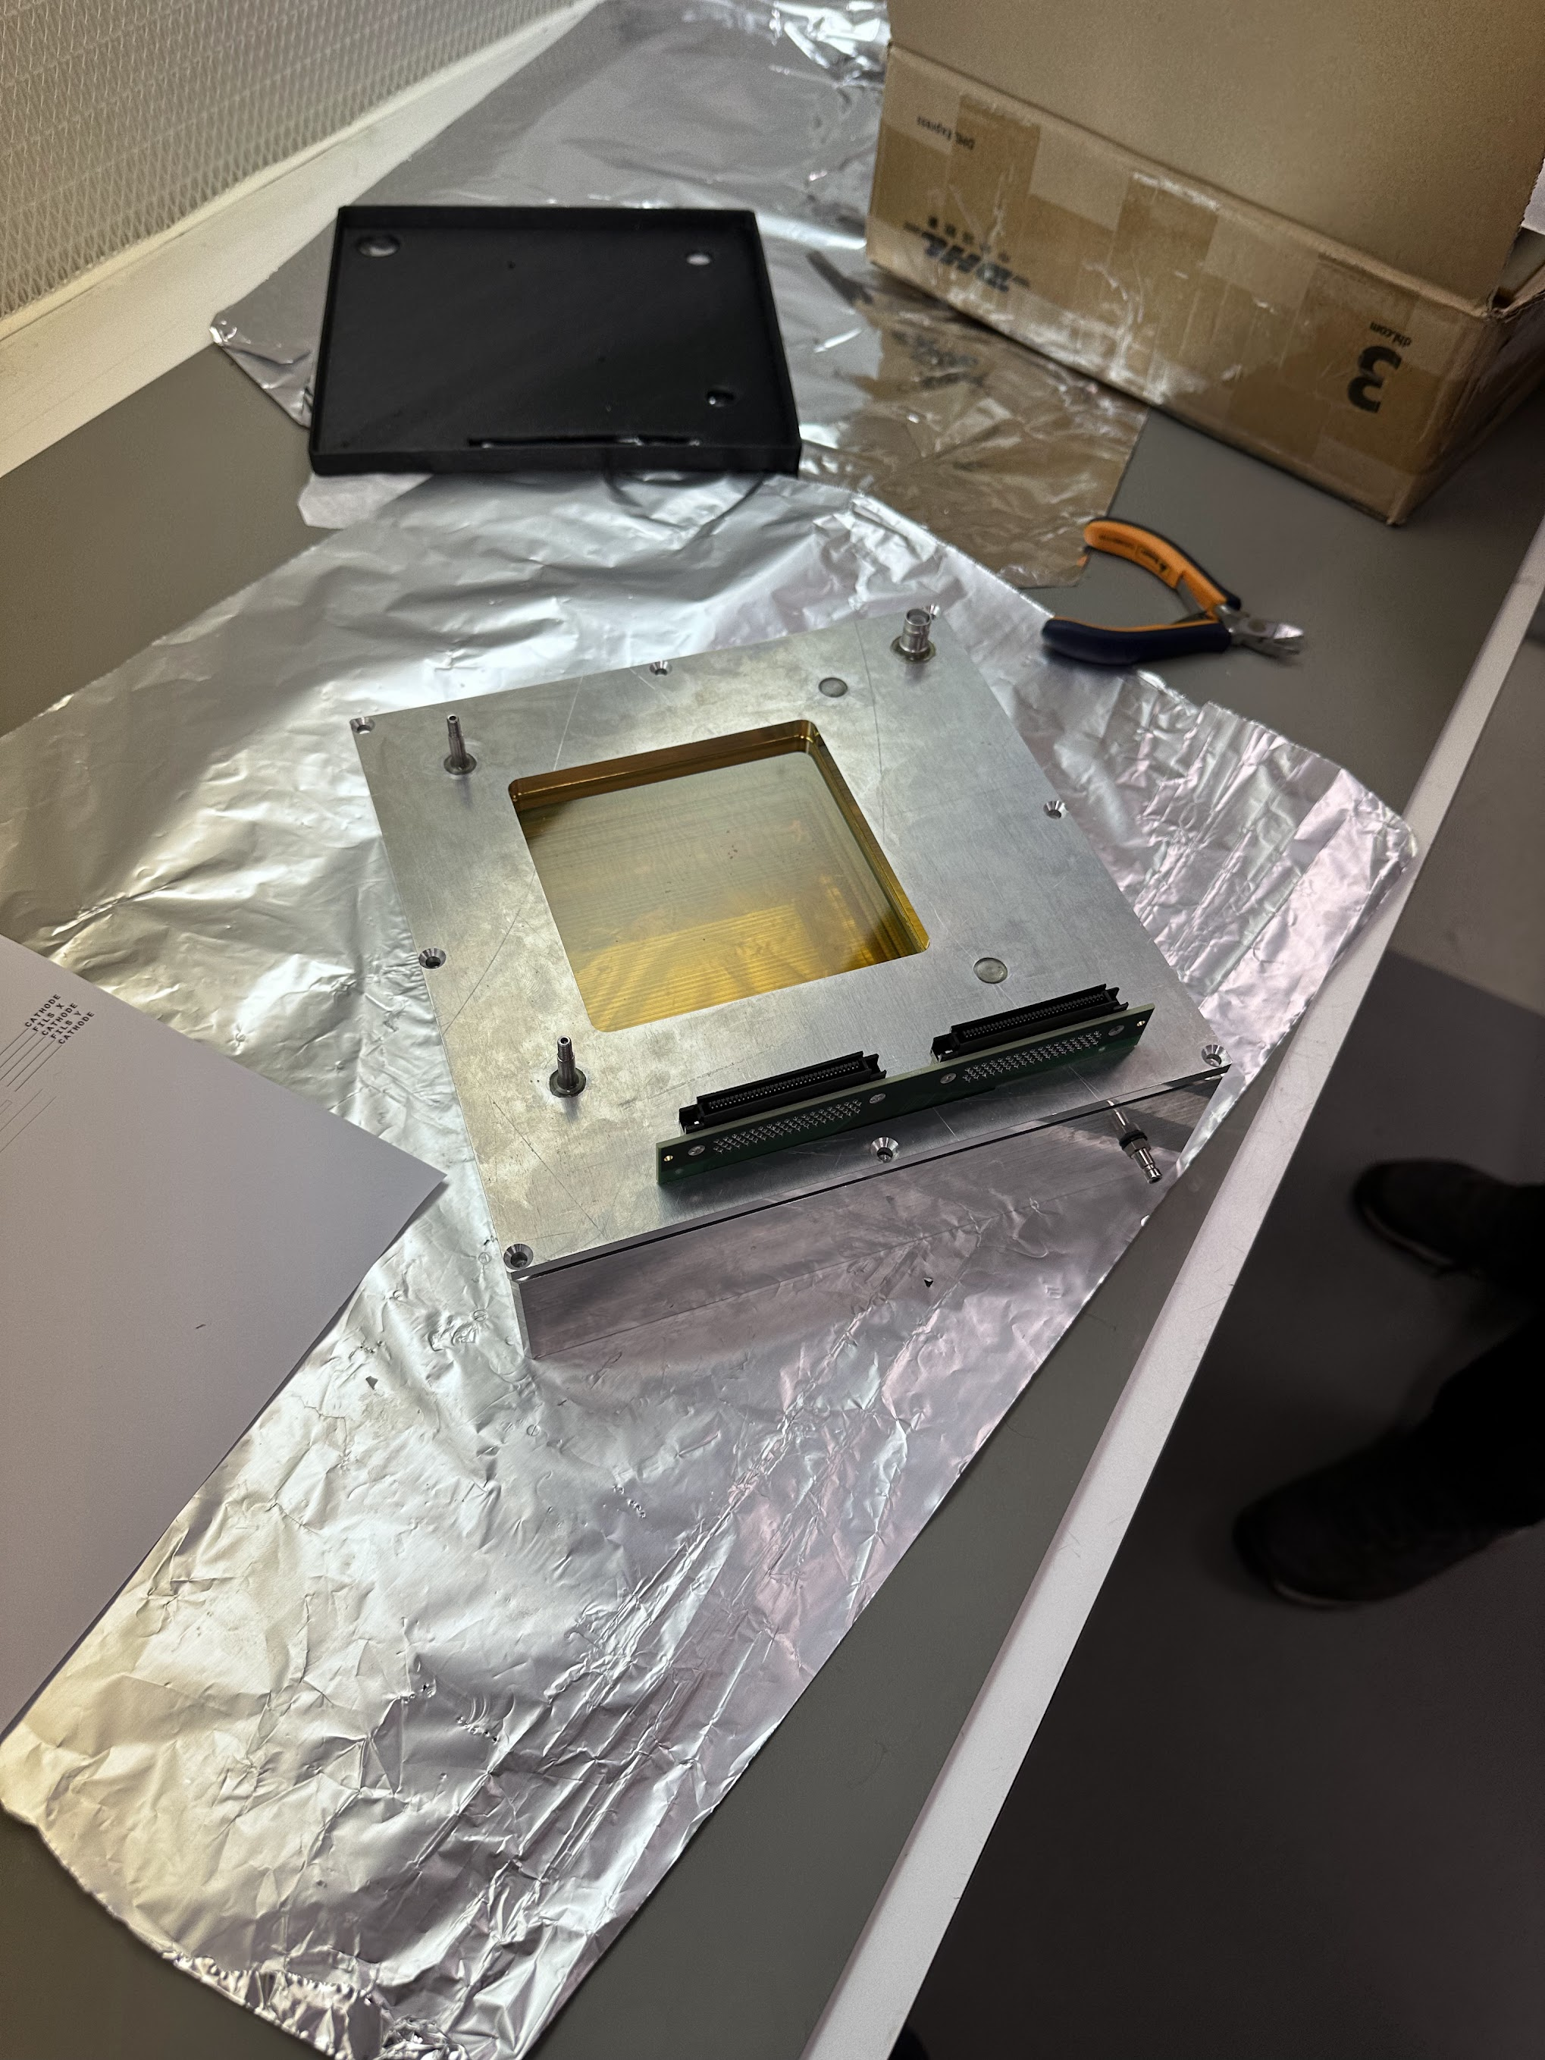
Detector box
closed

Slide 12
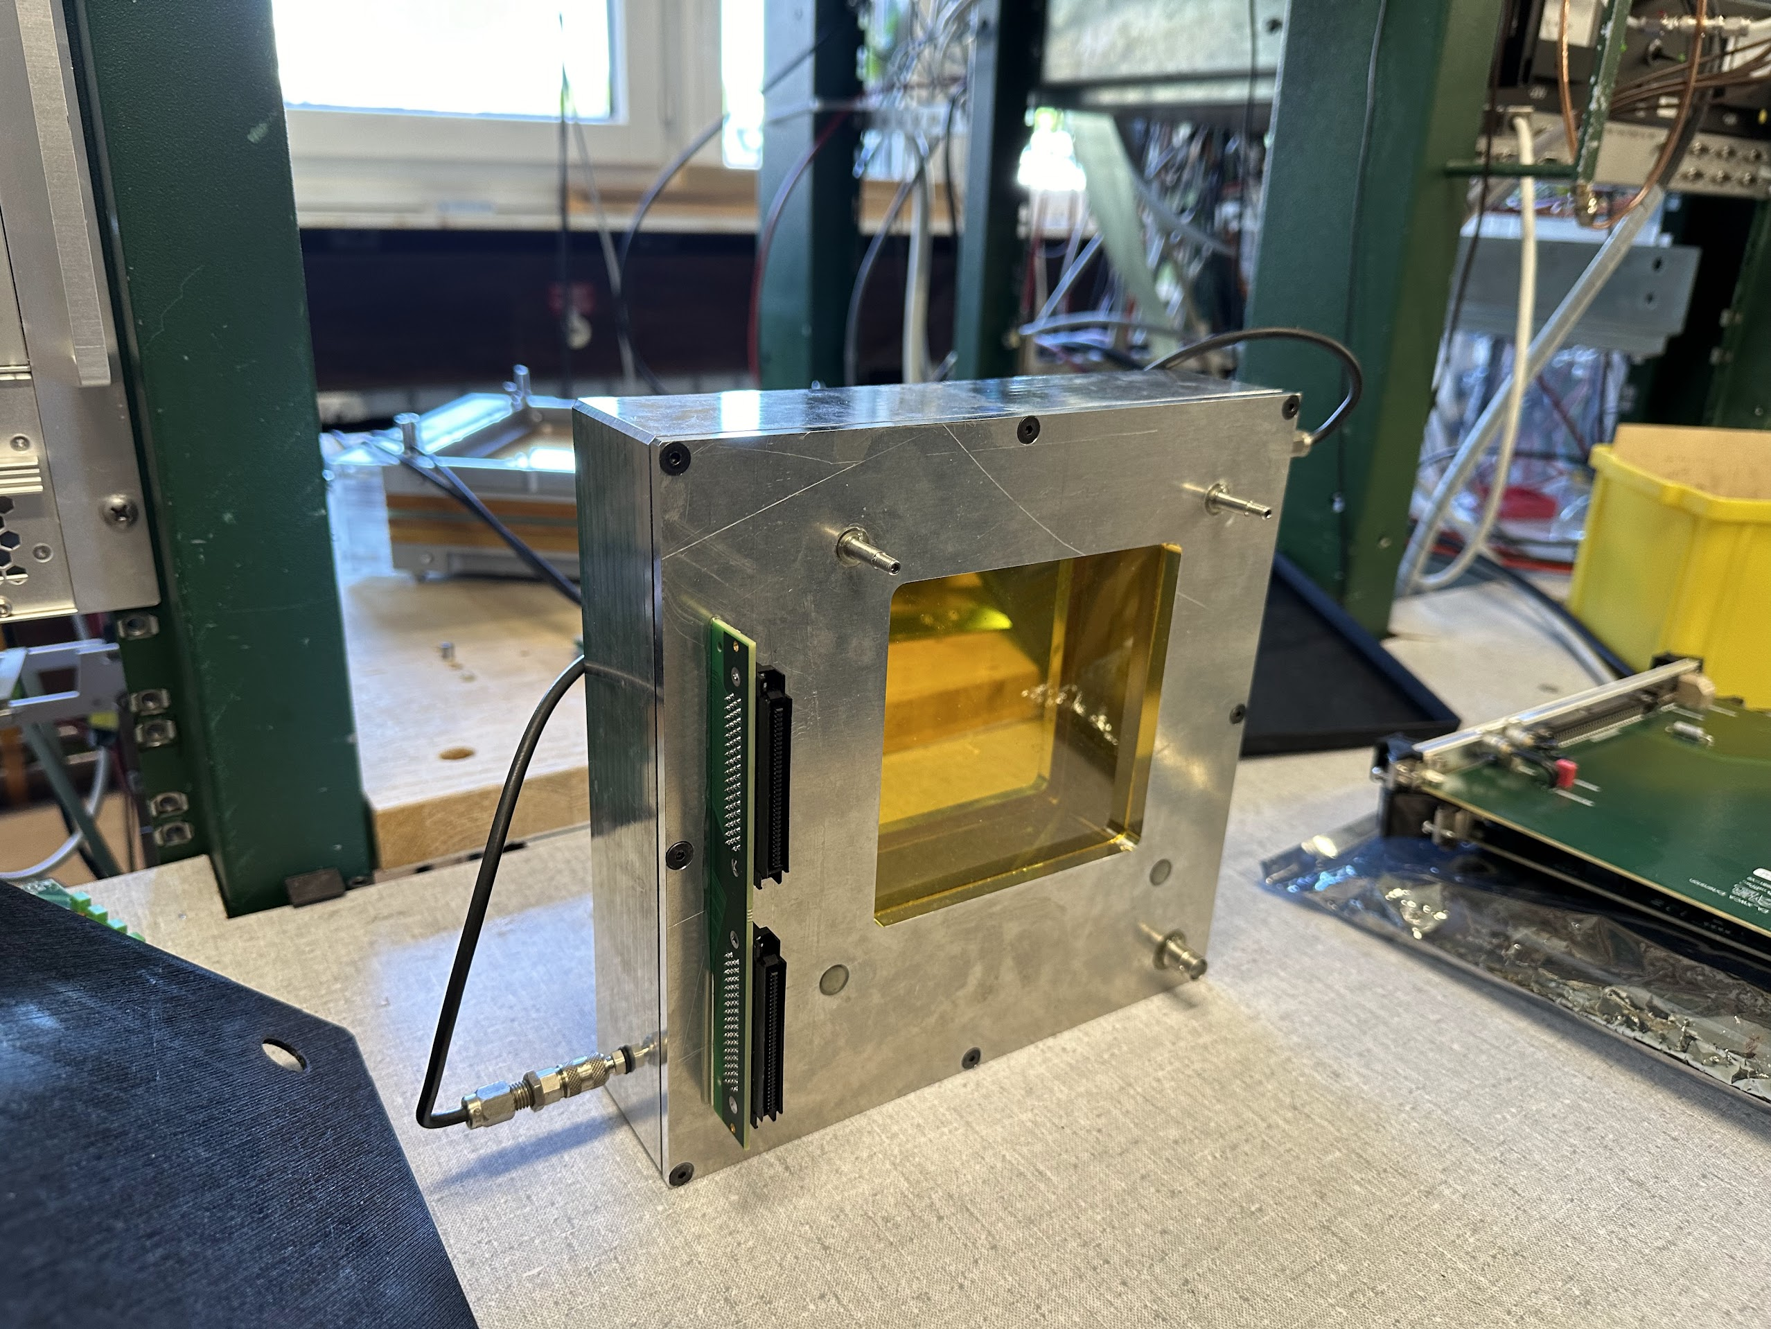
Connected to gas in the test bench

Slide 13
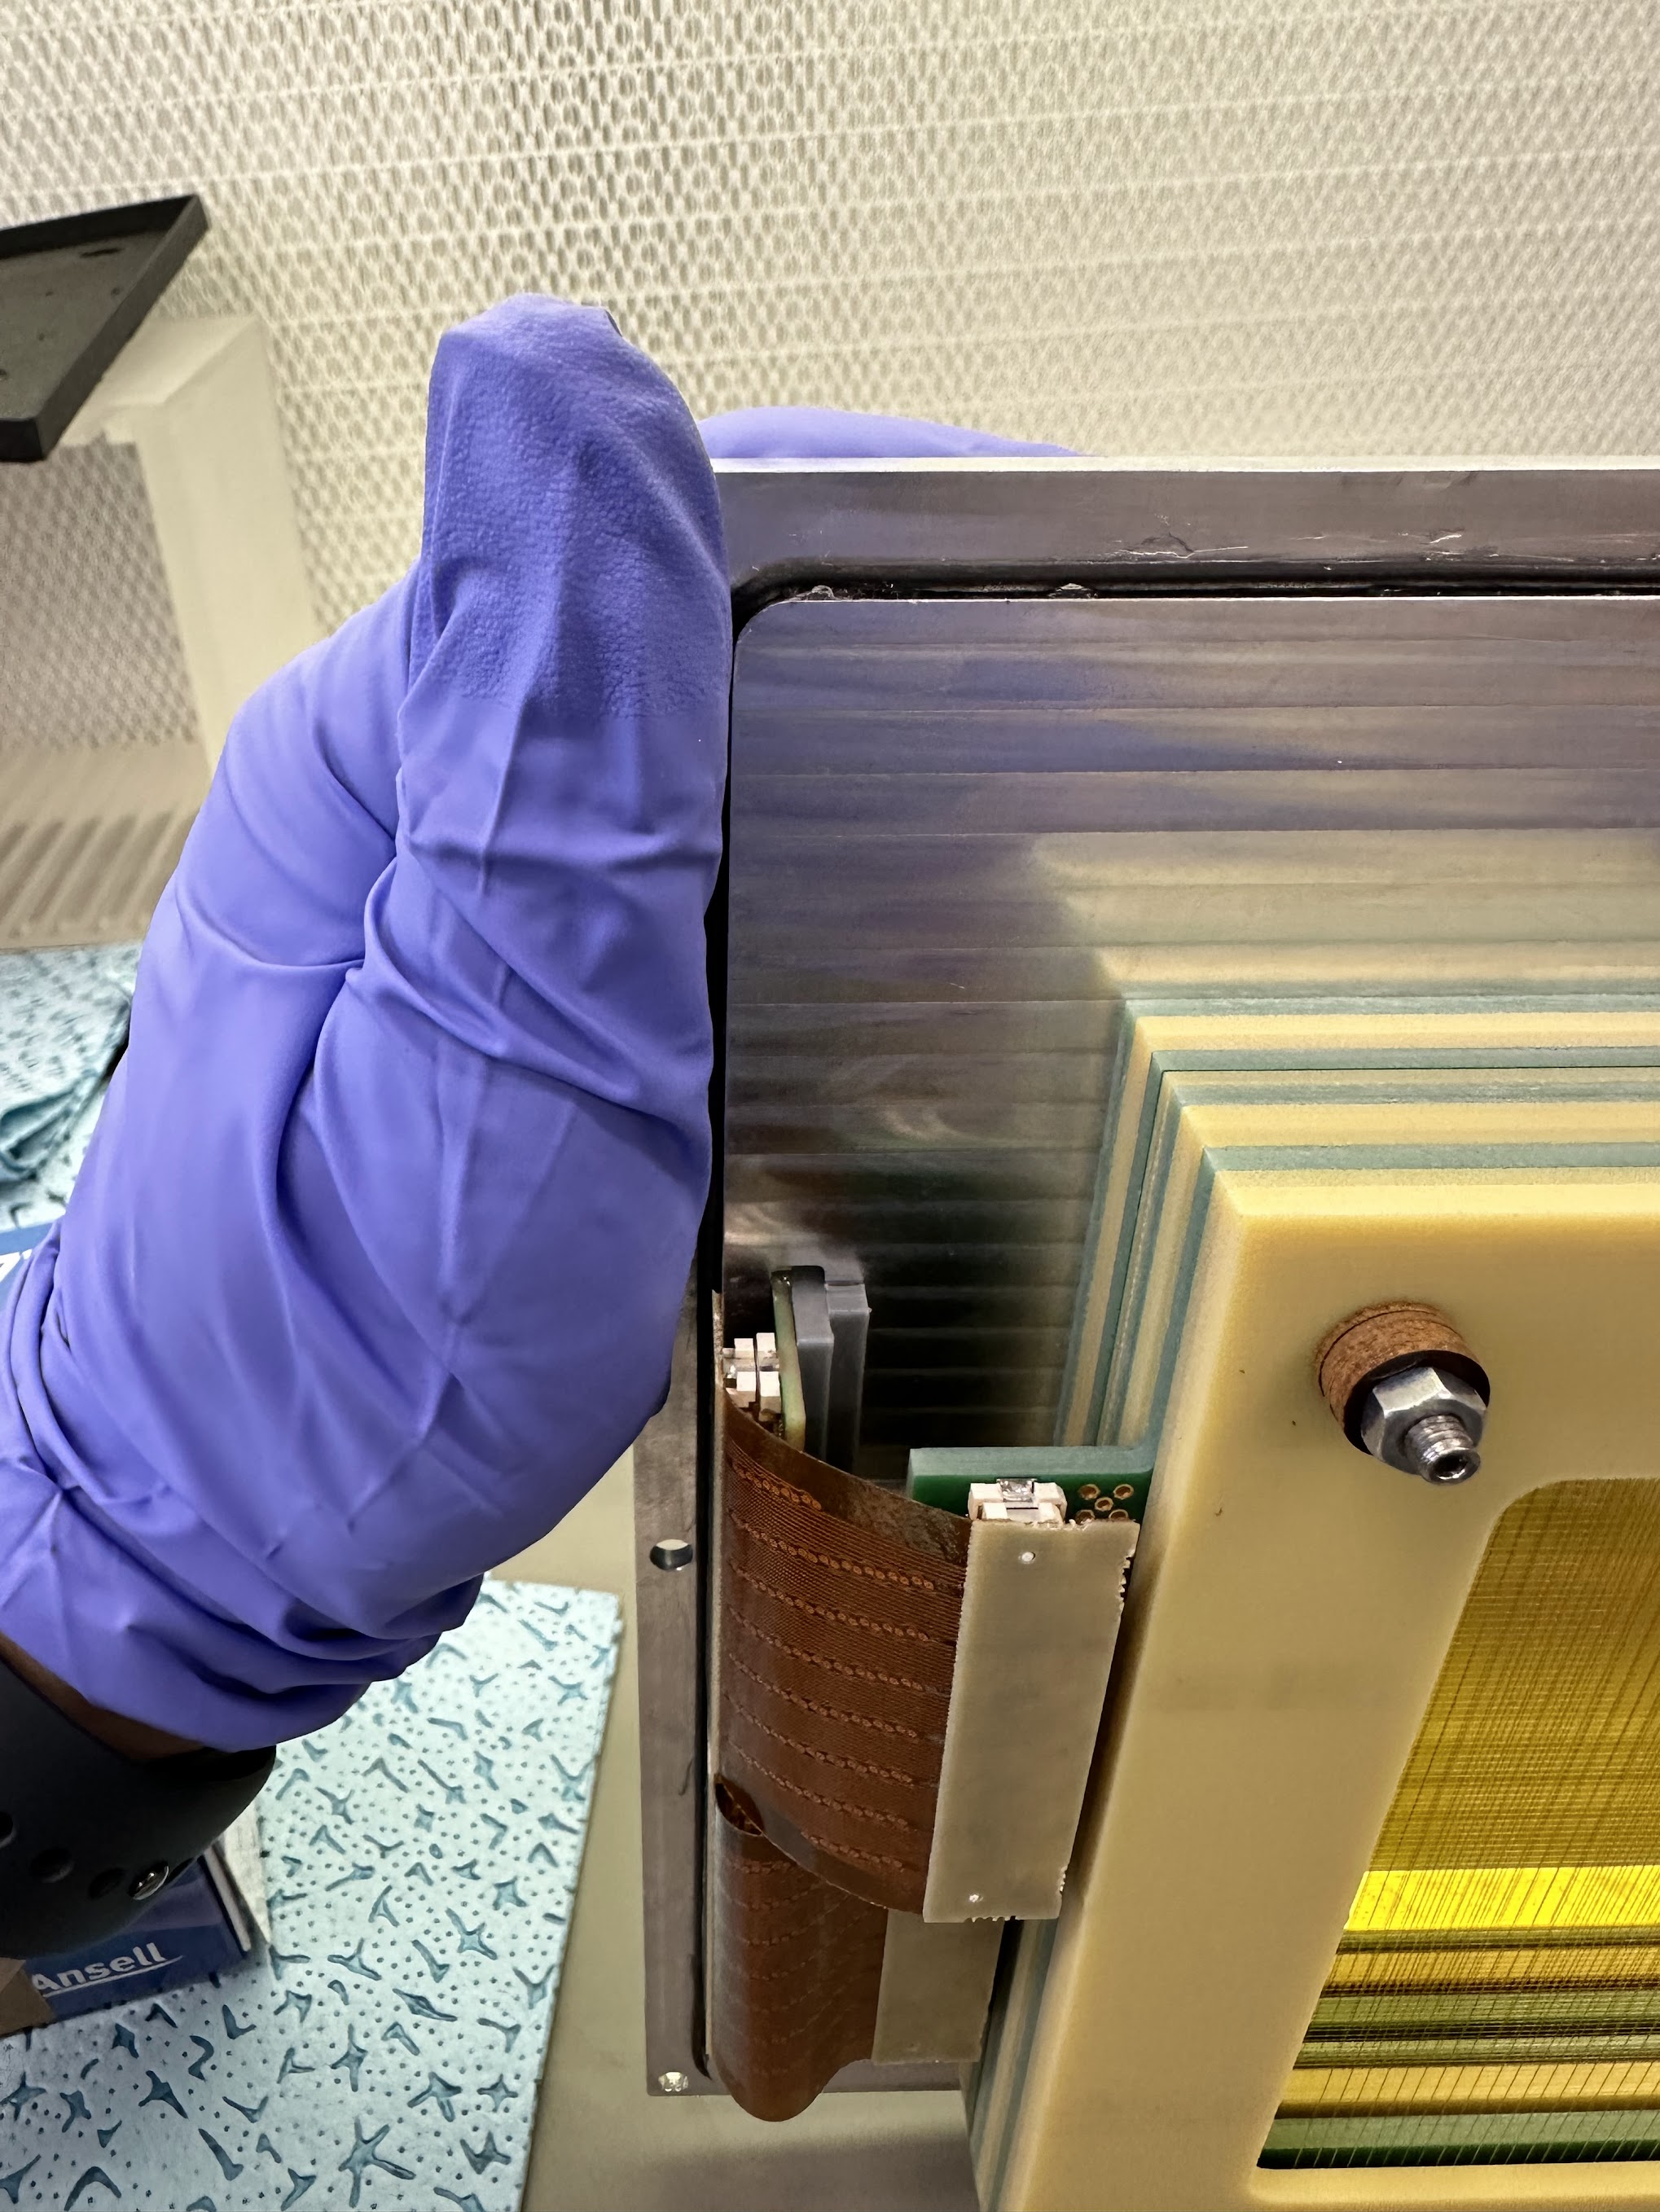
Clearance issue
with the signal PCB

Slide 14
Solution: make a groove in the box to make a place for the PCB
-> side problem: lost gas tightness
-> workaround: strong tape

Slide 15

Can you see the sparks?

Slide 16
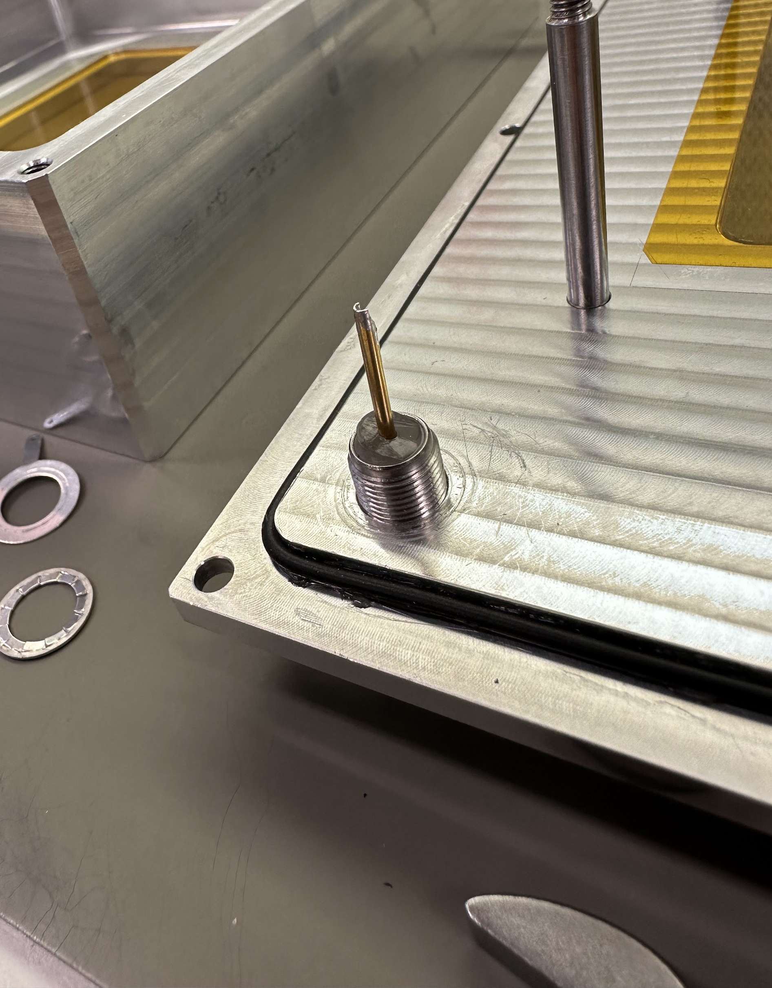
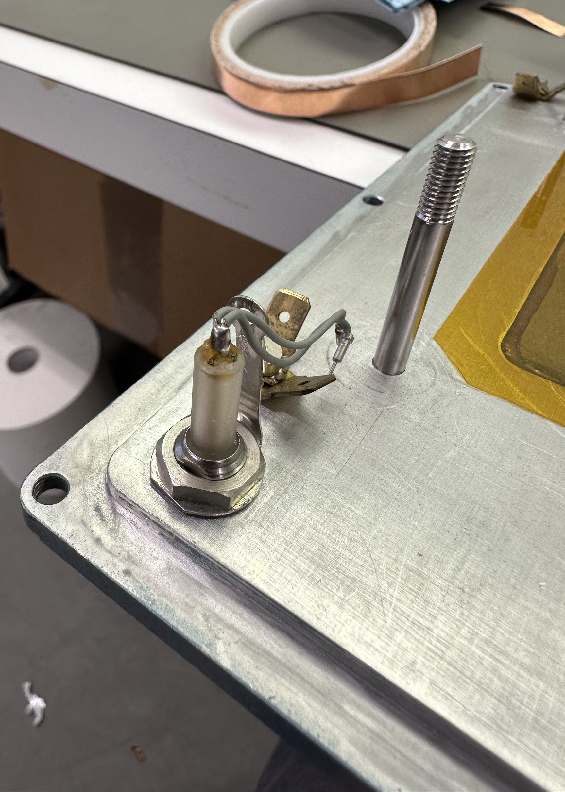
Found the issue: broken HV connector during manipulation – it went unnoticed
Broken insulation
How a good connector
looks like

Slide 17
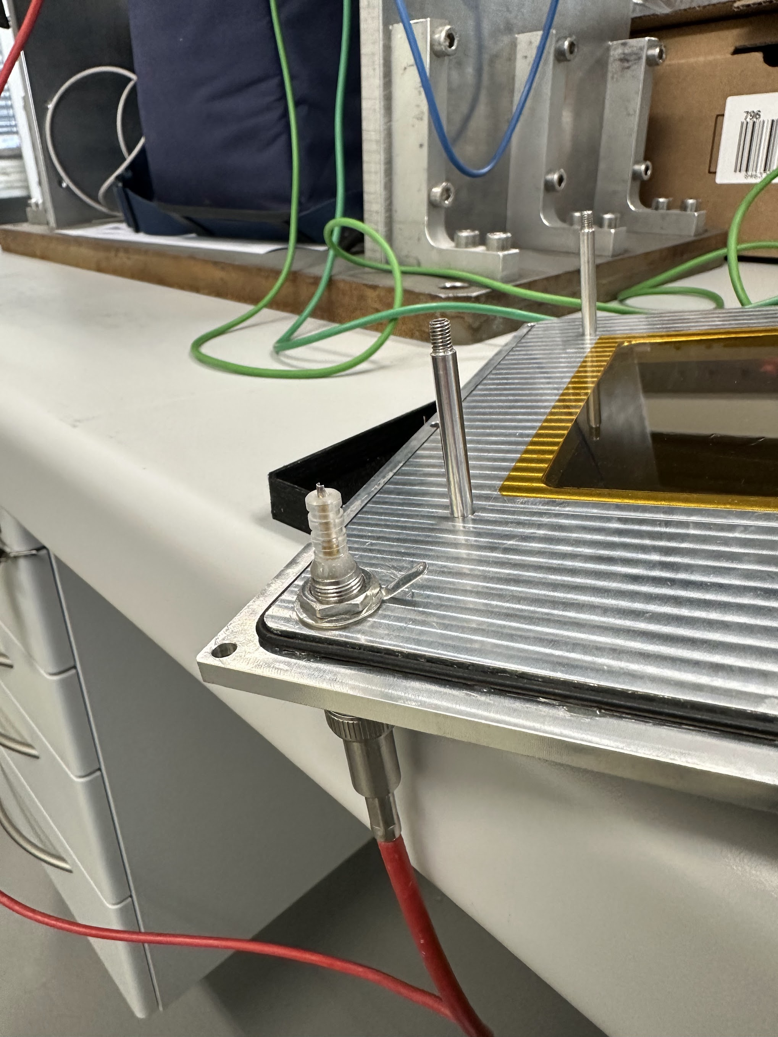
Solved thanks to
skillful technicians

Slide 18
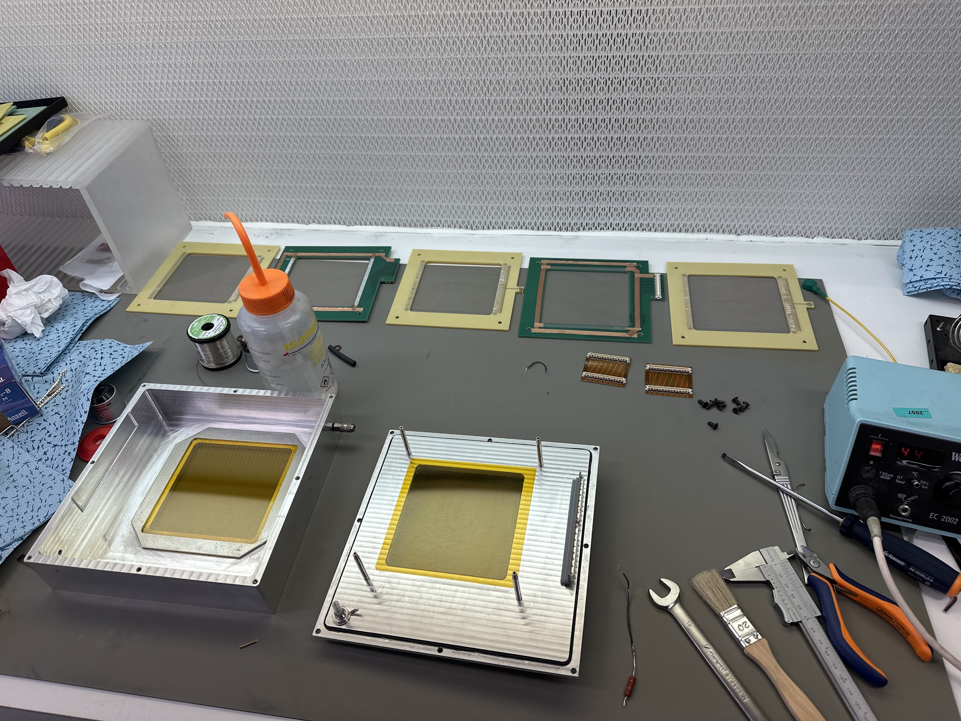
Ready to reassemble again

Slide 19
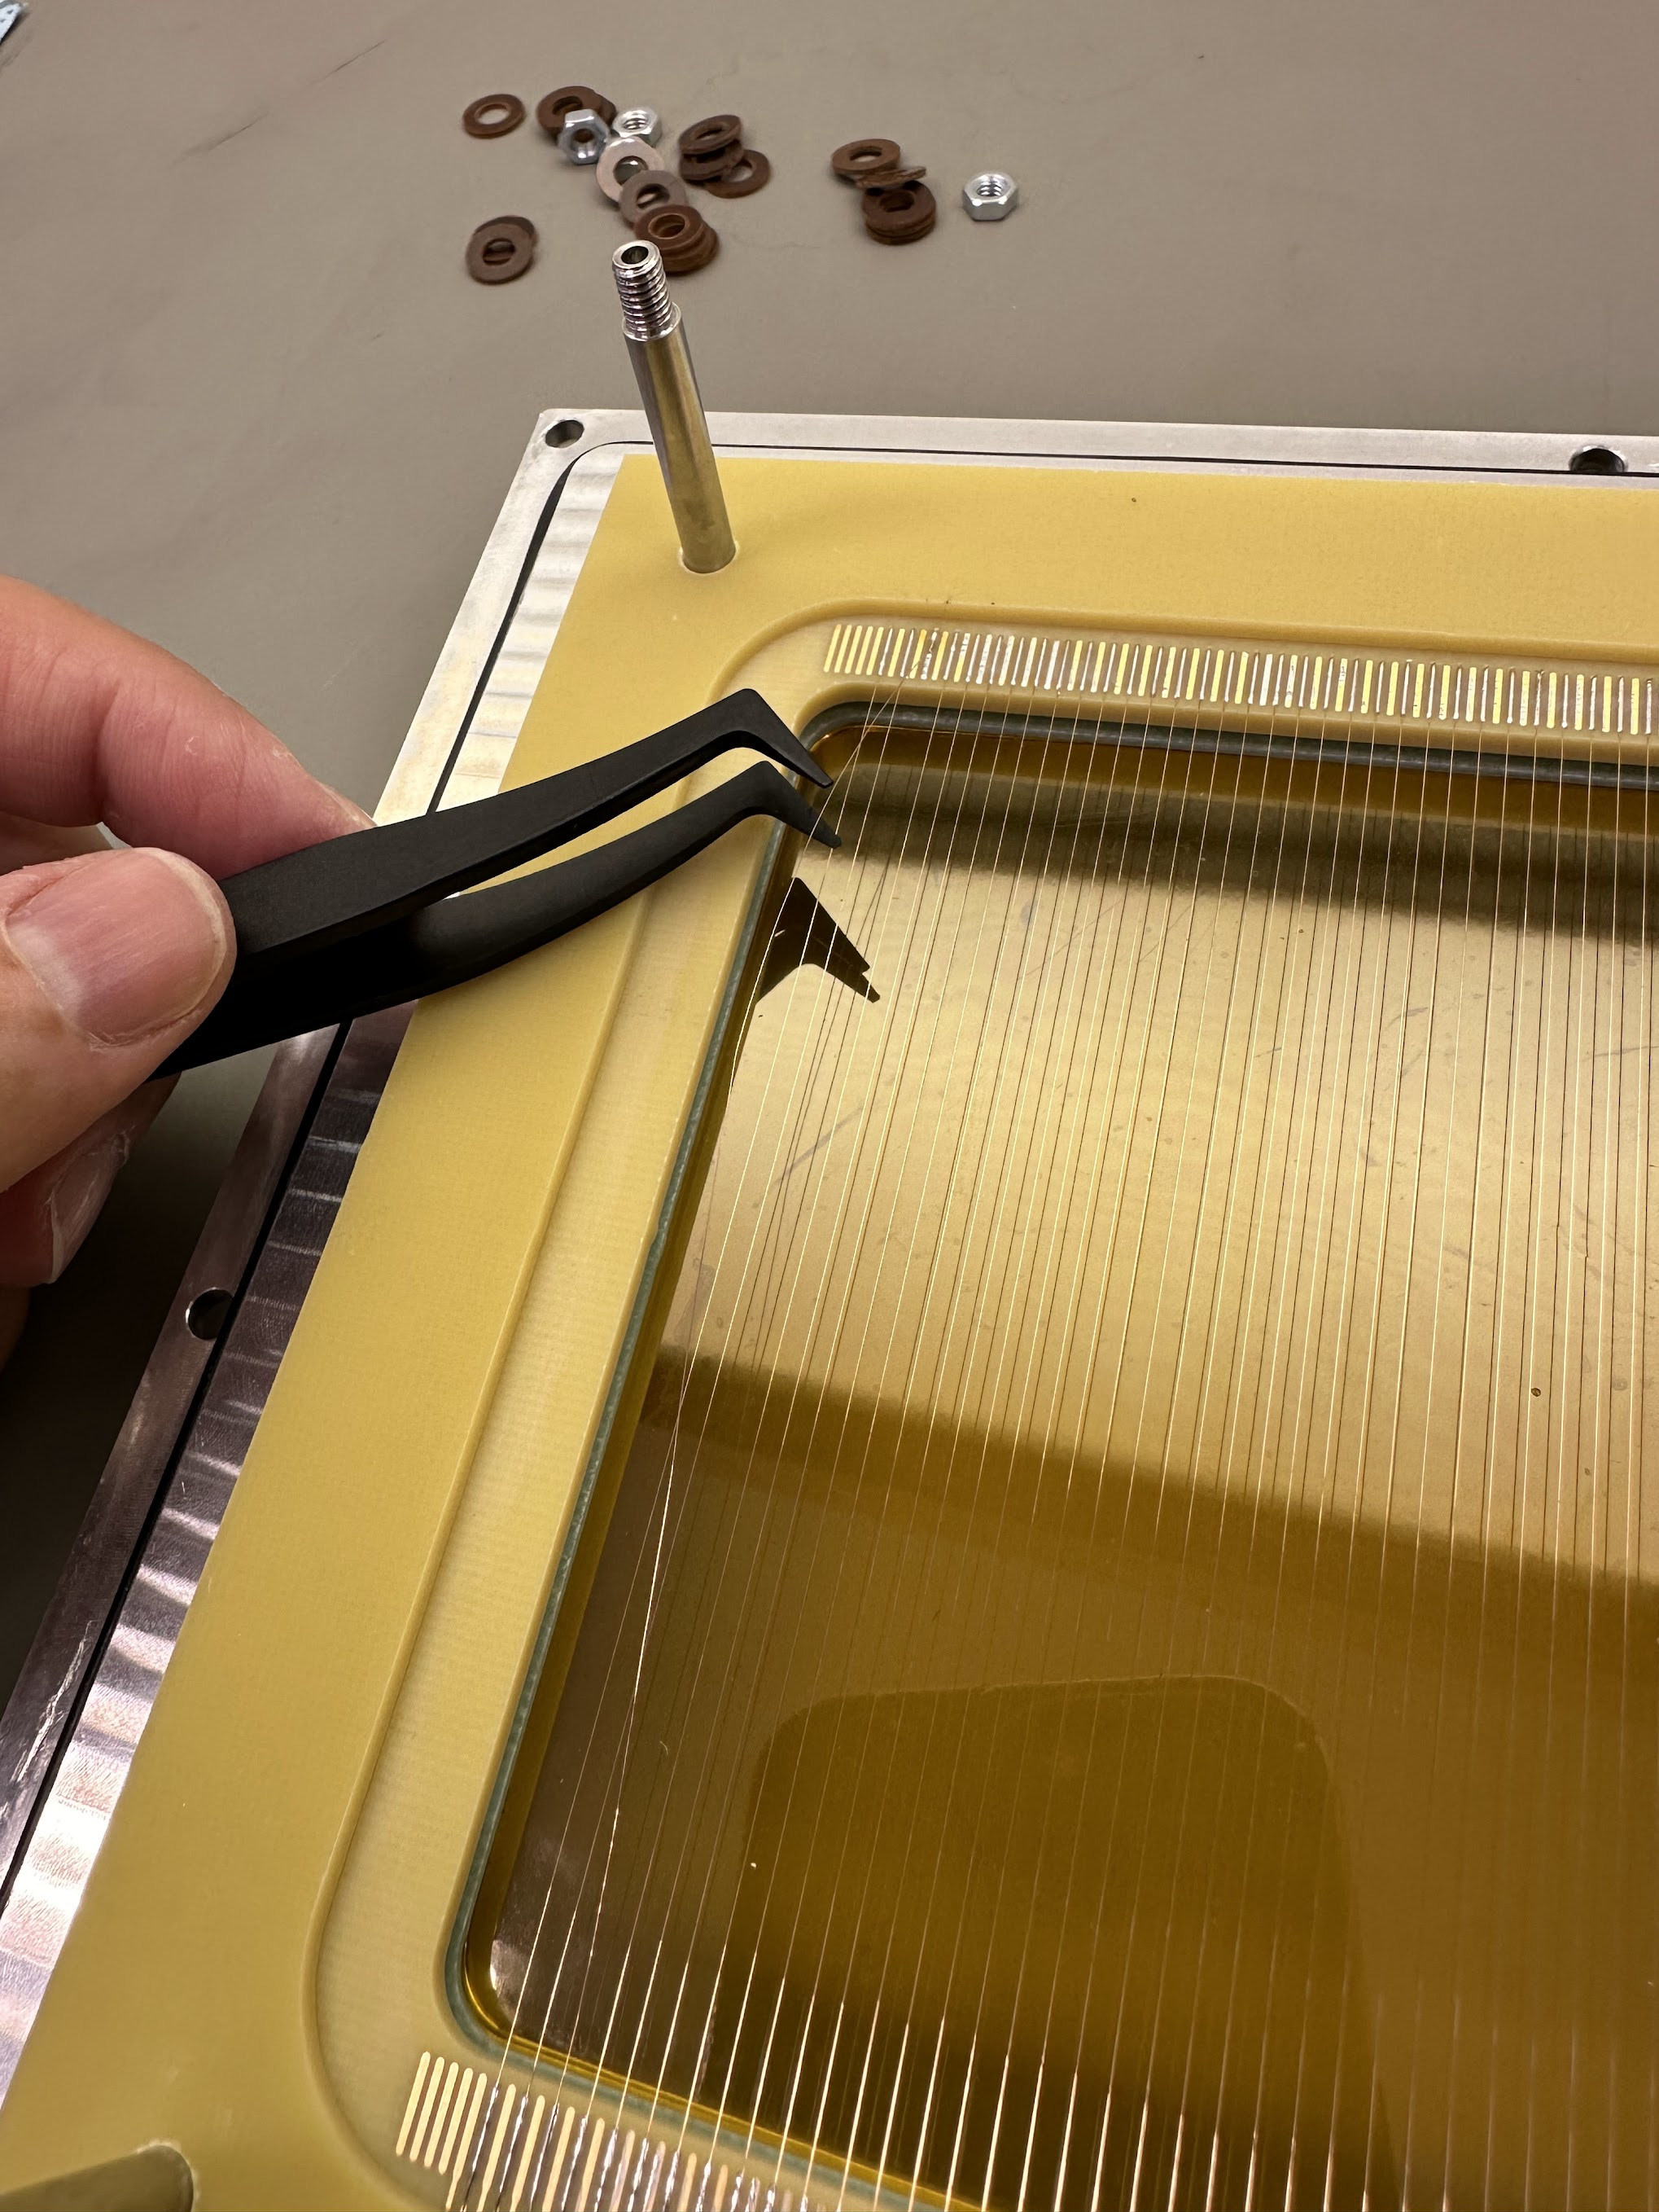
New issue:
unsoldered wire

Slide 20
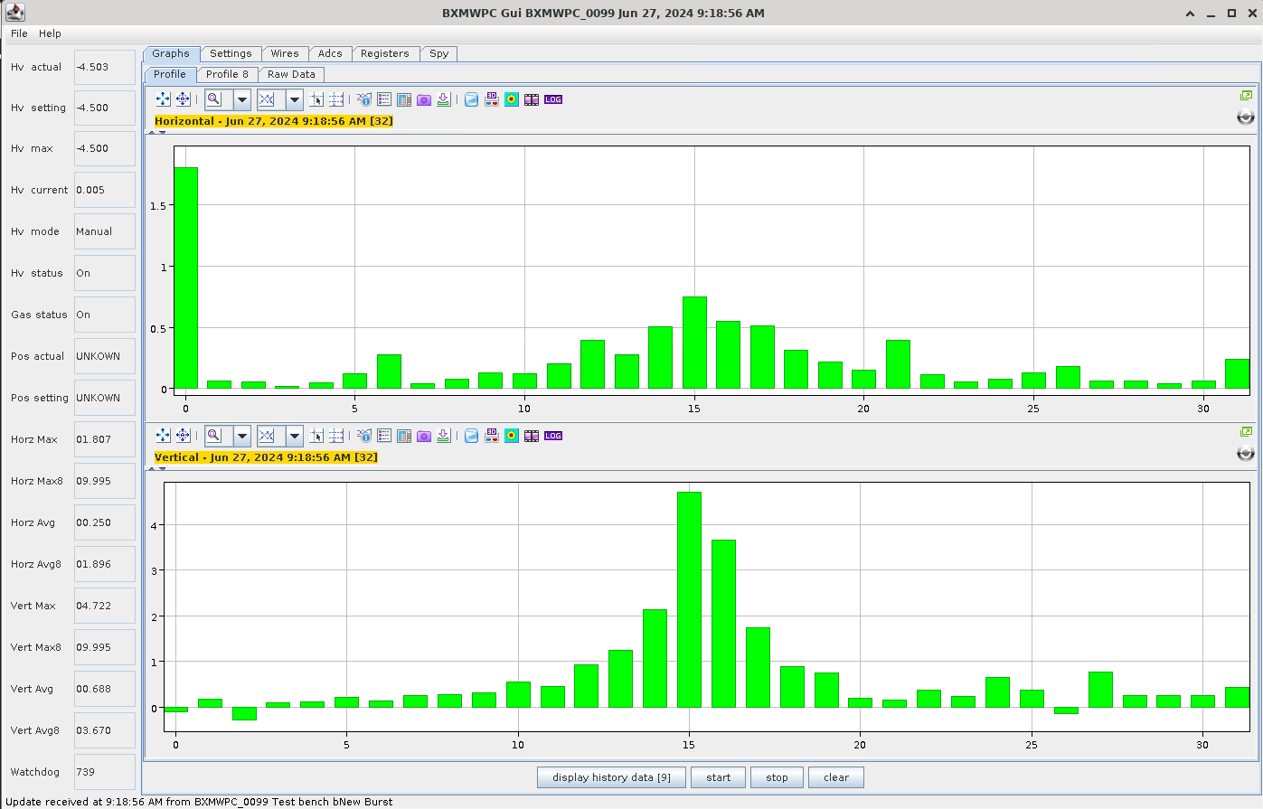
We finally made it work!

