Slide 1

ECR/Documents for Information and Approval
Giulia Romagnoli and Natalya Kahn for BE-EA, 2024-11-05
EA Documents - Agile Board - CERN Central Jira

Slide 2
LIST OF DOCUMENTS for Info
FOR INFORMATION EATM
Summary | Reporter | EA Projects | EDMS number | EDMS Status
Pre-DEC from HSE-RP following the office identification | Alicja Ostrega | North Area, NACONS | 3152090 - SPSX-E-LST-0027 | Released
Pre-DEC from SY-EPC following the office identification | Alicja Ostrega | North Area, NACONS | 3152091 - SPSX-E-LST-0028 | Released
Pre-DEC from TE-MSC following the office identification | Alicja Ostrega | North Area, NACONS | 3152093 - SPSX-E-LST-0030 | Released
Pre-DEC from TE-VSC following the office identification | Alicja Ostrega | North Area, NACONS | 3152094 - SPSX-E-LST-0031 | Released
NCR BA81 Extension | Mehdi Lamrani | North Area, NACONS | 3181653 – SPSX-SF-QN-0001 | Under Approval
Asset Replacement Request - XCSH.X0210045 | Giulia Romagnoli | North Area, NACONS | 3178541 – SPSX-TC-ARR-0010 | Released
Magnetic Measurement of SPMTN__HWP-00000002 | Philip Schwarz | North Area | 3179284 – SPSX-M-EP-0006 | Engineering check
Engineering Specification XCIO in H4 Beamline | Giulia Romagnoli | North Area | 2803124 – SPSX-TC-ES-0012 | Released
Assessing Jaw Apertures and Faults in Magnetic Collimators (XCM) at M2 Beamline through Measurements | Jan Buesa Orgaz | North Area | 3069473 – SPSX-TC-OP-0001 | Released
Mise hors tension partielle de la zone est lors du YETS 2024-2025 | Christophe Mugnier | East Area | 3171657 – PSZ-E-PRD-0003 | Under Approval

Slide 3
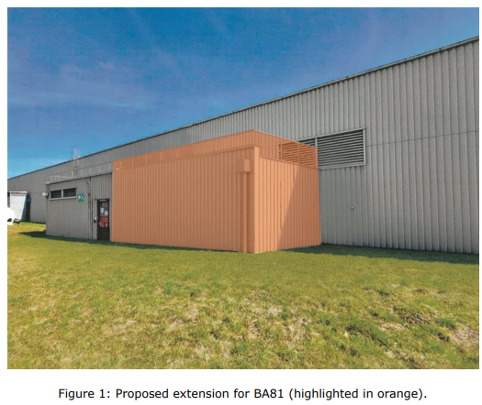
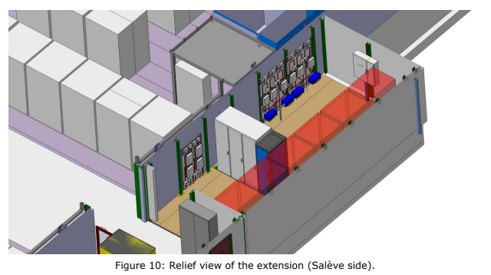
ECR for Information
SPSX-SF-EC-0009
Version 0.2
BA81 Extension
By Rachid Haddad and Mehdi Lamrani
This document describes the new extension of BA81 for hosting the fire detection equipment.
The BA81 extension (45m2) will accommodate the equipment for the new fire safety system, which will include a fire detection system, a fire protection system and a voice alarm system. The new system must be as close to the access point as possible to facilitate the intervention of firefighters in the event of an alarm.
The equipment in the extension will be:
Three racks which will be fed on the secure network. There must be access from each side of the racks.
A metal structure to install the eight fire detection plates
A bay integrating addressable control and signalling equipment
A bay integrating the fire safety control unit
A bay integrating the emergency sound system
Seven panels of three Distance Aspirating Smoke Detectors
A panel of two ASDs.
An LASD support (precautionary measure).

Slide 4
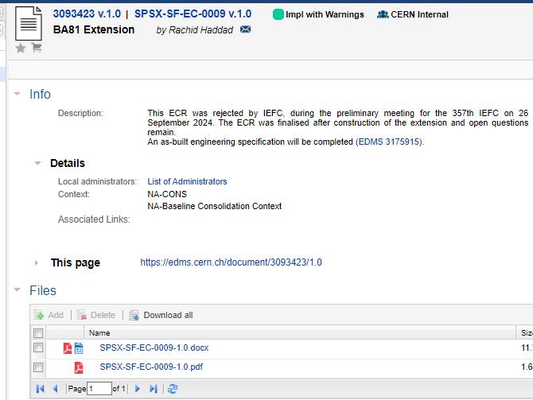
ECR for Information
SPSX-SF-EC-0009
Version 1.0
BA81 Extension
By Rachid Haddad and Mehdi Lamrani

Slide 5
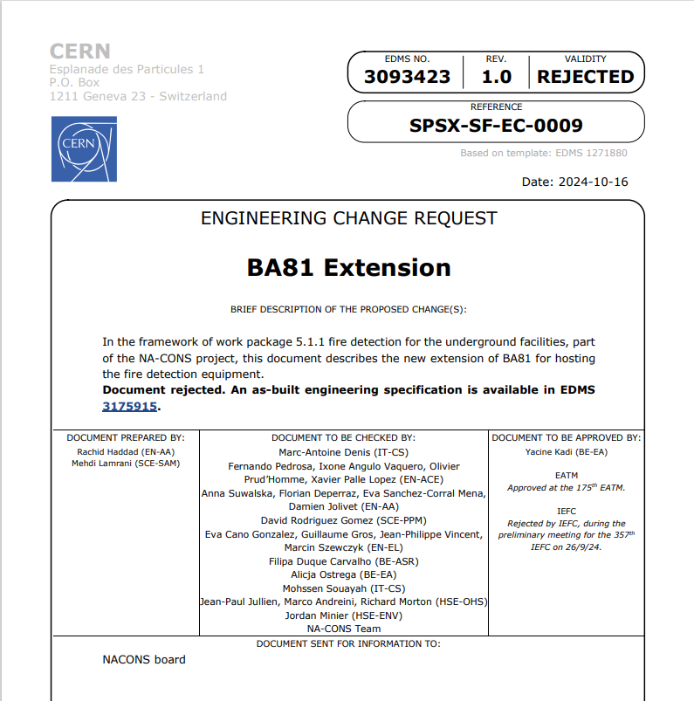
ECR for Information
SPSX-SF-EC-0009
Version 1.0
BA81 Extension
By Rachid Haddad and Mehdi Lamrani

Slide 6
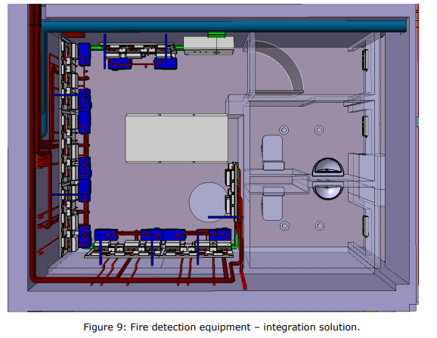
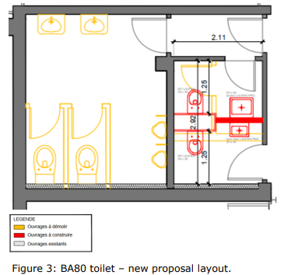
ECR for Information
SPSX-SF-EC-0005
Version 0.2
Installation of Racks for Underground Fire Detection in BA80 Surface Building
By Florian Deperraz
This document describes the redesign of the toilets in BA80 to house the new fire detection system.
The installation will involve:
2 ASD plates
8 LASD plates
3 racks
The main reasons for installing them in the BA80 toilets are:
Racks, long air sampling detectors (LASDs) and air sampling detectors (ASDs) must be as close as possible to the access point. In fact, the cables and pipes must go down through the PA80 shaft. LASDs are also limited to a maximum distance of 700 m from networks;
No space is available in BA80. After several integration studies, this is the most feasible solution;
During LS3, BA80 must be empty and unwired;
The equipment must not be separated and must be centralised in the same place to facilitate the intervention of firefighters.

Slide 7
LIST OF DOC for FUTURE APPROVAL
ECR INFO/FUTURE APPROVAL EATM
Summary | Reporter | EA Projects | EDMS number | EDMS Status
Low-energy Beams in the T10 Beamline of the East Area | Maarten Van Dijk | East Area | 3174332 - PSZ-L-EC-0003 | In Work
Installation 5 additional units of BLMs on P42 | Christos Zamantzas | North Area – NACONS | 3167561 – SPSX-B-EC-0011 | In Work
Collimator replacement renovated micro-collimators TT82 | Giulia Romagnoli | North Area – NACONS | 2961759 – SPSX-TC-EC-0001 | Engineering check
Collimator Replacement TDC2/TCC2 | Giulia Romagnoli | North Area – NACONS |  | In Work
Replacement of Big Vertical Collimator XCBV on M2 Beamline in TT84 - TBC | Giulia Romagnoli | North Area – NACONS | 2976670 – SPSX-TC-EC-0002 | Under Approval
Creation of New Lorry and Personnel Doors in Building 911 | Jean-Louis Grenard | North Area, HI-ECN3 | 3173295 – SPSX-J-EC-0008 | In Work
Replacement of XEMC support on H8 beamline | Eva Kamenicka | North Area | 3171836 - SPSX-H-EC-0001 | Engineering check
GIF++ extension/ gas balcony | Sylvain Girod | North Area |  | In Work
AUG installation EHN2+ AUL removal EHN1, GIF++/H8 and EHN2/M2/BA82 | Marcin Szewczyk | North Area | 3178530 - SPSX-SF-EC-0016 | In Work
PPE144 patch panel installation with passarelle modification | Sylvain Girod | North Area – NACONS | 3121860 – SPSX-J-EC-0006 | Under Approval
Buffer Zone BA81 | Iliasse Derrag | North Area | 3151414 – SPSX-J-EC-0007 | Under Approval

Slide 8
LIST OF DOCs for APPROVAL
ECR APPROVAL EATM
Summary | Reporter | EA Projects | EDMS number | EDMS Status
TT61 Magnet Storage | Germana Riddone | HiRadMat | 3157327 – ACC-PM-MG-0006 | Under Approval
Vacuum Chamber Installation in F61.MBXHD025 for CHIMERA/HEARTS | Dipanwita Banerjee | East Area | 3138917 – PSZ-V-EC-0001 | Under Approval
EHN1 Workshop Refurbishment | Iliasse Derrag | North Area | 3089621 – SPSX-J-EC-0005 | Under Approval
M2 Beamline Vacuum Modifications during YETS24-25 | Giulia Romagnoli | North Area – NACONS | 3169186 – SPSX-V-EC-0003 | Under Approval

Slide 9
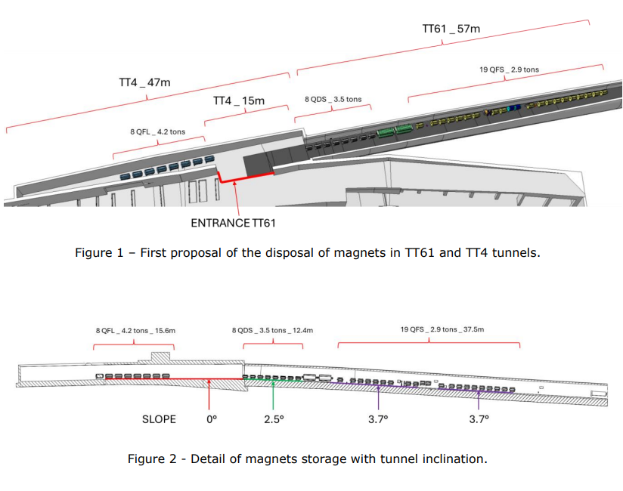
ECR for Approval
ACC-PM-MG-0006
Version 0.2
Storage of 35 Magnets in TT61 for ET and BST Projects
This document covers the displacement of 35 magnets from TT4 and TT5 to TT61 during YETS24-25 to allocate space for ET and BST Project.
By Germana Riddone
TT4 (Building 804) was occupied by a series of magnets, of which 35 remain. These are planned to be moved to TT61 to create space for the Beam Screen Treatment (BST) project and the Einstein Telescope (ET) project, which will both be located in TT4.
In TT61, some supports will be dismounted.

Slide 10
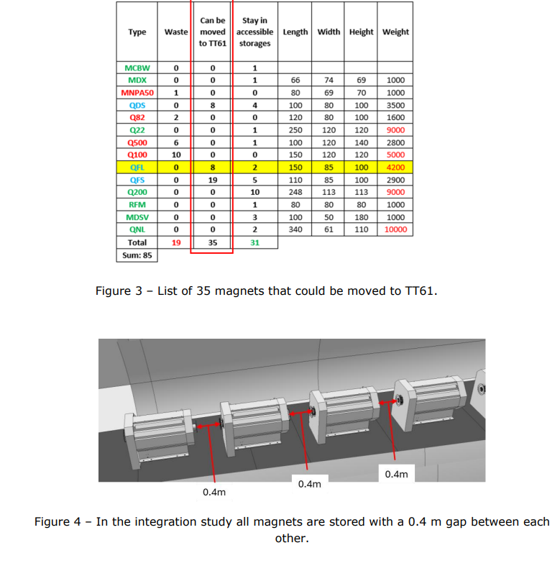
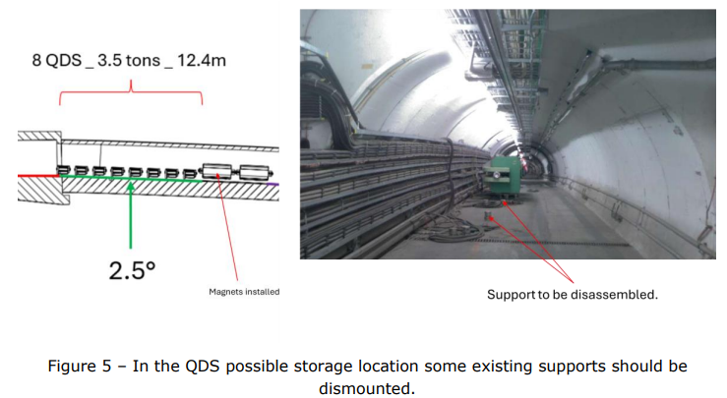
ECR for Approval
ACC-PM-MG-0006
Version 0.2
Storage of 35 Magnets in TT61 for ET and BST Projects
By Germana Riddone

Slide 11
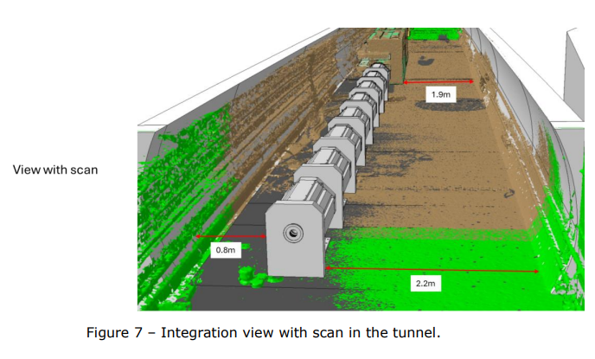
ECR for Approval
ACC-PM-MG-0006
Version 0.2
Storage of 35 Magnets in TT61 for ET and BST Projects
By Germana Riddone

Slide 12
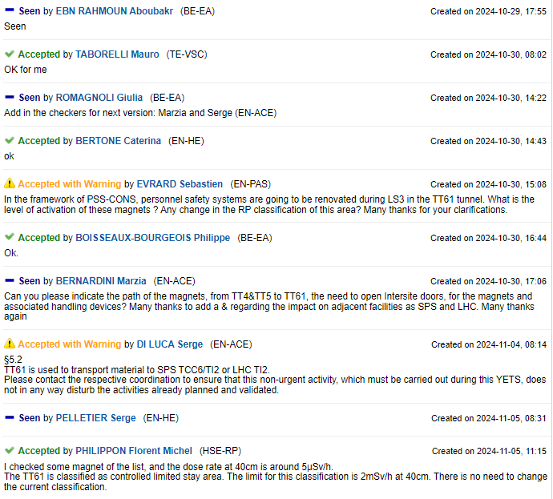
ECR for Approval
ACC-PM-MG-0006
Version 0.2
Storage of 35 Magnets in TT61 for ET and BST Projects
By Germana Riddone
Seeking approval from EATM

Slide 13
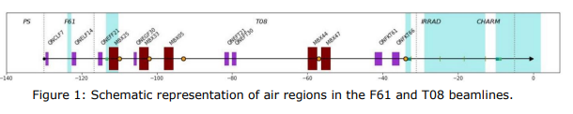
ECR for Approval
PSZ-V-EC-0001
Version 0.2
Vacuum Chamber Installation in F61.MBXHD025 for CHIMERA/HEARTS
By Dipanwita Banerjee
This document covers the request for vacuum to be completed within the F61.MBXHD025 magnet. This is for the operation of the T08 line with low-energy ions for the CHIMERA/HEARTS project.
The beam path extracted from the PS crosses five air regions within the F61 and T08 transfer lines to CHARM.
The air section in point 2 (from F61.BCTFV022 to 30 cm downstream of the F61.MBXHD025 magnet) will be integrated in vacuum as described in this document.

Slide 14
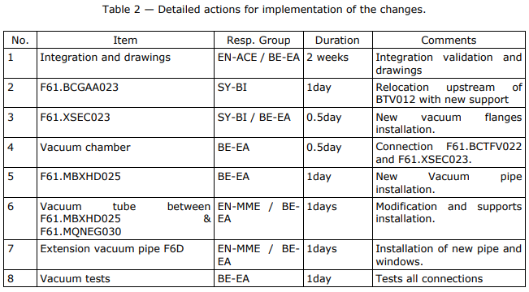
ECR for Approval
PSZ-V-EC-0001
Version 0.2
Vacuum Chamber Installation in F61.MBXHD025 for CHIMERA/HEARTS
By Dipanwita Banerjee

Slide 15
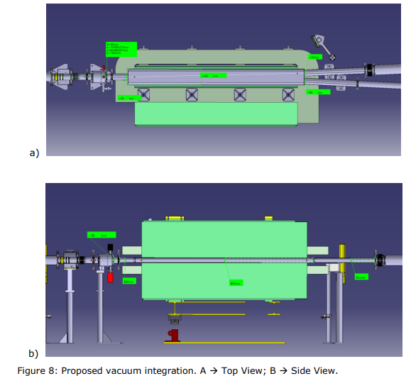
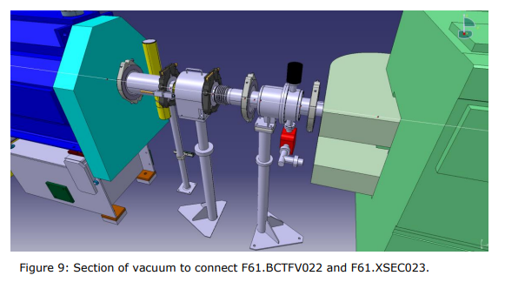
ECR for Approval
PSZ-V-EC-0001
Version 0.2
Vacuum Chamber Installation in F61.MBXHD025 for CHIMERA/HEARTS
By Dipanwita Banerjee

Slide 16
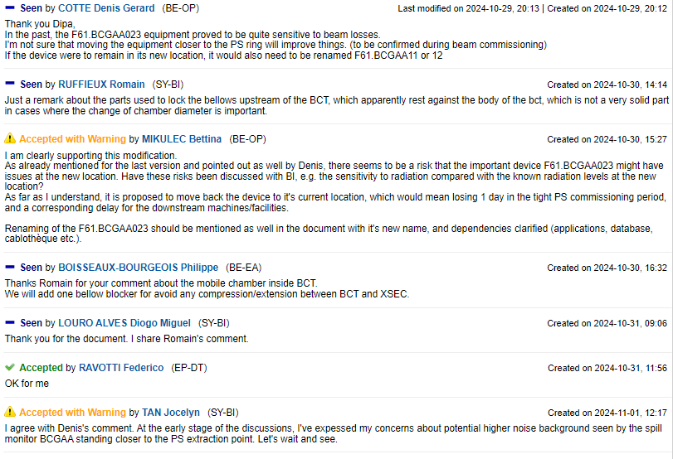
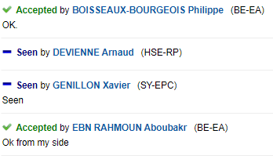
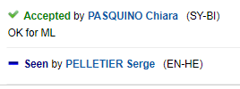
ECR for Approval
Vacuum Chamber Installation in F61.MBXHD025 for CHIMERA/HEARTS
PSZ-V-EC-0001
Version 0.2
By Dipanwita Banerjee
Seeking approval from EATM

Slide 17
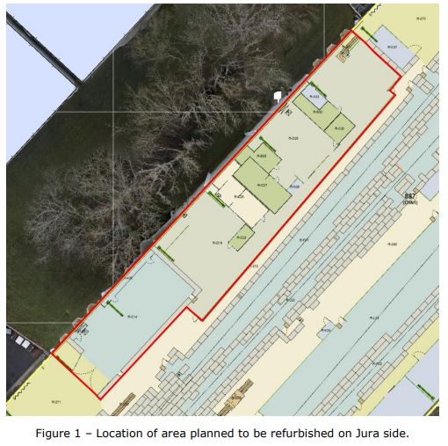
ECR for Approval
SPSX-J-EC-0005
Version 0.2
EHN1 Workshop Refurbishment
By Iliasse Derrag
This document covers the refurbishment/restructuring of BE-EA’s workshop in EHN1, Jura side, including the relocation of buffer zones and machines, the removal of barracks and the creation of a grey room.
The main reasons for the change are:
The reduced amount of machining done there
The lack of space for users’ arrival and departure. The additional space will be useful for handling operations and for performing maintenance and HSE load tests on the mechanical tables
To create a better place to carry out maintenance on CEDARs
The project involves the following changes:
Relocation of the RP buffer zone in 887/R-C37 to 887/R-D19.
Fence removal up to HNA133 barrack and door relocation.
Dismantling and removal of HNA125, HNA126, HNA127 barracks.
Installation of new barracks in newly liberated area: storage & vacuum.
Relocation of machine tools from 887/R-C14 to 887/R-D19.
Grey room style reconfiguration of 887/R-C14.
Other services involved include IT-CS, EN-EL, EN-AA, EN-CV, EN-HE, EN-ACE and HSE-RP.

Slide 18
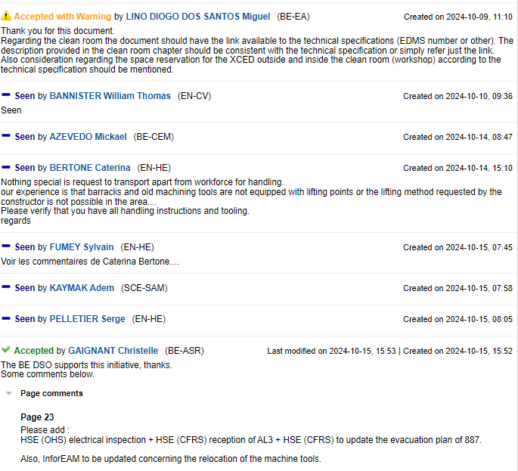
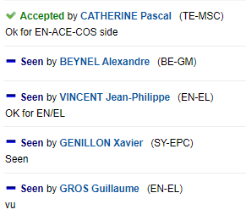
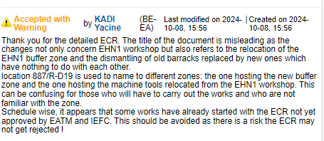
ECR for Approval
EHN1 Workshop Refurbishment
SPSX-J-EC-0005
Version 0.2
By Iliasse Derrag
Seeking approval from EATM

Slide 19
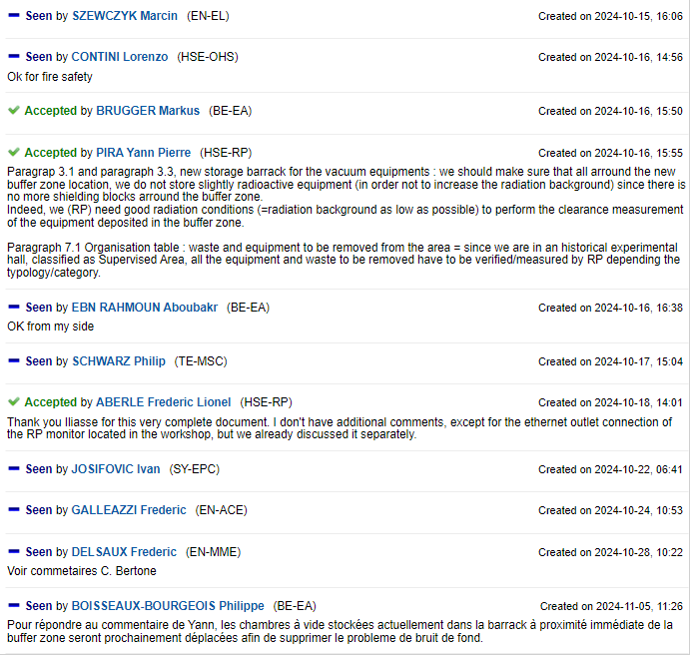
ECR for Approval
EHN1 Workshop Refurbishment
SPSX-J-EC-0005
Version 0.2
By Iliasse Derrag
Seeking approval from EATM

Slide 20
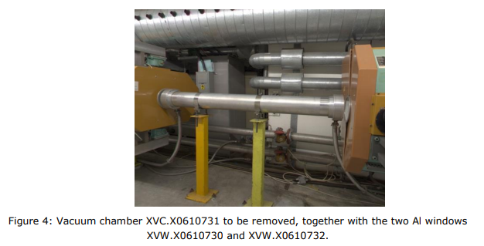
ECR for Approval
SPSX-V-EC-0003
Version 0.2
M2 Beamline Vacuum Modifications during YETS24-25
By Giulia Romagnoli
During YETS24-25 it is proposed to start doing some small modifications to the vacuum system of the M2 beamline in view of the bigger modifications to be carried out for the future physics operations (see EDMS 3129053).
The current M2 beamline has a lot of beam sections that remain in air. This increases the beam divergence at the CEDAR location (towards the end of the line). A solution for this is to put as much of the beamline under vacuum. This will happen for the AMBER Drell-Yan physics run (after LS3).
Changes for YETS24-25/YETS25-26 include:
Connect the magnet MBNV.X0610706 to the vacuum
Remove two short vacuum chambers and 4 windows that are located in between parts of the beamline without vacuum
The vacuum sector of the line should be connected upstream and downstream with a flexible by-pass of a total length of 31 m
Moving the magnetic collimator XCMV.X0610733

Slide 21
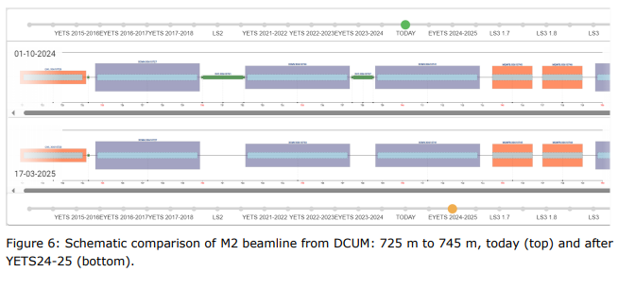
ECR for Approval
SPSX-V-EC-0003
Version 0.2
M2 Beamline Vacuum Modifications during YETS24-25
By Giulia Romagnoli

Slide 22
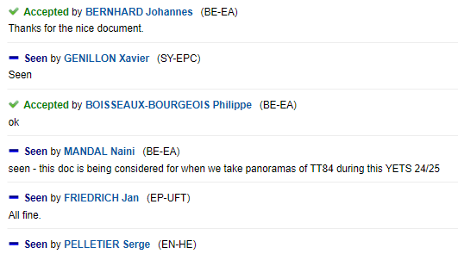
ECR for Approval
SPSX-V-EC-0003
Version 0.2
M2 Beamline Vacuum Modifications during YETS24-25
By Giulia Romagnoli
Seeking approval from EATM

Slide 23
Thank you!

